Slide 1

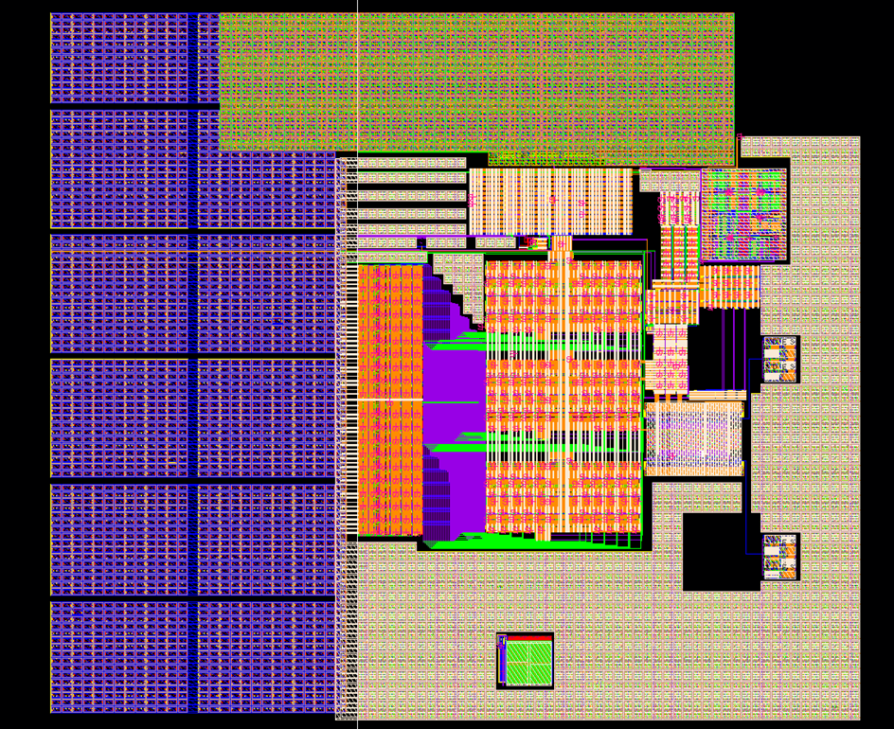
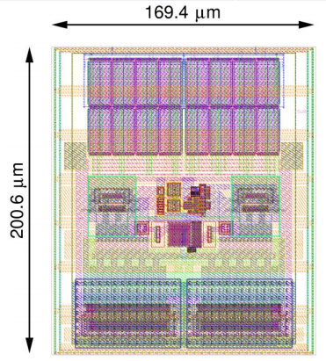
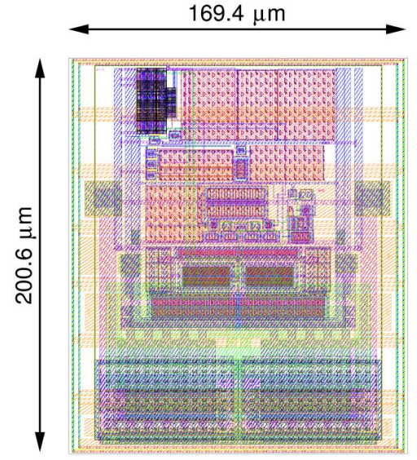
IP Sharing at University of Michigan
We have benefited from the following IPs shared by CERN to us:
All IPs are provided in IBM 130 nm CMOS (8RF-DM)
4.8 Gbps Serializer: Loads 120 bits @40 MHz at the input
ePLL:
40/80/160 MHz reference clock input; 160/320 MHz output
Programmable phase 11.25⁰ for 160 MHz; 22.5⁰ for the 320 MHz
SLVS TX and RX
transmit/receive SLVS signals up to 320 Mbps or clocks up to 320 MHz
TX: programmable driving strength
RX: 100 Ohm terminated; compatible with LVDS (V_{CM} =1.2 V)
1: 4.8 Gbps Serializer
2: ePLL
3: SLVS TX and RX
TX
RX

Slide 2
About sharing IP in US
We think it might be good if:
Have a common password-protected website for IP sharing
documentation about IP specification, manual, etc. included
Funding support from DOE/NSF for the IP development
Form a US IP development team, more general IP development with the funding
such as, clock components (DLL, PLL), IO drivers, SER/De-SER, bandgap reference …
Organize annual meeting (such as HEPIC2017) for discussion and exchanging ideas
seminar on leading technology development

