Slide 1
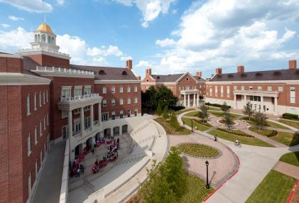
Design Database Sharing by SMU/EE
Ping Gui, Professor
Department of Electrical Engineering
Lyle School of Engineering
Southern Methodist University
HEPIC 2017
Oct. 4-6, 2017

Slide 2
Past Design Database Sharing Experience by SMU/EE
In the past, the SMU EE group and CERN shared the following design libraries
Bandgap reference design in 0.13um CMOS (provided by CERN)
5 Gb/s limiting amplifier and CML driver design in 0.13um IBM CMOS (provided by SMU/EE)
2 Gb/s line driver design with equalization in 65nm CMOS (provided by SMU/EE)
Phase shifter design in 0.13um CMOS (provided by SMU/EE)
Use as it is or make some modifications

Slide 3
Thoughts on Design Database Sharing
There are many common IC building blocks that can be shared between institutes.
Bandgap reference, Op-amp, PLL, CML driver, LDO, etc.
Database sharing can reduce overlapping efforts
The issues might be:
Patented design?
Limited technical support if it is a design done a couple of years ago (students graduated)
Acknowledgement of the work provided by other institutes

