Slide 1
Welcome
G. Haller
Director
Advanced Instrumentation for Research (AIR) Division
SLAC Technology Innovation Directorate

Slide 2
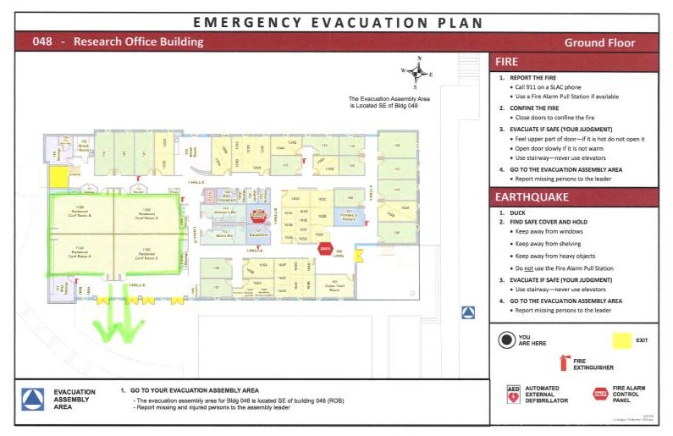
Safety First: In case of emergency

Slide 3
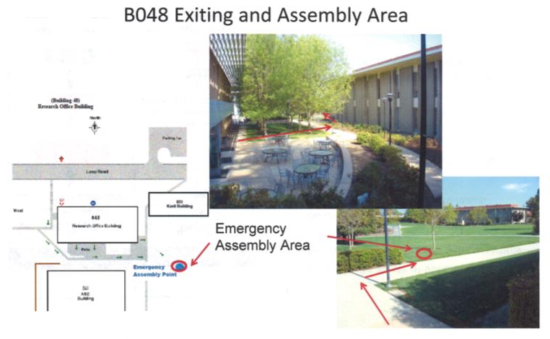
Safety First: In case of emergency

Slide 4
Safety First: In case of emergency

Slide 5
Some logistics
The workshop will be held in these rooms (Redwood Rooms, bldg. 48)
Breakfasts, Lunches and Coffee will be served outside
If you have brought posters with you, they will be hanged in the back of the room and people can discuss during lunch breaks
If you have not been able to upload talks, please send to Angelo (dragone@slac.stanford.edu)
The agenda is full so please try to stay on schedule to allow more time to converse, exchange ideas, grow collaborations

Slide 6
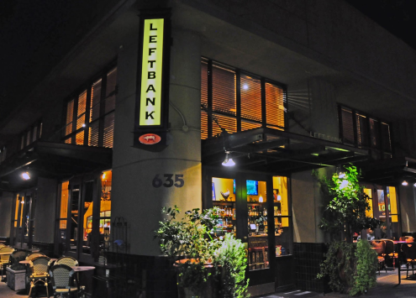
Social Dinner
Social Dinner will be tomorrow night
Downtown Menlo Park at 6:00pm
Left Bank Brasserie
at 635 Santa Cruz Avenue
If you need a ride please check with Angelo and remember there is always UBER or LYFT

Slide 7
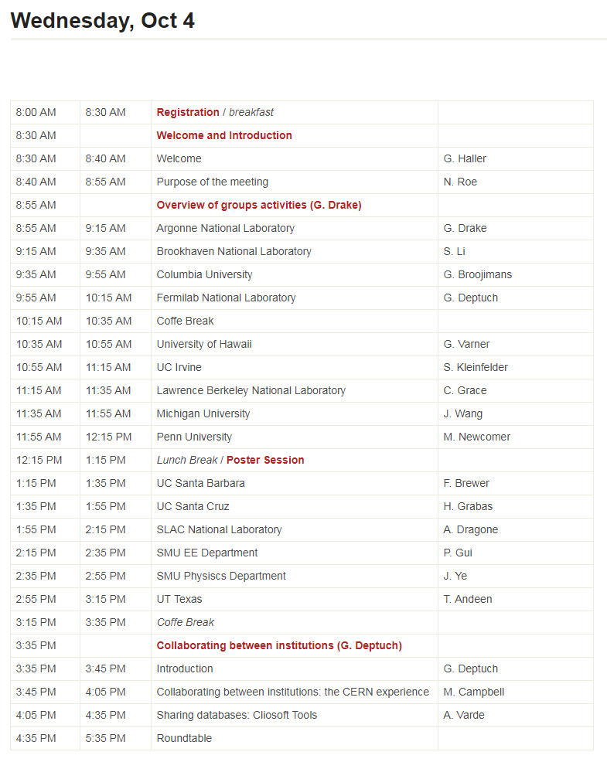
And now the Agenda

Slide 8
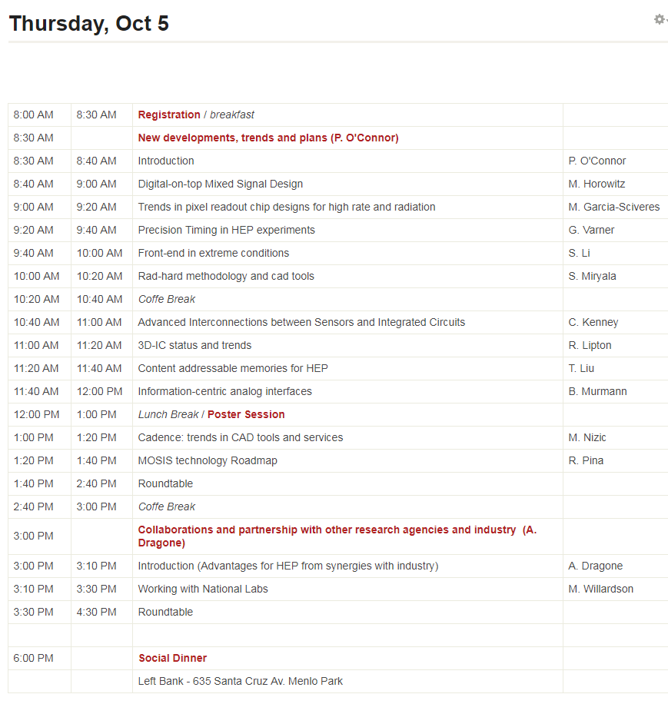
And now the Agenda

Slide 9
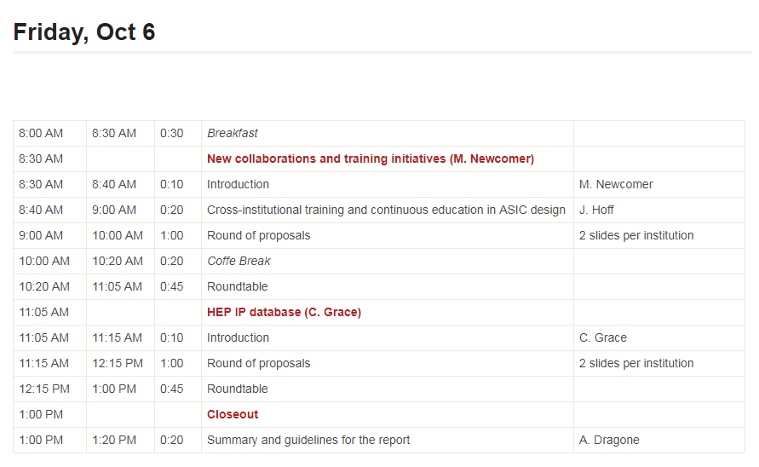
And now the Agenda

