Slide 1
Developing Low-Noise Front-End ASICs
-Microelectronics at BNL
Shaorui Li, Mietek Dabrowski, Alessio D’Andragora, Yuan Mei, Emerson Vernon
Instrumentation Division, Brookhaven National Lab
Wenbin Hou, Krithika Yethiraj, Gianluigi de Geronimo
Stony Brook University
Microelectronics at BNL

Slide 2
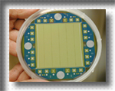
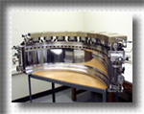
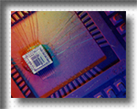
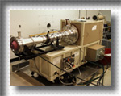
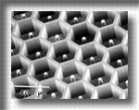
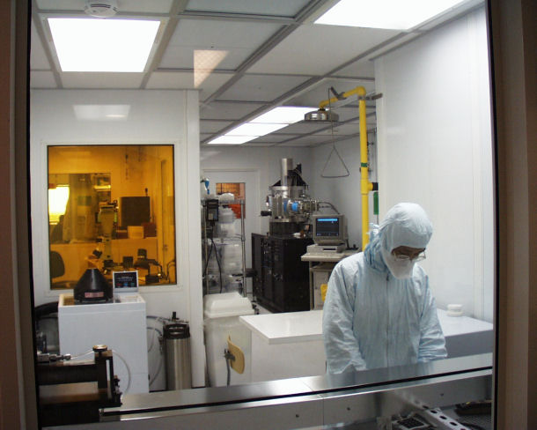
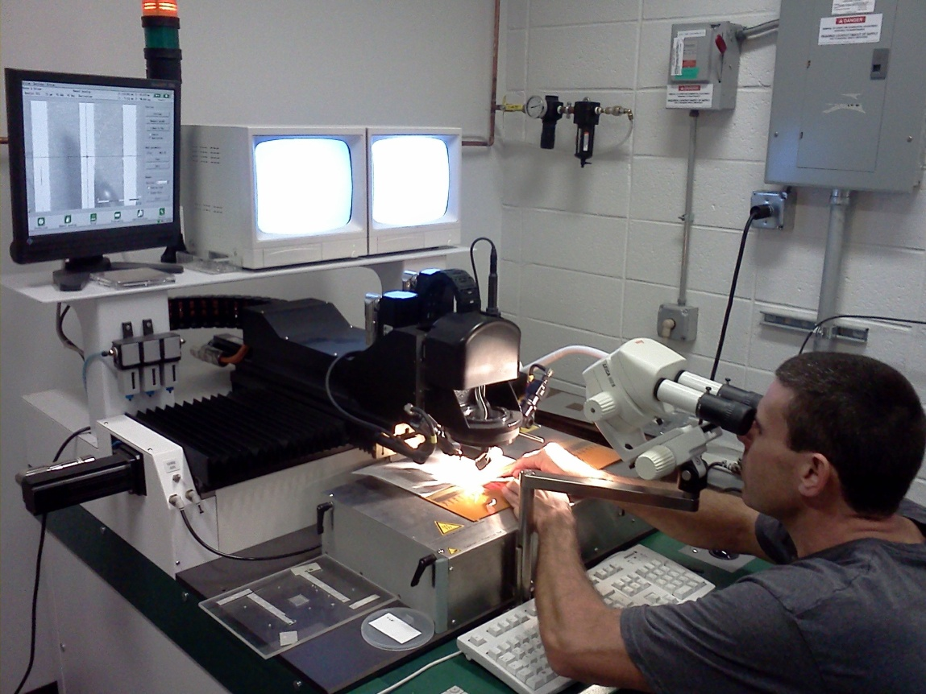
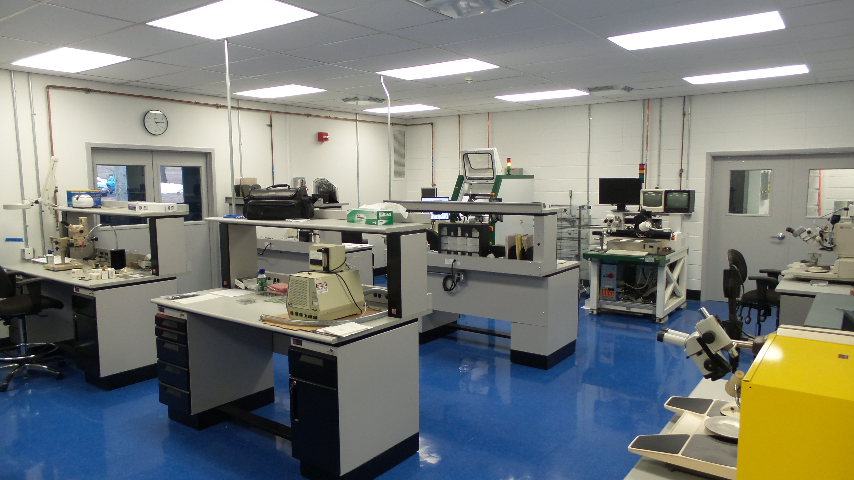
Instrumentation Division at BNL
Staff:
Approximately 45 total. About 14 scientists, 12 engineers, 11 technical.
Core Competencies:
Semiconductor Detectors: Silicon X- and gamma-ray detectors, silicon charged particle detectors, Si CCDs, germanium X- and gamma-ray detectors.
Gas and Noble Liquid Detectors: Micropattern gas detectors, noble liquid TPCs, noble liquid calorimetry, ³He based thermal neutron detectors.
Electronics: Low Noise ASICs, rad-hard electronics, digital signal processing, special printed circuit boards, high-density interconnect laboratory.
Lasers and Optics: Ultra-short photon and electron sources and measurements, photocathodes, optics and optical metrology.
Mission:
To develop state-of-the art instrumentation required for experimental research programs.
2
Notes:
2
2

Slide 3
Microelectronics at BNL
Since early '90, microelectronics at BNL successfully developed over 50 state-of-the-art ASICs with a wide range of impact and is especially renowned on:
  Low-noise low-power front-end optimized for high charge- and timing-resolution
  Cold electronics (enabling HEP large-scale cryogenic detectors)
  High functionality front-end ASICs (> 100,000 transistors per channel for ATLAS upgrade)
A major challenge is how to efficiently respond to the increase in demand, functionality and complexity
-> ASIC design resources (designers and CAD tools) need be increased
Notes:
3

Slide 4
Review of ASICs Developed at BNL
Year | ASIC Families | Collaborator | Publications | Impact areas
1996-1999 | ATLAS family | ATLAS | * | Particle Physics
1996-1999 | RHIC family | RHIC | * | Nuclear Physics
1997-2001 | CreV family | eV Products | * | Nonproliferation, Medical Imaging
2000-2004 | HERMES family | NSLS | * | Energy Sciences, Light Sources, Medical Imaging
2001-2009 | PDD family | eV Products | * | Energy Sciences, Light Sources
2002-2003 | CPG1 ASIC | LANL | * | Nonproliferation
2003-2004 | LEGS TPC ASIC | Physics | * | Nuclear & Particle Physics
2005-2008 | CPG2 ASIC | eV Products | * | Nonproliferation
2005-2007 | SNS He³ ASIC | ORNL | * | Energy Sciences
2005-2007 | Multiwindow ASIC | eV Products | * | Nonproliferation, Medical Imaging
2005-2008 | RATCAP ASIC | Medical | * | Medical Imaging, Neuroscience
2006-2011 | H3D family | DoD, UMich | * | Nonproliferation, Medical Imaging
2006-2009 | Compton Imager ASIC | NRL, NASA | * | Nonproliferation, Energy Sciences
2006-2010 | LUNAR family | NSLS, NASA | * | Energy Sciences, Light Sources
2010- | DUNE front-end ASIC | Physics | * | Particle Physics
2011- | DUNE ADC ASIC | Physics | * | Particle Physics
2011- | ATLAS VMM family | Physics | * | Particle & Nuclear Physics
2014- | MARS family | NSLS | * | Energy Sciences, Light Sources
2014- | HEXID 2D family | NSLS, NASA, SBU | * | Energy Sciences, Light Sources
2015- | Ge family | LBNL, LANL | * | Particle Physics, Energy Sciences, Nonproliferation
2015- | H3DD family | DoD |  | Nonproliferation, Particle & Nuclear Physics
2015- | ATLAS HLC ASIC | Physics | * | Particle Physics
2016- | SAR ADC ASIC | Physics |  | Particle Physics, Energy Sciences
2016- | LDO regulator | Physics |  | Particle Physics, Energy Sciences
4

Slide 5
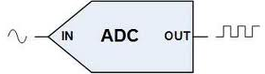
Developing Front-End Readout ASICs:
Increased Functionality and Complexity
Sense wire
Anti-aliasing filtering
(shaping)
-ADC
-amplitude/time
-waveform sampling
buffering
multiplexing
DSP
low-noise
charge amplification
Detector (capacitive source)
year 2000
· 250 nm technology
· 16,000 transistors
· 16 channels
· analog
year 2010
· 180 nm technology at cryo temp.
· ~ 1M transistors
· ~ 100 channels
· analog and mixed-signal
year 2011
· 130/65 nm technology
· >> 1M transistors
· >> 100 channels

Slide 6
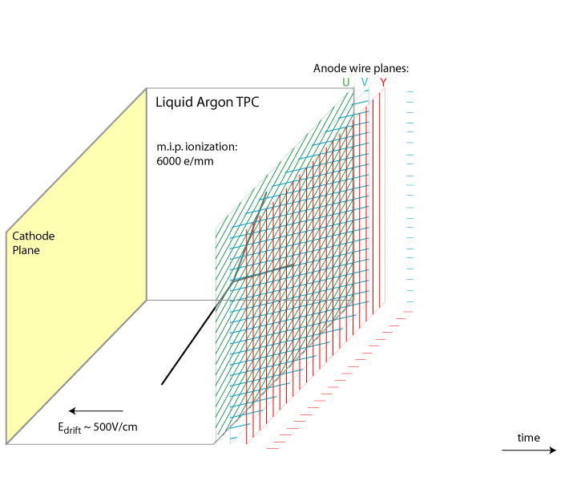
Cryogenic ASICs (µBooNE, ProtoDune, SBND, DUNE)
Up to 600,000 sensing wires
Low-noise and multiplexing
submerged in LAr (88K)
lifetime > 30 years
70m
Cryogenic electronics
voltage regulation
front-end
ADC
multiplexing
R&D on cryogenic characterization & lifetime
6

Slide 7
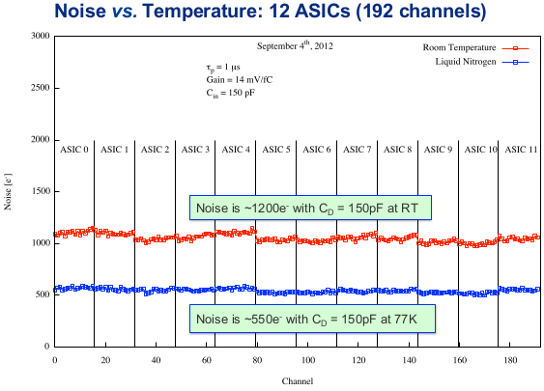
Cryogenic Analog Front-End ASIC
16 channels - charge amplifier, filter, buffer
Adjustable gain: 4.7, 7.8, 14 and 25 mV/fC
Adjustable filter time constant: 0.5, 1, 2, 3 μs
Selectable collection/non-collection mode
Selectable DC/AC (100 μs) coupling
Band-gap referenced biasing
Temperature sensor (~3 mV/ºC)
5.5 mW/channel (input MOSFET 3.6 mW)
Adopted in MicroBooNE, DRIFT, Argontube, CAPTAIN, LArIAT, LBNF 35T, LAr1-ND, ICARUS (CERN), candidate for nEXO
ASIC response in LN
Measured ENC in MicroBooNe
G. De Geronimo et al., IEEE TNS 58 2011

Slide 8
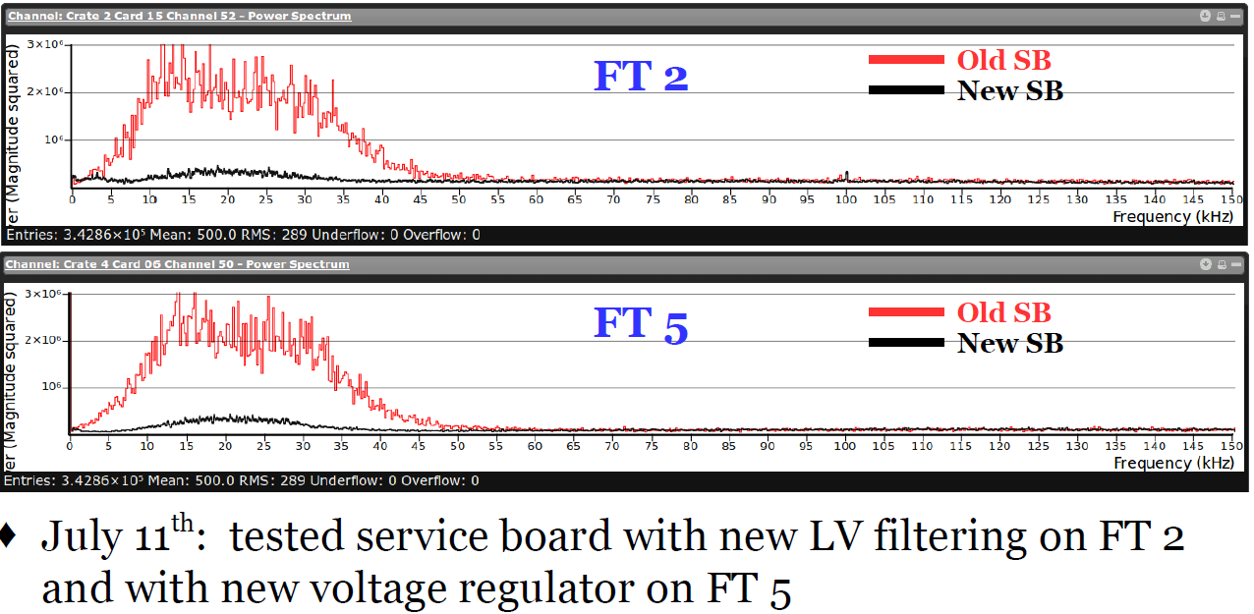
LDO (Low Drop-Out) Regulator
Commercial regulators are subject to trade-offs between noise and other general-purpose requirements which are not necessary for our FE-ASICs.
Our goal: very low noise @ low power, optimized for LAr FE ASIC.
nV/sqrt(Hz) in LAr | @ 1 kHz (1/f) | >100kHz (white)
LAr ASIC Input PMOS | 5 | 1.4
TPS78618 (uBooNE_ini) | 200 | 50
ADP7159 (uBooNE_rev) | 3 | 0.5
10k-30kHz noise observed in uBooNE, due to regulator noise amplified by the FE channel;
Issue fixed by using lower noise regulator or heavier on–board filtering.
uBooNE Service Board Test [Mooney_Aug2016]
[De Geronimo_June 2016]
8

Slide 9
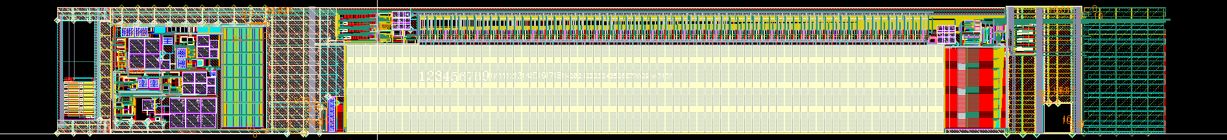
LAr ADC ASIC
Performance parameters :
  Sampling rate up to 2 MS/s
  Measured resolution 11.7-bit
  Low power ADC, maximum 5 mW/ch
  Input range 0.2 V to 1.5 V
  Clockless operation, ideal for low noise operation
  Small area favorable for multi-channel system
Features
  Low power mode with < 1us wake-up
  Adjustable offset
  Multiple options for internal control signals
INP16
ADC16
12 bits
FIFO
O8P/N
INP15
12 bits
O16P/N
ADC15
FIFO
EMPTY
INP1
12 bits
ADC1
CLK IN
BIAS
ASIC Simplified Block Diagram
0.28mm
2.4 mm
Single ADC Layout
9

Slide 10
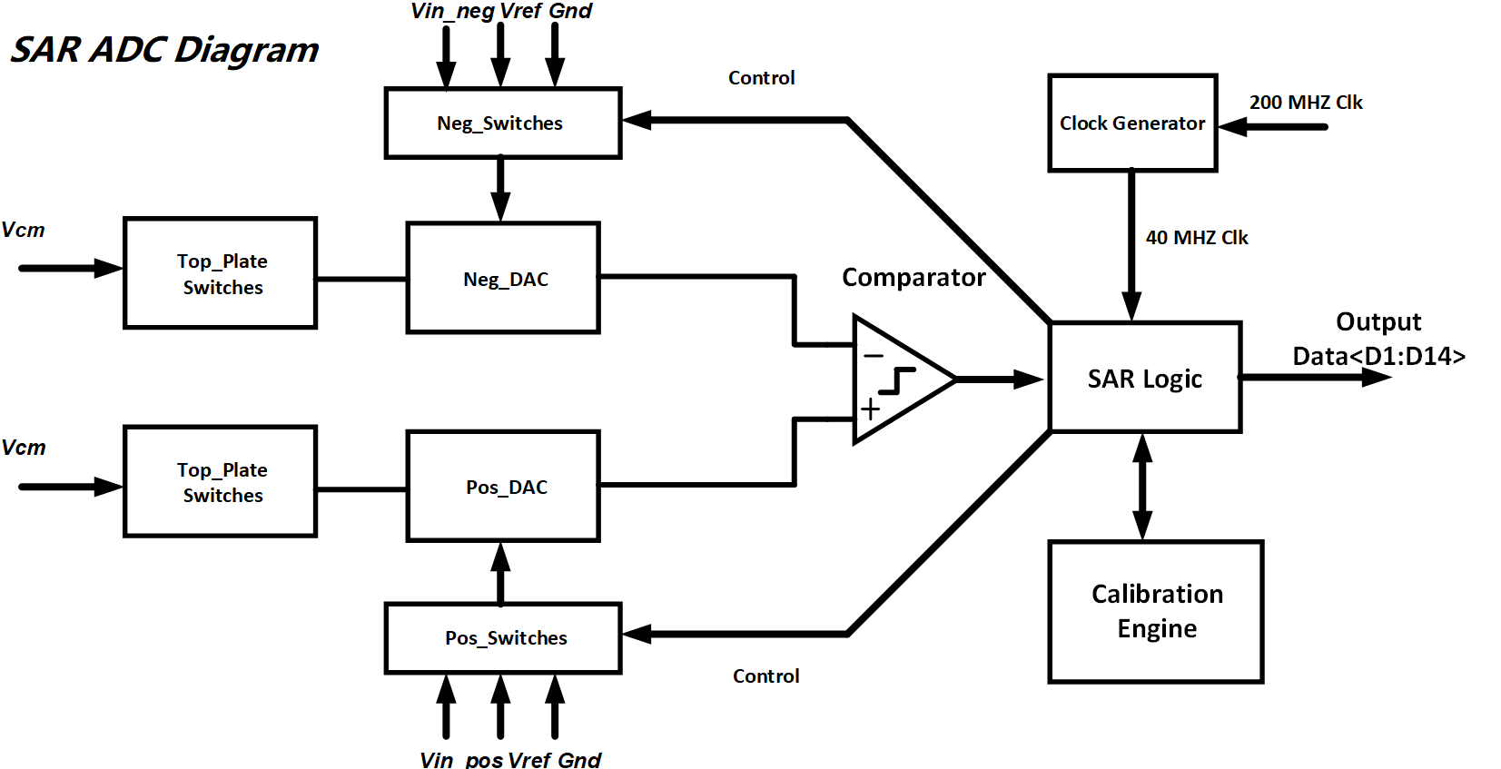
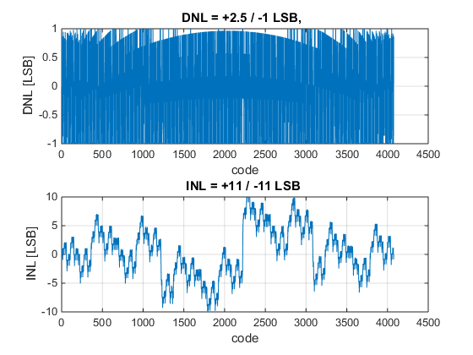
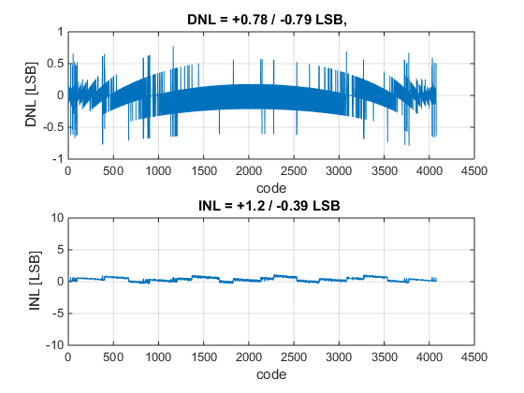
SAR (Successive Approximation Register) ADC
Most blocks are passive components
-> less risk in cold environment
Major linearity error come from DAC capacitor mismatch
-> calibrated to obtain high resolution
MIM capacitor mismatch is NOT sensitive to temperature
To achieve >10-bit resolution, DAC redundancy and calibration are necessary!
Without Calibration
With Calibration
No missing codes!
A lot missing codes!
10

Slide 11



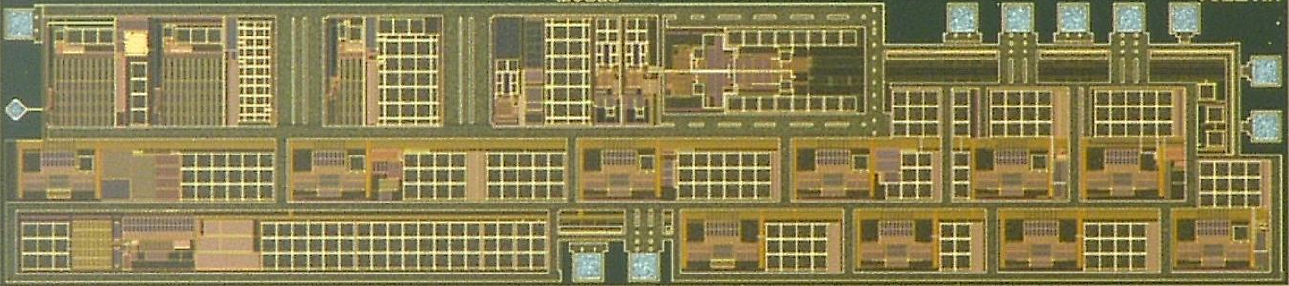
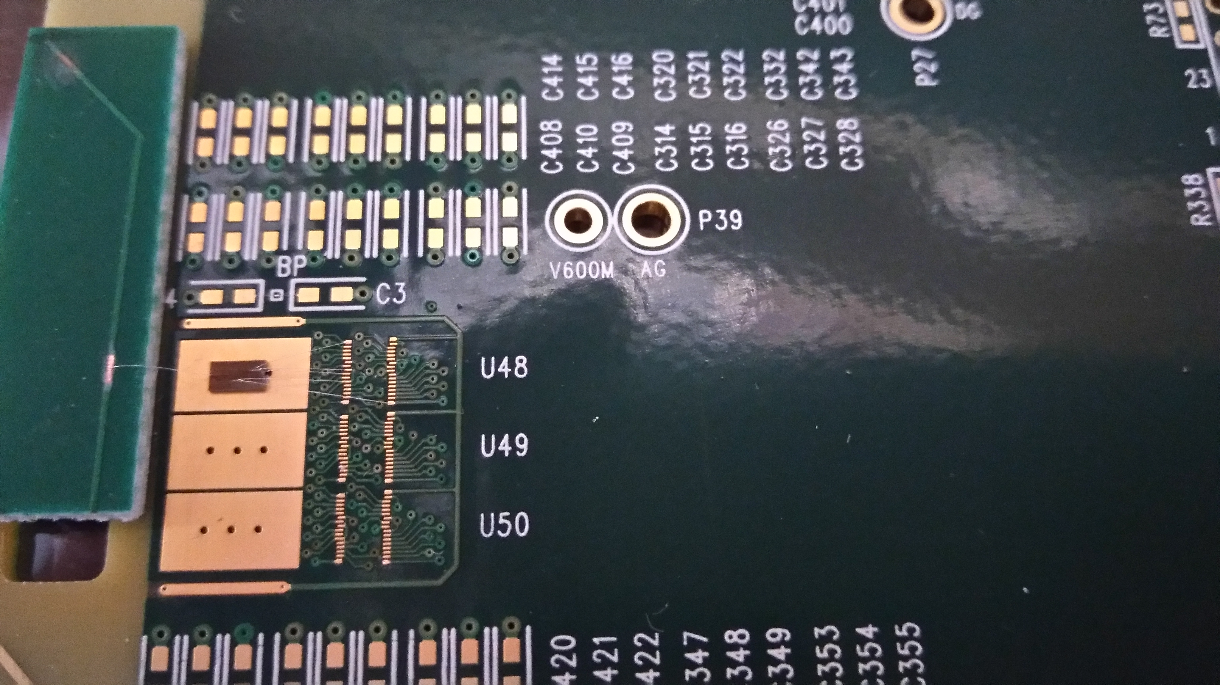
Very Low Noise ASIC for Germanium Point-Contact Detector in LAr
Large gain (~5000) of charge amplifier to lower noise contributions from later stages
Adaptive continuous reset successfully avoid dead-time and switching noise in charge amplifier, and automatically adjusts to detector leakage current.
Large bandwidth of anti-alias filter (AAF) to preserve 50ns pulse rise time
in
in
Three-stage Charge Amplifier (CA)
(charge gain = 5000)
*with adaptive continuous reset
Anti-Aliasing Filter (AAF)
Buffer
ADC
100-250 MS/s
Digital
Shaper
Trapezoidal weighting function
τ _{c}
Ge Point-Contact detector
C < 1 pF [P. Barton_LBNL]
τ_{p}
τ_{p}
V_{b}
Cdet (fF) | ENC_total (e-) | ENC _m1&lk (e-) | ENC_m1-1/f (e-)
200 (possible load) | 5.3 | 4.8 (~82%) | 4.5 (~71%)
100 (target load) | 3.9 | 3.5 (~78%) | 3.2 (~65%)
1 (without load) | 2.6 | 2.1 (~68%) | 1.9 (~48%)
11
11
[S. Li & G. De Geronimo, IEEE NSS 2017]

Slide 12
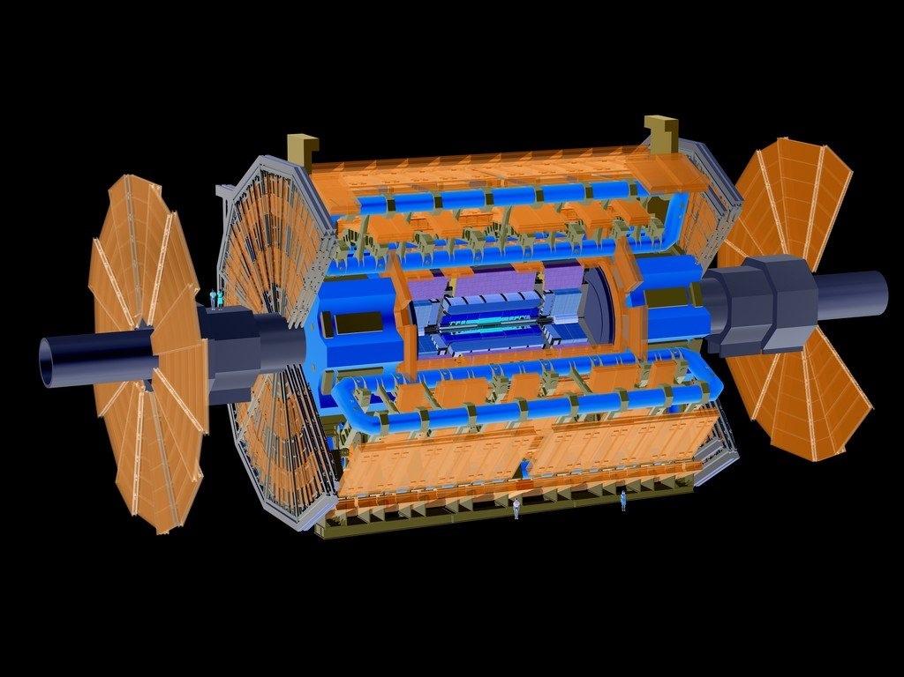

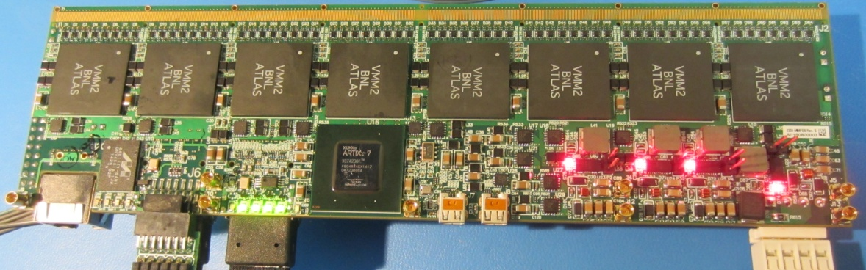
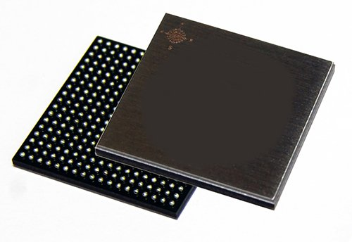
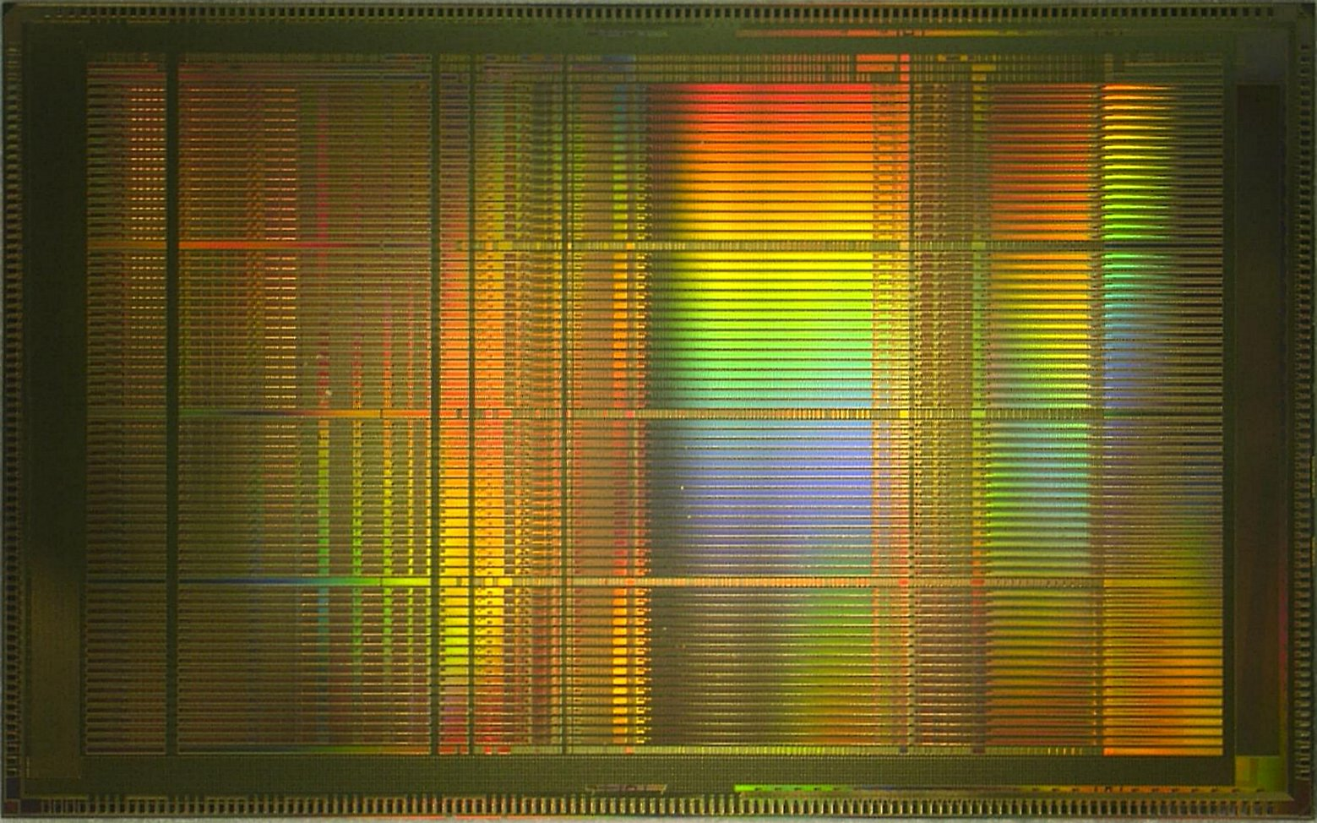
FE-SOC: ASIC for ATLAS Muon Spectrometer
New Small Wheels: 2.3M channels,
2pC @ < 1fC rms, 100ns @ < 1ns rms, 30pF-2nF
64 channels: low-noise amplification, peak, timing, discrimination, 3 ADCs, timestamp, FIFO, L0 handling
real-time address, sub-hysteresis, direct outputs, fully digital interface
CMOS 130nm, 13.5 mm x 8.4 mm,
transistor count/ch.: > 100,000
12
G. De Geronimo et al., IEEE TNS June 2013
Notes:
12

Slide 13
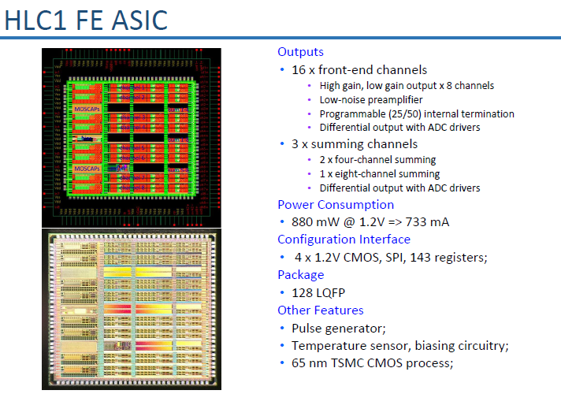
[G. De Geronimo, IEEE NSS 2017]

Slide 14
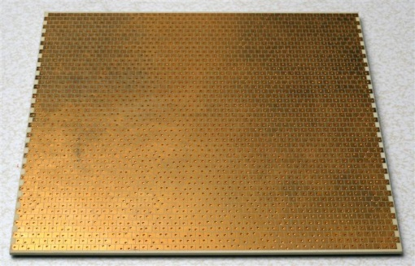
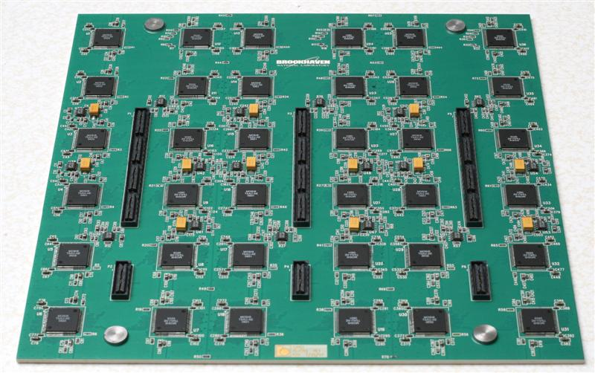
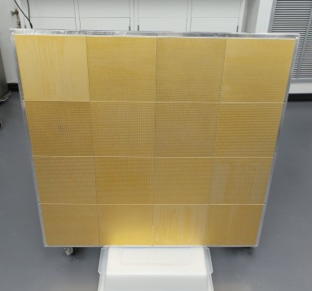
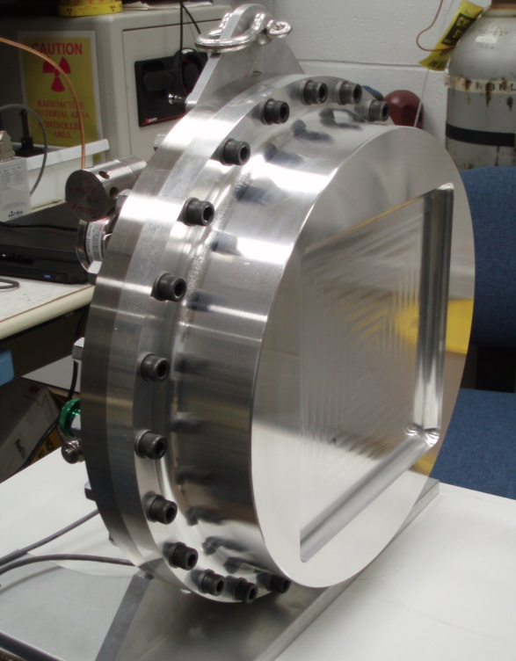
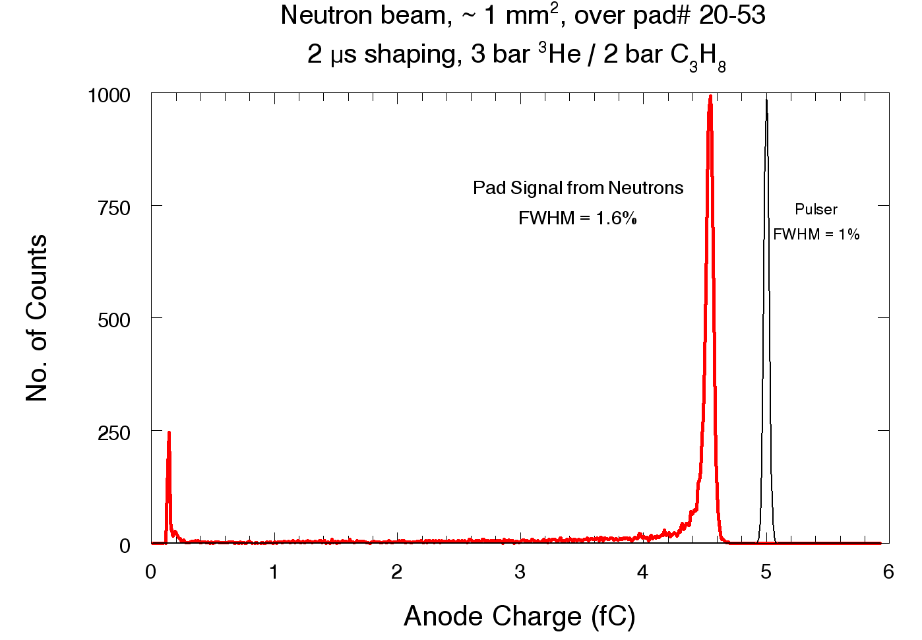
Two-Dimensional, Pad Detector for Neutron Scattering
³He + n → ³H + p +764keV (∼ 5 fC, or ∼ 30k electrons)
PAD side
24 cm × 24 cm anode pad board, with 5mm × 5mm pads → 2304 pixels
Array of 4 × 4 pad boards, comprising 37 k independent channels. Operation in ionization mode, i.e. unity gas gain, would not be not feasible without ASICs
ASIC side
SNS ASIC
64 channel 2mW/ch
Window
1 m × 1 m Detector for ANSTO
14
Notes:
14

Slide 15
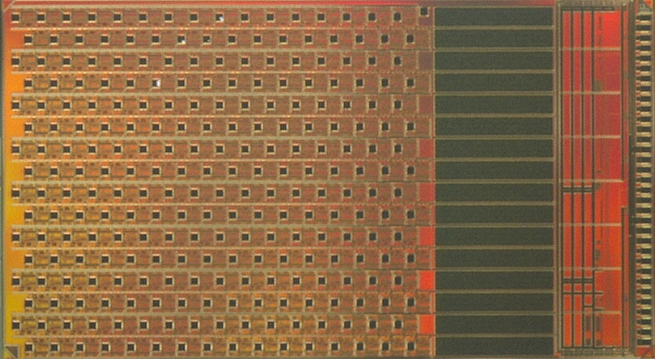
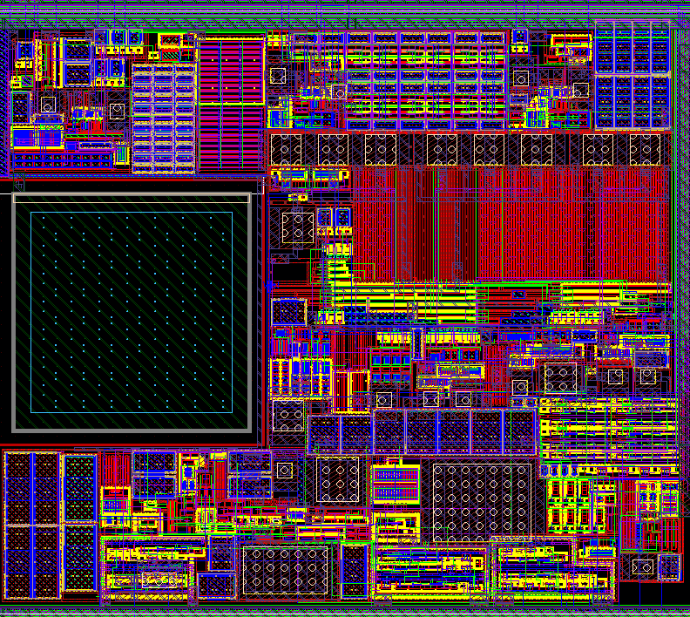
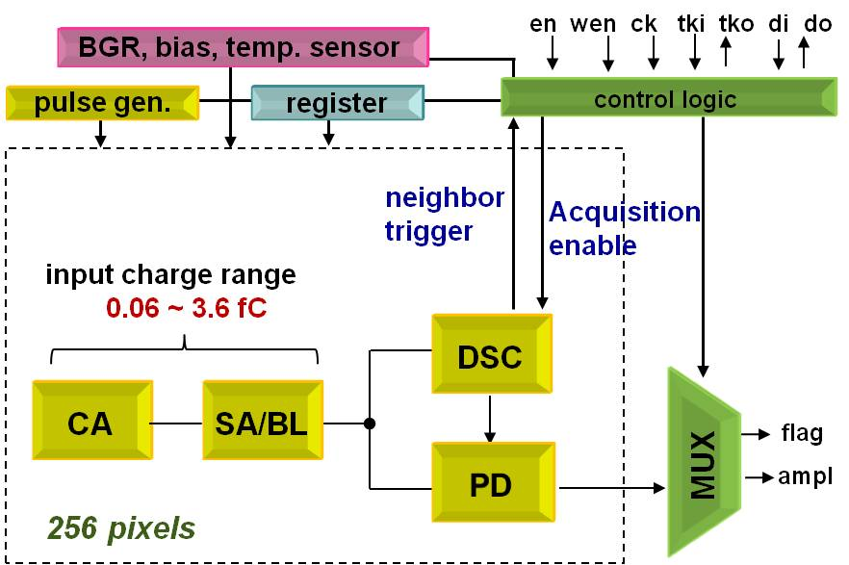
2-D ASIC Hi-Resolution X-ray Imager
~700,000 transistors in CMOS 130nm technology (1.2 V supply)
256 hexagonal channels at 250 µm pitch
  3-side abuttable, with 33 I/O pins only on the right side
Each channel includes:
-low-noise charge amplifier (adjustable gain: 0.25, 0.5, 1 V/fC)
-shaper (adjustable peaking time: 125, 250, 500, and 1000 ns)
-baseline stabilizer
-discriminator and peak-detector
~0.6 mW/channel
Simulated ENC: ~ 11 electrons (@ 60 fF det. cap. & 6pA leakage per pixel)
Limited area for low-noise low-power readout chain
No direct address control of each pixel, relying on token passing
[S. Li & G. De Geronimo, IEEE NSS 2017]

Slide 16
ASIC for High Resolution X-ray Spectrometers
Improving Radiation Resistance:
- Radiation degradation due to leakage current of NMOS↑
ENC degradation: peak at around 2 Mrad
Modified design to improve radiation resistance: replacing NMOS switch with PMOS switch; insert PMOS switch between NMOS current source and charge amp. input; increase device length; gate-enclosed layout.
[Rehak & Gatti _1983]
16 x 20mm² SDD pixels
~11 e⁻ resolution (93 eV) with 20 mm² SDD pixel
ENC before design modification
ENC after design modification
[S. Li & G. De Geronimo, IEEE TNS 2013]

Slide 17
[G. De Geronimo_Sept2016]

Slide 18
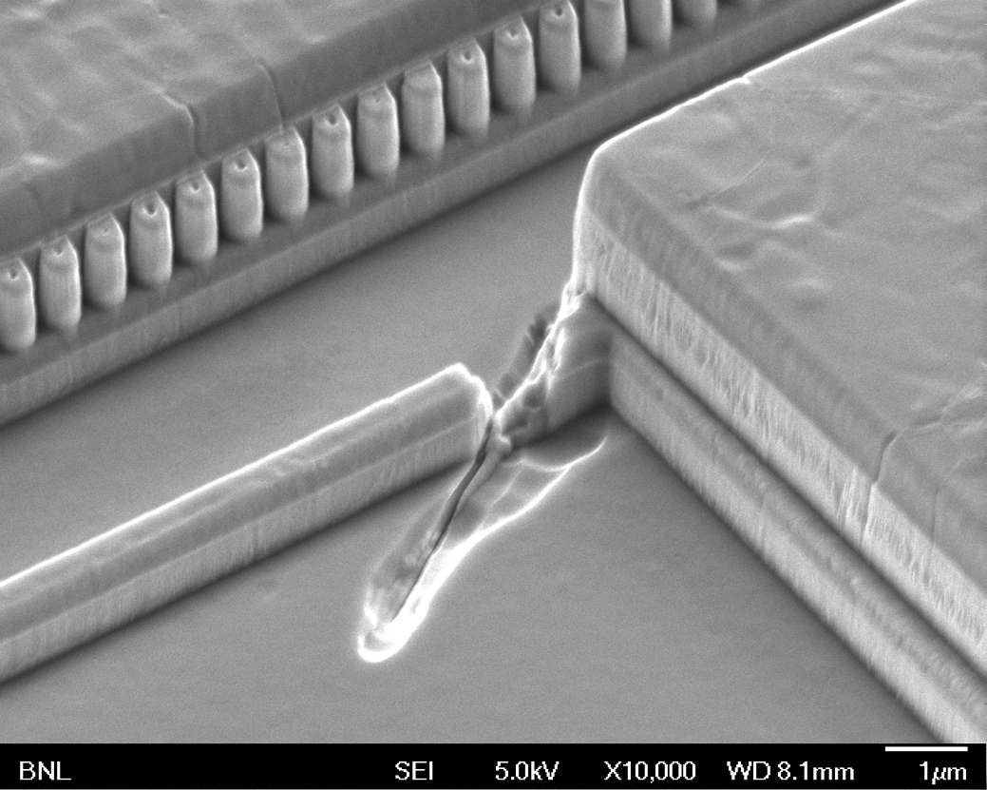
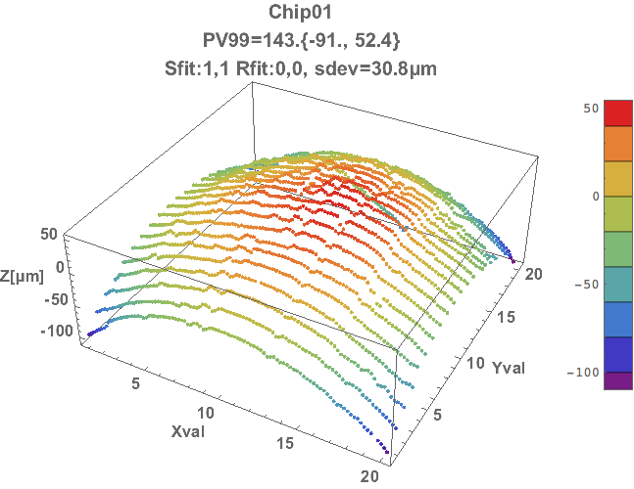
Resources
Mietek Dabrowski (Cryo FE)
Alessio D’Andragora (Cryo FE, H3DD)
Shaorui Li (Cryo FE, LDO_REG, HEXID, GE, LUNAR)
Yuan Mei (SAR_ADC)
Emerson Vernon (SAR_ADC, MARS, H3D)
*Wenbin Hou (SBU PhD, LDO_REG)
*Krithika Yethiraj (SBU PhD, SAR_ADC)
*Gianluigi De Geronimo (SBU, VMM, HLC, H3DD, Cryo FE&ADC, etc.)
ASIC design
Scientists
Sensors (solid-state, gas, liquid, cryo, ...)
Interconnects and assembly D. Pinelli, K. Luong
Printed circuit board K. Wolniewicz, K. Ackley, I. Gonzalez
Data acquisition and processing J. Fried, J. Mead
CAD tools and compuing A. Kandasamy
SEM laboratory, Optical metrology J. Warren, P. Takacs
ASICs
  Defect in LAr ASIC capacitor
  BGA package curvature in VMM
Developed in close collaboration with scientists
Require concentration of resources and expertise
18
Notes:
18

Slide 19

Collaborations
List of collaborations:
SBND/DUNE: FermiLab, LBNL
ATLAS upgrade: UPenn, CERN
nEXO: SLAC, Stanford, LLNL, TRIUMF, IHEP
Neutron Detector: ORNL, LANL, ANSTO
X-ray imager: NASA, WUSL, SBU, LANL
Germanium detector: LBNL, LANL
CZT detector: UMich, DoD
Compton Imager: NASA/NRL, SWRI, WUSL
Suggestion:
In the past we have successfully collaborated with physicists and engineers within the community;
As the scope and functionality of ASICs getting more complicated, collaborating with IC design experts would be greatly beneficial to our R&D.
19
Notes:
19

Slide 20
Conclusions
Advancements in radiation detectors are made possible due to advances in front-end ASICs, which are rapidly becoming systems-on-chip (FE-SOC)
Successful ASIC developments require concentration of resources and expertise, and close collaboration with experimental teams
  Front-end ASIC designs are dealing with an increase in demand, complexity, and functionality - and deal with the rapid progress of IC technologies (e.g. 0.5um->250nm->180nm->130nm->65nm)
ASIC capability for advanced detectors requires an increase in resources (designers, CAD tools), and an R&D program aligned with the HEP and BNL missions

Slide 21
Backup Slides
21

