Slide 1
Application Specific Integrated Circuits and System-on-Chips at SLAC
A. Dragone
TID - AIR Integrated Circuits Department Head.
(* dragone@slac.stanford.edu)
TID - AIR Integrated Circuits Dept.

Slide 2
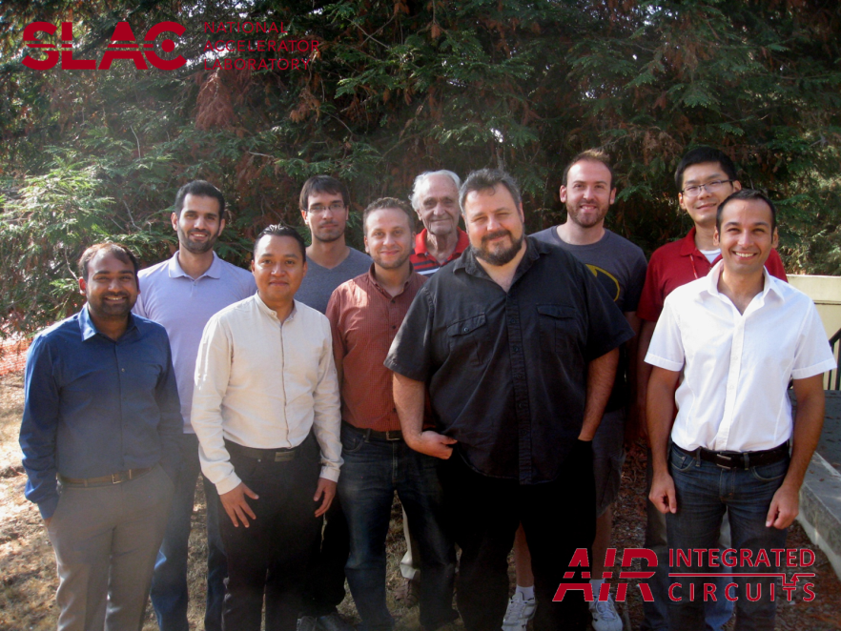
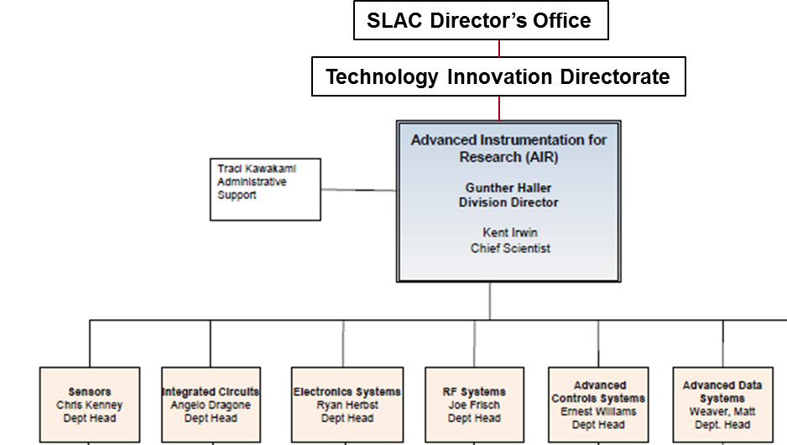
TID-AIR IC Department
A. Gupta, F. Abu-Nimeh, A. Pena Perez, B. Markovic, H. Ali, D. Freytag, A. Dragone, P. Caragiulo, X. Xu, C. Tamma
Key role in several instrumentation projects
Team of 10 ASIC designers (probably the largest team in the DoE laboratories) with complementary expertise (critical mass) + 2 visiting/student positions
Close connection with the scientist and the experiments
Close collaboration with multiple groups (Stanford EE, UCSC, UCD, University of Oregon, UTA, UNM, Bonn University, Stanford SPF, Stanford School of Medicine (3 groups), University of Sherbrook CA , Polytechnic Institute of Bari, DESY, EuXFEL)
Vast area of expertise bridging the knowledge required to successfully design instrumentation for several fields: HEP, BES-Photon Science, Space, Medical Imaging, National Security and innovative industrial application (WFO/CRADA)

Slide 3
Provides engineering for SLAC directorates
All SLAC internal developed LCLS/LCLS-II detectors
HEP: ATLAS, CDMS, HPS, etc.
LSST, CMB, Fermi, etc.
Startups, other institutions
9 detector
engineers/
scientists
24 electronics design engineers,
test engineers, layout techs,
and assembly techs
Device simulation
Advanced interconnection
System Characterization
Test systems design
Firmware support
GUI integration

Slide 4
Areas of expertise
Conceptual design of novel architectures
System modeling and simulation
Implementation of mixed-signal SoC architectures:
full custom or digital-on-top flow, low noise, low power, pixel or channel based, multi-voltage domains, designed for testability
Custom design of IP blocks
Analog:
ultra low noise, low power analog front-ends (amplification and optimal filtering),
high density circuits (pixels)
high speed custom interfaces
Digital:
custom as well as full synthesis from HDL language to synthetized circuit generation
auto placement and layout and full integrated verification\
Mixed Signal with System on Chip approach:
Full digital and analog on same ASIC with minimal I/Os
Signal converters ADCs, DACs, TDCs
Embedded Digital Signal Processors custom and IP based
Monolithic technologies:
CMOS sensors in standard technologies for light (Imagers, SPADs, SiPM), temperature, magnetic.
Integrating sensors on read-out ASICs: Imagers, MAPs, High Resistivity MAPS, SPADs, SiPMs.
ASIC in extreme conditions:
Cryogenic operation down to below LAr temperatures. Circuit design for LXe applications.
Rad-Hard design
Space.
High-Precision fast timing circuits (down to 20 psec)
Power management and energy harvesting circuits

Slide 5
Technologies
Skills and tools to design at every technology node
Chip delivery in various ASIC-technologies (250, 180, 180HV 130, 130HV, 65, 40 nm) at TSMC, IBM/GLOBALFOUNDRIES, AMS, LFoundry, TowerJazz, UMC
Advanced interconnection service for prototypes and volume (with AIR-Sensors Dept.)
Production test cards (with AIR Advance Electronics Dept.)
In house process for CMOS sensors designed in AIR and fabricated on-campus at Stanford Nanofabrication Lab by AIR engineers

Slide 6
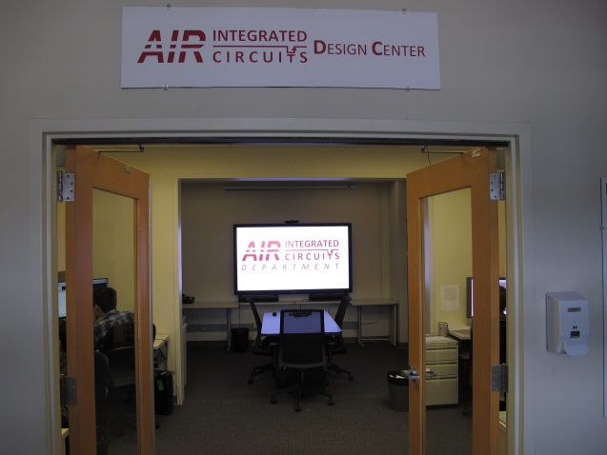
Facilities and Tools
Design Center
Dedicated CAD workstations
State-of-the-art CAD tools for:
Behavioral Modeling (Matlab, Simulink)
Schematic Entry and Layout (Cadence, Mentor Graphics, Tanner EDA)
Simulation (HSpice, Spectre, HSIM, NanoSim, AFS)
Verification (Assura, Calibre)
Digital design and synthesis (Modelsim, Synopsys Design Compiler)
Digital-on-top integration (Encounter, Liberate)
Device parameter extraction (Keysight MBP, WaferPro)

Slide 7
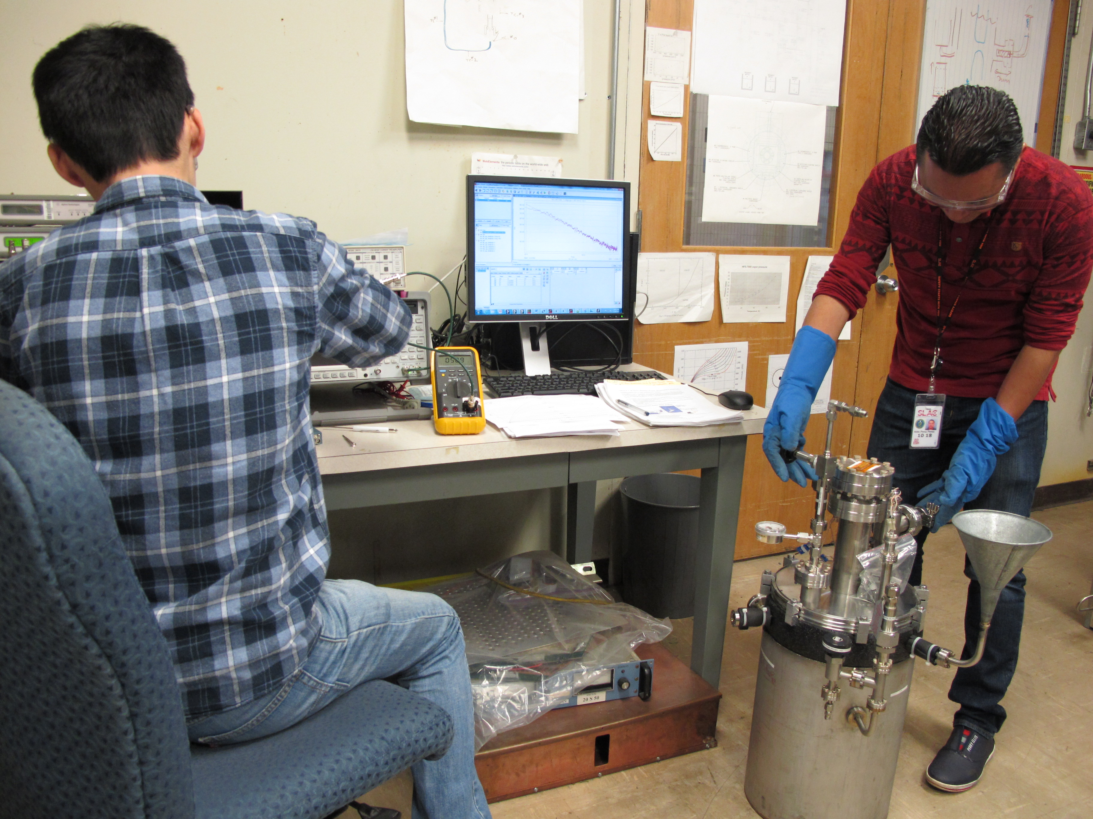
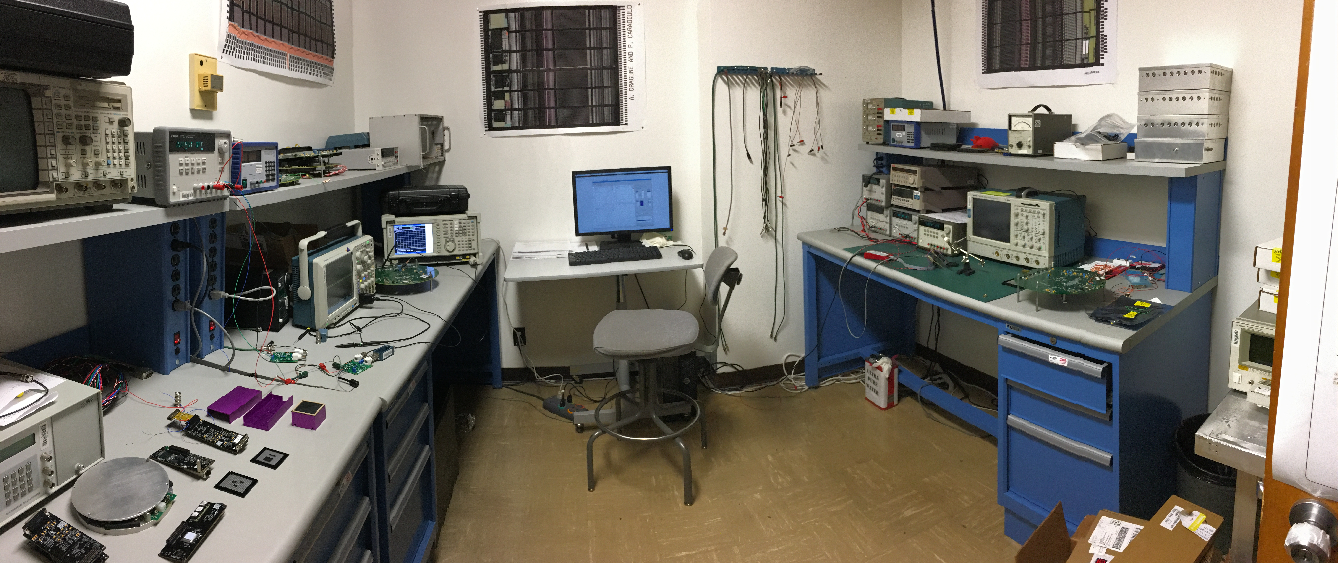
Facilities and Tools
Testing labs
Fully equipped with state-of-the-art testing instrumentation
Dedicated test setup for transistor modelling and parameter extraction
Setup for cryogenic measurements

Slide 8
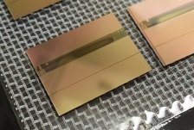
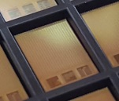
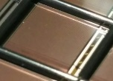
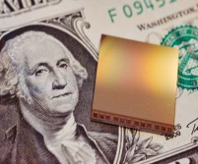
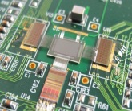
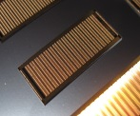
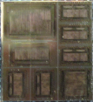
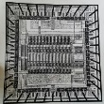
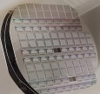
History: 33 years of ASICs for science at SLAC
More than 80 successful design. To name a few….
2016
CHESS first generation monolithic ASIC for ATLAS strips
2015
2014
cPix² a photon counting front-end ASIC for high repetition rate pump probe experiments
2013
tPix family a spatial and time resolving front-end ASIC for momentum spectroscopy
2012
ePix family second generation ASICs for LCLS Detectors
2011
eLine family first generation ASICs for LCLS Detectors
2008
kPix An Array of Self Triggered Charge Sensitive Cells Generating Digital Time and Amplitude Information
2003
FermiLat 9 different designs for space. 16000 ASIC working in space since 2008 (in collaboration with GSFC, NRL, UCSC)
1993
WASU A 900MHz Analog Memory Integrated Circuit for Waveform Acquisition
1984
MicroPlex the first ASIC for Particle Physics experiments

Slide 9
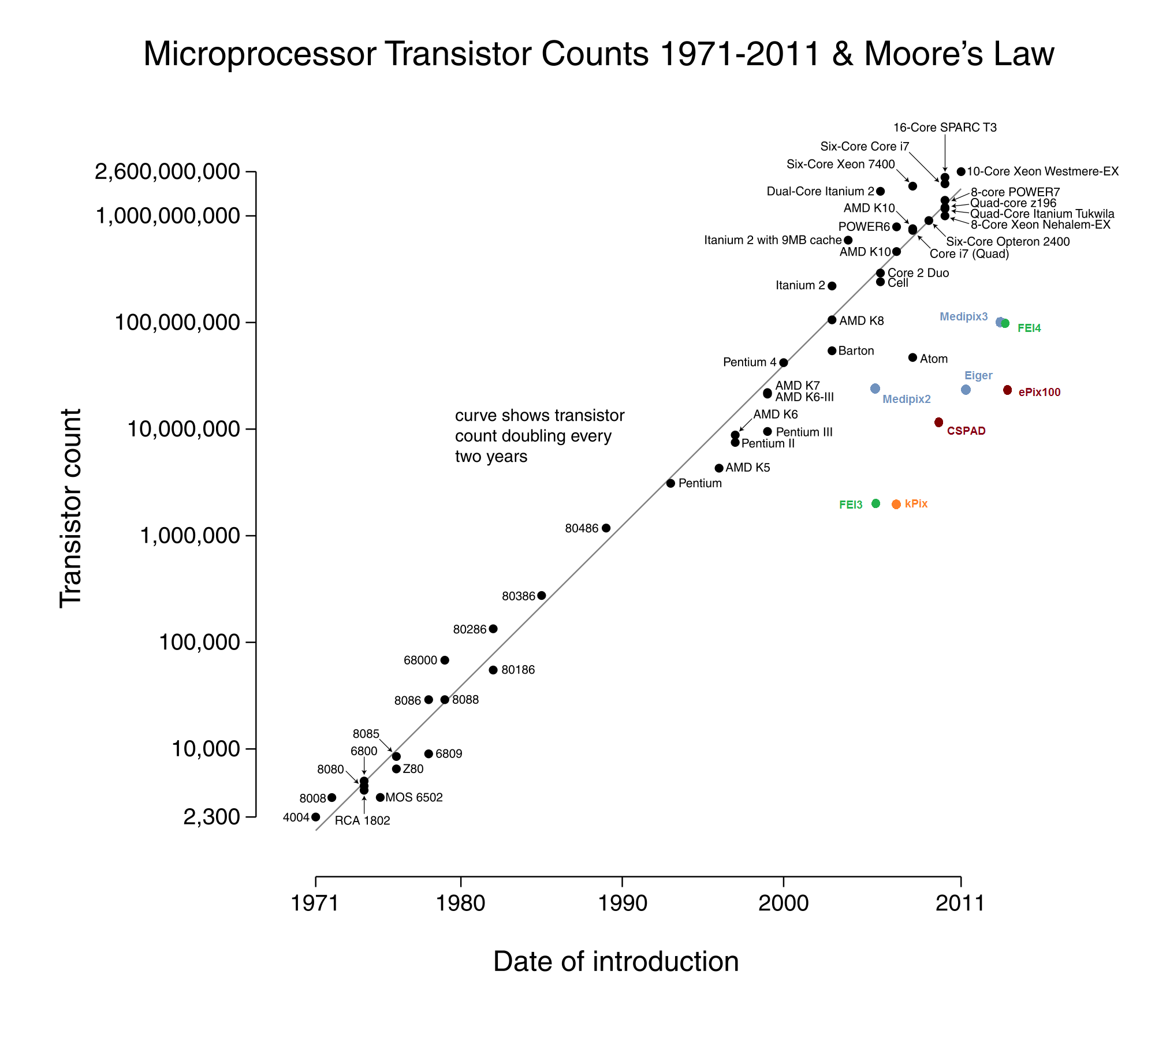
Partial hints on complexity
In the world of Microprocessors the transistor count is a measurement of complexity and performance.
This is only partially true in our field as performances are mostly related to the performance of the analog blocks . Still the transistor count can be used as a hint of the complexity of these designs the possibilities within a specific technology and the development resources required.
PS Integrating
PS Timing
HEP Integrating
WFO
0.13µm
tPix
0.25µm
OSPAD
tPix
SLAC pixel ASICS | Function | Transistor Count | Technology | Pixel size | Area
kPix | Integrating | 2.6M | 0.25 µm | 200µmx500µm | ½ FR
CSPAD | Integrating | 17.3M | 0.25 µm | 110µmx110µm | FR
ePix10k | Integrating | 18M | 0.25 µm | 100µmx100µm | FR
ePix100 | Integrating | 28M | 0.25 µm | 50µmx50µm | FR
tPix | Timing | 80M | 0.13 µm | 100µmx100µm | FR
OSPAD | 3D sensing | 28M | 0.13 µm | 100µmx100µm | ½ FR

Slide 10
Projects areas and statistics
Statistics over the last 15 designs
Average number of iteration per design
1.2
Average design time per ASIC (including testing)
8 months design and characterization
+ 2 months fabrication
Average number of designers per ASIC
2.5

Slide 11
List of current projects
Particle Physics:
HGTD: high granularity timing ASIC with sub-ns resolution for ATLAS upgrade (collaboration with UCSC, Omega group, SMU)
CHESS and COOL: HR-MAPS R&D for ATLAS upgrade (collaboration with UCSC)
CRYO: a waveform digitizer for cold experiments. SoC single chip solution for nEXO (risk mitigation version for DUNE)
Photon Science:
ePixHR10k, ePixHR250s, ePixHiZ, ePixΔ: three new pixel signal processors for high rate cameras at LCLS-II
tPix: sub-ns timing ASIC for momentum spectrometers at LCLS
cPix²: a dual gate, colored counter for synchrotron time-resolved applications
Medical Imaging / Neuroscience:
20ps resolution SoC for SiPM based TOF PET (collaboration with Stanford and DEI Poliba)
Multichannel active neuroprobes
Collaboration with Industry:
OSPAD: A Time Correlated Single Photon Counting ASIC for 3D sensing application
RXASIC: A front-end for GPR applications
Lib-V: A library of peripherals and interfaces for the RISC-V ecosystem

Slide 12
Projects Highlights …

Slide 13
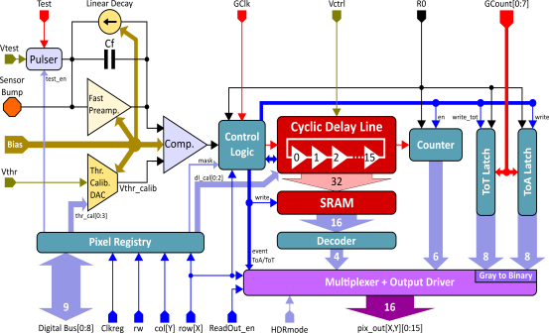
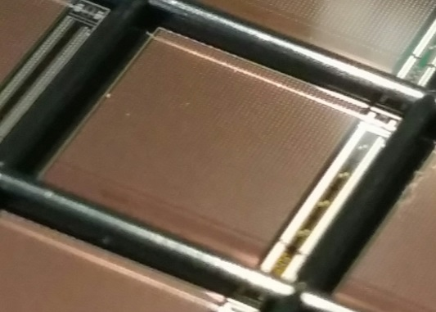
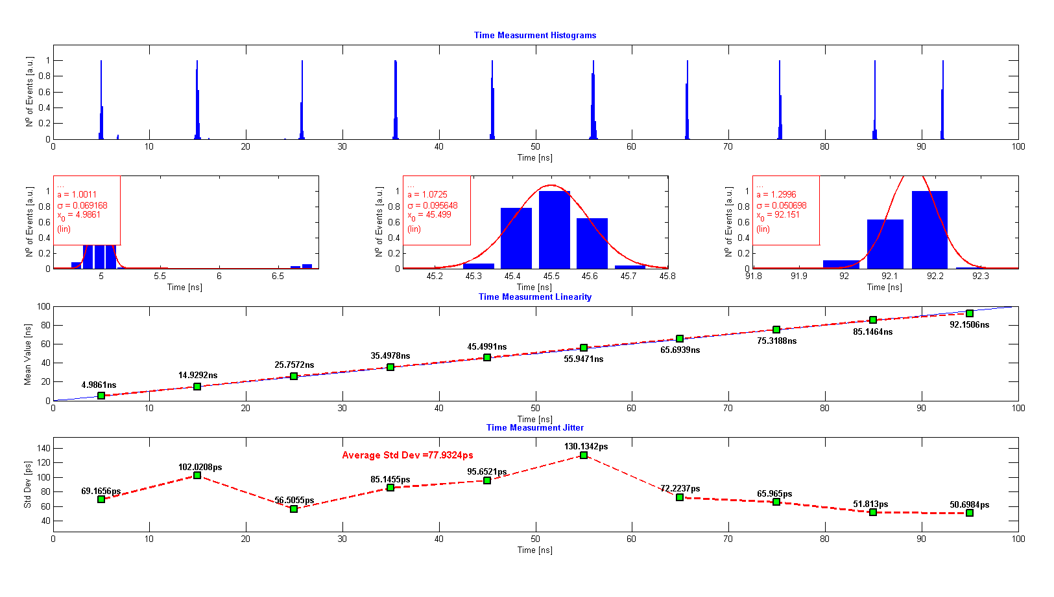
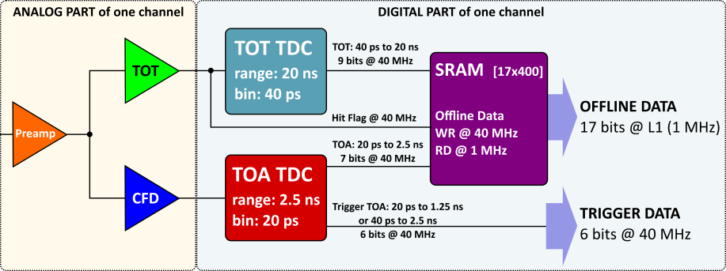
Timing ASICs
tPix, a fast timing pixel ASIC with sub-ns resolution:
Second Prototype designed, fabricated and in characterization
Improved performance with respect to the first version (resolution measured at ~78ps)
tPix pixel architecture
Expanding the capabilities for fast high granularity hit encoding with time tagging
adding position encoding
adding a sparsified continuous readout
tSPAD variant (with Stanford):
tPix version with integrated SPADs (monolithic) for sub100ps resolutions on large arrays
SPAD Single-Photon Avalanche Diode
PN junction biased in Geiger mode
avalanche multiplication
fast timing
can be built in standard HVCMOS
Altiroc: Readout ASIC for ATLAS HGTD detector
Design in collaboration with Omega group (France), UCSC, SMU
Analog section of the pixel designed fabricated and successfully tested
Prototype of the full pixel chain under design (TDCs (20ps) + FIFO designed by SLAC)
Omega
SLAC
Future plan
Submit 4x4 pixel prototype in Q2 2018

Slide 14
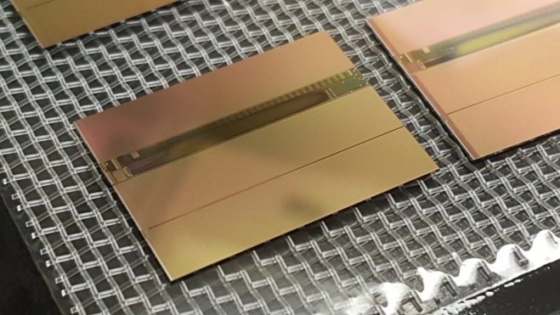
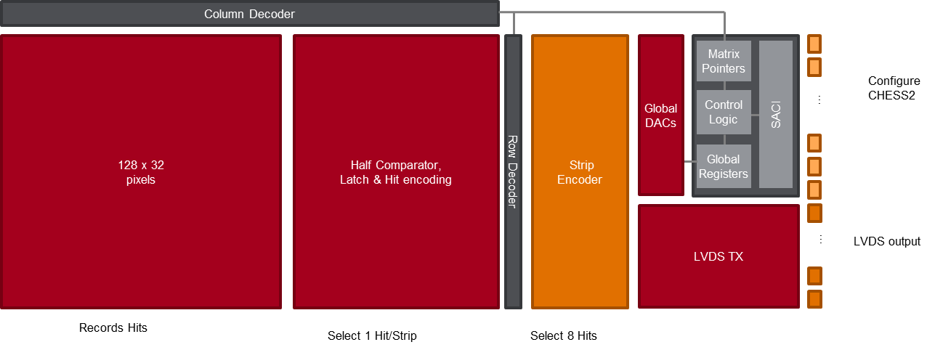
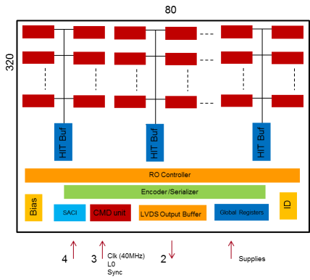
Monolithic ASICs
HV-CMOS strip detectors CHESS (with UCSC):
CHESS-II prototype designed fabricated and in characterization
SLAC responsible for the full architecture (pixel UCSC)
Concept proven.
SLAC section successfully tested
CHESS-II prototype
Future plan
Complete pixel characterization
Fabricate a second prototype (no funds at the moment)
Monolithic HR-full CMOS detectors – COOL (ATLAS outer pixel upgrade)
Test structure fabricated and in characterization
Tentative goals |  | COOL-1
Pixel size |  | 250x50 µm²
Array |  | 320x80
Full Size |  | reticles
Max. Signal |  | ~10ke⁻
Effective ENC |  | <120e⁻
DC Current cons. |  | ~ 20µA/pix
Future plan
Design a full architecture prototype (small pixel matrix)

Slide 15
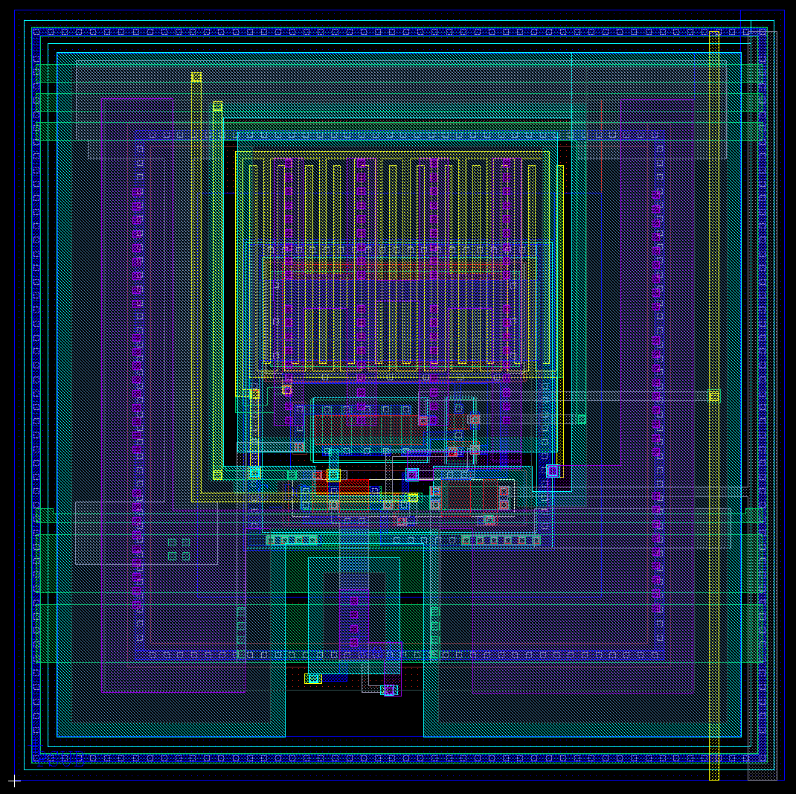
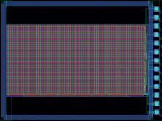
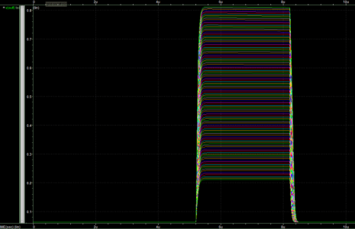
L-Foundry 25x25um² pixel imager for LCLS:
Prototype 64x32
Purpose: to evaluate technology for X-ray application
Pixel size 25x25 um²
Integration <10us
Energy range: 250 – 2,000 eV
Full scale: 200 photons
Noise 20e- (at room temperature, lower if cooled)
* Models are not verified yet
Pixel response
Pixel layout: ePix-like architecture CSA+CDS
ASIC arrived in June 2017

Slide 16
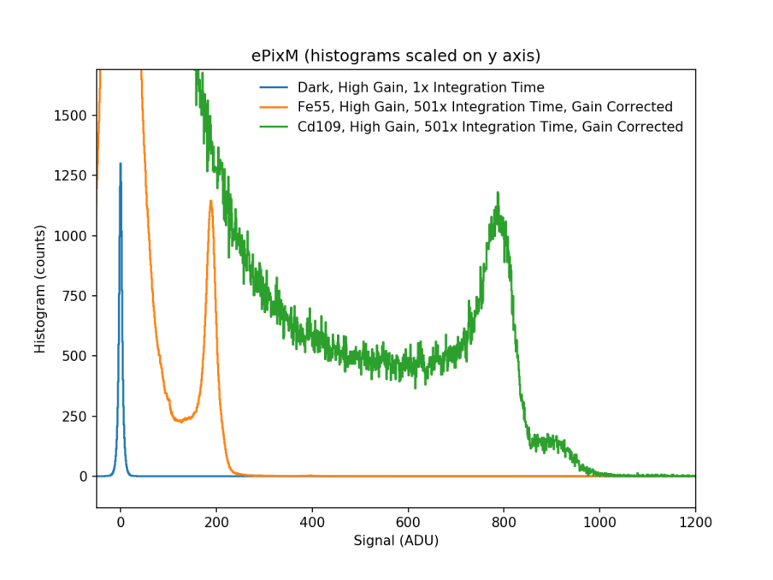
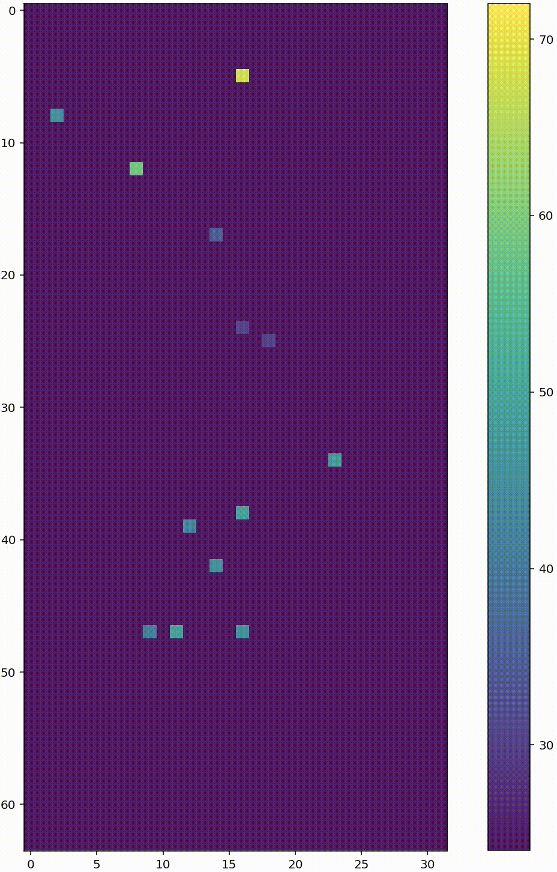
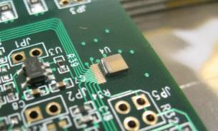
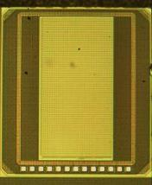
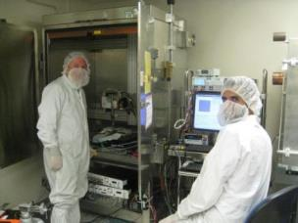
Prototype results
Preliminary board noise dominating (work in progress)
Fe55 live acquisition
ePixM LF 25um 64x32 prototype
G. Blaj and F. Abu-Nimeh

Slide 17
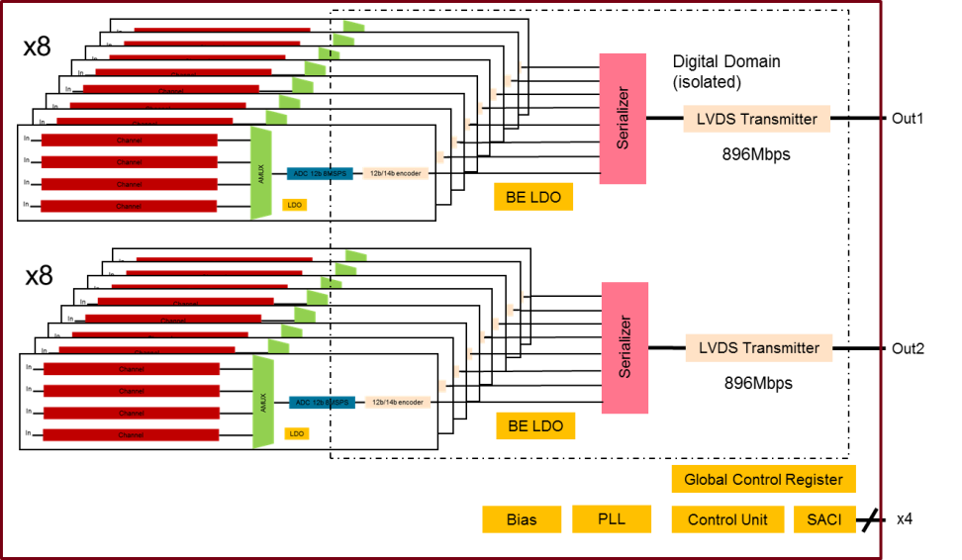
Cryogenic System-On-Chips ASICs
Waveform digitizing ASIC for cryogenic operation optimized for the charge readout in TPC experiments in noble liquids
Use a SoC approach (single ASIC with analog and digital functionalities)
With minimal number of IO/s Digitally Assisted (highly programmable in functionalities and operative points across a large range of temperatures)
On chip regulated
Overall Architecture:
64 channels divided in 2 32 channel sections with a single data output
Distributed supply regulation on-chip
4x1 multiplexing of channels into a single ADC with a dedicated LDO
8MSPS 12b SAR ADC (2 MSPS/ch)
12b/14b custom data encoding
Serialization and LVDS data transmission at 896Mbps
Digital domain isolated in DNW
Dedicated slow control unit (SACI) an global registers to control functions and operative points (digitally assisted operation of analog sections)
Achievements:
0.13um technology characterized at 160K and 80K
12b 8MSPS ADC design completed
Full readout digital back-end design completed
Future plans:
Complete the design and fabricated by the beginning of 2018

Slide 18
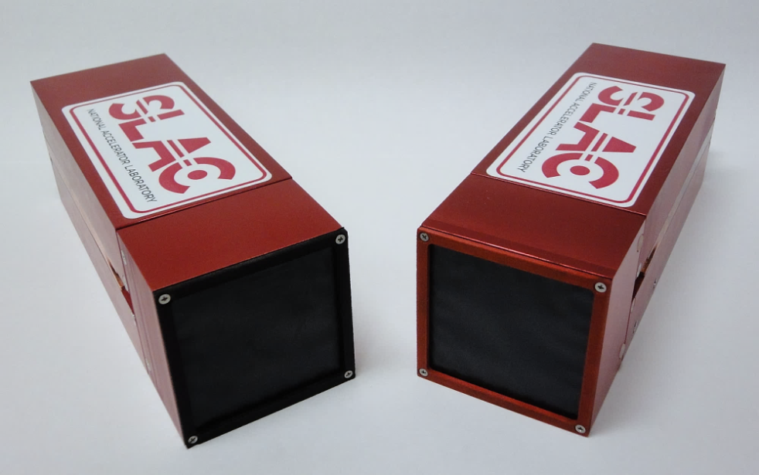
ePix Detectors for LCLS
Series of hybrid pixel detectors based on a common platform fully integrated with LCLS
Targeted for applications in the tender (2-5keV) and hard (5-12keV) regime at LCLS
Two variants developed for LCLS (ePix100 and ePix10k),
Several other developed (tPix, ePixS, cPix²) or under study (ePix10, ePixF, ePixΔ) that might be useful for LCLS
 | ePix100 | ePix10k
Technology | Hybrid pixel Detector | Hybrid pixel Detector
Mode of Operation | Integrating | Integrating with: auto-ranging high to low auto-ranging medium to low fixed high gain fixed medium gain fixed low gain
Pixel size | 50x50 µm² | 100x100 µm²
Module size | 540 kpixel | 135 kpixel
Frame rate | 120Hz (240 Hz) | 120Hz (240 Hz)
Range | 800 keV | Auto-ranging: 80000 keV Fixed high gain: 800 keV Fixed medium gain: 2400 keV Fixed low gain: 80000 keV
Noise r.m.s. | ~ 150eV | ~ 370eV (H-L), ~ 540eV (M-L)
ASIC DC Power cons. | 11µW/pix | 13µW/pix
Power pulsing (PP) | Yes | Yes
PP Power cons. | < 5µW/pix @ 120Hz | < 6µW/pix @ 120Hz
ePix cameras module : ePix10k (135 kpixel) and ePix100 (540 kpixel)
ePix100 specifications are matched to the requirements of XPCS experiments and for Wavelength Dispersive Spectrometers setups
ePix10k specifications are matched to the requirements of X-ray Diffraction experiments

Slide 19
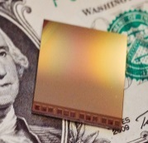
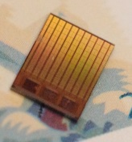
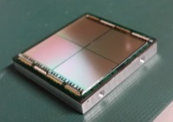
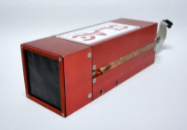
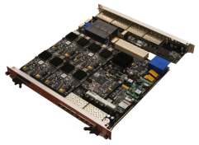
SLAC AIR X-ray Detectors family tree
ePix100:
Energy
Noise 50e- r.m.s.
Max Signal 800keV
Pix size 50umx50um
28M transistors
Sensors
ePix10k:
Energy
Noise 120e- r.m.s.
Max Signal 80000keV
Pix size 100umx100um
ePixS:
Multichannel spectroscopy
Noise 12e- r.m.s.
Max Signal 80keV
Pix size 500umx500um
ASICs
tPix :
Timing 100ps/1ns.
Window 1us/10us
Pix size 100umx100um
84M transistors
Camera Head
Standard Interface and Protocol
Standard Interface and Protocol
ePix Sensors:
Multiple variants 50um/100um pitch.
Multiple thicknesses
Active edges
Standard Interface
and Protocol
Compact / Modular Camera Modules
cPix² :
Counting dual gate dual color
Pix size 100umx100um
Counting Rate 13MHz
Several new variants (new branches)
under study:
ePix10
ePixF
ePixΔ
Standard Interface and Protocol
Common Camera DAQ:
PGP/ATACA based
from 1Gb/s to 80Gb/s
Standard Interface and Protocol
LCLS - Controls and Data

Slide 20
The ePix paradigm
Because of this modular approach at every level of abstraction, it represents an optimized cost effective plan with minimized development time and large possibility of expansion to fulfill new experiment opportunities as they arise
ePix architecture is extremely:
Versatile
Variants can be easily implemented by designing only few parts (LCLS detectors need to be disposable!)
Scalable
In size: multiple module can be connected together
In shape: multiple modules can be arranged in different configuration
In functionalities: modules of different kind can be used with a single detector
In performances: upgrading selectively parts, performance can be incrementally improved (speed, triggers, ROI etc.)
Cost effective
Each variant leverages on the precedent ones (use of previous implementation, gained knowledge etc.)
Efficient in terms of development time
Leveraging on precedent implementation new variants can be released in a short time
Power efficient
Deep level modularity leads to design time interleaved functionality that can be then be turned off when not needed
Fully integrated into LCLS system

Slide 21
The ePix family:
 |  | ePix100a | ePix10kp
Mode of Operation |  | INT | INT-with auto-ranging
Technology |  | 0.25 µm | 0.25 µm
Pixel size |  | 50x50 µm² | 100x100 µm²
Array |  | 352x384 | 48x48
Full Size |  | Full Reticle | ~5x5 mm²
Frame rate |  | 120Hz (240Hz) | 120Hz (240Hz)
Range |  | 220ke⁻ | 22Me⁻
Effective ENC |  | 50e⁻ | 140e⁻
FE Gain |  | 6.5µV/e⁻ | 6.5µV/e⁻, 64nV/e⁻
Polarity |  | positive | positive
Filtering |  | LP + CDS | LP + CDS
S/N |  | 44 | 16
DC Power cons. |  | 11µW/pix | 11µW/pix
Power pulsing |  | Yes | Yes
PP Power cons. |  | 5µW/pix @ 120Hz | 5µW/pix @ 120Hz
Pixel Matrix: fully analog.
Different designs for each detector variants
96
Row selector
352
Analog BE:
Bias
Provides Calibration and Monitoring support
Analog Multiplexing and Buffering
Bias
Buf.
Buf.
Buf.
Temp
Column selector
Balcony (ePix platform):
Diff. Analog Buffer
4
Digital BE:
Controls Configuration
Controls Acquisition and Readout
Analog Monitor
Global Registers
SACI
CMD unit

Slide 22
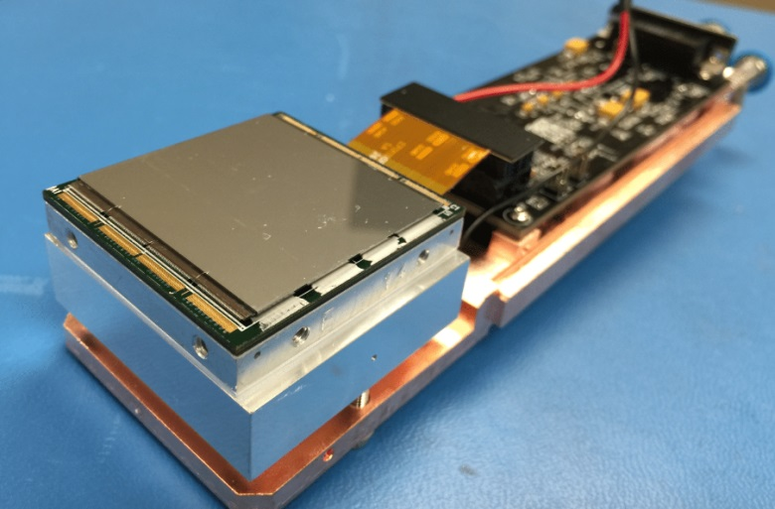
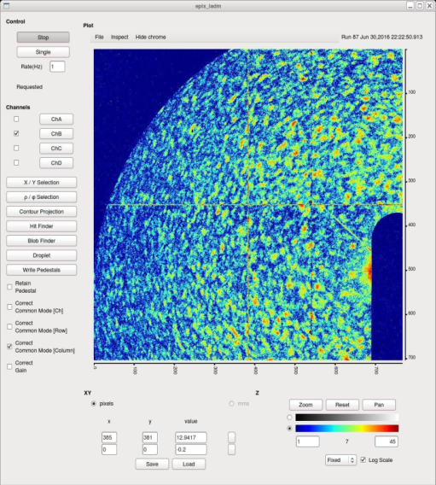
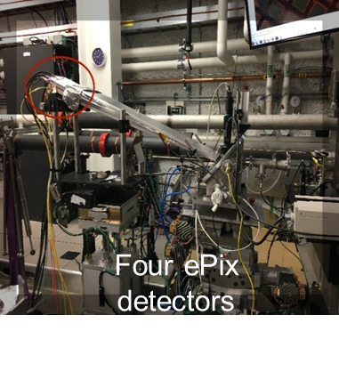
ePix100a highlights
ePix100 is optimized for low noise applications. It has pixels of 50µmx50µm size arranged in a 352x384 matrix. A resolution of 40e⁻ r.m.s. and a signal range of 35fC (100 photons at 8keV) has been achieved.
ePix100a:
ePix100 Pixel architecture:
Atomic-scale dynamics in liquids and glasses.
PI P. Fuoss
18% of this year Hard X-ray experiments at LCLS

Slide 23
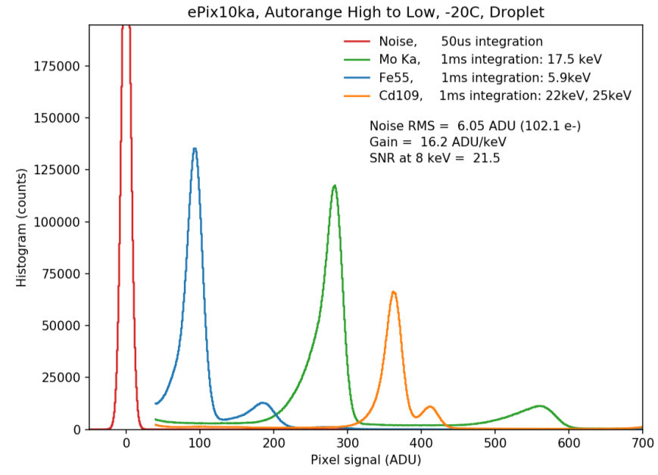
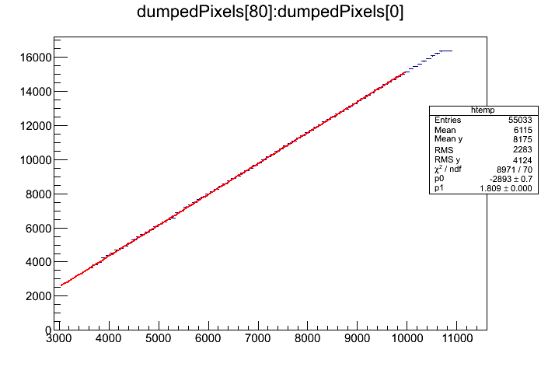
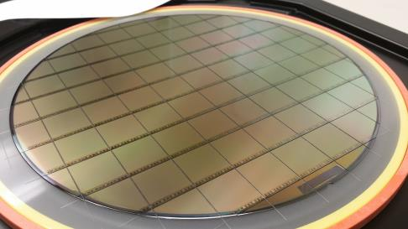
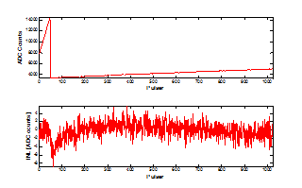
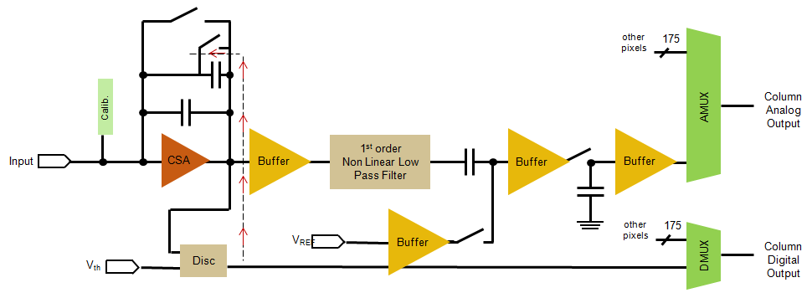
ePix10k highlights
ePix10k is optimized for high dynamic range applications. It has pixels of 100µmx100µm size arranged in a 176x192 matrix. A resolution of less than 100e⁻ r.m.s. and a signal range of 3.5pC (10k photons at 8keV) has been achieved.
More than 10,000 8keV photons
Linearity better than 0.7 %
Linearity measurements at LCLS, Cu k fluorescence, Low gain mode (K. Nishimura, S. Herrmann, G. Carini)
ePix10k Pixel architecture with auto-ranging:
Auto-range

Slide 24
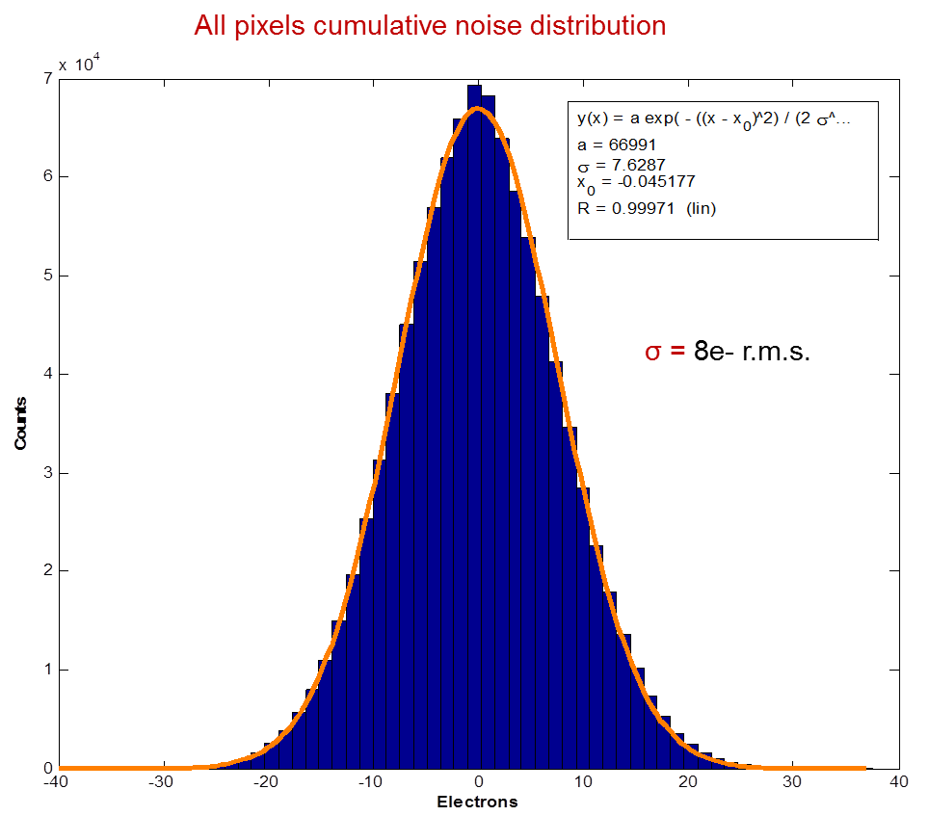
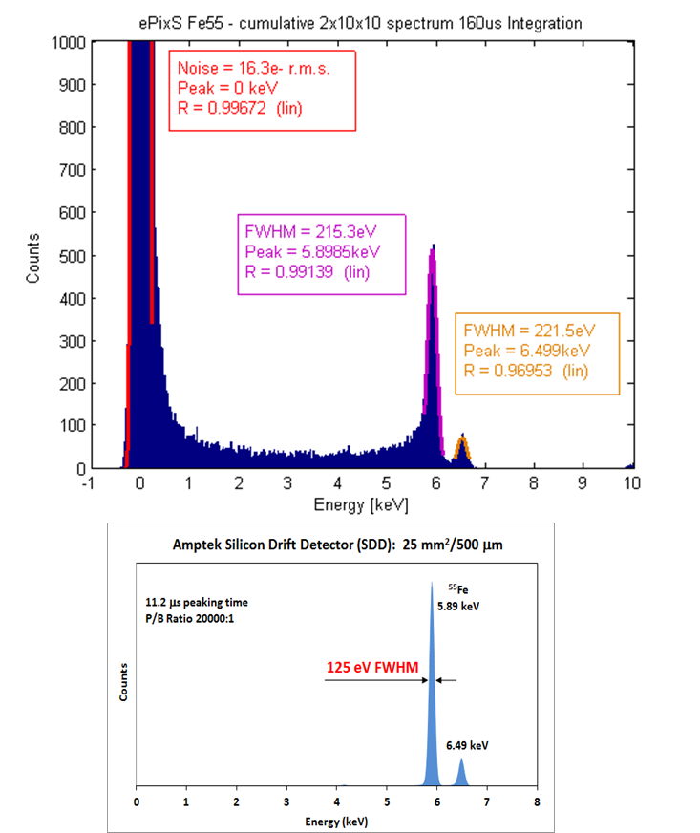
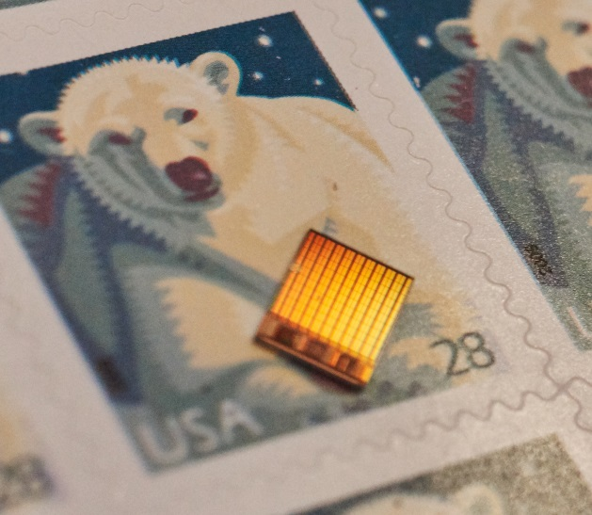
ePixS highlights
 |  | ePixS
Mode of Operation |  | Integrating
Technology |  | 0.25 µm
Pixel size |  | 500x500 µm²
Array |  | 10x10
Frame rate |  | 30kHz
Range |  | 22ke⁻
Effective ENC |  | 8e⁻ r.m.s.
FE Gain |  | 65µV/e⁻
Polarity |  | positive
Filtering |  | LP + CDS
S/N |  | 1000
DC Power cons |  | ~250µW/pix
Power pulsing |  | Yes
The spectrum shown is the cumulative spectrum of 200 channels and shows a resolution of 215eV FWHM.
Noise is dominated by sensor leakage current and the low activity of the source did not allow us to reduce the integration time below 160us
Image of the ePixS ASIC
Notes:
The architecture also features a dedicated control interface and all the required support electronics to perform configuration, calibration and readout of the matrix. The information from the pixel is readout multiplexing the columns on a single buffered analog output. The acquisition and the readout phase are non-overlapped and are controlled by a single periodic signal (ACQ) whose period defines the integration time. This signal is synchronized to the LCLS beam trigger. During the active part of the ACQ period the charge from the pixels is integrated and sampled. During the inactive period stored data are readout and the system is reset. To minimize power consumption a power pulsing scheme is implemented, reducing the power consumption of the various sections of the ASIC during their respective idle states. In frame and global calibration techniques have been implemented in the design. More details on these and other features implemented in the architecture will be reported at the meeting.

Slide 25
ePixHR ASICs architecture
HR10k Sensor: 32x6=192 columns
32
Pixel Matrix: fully analog.
Different designs for each detector variants
Row selector
176
Analog BE section:
Bias
Provides Calibration and Monitoring support
Bias
ΣΔ
ΣΔ
ΣΔ
DEC
DEC
DEC
Temp
Mixed Signal BE section:
Performs Analog to Digital Conversion
ΣΔ
Serializer
6
Balcony (ePix platform)
Back-End:
DEC
Global Registers
SACI
CMD unit
Digital BE section:
Controls Configuration
Controls Acquisition and Readout
Serialize digital data
LVDS Output Buffers
2017 SSRL/LCLS Users' Meeting
New Section

Slide 26
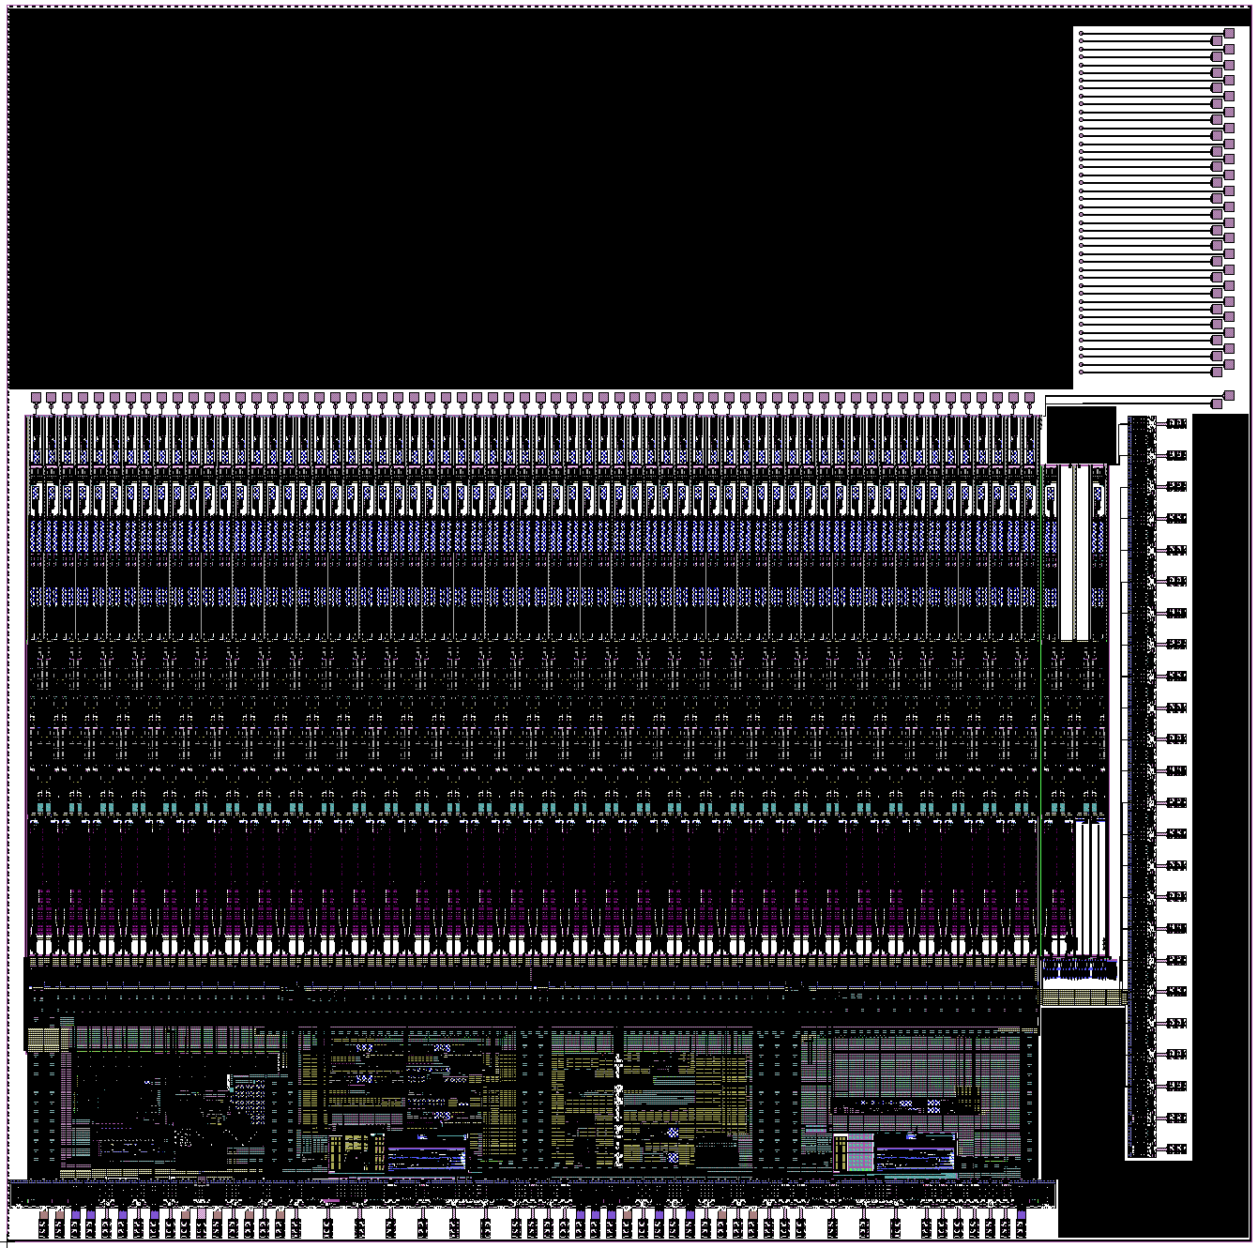
HR back-end prototype
ePixM bottom
ePixM Interface
7900µm
64 x Sigma Delta
Test Structures
7800µm
2700µm
32 Sigma Delta Digital Output Multiplexer
32 Sigma Delta Digital Output Multiplexer
Configuration, Calibration and Digital Monitors
DACs and Analog Monitors
Bias Circuits
1400µm
Refence Generation
PLL
Encoder + Serializer
Encoder + Serializer
6400µm

Slide 27
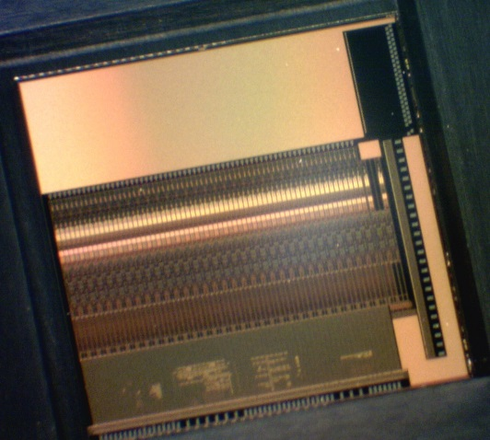
Performed first tests! – Linearity Test at >5kHz frame rate
Operational range
HR back-end arrived on 09/09/2017 !!
>5kHz frame rate demonstrated
major risk retired
P. Caragiulo, C. Tamma, D. Doering…… on a sunday night

Slide 28
Medical Imaging / Neuroscience
20ps resolution SoC for SiPM based TOF PET
Spike: a 2/4 prong active probe with 1024 recording channels (with Sensor department)
Electronics Time Resolution 10 – 20 ps (FWHM)
TDC Time Window ~ 5ns
Max Charge 1300 pC
Max Hit Rate 25K cps
Charge Resolution Single photon
Output Data Rate/CH 100 KHz
SiPM/Scintillator 1:1 coupling
Resolve Event Across 4 pixels
AFE Interface AC & Differential
# of Channels 64

Slide 29
OSPAD ASIC for ToF real-time histogramming (CRADA)
Block Diagram:
Layout:
Technology: TSMC 0.13µm HV
Breakdown Voltage (Vbd): 34V
Active Area Diameter: 20µm
Dark Count Rate (DCR): 1k cps
Photon Detection Efficiency (PDE) @ 850nm: Few %
80 macro-pixels with 32 SPADs each
Photon Counting: 20bit counter for each SPAD
Photon Timing: 10bit, 1ns resolution TDC and in-chip 1024 bin, 10bit depth Histogram unit per pixel

Slide 30
Other CRADA and WFO projects
40GHz Waveform sampler for Ground Penetrating Radar in Improvised Explosive Devices (IED) detection
CPUs and GPUs based on RISC open core ISA and analog peripheral libraries (Lib-V)
CRADA with private company designing SoC based on open core RISC architectures
SLAC designs libraries of analog peripherals IPs, I/Os and microprocessors assisting blocks.
Collaboration on the design of CPUs and GPUs for SLAC next generation cameras

Slide 31
Conclusion
AIR Integrated Circuits at SLAC develop state-of-the-art ASICs for processing of signals in sensing applications
Large group we diversified skills and tools covering all aspects of ASIC and SoC designs (devices with ~100M transistor developed completely in house)
Already collaborating with several institution within the HEP community as well as industrial partners
How can we increase more collaborations? Can labs become hubs by establishing synergies with smaller groups?

