Slide 1
UCSB R&D Efforts for HEP
F.Brewer, M. Miller
Supported by DOE, CERN Exploratory Funding

Slide 2
Our IP
Pulse-gate cell library
High-speed accurate timing cells
Used to make
Clocks
SERDES
Parallel PRBS sources/checker
Pads
HSTL 2.5GHz single ended
Differential edge (7+Gb/s)
Trinary pulse (4Gb/s)
Vast majority of IP is specific to 8rf (130nm CMOS), also pad and some cell designs in TSMC 65nm, Recent forays into 22nm FDSOI

Slide 3
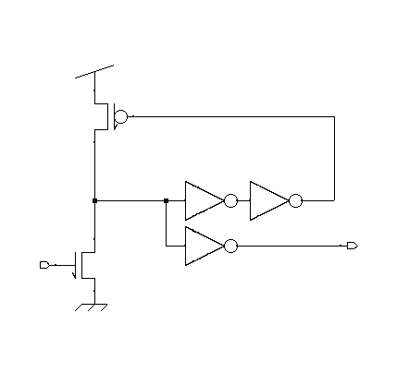
Pulse Gate Library
Rad-Hard Design
Latch-up Surround Implants/TID Model
6.4ux10u+4ux pitch
NMOS Pull-down guarded fire, self reset, output taps
And/Or/AOI/OAI/XOR/RS-latch/Arb/Delay
30pS delay; 2-5pS variance; 130pS rapidity
Verilog-A models
Timing insensitive to pulse amplitude or width; regenerated pulse width from internal timing.
Gates similar to Intel P4, composition rules differ
Low-order complexity timing verify

Slide 4
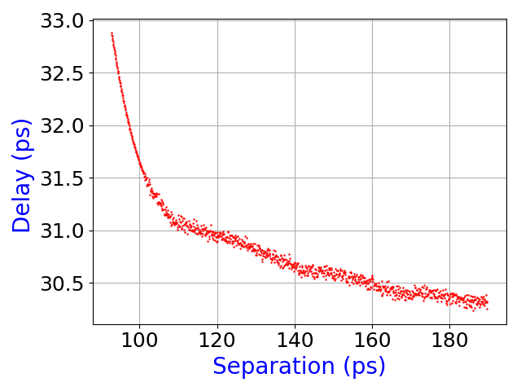
Pulse Dynamics
Pulses interact by repulsion
Weak attraction for large time separation
Exploit to ‘nudge’ timing away from critical events
Forces uniform timing around loops
Can couple loops to create Vernier timing
Injection Locking/DLL/PLL
GATE
Gate Delay

Slide 5
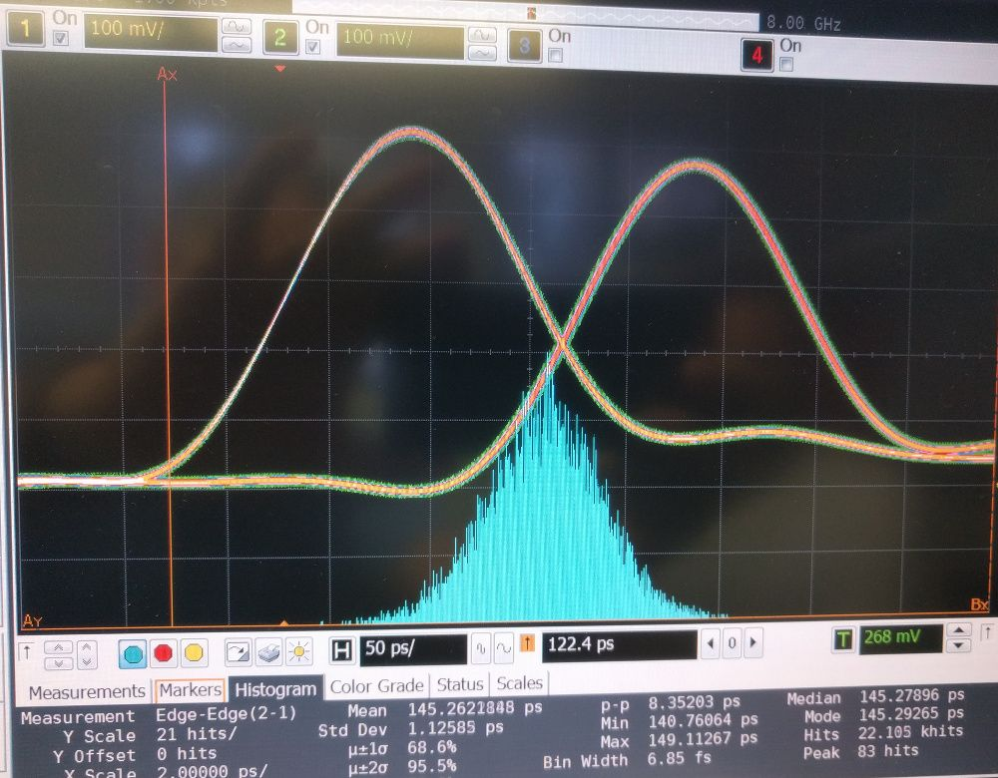
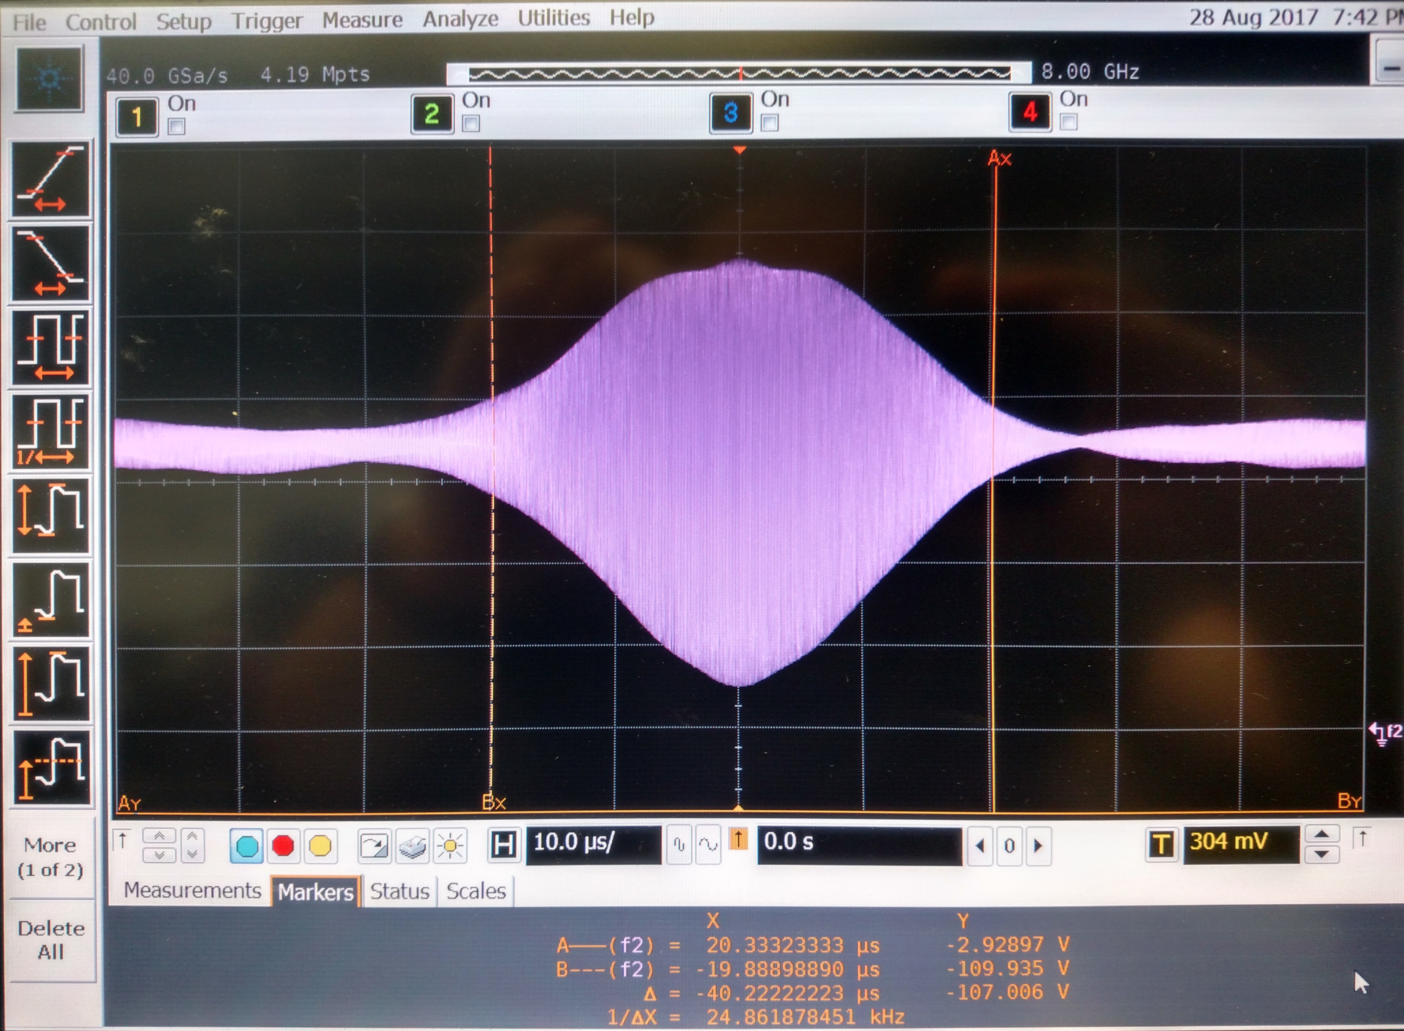
Timing
Cells use pulse-encoding
Asynchronous (local timed)
Can be used synchronously
Timing Accuracy ~1ps
Upper:
145ps delay (analog tuned)
External source
4 internal logic stages in chain, not counting I/O
Lower:
3GHz Oscillators accumulate ~150ps total jitter over 20us

Slide 6
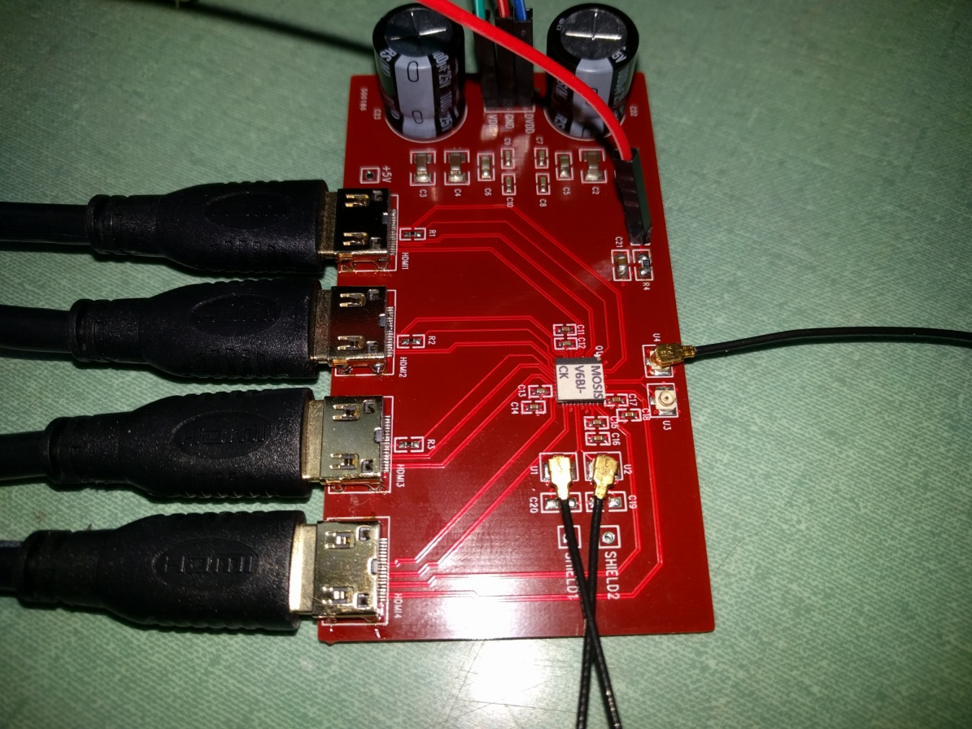
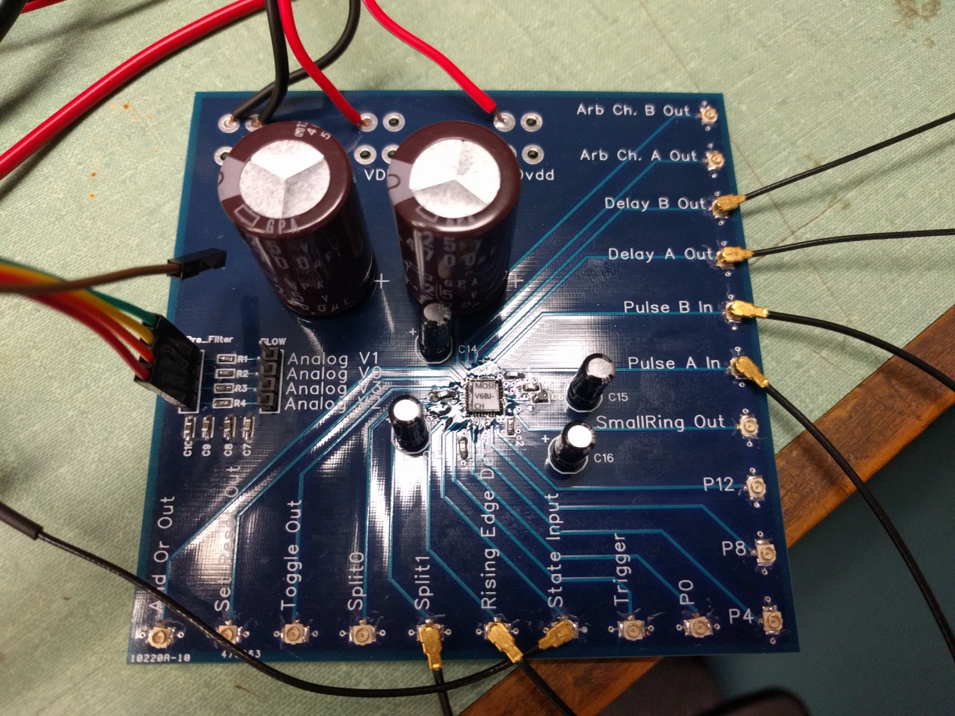
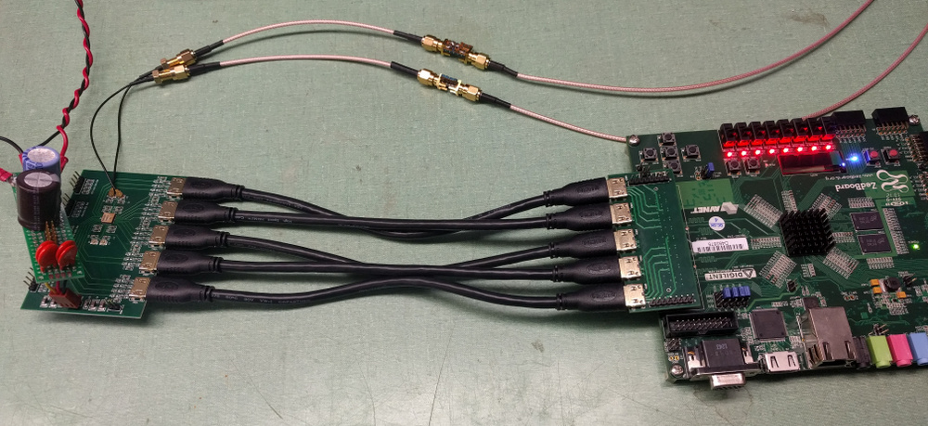

Slide 7
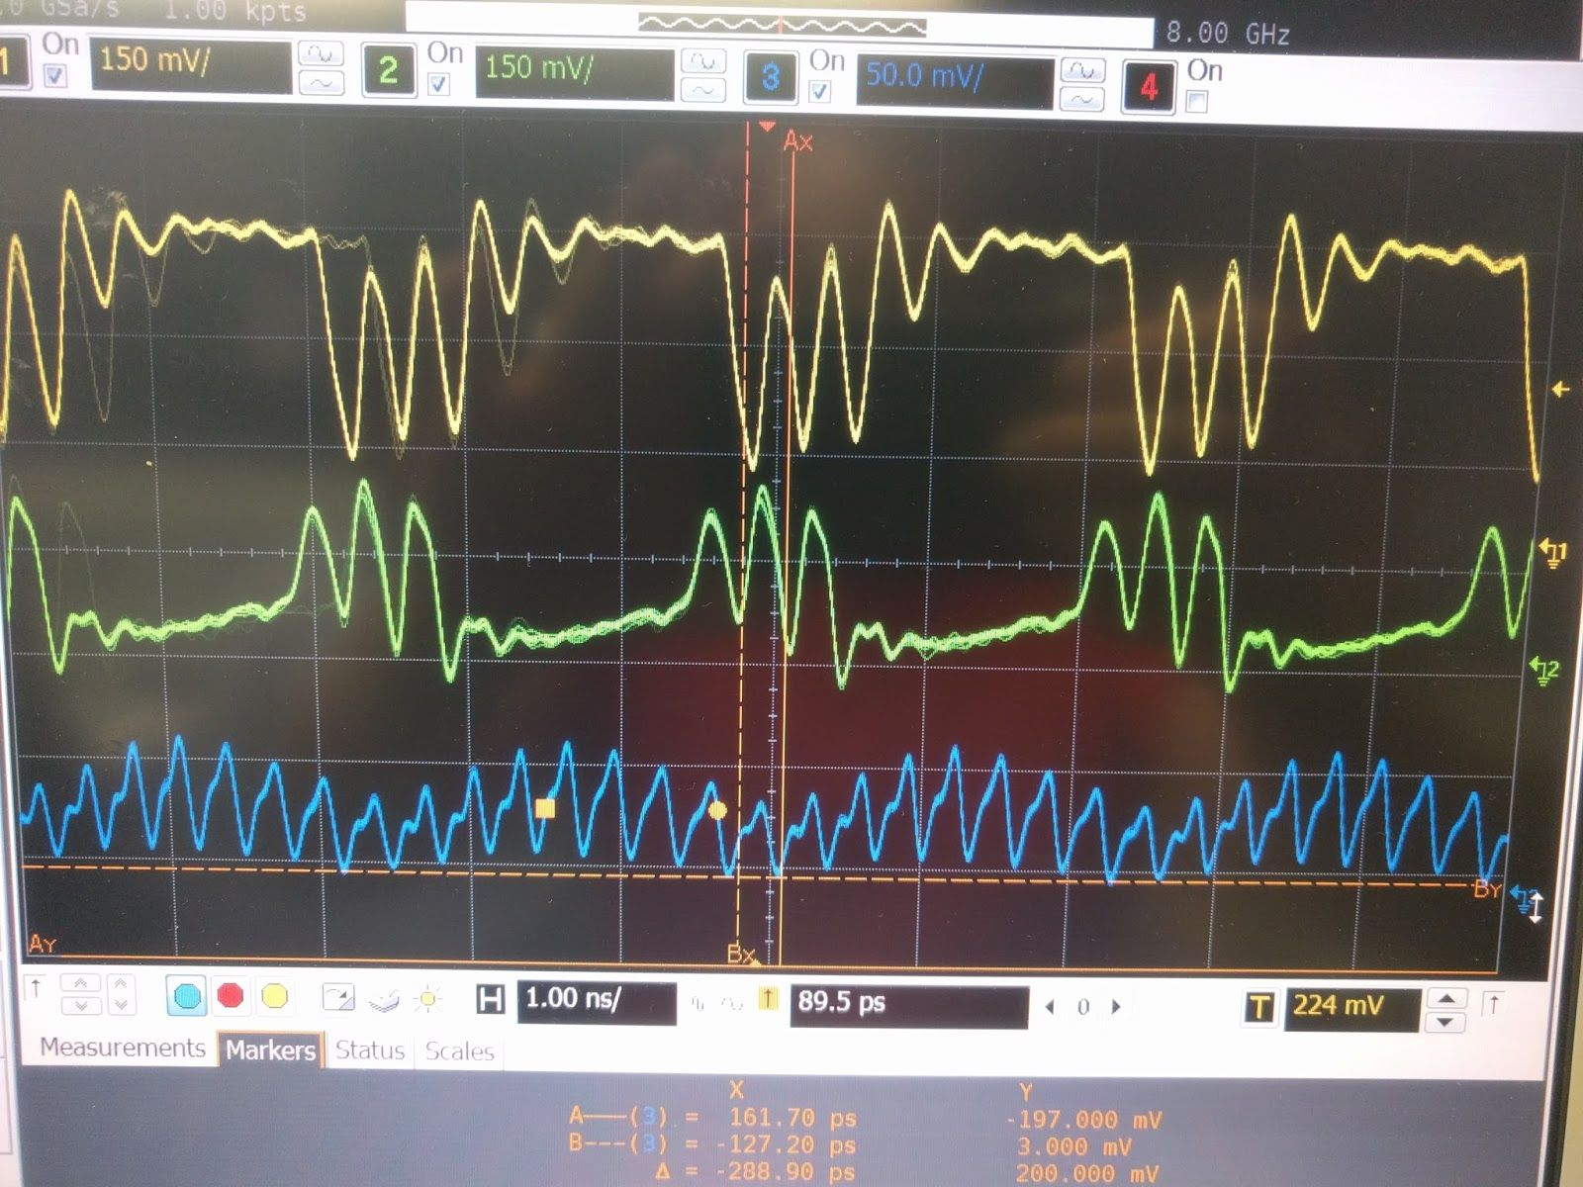
Serial Links & I/O
High-speed serial operates at the upper limits of a logic family
Pulse-based implementations of I/O have operated at > 5Gbps
Implementation of a traditional-style binary link operates at speeds of 6.5+ GBPS in 130nm
6.6Gbps operation @1.15v

Slide 8
Layout

Slide 9
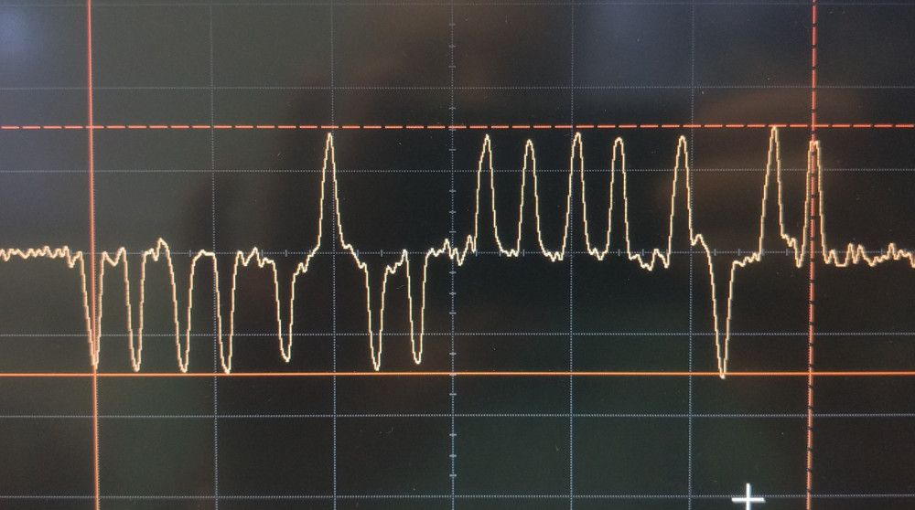
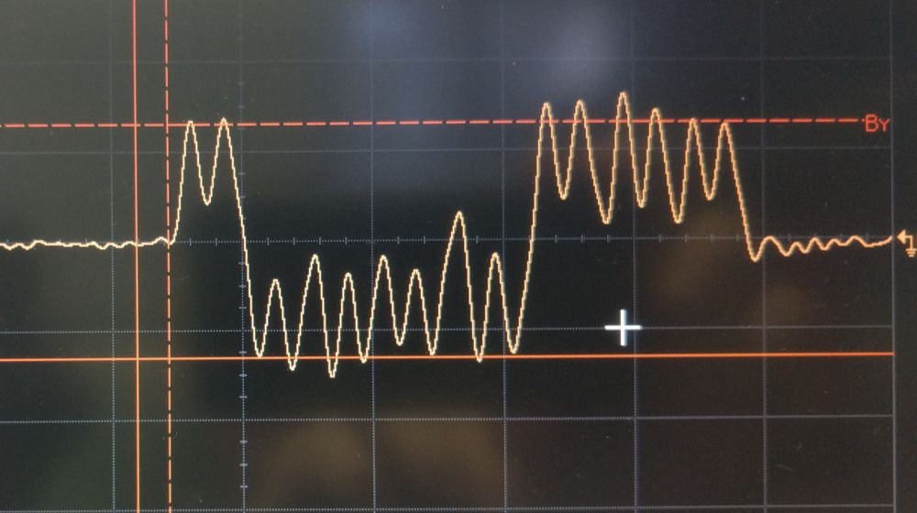
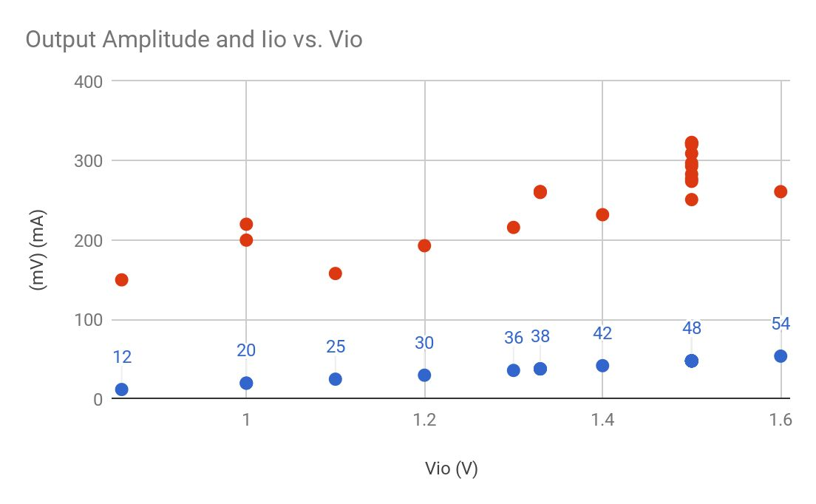
Asynchronous Low Power Links
3-level Differential Pulse
130nm results:
1.35GBPS @0.75V (8.9pJ/bit)
4.3GBPS @1.6V (12.6pJ/bit)
Useful for chip-chip

Slide 10
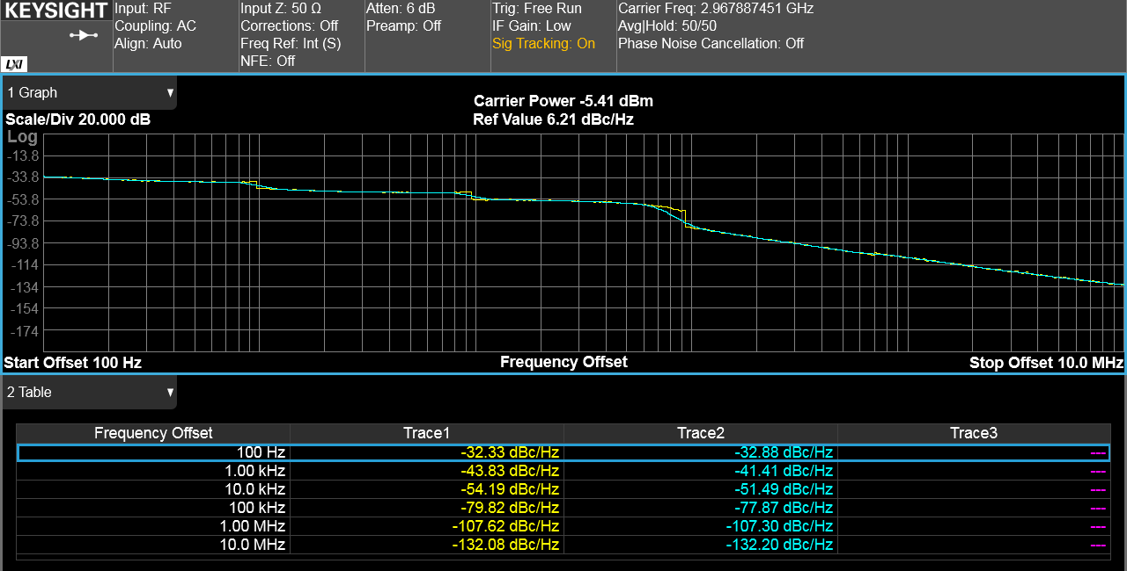
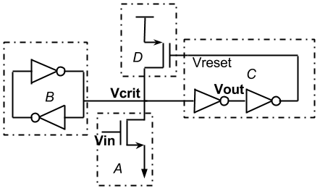
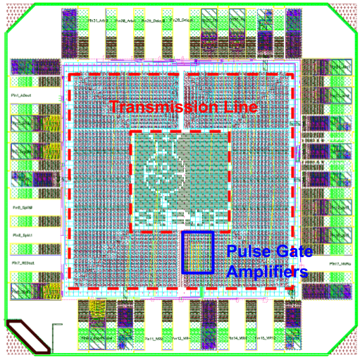
Oscillators/Clocks
Take advantage of pulse-pulse interactions
Soft coupling cycle to cycle averages out noise
Pulse Ring
Very small area
More stable than current starved inverter, Low Flicker Noise, Cheap
<-100dBc phase noise @10MHz
Transmission-Line Stabilized
Performance near that of crystal oscillators
~100dBc phase noise @ < 1MHz
Traveling-wave design reduces the impact of noise at any given transistor
Both have uniform 12-24 tap poly-phase output, both very hardened

Slide 11
Potential to Share
High Performance Digital/Timing/IO IP
With process/application tuning: (easy technology tuning)
Pulse gates are standard cells so can use P&R tools with custom interconnect constraints for medium scale IP.
Pads are very technology specific, but likely needed for any high speed design (>300MHz IO/pin).
Link IP is tough in practice: (hard technology, environment and use-case tuning)
Fiber is potentially much easier if willing to go slower!
Vcel and APD TID is likely serious problem.
Preliminary studies suggest at least ~30% performance left on the table with generic designs, far more if consider mitigation overhead.

Slide 12
Share IP (Cont’d)
Timing IP (Medium Complexity, requires Variability Mitigation)
Voltage to delay (1.1pS jitter)
Pulse/Edge Arbiter (1.2pS)
Vernier Digital Delay (16_17: 1.2pS digital resolution)
These can be used to make:
Arb. Asynch/Synch Sequential Circuits
Digital Time of Arrival with ~1pS resolution (130nm)
Low power/footprint Digital links w. cable compensation
PLL/DLL/Coupled Clocks

Slide 13
Other Technologies
65nm Differential Pad IP (TSMC/INFN Pisa)
130nm TSMC (1.2V) Pulse Gates
20% slower than IBM 8rf (1.5V) 130nm
65nm TSMC Pulse Gate study (14 GHz Rapidity)
Recent Collaboration with Prof. Buckwalter (UCSB)
22nm (Global FDSOI) 4-phase TM pulse clock at 14GHz
Pulse width allows direct N-path filter drive at 56GB/s
Plan to measure dynamics and arbitration resolution in 22nm.
Gate Re-implementation in 22 + Full-Custom TM-line layout

