Slide 1
Electronics design with emphasis on ASICs
Mitch Newcomer
Representing work of Rick Van Berg*
Nandor Dressnandt, Paul Keener, Adrian Nikolica, Zichen Tang
Bill Ashmanskas Engineer/Physicist , Ben Rosser (GS)
Brig Williams HEP, PI
Penn Instrumentation Group Leader: Inception till Retirement in 2014

Slide 2
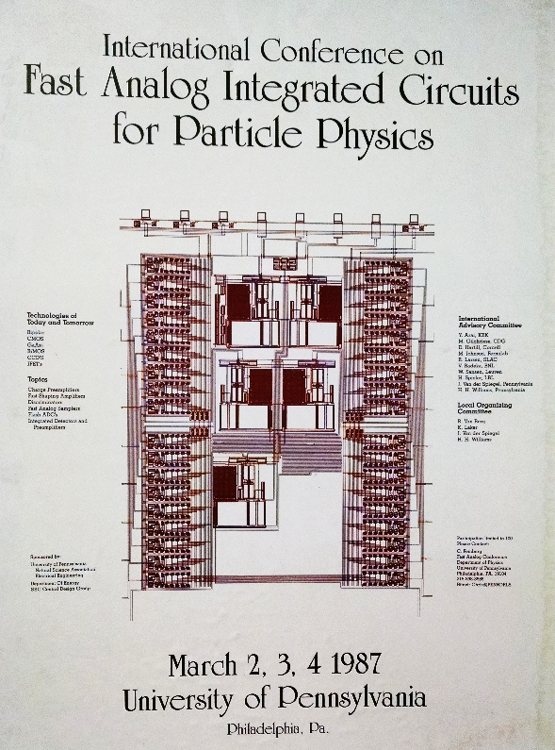
Penn’s Instrumentation Group
> 40 Years system and front end electronics design:
Large scale High Energy & Neutrino Detector systems
Medical Imaging ( PET, Hadron Therapy Imaging)
System Architecture Design
Sensor signal processing, Environmental monitoring
Data Aquisition
Importance of detector mounted ASICs realized early on:
→Penn organized ASIC conference in 1987.

Slide 3
ASIC related Projects accomplishments
Helped Establish the University program with Cadence with early 1990’s.
1989-90 collaborated with Fermilab in the design of two “semi-custom” analog bipolar ASICs for E781.
Low noise CMOS Silicon Strip readout ASIC, 1993. (S. Tedja)
Wire chamber readout ASICs: SDC(SSC)1992, COT (CDF) 1997 bipolar ;
ATLAS TRT (LHC) 2002, bi-CMOS; GLUEX (CEBAF) 2004 250nm CMOS.
Sudbury Neutrino Observatory, SNO (1997) Complete Electronics Chain: including 2 PMT readout bipolar ASICs & collaborative design of the QUSN7 CMOS readout chip, 20 PCB designs, Backplane, Crates, supplies.
ATLAS TRT DTMROC - Digital Time Measurement Read Out Chip
CERN, Krakow, Penn 2002 (250nm CMOS)

Slide 4
Recent: Analog Design Work
Advanced Detectors and LHC Upgrade
Fast Amp - 4 channel (prototyping) amplifier for 2 to 50pF sensor readout
300ps rise time. 5 to 200fC differential Outputs, 180nm SiGe.
ATLAS Upgrade Liquid Argon (collaboration with BNL for ATLAS -
Preamp/Shaper: SiGe Bipolar: 8WL (2009), IHP (2011), GF 7WL (2015)
Programmable (2-16ns), 10 bit DN analog delay IHP(2011)
Pulser block, optimized Band Gap for BNL’s 65nm Preamp/Shaper (2016)

Slide 5
Recent: Design Services & Prototyping
Cold ASIC work with FNAL (65nm CMOS) for DUNE -
Provided Liberty timing files for >100 Digital Library Cells revised by FNAL
(Increased length to reduce hot electron effects at LAr temperatures. )
Design and measurement of a 65nm tiny chip (2017) with ring oscillators, 32 Flip-flops to measure timing characteristics gate delay setup & hold times etc.

Slide 6
Current: ATLAS Strips Upgrade Electronics
( UCSC, CERN, DESY, RAL, UCL, Freiburg, Liverpool, Penn , +..)
Leadership Role in defining Strips Readout Architecture.
Responsible for “Star” sensor Readout approach for front end ASICs.
Fast cluster finder, LVDS I/O, ADC for 256 ch. ABCstar FEC
HCC star - (fabrication plan Feb 2018)
6b/8b Trigger / Storage Control protocol
160Mbps input channels for up to 11 ABCstar ASICs.
Output data formatting/module readout @ 640Mbps
Scaled LVDS I/O
AMAC Autonomous Monitoring and Control ASIC (MPW* Nov 2017)
Multi-drop Scaled LVDS, Tristate Scaled LVDS Drivers
14 simultaneous monitored quantities temp/voltage/current (1ms rep rate)
Automatic out of limit warning
Programmable Interlock functionality
Nov MPW os last scheduled GF130 MPW.

Slide 7
HCCstar Top Level Block Diagram

Slide 8
HCCstar Control Path

Slide 9
1 of 11 HCCstar Input Channels

Slide 10
AMAC V2 feature Diagram
LVDS Input
LVDS tristate output
Digital Status Input
Pwr up
On
HV Chrg. Pump Control
for Sensor Bias SW.
5X
Regulator
Controls
Register interface
Off
LAM
Autonomous
Monitor
10 Bit
DC DC input V, I
End of Ramp
Limits / Flags / Decisions
8 Bit D/A
5X
DC DC outputV, I
Comparator Outputs
Vsense ext
Vreg
Internal Temp
Internal Clock Programmable Ring Oscillator (~40MHz)
test
5X NTC
Core Voltage LDO Regulator
HV Bias I to V
Adjustable Band Gap
2nd Independent
Bandgap for internal LDO
Sensitive Analog Domain

Slide 11
Autonomous Monitoring Cycle
Ring Osc
Counter / Switch Logic
Reference Ramp for A/D Conversion
S1 S2 S3
D0 …D9
RESET
Switched Capacitor Integrator Ramp Cycle
1023 X | S1 | S2 | S3 | Reset
Charge | On | Off | Off | Off
Dump | Off | On | On | Off
1 X
Reset | On | Off | Off | On
Reset
comparator
10 bit Counter Latch
Ramp Counter Bus
Vsense i
~80 - 120mV
Band Gap Referenced
S1
Q inj
S2
10pF
..
~100fF
Ramp Reference
Programmable Voltage Ref.
S3
S1
comparator
Count
~1.1V
1023
10 bit Counter Latch
Vsense j
0V
~1ms
~1ms
0
Counter Driven Ramp Reference
Easy to add monitor comparators

Slide 12
ASIC Design tools
Cadence platform
Analog & simple digital
Virtuoso schematic / layout editor
Spectre (analog or mixed A&D) NC-Verilog (digital)
Synthesis Mixed A&D (digital on top flow)
RTL compiler rc ..→ Genus
Encounter → Innovus P&R

Slide 13
Multi- Institutional Project Management
SVN- project repository for current and previous designs
GIT- for present ATLAS Strips readout “star chips”. Using gitlab
repository at CERN
Cliosoft- Intend use for future designs. Requires multi- institution conversion for present chip set.

Slide 14
Verification tools
Spectre for Analog, Confirmation of fast digital Macros
Digital Verilog
Code Coverage tools
Incisive (NC – Verilog)
System simulation / verification tools (Chip/hybrid/modules)
Cocotb (Coroutine Co-simulation Test Bench) an open-source
verification framework for writing test bench code entirely in Python.
Eliminates cumbersome System Verilog (UVM) frameworks.

Slide 15
CERN
We should acknowledge the huge contributions and accessibility of the CERN Micro Electronics group in bringing along the Experimental community in the development and successful exploitation of CMOS technology.
Validation of the radiation tolerance of the sub-micron CMOS technologies.
Frame Contracts: Provide reliable access to common / relevant technologies negotiated with reasonable costs and multi-institutional access as a priority.
Uniform design kits: facilitate multi-institutional design
Shared IP: speeds designs & designers along and helps minimize the number of submission cycles for improved cost and schedule performance.
Training: PCB design, ASIC design flows
The example set by CERN Micro E has been enabling for many groups, an encouragement for an open HEP design community allowing the science potential to take priority over institutional ownership of designs and know how.

