Slide 1
Trends in CAD tools and services
Mladen Nizic, Engineering Director
HEP-IC Workshop
Menlo Park, CA
October 5, 2017

Slide 2
Agenda
Cadence Corporate and Technology Overview
Mixed-signal Solution
  Verification
  Low Power
  Physical Implementation and Signoff
Summary

Slide 3
Cadence Corporate Overview
Mladen Nizic, Engineering Director
HEP-IC Workshop
Menlo Park, CA
October 5, 2017

Slide 4

Who We Are
7,100+ employees
4,100+ R&D engineers 1,535 field engineers
21 countries
Broad portfolio of
solutions-based products
20 new products in the past 3 years; 50+ new IP products
40% of revenue invested in
R&D
1686 patents worldwide
26 global development centers

Slide 5

System Design Enablement
MOBILE
CLOUD/DATACENTER
AUTOMOTIVE
AERO/DEF
MEDICAL
AND MORE…
IP
SYSTEM INTEGRATION
System analysis * Hardware/Software verification * Software applications
PACKAGE AND BOARD
PCB design * Package design * PCB and package analysis
CHIP (Core EDA)
Design and implementation * IP/SoC verification * Software drivers
Partnerships with Ecosystem Leaders

Slide 6



Industry Trends
Mobile
Machine Learning
Social
Big Data
Security
AR/VR
IoT
Cloud/Data Center

Slide 7

Design Challenges
Mixed Signal
Verification
PPA
Validation
Time to Market
IP Integration

Slide 8














Partnership Is Crucial for Success
COLLABORATION
Customer
Notes:
We cannot achieve these result all by ourselves.
Our ecosystem is stronger than ever!
Great support for innovation from IP companies and foundries.

Slide 9


Culture
Customers
Their Success Is Our Success
Innovation
Think Big!
Quality
Execute with Excellence
Integrity
Be Accountable
Agility
Move Quickly
One Cadence
One Team

Slide 10
Cadence custom IC and PCB design leadership
Enabling smart product design from start to finish
CHARACTERIZATION
Liberate™
Variety
CHIP
Virtuoso®
Spectre®
PACKAGE
Allegro®
Virtuoso®
BOARD
Allegro®
Pspice®
OrCAD®
ANALYSIS
Sigrity™
Market Leadership for over 25 years
Mixed-signal
Differentiated and
comprehensive
support for IoT, Automotive, and Aero/Defense designs
Analog/RF
Advanced Node (16nm to 5nm)
Photonics Support
Rigid-flex Board Enablement
Advanced Packaging
In excess of 70 different ecosystem partners
System Design Enablement via an Extensive Ecosystem

Slide 11



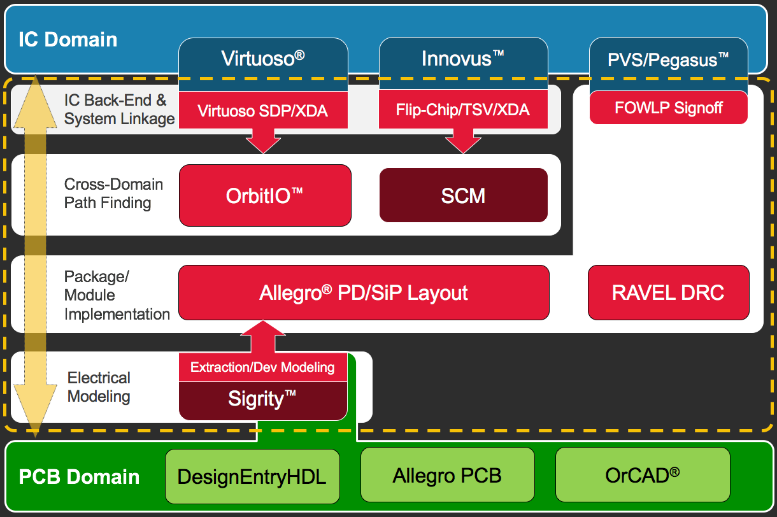
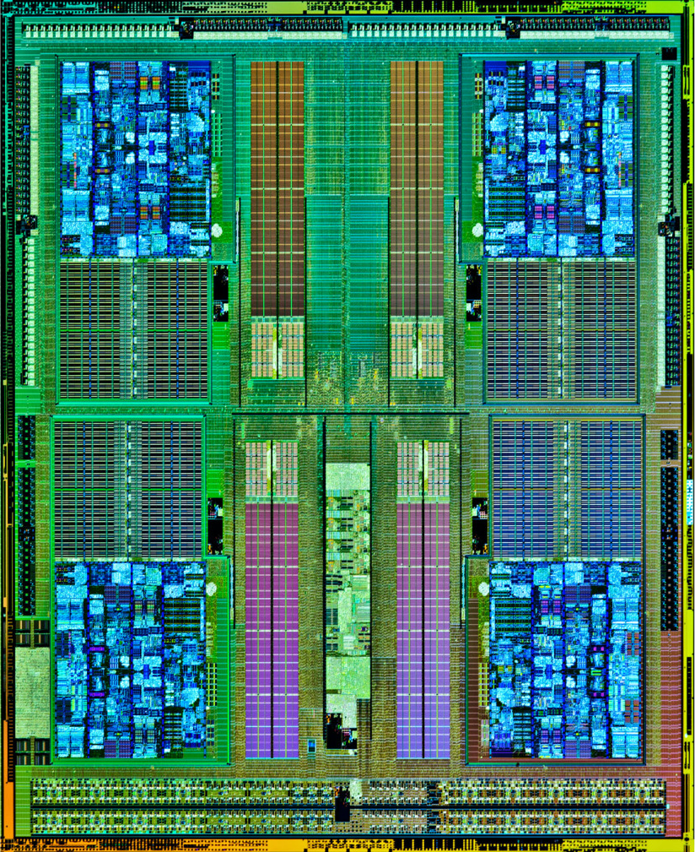
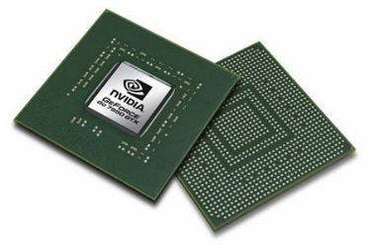
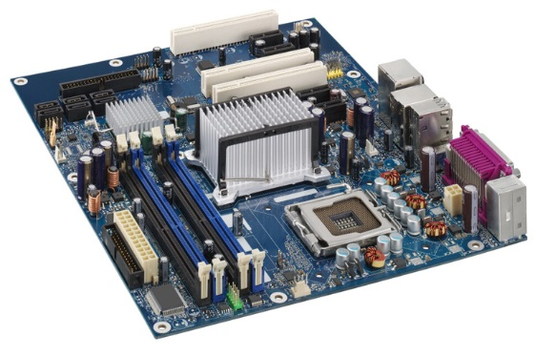
Virtuoso System Design Platform
Holistic solution eliminates the barrier between IC and package design teams
Vertically integrated
flow, from IC through
package onto PCB
IP
Cadence® IP
IC
Package
PCB

Slide 12

Cadence Verification Suite
Technology innovation leadership: Fast, Smart, and Optimized
Verification Fabric
VIP
VERIFICATION IP
vManager™
METRICS
Indago™
DEBUG
Perspec™
SW-DRIVEN TEST
Uniform multi-engine verification
JasperGold®
FORMAL & STATIC
Xcelium™
SIMULATION
Palladium® Z1
EMULATION
Protium™ S1
FPGA PROTOTYPE
Fast best-in-class engines
Smart flow-driven engine integrations
Optimized comprehensive solutions
Total throughput
Metric-driven signoff
Application-optimized
Cloud-centric architecture

Slide 13
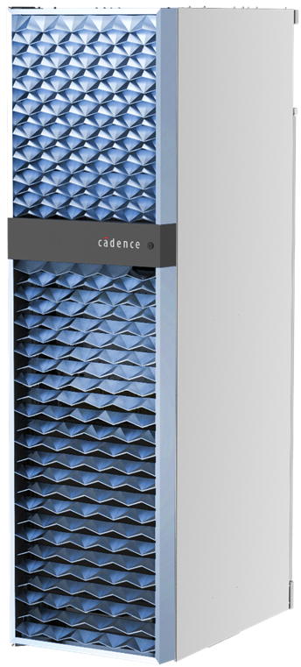
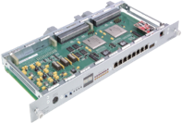
Palladium Z1 Emulation + Protium S1 Prototyping
RTL
Compile
Palladium® Z1
Best debug
SoC acceleration, HW/SW
Power and perf. analysis
Protium™ S1
Highest performance
SW development
HW/SW regressions
SpeedBridge
Adapters
Congruency and common environment

Slide 14

Cadence Implementation Leadership
Technology innovation leadership: Fast and Smart
Implementation Fabric
Common Engines, UI and Flows
Logical
Conformal
Electrical
Timing, Power
PPA Engines
Optimization
Physical
DRC
Genus™
Modus™
Joules™
Innovus™
Tempus™
Voltus™
Quantus™
Pegasus™
Best-in-class core tools
Common foundation engines
Differentiated productivity
FRONT END
PLACE AND ROUTE
ELECTRICAL SIGNOFF
DRC/LVS SIGNOFF
Massively parallel for speed and capacity
Best PPA and intelligent flows
Rapid convergence and ECO
Fully integrated mixed signal
© 2017 Cadence Design Systems, Inc. All rights reserved.

Slide 15
Verification IP
Verifies that the standard IP block works as specified
Verification IP Tool Suite
Simulation
VIP
Memory
Models
Accelerated
VIP
DDR/LPDDR
HBM
SD, SDIO,
eMMC
NAND, ONFI,
Toggle
SerDes
Tensilica DSP
Applications Processor
AFE
PCIe
Embedded Control
Embedded DSP
GPU
ADC, DAC
e.g., USB
Communications
USB
Vision/Imaging
VT Monitors
n
t
o
Custom
Logic
Memory
r
Audio/Voice/Speech
Customer Optimized
PLL/OSC
s
MIPI
S
Ethernet
PON
Display
System
Peripherals

Slide 16
Cadence Design IP Solution
Interface IP
Denali® Memory IP
Analog IP
Broad portfolio of protocols and technology for leading-edge SoC development
Tensilica® Processor IP
Verification IP
SoC Development
  Active in JEDEC, PCI-SIG,
  MIPI® Alliance, USB-IF, and VESA
  Developing IP for new standards
  early in lifecycle to enable market
Foundry relationships to gain early
access to new process technology
Silicon-proven IP to reduce risk
and ease of integration
>750 engineers, with ~2 decades
of experience developing IP
Low-Latency DDR4 and LPDDR4 Interface
High-Performance
Flash Interface
DDR/LPDDR
HBM
SD, SDIO,
eMMC
NAND, ONFI,
Toggle
High-Speed
PCI Express 4.0
SerDes
Tensilica DSP
Applications Processor
AFE
Embedded Control
PCIe
Embedded DSP
GPU
ADC, DAC
Communications
Mobile-Optimized
USB and PCIe
USB
Vision/Imaging
Custom
Logic
VT Monitors
Audio/Voice/Speech
Memory
MIPI
Customer Optimized
PLL / OSC
s
Ethernet
PON
Display
System
Peripherals
Complete Ethernet
Portfolio
High-Accuracy Analog
PLLs, AFEs

Slide 17

Cadence
Innovation is central to all that we do. We work side by side with our customers, providing solutions and design expertise to help them achieve their goals. Our System Design Enablement strategy helps systems and semiconductor companies create the world’s most advanced electronic products.

Slide 18
Mixed-signal Design Solution
Mladen Nizic, Engineering Director
HEP-IC Workshop
Menlo Park, CA
October 5, 2017

Slide 19
Biggest mixed-signal methodology challenges
Polling results from the Cadence mixed-signal seminar

Slide 20
Elements of MS Verification Solution
Automated, Digital-like Methodology applied on analog and mixed-signal
Assertion, Coverage and Metric-Driven Methodology
Behavioral Modeling
Simulation
Integrated Environment
Continuous advancements in performance and features
Methodology, library and tools abstracting analog and mixed-signal functionality to higher level

Slide 21
Spectre AMS Designer – Integrated Simulation Solution
Verilog-A
Verilog-AMS
VHDL-AMS
SystemC
Spectre AMS Designer
MATLAB
Simulink
Integrated AMS irun binding engine
Spectre Simulator
Spectre XPS-MS
Spectre APS
Xcelium Simulator
vManager Verifier
SPICE
Verilog/SV
VHDL
Ansi-C/C++
Compatible with the Virtuoso interactive and Xcelium command line use models

Slide 22

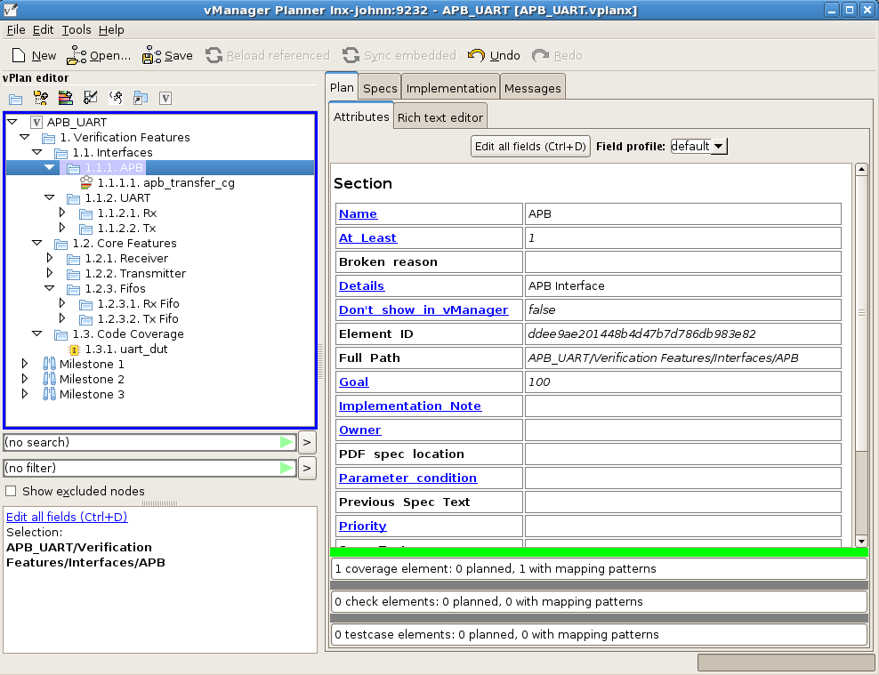


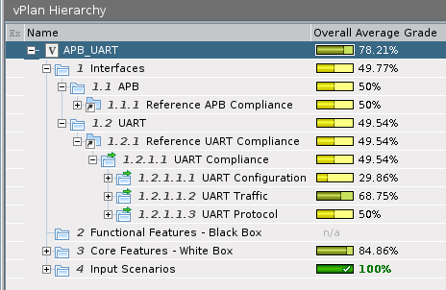
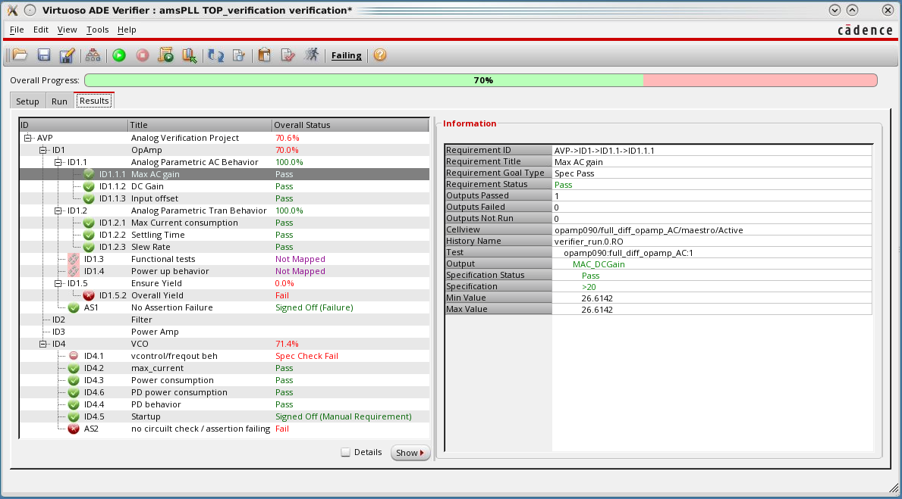
Virtuoso ADE Verifier
Bringing verification planning to Analog
A cockpit to drive plan-based verification for analog designs
  Analog verification flow driven by Top-down requirements
  Regression running capabilities enable more automated verification
Requirements-based
reports/pass/fail/summary
table to track progress
Supports customers needs for requirements tracking (lSO 26262)
Links analog verification to requirement management and digital verification tools
All stakeholders
SoC
Planning
Analog tem
Digital team
Create
Analog vPlan
Create Digital vPlan
Measure/ Results
Execute
Notes:
This is the demo story as animation

Slide 23



Metric-driven verification (MDV)
Planning with unified verification metrics
Analog Wire UVC
TB Top
env
agent
Seq driver
Real Numbers
seq
seq
seq
Code reuse and structure
  Common, well-understood testbench structure
  Separation of interface code from DUT-specific code
  Common file names and directory structure
Randomization of stimulus
  Explore combinations of stimulus and device configuration
  Common, powerful test-writing interface, reducing test-writing and maintenance effort
  Enable fewer simulations to reach spec-verification complete
Automatic checking
  Verifies correct device behavior for all possible stimulus variations
  Combination of behavioral code and assertions
Verification tracking using functional coverage
  Useful in risk mitigation and functional verification signoff
Monitor
BFM
Functional Specification
DUT-Specific and
Customizable
Signal Map
VAMS Gasket
CTRL
CTRL
CTRL
Waveform
Generator
Sampler
Metric-Based
Executable
Verification
Plan
To DUT – wreal/electrical
Measures and Drives:
Phase
Amplitude
Bias
0
Plan
Construct
Execute
Measure,
Analyze
0
Period
Notes:
23

Slide 24
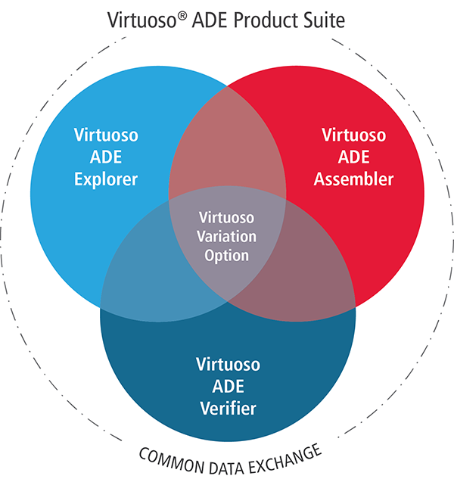

Enhancing the Virtuoso ADE Product Suite
An overview of good things in IC6.1.7
Virtuoso® ADE Explorer
  Highly interactive, single testbench analyzer assists engineers at the earliest stages of circuit design
Virtuoso ADE Assembler
  Interactive, multi-testbench environment pulls together all the parts of the design and their various specs to begin centering the design for manufacturing
Virtuoso Variation Option
  Extensive statistical verification for designs requiring high-sigma validation and for advanced nodes
Virtuoso ADE Verifier
  Introduces a formal method for overall electrical specification verification of analog circuits
Notes:
With IC6.1.7, we released a new set of “ADEs” with the names: Explorer, Assembler and Verifier.
These products will allow us to better align our products to the way our customers want to use them and second, establish what it means to do Analog Verification. Explorer is the “interactive” tool and is built to be lightweight and high performance. When working on a single test bench.
The Assembler is built upon the strength of our ADE XL tool for running multiple tests simultaneously and brings some of the current GXL variation tools (such as optimization and worst case corners) to the mainstream designers. For advanced node customers, we
offer the Variation Option on top of the Assembler to provide foundry certified variation technology for FinFETs.
And finally Verifier will give you the tools you need to replace disconnected analog functional verification methodologies with a slick, well integrated Virtuoso solution.

Slide 25
Real Number Modeling Benefits
Model development
time and effort
Much faster filtering of functional bugs early in verification process
Significant increase in verification coverage
Higher verification and design productivity
Benefit
Accuracy, level of details
Languages
Functional
Verification
Model what you need, not what you can
Clearly define model limitations
Top-down approach
    Generate models during architecture phase
    Verify specifications early in the design cycle
    Allow designers to compare their functionality early with expected results
    Swap more detailed models as they become available
Bottom-up approach
    Requires schematics to be ready
Recognize modeling as discipline/job
Share information across groups
  Pin list (type, allowed values, relations)
  Modeling engineer ⬌ analog designer
  Analog ⬌ SoC handoff
Automate as much as possible
Pure
Digital
Logic
Analog Performance
Simulation
Level of Abstraction
Real Number Model
Discrete,
Event-Based
Continuous,
Time-Based
Electrical:
Verilog-A
Verilog-AMS
VHDL-AMS
SPICE
Simulation Performance

Slide 26
SystemVerilog 2012 Extended Nettype Capabilities
Definition of “nettype” construct applicable to any datatype
Application to real datatype provides construct equivalent to VerilogAMS wreal
  Cadence package cds_rnm_pkg defines nettypes for SystemVerilog (SV) identical in name and operation to Verilog-AMS wreal flavors:
  wreal1driver, wreal4state, wrealavg, wrealsum ...
User-Defined Type (UDT) can use a structure of multiple values to define a net
User-Defined Resolution (UDR) functions can define how the net should merge multiple drivers of the UDT format to define the resultant net value
This greatly extends the possibilities of how interfaces between blocks can be defined
  Cadence package EE_pkg defines a nettype to define an electrical interface
  Multiple drivers can each drive the net with voltage or current and resistance values
  Resolution function computes resulting net voltage
Blk1
net
Blk2

Slide 27
Spectre AMS Designer with Xcelium-DMS
SV+AMS
Electrical to Real connect modules
Test-bench
and IP reuse
RNM
Modelling
Low power
intent design and verification
(IEEW1801 or CPF)
GPS
Cell
WiFi
FM
Bluetooth
SD 3.0
Memory
Card
SD 4.0
DRAM
NAND
FLASH
UFS
LPDDR
NAND
FLASH
SDIO
CSI2
Camera
Interface
CSI3
RFFE
LPDDR 2
Touch
Screen
Controller
LPDDR 3
DigRF
eMMC
UFS
I2C
Applications
Processor
Multimedia
Processor
Display
Driver
AMBA4 ACE,
AXI, AHB
OCP 2.0, 3.0
DSI
LLI
Audio
Interface
SLIMbus
SLIMbus
cJTAG
HDMI
USB 2.0
USB 3.0
USB OTG
SPMI
GBT
Motion
Sensors
USB
Interface
Power
Control
Test
Port
Trace
Port
External
Display
Driver

Slide 28
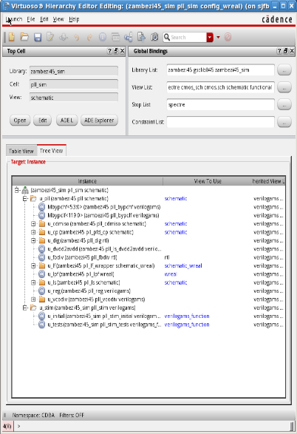
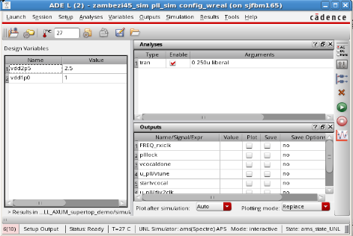
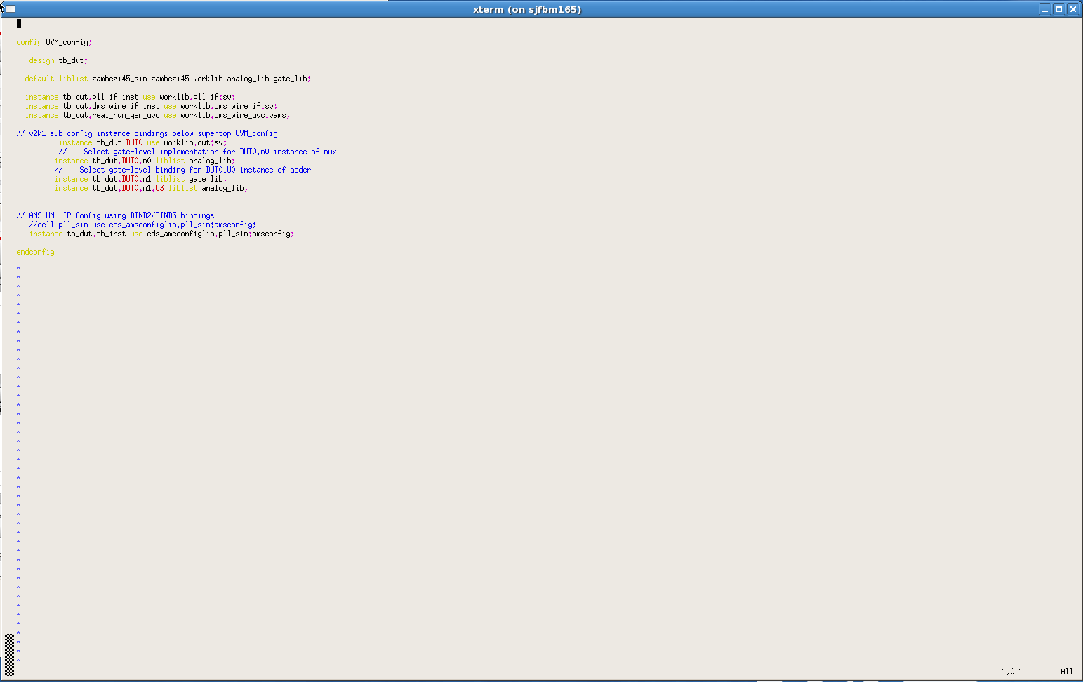
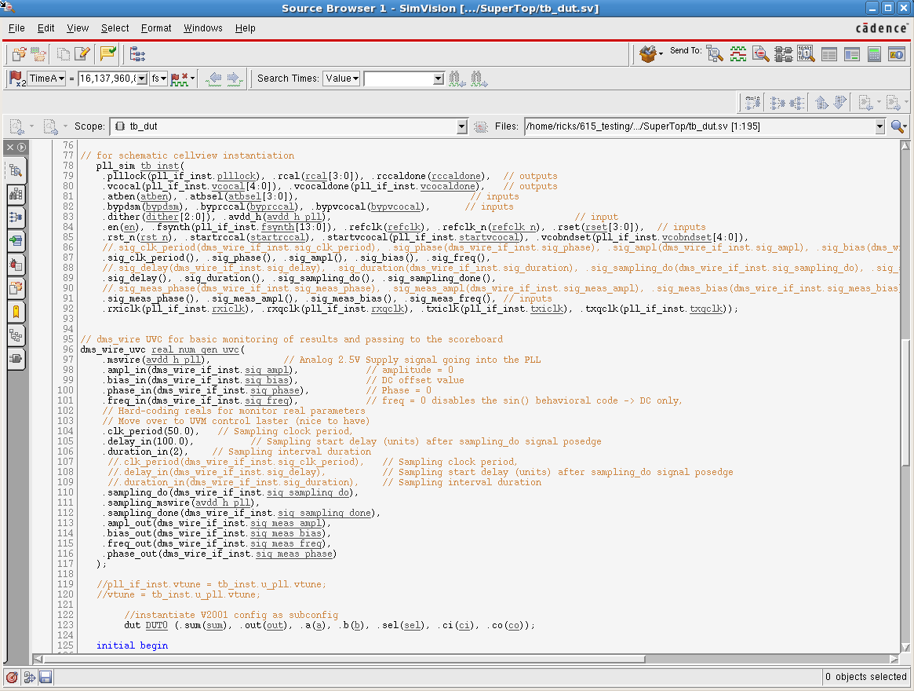
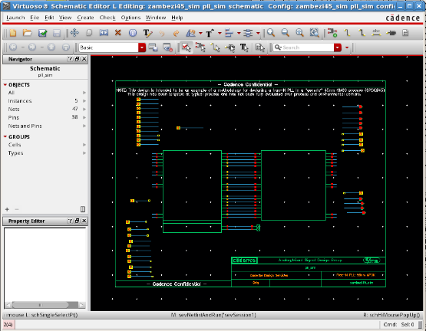
Uniting AMS IP and MS SoC Verification
AMS IP Verification
MS SoC Verification
Use SoC testbench to validate AMS IP in the same context
SV UVM bench
Provide IP in a form easy to integrate in SoC verification

Slide 29
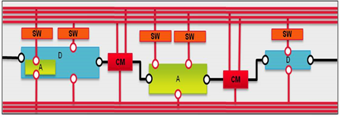
Low-Power Verification in Mixed-Signal Design
Spectre AMS Designer
Power-Aware Simulation of MS designs
Dynamic simulation using Spectre AMS Designer
  Manage power connectivity and signal conversion at interfaces between analog and digital
Static verification using Virtuoso Schematic and Conformal® Low Power
  Enabled by power intent extraction from schematic and integration of Conformal Low Power with Virtuoso environment
  LP intent verification for custom block in schematic
  Macro generation for full-chip LP verification
Static LP verification for schematic-based designs
Virtuoso Schematic
and Conformal Low Power
Top-level intent
Schematic
netlist
Static Verification
1801/UPF

Slide 30
Mixed-Signal Low-Power Simulation
Typical types of supply-path configuration
Power Supply Network |  | Type 1 (Top-level behavioral simulation) | Type 2 (Traditional low-power simulation) | Type 3 (CPF/1801 on top entire design) | Type 4 (Mixed- signal supply connection)
Digital | Power Supply | CPF/1801 | CPF/1801 | CPF/1801 | Electrical
 | Connection | CPF/1801 | CPF/1801 | CPF/1801 | CPF/1801
 | Design Block | Logic | Logic | Logic | Logic
Analog | Power Supply | Behavior | Electrical | CPF/1801 | Electrical
 | Connection | Behavior | Electrical | CPF/1801 | CPF/1801
 | Design Block | Behavior | Electrical | Electrical | Electrical
AMS Designer Supported |  | ☑ | ☑ | ☑ | ☑
VDD2
VDD1
Connection
SW
Digital
Power
Digital
Design
Block
VSS
VDDA2
VDDA1
SW
Connection
Analog
Power
Analog
Design
Block
VSSA

Slide 31
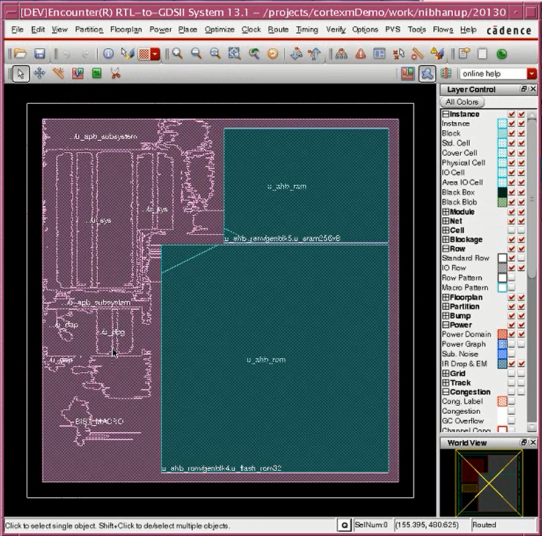
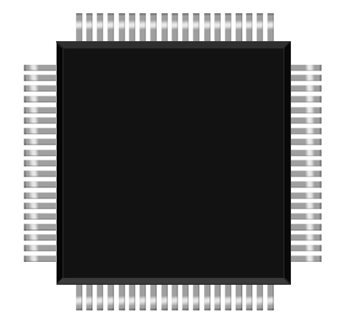
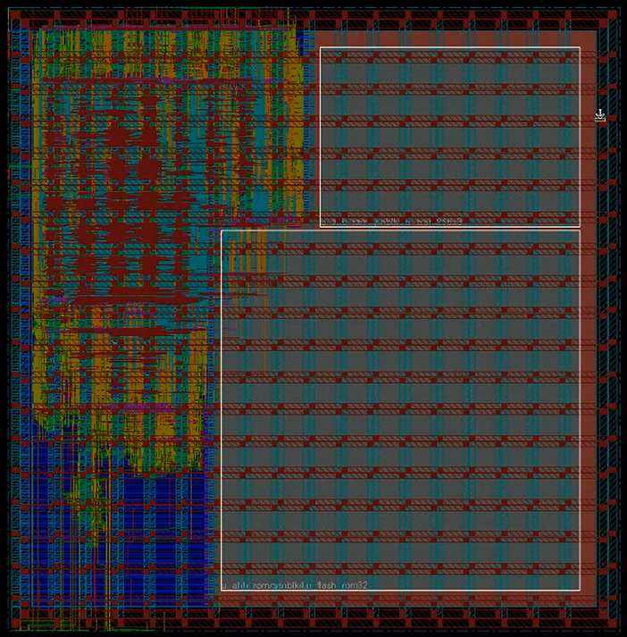
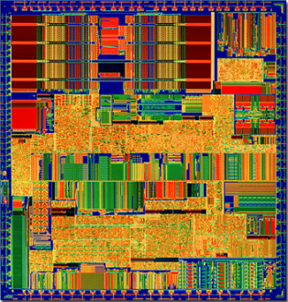
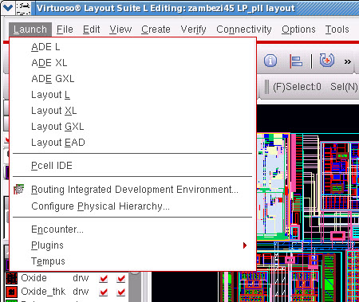
Integrated Physical Implementation and Signoff Flows
Virtuoso® Digital Implementation
Mixed-signal OpenAccess-enabled implementation flows
VDS-Timing
Innovus™/Tempus™ Solutions
Virtuoso Solution
VDS-Power
D
A
D
A
D
A
D
A
D
D
A
A
Full chip
design
interoperates
A
A
D
D
Voltus™ Platform
Virtuoso Platform
Voltus
Full-Chip
Spectre® APS, XPS
Power Grid Views
PGV
Voltus
Block and IP
Voltus-FI
Transistor
Digital (SoC)
IR Drop and EM
Mixed Signal
Custom/Analog
IR Drop and EM
Virtuoso Digital Signoff – Power
Virtuoso Digital Signoff – Timing

Slide 32
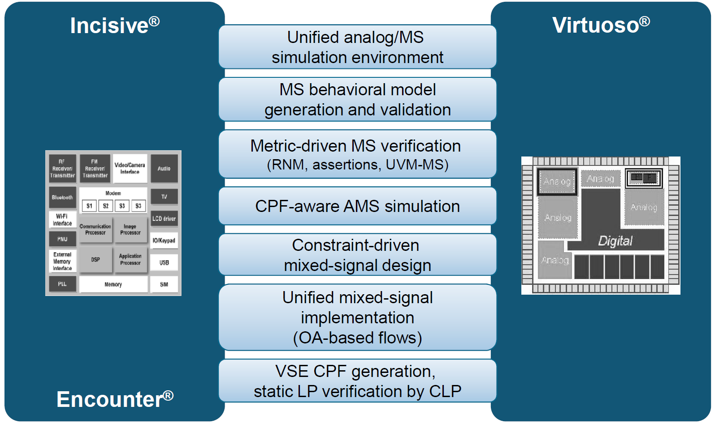






Cadence Mixed-signal Solution
Comprehensive, interoperable, and proven
Xcelium ®
Spectre®
Low Power Verification
Innovus ®
MS Signoff

