Slide 1
VISITOR SAFETY AT THE LAWRENCE BERKELEY NATIONAL LABORATORY

Slide 2
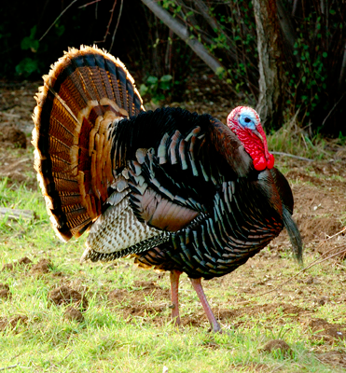
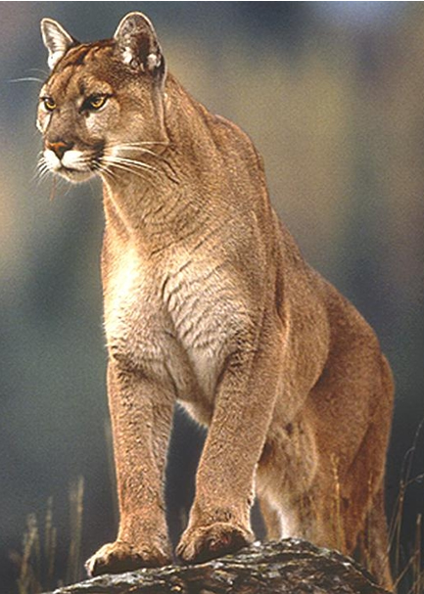
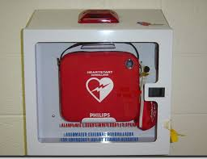
General Information – Safety at LBNL
DOE Facility
Call 911 from a Lab phone in an emergency
Due to construction the speed limit is 15 mph
Do not attempt to touch any wild animals onsite
No smoking, except outside at designated locations
Defibrillator located various places on-site

Slide 3



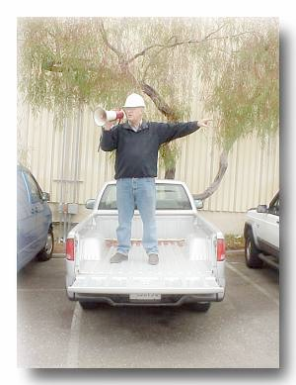
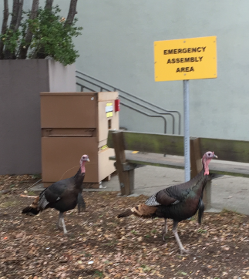
Earthquake Response
Drop down on the floor.
Cover under a sturdy desk, table or other furniture.
Hold on to furniture if it isn’t bolted to the floor and be prepared to move with it.
Evacuate to assembly area (usually in parking lot) when shaking stops. Take personal items.
Follow Directions from the Building Emergency Team.

Slide 4
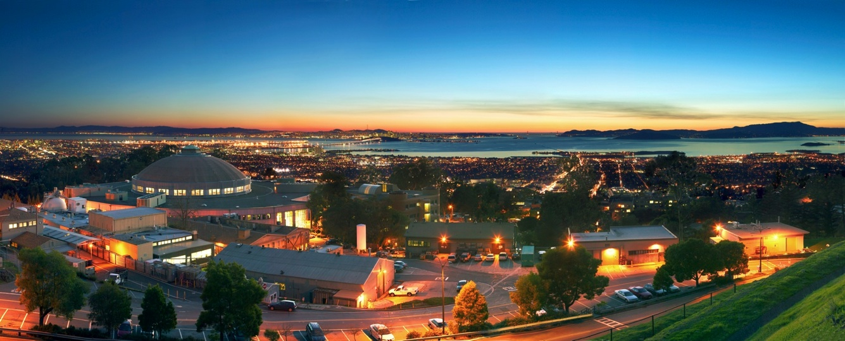
Cosmic Visions – Dark Energy Workshop
LBNL, Nov. 14 - 15, 2017

Slide 5
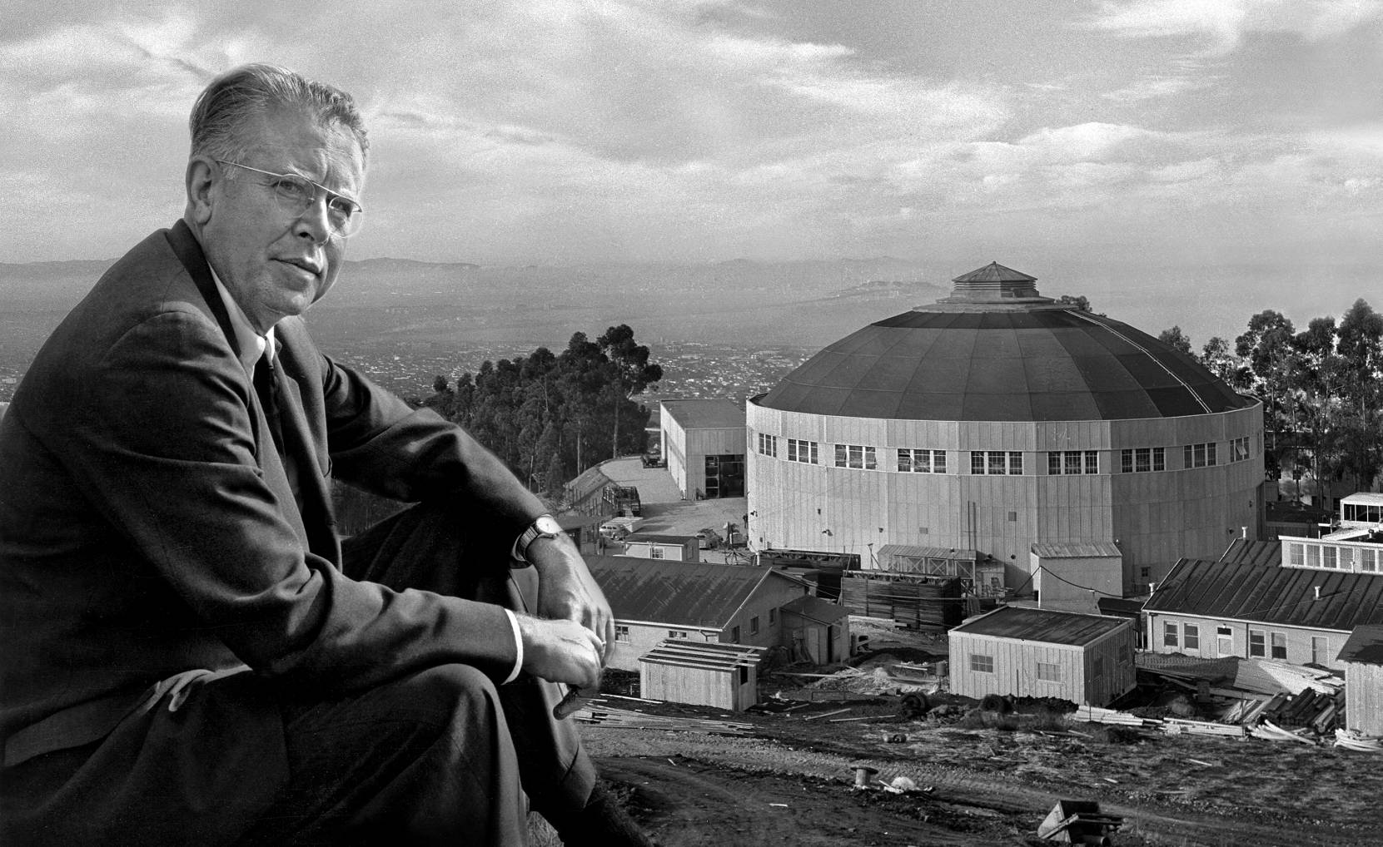
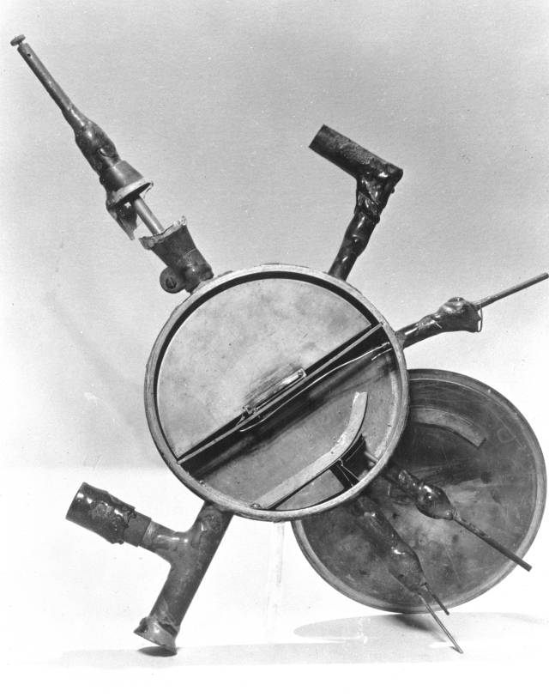
Welcome to Berkeley Lab!
Established in 1931
The small seed from
which Big Science grew.
E. O Lawrence and the 184” cyclotron (circa 1940).

Slide 6
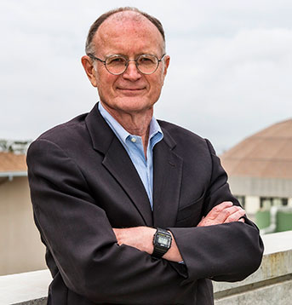
Welcome to Berkeley Lab!
Established in 1931
The small seed from
which Big Science grew.
Director Mike Witherell
E. O Lawrence and the 184” cyclotron (circa 1940).
Today Berkeley Lab has 20 scientific divisions organized in 6 areas:
Physical Sciences, Computing Sciences, BioSciences, Energy Sciences, Energy Technologies and Earth and Environmental Sciences
Physical Sciences
Computing Sciences
BioSciences
Energy Sciences
Energy Technologies
Earth and Environmental Sciences

Slide 7
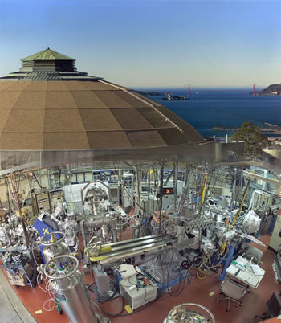
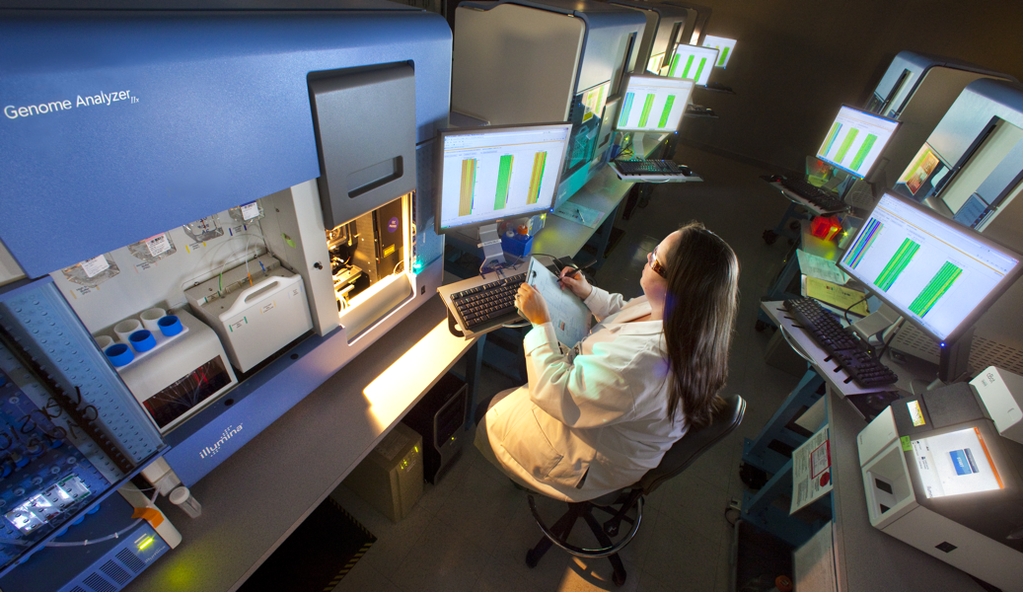
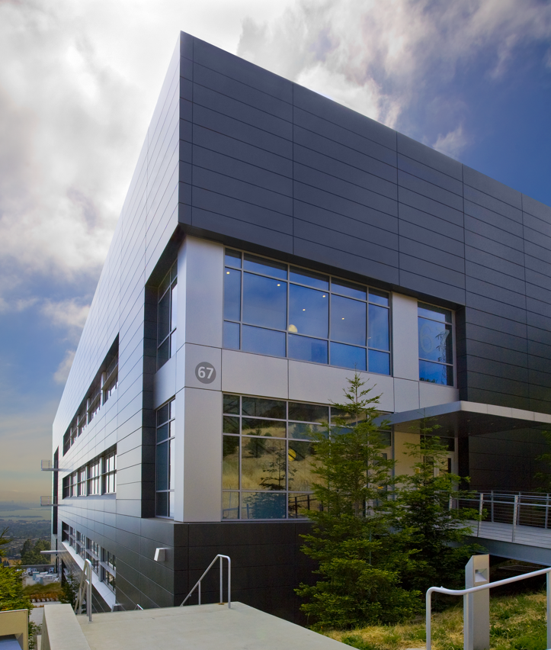
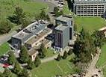
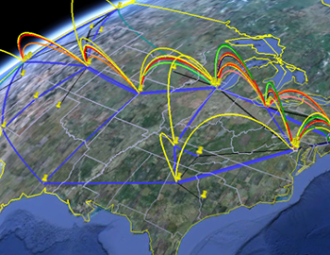
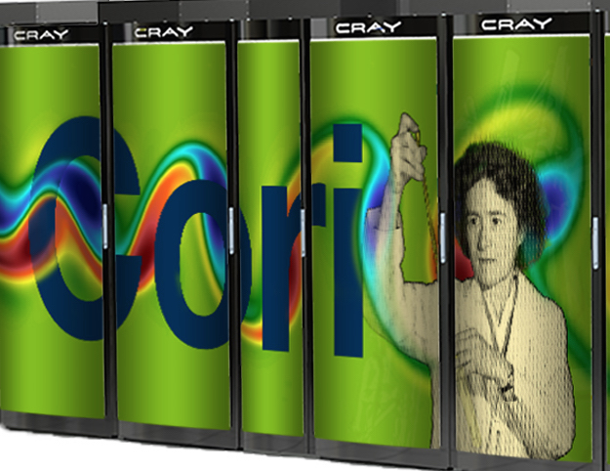
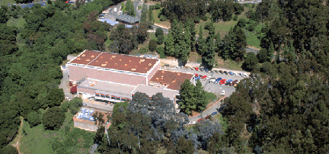
Berkeley Lab User Facilities
Joint Genomics Insitute
Molecular Foundry
Advanced Light Source
National Center for
Electron Microscopy
(NCEM)
National Energy Research
Scientific Computing Center
(NERSC)
88” Cyclotron
Energy Sciences Network (ESNet)

Slide 8
Brief History of NERSC and
Cosmic Frontier Computing
1996: NERSC moved from LLNL to LBNL
1997: Smoot LDRD for CMB Data Analysis
  Used for Maxima and Boomerang
  2007: Center for Computational Cosmology (C3) founded
2007-2016: NERSC supports Planck data releases
  Thousands of mission realizations utilizing 100M’s CPU-hours
Next generation Cosmic Frontier experiments using NERSC include DESI, LZ, LSST-DESC
We are actively working with OHEP on multi-year NERSC allocations, improving access/usability for HEP users, etc.

Slide 9
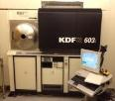
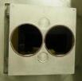
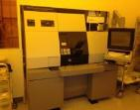
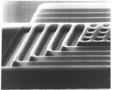

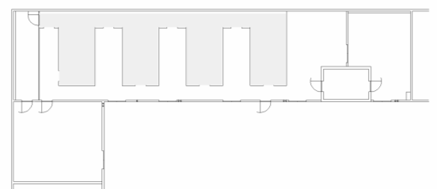


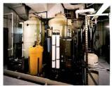


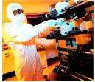

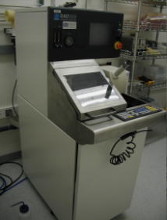
LBNL MicroSystems Lab
THIN FILM DEPOSITION
PHOTOLITHOGRAPHY
PLASMA ENHANCED CVD
Designed and fabricated
red-sensitive CCDs for
BOSS, DES and DESI.
LBNL technology used by
HyperSuprimCam, LSST, etc.
CLASS 10 CLEAN AREA
DRY ETCHING
700 sq ft
WATER PURIFICATION
WET CHEMISTRY
THERMAL PROCESSING
DICING SAW

Slide 10
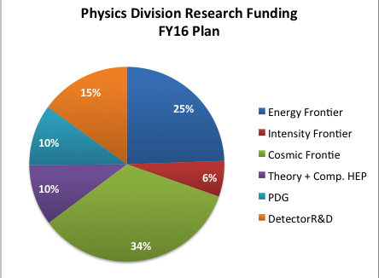
LBNL HEP Program
Major Programs
  Energy Frontier: ATLAS
  Cosmic Frontier: LZ, DESI, CMB, SNe
Other efforts
  Intensity Frontier: Mu2e, Daya Bay & DUNE
  Theory
  Particle Data Group
  Detector R&D
  Computational HEP
Strong connections to UC Berkeley and to LBNL Accelerator, Engineering, Material Science & Computing Divisions
Det.
R&D
ATLAS
PDG
Theory
I.F.
DESI, LZ, CMB
LBNL is playing a key role in P5 implementation.

Slide 11
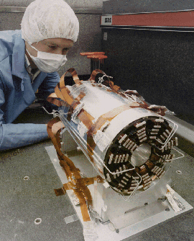
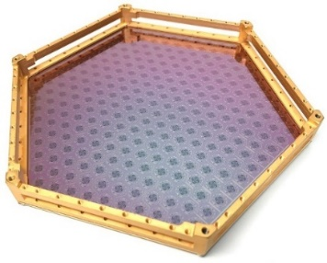
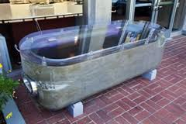
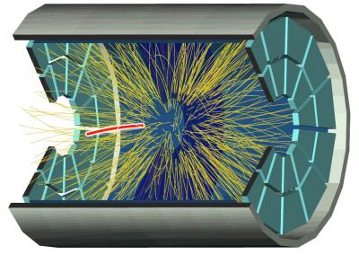
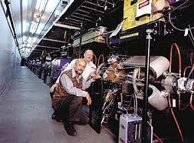
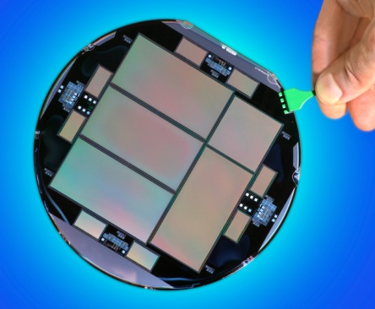
Physics Division: Tradition of Innovation
  Responsible for many “game-changers”: TPC detector, silicon vertex detectors/SVX readout, asymmetric B Factory, pixel detectors, COBE, Type Ia SNe, red-sensitive CCDs, multi-chroic CMB detectors and frequency multiplexed readout……
  Innovations that enable science…

Slide 12
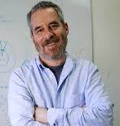
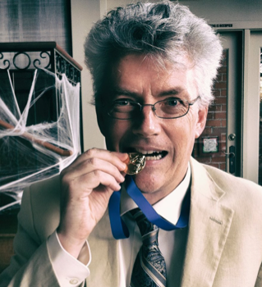
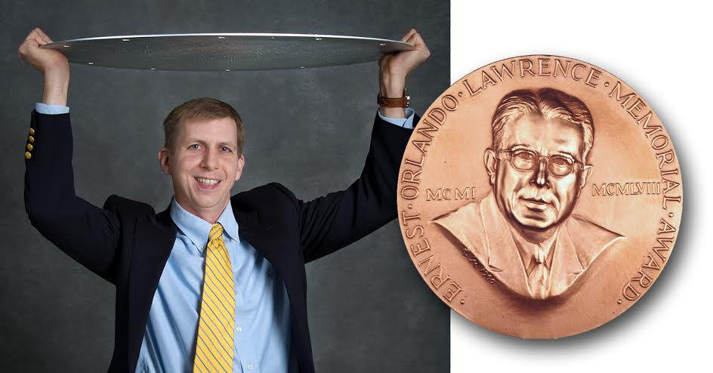
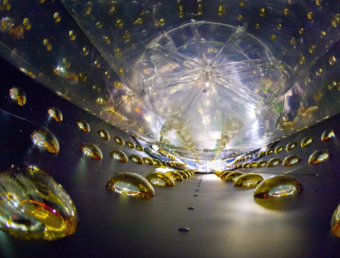
Award Winning Science
Nobel prizes: Smoot (2006) and Perlmutter (2011)
Breakthrough Prize: Perlmutter (2015), Luk (2016) + Daya Bay, SNO, Kamland teams
NASA Exceptional Public Achievement Award: Julian Borrill (2016)
Lawrence Award: David Schlegel in (2015)
Panofsky Prize: Kam-Biu Luk (2014)
MacArthur Award: Carl Haber (2013)
Sakurai Prize: Ian Hinchliffe (2011)
Saul Perlmutter
Carl Haber
George F. Smoot
  Julian Borrill
Daya Bay
David Schlegel

Slide 13
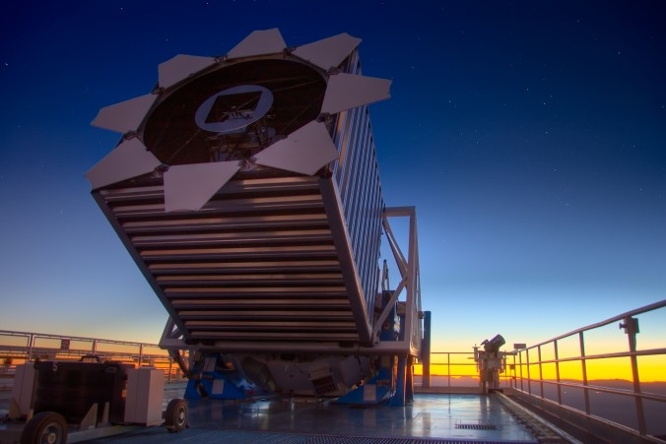
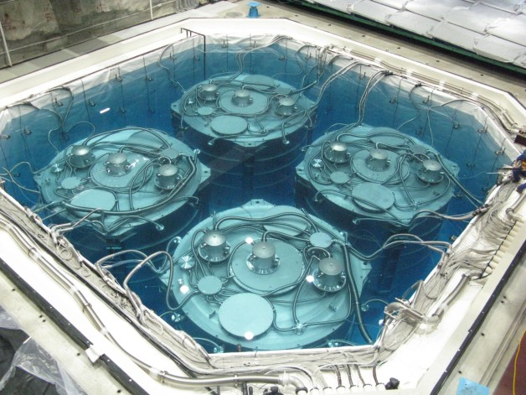
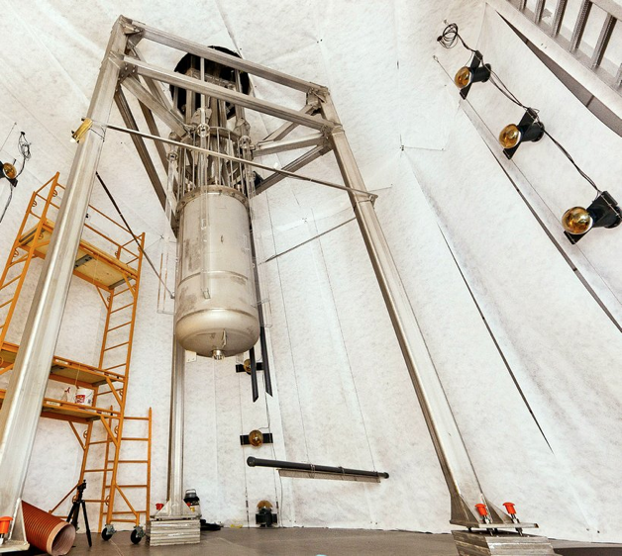
Physics Division Projects – Recently Completed
  BOSS
  LUX
  Daya Bay
BOSS –
Dark Energy
Daya Bay –
Neutrino Oscillations
LUX –
Dark Matter

Slide 14
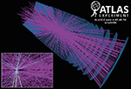
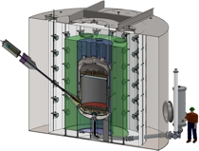
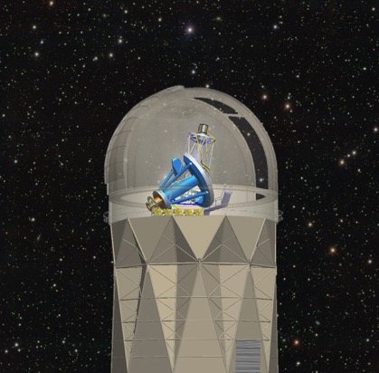
Physics Division Projects – Next Generation
  DESI
  LZ
  ATLAS Upgrades
ATLAS ITK
Upgrade
(Haber)
LZ: G2
Dark Matter
Experiment
(Gilchriese)
DESI:
First Stage IV
Dark Energy
Experiment
(Levi)
Installation on Mayall begins in 3 months!
Cosmic Visions is looking for opportunities beyond
LZ, DESI & LSST

Slide 15
Meeting Logistics
Group photo today at 9:45 in front of main entrance (outside 4th floor lobby)
Lunch - box lunches (for those who pre-paid) will be outside auditorium, seating outside in tent
  Otherwise cafeteria is open for lunch
Reception tonight after session – in tent
  Micro brew beer by Julian Borrill

Slide 16
Dark Energy Micro Brews
BAO Blonde (4.4%)
RSD Red (5.4%)
Lyman-Alpha IPA (7.5%)
Weak Lensing Imperial Stout (11.5%)
Thanks to
Julian Borrill,
Brewmeister

Slide 17
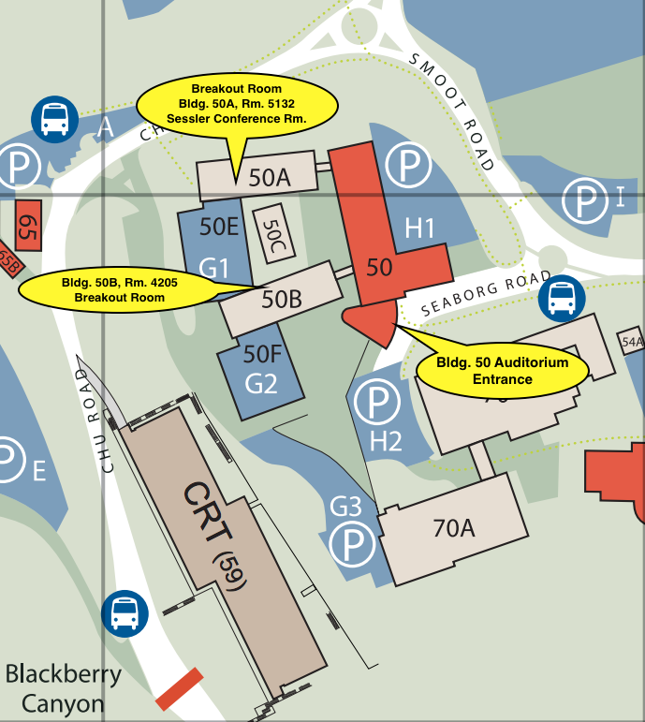
Parallel sessions
Parallel Session Rooms:
Auditorium
Bldg. 50A, Rm 5132 - From the Auditorium, go up the stairs, walk to the end of the corridor, turn left.
Bldg. 50B, Rm. 4205 - From the Auditorium, go down the stairs, turn left.
ZOOM: Each session has a unique meeting ID – see indico page.
21 cm | 50A-5132
Southern Spectroscopic Survey Roadmaps | Auditorium
New Technology (show of hands) | 50B-4205
Theory, Analysis, and Computing | 50A-5132
New Observational Windows to Enhance LSST and DESI | Auditorium

