Slide 1

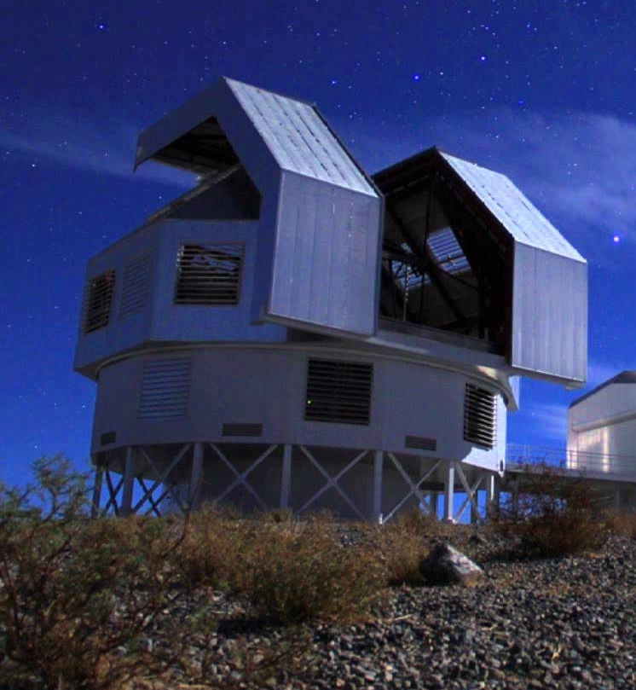
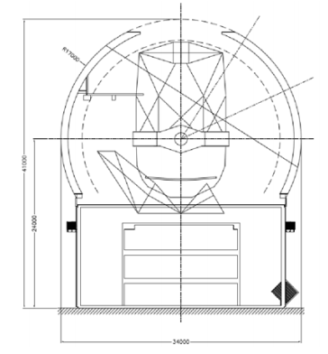
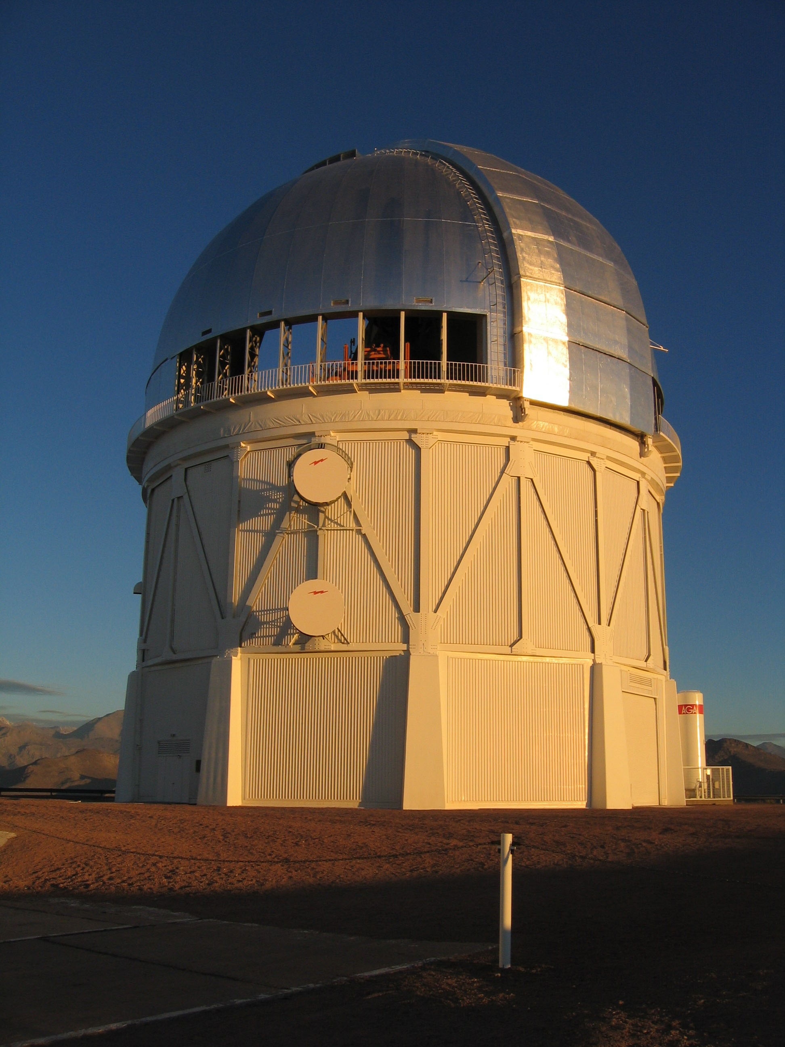
Southern Spectroscopic Survey Roadmap: Summary
Josh Frieman, Kyle Dawson,
Jeff Newman

Slide 2
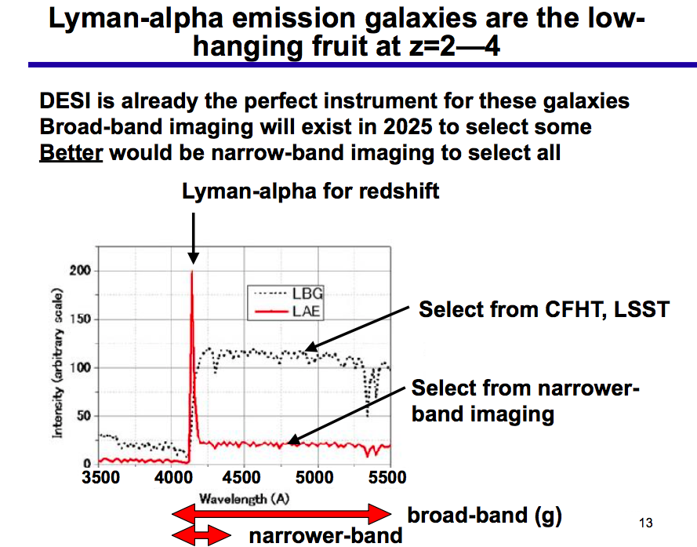
DESI-II
Schlegel

Slide 3
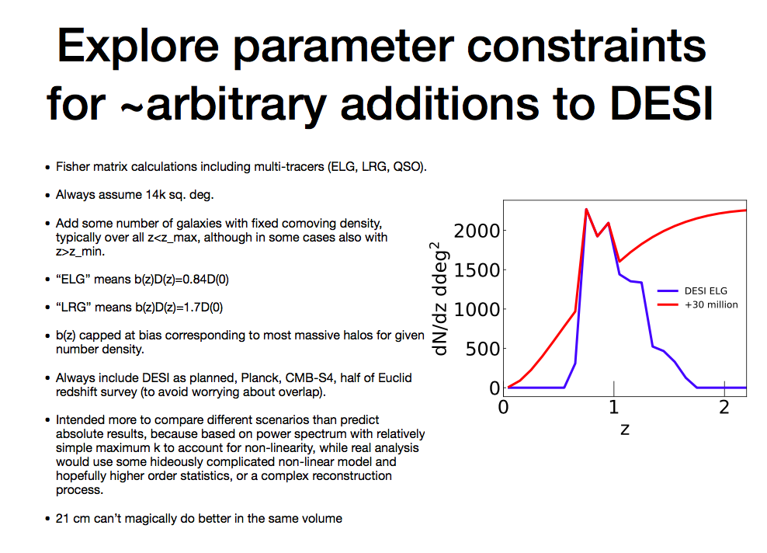
DESI-II
McDonald

Slide 4
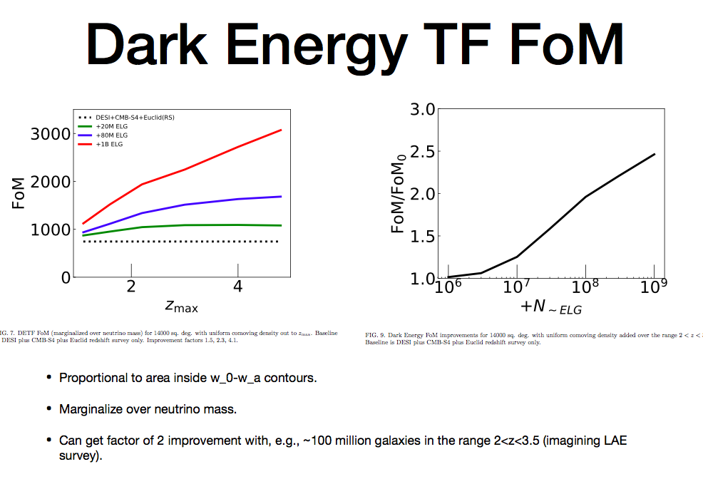
DESI-II
McDonald

Slide 5
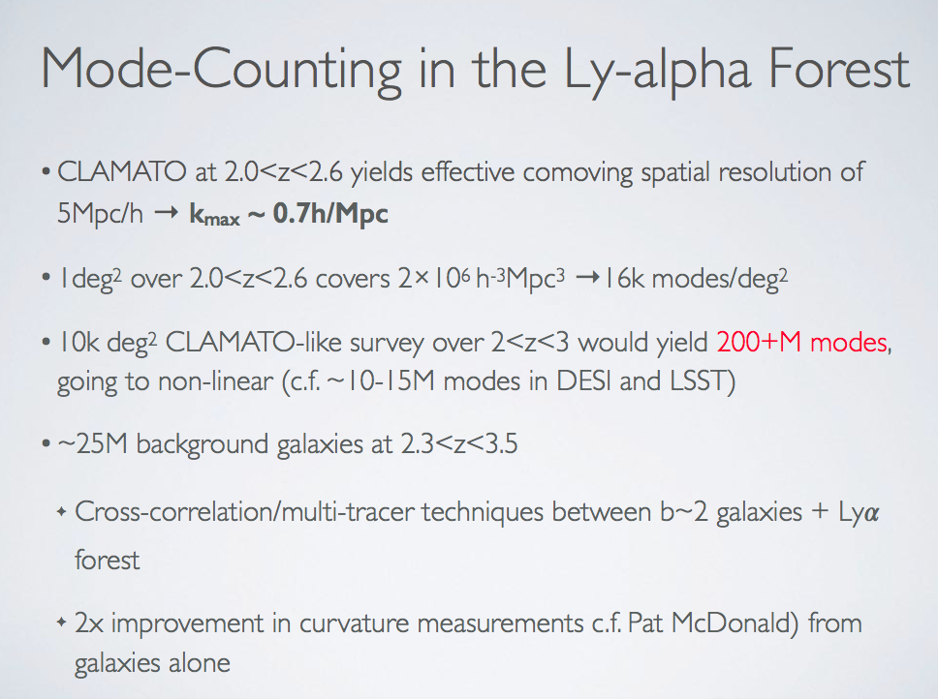
DESI-II
McDonald
Lee

Slide 6
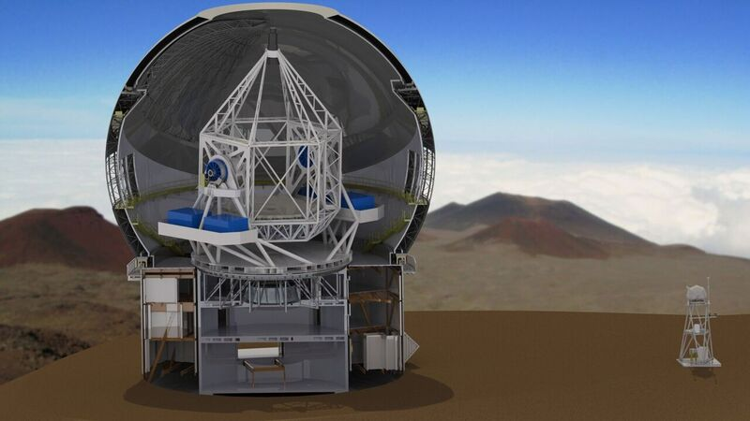
MSE is the future of CFHT
Maunakea Spectroscopic Explorer
4332-fiber positioner, 1.5 square degree FoV
11.25m f/2 segmented primary
Low/Mid-resolution spectrometers
High-resolution spectrometers
Current MSE Baseline Design
Hall

Slide 7
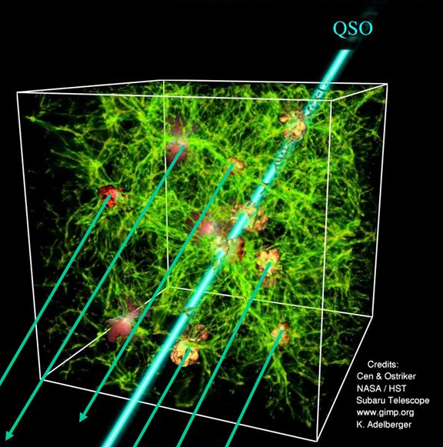
Top-level WFOS Capabilities
Primarily multi-object survey instrument
Also single-object rapid discovery/identification for transient science
R~5000 spectroscopy from 310 - 1000 nm
R~1500 mode beneficial if multiplex and S/N improve
GLAO ready
IGM Tomography
Bundy

Slide 8
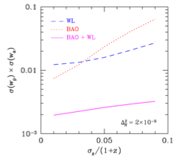
LSST Photo-z Training
LSST Forecasts
Newman et al. 2015
Product of errors on w and dw/da
(i.e., expansion rate at a given time and its rate of change)
Photo-z training offers 50% gains on billion dollar experiments
Photo-z precision
with training
without training
Bundy

Slide 9
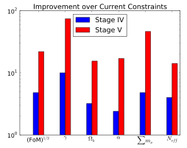

Cosmology with a ~billion spectra
Cosmology parameters from RSD power spectrum
    lots of information left in the sky
from cosmic visions report
assumes kmax = 0.5 h/Mpc
Krause

Slide 10
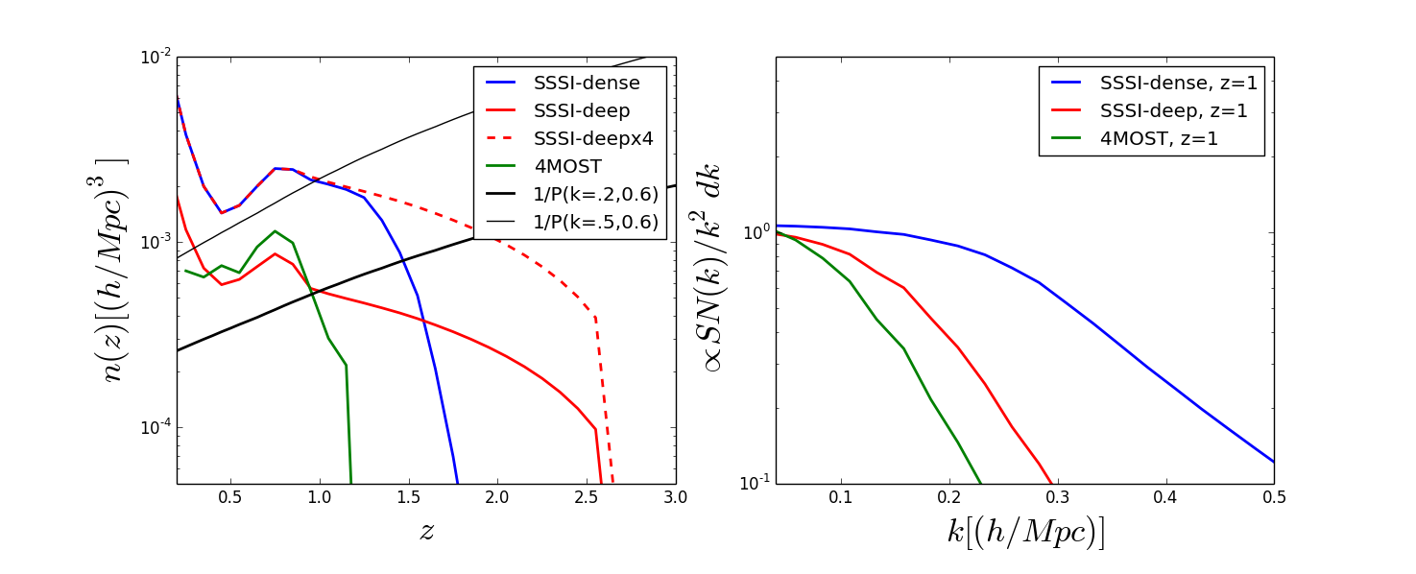
Cosmological Parameters from SSSI:
SSSI Modeling
SSSI Baseline Scenarios
  - SSSI-dense: 4xDESI-like density -> better sampling at large k
  - SSSI-deep: DESI-like + high-z sample -> extend redshift baseline
  - multi-tracer analysis with ELG, LRG, QSO samples
kmax = 0.2
Krause

Slide 11
Cosmological Parameters from SSSI:
Constraints
NB: Lya, CMB-S4, survey cross-correlations not yet included
Stage IV + SSSI includes improved photo-z calibration
 | Stage IV | +SSSI dense, kmax=.2 | +SSSI dense, kmax=.5 | +SSSI deep, kmax=.2 | +SSSI deep, kmax=.5 | +SSSI deepx4, kmax=.2 | +SSSI deepx4, kmax=.5
FoM | 1089 | 1486 | 2430 | 1425 | 1972 | 1697 | 2860
𝜎(wa) | 0.082 | 0.070 | 0.050 | 0.071 | 0.060 | 0.062 | 0.051
𝜎(𝞪s) | 0.0028 | 0.0022 | 0.0016 | 0.0022 | 0.0019 | 0.0020 | 0.0013
𝜎(μ) 𝜎(𝛴) | 0.019, 0.033 | 0.014, 0.027 | - | 0.015, 0.028 | - | 0.012 0.023 | -
Krause

Slide 12

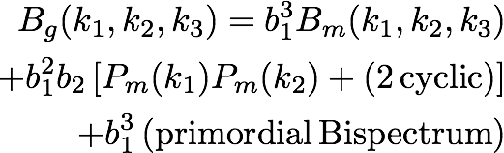
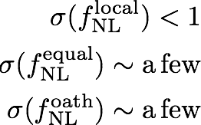
Cosmology with a ~ billion spectra:Bispectrum
non-lin. gravitational evolution
quadratic galaxy biasing
High S/N Bispectra may uncover new physics
  Measuring amplitude of primordial non-Gaussianity templates will distinguish between single/multi-field inflation, constrain slow roll
  Anisotropic non-Gaussianity, search for features
  Plenty of room, and S/N, for new ideas :)
inflation
<- driven by scale-dep. bias, z< 2.5
preliminary!
<- driven by high-z coverage
Krause

Slide 13
Questions overlapping other groups
Technology questions:
          GLAO
          Fiber pitch: (how) can we get to very small pitch?
          NIR detectors
Theory questions:
how do we exploit cosmological information at small scales?
need to model Ly-alpha forest for forecasts
New windows: e.g., SN hosts, GW standard sirens,…
Will wide-band imaging be sufficient?
e.g., potential advantages of deep spectroscopy & multi-
band imaging, e.g., of LSST deep drilling fields

Slide 14
General Questions/Issues
Flesh out complementarity with non-cosmological science & connect with that community: will likely determine scale
          Sharpen aperture requirements for science cases
          Sharpen location (hemisphere) requirements: how much LSST overlap is needed?
          Flesh out roadmap options and carry out trade studies:
          Science requirements → Survey design → Facilities
          DESI → DESI-II → LSST spectroscopy → Dedicated facility
          2019 2024? late 2020’s? 2030’s
          DESI-II: stay north, move south, clone south, or new instrument in south, e.g., with much smaller pitch?
          LSST spectroscopy: Magellan? PSF? MSE? GSMT?

