Slide 1
Accelerator R&D for Mu2e-II
Steve Werkema
Mu2e-II Workshop
8 December 2017

Slide 2
Mu2e-II Beam

Slide 3
Mu2e and Mu2e-II Proton Beam Parameters
Parameter | Mu2e | Mu2e II | Units
Total Protons on Target (3 yr) | 4.7×10²⁰ | 4.4×10²² | protons
Pulse Repetition Rate | 590 | 500 - 1250 | kHz
Time Between Pulses | 1695 | 800 - 2000 | nsec
Pulse Base Width | 250 | 100 | nsec
Extinction Level | 10⁻¹⁰ | 10⁻¹¹
Average Intensity per Pulse | 3.9×10⁷ | 5.6 – 14 ×10⁸ | protons
Pulse-to-Pulse Intensity Variation | <50 | <10 | %
Beam Kinetic Energy | 7946 | 800 | MeV
Beam Power | 7.3 | 100 | kW
Duty Factor | 25 | 90 | %
NOTE:
Blue numbers are calculated from the other parameters.
Total POT assumes 67% accelerator up-time
Notes:
Mu2e-II parameters are subject to change. This set of parameters is sufficient to illustrate the accelerator issues associated with Mu2e-II.
Mu2e beam power is calculated using the proton kinetic energy. Beam power = 8.1 kW using total energy.
NOTEs:
Beam powers greater than 100 kW are possible at 800 MeV.
The Mu2e-II duty factor may be impacted by other users (e.g. LBNF).

Slide 4
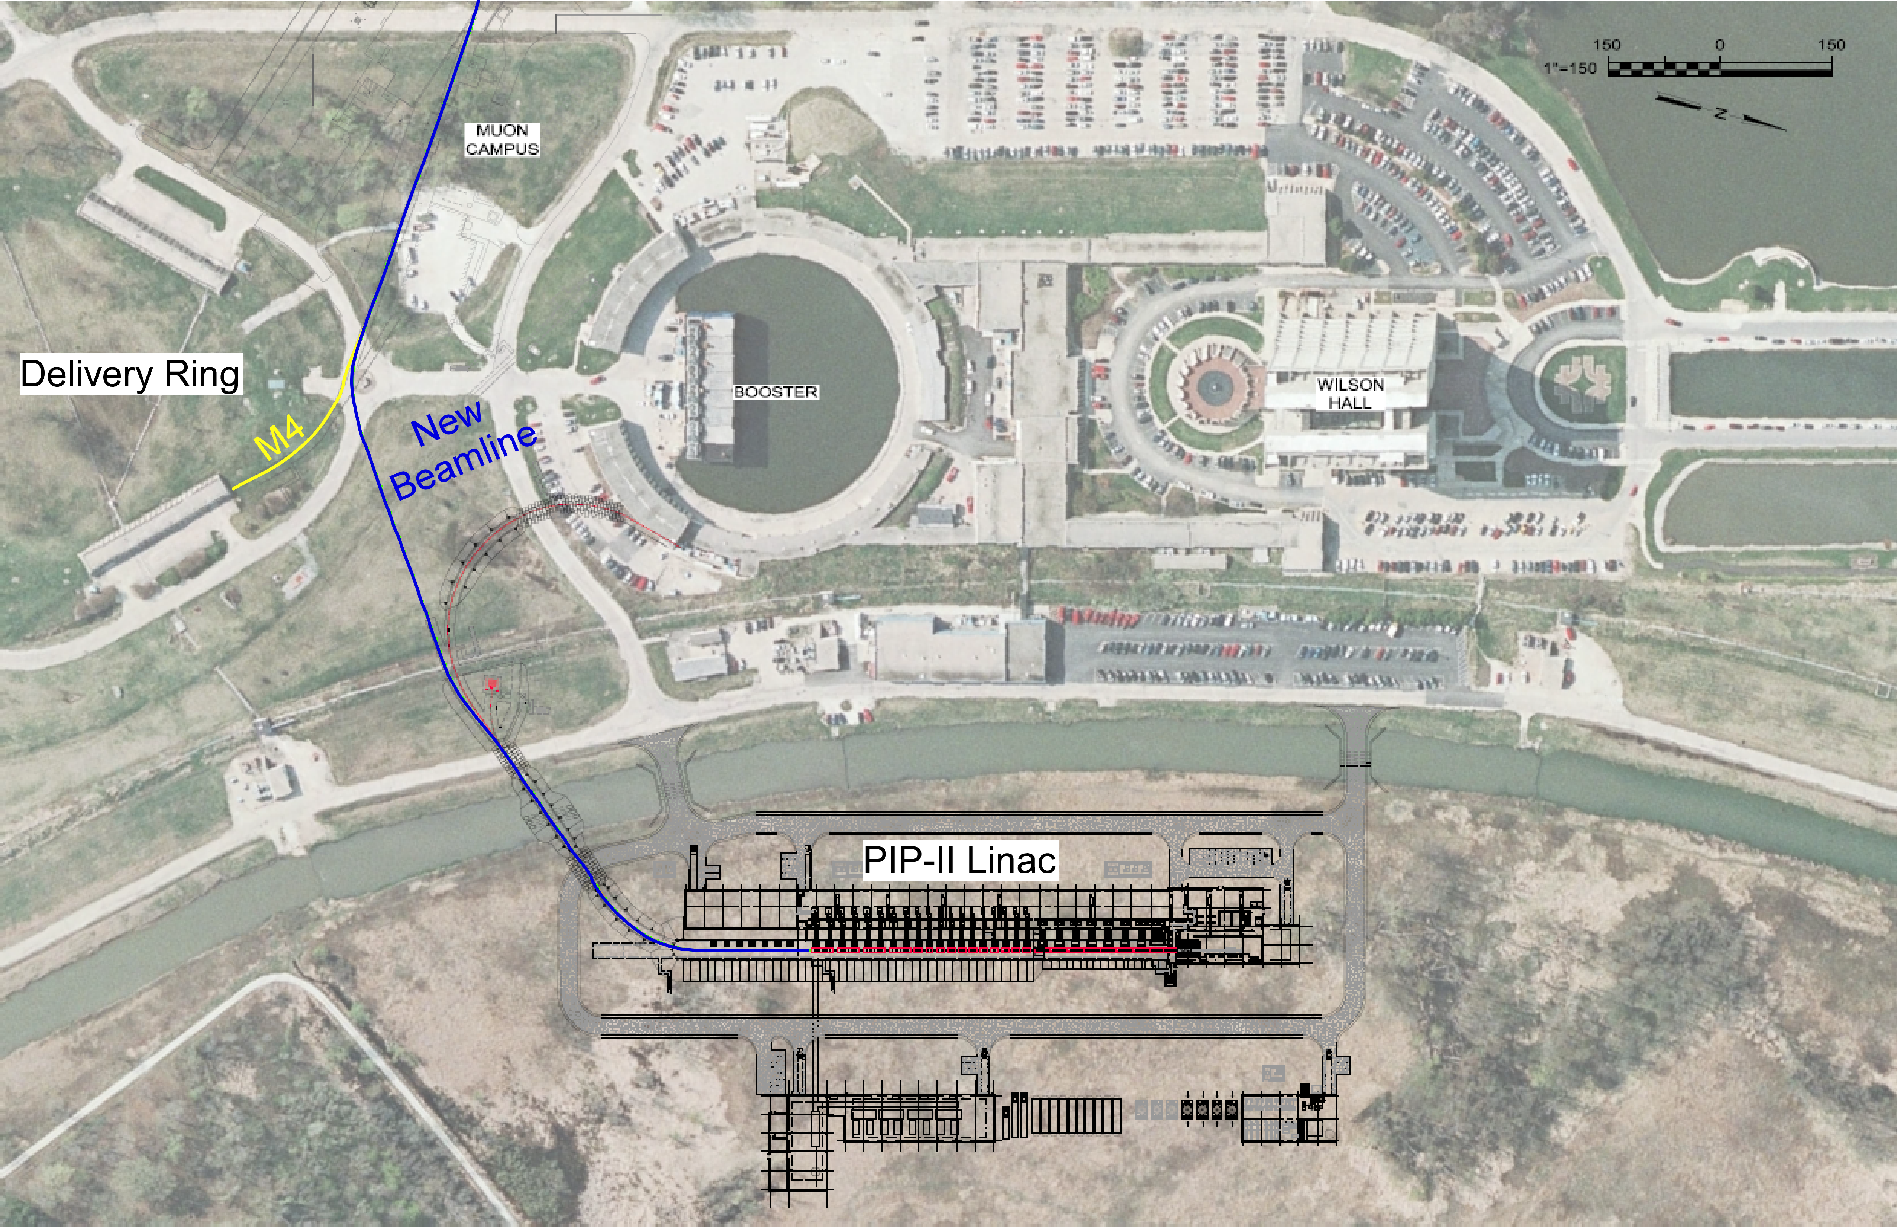
Mu2e II Beam Delivery
MC-1
Notes:
Extracted from PIP-II CDR V0.01 Appendix A (http://pxie.fnal.gov/PIP-II_CDR/default.htm).
PIP-II Linac replaces the present Linac. Designed to deliver 800 MeV H⁻ beam to the Booster.
Use upstream end of transfer line to Booster. Switching magnet directs Mu2e beam to M4 line.
Optics of the new beamline is designed to match that of the existing M4 line where the two lines merge.
A new beam enclosure must be built connecting the Linac to Booster enclosure and the M4 enclosure.

Slide 5
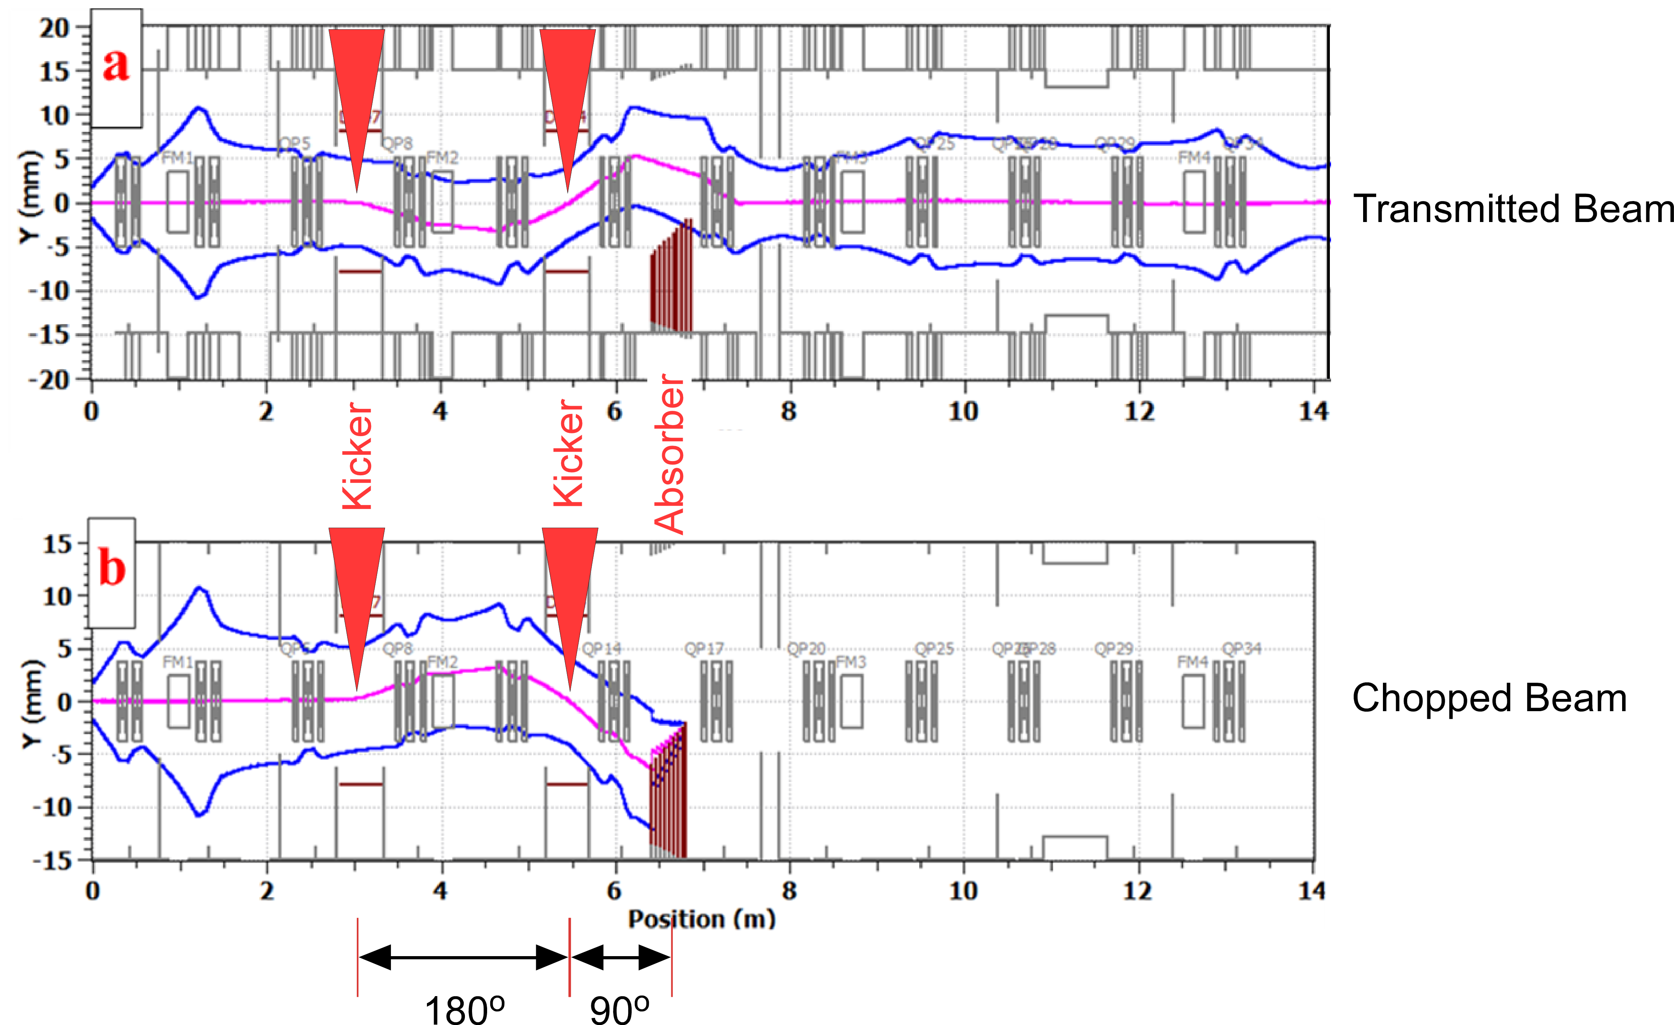
Pulsed Beam Formation – Beam transport through MEBT
Quadrupole Triplets
PIP-II Medium Energy Beam Transport (MEBT) section.
Pulse formation is accomplished by a fast bunch-by-bunch chopper.
Chopper consists of two fast vertical kicker magnets and a beam absorber
Kickers are excited during transmission and chopping
Input: Bunch train of 2.1 MeV H⁻ ions @162.5 MHz (6 nsec bunch-bunch)
Transmitted bunch: Upstream kicker defects down, downstream kicker deflects up, bunch clears absorber
Chopped bunch: Upstream kicker defects up, downstream kicker deflects down, bunch hits absorber
This system can produce 100 nsec pulsed beam with 800 – 2000 nsec bunch spacing.
Notes:
Beam envelope plots from PIP-II CDR V0.01 Figure 3.16 (http://pxie.fnal.gov/PIP-II_CDR/default.htm).
Beam center is magenta
3-sigma beam envelope is in blue

Slide 6
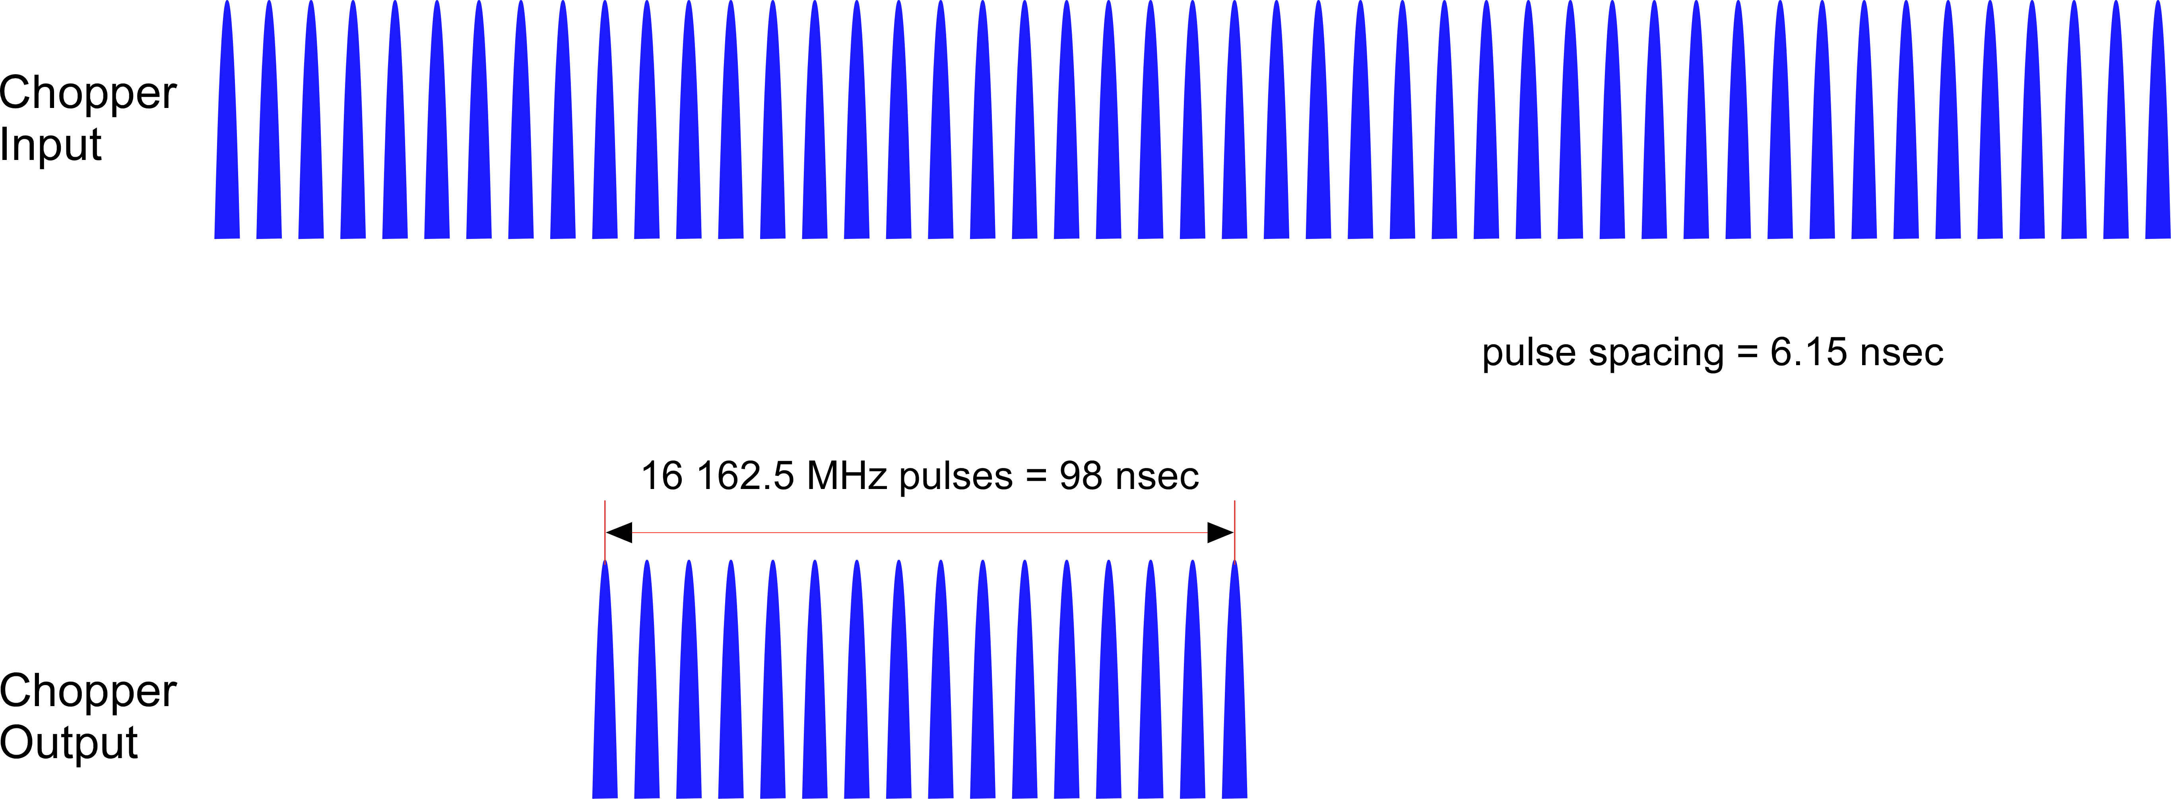
MEBT Chopper Operation for Mu2e-II
Removed
Removed
Notes:
LEBT chopper will eliminate most leading and trailing bunches upstream of MEBT
Upstream collimation will remove transverse tails
This is the longitudinal profile seen by the production target
Notes:
LEBT = Low Energy Beam Transport

Slide 7
Beam Related Issues

Slide 8
List of Major Issues
Extinction depends on MEBT chopper system – can this system achieve the required 10⁻¹¹ extinction factor?
Where to strip H⁻ to p. Can we transport and target H⁻ ?
Beam enclosure and Mu2e building radiation shielding. Present facilities designed for 8 kW. Can shielding be augmented to accommodate 100 kW?
Primary beam transport into and through the PS – can we still hit the target and dump? What are the implications for the extinction monitor?
Target and target handling upgrades required for 100 kW beam.
HRS upgrades to provide the additional PS and TS thermal and radiation shielding required for 100 kW beam.

Slide 9
Extinction
Chopped Beam
What level of out-of-time extinction can we expect from the MEBT chopper system
Some simulations have been done. MEBT Chopper estimated extinction factor is 10⁻⁹.
Additional beamline extinction system required –Mu2e AC Dipole system (with modifications) still required.
Extinction testing at PIP2IT (PIXIE) cancelled to reduce costs ⇒ this test program must be restored.
3σ beam envelope at edge of absorber
Is 0.135% of gaussian beam transmitted?
Answer: NO
  Tails beyond 3σ removed by upstream collimation and LEBT chopper
  Does this get us to an extinction factor of 10⁻¹¹?
Notes:
The current proposed path for extinction testing at PIP2IT is via a LDRD.

Slide 10
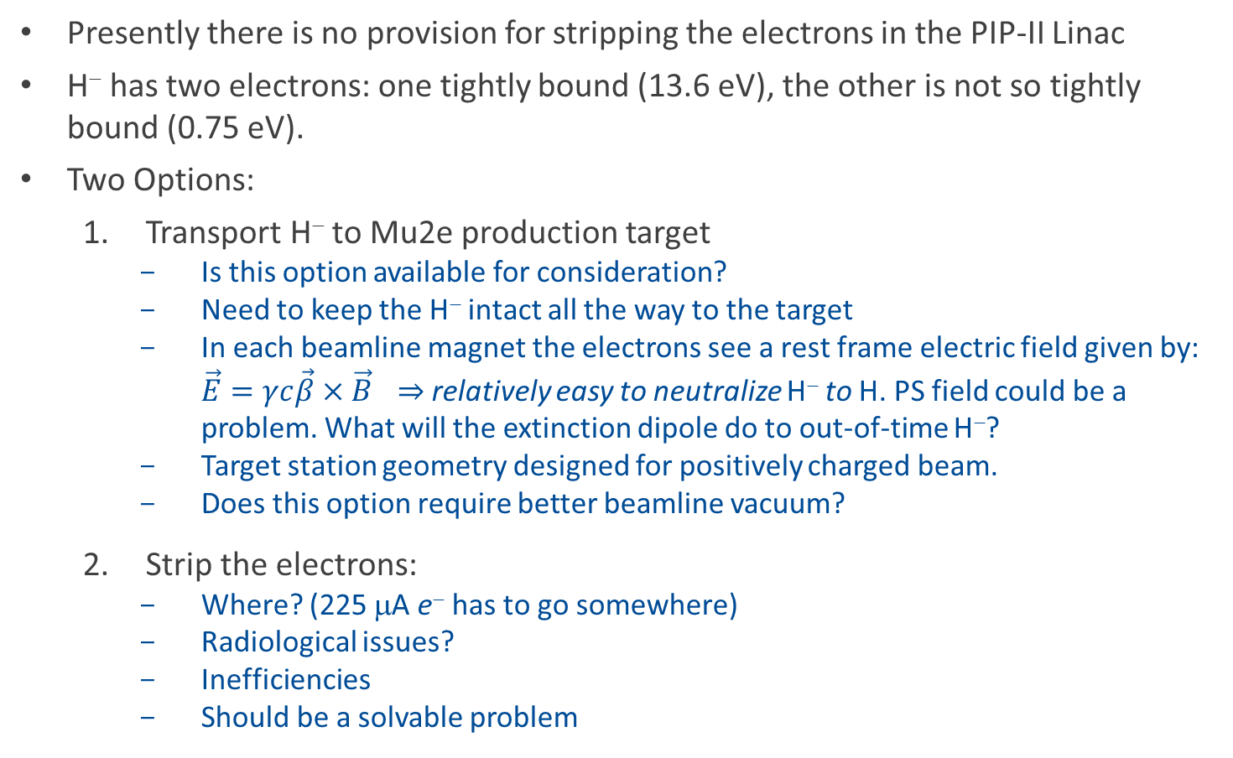
H⁻ Stripping
Presently there is no provision for stripping the electrons in the PIP-II Linac
H⁻ has two electrons: one tightly bound (13.6 eV), the other is not so tightly bound (0.75 eV).
Two Options:
  Transport H⁻ to Mu2e production target
    Is this option available for consideration?
    Need to keep the H⁻ intact all the way to the target
    In each beamline magnet the electrons see a rest frame electric field given by: $\vec{E}=γc\vec{β}×\vec{B}$ ⇒ relatively easy to neutralize H⁻ to H. PS field could be a problem. What will the extinction dipole do to out-of-time H⁻?
    Target station geometry designed for positively charged beam.
    Does this option require better beamline vacuum?
  Strip the electrons:
    Where? (225 μA e⁻ has to go somewhere)
    Radiological issues?
    Inefficiencies
    Should be a solvable problem
Notes:
Note: stripping for present Booster injection is at 400 MeV. For a given B, the rest frame electric field is 1.5 times greater at 800 MeV.

Slide 11
Radiological Issues
Mu2e-II removes from consideration two very serious radiological liabilities
  Resonant Extraction (very lossy)
  Poor shielding of the Delivery Ring enclosure
However, the increased beam power on target greatly aggravates the radiological hazard in the Mu2e building.
  Radiological conditions for 8 kW primary beam:
    Radiation does rates on berm above PS hall: 3 – 5 mRem/hr (steel shielding required to achieve these rates)
    Sky shine does rate at Wilson Hall ≲ 0.1 mRem/yr
    West wall concrete augmented to prevent surface and ground water activation
  Mu2e-II beam 14× greater beam power, 14 – 22× greater intensity per pulse, 3.5× greater duty factor give:
    increased dose rates on berm at the Mu2e building
    increased sky shine dose rates in remote locations (i.e. Wilson Hall, Site Boundary)
    much greater target and beam dump activation
Greater neutron and charged particle fluence toward Mu2e detectors
Very little space available to augment shielding

Slide 12
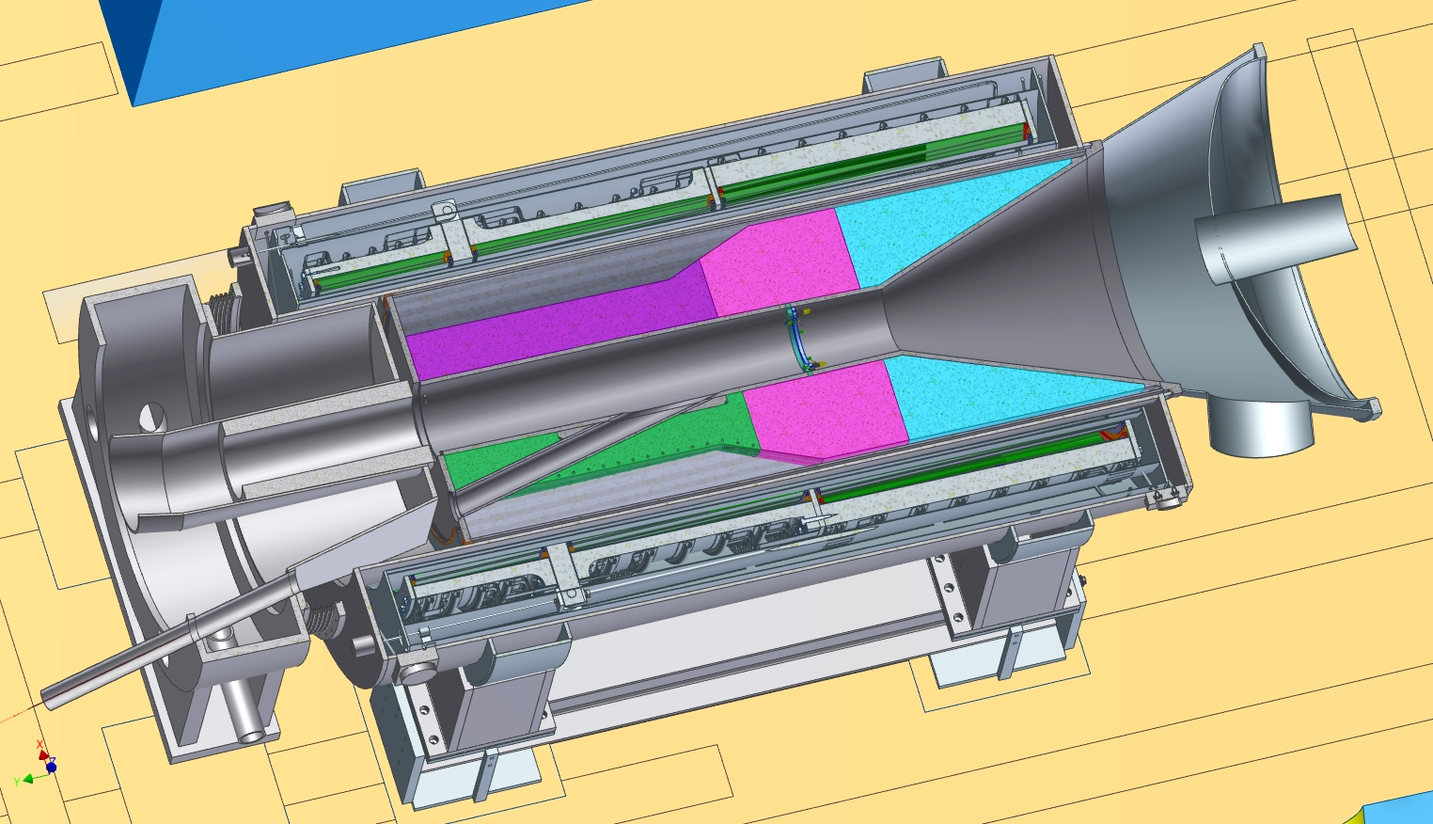
Primary Beam Transport through the Solenoids:
8 GeV Proton Beam Trajectory
8 GeV proton beam enters PS:
0.57 m off-axis
vertical pitch = -3.1°
horizontal bearing = 13.6° relative to the PS axis
For 8 GeV beam, the horizontal projection of the proton trajectory is well approximated by a straight line.
This is not the case at 800 MeV.
Target
~14°
Horizontal section of production solenoid.
PS axis is parallel to the magnetic field.
Notes:
Notes:
The horizontal bearing changes from 13.6$°$ (at PS entrance) to 14$°$ (at target) due to the small vertical pitch of the beam velocity vector.
The vertical pitch of the beam increases from -3.1$°$ to 0$°$ due to the horizontal bearing of beam velocity vector

Slide 13
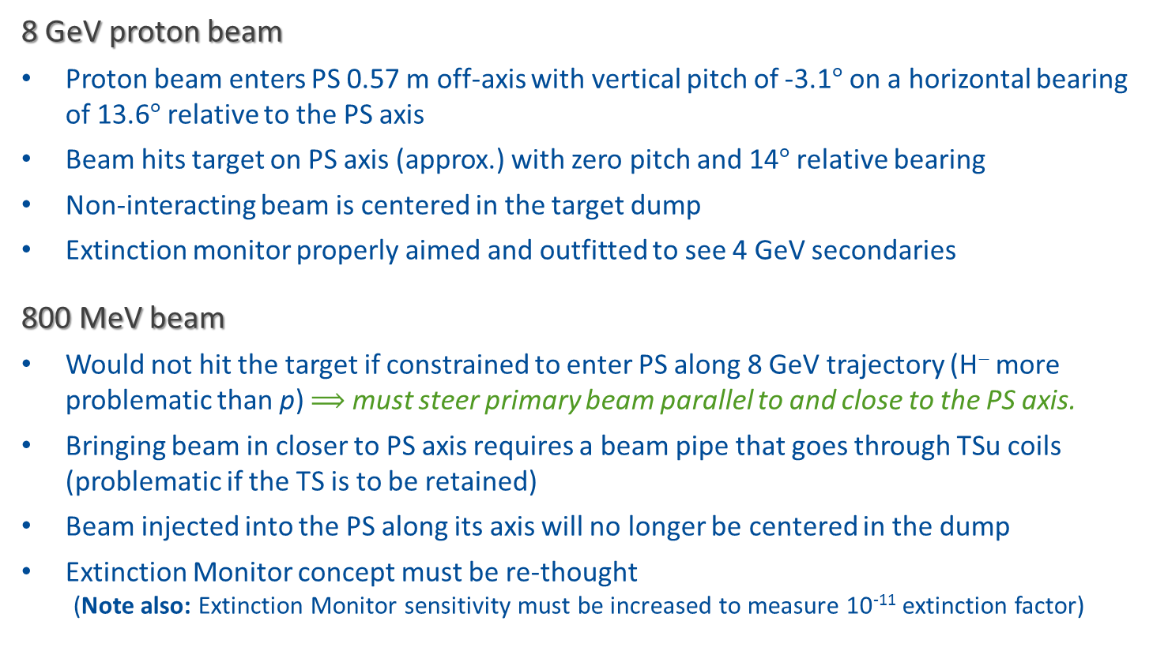
Primary Beam Transport through the Solenoids
8 GeV proton beam
Proton beam enters PS 0.57 m off-axis with vertical pitch of -3.1° on a horizontal bearing of 13.6° relative to the PS axis
Beam hits target on PS axis (approx.) with zero pitch and 14° relative bearing
Non-interacting beam is centered in the target dump
Extinction monitor properly aimed and outfitted to see 4 GeV secondaries
800 MeV beam
Would not hit the target if constrained to enter PS along 8 GeV trajectory (H⁻ more problematic than p) $⟹$ must steer primary beam parallel to and close to the PS axis.
Bringing beam in closer to PS axis requires a beam pipe that goes through TSu coils (problematic if the TS is to be retained)
Beam injected into the PS along its axis will no longer be centered in the dump
Extinction Monitor concept must be re-thought
  (Note also: Extinction Monitor sensitivity must be increased to measure 10^{‐11} extinction factor)

Slide 14
Target Station Issues
Present target is radiatively cooled – designed to survive one year of 8 kW beam
  One year target lifetime at 100 kW will require forced cooling of the target.
  A conceptual design of a target cooling system exits (next slide)
At 100 kW, radiation damage to the target will be an issue – may be the principle factor determining target lifetime ⟹ R&D Required
The present target beam dump is air cooled
  Target dump for 100 kW primary beam will require water cooling
  Requires disassembly of a highly radioactive component (i.e. the present dump after 3+ years of exposure)
Target handling system will require upgrade to accommodate a more radioactive target and the cooling system plumbing.

Slide 15
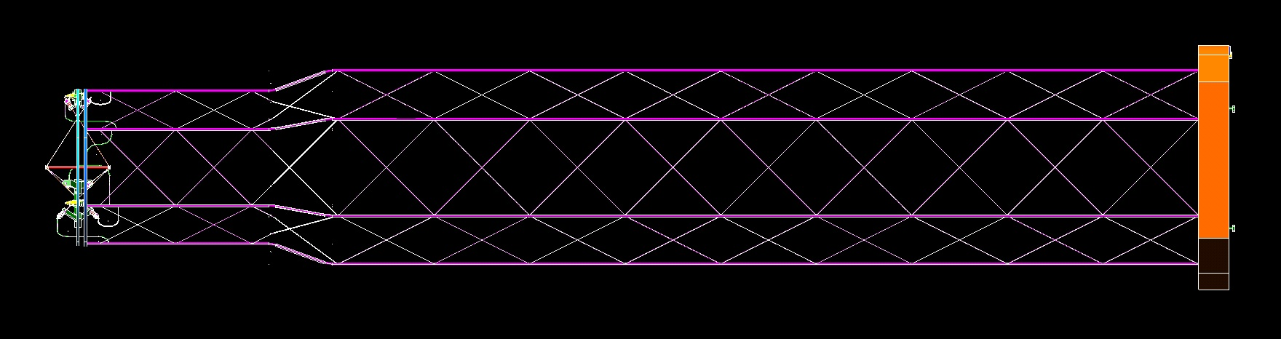
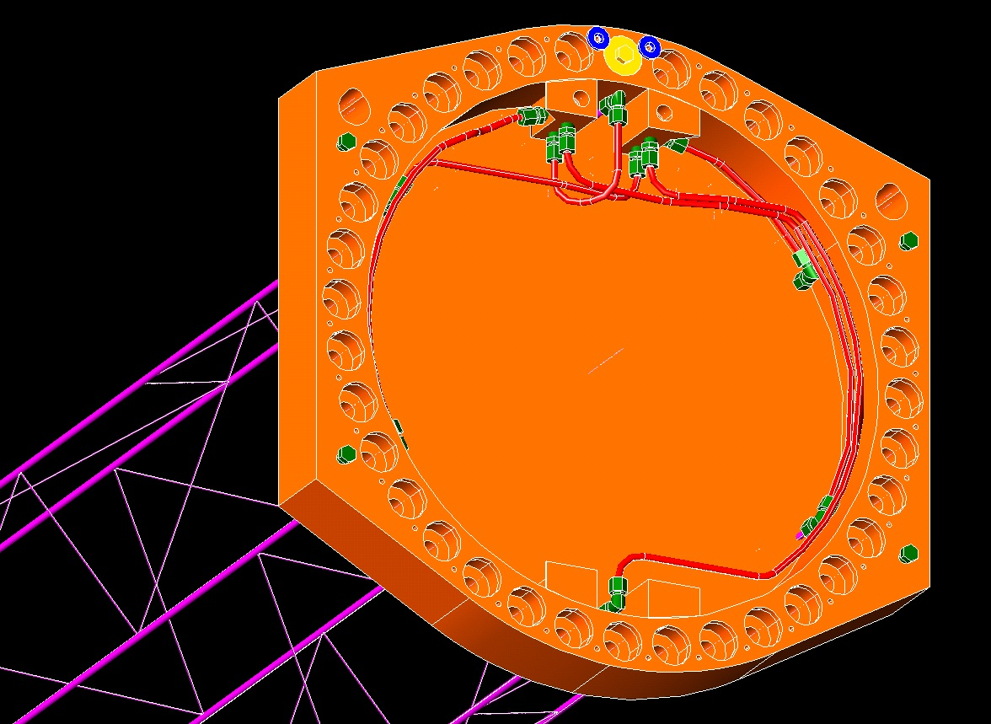
Target Cooling Scheme – Mike Campbell (Mu2e-doc-4146)
Target Ring
Concept for a plumbing scheme for a cooled target has been developed
Very low mass – minimal impact on muon yield
Target would be enclosed in a Titanium jacket
Target change-out includes plumbing replacement
PS End cap fittings

Slide 16
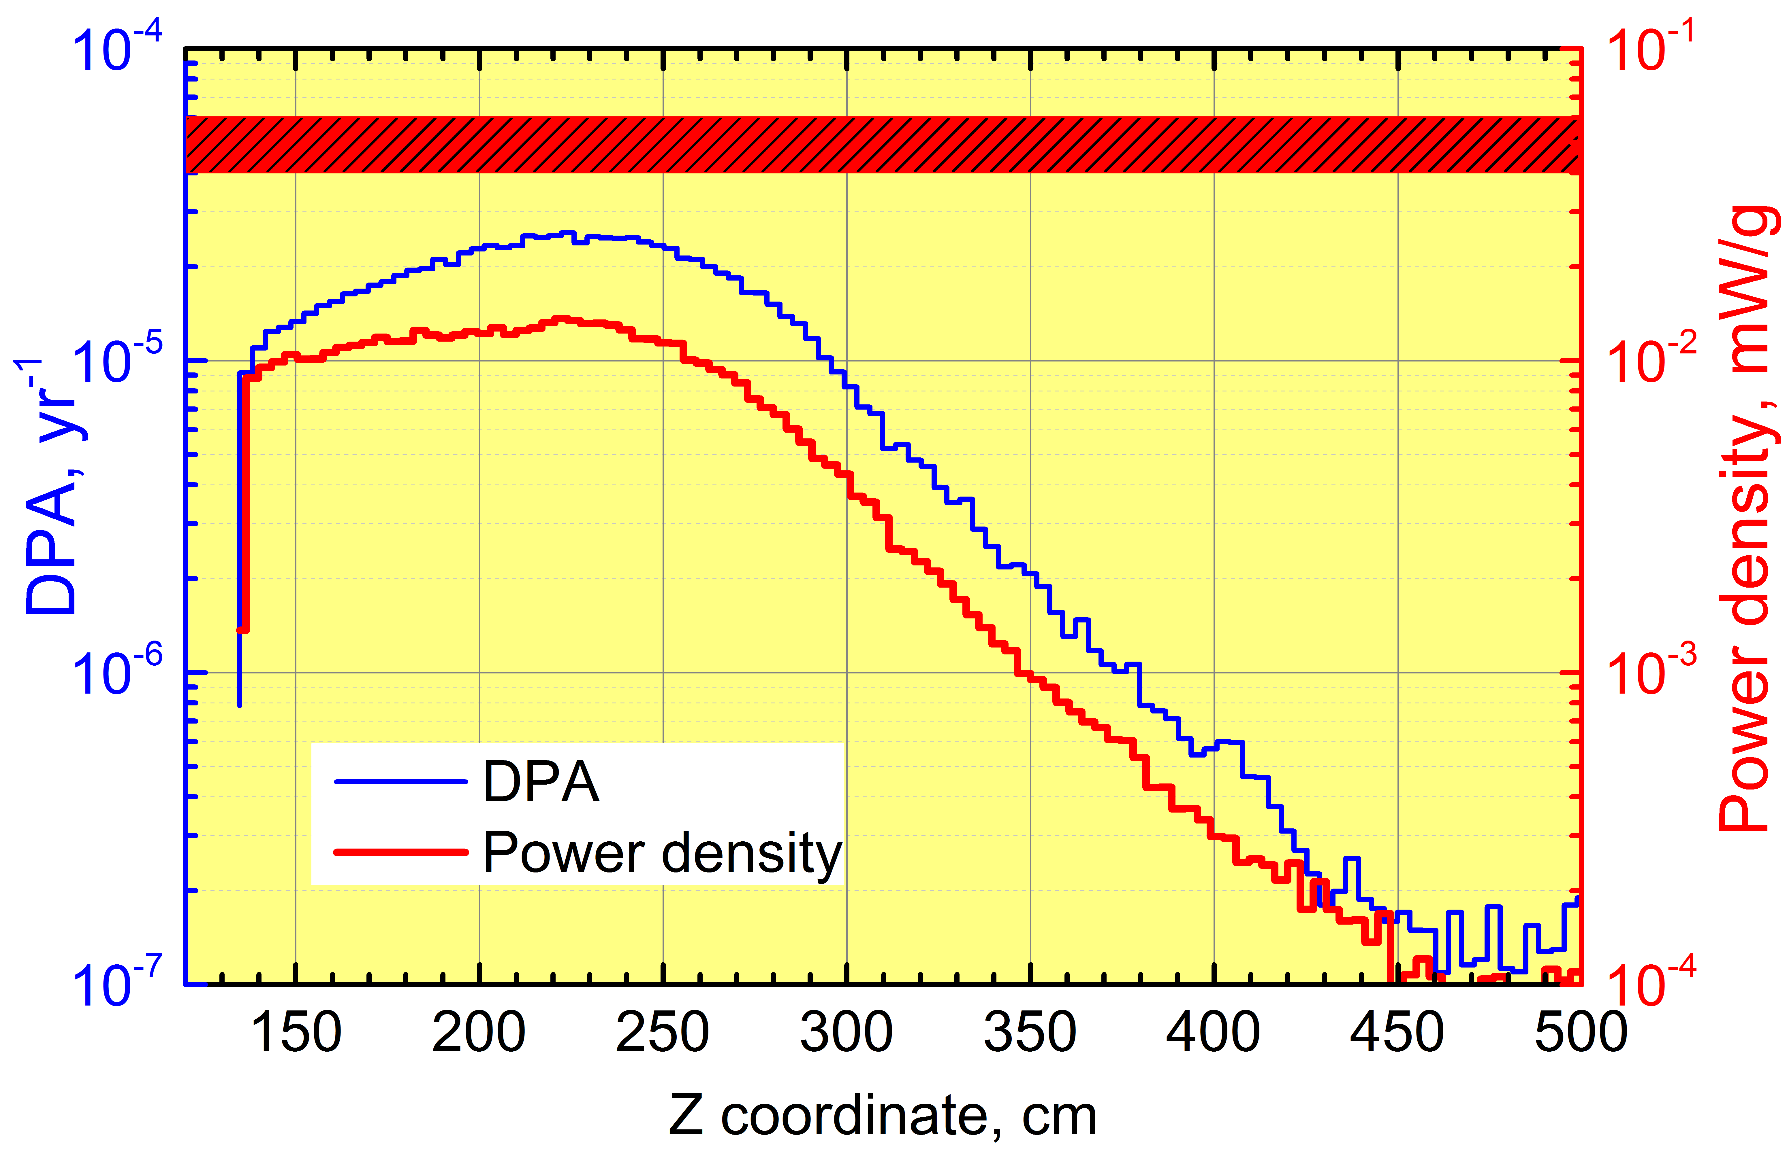
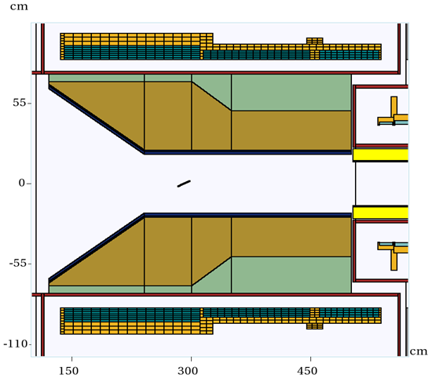
Simulated 8 GeV HRS Performance
MARS Simulations
Vitaly Pronskikh
PS DPA Limit
PS Pwr Density Limit
T
Notes:
The line labeled “T” is the proton target.
At 100 kW expect:
DPA and Power Density to increase everywhere
Peak DPA and Power Density will move upstream – toward the target

Slide 17
HRS Upgrades
At 8 GeV, HRS radiation damage and energy deposition margins are small
  no room to increase beam power
  do not want to warm up for annealing more than once per year
  ⇒ HRS must be replaced
HRS removal will be difficult
  HRS is welded to the PS cryostat
  HRS will be extremely radioactive after Mu2e run
  Must consider removing both HRS and PS together
Options for improving heat and radiation shielding:
  Change material (tungsten instead of bronze) – very expensive
  Increase HRS thickness – lost muon yield

Slide 18
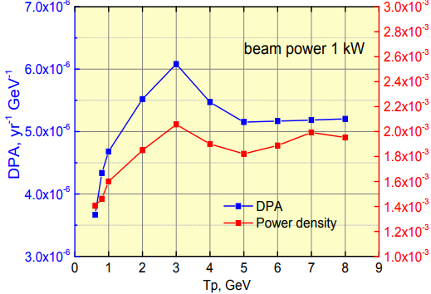
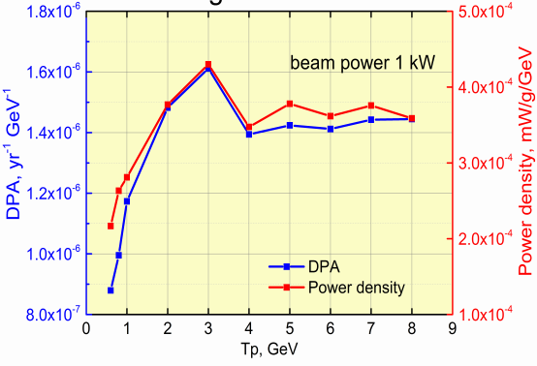
Replacement HRS
Plots: Vitaly Pronskikh
Mu2e-doc-3205
Bronze HRS
Tungsten HRS
Estimated Mu2e-II DPA and Pwr Density @100 kW with Tungsten HRS:
Mu2e-II | Value | Limit
DPA (DPA/yr) | 16×10⁻⁵ | 4×10⁻⁵
Power Density (mW/g) | 4.2×10⁻² | 3.0×10⁻²
Conclusion:
Changing material to Tungsten not sufficient
Notes:
Note: I’m assuming that DPA yr⁻¹ GeV⁻¹ is really DPA/yr/kW and that mW/g/GeV is really mW/g/kW.
The Mu2e-II DPA and Power Density values are taken from D. Glenzinski et.al. “Status of Production Target simulations for Mu2e II” Mu2e-doc-3205 (Aug. 2013).

Slide 19
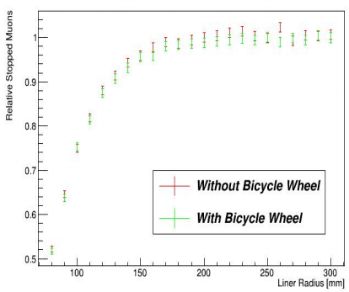
HRS Options
Build Tungsten HRS and do nothing else – warm up 2 to 3 times per year to anneal PS coils
Build Tungsten HRS with increased thickness (smaller bore)
  From Vitaly: 9 cm decrease in HRS radius lowers DPA 4×
  We require 2.5× reduction (25 cm → 19 cm)
  Muon yield decreases by less than 5%
HOWEVER, all of the plumbing to cool the target takes up space inside the HRS bore decreasing the effective radius.
Mu2e-II HRS
Mu2e HRS
J. Popp & K. Lynch
Mu2e-doc-3165

Slide 20
Accelerator Issues Approximately Ordered by Difficulty
Primary beam transport into and through the PS – How do we hit the target, dump, and extinction monitor?
Radiological issues – Can shielding be augmented to accommodate 100 kW?
Target and target handling upgrades required for 100 kW beam.
HRS upgrades
Extinction – Can MEBT chopper + beamline extinction system achieve the required 10⁻¹¹ extinction?
Where to strip H⁻ to p – Can we transport and target H⁻ ?
Notes:
First three are major issues:
greatest potential to require significant compromise of capabilities
most difficult and expensive to resolve

