Slide 1
Improvements in performance of the Muon Campus beamline
Diktys Stratakis
Fermi National Accelerator Laboratory
Mu2e II Workshop
December 08, 2017

Slide 2
Outline
The Fermilab Muon g-2 Experiment
The Fermilab Muon Campus
  Description of its main components
Expected performance of the Muon Campus
  End-to-end simulation model
  Muon, pion and proton rates
Possibilities for improvements
  Describe a novel idea that could increase the # of stored muons
Future work and summary

Slide 3
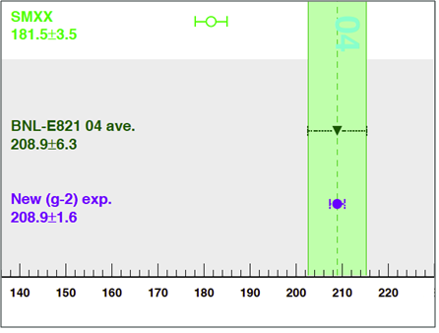
A hint of new physics?
Standard model: g_{theory}= 2.00 233 183 630 (99)
Last measured : g_{meas} = 2.00 233 184 178 (126)
What other physics must be added to make g_{theory}=g_{meas}?
Theory
Current discrepancy between theory/experiment
Experiment
Goal of the new g-2 experiment (fourfold improvement: 140 ppb)
Blum et al., arXiv:1311.2198v1

Slide 4
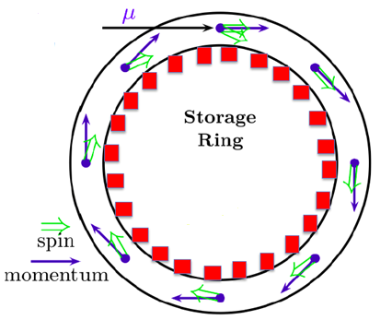
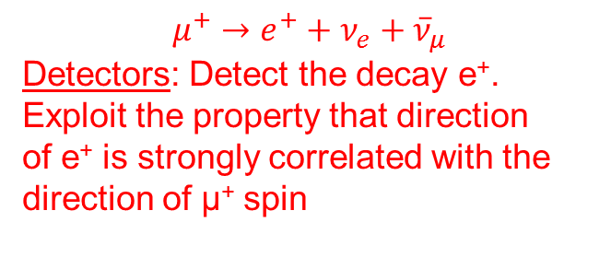
Principle for measuring g-2
Inject polarized μ⁺ into a
storage ring (SR)
Uniform field: B=1.45 T
Electrostatic quadrupoles: For vertical focusing
$$μ^{+}→e^{+}+ν_{e}+{\overline{ν}}_{μ}$$
Detectors: Detect the decay e⁺.
Exploit the property that direction
of e⁺ is strongly correlated with the direction of μ⁺ spin
Zero: by using “magic” 3.1
Gev/c μ⁺
Precession frequency: ${\vec{ω}}_{a}=\frac{e}{mc}\left[a_{μ}\vec{B}−\left(a_{μ}−\frac{1}{γ^{2}−1}\right)\vec{β}×\vec{E}\right]$

Slide 5
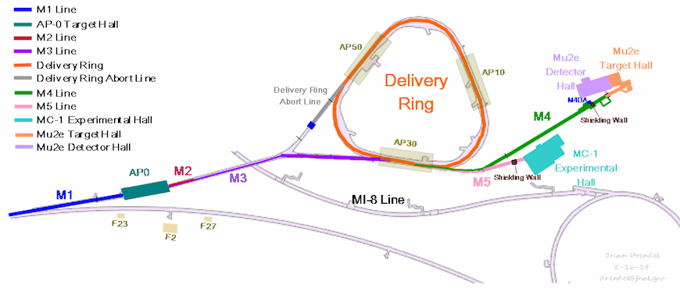
Muon Campus overview
After a few turns all π⁺ convert to μ⁺
Protons separate and are removed
3.1 GeV/c secondaries (π⁺, μ⁺, p) travel along M2 & M3
μ⁺ are extracted from the ring and transferred into the storage ring via M4, M5
8.89 GeV/c p beam impacts the target
μ⁺ enter the g-2 storage ring
A precision of 140 ppb will require the delivery of 1.1x10¹⁴ muons at the end of M5

Slide 6
Estimating the rates of secondaries
Significant effort has been placed, over the last two years, so that to estimate accurately the pion, muon and proton rates along the Muon Campus
Goal: Have at least two codes for each beamline section
Fortunately, good agreement between individual codes has been found
STORAGE RING
TARGET
BEAMLINES
G4beamline
BMAD
COSY
gm2ringsim
G4beamline
MARS
G4beamline
BMAD
COSY

Slide 7
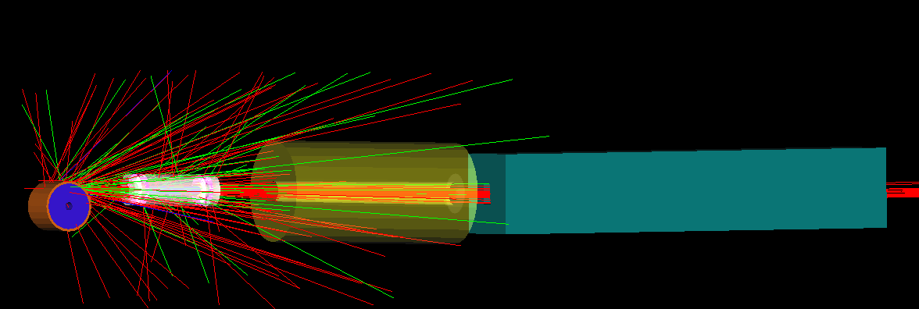
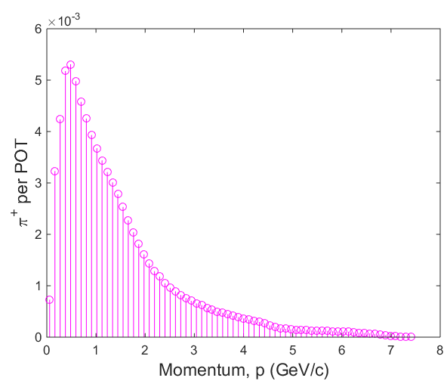
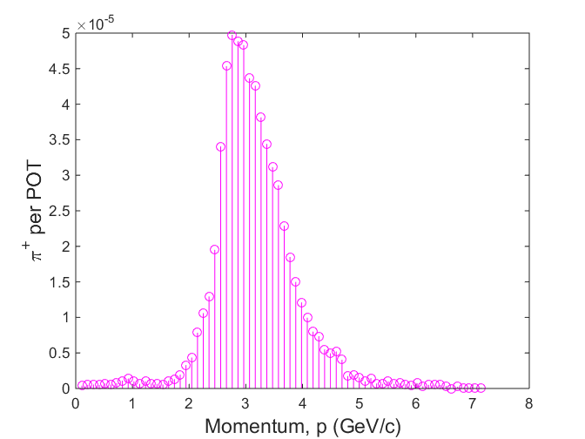
Target station
Target
Li-lens
Collimator
Pulsed magnet
Parameter | Value
Protons on target (POT) per pulse | 10¹²
Pulse width | 120 ns
Number of pulses | 16
Cycle length | 1.4 s
Incoming beam momentum | 8.89 GeV/c
Selection momentum | 3.1 GeV/c
π⁺ before
selection
π⁺ after
selection

Slide 8
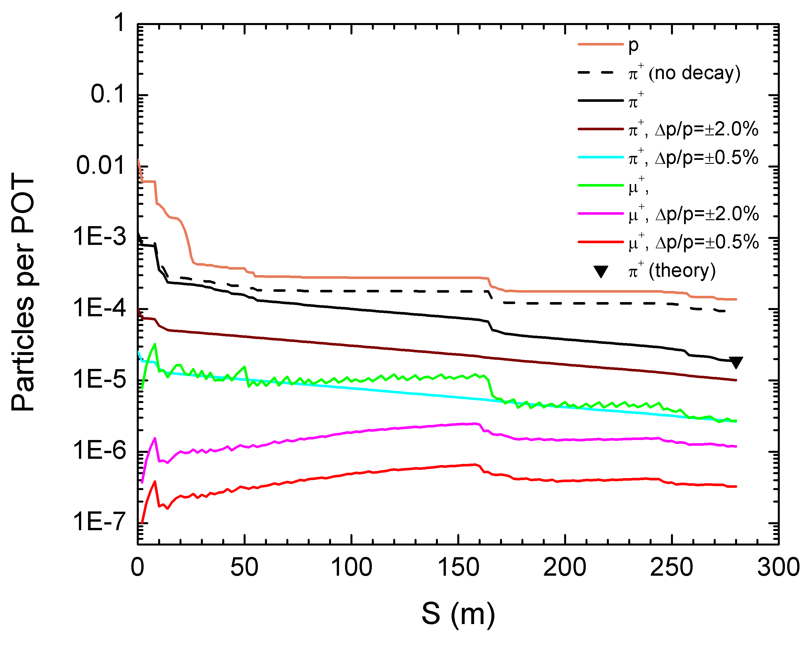
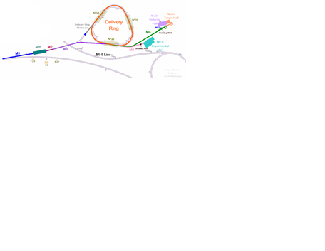
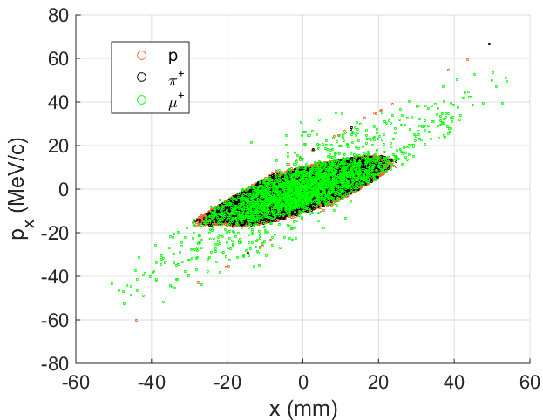
Performance within M2 & M3 lines
1.37x10⁻⁴ POT (p)
1.87x10⁻⁵ POT (π⁺)
2.62x10⁻⁶ POT (μ⁺)
DR entrance

Slide 9
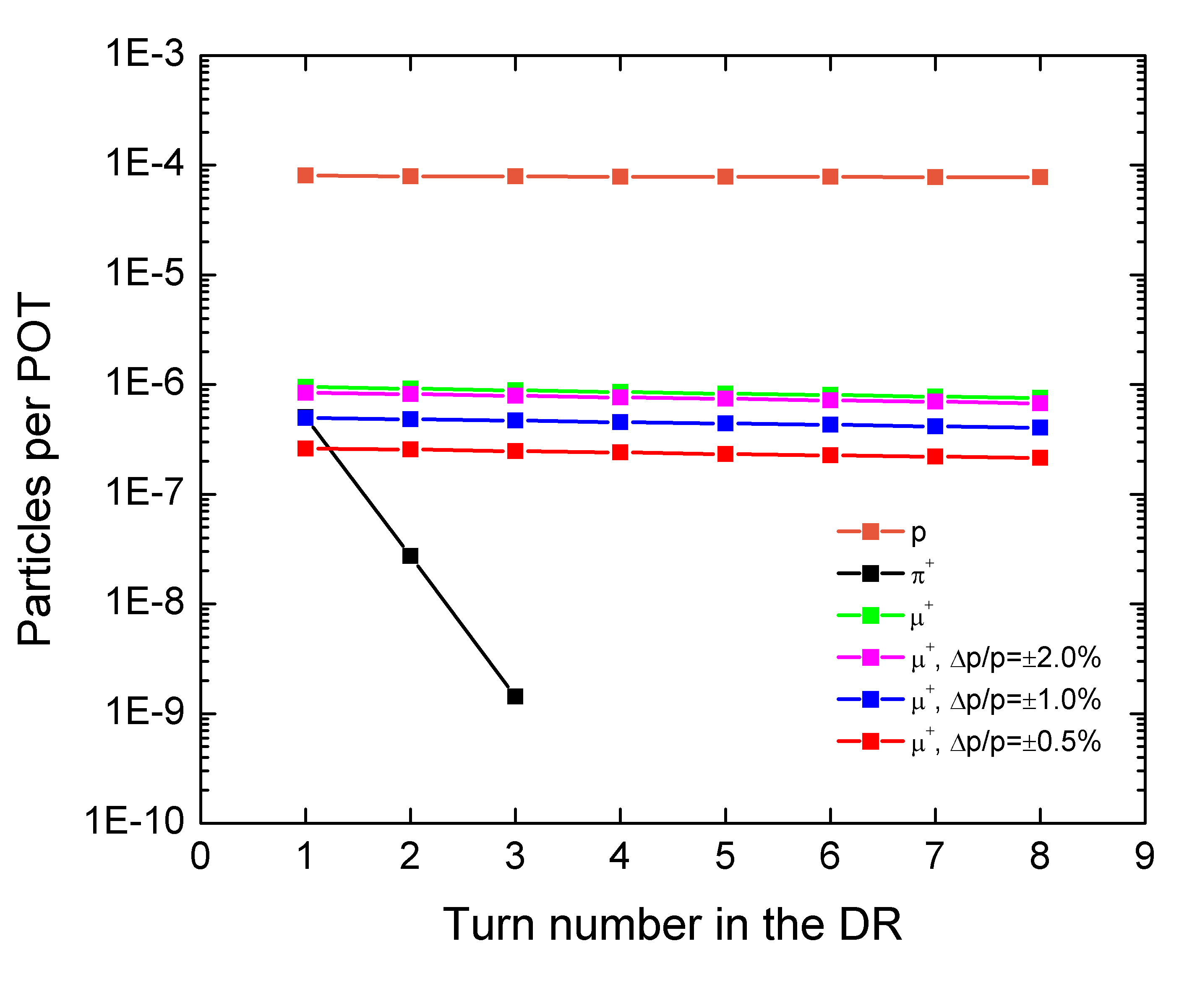
Performance in the Delivery Ring (DR)
Extraction point

Slide 10
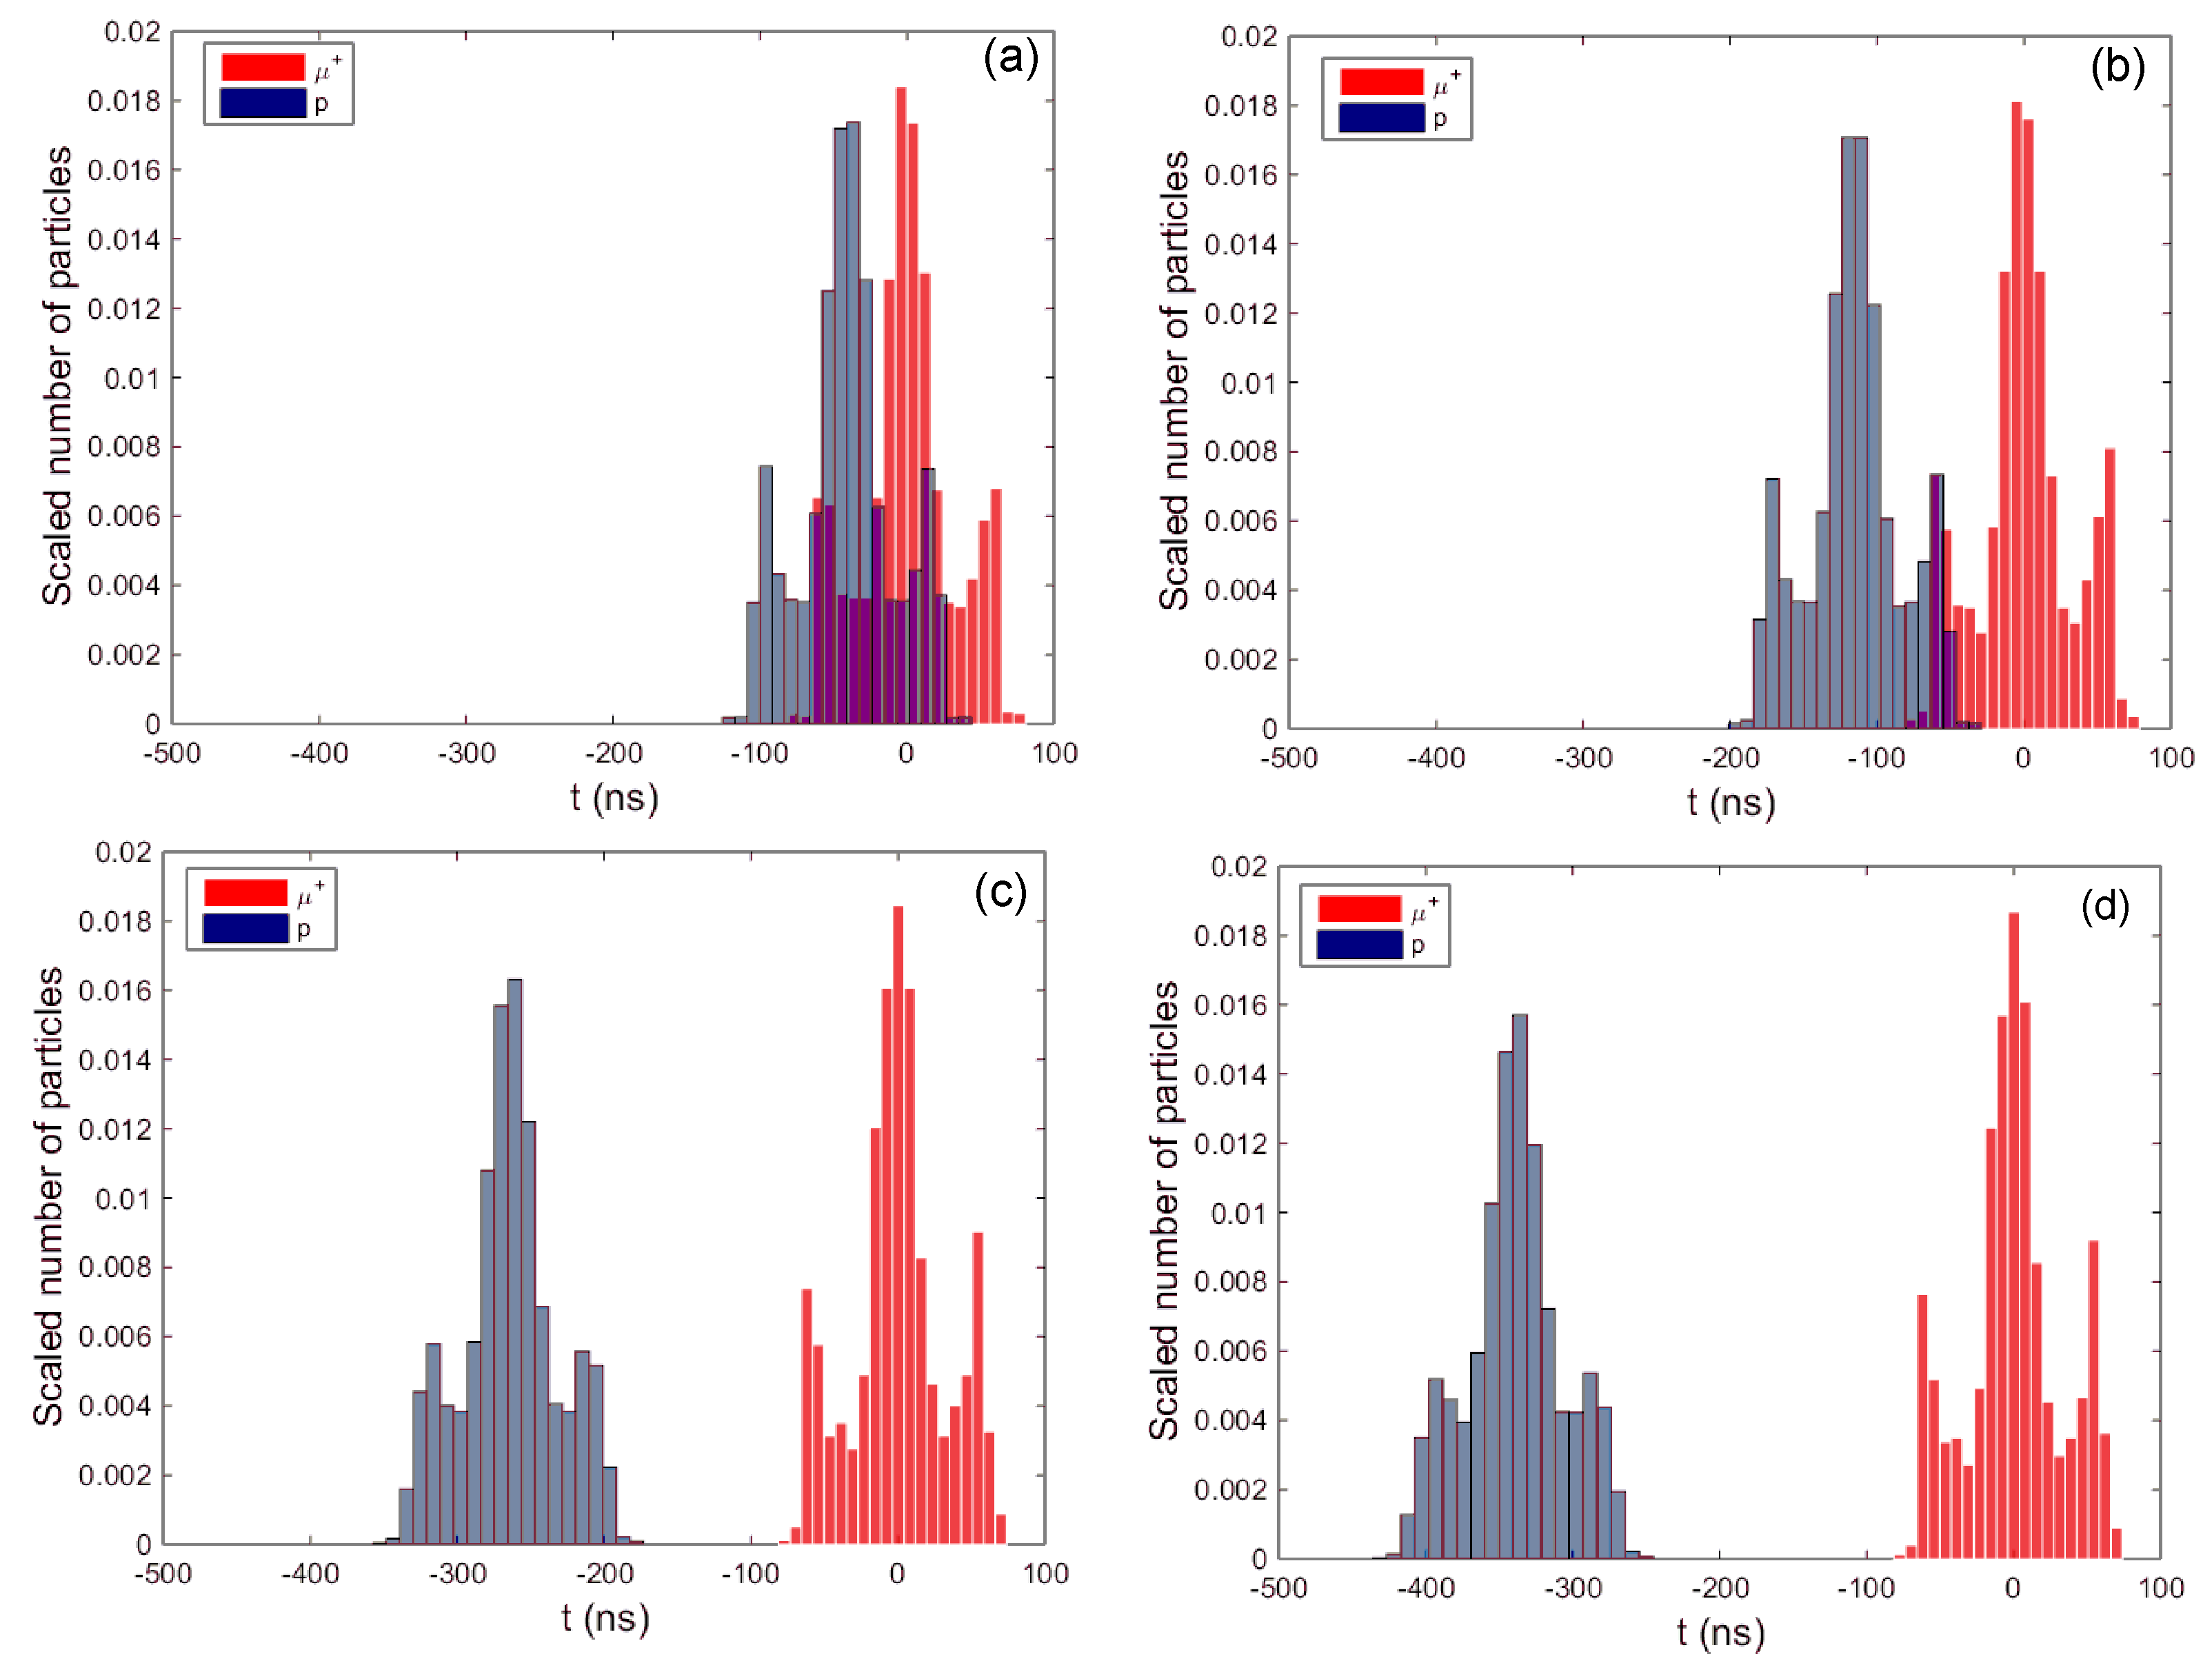
Separation of protons in the DR
Entrance to DR
Turn 1
Turn 3
Turn 4
210 ns

Slide 11
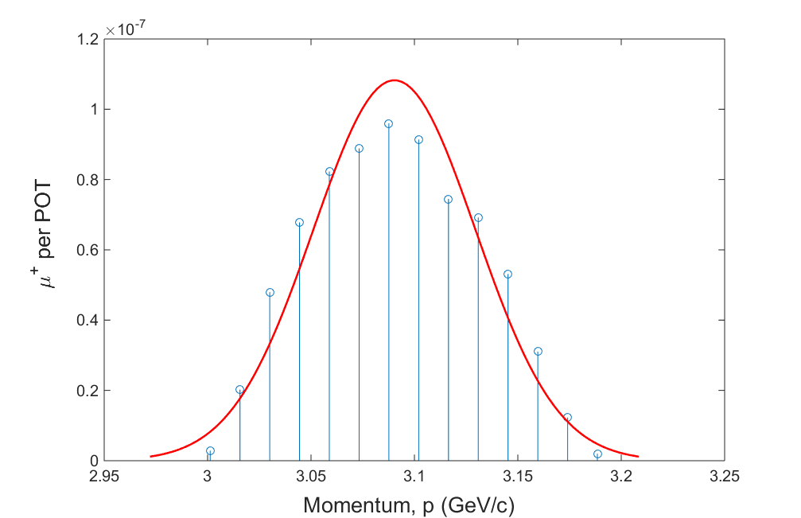
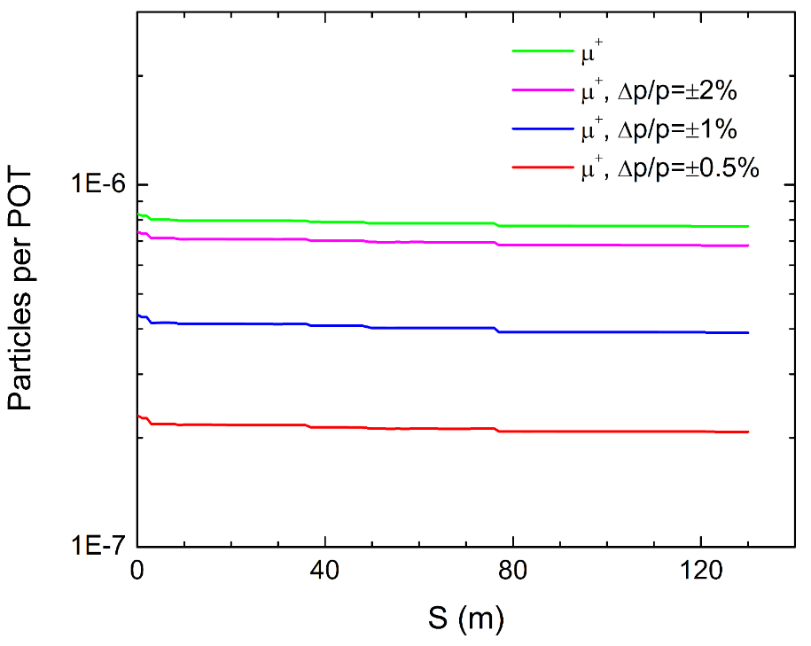
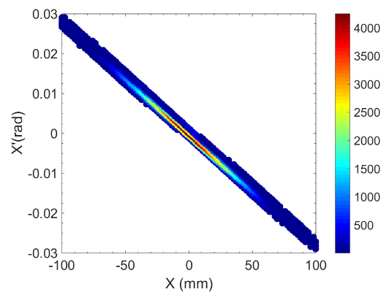
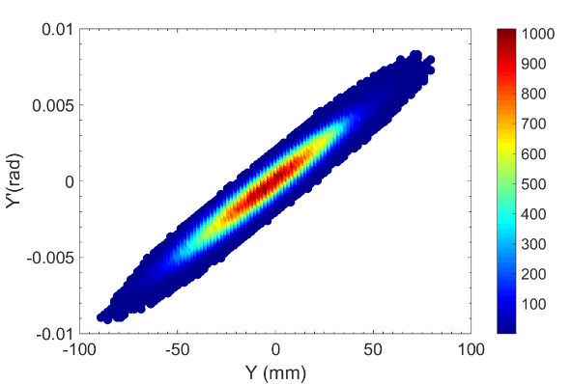
Performance within M4 & M5 lines
Beam at SR Entrance
SR entrance
Simulation predicts ~7x10⁵ muons per fill make it to the SR

Slide 12
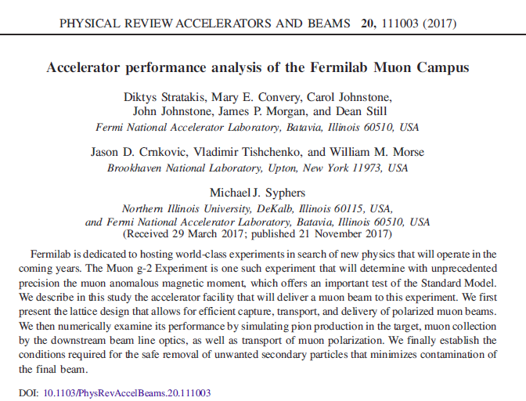
New Phys. Rev paper
Simulated rates have been published!

Slide 13
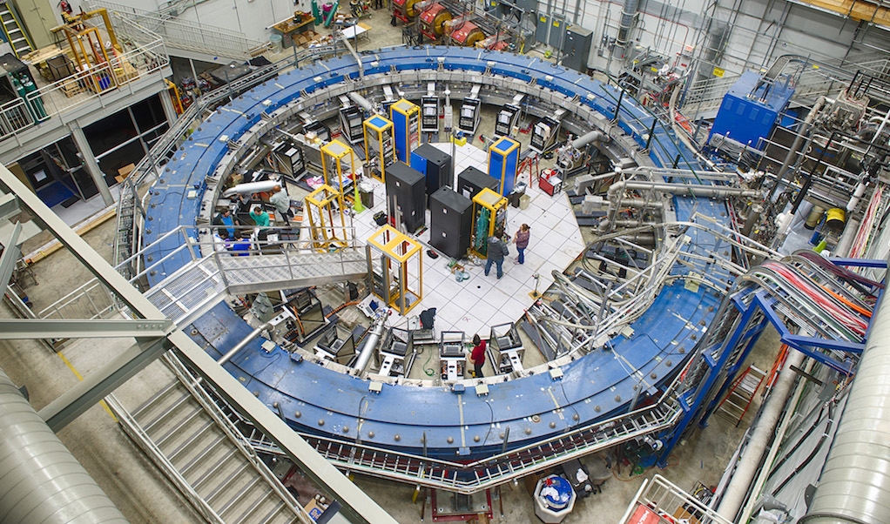
The g-2 storage ring
Beam physics is very complex and can lead to losses
  Beam is injected through a narrow aperture (inflector)
  Beta function mismatch
  Dispersion mismatch
  Momentum mismatch

Slide 14
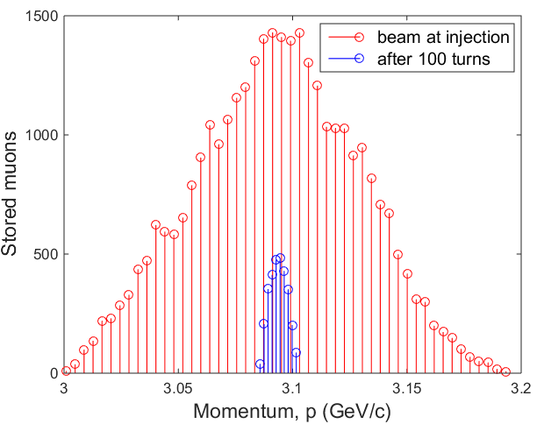
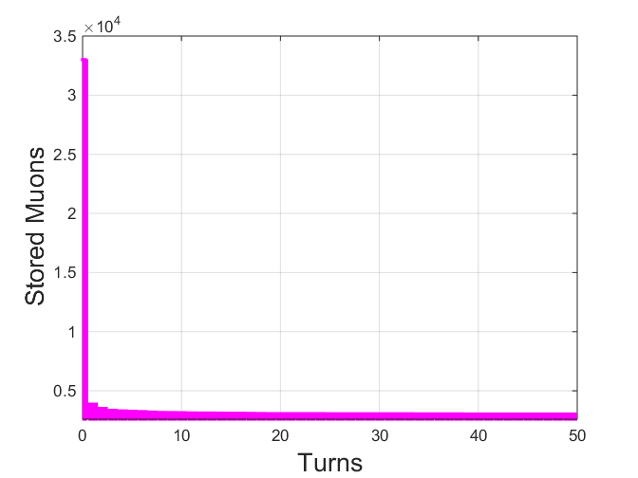
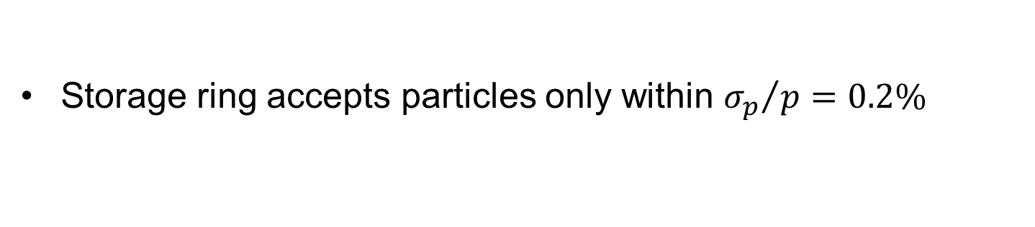
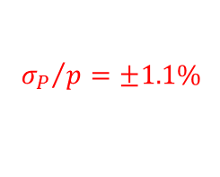
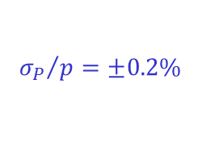
Momentum acceptance
$${σ_{P}}/{p=±1.1\%}$$
$${σ_{P}}/{p=±0.2\%}$$
Storage ring accepts particles only within ${σ_{p}}/{p=0.2\%}$

Slide 15
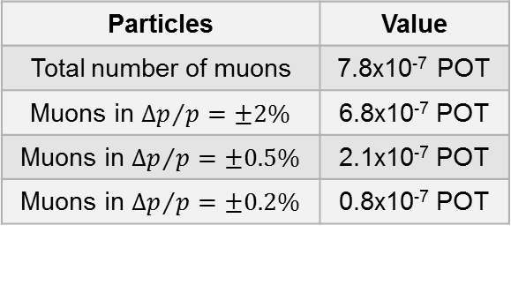
Delivered beam at the end of M5
Particles | Value
Total number of muons | 7.8x10⁻⁷ POT
Muons in ${∆p}/{p=±2\%}$ | 6.8x10⁻⁷ POT
Muons in ${∆p}/{p=±0.5\%}$ | 2.1x10⁻⁷ POT
Muons in ${∆p}/{p=±0.2\%}$ | 0.8x10⁻⁷ POT
At the end of M5, near 85-90% of the muon beam is outside the desired momentum acceptance
Unfortunately, there is no good way to control this

Slide 16
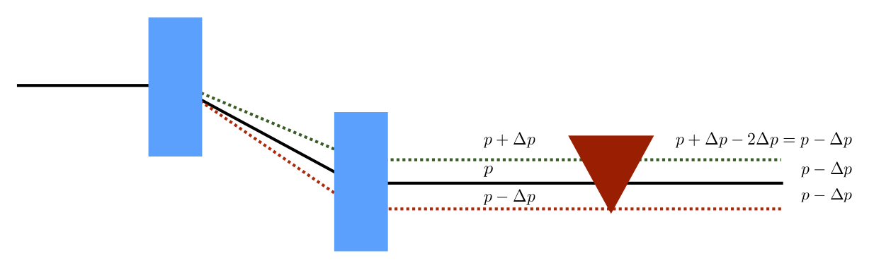
Solution: Cooling
Place a wedge material in a dispersive area in such a way that the high-energy particles traverse more material that the low energy ones.
The wedge creates a correlation between the amounts of energy loss within the wedge material with the energy of the individual particles when placed in a region of dispersion
As a result the net energy spread is reduced

Slide 17
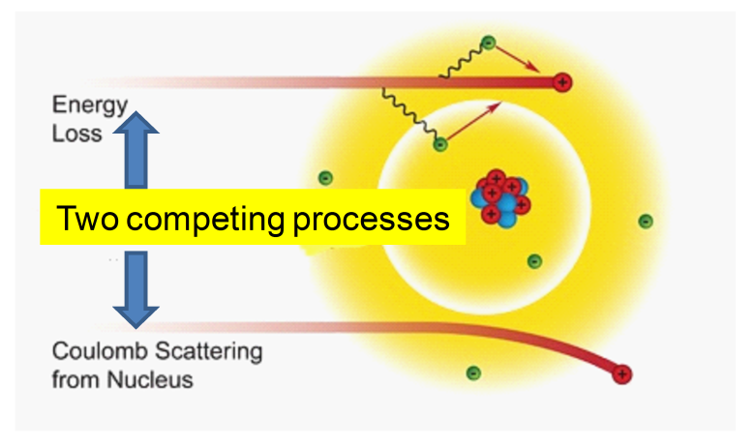
Cooling requirements
There are competing processes involved in ionization cooling
  Cooling from ionization of the material
  Heating from Coulomb scattering
We require a material with:
  Low atomic number Z to reduce scattering
We require a location with:
  High dispersion
  Low beta function...

Slide 18
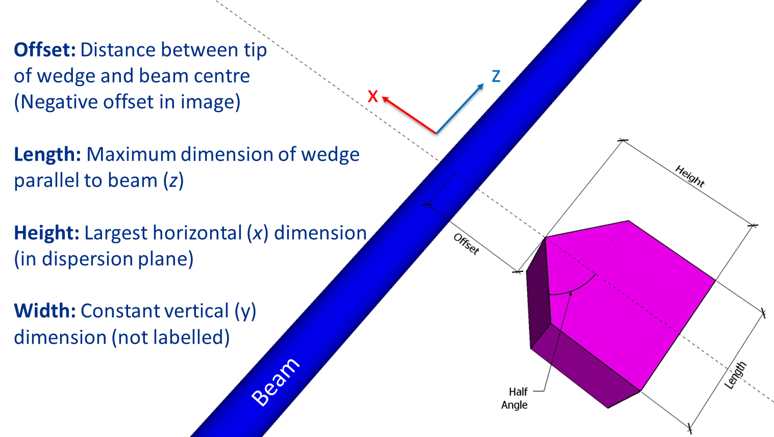
Wedge geometry is important
Optimized for different materials: polyethylene, beryllium, diamond, vanadium, lithium hydride, nickel,…

Slide 19
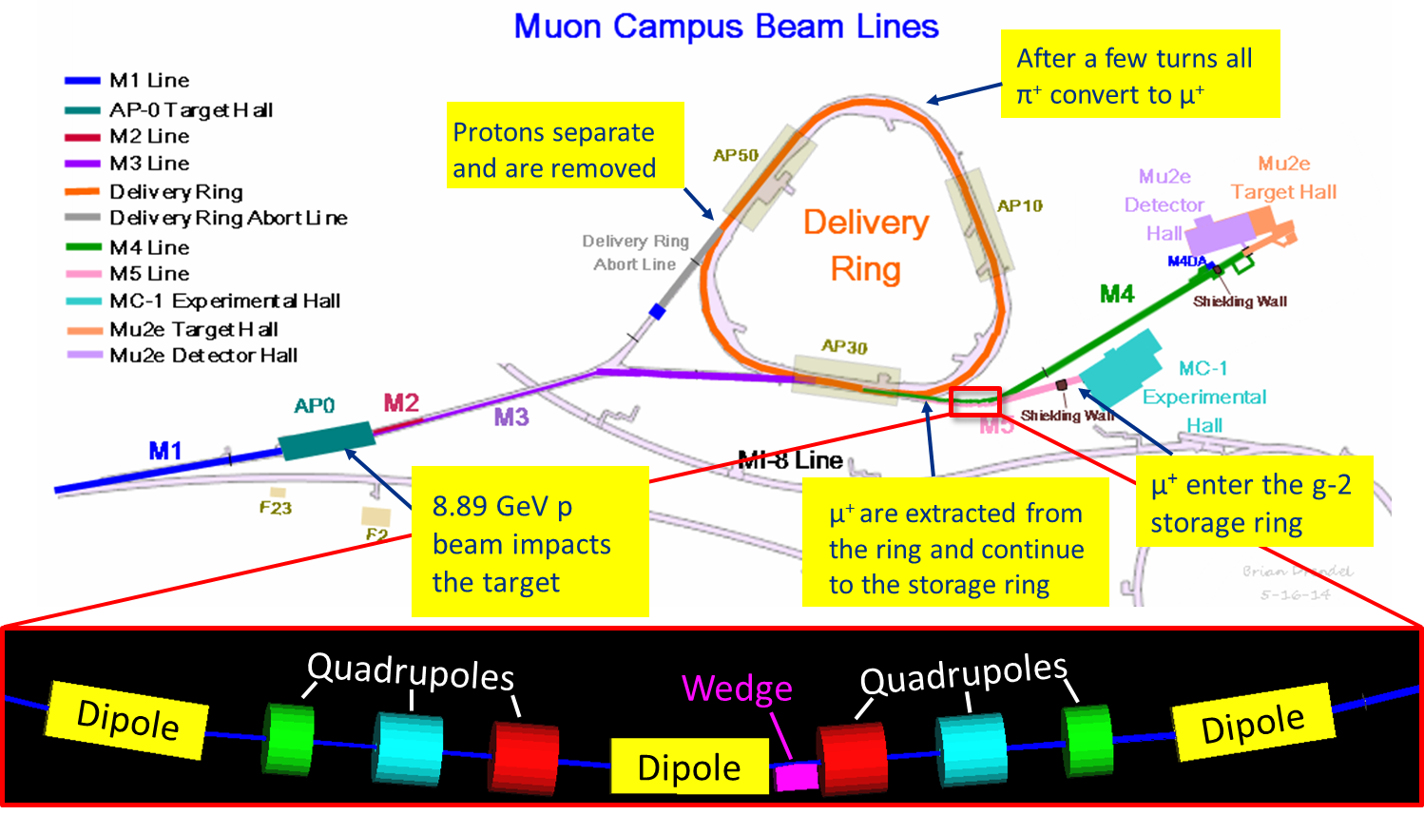
Location in the Muon Campus
Maximum allowed length = 150 mm

Slide 20
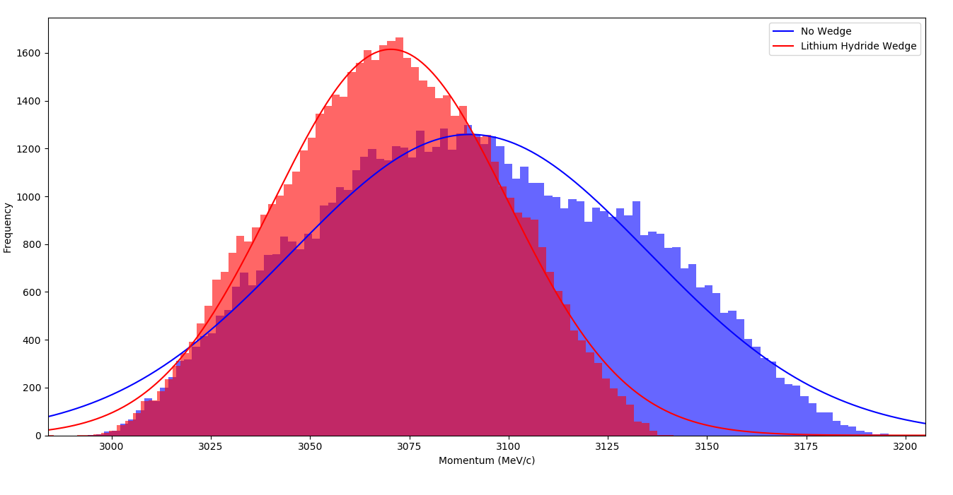
Effect in momentum

Slide 21
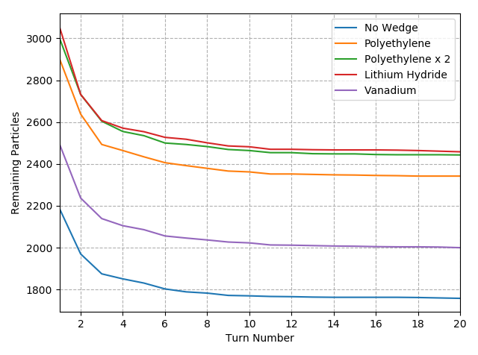
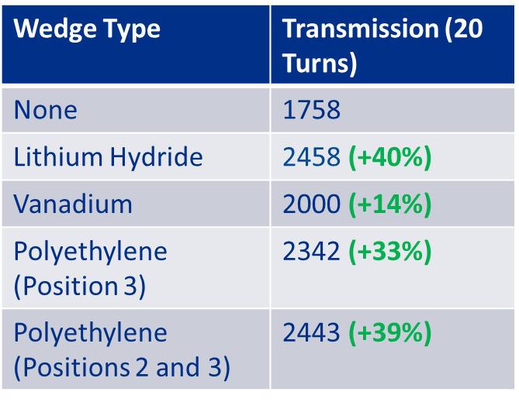
Stored muons
Preliminary simulations inside the Muon g-2 storage ring have been performed

Slide 22
Summary of main findings
Suitable location
  Last bend of the M5 which is 70 m upstream the SR
Material of choice
  Many attractive materials. Taking into account cost, availability and performance polyethylene is very promising
Performance
  Near ~30% gain on stored muons by installing two 150 mm long wedges
Polarization
  Polarization remains 96% as desired by g-2

Slide 23
LDRD proposal status
September 2017: Submitted LDRD preproposal
October 2017: Encouraged for submission of a full proposal
December 2017: Submitted the proposal…
The team:
  Diktys Stratakis (PI) & Mike Syphers (co-PI)
  Jim Morgan (Project manager)
  Jesse Batko (Mechanical Engineering)
  Dirk Hurd (Designer/Drafter)
  Dave Peterson (Electrical Engineering)
  Dan Vrbos (Lead Installation Tech.)
  Jim Budlong (Cable installation)
  Carol Johnstone + Grad. Student/ Postdoc (Beam optics)

Slide 24
Conclusions
Developed a end-to-end simulation model for the Muon Campus – first results published in Phys. Rev. AB
Muon campus can deliver ~700,000 μ⁺ per bunch at the entrance of the SR. 3% are stored eventually.
A LDRD proposal with the goal to design, install and commission an innovative wedge absorber system before injection into the Storage Ring has been submitted
It will provide improvements in the number of stored muons that are required to minimize the statistical uncertainty in the Muon g-2 measurement.
Devices are relatively inexpensive and straightforward to implement and thus the benefits to the Experiment potentially can be high for a fairly modest investment.

Slide 25
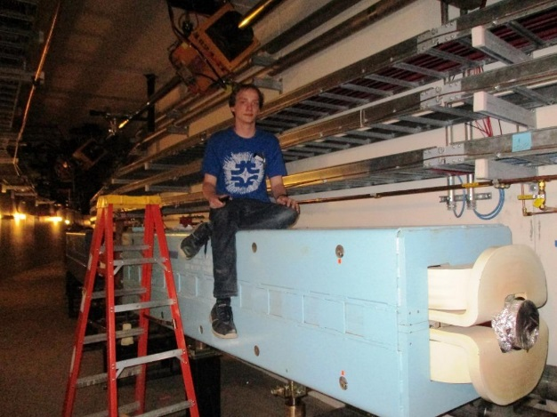
Acknowledgment
Joe Bradley from Univ. Edinburgh (Helen Edwards 2017 Intern)

Slide 26
Parameter sensitivity (polyethylene)

Slide 27
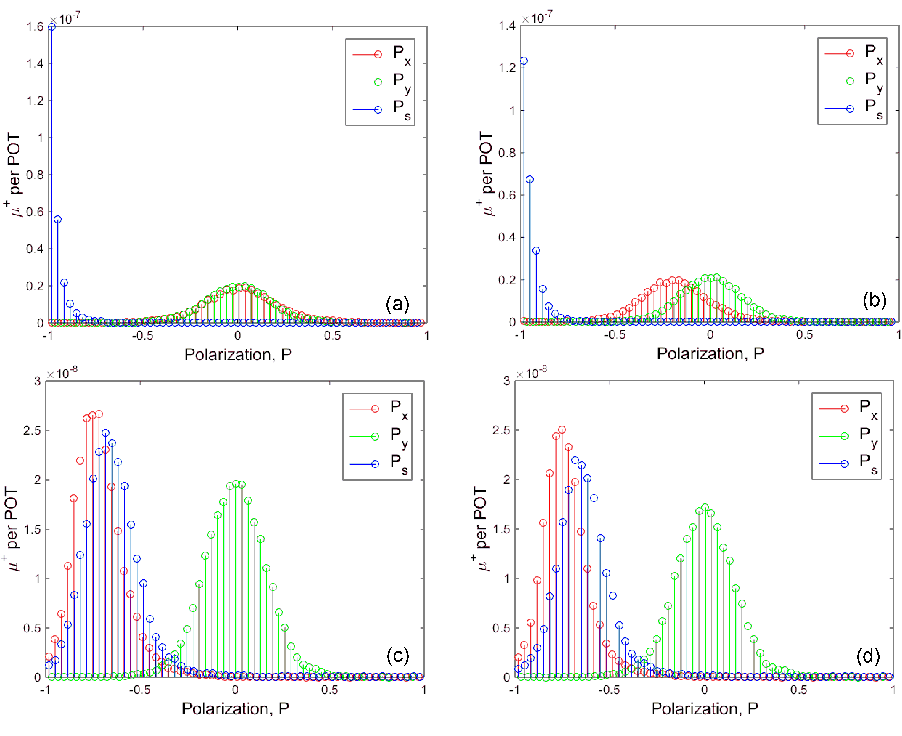
Beam polarization
Entrance to DR
Turn 1
Turn 4
Entrance to SR
<P>=96%

Slide 28
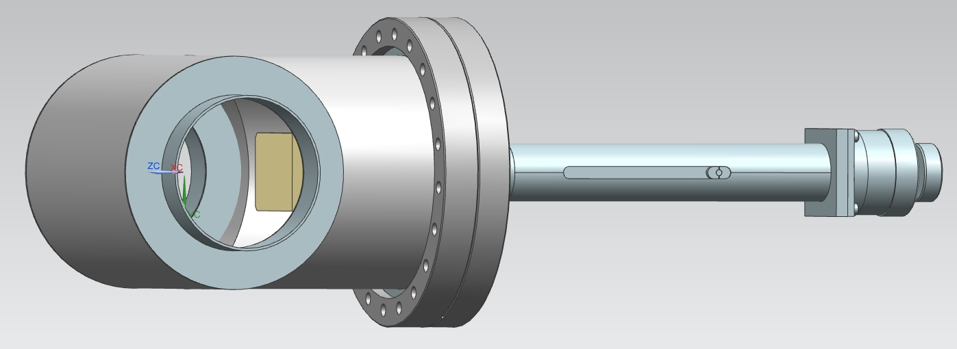
Design
Wedge vacuum assembly, with the vacuum pipe and wedge at left and insertion actuator at right.

