Slide 1
Enhancing LSST with WFIRST:
A few elements of a missing program
Saul Perlmutter
Cosmic Visions meeting
Berkeley Lab
November, 2017

Slide 2
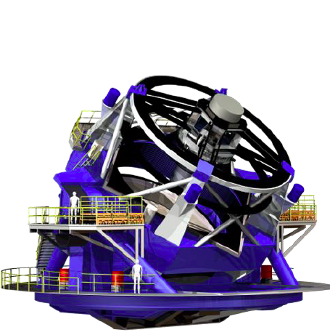
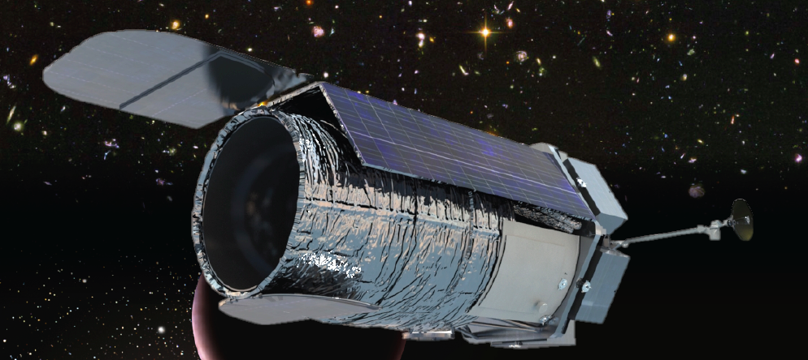
+

Slide 3
There is much to be gained if DOE can support a project effort that fills the gaps to make it possible to do the science that requires LSST + WFIRST:
  WFIRST IFC galaxy spectroscopy to calibrate the photo-z’s in parts of parameter space that are difficult/impossible from the ground (see previous discussion).
  WFIRST WFC galaxy NIR photometry to build photo-z’s, presumably by joint-pixel processing (see next discussion).
  LSST cadenced SN discovery that can be followed with WFIRST WFC + IFC to provide NIR imaging and spectrophotometry data unavailable from the ground (see last discussion tomorrow morning on scheduling synergy).
  WFIRST IFC SN spectrophotometry of ~2000 LSST SNe to train the photometry classifiers.
  WFIRST IFC and WFC triggered follow-up of particular LSST transients (see first discussions tomorrow morning).
All of these require much planning and design, then pipeline building, execution, reduction, and analysis. Currently, not either DOE or NASA ownership.

Slide 4
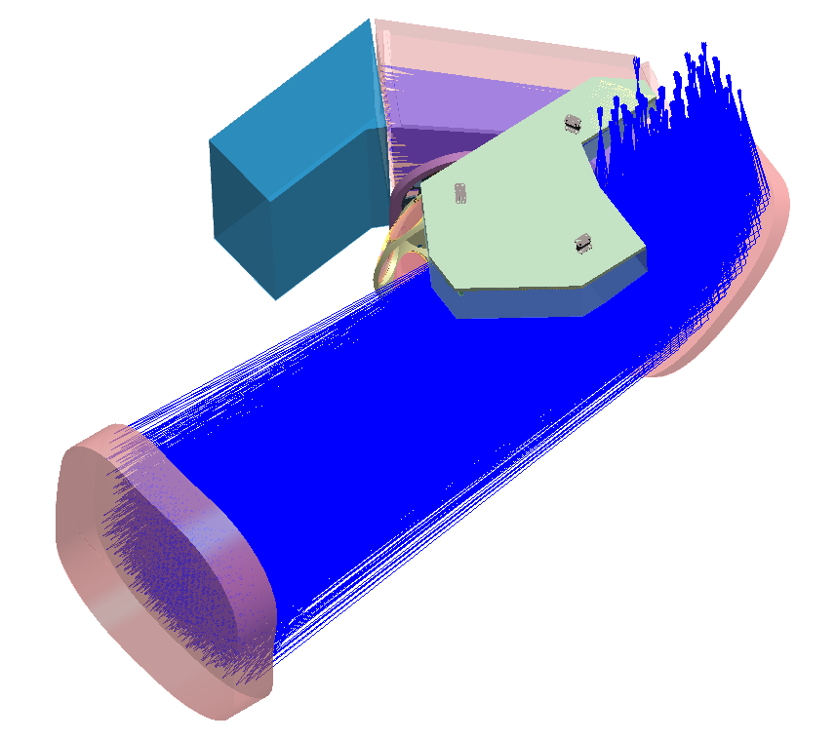

Slide 5
Use the 0.28 sq degree Wide Field Imager (with 0.11” pixels) to follow supernovae in NIR bands.
IFU

Slide 6
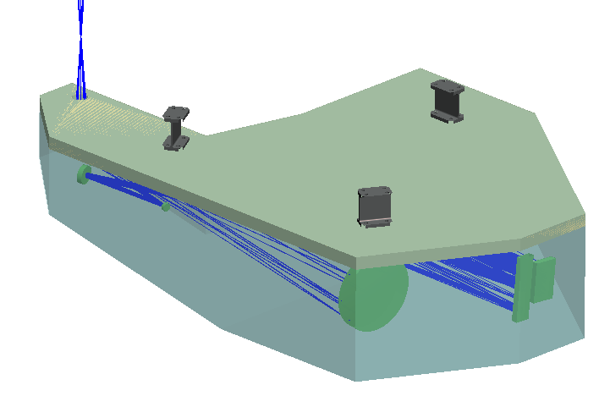
Small, compact assembly:
  ~ 6 to 7 kg
  30 x 50 x 12.5 cm
IFU
IFU Bench, including Relay, Slicer and Detector

Slide 7


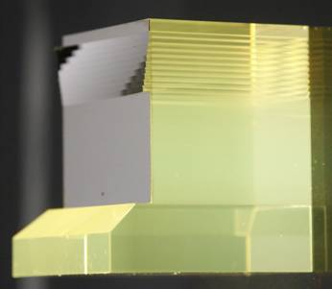
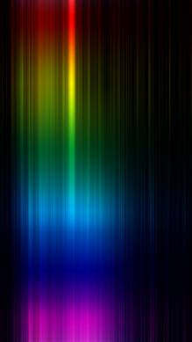
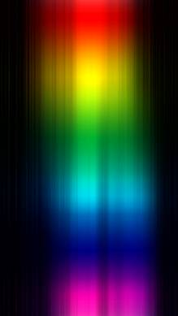
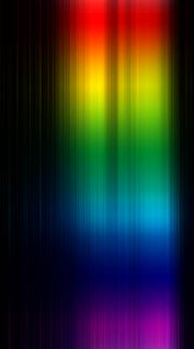
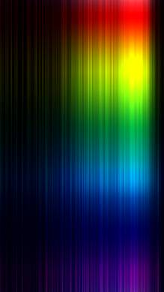
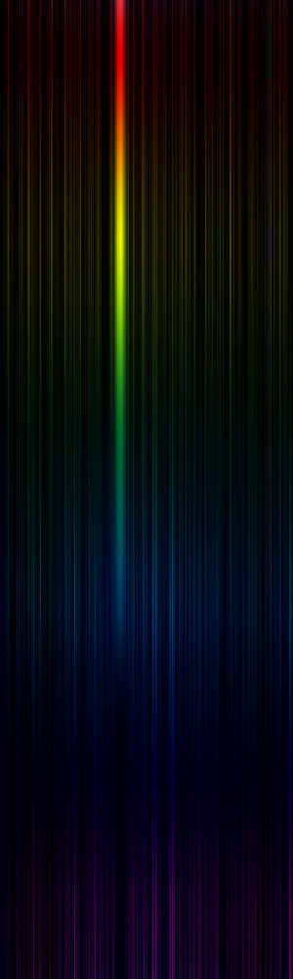
Integral Field Spectroscopy Concept
SN
Telescope Focal Plane
Slicer
Mirror
Array
Telescope
  Baseline:
  3" x 3" with 0.15” slits
  0.05” pixels
  0.42 – 2.0 μm wavelengths
  R = ~ 75—100
Row of Pupil Mirrors
Row of Slit Mirrors
λ

Slide 8
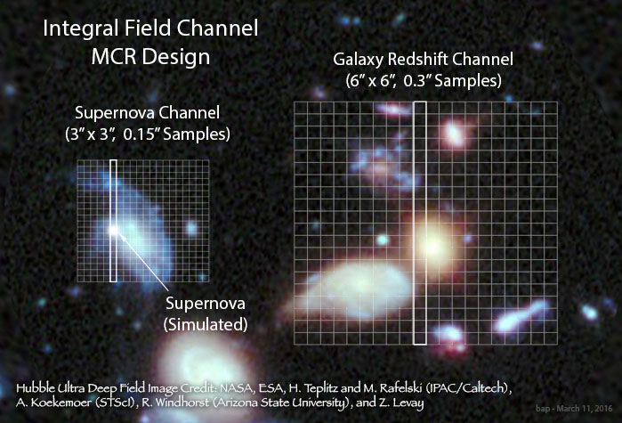

Slide 9
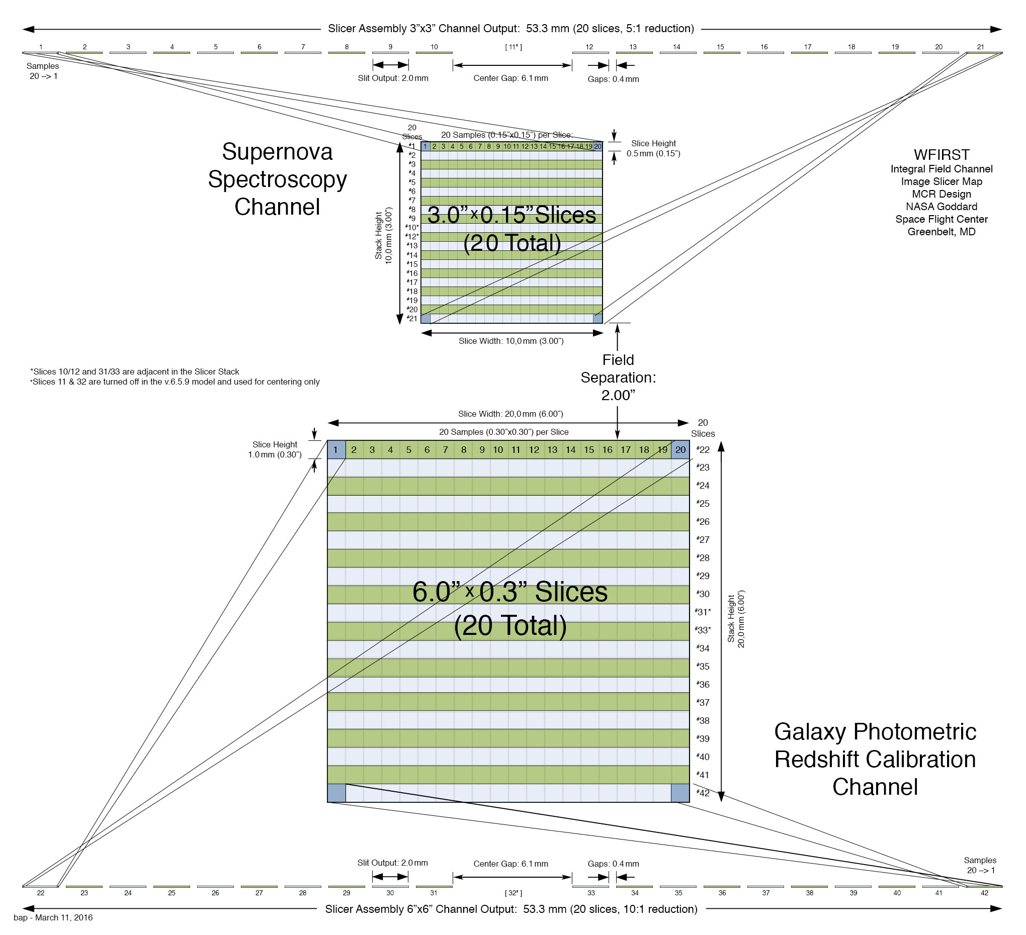

Slide 10
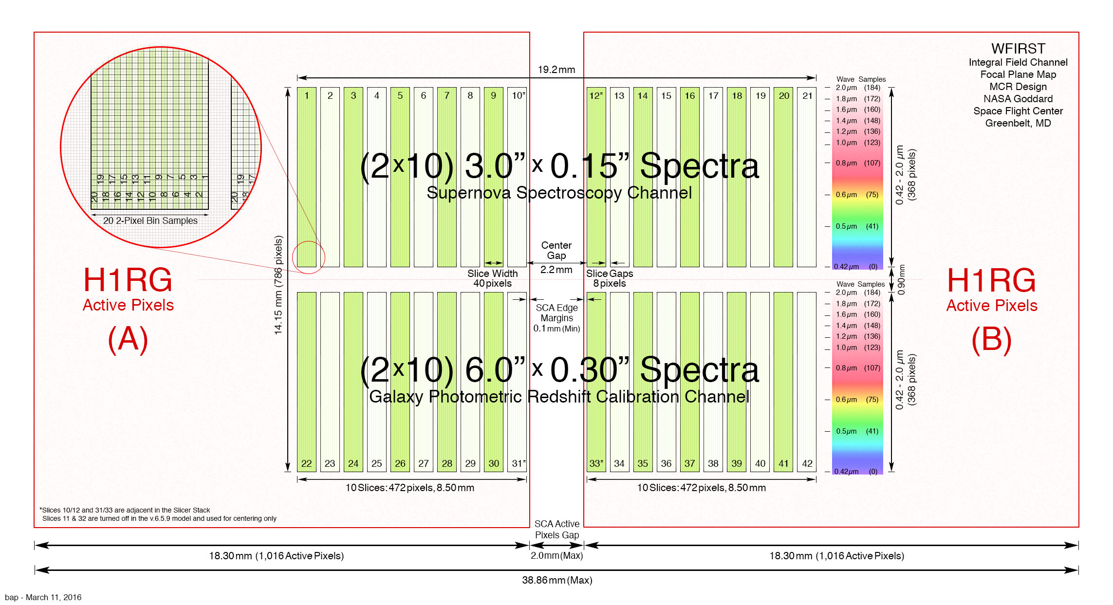
0.05” pixels
4
4
0.1” pixels

Slide 11
Where the spot distance of and on the FPA surface is n pixel (pixel size 10um).

Slide 12
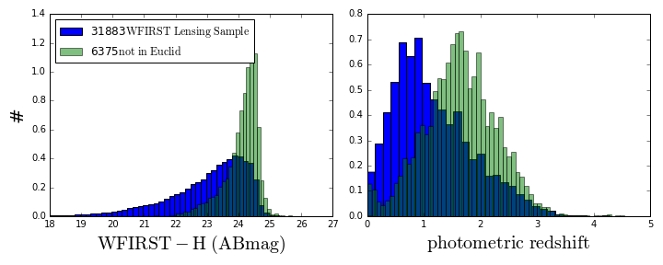
Comparison of WFIRST and Euclid lensing sample
Analysis based on CANDELS (HST) catalog
  Converted to LSST + WFIRST colors
  Nominal WFIRST shape cut
  31,883 total sources
Full WFIRST lensing sample in blue+green, WFIRST faint sample (missed in Euclid sample) in green
Here the “Euclid sample” is defined to be RIZ<25
  0.5 mag deeper than nominal Euclid
  Depth being targeted for C3R2 spectroscopy
WFIRST faint sample (6375 sources, ~20% of total) has higher mean redshift than full WFIRST lensing sample
  Not a surprise
Overall redshift range is similar
Euclid and WFIRST
WFIRST only
Dore, Capak, Hematti, and Masters
Notes:
Sum is the total WFIRST sample

Slide 13
Comparison of WFIRST and Euclid lensing sample
Significant number of galaxies not in the Euclid Sample
  20% of WFIRST sample have RIZ>25
These will be hard to get spectra for from the ground
What fraction don’t have colors in the C3R2 sample?
  Complete Calibration of the Color-Redshift Relation (C3R2, P. Capak and D. Stern, et al.), aims at taking spectra of ~10k galaxies to calibrate photo-z using the Keck, and also Magellan, VLT and the GCT.
  Al collected ~5k spectra and will last about 1.5 more year.
Dore, Capak, Hematti, and Masters
Notes:
C3R2 10,000 galaxies in combination of cosmos, sxds, cdfs, goods north.
Right now it is 40-50 nights of KECK
A primary objective of both WFIRST and Euclid is to provide a 3D map of the distribution of matter across a significant fraction of the universe from the weak lensing shear field, but to do so requires robust distances to billions of galaxies. I will report on a multi-semester program, expected to total approximately 40 nights with Keck over the next two years. This program, supporting both the NASA PCOS and COR science goals, will obtain the necessary galaxy spectroscopy to calibrate the color-redshift relation for the Euclid mission, and make significant progress towards the WFIRST requirements. The program, called C3R2 or Complete Calibration of the Color-Redshift Relation, already encompasses 10 allocated nights of NASA Keck Key Strategic Mission Support (PI D. Stern), 12 allocated nights from Caltech (PI J. Cohen), 3 allocated nights from the University of Hawaii (PI D. Sanders), and 1.5 allocated nights from UC-Riverside (PI B. Mobasher). We are also pursuing opportunities at additional 8- to 10-meter class telescopes, including Magellan, VLT and GCT. I will present the motivation for this program, the plans, and current results.

Slide 14
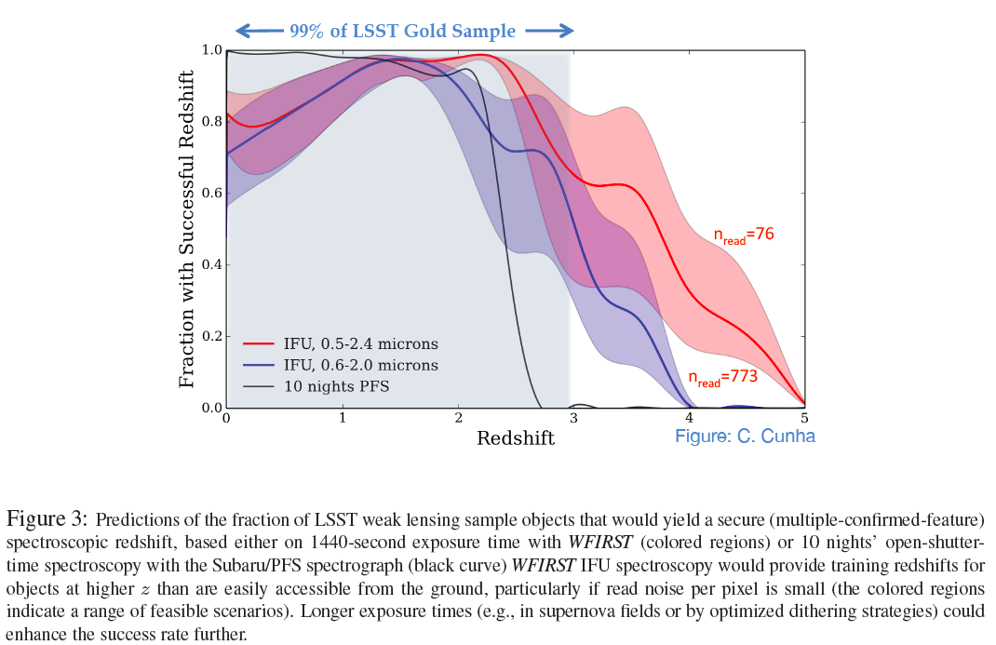
LSST-WFIRST photo-z calibration
WFIRST SDT Report

Slide 15
LSST’s SN program
starts out photometry-based

Slide 16
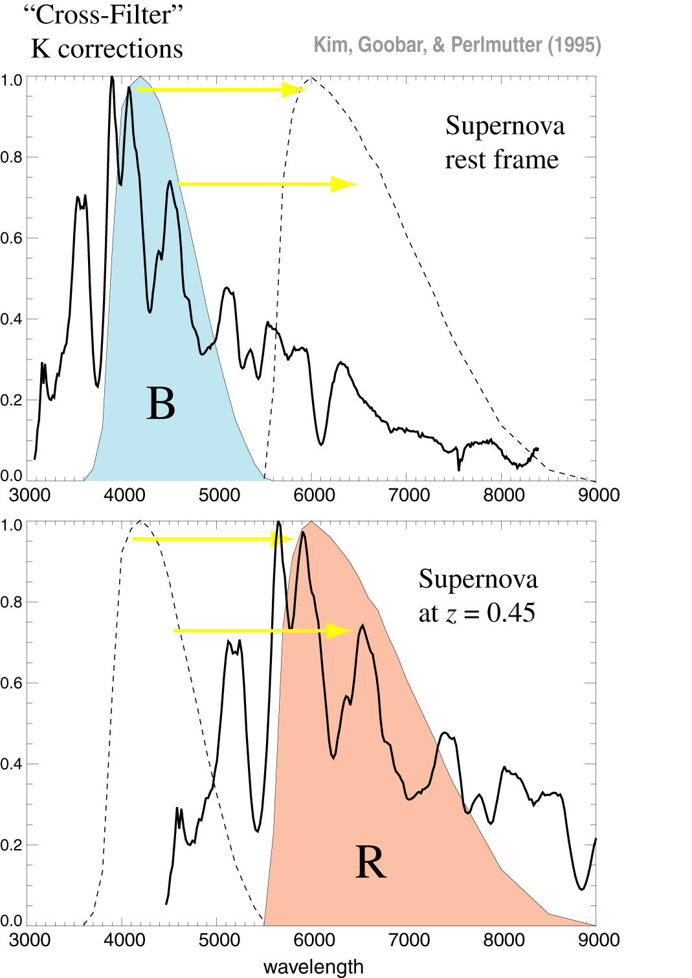
Filters: K-corrections
But when the filters don’t match perfectly across redshift, this approach is accurate only to the extent that the spectral template family captures the distribution of SN Ia behavior – at both low and high redshift.

Slide 17
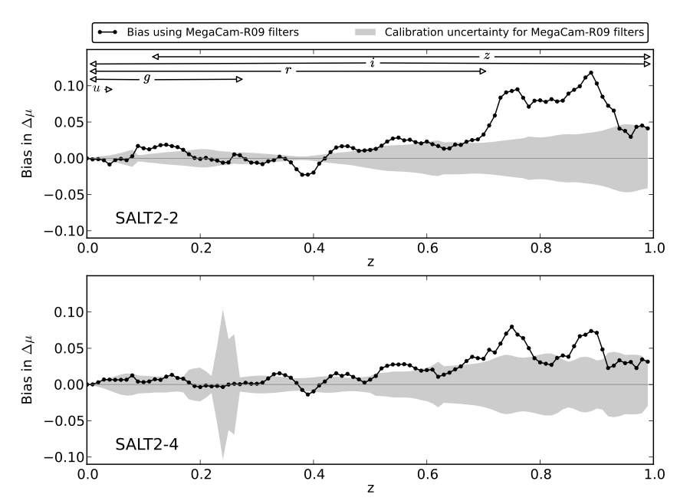
Average K-correction bias
from a single-parameter spectral time series
Implied bias on current estimates of w is 0.03. This compares with overall error of 0.06
Bias on w in the range 0.03 – 0.06 if there is population drift, even if full spectral diversity is sampled with nearby SNe
Saunders+ (ApJ 2015)
Nearby SN Factory
Notes:
Let’s start with something mundane

Slide 18
Dust Systematic: Spectral indicator distinguishes
dust reddening from intrinsic SN color
SN broadband dust law
Expected dust law
Expected dust law
more dimming due to dust
After removing 1st and 2nd components
of spectral variation
Expected dust law
bluer
redder
bluer
redder
Chotard et al 2011 (SNfactory)

Slide 19
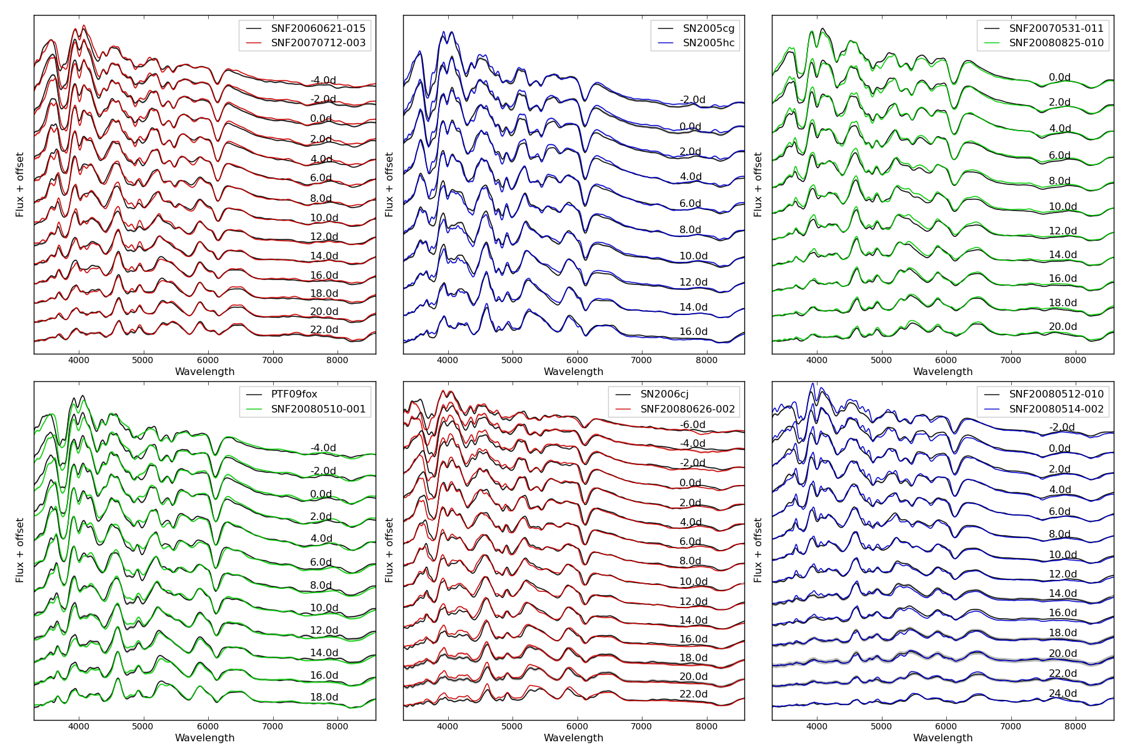
Twins study from SN Factory spectral time-series
Fakhouri, Boone+ ApJ 2015
Notes:
A bliinded analysis! Last week, we removed the blind. Result…

Slide 20
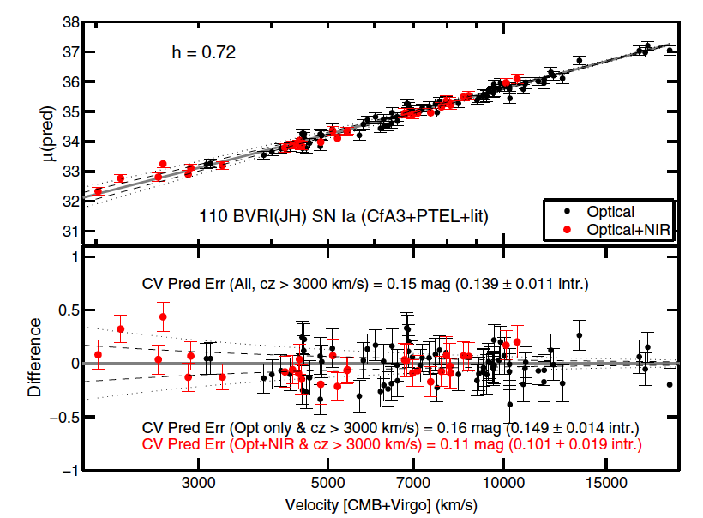
NIR Standardization
A route to better
standardization:
Add J and H band.
(J band is not as big
an improvement as H band.)
WFIRST can
obtain H band out to
z = 0.12 (with 2 micron cutoff) or z = 0.35 with (2.5 micron cutoff).
Mandel et al (2011)

Slide 21
Twin SNe
Nearby SN Factory
Fakhouri, Boone, et al.
(ApJ, 2015)
0.20
0.15
SALT
RMS
Δmag
for SN pairs in the %-ile bin
NB: Blind analysis
methods used.
0.10
Well-matched bin’s σ(d_{L}) ~ 4%
0.05
Well-matched
Twins
Not Twins
0.00
0
25
50
75
100
“Twinness ranking” %-ile (binned)

Slide 22
LSST’s SN program
starts out photometry-based

Slide 23
+

Slide 24
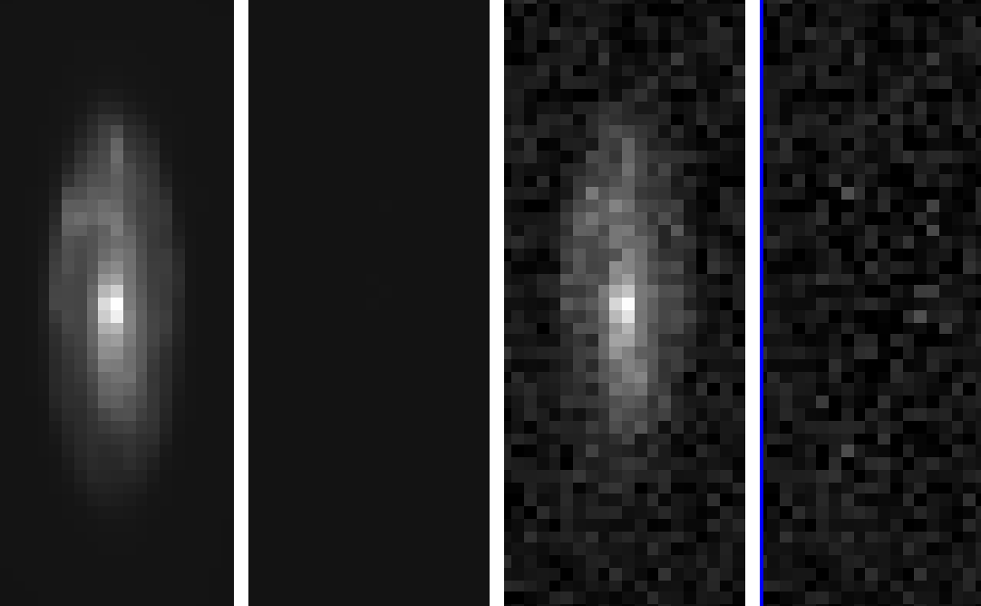
SN photometry uncertainty from IFC while subtracting host gal. light.
David Rubin
noise-free data: 0.8µm
noise-free residual
data with noise
residual
RMS: 0.3%!
(single wavelength shown for clarity)
The final noise is dominated by sky and read noise, not subtraction error

Slide 25
WFIRST Spectrophotometry
Two epochs near maximum with increasing S/N.
Reference epoch(s) after SN has faded.

Slide 26
Twins study from SN Factory spectral time-series
Fakhouri, Boone+ ApJ 2015
Notes:
A bliinded analysis! Last week, we removed the blind. Result…

Slide 27
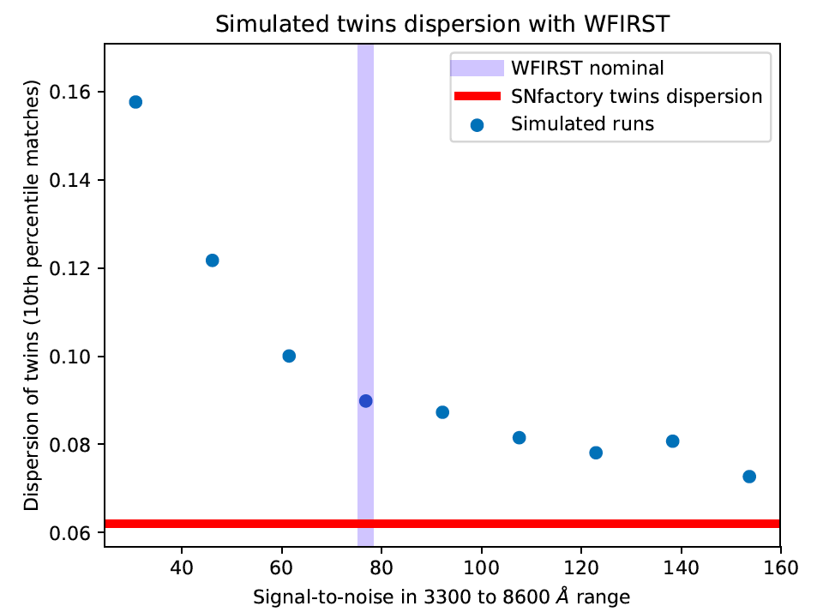
Spectral feature measurements and twinning using IFC, as fn. of S/N.
Kyle Boone

Slide 28
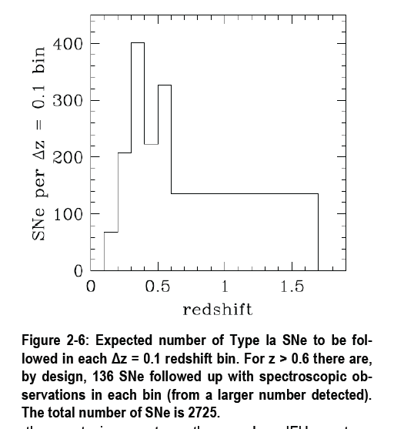
LSST
discoveries
WFIRST discoveries

Slide 29
Redshift Precision
(from SN alone, before using host-galaxy)
(using > 3300A restframe)

Slide 30
This is a mutual LSST-WFIRST win-win:
Current SN program concepts with and without LSST discoveries at z < 0.8.
Program Concept | Number of SNe |  |  | FoM (±~10)
z = | 0.1--0.4 | 0.4--0.8 | 0.8--1.7 | Without Rv drift syst. | With the systematics
2-band WFIRST imaging discovery and lightcurves. Spectrophotometric time series. | 420 | 912 | 606 | 350 | 300
LSST & WFIRST imaging discovery and lightcurves. Spectrophotometric time series. | 591 | 1,712 | 909 | 460 | 360
Note: These numbers are based on full simulations with more optimal exposure time/redshift distributions, correlation-accounted systematics, host-galaxy light, and vetted ETCs, not the straw-man SDT notional program.

Slide 31
This is a mutual LSST-WFIRST win-win:
Current SN program concepts with and without LSST discoveries at z < 0.8.
Program Concept | Number of SNe |  |  | FoM (±~10)
z = | 0.1--0.4 | 0.4--0.8 | 0.8--1.7 | Without Rv drift syst. | With the systematics
2-band WFIRST imaging discovery and lightcurves. Spectrophotometric time series. | 420 | 912 | 606 | 350 | 300
LSST discovery and lightcurves. WFIRST spectrophotometric time series. | 2,239 | 6,101 | 0 | 375 | 210
LSST & WFIRST imaging discovery and lightcurves. Spectrophotometric time series. | 591 | 1,712 | 909 | 460 | 360

Slide 32
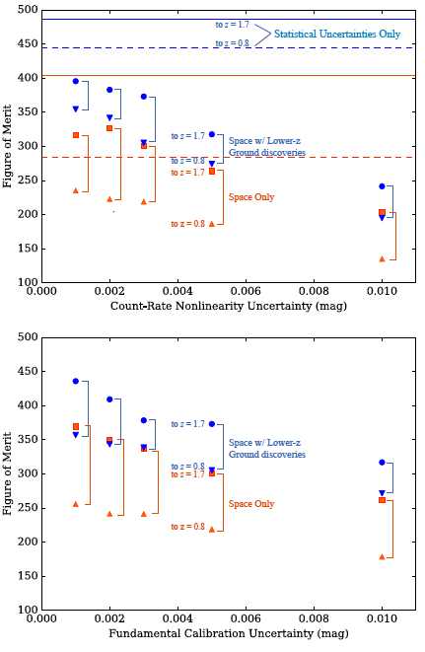
David Rubin
Notes:
0.2% shift parameter
hierarchy doesn’t change with preliminary BAO

Slide 33
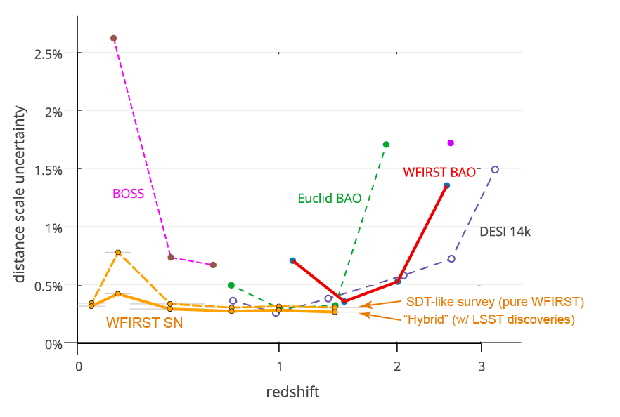
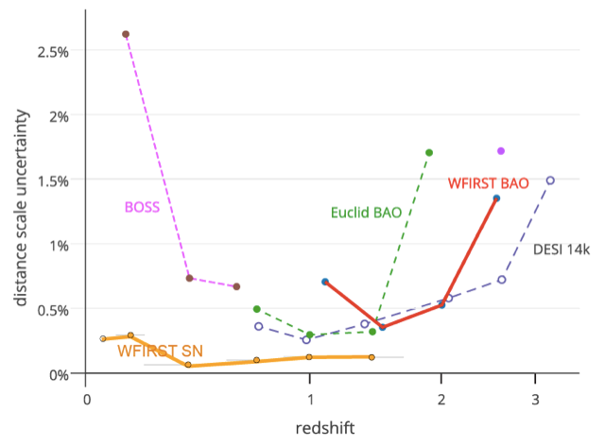
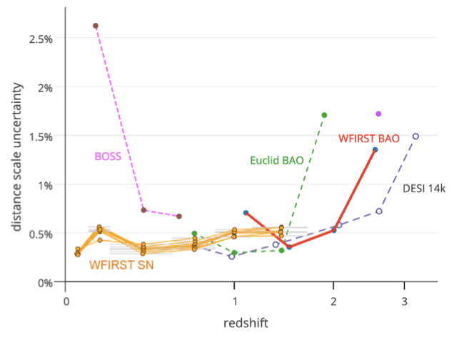
Statistical Uncertainties Only
Notes:
0.2% shift parameter
hierarchy doesn’t change with preliminary BAO

Slide 34
There is much to be gained if DOE can support a project effort that fills the gaps to make it possible to do the science that requires LSST + WFIRST:
  WFIRST IFC galaxy spectroscopy to calibrate the photo-z’s in parts of parameter space that are difficult/impossible from the ground (see previous discussion).
  WFIRST WFC galaxy NIR photometry to build photo-z’s, presumably by joint-pixel processing (see next discussion).
  LSST cadenced SN discovery that can be followed with WFIRST WFC + IFC to provide NIR imaging and spectrophotometry data unavailable from the ground (see last discussion tomorrow morning on scheduling synergy).
  WFIRST IFC SN spectrophotometry of ~2000 LSST SNe to train the photometry classifiers.
  WFIRST IFC and WFC triggered follow-up of particular LSST transients (see first discussions tomorrow morning).
All of these require much planning and design, then pipeline building, execution, reduction, and analysis. Currently, not either DOE or NASA ownership.

Slide 35
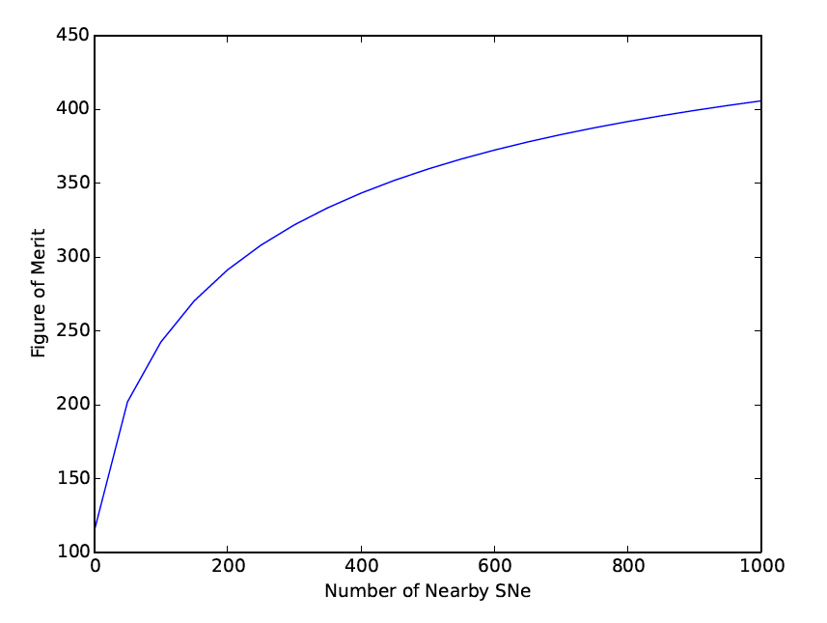
Distance measurements improve as the number of nearby (z < 0.1) SNe is made comparable to the number of distant SNe
Projected WFIRST FoM as a function of number of low-z SNe Ia
Gains to be made with
further low-redshift SN work.
Nearby
SN
Factory

