Slide 1
Astrophysics and Dark Energy with Large-Aperture, Wide-Field Spectroscopy
Adam S. Bolton, NOAO
2017 November 14

Slide 2
Survey Spectroscopy Maximizes LSST
Common cause between astronomy and cosmology
A large-aperture (8-10m), wide-field ( ≳ degree²), multiplexed (many 1000’s) spectroscopic telescope in the southern hemisphere is the highest “unsolved” priority for maximizing the astronomy and astrophysics science return on the investment in LSST.
Co-evolution of dark matter, galaxies, and black holes
Structure of the Milky Way and its dwarf satellites
Physics of stellar variability
This same class of facility would maximize the cosmological science reach of LSST
This presents a clear opportunity for inter-agency and international collaboration

Slide 3
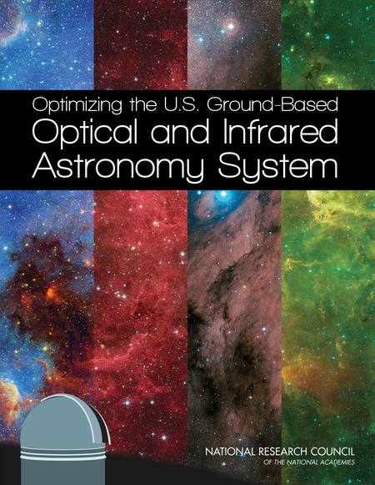
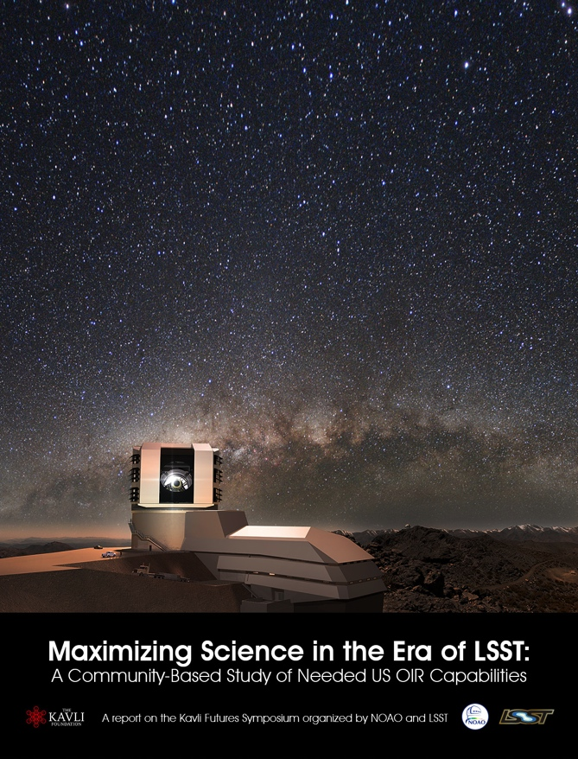
Wide-Field MOS = High Priority
Confirmed and detailed by recent reports
OIR System Report (Elmegreen et al.)
http://sites.nationalacademies.org/bpa/bpa_087934
Recommendation: The National Science Foundation should support the development of a wide-field, highly multiplexed spectroscopic capability on a medium- or large-aperture telescope in the Southern Hemisphere to enable a wide variety of science…
Maximizing Science (Najita & Willman et al.)
https://arxiv.org/abs/1610.01661
Recommendation: Develop or obtain access to a highly multiplexed, wide-field optical multi-object spectroscopic capability on an 8m-class telescope, preferably in the Southern Hemisphere.

Slide 4
Major astrophysics science drivers
Numbers approximate, from Maximizing Science Report
Environment-dependent galaxy evolution from a survey of ~100,000 galaxies to z = 2 in LSST deep-drilling fields
Requires ~ 2,000 hours on a Subaru/PFS-like facility
Stellar populations, kinematics, and dark matter in the Milky Way and local dwarf galaxies
Requires ~10,000 hours on a Subaru/PFS-like facility
Characterization of stellar parameters for studies of variability, rotation, and magnetism in field and clusters
Requires ~ 4,000 hours on a Subaru/PFS-like facility
Also: targeting LSST transients on spare fibers during other surveys; supplementing supernova cosmology by obtaining redshifts for past photometric SN hosts
(slide adapted from J. Newman)

Slide 5
Basic Parameters
From science cases in Maximizing Science Report
8m-class aperture
(3-5m maybe ok with large allocations for some science)
R ~ 5,000 in red; R ~ 2,500 in blue
(R ~ 20,000 – 100,000 desired for stellar chemistry)
0.37 to 1 micron wavelength coverage required
(0.35 to 1.3-1.5 desired for extragalactic science)
> 1 degree diameter FOV
(20 arcmin FOV minimum)
Multiplexing of ~ 2,500 – 5,000
Southern hemisphere location
(Northern maybe ok for some science)
Community access

Slide 6
Sustained Interest in the NSF Sphere
Significant conceptual and detailed design heritage
ca. 1999
ca. 2003
ca. 2008
ca. 2011
ca. now!

Slide 7
Implementation paths
As currently identified
DESI-2 in North
DESI or DESI-like instrument in south
Obtaining US community access to Subaru-PSF
Maunakea Spectroscopic Explorer
Partnership with ESO in South
Southern Spectroscopic Survey Instrument (SSSI)
Potential NSF+DOE interagency collaboration, following history of BOSS, DES, DESI, LSST
Some combination or superposition of more than one of the above

Slide 8
Astro 2020 Decadal Survey
(Timeline may have changed since this slide was made)
2018 March: Astro 2020 proposal submitted to Agencies
2018 December: Chair nominated
2019 January: AAS Town Hall
2019 Feb/March: Committee begins meeting
2019 May/June: Panels begin meeting
2020 May: Panels complete reports and deliver to Committee
2020 August: Review of survey and panel reports begins
2020 December: Astro 2020 completed and report released to Agencies and public

Slide 9
Decadal Survey Planning
NOAO activities to coordinate community input
2020 Decadal Survey planning website
www.noao.edu/2020Decadal
Community planning meeting
20-21 February 2018, (ex-)Marriott, Tucson, AZ
Analogous to CVDE for OIR astronomy community
SnowPAC 2018 (Big Questions, Big Surveys, Big Data)
http://www.physics.utah.edu/snowpac
11-16 March 2018, Snowbird Resort, UT
Joint sponsorship by NOAO and U. of Utah
Build on previous work to develop coordinated cosmology and astrophysics cases and concepts for input to Astro 2020 and P5 processes

Slide 10
Questions / Discussion

