Slide 1

MSE additional points (Wednesday)
Fiber positioners use spines: AAO Sphinx technology (updated Echidna positioners; Echidna used for 7 yrs on Subaru/FMOS, and in final design for 4MOST)
FRD testing: Zhang, Zheng & Saunders 2016 SPIE
Calibrations taken in same positions as science fields
Pitch is 7.77 mm. A pitch of 5 mm has been stated as possible, which would increase fiber number by 2.4x
A 4x increase in fiber number (to ~17,000) is probably the most allowed by prime focus space constraints
MSE designed for science requirements to be met at zenith distances <50 degrees (e.g., DEC=-30), and observations possible to ZD=60 (DEC=-40) at least.

Slide 2
Approx. budget breakdown
for $300M cost cap
(e.g., 6 partners
@ $50M each)
Approx. ratios 4:2:1:1 Instruments : Telescope : Enclosure : Other

Slide 3
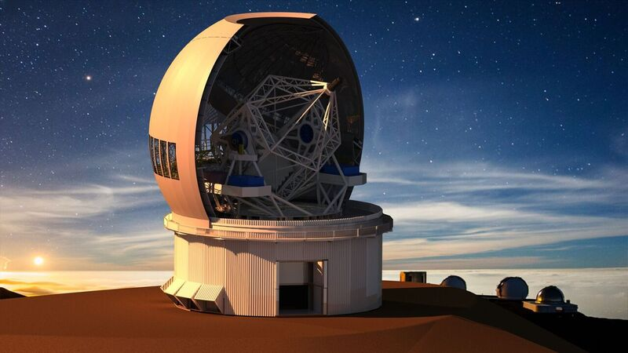
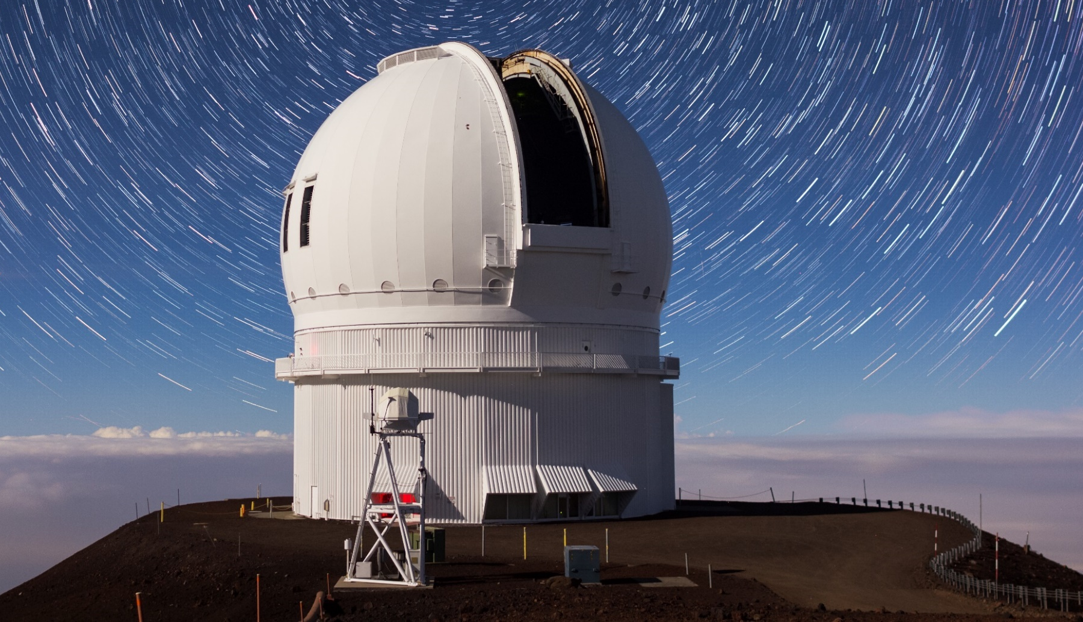
MSE: Maunakea Spectroscopic Explorer
Pat Hall (York U.), MSE Mgmt Group Chair-elect
New
Existing (along
with CFHT/MK
infrastructure)

Slide 4
MSE: Maunakea Spectroscopic Explorer
Pat Hall (York U.), MSE Mgmt Group Chair-elect
New
Existing (along
with CFHT/MK
infrastructure)

Slide 5
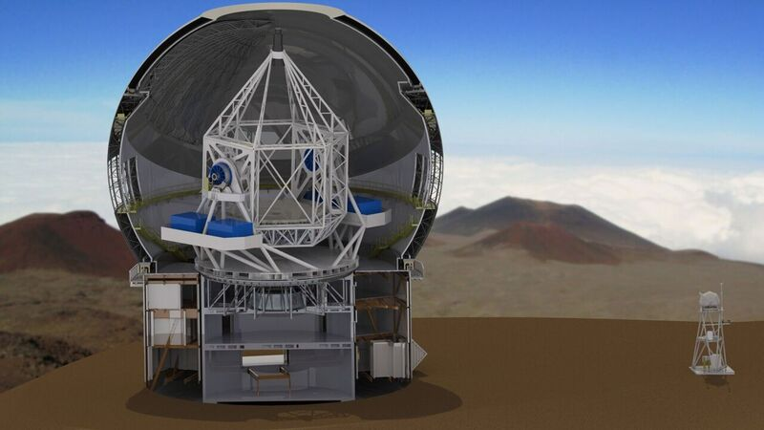
MSE is the future of CFHT
Maunakea Spectroscopic Explorer
4332-fiber positioner, 1.5 square degree FoV
11.25m f/2 segmented primary
Low/Mid-resolution spectrometers
High-resolution spectrometers
Current MSE Baseline Design

Slide 6
MSE: the Facility
See arXiv:1606.00060 (MSE Concise Overview) and arXiv:1606.00043 (MSE Detailed Science Case)
Enables a broad range of science goals: deep galaxy/IGM surveys, stellar chemical tagging, dwarf galaxy σ_{LOS}, quasar RM, transients, …
Run as a dedicated spectroscopic survey facility
WFC/ADC corrects a 1.5 deg² FoV
Etendue = FoV x M1 area = 149 m² deg²; compare to Subaru/PFS=66 m² deg², VLT/MOONS=9.4 m² deg²
Expect median focal plane seeing of 0.51” FWHM
AAO Sphinx positioners: 4332 fibers simultaneously, covering FoV four times over, target separations >7”

Slide 7
MSE: the Spectra
3249 positioners (full FoV 3 times over) with 1” fibers (in 0.51” seeing) feeding LMR Spectrographs with Low (R~3300) and Medium (R~5900) Resolution modes
R~3300: wavelength coverage 360-1300 nm (J band!)
R~5900: 370-460 / 505-630 / 720-900 / 1452-1780 nm (H!)
LR: 1 hr, m_{AB}=24: SNR/res.el.=3 in optical, 2 in J, 1 in H
MR: 1 hr, m_{AB}=23.5: SNR/res.el.=2-3 in optical
Spectrophotometry to 3%, sky subtraction goal 0.5%
1083 positioners (full FoV) with 0.8” fibers feeding High Resolution (R~40,000) spectrographs with three λ/30 wavelength windows (UV, Blue, Red)
Modular design to allow future installation of IFUs

Slide 8
Who’s involved in MSE?
France
China
Spain
Canada
Australia
Hawaii
India
CFHT Corporation (Project Scientist: Alan McConnachie, Manager: Rick Murowinski, Engineer: Kei Szeto)
Your country or institution here!
Governance through a Management Group and a Science Advisory Group

Slide 9
Current and near-future status
Maunakea (+20 Lat) is best telescope site N of equator
After TMT siting, no new sites on Maunakea
Redevelopment is permitted, and CFHT has 40 years of good community relations [EnVision Maunakea]
Subsystem Conceptual Design Reviews concluded
System Conceptual Design Review mid-January 2018 (chair: Michael Strauss)
Prospectus will follow by March 2018
Project Office is working under a $300M cost cap
Cost/Performance Trade Studies will be a Project Office priority in 2018, as part of…
Notes:
Tropical site!

Slide 10
PDP: Preliminary Design Phase
Partners in the preliminary design phase have the greatest chance of influencing MSE design choices
Both cash and in-kind contributions will be needed
Envisioned governance: each partner’s number of shares in MSE will reflect their relative contribution to design, construction, and/or operations
Full partners (above some threshold) will propose and run surveys, have full data access, determine future scientific directions and technical upgrades
Associate partners will have limited data access (for a certain number of people, or for certain surveys, etc.)
Roadmap involves funding, design, and permits:

Slide 11
Roadmap: 2018 onward
Maunakea Spectroscopic Explorer
Conceptual Design ✔
Master
Lease
Renewal
Long term plans lobbying
Fund Raising
Trade Studies + Preliminary
Design
EIS
Permits
Final Design
Construction (post-2022)

Slide 12
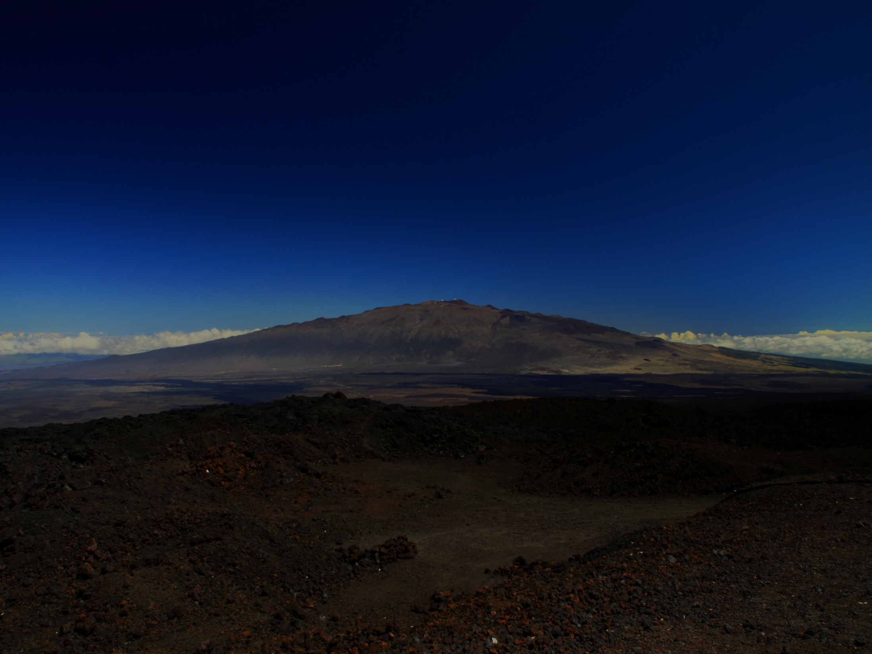
Mahalo…

Slide 13
Maunakea Spectroscopic Explorer
Mahalo…
mse.cfht.hawaii.edu - phall@yorku.ca
Mauna Kea will forever be known throughout the world as the site of profound discoveries about the universe. These witnesses see TMT and the other telescopes, not as objects spoiling the landscape, but as portals to discovery placed in this site made ideal for them.
–Hawai’i BLNR TMT contested case hearing decision

Slide 14
EnVision Maunakea
A year in the making and launched in June 2016, EnVision Maunakea is a program/process of community discussions on Hawai‘i Island intended to enable respectful dialog and develop a community based vision for the future of Maunakea
Essential elements include a Hui Ho‘olohe (community advisory council) overseeing ‘Aha Kūkā (listening sessions) that inform island-wide surveys, all managed by a community convener (Friends of the Future)
The product will be a unique and compelling document intended to inform future policies, agreements, and decisions pertaining to Maunakea

Slide 15
Sphinx
positioner
layout

Slide 16
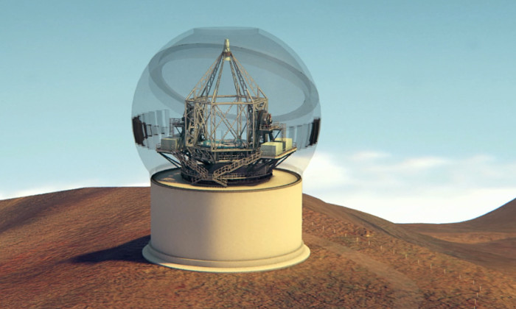
Programmatics
Maunakea Spectroscopic Explorer
For permits/construction MSE has many advantages over TMT in Hawaii
  Building on an existing (previously disturbed) site, no increase in footprint, 40 year history of CFHT in Hawaii Island community, in good standing
MSE requires a new Maunakea Science Reserve Master Lease to proceed with construction
The challenge with securing MSE permits in Hawaii will substantially be “behind” the project once a Master Lease renewal is secured
Extensive efforts are underway at CFHT to resolve the conflict over Maunakea in a meaningful and lasting way (EnVision Maunakea)
Though risks abound in a project of this scale, the primary challenge for MSE is funding in an uncertain climate, both in Hawaii and internationally

