Slide 1
LSST sensors
P. O’Connor
Brookhaven National Laboratory, Upton, NY
Subsystem physicist, LSST science rafts
Cosmic Visions Dark Energy
LBNL 20171115

Slide 2
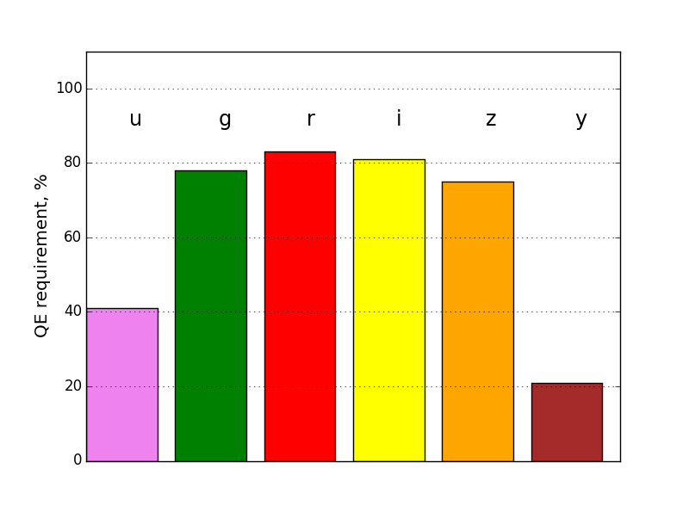
Science drivers
Image size
Single image depth
Seeing | Delivered image FWHM | Instrumental contribution
0.44” | 0.56” | 0.31”
0.60” | 0.69” | 0.34”
0.80” | 0.87” | 0.34”
Filter | 5σ limiting mag (T_{exp}=30s, AM=1, Seeing = 0.67”)
u | 23.9
g | 25.0
r | 24.7
i | 24.0
z | 23.3
y | 22.1
Spectral
Throughput losses
Spatial | FPA active area | ≥ 90%
Temporal | Shutter open fraction | ≥ 80%

Slide 3
Sensor requirements
Parameter | Goal (Thresh.) | unit
Total active area | 3096 (2654) | cm²
QE u | 41 | %
QE g | 78 | %
QE r | 88 | %
QE i | 81 | %
QE z | 75 | %
QE y | 21 | %
Diffusion | 5.0 | μm rms
Read time | 2 (3) | sec
Read noise | 9 (13) | e⁻ rms
Video crosstalk | 0.2 | %
Gain stability | 0.1 | %
Pixel size | 10 | μm
Nonplanarity | 18 | μm p-v
Fill factor | 92 | %

Slide 4
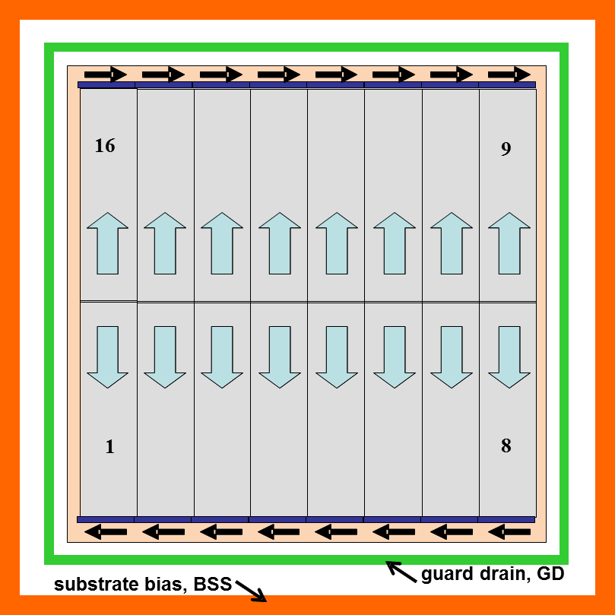
Detector design
High resistivity p-type silicon CCD, 100μm thick, fully depleted, back illuminated
10μm pixels, 4K x 4K full-frame format
16-fold parallel output
4-side buttable package, ±9μm coplanarity across full set
Specified mechanical mounting and alignment features, and electrical interface
Operating temperature -100C

Slide 5
R&D prototype phase, 2005 - 2012
Prototype contracts with 2 CCD suppliers
Establish EO and metrology test lab
Demonstrate existence proof of sensor performance
Confirm diffusion model
Measure electronic crosstalk between channels (intra-CCD)
Investigate ‘tall pixel’ effects and other nonidealities
Demonstrate 9Hz ROI readout (guide mode)

Slide 6
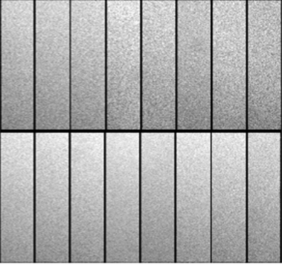
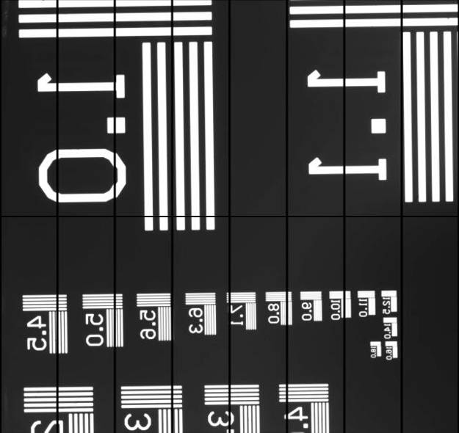
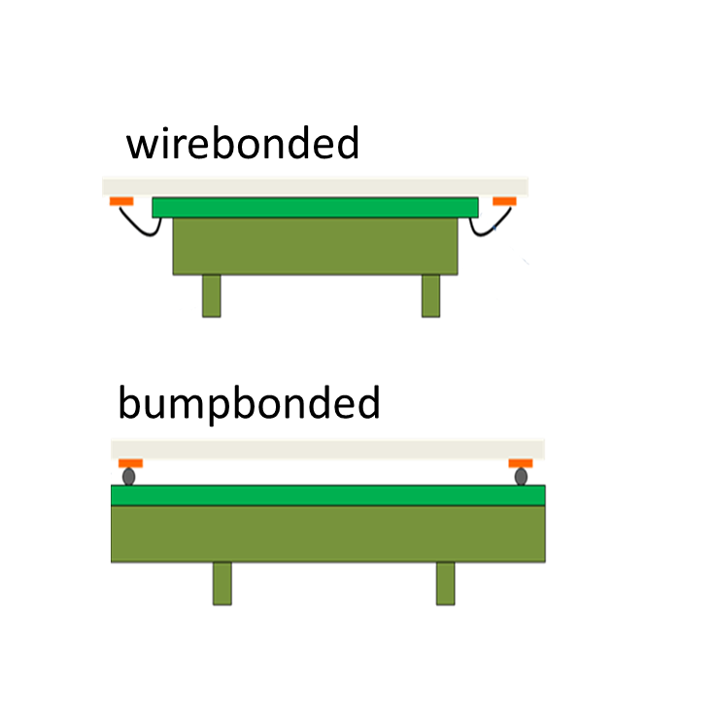
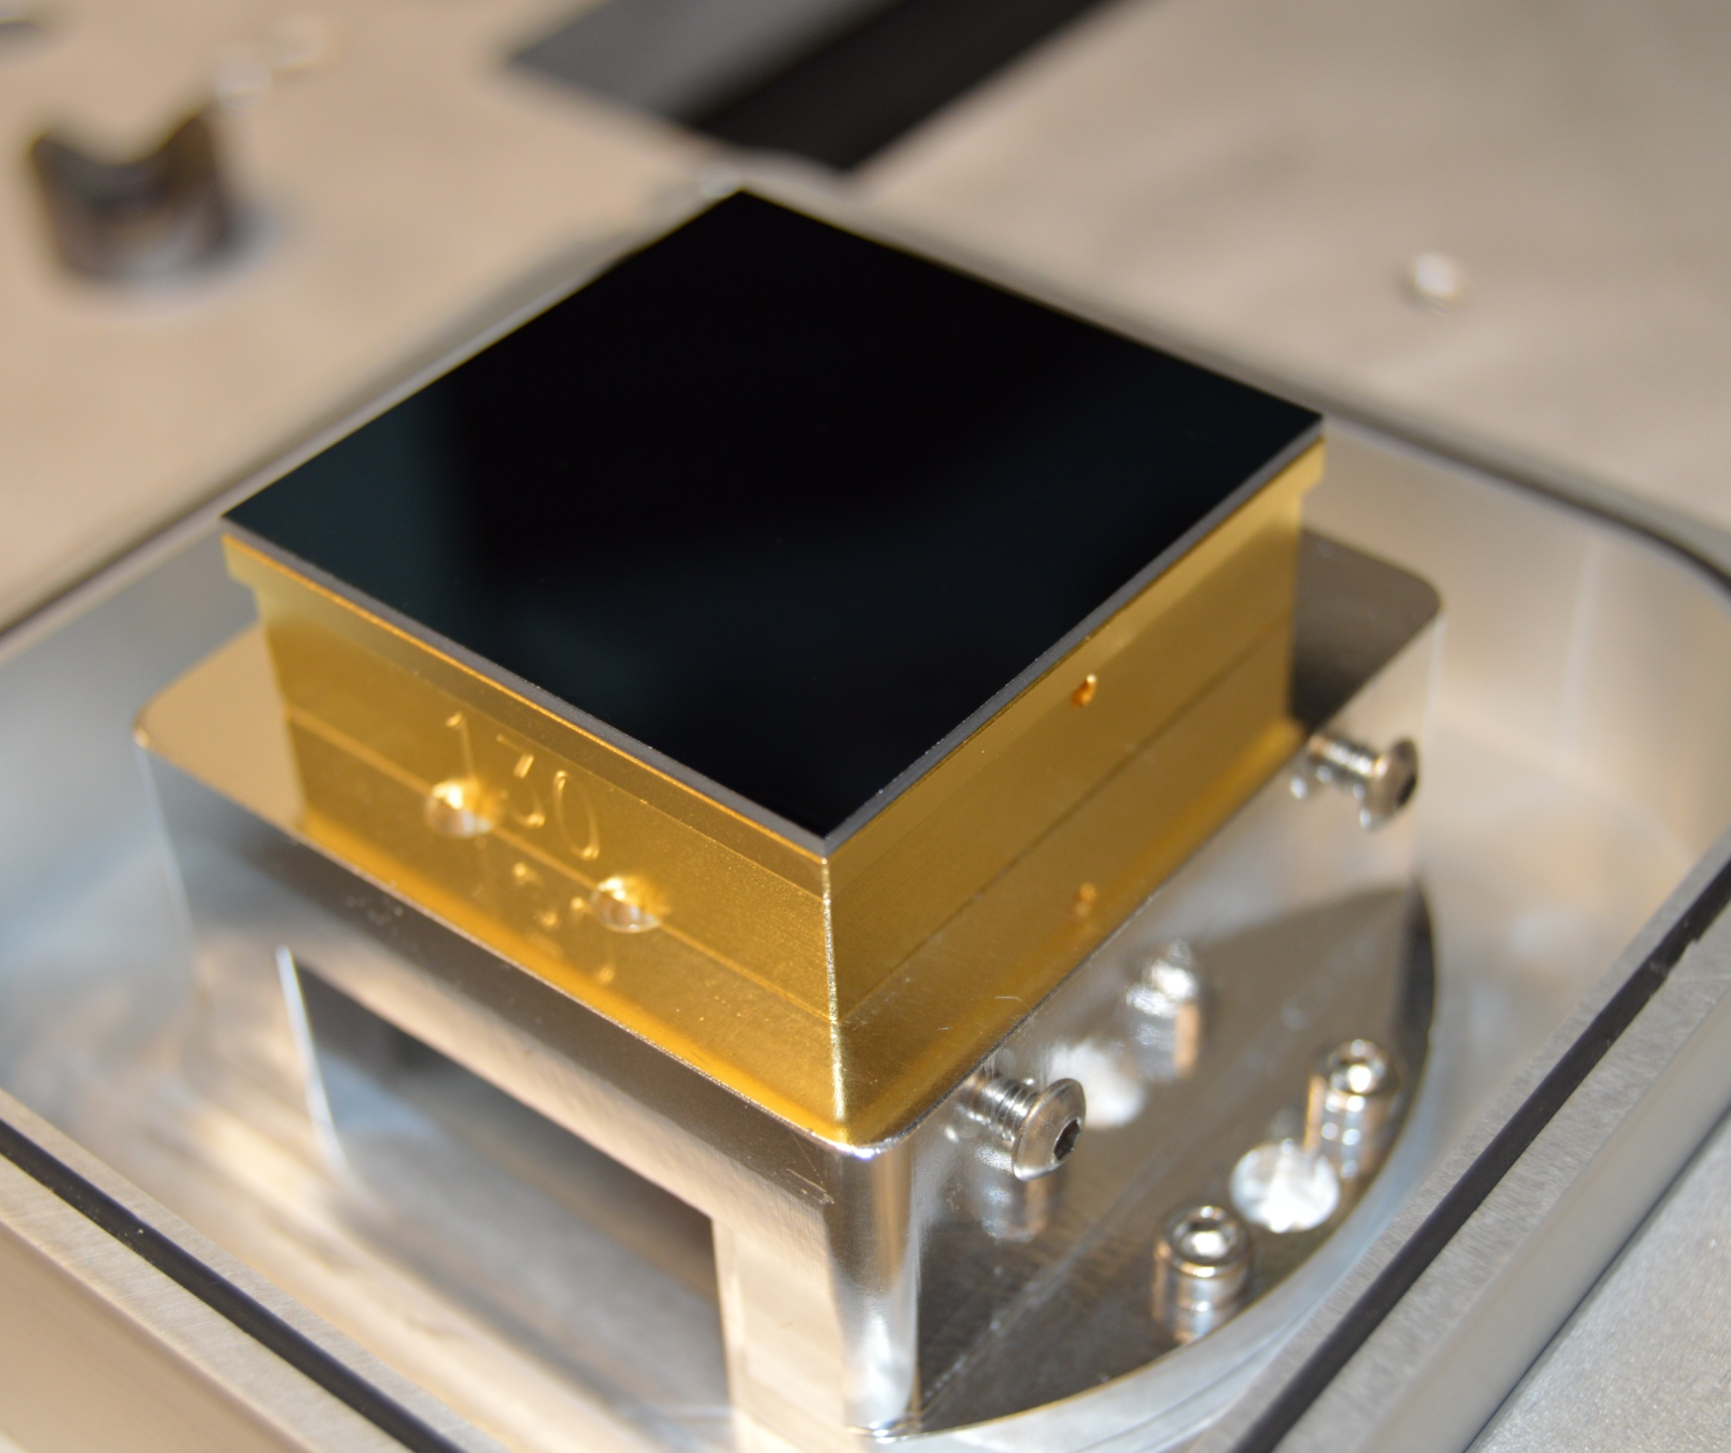
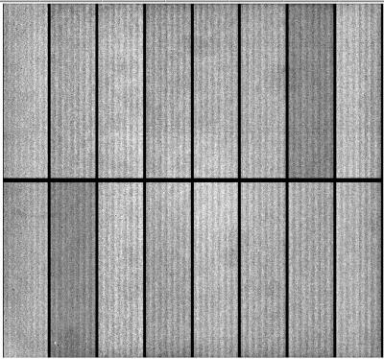
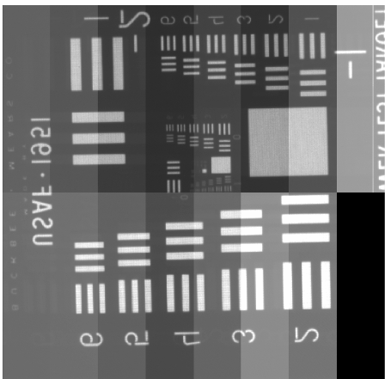
2 detector variants
CCD in test fixture
Uniform illumination
Test target image
Package
T-E2v CCD250
T-DALSA/ITL STA3800C
(overscan displayed)
(overscan suppressed)

Slide 7
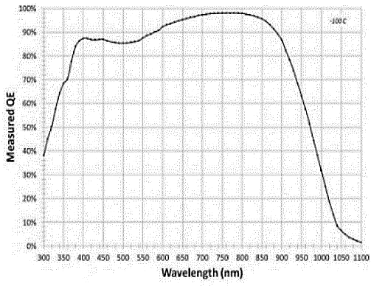
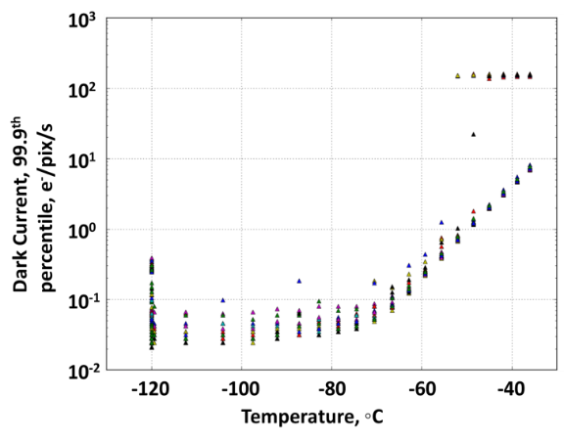
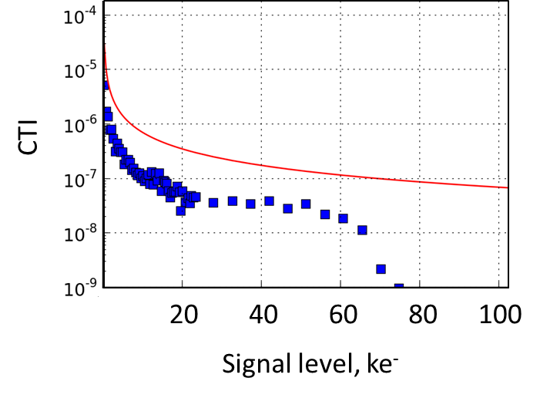
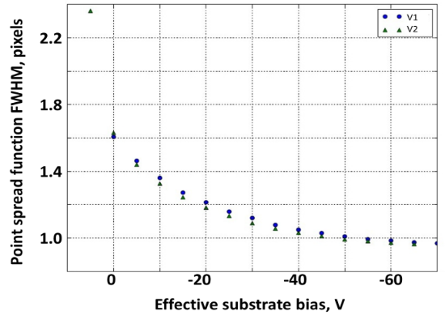
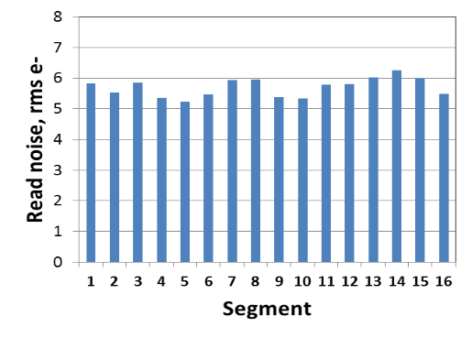
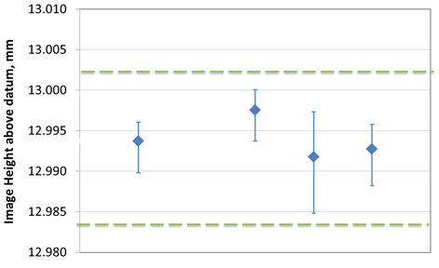
Sensor prototype performance
QE
Dark current
Charge transfer inefficiency
PSF
Read noise
Height of image surface
Radeka, V., et al. "LSST sensor requirements and characterization of the prototype LSST CCDs." Journal of Instrumentation 4.03 (2009): P03002..
Usable pixel fraction > 99.99%

Slide 8
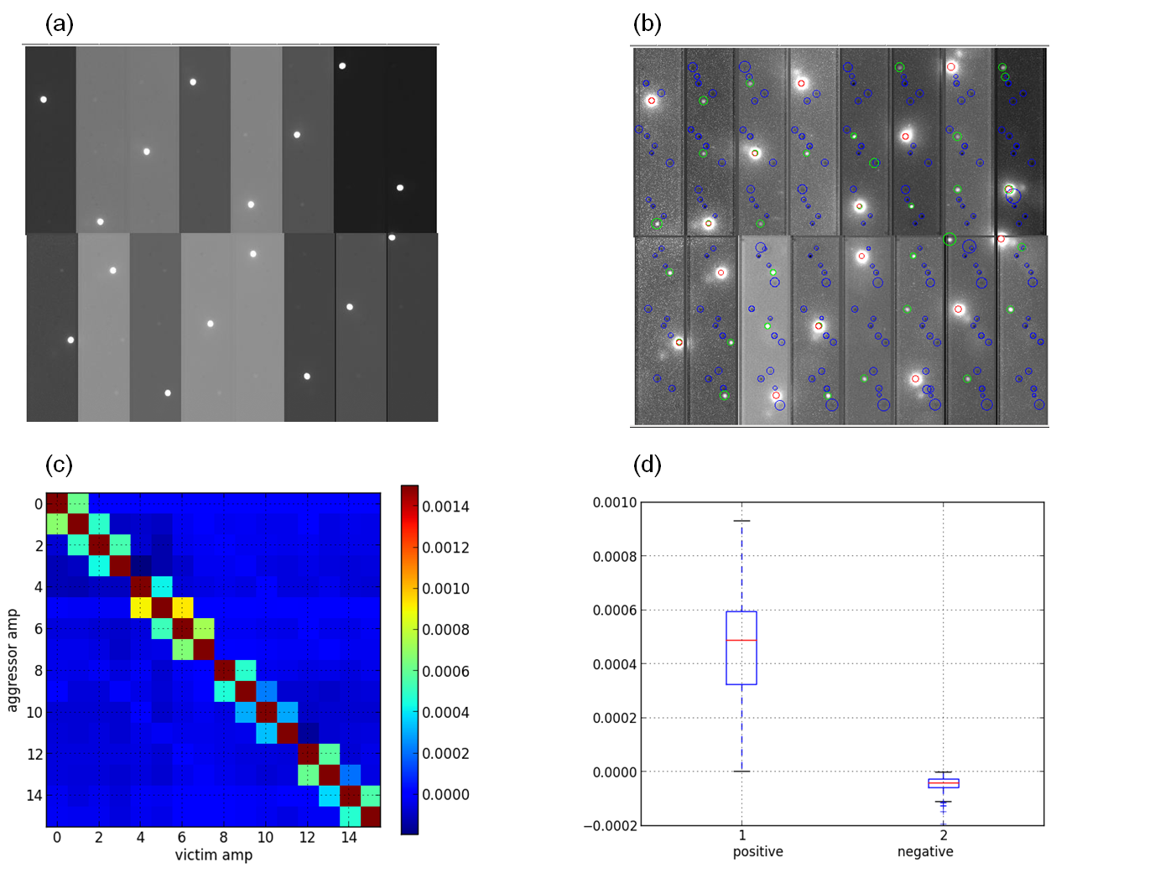
Crosstalk – intra-CCD
Staggered aggressor pattern
Averaged and stretched to show victims
Crosstalk matrix
O'Connor, P. "Crosstalk in multi-output CCDs for LSST." Journal of Instrumentation 10.05 (2015): C05010.

Slide 9
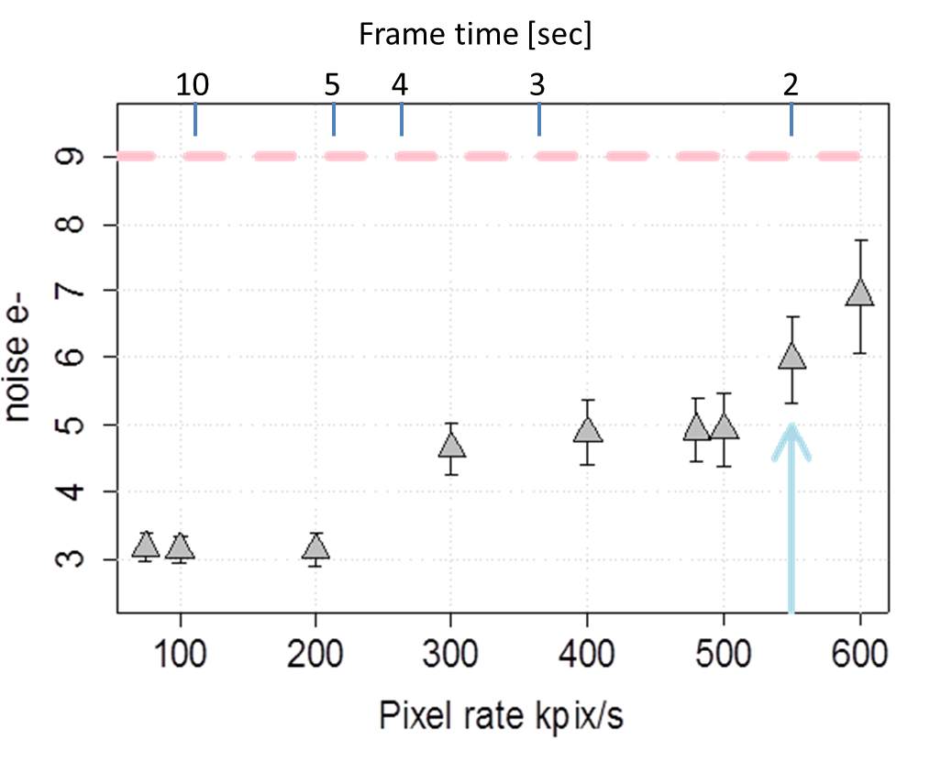
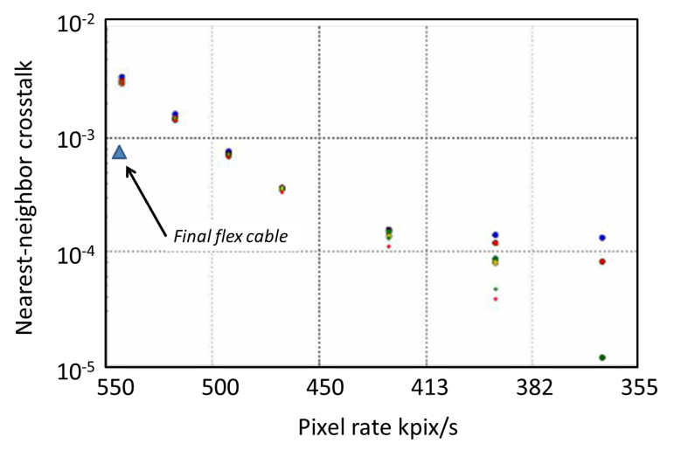
Speed tests
Read noise vs. pixel rate
Crosstalk vs. pixel rate
<6e⁻ noise@ 550kpix/s
.08% worst xtalk @ 550kpix/s

Slide 10
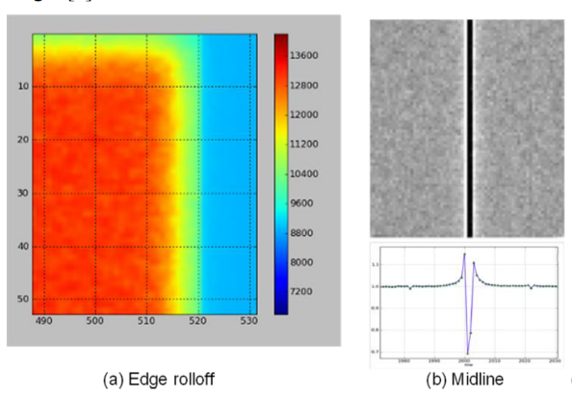
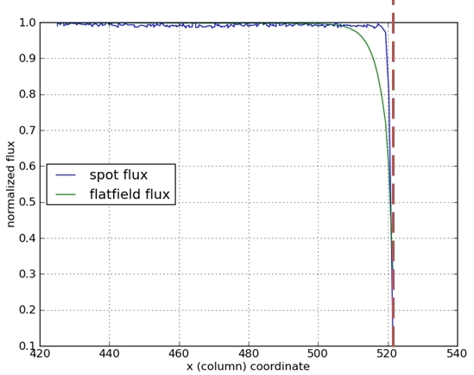
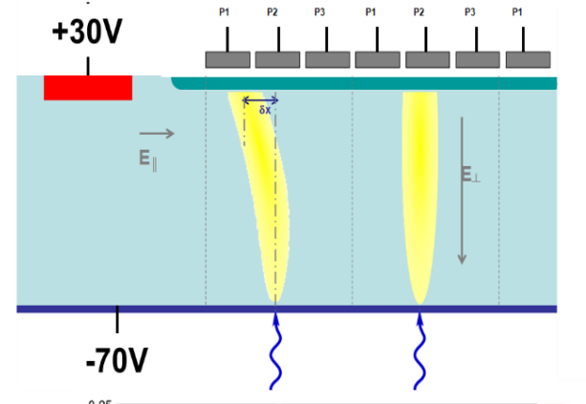
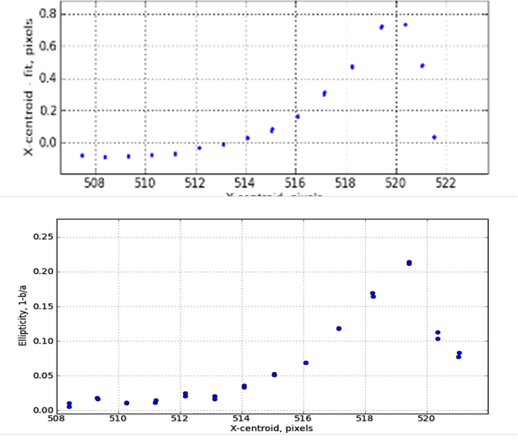

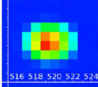
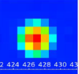
“Tall pixel” effects
flatfields
point sources: optical
flux
X-ray
position
shape
A. Nomerotski

Slide 11
Vertical slice tests, 2012 - 2016
Complete development of raft readout electronics
Establish test lab with elx. + multiple sensors in Dewar
Re-verify EO performance in integrated configuration
Demonstrate virtual oscilloscope + diagnostics

Slide 12
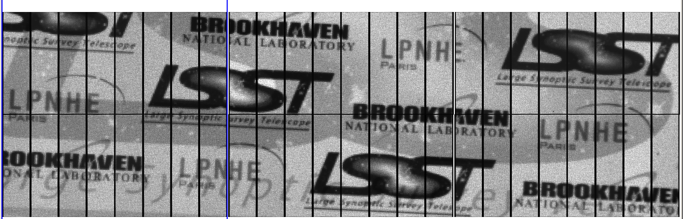
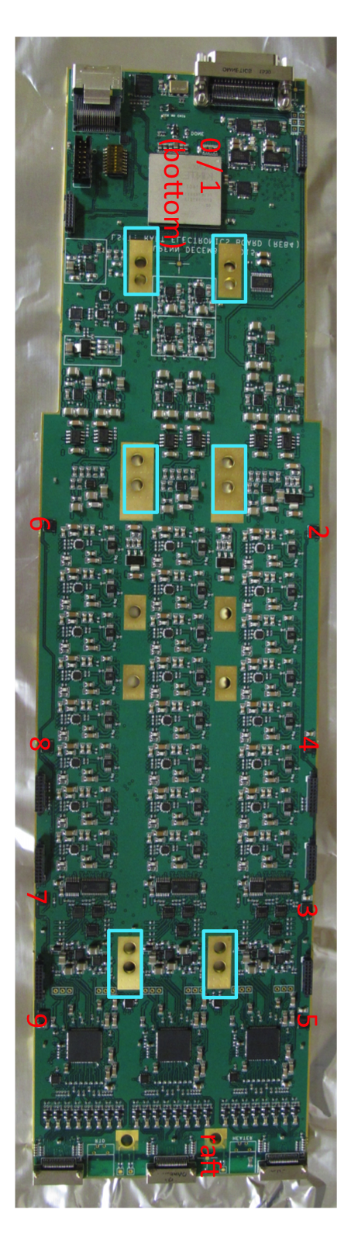
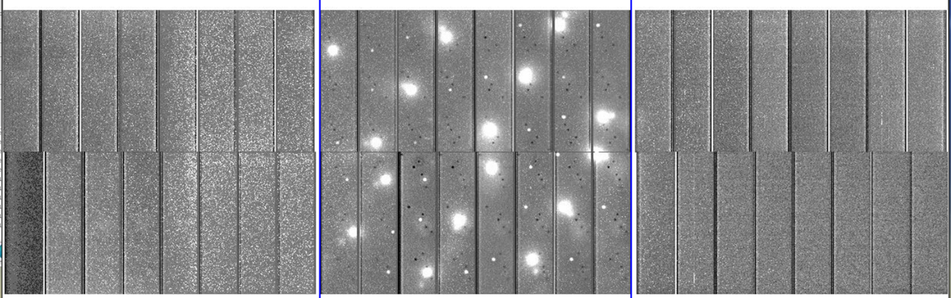
Multi-CCD readout, near-final electronics
Imaging – 3 CCDs, 48-channel readout board in Dewar
(lack of) inter-CCD crosstalk

Slide 13
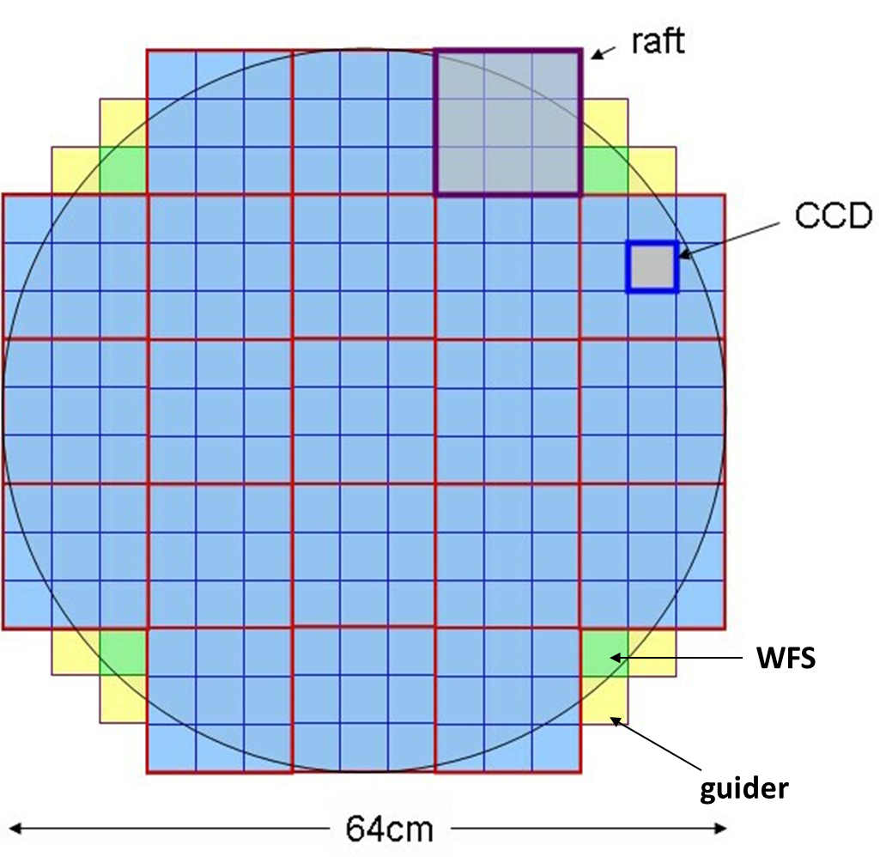
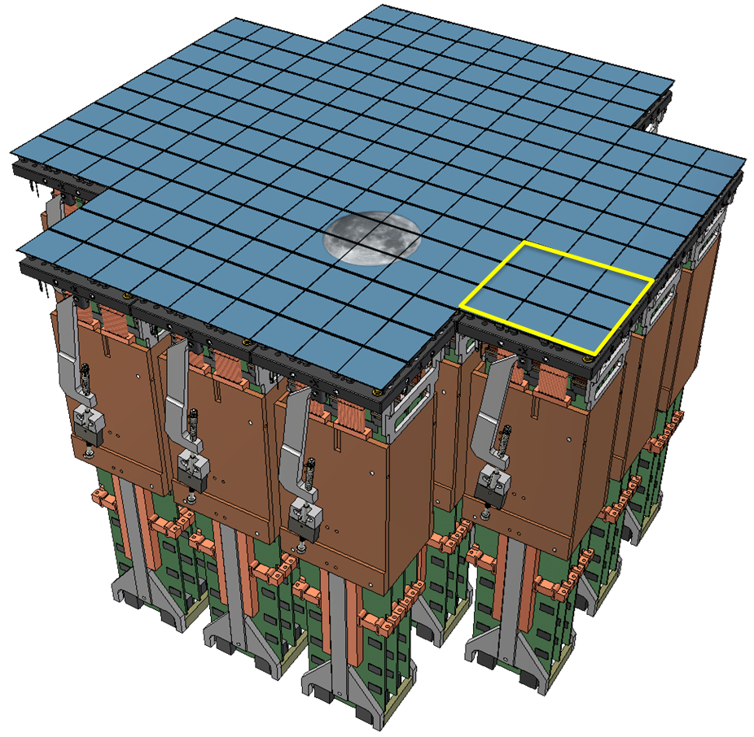
Focal plane organization
3100 cm² active area
189 science CCDs, 4K x 4K, 16-output
21 science rafts, 9 CCDs on common mount
Corner rafts for guiding and wavefront sensing

Slide 14
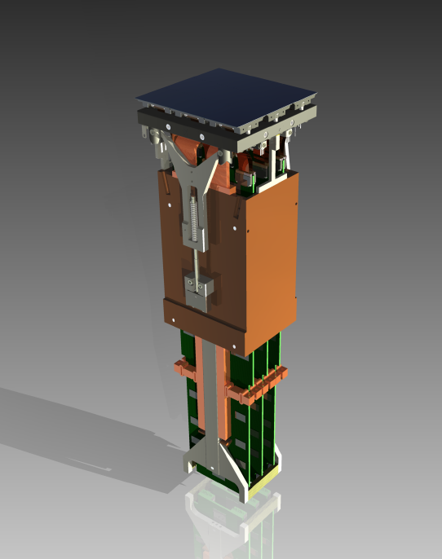
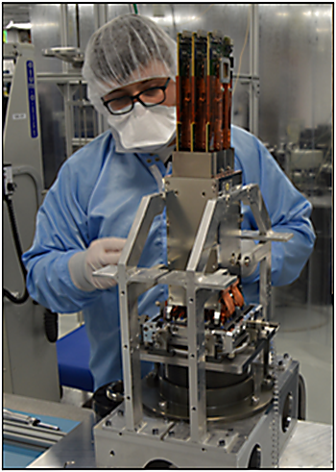
Raft Tower Module (RTM)
Complete 144-Mpixel imager
Provide control signals for CCD operation
Low noise analog signal processing
Digitizing, multiplexing of pixel data
Diagnostics
Support and maintain alignment of sensors
Thermal management of sensors and electronics
12.7 x 12.7 x 42cm³; 12kg
CCDs
electronics
Photons in – photons out

Slide 15
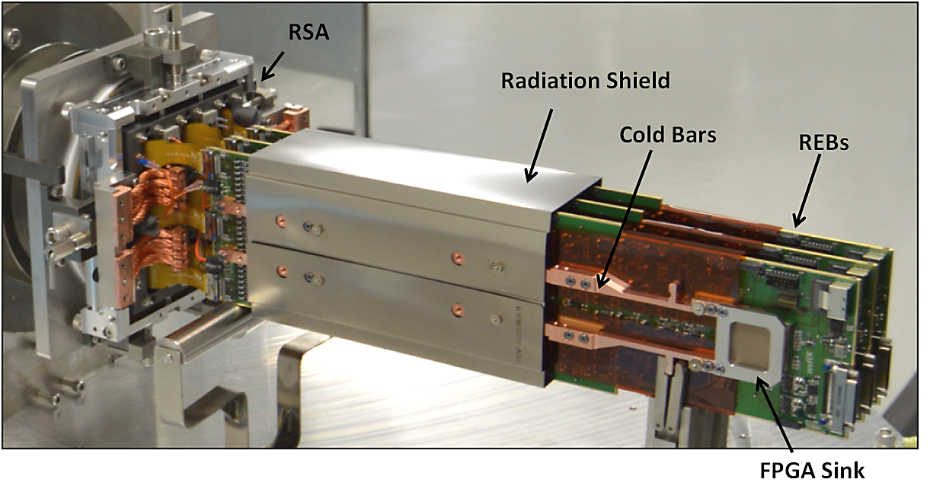
RTM prior to REC installation

Slide 16
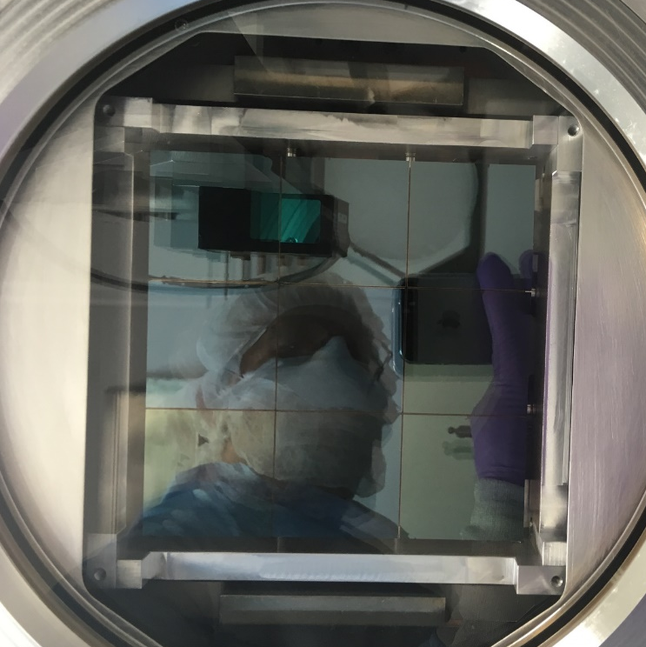
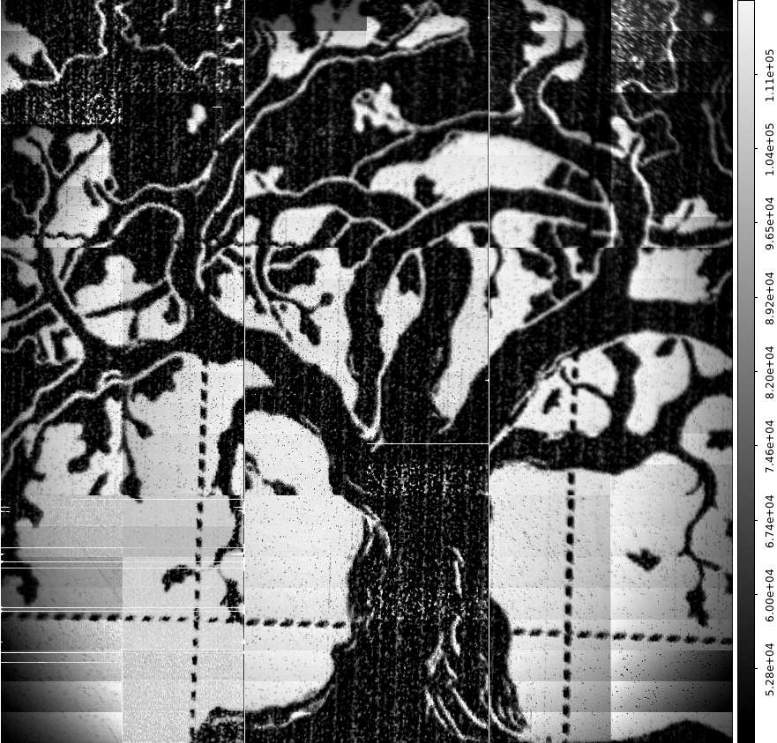
Tower in cryostat
Image from first engineering RTM
Equivalent to 70 HDTV frames
Friday, Jan 27 2017
ETU#1 in TS-8 at BNLj

Slide 17
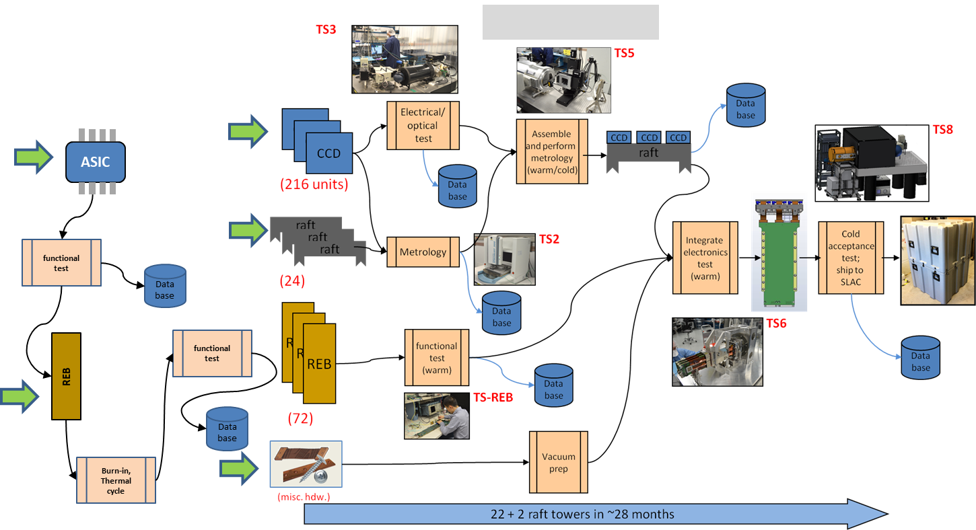
Production phase 2016 – early 2019

Slide 18
RTM production status Nov. 2017
assembled and tested
ETU1
ETU2
awaiting test
RTM1
RTM2
RTM3
RTM4
RTM5
RTM6
RTM7
RTM8
RTM9
RTM10
RTM11
RTM22
…
T-e2v sensors
Assembled this year: 11 rafts
99 CCDs
1.584Gpix
ITL sensors
future production

Slide 19
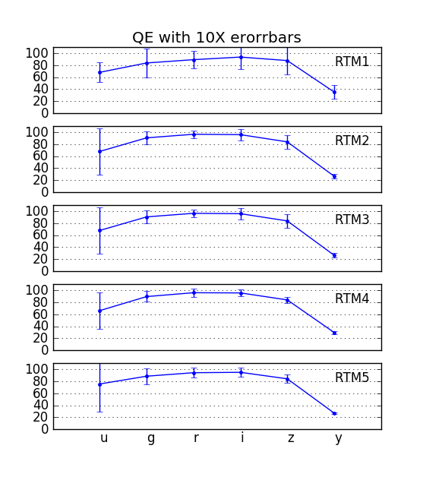
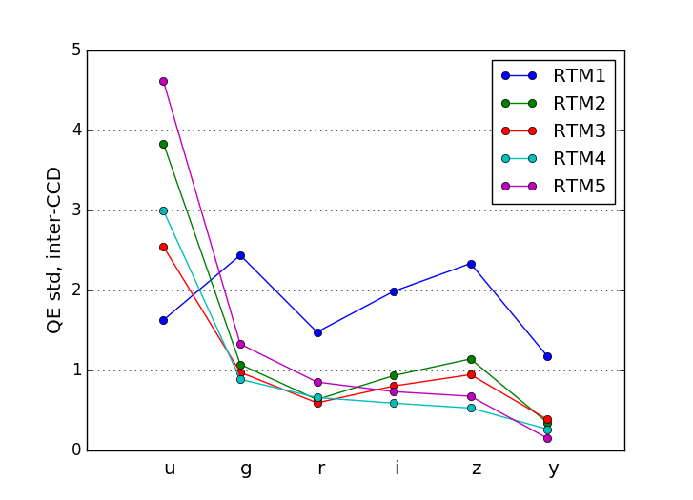
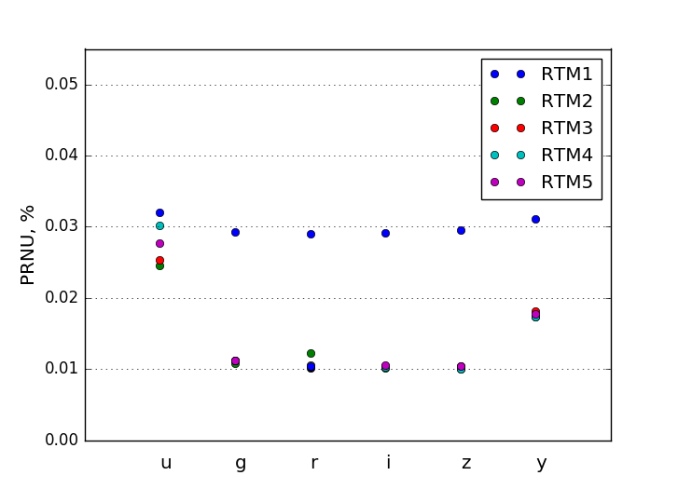
QE: values, inter- and intra-CCD variation
%
%
%
%
%
%

Slide 20
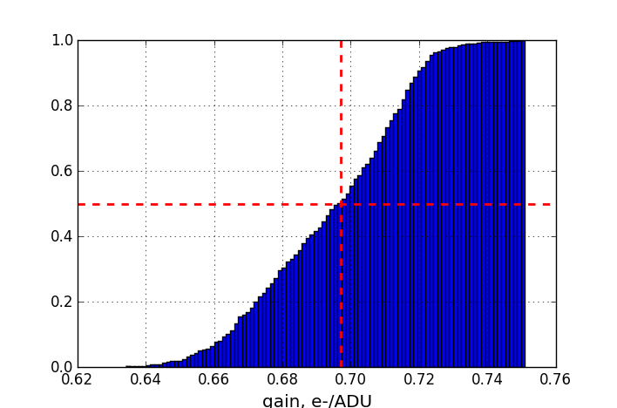
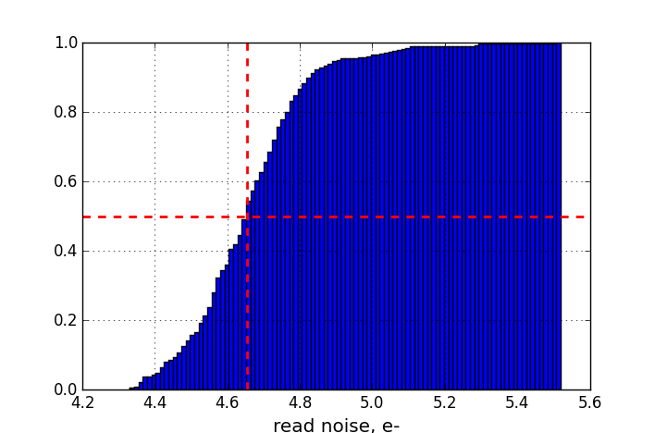
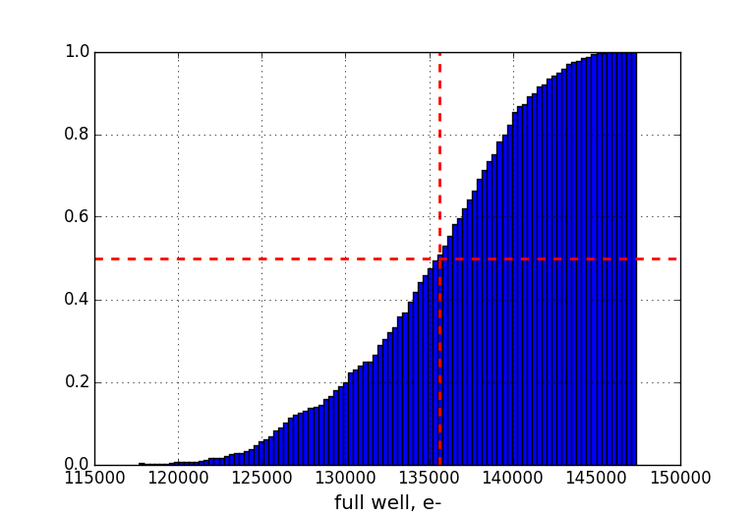
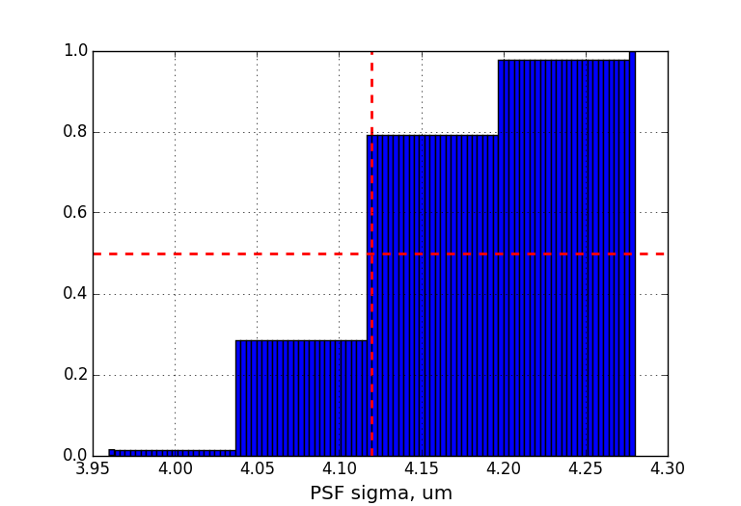
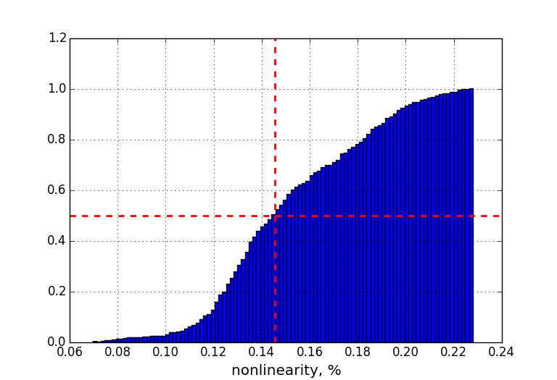
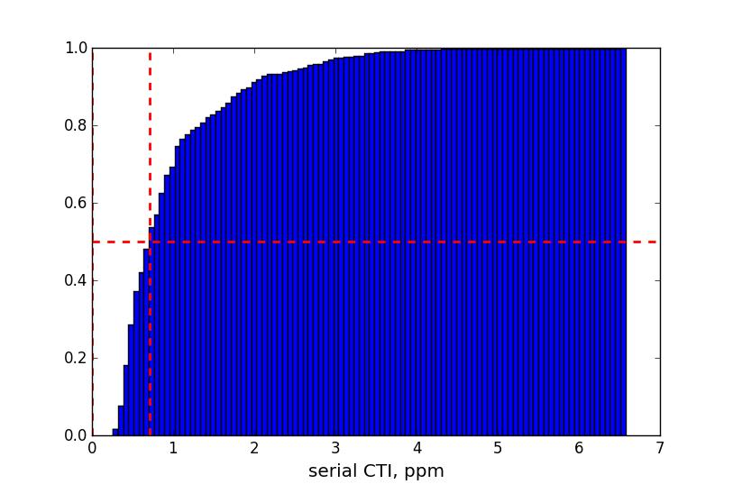
EO performance statistics: 3 rafts (432 channels)
gain e-/ADU
spec | --
<x> | 0.70
1σ | 0.02
95% | 0.08
read noise e-
spec | 9
<x> | 4.66
1σ | 0.16
95% | 0.68
full well ke-
spec | <175
<x> | 136
1σ | 5.5
95% | 20.3
PSF σ
spec | 5
<x> | 4.12
1σ | .062
95% | .160
nonlin %
spec | 3
<x> | 0.15
1σ | 0.03
95% | 0.11
HCTI ppm
spec | 5
<x> | 0.72
1σ | 0.76
95% | 2.69

Slide 21
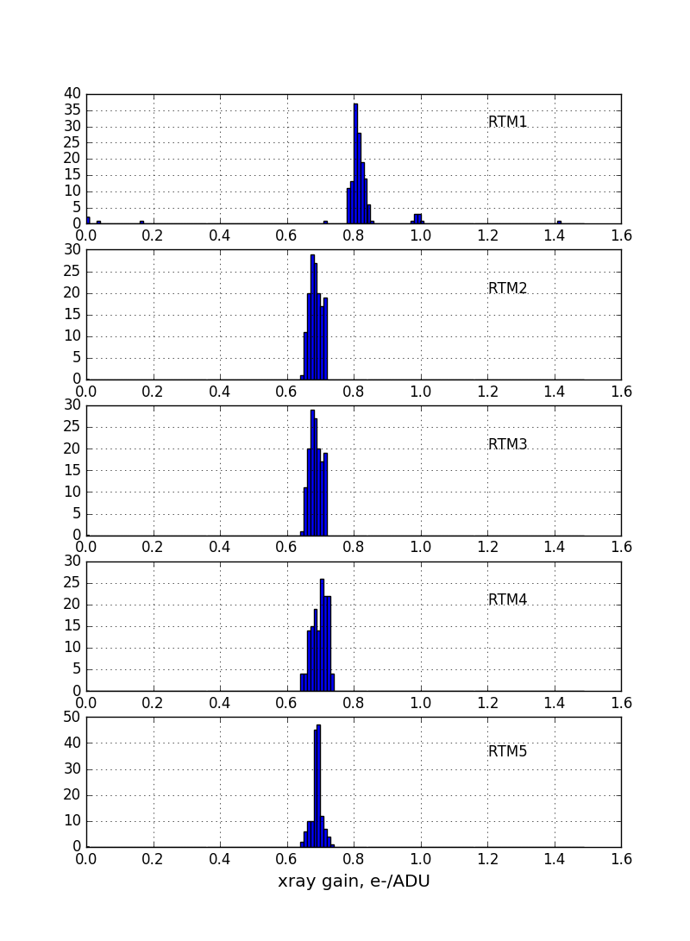
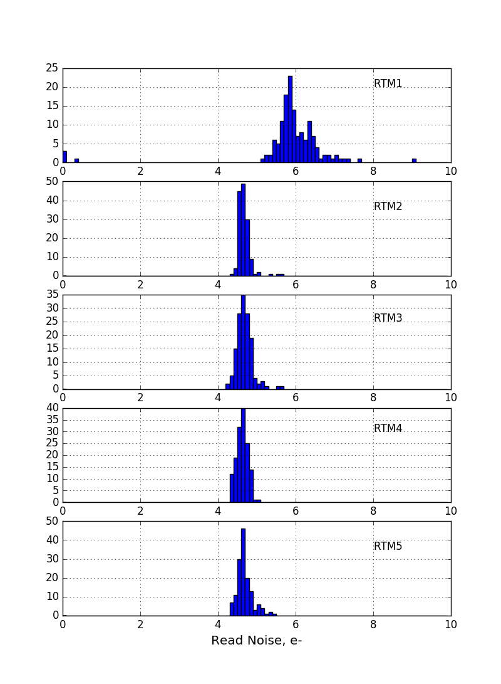
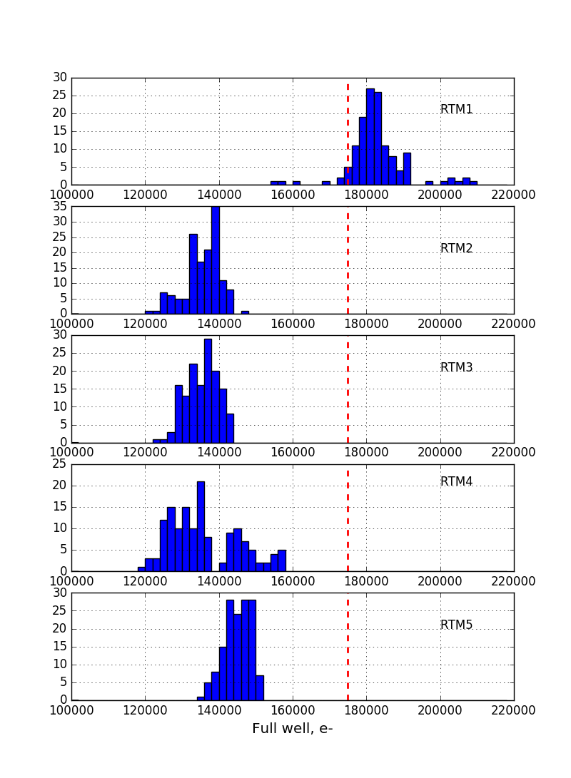
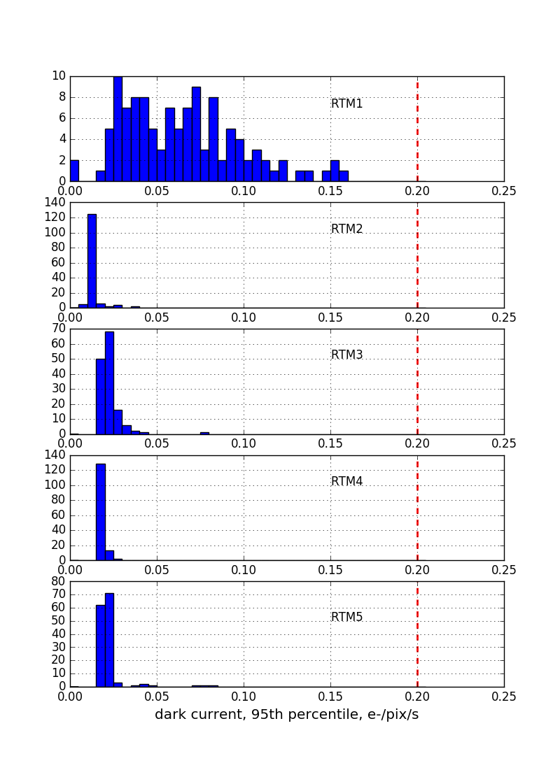
Parameter distributions, 5 rafts:
dark current
(95th percentile)
gain
noise
full well

Slide 22
Absolute height of image surface – 6 rafts
target
10μm
Room temperature measurements

Slide 23
Image surface coplanarity

Slide 24
Performance goals
  2 second readout time
  9e- read noise
  QE > 75% (450 < λ < 870nm)
  QE > 20% from 320 < λ < 1050nm
  > 99.9995 % CTE serial and parallel
  99.0% operable pixels
  91.4% area fill factor
  < 0.24’’ FWHM diffusion PSF
  0.3% electronic crosstalk
  < 58W power per RTM

Slide 25
Performance goals achieved
  2 second readout time 1.975s
  9e- read noise 4.7 ± 0.17 e-
  QE > 75% (450 < λ < 870nm) 85%
  QE > 20% from 320 < λ < 1050nm 23%
  > 99.9995 % CTE serial and parallel 99.9999%
  99.0% operable pixels 99.97%
  91.4% area fill factor 92.97%
  < 0.24’’ FWHM diffusion PSF 0.18”
  0.3% electronic crosstalk 0.03%
  < 58W power per RTM 39W

Slide 26
Final thoughts
Combination of characteristics that optimize LSST sensors for a wide, fast, deep imaging survey don’t map readily into other DE programs:
  Noise is good but not state-of-the-art
  NIR sensitivity is good but not state-of-the-art
  Fast readout less important for spectroscopy
  More susceptible to radiation damage than p-channel CCDs for space applications
Potentially useful for transient studies (GW follow-up?)
Compact, low power mosaic building-block construction techniques adaptable to alternative sensor types
Other suggestions?

Slide 27
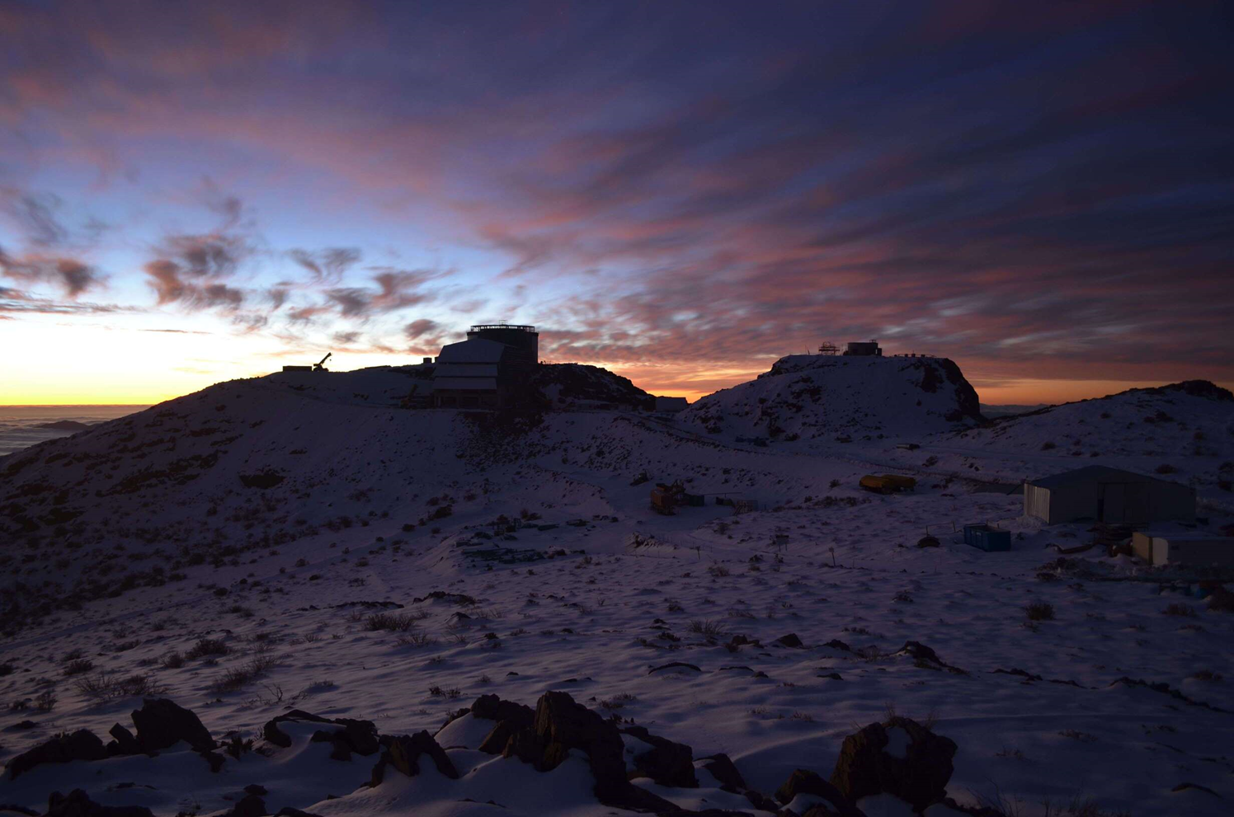
THANK YOU

Slide 28
REFERENCES
SDW2013 “System Tests of LSST Integrated Readout Chain” Florence, POC
SPIE2016 “Integrated System Tests of the LSST Raft Tower Modules”, Edinburgh, POC
”Electro-optical testing of fully depleted CCD image sensors for the Large Synoptic Survey Telescope camera”, Vol. 9154 (2014), pp. 915418-915418-17, doi:10.1117/12.2056733 by Peter E. Doherty, Pierre Antilogus, Pierre Astier, et al.
LSST sensor requirements and characterization of the prototype LSST CCDsV Radeka, J Frank, JC Geary, DK Gilmore, I Kotov, P O'Connor, P Takacs, Journal of Instrumentation 4 (03), P03002
Development of the LSST raft tower modules, Society of Photo-Optical Instrumentation Engineers (SPIE) Conference Series, Vol. 8453 (July 2012), doi:10.1117/12.926645 by P. O'Connor, I. Kotov, P. Z. Takacs, et al.
Technology of the LSST focal plane, Nuclear Instruments and Methods in Physics Research Section A: Accelerators, Spectrometers, Detectors and Associated Equipment, Vol. 582, No. 3. (01 December 2007), pp. 902-909, doi:10.1016/j.nima.2007.07.120, by P. Oconnor, J. Geary, K. Gilmore, J. Oliver, V. Radeka, P. Takacs
Lu, W., et al. "CCD emulator design for LSST camera." SPIE Astronomical Telescopes+ Instrumentation. International Society for Optics and Photonics, 2016.
O'Connor, P., J. Fried, and I. Kotov. "An advanced CCD emulator with 32MB image memory." SPIE Astronomical Telescopes+ Instrumentation. International Society for Optics and Photonics, 2012
P. O'Connor, I. Kotov, P. Z. Takacs, J. S. Frank, S. Plate, R. Van Berg, M. Newcomer, P. Antilogus, Hervé Lebbolo, V. Tocut, C. Juramy, P. Doherty, N. Felt, "Development of the LSST raft tower modules", Proc. SPIE 8453, High Energy, Optical, and Infrared Detectors for Astronomy V, 84530L (25 September 2012); doi: 10.1117/12.926645; http://dx.doi.org/10.1117/12.926645

Slide 29
Design thickness study
Choice of operating temperature impacts thickness decision.
  Warmer operation improves long-wavelength QE
  Limit set by dark current and/or bright defect rate; 173K is baseline
diffusion PSF σ, μm
model including velocity saturation, 5kV/cm
0.30
6
PSF FWHM, arcsec
0.25
5
0.20
4
0.15
3
0.1
0.2
0.3
0.4
Internal Quantum Efficiency at 1000nm

Slide 30
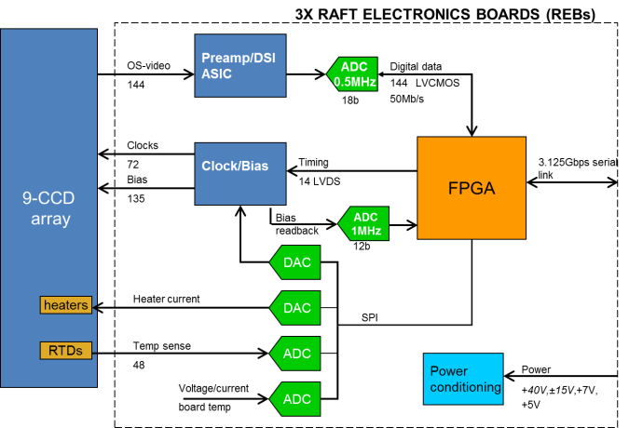
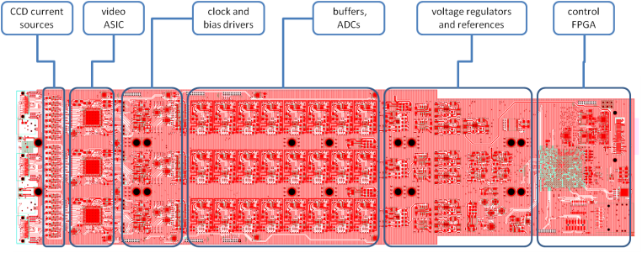

Raft electronics
Functions:
Video CDS processing
18-bit digitization and serialization
HV clock and bias generation
CCD temperature monitoring and control
Onboard diagnostic features including waveform recorder
Implementation:
Three 4” x 16”, 14-layer boards
Video processing in CMOS ASIC (x18)
Xilinx XC7K160T FPGA (x3)
AD7982 18-bit 1MSa/s SAR ADC (x144)
+40/±15/+8/+7/+5V supplies, onboard regulators

Slide 31




Virtual sampling scope mode of video digitizer
Arrange a repetitive CCD output waveform (i.e. dark, flat)
Acquire one sample per pixel period, incrementing the ADC sampling clock 10ns per pixel
Combined with “transparent mode” feature of DSI ASIC, creates virtual 100MHz, 18b oscilloscope for probing video channels
(a) ASPIC DSI mode
(b) ASPIC Transparent mode – amplified CCD output

Slide 32

144-channel waveforms using virtual ‘scope

Slide 33



Noise correlations
Single CCD
Full raft CCD
0.2
0.1
0

