Slide 1
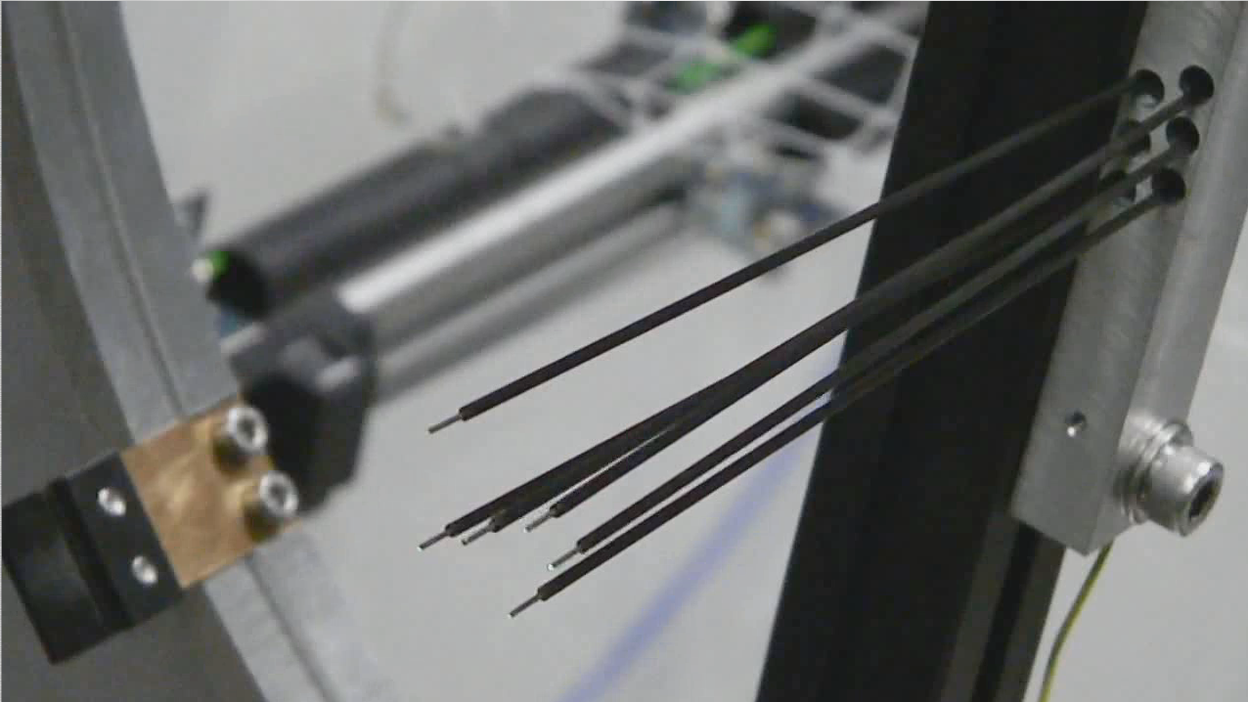
A piece of Fiber Positioner R&D
“DESpec: A good idea ahead of its time”
Tom Diehl (FNAL)
Cosmic Visions
Nov. 15, 2017
Photo: Will Saunders

Slide 2
Optical Fiber Positioners
Skipped a step: economics that drives us to fiber positioners
Precisely hold the tip of optical fibers on the desired RA & DEC of the galaxy (specs typical of Echidna Mark 1)
  Premium on small (7 mm) spacing between actuators (pitch)
  ± 0.14” (± 1/2 pixel on DECam) position accuracy corresponds to ±7.5 um.
  60” target separation is ~3.2 mm spacing between fiber tips
  Fast reconfiguration time: 90 seconds or less
  Maximum throughput, highly reliable …
Tilting Spines and Twirling Posts
  Advantages/Disadvantages for each type (discuss at length)
  Relatively high density of positioners on the focal plane made Tilting Spines the best choice for DESPec
  The new Tilting Spine design (J. Gilbert & G. Dalton SPIE 2016) alleviates the spine’s disadvantages

Slide 3
Mohawk Tilting Spine
6 ¾ mm pitch
Length about 16 cm
Patrol radius ~ 7 mm
Positioning accuracy < 10 microns is already achieved
Improved configuration time is about 60 seconds.
Issue of “tilt defocus” drives the design to long spines.
New design low-voltage spine (2016)
Echidna spine picture from
Graham Murray (Durham)

Slide 4
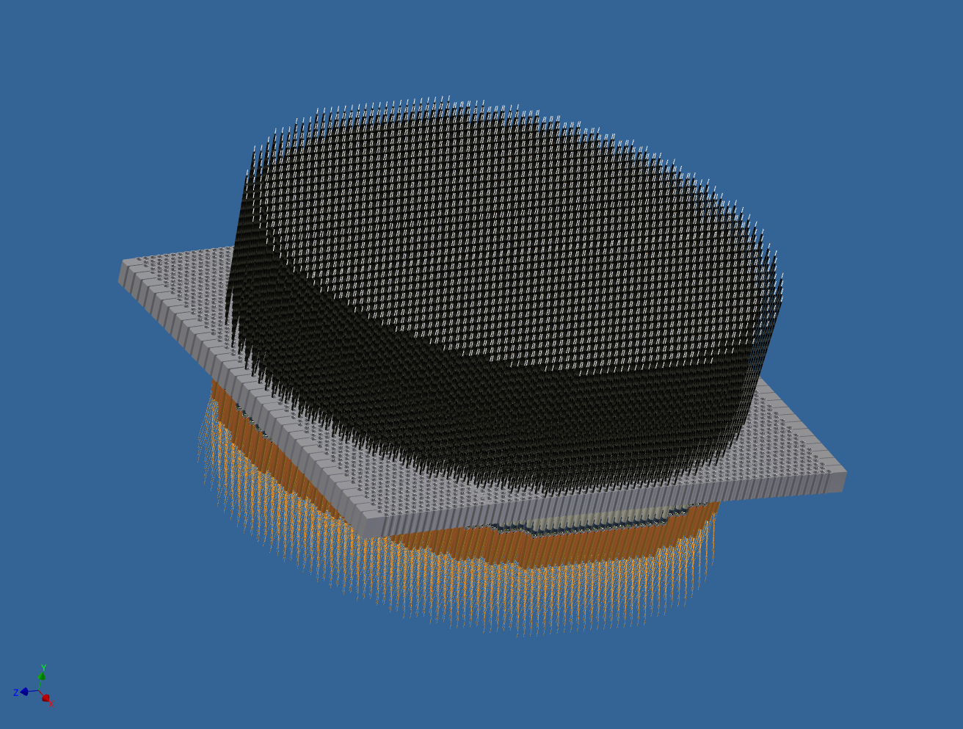
MOHAWK fiber positioner
4000 spines, 450mm Focal Plane diameter, 6.75mm pitch.
Curved modules, each with two rows of spines, fit together like staves of a barrel to form spherical surface.
Will Saunders, AAO

Slide 5
Development of Mohawk Spines
From AAO (Will S.) May 31, 2012

Slide 6
Spines vs Twirling Posts
Tilting Spines
  Pitch 6 mm
  Patrol Radius ~ 1.2 * pitch
  Maximum packing ~ 7
  6 or 7 parts maybe 10 in Model 2
  Better targeting efficiency
  More effective for close targets
  Light loss with tilt
  FRD affects sky subtraction
  Both above are mitigated by longer spines
Twirling Posts
  Pitch 10 mm
  Patrol radius ~0.7 * pitch
  Maximum packing ~ 2
  ~ 28 parts
  Faster to position than initial spine versions

Slide 7
R&D
Understand & replicate the technology. Collaborate w/ AAO, perhaps.
Engineering:
  Reduce the pitch, how?
  Increase the length
Incremental improvements have a big payoff because of r^2

