Slide 1

QUANTUM SENSORS
Swapan Chattopadhyay
US Cosmic Visions: Dark Energy 2017
November 14-15, 2017
LBNL

Slide 2
Acknowledgments
Aaron Chou, Rob Plunkett, Roni Harnik, Joe Lykken (Fermilab)
Mark Kasevich, Peter Graham, Jason Hogan (Stanford)
Surjeet Rajendran, Holger Muller (Berkeley)
Jonathon Coleman (Liverpool)
James Siegrist, Lali Chatterjee (DOE OHEP)

Slide 3
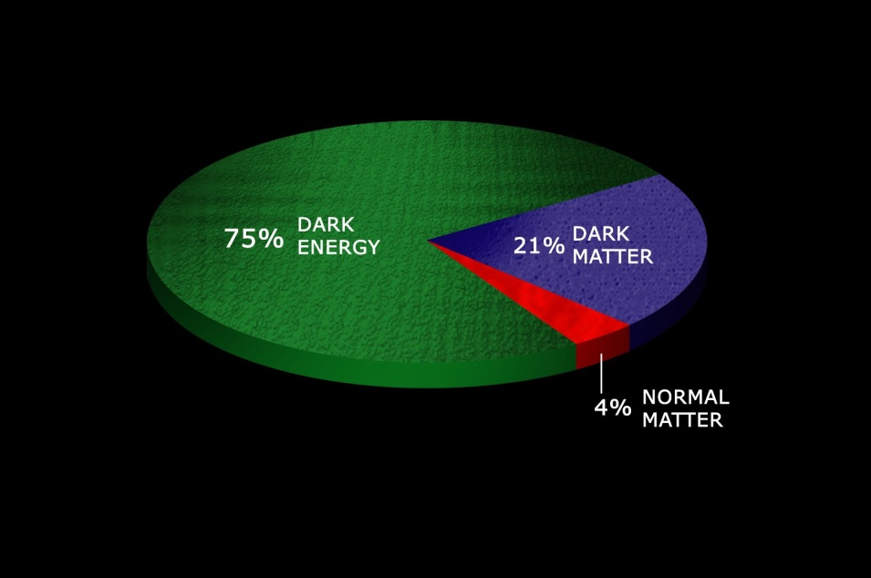
Today’s Measure of the Mass-Energy Budget of the Universe

Slide 4
DARK SECTOR – 5 Big Questions
→ Where? → Surveys, maps, images, spectroscopy
→ How much? → Measurements of galaxy rotation curves, cosmic acceleration
→ What ? → Nature **
→ How ? → Dynamics **
→ Why? → We will probably never know!
Underlying Assumption:
Dark Matter, Dark Energy and Gravity (e.g. cosmic gravitational background radiation from early universe) are fundamentally related and pervades space everywhere, including our earth-based laboratory
** What is being asked?

Slide 5
The questions begs itself: is ‘dark energy’ real, is ‘cosmological constant’ a real ‘fundamental’ constant or is there underlying physics that can explain it?
If it is a fundamental constant, it must eventually show up in other observations and processes as a fundamental unit like we had experienced happening with the Planck’s constant, ‘h’!
So far no evidence of cosmological constant showing up fundamentally anywhere else → begs experimental ‘sensing’ of the field or force associated with this constant i.e. ‘dark’ energy!

Slide 6
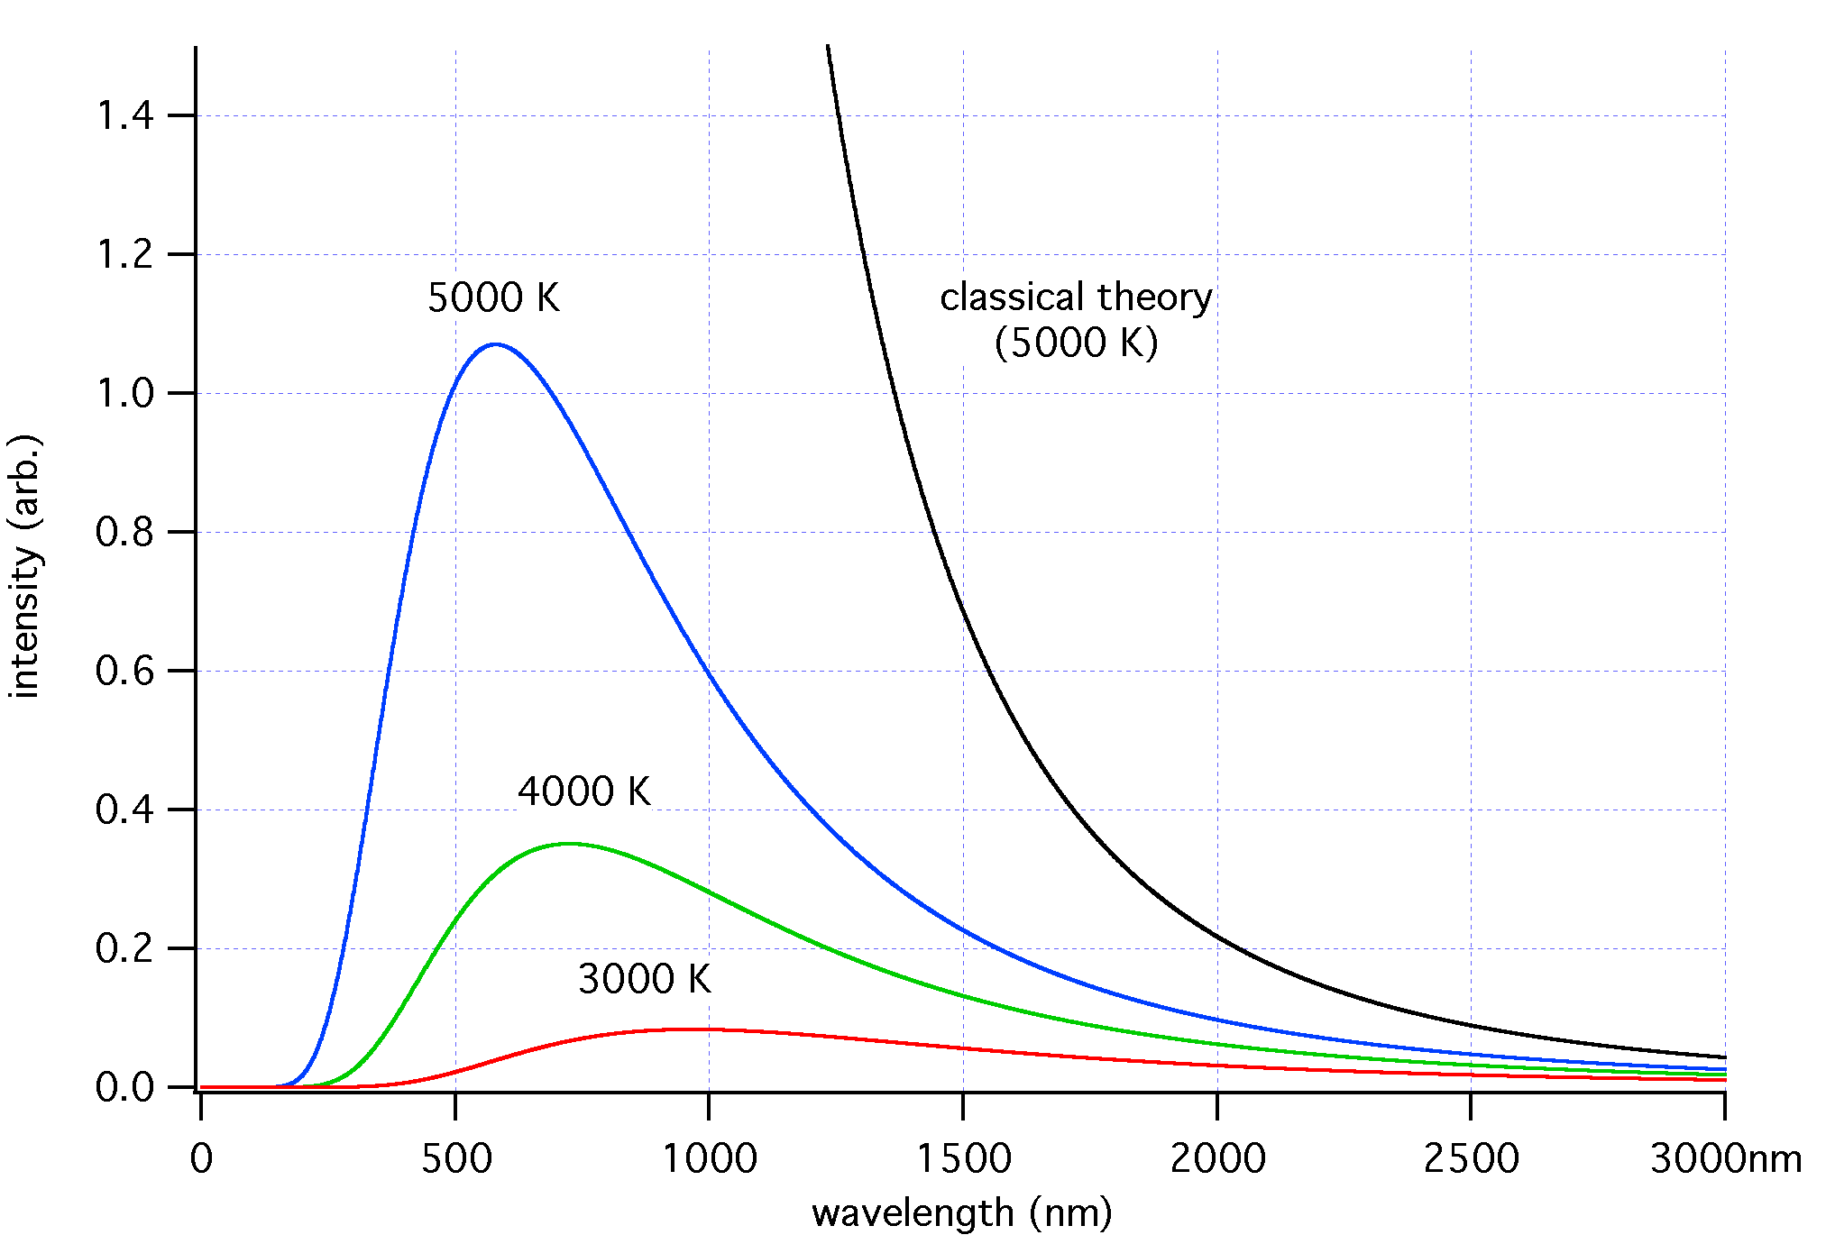
An analogy from the past…
We’ve seen something like this before: ~ 1880’s - early 1900’s physics faced three profound experimental puzzles:
1. Blackbody spectrum (Planck used ‘h’ as an experimental fitting parameter to explain observed
black-body radiation : Planck’s constant ‘h’)
2. Photoelectric effect (‘h’ shows up again but fundamentally: Einstein had to consider light coming
discrete packets e.g. ‘photons’, carrying energy = ( h x frequency)
3. Discrete atomic spectra (‘h’ shows up fundamentally yet again: Bohr had to use postulate discrete
electron orbits ‘quantized’ in angular momentum using ‘h’ to explain atomic spectra)
.
.
E4
E3
E2
E1
e⁻

Slide 7
EXAMPLE: DARK MATTER/ENERGY and FORCE ESTIMATES
Ω_{DE}
= 6.3×10⁻¹⁰ Jm⁻³
The average observed “Dark Energy” density, assuming uniform density, is the same energy density possessed by a static electric field of:
E = 12 V/m (Dark Energy)
“Dark Matter” density is even higher implying:
E ~ 10 kV/m !! (Dark Matter)
Ω_{DM}
~ 4×10⁻¹⁰ Nm⁻²
→ Measurement of Casimir effect (1996)
~ 1.3×10⁻¹⁰ Nm⁻²
→ Cold cathode ionization gauge

Slide 8
But DC effects are hard to measure unless there are fluctuations and our experience tells us that there is nothing which is fixed in space and time in the universe: the quantum mechanical vacuum – even after you take away electromagnetic, strong, weak, gravitational interactions from a volume of space -- is a seething turmoil of fluctuations…!!!
A proper understanding of these vacuum fluctuations would require measuring fluctuations at two different points of space-time vacuum…’i’and ‘j’ → Cij
‘i’
‘j’

Slide 9
SCENARIOS
→ Earth-based Observations and Measurements of Outer Space
→ Space-based Observations and Measurements of Outer Space (satellites)
→ Earth-based Observations and Measurements of the Dark Sector on Earth**
** I will be talking about this only.

Slide 10
Quantum Sensors: APPLICATIONS
→ New technology **
→ New Observational Window **
→ New Theory
** What I will talk about

Slide 11
Quantum Sensors – i.e. instruments that exploit quantum physics in general and the fundamental phenomenon of “quantum entanglement” in natural systems in particular -- have the potential of enabling “precision-” and “discovery-class” research in Fundamental Science, Quantum Information Science and Computing.

Slide 12
QUANTUM SENSORS (cont’d)
Ultimately all “signals” from experimental observation of systems are classical electric currents or voltages.
But if the source of the signal is connected with a fundamental quantum phenomena or arises from the superposition or interference of wave functions of systems which are fundamentally “entangled” quantum mechanically, the signal typically has much higher intrinsic resolution than their classical counterparts. Instruments that provide such quantum-mechanically “correlated” signals are known as “Quantum Sensors”.
Hence their potential for “precision” and “discovery”-class
→ Fundamental and Information Science via quantum-limited
“macroscopic” sensors
→ Advanced Computing via quantum-limited “macroscopic” computers
Quantum entanglement on a macroscopic scale is the magic phrase here!

Slide 13
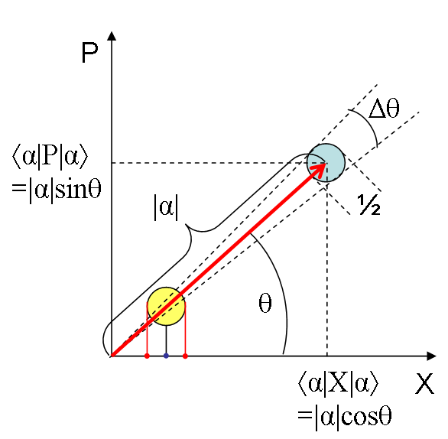
EXAMPLE: Low Level RF Detection:
Quantum-limited amplifiers suffer from zero-point noise
½ ħ= quantum of phase space area.
Simultaneous measurement of wave amplitude and phase gives irreducible zero-point noise in measurement.
(Caves, 1982)
Thermal noise = ½ kT per resolved mode
Quantum noise = 1 photon per resolved mode in the T=0 limit.
Noise photon rate exceeds signal rate in many high frequency high precision signal detection schemes for exotic searches of very “weak” processes..
Need new sensor technology….

Slide 14
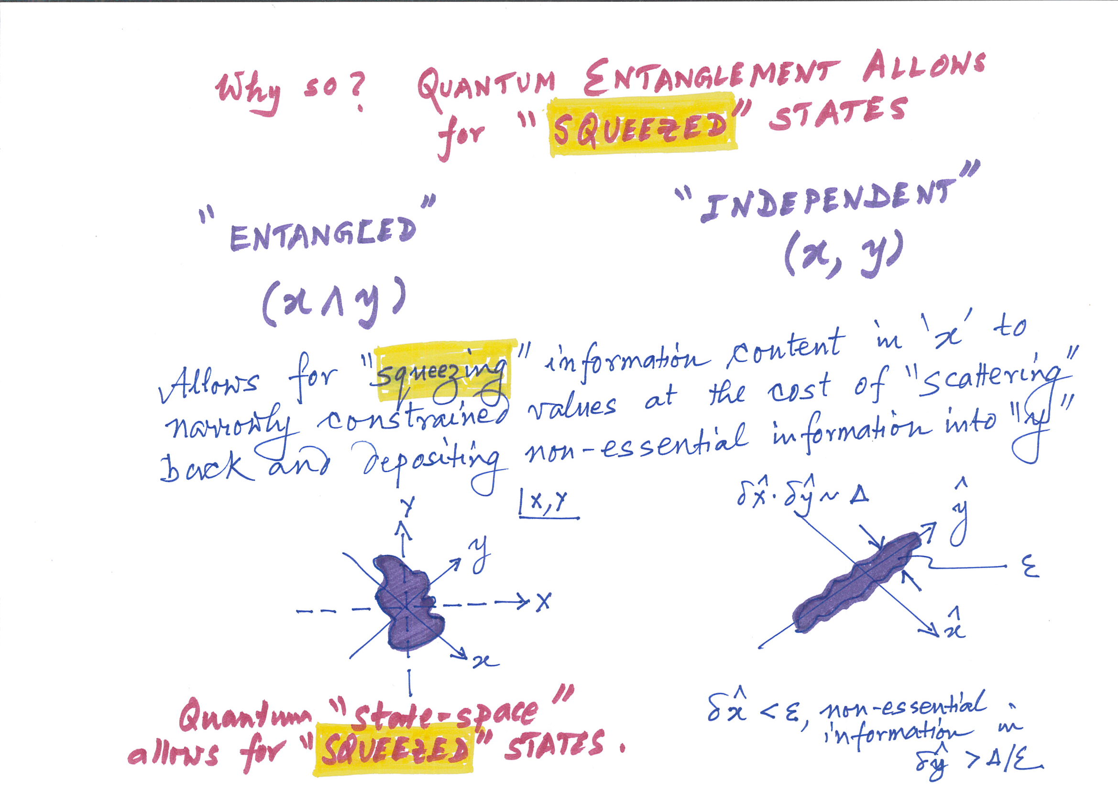
WHY SO?
Quantum Entanglement allows for “Squeezed” states

Slide 15
Quantum Non-Demolition (QND) single photon counting technique can do much better : Probing cavity photon number exactly without absorbing/destroying any photon
Number operator commutes with the Hamiltonian→ all back reaction is put into the phase. Noise = shot noise, thermal backgrounds.
Demonstrated with Rydberg atoms, (Haroche/Wineland Nobel Prize 2012)
Implemented as solid state qubits for quantum computing,
(Schoelkopf/ Schuster, 2007)
At T<30 mK, 10 GHz, Boltzmann-suppressed thermal blackbody photon background rate is 10⁻⁴ of zero-point noise.
Phase space area is still ½ħ but is squeezed in radial (amplitude) direction. Phase of wave is randomized.
4 orders of magnitude improvement in sensitivity for probing “ultra-weak” processes!

Slide 16
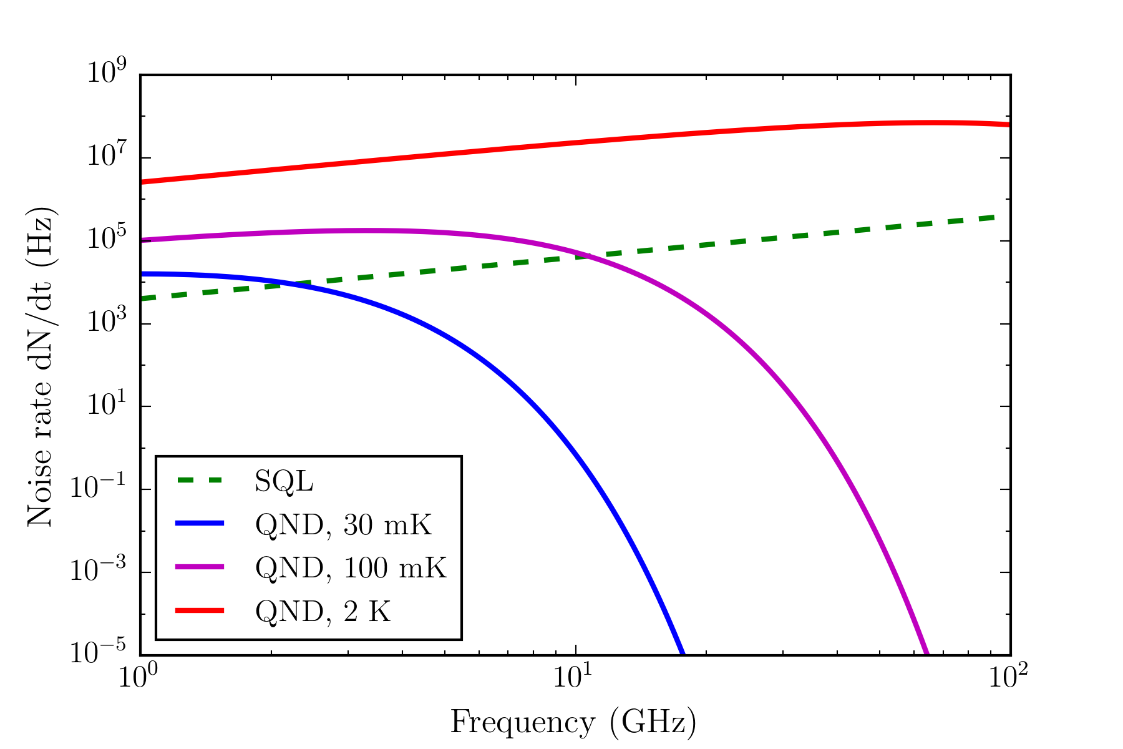
Noise rates, qubits vs quantum-limited amplifiers
Linear amplifiers suffer from the “standard quantum limit” (SQL, Caves, 1980): 1 photon’s worth of noise per frequency-resolved mode. Quantum Non-Demolition (QND) measurements’ noise is blackbody-dominant. Cooling to O(10) mK gives clear benefits.

Slide 17
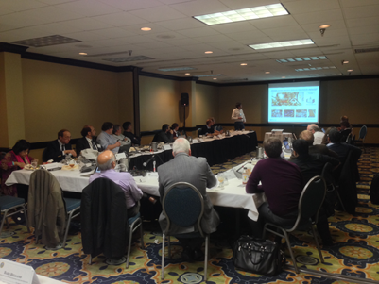
DOE
ROUND TABLE
Feb. 25, 2016
Gaithersburg, Maryland
(OHEP, ASCR, BES) including NSF, NIST and OSTP
Cross-cutting Opportunities and challenges at the quantum frontier that includes quantum sensors for HEP, material science and quantum computing

Slide 18
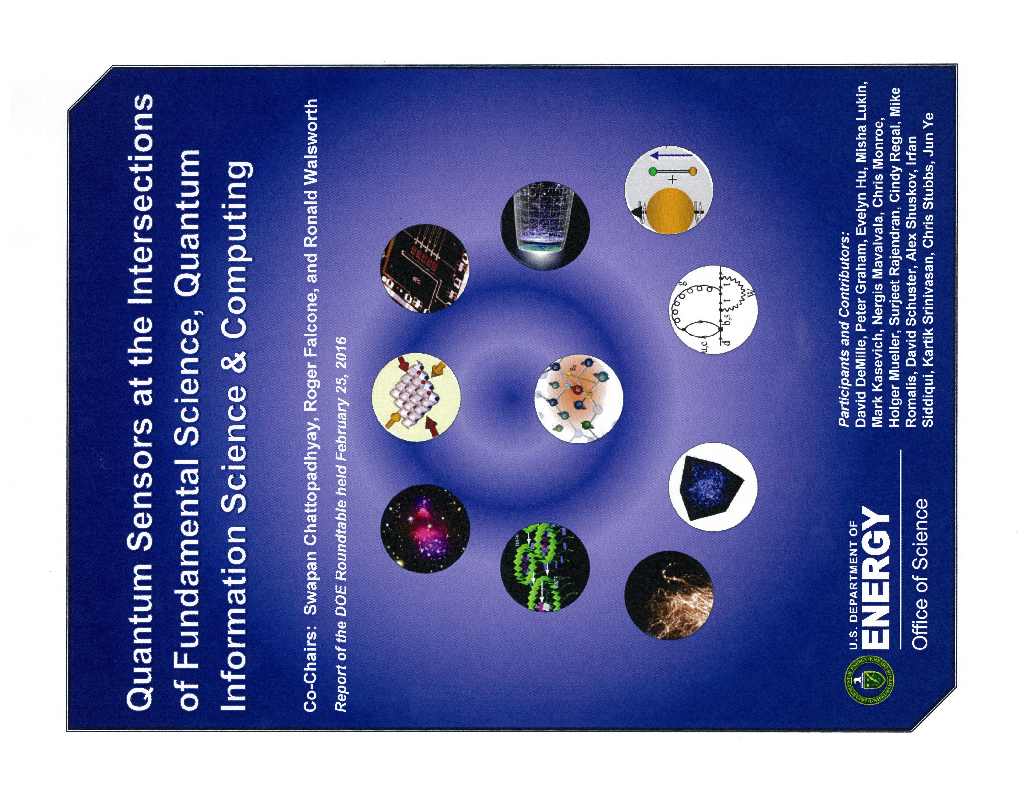

Slide 19
Google, Microsoft, IBM, Harvard, Yale, Stanford, U. Chicago, FNAL, ANL, LBNL, ORNL…all gather on October 18, 2016 at…

Slide 20
Quantum Sensors: APPLICATIONS
→ Quantum Computers: Quantum Information Science
→ Searches for New Particles/Interactions :“Dark” Matter/Energy ***
→ Probes of the very early universe: Inflationary Cosmology ***
→ Biological Signals (magneto-encephalography): Neuro-science
→ New “strongly correlated” Materials: Material Science
→ Detection of “Weak” Environmental Signals: Geo-science
*** I will cover only these albeit very briefly in this lecture.

Slide 21
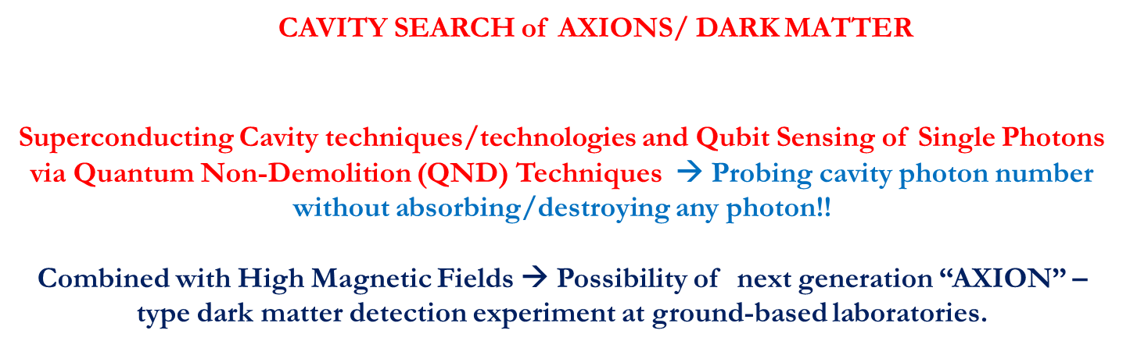
“Dark” matter Search and Detection:
Cavity Electrodynamics with “Qubits”

Slide 22

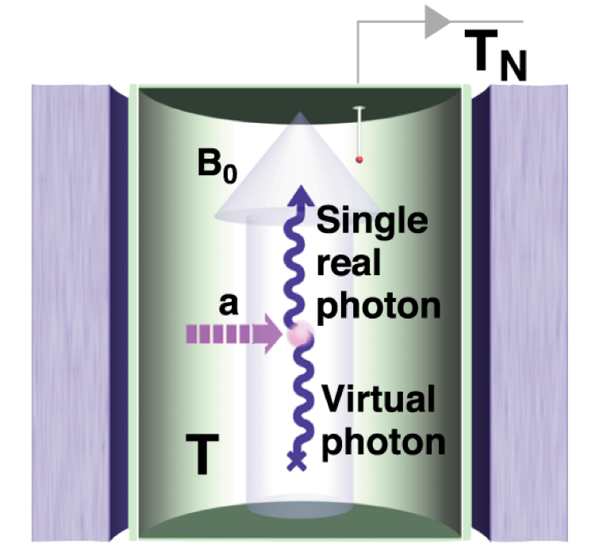
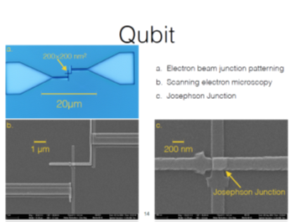
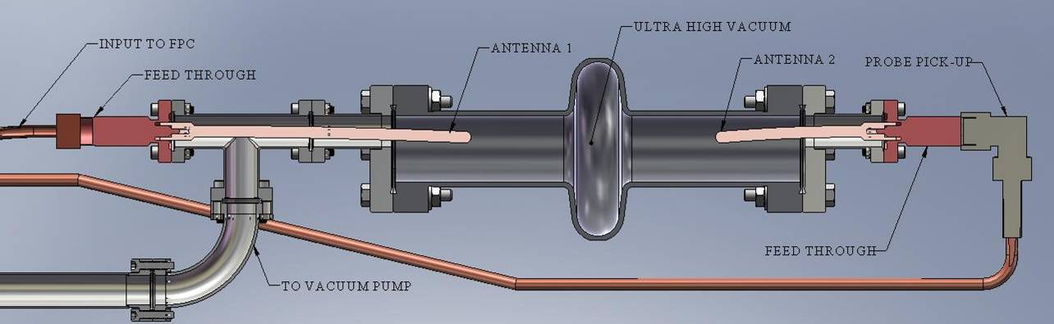
Dark Matter Detection: What kind of Effects are we looking for? 1 in 10,000,000,000,000,000,000,000,000 !!!
shield
Normal Matter
Could detect “Dark photons” or embedded in a magnetic field, could detect “Axions”.
Blocked
Dark Matter
Fancy Detector: Quantum Sensor
Pierces
Tunable superconducting resonant LC circuit (a radio)

Slide 23
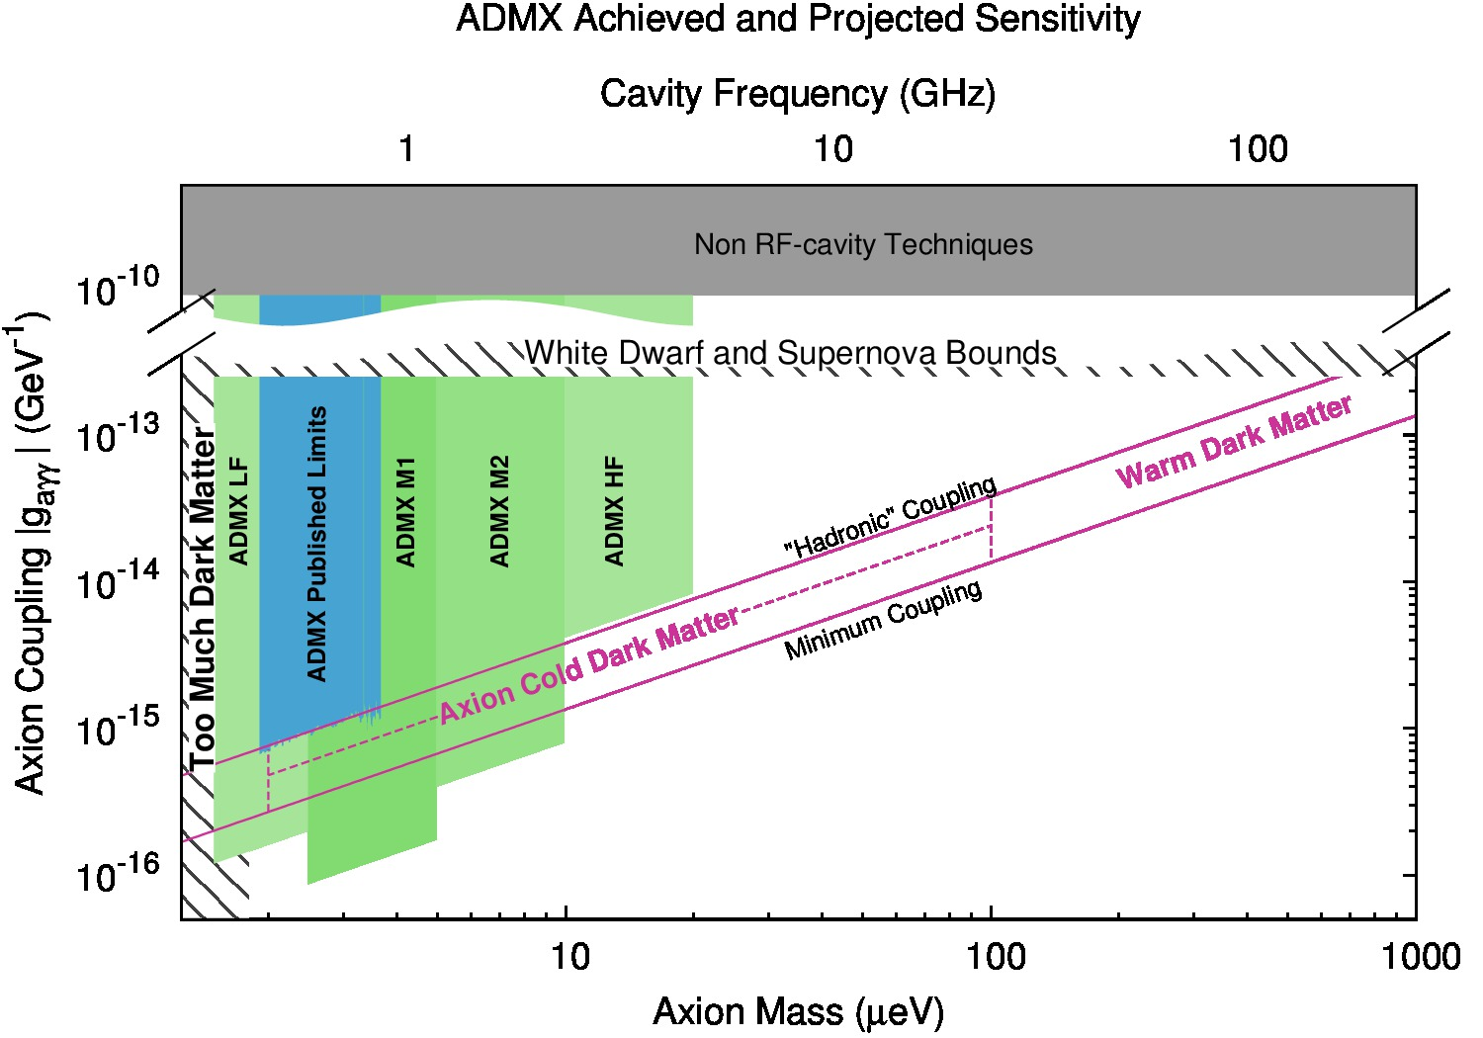
Qubit-based detectors enable coverage of remaining dark matter Axion parameter space – basis of Gen-3 ADMX experiment
ADMX Gen2 2015-2020
Lots of low hanging fruit for fundamental science applications in time frame of a decade as knowledge transfer before a practical quantum computer becomes practical in many decades!

Slide 24
Probing the Very Early Universe: via Atomic Beam Interferometry
Detection of Stochastic Low Frequency Gravitational Wave Background from the “Inflationary” Era

Slide 25
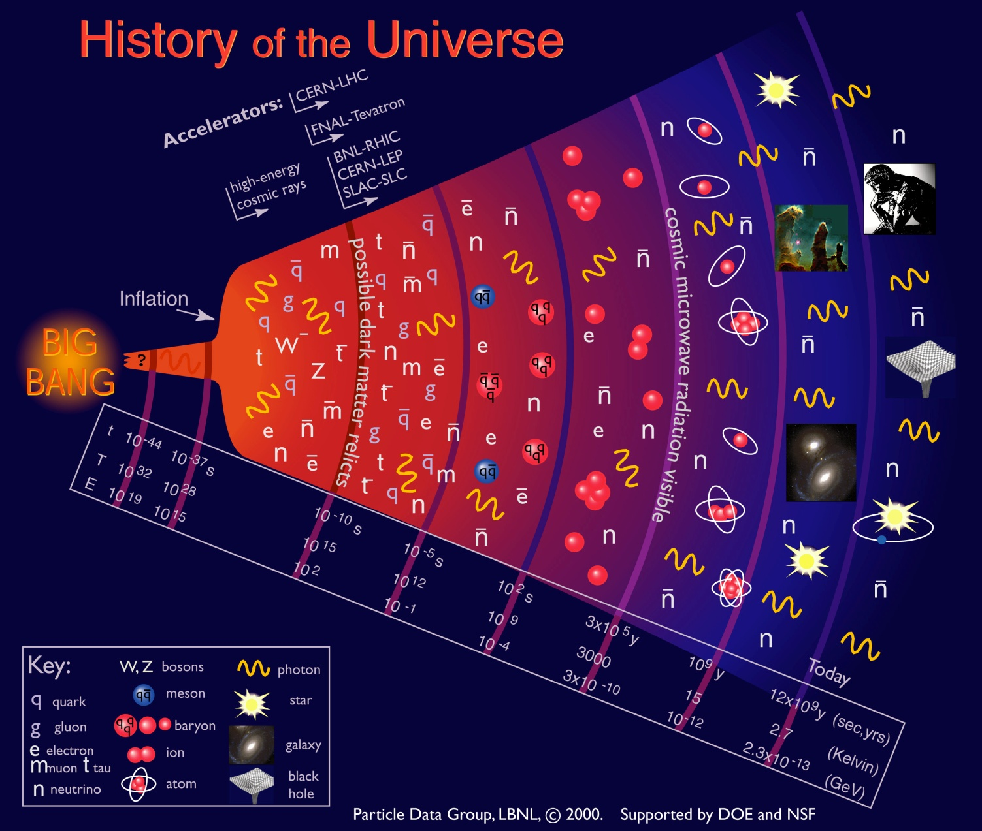
Telescopes to the early universe
Big
Bang
now

Slide 26
Telescopes to the early universe
Big
Bang
now

Slide 27
How to probe the very early universe? Gravitational waves from the very early phase (“either “bang” or “bounce”, inflation or not, may offer us appropriate probes of very early universe and the “dark sector” (nothing else – not photons or even neutrinos – seem to be of help here!)
Atomic Beam Interferometer Techniques for Dark Matter/Energy and Gravitational Wave Background Radiation Detection

Slide 28
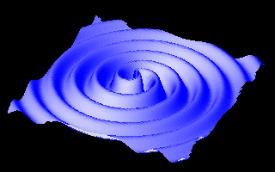
“Coherent” Gravitational Radiation
Gravitational radiation predicted by General Relativity
  Ripples in the curvature of space-time that propagate as tensor waves
Indirect evidence in seen in decay rate of binary pulsars by Hulse and Taylor
Direct observation of gravitational waves in LIGO November, 2015
(~20 – 30 Hz)

Slide 29
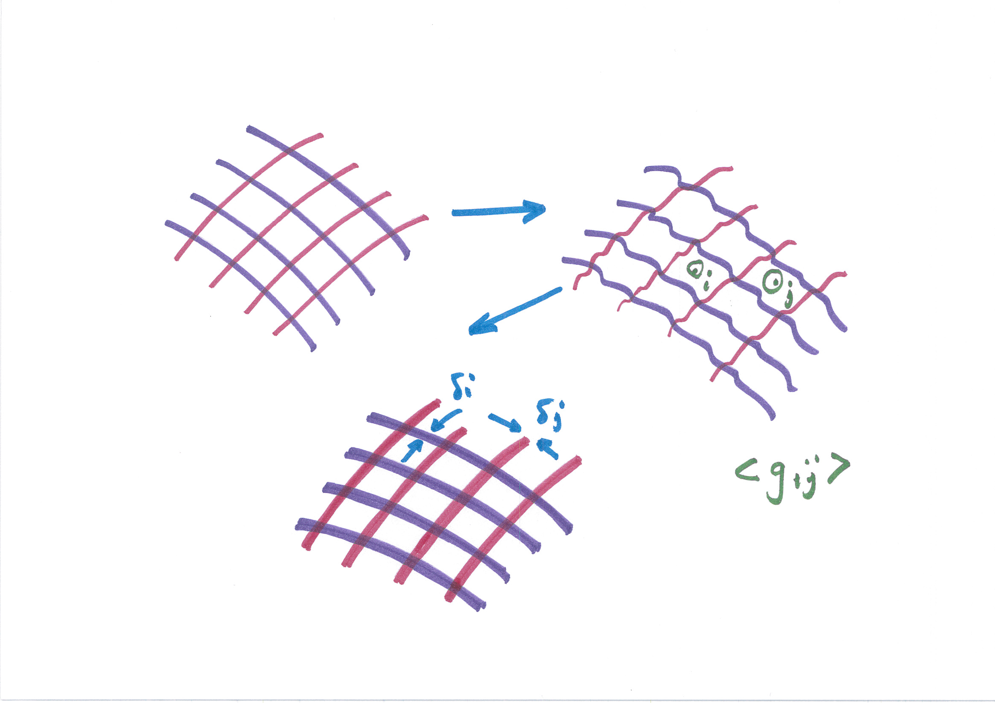
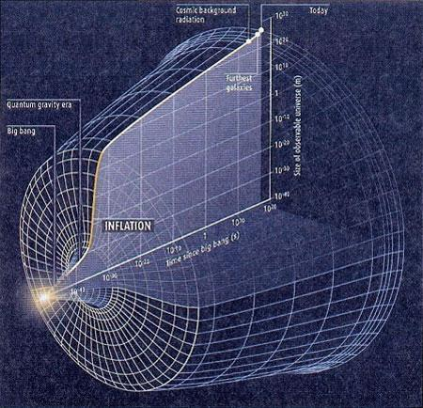
Stochastic Gravitational Radiation
Uniformity and isotropy of space embodied in the “cosmological principle” often explained by the conjecture of “ cosmic inflation”
At the end of the so-called inflationary period, the universe must have experienced a gravitational crunch, whose “tremors” must exist today as “stochastic” background gravitational waves;
Can we design sensors to “feel” these gravitational tremors ?

Slide 30

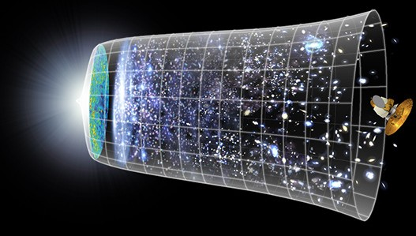
Gravitational Wave Spectrum
CMB
new sensors
10⁻² Hz 10⁻¹ Hz 1 Hz 10
LIGO
10⁻¹⁸ Hz
10⁻⁴ Hz 10⁻³ Hz
Hz 10² Hz
10³ Hz
e.g. inflation may be observable in
1 Hz Band
Cosmology best probed at frequencies ~ 1 Hz and below:
e.g. phase transitions, reheating, dark
energy (redshifts), etc.

Slide 31
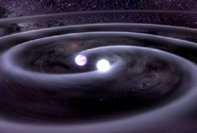

GW detection with atoms
frequency
L (1 + h sin(ωt ))
strain
Measure differential acceleration between two inertial masses
 | LIGO | Atom Interferometry
Proof mass | Suspended end mirrors | Freely falling atoms
Proof mass separation | Laser interferometry | Light flight time
Reference | 2nd interferometer arm | Atomic phase (clock)

Slide 32
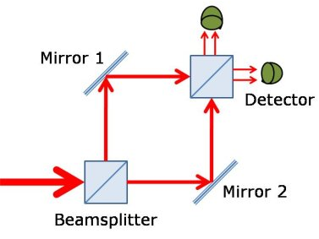
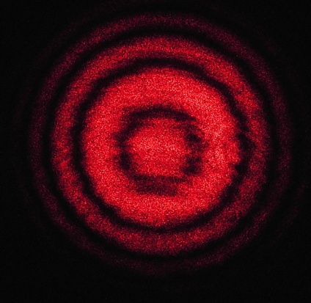
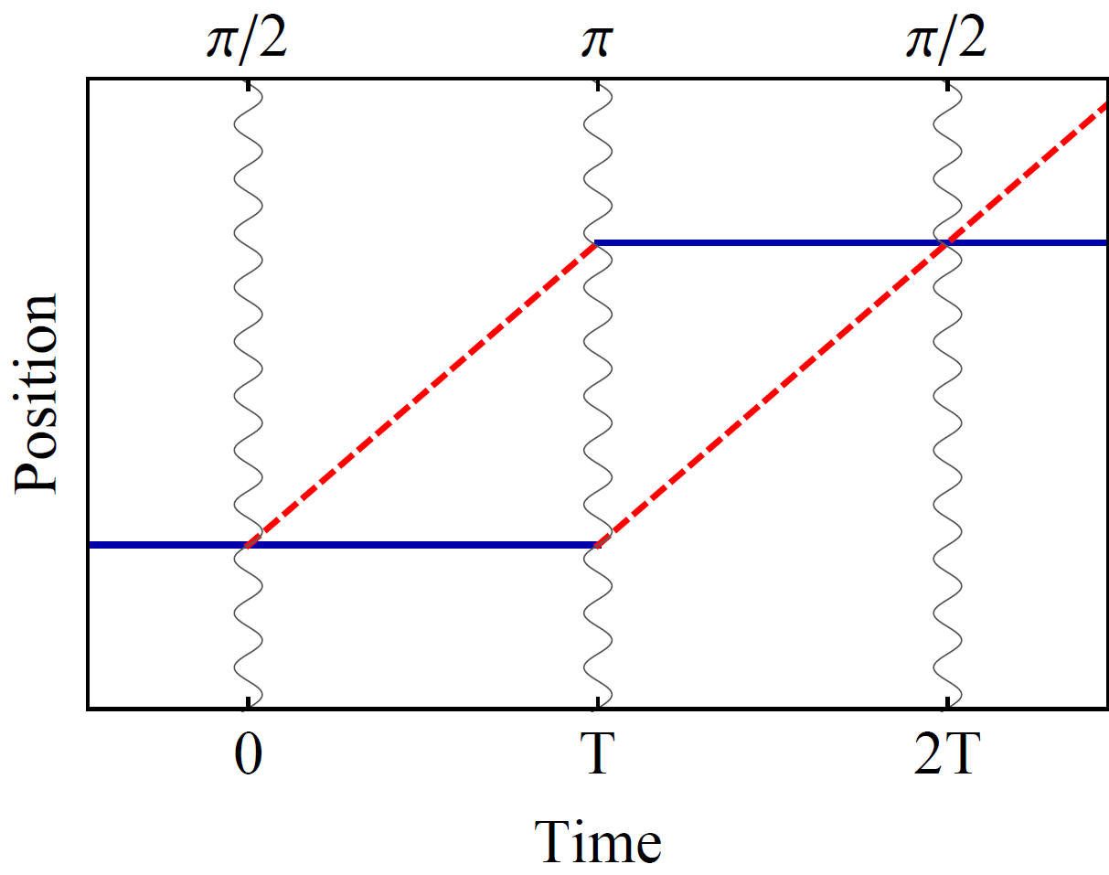
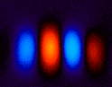
Atom interference
Light interferometer
Light
Light fringes
Atom interferometer
Beamsplitter
Atom fringes
Atom
Beamsplitter
Mirror
http://scienceblogs.com/principles/2013/10/22/quantum-erasure/
http://www.cobolt.se/interferometry.html

Slide 33

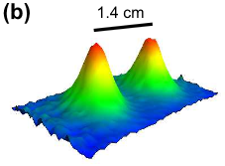
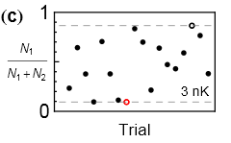
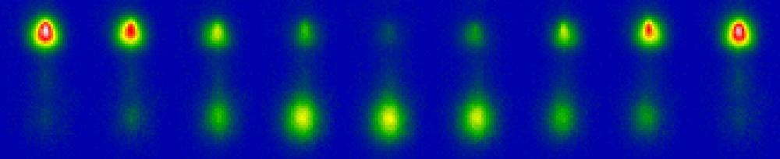

Interference at long interrogation time
Port 1
Port 2
Wavepacket separation at apex (this data 50 nK)
2T = 2.3 sec; Near full contrast
6.7×10⁻¹² g/shot (inferred)
Demonstrated statistical resolution: ~5 ×10⁻¹³ g in 1 hr (⁸⁷Rb)
Interference (3 nK cloud)
Dickerson, et al., PRL 111, 083001 (2013).

Slide 34
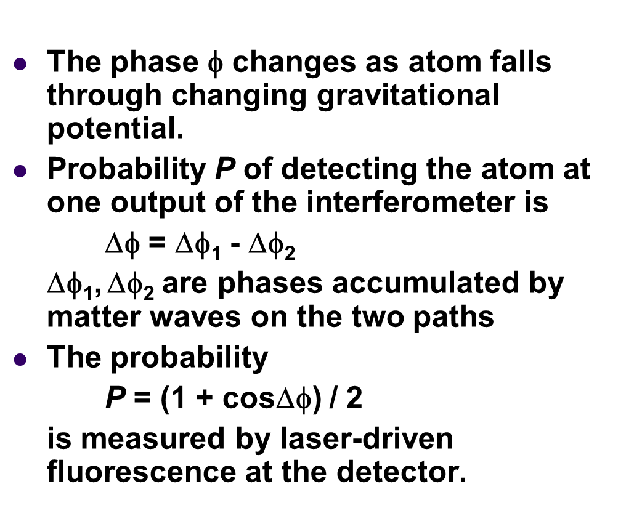
Wave function of atom has phase factor exp(iφ)
The wavefunction
Phase
~ k.z ~ k.g.
10 m fall ~1 sec
100 m fall ~ 3.2 secs
1000 m fall ~ 10 secs
T²

Slide 35
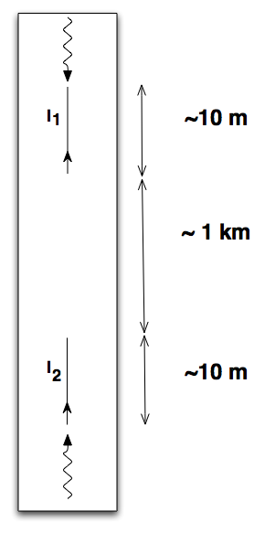
Dark Energy and Gravitational Wave Detection with Atomic clock Gradiometers
Gravitational waves @ 1 Hz could open the window for direct tests of cosmic inflation, frequency range inaccessible to LIGO/LISA. Atomic interferometers can also be sensitive detectors of “dark” energy.
EXAMPLE:
Two 10 m atom interferometers at either ends of a mine shaft. Both interferometers will be operated by common lasers. Signal scales with length ~ 1 km between interferometers.
Allows free fall time ~ 1s. Maximally sensitive in the
1 Hz band.
→ POSSIBILITIES in the Sanford Lab where
DUNE long-baseline neutrino experiment
will be carried out by a global team using
high powered beams from Fermilab sent
to underground detectors with a vertical
shaft of a few kilometers.

Slide 36
Clock Gradiometer
Common interferometer laser beam
• Clock - Single photon transitions in clock atoms (Sr, Yb,..)
• Gradiometer - Compare two separated clock atoms
• Inertially sensitive (e.g., accelerometer pulse sequence)
• Common laser phase noise

Slide 37
∆φ=0

Slide 38
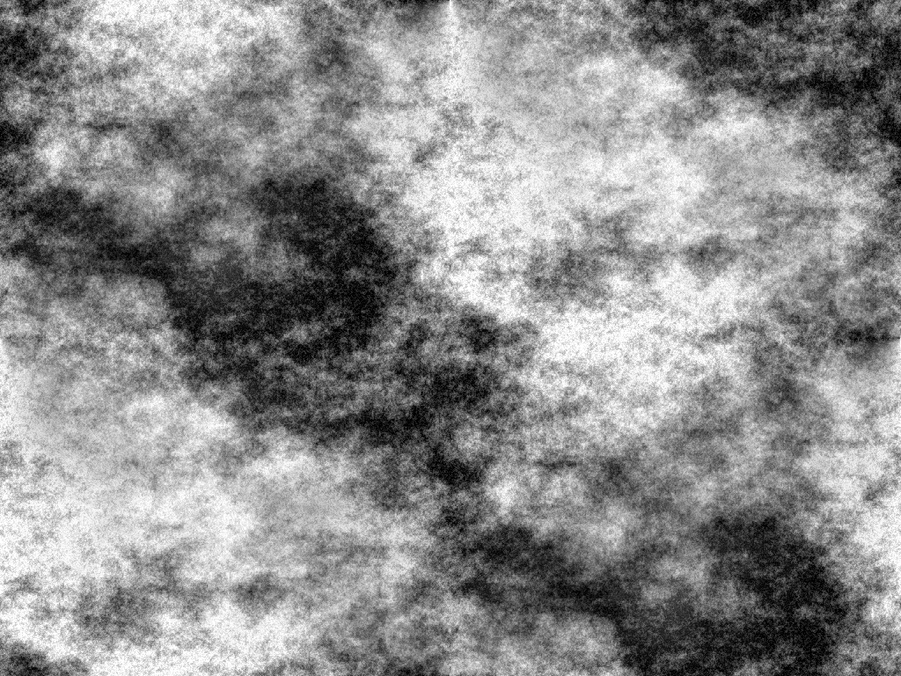
∆φ≠0…

Slide 39
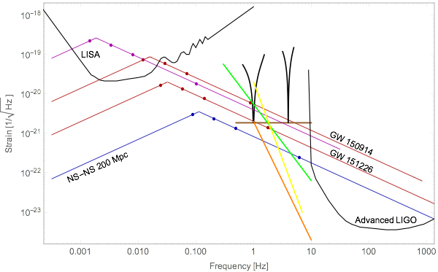
Projected Terrestrial GW Sensitivity

Slide 40
Mid-band Gravitational Wave Detection
C. J. Moore et al., Class. Quantum Grav. 32, 015014 (2015)

Slide 41
Hence “dark” sector and gravitational wave background search using Atomic Beam Interferometers at Fermilab.
Early Explorations at Fermilab
Precision Neutrino science in deep underground facilities a Core Competency of Fermilab.
A vertical underground shaft a few kilometers long already exists at the Sanford Lab housing the DUNE experiment.
A 100 meter tall NuMI shaft already exists in the MINOS facility which can be carefully examined for an intermediate experiment.

Slide 42
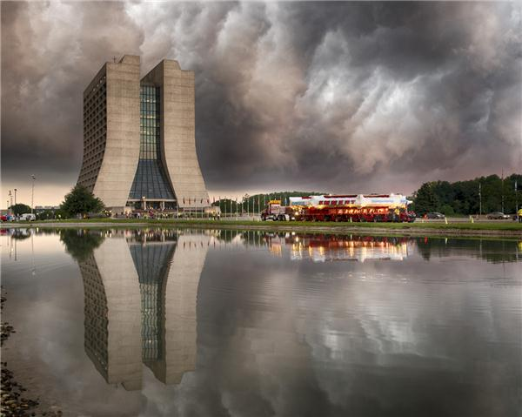
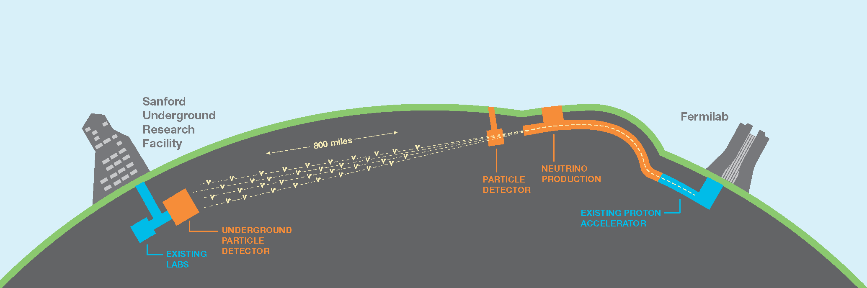
LBNF-DUNE @ Fermilab houses 4 km vertical shaft

Slide 43
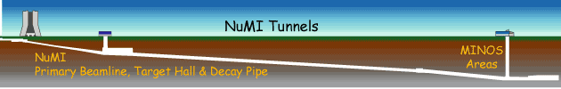
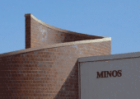
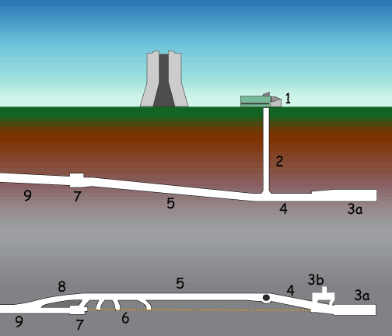
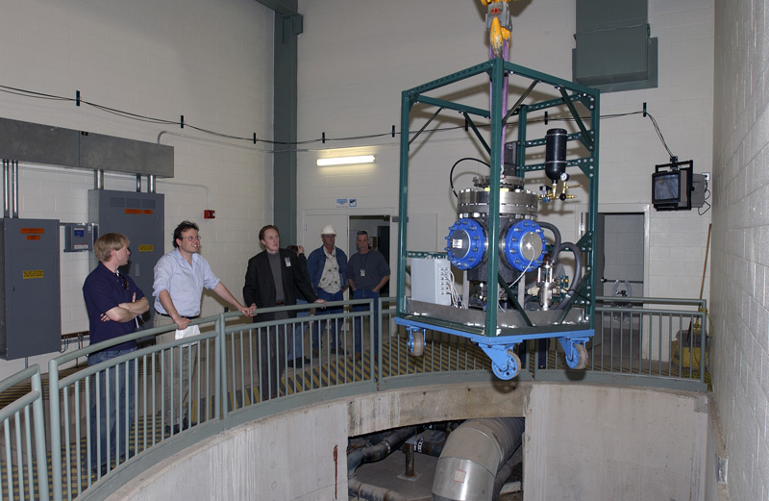
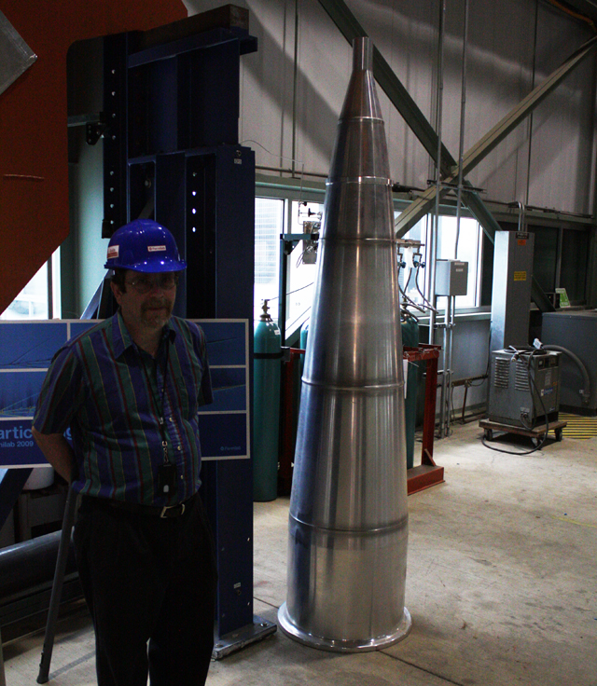
105 meter tall NuMI shaft in the MINOS

Slide 44
Estimated Sensitivity
GW strain sensitivity
DM sensitivity (coupling
to electron mass)

Slide 45
CHALLENGES:
Systematic accounting of various noise sources
Gravity Gradient Noise
Environmental Newtonian Noise
Coriolis Effect
Intrinsic Atomic Clock Stability (currently but projected to extend to with 10⁸ free Sr atoms at 50 pK as opposed to much fewer atoms bound in an optical lattice, thus raising ‘shot’ noise)
Laser wave-front “jitter”/noise (equivalent to seismic noise in LIGO)
10⁻¹⁸
10⁻²²

Slide 46
OUTLOOK
HOW to EXPLOIT THE PROMISE of QUANTUM SENSORS!
Potential laboratory-based “mezzo-scale” scientific experiments, incorporating quantum sensors, laboratory core competencies in Microwave Superconductivity and Detector Technologies and in collaboration with academic experts in Superconducting Qubits and Atomic Beam techniques
→ Will advance the field of particles physics, astrophysics and cosmology.
Such a program has the promise to complement the program based on
accelerators, colliders and other detector facilities, reaching frontiers
unexplored to date;
The potential for developing a prototype Quantum Computer surpassing classical computation limits exploiting superconducting technology is too exciting to be ignored;
→ Critical for the education, training and engagement of the next generation of scientists/engineers!

Slide 47
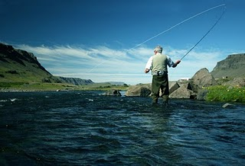
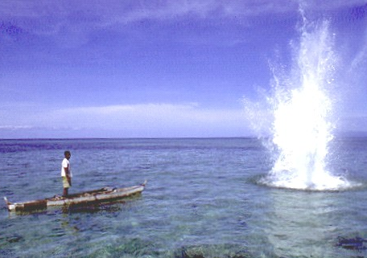
Thank You!!!!
(Photo courtesy: Chris Stubbs, Harvard)

