Slide 1
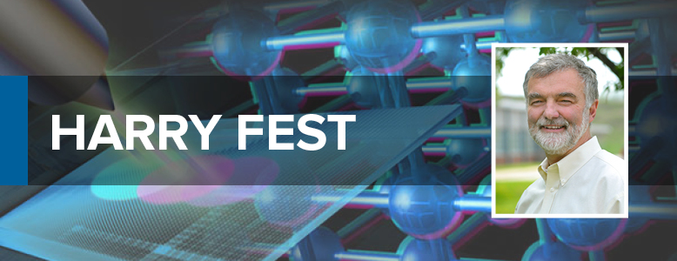
Neutrinos at Fermilab
Neutrinos at Argonne

Slide 2
E594 goals
Neutral currents had been firmly established by Jorge, Harry and others at CERN & FNAL.
Harry and others at CERN & FNAL used charged current (CC) events to measure structure functions
The main goal was to measure neutral current (NC) structure functions using a detector that could better measure the angle of hadron showers,
R = NC/CC ratio for ν & ν sensitive to Weak mixing angle/Weinberg angle θ_{W}

Slide 3
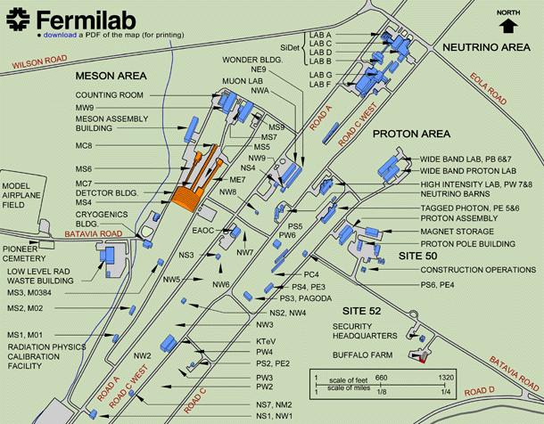
MIT, FNAL & MSU used Lab C
Lab C

Slide 4
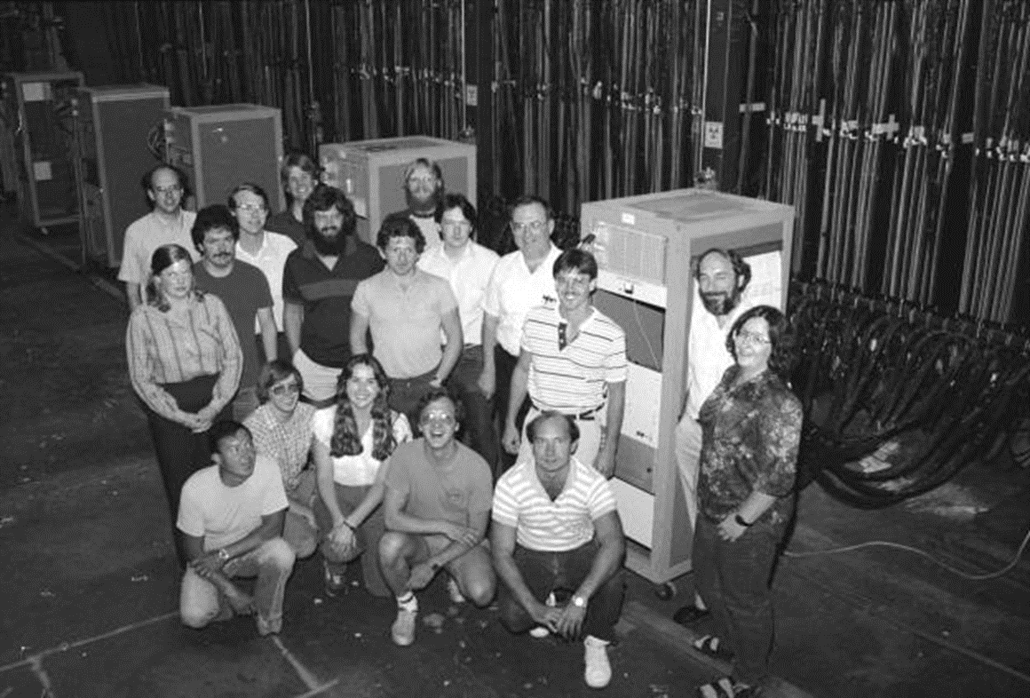
E594 detector
Each module had:
8 x flash chambers
4 u flash chambers
4 v flash chambers
8 planes of sand
8 planes of steel shot
1 proportional counter

Slide 5
E594 sample events
Neutral Current
Charged Current
Quasielastic

Slide 6
Fermilab neutrino beams
Wide band beam (WBB)
  Use horns to focus maximum flux of π and K forward
  Largest flux
Narrow band beam (NBB)
  Use dipoles to momentum select π and K.
  Two body decay kinematics leads to correlation of radial vertex in the detector with neutrino energy
  “dichromatic beam”

Slide 7
Weinberg’s nose
Wide band beam
Ratios of NC to CC events for neutrino and antineutrino

Slide 8
Oscillations (NBB)
Harry with Juan Bofill
In quasielastic interactions, the final state leptons (mostly muons) approximately have the full beam energy.
If ν_{μ} →ν_{τ}, the τ will have the beam energy, but will not go far in the detector before it decays. It decays about 18% each: τ ◊ μνν; τ◊eνν
The e and μ will have less than half the beam energy.
Bofill et al., Phys. Rev. D36 3309 1987.

Slide 9
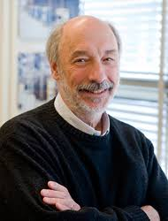
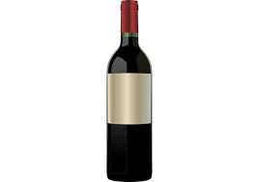
From
Frank Taylor, MIT
E594 co-spokesperson
I recollect that Harry worked with Juan Bofill on neutrino oscillations, which ultimately lead to Juan's thesis and a publication of Bofill, et al. that appeared in PRD (Phys. Rev. D36 (1987) 3309). Juan and Harry worked well together and Harry was Juan's informal thesis advisor. Harry was a 'happy warrior', always quick to understand and ready for a comeback to any joke cast his way. Harry was invited to give a Wine and Cheese Seminar on our search for oscillations but at a time when the analysis was still in the very early stages. I was worried about what Harry (and Juan) would be able to report – especially in light of the competition of the Lab E neutrino experiment, which was focused on a two-detector exploration of neutrino oscillations and had a larger team and a heavier detector. There were several E594 meetings to go over the material on Thursday but the talk had not 'converged' before late afternoon. As a consequence, Juan and Harry decided to meet after dinner back at the lab to work on the final transparencies. I joined them on the tenth floor of the HR and found them in deep discussion and the talk not together. Further, in order to aid in clear thinking, they had opened a bottle of red wine and were sipping and discussing the analysis. I tried to help but was completely out of depth and left them to complete the talk, which must have taken a good part of Thursday night and early Friday morning. By Friday afternoon, Harry and Juan had the talk together and Harry gave it with great calm and grace under the inevitable fire from Drasko Jovanovic. That was Harry –
Harry – I wish you all the best in retirement. It is a chance to sip red wine without having to prepare a talk for the next day.

Slide 10
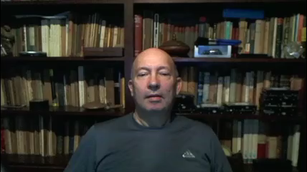
Juan Bofill

Slide 11
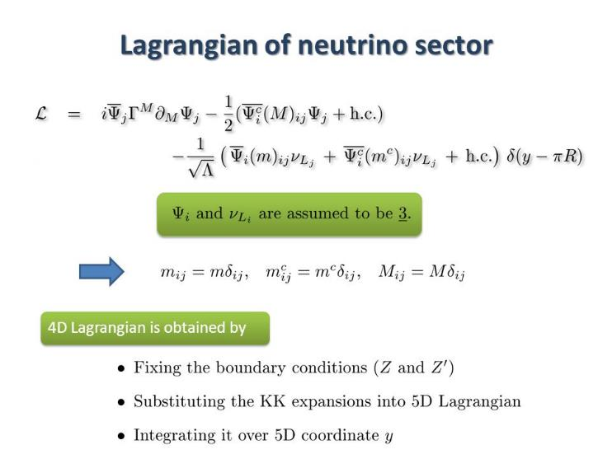
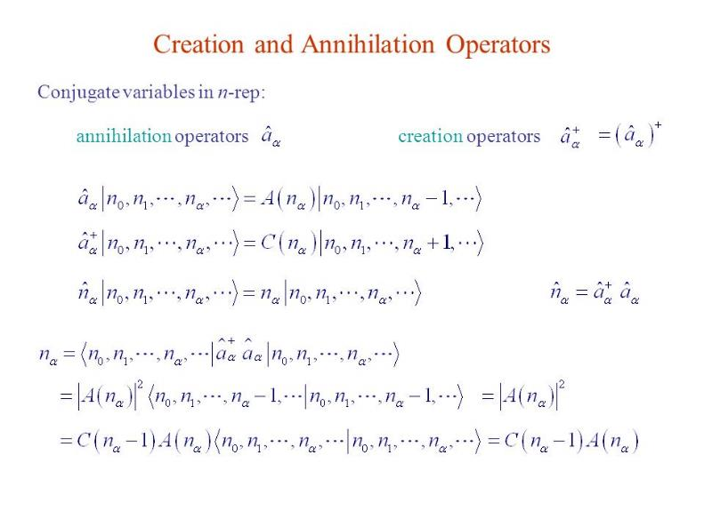
E594’s greatest accomplishment
neutrino creation operators
Neutrino Lagrangian creation operators

Slide 12
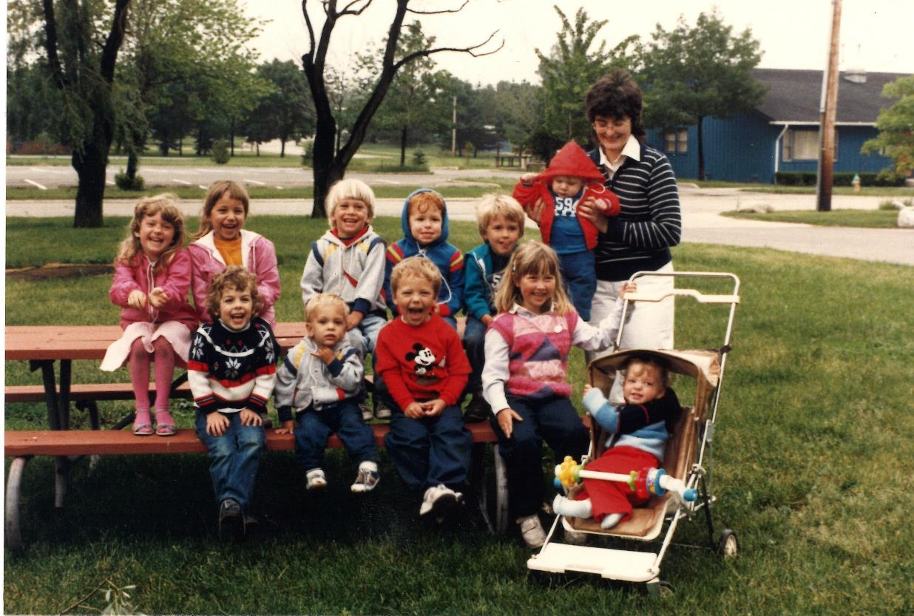
E594’s greatest accomplishment
A different creation operator

Slide 13
Neutrinos at ANL
Shifting to Argonne
After a worldwide division director search in 2004, Harry came to HEP in 2005 and stayed in HEP until 2014 and at ANL till 2018
This overlapped a time of intense activity for the neutrino group and remarkable progress in our understanding of the neutrino sector
Since the end of E594, we’ve gone from “neutrinos are massless” to measuring 3 mixing angles, both Δm², and arguably the mass ordering and evidence for CP violation in the neutrino sector.

Slide 14
ν at Argonne
Before Harry
1970s Long history of νs at ANL, ZGS bubble chamber
Neutrino group evolved from PDK group
  Soudan 1 1980-1985
  Soudan 2 1984-1999
Soudan mine natural location for MINOS
  Approved 1995
Super-K confirmed neutrino oscillations 1998
Followed quickly by resolution of solar neutrino anomaly by SNO, solar mixing angle by KamLAND, ν_{τ} by DONUT

Slide 15
ν at Argonne since Harry
MINOS analysis
Reactor experiment
NOνA
LBNE/DUNE

Slide 16
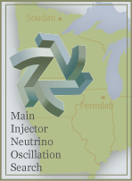
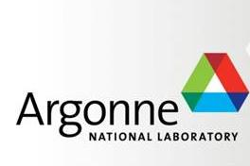
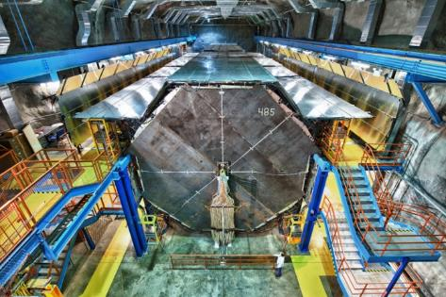
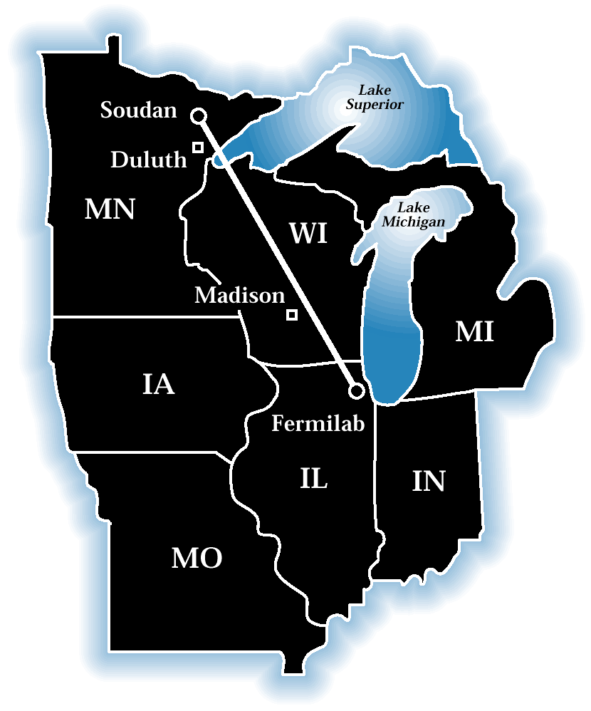
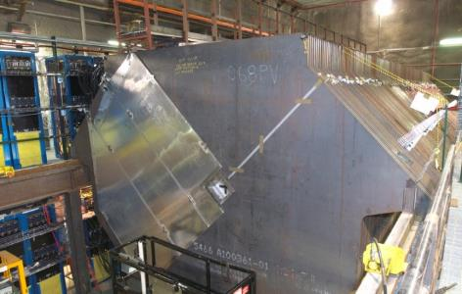
MINOS
16
Long-baseline neutrino oscillation
experiment
  L/E ~500 km / GeV
Exposed by the NuMI beam
  Runs off the FNAL Main Injector
Two detector system used to
minimise systematics:
  Beam flux/interaction cross-sections
Look for:
  ν_{μ} disappearance
  ν_{e} appearance
  Neutral current events
Far Detector
Near Detector

Slide 17
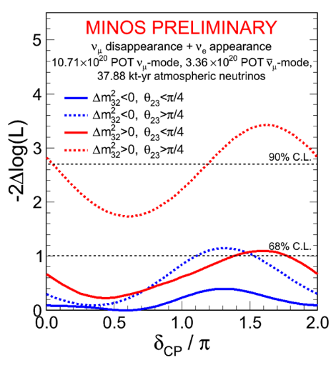
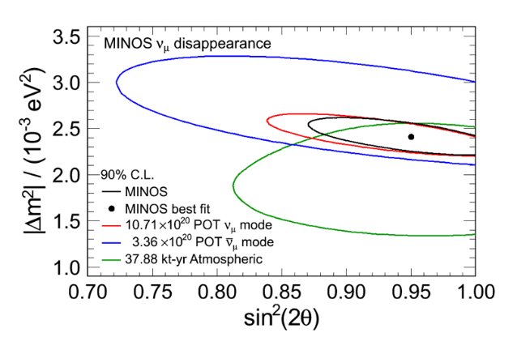
MINOS results
World’s best measurement of Δm²₃₂
First comparison of
ν & ν.
A first indication of ν_{e} appearance

Slide 18

After MINOS, what next for ν?
A Groucho Marx Question*, “Two of the three mixing angles have been measured. What should we do next?”
* At the end of the show, Losing contestants would get questions with obvious answers, so that everyone won some money. Example: “Who was the Jane Addams Memorial Tollway named after?”

Slide 19
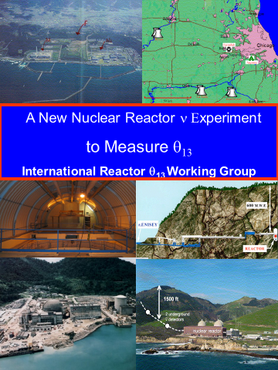
Reactor study
2004
Argonne Led the International reactor neutrino working group whose report led to Double Chooz, Daya Bay and RENO

Slide 20
Double Chooz

Slide 21
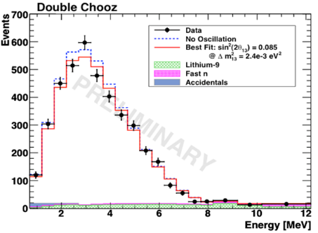
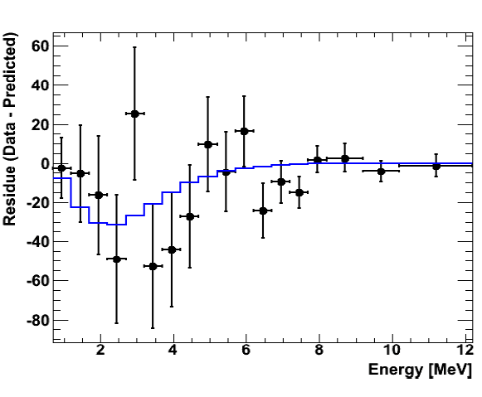
Double Chooz results
Rate+Shape Analysis:
sin²(2θ₁₃)=0.085+-0.051 (0.041 stat.)
First indication of non-zero θ₁₃ in the new round of reactor neutrino experiments. (2011)
This result led Daya Bay to stop construction, run 6 of their 8 detectors, and get the same result in 5 weeks.

Slide 22
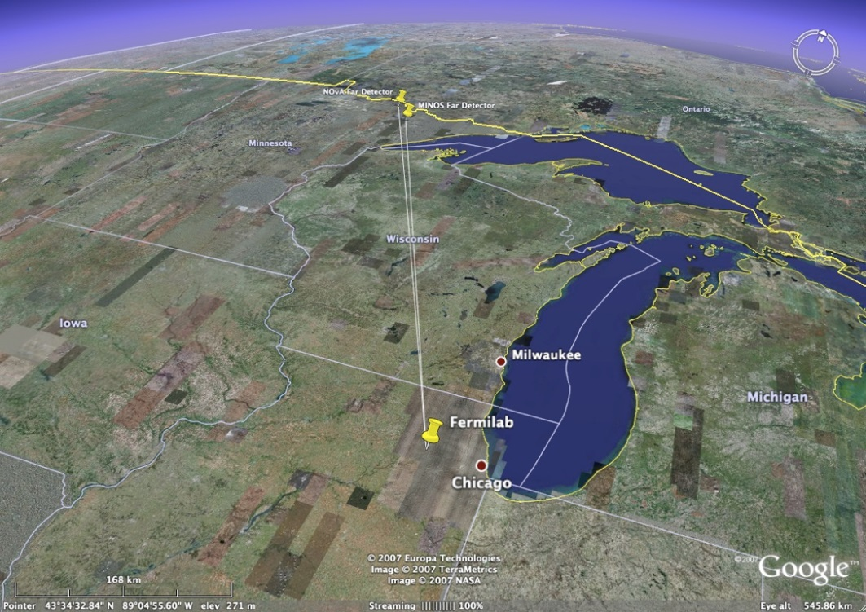
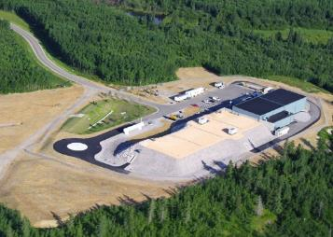
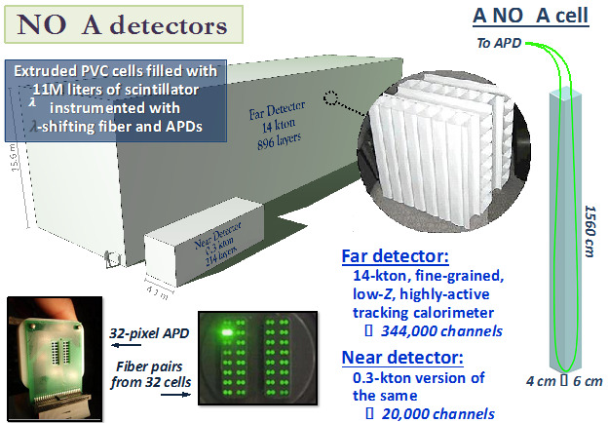
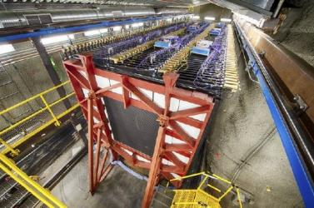
NOvA off-axis ν experiment
Far detector 810 km from source and
14.6 mrad off-axis
Far detector
Near detector

Slide 23
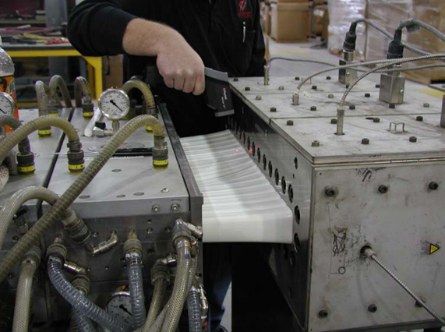
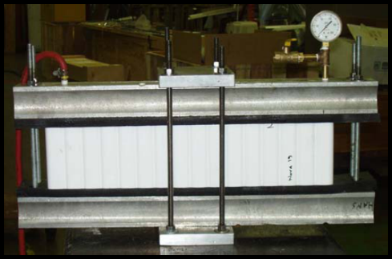
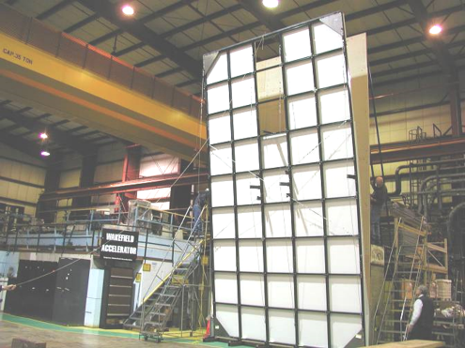
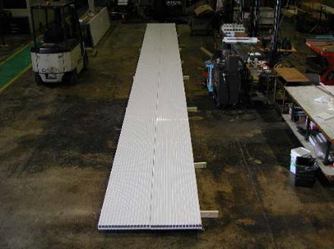
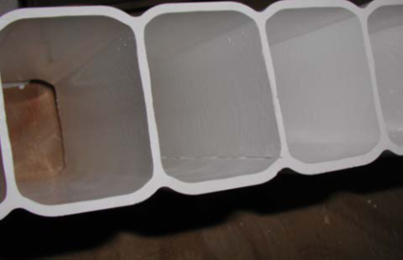
NOνA construction
Building extrusions
Testing Extrusions

Slide 24
NOνA results
ν_{μ} disappearance and ν_{e} appearance from .9e20 POT
Inverted mass ordering ruled out at 95% CL by NOvA alone.

Slide 25

Intensity Frontier Activities leading to P5
August 2011
Sections on:
Neutrinos
Heavy quarks
Charged leptons
Nucleon decay
New particles
Nuclei & atoms

Slide 26

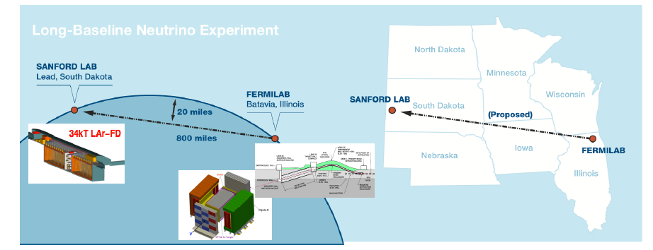
LBNE/DUNE
We helped establish LBNE→ELBNF →DUNE ; now >1000
Will measure ν parameters, search for nucleon decay, & measure a galactic supernova if it happens during lifetime.

Slide 27
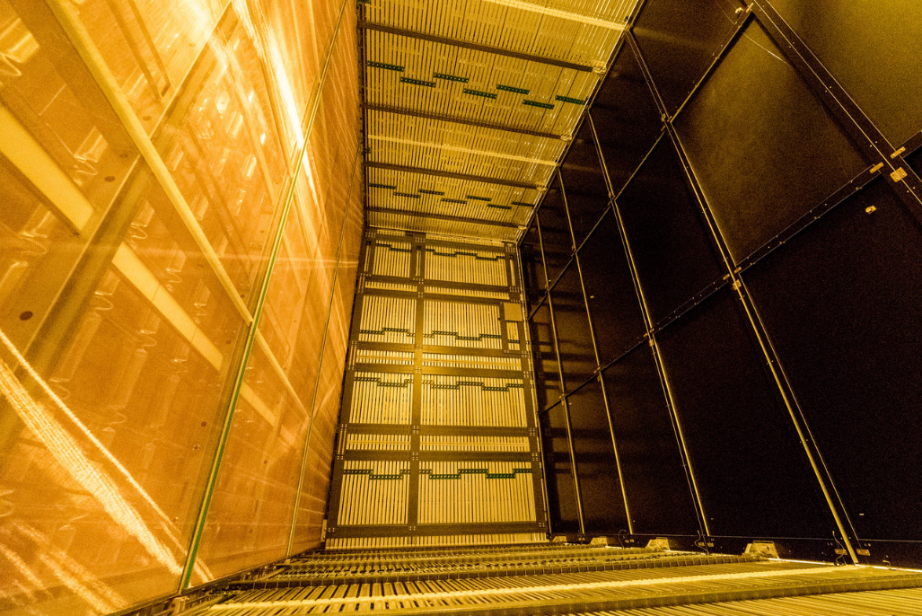
ProtoDUNE
Light Sources
Developed at ANL
Field Cage
Designed at ANL
Cathode Planes
Fabricated at ANL
Photon Detector Readout
Built at ANL

Slide 28
Amy Allen
Dave Ayres
Ioanna Anghel
Mobolaji Bankole
Louie Baqrrett
Minerba Betancourt
Paul Bloom
Matthew Castillon
Cesar Castomonte
Michelangelo D’Agostino
Gavin Davies
Mason Dearborn
Ranjan Dharmapalan
Xiangyu Ding
Zelimir Djurcic
Tiernan Evans
Tom Fields
John Forbes
Tapasi Ghosh
Gavril Giurgiu
Ricardo Gomes
Dan Gonzalez
Lisa Goodenough
Maury Goodman
Muhammed Hayat
Andrew Hoffman
Xiabo Huang
Lisa Lin
Iris Liu
Sarah Mancini
Aaron McGowan
Travis Mui
Alex Munoz
Ryan Murphy
Jon Paley
Monica Ramirez
Sarah Phan-Budd
Juergen Reichenbacher
David Reyna
Himansu Sahoo
Phil Schreiner
Jose Sepulveda-Quiroz
Louise Suter
Richard Talaga
Stefano Tognini
Matthew Wetstein
Guang Yang
Julia Ye
Raquel Young
Shiqi Yu
50 ANL Neutrino group people
2005-2017
Harry was always very supportive of the students and physicists in the ν group.
He supported our manpower needs, and gave us help from engineers & technicians, who did much of the real work
With that help, MINOS, Double Chooz, NOvA, LBNE & DUNE made significant contributions as we’ve understood the neutrino parameters one at a time
And planned for the future of U.S. HEP

Slide 29
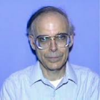
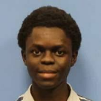
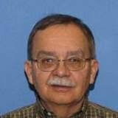
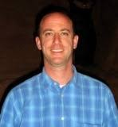
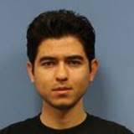
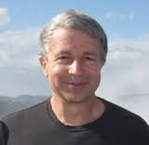
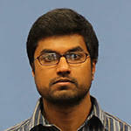
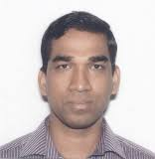
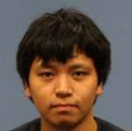
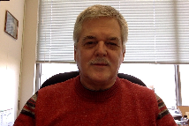
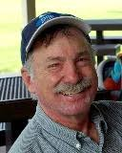

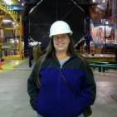


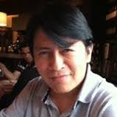
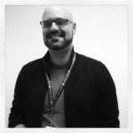

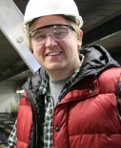
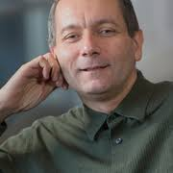
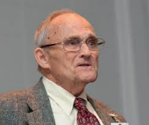
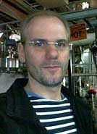
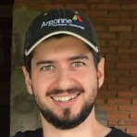
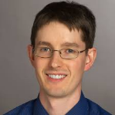








50 ANL Neutrino group people
2005-2017
Amy Allen
Dave Ayres
Ioanna Anghel
Mobolaji Bankole
Louie Baqrrett
Minerba Betancourt
Paul Bloom
Matthew Castillon
Cesar Castomonte
Michelangelo D’Agostino
Gavin Davies
Mason Dearborn
Ranjan Dharmapalan
Xiangyu Ding
Zelimir Djurcic
Tiernan Evans
Tom Fields
John Forbes
Tapasi Ghosh
Gavril Giurgiu
Ricardo Gomes
Dan Gonzalez
Lisa Goodenough
Maury Goodman
Muhammed Hayat
Andrew Hoffman
Xiabo Huang
Lisa Lin
Iris Liu
Sarah Mancini
Aaron McGowan
Travis Mui
Alex Munoz
Ryan Murphy
Jon Paley
Monica Ramirez
Sarah Phan-Budd
Juergen Reichenbacher
David Reyna
Himansu Sahoo
Phil Schreiner
Jose Sepulveda-Quiroz
Louise Suter
Richard Talaga
Stefano Tognini
Matthew Wetstein
Guang Yang
Julia Ye
Raquel Young
Shiqi Yu

Slide 30














From ANL Neutrino people
Amy Allen
Dave Ayres
Ioanna Anghel
Mobolaji Bankole
Louie Baqrrett
Minerba Betancourt
Paul Bloom
Matthew Castillon
Cesar Castomonte
Michelangelo D’Agostino
Gavin Davies
Mason Dearborn
Ranjan Dharmapalan
Xiangyu Ding
Zelimir Djurcic
Tiernan Evans
Tom Fields
John Forbes
Tapasi Ghosh
Gavril Giurgiu
Ricardo Gomes
Dan Gonzalez
Lisa Goodenough
Maury Goodman
Muhammed Hayat
Andrew Hoffman
Xiabo Huang
Lisa Lin
Iris Liu
Sarah Mancini
Aaron McGowan
Travis Mui
Alex Munoz
Ryan Murphy
Jon Paley
Monica Ramirez
Sarah Phan-Budd
Juergen Reichenbacher
David Reyna
Himansu Sahoo
Phil Schreiner
Jose Sepulveda-Quiroz
Louise Suter
Richard Talaga
Stefano Tognini
Matthew Wetstein
Guang Yang
Julia Ye
Raquel Young
Shiqi Yu
Thanks
Harry
&
Good Luck!!!!!

