Slide 1
pp and ep Colliders in the Time of Harry
Tom LeCompte
High Energy Physics Division
Argonne National Laboratory
Present address:
Office of High Energy Physics
Office of Science SC-25
US Department of Energy

Slide 2
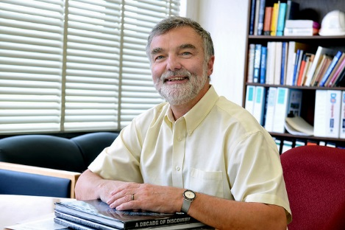
Non-Outline
“Each of our successes belongs to all of us.”
I invite you to share in some of the Division’s success in collider physics
  Zeus at Hera/DESY
  ATLAS at the LHC/CERN

Slide 3
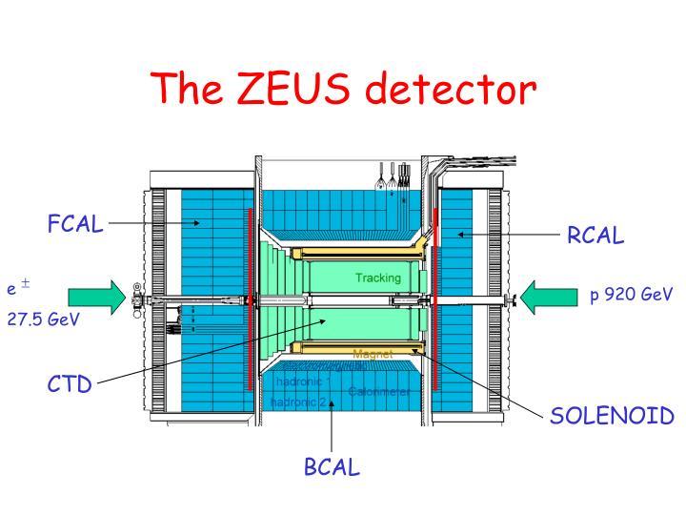
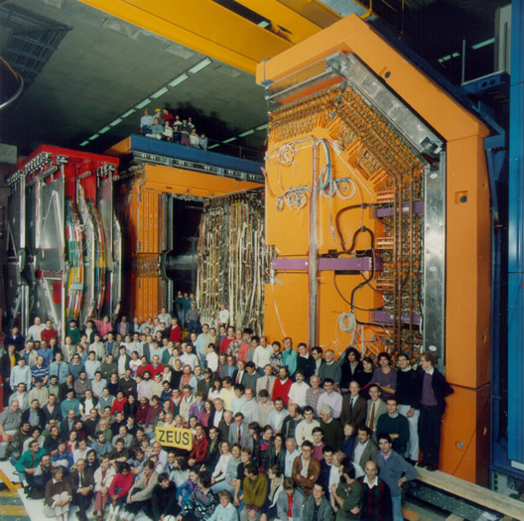
Zeus at HERA
HERA was an electron-proton collider at DESY in Hamburg, Germany, intended to study the structure of the proton
ANL had a number of leadership roles, including spokesperson
We were ramping down just as Harry was joining us

Slide 4
Proton Structure (Parton Density Functions) Today
One fit from CTEQ and one from MRS is shown
  These are global fits from all the data
Despite differences in procedure, the conclusions are remarkably similar
  Lends confidence to the process
The gluon distribution is enormous:
  The proton is mostly glue, not mostly quarks
Want to know the uncertainties?
Use the Durham pdf plotter: http://durpdg.dur.ac.uk/hepdata/pdf3.html

Slide 5
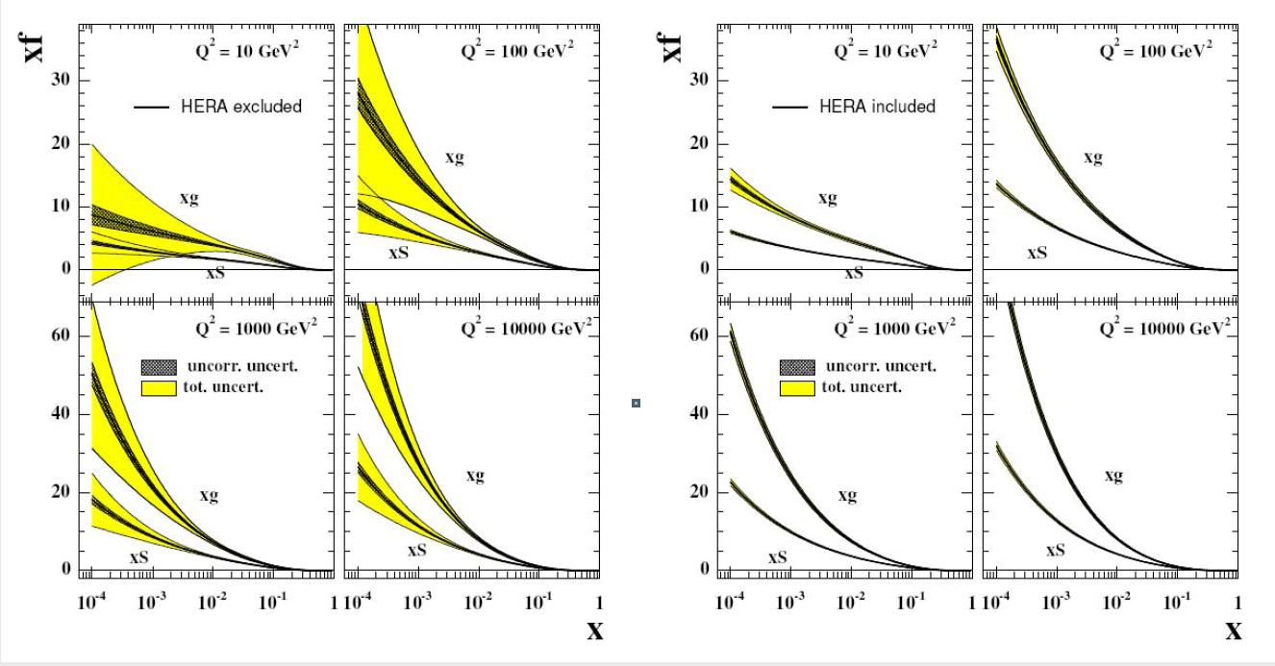
HERA: Before and After
HERA revolutionized our knowledge of parton densities
  If you don’t believe me, look at papers pre-HERA and post-HERA
  It’s even more dramatic than it looks, as the shapes in the left plots are still informed by the HERA data. Otherwise, the shapes would be more a function of imagination than of physics.
There is still a need to explore for the LHC, where higher Q² matters.

Slide 6
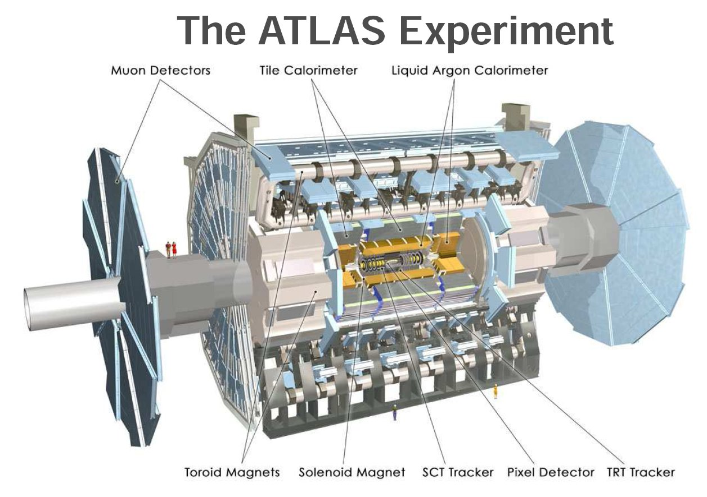
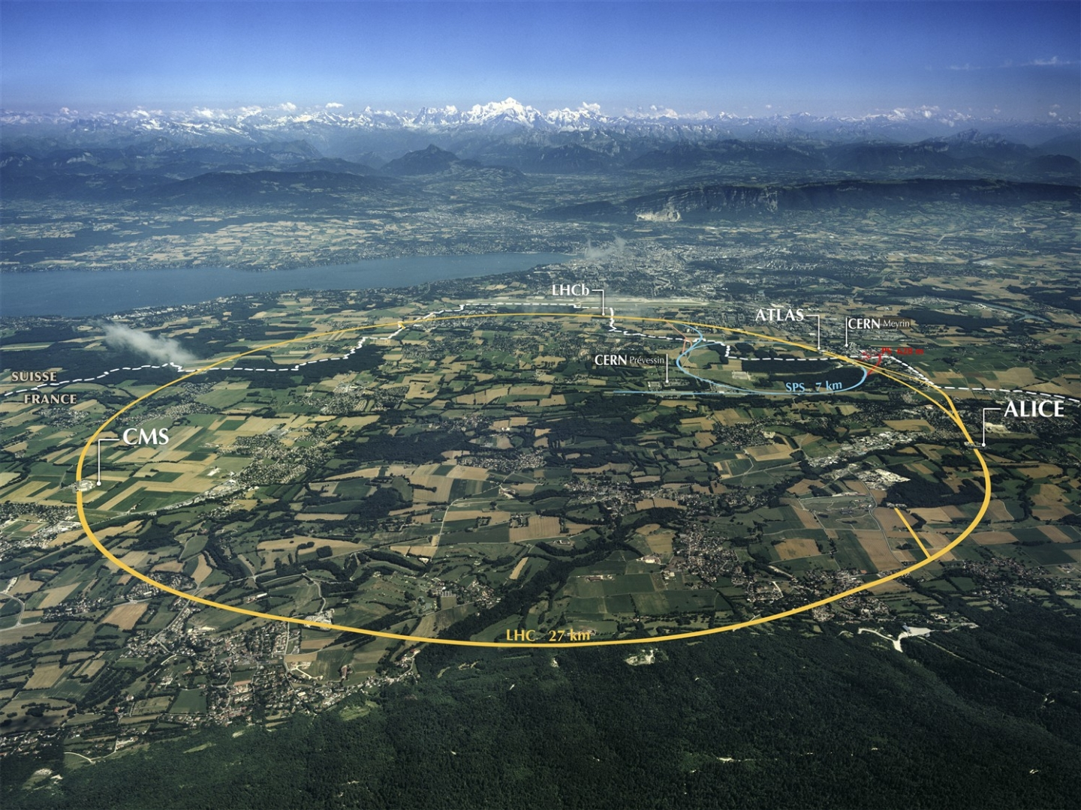
ATLAS at CERN’s Large Hadron Collider
A proton-proton collider operating at 7, 8 and now 13 TeV
Argonne’s Responsibilities
  Tile Calorimeter
  Trigger Region-of-Interest Builder (ROIB)
  Software and Computing
And of course, the science
ANL held a number of leadership positions here too: conveners, project managers, physics coordinator…

Slide 7
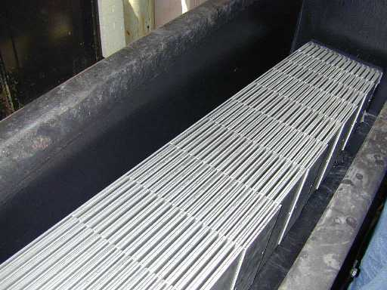
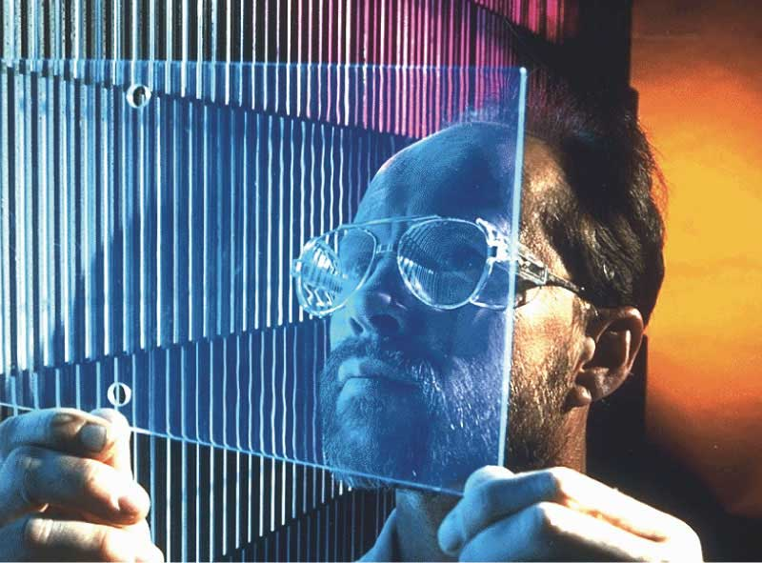
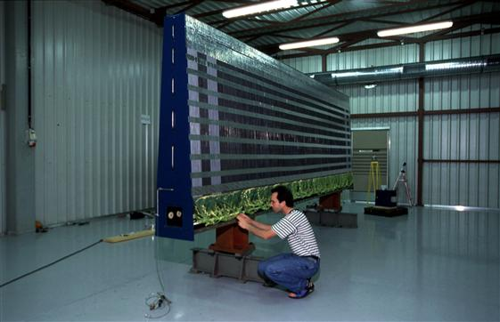
Tile Calorimeter
Scintillator tiles…
…which combine to make modules…
…are placed in submodules…

Slide 8
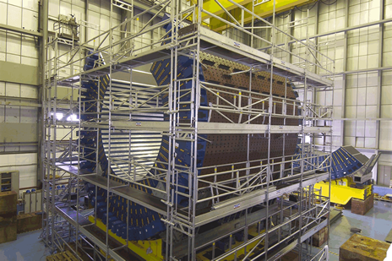
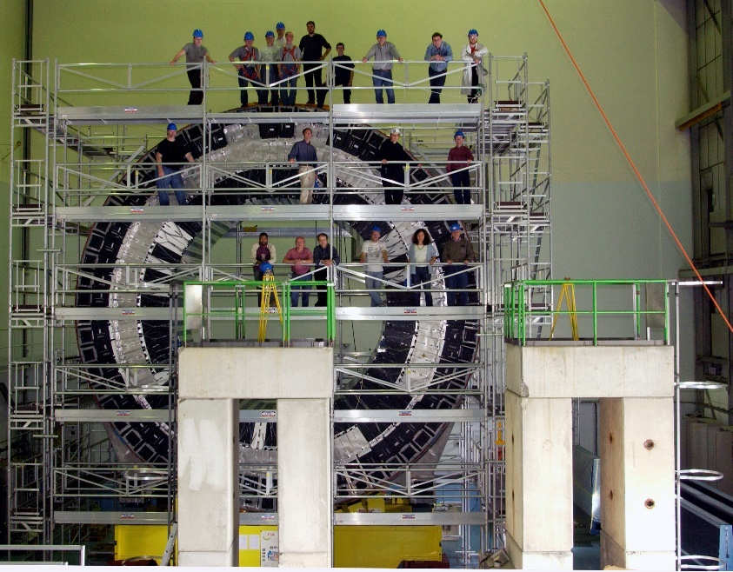
Tile Calorimeter
…which are then stacked…
…until assembly is complete.
When complete there are 192 modules
  64 in the central barrel
  64 each in the two extended (higher rapidity) barrels
    A-side (Argonne & Airport), C-side (Catalonia & Charly’s)

Slide 9
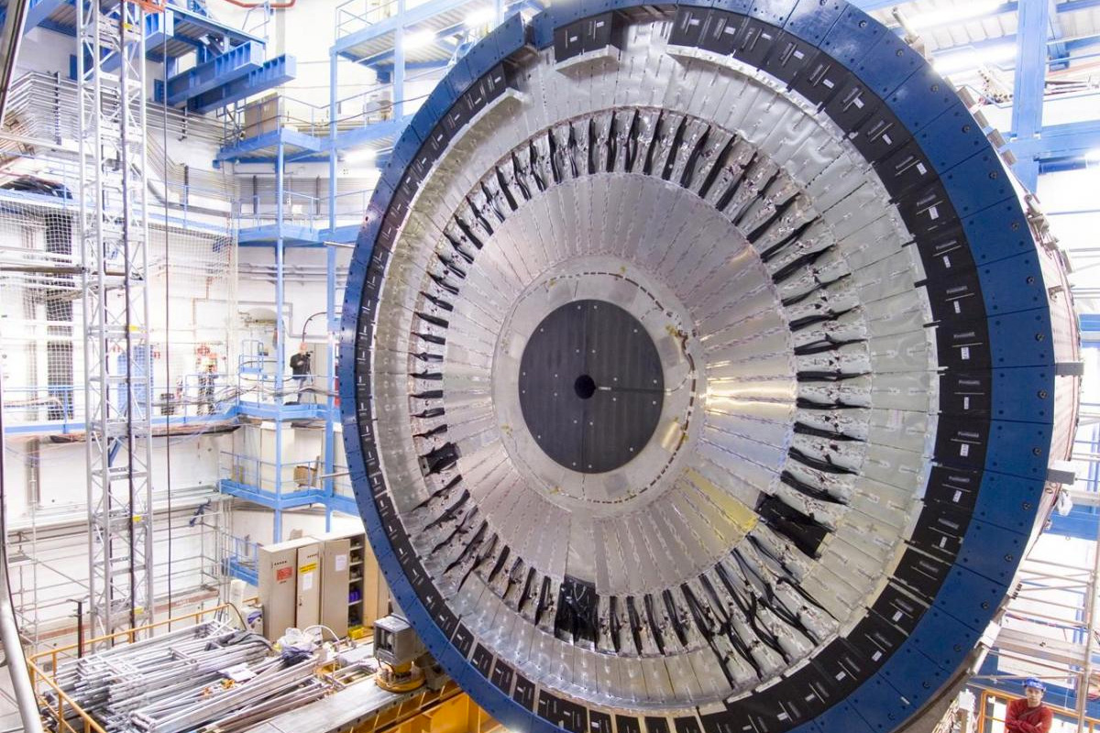
Tile Calorimeter
Tile Calorimeter installed in the cavern
The resolution is excellent: not the absolute best in the world – but the best is 200x smaller.
The limiting factor on hadronic resolution is not from the TileCal itself, but instead from hadrons interacting upstream.

Slide 10
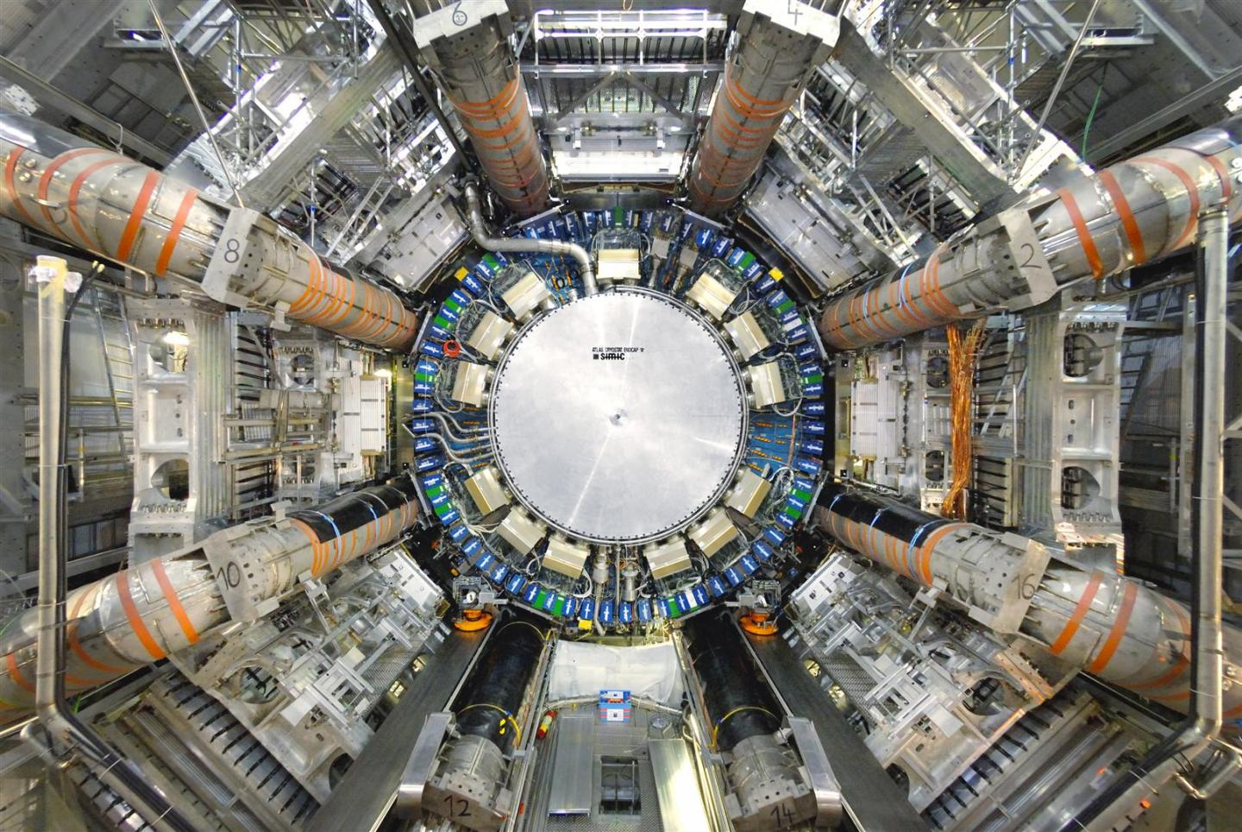
Tile Calorimeter
Tile Calorimeter inserted into ATLAS, where it
forms the centerpiece to this iconic photograph.

Slide 11
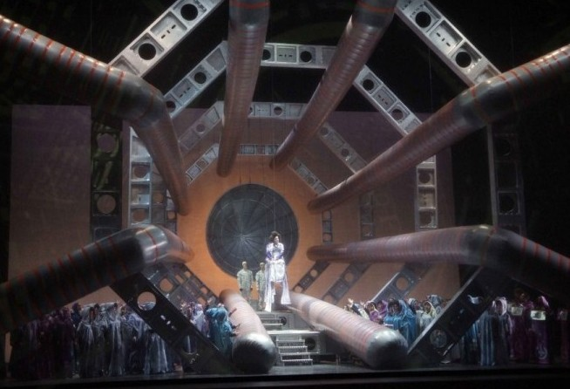
How Iconic?
Les Troyens, Hector Berlioz, staged in valencia (2009)
Set by Roland Olbeter

Slide 12
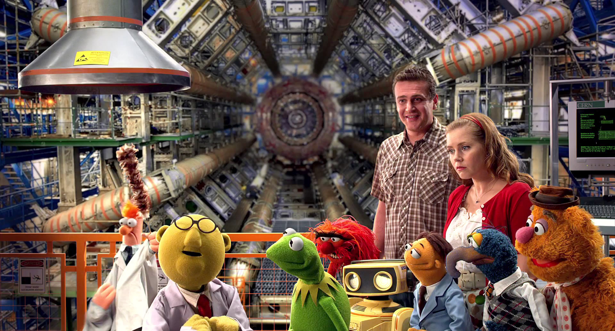
How Iconic?
The Muppets (2011 Film)

Slide 13
How Iconic?
The Muppets (2011 Film)
Beaker is the archetypical graduate student.

Slide 14
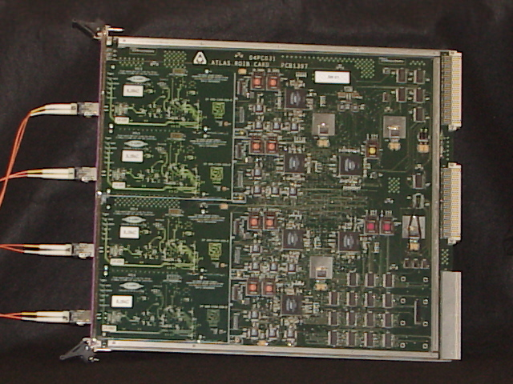
Region of Interest Builder
The ATLAS trigger works under the principle of “region of interest”
The idea is to let Level 2 take a closer look at the object(s) that produced the Level 1 trigger.
This board makes the relevant data available to the Level 2 processors

Slide 15

What It’s Like Being on Call for the ROIB
A complete list of ROIB failures:

Slide 16
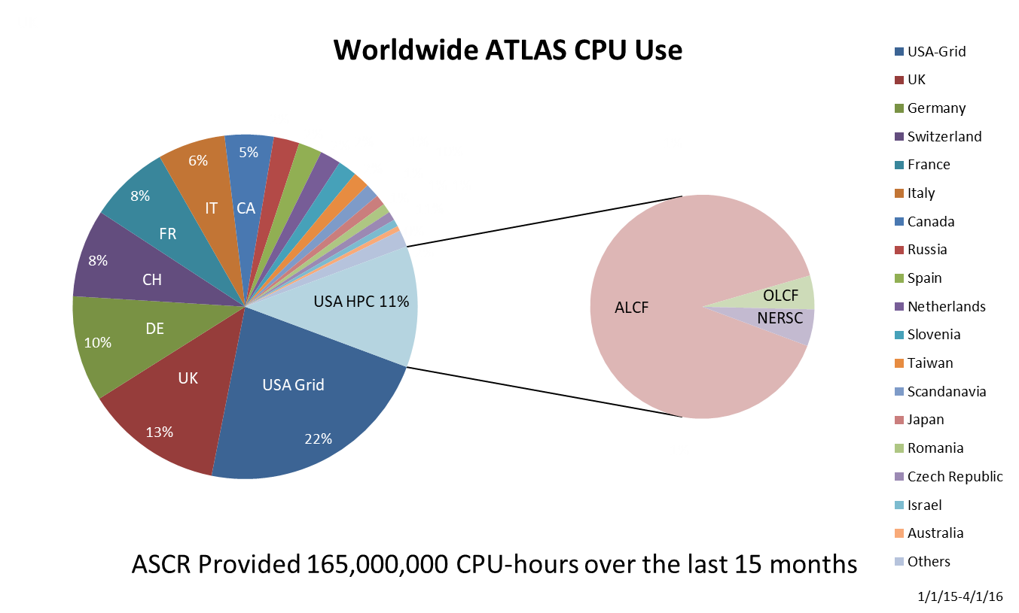
Computing
Argonne has unique expertise with data
  Which the LHC has a lot of, and is getting more
No byte from ATLAS is written without going through Argonne code
In addition to data, we also do metadata – data about the events we record
A historic, but still fun, plot
Argonne was a pioneer in using supercomputers for experimental HEP
  Argonne is a multi-mission Laboratory; ALCF’s presence was key
  If a country, Argonne would be tied with Germany as #3
The appetite for computing isn’t going away
  Argonne will be part of the solution for HL-LHC

Slide 17
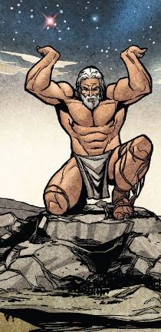

Harry and ATLAS
Harry was monumentally supportive of ATLAS and its scientific opportunities.
Most of my conversations with Harry went like this:
Me: There is this opportunity…
Harry (interrupting): Do it.
Me: But I need…
Harry (interrupting): You can have it.
Now that I’ve seen resource management from the “other side” I’m even more appreciative.
This kind of support is not as easy as it looks, and when I took on some risk, Harry did as well.
Now on to the physics…

Slide 18
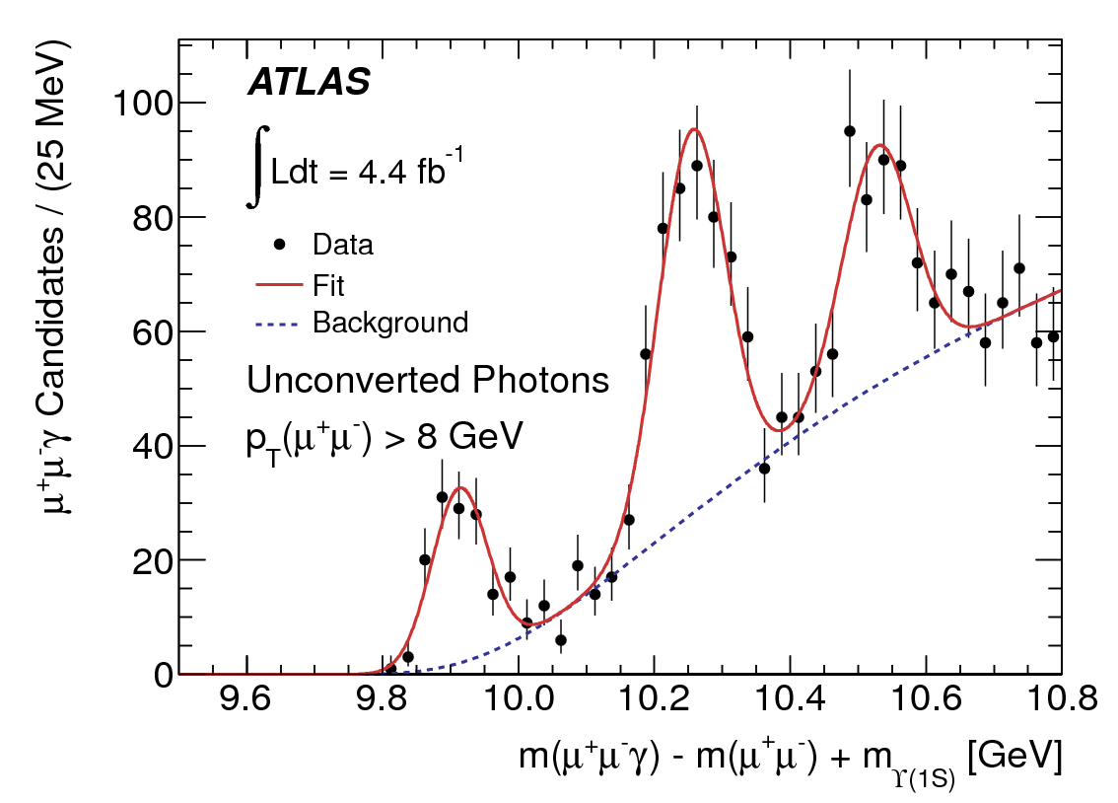
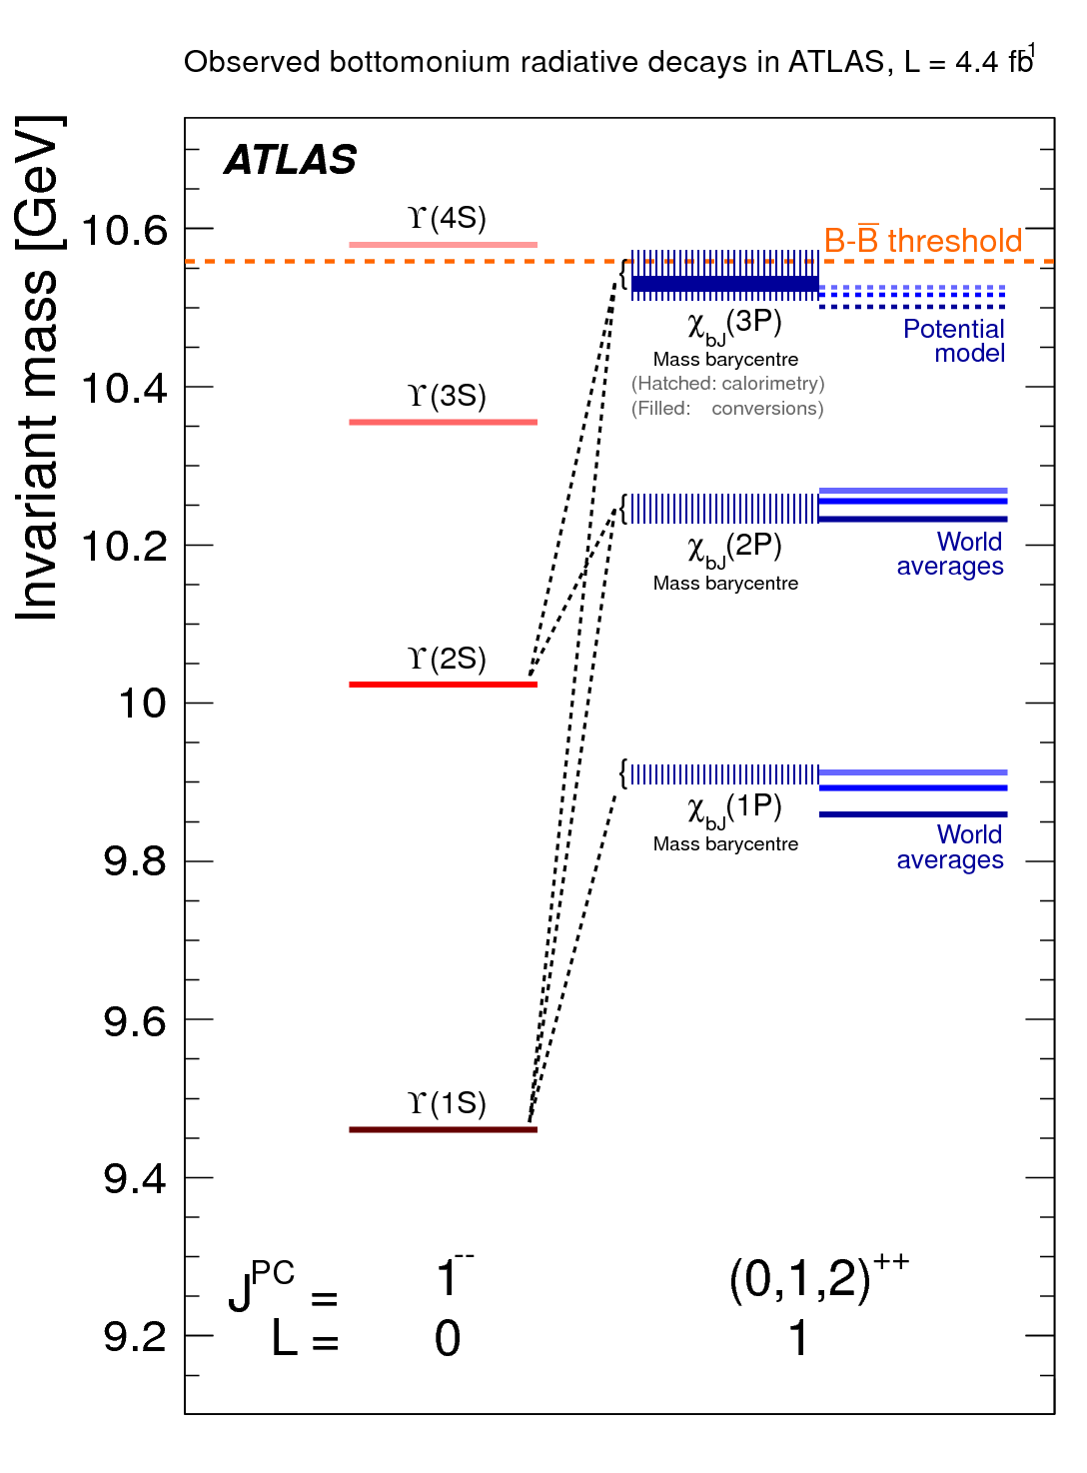
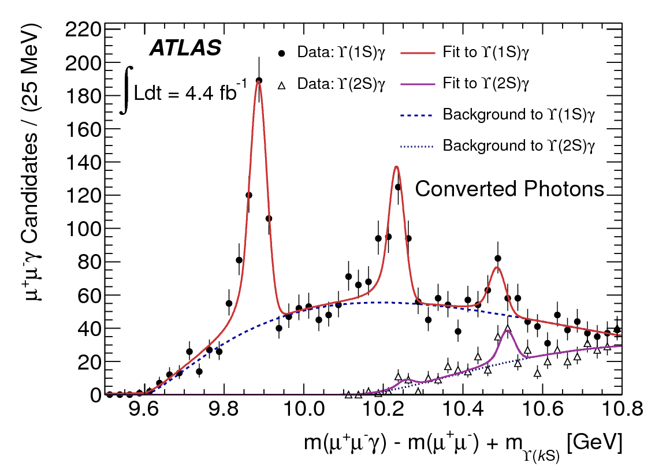
So, did the LHC find anything?
Our first new particle!
Even our first new boson!
Quarkonium: ³P₁(n=3) → ³S₁ (n=1,2)

Slide 19

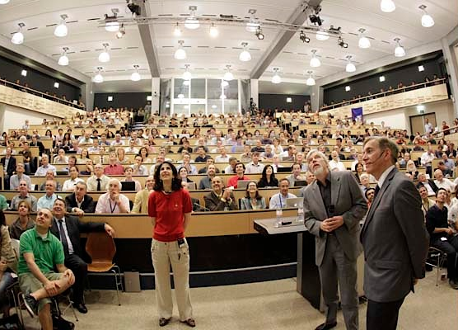
Higgs Boson Discovery
July 4, 2012. Some of us were there in person.
We had major roles in both discovery channels.

Slide 20

Higgs in Four Leptons

Slide 21

Higgs in Diphotons

Slide 22
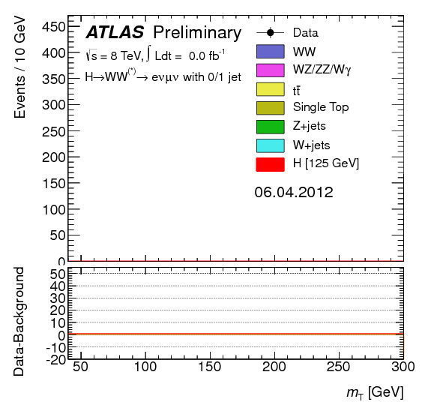
Higgs in WW

Slide 23
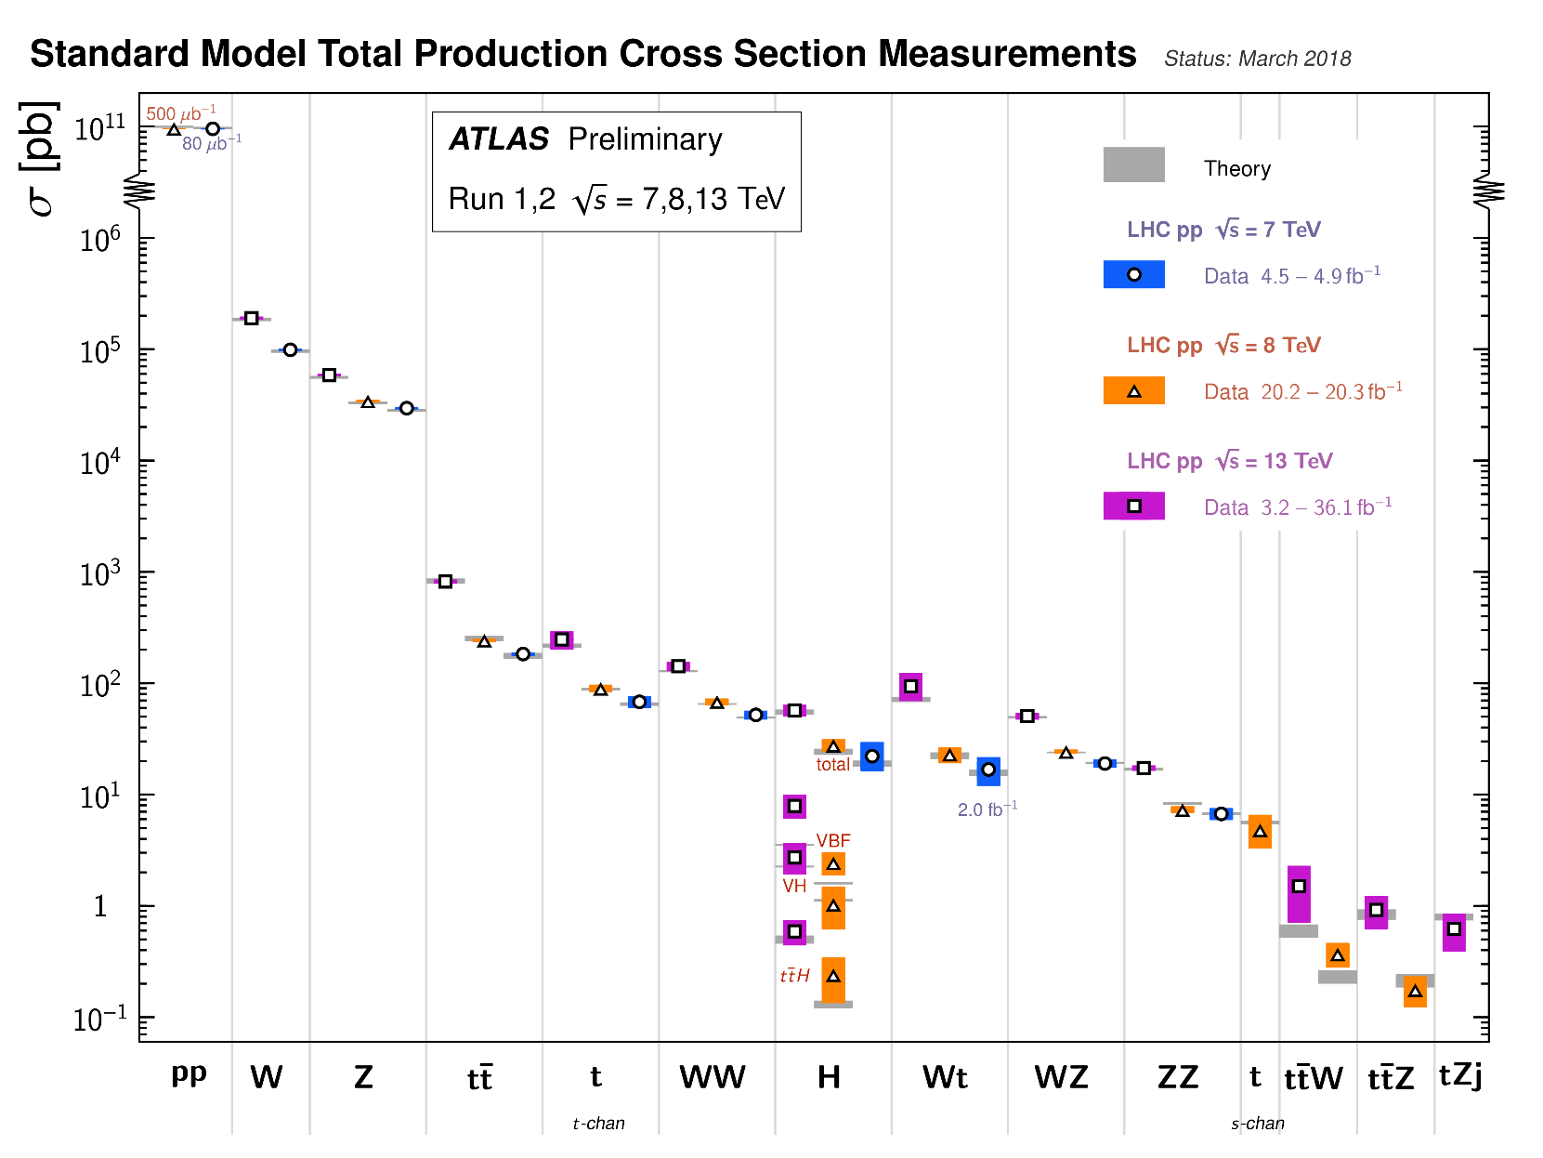

A Bevy of Standard Model Measurements
Many of these points have ANL involvement

Slide 24
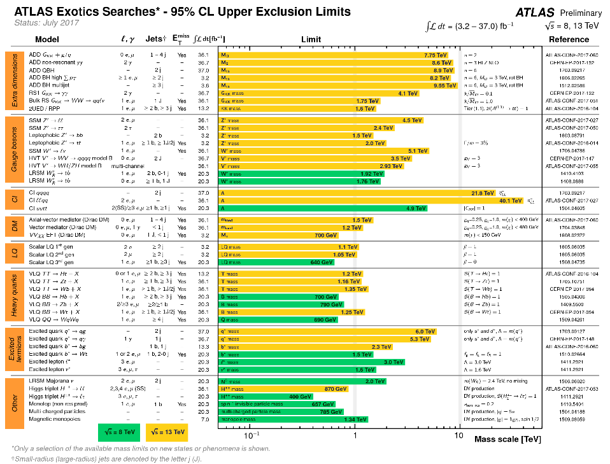
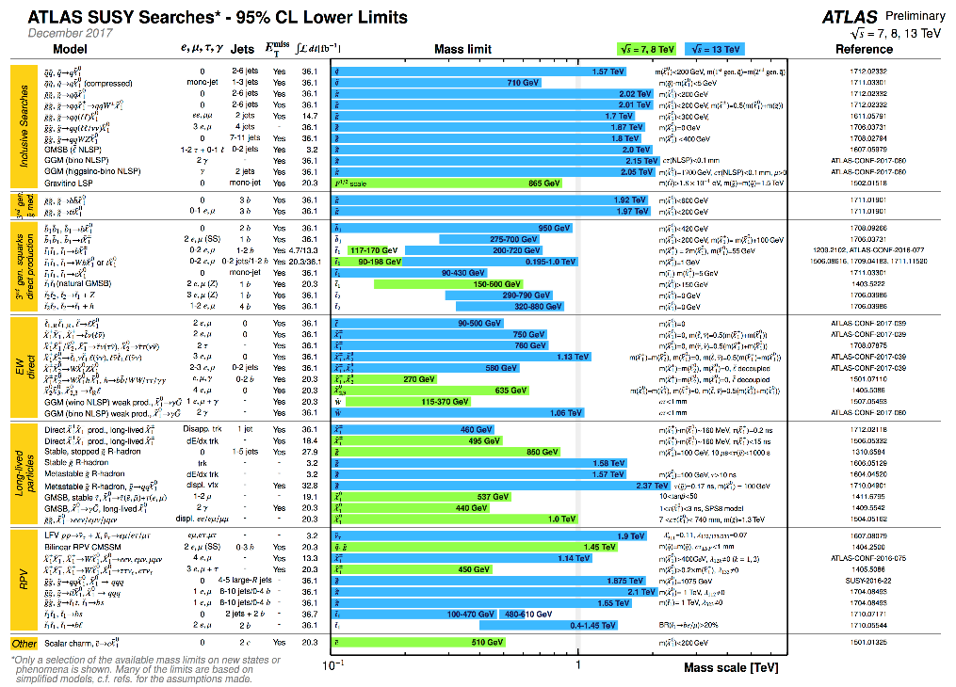
And Searches Galore
As of last Wednesday, 349 separate search papers published on searches
  No surprises
In most cases, we’re ~10x as sensitive as pre-LHC experiments, sometimes more, sometimes much more.
As before, many of these have substantial Argonne scientific involvement

Slide 25

Summary & The Future
A tremendous amount of science has come out
of the LHC program
Whatever the future holds: HL-LHC, ILC, HE-LHC or a future collider, we’re on a sound foundation
thanks to Harry.
Thanks!

