Slide 1







The Tynode
and the High QE Photocathode for ultra fast pixelized particle detectors
On behalf of the Membrane project:
Harry van der Graaf, Jeff de Fazio,
Hong Wah Chan, Annemarie Theulings, Violeta Prodanović, John Smedley, Kees Hagen, Lina Sarro, Gert Nützel, Serge D. Pinto, Henk van Zeijl
(was) supported by ERC – Advanced 2012 “MEMBrane” 320764
Ulitima 2018, Sept 14
Argonne NL, Ill, USA

Slide 2
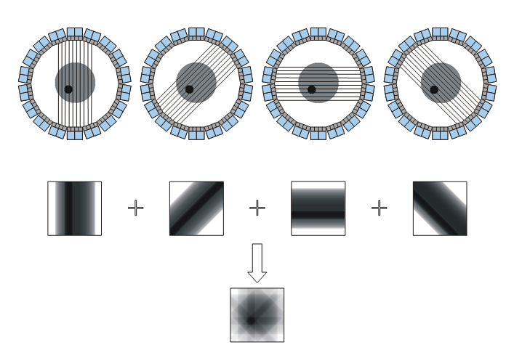
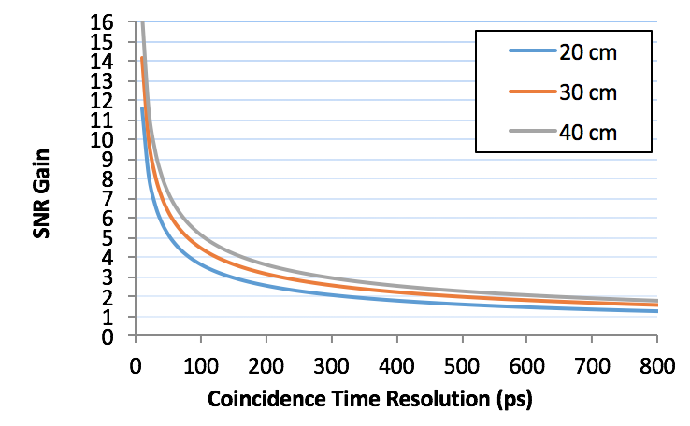
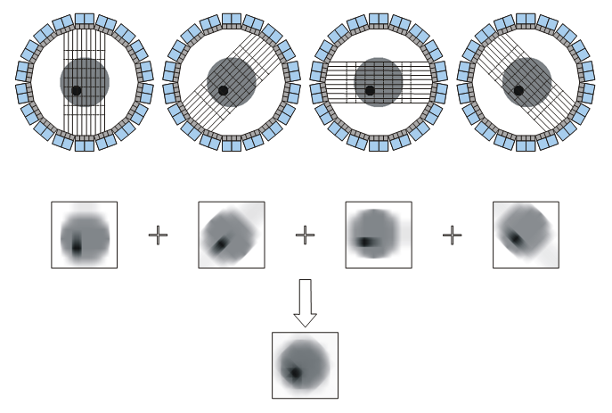
Time of Flight PET
Detector B
Δt = t_{A} – t_{B} = [(d+d₁) – (d-d₁)]/c
d₁ = c Δt/2
t_{B}
d
d₁
Patient
e⁺
e⁻
t_{A}
SNR_{TOF} = √(2D/cDt) · SNR_{conv}
Detector A
δt (ps)
δx (cm)
SNR*
10
100
300
500
0.15
1.5
4.5
7.5
16
5.2
3.0
2.3
State-of-the-art
* SNR gain for 40 cm phantom
Notes:
SNR is proportional to SQRT (NEC). So TOF is a sensitivity amplifier.

Slide 3
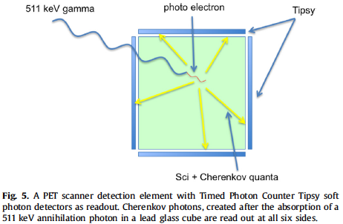
The Cherenkov-ToF-PET scanner
4D (X,Y,Z,t) measurement of absorption/conversion point of 511 keV quantum:
only 4 ChQs are required for 4D fix using GPS algorithm

Slide 4
with 10 ps time resolution:
Reconstruction of interaction point
origin of all prompt Cherenkov photons
4D GPS analysis method:
Only 4 Cherenkov photons detected are required for 4D fix.
This is no longer Tomography. Instead, per event, the annihilation point is measured.

Slide 5
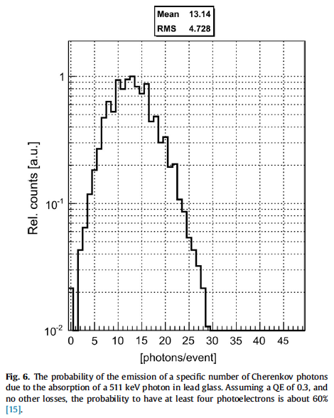
Cherenkov photons emitted
by 511 keV photo-electron
in lead glass
Average for Led Glass: 14
Average for Sapphire: 20

Slide 6
All we need is a detector for individual soft photons:
with good 2D spatial resolution (from granularity)
with good time resolution per photon (20, 10, 5 ps)
with good efficiency, pref > 0.9
without practical problems (rate effects, rate limitations, afterpulsing etc)
with low shot noise (dark rate)

Slide 7
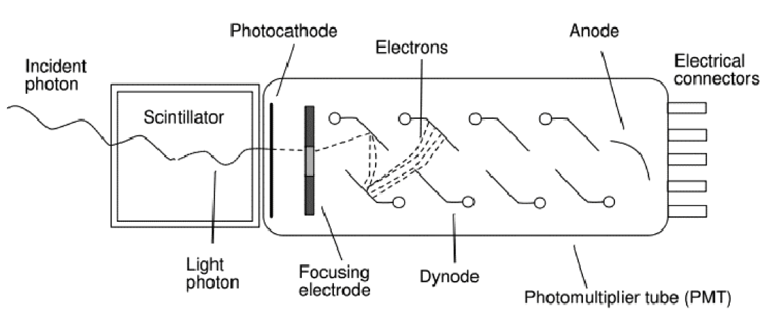
A very successful photon detector: the Photomultiplier (1934 -1936)
‘good’ quantum efficiency
rather fast
low noise @ high gain: very sensitive
little dark current, no bias current
radiation hard
quite linear
voluminous, bulky & heavy
no spatial resolution, not even 1D
expensive
quite radioactive
can’t stand B fields
Amplification by multiplication: low noise!

Slide 8
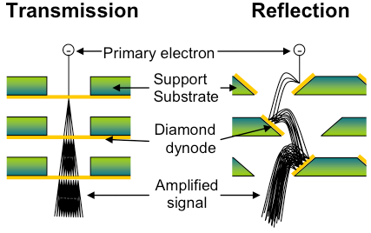
Dynode: amplification by multiplication
New: the Transmission Dynode
Tynode®
Trynode®

Slide 9
The Timed Photon Counter TiPC “Tipsy” PMT
High gain
Low noise
Secondary Electron Yield (SEY)
Gain = δ^{N}
…Can we make it smaller?
Transmission dynodes – Tynodes
Dark noise free electron multiplication mechanism
Stacking the photocathode, Tynodes and pixel chip → compact device
Pixelated detector → spatial resolution (imaging)
Operation of the detector in high B-field.
Time resolution: of order ps due to form factor and straight electron path’s
2D spatial resolution = 10 µm
gain of 30 k sufficient for driving pixels digitally
9

Slide 11

Path towards first prototype
We have created many tynodes of various sizes and materials
Most recently, we have achieved transmission yields of 5.5 with 5 nm MgO membranes, coated with 2.5 nm TiN, without other special surface treatments
Now working towards building a first prototype device
MEMS technology

Slide 12

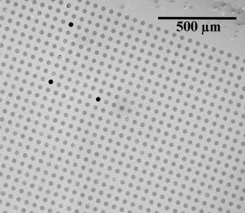
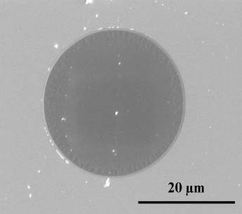
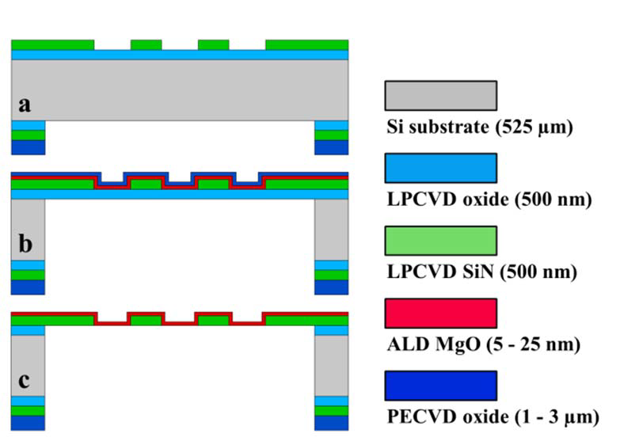
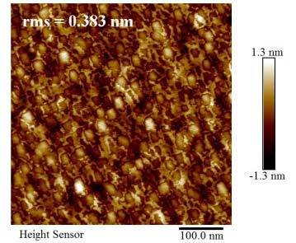
MEMS fabriaction of Tynodes: ALD MgO
Thermal ALD reactor with (Mg(Cp)₂) and H₂O as precursors
Deposition temperature: 200 °C
Measured stress: ~ -200 MPa
Growth rate = 0.165 nm/cycle (3 + 15 + 1 + 15 sec)
SEM captures of 5 nm thin MgO membranes in 64 x 64 array
12
AFM image of released 25 nm thin MgO
membrane

Slide 13
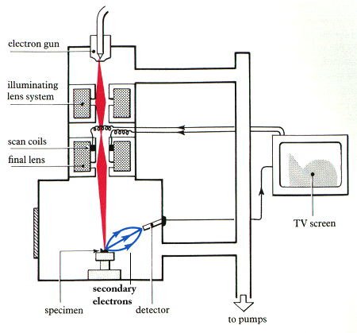
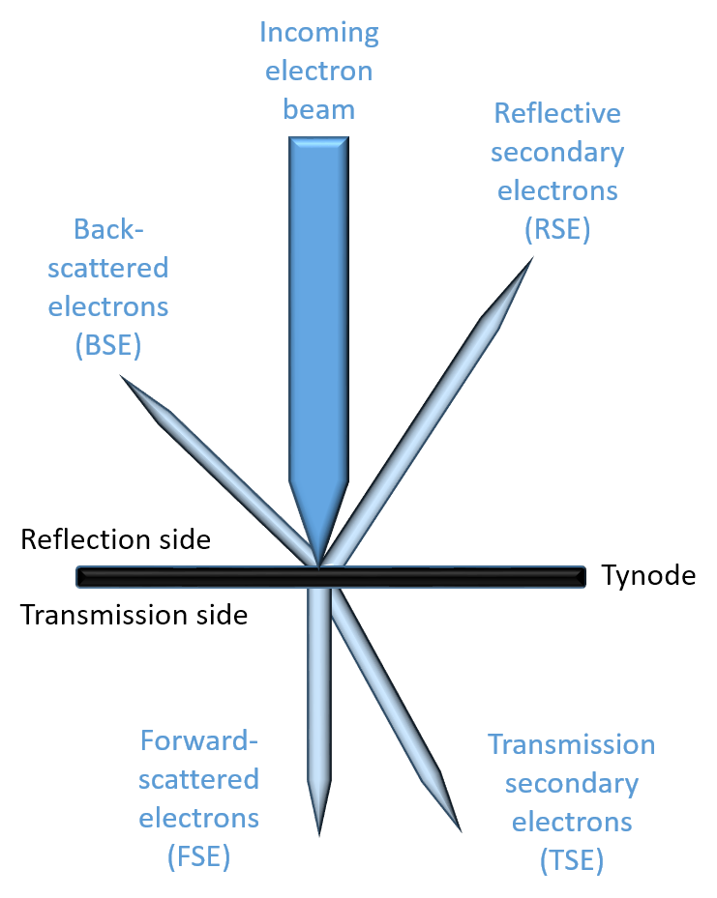

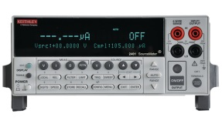
TSEY Measurement in SEM
Scanning Electron Microscope:
  Electron beam energy
  Measure beam current
  Acquire image (4.2 min)
Keithley 2450 Sourcemeters
  Measure Sample Current
  Measure anode Collector Current
Repeat for different beam energies
Process data
SEM e⁻ beam
sample holder
anode
Keithley source meters

Slide 15
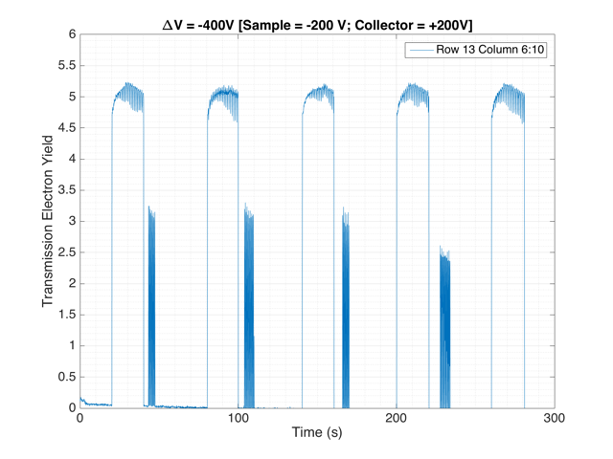
!! 5.2 !!
TSEY
November 2016: TSEYmax = 5.5

Slide 16
Al₂O₃ Measurements and Simulation using
low-energy GEANT extensions
Measurement
Simulations
10 nm
25 nm
50 nm
A decrease in yield, combined with increase in optimum primary electron energy is observed as a function of sample thickness
Good correlation to measurements seen for the simulations.

Slide 17
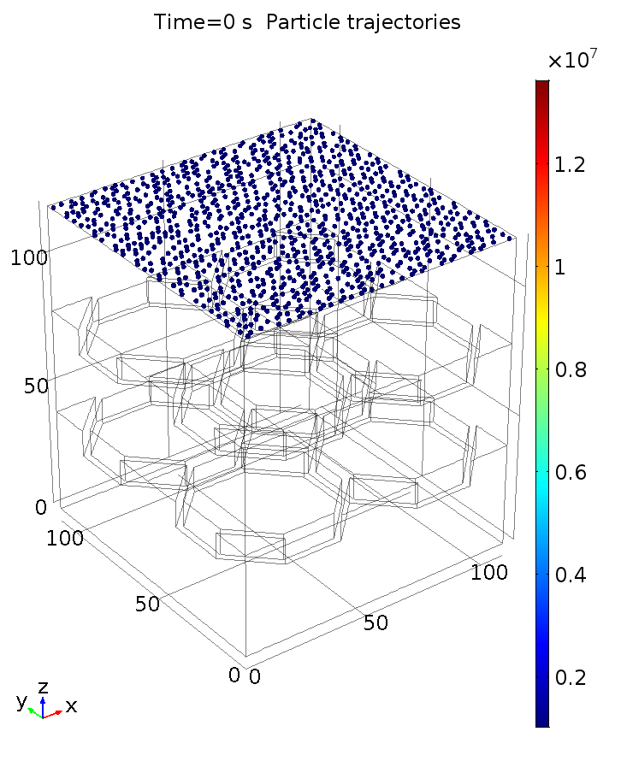
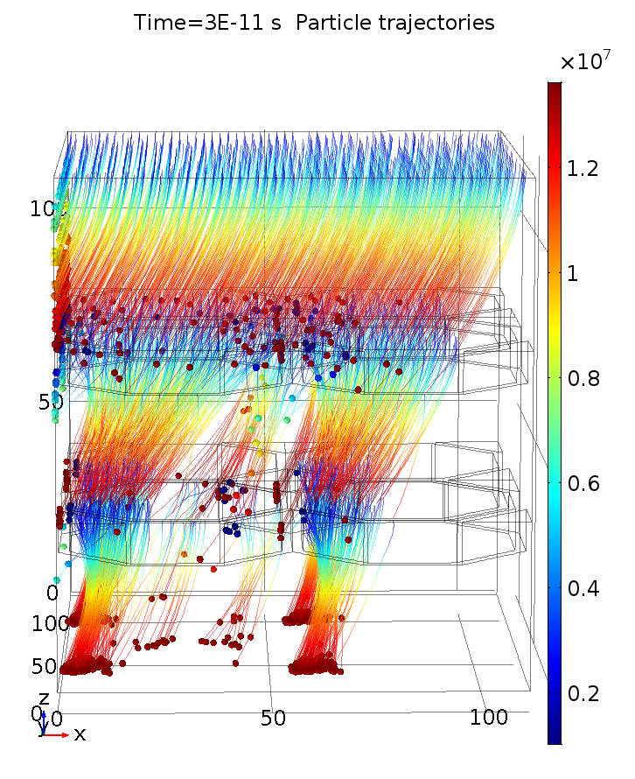
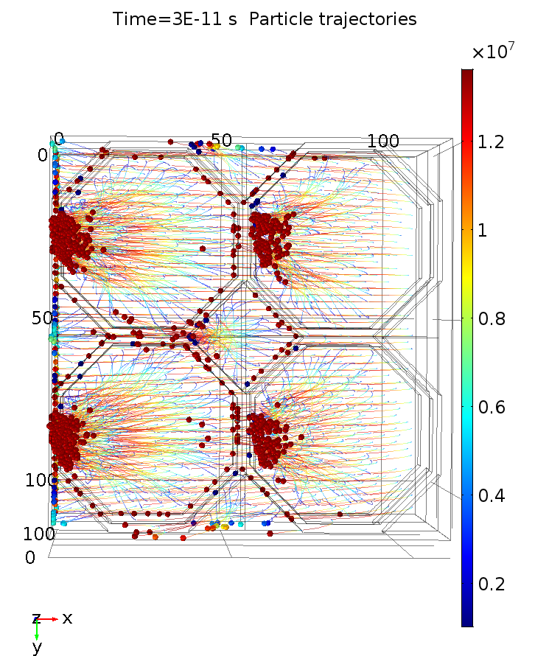
Magnetic field

Slide 18
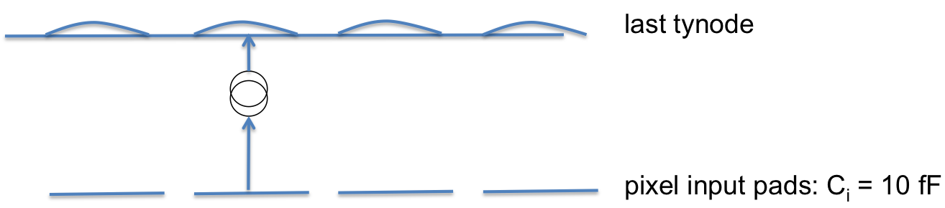
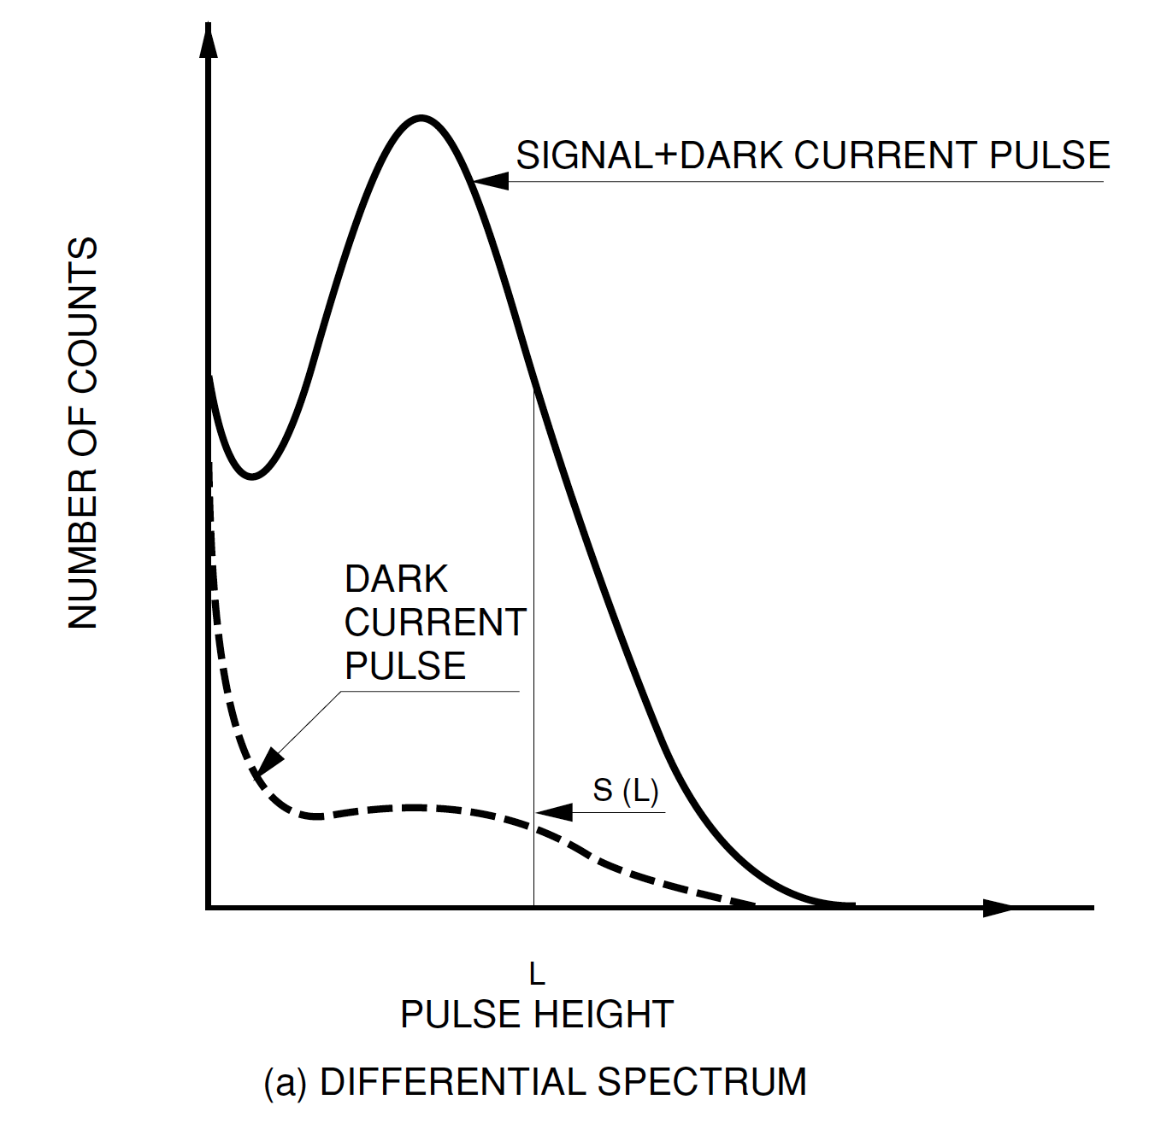
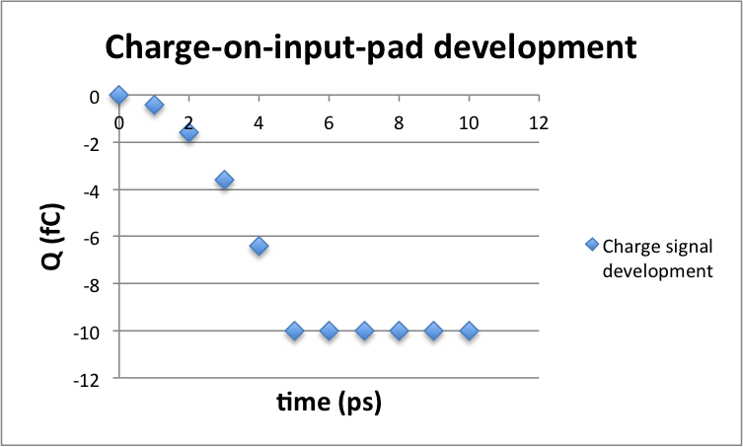

Why is Tipsy so fast?
electron mobility in vacuum: free electron!
amplitude distribution
signal is build when
electrons cross the last gap
Waveform Analysis? sub ps potential!
Readout per pixel: TDC + ToT
With TimePix-4: 200 ps
With 20 ps
60 k e⁻

Slide 19
TimePix 1
TimePix 3
TimePix 4 being designed
Pix 20: 20 ps TDC per pixel: fully digital
T₀
T₁
T₂
50 GHz free osc: no PPL!
starts at avalanche event
stops at 2nd 40 MHz ext clock
40 MHz ext sync from acc
avalanche
T₁ 1st readout of 50 GHz clock: ‘arrival time
T₂-T₁ number of cycles in 25 ns: calib 50 GHz clock
Applicable in 90 nm tech

Slide 20
Trend in Si-PMs: 3D separation of sensor and pixel chip
absorber/avalanche sensor
bump bondings
pixel chip
Digital (single photon sensitive) detector: input capacitance ~ 10 fF
With time resolution better than 20 ps: pixelisation: no signal processing possible
Time resolution below 10 ps: limited by present Si technology
➔ development of PIX 20: a digital pixel chip with a 20 ps TDC per pixel

Slide 21
Timed Photon Counter – TipsyZero – Fabrication of First Prototype
Finalized layout of MgO domes
Sputtered TiN (2 nm)
ALD MgO (5 - 25 nm)
LPCVD SiN (500 nm)
Thermal oxide (500 nm)
PECVD oxide (> 2 um)
Si (525 um)
We intend to manually stack 5 of these tynodes and place the stack above a TimePix-1 chip
When in a close stack, we may achieve higher yields from close, extracting fields:
  There is a report¹ that, with a single Si membrane, yields of 200 has
  been reached due to a strong extracting field. We may have an even
  much higher extracting field!
1) Qin, Kim, Blick. APL 91, 183506 (2007).

Slide 22
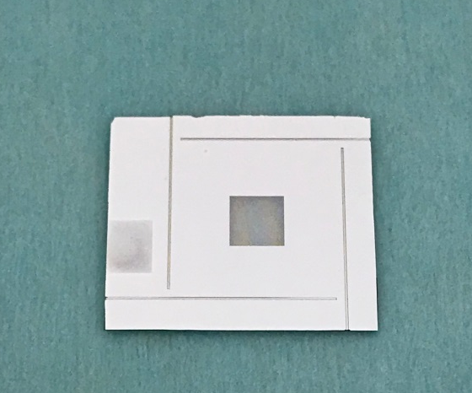
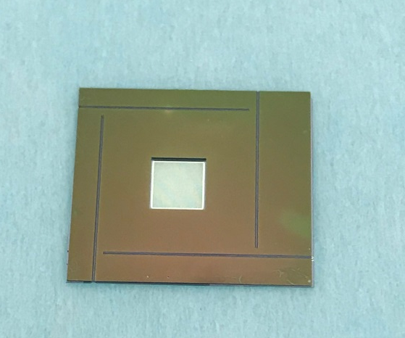
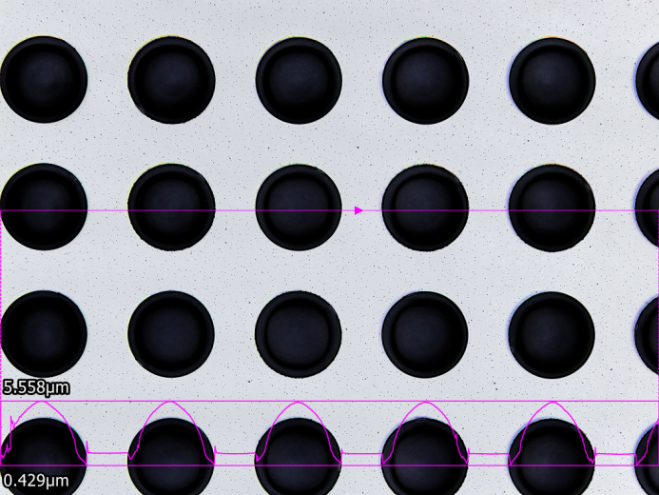
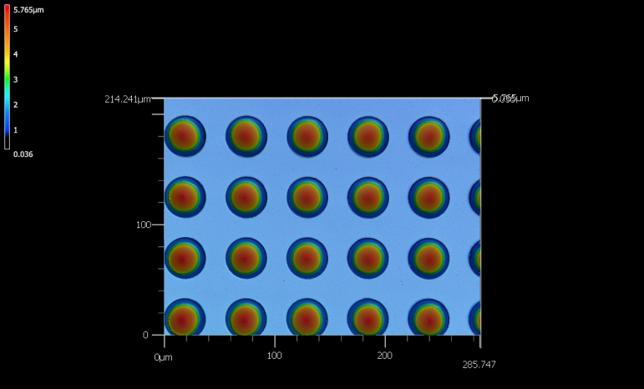
Tynodes with grooves for alignment
(fabricated on 300 µm-thick Si wafer)
Tynode chip: FRONT SIDE
Tynode chip: BACK SIDE
Contact pad
KOH-defined grooves for glass rods
(depth = 60 µm)
Grooves on the back side are placed exactly under ones defined on the front side
Curved tynodes
Al mesh
(to suppress charging up)
15 nm–thick ALD alumina
transmission membrane

Slide 23
Tynode positioning. The bottom tynode is aligned in the Zeiss microscope
Quartz wire
dia 200 μm
Pixel chip

Slide 24
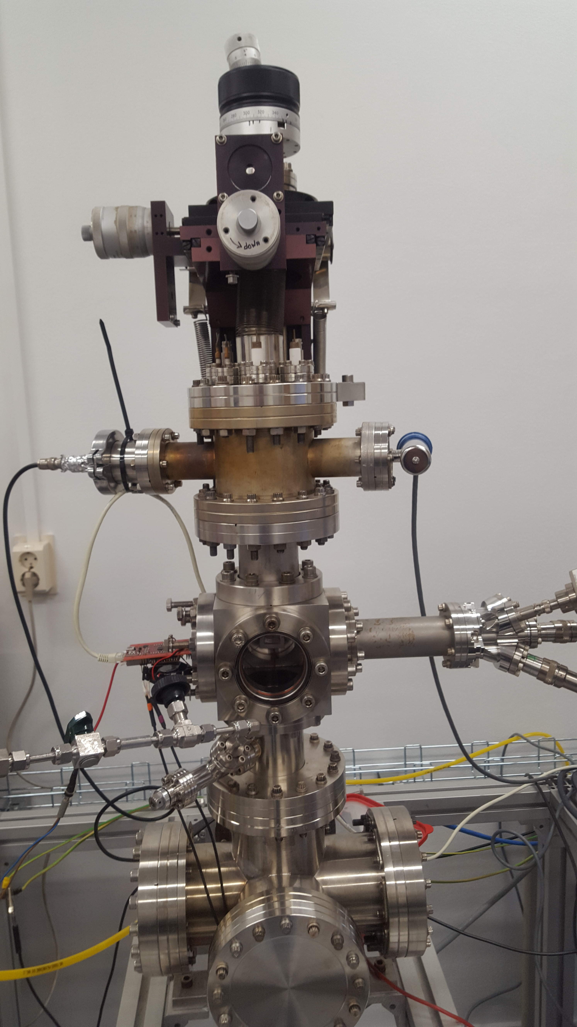
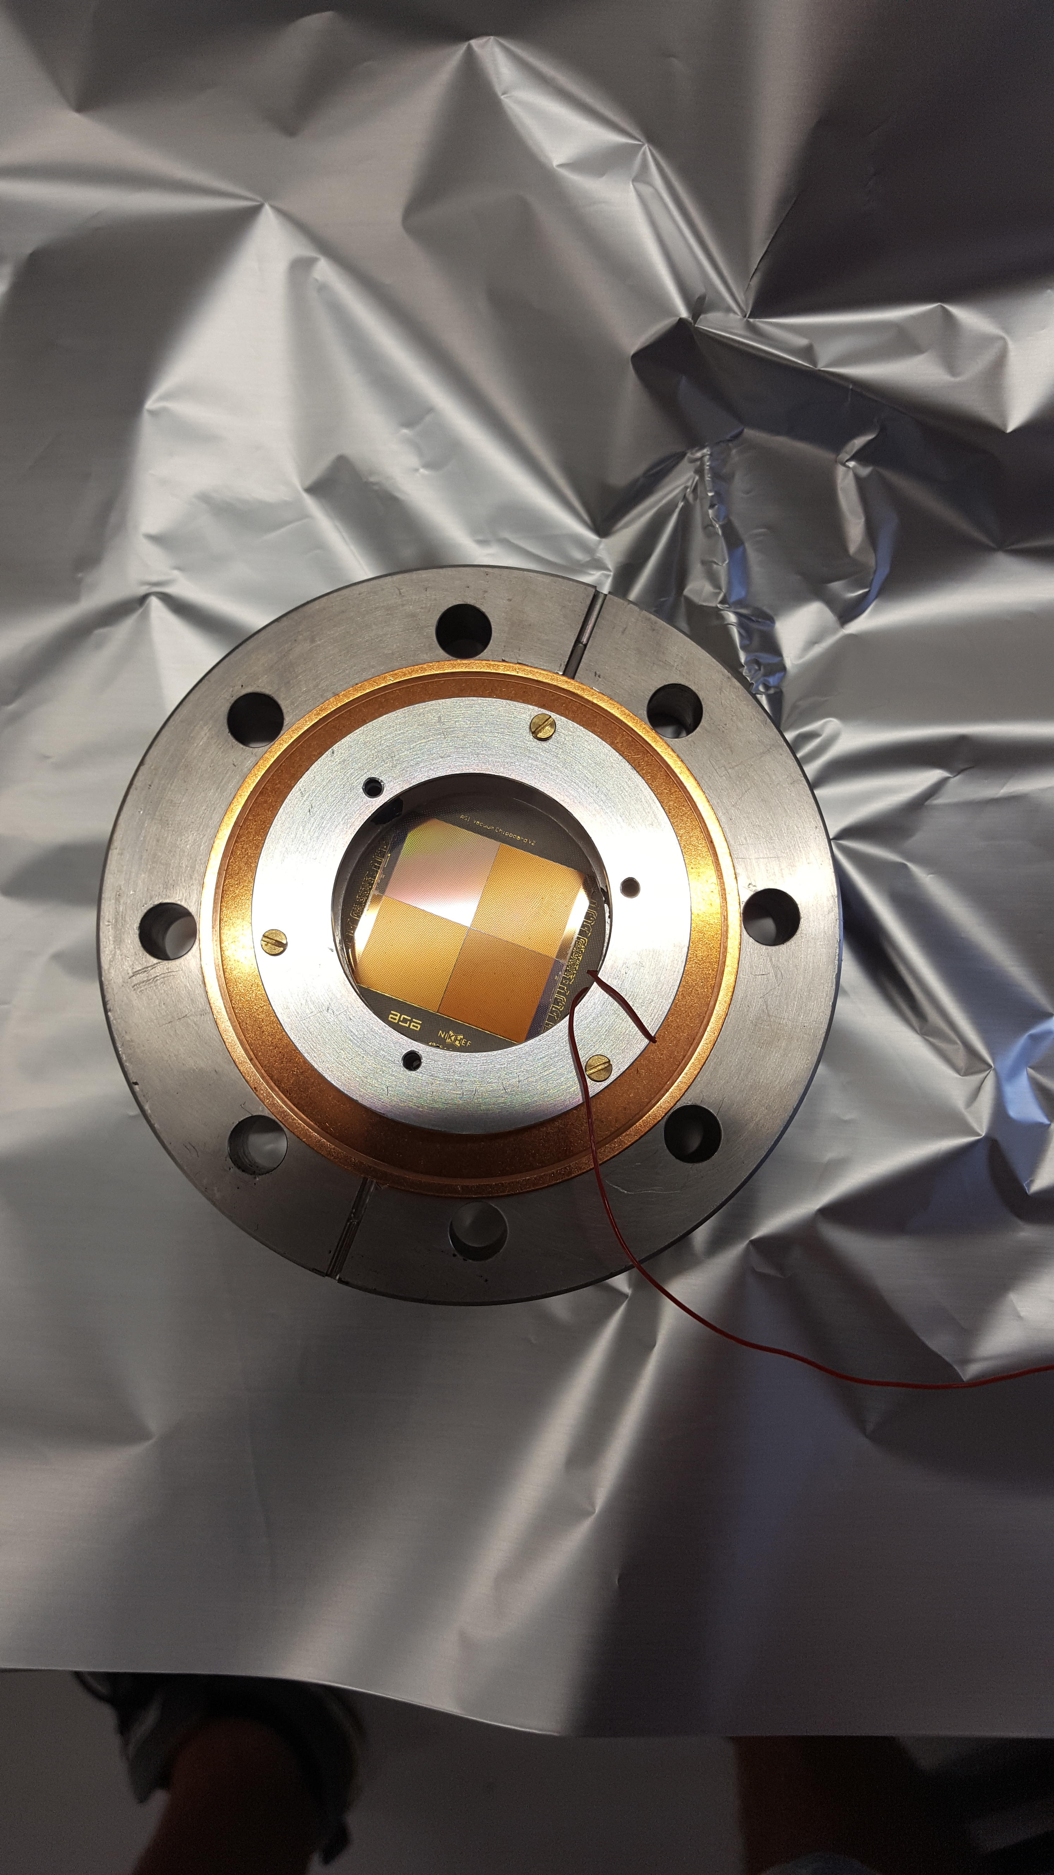

Slide 25
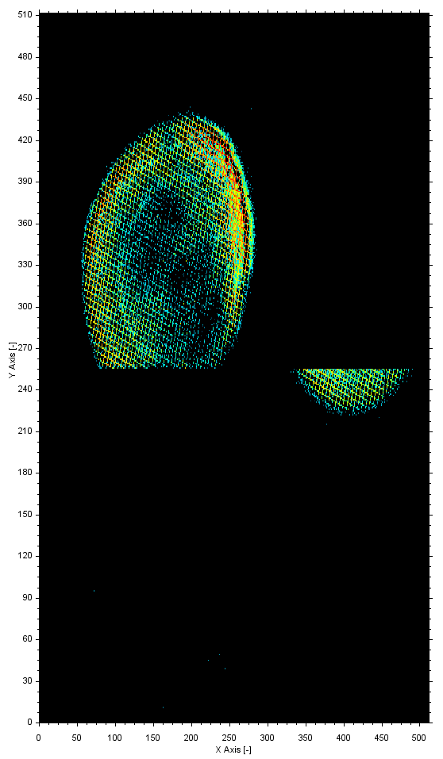
e-gun (Kimball)
very open mesh
naked TimePix-1 chips

Slide 26
Concept - Fabrication TipsyZero into a Photonis PLANACONTM Style Device
TimePix-1 pixel chip on Kyocera carrier board
● Ultra high vacuum compatible, sealing with Planacon window, photocathode compatible
TipsyZero will be limited to the 10 ns bin size of TPX-1 or 1 ns bin size of TPX-3
a new TimePix NN with 10 ps time resolution
Fan-out ceramic with metalized top-traces for HV distribution
Metal studs and weld ribbons to electrode rings
Backside metalized ASIC (TIMEPIX) with tynodes eutectic bonded into envelope + wirebonds

Slide 27
a high Quantum Efficiency photocathode

Slide 28
Principle
Window
glass, quartz, sapphire
(bi) alkali layers
absorption
diffusion, propagation of photo-electron
emission
QE never exceeds 0.5
real practical solutions (Photonis, Hamamatsu) are classified

Slide 29
Tipsy’s only limitation: its efficiency equals the QE of photocathodes: 0.4 at best
Therefore: the High Quantum-Efficiency (QE) Photocathode
Window
glass, quartz, sapphire
graphene
[Alkali] monolayers
graphene
termination (Cs, H)
δ V
Active photocathode: drift field pushing electrons to emission vacuum surface
electric field created in between by potential defining graphene planes
all layers build up individually by atomic layer deposition ALD
electron emission stimulated by negative electron affinity by termination (crucial)
First designed after ab initio simulations of 3D atomic building blocks
Proposal for theoretical concept study: let us first understand the present state-of-the-art

Slide 30
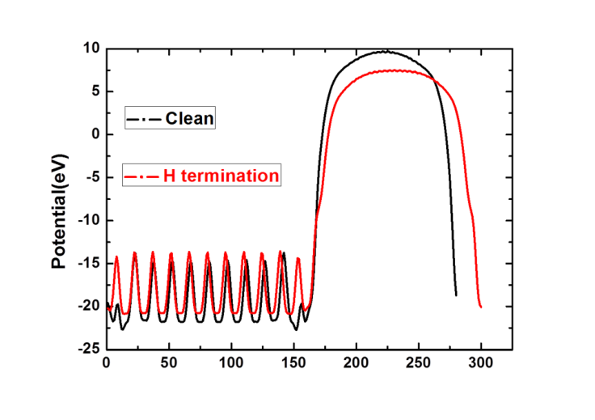
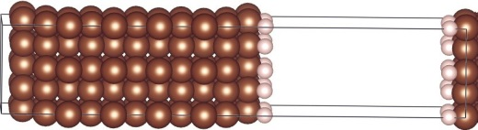
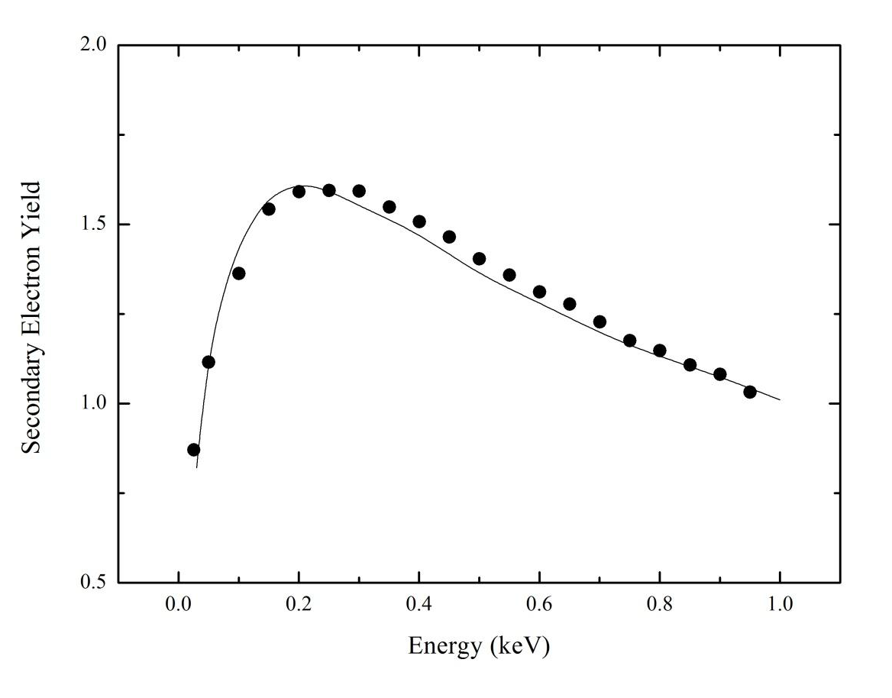
Solid State Physics
Density Functional Theory simulations
Electron density, energy distributions
density structure,
band gap
work function,
optical data
Monte Carlo simulations
Vienna Ab-Initio Simulation Program
VASP
(T) SEY

Slide 31
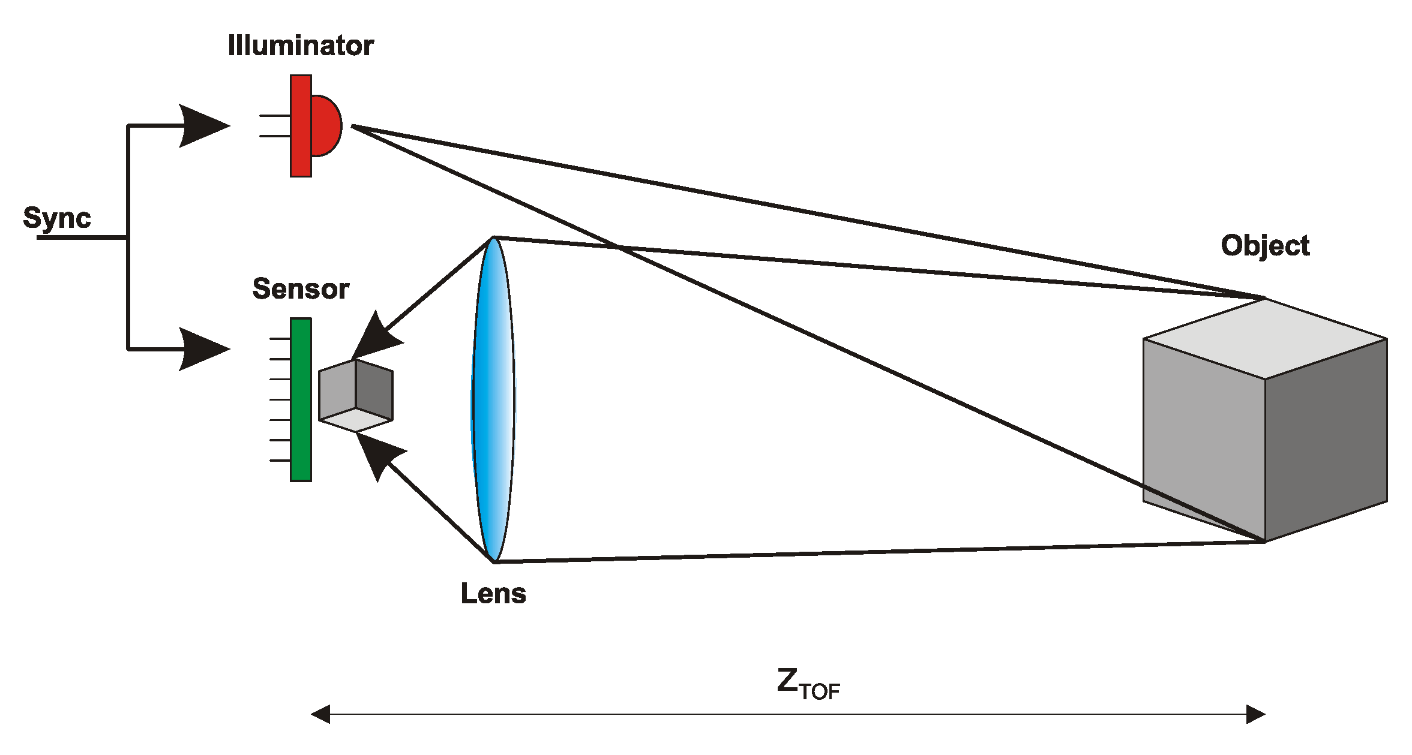
Tipsy applications
(assuming high QE and 20 – 10 ps time resolution)
3D Machine viewing: robotics
Self-driving of vehicles: situation info source
Prompt 3D Imaging with
z-resolution of 0.5 mm
Tipsy in iPhoneS10 (2022)?

Slide 32
the future: the Cherenkov tracker
Ch Photon + MIP detector
transparent (mylar) foil
Vacuum!
Cherenkov photons are emitted with given angle with track
see TORCH

Slide 33
Future inner (central) tracker in collider experiments:
the Cherenkov tracker
very low detector mass
Tipsy layer at safe distance from interaction point
no extrapolation
Tipsy
Cylindrical layer
thin transparent foils
generating Cherenkov photons
The Vacuum Cherenkov CentralTracker

Slide 34
With high-QE 10 ps soft photon detectors:
Machine viewing: self-driving of automobiles: no stereo reconstruction
prompt 3D viewing by measuring ToF of photons from ps flashlight
Cherenkov photons are prompt & rapid: scintillator photons are slow ………..and outdated?

Slide 35
Ultra fast, digital (single electron) detectors must be pixelised in order to limit the input capacitance to a minimum and the total counting rate to a maximum.
Transient recording (waveform analysis), and processing per pixel is not practical/possible (now).
Ultra fast detectors require a specific digital pixel chip with a ‘clock pulse counting’-TDC per pixel.
A stack of tynodes may generate the so far fastest detector charge signal, completed within 5 ps
The time resolution of a Tipsy detector may be limited by what can be achieved with Si CMOS electronics (or GaAs, ……)
Cherenkov photons are prompt & rapid: most scintillator photons are slow ….
Conclusions

Slide 36
The Tynode
and the High QE Photocathode for ultra fast pixelized particle detectors
On behalf of the Membrane project:
Harry van der Graaf, Jeff de Fazio,
Hong Wah Chan, Annemarie Theulings, Violeta Prodanović, John Smedley, Kees Hagen, Lina Sarro, Gert Nützel, Serge D. Pinto, Henk van Zeijl
(was) supported by ERC – Advanced 2012 “MEMBrane” 320764
Ulitima 2018, Sept 14
Argonne NL, Ill, USA
H. van der Graaf et al.: The Tynode: A new vacuum electron multiplier.
Nucl. Instr. & Methods, in press. http://dx.doi.org/10.1016/j.nima.2016.11.064. T
H. van der Graaf et al.: Potential applications of electron emission membranes in medicine.
Nucl. Instr & Methods, special Medical Physics issue on “Advances in detectors and
applications for Medicine”. A809 (2016) 171-174. http://dx.doi.org/10.1016/j.nima.2015.10.084.

