Slide 1
Nanosecond, burst mode X-ray imager development at Sandia National Laboratories
Liam D. Claus, 09/11/2018
SAND2018-9347C

Slide 2
Fast Time-Gated Imager Overview

Slide 3
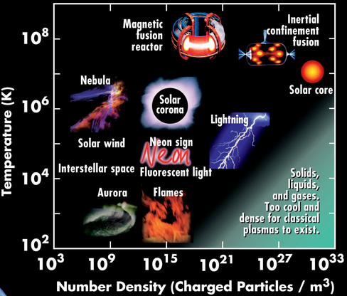
High Energy Density Physics is the study of the physics of matter and radiation under extreme conditions (energy densities greater than 10¹¹J/m³)
http://www.cpepphysics.org/fusion_chart.html
My customers primarily study plasmas
  Astrophysical phenomena
  Inertial Confinement Fusion (ICF)

Slide 4
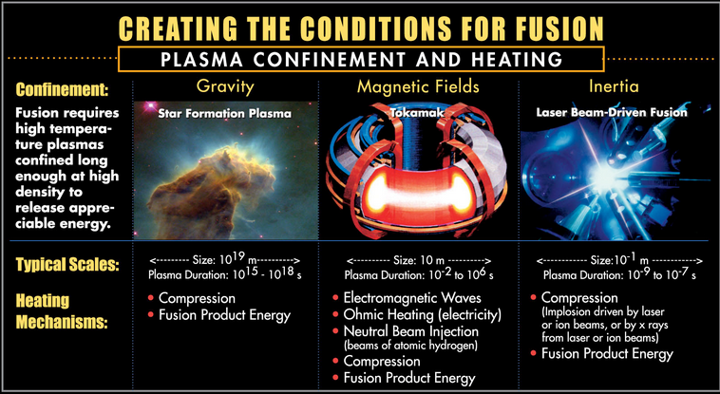
High Energy Density Physics is the study of the physics of matter and radiation under extreme conditions (energy densities greater than 10¹¹J/m³)
http://www.cpepphysics.org/fusion_chart.html
My customers primarily study plasmas
  Astrophysical phenomena
  Inertial Confinement Fusion (ICF)
Laboratory experiments exist to study these events
  Experiments occur on ps to ns timescales
  Single, one off experiments
http://www.cpepphysics.org/fusion_chart.html

Slide 5
Inertial Confinement Fusion is an ongoing area of research
Inertial confinement fusion aims to produce fusion energy by confining a plasma using the inertia of the plasma itself
http://www.cpepphysics.org/fusion_chart.html

Slide 6
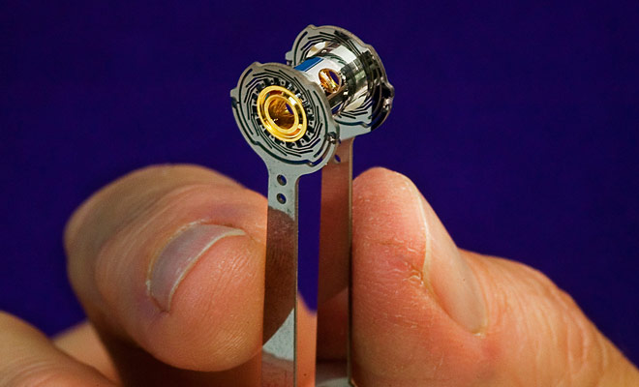
Inertial Confinement Fusion is an ongoing area of research
Inertial confinement fusion aims to produce fusion energy by confining a plasma using the inertia of the plasma itself
A fusion pellet is placed inside a gold hohlraum and subjected to intense heating via lasers or X-rays
http://www.cpepphysics.org/fusion_chart.html

Slide 7
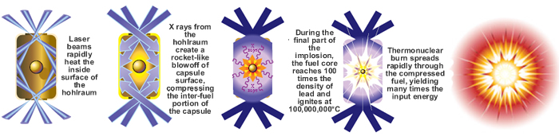
Inertial Confinement Fusion is an ongoing area of research
Inertial confinement fusion aims to produce fusion energy by confining a plasma using the inertia of the plasma itself
A fusion pellet is placed inside a gold hohlraum and subjected to intense heating via lasers or X-rays
The energy in the hohlraum is re-emitted as X-rays that drive the pellet to implode
http://www.cpepphysics.org/fusion_chart.html

Slide 8

Hybrid-CMOS image sensors offer significant potential for improving the fidelity of experimental data
Hybrid-CMOS (hCMOS) imagers can achieve:
  Electronic shutters operating at one billionth of a second
  Multiple image frames deliver a temporal history of experiments
  Improved SNR by gating out background radiation
  CMOS scalability provides large detector area and high spatial resolution
High frame rate image sequence tells the entire story
Fast shutter eliminates motion blur

Slide 9
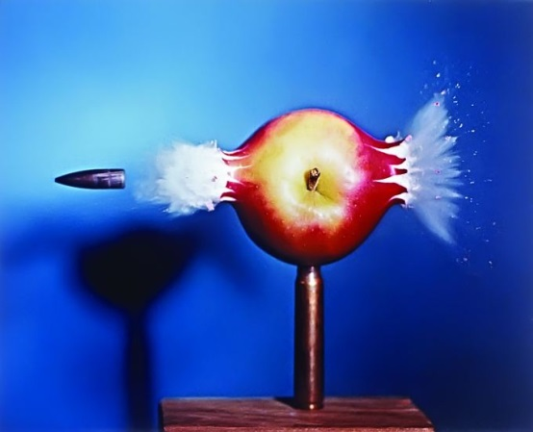
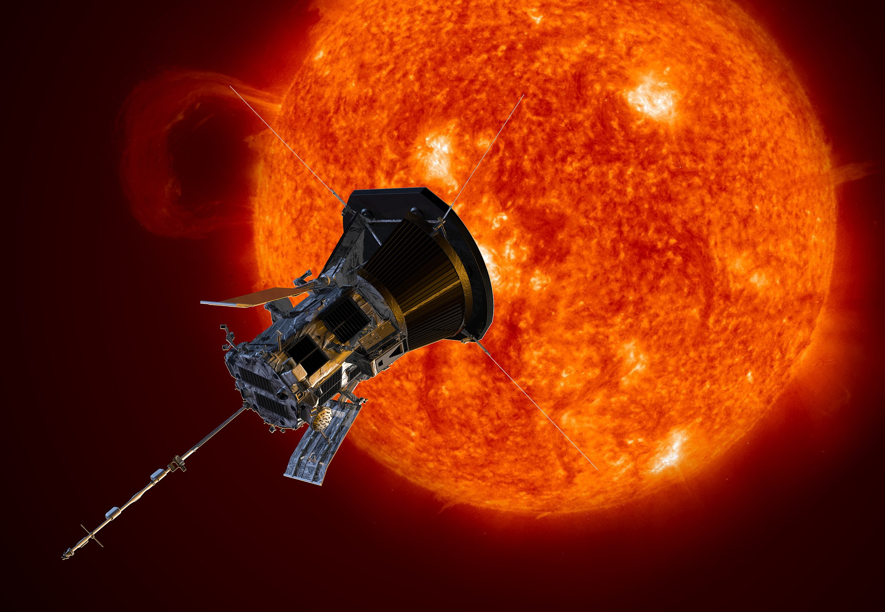
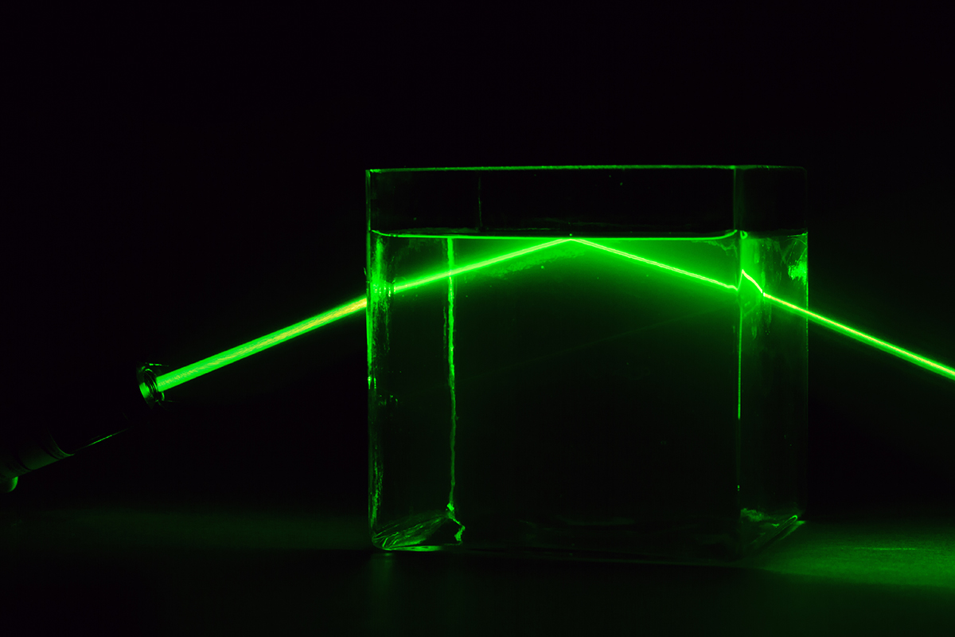
Hybrid-CMOS image sensors offer significant potential for improving the fidelity of experimental data
Hybrid-CMOS (hCMOS) imagers can achieve:
  Electronic shutters operating at one billionth of a second
  Multiple image frames deliver a temporal history of experiments
  Improved SNR by gating out background radiation
  CMOS scalability provides large detector area and high spatial resolution
Object | Speed (m/s) | Distance traveled per nanosecond (m/ns)
Rifle Bullet | 762 | 762 nanometers
Parker Solar Probe | 1.944 x 10⁵ | 194 micrometers
Light in vacuum | 2.998 x 10⁸ | 0.3 meters
Harold E. Edgerton, Bullet through Apple, 1964
NASA/Johns Hopkins APL/Steve Gribben
GIPhotoStock/SPL

Slide 10
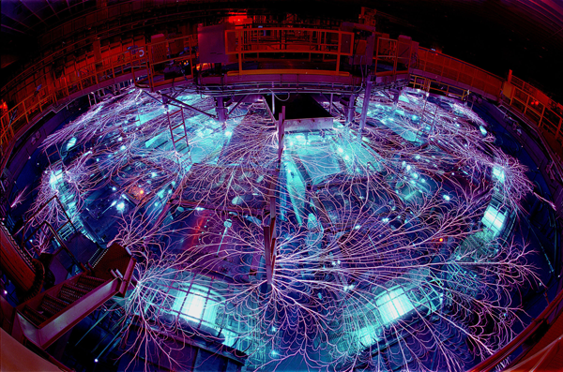
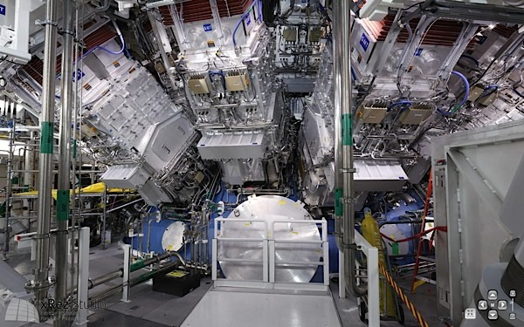
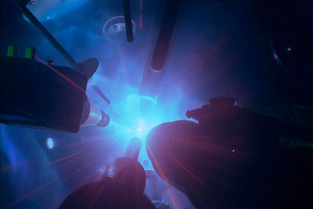
The Ultrafast X-ray Imager (UXI) program set out to develop nanosecond time-gated, multi-frame imagers for the ICF program at Sandia and the other national ICF facilities
X-ray imaging is a valuable diagnostic for High Energy Density (HED) physics research
Ultra-fast, burst-mode hybrid CMOS imagers can revolutionize HEDP understanding
Faster frame-rate reduces motion blur while multiple frames provide a temporal history of an evolving experiment
  Delivers deeper understanding of experimental results
Existing time-gated X-ray imagers are based on microchannel plate technology developed in the 1990’s and suffer from a number of limitations
  Moderate dynamic range
  Gain errors
  Difficult and expensive to calibrate
Z-Machine
NIF
Omega

Slide 11
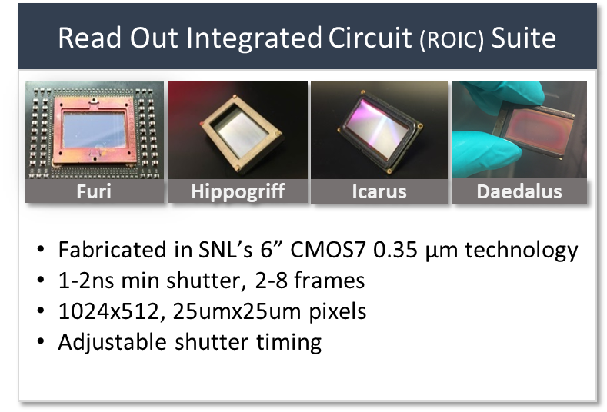
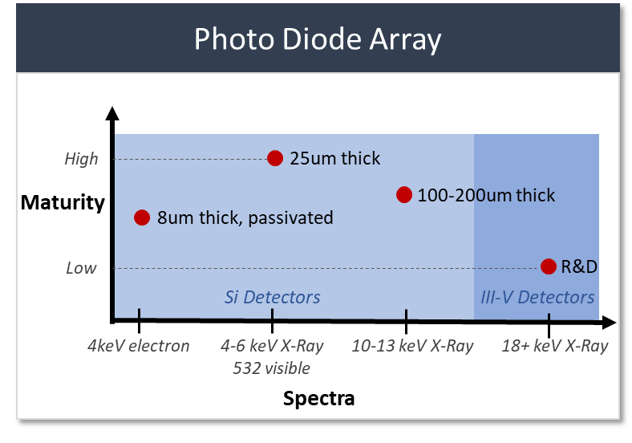
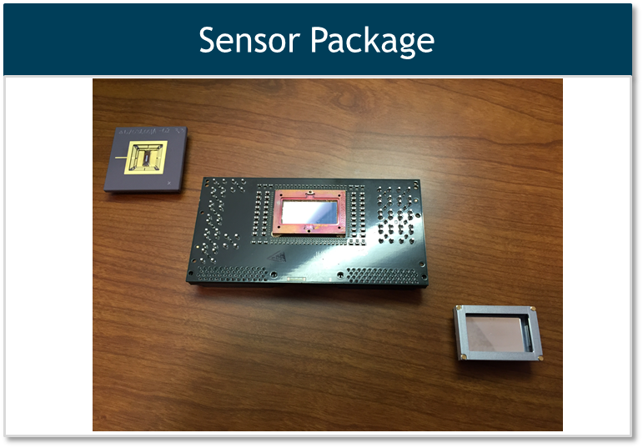
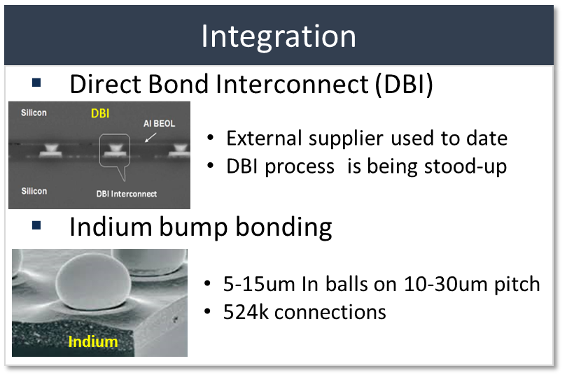
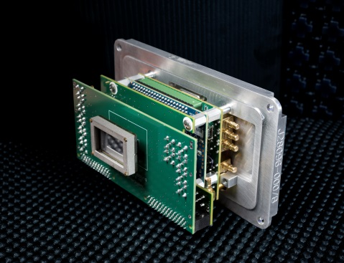
Many parts come together to become a hybrid CMOS UXI camera
Photons
Bias Metal
Detector
Bonding Layer
ROIC
UXI Hybrid CMOS Sensor
Package
Camera System Development for Facility Specific Needs (Z-machine/NIF)

Slide 12
SNL is unique in that we can design and manufacture our own detectors in different materials for the silicon ROICs we design and produce
UXI had developed a number of Si detectors and seeded research in III-V materials
Full BEOL available to the photodiode layer greatly expands our capability
  Integration of 5 metal layers in addition to passive components
    2 layers of stacked MIM caps
We are uniquely poised to deliver sensors in both Si and other materials given the significant capabilities collocated at MESA
  III-V detectors will greatly expand
  experimental range and reach/impact
  available to our customers
  Backside PD development could provide
  an immediate path to increased capabilities
  and reduced cost
High
25um thick
Maturity
100-200um thick
8um thick, passivated
Low
R&D
Si Detectors
III-V Detectors
4keV electron
4-6 keV X-Ray
532 nm visible
10-13 keV X-Ray
18+ keV X-Ray

Slide 13
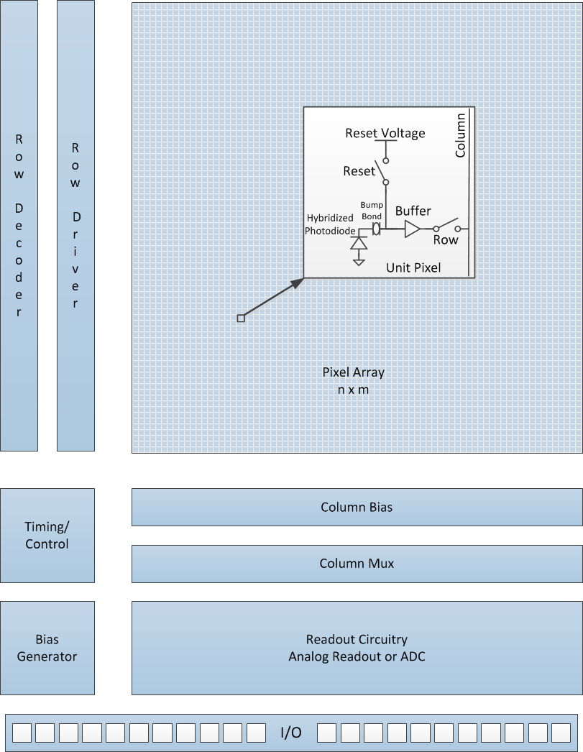
Traditional CMOS camera architecture serves as the base concept for burst mode imager development
A photodiode acts as the photon-to-electron transducer
Pixel circuitry converts this electron charge (Q) to a voltage or current
Support circuitry facilitates decode and readout of the pixel array

Slide 14
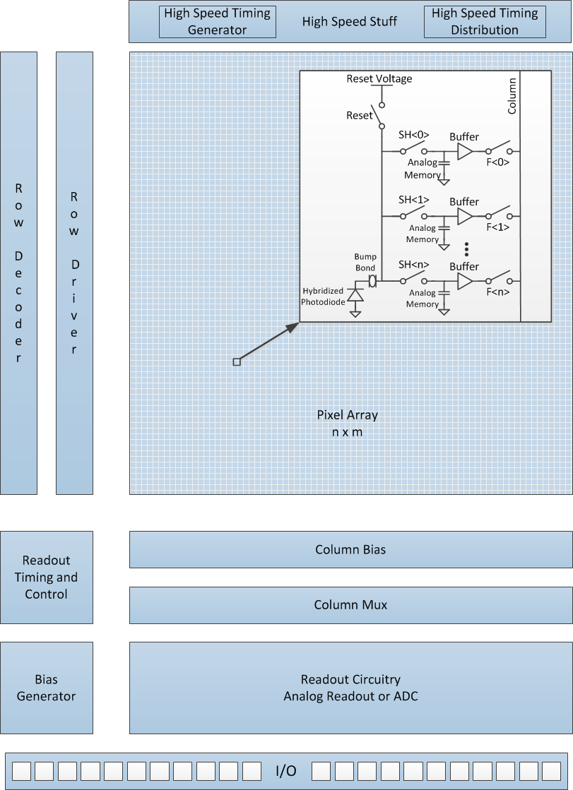
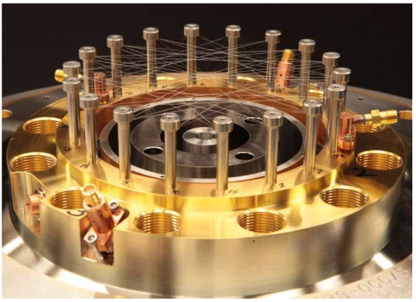
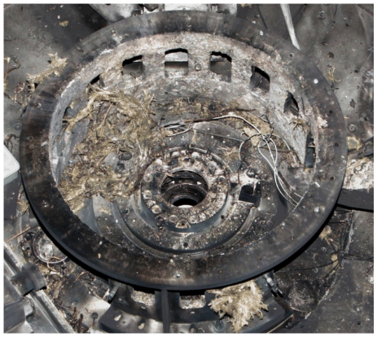
ICF facilities operate on a very slow rep rate so burst mode imagers fit the application well
Burst mode cameras store each frame of image data in-situ for high speed operation
  Multiplexes multiple pixels into one
  A transistor switch acts as an electronic “shutter” for each frame
  In-pixel storage introduces conflict between
  Pixel spatial resolution
  Full well capacity
  Number of frames
  Capacitive density is a critical design element
Configure the part prior to the experiment
Trigger and capture images on a high speed (ns) timescale
Read off information stored in-pixel on a slow (µs-ms) timescale
+
=

Slide 15
Sandia hCMOS have three distinct operational phases when capturing an image
Configuration Phase
  Shutter profile is entered
Triggered Image Capture
  Pixel array and diagnostics are reset
  High speed shutters generated/distributed
  Images captured and stored
Readout
  Random access readout of images
Timing Generation and Distribution
Row Decoder
Replication
Row Driver
Row Driver
Replication
Photodiode
Array
Reset Voltage
Pixel Example
Pixel
Reset
Frame 1
Read Ctrl
Photons
3D
Interconnect
Shutter1
e-
Frame 2
Read Ctrl
e⁻
Shutter2
Column
Output
Pixel Array
Diagnostic
&
Bias
Column Bias
Trigger
Timing Example
Column Mux
Photons
Output Driver
`
Shutter1
Shutter2

Slide 16
UXI sensors

Slide 17
ROIC design goals were developed to satisfy a broad suite of end-use applications
Large area imagers
  Expensive to lens X-rays
  Makes it difficult to propagate high speed signals
Fine spatial resolution
  Trade off between number of frames and full well
User programmable timing for experimental flexibility
Low jitter operation for facility/experiment synchronization
Targeted SNL’s 350 nm CMOS7 SOI technology
  High speed performance and transistor density are limited
  In house facilities allow for close relationship with the fab
  Radiation hardened by process
Requirement | Initial Goals | Holy Grail
Array size | 1024 x 512 | 1024 x 512
Pixel size | 25 μm | 25 - 40 μm
Number of frames | 4 | 6 - 24
Min integration time | 2 ns | 250 - 300 ps
Min inter-frame time | 2 ns | 250 - 300 ps
Timing skew | < 10% | < 10%
F-F/array gain errors | < 10% | < 10%
Full well | 500 ke⁻ | 5 M e⁻
Noise floor | 500 e⁻ | 250 e⁻
Dynamic range | 60 dB (10 bit) | > 60 dB (11 bit)
Abutable | No | 2 side

Slide 18
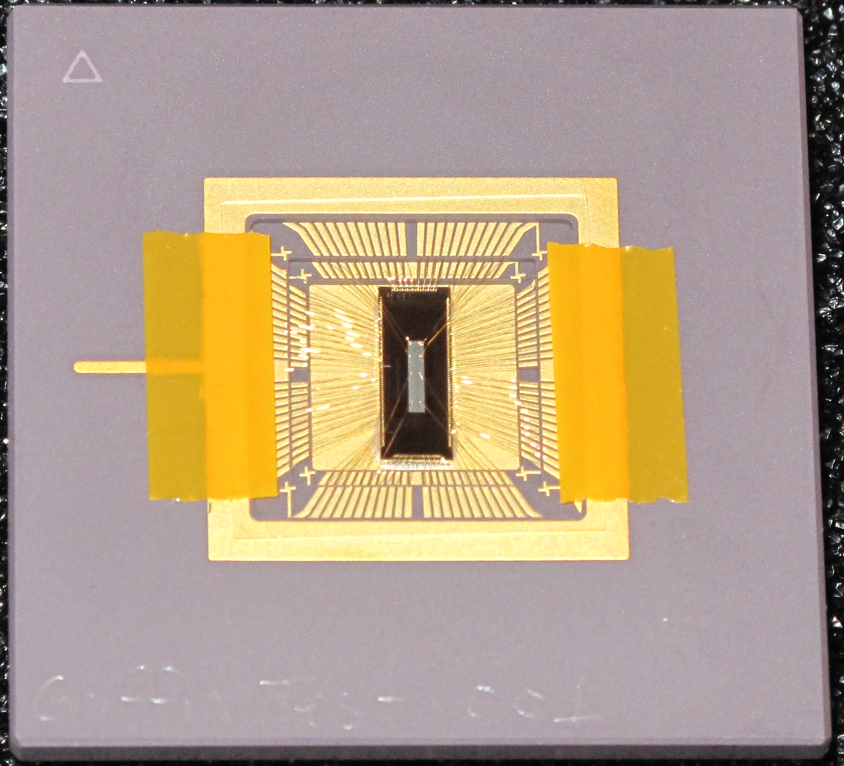
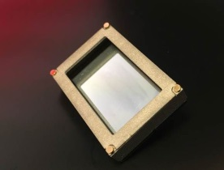
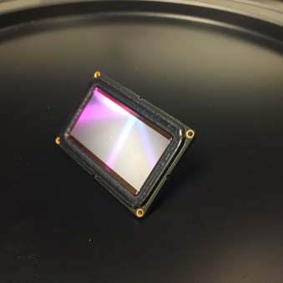
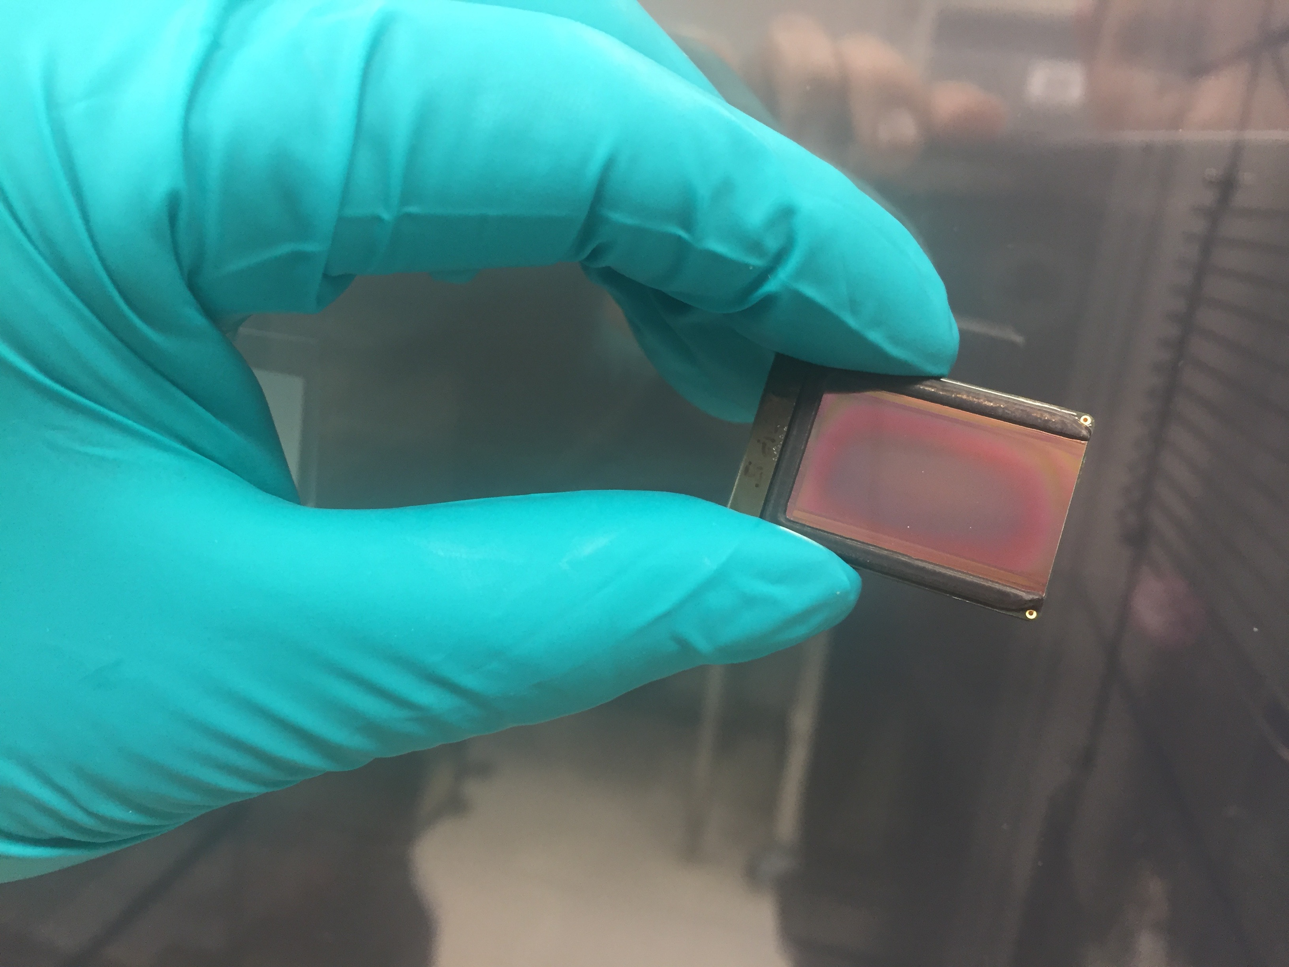
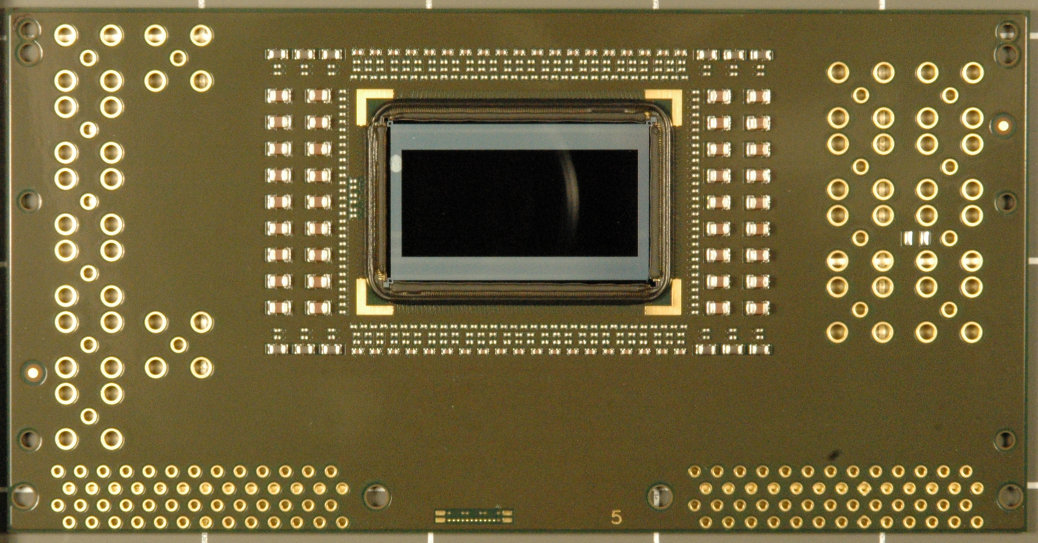
Fielded Sensor History
 | In Use |  |  |  | In Test
 | Furi | Hippogriff | Icarus |  | Daedalus
Year | FY14 | FY15 | FY16 |  | FY18
Min Integration time | ~1.5 ns | ~2 ns | ~1.5 ns |  | ~1.0 ns
Frames | 2 | 2 (full resolution) 4 or 8 (Row interlaced) | *4 (full resolution) *8 (L/R interlaced) |  | 3 (full resolution) 6+ (Row/L/R interlacing)
Tiling Option | No | No | No |  | One Side
CMOS Process | 350 nm (SNL) | 350 nm (SNL) | 350 nm (SNL) |  | 350 nm (SNL)
Pixels | 448 x 1024 | 448 x 1024 | 512 x 1024 |  | 512 x 1024
Pixel Size | 25 μm x 25 μm | 25 μm x 25 μm | 25 μm x 25 μm |  | 25 μm x 25 μm
Capacitor Full Well | 1.5 million e⁻ | 1.5 million e⁻ | 0.5 million e⁻ |  | 1.5 million e⁻
…

Slide 19
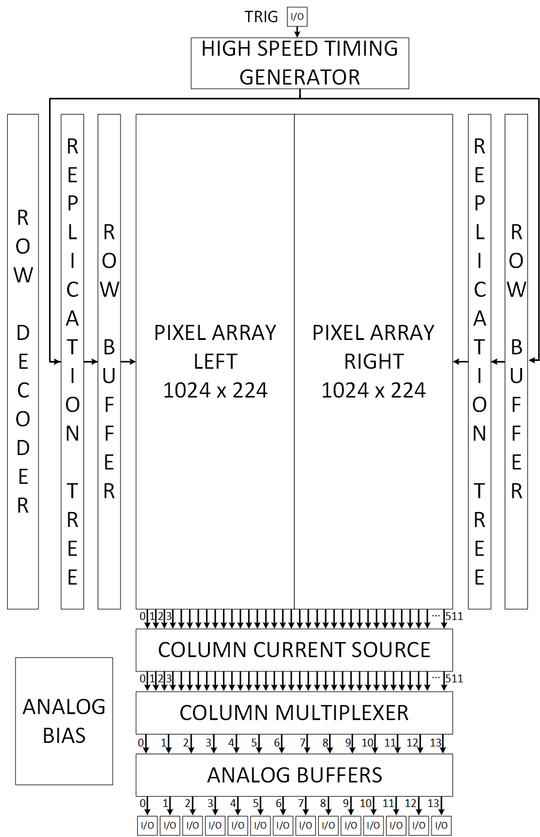
Furi was the first generation large scale imager to be fielded as a diagnostic
ROIC performance
  1024 x 448 pixels
  25 µm pixel pitch
  2 frames per pixel
  1.5 Me⁻ full well
  1500 e⁻ noise floor
  60 dB dynamic range
  < 2 ns minimum integration time
  < 2 ns minimum inter-frame time
  Common anode detector
ROIC features
  Digitally programmable shutter timing generator
Furi block diagram
Active array size: 11.2 mm x 25.6 mm

Slide 20
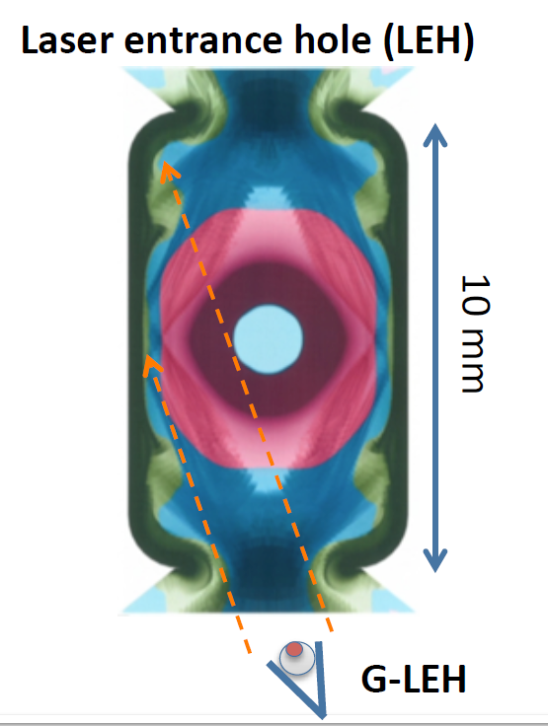
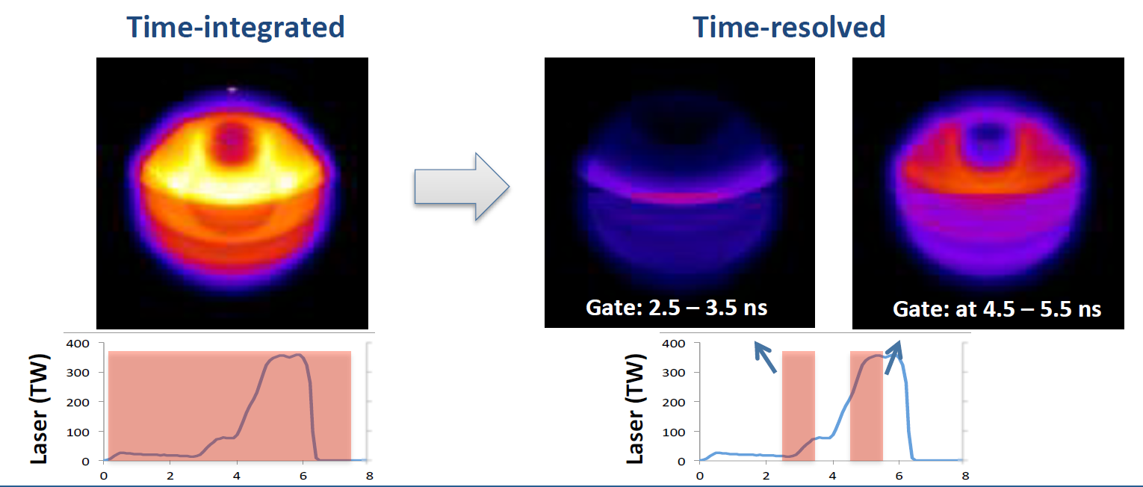
LLNL/NIF has fielded 2 UXI imagers to date with multiple additional diagnostics planned
First UXI system fielded on the NIF was a first generation, 2 frame Furi image sensor
  Direct emission pin hole imaging of the Laser Entrance Hole
  Provided a time gated history of the experiment for investigating multiple phenomena
    Cross-beam energy transfer
    Capsule size
    Laser entrance hole size
    Instability development
G-LEH line of sight
Chen, H., et. al., “A high-speed two-frame, 1-2 ns gated X-ray CMOS imager used as a hohlraum diagnostic on the National Ignition Facility,” Rev. Sci. Instrum. 87, 11E203 (2016).

Slide 21
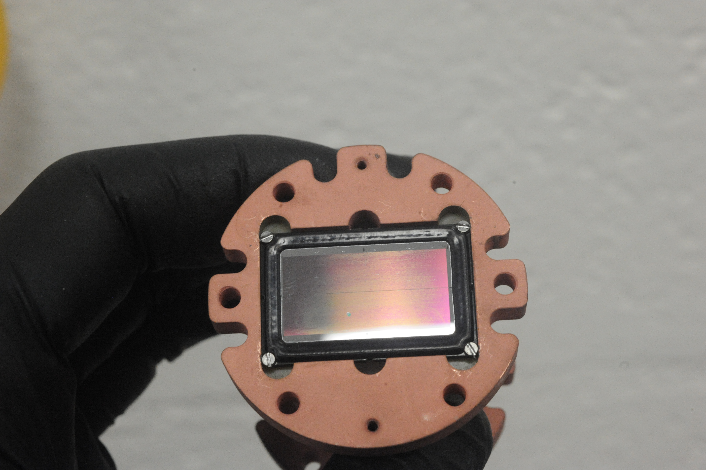
Icarus design specs and operational modes
ROIC performance
  1024 x 512 pixels
  25 µm pixel pitch
  4 frames per pixel
  500 ke⁻ full well
  500 e⁻ noise floor
  60 dB dynamic range
  < 2 ns minimum integration time
  < 2 ns minimum inter-frame time
  Common cathode detector
    Slower risetime
    Better for manufacturing for low energy x-ray sensitivity
ROIC features
  Digitally programmable shutter timing generator
  Fully independent hemisphere shutter timing
  Left/Right hemisphere shutter fine tuning
Active array size: 12.8 mm x 25.6 mm

Slide 22
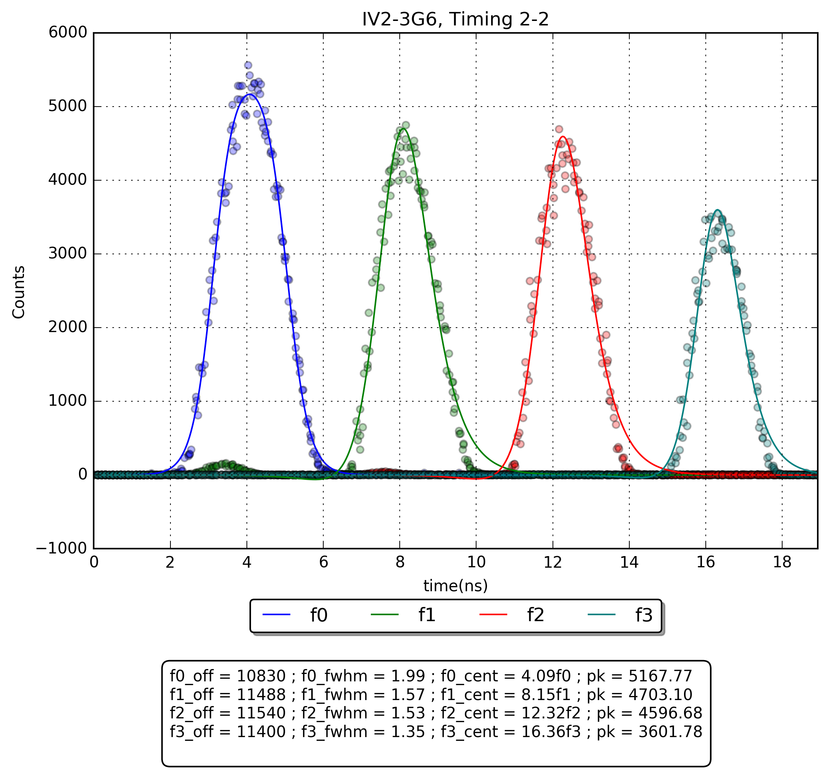
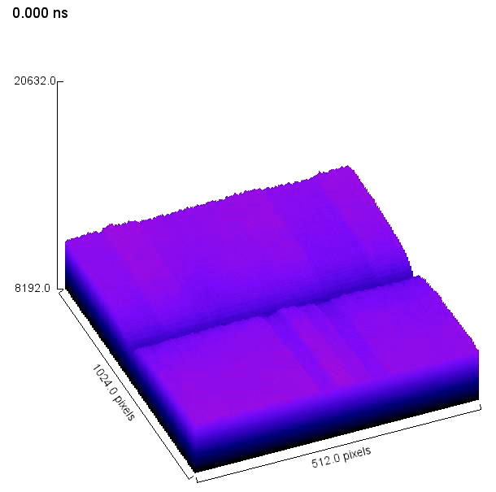
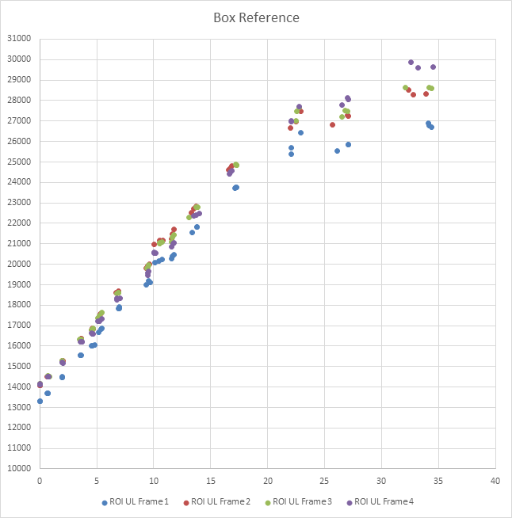
Icarus optical test results demonstrate good performance
SH0 | 1.99 ns
SH1 | 1.57 ns
SH2 | 1.53 ns
SH3 | 1.35 ns
2 ns timing shutter profile, full array exposure, 36% full well illumination
3D shutter profile
Optical linearity sweep, 4 ns integration time, 3 ns inter-frame time

Slide 23
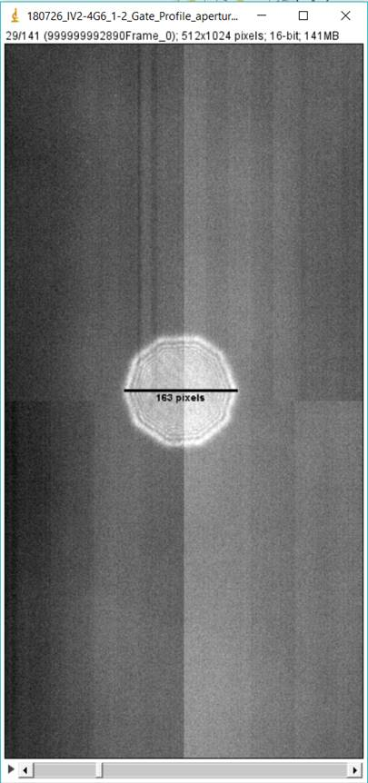
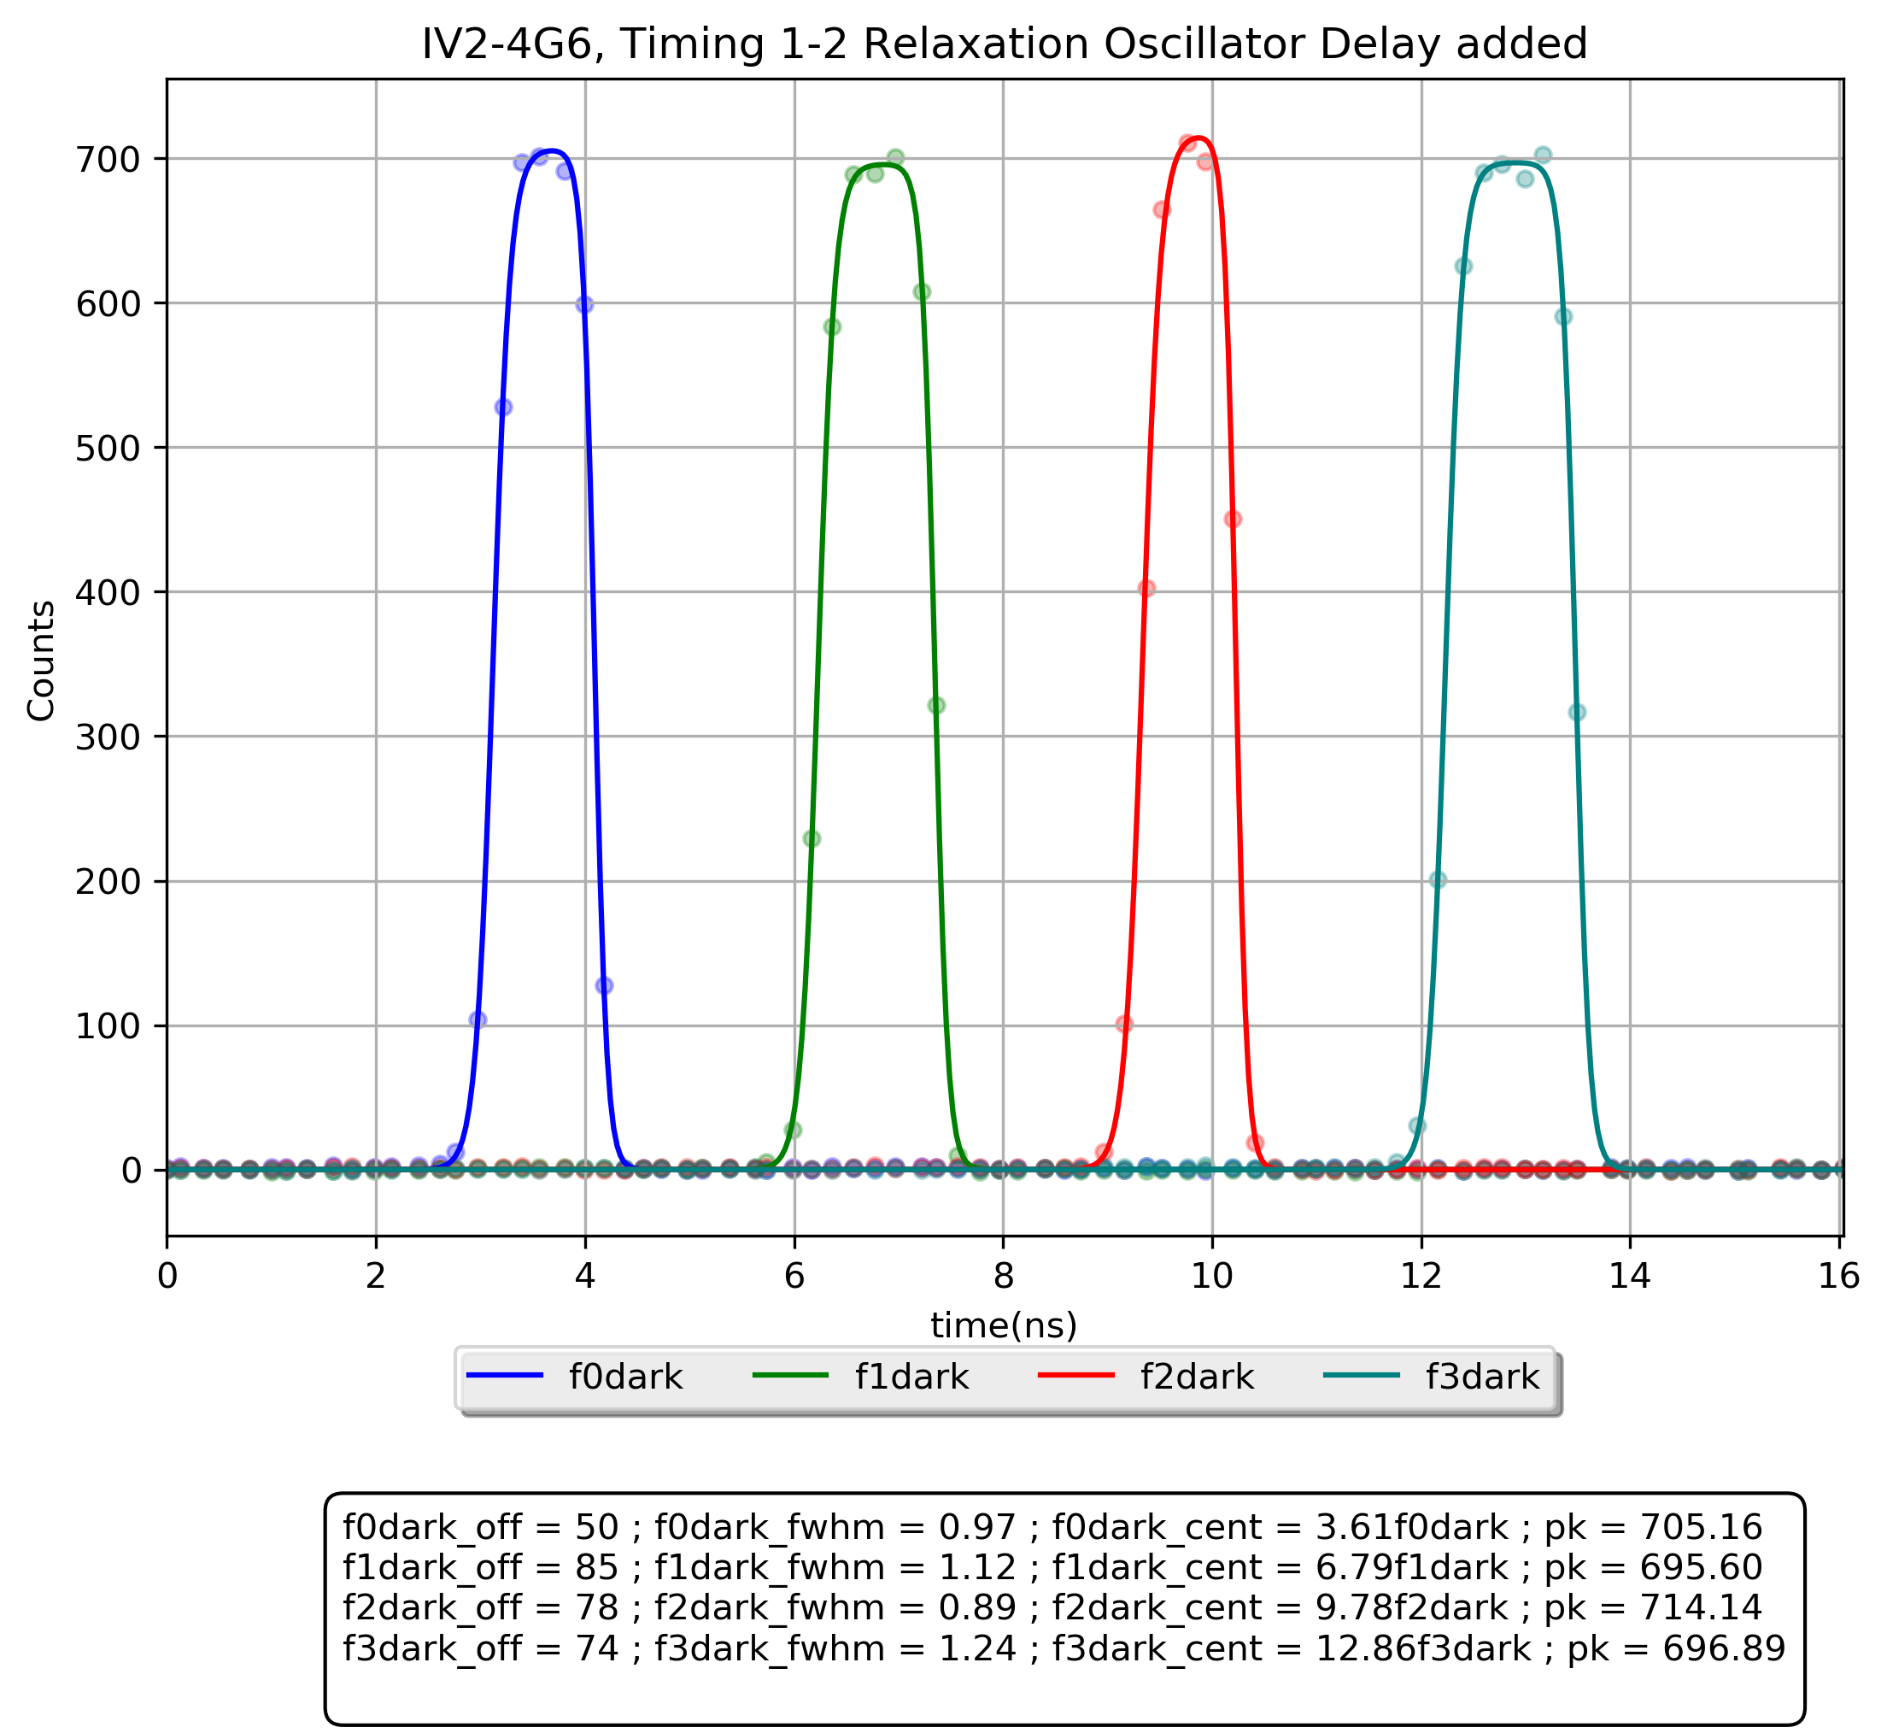
Global effects and photodiode speed dominate fastest integration time currently achievable with Icarus
SH0 | 0.97 ns
SH1 | 1.12 ns
SH2 | 0.89 ns
SH3 | 1.24 ns
1 ns timing shutter profile, aperture exposing ~4 % of the array, 5.6% full well illumination, 8 µm thick photodiode
Aperture shutter profile

Slide 24
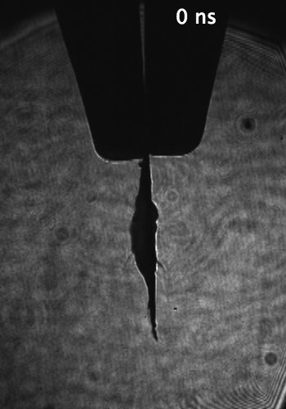
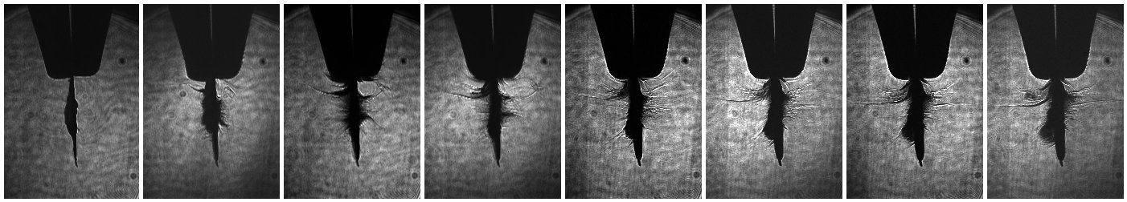
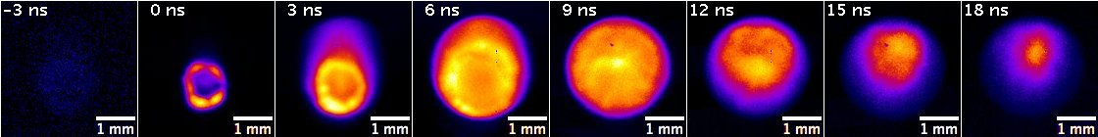
SNL’s Z-machine has used Icarus sensors for multiple applications
Laser pre-heating experiments in the Pecos test chamber provides valuable test capability without requiring experimental Z-machine shots
  Icarus sensors, projecting onto both hemispheres, timed sequentially, to yield 8 frames
  Icarus sensors have been configured to provide both axial and side on views
0 ns
27 ns
54 ns
81 ns
108 ns
135 ns
162 ns
189 ns
4
2
mm
Side View @ 27 ns
0
0
2
4
mm
Porter, J.L. SNL
Axial View @ 2 ns

Slide 25
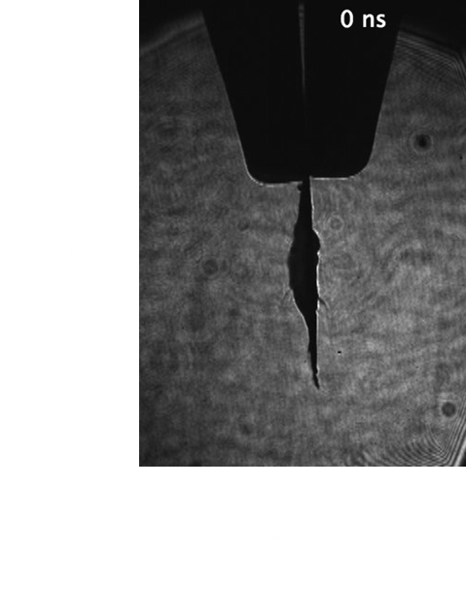
SNL’s Z-machine has used Icarus sensors for multiple applications
Laser pre-heating experiments in the Pecos test chamber provides valuable test capability without requiring experimental Z-machine shots
  Icarus sensors, projecting onto both hemispheres, timed sequentially, to yield 8 frames
  Icarus sensors have been configured to provide both axial and side on views
0 ns
27 ns
54 ns
81 ns
108 ns
135 ns
162 ns
189 ns
Side View @ 27 ns
Porter, J.L. SNL
Axial View @ 2 ns

Slide 26
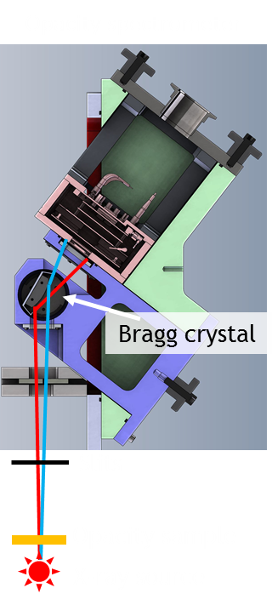
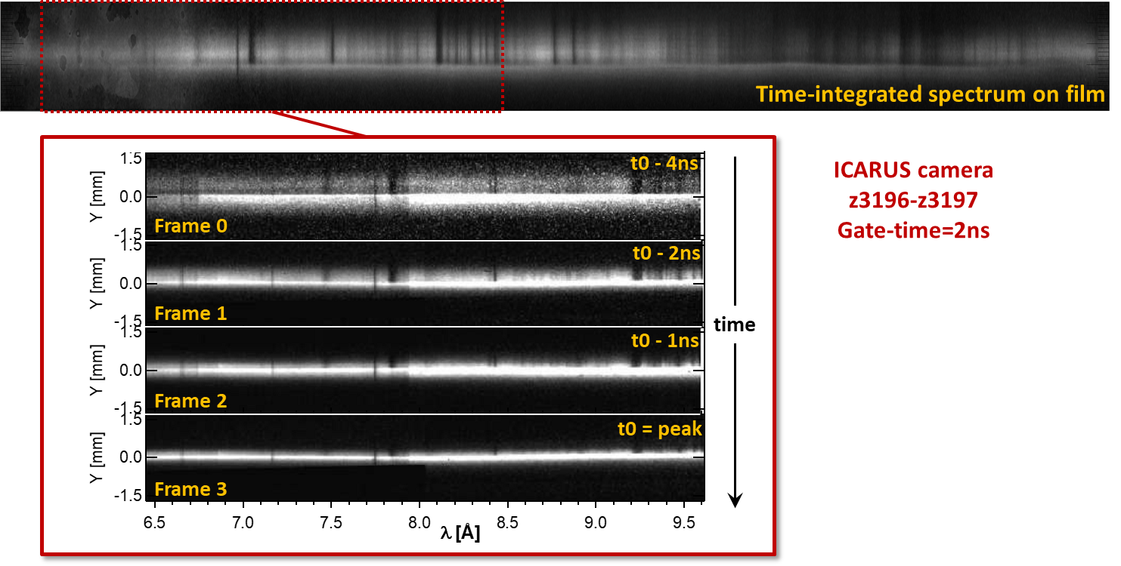
SNL’s Z-machine has used UXI sensors for multiple applications
Multi-frame, time resolved X-ray opacity spectrometer utilizing an Icarus sensor observing the opacity of Nickel under conditions found in the solar interior
Porter, J.L. SNL

Slide 27
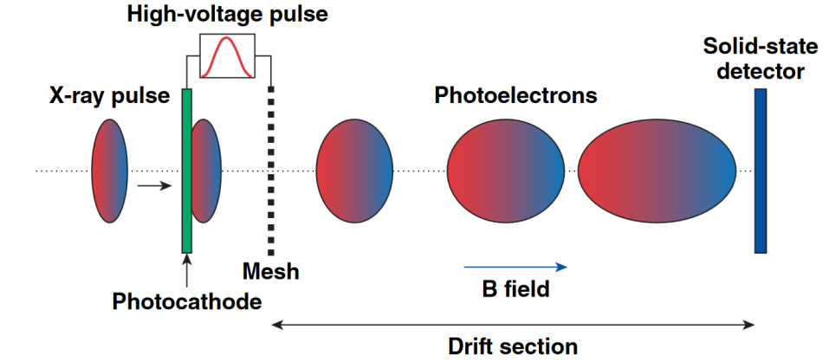
LLE was the first Single Line-Of-Sight diagnostic fielded
Icarus sensor coupled to a pulse dilation tube yields 4, 30 ps time gated images
  Tele-temporal lens magnifies an input signal temporally
  Provides a Single Line of Site (SLOS) multi-frame capability
  2 ns Icarus integration time
  30 ps temporal resolution
  Pinhole imager
Voltage Ramp
Time Dilation Imaging concept

Slide 28
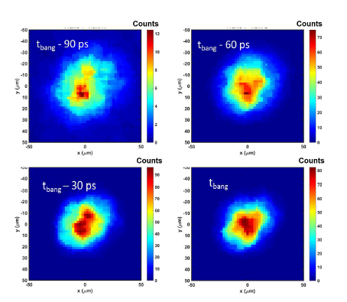
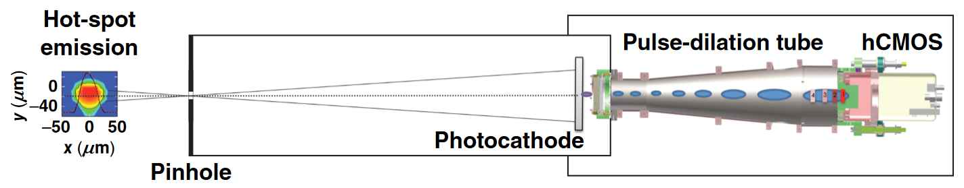
LLE was the first Single Line-Of-Sight diagnostic fielded
Icarus sensor coupled to a pulse dilation tube yields 4, 30 ps time gated images
  Tele-temporal lens magnifies an input signal temporally
  Provides a Single Line of Site (SLOS) multi-frame capability
  2 ns Icarus integration time
  30 ps temporal resolution
  Pinhole imager
SLOS-TRXI Time Dilation Imager
Multiple pinhole images averaged in order to improve signal fidelity. 80X temporal mag
Theobald, W., et. al., “The Single Line-of-Sight Time-Resolved X-ray Imager diagnostic on OMEGA,” Rev. Sci. Instrum., (Submitted 2018).

Slide 29
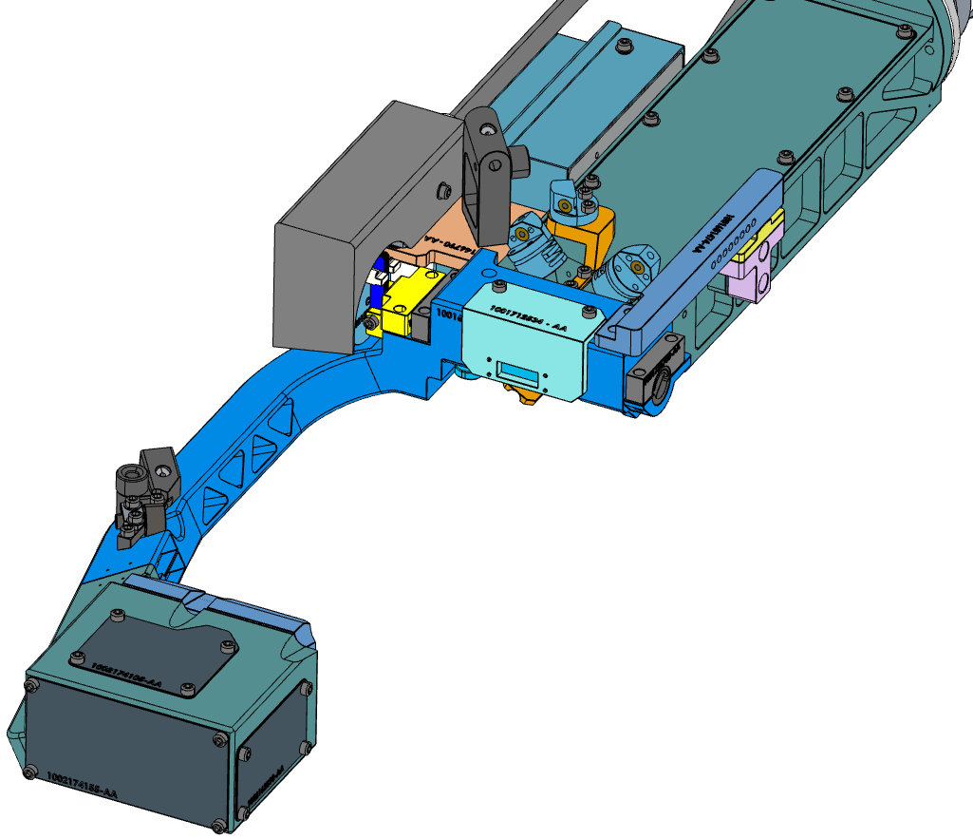
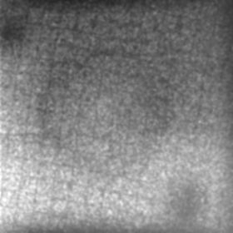
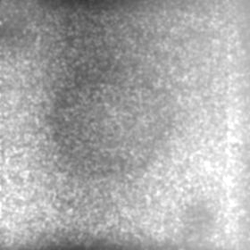
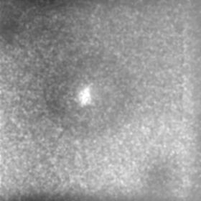
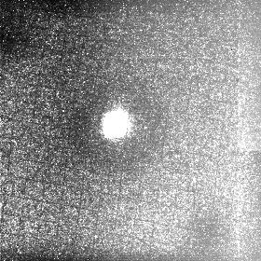

LLNL/NIF has fielded SLOS-Crystal Backlighter Imager (CBI) to image ICF implosions closer to bangtime than ever before
Icarus sensor + pulse dilation tube + curved crystal backlighter imaging system
  Same tele-temporal SLOS tube as developed for LLE
  2 ns Icarus integration time
  35-150 ps temporal resolution
  X-ray backlight with a curved crystal optic
Laser
(1 NIF quad)
~7.35ns
~7.45ns
~7.52ns
~7.6ns (bangtime)
Aperture box
Backlighter (Se)
Target
at TCC
Si Crystal
housing
~700µm at TCC
~8µm spatial resolution, 55ps gate time
Credit: Arthur Carpenter, et al. LLNL

Slide 30
Daedalus has been tested electrically and will improve on past sensor performance
ROIC performance
  1024 x 512 pixels
  25 µm pixel pitch
  3 frames per pixel
  1.5 Me⁻ full well
  500 e⁻ noise floor
  70 dB dynamic range
  < 1.5 ns minimum integration time
  < 1.5 ns minimum inter-frame time
  Common cathode detector
ROIC features
  Improved digital timing distribution architecture
  Infinite interlacing capability
  High full well single frame mode
  Zero Dead Time interlacing mode
  Improve row timing skew to < 150 ps
  1 side abutable for a 512 x 2048 possible tiled imager
Active array size: 12.8 mm x 25.6 mm

Slide 31
Optical testing is required to determine ultimate performance of Daedalus but initial electrical testing is positive
Frame Number | Read Noise (ADC LSB) | Read Noise (V_{rms})
0 | 2.9 | 220.4 µV
1 | 2.2 | 167.2 µV
2 | 2.2 | 167.2 µV

Slide 32
Next Steps

Slide 33
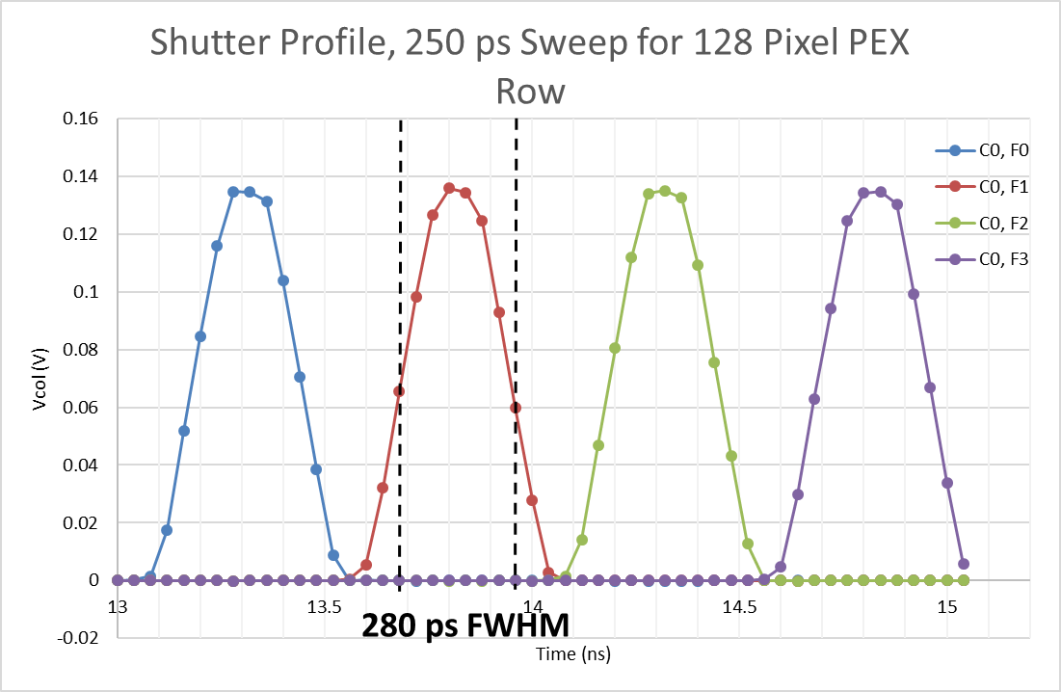
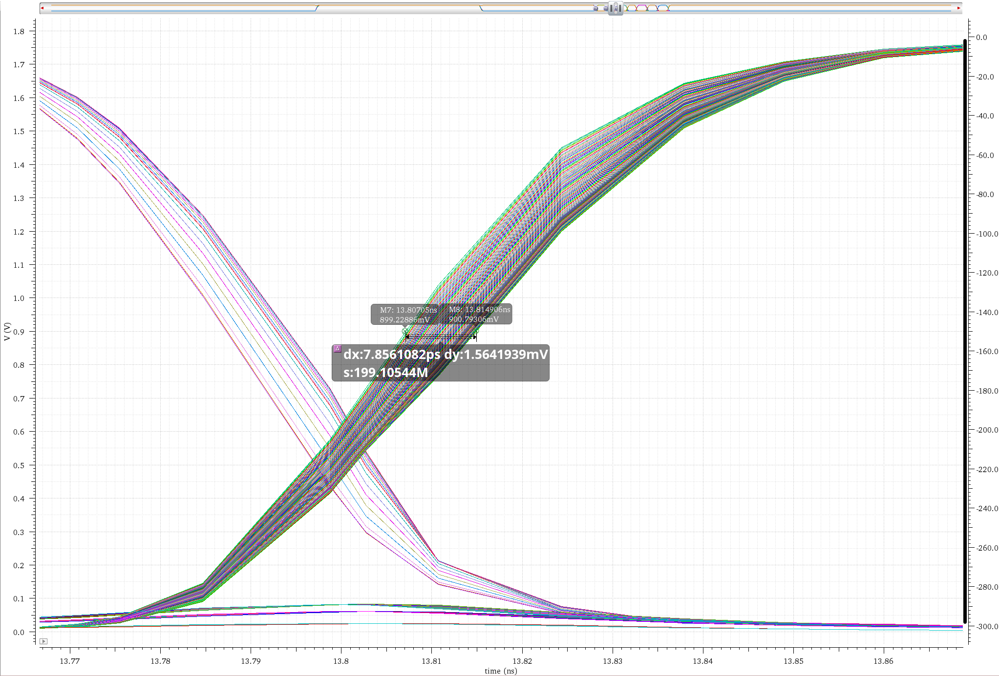
180 nm CMOS8 development image sensor named Sisyphus has been fabricated and is awaiting test
Primarily intended as a CMOS8 development vehicle
  Leverage 7 levels of metal
  Smaller feature size
  Channel leakage is largest unknown
Largely based on the Daedalus architecture
256 x 256 pixel array
  6.4 mm² active area
25 µm pitch
4 frame
500 ke⁻ full well
Design goal of 250 ps integration time and inter-frame time
8 ps skew for rising shutter input pulse across columns

Slide 34
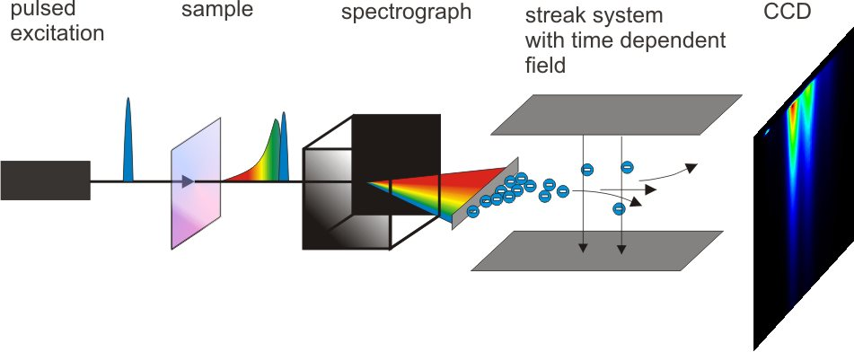

Solid state streak camera (SSSC) concept for time resolved spectroscopy
Streak cameras produce a time resolved 1D image
Past endeavors in solid state streak cameras have utilized Switched Capacitor Arrays (SCA)
  DRS4, PSEC4, Kleinfelder
Where a standard UXI camera endeavors to trigger the entire array at once, the SSSC intentionally adds delay between adjacent columns
  In this way, temporal information is captured spatially
  Faster than SCA’s because each input is only loaded by a single pixel capacitance rather than many
  2 pixel types
    Type 1, 256 columns (samples) x 256 rows (6.4 mm spatial area)
    Type 2, 128 columns (samples) x 256 rows (6.4 mm spatial area)
Time
Space
Traditional streak camera based spectrometer
SSSC concept

Slide 35
The SSSC prototype has been fabricated in CMOS8 and is awaiting functional testing
The base MOGI pixel consists of a timing block and signal capture block
The timing block receives a falling-edge trigger from the previous pixel and generates the nStart and nStop signals
The nStart signal is the trigger for the next pixel
The nStart and nStop signals are shorted across rows to ensure the entire array is uniformly timed
Test chip has been fabricated and is awaiting test
Base, Min T_{dly} | 80.6 ps
Base, Min T_{int} | 69.8 ps
CDS, Min T_{dly} | 85.9 ps
CDS, Min T_{int} | 67.4 ps

Slide 36

Future work and applications are expanding the scope of the UXI program
Multiple additional facilities are fielding or plan to field UXI sensors
  19 additional diagnostics are planned for ICF diagnostics utilizing UXI sensors
    Stanford Linear Accelerator (SLAC)
    French CEA, Laser Mega Joule
  Other DOD/NW applications

Slide 37


Future work is expanding the capabilities of the UXI program
Exploring novel pixel designs
  High full-well attenuating pixels
III-V detectors for direct, high-energy X-ray imaging coupled to high full well (> 1.5M e⁻) ROICS
  When biased at saturation velocity, GaAs is 1.25x faster than Si
  Demonstrated performance with 20 µm thick discrete detectors
  Pixilated arrays are the next design effort
Faster readout for reduced dead-time between shots
Improved capacitive density
  In-house programs to develop High-K dielectric MIMs
  In-house program to develop vertical trench capacitors
M. Suzuki et al., "An over 1Mfps global shutter CMOS image sensor with 480 frame storage using vertical analog memory integration," 2016 IEEE International Electron Devices Meeting (IEDM), San Francisco, CA, 2016, pp. 8.5.1-8.5.4.

Slide 38

Is there a path to 2D, sub 100 ps imagers?
Etoh, Takeharu Goji et al. “The Theoretical Highest Frame Rate of Silicon Image Sensors.” Ed. Vittorio M. N. Passaro. Sensors (Basel, Switzerland) 17.3 (2017): 483. PMC. Web. 2 May 2018.

Slide 39
Backup

Slide 40

Row-wise timing skew is also an issue with current UXI camera implementations
Driving the distributed RC load of many pixels introduces a timing skew from the outermost pixel columns to the innermost pixel columns
Icarus exhibited slightly worse timing skew (400 ps) than past camera due to increasing the pixel row length from 224 to 256
  Hemisphere offset tuned to 70 ps
~400 ps row skew
~70 ps hemisphere offset

Slide 41





Daedalus is functional electrically and is currently undergoing packaging with a planned first light occurring mid June, 2018
1 ns
1 ns row shutter timing parasitic sim
1 ns simulated shutter profile
2 tiled imager concept
Active array size: 12.8 mm x 51.2 mm
High Full-Well mode DR simulation > 4 million e⁻

