Slide 1
Time-Resolved Macromolecular Structure Determination at Pulsed X-ray Sources
ULITIMA
September 2018
Marius Schmidt
www.people.uwm.edu/smarius/
m-schmidt@uwm.edu

Slide 2
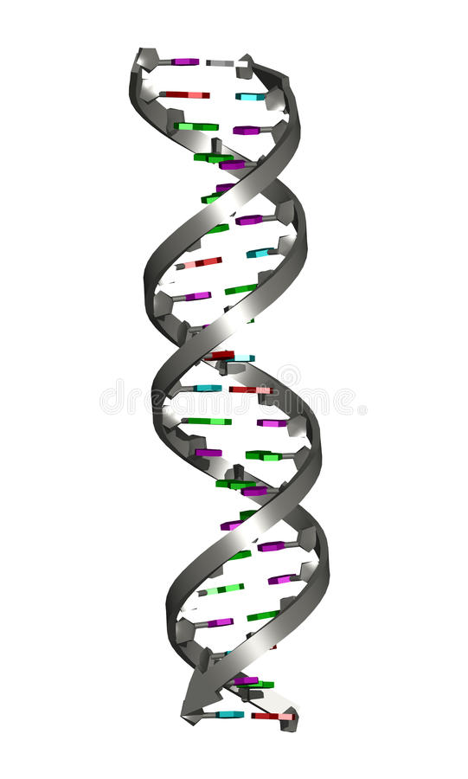
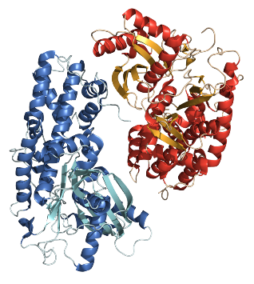
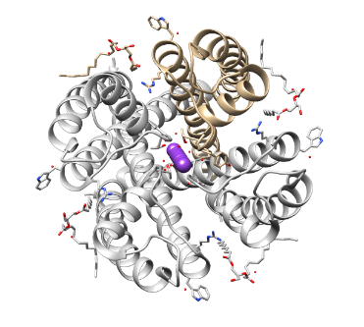
Bio-Macromolecules
The Bricks of Life
Proteins
functions for life
catalysis
copying the information for life
energy production
metabolism
cognitive abilities
defense against pathogens
perception of the environment:
sound, vision, smell, taste, touch
mobility and maintaining structural integrity
… many more
Nucleic Acids
blueprint for life
regulation
ribozymes
double helix
riboswitch
hexokinase, metabolism
potassium channel
photosystem II, energy, O₂

Slide 3
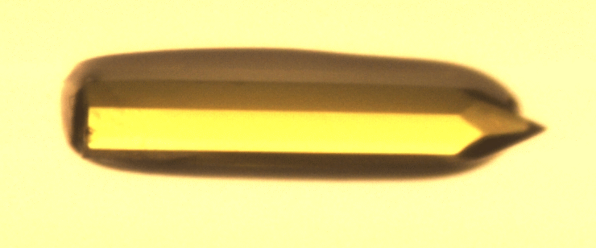
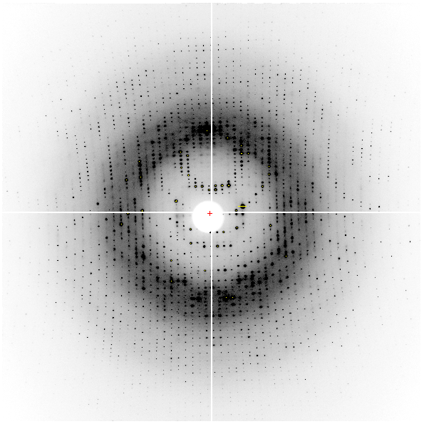
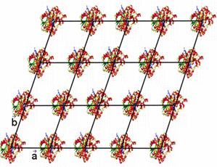
X-ray Diffraction Experiment
diffraction pattern with Bragg reflections
bio-macromolecules form crystals
X-rays
crystal, ordered
3D-array of particles

Slide 4
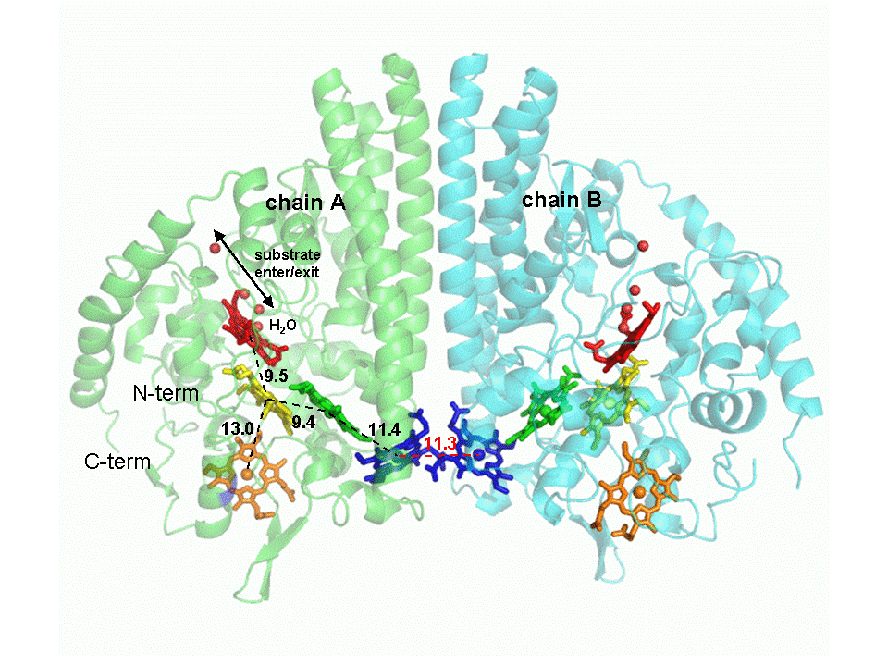
X-ray Structure
Cytochrome C Nitrite Reductase (ccNIR)
enzyme, biocatalyst
catalyzes the reduction of nitrite to ammonia
Shewanella oneidensis ccNIR
Youngblut et al., 2012

Slide 5
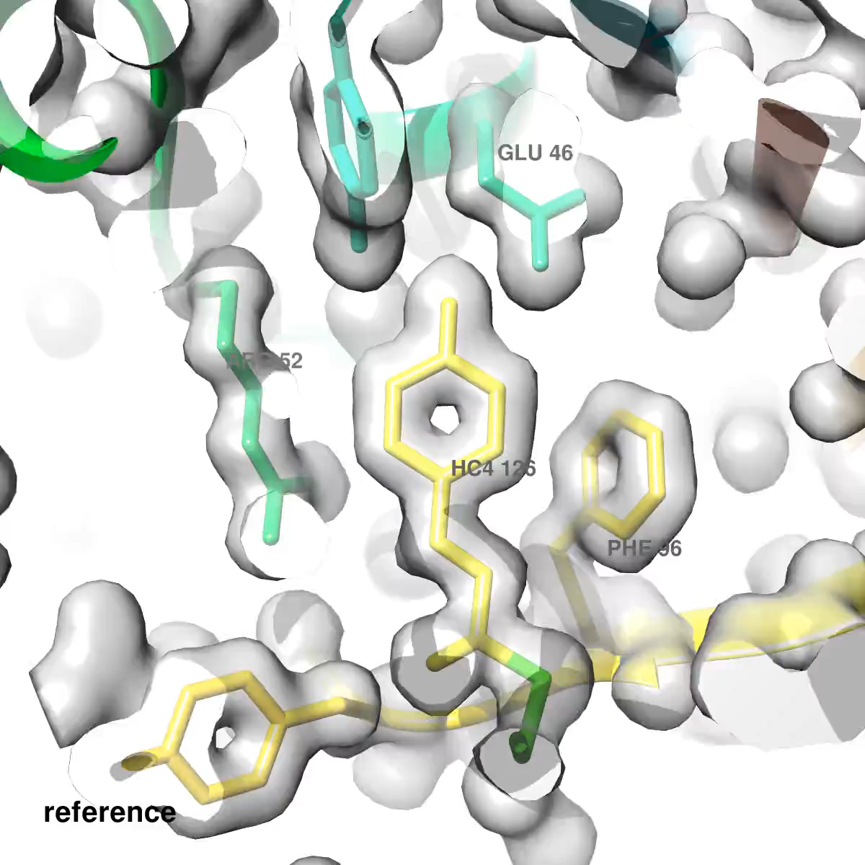
Biological Macromolecules in Motion
Notes:
From conception to reality 2003 – 2013, ten year to create this, I will explain to you how to make such movies

Slide 6
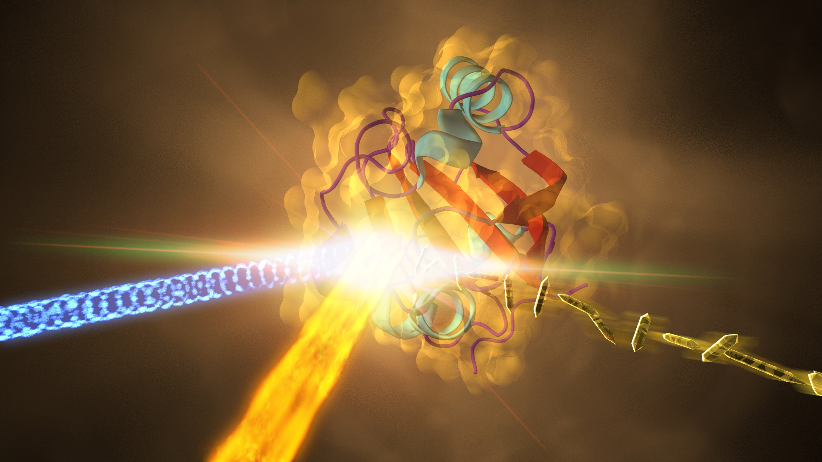
The Fastest “Camera” in the World
Movie with 25 Trillion ! Pictures per Second
2014, LCLS Press Release
Notes:
I will show you a landscape from this initial movie to the fastest camera in 2014, and we did not stop here. I will show you enzyme-substrate reaction on slow time-scales.

Slide 7
Time-Resolved Diffraction
systems scale
molecular machines
translation
transportation
100 Å
10 Å
1 Å
0.1 Å
residue scale
intermediates
substrate binding
enzymatic cycles
Log length scale
enzymology
atomic scale
electronic excitations
ultrafast configurational
changes
1 fs 1 ps 1 ns 1 μs 1 ms 1 s
Log time scale
Notes:
We are going from the very fast to enzymology, and the goal is going to the slowest time scales with the largest structural changes.

Slide 8
Time-Resolved Diffraction
Brownian ratchets
rugged energy landscapes
diffusion
physics of complex systems
100 Å
10 Å
1 Å
0.1 Å
chemical kinetics
transient states
catalytic mechanisms
Log length scale
enzymology
Einstein coefficients
quantum chemistry
conical intersections
electronic interactions
fundamental fluctuations
1 fs 1 ps 1 ns 1 μs 1 ms 1 s
Log time scale
Notes:
My perspective on this slide

Slide 9
Time-Resolved X-ray Diffraction
Goals
aims
extract kinetics and dynamics
energy landscapes
rate coefficient
barriers of activation
and
molecular structures along the reaction pathway
for
reversible reactions
and
irreversible (catalyzed) reactions
from
X-ray Diffraction Data Alone

Slide 10

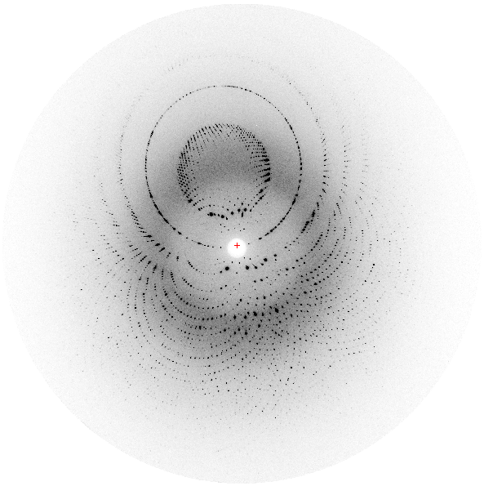
Time-Resolution
The Pump-Probe Experiment
Time-resolution:
shortest delay feasible
here ~4 ns
delay
Δt
laser, pump
X-ray, probe
time-dependent diffraction pattern
4 ns
100 ps
crystal

Slide 11
Time-Resolved Structure Determination
Crystallo-Kinetic Analysis
light initiated reactions
(more general reaction initiation later in this talk)
light sensitive protein
well diffracting crystals
setup experiment at time-resolved crystallography beamline
(such as Advanced Photon Source 14-ID-B, BioCARS)
collect and process reference data in the dark
collect and process time-resolved data after
reaction initiation by laser pulse
calculate difference maps
difference maps range from the beginning to the end of reaction
analyze time series of difference maps
extract structures of intermediates
determine chemical, kinetic mechanism

Slide 12
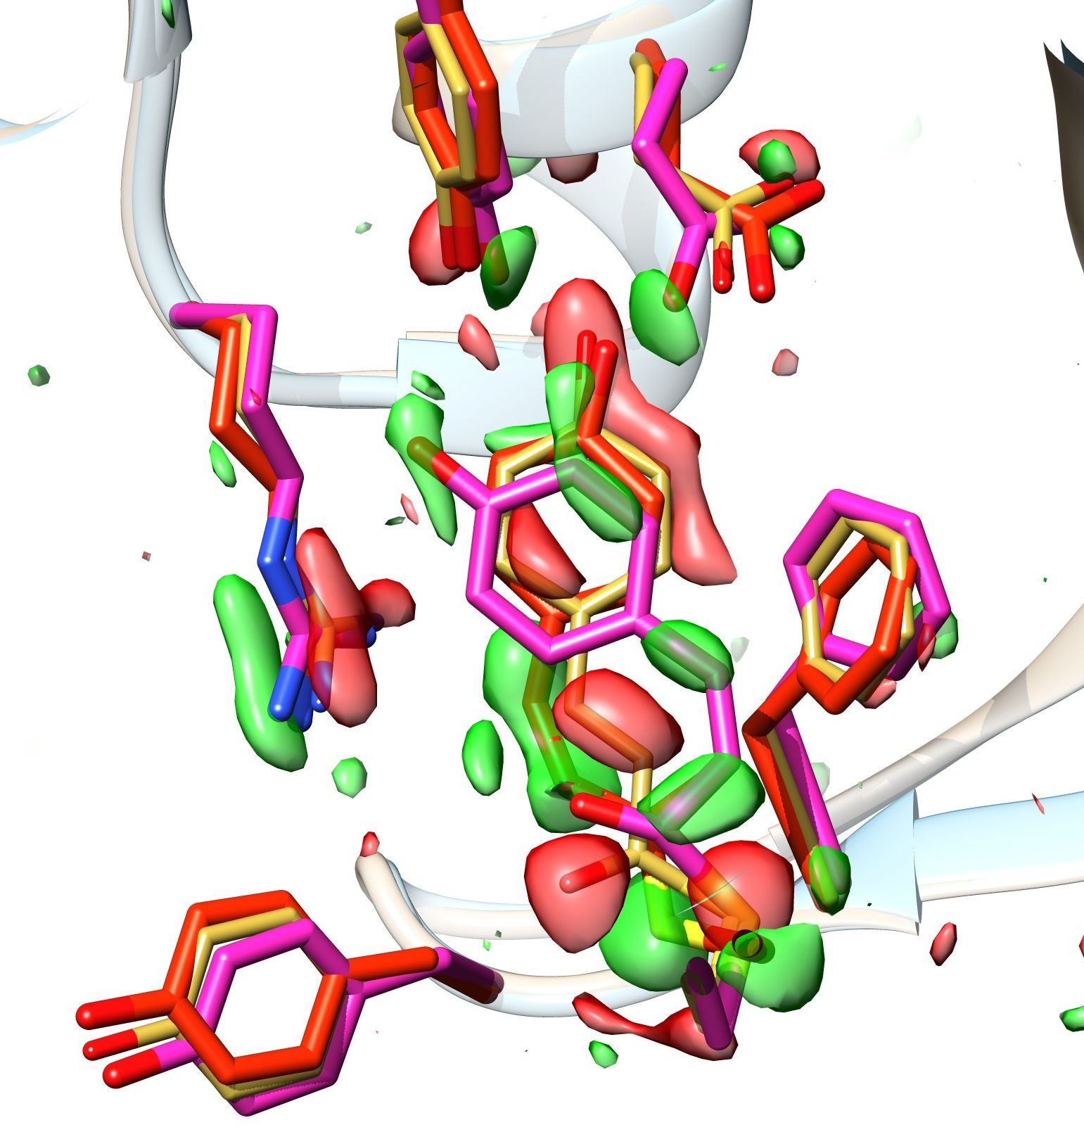
Difference Maps
Drive the Analysis
difference
electron density
structures
dark/reference
positive
negative
pR1
pR2
structural
displacements
Δt = 1 μs
Notes:
Emphasize displacements

Slide 13
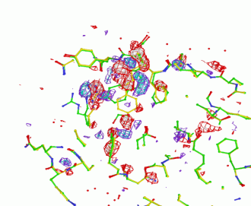
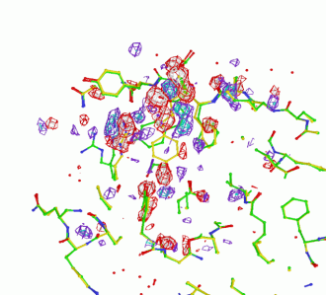
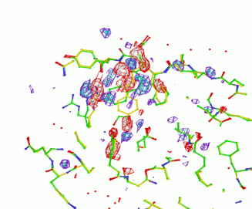
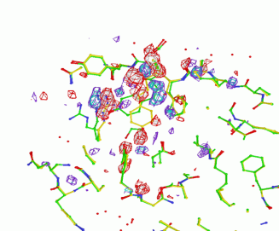
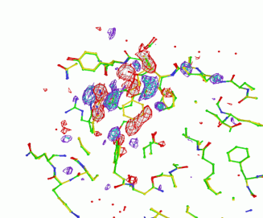
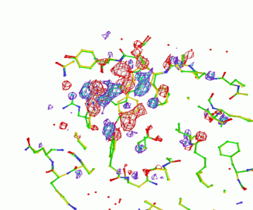
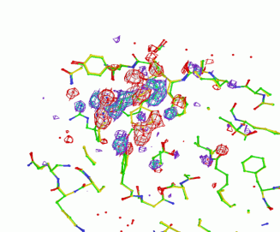
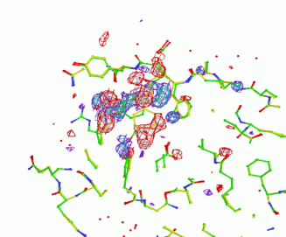
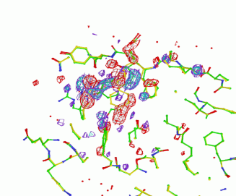
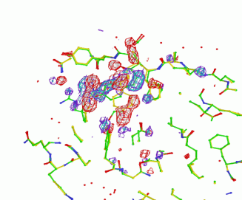
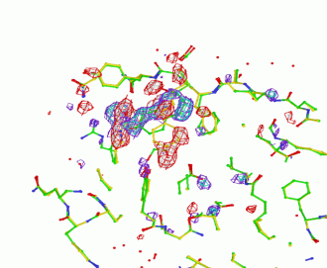
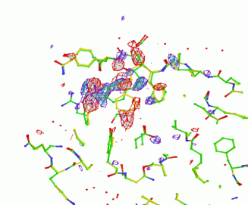
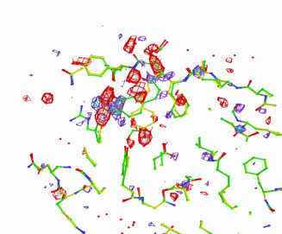
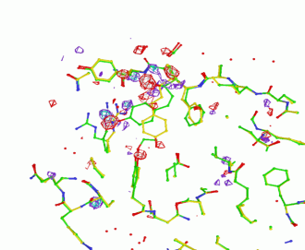
Structure and Kinetics
Time-Series Mandatory
spans from beginning to the end of a reaction
consists of difference maps
time-delays equidistant on a logarithmic time-scale
- log t -
start
end
2ns 1s
deconvolution (separation) of structures of transient states
determination of a chemical, kinetic mechanism
Notes:
PYP was the driving biological system to develop this method

Slide 14
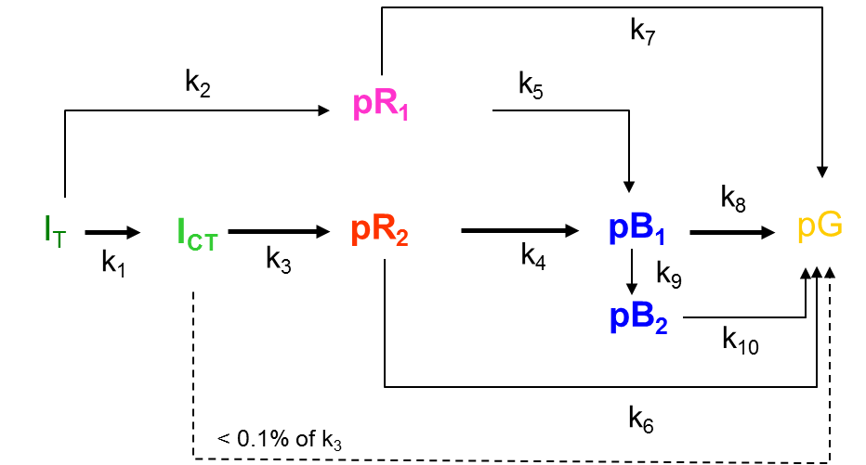
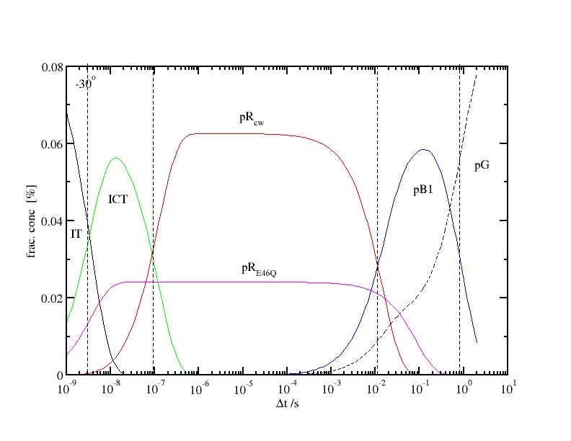
Interpretation of a Comprehensive Time-Series
(time-series = kinetics)
crystallo-kinetic software
‘SVD4TX’ and ‘GetMech’
time-series of
difference maps
pG
analysis by Singular
Value Decomposition
kinetic
modeling
structures of
intermediates
pR₂
fractional conc.
post-refinement
pR₁
concentration
profile
Schmidt et al., BJ, 2003
delay [s]
Notes:
One of the biggest problems to be solved in TR crystallography. How to interpret these maps. We developed a set of Fortran programs to interpret time-series of time-resolved difference maps

Slide 15
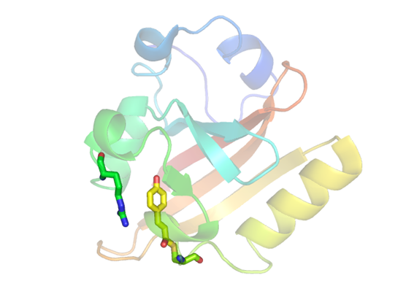
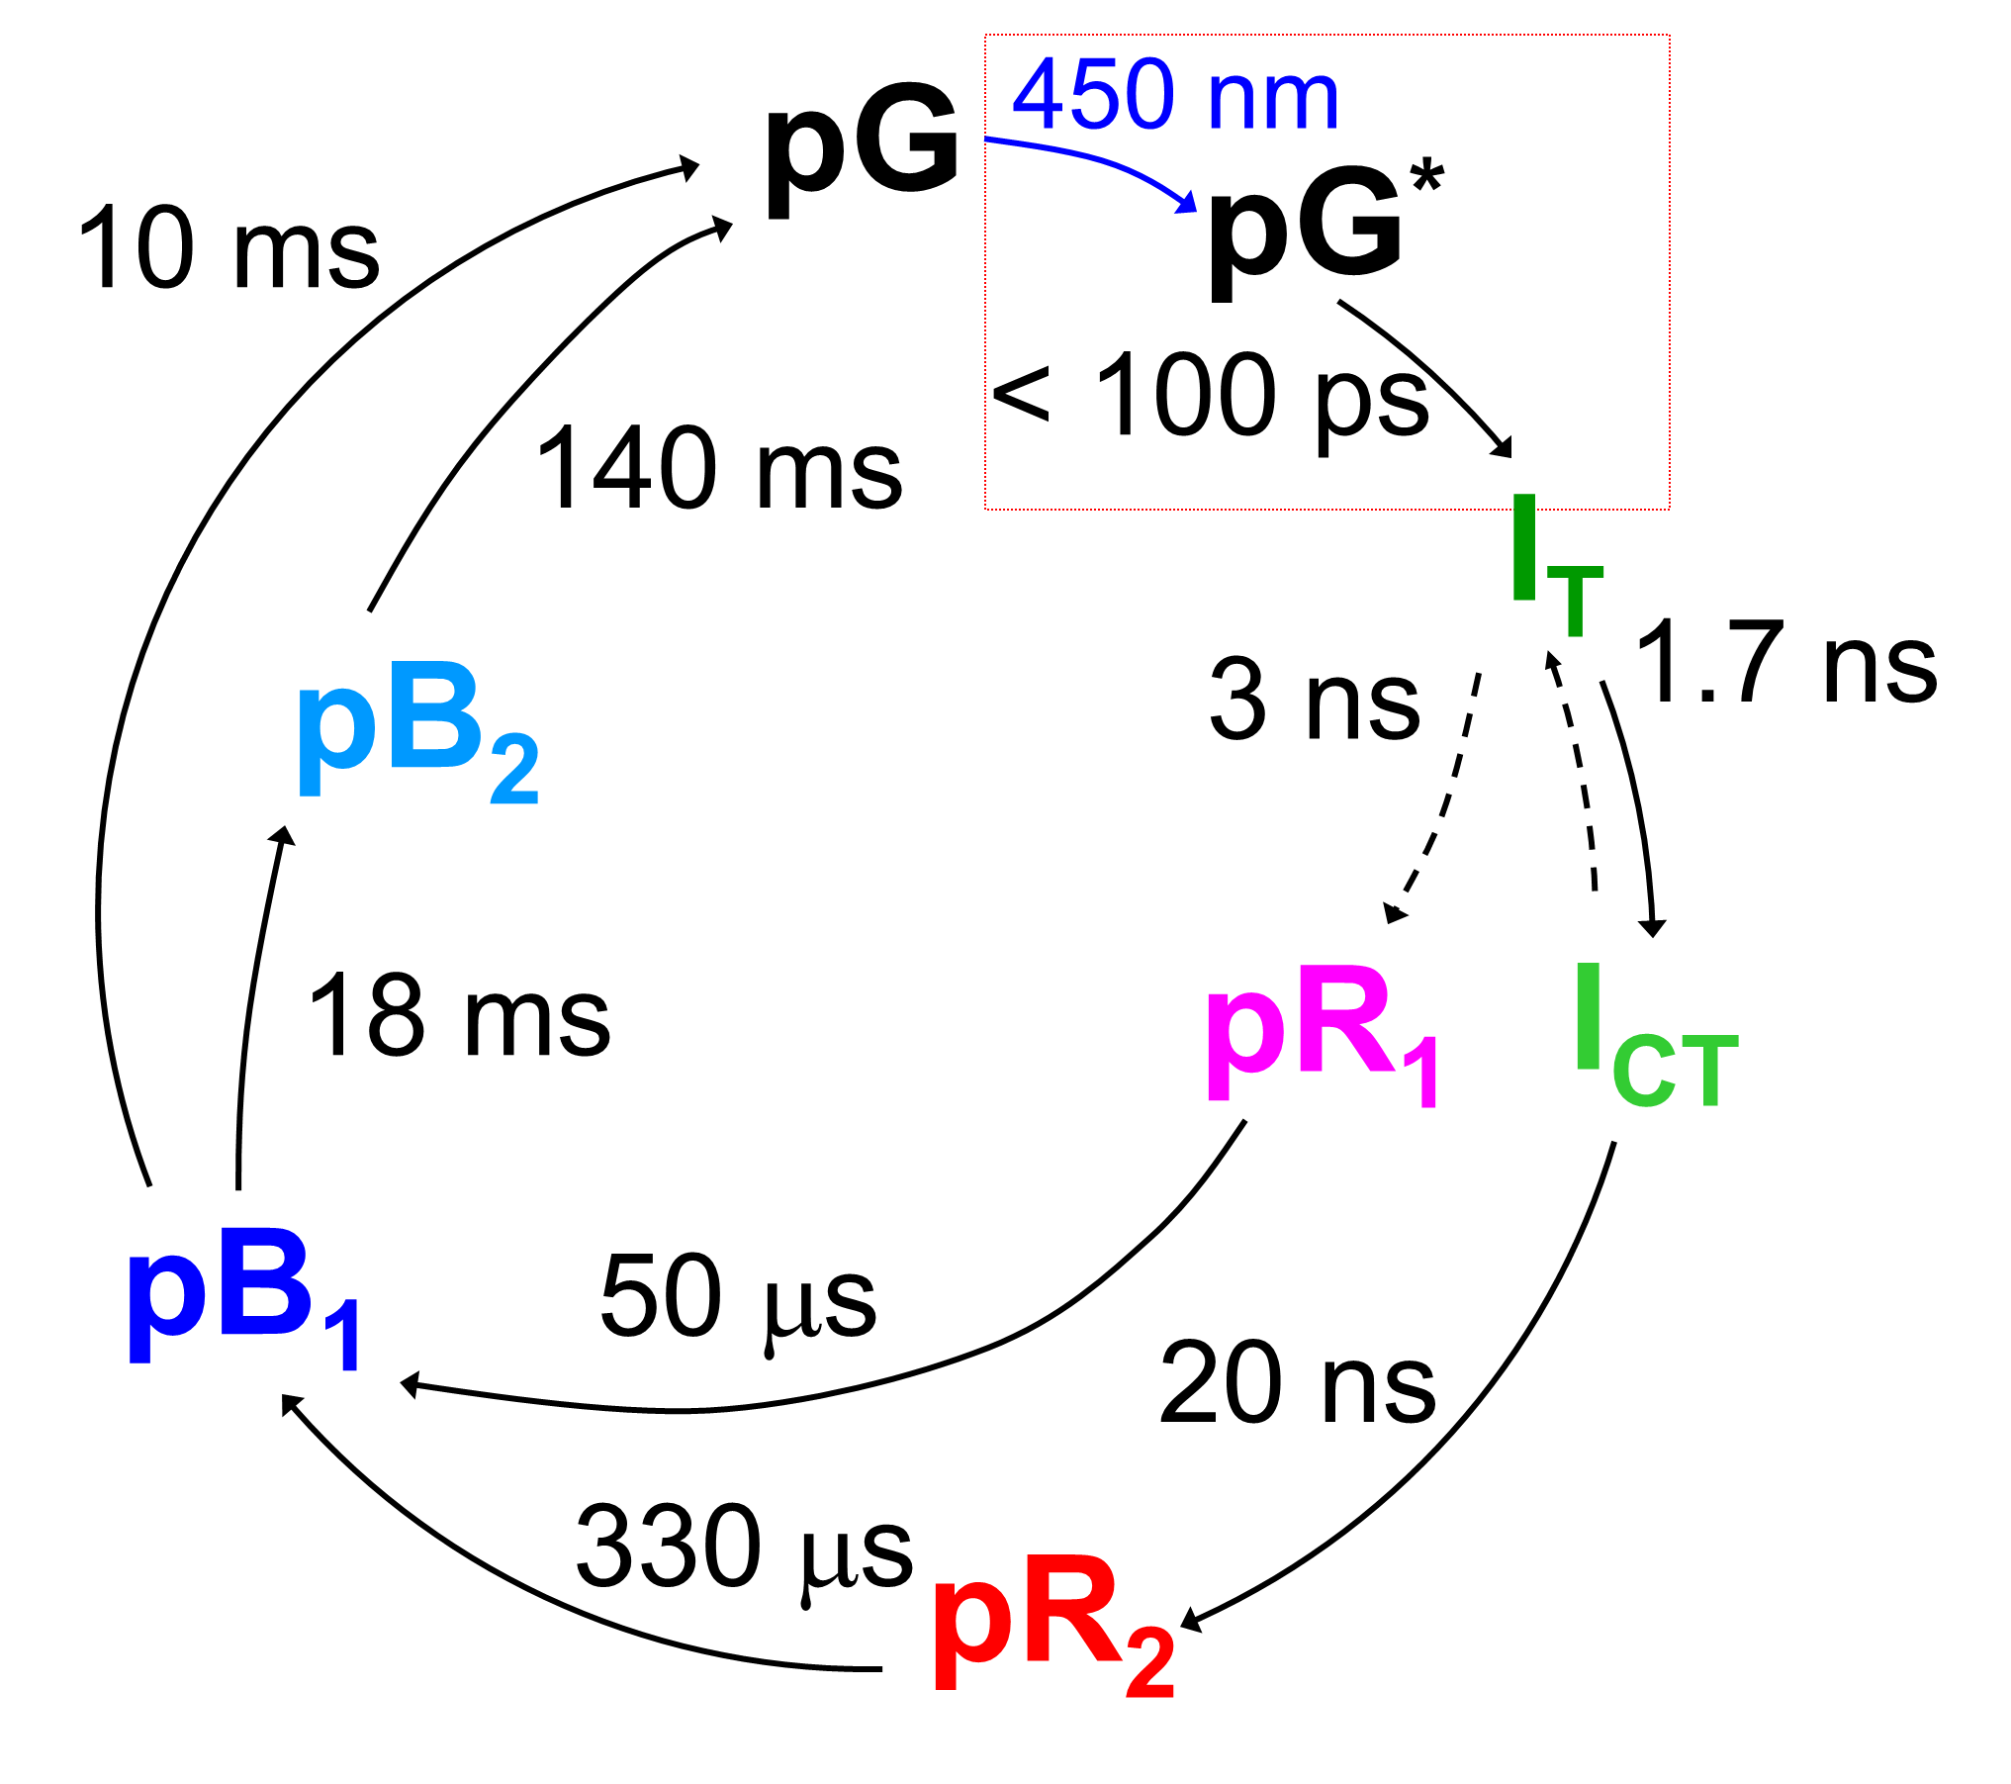
Movie
Appearance and Disappearance of Electron Density
Schmidt et al., 2003, 2004, Ihee et al. ,2005, Ihee et al., 2013, Schmidt 2008, Schmidt et al., 2013
Photoactive Yellow Protein (PYP)
p-coumaric acid
MW: 14.7 kDa
www.people.uwm.edu/smarius/
Notes:
This movie is fusion of many papers from 2003 to 2013. The movie can be downloaded from my web-page.

Slide 16
Limitations
will be addressed
limited X-ray intensity
loss free focusing is challenging, bigger crystals required
time-resolution ~100 ps (X-ray pulse duration) not sufficient
cyclic reactions preferred over single pass (facilitates multiple exposures)
reaction initiation difficult when biomolecule not intrinsically photoactive
crystal quality is critical (high mosaicity will impede the experiment)
radiation damage must be addressed
room temperature (protein dynamics required)
excludes many (almost all) highly relevant enzymes
resolve these limitations

Slide 17
Biological Systems to Resolve these Limitations
(1) Femtosecond Time Scale, PYP
trans to cis isomerization of p-coumaric acid is not time-resolved at synchrotron
100 ps X-ray pulses available at synchrotron do not allow femtosecond time resolution
fundamental motions are on the femtosecond time scale
early processes of vision are similar (cis-trans isomerization of retinal)
(2) bio-medically relevant enzymes, β-lactamase
enzymes are bio-medically, pharmaceutically and biologically extremely important
in general enzymes are not photoactive
new ideas for reaction initiation needed
Notes:
Chose PYP, because it form great diffracting crystal, that can be produce in high amount. For that development we needed grams of protein.
If it works for beta-lactamase it works for many enzymes …

Slide 18
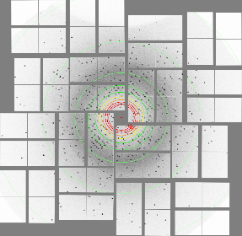
Structural Femtochemistry
X-ray Source with Femtosecond Pulses
visualization of femtosecond electron density displacements
electronic excited state dynamics
observation of transition to the ground state
ground state dynamics
fundamental modes of motion drive the reaction
need femtosecond time resolution
optical laser, pump
X-ray, probe
Δt
100 fs
100 fs
Notes:
come back to the experiment later

Slide 19
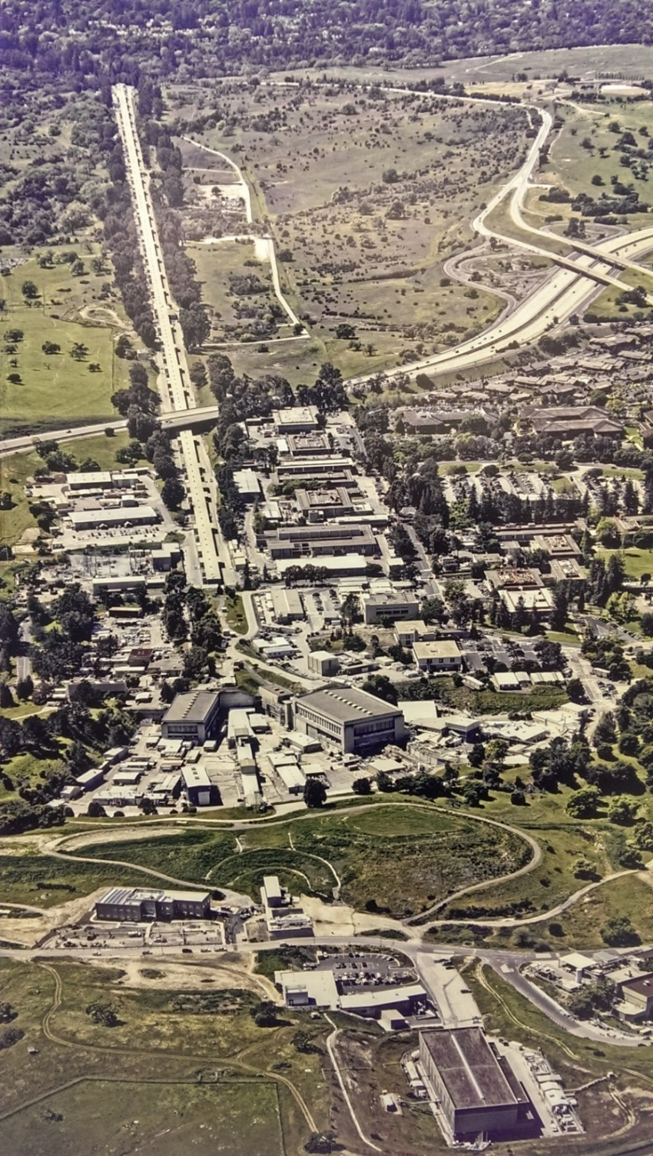
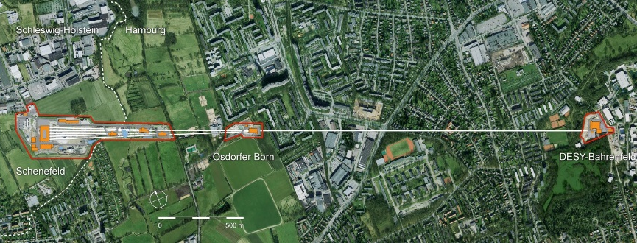
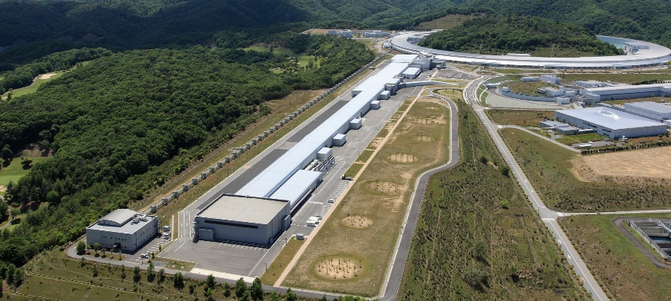
Femtosecond X-ray Pulses @XFELs
European XFEL, between Bahrenfeld and Schenefeld,
DESY Hamburg, Germany
Linac Coherent Light Source
(LCLS), SLAC, Menlo Park, CA
Spring-8 Ångstrøm Compact Free Electron Laser
(SACLA), Harima, Japan
Notes:
FEL were inveted in 70 th, XFELs are around since 2009 with the first one in the US. And it took until 2014 for the first successful time-resolved experiment, which does done by an amazing graduate student in my lab.

Slide 20

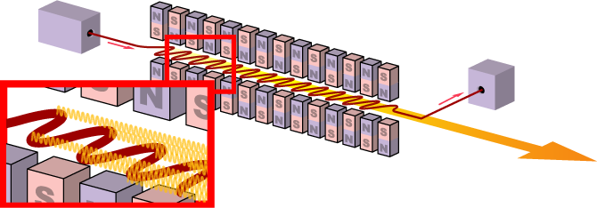
Evolution of the FEL
FEL
original design (1971)
stimulated emission
25 MeV and 3.2 cm
undulator period
infrared
Star Wars
XFEL
10 - 20 GeV electrons
~ 300 m undulators
10 keV X-rays
self amplified spontaneous emission (SASE)

Slide 21
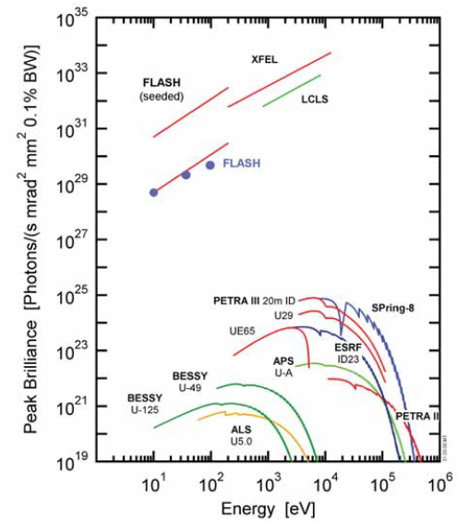
Massive Increase in Brilliance
XFEL for 9 keV X-rays
Flux at sample: 5 x 10¹² photons/pulse
Full bandwidth: 0.2%
Focal spot: 1 μm
Pulse duration: 40 fs
2.5 x 10¹² photons in 0.1% bw
2.5 x 10¹² photons/μm² in 0.1% bw
Synchrotron
Flux at sample: 5 x 10¹⁰ photons/pulse
Full bandwidth: 5%
Focal spot (no loss): 30 x 15 μm²
Pulse duration: 100 ps
1 x 10⁹ photons in 0.1% bw
2 x 10⁶ photons/μm² in 0.1% bw
9 keV

Slide 22
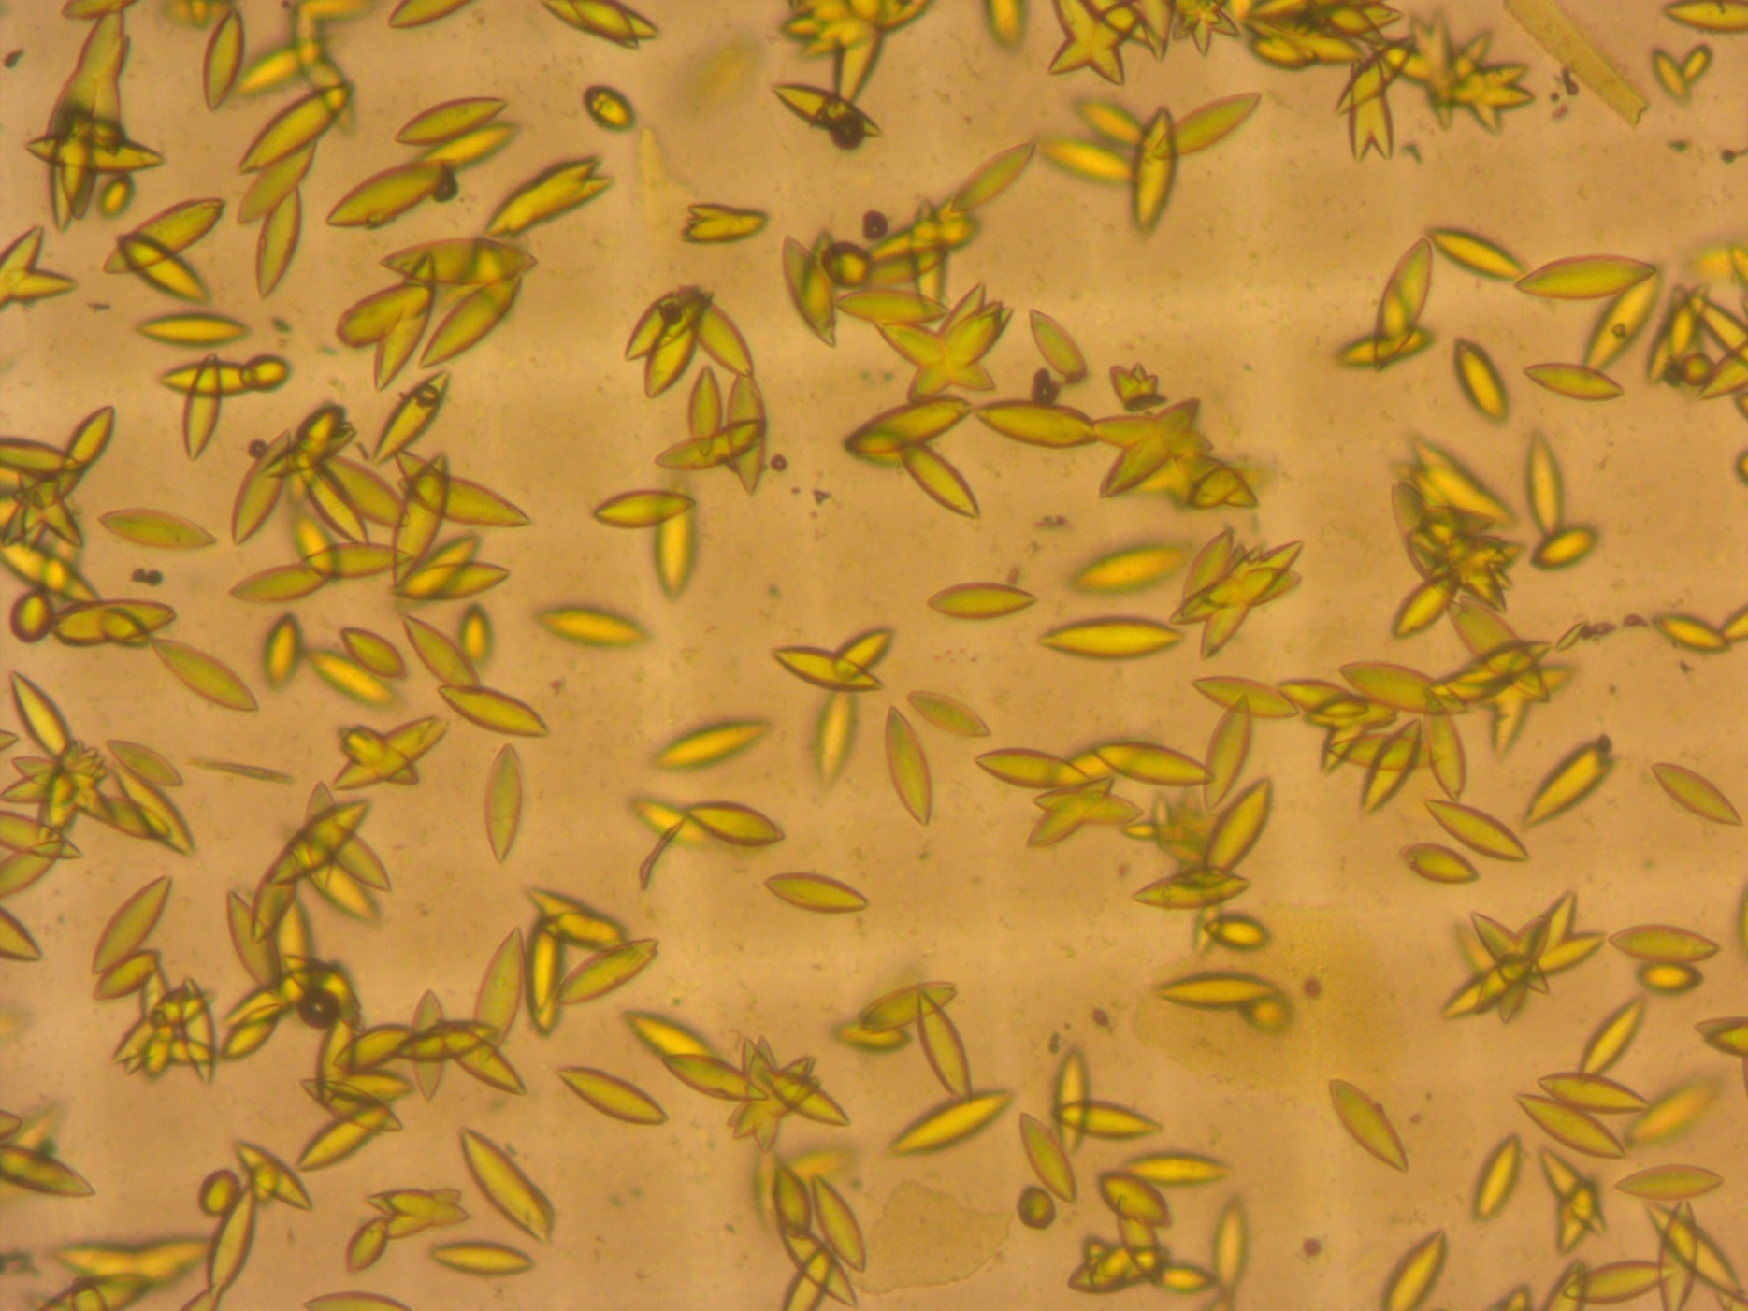
Microcrystals of Photoactive Yellow Protein
50 μm
Notes:
A relief for crystallographer, since no big crystals are required, crystals form in the first hour…

Slide 23
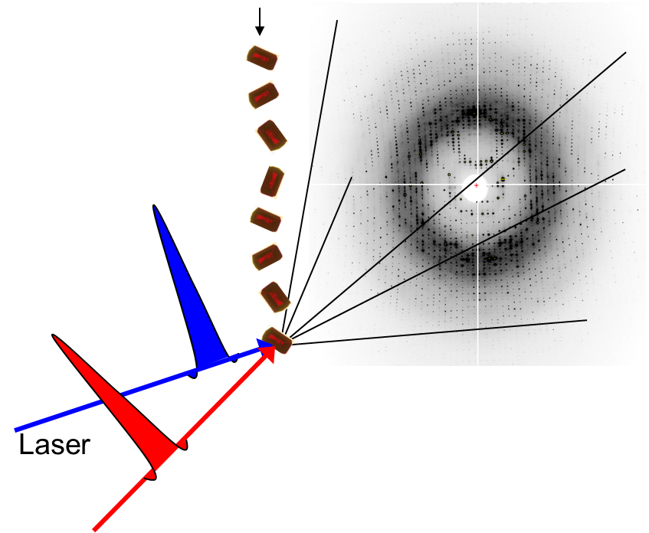
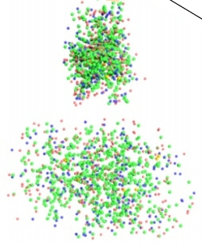
Injector
“Diffraction-Before-Destruction Principle”
stream of tiny crystals ~1-5 μm
diffraction pattern
within 40 fs
from ONE tiny crystal
Workhorse:
Gas Dynamic Virtual Nozzle
(Doak, Weierstall, Spence)
radiation damage
explosion, disintegration
X-ray
10¹² photons
focused to 1 μm
Notes:
One by one, in random orientation.

Slide 24
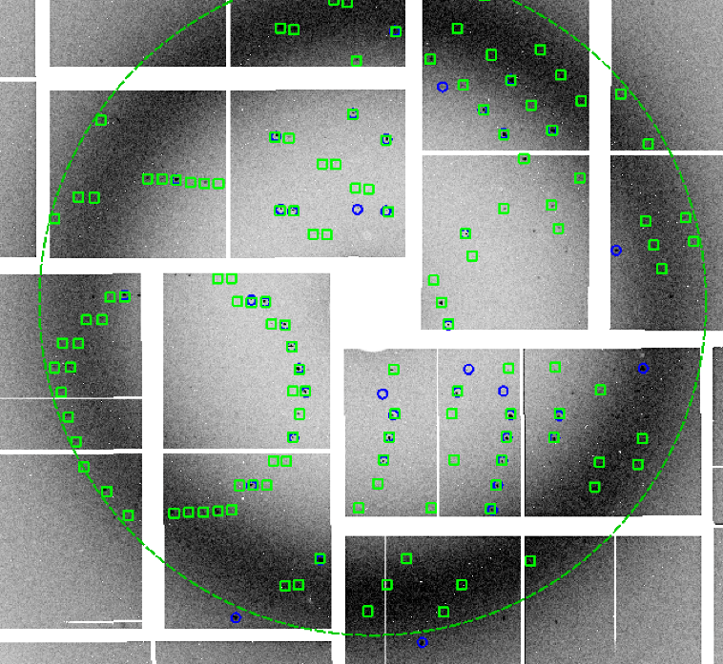
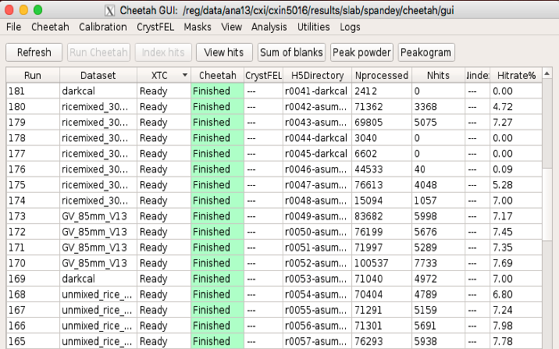
New Software
Revolutionizes Macromolecular Crystallography
Identification of diffraction patterns with Bragg reflections
separation from blanks (no crystals in the X-ray interaction volume)
Determination of the orientation (indexing) of the diffracting crystal
Determination of the Bragg spot intensity
- highly partial reflections
4. Averaging of highly partial Bragg intensities to full reflection intensities
- Monte Carlo integration
5. Proper scaling
6. Quality control
=> Data set
Indexed pattern (CrystFel)
Thomas White, CFEL
Cheetah (Hitfinder)
Anton Barty, CFEL
Notes:
Essential to get familiar with new software (one of few groups how to use the software)

Slide 25
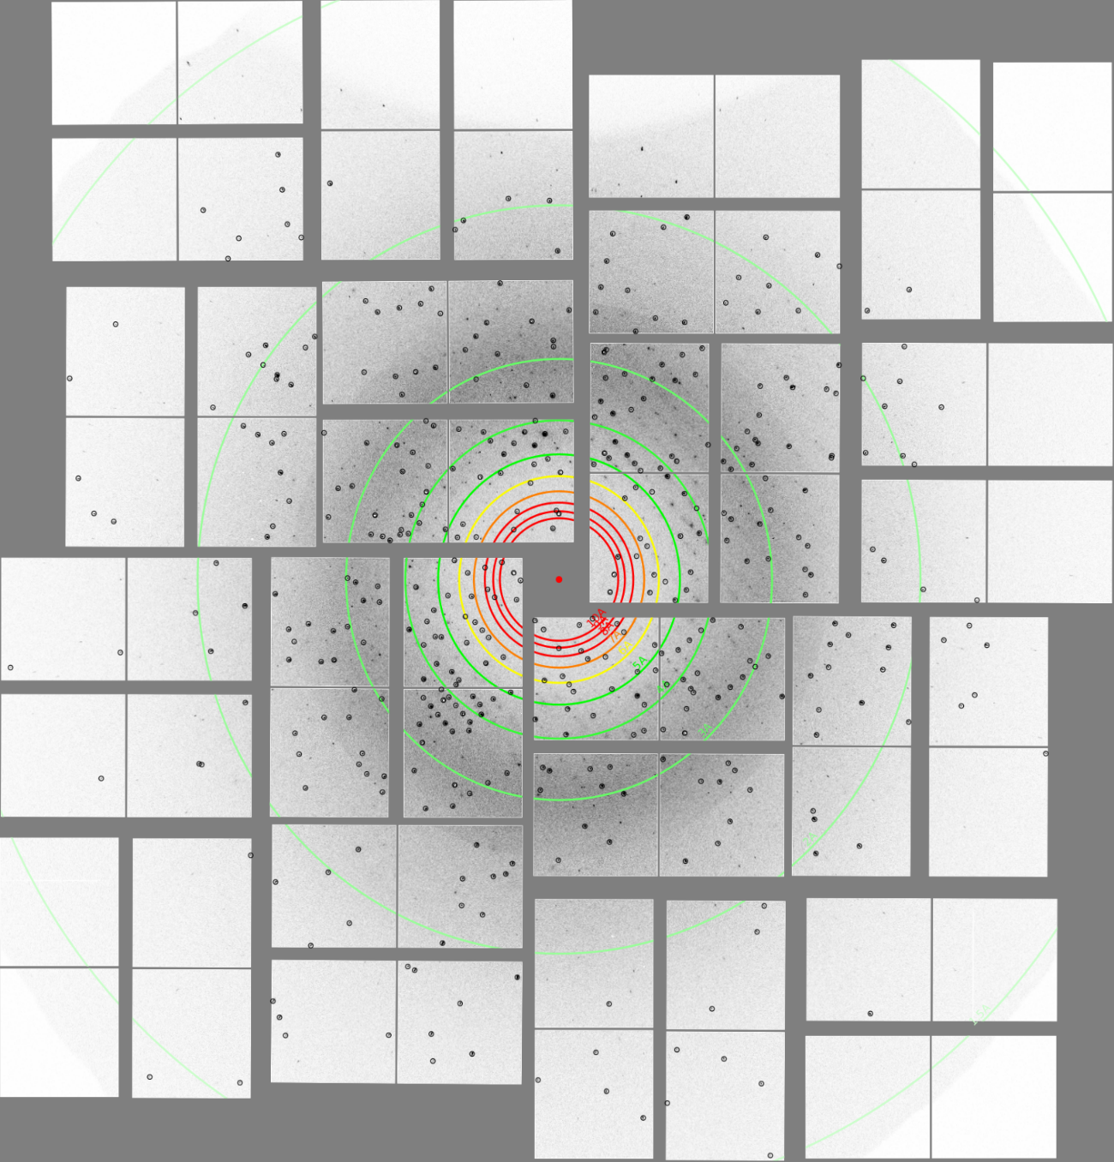
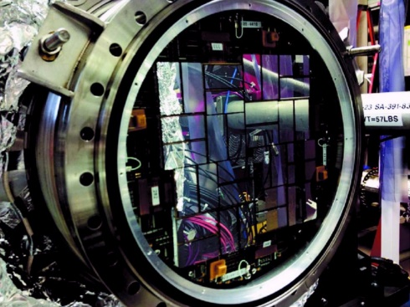
Cornell Stanford Pixel Array Detector
CSPAD
120 Hz
high gain mode:
350 photons/pixel
low gain mode:
3500 photons/pixel
(gain has to be preset)
here
2.3 Mpixel version
(110 μm pixels)
3 Å
Notes:
hybrid pixel detector (active pixel sensor), not monolithic yet

Slide 26
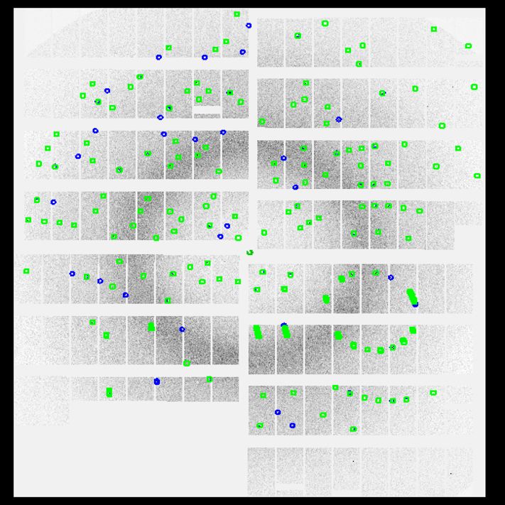
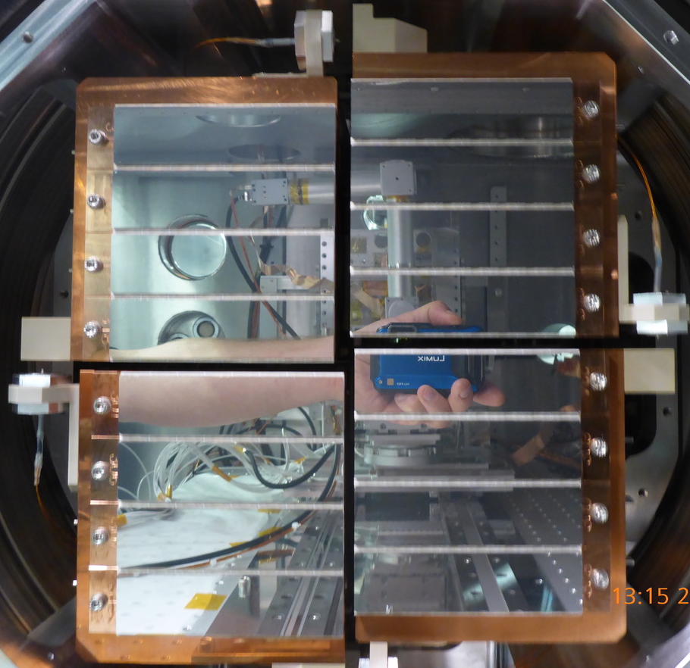

Adaptive Gain Integrating Pixel Detector
AGIPD
4.5 MHz
three gain levels
shift automatically
up to 10,000 photons/pixel
1 Mpixel (200 μm pixels)
store 2700 images
99.4 ms
$$⋯$$
1 2700

Slide 27
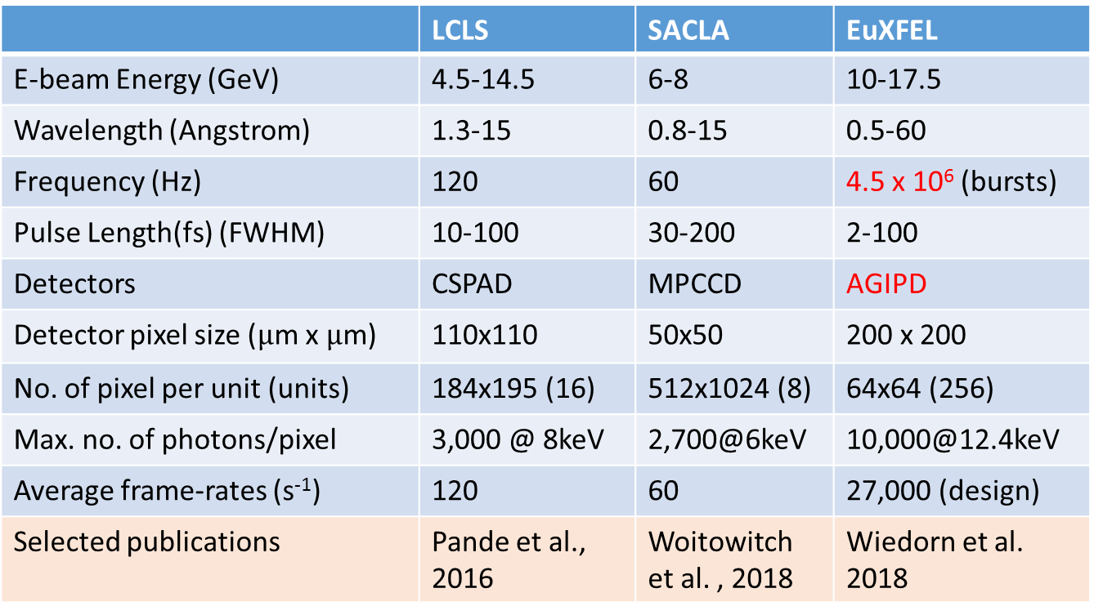
Comparison of various XFELs
high rep rate XFEL
 | LCLS | SACLA | EuXFEL
E-beam Energy (GeV) | 4.5-14.5 | 6-8 | 10-17.5
Wavelength (Angstrom) | 1.3-15 | 0.8-15 | 0.5-60
Frequency (Hz) | 120 | 60 | 4.5 x 10⁶ (bursts)
Pulse Length(fs) (FWHM) | 10-100 | 30-200 | 2-100
Detectors | CSPAD | MPCCD | AGIPD
Detector pixel size ($μ$m x $μ$m) | 110x110 | 50x50 | 200 x 200
No. of pixel per unit (units) | 184x195 (16) | 512x1024 (8) | 64x64 (256)
Max. no. of photons/pixel | 3,000 @ 8keV | 2,700@6keV | 10,000@12.4keV
Average frame-rates (s⁻¹) | 120 | 60 | 27,000 (design)
Selected publications | Pande et al., 2016 | Woitowitch et al. , 2018 | Wiedorn et al. 2018

Slide 28
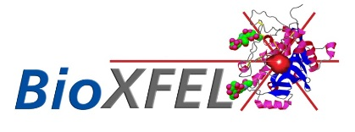

XFELs and Biology
XFEL is complicated technology
XFEL is expensive
Beamtime at XFEL is hard to get
No infrastructure for experiments on biological samples
Generate expertise to perform experiments with biological systems
Push the envelope
Need a collaborative, pioneering effort
Science and Technology Center
multi-million dollar enterprise for 10 years

Slide 29










Time-Resolved Serial Femtosecond
Crystallography
Fromme
Spence
Weierstall
Boutet
Aquila
Liang
Hunter
Schmidt
Schwander
Ourmazd
Pollack
Grant
TEAM
Frank
Chapman
Groenhof
van Thor
Srajer
Moffat
Philips
Notes:
We had the honor to do the first successful time-resolved experiment with atomic resolution.,

Slide 30



Scientific Applications
Experiments and Future
I. Trans to Cis Isomerization in Photoactive Yellow Protein
femtosecond time scale, structure based femtochemistry
dynamics on excited state potential energy surface
transition through conical intersection
II. Structure Based Enzymology with β-lactamase
enzyme responsible for broad spectrum antibiotic resistance
mix-and-inject approach
the time-scale from 30 ms to 2 s
III. Single Particle Simulations with Light Regulated Enzymes
single particle diffraction
time-resolved single particle diffraction
feasibility
Selected results from multiple beamtimes at XFELs (LCLS, SACLA and EuXFEL)
and synchrotron (APS)

Slide 31
I. Trans to Cis Isomerization in PYP
remainder: trans to cis isomerization in PYP not time-resolved
goal: observe (for the first time) a trans to cis isomerization
in real-time, in 4-D, by shifting electron clouds
time-scale: 100 fs to 3 ps after reaction initiation
time-resolution: c.a. 100 fs
several control experiments necessary
proof of principle that TR-SFX possible at XFEL
femtosecond absorption spectroscopy on crystals
trans
cis
PYP photocycle
Tyr42
Glu46
pCA
trans
pG
cis
I_{CT}
Cys69

Slide 32
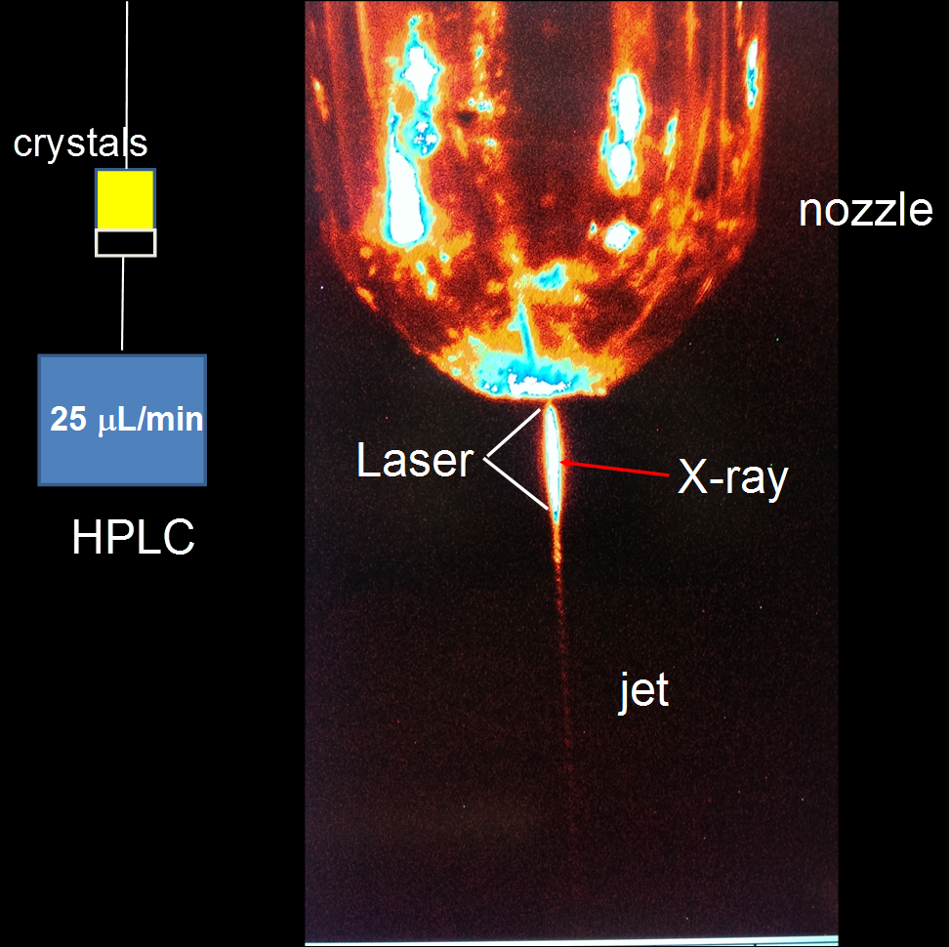
Microcrystal Injection
(150 μm)
(1.2 μm)
(5 μm)

Slide 33
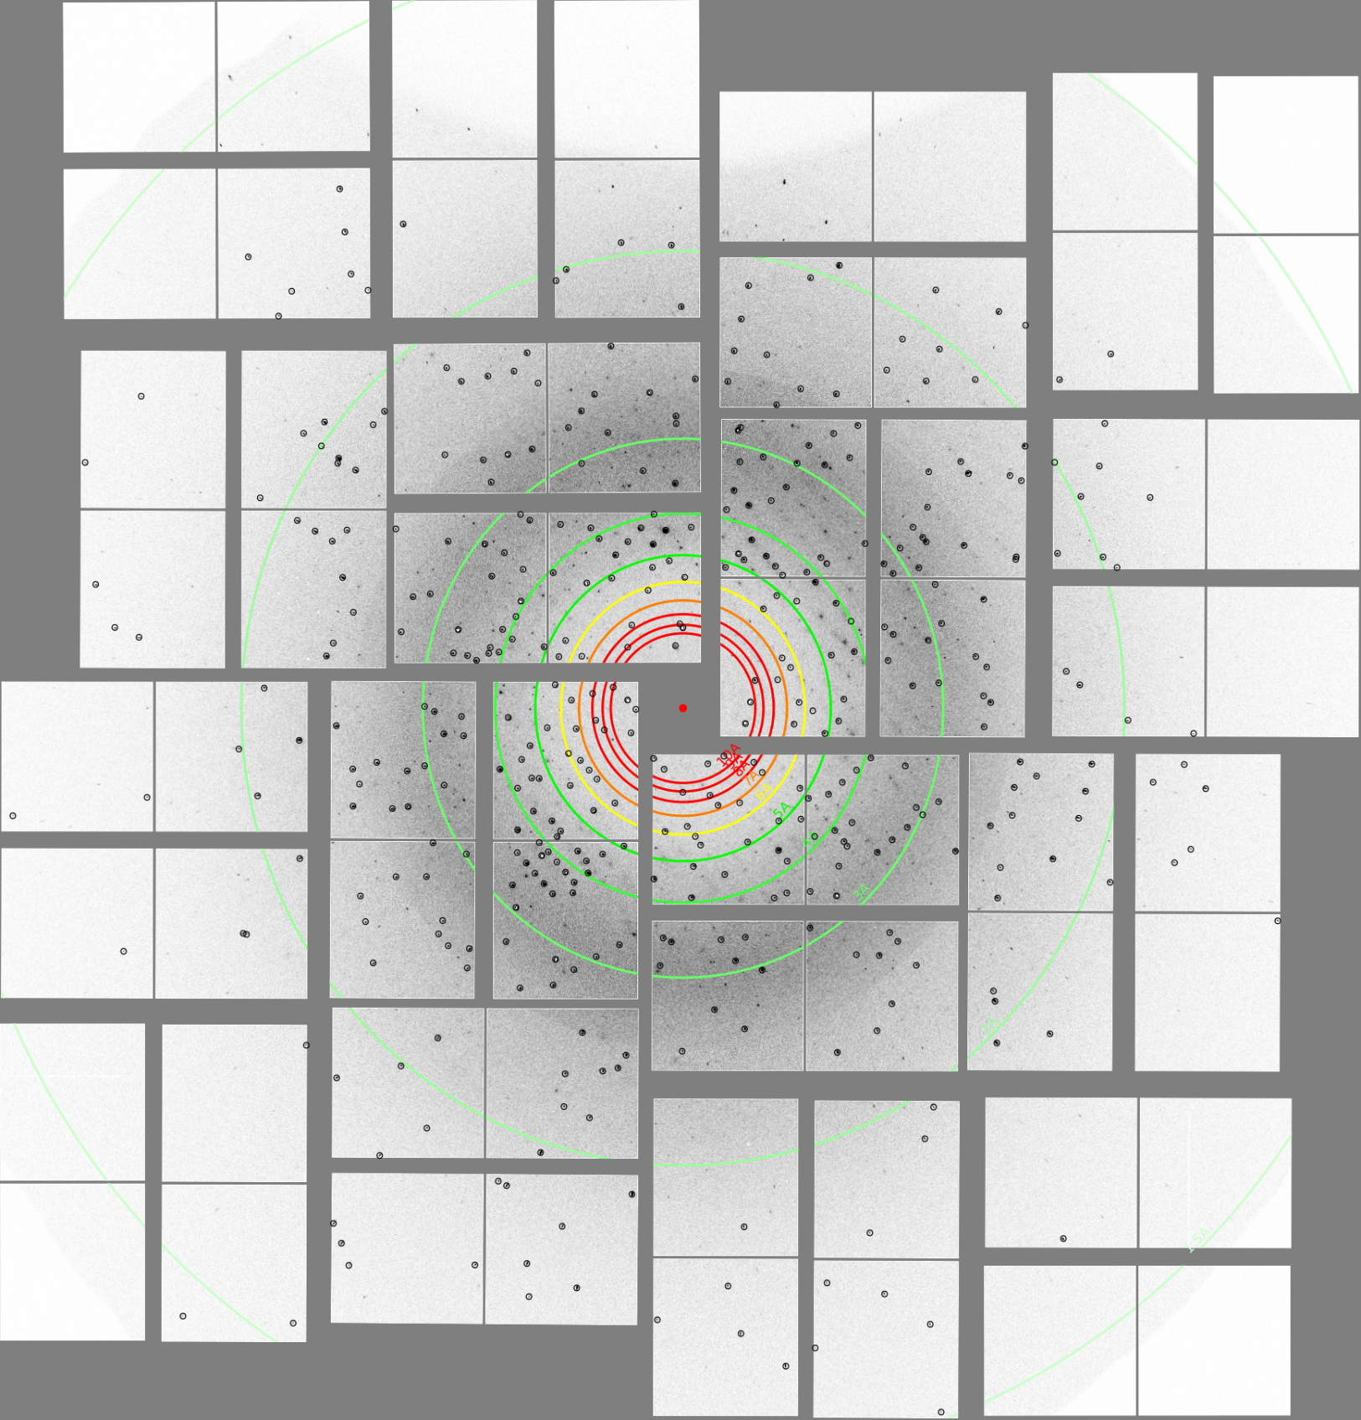
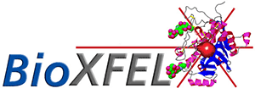
3 Å
2 Å

Slide 34
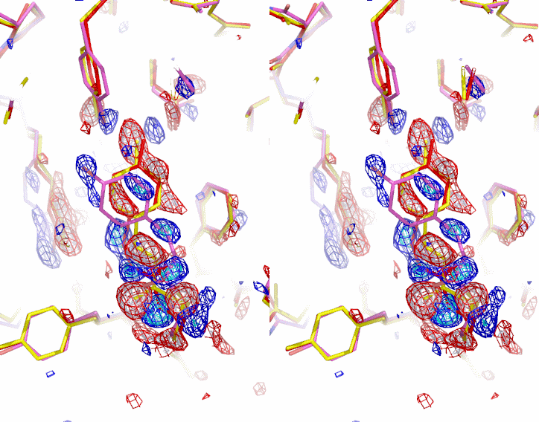
Difference Electron Density from TR-SFX
Tenboer et al., 2014, Science
1.6 Å
Δt = 1 μs
A
A
Glu46
Glu46
Tyr42
Tyr42
pCA
pCA
Arg52
Arg52
Tyr98
Tyr98

Slide 35
The Fastest “Camera” in the World
Movie with 25 Trillion ! Pictures per Second
2014, LCLS Press Release

Slide 36
Femtosecond Excitation
nanosecond laser pulse: ~80 % of molecules in photocycle
multiple excitation possible
femtosecond laser pulses: ~10 % of molecules in photocycle
population transfer with the primary yield
femtosecond laser at LCLS supports 120 Hz pump-probe data collection
Δt
laser X-ray
140 fs
40 fs
8.3 ms
light data at 120 Hz

Slide 37
Data
to 1.6 Å
Time | # indexed | R-split [%] | CC* | Completeness | Multiplicity
142 fs | 38606 | 9.01 (26.05) | 0.997 (0.962) | 99.92 (100) | 714.75 (48.5)
269 fs | 38786 | 9.16 (26.08) | 0.997 (0.959) | 100 (100) | 695.25 (49.6)
455 fs | 37563 | 9.86 (26.58) | 0.996 (0.957) | 99.84 (100) | 637.31 (57.7)
699 fs | 43617 | 7.53 (16.94) | 0.998 (0.984) | 99.92 (100) | 931.65 (124.9)
799 fs | 44892 | 7.57 (19.84) | 0.998 (0.974) | 99.84 (100) | 961.51 (121.1)
856 fs | 44470 | 7.61 (17.60) | 0.997 (0.983) | 99.92 (100) | 955.96 (112.9)
915 fs | 44180 | 7.58 (18.75) | 0.998 (0.981) | 99.84 (100) | 927.25 (106.3)
1023 fs | 45880 | 7.53 (17.19) | 0.998 (0.978) | 99.76 (100) | 971.3 (123.7)
3 ps | 76411 | 5.43 (14.36) | 0.999 (0.989) | 100 (100) | 1685.8 (145.9)

Slide 38


Trans at 250 fs, Cis at 3 ps
Pande et al., 2016, Science
269 fs
3 ps

Slide 39














Femtosecond Time-Series
Pande et al., 2016, Science
A
B
Glu46
C
D
E
F
G
α1
α1
Tyr42
β3
α2
α3
pCA
β1
α4
Arg52
α4
α5
β2
β1
α1
α1
β3
α4
β1
β1
β2
142 fs
269 fs
455 fs
799 fs
915 fs
1023 fs
3 ps

Slide 40



Trans to Cis Isomerization Captured in Real Time
Laser excitation
dark
cis
ϕ_{tail}
torsion
3 ps
trans
cis
39 deg

Slide 41

Excited State PES to Ground State PES
QM/MM calculations
(Gerrit Groenhof, Jyvaskyla)
highly complex
computationally intensive
Notes:
Talk about conical intersection, exited state dynamics, driven by electrostatic forces. Mention functional modes

Slide 42
More Structural Femtochemistry
More Electronic Excited States
Other Groups
Carbonmonoxy - Myoglobin
Barends et al., 2015, Science
Bacteriorhodopsin
Nogly et al., 2018, Science
Photoswitchable Fluorescent Protein,
rsEGFP2,
Coquelle et al., 2017, Nat. Chem.
1 ps
Notes:
The pioneering work that we did in 2014 resulted in successful application of our methodology to other, more complex systems, affirming the idea that this is a universal method that will work on other systems

Slide 43
Key Results
proof of principle experiment in 2014
TR-SFX works at X-ray FEL at high, near atomic resolution
TR-SFX works with femtosecond time-resolution
structural characterization of trans/cis isomerization
electronic excited state dynamics!!!
transition through conical intersection
opportunity to structurally characterize early laser induced damage
opportunity to optically control the reaction dynamics
understand light control in biology
structural basis for enhanced fluorescence
we need longer time delays to look at catalysis
Notes:
Say, we can make now better fluorescent biomarkers, and even increase fluorescence by laser characteristics (chirp, pulse-duration)

Slide 44


II. Structure Based Enzymology
objective: capture enzymes of biomedical importance in real time
enzyme substrate interactions
mechanism of catalysis
enzyme structure - function relationships
enzyme/protein dynamics in real time
biomedically relevant examples
cancer
receptor ligand interactions (GPCRs, RTKs, Toll, …, etc)
receptor activation
soluble targets
infectious diseases
conferring antibiotic resistance (BlaC, TetDs)
two component systems (HK and response regulator)
Toll (1ZIW, 2.1 Å)
IDO1 (4U74, 2.4 Å)
Notes:
indoleamine-2,3-dioxygenase, in the Tryptophane catabolism, leads to depletion of Tryptophane which has a strong implication on immune system, cylco-oxidase, Nitric oxide synthase

Slide 45

First Structure of an Enzyme
1965
Lysozyme, Blake et al., 1965
cleaves bacterial cell walls
David Phillips
catalytic cleft
since then:
how does it work ?
can we see it in action ?
observe catalysis in real time
C-terminus
N-terminus

Slide 46

Structure Based Enzymology
Mycobacterium tuberculosis β-lactamase
Ceftriaxone
Ser70
Glu168
Ser128
N
C
M. tuberculosis BlaC
32 kDA
antibiotic resistance is a world-wide challenge
tuberculosis is _the_ number one killer among infectious diseases (1.5 M deaths/year)
β-lactamases destroy lactam antibiotics (penicillins, cephalosporins, etc.)
reaction of β-lactamase with cephalosporins is not structurally characterized
ideal for proof of principal experiments: intermediates in the millisecond time range
Notes:
We chose BlaC because it is a conserved system for antibiotic resistance and found in almost all gram-negative bacteria and gram-positive bacteria (MRSA, through horizontal gene ransfer).

Slide 47
Antibiotic Inactivation
Ceftriaxone Modification
ring opening
inactivation
Notes:
Release group can be cytotoxic, double effect.

Slide 48
β-lactamase and Penicillin Binding Protein
BlaC/PBP active site
PBP
BlaC, 35 kDa

Slide 49


Kinetic Mechanism
Substrate S, Ceftriaxone
release group
Ser70
Glu168
Ser128
N
structure of ES ?
structure of ES* ?
k: rate coefficients ?
turnover in solution: 0.5 s⁻¹ (2 s)
C
32 kDA
Enzyme E

Slide 50

The Holy Grail
Single Turnover Kinetics, Mixing
‘mix-and-inject’ (Schmidt, Adv. Cond. Mat. Phys, 2013)
enzyme microcrystals
substrate
in stabilization buffer
Notes:
elaborate on single turnover reactions as opposed to cyclic reactions

Slide 51
Diffusion is Governed by Fick’s Laws
Fick’s 2nd law
Laplacian (div grad)
diffusion coefficient
concentration in crystal
analytic solutions subject to certain boundary conditions
allows computation/estimation of diffusion times

Slide 52
Calculation, Simulation, Experiment
Schmidt, Adv. Cond. Mat. Phys, 2013
Diffusion into glycogen-phosphorylase crystals
D of Glucose: 5 x 10⁻⁶ cm²/s
From solving num. simul. measured
Fick’s 2nd law
τ_{L}= 16 s 25 s < 1min
400 μm
Geremia et al., 2006
Johnson, Hajdu, 1990
400 μm
1600 μm
40 μm
τ_{L}= 100 ms
-/-
40 μm
40 μm
-/-
ms-time resolution
4 μm
4 μm
τ_{L}= 1 ms
4 μm
need XFEL
diffraction before destruction

Slide 53

Initial Experiment with BlaC
Kupitz et al., Struc. Dynamics 2017
β-lactamases
structures of transient states
concentrations
mechanism
structure and kinetics at
the same time!

Slide 54



Pushing the Envelope
Optimized Mixing Injectors
CEF substrate
gas
β-lactamase crystals
CEF substrate
Cornell mixing injector design (Pollack group)
GDVN style
sub-ms time-resolution possible
versatile at LCLS and EuXFEL
X-rays
Chapman
Spence
Weierstall
Pollack
Notes:
Here I show the Cornell design, but other groups are also active in mixing injector development

Slide 55

Unmixed
Olmos et al. (2018), BMC Biology
H₂O
phosphate
Ser 70
unmixed

Slide 56

30 ms after Mixing
Olmos et al. (2018), BMC Biology
Ceftriaxone
H₂O
Ser 70
30 ms

Slide 57

100 ms after Mixing
Olmos et al. (2018), BMC Biology
Ceftriaxone
no bond
H₂O
Ser 70
100 ms

Slide 58

500 ms after Mixing
Olmos et al. (2018), BMC Biology
Ceftriaxone
H₂O
Ser 70
500 ms

Slide 59

2 s after Mixing
Olmos et al. (2018), BMC Biology
Ceftriaxone
H₂O
Ser 70
2 s

Slide 60

Kinetic Mechanism with Product Inhibition
S: ceftriaxone
S=S₀${( 1−e}^{−t/τ_{D}} )$
k₂ depends on product
confirmed by NMR (Szysperski)
k₁
k₂
k₃
E
ES
E-CFO*
E
k₋₁
R
CFO

Slide 61

Structure Based Enzymology
ambient temperatures
diffusion faster than catalytic cycle
mixing faster than diffusion
general approach for all kinds of enzymes

Slide 62

The Birth of a New Field
Mix-and-Inject Serial Crystallography
enzymology
Schmidt, 2013
Kupitz et al., 2017
Olmos et al., 2018
mix-and-diffuse of inhibitors
here inhibitor for lysozyme
Beyerlein et al., …, Oberthuer (2017)
IUCrJ
adenine binding to riboswitch
Stagno et al., Wang, 2017
Nature
versatile
general
bio-medically relevant
Notes:
all highly relevant

Slide 63
Established Versatile Methods at XFELs
‘mix-and-inject’ serial crystallography
femtosecond X-ray pulses, ‘diffraction-before-destruction’
X-rays intense, quasi monochromatic
sufficient X-ray intensity
microcrystals provide sub-ms time-resolution
femtosecond X-ray pulses avoid radiation damage
cyclic reactions and non-cyclic (single-pass) reaction on same footing
reaction initiation possible with non-photoactive enzymes
crystal quality is not that critical (quasi-monochromatic radiation)
long time series possible without radiation damage
all reactions at ambient temperature
problems solved
versatile
general
relevant

Slide 64

‘Mix-and-Inject’ at High-Repetition Rate XFELs
Avenue to rapid collection of multiple movies with several ligands
if EuXFEL fully up to specifications: dataset in 10 s, with 5% hit rate
1000 datasets in 10,000 s (~ 3 h)
10 time points for 100 compounds can be tested
application by diffusion
requirements for 1000 datasets
substrates: 50 μL/min, 10 s each => 10 – 100 μL each is enough
crystals: 10 μL/min for 3 h: 1.8 mL; c.a. 50 mg for all 1000 datasets
microcrystals
compound 1
even 10 x faster at LCLS-II-HE
LCLS upgrade after 2022
unimaginable amount of data
5 billion detector readouts
> 100 Petabytes (10¹⁷ B) per shift
precision movies for tailored ligands
compound 2
mixer
$$⋮$$
variable
delay
compound 100
multiport manifold
microfluidic
X-ray pulses
< 27,000/s >
jet
Notes:
Multi-substrate reactions, enzymes that bind to multiple substrates at the same time. Given our recent work, a selected few of our colleges and myself provided the scientific cases for LCLS-II and LCLS-II-HE to the DOE. This input has been based on experiments that I did at the EuXFEL. I want to show you at least a couple of slides from this first experiment.

Slide 65
SFX at the European XFEL
Wiedorn et al., Nature Communications, 2018
European XFEL (EuXFEL)

Slide 66

First (User) Experiment at EuXFEL
Experiment led by Anton Barty, CFEL
September 2017, and March 2018
Notes:
Ulrich Trunk showed some results. I do not need to repeat this here.

Slide 67
SFX at High Repetition XFELs
EU-XFEL
MHz data collection feasible
jet explosion does not affect hit/indexing rate
excellent data
average data collection rates improve
300 exposures/s (in Nov. 2017)
1200 exposures/s (in Aug. 2018), 10 times faster than LCLS
final design: average of 27,000 exposures/s
LCLS-II (online by the end of 2019)
high and continuous X-ray pulse repetition rate, 300 kHz
LCLS-II tender X-ray range up to ~3 keV without loss of intensity
LCLS-II-HE after 2022, up to 20 keV X-rays
Notes:
mention that I am invited to participate in discussion for instrumental needs, mention to move the detector closer

Slide 68

III. The Future
Structure Based Enzymology without Crystals
With Crystals
packing may impede diffusion
may impede kinetics
crystal contacts may be disrupted (no Bragg peaks)
crystal quality prohibitively inferior with large complexes
Without Crystals
no lattice constraints
fastest diffusion
no size limitation (large complexes)
no phase problem
single particle diffraction patterns are oversampled
phase can be iteratively retrieved
effector domain
enzyme
phytochrome
proof of principle experiments necessary
light controlled kinase (phytochromes)

Slide 69

PR772 Virus from Single Particle Initiative
Hosseinizadeh et al., Ourmazd, Nature Methods 2017
90 Å
Notes:
This work on phytochromes is inspired by our work on larger system. We think that we can be successful with smaller enzymes.

Slide 70



What are Phytochromes?
Discovered in plants
red/far-red photoreceptors
germination
greening
flowering
growth towards light
chloroplast development
also discovered in photosynthetic (cyano, and purple) bacteria
Surprise !!!
also in non-photosynthetic bacteria
what are they doing there?
30x
100x
Myxobacterial fruiting bodies
microbial factories of secondary
metabolites, unexplored source of
natural products

Slide 71

Bacteriophytochromes (BphPs)
Red/Far-Red Photoreceptors
BV absorption 700 nm – 750 nm
ideal for biomarker in the near IR
Biliverdin (BV)
poorly florescent due to isomerization
suppress isomerization in BphPs
determine mechanism
Shu …, Tsien (2009), Science

Slide 72
Myxobacterium Stigmatella aurantiaca
has two Phytochromes
19-ID-D (SBC)
Woitowich et al., Schmidt*, Stojkovic*, IUCrJ 5 (2018)
in collaboration with
E. Stojkovic, NEIU
PHY
GAF
PAS
double
kink
BV
BV
fine tune photomorphogenic response
in the red/far-red
SaBphP1
SaBphP2
Notes:
These phytochromes differ in their photocycle, although they share the same domain compostion and bind the same chromophore.

Slide 73


SaBphP1-PCM (Pr) morphed on DrBphP-PCM (Pfr)
Woitowich, et al., Stojkovic Takala et al., Westenhoff
IUCrJ, 2018 Nature, 2014
PHY
GAF
PAS
kink
sheet to helix
Notes:
Imagine, Someone has the idea of attaching a drug between the two PHY domains. Upon light illumination it would be released. Again, red light penetrates deeply into the tissue.

Slide 74

SaBphP1-PCM (Pr) morphed on DrBphP-PCM (Pfr)
Woitowich, et al., Stojkovic Takala et al., Westenhoff
IUCrJ, 2018 Nature, 2014
PHY
GAF
PAS
kink
sheet to helix
Notes:
The signal travel 150 A to generate a 20 A conformation change all induced by light absorption. Imagine, someone has the idea of attaching a drug between the two PHY domains. Upon light illumination it would be released. Again, red light penetrates deeply into the tissue. What a diagnostic tool. Precision compound delivery possible.

Slide 75

Long Term Goals
observe the Z to E isomerization in full length phytochrome
move to time-resolved experiments with single particles
enzyme
D ~ 50 Å
Burgie et al., Viestra 2016
Takala et al., Westenhoff, 2014
75
180 kDa

Slide 76

Towards Single Molecule X-ray Diffraction
Tender X-ray Source (LCLS-II)
λ=12 Å
d_{min}=10 Å
realistic simulation
full length phytochrome
pixel-y
pixel-x
Notes:
We are currently doing these simulations. A graduate student of mine does the calculations. One important goal is to find out, how many diffraction patterns are necessary to reach a certain signal to noise that phasing is successful at a given resolution.

Slide 77

3D diffraction volume
q_{y} [Å⁻¹]
q_{z}
[Å⁻¹]
q_{x} [Å⁻¹]

Slide 78





Time-Resolved Single Particle Diffraction
Simulations
full length, unperturbed
density at 10 Å
oversampled, phased
after photon absorption:
unknown full length structure
Difference density (10 Å)
(red negative, green positive)
distinguishes models
alternate models in literature
spread (up), cross (down)
Notes:
this is the first time that a time-resolved experiment is thought about. We can start these experiments right away with cryo-EM.

Slide 79
Low Resolution Single Particle cryo-EM
Burgie et al., 2014, J. Biol. Chem. (Viestra group)
180 kDa
d_{min}~ 25 Å
full length constructs of both Myxobacterial phytochromes available
high resolution cryo-EM structures of Pr and Pfr required
compare to crystallography
single particle X-ray diffraction

Slide 80
Simulations Promising
Need Experiments
LCLS-II is at the Horizon (2019)
hard X-rays, still 120 Hz
tender X-rays (0.4 - 3 keV), up to 300 kHz
we made a case for LCLS-II-HE (in Oct 2017),
up to 20 keV hard X-rays, 300 kHz
European XFEL is online
first experiments, UWM and BioXFEL contributed to multiple proposals
developing TR-SFX at LCLS-II/EuXFEL
developing mix-and-inject at LCLS-II/EuXFEL
single particle diffraction at LCLS-II/EuXFEL
Cryo-EM can be done right now
cryo electron microscopy on full length phytochromes in Pr and Pfr
energy landscape of the Pr to Pfr transition from single particles

Slide 81
Summary and Future Projects
enzymes and receptors
soluble enzymes, implications e.g. for cancer and infectious diseases
ligand binding to receptors (signaling into cells)
light activated
structural base for in-vivo imaging, phytochromes, other biliproteins (smURFPs)
small compound release (large conformation change)
regulation of histidine kinase activity
viruses
trigger structural changes in microcrystals or single particles
release of genetic material
data collection and algorithm development
process high volume data (potentially Petabytes)
analyze multiple time-series
process and analyze single particle data
Notes:
Paul Fuoss talked about this directly after Ulrich Trunk

Slide 82

Crystallography Evolves
light to ligand triggered reactions
PYP and β-lactamase
single time points and entire time
series
β-lactamase (2 s) and from 30 ms – 2 s
small to large proteins
PYP to phytochromes
ultrafast to slower timescales
femtosecond to second
crystallography and single particles
PYP
β-lactamase
bacterial phytochrome

Slide 83







Contributors and Collaborators
K. Moffat
V. Srajer
R. Henning
G. Phillips
J. Olmos
D. Xu
M. Miller
H. Chapman
S. Baijt
M. Heyman
D. Oberthuer
A. Testikova
M. Wiedorn
J. Knoska
O. Yefanov
C. Gati
A. Barty
T. White
M. Metz
A. Meents
A. Morgan
J. Tenboer
J. Brayshaw
K. Pande
C. Kupitz
S. Pandey
I. Poudyal
A. Ourmazd
L. Tremblay
P. Schwander
L. Pollack
A. Katz
G. Calvey
Y. Chen
P. Fromme
J. M-Garcia
S. Basu
C. Conrad
J. Coe
S. Roy-Chowd.
R. Fromme
J. Spence
N. Zatsepin
U. Weierstall
D. Wang
D. James
D. Meza
N. Nagaratnam
S. Boutet
A. Aquila
D. Milathianaki
J. Koglin
M. Hunter
M. Liang
D. Deponte
J. Robinson
M. Seaberg
E. Stojkovic
P. Waltz
J. Varela
G. Tracy
J. van Thor
C. Hutchinson
T. Grant
G. Groenhof
D. Morozov
S. Westenhoff
E. Claesen
P. Edlund
J. Ihalainen
H. Takala
R. Tanaka
E. Nango
E. Mizohata
T. Nakane
K.Tono
S. Owada
Y. Joti
M. Frank
National Science Foundation Science & Technology Center

Slide 84

Team of the First Experiment at the EuXFEL
Sept 2017

Slide 85

II. SFX at the European XFEL
> 100 collaborators

Slide 86




The Newest Class of NSF Science and Technology Centers
2016
imaging in real time, optical microscopes
CEMB, MechanoBiology, forces
Center for cellular construction, the cell as engineering project
Bright electron beams, bright synchrotron beams

Slide 87
Ourmazd, BioRxiv

Slide 88


β-lactamase activity assay - 1D ¹H NMR spectroscopy
UV and NMR-based assays were established to (i) validate enzymatic activity for NMR samples, and to (ii) measure Michaelis-Menten parameters accurately under conditions of NMR / XFEL data acquisition. Since hydrolysis of the substrate is irreversible, these parameters can be obtained using the integrated Michaelis-Menten equation. Results of a representative NMR assay are shown here.
A
B
Selected spectral region taken from a series of 1D ¹H NMR spectra recoded to monitor product formation (left signal) and substrate (ceftriaxone) consumption (right signal).
Plot of product signal intensity versus time.
Fit of the linearized, integrated Michaelis-Menten equation to the data of (B) yielding K_{m} ~ 530 µM, k_{cat} ~20 min⁻¹.
S denotes the substrate concentration.
Concentrations: 500 µM Ceftriaxone (~K_{m}) at t = 0 and 1.5 μM β-lactamase in 50 µM NaPi buffer (pH 6.5).
C

Slide 90
First Structure of an Enzyme
Lysozyme, Blake et al., 1965
cleaves bacterial cell walls
David Phillips

Slide 91
Cornell Stanford Pixel Array Detector
CSPAD
120 Hz
high gain mode:
350 photons/pixel
low gain mode:
2500 photons/pixel
(gain has to be preset)
here
2.3 Mpixel version
(110 μm pixels)
3 Å

Slide 92
Adaptive Gain Integrating Pixel Detector
AGIPD
4.5 MHz
three gain levels
shifted automatically
up to 10,000 photons/pixel
1 Mpixel (200 μm pixels)

Slide 93

The Ultrafast Time Scale
Timing Tool

Slide 94
Time-Resolved Diffraction
Biological Molecules are NOT Static
Enzymes are Bio-Catalysts
they enable biochemical reactions in all organisms
metabolism, signaling, more …
essential for survival
enzymes are prime drug targets
infectious diseases
cancer …, many more
Three synonyms for the catalytic function of enzymes
the catalytic cycle (biology, biochemistry)
the catalytic pathway (biophysics)
the kinetic mechanism (chemistry)
example of kinetic mechanism
k_{on}
k₂
k₃
Questions:
molecular structures of E, ES, ES*
kinetics = time dependent occupancy
of these intermediates,
E + S
ES
ES*
E
k_{off}
release
group
product
rate coefficients

Slide 95

Time-Resolved Diffraction
Ser70
Glu168
Ser128
N
structure of ES ?
structure of ES* ?
k: rate coefficients ?
C
32 kDA

Slide 96
II. SFX at the European XFEL
Avenue to high throughput screening studies
if EuXFEL fully up to specifications: dataset in 10 s, even with 0.5% hit rate
1000 datasets in 10,000 s (~ 3 h)
1000 compounds can be tested
application by diffusion
requirements for 1000 datasets
substrates: 50 μL/min, 10 s each => 10 – 100 μL each is enough
crystals: 10 μL/min for 3 h: 1.8 mL; c.a. 50 mg for all 1000 datasets
microcrystals
compound 1
compound 2
mixer
$$⋮$$
compound 1000
delay
multiport manifold
microfluidic
X-ray pulses
< 27,000/s >
jet

Slide 97


Simulated oversampled intensities
A National Science Foundation
Science and Technology Center
2 x oversampling:
calculate |F| at integer
positions in 2D
box size
Box
D
2D

Slide 98


Speckles in Time-Resolved Structure Determination
A National Science Foundation
Science and Technology Center
Start Phases, random
Observed Amplitudes
FFT
Discard calculated amplitudes
keep the phases, and
combine with observed
amplitudes
Delete outside support
Flip electron density < threshold (Superflip)
Modify support (Shrink Wrap)
Calculated Amplitudes
and phases
new support

Slide 99
Follow the R-factor
Superflip and Shrink-Wrap
A National Science Foundation
Science and Technology Center

Slide 100
oversampled amplitudes
random phases

Slide 101

oversampled amplitudes
calculated phases

Slide 102

oversampled amplitudes
calculated phases

Slide 103

oversampled amplitudes
calculated phases

Slide 104

oversampled amplitudes
calculated phases

Slide 105

oversampled amplitudes
calculated phases

Slide 106

oversampled amplitudes
calculated phases

Slide 107

Pump-Probe Geometry

Slide 108
Evolution of the FEL
FEL
original design (1971)
stimulated emission
by electron beam
24 MeV and 3.2 cm
undulator period
infrared
Star Wars
XFEL
10 - 20 GeV electrons
~ 200 m undulators
10 keV X-rays

Slide 109
Spatially Coherent Radiation
Electrons: beginning middle end
electrons bunch up
slippage by 1 λ
results in saturation
X-rays
realistic from unseeded SASE: spiky GW pulses with ~50 fs pulse width, and ~0.1% bandwidth

Slide 110

Proof of Principle Experiment
Laser Setup
fiber
ns-laser
20 Hz
ns-laser
20 Hz
XFEL RF

Slide 111
Measure the Jitter
laser
`
X-ray
Marius Schmidt, UWM Physics Department
delay [fs] = pixel = wavelength

Slide 112
Bio-Macromolecules
The Bricks of Life
Nucleic Acids
blueprint for life
regulation
ribozymes
Proteins
functions for life
catalysis
copying the information for life
energy production
metabolism
cognitive abilities
defense against pathogens
perception of the environment:
sound, vision, smell, taste, touch
mobility and maintaining structural integrity
… many more
double helix
riboswitch
potassium channel
hexokinase, metabolism
photosystem II, energy, O₂

Slide 113
Adaptive Gain Integrating Pixel Detector
AGIPD
4.5 MHz
three gain levels
shift automatically
up to 10,000 photons/pixel
1 Mpixel (200 μm pixels)
store 2700 images
99.4 ms
$$⋯$$
1 2700

Slide 114

Variation of Temperature
gas stream
-40 ºC to 70 ºC
air insulation
P: pin
E: epoxy glue
C: crystal
S: mother liquor
G: gas stream

Slide 115

We can do more: 5-dimensional Crystallography
PYP cycles at -40 ºC
Schmidt et al., Acta Crystallogr. A, 2010
Schmidt et al., Acta Crystallogr. D, 2013
time [s]

Slide 116

PYP cycles at +30 ºC
time [s]

Slide 117



Transition State Equation
k₃
k₄
k₈

Slide 118
Time-Resolved Diffraction
Biological Macromolecules in Motion
Receptors/Light Perception/Energy Conversion
receptors for visible light
transform light energy in chemical energy
others …, hormones, growth factors etc.
Enzymes
enzymes are bio-catalysts
they enable biochemical reactions in all organisms
essential for survival
all undergo structural changes essential for function
understanding function
Put PYP in
β-lactamase, antibiotic inactivation
Olmos et al., 2018, BMC Biology

Slide 119
X-ray Diffraction Experiment
diffraction pattern with Bragg reflections
Put in multiple crystals, PYP, ccNIR, phytochromes
bio-macromolecules form crystals
X-rays
crystal, ordered
3D-array of particles

Slide 120
Representation of a Structure
Cytochrome C Nitrite Reductase (ccNIR)
enzyme, biocatalyst
catalyzes the reduction of nitrite to ammonia
Shewanella oneidensis ccNIR
Youngblut et al., 2012

Slide 121
Example of a Cyclic Reaction
Photoactive Yellow Protein (PYP)
p-coumaric acid (pCA)
X-ray
laser
Δt
Photocycle

Slide 122
Photoactive Yellow Protein
TR crystallography in the U.S. and worldwide
Laue beamlines in the US and worldwide
push time-resolution
extract structures of transient states
deconvolute mixtures
determine chemical, kinetic mechanisms from TR X-ray data
structure and kinetics at the same time
optical control of population transfer
helped to evolve TR crystallography beyond expectations (this talk)
application to other systems

Slide 123


Time-Resolved Laue Crystallography
BioCARS
Advanced Photon Source BioCARS

Slide 124
State of the Art
Laue Data Collection
1 - 10 pump-probe repeats/detector readout
25 different crystal settings to
cover reciprocal space
9 orders of magnitude in time to cover reaction
X-ray
laser
Δt

Slide 125


Difference Maps
Drive the Analysis
time resolved scattering patterns
corresponding dark Laue exposures
spacegroup | P6₃, hexagonal
unit cell [Å] | a=66.8 c=41
resolution [Å] | 0.9 [cryo] 1.5 [Laue] 1.5 [LCLS]
difference electron density map Δρ(x,y,z,t)
pH 7, 10º C, Δt = 2 μs
X-ray
laser
Δt

Slide 126


Structure, Kinetics, Energetics
at 300 K
(+27º C)
at room temp:
1 kT = 2.5 kJ/mol
pB -> pG
out of 40 billion trials
one is successful
Free energy values of the states from Van Brederode et al., 1996, from solution!!!

Slide 127
New Technology
A. X-ray diffraction experiment
Sample
Interaction of sample with X-rays (injection)
X-ray detector that can cope with the pulse repetition frequency
(AGIPD, CSPAD, …, others)
B. Reaction initiation for time-resolved experiments
Laser (femtosecond pulsed for femtosecond time-resolved)
Mixing Injector
Others means (electric field etc.)
C. Software for data processing and data analysis!!!
show examples

Slide 128



Proof of Principle Experiment
Laser/XFEL pulse sequence
Δt = 1 μs
two 20 Hz ns-lasers available
Despina Milathianaki Jason Tenboer
X-ray
time

Slide 129


SFX at the European XFEL
Newest Results
burst: 30 X-ray pulses at 1.1 MHz
1 2 30 (train)
100 ms
$$⋯$$
890 ns
AGIPD readout always at 4.5 MHz
30 out of 120 frames exposed by X-rays
100 ms
$$⋯$$
1 4 120
Adaptive Gain Integrating Pixel Detector (AGIPD)
AGIPD

Slide 130

Laser Pulses
Nanosecond versus Femtosecond
5 ns laser pulse
example: penetration depth with 5 ns laser pulses
concentration
penetration depth [μm]
80% of the molecules activated in the 5 μm
crystals after the laser pulse

Slide 131

Laser Pulses
Nanosecond versus Femtosecond
140 fs laser pulse, power series, Δt = 180 μs
population transfer into photocycle
difference absorption
900 fs
7%
wavelength
after 1.2 mJ/mm² 490 nm peak does not increase
but bleach (450 nm) increases
(irreversible damage)
7% (rather than 80%) of molecules
in photocycle ( => more snapshots)

Slide 132
fs-Laser Excitation
Positive Control
140 fs laser excitation
40 fs X-ray probe
200 ns delay positive control
200 ns
laser X-ray
140 fs
40 fs
8.3 ms
light data at 120 Hz
Marius Schmidt, UWM Physics Department

Slide 133

“trans” at 250 fs
Pande et al., 2016, Science
269 fs

Slide 134
Structural Interpretation of
Jablonski Diagram
attoseconds
Energy
excited states
escape to
photocycle
~2 picoseconds
ground state
Structural change
Einstein coefficients k
relaxation rates (dashed black, magenta, blue, red, green)
diagram now populated with molecular __structures__
Marius Schmidt, UWM Physics Department, m-schmidt@uwm.edu

Slide 135









Ultimate Goal: Structural Characterization
of a Reaction, from Fundamental Motions to
the End … Reached!
ES-PES
GS-PES
thermally driven
GS-PES
Tyr42
(1)
Glu46
3 ns
50 μs
pR₁
Arg52
pCA
1.7 ns
Cys69
(2)
100 μs
pB₁
(dark)
250 fs
800 fs
3 ps
IT/pR0
fs-laser
excitation
140 fs
450 nm
100 ps
20 ns
trans-cis
isomerization
I_{CT}
pR₂
50 ms
chemical kinetics
Born-Oppenheimer approximation _not_ valid
Marius Schmidt, UWM Physics Department

Slide 136
First Structure of an Enzyme
1965
Lysozyme, Blake et al., 1965
cleaves bacterial cell walls
David Phillips
catalytic cleft
since then:
how does it work ?
can we see it in action ?
observe catalysis in real time
C-terminus
N-terminus

Slide 137
The Holy Grail
Single Turnover Kinetics, Mixing
L.A. Sluyterman, M. J. M. De Graaf, 1969
The activity of papain in the crystalline state
Biochem Biophys Acta
The rate of conversion of dissolved substrate by a suspension of enzyme crystals is governed by the rate of diffusion and the reaction rate of the substrate inside the crystal. If the crystal is thin enough the diffusion is not rate limiting.

Slide 138

Mixer: Simple T-Junction
Kupitz et al., 2017

Slide 139
History of FELs
Context of Macromolecular Diffraction
1971
John Madey (in the 1970, infrared FEL, with 10 μm wavelength)
Bonifatio, Pellegrini (in the 1980, self amplified spontaneous emission, SASE,
principle, opportunity for shorter wavelengths)
Pellegrini (pushing for hard X-ray XFEL)
2000
Convincing arguments for single particle macromolecular diffraction
with XFEL radiation (Neutze, … Hajdu), Hoppe’s dream
SPPS
2005
FLASH (Hamburg), 4 nm to 30 nm, low resolution, single particle
Investigations, demonstration of the “diffraction-before-destruction” principle
2009
Early User experiments at the Linac Coherent Light Source (LCLS)
2011
Demonstration of serial femtosecond nanocrystallography (Chapman et al.)
2012
Near atomic resolution SFX with biological macromolecules (Boutet et al.)
2013
Single particle diffraction from giant virus (320 Å resolution, Seibert et al.)
2014
Demonstration that time-resolved serial femtosecond crystallography
works (gateway to the femtosecond time-scale, Tenboer et al.)
2017
Early User experiments at the European XFEL …, ongoing

Slide 140


History of BioXFEL
An NSF funded Science and Technology Center
2008
a consortium of 9 universities applied for a NSF STC called BioXFEL
- declined -
2011
a similar consortium of universities applied for a NSF STC called BioXFEL
again …, this time funded
2013
STC started ($25 M funds)
2018
STC goes into second round (another $25 M)
2023
end of STC funding
E. Lattman, UB
director
J. Spence, ASU
Scientific director

Slide 141


SFX at the European XFEL
Newest Results with MHz Data Collection Rates
hits
indexed
crystals
1.1 MHz
800 μJ/pulse
Beamsize : 20 x 20 μm²
Jet velocity: ~30 m/s
hit/indexing rate does not
change in subsequent pulses
detector frame number (every 4th is exposed by X-ray pulse)
Notes:
AGIPD, monolithic detector

Slide 142



SFX at the European XFEL
β-lactamase from multidrug resistant
Klebsiella pneumonia
In complex with inhibitor Avibactam
 | EuXFEL
Total collected Hits | 2,455000 12,275 (0.5%)
Indexed Images | 10,663
Resolution | 1.7
Spacegroup | P321
Unit Cell [Å,º] (a,b,c and $γ$ ) | 41.82 41.82 233.12 120
Completeness | 100(99.7)
Multiplicity | 50.30(8.8)
SNR | 4.00 (1.80)
R_{split} [%] | 19.56(67.43)
CC-half[%] | 94.63(47.71)
Ser70
Ser70
left, 2Fo-Fc map
right, SA Fo-Fc omit map
we are involved in hit finding, indexing, data analysis and data interpretation
Betzel, Uni Hamburg
Notes:
If EuXFEL is to spec, then we can make this density in 10 s. This increadibly important to generate multiple movies for a single proteins interacting with multiple substrates.

