Slide 1


From Optical to X-Ray Ghost Imaging
Thomas Smith, Zhehui (Jeff) Wang, and Yanhua Shih

Slide 2
Classical Imaging
Gaussian thin lens
equation
Imaging: a point-to-point mapping between the object plane and the image plane; all radiations emitted or scattered from a point on the object plane “collapse” to a unique point on the image plane.

Slide 3
Classical Imaging: result of first-order interference
(1) Light from each interfere constructively at an unique
and interfere destructively at all other points;
(2) Light received at comes from a unique point due to the
constructive-destructive interference.

Slide 4
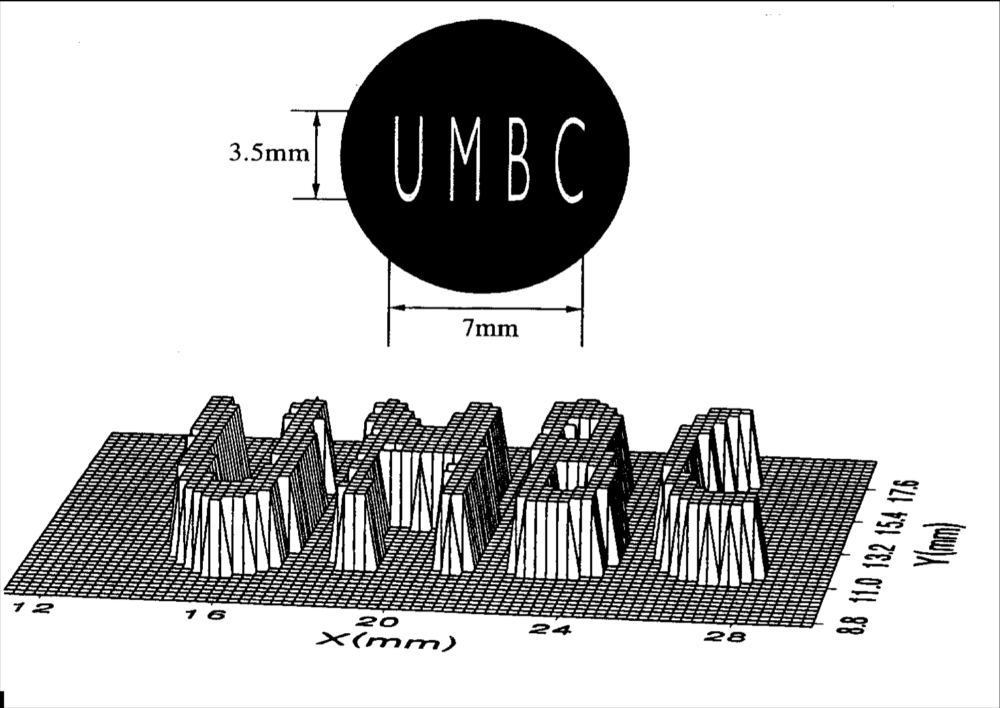
Ghost Imaging: the 1995 experiment
So
Biphoton
Source
Si
Pittman et al., PRA, 52, R3429 (1995); PRL, 74, 3600 (1995).

Slide 5
Entangled Ghost Imaging
Bucket
Detector
CCD
Array
Klyshko’s “unfolded” picture of the 1995 Ghost Imaging experiment

Slide 6
In the 1995 ghost imaging paper (PRA, 52, R3429), it was concluded:
“… indeed it is possible to imagine some type of classical source that could partially emulate this behavior…”

Slide 7
It took 10 years to figure out how to experimentally achieve self-interference of two randomly paired and randomly created photons in thermal state; a lensless ghost imaging experiment using thermal light source was successfully demonstrated in 2005.
A. Valencia, G. Scarcelli, M. D’Angelo and Y.H. Shih, PRL, 94, 063601 (2005).

Slide 8
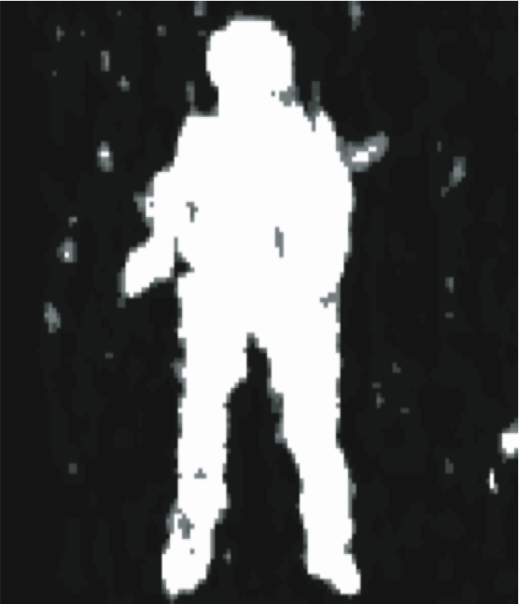
Lensless thermal light Ghost Imaging
A photon counting detector, D₂, is used to collect and to count all the photons that are randomly scattered-reflected from the toy soldier. A CCD array (2D) was facing the light source instead of the object. An image of the soldier was observed in the measurement of photon number fluctuation correlation of D₂ and the CCD.
R. Myers, K.S. Deacon, and Y.H. Shih, Phys. Rev, A77, R041801 (2008).

Slide 9
Lensless thermal light Ghost Imaging
- Result of self-interference of a random pair of photons
j
Bucket
Detector
k
CCD
Array
d
d
Klyshko’s picture of the thermal light Ghost Imaging experiment
A large number of randomly distributed and randomly paired subfields superposed constructively at , and destructively at all other transverse coordinates in the intensity fluctuation correlation measurement.

Slide 10
Two-photon interference
vs
Speckle-to-speckle correlation

Slide 11
Speckle-to-speckle correlation
D₁
D₂
A. Gatti, et al., Phys. Rev. Lett. 90, 133603 (2003).

Slide 12
Classical Simulation: correlated laser beams
The point-to-point correlation is made shot by shot by two co-rotating laser beams. A ghost shadow can be made in coincidences by “blocking-unblocking” of the correlated laser beams.
R.S. Bennink, S.J. Bentley, and R.W. Boyd, Phys. Rev. Lett. 89, 113601 (2002).

Slide 13
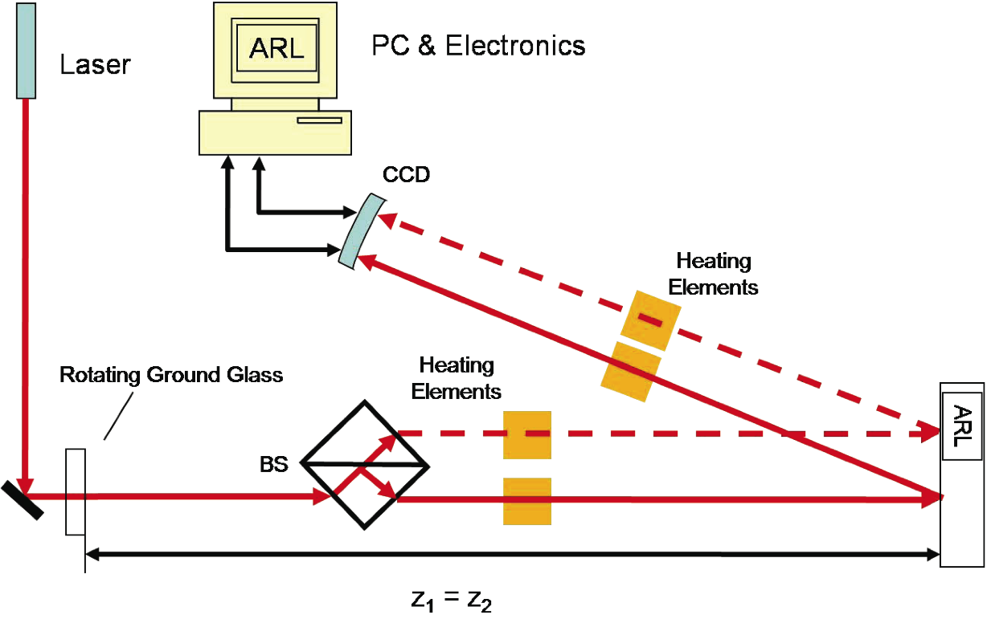
Lensless Ghost Imaging: Turbulence-free
Refractive index structure
parameter:
“…extremely high level of
atmospheric turbulence…”
Classical images are “blurred” out.
R. Meyers, K.S. Deacon, Y.H. Shih, Applied Phys. Lett., 98, 111115 (2011).

Slide 14
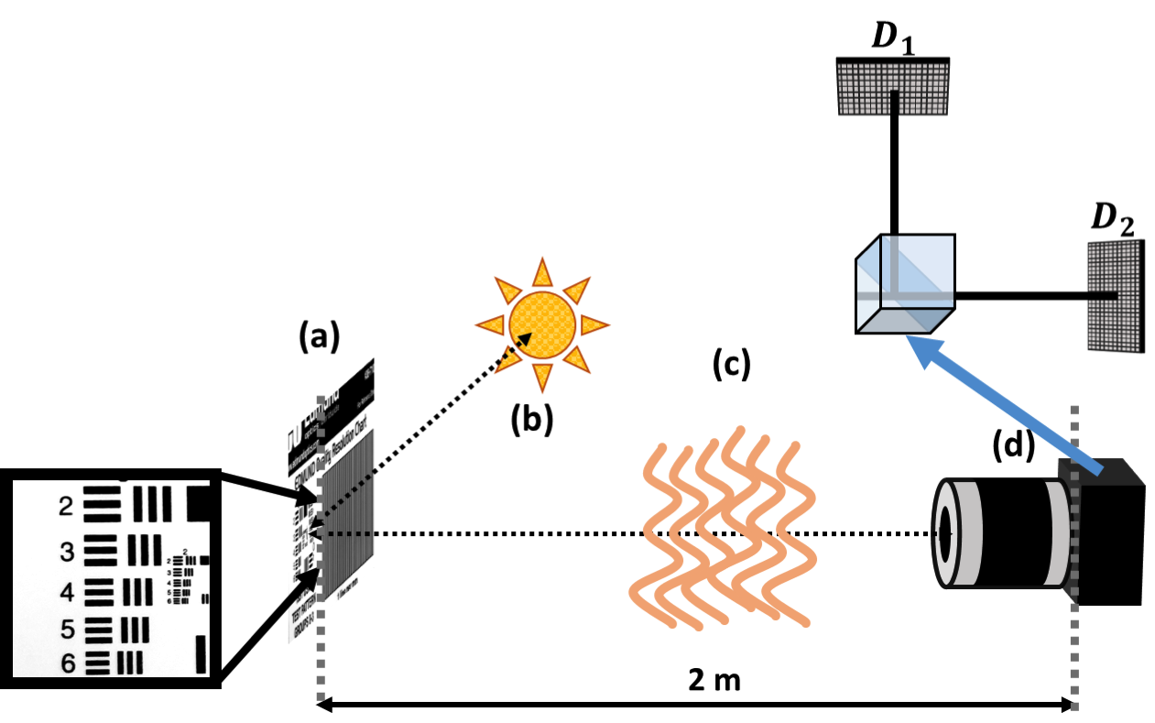
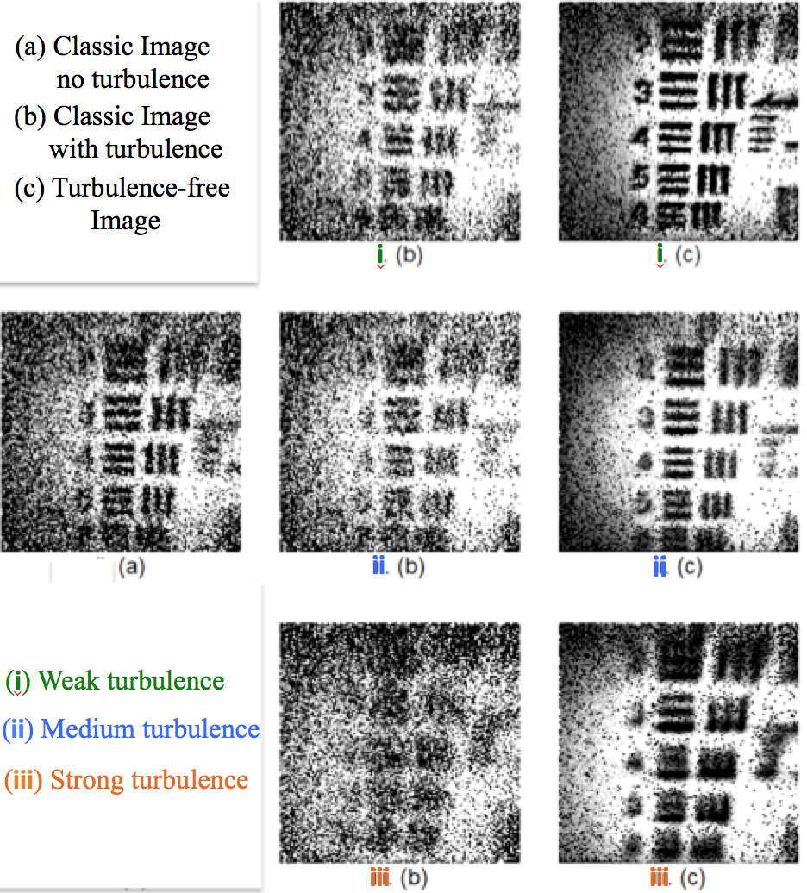
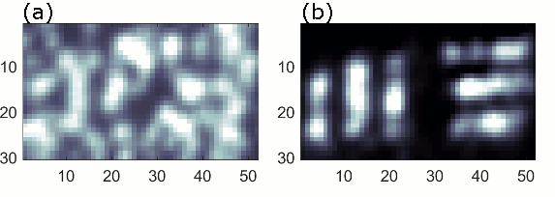
Turbulence-free Camera
Natural
White Light
Tarsier Camera: turbulence-free with
resolution beyond classical limit

Slide 15
How does lensless ghost imaging with thermal light work?

Slide 16
Einstein’s Picture
In a thermal state, a large number of subsources randomly emit subfields (photons) with random phases. These subfields propagate through space and time, 𝑔_{𝑚}(𝒓, 𝑡).
𝐸_{𝑚}
𝑔_{𝑚}
𝐸_{𝑚}(𝒓, 𝑡) = 𝐸_{𝑚}(𝒓_{𝑚}, 𝑡_{𝑚}) 𝑔_{𝑚}(𝒓, 𝑡)
𝐸_{𝑚}(𝒓_{𝑚}, 𝑡_{𝑚}) = 𝑎_{𝑚}(𝒓_{𝑚}, 𝑡_{𝑚}) 𝑒^{𝑖φ𝑚}
𝑔_{𝑚}(𝒓, 𝑡) = 𝑒^{𝑖(𝒌∙(𝒓 - 𝒓𝑚) - ω(𝑡 - 𝑡𝑚))}
Subfields
𝐸_{𝑛}
𝑔_{𝑛}
𝐸_{𝑝}
Propagators
𝑔_{𝑝}
Subsources

Slide 17
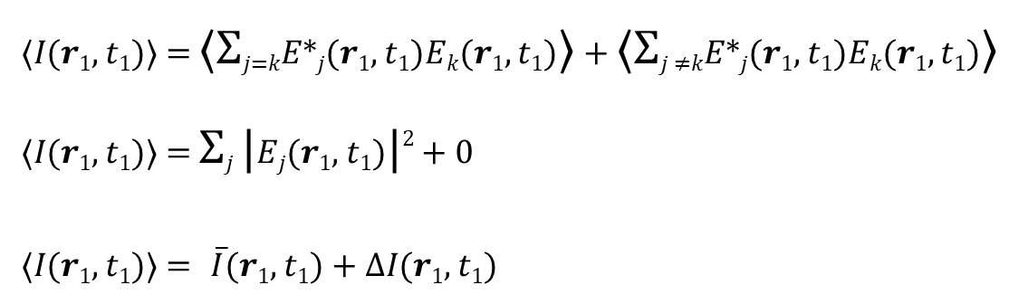
Measuring Intensity
When photons of all possible phases are present in a measurement, only the 𝑗=𝑘 terms survive.
In an actual measurement, often the light source is too dim, or collection time too short to collect all possible phases. The 𝑗≠𝑘 becomes a non-zero fluctuation about a mean intensity.

Slide 18
Intensity Fluctuation Correlation
Which is the cross term of the following superposition:

Slide 19
Lensless thermal light Ghost Imaging
- Result of self-interference of a random photon pair
j
Bucket
Detector
k
CCD
Array
d
d
Klyshko’s picture of the thermal light Ghost Imaging experiment

Slide 20
How does turbulence affect this measurement?
j
Bucket
Detector
k
CCD
Array
d
d
Optical turbulence introduces random phase shifts to the potential paths of propagation of each photon. With each path experiencing a different phase shift, the image will be blurred.

Slide 21
Achieving Path Overlap
D₁
Source
D₂
However, the blue and red two-photon amplitudes experience the same turbulence with the same phase variation when

Slide 22
Lensless Ghost Imaging: Turbulence-free
Refractive index structure
parameter:
“…extremely high level of
atmospheric turbulence…”
Classical images are “blurred” out.
R. Meyers, K.S. Deacon, Y.H. Shih, Applied Phys. Lett., 98, 111115 (2011).

Slide 23
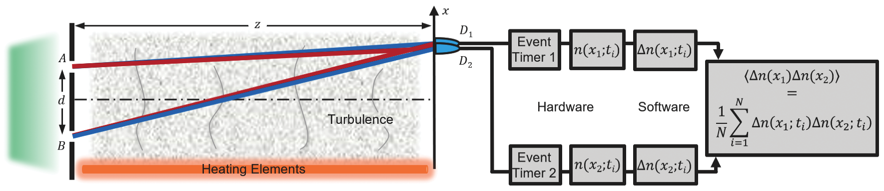
A Turbulence-free Double-slit Interferometer
The blue and red two-photon amplitudes experience the same turbulence with the same phase variation when .
T. A. Smith and Y. H. Shih, Phys. Rev. Lett., 120, 063606 (2018).

Slide 24
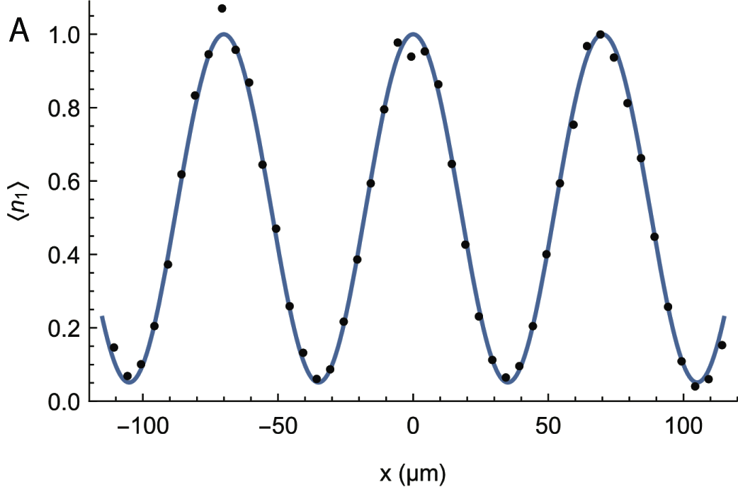
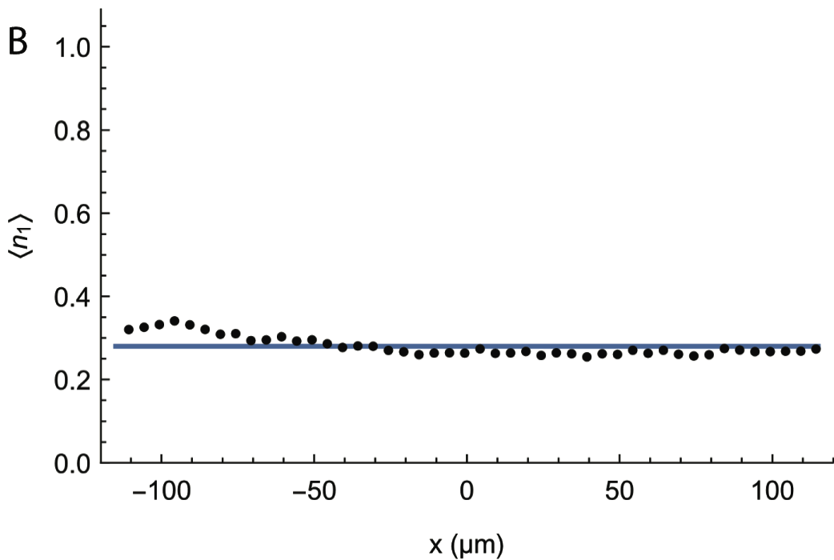
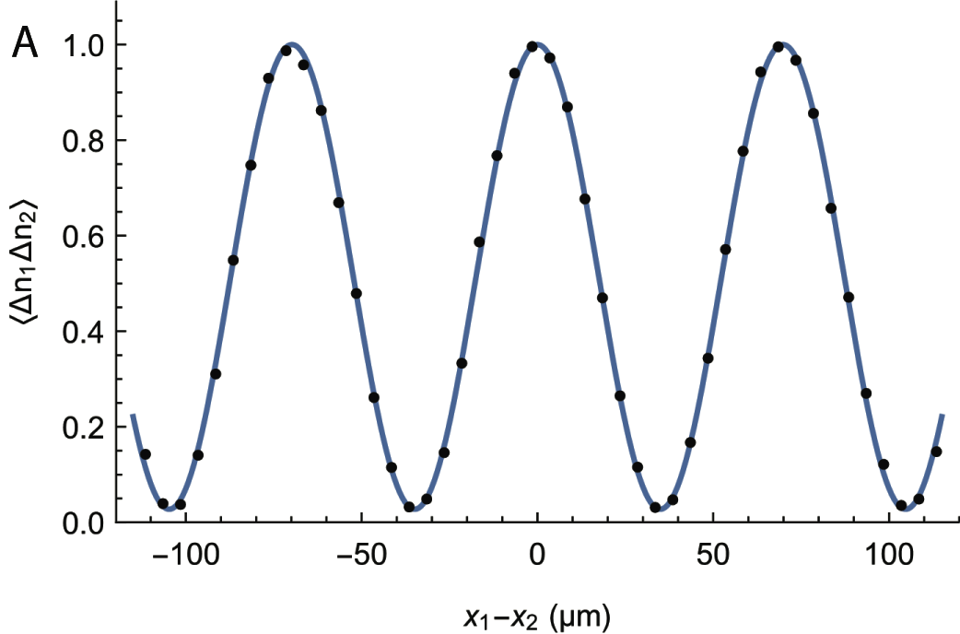
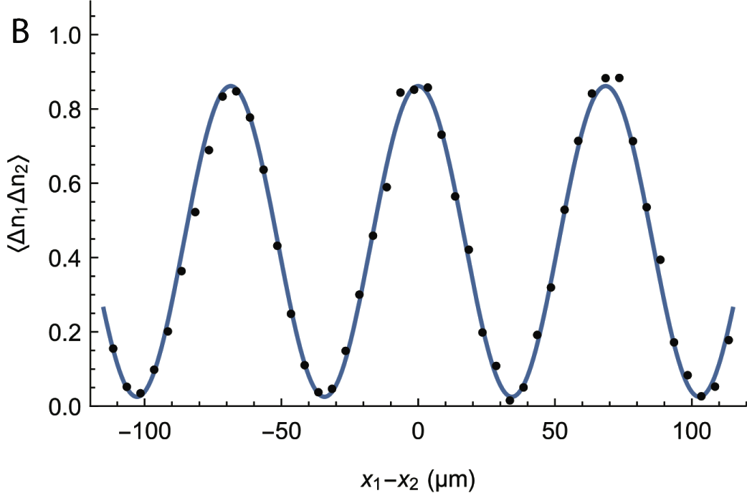
(A) Without turbulence, the classic double-slit interferometer produces an interference pattern in when .
(B) When turbulence was introduced, the turbulence “blurs” the classic double-slit interference pattern in completely.
(C) Without turbulence, the measurement of
produces an interference pattern
when .
(D) When turbulence was introduced, the interference pattern in remained with almost 100% visibility!

Slide 25
What About X rays?
X-ray
Beam Splitter
“Pixel Array” Camera
X–ray Beam
Object
LANL
Computer
“Bucket Detector”
Camera
X-ray beam splitter?
Bragg/Laue diffraction,
perhaps metamaterial?
Required exposure time?
Faster the better, ideally within the coherence time of the light

Slide 26
X ray Ghost Imaging
Pros
Point-point imaging without the need of a lens
Fewer photons required to form an image
Up to nanometer resolution
Ability to generate 3D images
Potentially Insensitive to optical turbulence
Cons/Obstacles
More time needed than standard intensity measurements
Prefer a 50/50 beam splitter
Prefer single frame detection times shorter than the coherence time of the X rays

Slide 27
Thank you!

