Slide 1
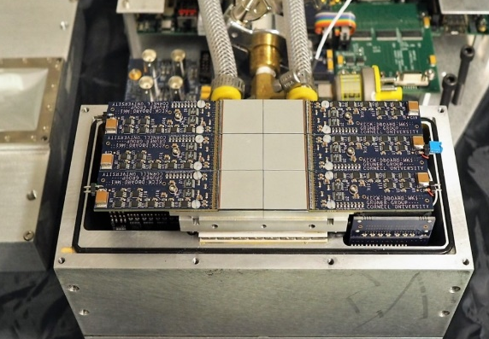
High Speed PADs at Cornell
Practical experience with high-speed
x-ray pixel array detectors and x-ray
sensing materials

Slide 2
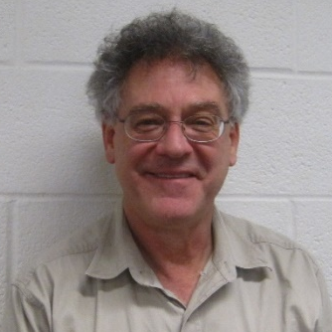
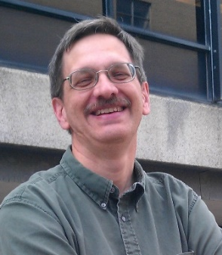

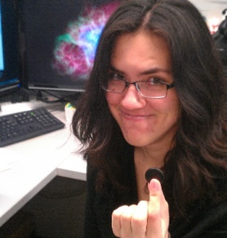
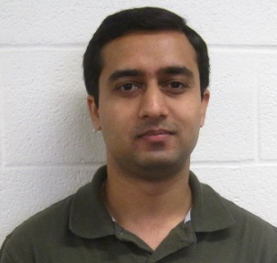
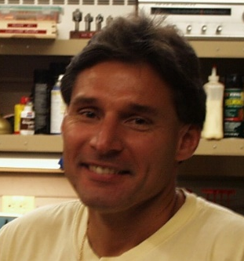
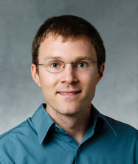
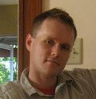
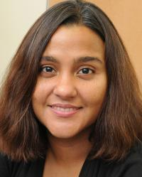
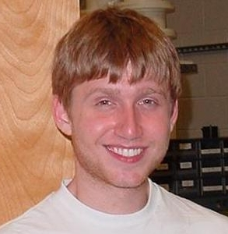


Who we are
Permanent members
Sol Gruner
Mark Tate
Hugh Philipp
Kate Shanks
Prafull Purohit
Present Student members
Marty Novak
Divya Gadkari (graduate), Jonathan Okasinski (undergrad)
Some past members
Lucas Koerner
(U. St. Thomas)
Dan Schuette
(MIT-LL)
Marianne Hromalik
(SUNY Oswego)
Joel Weiss
(Apple)
Julian Becker
(DESY)
Darol Chamberlain

Slide 3
Outline Slide
Landscape of detector development.
Cornell detectors and practical use
Way forward

Slide 4
“Landscape” of detector capabilities…
pnCCD
(200 Hz)
Phosphor-coupled CCDs
SACLA MP-CCD
(60 Hz)
MMPAD (1.1 kHz)
In-pixel frame storage
CS-PAD
(120 Hz)
Keck PAD
(10 MHz)
1s
100 ms
10 ms
1 ms
100 µs
10 µs
1 µs
100 ns
1 Hz
10 Hz
100 Hz
1 kHz
10 kHz
100 kHz
1 MHz
10 MHz
GE flat-panel detector
(30 Hz)
Medipix3
(12-bit @ 2 kHz
1-bit @ 24 kHz)
AGIPD
(4.5 MHz)
Pilatus 100k
(300 Hz)
Pilatus 6M X Series (100 Hz)
Eiger
(12-bit @ 8 kHz,
4-bit @ 22 kHz)
*Frame rates listed are maximum stated frame rates as of June 2015
**Maximum frame rate is often defined as 1/(read time)

Slide 5
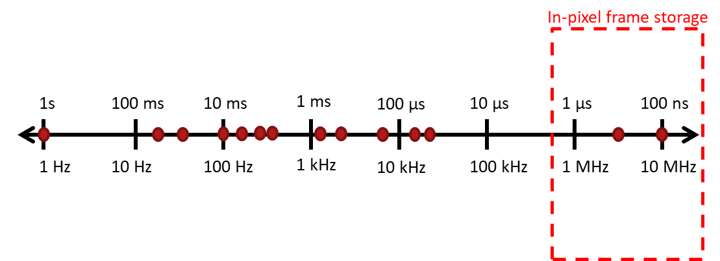
“Landscape” of detector capabilities…
Continuous framing more difficult
Strong function of x-ray energy
Continuous framing
Sensor material
Limitations
10 ns
1 ns
100 ps
100 MHz
1 GHz
10 GHz
APS 1296 bunch mode
(350 MHz)
Original
MaRIE Imager Specs
Type I,Type II
500 MHz, 3 GHz
5

Slide 6
“Landscape” of detector capabilities…
Strong function of x-ray energy
Continuous framing
Sensor material
Limitations
10 ns
1 ns
100 ps
100 MHz
1 GHz
10 GHz
Increased frame rates
Triggering & synchronization
Data transfer
Data Storage
APS 1296 bunch mode
(350 MHz)
Original
MaRIE Imager Specs
Type I,Type II
500 MHz, 3 GHz
6

Slide 7
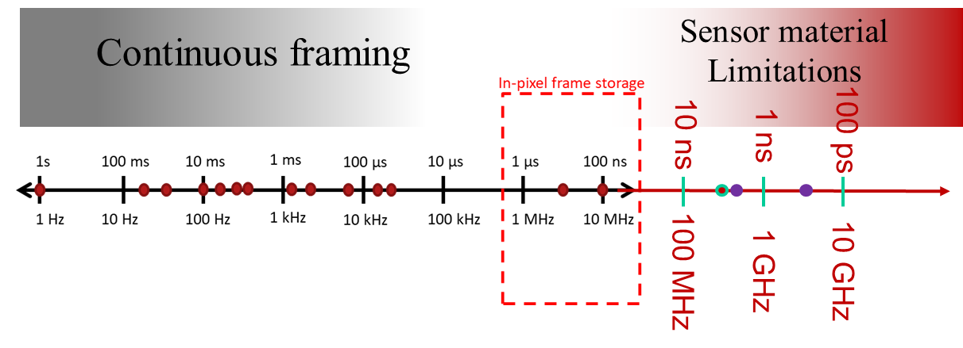
Cornell detector development efforts
Materials
  Si, CdTe, Ge, GaAs
Continuous framing
  Developing 10 kHz+ continuous framerates.
High Dynamic Range
  MMPAD* and related detector development
Burst mode imaging
  KeckPAD*
Scientific collaboration - to find new applications for detectors.
  Tools create opportunities!
* Being commercialized by Sydor Instruments

Slide 8
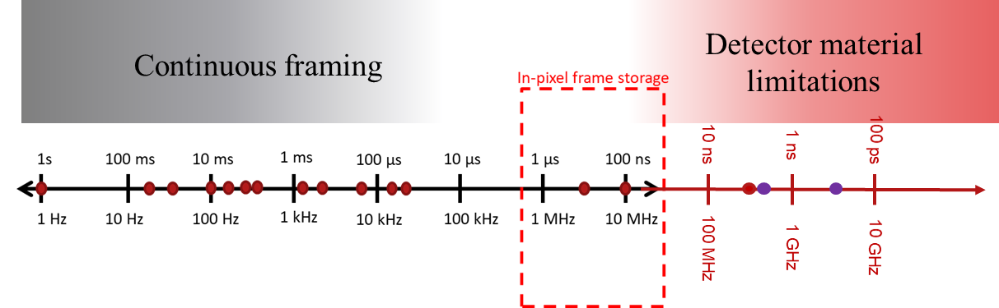
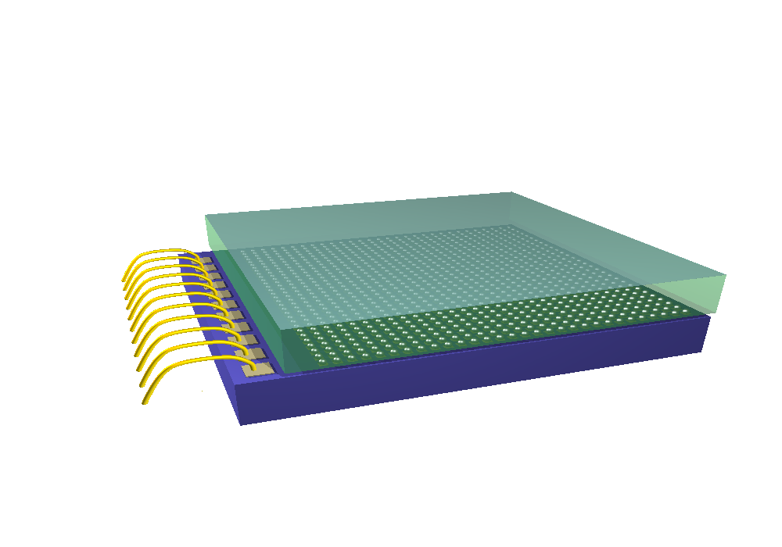
PAD structure
Cornell typical sensor:
Si (500 μm)
CdTe (750 μm)
HV
sensor
thickness
sensor
ASIC
ASIC: custom CMOS, most recent TSMC 0.18um
Not to scale

Slide 9
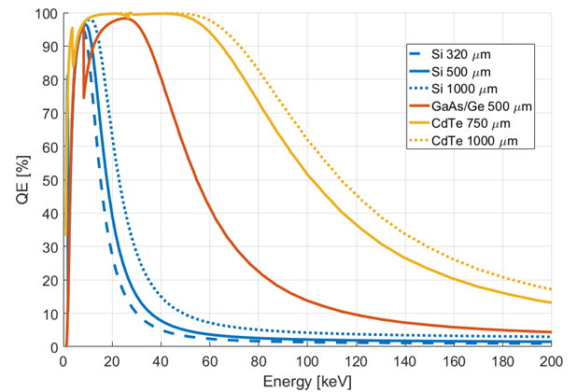
Materials

Slide 10
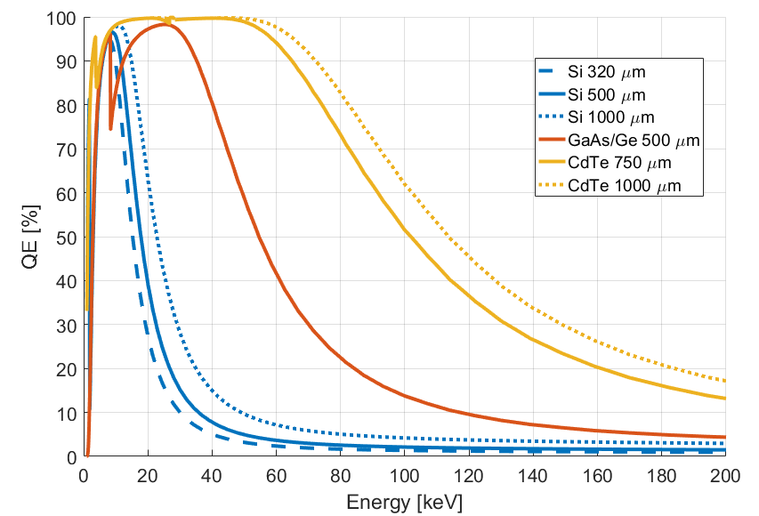
Materials
Material | ρ [g/cm³] | Z | E_{gap} [eV] | E [eV] Pair creation | µ_{e} [cm²/Vs] | µ_{h} [cm²/Vs] | τ_{e} | τ_{h}
Silicon | 2.33 | 14 | 1.12 | 3.6 | 1500 | 400 | >1ms | >1ms
Ge | 5.33 | 32 | 0.67 | 2.9 | 3900 | 1900 | >1ms | >1ms
GaAs | 5.32 | 31,33 | 1.42 | 4.3 | 4000 | 300 | ~10ns | ~ 1ns
CdTe | 5.85 | 48,52 | 1.44 | 4.4 | 1100 | 90 | ~ 3µs | ~ 2µs
Biggest drawbacks:
Si: low ρ,Z
=> low QE at high E
Ge: low E_{gap}
=> needs cryo cooling
GaAs: low τ
=> energy dependence
CdTe: slow; material polarization
=> speed, complexity

Slide 11
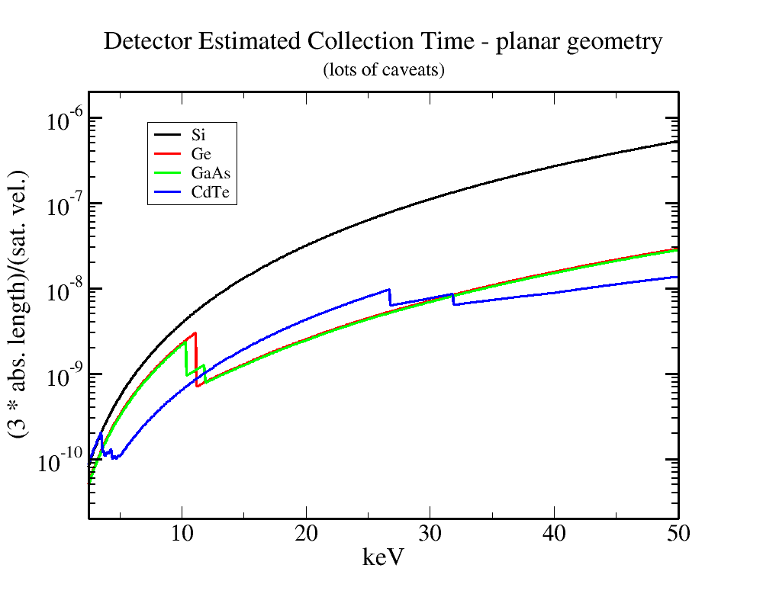
Detector Speed
153 ns
2.9 ns
2.0 ns
333ps
Thicker sensors
Oversimplified
Mobility and peak carrier velocity in context of x-ray absorption length.
What thickness of materials are available?

Slide 12
Outline Slide
General capabilities of PADs and sensor materials
Cornell detectors and practical use
Way forward

Slide 13
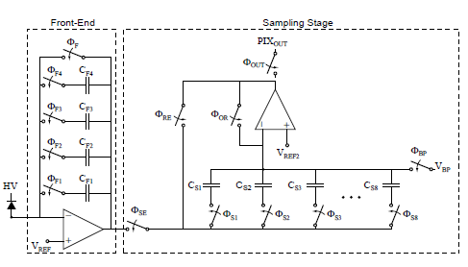

Keck PAD
Integration caps -
300, 466, 500, 700 fF
In-pixel frame storage provides down to ~100 ns spacing between stored frames (~10 MHz)
Storage caps
Above: Simplified Pixel Schematics
Read time | 0.86 ms/frame
Storage caps/pixel | 8
Read noise | 1 photon @ 8 keV (C_{F} = 300 fF) 4 photons @ 8 keV (C_{F} = 1966 fF)
Well capacity | 1112 photons @ 8 keV (C_{F} = 300 fF) 7288 photons @ 8 keV (C_{F} = 1966 fF)
Sensors: Si and CdTe diodes.
Pixel size: 150 µm x 150 µm
Each tile: 128 x 129 pixels.
H. Philipp, et. al., (2015), J. Synchrotron Radiation. 23: 395-403.

Slide 14
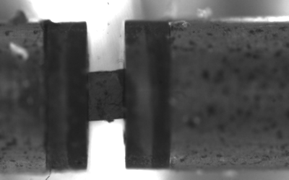
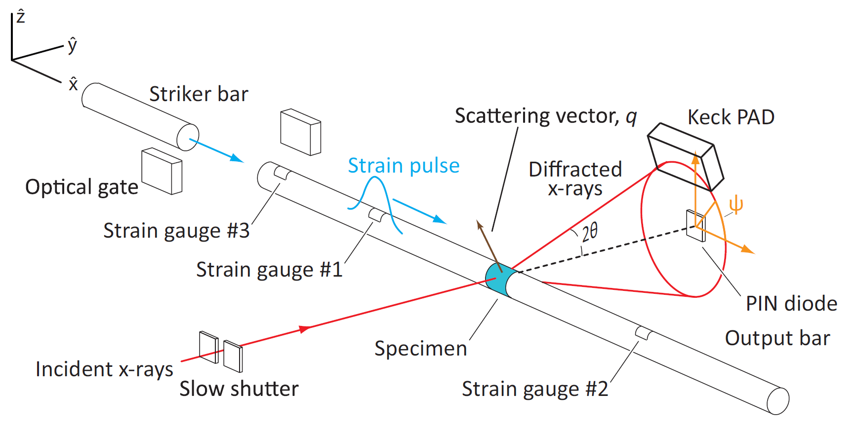
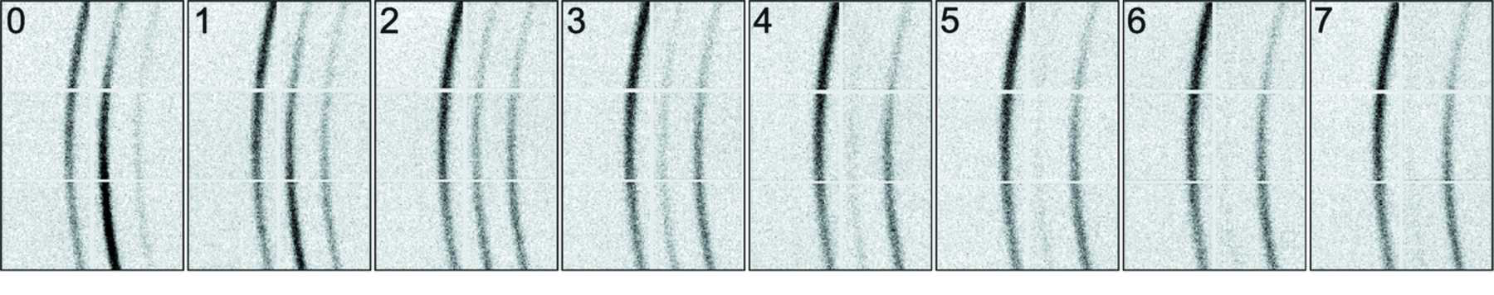
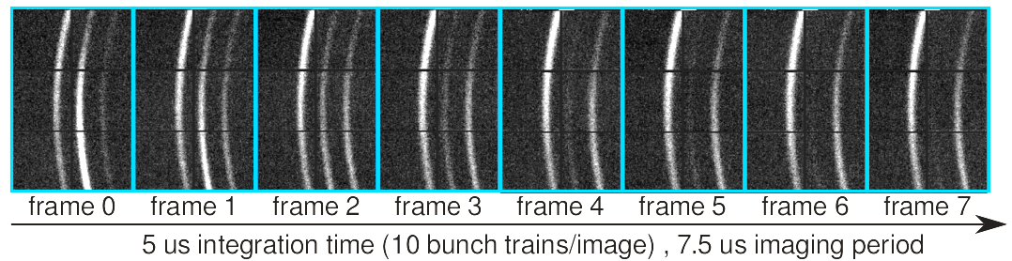
Metals under stress @ CHESS G3
Kolsky bar apparatus
Optical video, 1 million FPS
Collaborators: Hufnagel group @ Johns Hopkins & Army Research Office
Goal: study deformation of metal compounds under high strain rates
Energy: 10 keV
Silicon diode sensor
C. J. Hustedt et al., J. of Dynamical Behavior of Materials. 44 (2018) 222-230.
Lambert et al., Review of Scientific Instruments 85, 093901 (2014)

Slide 15
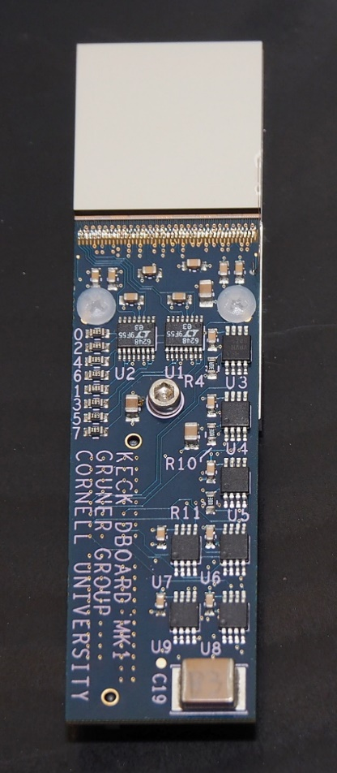
More on CdTe diode
CdTe : Acrorad Co., Ltd., Japan.
Bumping and module mating to ASICs:
Oy Ajat Ltd., Finland.
Diode structure: In/Pt Schottky type with a pixelated, Pt contact. Hole collecting.
Pixel size: 150 um x 150 um.

Slide 16
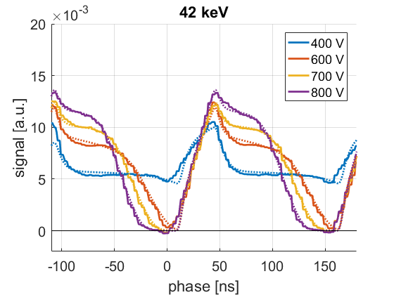
CdTe Keck-PAD data from APS
(beamline: DCS, 35IDE)
750 μm thick sensor
e- : initial feature
holes: lagging feature
Both charge carriers relevant.
  Think GaAs:
    μ_{n} ~ 8500 cm² V⁻¹s⁻¹
    μ_{p} ~ 400 cm² V⁻¹s⁻¹
Bunch period
153 ns
~40 ns integration window
Figure: Julian Becker, et. al. (2017) JINST 12: P06022

Slide 17
Mixed-Mode PAD (MM-PAD)
Mixed analog and digital readout provides extended dynamic range
Read time (frame rate) | 0.86 ms (1.1 kHz)
Read noise (RMS) | 0.16 photons @ 8 keV
Well capacity | 4.7 x 10⁷ photons/pix/frame @ 8 keV
Sustained count rate | >10⁸ ph/pix/s
Instantaneous count rate | > 10¹² ph/pix/s (e.g. ~200 ph/pix/pulse)

Slide 18
MM-PAD: application (Si sensor)
per pixel per 100 ms frame
No beamstop
Coherent diffractive imaging
Capture scattering pattern from Au test object @ 100 ms per frame
10⁶ photons per pixel full scale
Dynamic range and tolerance of high flux are key
(PETRA III: Mancuso group from European XFEL –
see Giewekemeyer et al., Journal of Synchrotron Radiation (2014) 21, 1167-1174)

Slide 19
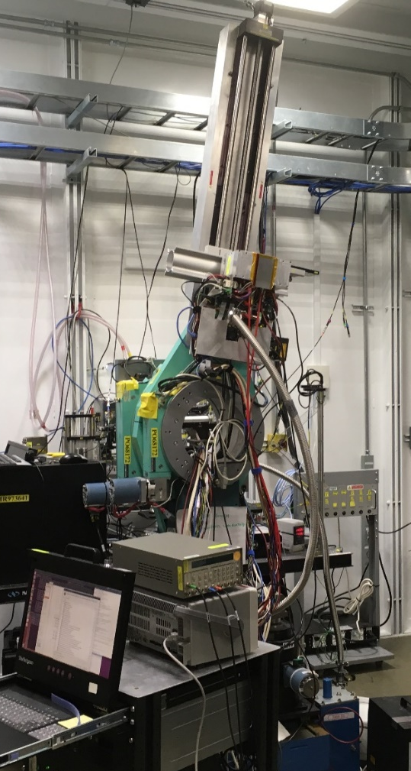
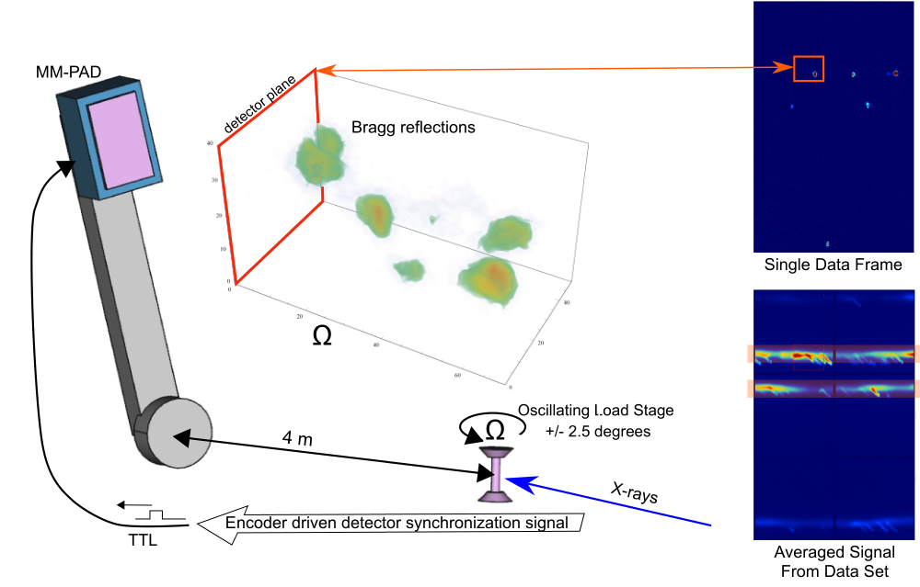
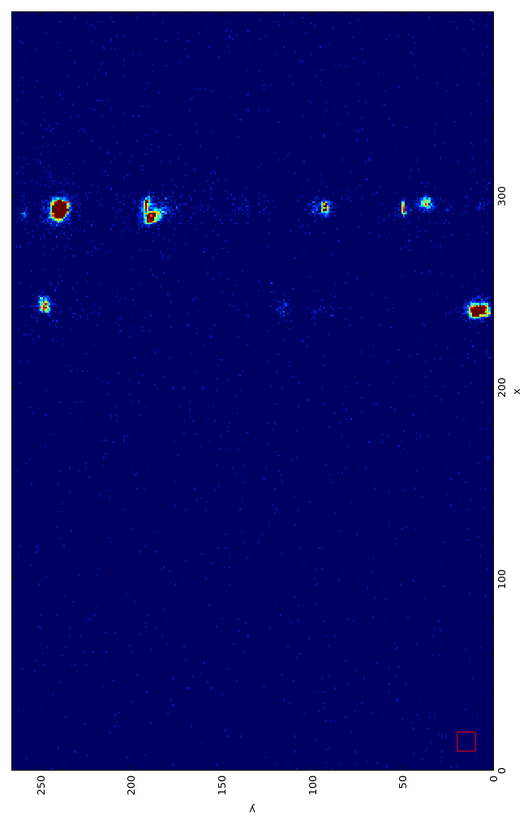
MM-PAD: application (CdTe sensor)
80 keV
Ti alloys
APS Beamline: 1-ID-E
Armand Beaudoin, Kamalika Chatterjee

Slide 20
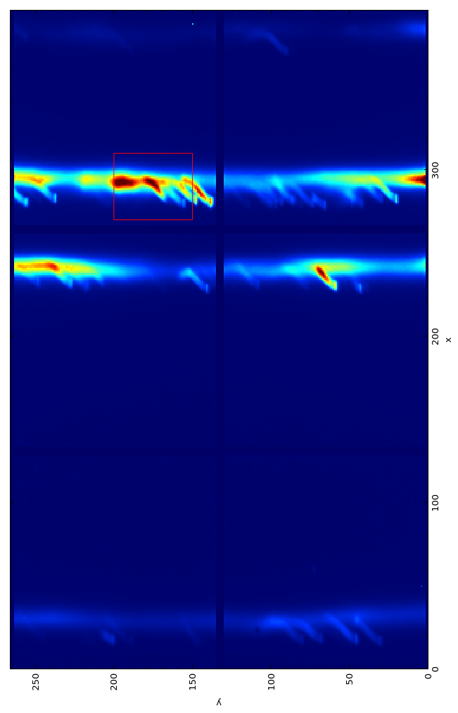
MM-PAD: application (CdTe sensor)
Sum of all times
80 keV
APS Beamline: 1-ID-E
Armand Beaudoin, Kamalika Chatterjee

Slide 21
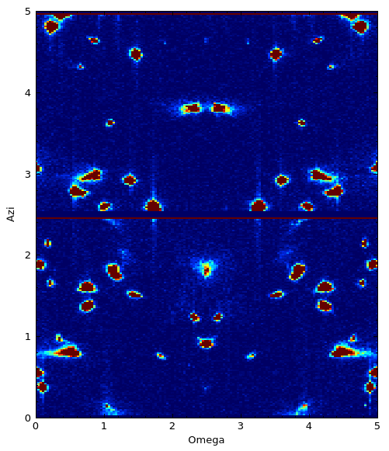
MM-PAD: application (CdTe sensor)
APS Beamline: 1-ID-E
Armand Beaudoin, Kamalika Chatterjee

Slide 22
CdTe
Problems
Significant polarization 10¹⁰ photons/pixel or long period of time.
Polarization: dose dependent accumulation of space charge.
Reset in few minutes with small forward bias on diode.
Becker, et. al., (2016) JINST 11: P12013
doi:10.1088/1748-0221/11/12/P12013

Slide 23
GaAs
Testing Chromium compensated GaAs in ohmic configuration.
Carrier lifetimes low.
Charge collection strongly dependent on temperature.
Not optimized for integrating detectors.
Reference: J. Becker, et al., Characterization of chromium compensated GaAs as an X-ray sensor material for charge-integrating pixel array detectors. JINST 13 (2018) P01007.

Slide 24
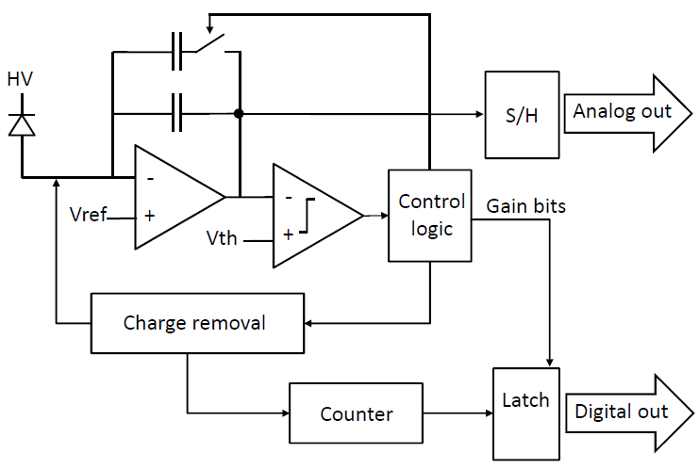
2017 submission
further improvements to MM-PAD pixel
Dual track/hold circuit Differential output
Expose-during-readout operation
CF_{LG}
CF_{HG}
Faster readout:
ASIC capable of < 100 ns/pixel
128 x 128 pixels in 16 channels: ~10 kHz
8 channels: ~5 kHz
4 channels: ~1 kHz
Dual 16-bit counters Expose-during-readout operation
24
Notes:
24

Slide 25
MM-PAD 2.0 - High Current Testing
No sensor, external current source
Inferred Input vs Actual Input
Max oscillator
frequency
MMPAD 1.0 Saturation
Design goal
25
Notes:
25

Slide 26
Outline Slide
General capabilities of PADs and sensor materials
Cornell detectors and practical use
Way forward

Slide 27
How to speed up ASIC for continuous readout?
A lot of room for improvement on the readout/ASIC side before detector limitations.
MM-PAD 2.0 running at 10 kHz:
  (10k x 1282 pixels x 32 bits/pixel) = 5.24 Gbits/s per ASIC.
Some options:
  Brute force, parallelize readout.
  Sparse readout
  Lossless data compression (easiest, don’t transfer lots of zeros)
  Use on chip optical modulators (optical Mach-Zehnder modulator 10’s of Gbps) – problem is identifying an accessible technology.

Slide 28
Conclusions
New detector materials or geometries are essential for meeting high-speed, high energy imaging. Absorption length and mobility must be considered.
The Cornell detector group has demonstrated both high speed and high energy imaging with new materials coupled to existing PADs.
Development of high-speed, high-dynamic range imaging with continuous readout is continuing.
We are always looking for collaborators to help us put detectors in the hands of users.

Slide 29
Who we are
Permanent members
Sol Gruner
Mark Tate
Hugh Philipp
Kate Shanks
Prafull Purohit
Present Student members
Marty Novak
Divya Gadkari (graduate), Jonathan Okasinski (undergrad)
Some past members
Lucas Koerner
(U. St. Thomas)
Dan Schuette
(MIT-LL)
Marianne Hromalik
(SUNY Oswego)
Joel Weiss
(Apple)
Julian Becker
(DESY)
Darol Chamberlain

Slide 30
Additional Slides after here

Slide 31
Continuous framing
Sensor material
Limitations
10 ns
1 ns
100 ps
100 MHz
1 GHz
10 GHz

Slide 32
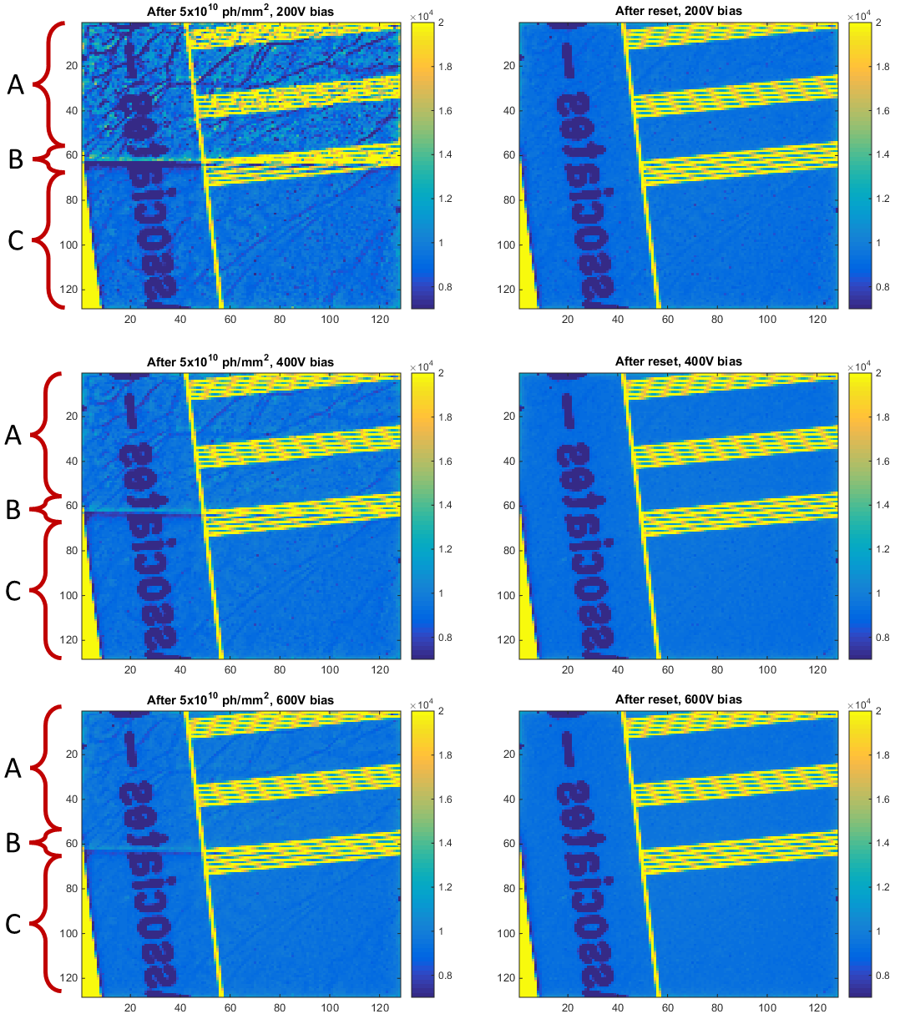
CdTe
Problems
Polarization significant after X photons/pixel or long period of time.
Polarization: dose dependent accumulation of space charge.
Can be reset in a few minutes with small positive bias on diode.
Region A was undosed and shows increased variance but the same average signal.
Region B is in between the dosed and
undosed region and shows the lateral displacement artifact.
Region C was dosed and shows
a reduction in signal, but less variance than in region A.
Before reset
After reset
Becker, et. al., (2016) JINST 11: P12013
doi:10.1088/1748-0221/11/12/P12013

Slide 33
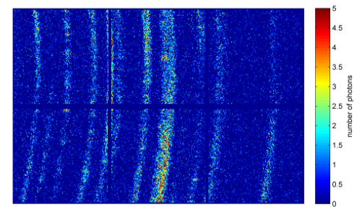
MM-PAD: applications (Si sensor)
Wide dynamic range gives extraordinary experimental flexibility
5
Example #1: materials science
Capture diffraction from Ni₃Al multilayer foil undergoing thermite-like reaction @ 2 ms per frame
5 photons per pixel full scale
Single-photon sensitivity is key
(CHESS: Hufnagel group at Johns Hopkins)
4
3
Number of photons
2
1
0
Example #2: coherent diffractive imaging
Capture scattering pattern from Au test object @ 100 ms per frame
10⁶ photons per pixel full scale
Dynamic range and tolerance of high flux are key
(PETRA III: Mancuso group from European XFEL –
see Giewekemeyer et al., Journal of Synchrotron Radiation (2014) 21, 1167-1174)

Slide 34
MM-PAD: application (CdTe sensor)
Tracking Bragg peaks of polycrystalline sample in a volume of reciprocal space.
Observe grain evolution of Ti sample under stress (in load stage).

