Slide 2
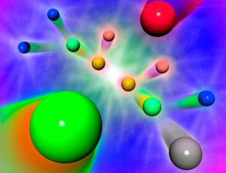
LHC Implications for the pMSSM
Cahill-Rowley, JLH, Hoeche, Ismail, Rizzo 1206.4321, 1206.5800, 1211.1981,
1211.7106, in preparation

Slide 3
pMSSM Studies
Berger, Cahill-Rowley, Conley, Cotta, Gainer, JLH, Hoeche, Howe, Ismail, Le, Rizzo 0812.0980, 1007.5520, 1009.2539, 1103.1697, 1105.1199, 1111.2604, 1206.4321, 1206.5800, 1211.1981, 1211.7106
AbdusSalam, Allanach, Chourdhury, Quevedo, Feroz, Hobson 0909.2548, 1009.4308, 1106.2317, 1210.3331, 1211.0999
Sekmen, Kraml, Lykken, Moortgat, Padhi, Pape, Pierini, Prosper, Spiropulu 1109.5119
Arbey, Battaglia, Djouadi, Mahmoudi 1110.3726, 1112.3032, 1205.2557, 1207.1348, 1211.4004
Strubig, Caron, Rammensee 1202.6244
Carena, Lykken, Sekmen, Shah, Wagner 1205.5903
Bechtle, Heinemeyer, Stal, Stefaniak, Weiglein, Zeune 1211.1955

Slide 4
The pMSSM Model Framework
The phenomenological MSSM (pMSSM)
Most general CP-conserving MSSM with R-parity
Minimal Flavor Violation, First 2 sfermion generations are degenerate w/ negligible Yukawas
No GUT, SUSY-breaking, high-scale assumptions!
19/20 real, weak-scale parameters (Neutralino/Gravitino LSP)
scalars:
m_{Q1}, m_{Q3}, m_{u1}, m_{d1}, m_{u3}, m_{d3}, m_{L1}, m_{L3}, m_{e1}, m_{e3}
gauginos: M₁, M₂, M₃
tri-linear couplings: A_{b}, A_{t}, A_{τ}
Higgs/Higgsino: μ, M_{A}, tanβ
(Gravitino: M_{G})
Supersymmetry without Prejudice
Berger, Gainer, JLH, Rizzo 0812.0980

Slide 5
REMINDER:
SUSY is not a single
model but a very large
theoretical framework
SUSY
N=1
MSSM
Dirac
gauginos
pMSSM
NMSSM
singlinos
U(1)’
CMSSM

Slide 6
Study of the pMSSM (Neutralino/Gravitino LSP)
Scan with Linear Priors
Perform large scan over
Parameters
100 GeV ≤ m_{sfermions} ≤ 4 TeV
50 GeV ≤ |M₁, M₂, μ| ≤ 4 TeV
400 GeV ≤ M₃ ≤ 4 TeV
100 GeV ≤ M_{A} ≤ 4 TeV
1 ≤ tanβ ≤ 60
|A_{t,b,τ}| ≤ 4 TeV
(1 ev ≤ m_{G} ≤ 1 TeV) (log prior)
Subject these points to
Constraints from:
Flavor physics
EW precision measurements
Collider searches
Cosmology
~225,000 models survive constraints for each LSP type!

Slide 7
Model Constraints
Δρ / W-mass
Γ(Z→ invisible)
Δ(g-2)_{μ}
b →s γ
Meson-Antimeson Mixing
B→τν
B_{s}→μμ
Direct Detection of Dark Matter (SI & SD)
WMAP Dark Matter density upper bound
BBN energy deposition for gravitinos
Relic ν’s & diffuse photon bounds
LEP and Tevatron Direct Higgs & SUSY
searches
LHC stable sparticle searches
No tachyons or color/charge breaking
minima
Stable vacua only

Slide 8
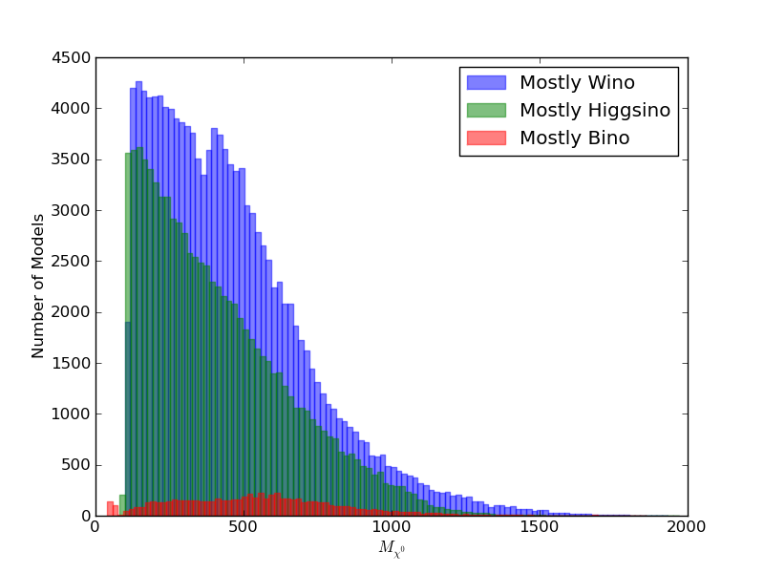
Neutralino Mass Distribution

Slide 9
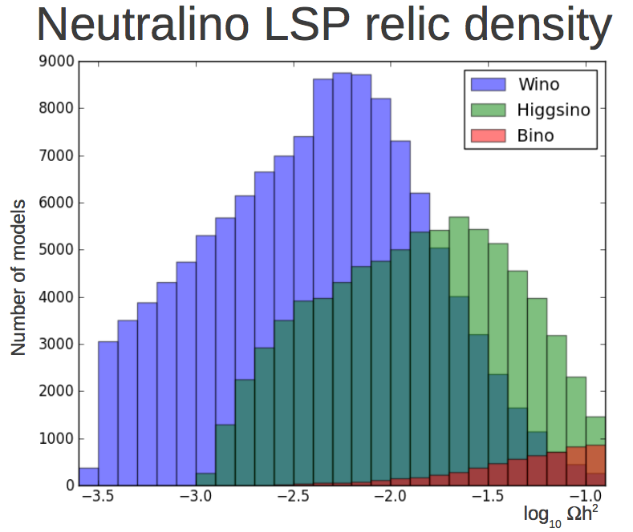
Winos and Higgsinos annihilate more

Slide 10
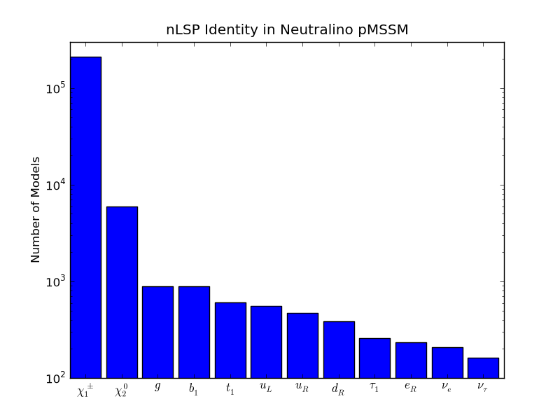
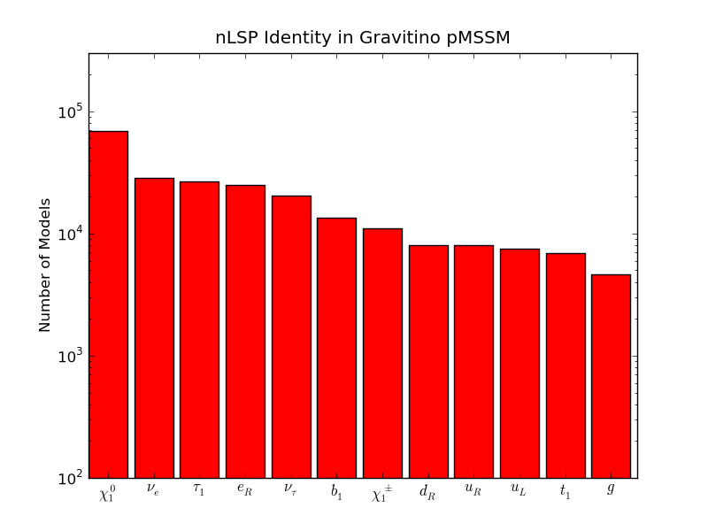
Identity of the Next-to-LSP
The frequency of various NLSP identities is strongly
dependent on the LSP choice
This can have a potentially large influence on LHC SUSY
searches (apart from, e.g., additional cascades)
Χ LSP
G LSP

Slide 11
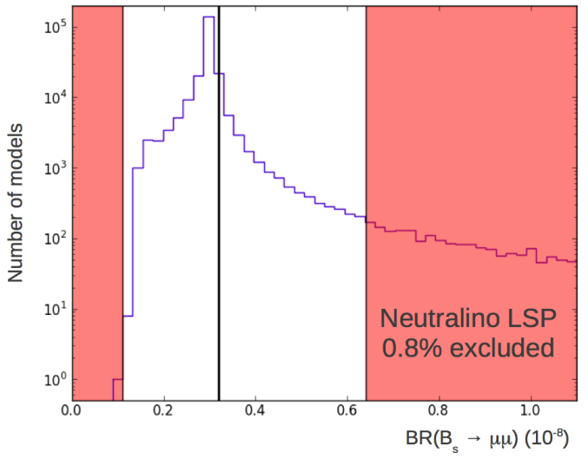
Non-MET Searches
LHCb: B(B_{s} ➔μμ) = (3.2^{+1.5}_{-1.2}) x 10⁻⁹
95% CL interval:
[1.1,6.4] x 10⁻⁹
Excludes
1819 χ LSP models
2167 G LSP models

Slide 12
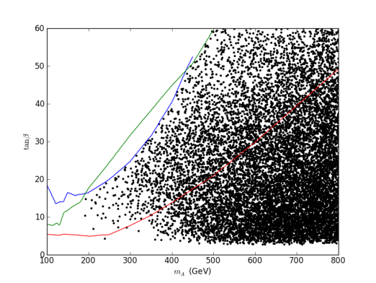
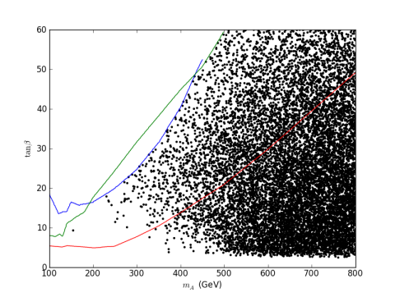
Impact of A,H →ττ Searches
G LSP
tan β
CMS 13 fb⁻¹
χ LSP
M_{A}
3671(3309) models removed from the χ (G) LSP set…

Slide 13
ATLAS MET-based SUSY Analyses
@ 7 & 8 TeV
Apply the general LHC SUSY MET-based searches to our model sets
We (almost) exclusively follow the ATLAS analysis suite as
closely as possible with fast MC (modified versions of PGS,
Pythia, SoftSUSY, SDECAY, HDECAY)
Generate signal events for every model for all ~90 SUSY processes (~10¹³ events!) & scale to NLO with Prospino
Validated our results with ATLAS benchmark models
We combine the various analyses signal regions (as ATLAS
does) into : nj0l, multi-j, nj1l, nj2l and we quote the coverage
for each as well as the combined result..
This approach is CPU intensive!!

Slide 14
What is NOT included:
τ-based analyses NOT (yet! ) included since at present the
ID efficiency is low & the mis-tag rate is high
Mono-jet/γ analyses: these require special treatment w/
MADGRAPH+NLO matching
Analyses for which no signal would be generated in the
pMSSM (e.g., exotic resonances)

Slide 15
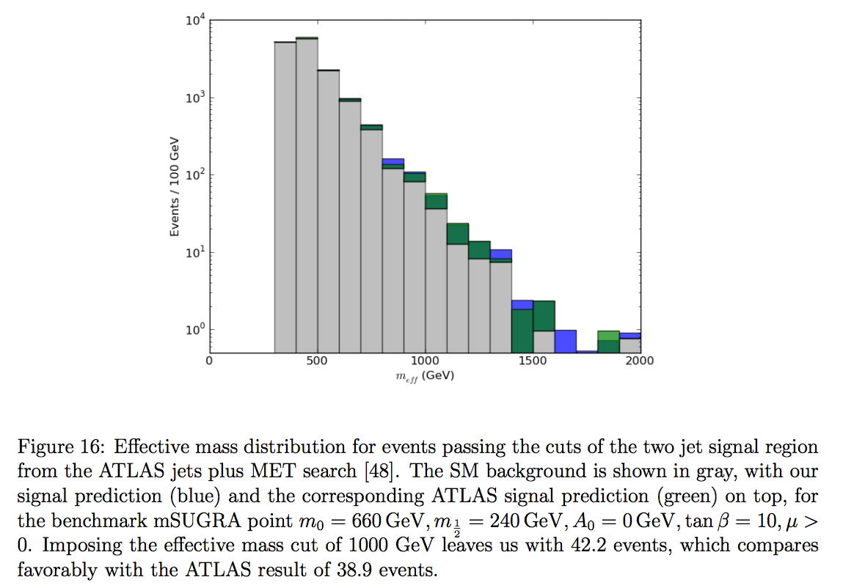
Benchmark Validation

Slide 16
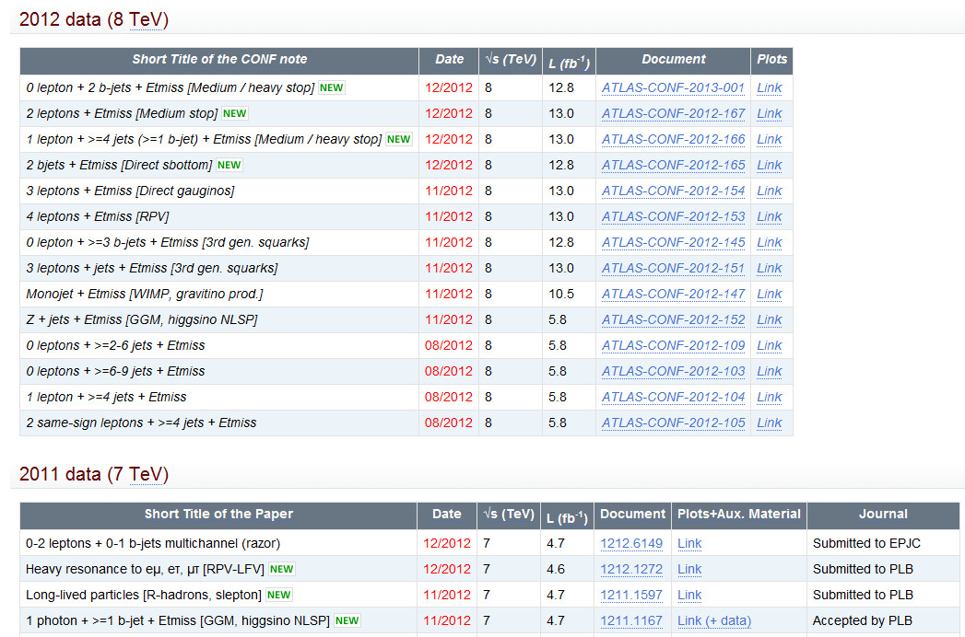
Employ all publically released ATLAS analyses since 1 March
✓
X
X
CMS
✓

Slide 17
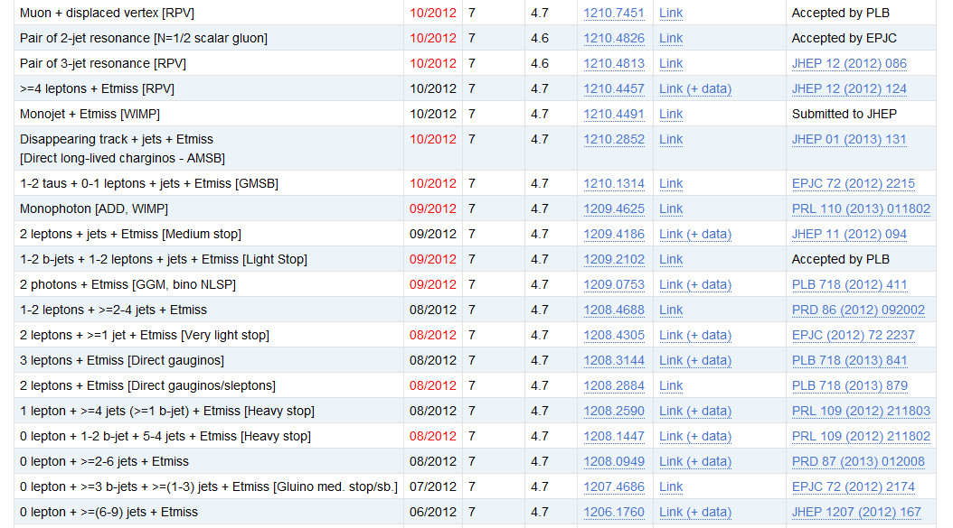
✓
X
✓
X
✓
✓
✓
✓
✓
✓
✓
✓
✓
✓
✓
✓
✓
✓
✓
✓

Slide 18
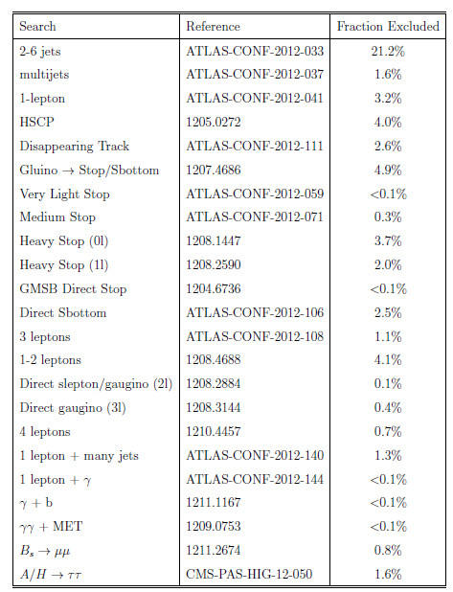
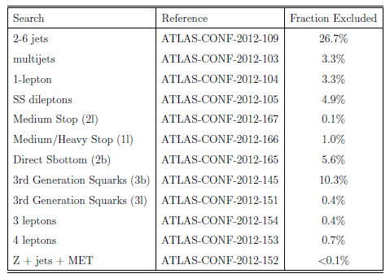
LHC Search Results for the pMSSM with Neutralino LSP: percentage of models excluded by data
7 TeV Searches
8 TeV Searches
Very (Very) Preliminary
✓
✓
→
✓
→
✓
Very (Very) Preliminary
✓
✓
✓
✓
✓ = Newly added search
✓
✓
Total Excluded ~35% (was ~32% !)
No effect from m_{h} = 126±3 GeV cut
✓
✓
✓
✓
The new 8 TeV 3rd gen searches are
seen to have more power !
✓

Slide 19
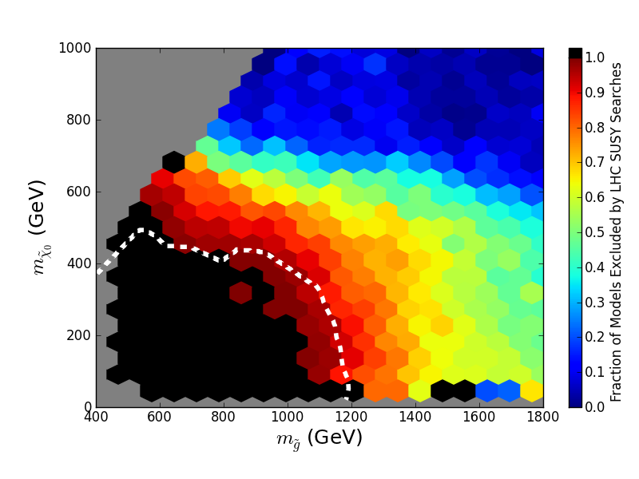
Effects of LHC Searches on Neutralino LSP Sample
Simplified Model Limit (ATLAS)

Slide 20
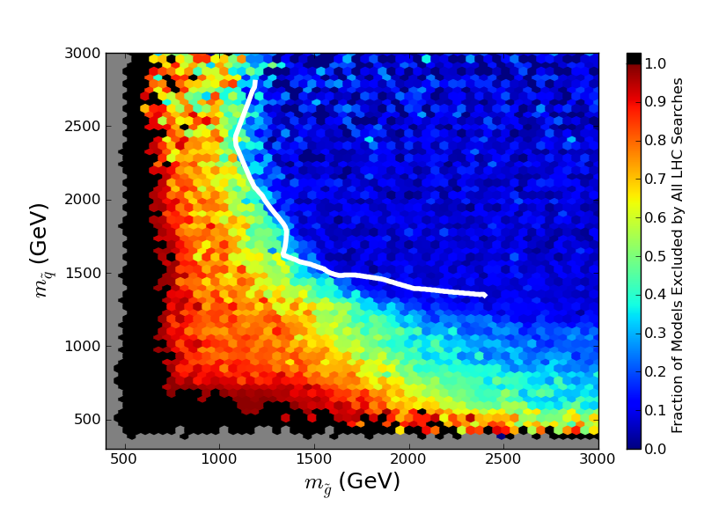
Effects of LHC Searches on Neutralino LSP Sample

Slide 21
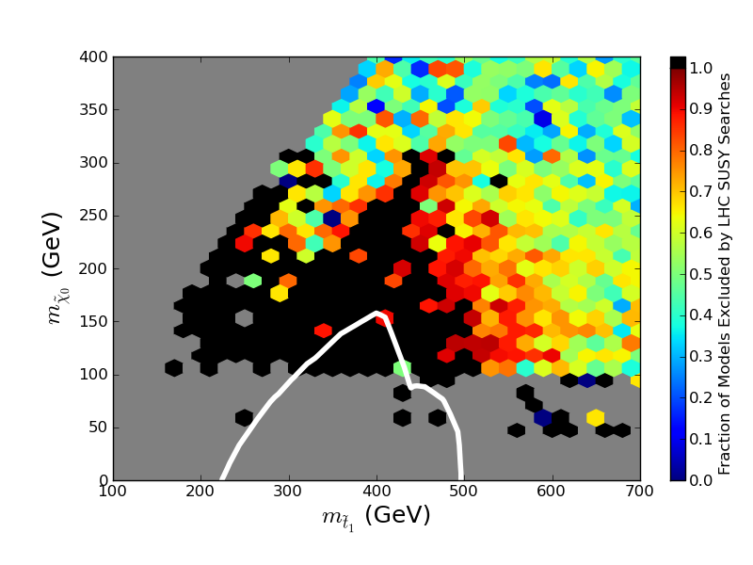
Effects of LHC Searches on Neutralino LSP Sample

Slide 22
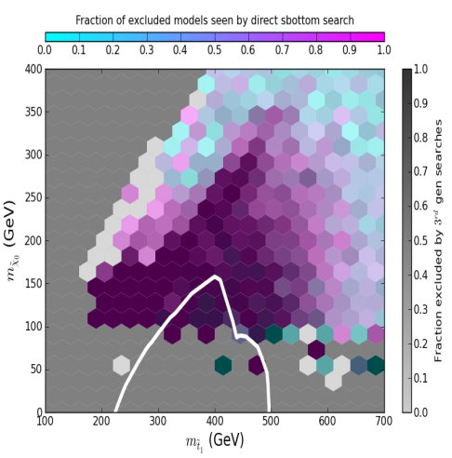
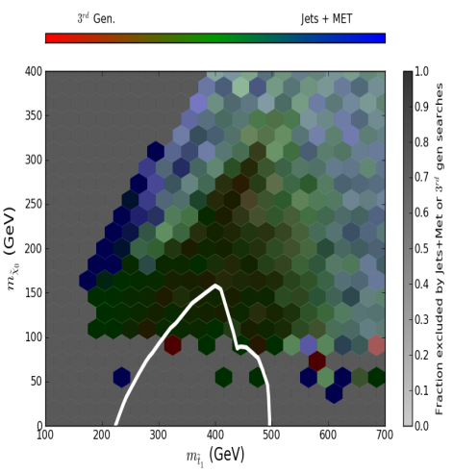
Effects of LHC Searches on Neutralino LSP Sample

Slide 23
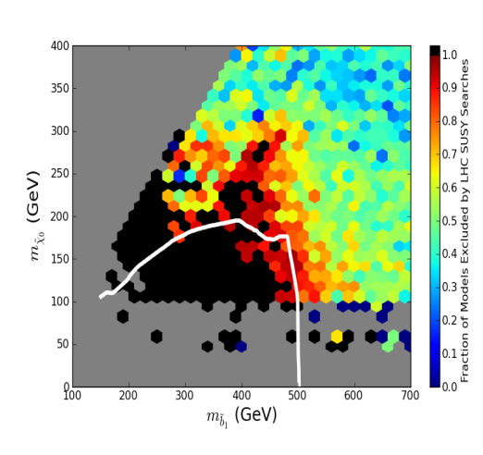
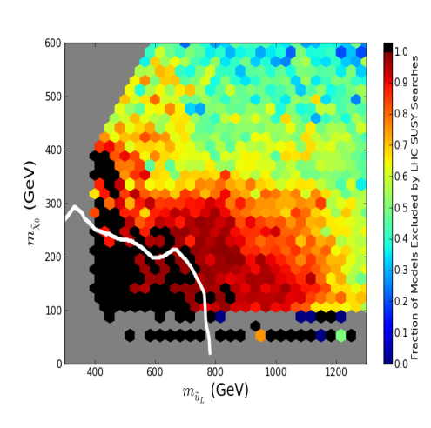
Effects of LHC Searches on Neutralino LSP Sample

Slide 24
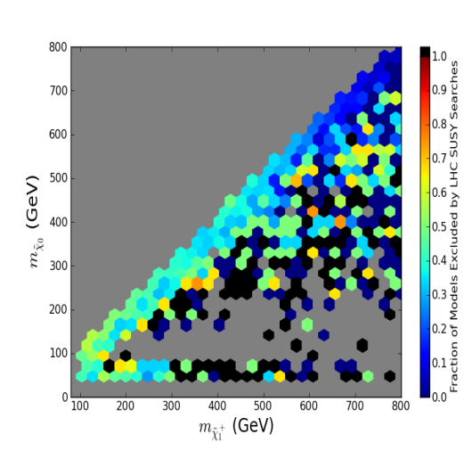
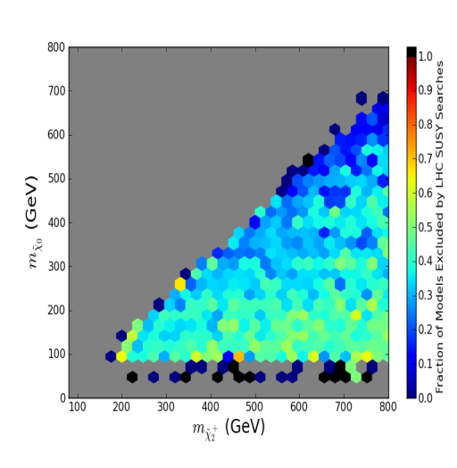
Effects of LHC Searches on Neutralino LSP Sample

Slide 25
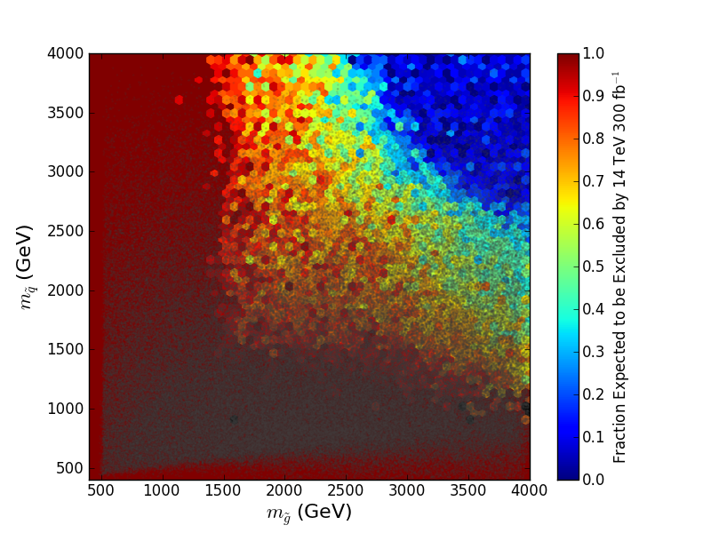
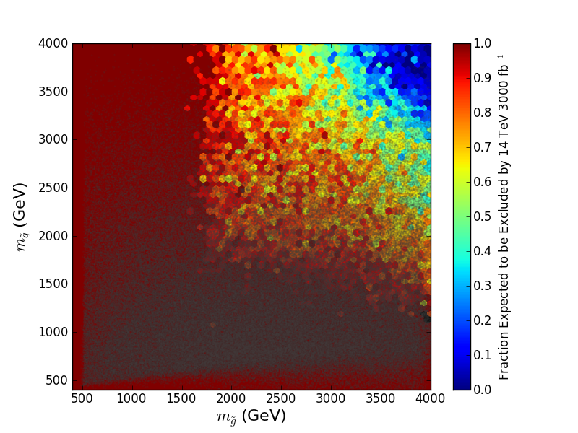
Educated Guess of 14 TeV LHC pMSSM Coverage for 0.3 & 3 ab⁻¹
An real estimate of coverage will require ‘doing’ the
14 TeV analyses.. Work in progress!

Slide 26
Some New Features for Gravitino LSP Set
For non-G decays (e.g., for the NNLSP → NLSP) add all 3-body sparticle
decays not in SUSY-Hit via CalcHEP
Add relevant 4 & 5-body decays for gluinos, t₁ & χ₁±
→ RESULT: NNLSPs can also be detector stable
For NLSP decays to G, add all 3- & 4-body modes w/ BBN relevant
lifetimes (~10⁻⁴ to 10¹⁴ sec) via MadGraph
Calculate NLSP density using Micromegas & rescale to the gravitino mass
Use lifetime & BF info for NLSPs from modified SUSY-Hit & check the
constraints on EM or hadronic energy deposition during BBN
Apply constraints from the cosmo relic ν & diffuse photon fluxes

Slide 27
Gravitino Model Searches @ 7 TeV: percentage of
models excluded by data
7 TeV ~5 fb⁻¹ 8 TeV ~6 fb⁻¹ w/ Higgs cut (8 TeV)
nj0l 17.76% 21.83% 20.82 %
multi-j 2.27% 4.13% 4.02%
nj1l 5.31% 5.38% 5.05%
SS dileptons 11.50% 11.14%
(sub)total 19.44% 28.69% 27.19%
HSCP 16.93%
3rd Gen 11.14%
Multi-l 12.10%
ϒϒ+MET 5.2%
Total models remaining: 53.25%, 54.42% with Higgs mass cut
Work in progress

Slide 28
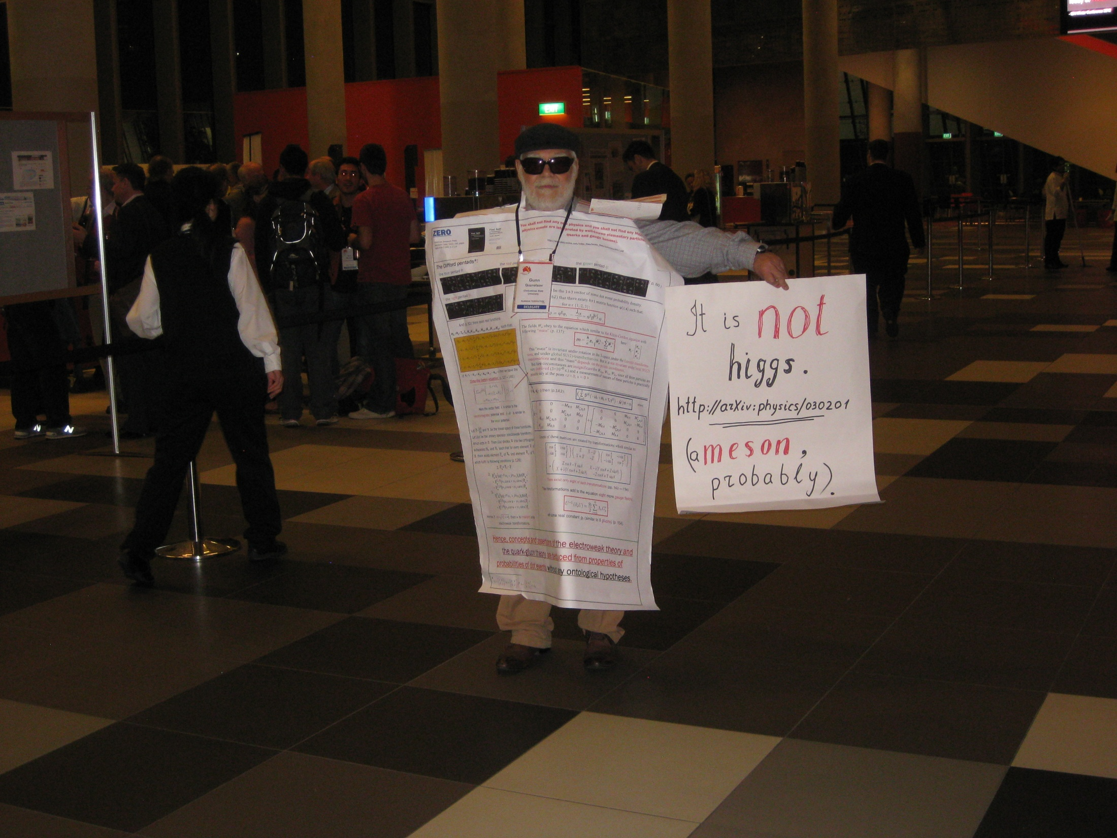

Slide 29
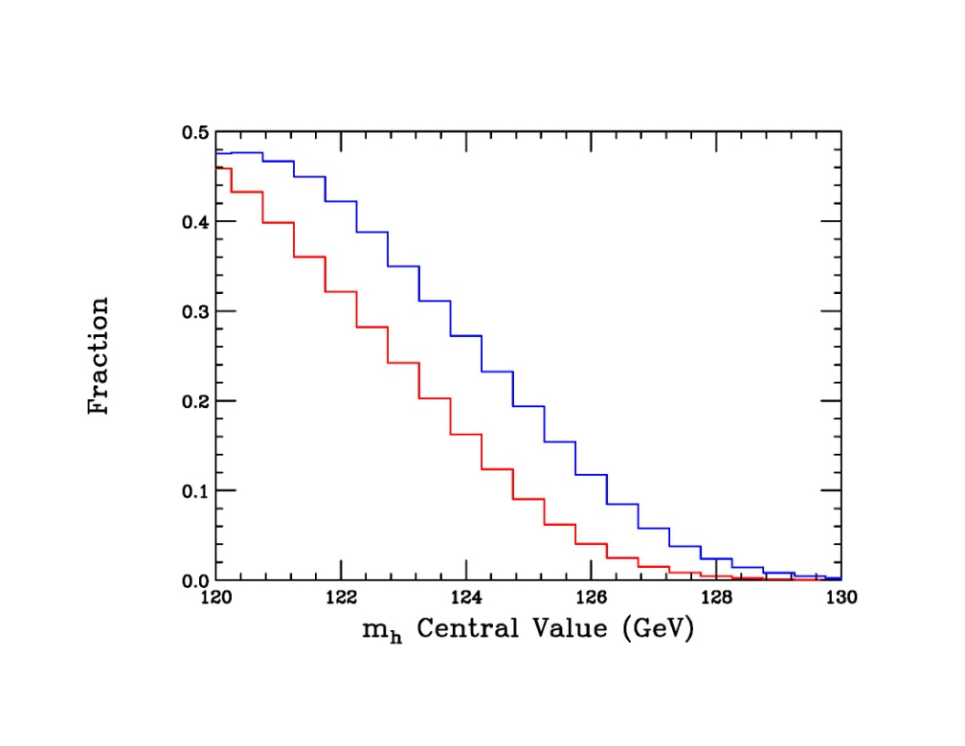
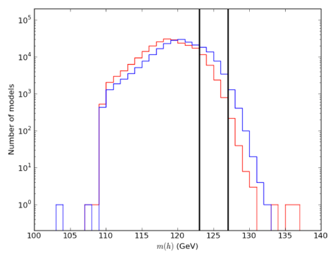
Predictions for Lightest Higgs Mass in the pMSSM
Models consistent with EW Precision, B Physics, Cosmology,
and Collider data
~40k models with m = 126±3 GeV
Neutralino LSP
Gravitino LSP

Slide 30
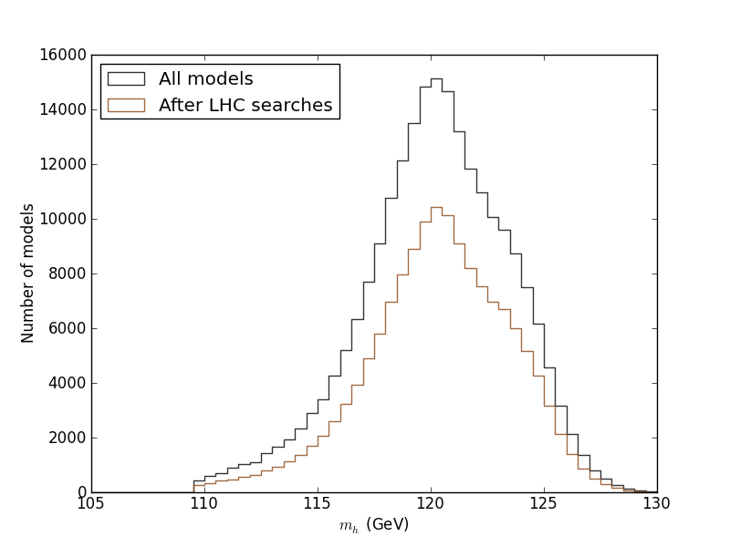
The MET-based searches are roughly independent of the
of the Higgs mass: the predicted mass of the Higgs is roughly
independent of the SUSY searches

Slide 31
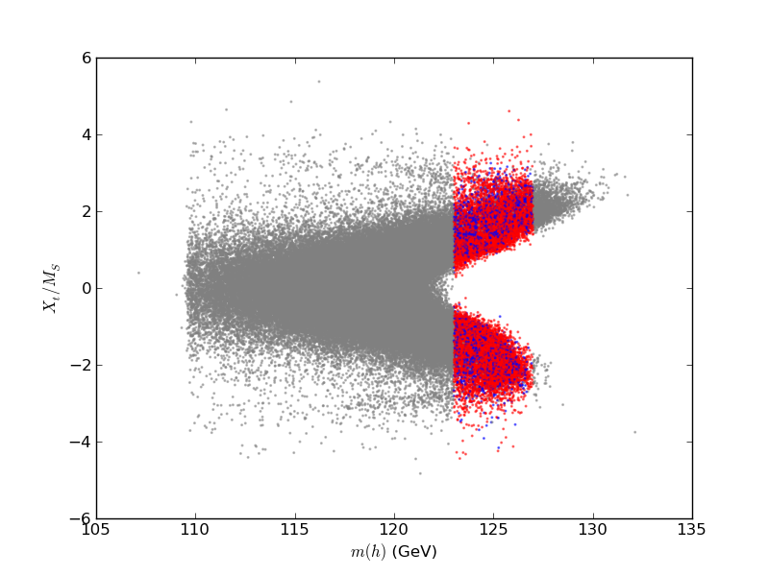
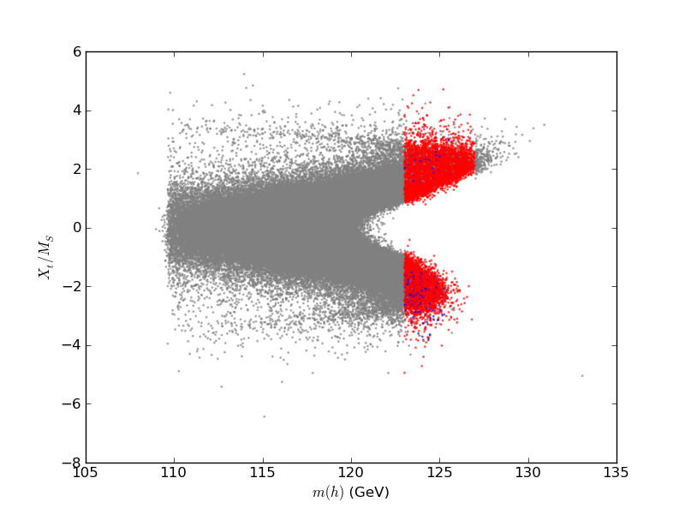
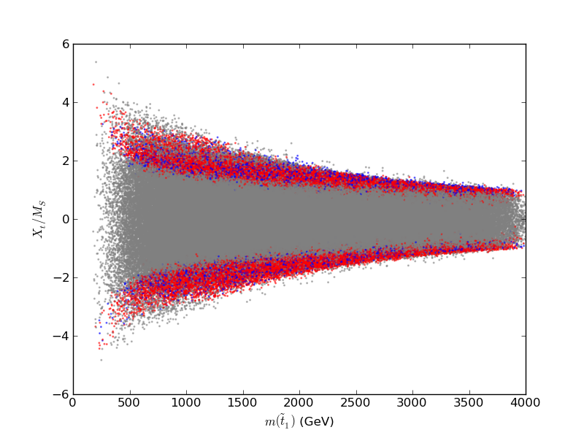
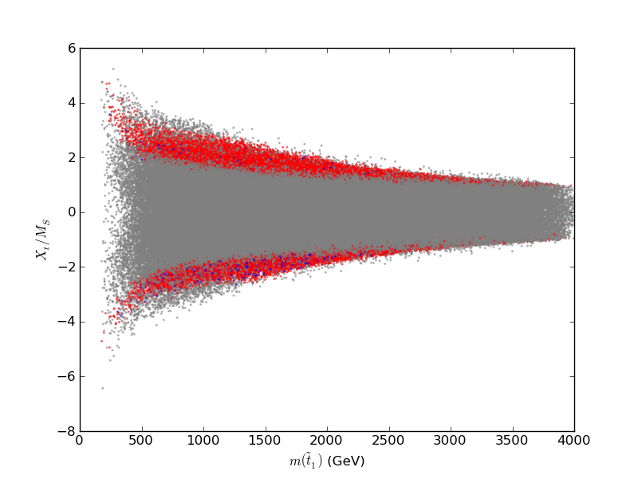
Special parameter regions needed for the126 GeV Higgs
χ₁⁰ LSP
G LSP
Need large stop mixing: X_{t} = A_{t} - μcotβ

Slide 32
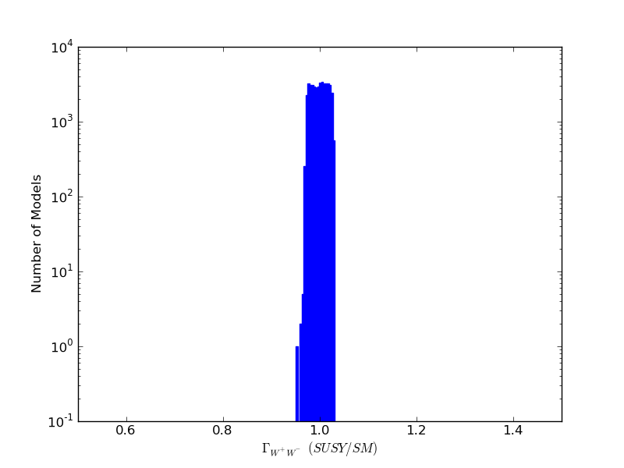
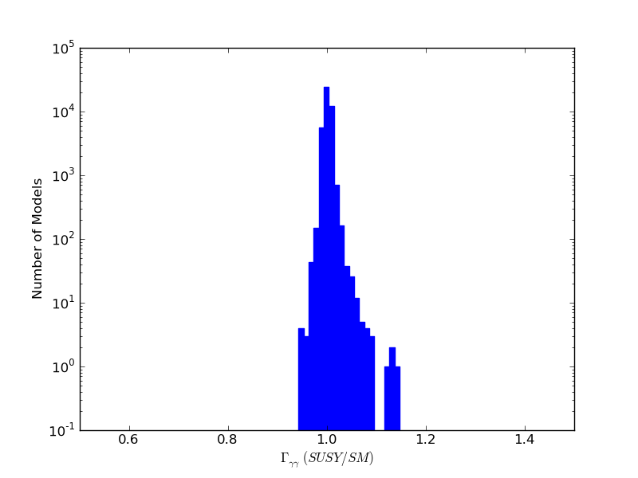
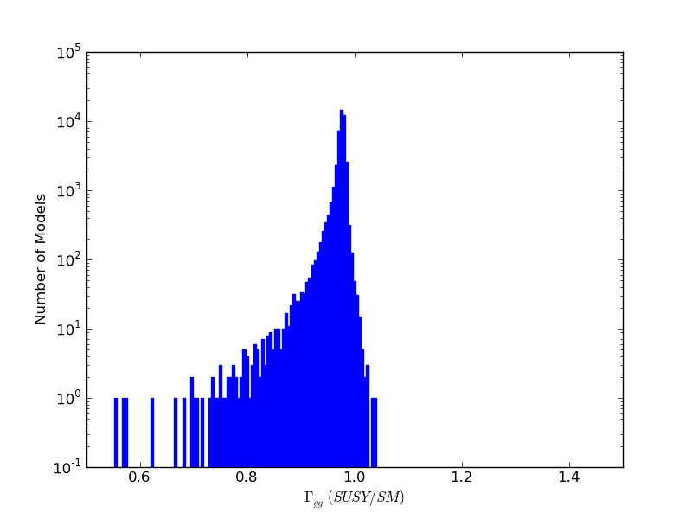
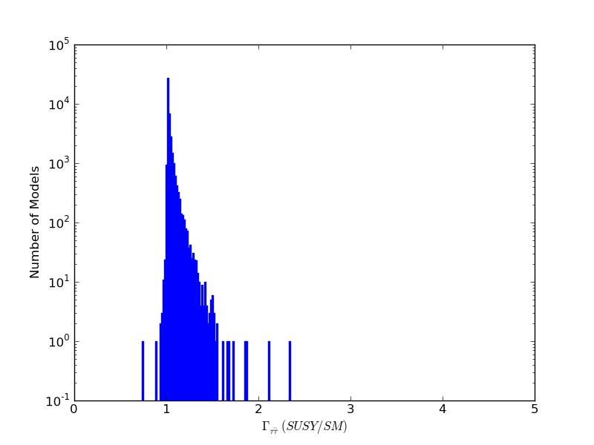
Examination of Partial Widths
χ₁⁰ LSP
Most partial widths are close to
their SM values due to decoupling
Precision measurements could
Select pMSSM parameters
(work in progress!)
W
γ
g
τ

Slide 33
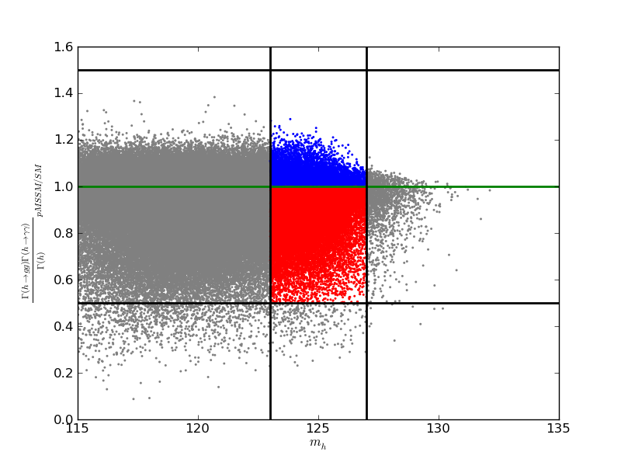
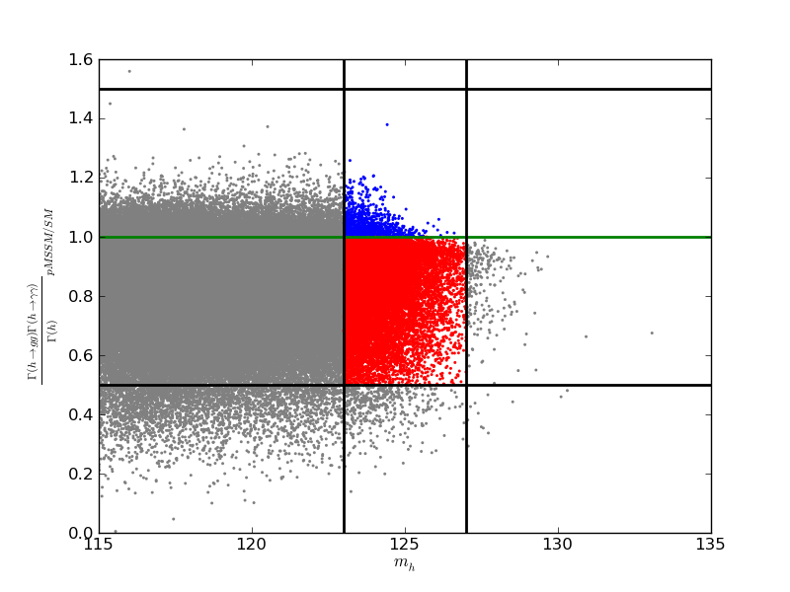
Higgs to γγ Rate
R_{XX} = σ(gg→h) B(h→XX)|_{pMSSM/SM}
χ₁⁰ LSP
G LSP
R_{γγ}
4.5%
14.8%
0.5%
8.5%

Slide 34
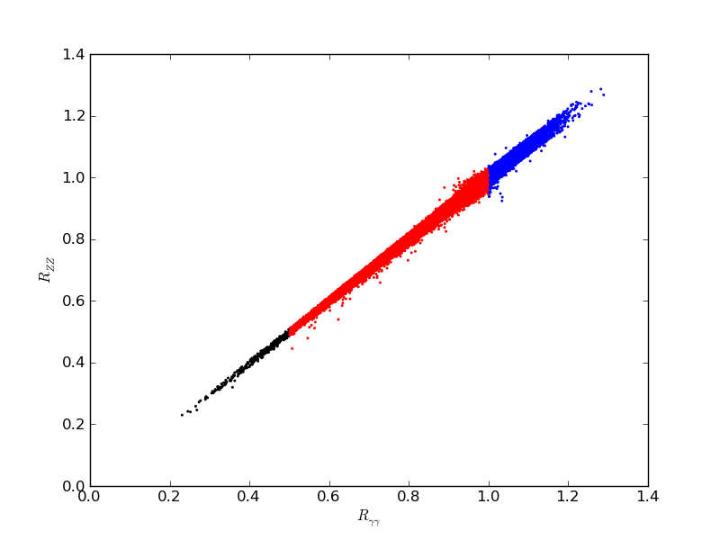
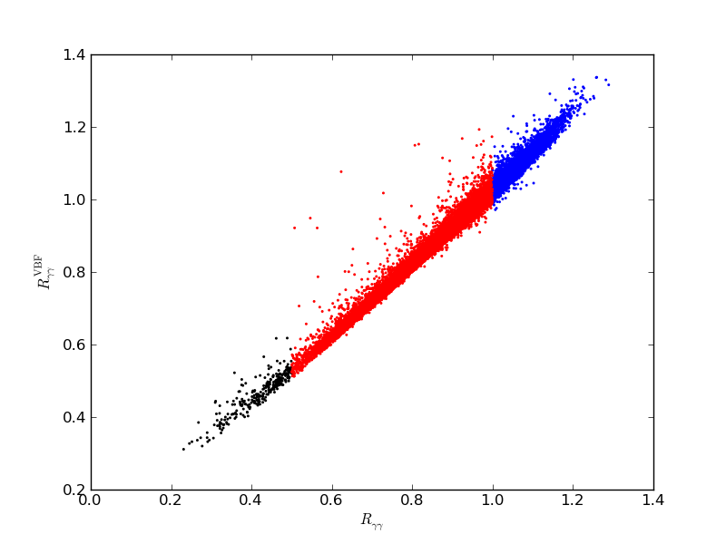
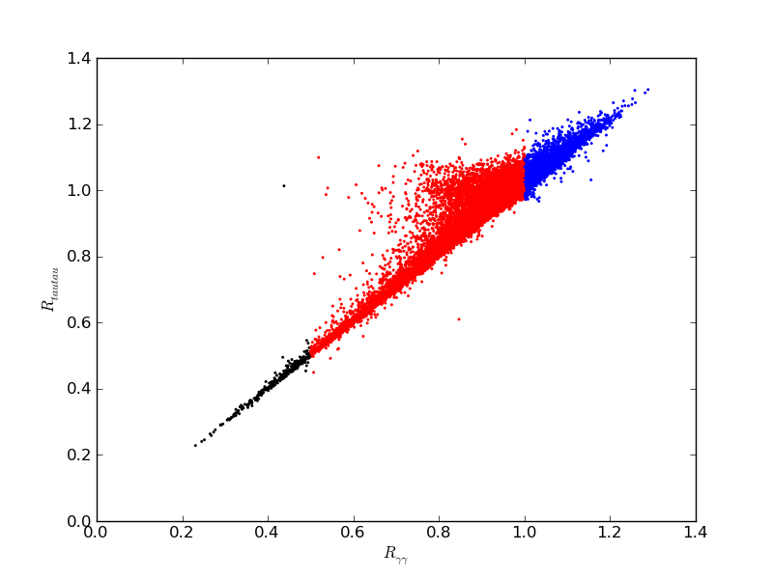
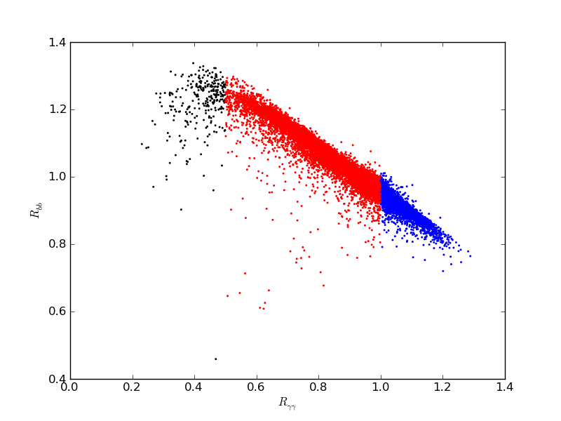
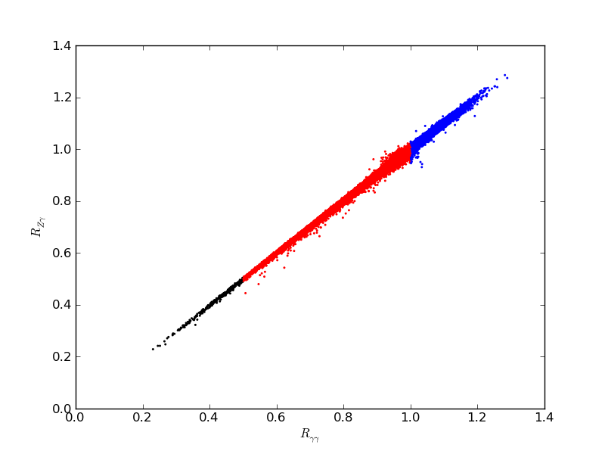
Correlations: χ₁⁰ LSP
Z
VBF
τ
γZ
b

Slide 35
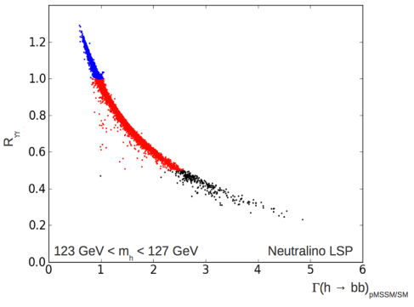
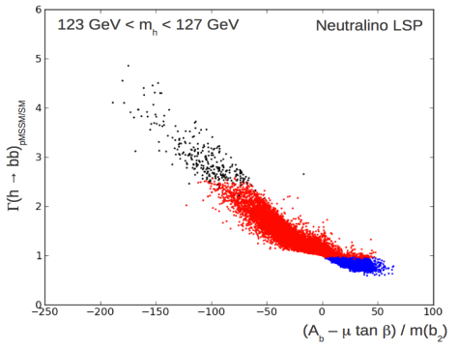
h→bb is quite different…
Large hbb coupling loop corrections decouple very slowly
especially if there is large sbottom mixing (Haber etal.)
These lead to a significant Higgs width increase/decrease
since it is the dominant decay mode
χ₁⁰ LSP

Slide 36
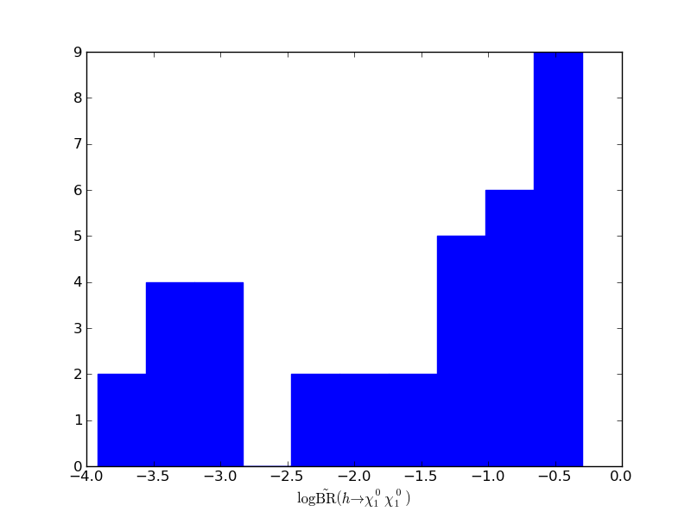
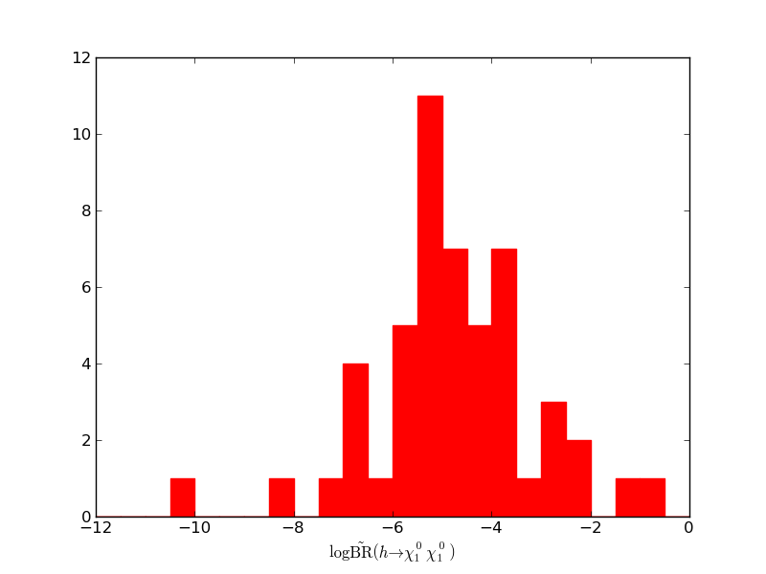
Invisible Higgs Decays
χ₁⁰ LSP
G LSP
↑
↑
It will be important to continue to search for unusual Higgs
decay modes as further tests of new physics

Slide 37
Naturalness Criterion
Standard prescription to compute fine-tuning:
Take mass relation w/ radiative corrections
Compute dependence on each SUSY parameter, p_{i}
Overall fine-tuning of model given by
Δ = max|Z_{i}|
+ higher order
Barbieri, Giudice
Kasahara, Freese, Gondolo

Slide 38
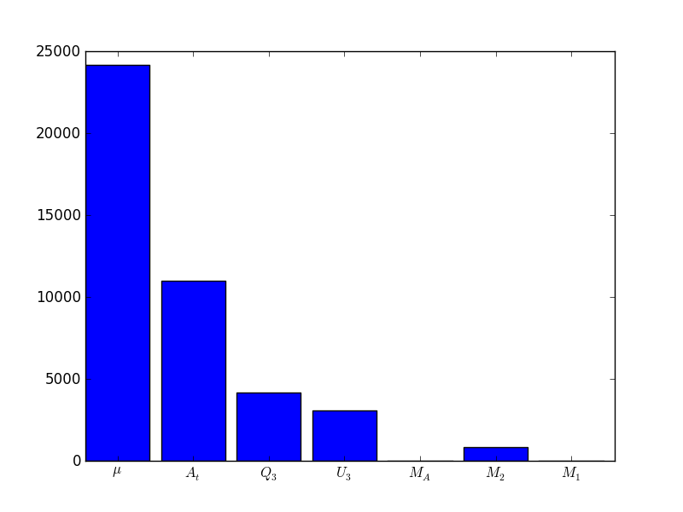
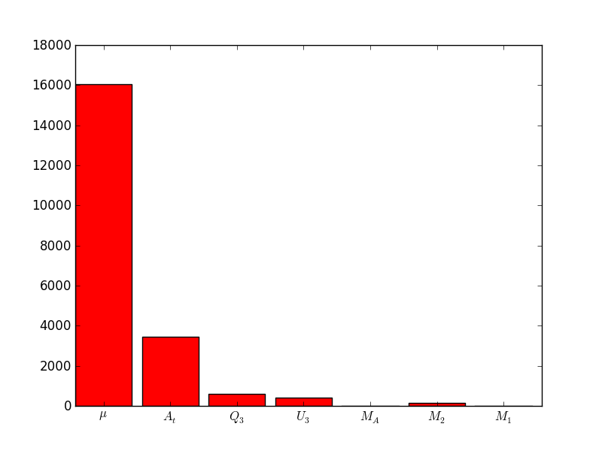
Dominant FT Contributors
χ₁⁰ LSP
G LSP

Slide 39
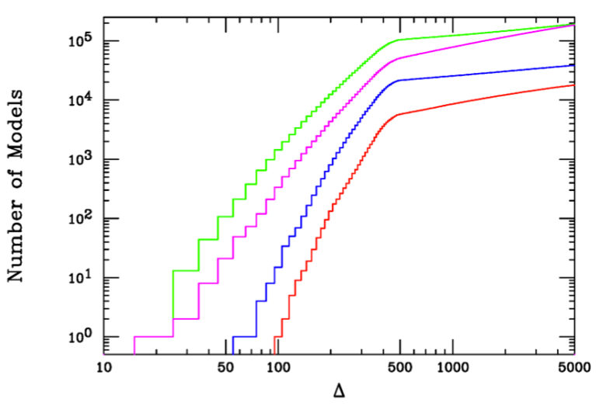
Fine-Tuning in the pMSSM
Neutralino LSP
Gravitino LSP
m_{h} = 126 ± 3 GeV

Slide 40
Fine-Tuning in the pMSSM
Neutralino LSP
Gravitino LSP
m_{h} = 126 ± 3 GeV
13 + 1 models with Δ < 100,
4+1 of these are excluded by the LHC

Slide 41
Effects of LHC Searches on Neutralino LSP Sample
Strong SUSY Production
Weak SUSY Production

Slide 42
Low Fine-Tuning Model Spectra I

Slide 43
Low Fine-Tuning Model Spectra I

Slide 44
Low Fine-Tuning Model Spectra II

Slide 46
(36%)

Slide 47
Snowmass 2013
LHC
qq → χχ
ID
DD
χχ→ qq
qχ→ qχ
Complementarity

Slide 48
Dark Matter Complementarity Study
Ingredients
7 & 8 TeV LHC MET & non-MET → 14 TeV
DD w/ Xenon & COUPP
ID w/ FERMI & CTA
ICE³
Complementarity
What do these different
experiments say about
the LSP & the pMSSM
in general ?
What happens when
they are combined ?

Slide 49
Well-tempered neutralino
Bino co-annihilation
1.7 TeV wino
1 TeV Higgsino
Other annihilations
Bino annihilation through h/Z funnels

Slide 50
DM : Direct Detection
Both SD & SI DD searches probe regions of the pMSSM
parameter space
The potential coverage is quite significant for SI searches
~23%
~2%
~50%

Slide 51
pMSSM models go quite deep in terms of SI cross sections
LUX-Zeplin
~50%
!

Slide 52
Indirect Detection: FERMI & CTA
Conventionally, IDM searches assume that WIMPs annihilate
into only one final state & quote a cross section limit based on
the corresponding flux limit
In the pMSSM the LSP
properties & SUSY mass
spectra are more complicated
so that multiple final states
will contribute to the γ flux
Thus the flux limit itself is the
quantity of interest & must be
calculated for each model
FERMI

Slide 53
Weighted σ’s cover an enormous range…
(An Older Model Set)

Slide 54
FERMI 2-yr Dwarfs are still
a factor of a few away from
this model set but they will
soon get there
CTA @ 5 yrs will have
access to a reasonable fraction
of these models
FERMI
~18.8%
CTA
FERMI

Slide 55
ICE³ @ 5yrs
DM swept up by the sun can collect & then pair-annihilate in
the solar core thus producing high-E neutrinos from the decay
of the corresponding annihilation products
Again, since the LSP properties & SUSY spectra vary widely
in the pMSSM the potential flux must be calculated for each
model separately & then compared with the expected limit
Models not leading to an equilibrium in capture/annihilation
rate for DM in the sun (~ 48% !) are not well-probed by
ICE³ . It is mostly mixed bino-Higgsino LSP combinations
that are visible & these have large relic densities.

Slide 56
DD = XENON1T + COUPP500
77%
0%
22%
1%

Slide 57
DD = XENON1T + COUPP500 ID = FERMI + CTA
66%
11%
15%
8%

Slide 58
Complementarity of Searches

Slide 59
OVERALL Combined Search Efficiency
~61% of models excluded

Slide 60
Well-tempered neutralino
Bino co-annihilation
1.7 TeV wino
1 TeV Higgsino
Other annihilations
Bino annihilation through h/Z funnels

Slide 61
Remaining Model Set
Well-tempered neutralino
Bino co-annihilation
1.7 TeV wino
1 TeV Higgsino
Bino annihilation through h/Z funnels
Other annihilations

Slide 62
Remaining Model Set
Well-tempered neutralino
Bino co-annihilation
1.7 TeV wino
1 TeV Higgsino
Bino annihilation through h/Z funnels
Other annihilations

Slide 63
Conclusions
Relatively easy to accommodate 126±3 GeV Higgs in the pMSSM
Selects region of stop mixing
Higgs branching fractions are correlated
Lower bb predicted
Lower ττ difficult
Reasonable fine-tuning ~1% is possible
Selects region of parameter space
Light stop/sbottom
Very light and compressed EW-ino sector: ILC!
Strong bounds from LHC and Dark Matter searches!
Future Plans
Provide Snowmass benchmarks for EF, IF and CF groups (6 models chosen) www.slac.stanford.edu/~aismail
Study @ 14 TeV LHC, Higgs properties, flavor physics
New set of points focused on 126 GeV higgs + low fine-tuning

Slide 64
Backup

Slide 65
Ratio Distributions for χ₁⁰ LSP
R_{γγ}
R_{ZZ}
R_{VBF}
R_{ττ}
R_{γz}

Slide 66
Rγγ Dependence on stau mass

Slide 67
‘All-But’ Survivor Density Distributions

Slide 68
Direct Detection of Dark Matter

Slide 69
Before & After LSP Property Distributions II

Slide 70
Before & After LSP Property Distributions

Slide 71
Pair-Wise Search Comparison

Slide 72
Search Exclusion Efficiencies: Xenon-axis

Slide 73
Search Exclusion Efficiencies: CTA-axis

Slide 74
Search Exclusion Efficiencies: ICE³ -axis

Slide 75
Search Exclusion Efficiencies: LHC-axis

Slide 76
Search Exclusion Efficiencies: Ω-axis

Slide 82
Gaugino Mass Spectra
The mass spectra of the MSSM fields are (indirectly) influenced
by the nature of the LSP
Other sparticle masses are less influenced due to scan ranges
χ₁⁰ Mass
χ₁⁰ LSP
G LSP
χ₁± Mass

Slide 84
χ₁⁰ LSP
G LSP
Total width
R_{ΥΥ}
r_{b}

Slide 85
Direct Detection of Dark Matter

Slide 86
An Example :
#146314G w/ FT=95.9
t₁ (669)
Light Stop Decays
b
3
t
22
χ₂⁺ (620)
W
23
Z,
h
W
t
52
χ₂⁰ (399)
Z*
γ
21
W*
26,
24
b
23
16,6
χ₁⁰ (384)
W*
78
100
χ₁⁺ (381)
W G

Slide 87
An Example :
#2592398 w/ FT_{BBHMT} =6.6
t₁ (611)
Light Stop Decays
t
40
t
51
χ₃⁰ (144)
Z
b
3
χ₂⁰ (133)
W*
t
5
1
Z*
χ₁⁺ (126)
W*
100
99
100
χ₁⁰ (43)

Slide 88
No Sign of SUSY (YET)
LHC Results in the CMSSM:
Looking difficult for the CMSSM
SUSY
LHC

Slide 89
Stab. Part.
searches
BBN
Some properties of
the gravitino LSP
models

Slide 90
Electroweak Content of χ₁⁰
With most of the neutralino parameters ~ 1 TeV the mass &
electroweak eigenstates are generally quite close !

Slide 91
Invisible Higgs decays
In the neutralino (gravitino) model set 36 (51) models have kinematically
accessible h (=125 ±2 GeV) decays to pairs of neutralinos which are
mostly bino w/ a small Higgsino admixture. (There are a higher fraction of
bino χ₁⁰ s in the gravitino set but there are fewer Higgs in this mass range.)
The rate scales ~ as the product of the bino & Higgsino fractions.
In the neutralino set this is the usual ‘invisible Higgs decay’. 15/36 have
h → invisible BF > 10% & in one case it’s ≈ 50%
In the gravitino set the NLSP neutralino will decay to γ +gravitino producing
a γγ + (small ?) MET signature. The neutralinos in this set have high bino
purity & thus we expect a lower BF in this mode. Only 1/51 models lead
to a BF > 1% (19%).

Slide 92
pMSSM Special Low-FT Neutralino LSP Model Set
m_{h} = 126 ± 3 GeV
Ωh² |_{DM} = 0.1153 ± 0.0095
FT better than 1%
~10k model points

