Slide 1
C T A Camera Mechanics
Design Review Argonne May 9, 2014
Rich Northrop University of Chicago
Final

Slide 2
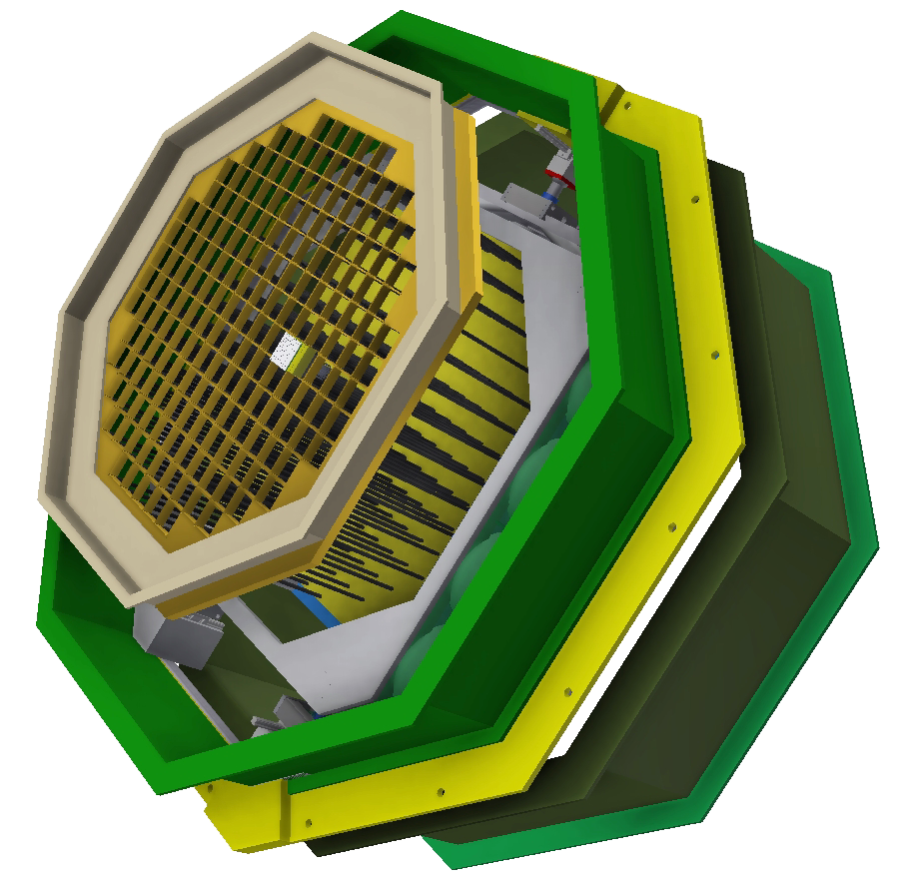
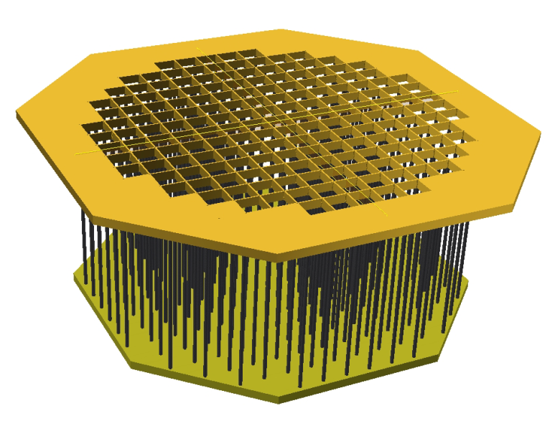
Camera Mechanics Crate / Camera Assembly
( OSS Mount Ring Not Shown )
Crate –
Top Lattice, Carbon Fiber Posts, & Bulkhead
Weight of empty Crate (as shown) - 118.8 kg (262 lbs.)
Weight of Crate with 177 Modules - 264.0 kg (582 lbs.)
Crate with Focal Plane Box being installed into Inner Frame

Slide 3
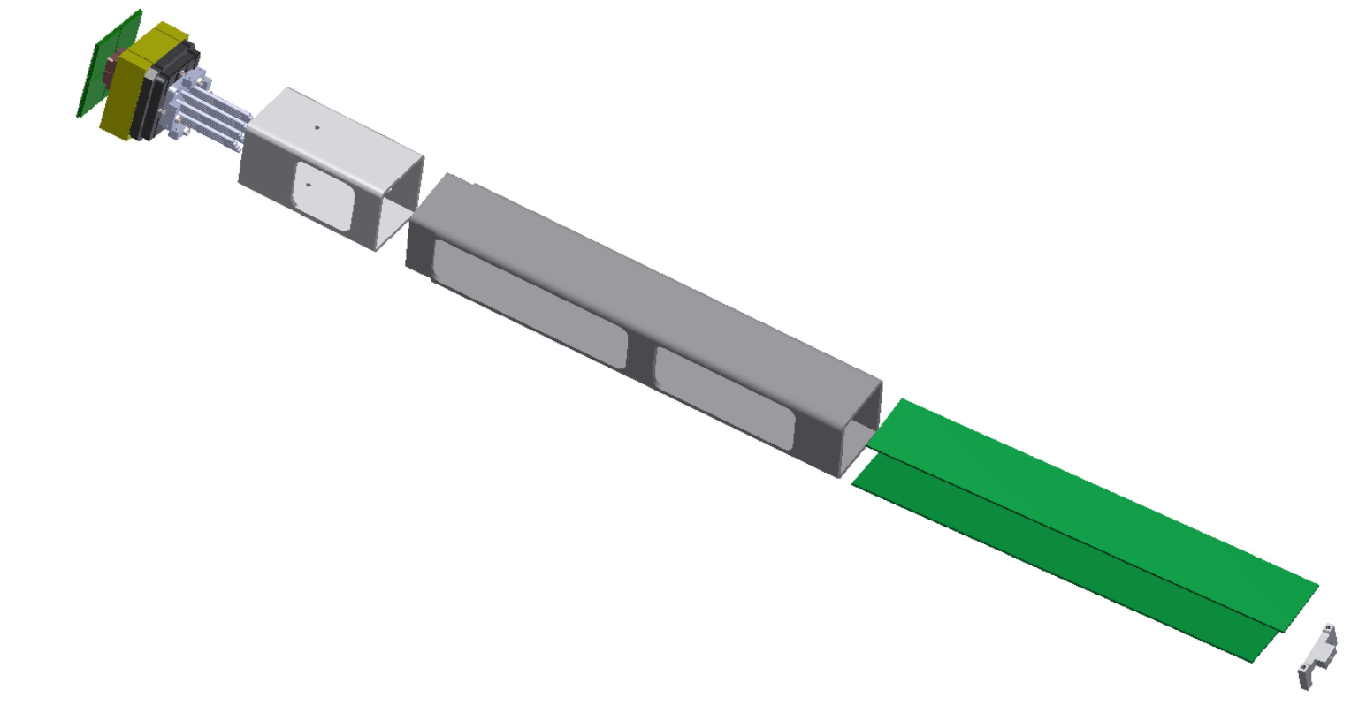
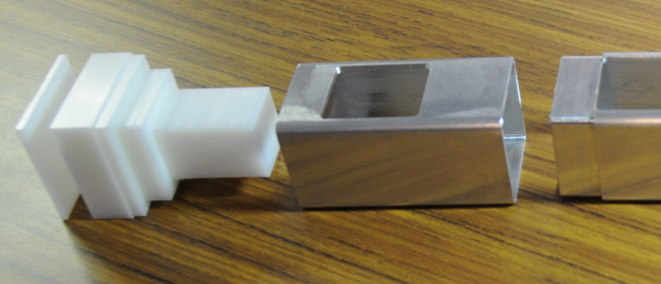
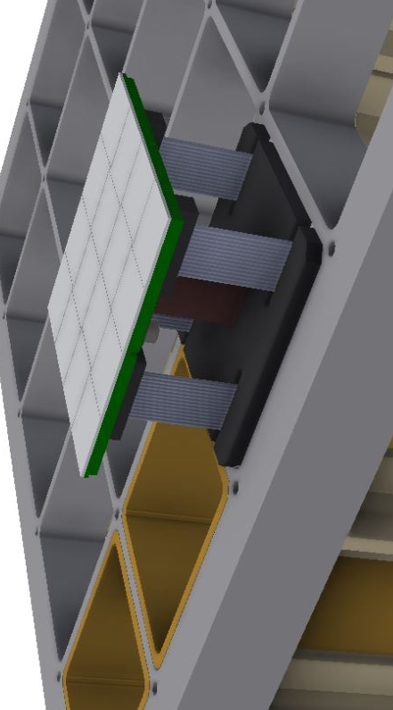
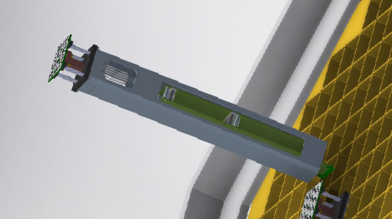
Camera Mechanics - Sensor/Cage/FEE/Base Block Design
Sensor / Foam/Heat Sink
Top Cage Section
Bottom Cage Section
Thermal Slip Joint
FEE Boards
Base Mount Bracket
Sensor Fiducial Surface
Module Prior to Insertion

Slide 4
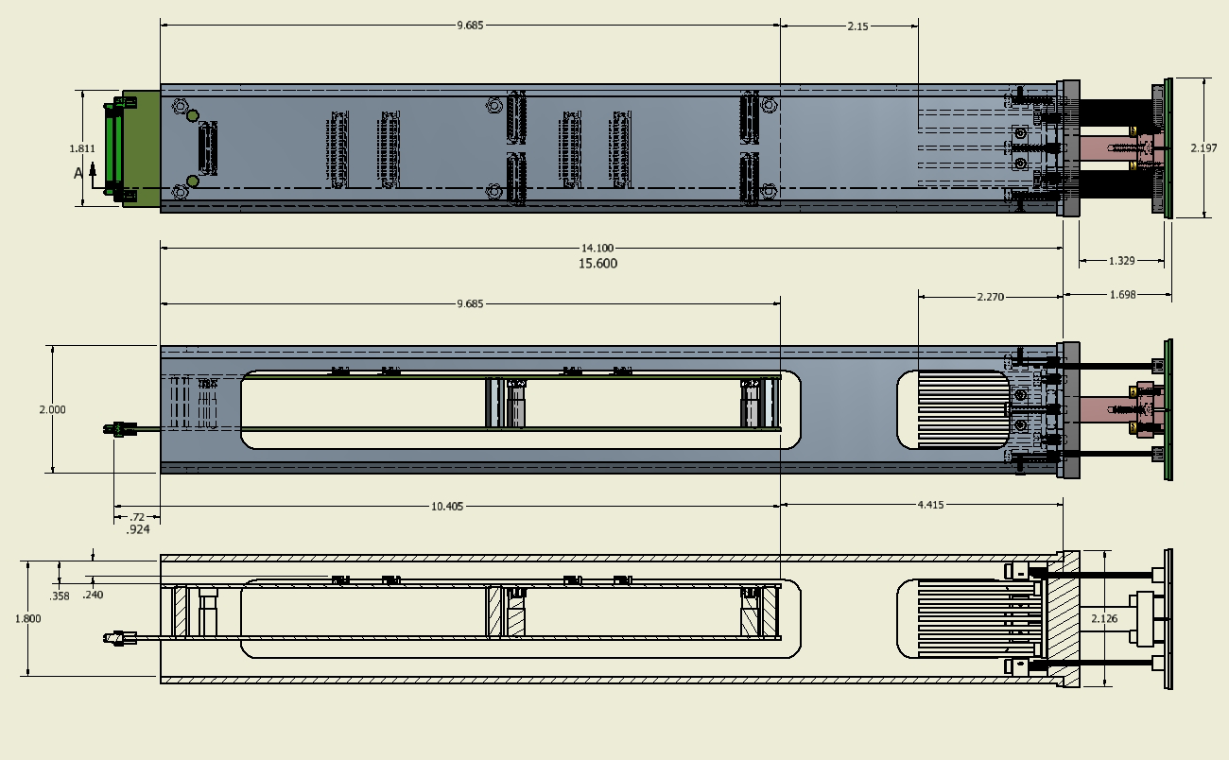
Camera Mechanics Cage / FEE / Sensor
Major Revision Pending FEE Final Design

Slide 5
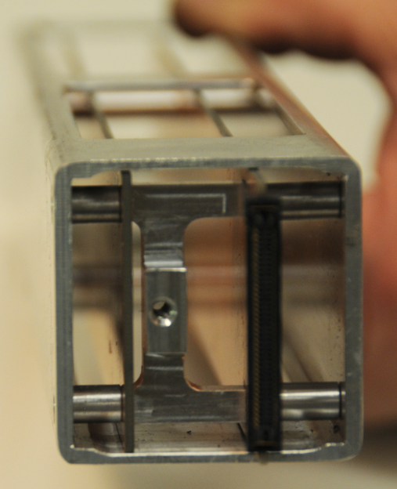
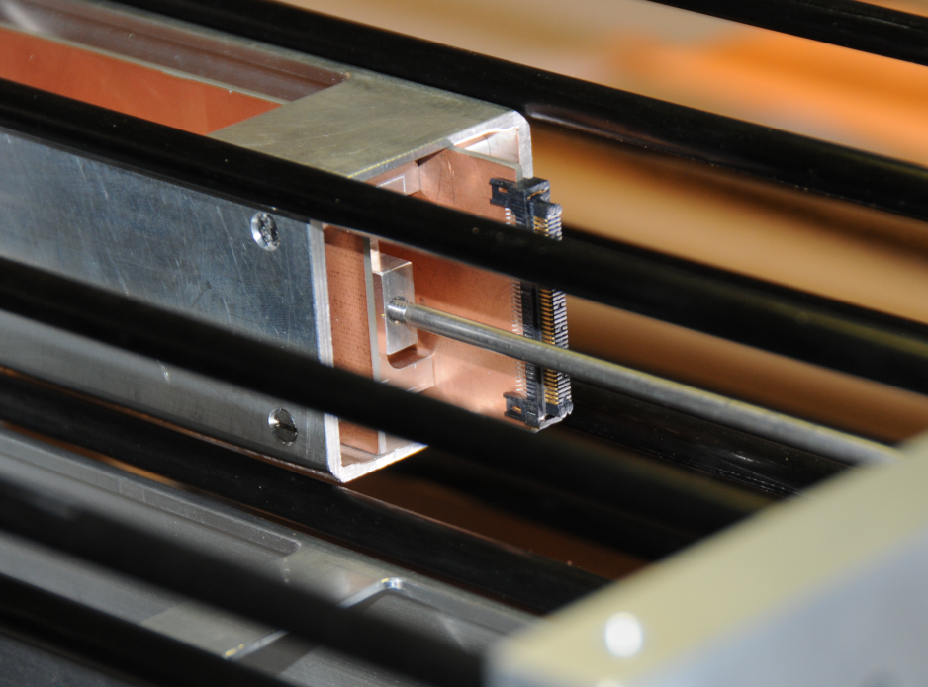
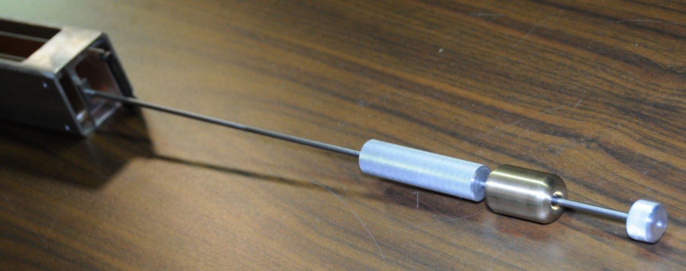
Camera Mechanics Mount Bracket / Injector-Ejector tool
Sliding Weight

Slide 6
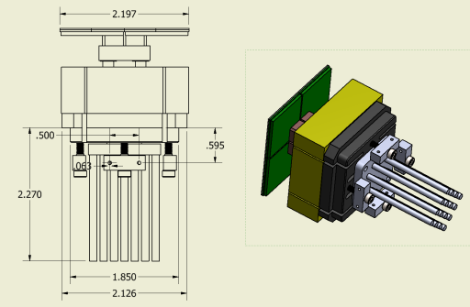
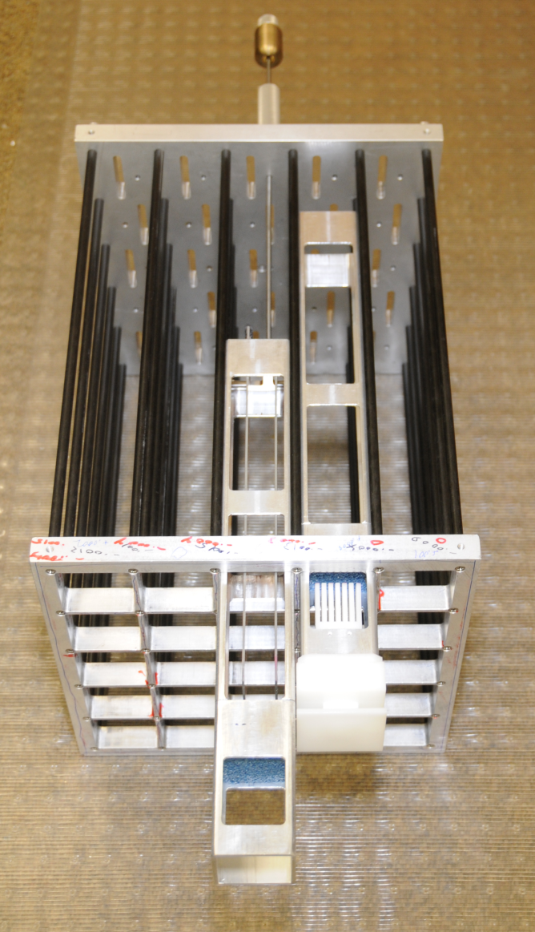
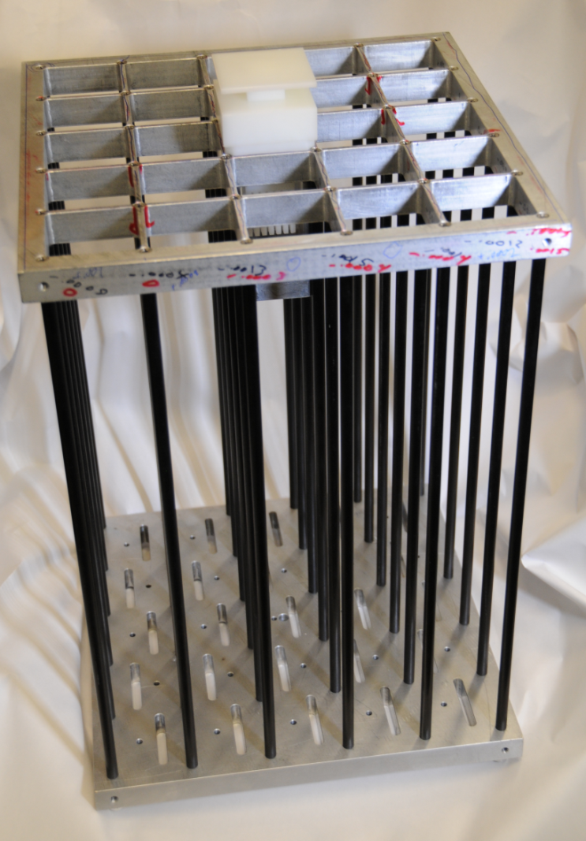
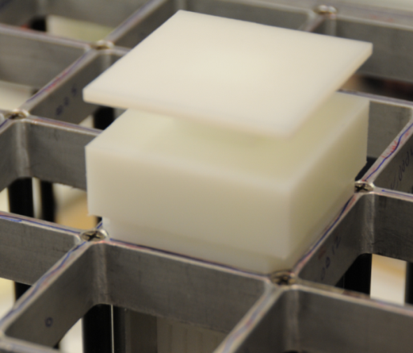
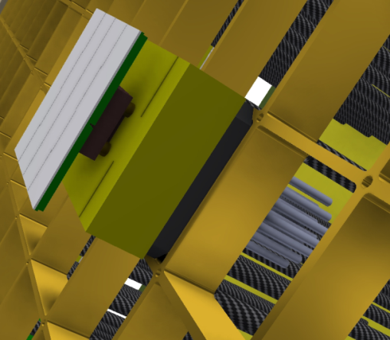
Camera Mechanics 5 x 5 Test Crate / Sensor

Slide 7
Test Module thermal cycling tests
Test Module Vibration tests
Flatness
Hardware Show and Tell
Post ends - inserts - Locktite

Slide 8
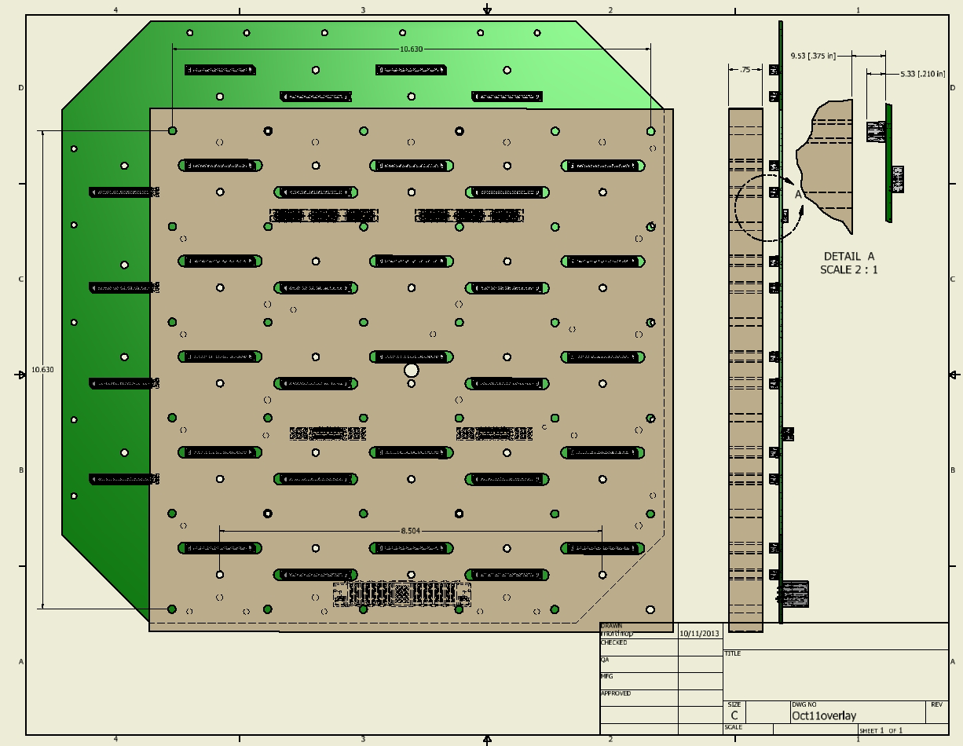
Camera Mechanics 5 x 5 Bulkhead – Motherboard
Latest MB Design ?

Slide 9
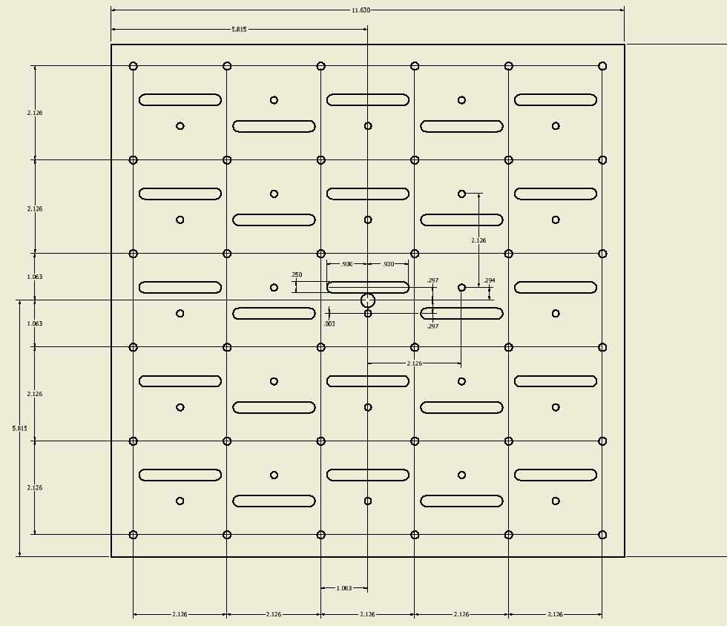
Camera Mechanics 5 x 5 Bulkhead Detail

Slide 10
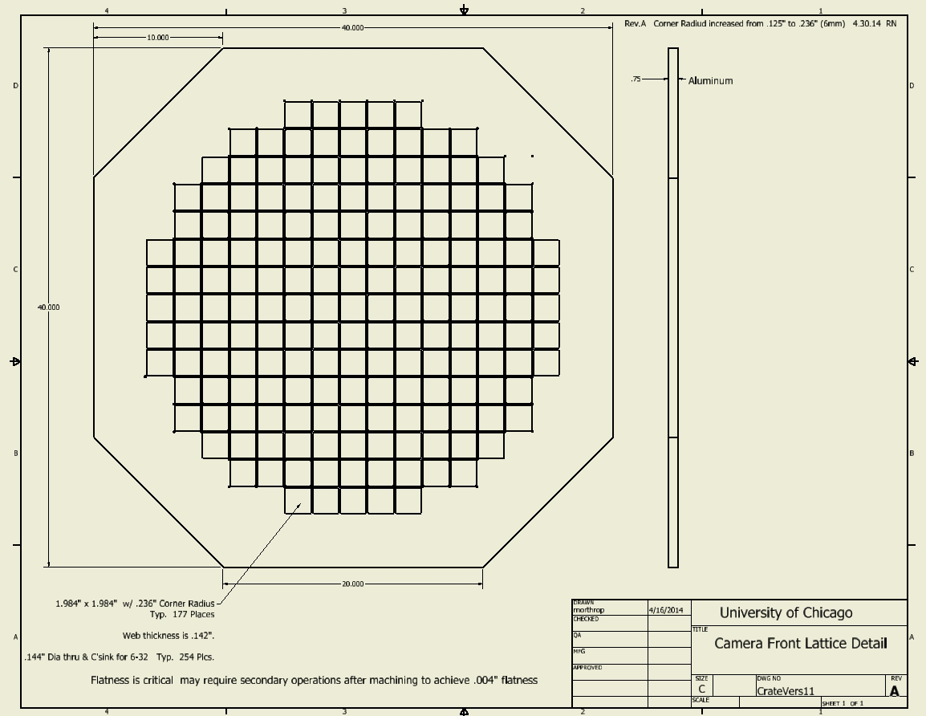
Camera Mechanics Lattice

Slide 11
Camera Mechanics Selected Design Issues
Final FEE configuration , Mounting , & Rear Connector mate
Surface treatment for Lattice or Cage
Lattice Flatness (.004” TIR ) vs. costs ($23,285)
Crate Mounting to Inner Frame details (hard mount to top - float/pin (Z)
Final Cooling Design & Testing
Inner & Outer covers - Access - component mounting
CMM ?

