Slide 1
Ultrasensitive Detectors and Broadband Quantum-limited Amplifiers Based on Nitride Superconductors
Jiansong Gao
NIST Quantum Devices Group
Boulder, CO
Argonne, Sep 19, 2014

Slide 2
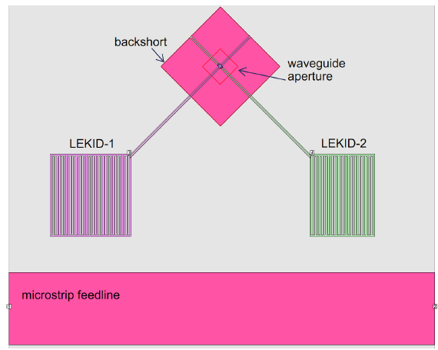
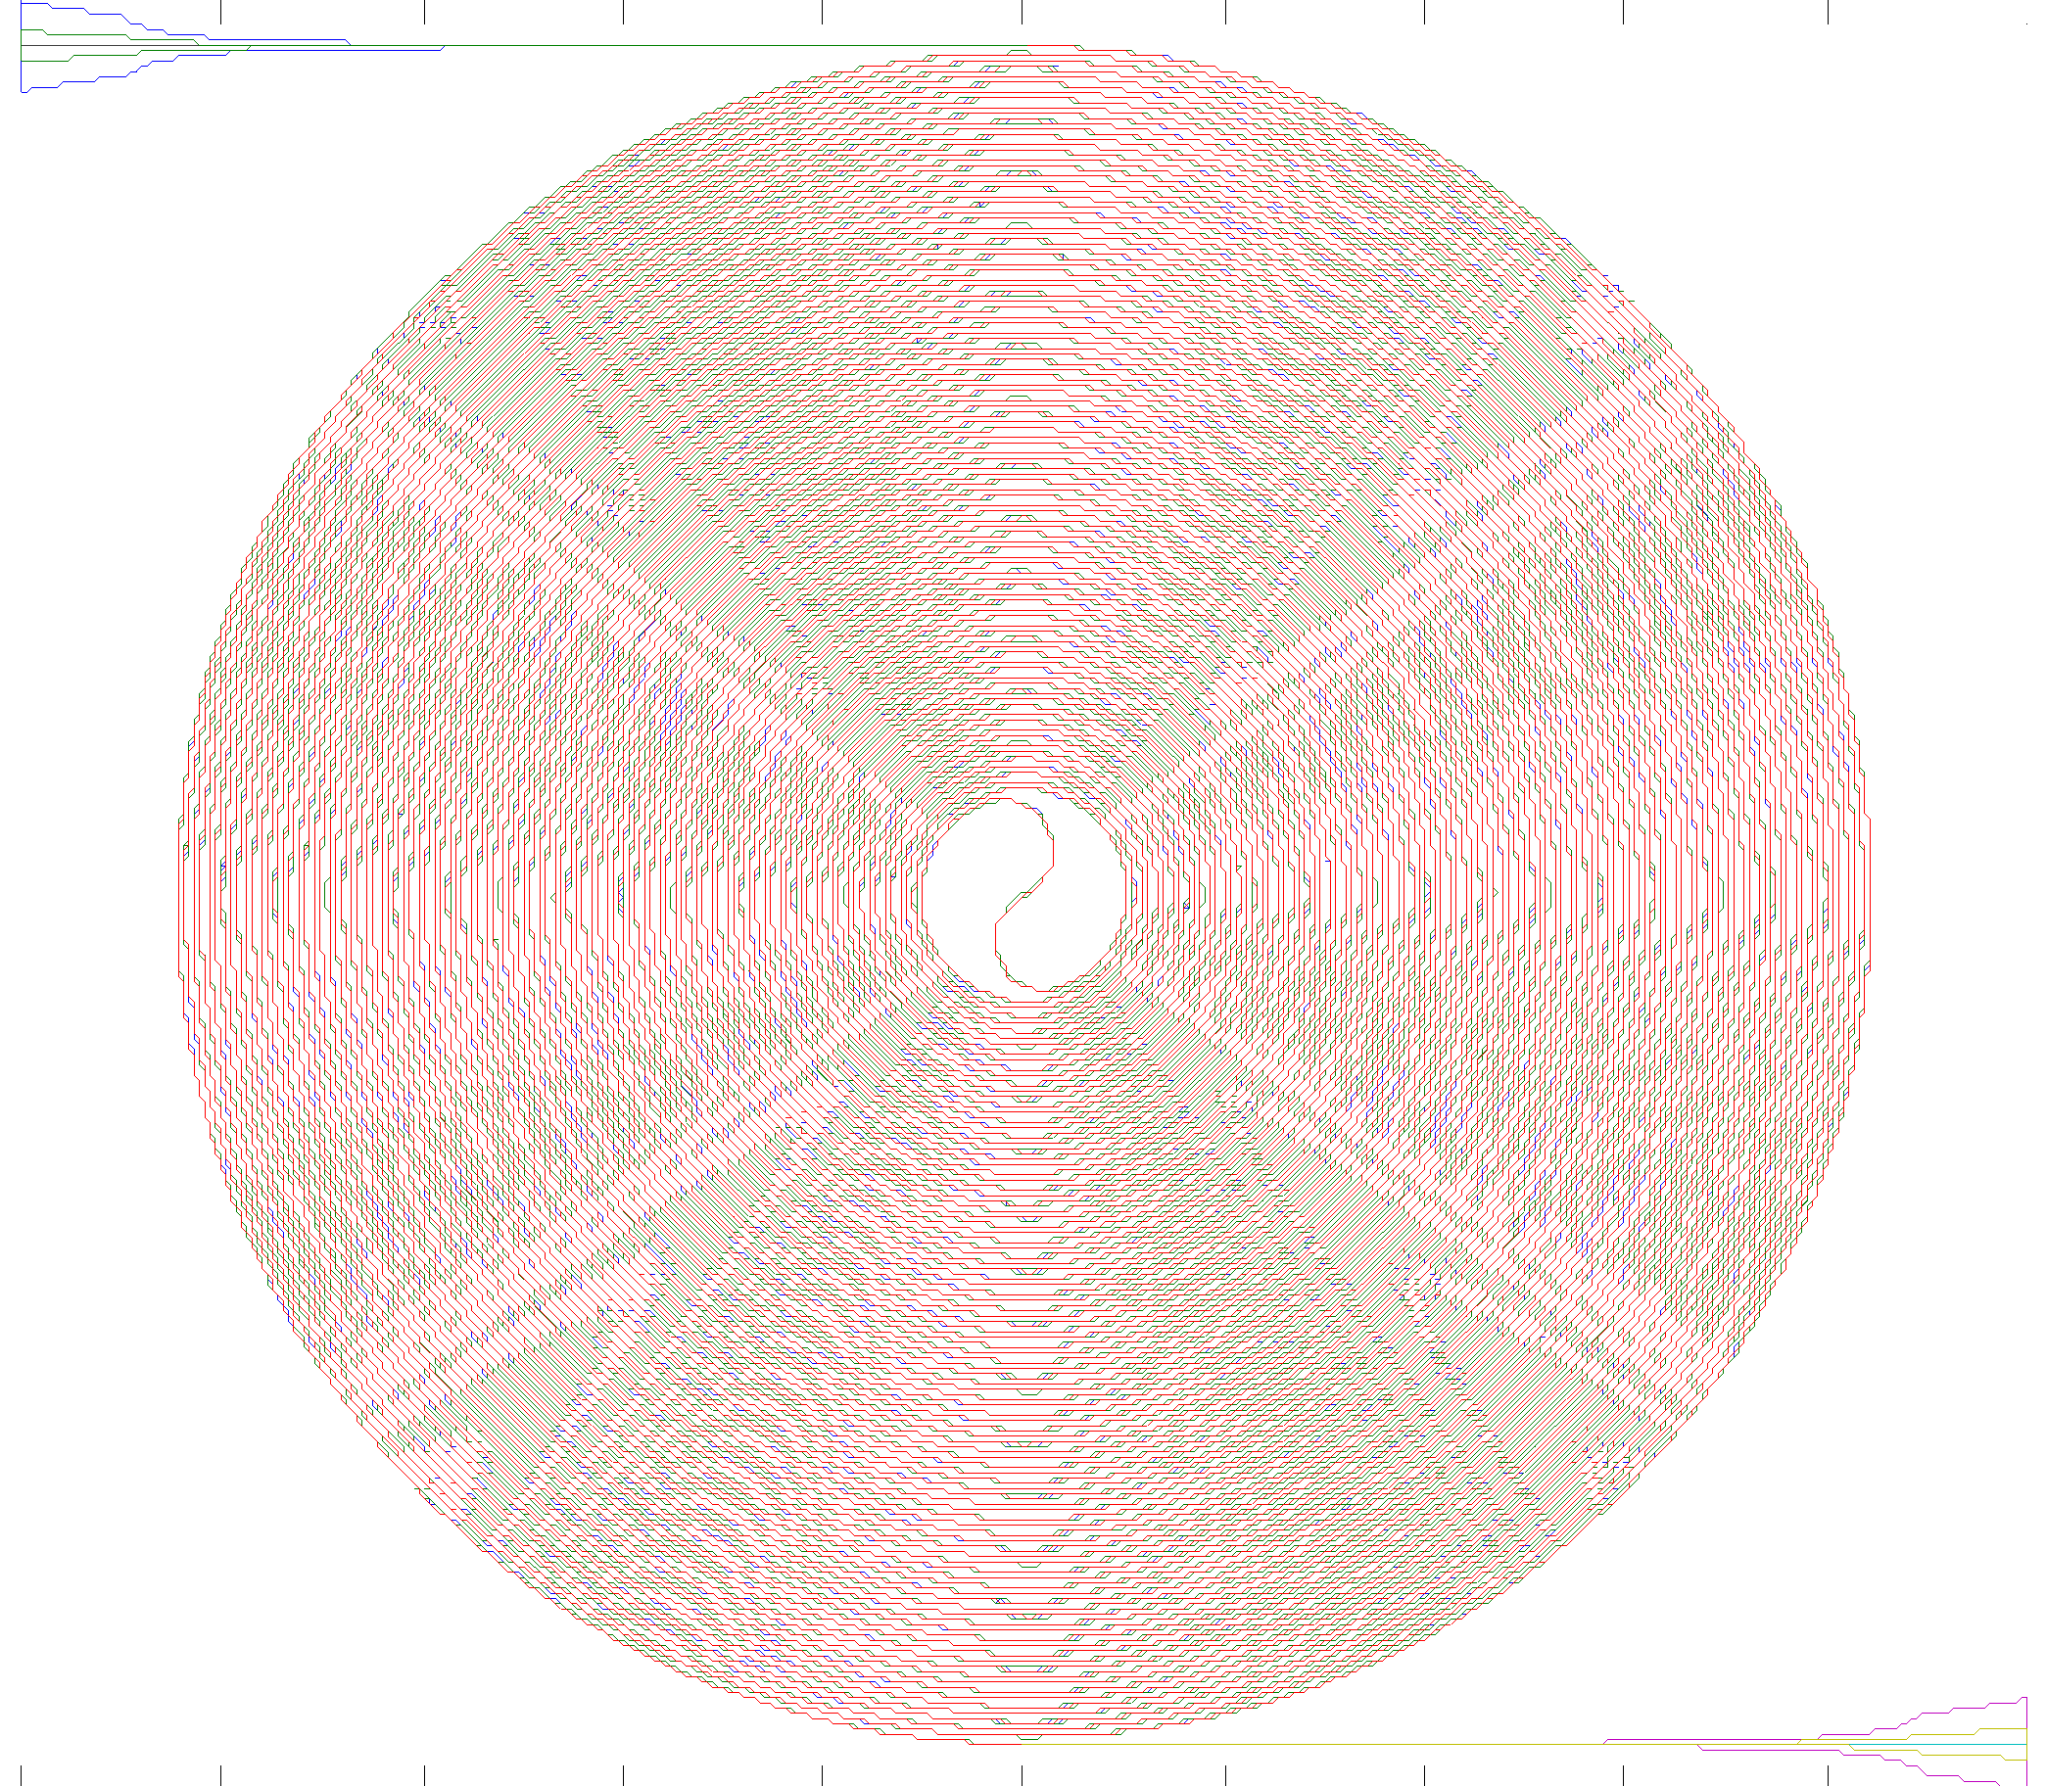
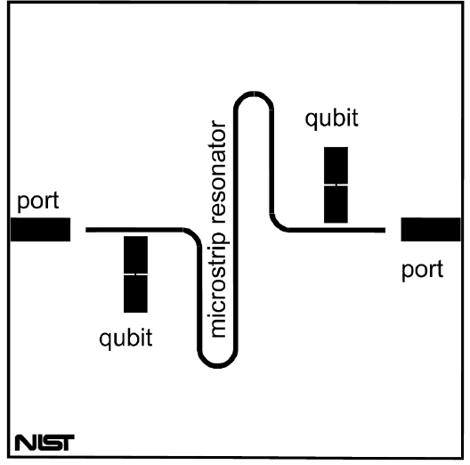


An overview: TiN/NbTiN projects at Quantum Devices Group
Quantum Sensor group
(Novel Devices Team)
Quantum material group
(Dave Pappas, Mike Vissers)
detector & qubit readout
Kinetic Inductance Traveling-Wave Parametric Amplifier
Feedhorn-coupled dual-pol LEKID for Submm
On-chip 2D transmon qubit
TiN circuit + Al junction, T₁~40 μs
NearIR
photon
counting
MKID
for QO
Novel nonlinear
Kinetic
Inductance
Devices
(e.g. Tunable Resonator)
TiN growth: Tc~ 0 – 5K
Stoichiometric
TiN/Ti/TiN trilayer
TiN Tc~4.5K
Ti Tc~0.4 K
TiN Tc~4.5 K
Si substrate

Slide 3
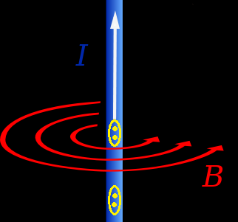
Kinetic Inductance of Superconductor
Electrons are bound into Cooper pairs at T<T_{c}
Kinetic inductance: L_{ki}

Slide 4
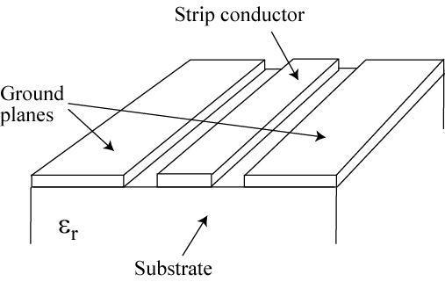
Microwave Kinetic Inductance Detectors
(MKIDs)
Use superconducting resonators to sense quasiparticles
V_{in}
V_{out}
readout tone
Al, Nb, …
CPW: coplanar waveguide
  Invented by J. Zmuidzinas and H. Leduc at Caltech/JPL in 2000.

Slide 5
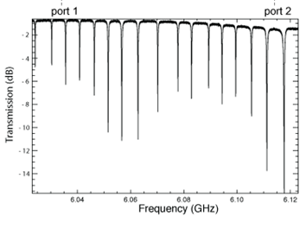
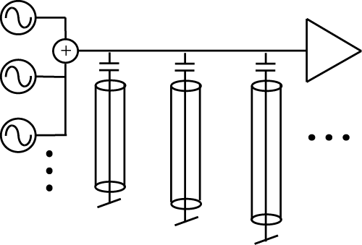
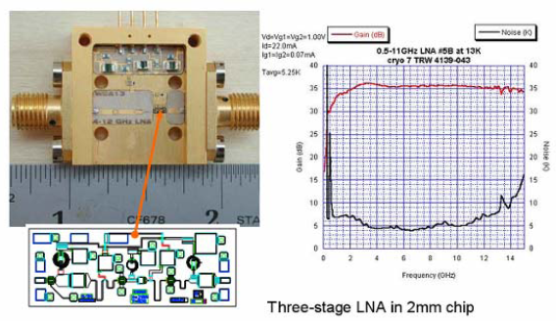
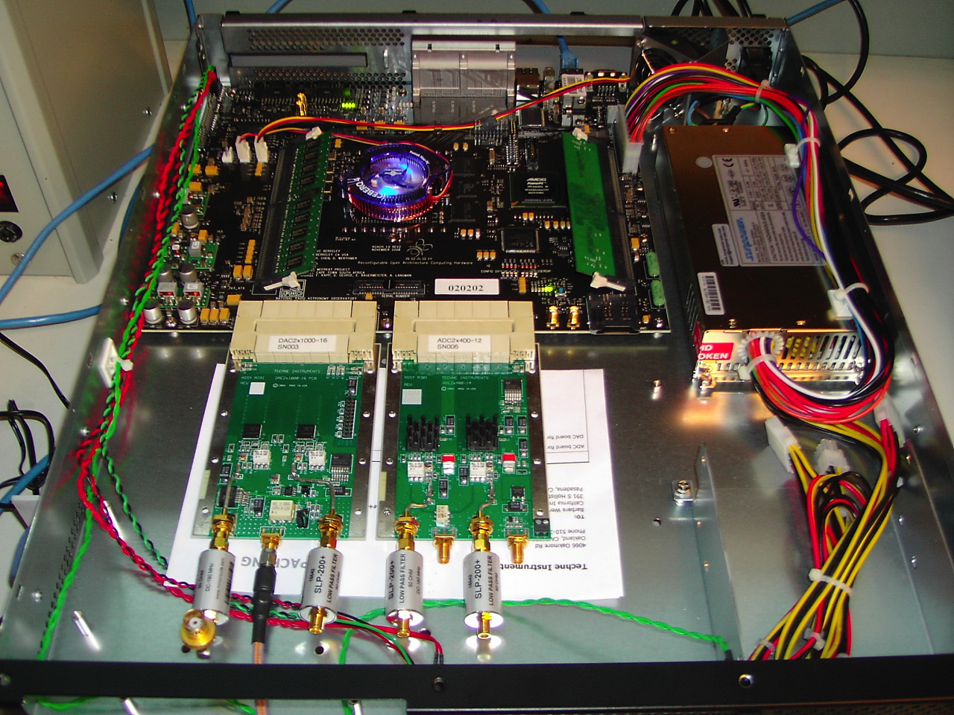
Frequency domain multiplexing
In
Out
HEMT
Broadband low-noise amplifier
Digital readout – 500MHz AD/DA
A high electron mobility transistor amplifier (HEMT) provides ~ 4 GHz of bandwidth with Tn <5 K, allowing >1000 MKIDs to be readout with one pair of coaxial cables!

Slide 6
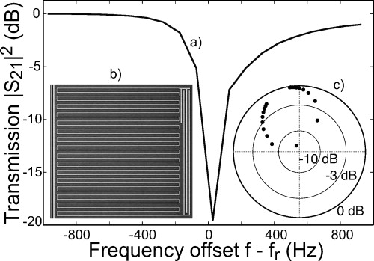
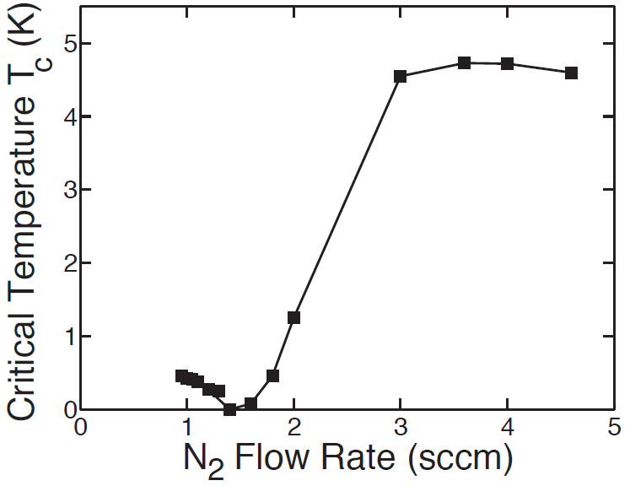
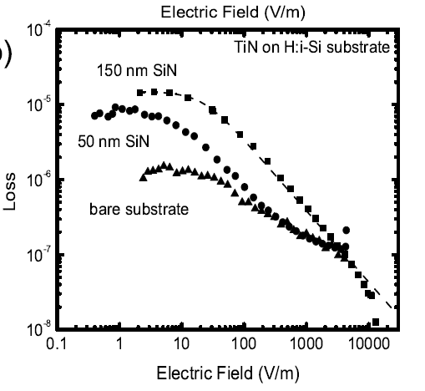
TiN - ideal material for MKID
Sub-stoichiometric
Ti_{x}N , x>1
Stoichiometric
TiN
Applied to MKID in 2009
Qi~30M!
2010 started in Pappas’ group
=1/Q_{i}
tunable Tc (400mK -> 0 -> 5 K)
high ρ_{n} ~100 μΩ•cm
efficient photon absorption
high Q
1M
high L_{ki} and responsivity
Similar for NbTiN, Tc ~ 15 K
10M
Leduc, etal, APL 97, 102509 (2010)
Vissers, etal , APL 97, 232509 (2010)

Slide 7
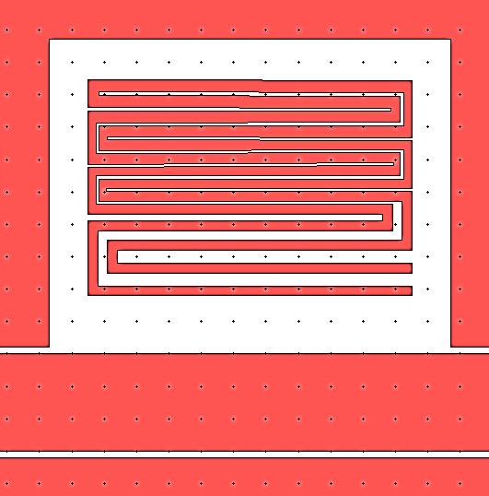
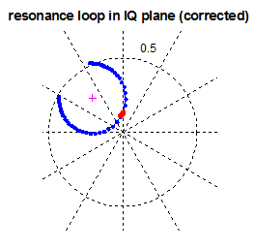
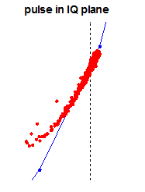
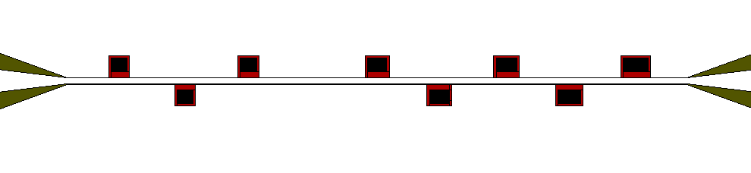
TiN MKID for NIR photon counting
1550nm
photon
dissipation
P
100μm
frequency
f₀ ~ 5 – 8 GHz, Q ~10 -100 k
20nm sub-stoichiometric TiN film on Si, target Tc~800 mK

Slide 8
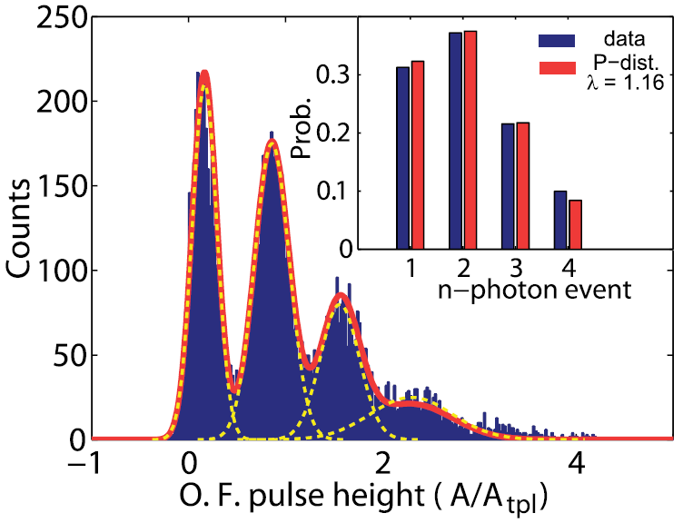
Counting 1550 nm Photons
Histogram of optimally-filtered pulse height
100ns
1 ms
10000 laser pulses
- Single photon resolving, ΔE (FWHM) = 0.27, 0.40, 0.44 for the 0-, 1-, 2-photon peak
- Fits to Possion distribution of λ = 1.16
J. Gao et al., APL 101 (14), 142602 (2012)

Slide 9
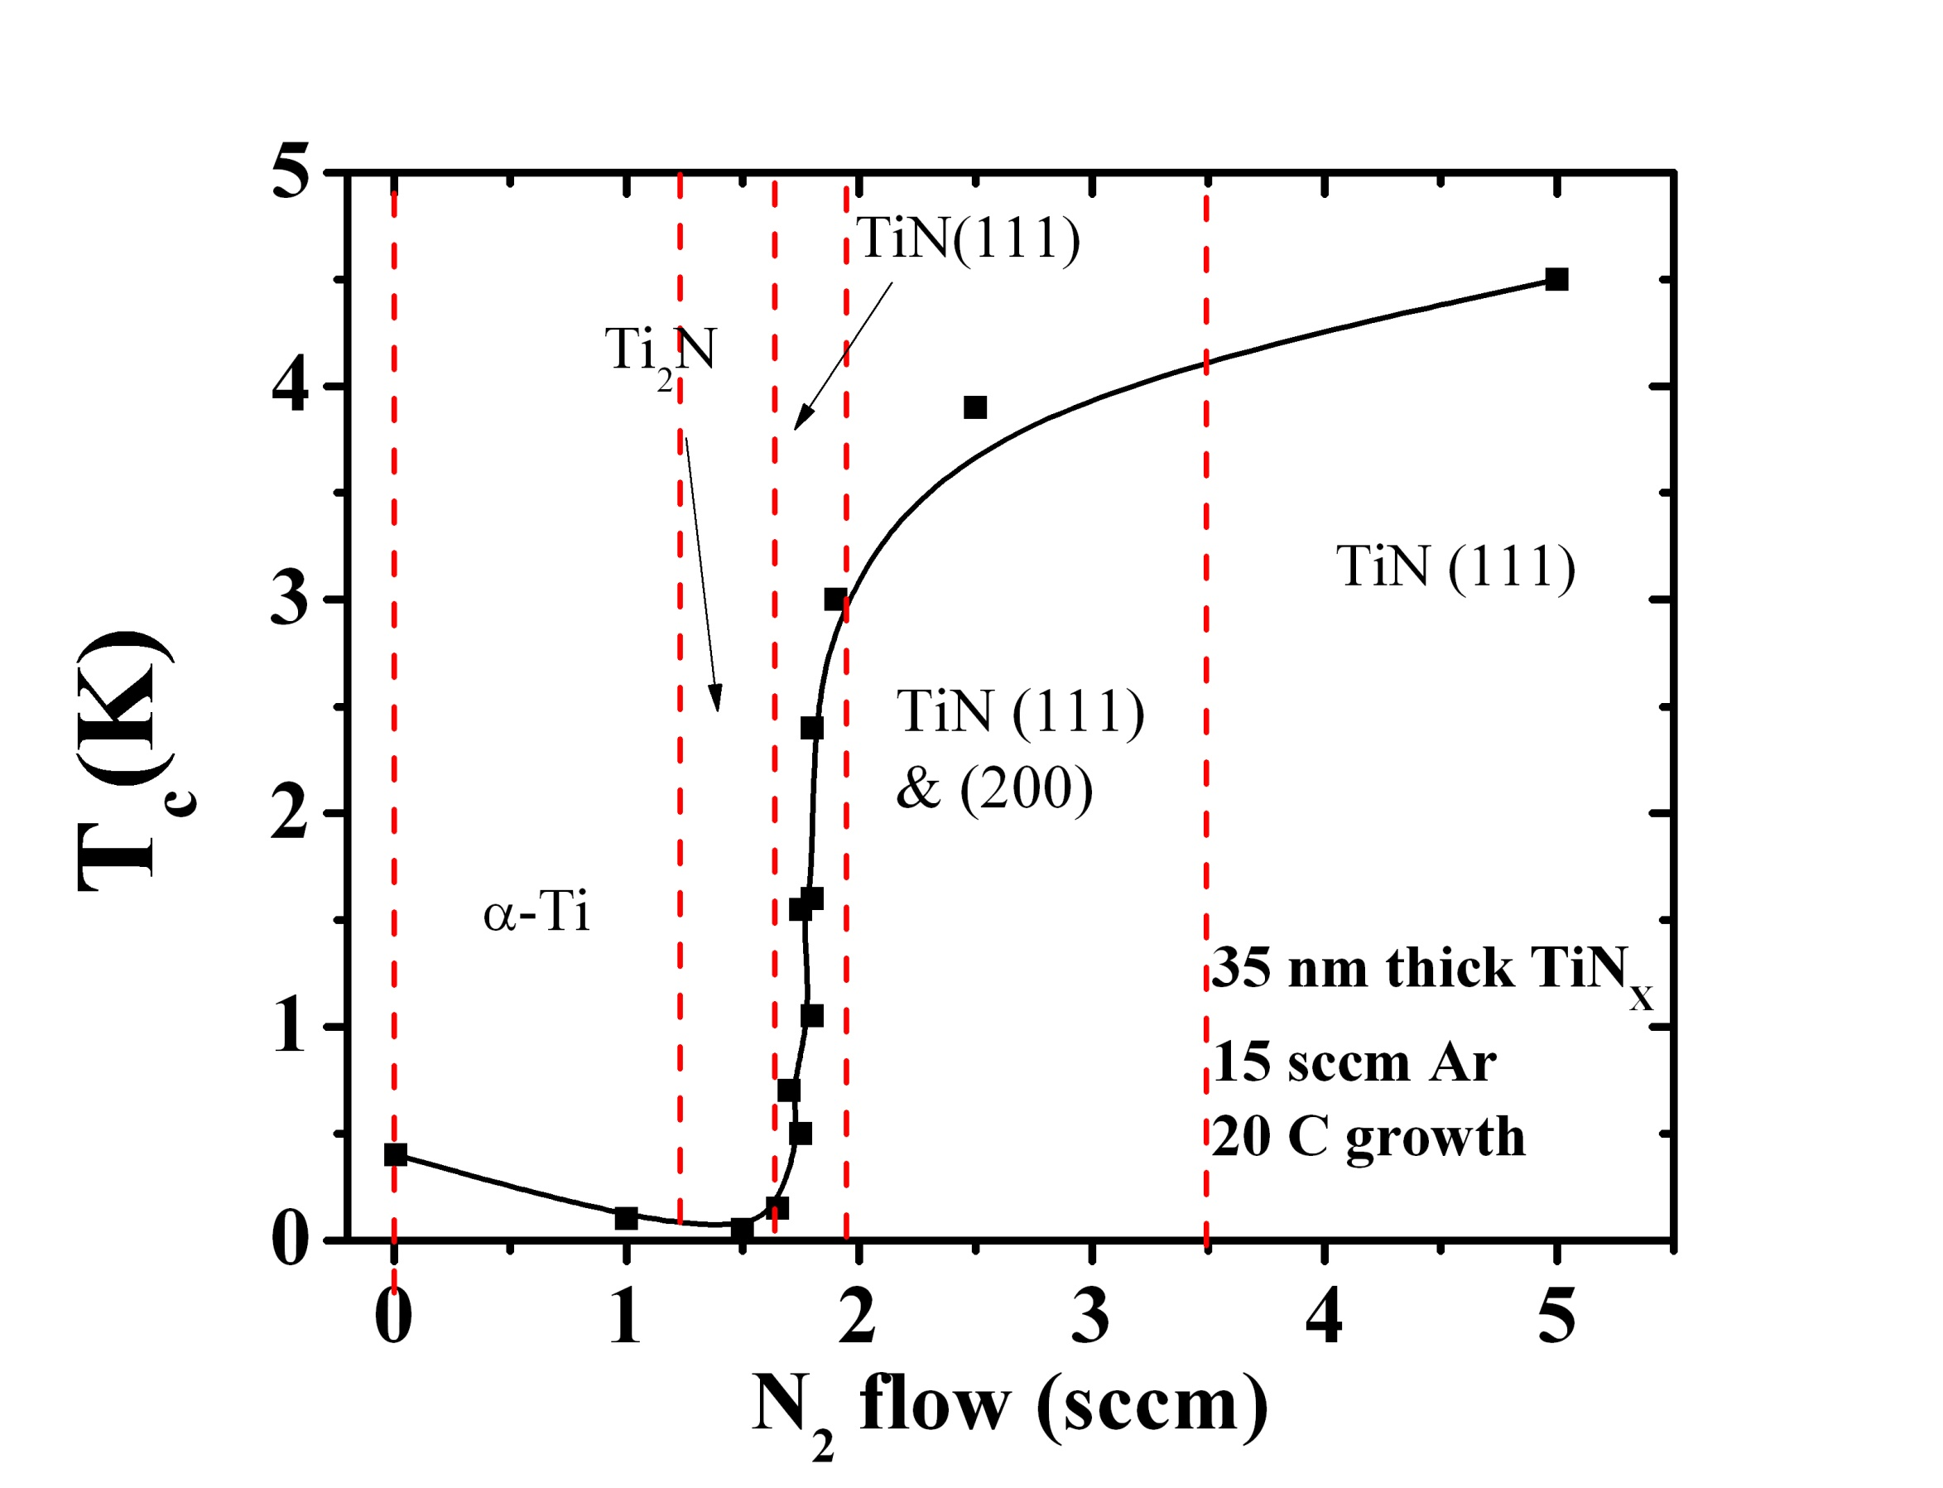
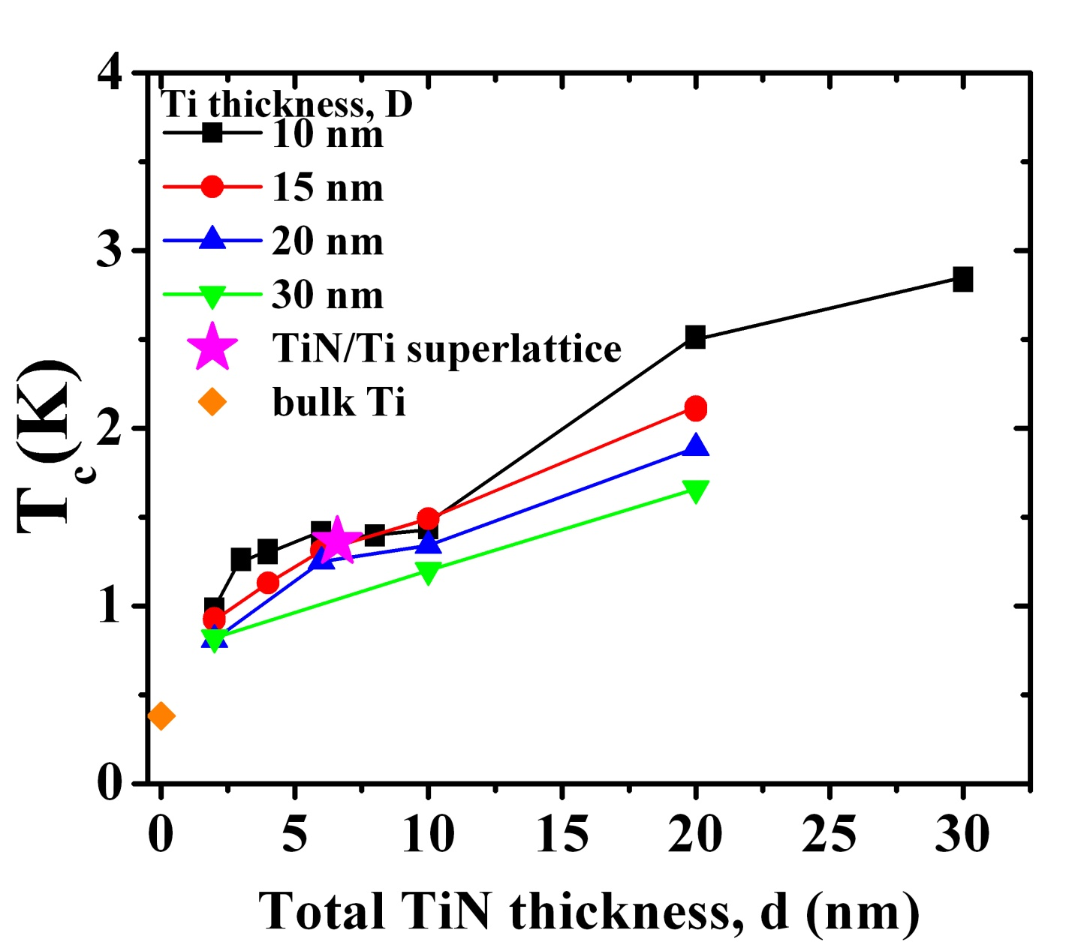
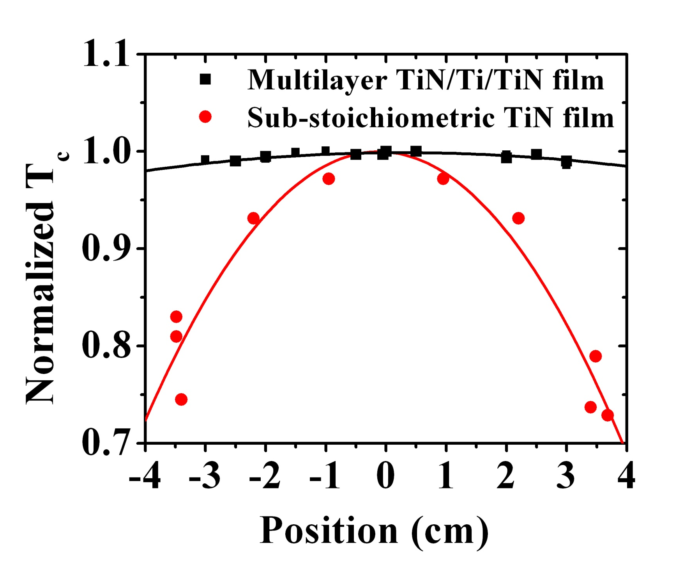
TiN/Ti/TiN trilayer
Steep slope in T_{c} vs N₂ around 1K
Difficult to reach target T_{c}
Solution (Mike Vissers): trilayer + proximity effect
TiN Tc~4.5K
Ti Tc~0.4 K
Film is very uniform
T_{c} tunable between 0.8 – 3K
Adequate high Q (500k)
t
TiN Tc~4.5 K
Si substrate
M. R. Vissers et al., APL 102 (23), 232603 (2012)

Slide 10
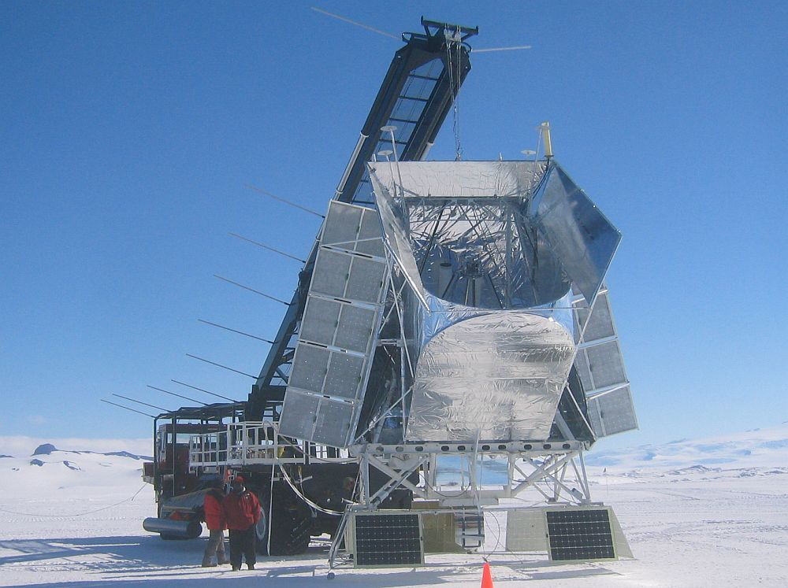
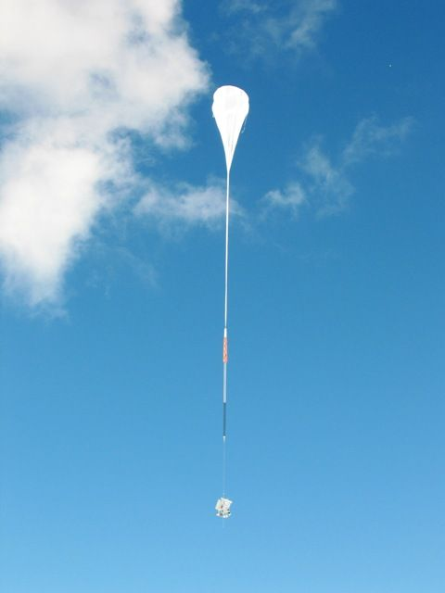
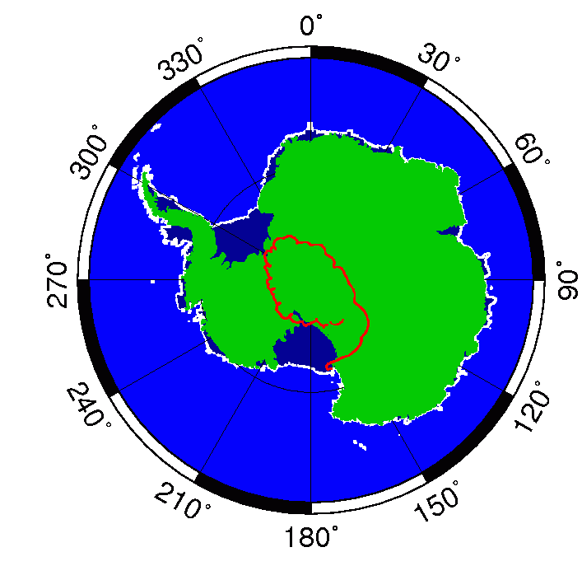
Feedhorn-coupled MKIDs
BLAST: Balloon-borne Large Aperture Submillimeter Telescope
1.8 m mirror
feedhorn coupled
250, 350, and 500µm
study star formation
PI: Mark Devlin (Upenn)
BLAST | BLAST-Pol | Super BLAST-TNG
270 NTD detectors 2006 | BLAST + Single Pol. 2010 | 2000 MKID Dual –pol detector 2016

Slide 11
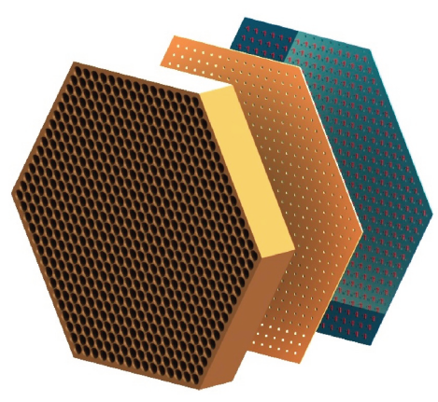
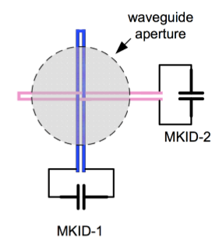
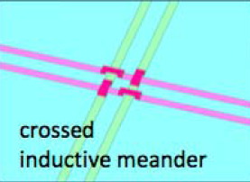
POLEKID - detector concept
feedhorn -> waveguide interface-> detector wafer
Via bridges at crossing
3 detectors wafers with total 2000 MKIDs
Dual-pol on single pixel hard for TES

Slide 12
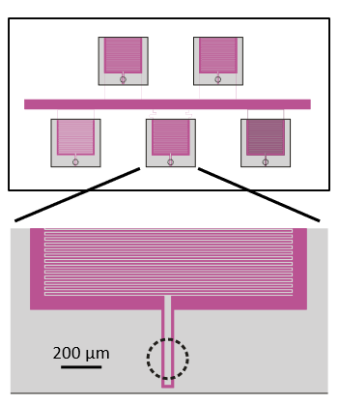
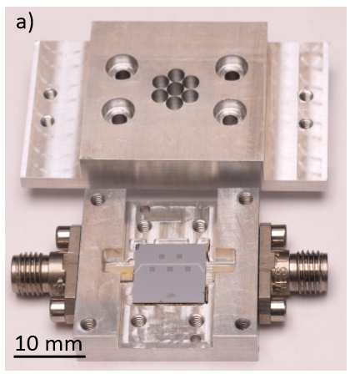
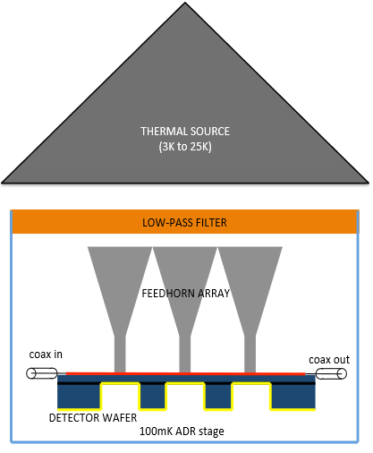
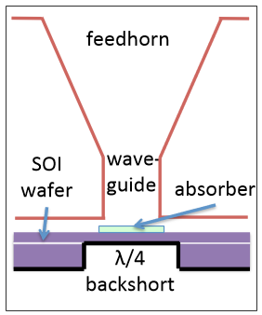
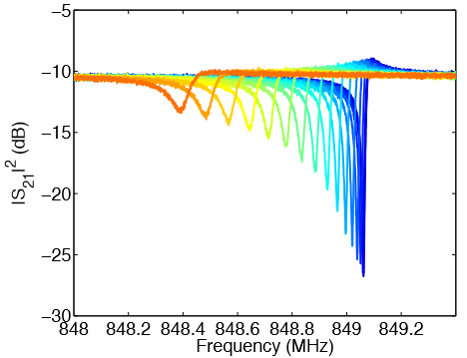
Optical test of prototype detector
20nm trilayer TiN, Tc ~ 1.5 K
19um Si membrane (SOI) with Nb backshort
Big IDC to suppress TLS noise
Small inductor strip to boost responsivity

Slide 13
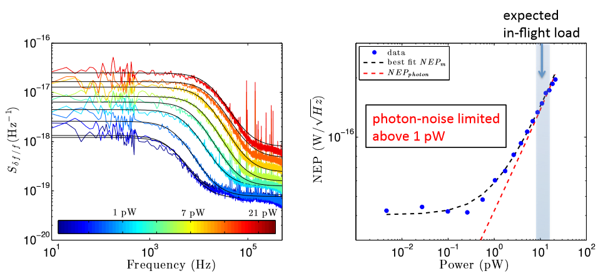
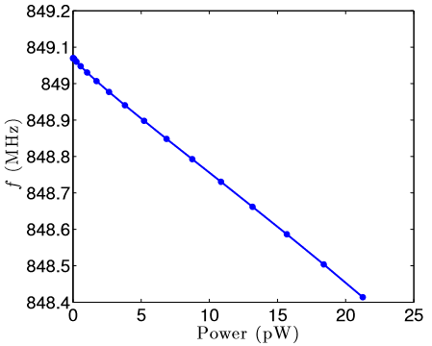
Photon noise limited sensitivity

Slide 14
Kinetic Inductance Traveling-wave parametric amplifier (KIT)
Multiplexed readout of MKID detector and qubits both require broadband, high saturation power and quantum limited amplifier.
Josephson Parametric Amplifier (JPA) has achieved quantum-limited noise, but the saturation power is low and bandwidth is narrow.
Solution
- Saturation power: nonlinear junction inductance -> nonlinear kinetic inductance
- Bandwidth: resonator -> traveling wave (transmission line)
New problem to solve in KIT
Harmonic generation and shock wave formation R. Landauer, JAP 31 (1960)
Phase matching for broad bandwidth and high gain
            G.P. Agrawal, Nonlinear Fiber Optics (2001)

Slide 15
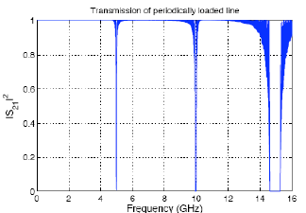
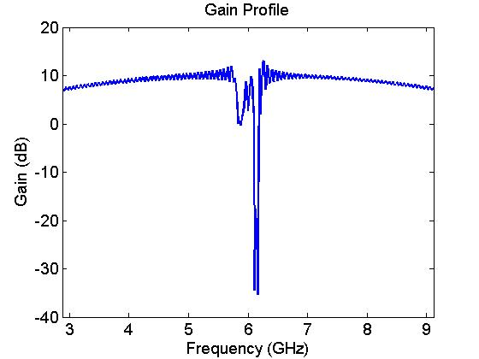
Dispersion engineering
g
g
…
s
s_{l}
Periodic impedance loadings create 3 stops bands.
Suppress the 3rd harmonic (prevent shock)
Make pump travel slower (phase match!)
Easy to make (a layer of metal, no junctions)
Δk=k-ω/v_{p}
f_{p}
3f_{p}
Proposed by J. Zmuidzinas (Caltech/JPL) in 2011
Demonstrated by Eom etal., Nature 8 (2012)

Slide 16
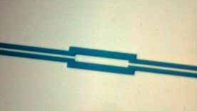
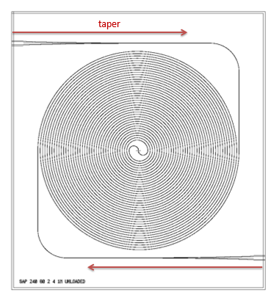
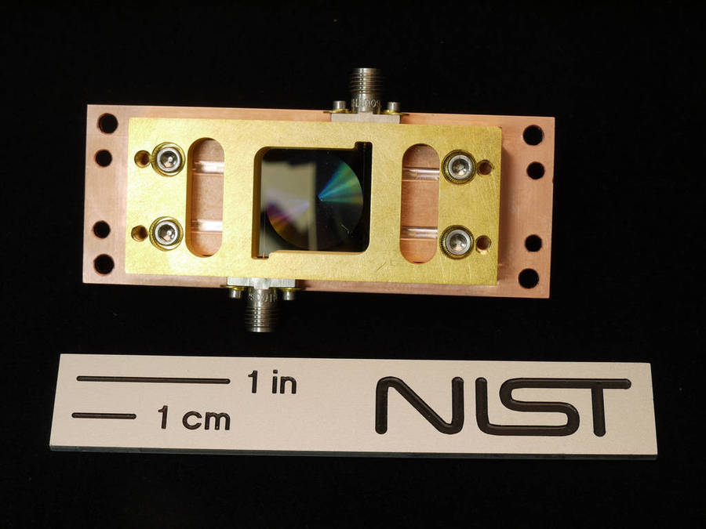
NIST KIT amplifier
Z₀~200Ω
s = 2μm, s_{l} = 6μm, g = g_{l} =2μm
2 cm
Numerical simulation: S. Chaudhuri
Design & Measurement: C. Bockstiegel
Fabrication: M. Vissers
- 20 nm NbTiN film (T_{c} ~ 14 K) on intrinsic Si
- 2.2-m long double spiral CPW on 2cm chip
- Klopfenstein taper for impedance transformation
C. Bockstiegel, @ LTD15

Slide 17
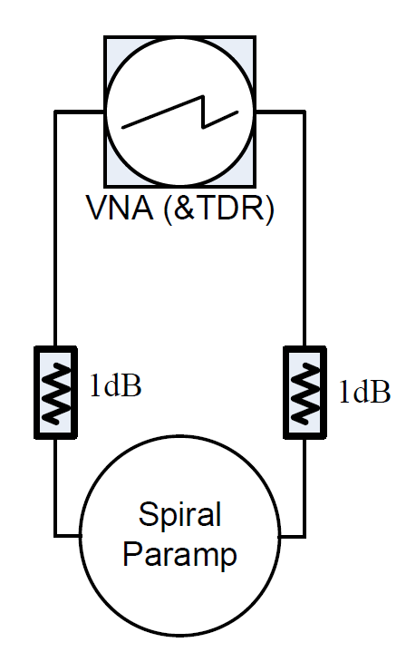
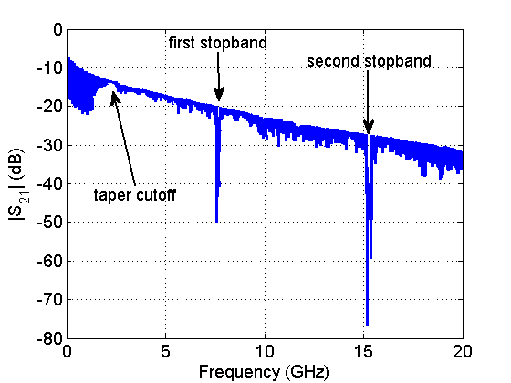
Device characterization – S21
4K
30 mK
- Measurement config in dilution refrigerator
- Low power transmission showing band structure created by periodic loadings

Slide 18
Broadband gain – single device
Gain profile of the KIT amplifier, f_{p} ~ 7.5 GHz, P_{p}~-7dBm (200μW)

Slide 19
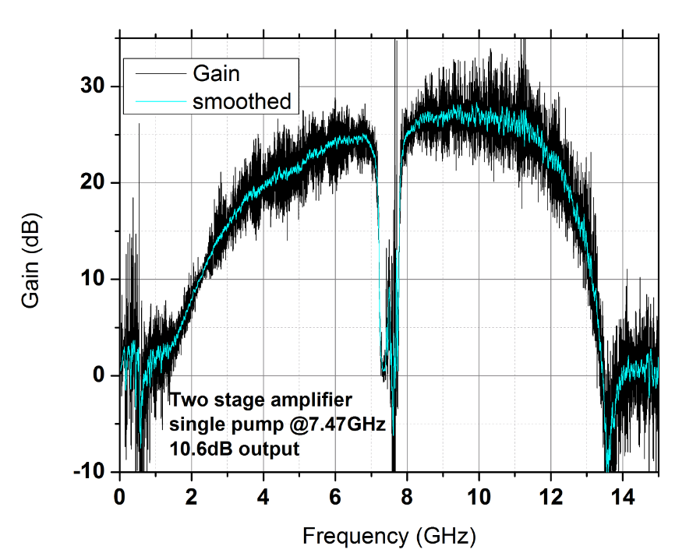
Broadband gain – two devices in series
Greater than 20 dB gain over 4GHz achieved!

Slide 20
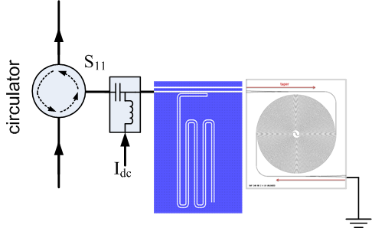

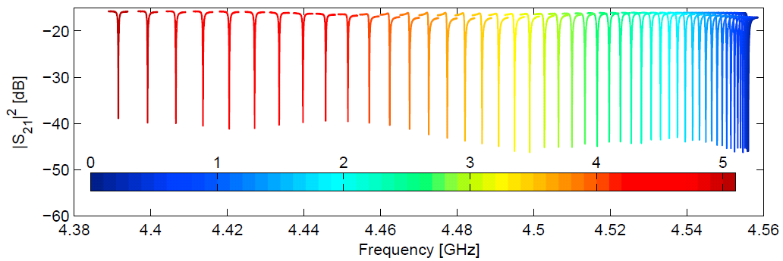
Nonlinear KI devices – tunable devices
Tunable coupler
Tunable coupler, resonator, phase shifter, filter, antenna ….
Applications in QC, detector, …
N
Tunable resonator
I_{dc}

Slide 21
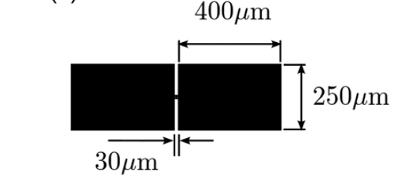
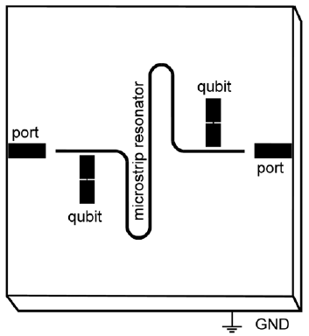
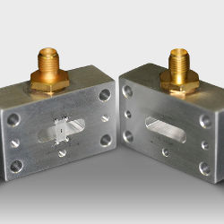
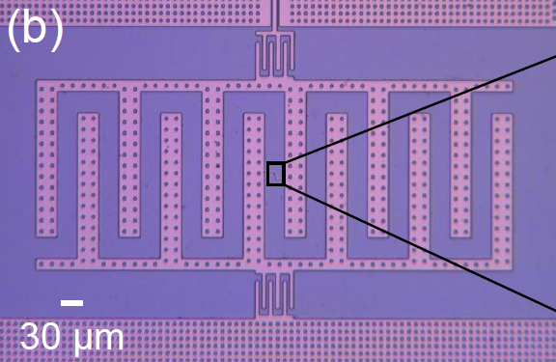
TiN Qubit (Pappas’ group)
TiN circuit + Al junction
x
NIST: ~35 μs
3D qubit: ~100 μs
(Yale, IBM)
x
Sandberg, APL 102, 072601 (2013)
IBM: ~50 μs
Chang, APL 103, 012602 (2013)

Slide 22
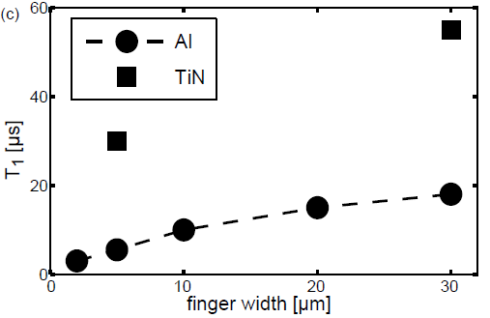
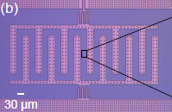
Why TiN Qubit
Goal:
T1 ~ 50 μs => Q_{i} ~ 1 M
T1 ~ 500 μs => Q_{i} ~ 10 M
=1/Q_{i}
Only TiN Q_{i}>10 M at high power (no 3D)
other losses, such as quasipartile, trapped flux and radiation, are already low. TLS is the only problem to address.
Q_{i}>10M!
Open question:
Loss of bulk Si? Q > 10 M ?
IBM TiN qubits
Chang etal, APL 103, 012602 (2013)

Slide 23
Summary – research theme
Kinetic Inductance Detectors
Supercond. Qubits
Micro-resonators
Our Goal:
- photon noise limited
- as sensitive as TES
Current: achieved@1.2 THz
Prob.: TLS noise
Approach:
- reduce TLS
- QL amplifier
Two-level systems
Our Goal: T1~ 500 μs
Current: a factor of ~10 away
Prob.: TLS decoherence
Approach: reduce TLS
TiN, NbTiN, trilayer
Quantum -limited Amplifiers
Novel Nonlinear KI Devices
Our Goal: quantum-limit
Current: a factor of ~3 away
Prob.: heat-sinking, yield, gain ripple

Slide 24
Collaborators
NIST:
Detector: Joel Ullom, Jiansong Gao, Johannes Hubmayr, Dan Becker, Dan Schimidt, Jeff Van Lanen, Yiwen Wang, Gene Hilton, Leila Vale
Qubit: David Pappas, Mike Vissers, Jose Aumentado, Leonardo Ranzani
Optical: Sae Woo Nam, Ariana Lita
Imaging: Aric Sanders
……
CU: Konrad Lehnert, Christ Abeles
Caltech/JPL: Jonas Zmuidzinas, Peter Day, Rick Leduc
Stanford: Kent Irwin, Saptarshi Chaudhuri, Dale Li, Sherry Cho
UCSB: Ben Mazin, John Martinis, Clint Bockstiegel
SLU: David Wisbey
BLAST: Mark Devlin (UPenn) + Cardiff + ASU + …
IBM: Matthias Steffen, Martin Sandberg, Josie Chang …

Slide 25
Thank you !

