Slide 1
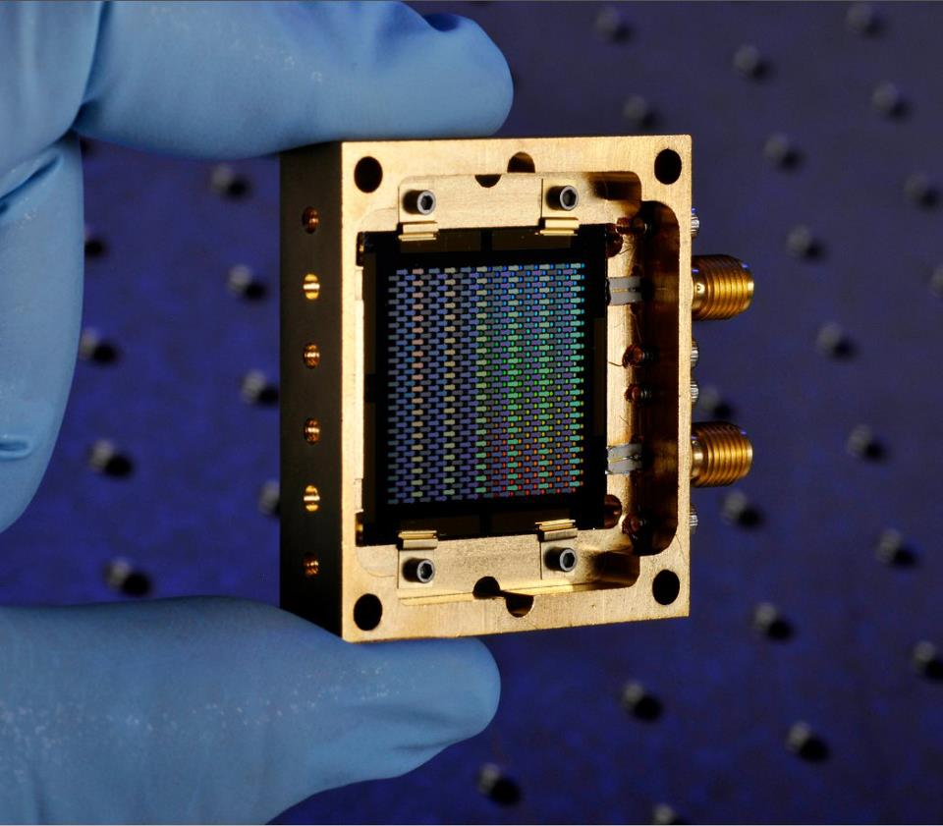
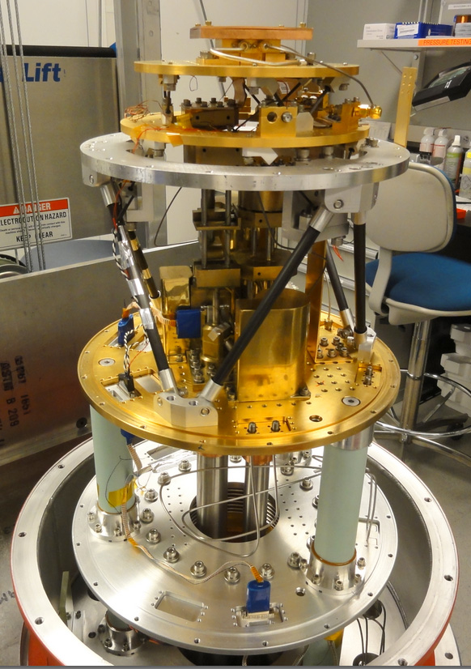
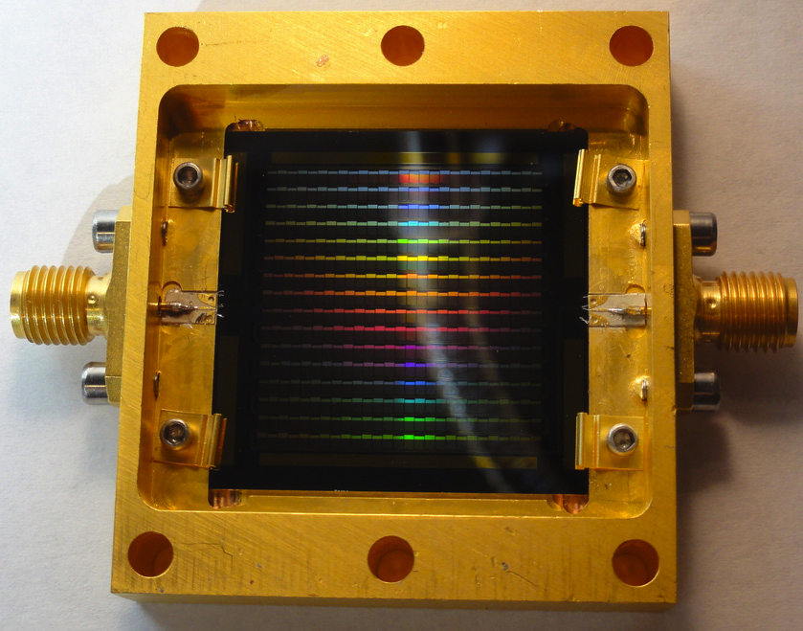


MAKO
A 350/850μm camera designed for operation at the Caltech Submillimeter Observatory
Christopher McKenney
Notes:
Hi, I’m Chris McKenney and I’ll be talking about MAKO – a 350 micon camera designed for operation at the Caltech Submillimeter Observatory.

Slide 2
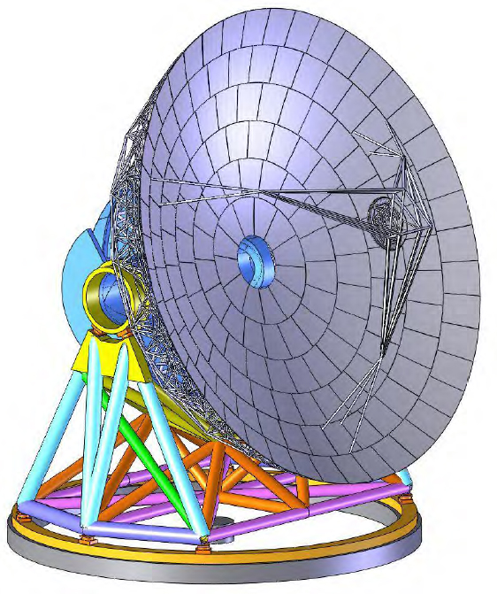
MAKO Technology Goals
SHARC-II already at CSO
  384 pixels
  Background limited
  Fills ~ ¼ of the focal plane
Why MAKO?
Large-Scale Arrays (~ 10⁵ pixels)
Pathfinder cameras for future telescopes such as CCAT
Current FIR technology has sufficient NEP
Need to significantly scale:
  Readout/Multiplexing
  Fabrication
Notes:
It’s worth noting that CSO already has a background limited 350 micron camera – SHARC-II. This is a 384 pixel camera which fills about 1/4th of the focal plane. However the purpose of MAKO is really to drive technology toward large scale arrays, to serve as a pathfinder for the sort of large scale – 100,000 pixel arrays – that future telescopes such as CCAT might need. While current technology has sufficiently low NEPs, massive scaling is needed both on the readout and multiplexing side as well as fabrication.

Slide 3
MAKO: “Real” Goals
Filling large focal planes requires lots of pixels
Make fabrication and readout negligible parts of instrument cost
Our Goals:
  < $1 / pixel: Fabrication
  < $1 / pixel: Readout
  Reasonable NEPs (with a clear path forward to improve)
TESes exist and have good NEPs – reasonable cost for ~ 100 – 1000 pixel arrays
Notes:
It’s worth noting that CSO already has a background limited 350 micron camera – SHARC-II. This is a 384 pixel camera which fills about 1/4th of the focal plane. However the purpose of MAKO is really to drive technology toward large scale arrays, to serve as a pathfinder for the sort of large scale – 100,000 pixel arrays – that future telescopes such as CCAT might need. While current technology has sufficiently low NEPs, massive scaling is needed both on the readout and multiplexing side as well as fabrication.

Slide 4
MAKO Candidate Pixel Requirements
Multiplexing
> 400 pixels / line
RF readout < 250 MHz
Cryogenics
³He System
T ~ 240 mK
One pair of RF lines
Optics
F ~ 4.5
λ = 350 μm
P_{inc} ~ 25 – 50 pW
Fabrication
High yield
Stepper Lithography
TiN superconductor
Notes:
My initial inovlvment with MAKO was designing and testing the detectors. Candidate pixels had to meet a variety of simultaneous and often conflicting goals. Our multiplexing requirements meant we needed at least 400 pixels per line, while fitting all of our pixels in to an RF readout with frequencuies less than 250 MHz. Our cryogenics system was a simple Helium-3 system with a base temperature of around 1 K, which will have implications for superconductng material choices. It also introduced a limit of one pair of RF lines, though we’ve since upgraded to two sets. The optics at CSO set some pixel dimensions with a fixed F# of 4.5 and lambda=350 micron, as well as loading requirements for the pixel at 25-50 pW. Finally, we needed fabrication processes which could give high yield while being done with existing stepper technology; and additionally we wanted to use TiN which our MDL had experience using.

Slide 5
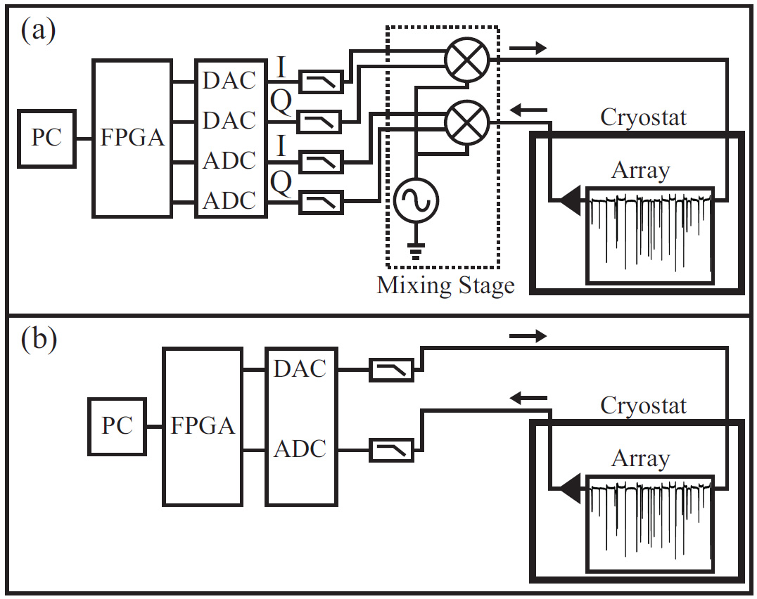
Low Cost Readout: Radio-Frequency Operation: MKIDs
X
FPGA implements digital channelizer for readout tone separation
Microwave (GHz) readout requires up/down frequency conversion
RF readout (< 500 MHz) allows “direct drive’’ with ADC/DAC
  Reduces readout complexity and cost
  Converters are typically 12-bit, 500 MSPS (ADC < $200 ea)
Microwave readout
RF readout
L. Swenson, LTD-15
Notes:
We’ve also made our life easier by removing the “M” from MKID and operating in the radio-frequency. Here we use an FPGA to directly generate and read back the tones. In the traditional microwave readout shown on top the tones go through an up and down converting stage, so that level of complexity is removed. This dramatically reduces complexity and cost, the ADC and DAC converters are typically available for less than $200 each.

Slide 6
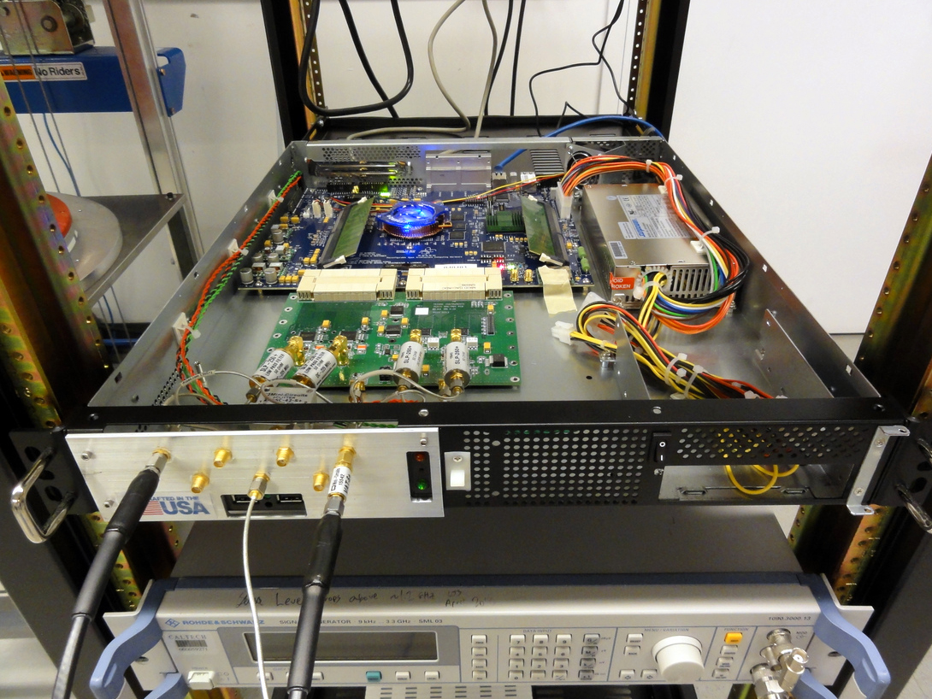
MAKO Readout
ROACH Readout
  Open-source FPGA readout (CASPER/Berkeley)
  Adopted existing hardware to meet observing date
  Maximum readout frequency: 250 MHz
    500 MSPS ADC converters operating in 1st Nyquist zone
MAKO implemented with ~ 500 pixels with one ADC and one DAC
FPGA firmware supports up to 4k pixels per ROACH
FPGA firmware developed by R. Monroe/JPL
Notes:
For the MAKO readout we implemented the ROACH, which is an open source FPGA readout from the CASPER collaboration. We adopted existing hardware to meet our observing date; this readout gave a maximum readout frequency of 250 MHz corresponding to 500 mega-samples per second in the 1st nyquist zone. We impltemented MAKO using 500 pixels with one ADC and one DAC, though the FPGA firmware supports up to 4k pixels per ROACH. The FPGA firmware was designed by Ryan Monroe at JPL.

Slide 7
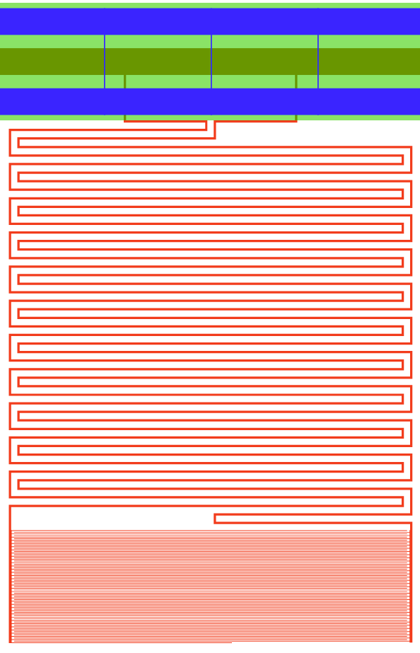
MAKO Detector Array: Gen-1 Design
CSO/MAKO demonstration
  April 2013
LE-KID pixel style
  F# and λ set absorber size:
    Fλ / 2 ~ 0.8 mm
  Matching of absorber to wave impedance in silicon (~100 Ω) determines TiN fill factor and volume of inductor/absorber
  Capacitor area: trade-off between readout frequency & capacitor noise vs focal plane filling efficiency
  432 pixels fills one stepper field
    Allowed rapid iteration/testing
  Resonator/CPW is 3 layer fab
0.8 mm
1.4 mm
0.8 mm
Notes:
The first generation of detectors for MAKO was designed to go to the CSO in April 2013. A schematic is shown on the right here, this is based on the LE-KID pixel discussed before. The overall dimensions of the inductor are set by the F# and wavelength, while matching the absorber to wave impedance in Silicon determines the TiN fill factor and volume of the inductor/absorber. The capacitor area is a trade off between many competing goals: readout frequency, capacitor noise, and focal plane filling efficiency. We also liked this design because it allowed us to fit 432 pixels in to a single stepper mask and field, giving simple fab and allowing rapid iteration and testing.

Slide 8
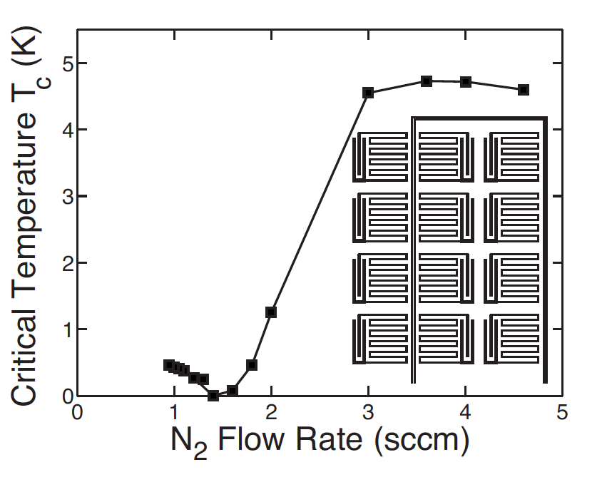
TiN + LE-KID Design: RF Frequency Operation
Multiplexing requirement: frequencies < 250 MHz
TiN: High resistivity superconductor
High kinetic inductance = low frequency
Adjustable Tc via N₂ during depostion
Achievable Tc ~ 0.8 - 5 K
  Meets cryogenic requirements (Tc ~ 1 K)
Long quasiparticle lifetime gives good optical response
  Tc ~ 1K, τ_{qp} ~ 100 μs
  Lifetime appears to scale as Tc⁻²
Leduc, et. al. APL 97 (102509) / 2010
Notes:
Multiplexing sets a requrement that our frequencies be less than 250 MHz. To do this we needed a material with a very high kinetic inductance – which scales with the resistance and inversely with Tc. TiN is a highly resistive normal metal – somehting like 100 micro-ohm cm – allowing these low frequencies to be achievable. It offers many additional benefits for pixel design. The first is that the Tc is adjustable via N2 flow during deposition, shown here Tcs ~ 0.8 – 5 K have been achieved, offering a wide variety of applications. Tcs of about 1 K meet our cryogenic requiremnets. The long qp lifetime of TiN gives good optical response, which dark lifetimes ~ 100 us having been measured.

Slide 9
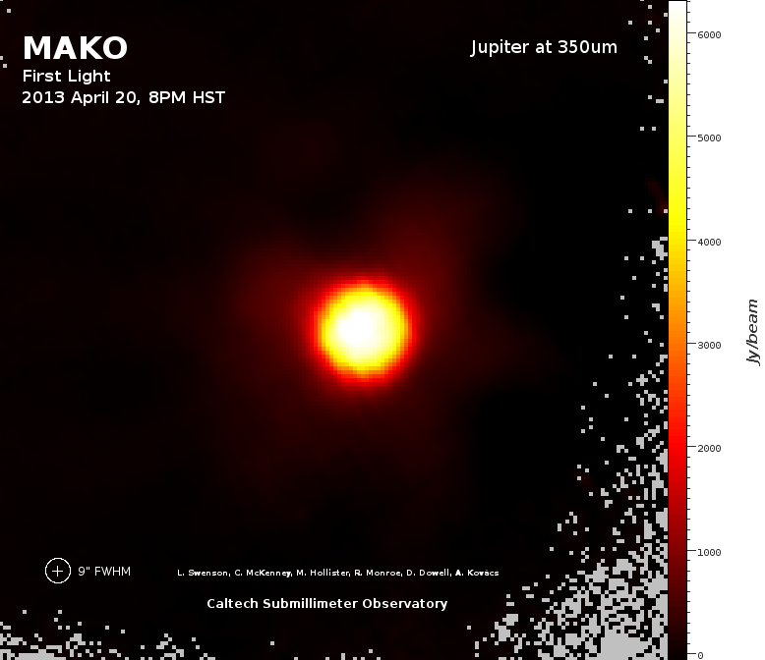
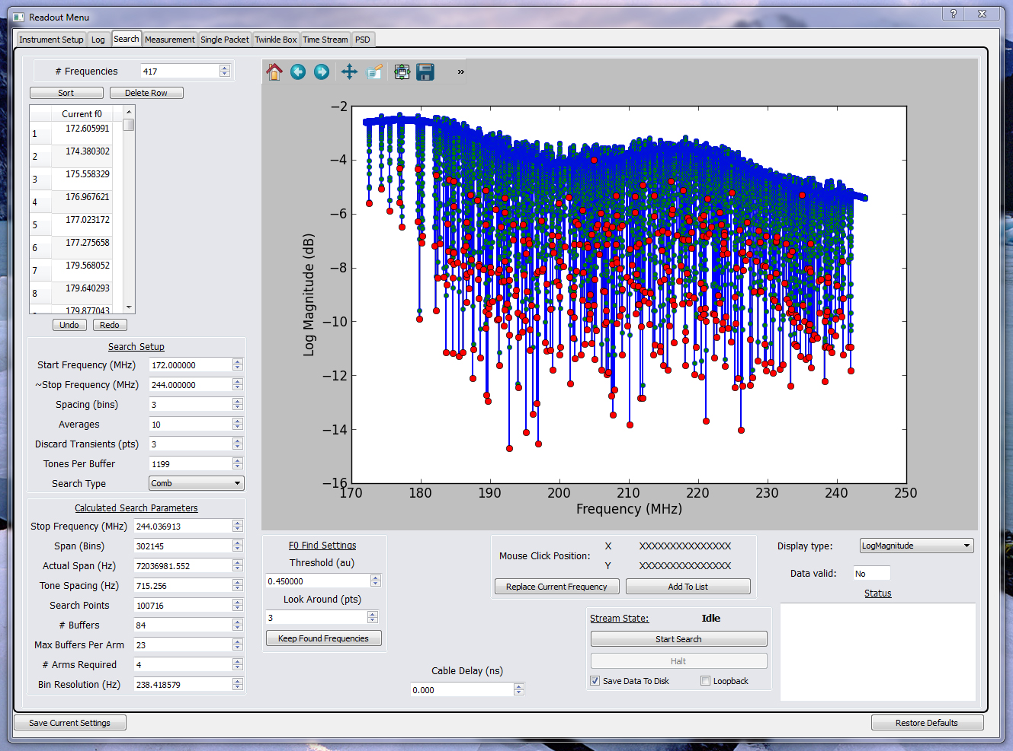
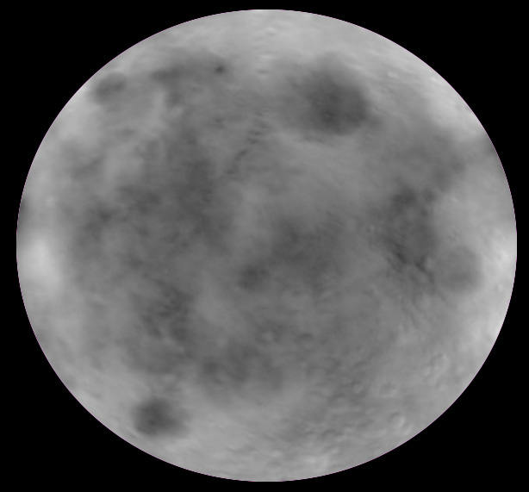
MAKO goes to the CSO: April 2013
Identified and tracked 400 pixels in real time
First light: Jupiter at 350μm
Readout software by L. Swenson
The moon at λ = 350 μm
Notes:
Using readout software devloped by Loren Swenson we were able to identify and track nearly 400 resonators in real time. In the upper right is our first light image of Jupiter. We also had a lot of poor weather nights, and since our primary motivation was testing the readout we took some pretty pictures of the moon.

Slide 10
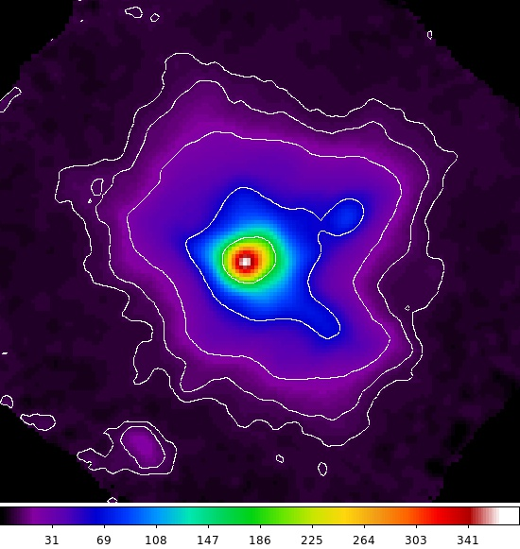
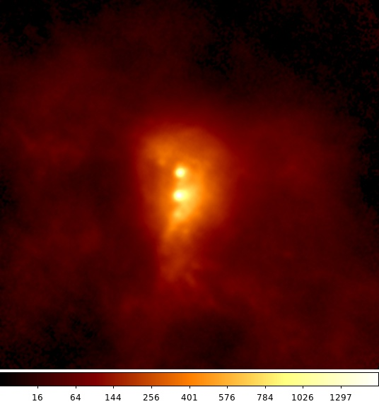
MAKO goes to the CSO
And takes some pretty pictures too…
G34.3
SgB2
Notes:
We also had a few good weather nights, and we used those to take some fun astronomical images. Here we see a large nebular on the left, while on the right is Sagitarius B2 in our own galaxy. So that was the fun astronomy part.

Slide 11
MAKO Gen-1 CSO Results
Readout successful
Readout at 400 pixels/line demonstrated
MUX density ~ 1000/octave
Low cost
Improvements Needed
NEFD was ~ 7x worse than SHARC-II
Smaller pixel and single-polarization account for about 40%
Further improvement to detector response and noise needed
Notes:
The results from our first run were overall good. Our biggest hurdle of showing this readout method works was met, and we demonstrated 400 pixels/line corresponding to a mux density of nearly 1000 pixels/octave. Most importantly, we did this on a very low cost readout, achieving nearly $1 per pixel readout costs. But improvements are needed to make this a viable ground based observing technology. The measured NEFD was about 7x worse than SHARC-II for the best pixels. Our small pixel and single-polarization about for some fraction of htat, but further improvements in response and noise are needed to hit necessary NEP goals.

Slide 12
Goals for Aug/Sep 2014 CSO Run:
NEP Closer to BLIP
Polarization insenstivie (or dual-polarization) response
Mature readout
350 micron / 850 micron detectors
Decided on an ambitious schedule to meet CCAT design deadlines and show on-sky performance
Why not make the fabrication even simpler?
Notes:
We also read out all detector simulatneously using the ROACH readout. Many of them appear to be near BLIP, with some excess noise from the amplifier. I’ve plotted here a typical NEP plot based on noise-spectra and responsivity as measured with the multitone readout. Reducing the temperature by blanking off the cryostat appears to reduce the noise in all detectors. We seem to be very close to where we predict the photon limit to be. It should be noted that there are some overall uncertainties in our system on the order of 20-30% arising from imperfections in the optics and not knowing how “black” our blackbody truly is at 350 micron.

Slide 13
Microlens Coupling: Improve Response Per Photon
Simplify Fabrication – increase yield, decrease fab time
Couple to microlens – increase response, decrease noise
Gen-1
Single-Pol LE-KID
Gen-2
Microlens Coupled Single-Pol LE-KID
Diffraction limited lens:
This also decreases noise, for reasons beyond the scope of a half slide that can be discussed if there is interest.
Notes:
So I began designing our generation-2 pixels. We had two primary goals in mind – once again, we wanted something that could simplify fab, to increase our detector array yield and decrease the turnaround time to make new arrays. But most importantly we wanted to couple to a microlens to increase the response and decrease the noise. On the left is the simple LE-KID design. We had about a 70% fill fraction with the inductor, while the capacitor and CPW represented dead space on the focal plane. Most importantly the volume of active material in relation to incident light is fixed in this design. On the right is a spot pattern from a simulated microlens in HFSS with a microlens-coupled LE-KID design superimposed on it. Not only can we reduce the active area for a a fixed loading, but with a diffraction limited lens we can still capture about 86% of the light out to the first Airy null.

Slide 14
Simple Fabrication: Interdigitated Electrode Coupling
IDE Coupling
100 MHz in Si: λ ~ 1 meter
Treat elements as lumped
In parallel with transmission line
Rectangular RF feed pattern
RF In
RF Out
Notes:
This coupling scheme takes advantage of the long wavelenght in silicon at 100 MHz, allowing us to treat the LC rsonators as essentially lumped elements over the full array. Using this scheme we can place all reosnators in parallel with the transmission line, as shown below.

Slide 15
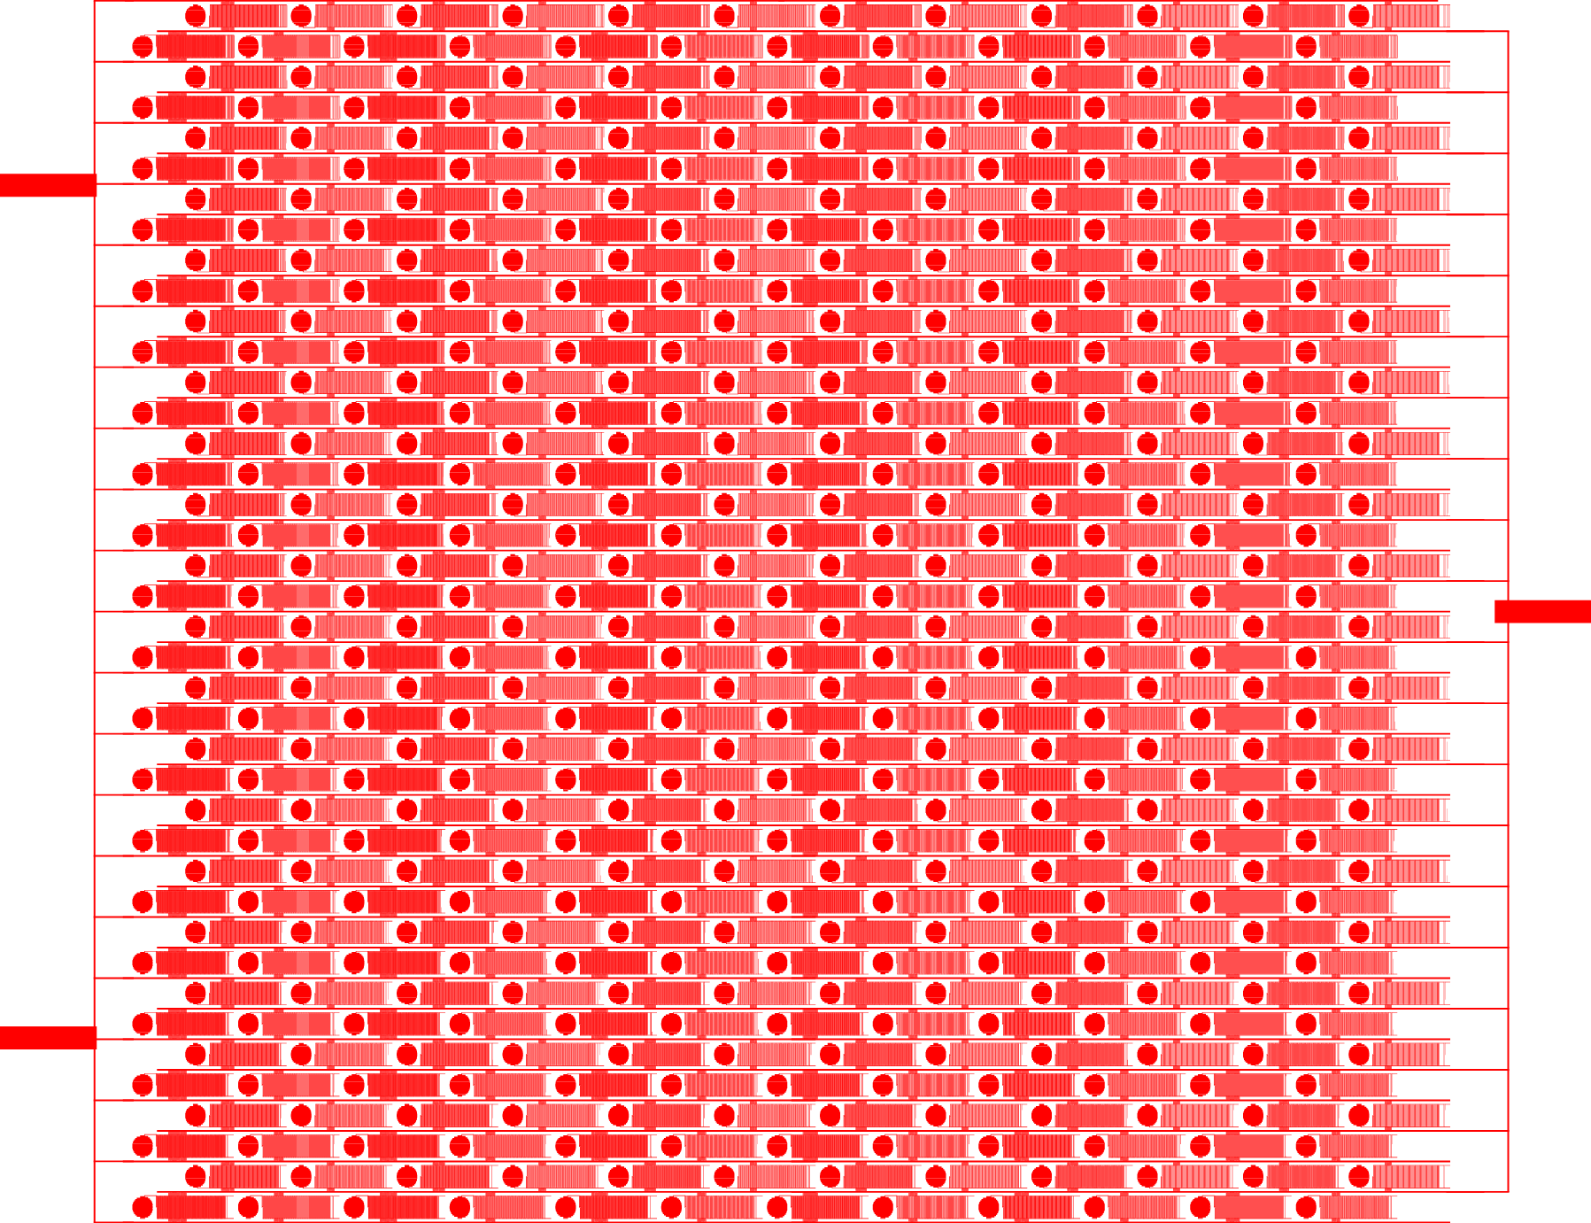
Interdigitated Electrode Coupling
TiN/resonators: Single layer fab
40 nm TiN film (Tc ~ 1.2K)
480 Pixels on single layer/die
RF In
Ground
RF Out
Notes:
As mentioned earlier, one of the additional goals was to simplify fabrication. To do that we cooked up this interdigitated electrode scheme, where we have an RF in and out on the same side, while a ground is connected to the other. This lets us do all of the TiN resonator and coupling in a single fabrication layer – a 40nm TiN film with 480 pixels on a single layer/die.

Slide 16

Interdigitated Electrode Coupling
TiN/resonators: Single layer fab
40 nm TiN film (Tc ~ 1.2K)
480 Pixels on single layer/die
RF In
Ground
RF Out
Lens Area = 1 mm²
Notes:
As mentioned earlier, one of the additional goals was to simplify fabrication. To do that we cooked up this interdigitated electrode scheme, where we have an RF in and out on the same side, while a ground is connected to the other. This lets us do all of the TiN resonator and coupling in a single fabrication layer – a 40nm TiN film with 480 pixels on a single layer/die.

Slide 17
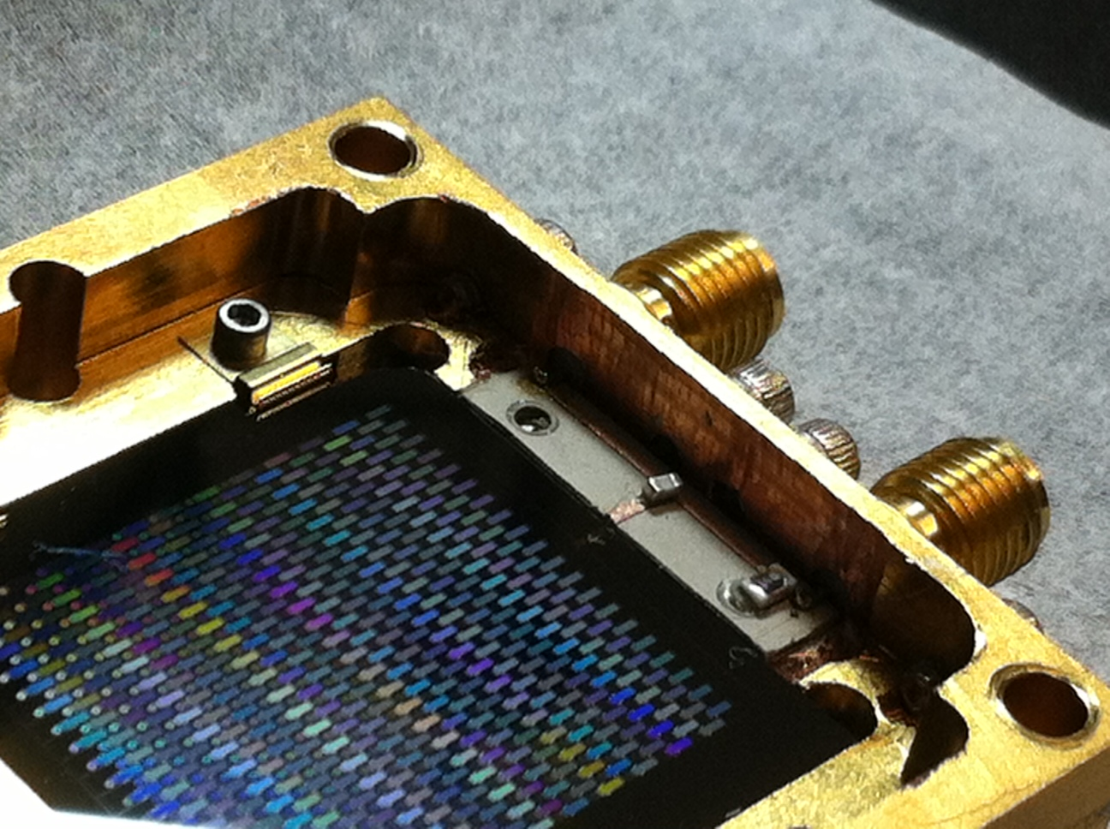
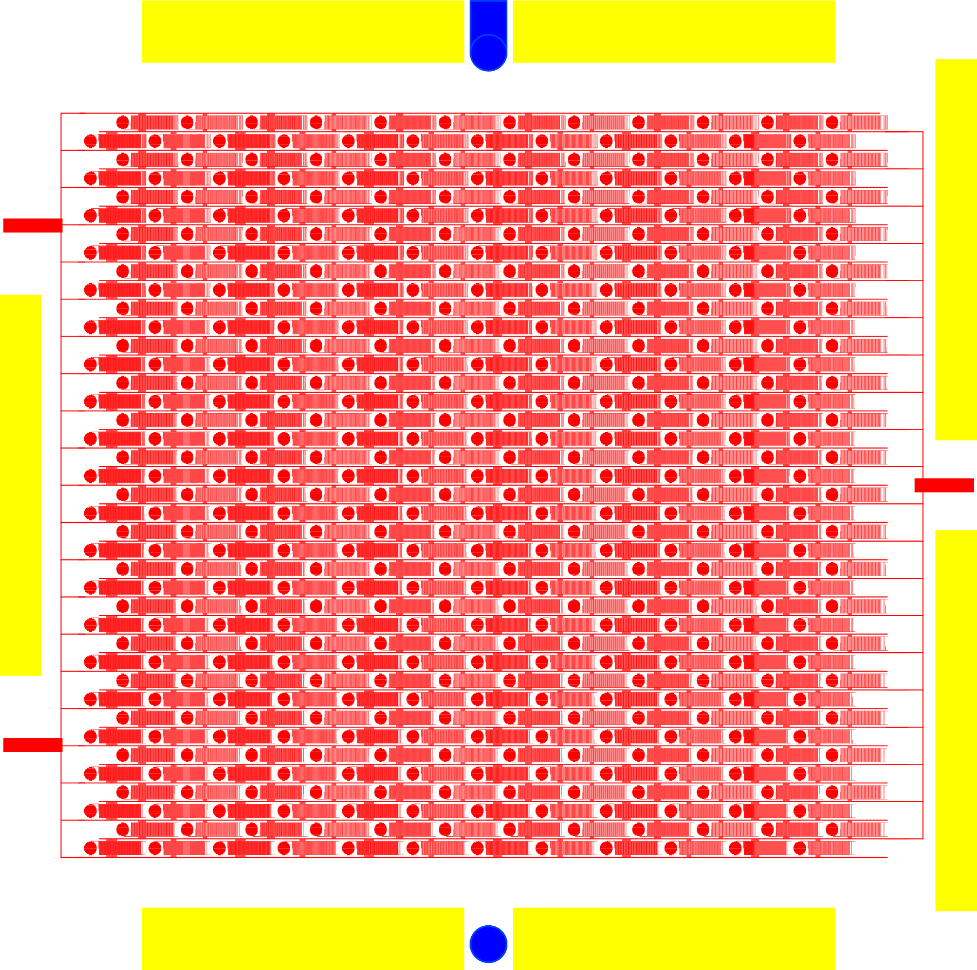
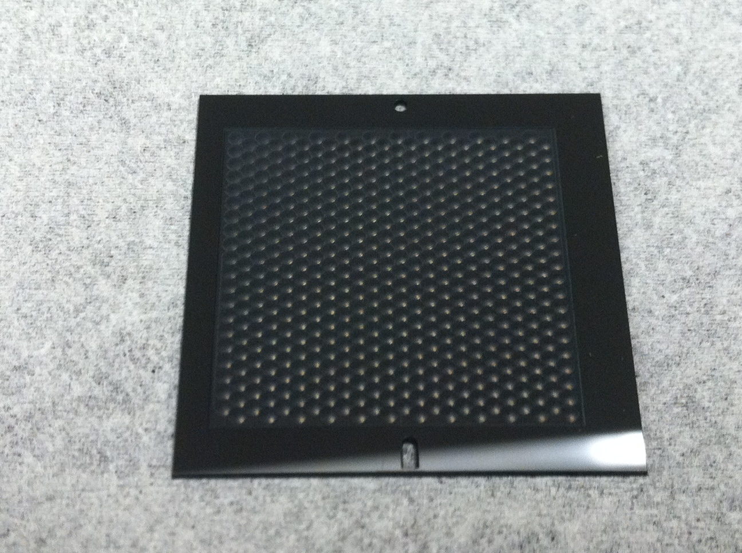
Gen-2: Device Fabrication
Gold for thermalization
Holes for pin alignment to microlens
Packaged Gen2 Device
Laser-etched Si microlens array
Notes:
So when I said one layer for the TiN/resonators earlier, that was a true statement – but full device fabrication involves two more coarse processing steps. Because we are using a microlens array the easiest way to align is a simple pin and slot – these can give easily 25 micron alignmnet accuracy. Additionally we put down some large gold strips for heat sinking and thermalization. Shown on right is the packaged device and below a photo of the laser-etched microlens array.

Slide 18
Gen-2: Improved noise and response
Many detectors appear to be near BLIP in lab
Excess noise at 300K loading: 10 – 30% from amplifier
Read out all detectors simultaneously with ROACH readout
Notes:
We also read out all detector simulatneously using the ROACH readout. Many of them appear to be near BLIP, with some excess noise from the amplifier. I’ve plotted here a typical NEP plot based on noise-spectra and responsivity as measured with the multitone readout. Reducing the temperature by blanking off the cryostat appears to reduce the noise in all detectors. We seem to be very close to where we predict the photon limit to be. It should be noted that there are some overall uncertainties in our system on the order of 20-30% arising from imperfections in the optics and not knowing how “black” our blackbody truly is at 350 micron.

Slide 19
Gen-2: Lab Testing
NEPs peaked around expected photon NEP
Excess noise largely amplifier noise
Notes:
Looking at more statistics helps bolster the belief that we are near background limited. On the left are two histograms showing the response and noise. We see a very wide spread likely due to variations in geometry of the capacitor for noise and Tc for response. But when the complete system NEPs are calculated as hwon on the right they are closely clumped around a single value, as we would expect for all of them receiving the same photon loading.

Slide 20
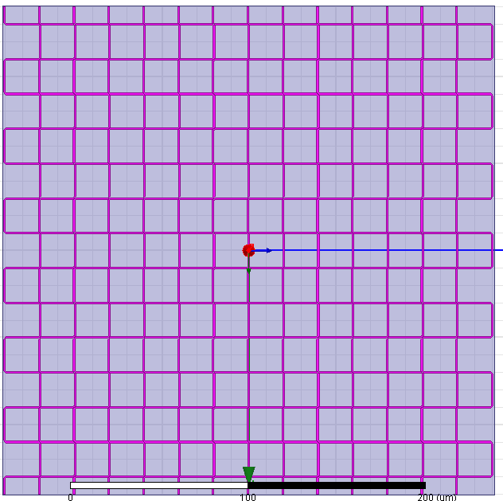

Gen-3: Dual Polarization
TiN:
High sheet resistivity for 350μm photons
  Make each “line” resistance >> capacitive reactance at λ=350μm
TiN Sheet Resistance
Capacitive reactance
Notes:
While we want to continue reducing noise, the gen-2 devices were very close to the BLIP limits needed for single polarization devices. The next biggest gain would be adding a secnd polarization, but we wanted to do this in a fabrication-simple way. So I took advantage of the high sheet resistance of TiN at 350um and used this odd ooking meandered design. Here the inductor meaners around in this pattern such that along each line the incident photons see a line resistance which dominantes over the capactive reactance at 350 micron.

Slide 21
Gen-3: Dual Polarization
TiN:
High sheet resistivity for 350μm photons
  Make each “line” resistance >> capacitive reactance at λ=350μm
  Incident radiation sees TiN effective resistivity
350 um
HFSS:
> 95% absorption in both polarizations at 350μm
Notes:
HFSS simulations predict > 95% absorption in both polarizations

Slide 22
Gen-3: Dual Polarization
TiN:
High sheet resistivity for 350μm photons
  Make each “line” resistance >> capacitive reactance at λ=350μm
  Incident radiation sees TiN effective resistivity
Superconductor at 100 MHz
  Capacitive reactance large compared to inductive path
RF Path
Notes:
Meanwhile the superconductor properties dominate at 100 MHz, where the capacitve reactance is large compared to the inductive path, allowing the signal to just snake on down in a single meander. Therefore we now have a dual-polarization absorber using the same fabrication process as the single pol device.

Slide 23
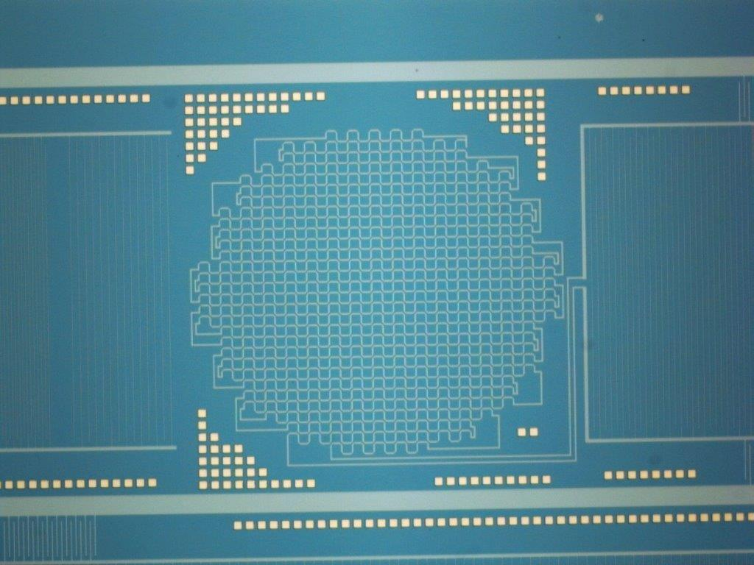
Gen-3: Fabrication
Dual-Polarization inductor
IDC Capacitor (1μm fingers)
Gold added for excess phonon thermalization
Notes:
So I went ahead and made a mask and fabricated the device, a picture of which is shown here. In the center is the dual inductor. Off to the right it is visibly coupled to an IDC, but the lines are made using 1 micron trace widths and barely noticable. In the upper right just barely visible are the coupling capacitor traces. We also added gold squares for excess phonon thermalization.

Slide 24
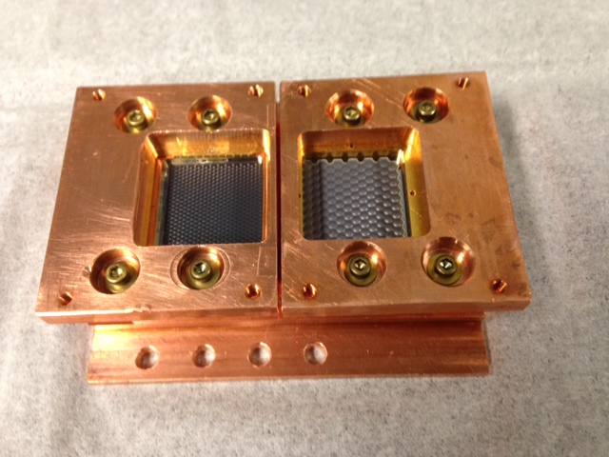
Gen-3: On Sky!
850 micron pixels are similar to 350 micron pixels
Area = 4 mm²
Notes:
So I went ahead and made a mask and fabricated the device, a picture of which is shown here. In the center is the dual inductor. Off to the right it is visibly coupled to an IDC, but the lines are made using 1 micron trace widths and barely noticable. In the upper right just barely visible are the coupling capacitor traces. We also added gold squares for excess phonon thermalization.

Slide 25
Gen-3: On Sky (Aug 2014)
850 μm
350 μm
Total pixels identified: 560 / 600 (93 % yield)
Frequency separation aids with pixel physical location identification but is not required
All measured on single set of RF lines from ROACH ADC/DAC
Notes:
So I went ahead and made a mask and fabricated the device, a picture of which is shown here. In the center is the dual inductor. Off to the right it is visibly coupled to an IDC, but the lines are made using 1 micron trace widths and barely noticable. In the upper right just barely visible are the coupling capacitor traces. We also added gold squares for excess phonon thermalization.

Slide 26
Gen-3: Pixel noise limits?
Sky emissivity > 90%: Too hot to do good BLIP tests
But all KID noise sources are RF power dependent
  Reduce power by 15 dB, see amplifier noise go up
  If it were dominant source would increase ~ 30x. So dominant noise source is not amplifier or TLS. Dominated either by sky noise or shot noise!
Notes:
So I went ahead and made a mask and fabricated the device, a picture of which is shown here. In the center is the dual inductor. Off to the right it is visibly coupled to an IDC, but the lines are made using 1 micron trace widths and barely noticable. In the upper right just barely visible are the coupling capacitor traces. We also added gold squares for excess phonon thermalization.

Slide 27
Conclusions
MAKO had its second run Aug/Sept 2014
  Demonstrated improved NEP (at least 4x improvement)
  Dual Polarization worked to within 10% of simulations
  350/850 micron demonstrated
Have developed a low-per pixel readout and fab cost which meets the NEP and cost needs for large-scale arrays
Continued development will reduce costs and improve NEP further
Notes:
I’ll finish by saying that MAKO is returning to the sky in August – I’m flying back to pack everything tomorrow. We hope to demonstrate better on sky performance with the new detectors, and currently have packaged the dual-polarziation design. We’ve developed a low per-pixel readout and fabrication cost which meet the NEP and cost needs for large scale arrays. We hope that continued devleopment will reduce costs and improve the NEP further. Thanks.

