Slide 1
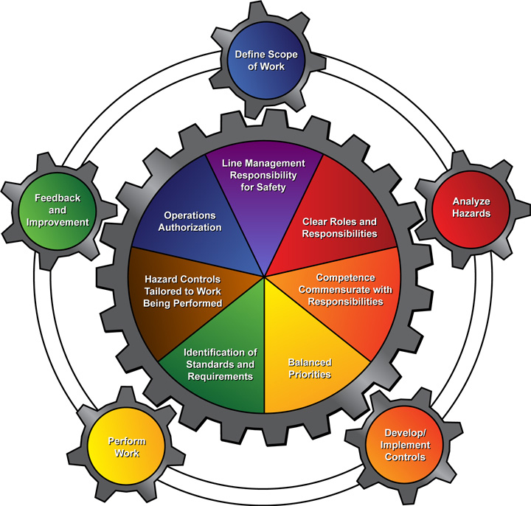
Integrated
Safety
Management
Integrated
Safety
Management
High Energy Physics Division
ISM__June 2014
Leon Reed

Slide 2
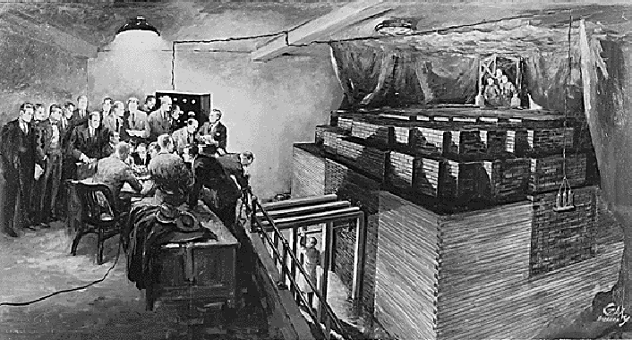
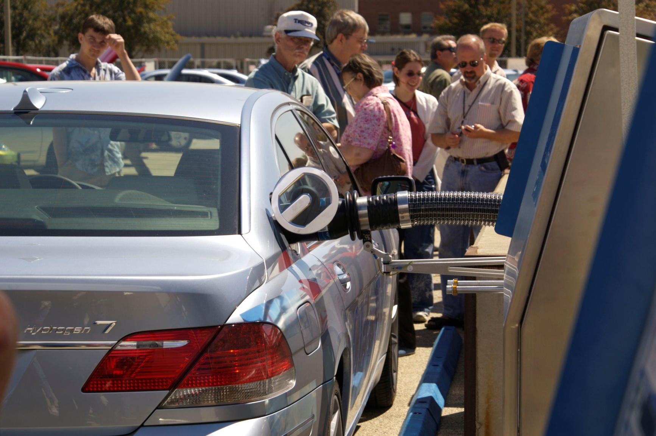
The evolution of ISM, Argonne’s mission of science research and technology
...the first sustained nuclear chain reaction
…to Argonne's research on advanced transportation technologies

Slide 3

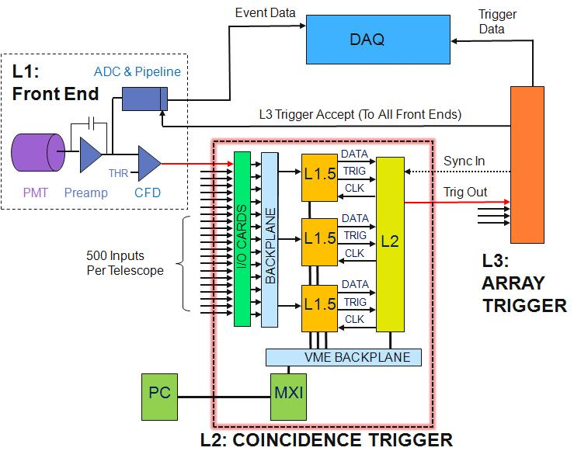

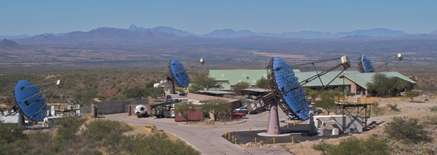
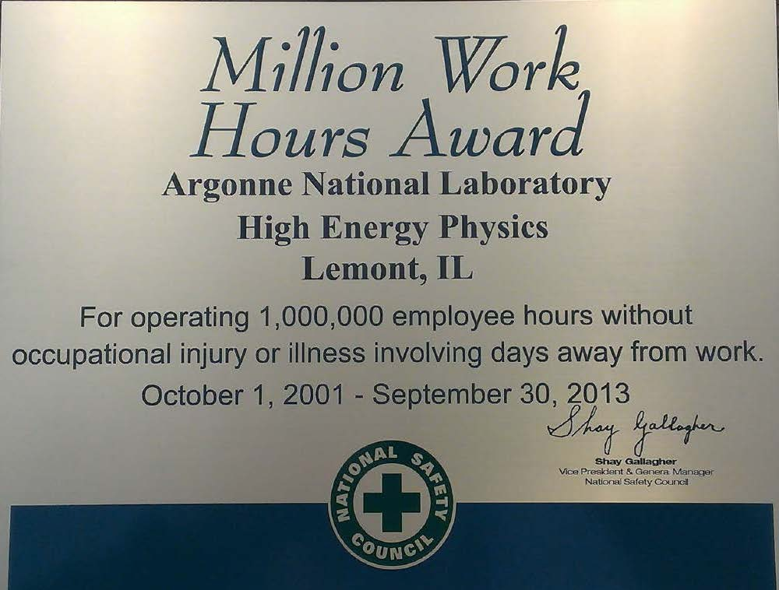

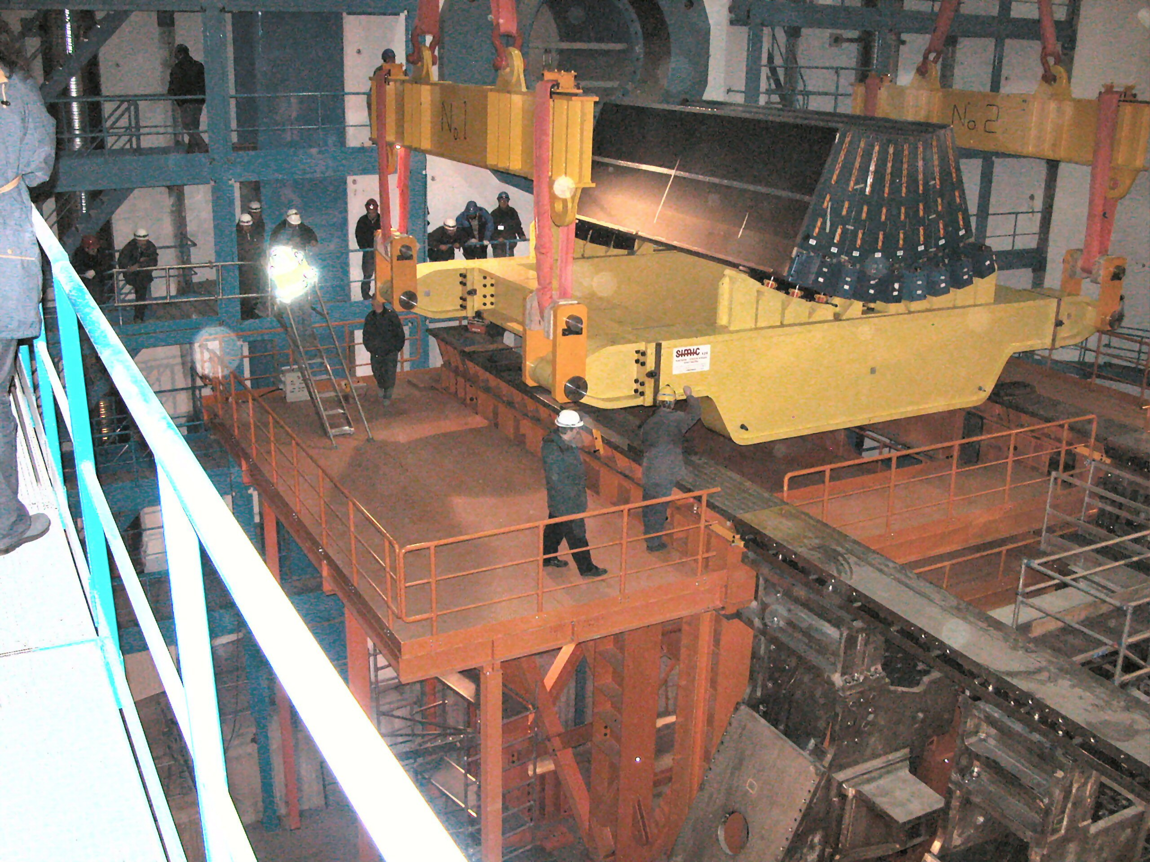
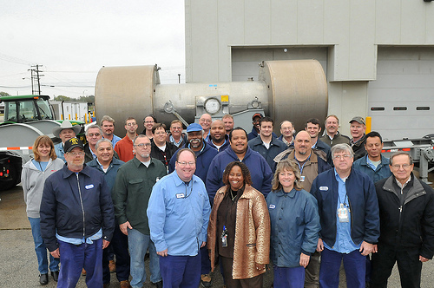
ensure safety in the workplace, support Argonne’s mission, and embrace LMS-PROC-200 (WP&C)

Slide 4
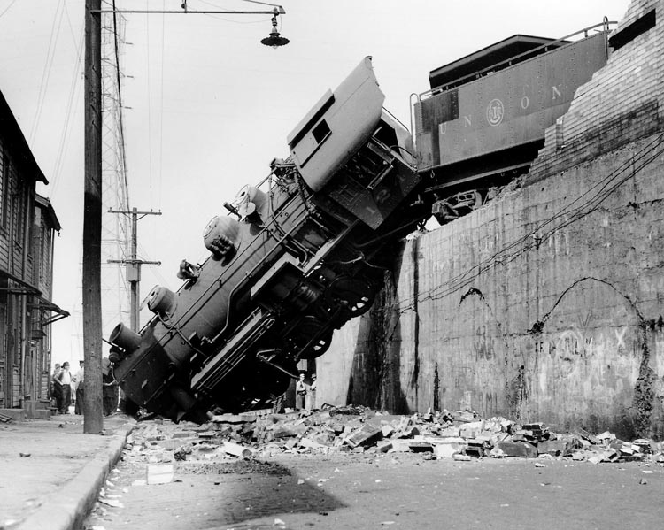
____ _____ _____ _____ HAPPENS
Work Planning and Control (WP&C) is part of ISM
WP&C, LMS-PROC-200 establishes the requirements for written Work Control Documents (WCDs) for work projects
“ISM” is a process achieved through Planned, Documented and Controlled Work Activities

Slide 5
Argonne’s Recent Incidents
According to statistics, one in two million unsafe acts results in a fatality
  Every fatality starts with an unsafe act
  For every 2 million unsafe acts, there are 240,000 near misses, 20,000 minor injuries, 400 reportable
  serious injuries leading up to a death
1
Fatality
400
Reportable Injuries
20,000
Minor Injuries
240,000
Near Misses
2 Million
Unsafe Acts

Slide 6
ISM is good housekeeping
Laboratory Director Peter B. Littlewood encourages organizations and individuals to focus on improving housekeeping postures.
HEP is a current participant in the Laboratory audit during the months of June and July 2014 as it pertains to housekeeping and physical examination of all division lab and office space.
Message from the Laboratory Director
By accessing the link https://www.youtube.com/embed/OfPjYmnInJg?rel=0 hear more from the Lab Director about ISM.

Slide 7

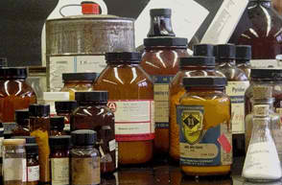
chemical waste cost brings a new chemical management system
the Chemical Ordering, Records, and Attribute Library (CORAL) creates and manages chemical records, inventories and tracks chemicals using new SDS labeling format and RFID tag
December 1, 2013 ESH 196A employee training on labels, SDS format
June 1, 2015 Manufacturers and vendors comply with SDS labeling
December 1, 2015 Last day vendors ship with old labeling system
...Arrange with division safety coordinator and dispose legendary chemical waste..

Slide 8
Points for Discussion….
HEP conducts different kinds of work. All work has potential hazards.
Point #1
document the controls for all foreknown hazards …especially when the potential for those hazards exceed some laboratory threshold
Discuss work activity with your group leader if you’re uncertain about the need for WP&C documentation -- the group leader judges if WP&C doc is needed, he/she then contacts the ES&H coordinator
Point #2
chemical mismanagement cost 3 times the purchase cost for waste
Point #3
good housekeeping is good ISM

Slide 9
)(ancient safety proverbs)(
)(The course to Integrated Safety Management is to ensure safety, reduce cost and the chance for misfortune)(

