Slide 1

Division of High Energy Physics
2D Crystals – Future of Innovative Devices
Saptarshi Das, PhD
Current Affiliations
(June 2013 – Present)
Post-doctoral Research Scholar
Division of High Energy Physics
Argonne National Laboratory
Lemont, Illinois 60439
2. Adjunct Birck Research Scholar
Birck Nanotechnology Center
Purdue University
West Lafayette, Indiana 47907

Slide 2
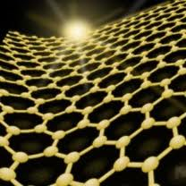
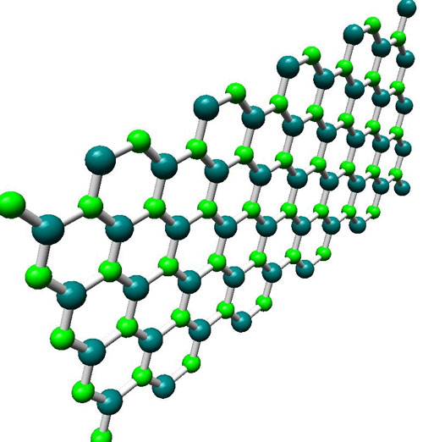
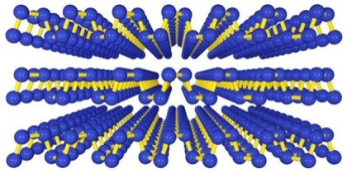
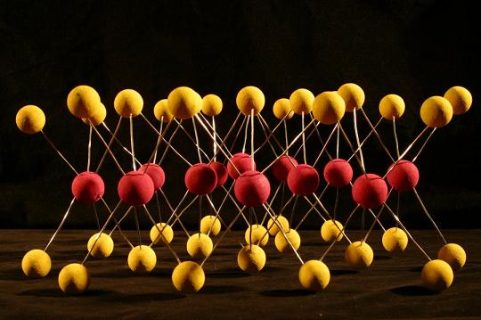
Natural 2D Crystals
Division of High Energy Physics
Excellent Conductor
Excellent Insulator
Graphene
h-BN
Phosphorene
Excellent Semiconductors
Transition Metal Dichalcogenides

Slide 3
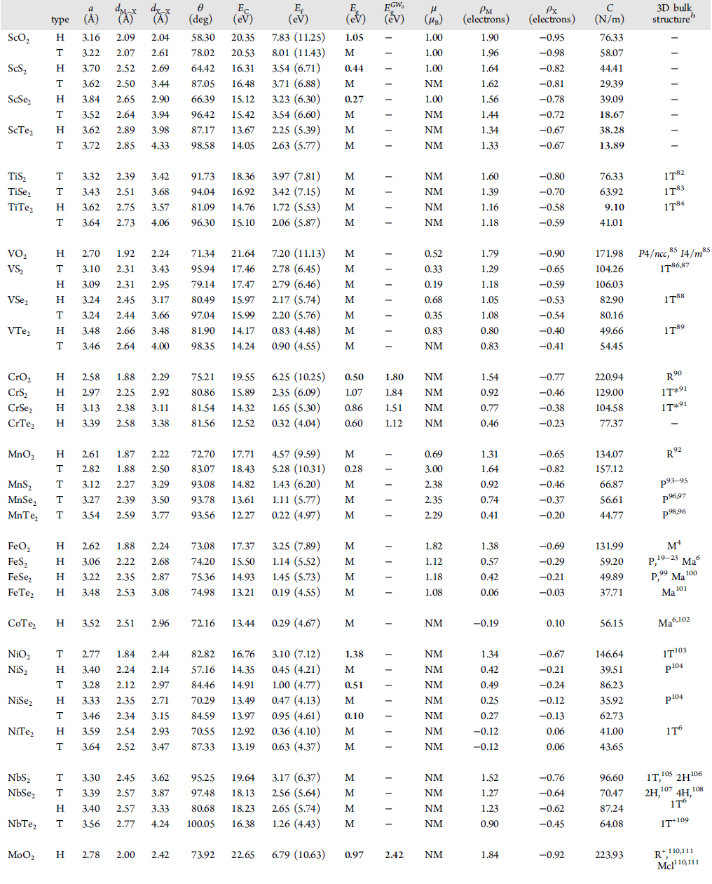
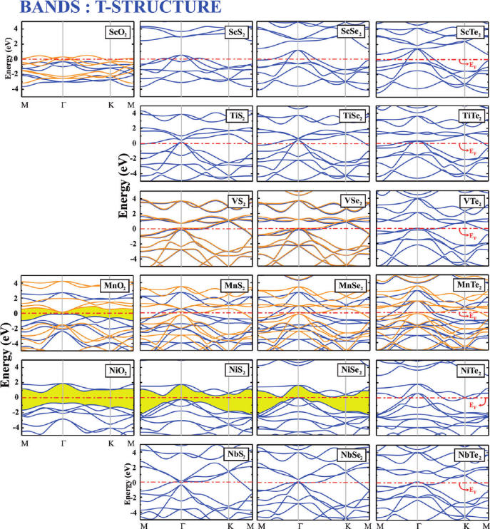
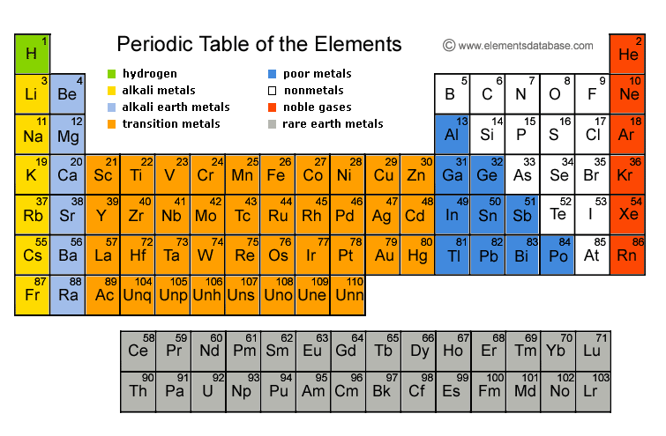
Natural 2D Crystals
Division of High Energy Physics
Transition Metal Dichalcogenides
88 TMDs have been explored since 1960s
Metals: ScTe₂ ,TaS₂ , etc.
Semiconductors: WSe₂ , MoS₂, etc.
Insulators: PtSe₂ ,PdS₂ , etc.
Superconductors: VS₂ , NbSe₂ , etc.
Periodic Table of Elements
MX₂
M = Transition Metal
X = Chalcogen

Slide 4
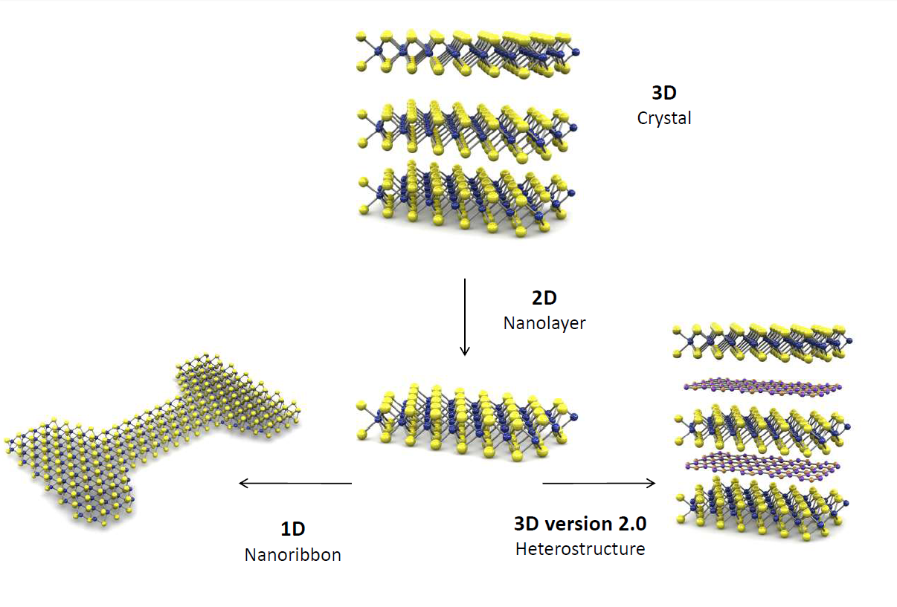
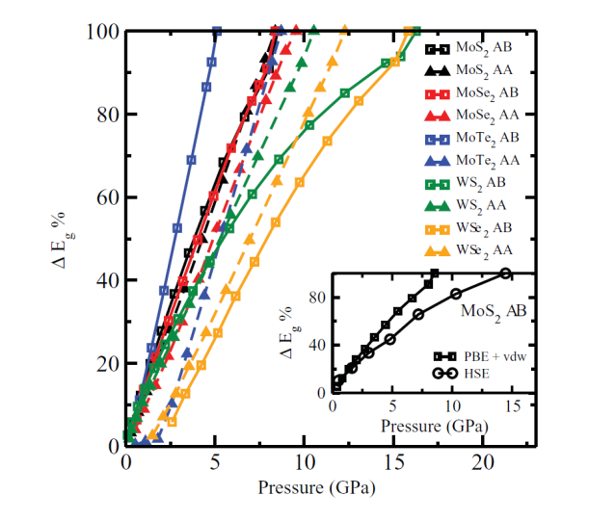
Tunable Electronic Structure
Division of High Energy Physics
Electric Field
Mechanical Force
Thermal Gradient
Thickness Scaling
Ashok Kumar, et al. Modeling and Simulation in Material Science and Engineering, 21, 065015, 2012
Swastibrata Bhattacharyya, et al. Physical Review B, 86, 075454, 2012
Green Devices
Gate Tunable Electrical, Mechanical, Thermal and Optical Properties
Advanced Electronics Components
Detectors
Amplifiers
Filters
Modulators
Resonators
Ultra Low Power
High Performance
Gate
Dielectric
Piezoelectric
Thermoelectric
Source
Drain
Substrate

Slide 5
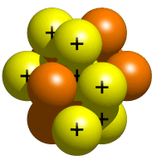
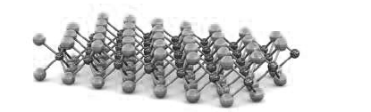
Engineering Novel Materials
Division of High Energy Physics
Intercalation of Ions
Induced Superconductivity
Controlled Growth
Physical Stacking

Slide 6

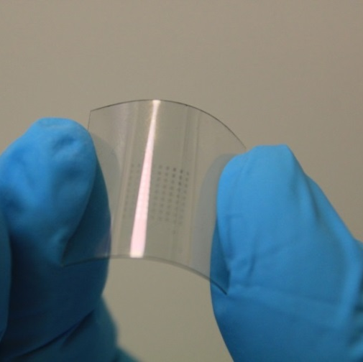
Flexible and Transparent Electronics
Division of High Energy Physics
Strain Effect: Flexibility
Without Strain
With Strain
Device Transparency
Active Device on Flexible Substrate
WSe₂ Flakes
Thinnest Thin Film Transistor Ever
(only 10 atomic layers: 3-4nm)
Wireless Detectors
Energy Efficient
Cost Effective
High Performance
Saptarshi Das, et al. All Two Dimensional, Flexible, Transparent and Thinnest Thin Film Transistor. Nano Letters 14 (5), 2014.

Slide 7
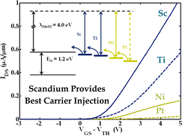
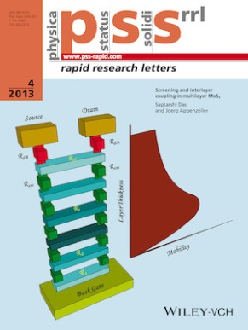
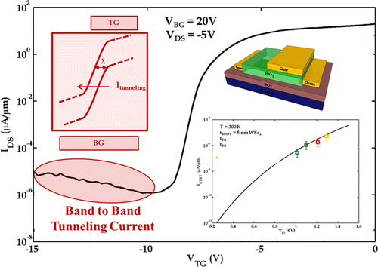
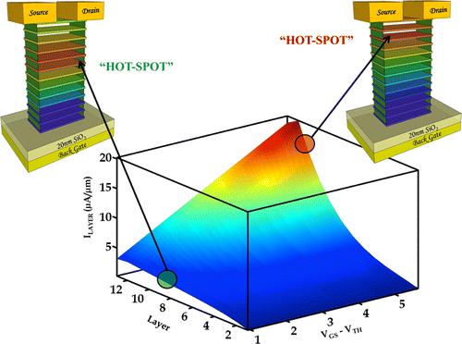

Accomplished Work
Division of High Energy Physics
Saptarshi Das. et al. High Performance Multi-layer MoS₂ Transistor with Sc Contacts.
Nano Letters, 13(1), 2013.
Nano Letters Top 20 Cited Article of 2013
Saptarshi Das, et al., Screening and Interlayer Coupling in Multilayer MoS₂
Physica Status Solidi, RRL, 7 (4), 2013.
Cover Article of the Journal
Saptarshi Das. et al. WSe₂ FET with Enhanced Ambipolar Characteristics.
Applied Physics Letters, 103, 2013.
Saptarshi Das, et al. All Two Dimensional, Flexible, Transparent and Thinnest Thin Film Transistor.
Nano Letters 14 (5), 2014.
Saptarshi Das. et al. Towards Low Power Electronics: Tunneling Phenomenon in TMDs ACS Nano, 8(2), 2014.
Saptarshi Das, et al. Where does the Current Flow in the Two Dimensional Layered Systems.
Nano Letters, 13 (7), 2013.

Slide 8
Division of High Energy Physics
Thank You

