Slide 1

Division of High Energy Physics
2D Crystals – Future of Innovative Devices
Saptarshi Das, PhD
Current Affiliations
(June 2013 – Present)
Post-doctoral Research Scholar
Division of High Energy Physics
Argonne National Laboratory
Lemont, Illinois 60439
2. Adjunct Birck Research Scholar
Birck Nanotechnology Center
Purdue University
West Lafayette, Indiana 47907

Slide 2
Division of High Energy Physics
Overview of 2D Crystals
Bandgap Engineering for Innovative Electronics
Flexible and Transparent Electronics
Conclusion

Slide 3
Division of High Energy Physics
Overview of 2D Crystals
Bandgap Engineering for Innovative Electronics
Flexible and Transparent Electronics
Conclusion

Slide 4
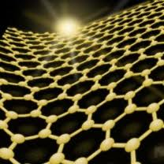
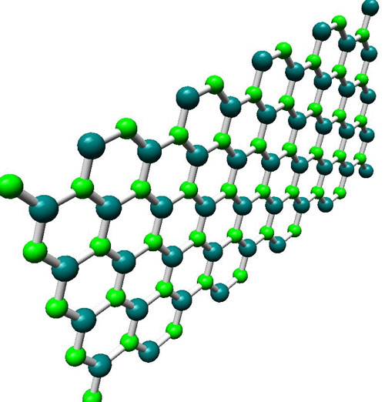
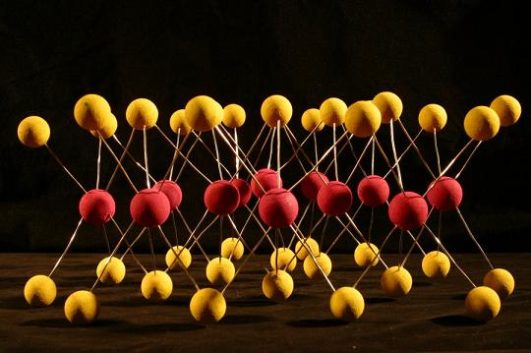
Natural 2D Crystals
Division of High Energy Physics
Excellent Conductor
Excellent Insulator
Graphene
h-BN
Transition Metal Dichalcogenides

Slide 5
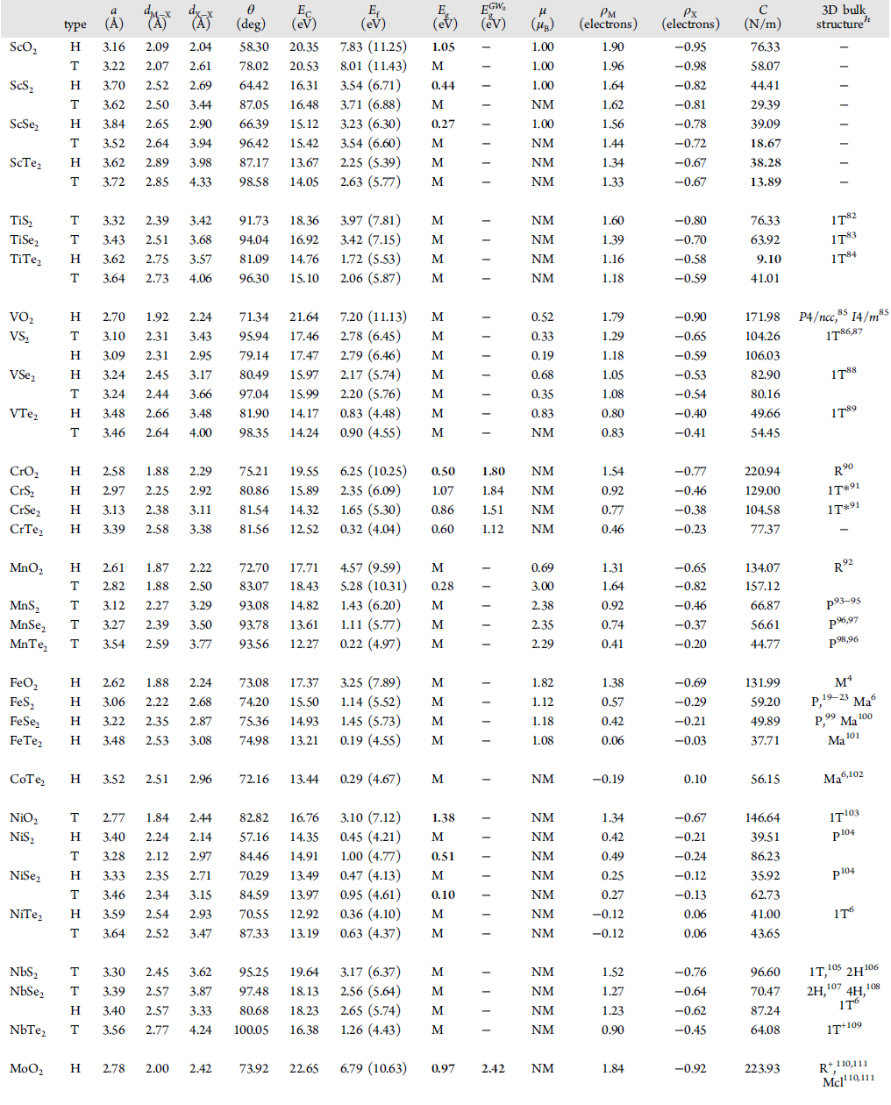
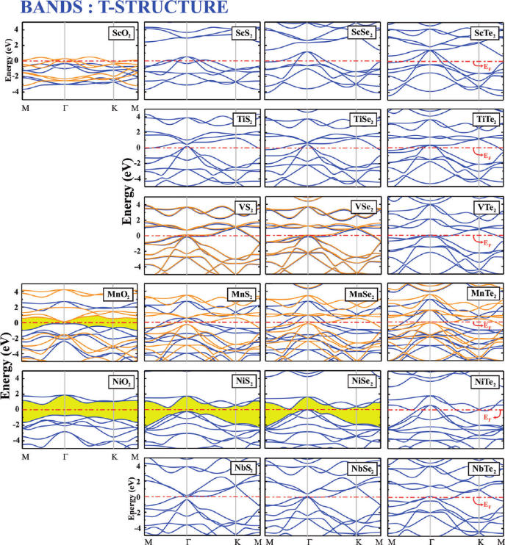
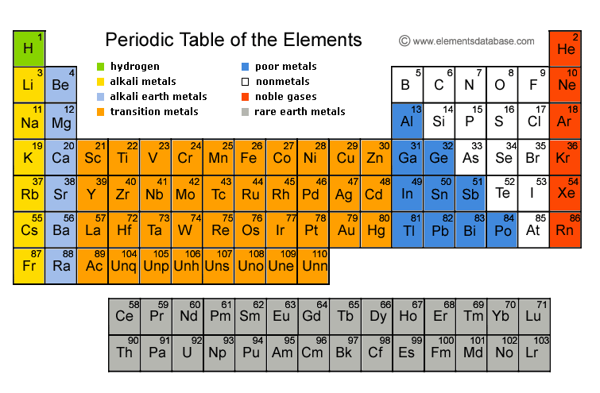
Natural 2D Crystals
Division of High Energy Physics
Transition Metal Dichalcogenides
88 TMDs have been explored since 1960s
Metals: ScTe₂ ,TaS₂ , etc.
Semiconductors: WSe₂ , MoS₂, etc.
Insulators: PtSe₂ ,PdS₂ , etc.
Superconductors: VS₂ , NbSe₂ , etc.
Periodic Table of Elements
MX₂
M = Transition Metal
X = Chalcogen

Slide 6
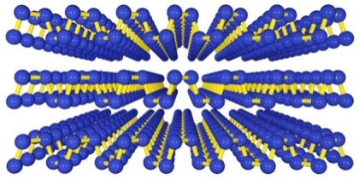
Natural 2D Crystals
Division of High Energy Physics
Excellent Conductor
Excellent Insulator
Graphene
h-BN
Phosphorene
Transition Metal Dichalcogenides

Slide 7
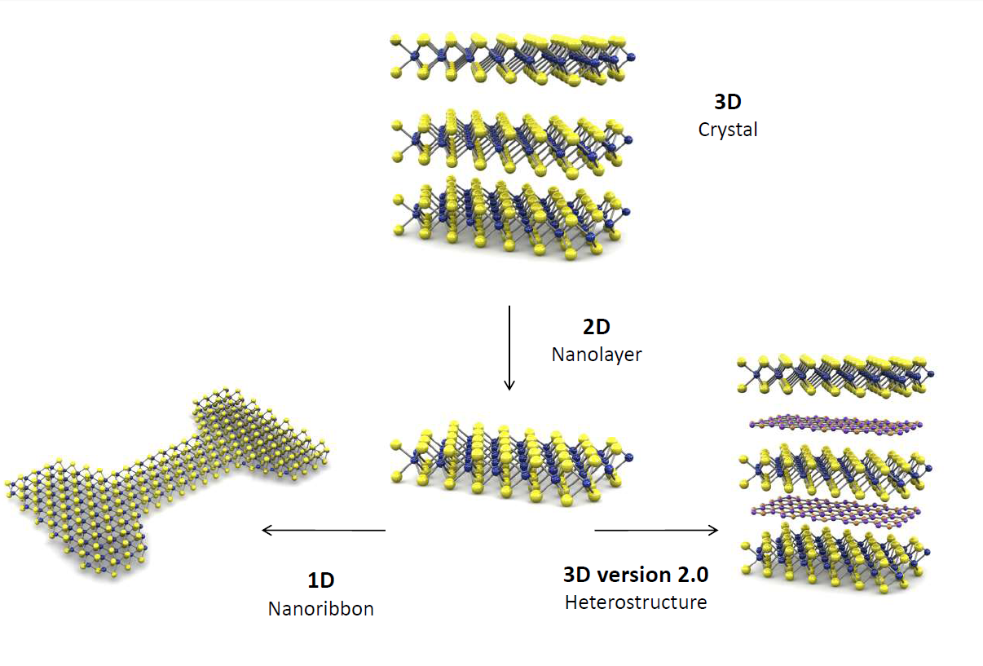
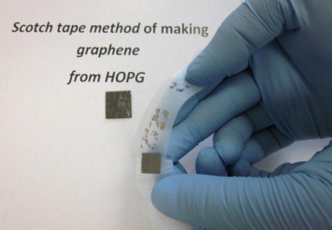
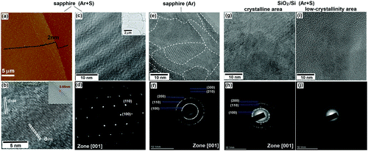
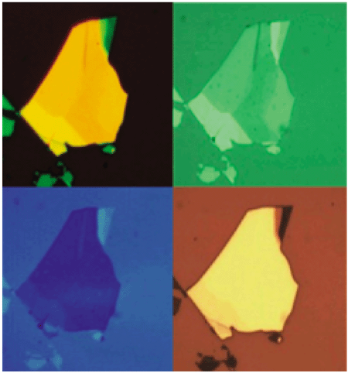
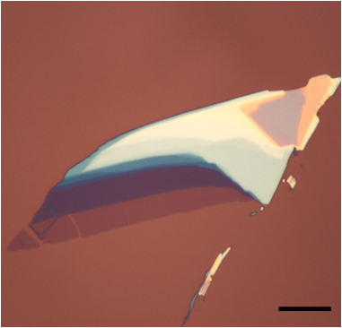
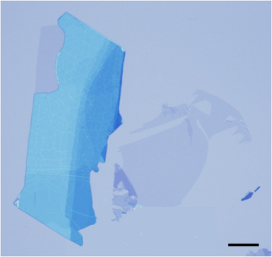
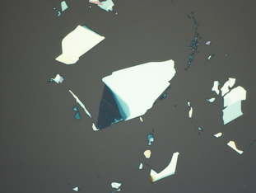
Exfoliation
Division of High Energy Physics
Large Scale Growth
Physical Vapor Deposition
Hydrothermal Synthesis
Electrochemical Synthesis
Liu, K. et al. Nano Letters, 12, 2012
Patel, P. R., et al. J.Adv.Dev.Res. 3, 2012

Slide 8
Layered Compounds
Division of High Energy Physics
Notes:
.

Slide 9
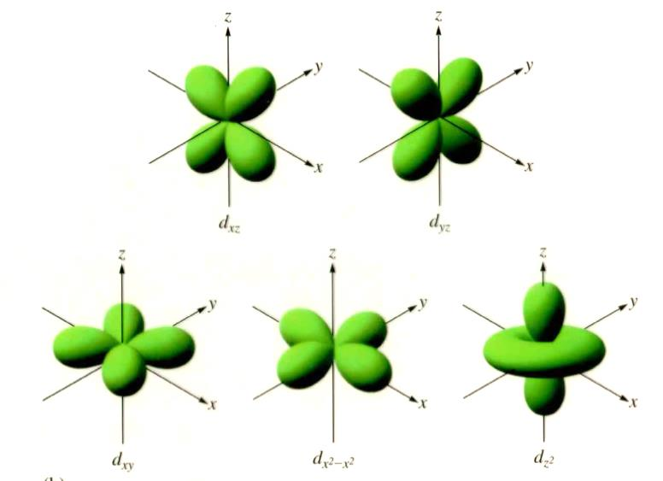
The d-orbital electronics
Division of High Energy Physics
Mo: [Kr]. 5d⁵.6s¹
W: [Xe].4f¹⁴.5d⁴.6s²
For the first time we have Semiconductors with conduction electrons contributed by d-orbital
Periodic Table of Elements
Significant Change in Band-structure due to :
Charge
Strain
Heat
Light
MX₂
M = Transition Metal
X = Chalcogen

Slide 10
Division of High Energy Physics
Overview of 2D Crystals
Bandgap Engineering for Innovative Electronics
Flexible and Transparent Electronics
Conclusion

Slide 11
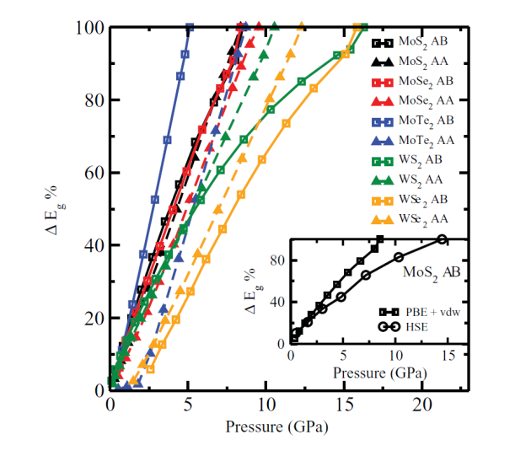
Metal Insulator Transition in TMDs
Division of High Energy Physics
Electric Field
Mechanical Force
Thermal Gradient
Thickness Scaling
Ashok Kumar, et al. Modeling and Simulation in Material Science and Engineering, 21, 065015, 2012
Swastibrata Bhattacharyya, et al. Physical Review B, 86, 075454, 2012
Green Devices
Gate Tunable Electrical, Mechanical, Thermal and Optical Properties
Advanced Electronics Components
Detectors
Amplifiers
Filters
Modulators
Resonators
Ultra Low Power
High Performance
Gate
Dielectric
Piezoelectric
Thermoelectric
Source
Drain
Substrate

Slide 12

Phosphorene
Saptarshi Das, et al. Tunable Transport Gap in Phosphorene.
under review, 2014.
Division of High Energy Physics
Phosphorene
T = 300K
V_{DS} = -0.2 V
Ni
Contact
2 Layers
4 Layers
6 Layers
10 Layers
25 Layers
Ni
Contact
5 µm

Slide 13
Division of High Energy Physics
Overview of 2D Crystals
Bandgap Engineering for Innovative Electronics
Flexible and Transparent Electronics
Conclusion

Slide 14
All 2D Thin Film Transistor
Division of High Energy Physics
WSe₂
Graphene
Al
Al
20nm SiO2: Back Gate Oxide
Highly Doped Si: Back Gate Electrode
Exfoliation and identification of WSe₂ flakes
Transfer of CVD grown graphene
Electron beam lithography followed by Al evaporation to create mask for graphene etch
Oxygen plasma etch of graphene from the channel area

Slide 15
All 2D Thin Film Transistor
Division of High Energy Physics
WSe₂
Al
Graphene
Al
h-BN
Al
Al
Al
20nm SiO2: Back Gate Oxide
Highly Doped Si: Back Gate Electrode
Transfer of few layer h-BN
Removal of Al from the graphene-WSe₂ contact interface
Transfer of CVD grown graphene
Electron beam lithography of Al etch mask for patterning graphene top gate electrode
Oxygen plasma etch of graphene

Slide 16
All 2D Thin Film Transistor
Division of High Energy Physics
WSe₂
Al
Graphene
Al
Al
h-BN
20nm SiO2: Back Gate Oxide
Highly Doped Si: Back Gate Electrode
Removal of Al etch mask

Slide 17
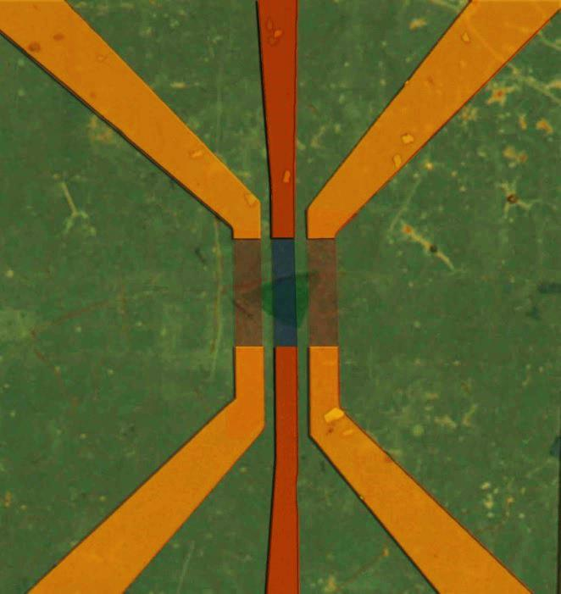
All 2D Thin Film Transistor
Saptarshi Das, et al. All Two Dimensional, Flexible, Transparent and Thinnest Thin Film Transistor.
Nano Letters 14 (5), 2014.
Division of High Energy Physics
Back Gate Transfer Characteristics
V_{DS} = -1.0 V
Bi-Layer WSe₂ Flake
Graphene Contact
20nm SiO₂ Gate Dielectric
Graphene / h-BN Top Gate
Graphene
Drain
Graphene
Source
Ambipolar Conduction
Bi-Layer
WSe₂
Mobility: 24 cm²/V.s
ON/OFF : 2x10⁷
Electron Branch
Hole Branch
5µm
Mobility: 45 cm²/V.s
ON/OFF : 7x10⁷

Slide 18
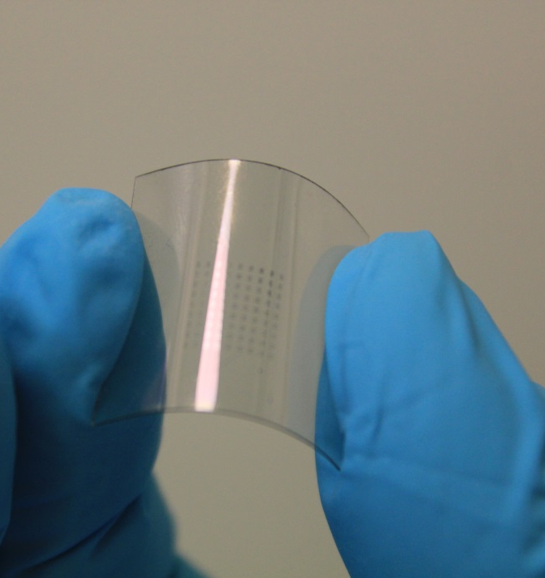
Flexible TFT on PET
Division of High Energy Physics
Transfer
Characteristics
V_{DS} = -1.0 V
V_{DS} = -0.1 V
Bi-Layer WSe₂ Flake
Graphene Contact
h-BN Gate Dielectric
Output Characteristics
V_{GS} = -0.6V:0.1V:-0.3V
(f)

Slide 19

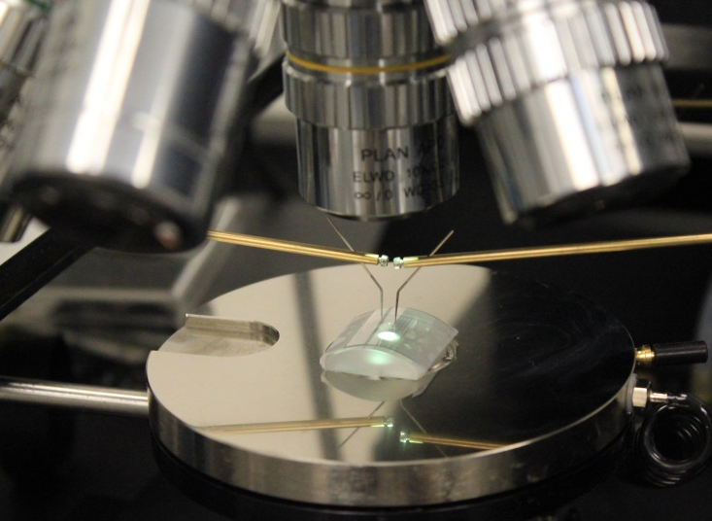
Effect of Strain
Division of High Energy Physics
Top Gate Transfer Characteristics
Without Strain
With Strain
3-Layer WSe₂ Flake
Graphene Contact
van der Walls epitaxy compensates for strain
(f)

Slide 20
Optical Transparency
Division of High Energy Physics
Active Device on Flexible Substrate
WSe₂ Flakes
Active device was found to be 88% Transparent
(f)

Slide 21
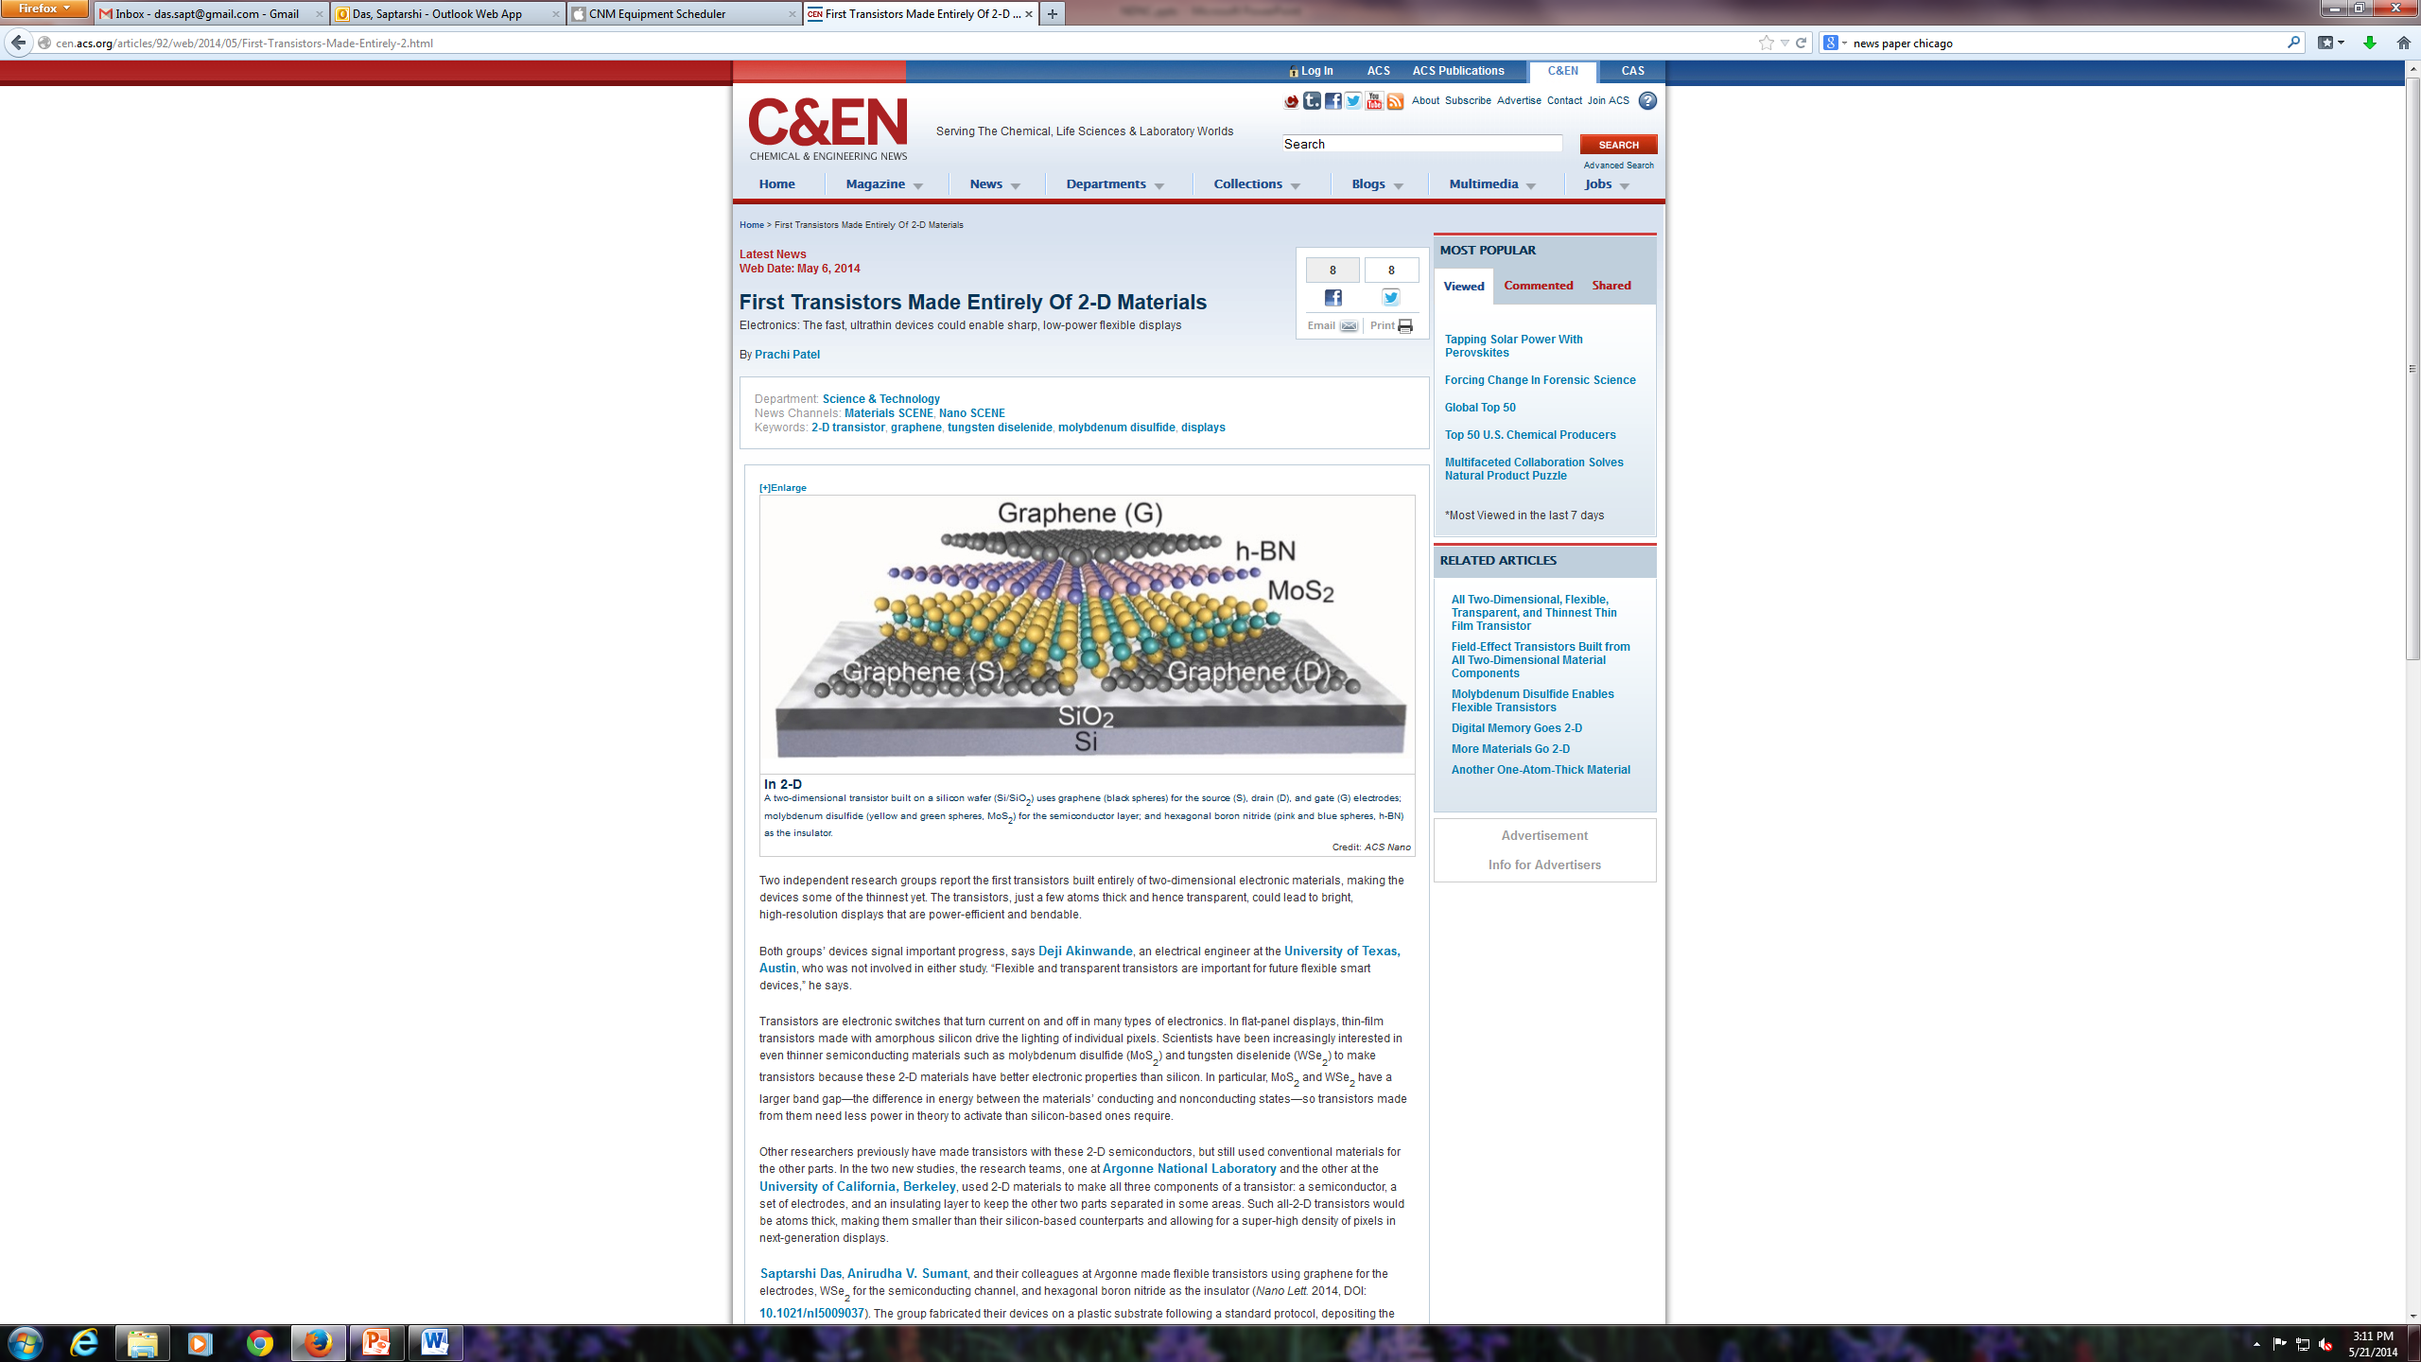

Thinnest Transistor Ever
Saptarshi Das, et al. All Two Dimensional, Flexible, Transparent and Thinnest Thin Film Transistor.
Nano Letters 14 (5), 2014.
Center for Nanoscale Materials
All Two Dimensional
High Mobility
(100x better than a-Si)
High ON-OFF current ratio
Ambipolar
Flexible and
Transparent
Thinnest Thin Film Transistor
(3-4nm)
Wireless Detectors
Energy Efficient
Cost Effective
High Performance

Slide 22
Division of High Energy Physics
Overview of 2D Crystals
Bandgap Engineering for Innovative Electronics
Flexible and Transparent Electronics
Conclusion

Slide 23
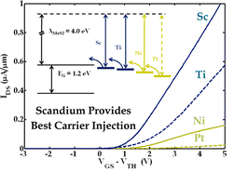
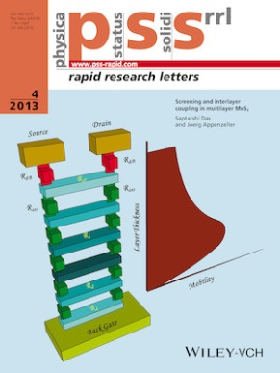
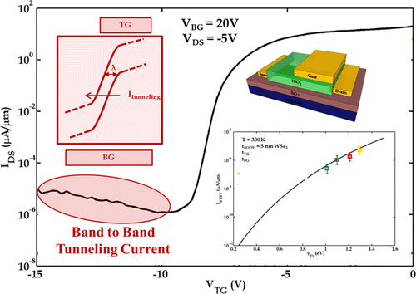
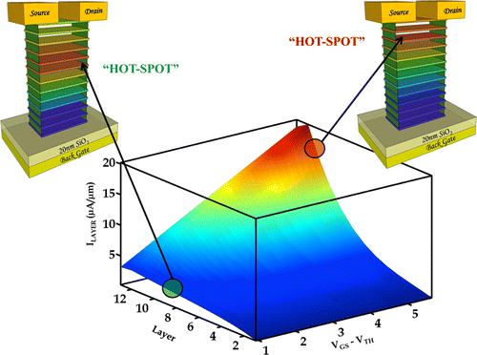
Conclusion
Division of High Energy Physics
Saptarshi Das. et al. High Performance Multi-layer MoS₂ Transistor with Sc Contacts.
Nano Letters, 13(1), 2013.
Nano Letters Top 20 Cited Article of 2013
Saptarshi Das, et al., Screening and Interlayer Coupling in Multilayer MoS₂
Physica Status Solidi, RRL, 7 (4), 2013.
Cover Article of the Journal
Saptarshi Das. et al. WSe₂ FET with Enhanced Ambipolar Characteristics.
Applied Physics Letters, 103, 2013.
Saptarshi Das. et al. Towards Low Power Electronics: Tunneling Phenomenon in TMDs ACS Nano, 8(2), 2014.
Saptarshi Das, et al. Where does the Current Flow in the Two Dimensional Layered Systems.
Nano Letters, 13 (7), 2013.

Slide 24
Conclusion
Division of High Energy Physics
Extreme Sensitivity and Tunability of 2D Crystals make them viable for Energy Efficient, High Performance and Low Cost Detector Designs

Slide 25


Acknowledgement
Division of High Energy Physics
Postdoc Advisor
Dr. Andreas Roelofs
Director of Nanoscience and Technology Division
Argonne National Laboratory
Lemont, Illinois, 60439
PhD Advisor
Dr. Joerg Appenzeller
Scientific Director of Birck nanotechnology Center &
Professor of Electrical and Computer Engineering
Purdue University
West Lafayette, Indiana, 47907
Collaborators
Marcel Demarteau
Wei Zhang
Richard Gulotty
Abhijith Prakash
This work is supported by the DOE Office of High Energy Physics under DoE contract number DE-AC02-06CH11357
Use of the Center for Nanoscale Materials was supported by the U. S. Department of Energy, Office of Science, Office of Basic Energy Sciences, under Contract No. DE-AC02-06CH11357.

