Slide 1
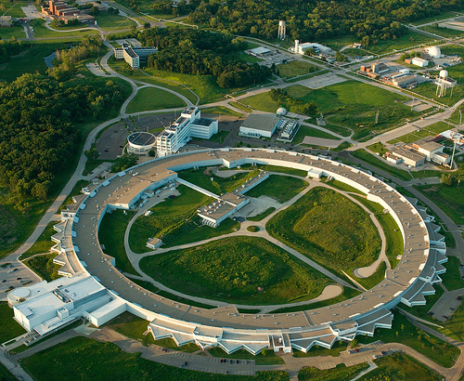
X-Ray Detector Development at ANL/APS
Antonino Miceli & Robert Bradford
Detectors Group/XSD
August 1, 2014
MPI-HLL visit

Slide 2
Outline
APS Group Overview
  Detector Pool
  Detector testing beamline @ 1-BM
  DAQ electronics
  Detector R&D
Superconducting energy dispersive detector (i.e., MKIDs) for x-ray spectroscopy
Germanium strip detectors for energy-dispersive diffraction
MHz-framing integrating pixel detectors (“FASPAX”) for dynamic phenomena
Sparsified pixel detectors for time-resolved x-ray speckle (“VIPIC”)

Slide 3
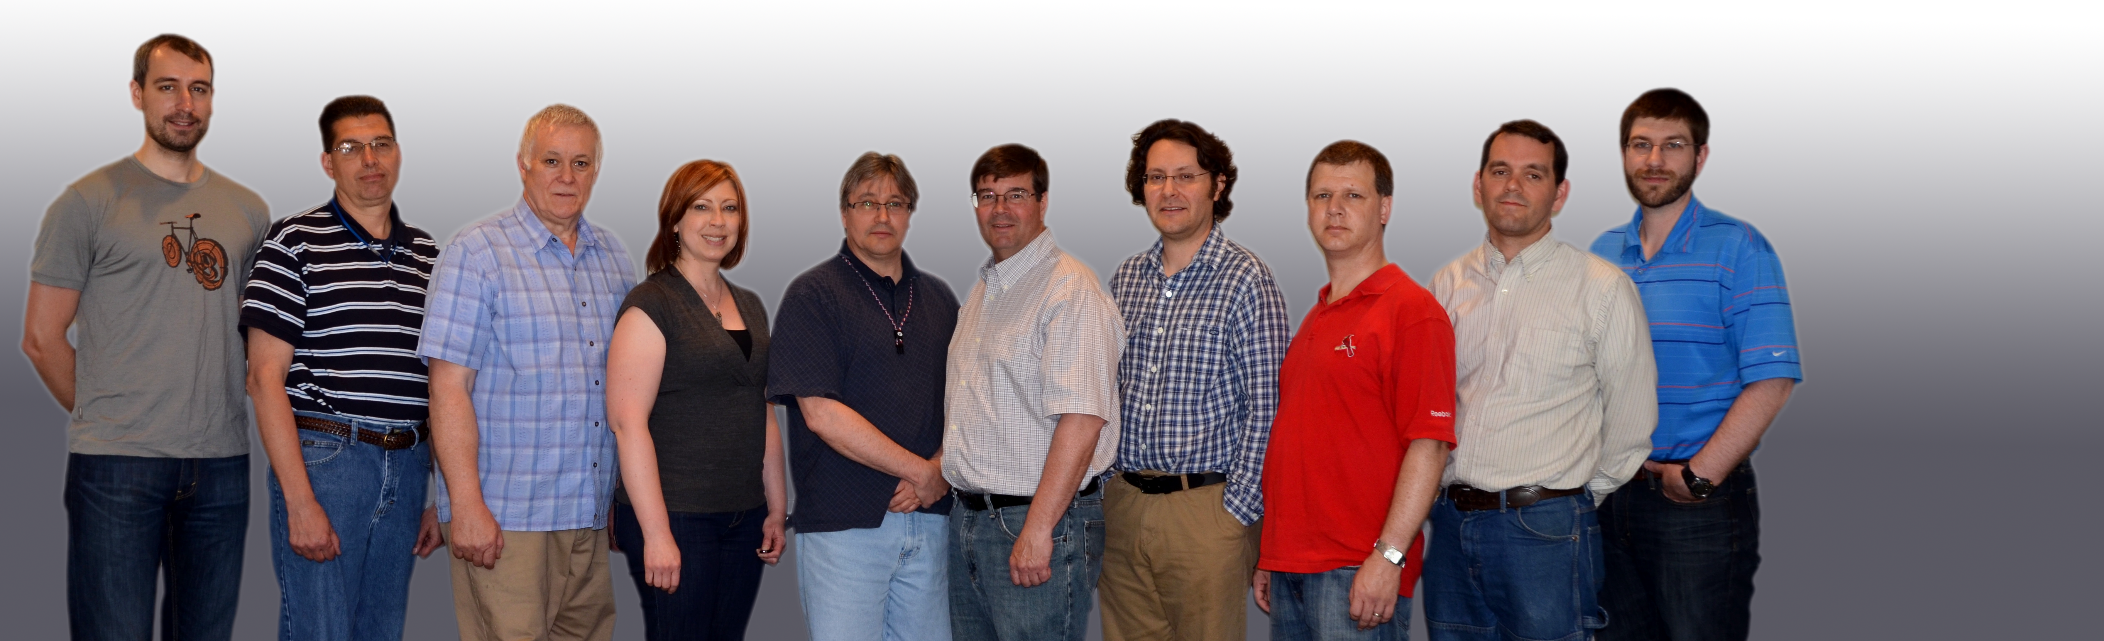
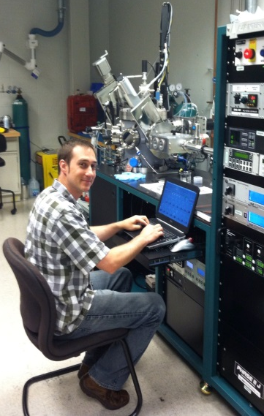
APS Detectors Group
Detector Pool
Moore, Woods, Piatak
Multiplexing of cutting-edge commercial detectors across APS
Testing beamline at 1-BM
Detector Electronics
Kline, Madden, Weizeorick, Baldwin
DAQs, timing distribution, V-to-F, CCDs
Detector R&D
Bradford, Cecil, Gades, Yan (PhD student)
Superconducting detectors
Pixel array detectors
Collaborators
ANL/UChicago Low Temp Detectors (Chang et al)
Fermilab ASIC group: FASPAX, VIPIC
BNL: VIPIC, Ge strip (Siddons et al)
US small businesses: Agiltron, RMD, Voxtel

Slide 4
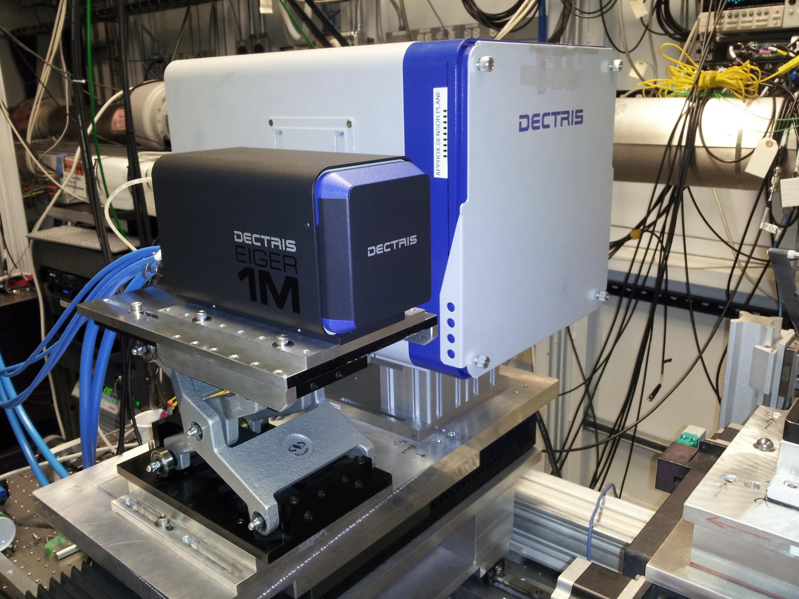
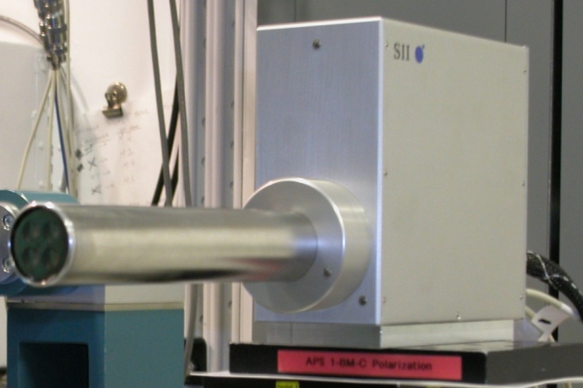
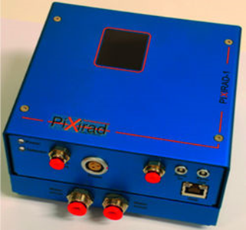
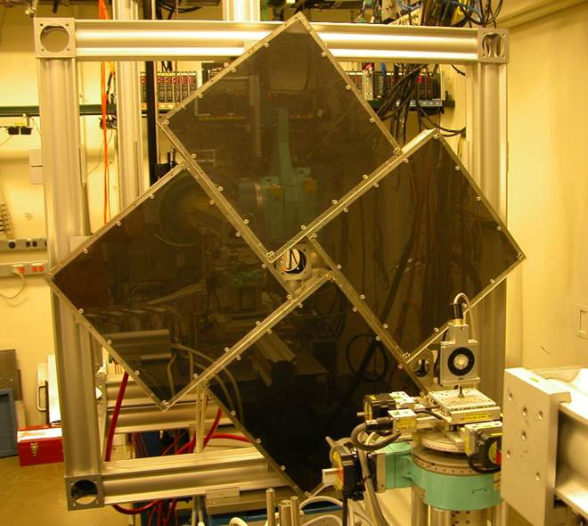
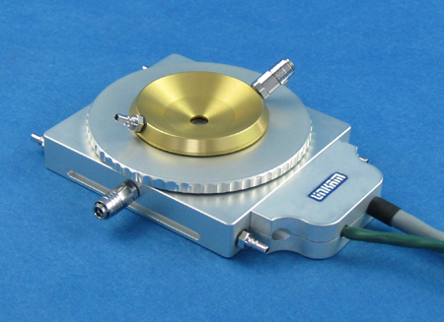
APS Detector Pool
Outlet to introduce new, cutting‐edge commercial detectors to the entire APS community
  GE a‐Si flat panels, Vortex ME-4 SDDs, Pilatus, Pixirad CdTe & Eiger
~ 500 requests/year!
24/7 support
Dectris Pilatus & Eiger
Hitachi 4x SDDs
Pixirad CdTe PAD (INFN-Pisa)
GE a-Si flat panels (4x)
Thermal Stages
Scintillator Microscope
~ 120 cm

Slide 5
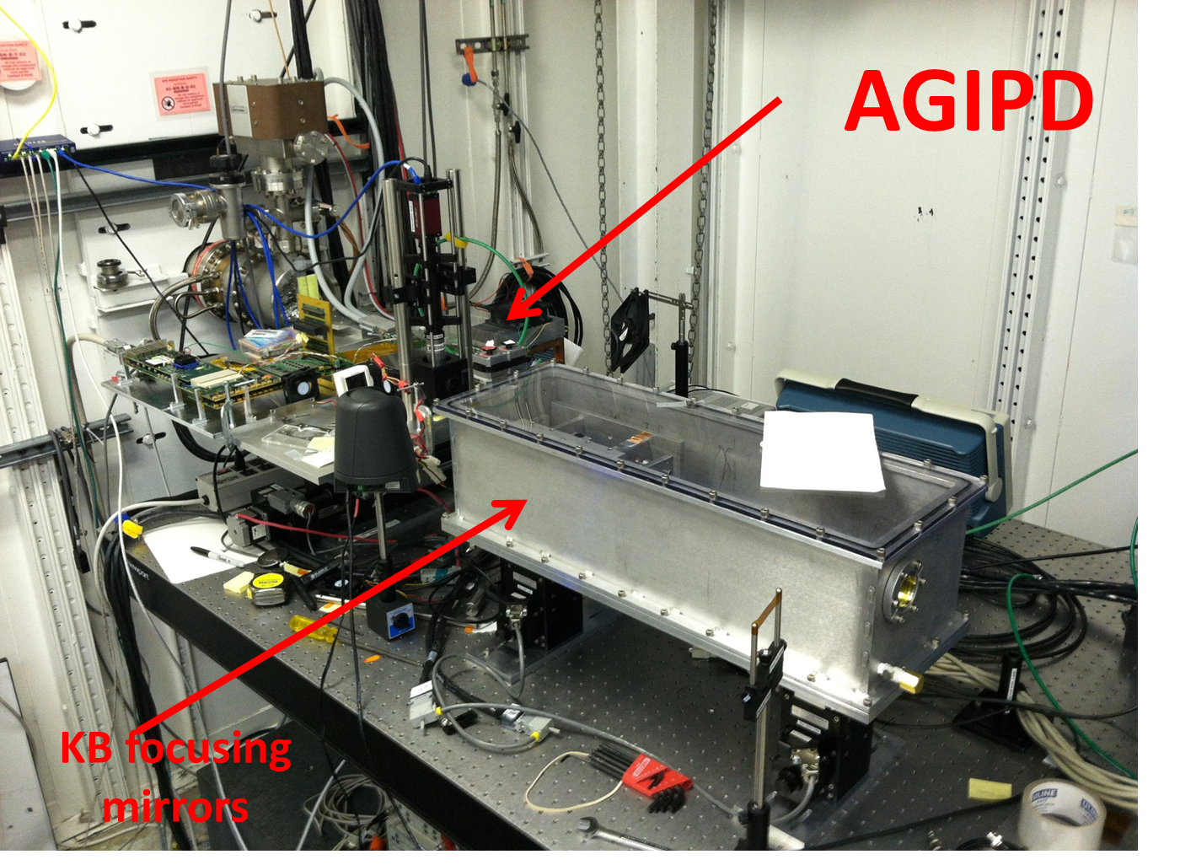
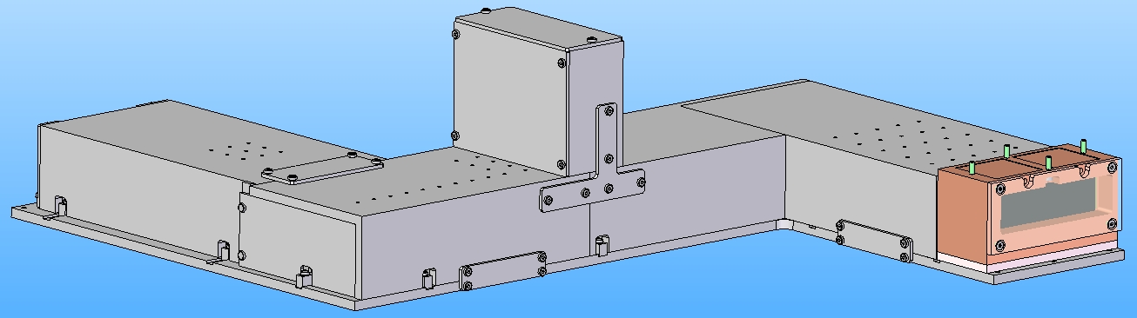

Detector Testing Beamline @ 1-BM
Optics & Detector Beamline @ 1-BM
Scintillator/optics testing for x-ray microscopy applications
Timing testing
  EuXFEL’s AGIPD (DESY/PSI) module tested in June 2014 at 6.5 MHz repetition rate
  ~ 1000 photons/bunch/pixel at 1-BM at 10 keV

Slide 6
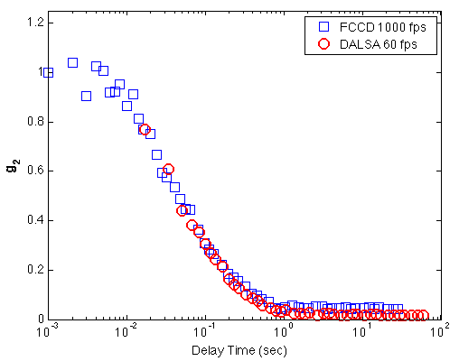
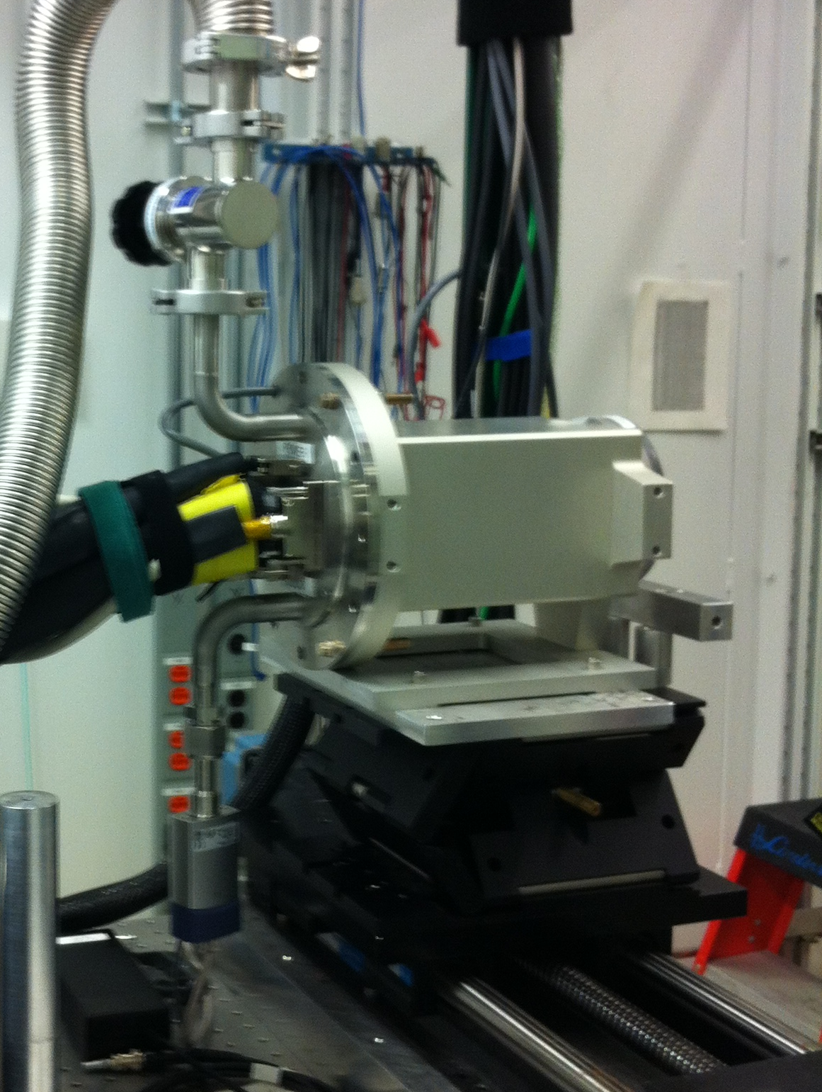
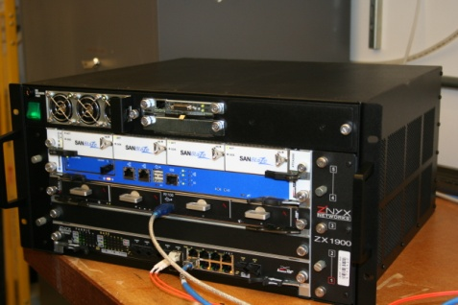
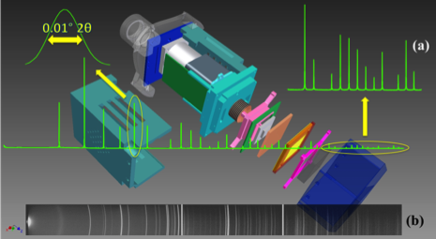
DAQ electronics
Fast & Thick CCD (ANL + LBL)
  2nd generation thick, fast CCD (30 μm pixel size, 1k x 1k, frame store)
  Sustained frame rates
    Full frame: 960 x 962 @ 100 fps
    ROI: 960 x 92 @ 1000 fps
    ATCA-based DAQ
    Sustained rates enabled by MPI data compression software
  Scientific Impact
    1 millisecond area detector with <50 μm pixels
Scanning CCD for powder diffraction
  Novel time-delay integration mode
  Complete detector design
  J. App. Cryst. 46, 1058 (2013)
Beamline Electronics
  Synchronization electronics, VTFs, etc.
APS 8-ID
The autocorrelations are measured with the ANL-LBL Fast CCD detector operated in a small region of interest mode enabling sampling times of 0.001 sec. As a comparison, the data measured under identical conditions by DALSA CCD detector operating at 60 fps which has been the state-of-the-art for XPCS detector until now.
FCCD2 @ 8-ID

Slide 7
Detector R&D Initiatives
Superconducting energy dispersive detectors
  Target application: chemical imaging (XES) at scanning nanoprobes
  Seeded by DOE Early Career Grant
  APS & HEP teams share equipment and expertise
  Joint ANL-NIST-SLAC submitted proposal for microwave resonator-coupled SQUID/TES
Germanium strip detectors
  Target applications: Energy-dispersive diffraction and high-energy powder diffraction
  Collaboration with BNL (Siddons) & Semikon (Jülich)
  Joint ANL-BNL project funded from DOE
MHz-framing Integrating pixel detectors (“FASPAX”)
  Target application: pump-probe-probe-probe .. diffraction
    Pump-probe crystallography (Sector 14) & Dynamic compression (Sector 35)
  Movies of dynamic processes with a burst frame rate of 13 MHz
  Collaboration with Fermilab’s ASIC group
  APS-Upgrade funded
Sparsified pixel detectors for time-resolved speckle (XPCS) (“VIPIC”)
  Target application: Microsecond time-tagged photon readout for ultra-fast XPCS
  First synchrotron tests of prototype scheduled for July 2014 at 8-ID
  Joint ANL-BNL-FNAL proposal submitted to DOE
    Deliver two 1-Megapixel detectors for APS and NSLS-2

Slide 8
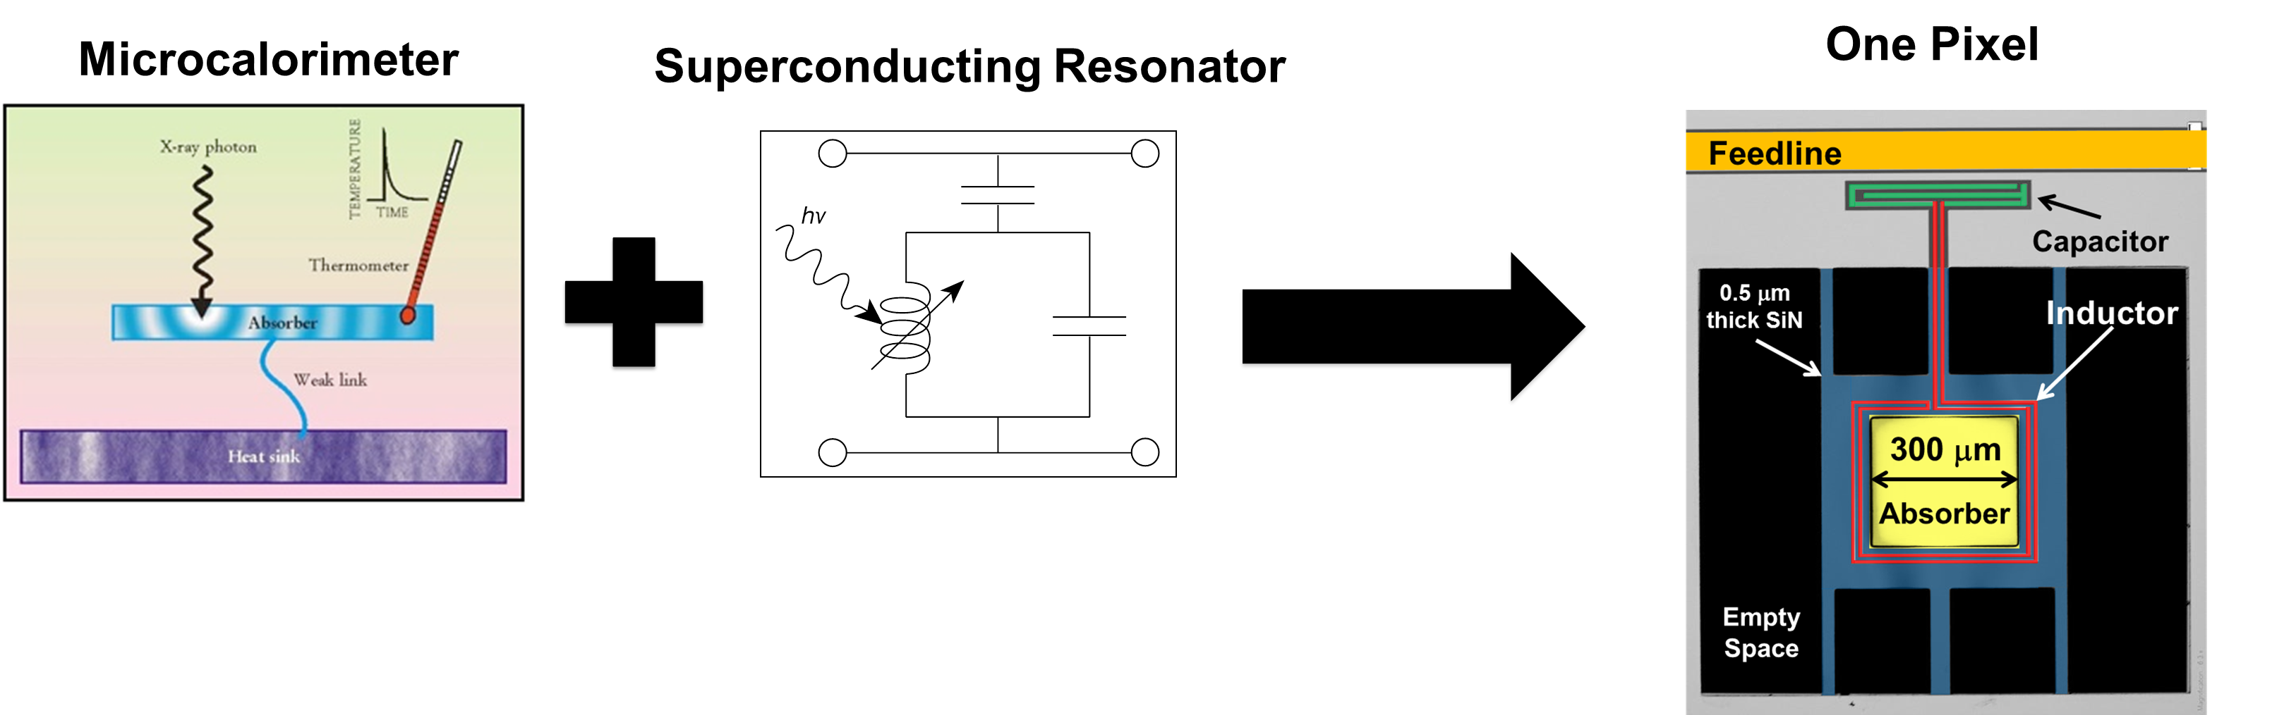
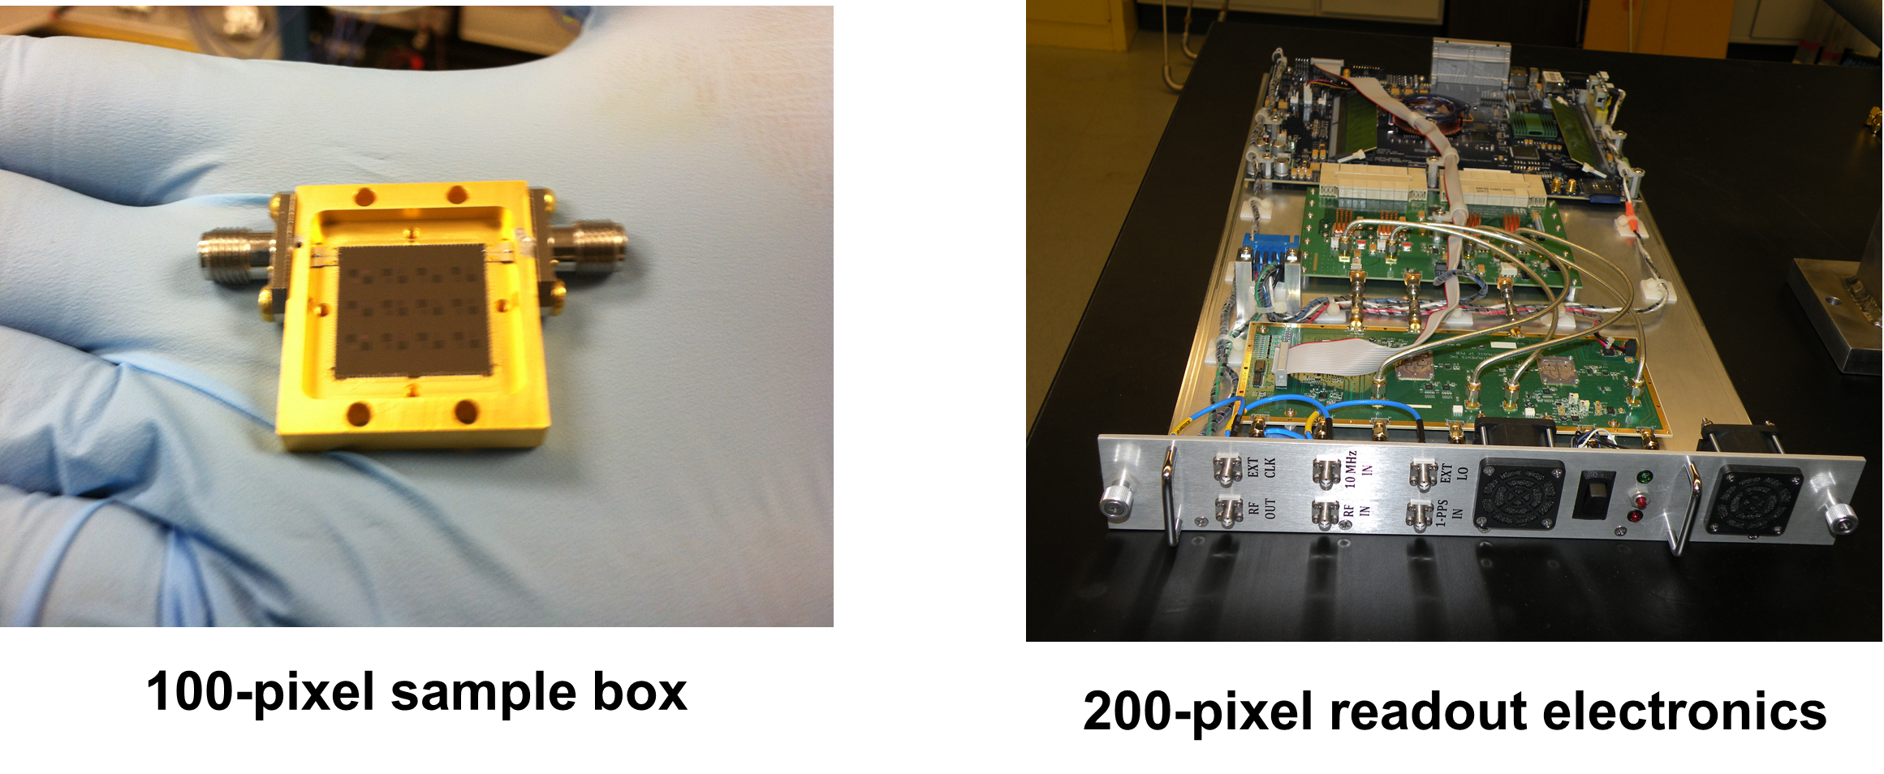
Superconducting energy dispersive detectors
Developing superconducting detectors with sub-5-eV energy resolution and high count rates through pixellation for spectroscopy applications
Superconducting resonator technology (MKID) can provide high-energy-resolution, multiplexed x-ray detectors with ~ 100-fold improved resolution
  Resonator-based technology is straightforwardly multiplexable (10³ – 10⁴ pixels)
  Microcalorimeters can operate over a wide range of energies (0.2 - 100 keV)
  Per-pixel count rate ~ 100 cps → Need to multiplex many of pixels
  E / ΔE > 2000
Current work
Improving noise (90 eV histogram and 40 eV baseline)
  New design with 10 eV baseline noise.
Multi-pixel readout electronics and software
  Compatible with μ-wave TESs
Multivariate-based pulse processing methods

Slide 9
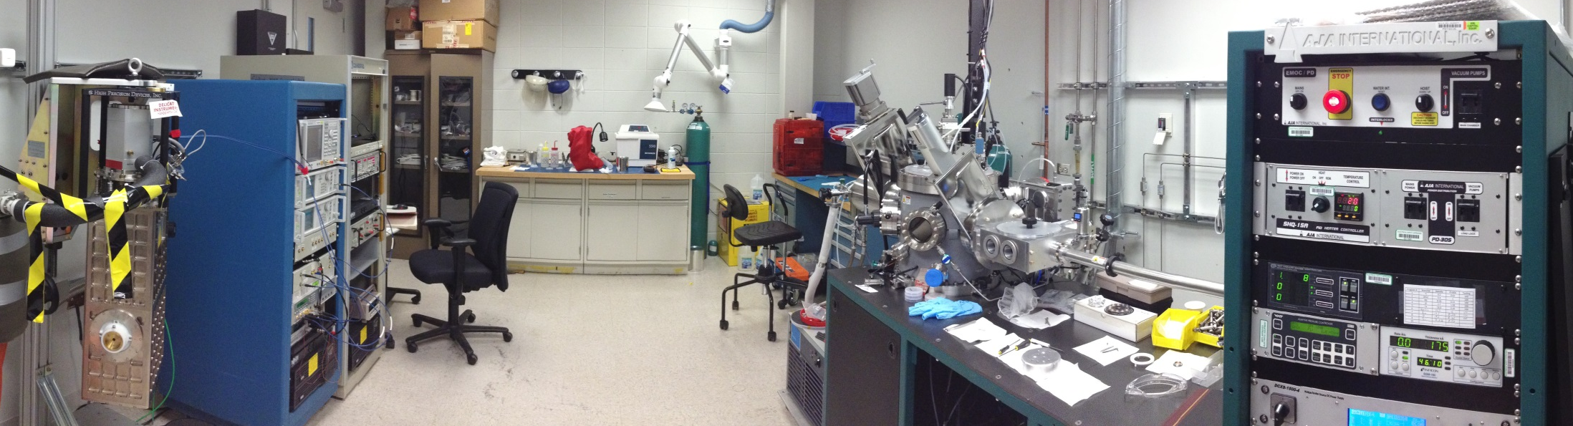
MKIDs @ APS for synchrotrons
The goal is energy resolution < 10 eV with good count rate capabilities (> 100kcps)
Three Main Aspects:
  Device Design & Fabrication
    Completely in-house with dedicated UHV deposition chamber (into new cleanroom in 2015)
  Cryogenics and Device Characterization
    Turnkey 100 mK cryostat (cryogen-free)
  Readout electronics
    Multi-pixel readout using software defined radio

Slide 10
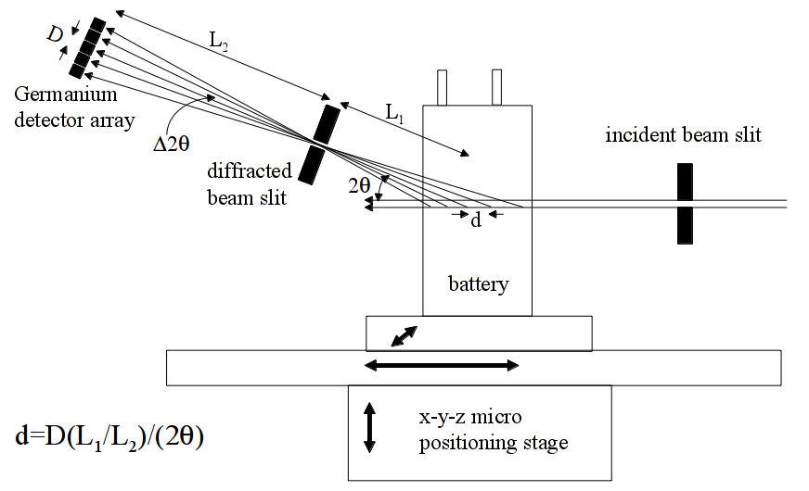
Germanium strip detectors
Application: Energy-dispersive diffraction
  White-beam diffraction (< 200 keV)
  Energy resolution gives d-spacing
1-D Ge detector → Full determination of strains in engineering samples
Notes:
Each section of the sample along the incident beam direction is separately captured by one part of the detector, eliminating the need to scan in that direction.

Slide 11
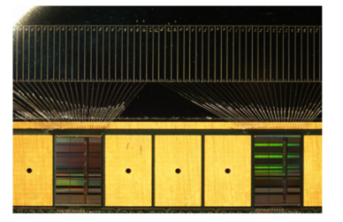
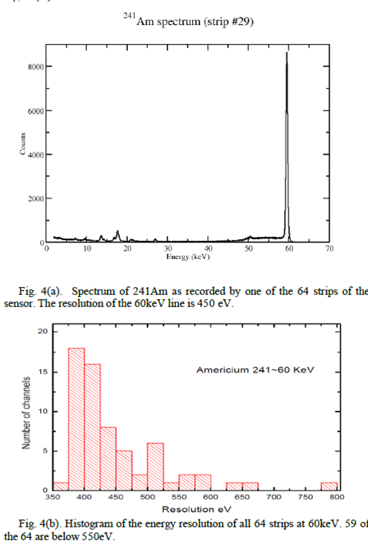
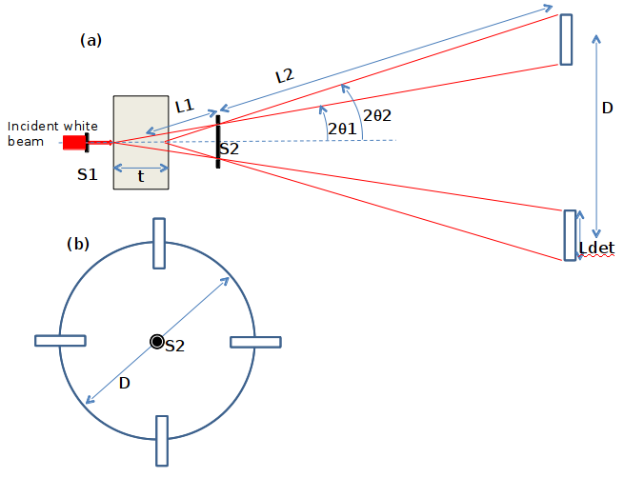
Germanium strip detectors
Germanium sensor + ASIC readout
  Semikon: Ge strip sensor
    3mm thick, 0.125-0.5mm pitch
  BNL: Low-noise spectroscopic ASIC readout (Siddons & De Geronimo)
  ANL: Mechanical design
Four strip geometry
A. K. Rumaiz, et al, A Monolithic Segmented Germanium Detector with Highly Integrated Readout, IEEE NSS 2013

Slide 12
MHz-framing Integrating pixel detectors (“FASPAX”)
Fermi-Argonne Semiconductor Pixelated Array X-ray detector:
  13 MHz burst image rate
    In-pixel buffering of >50 images
    Image rate matched to bunch rate of timing mode fill pattern of Upgraded APS
    Novel timing structures (logarithmic)
  Wide dynamic range
    Novel current splitting passive integrator with three gain ranges (self-selecting)
    Single photon sensitivity to 10⁵ photons/pixel/pulse
  Novel gap-less sensor based on Si or glass interposer
Optimized for time-resolved applications
  Single-bunch imaging
  Pump-probe of irreversible processes
Possible variant with no analog storage and smaller pixels for CDI
Basic Detector Parameters
Sensor | Si (500 μm), CdTe
Pixel Size | 100 μ
Burst/Average frame rate | 13 MHz/~few kHz
Dynamic Range | up to 10⁵ photons/pixel/pulse

Slide 13
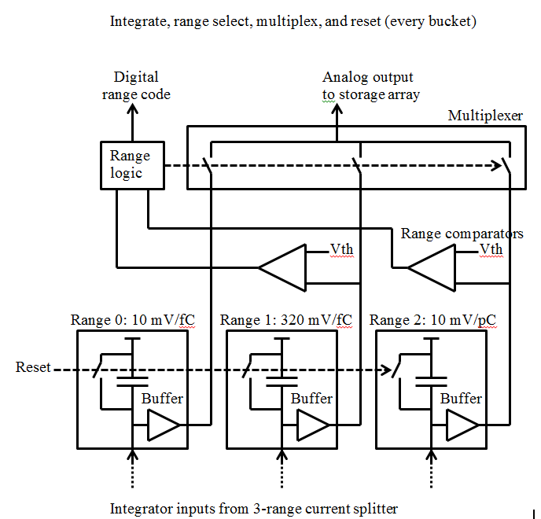
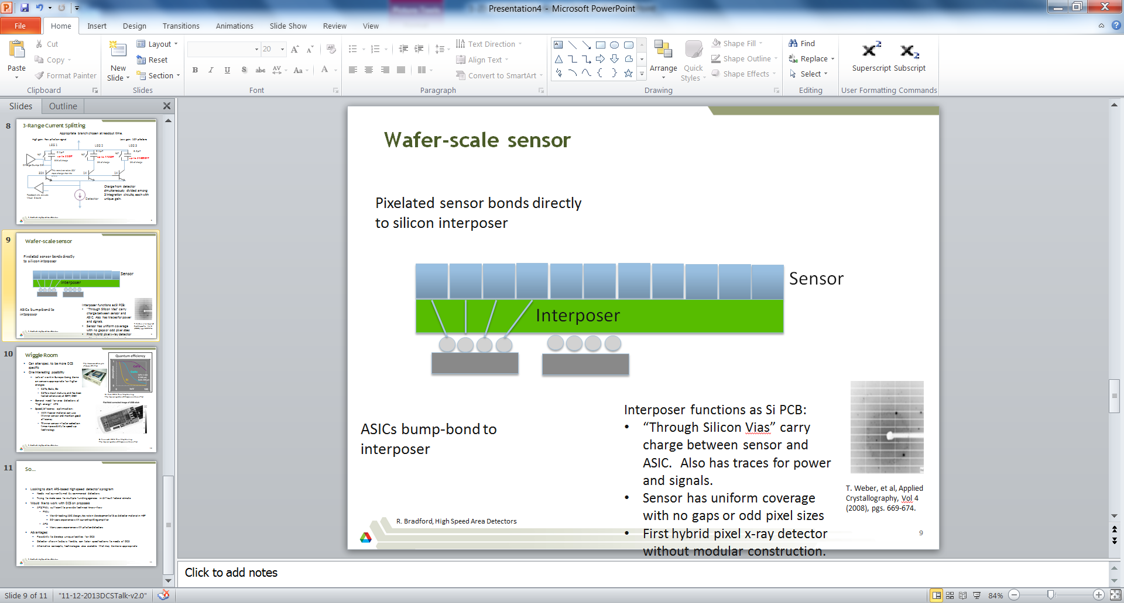
FASPAX
ASIC - Being designed by Fermilab ASIC Design Group
Integration circuit modeled after QIE chips used in HEP for 20 years
Current Status:
Just beginning work with $3M funding commitment from APS Upgrade
  Prototype main aspects of detector
  Remainder of funding likely through larger APS-U proposal
Gapless sensor: Interposer facilitates tapered pixel to cover control regions of ASIC and eliminate wire bonds.

Slide 14
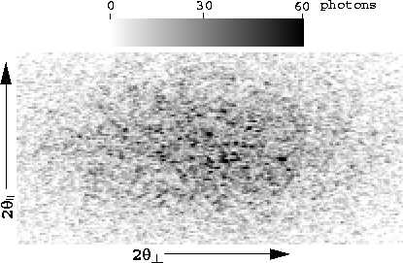
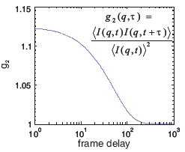
Sparsified pixel detectors for time-resolved x-ray speckle (“VIPIC”)
Detector optimized for X-ray Photo-Correlation Spectroscopy (XPCS)
  Coherent phenomenon used to study dynamics of “soft condensed matter”
  Speckle pattern results from superposition of multiple single particle diffraction patterns
  Track intensity at specific point in space to calculate auto-correlation function
VIPIC Detector:
  Vertically Integrated Photon Imaging Chip
  Sparsified readout: <1% pixel occupancy, so detetor reads out only channels receiving hits.
  High temporal resolution: 10 μs
http://sector7.xray.aps.anl.gov/~dufresne/UofM/xpcs.html
http://sinhagroup.ucsd.edu/Research_XPCS.htm

Slide 15
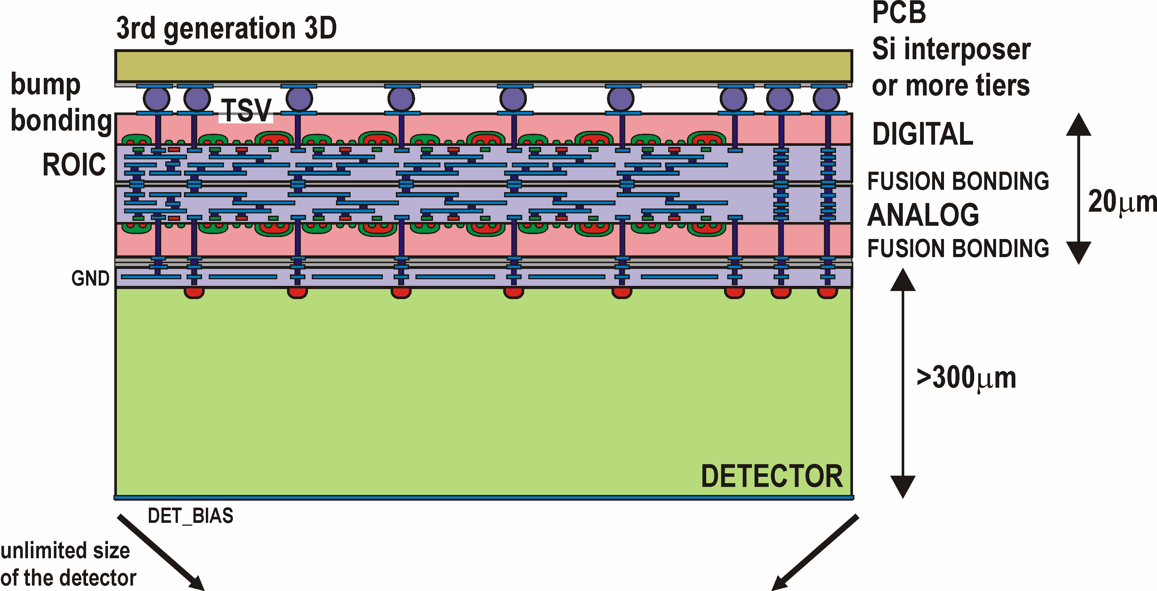
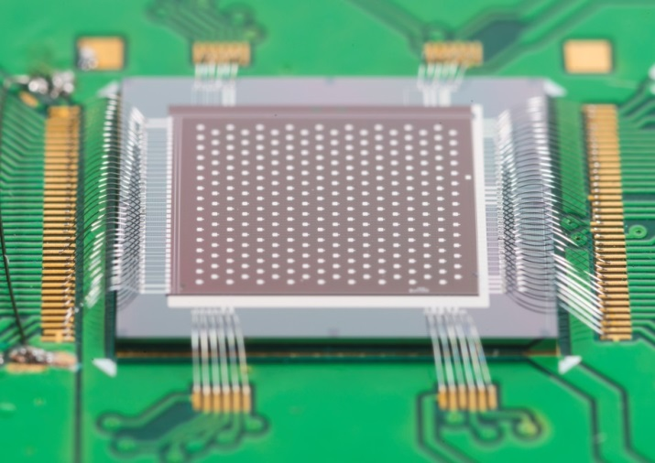
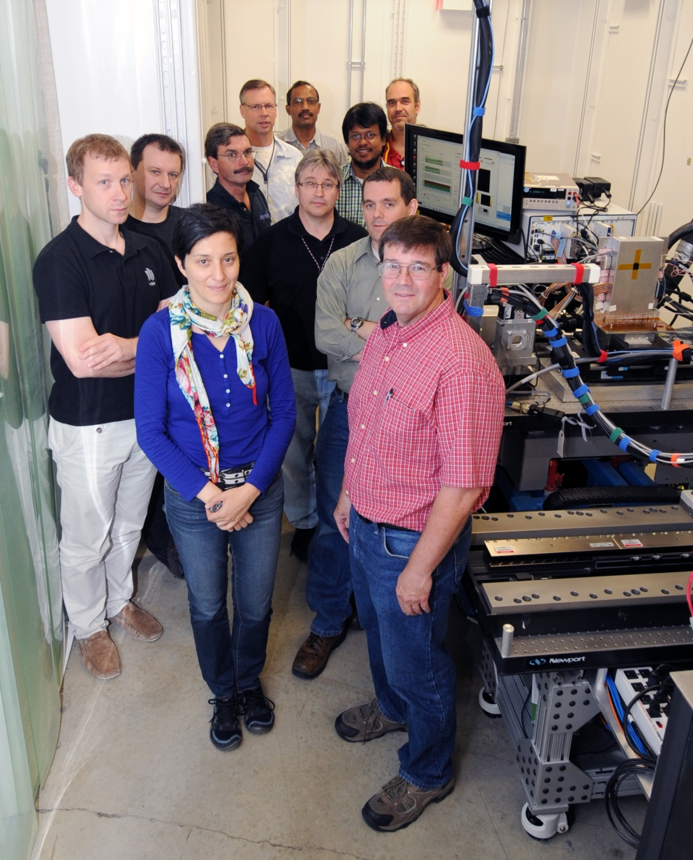
VIPIC
Novel detector structure:
3D ASIC: 2 layers of CMOS
Fusion bonded sensor
Hybrids bump-bonded to LTCC support board through TSVs on back of ASIC
Moving forward:
ANL joining existing BNL/Fermilab collaboration
Collaboration submitted proposal to DOE for next phase of VIPIC development:
  Deliver 1MPixel detectors to NSLS-II and APS
  Have already received FY2014-2015 funding commitment
Last week at 8-ID: First beam tests of existing prototype detector

Slide 16
Summary
Group has diverse activities to meet the needs of APS:
Detector Pool
  Equipment loan for non-standard beamline applications
  Beamline support for detector-related issues
  Integration of new detectors
Data Acquisition:
  Engineering for general beamline electronics and data acquisitions systems
Development:
  Established effort in super-conducting energy dispersive detectors
  Germanium strip detector effort for high energy applications
  New efforts in pixelated area detectors for coherent science (VIPIC) and time-resolved techniques (FASPAX)
  Strong collaborative efforts with many different groups in the US
    Fermilab, Brookhaven

Slide 17
Extra Slides

Slide 18

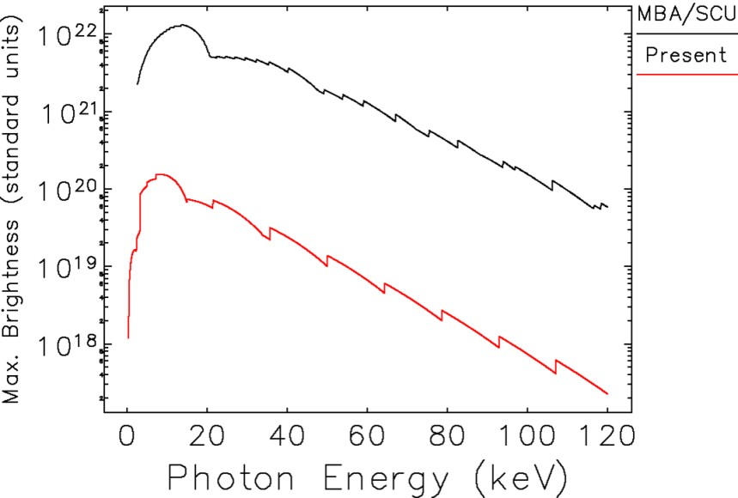

APS Multi Bend Achromat (MBA) Upgrade
Long term (5-6 year) Plan
Particle Beam Profiles
Dramatically enhance the performance
of the APS as a hard x-ray source
APS Now
MBA
1 mm

Slide 19
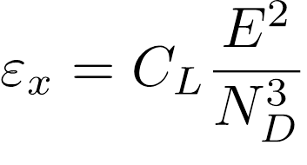
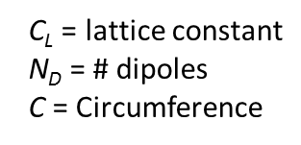
Multi-bend Achromat Magnet Lattice
Lattice design evolution from double-bend achromats (DBA) to multi-bend achromats (MBA): lower emittance from increased number of dipole magnets
DBA
7BA
D. Einfeld et al., Proc. PAC 95, Dallas TX
Emittance ε is the product of the size and divergence of the electron beam. Thus, a lower emittance results in a higher brightness X-ray source.
Factor of > 40 improvement in emittance from cubic scaling
Notes:
I've shown you what I hope are compelling examples of future science that will be enabled by the new, 4th generation of storage ring x-ray source using MBA magnet lattice technology
So what does this MBA technology consist of?
These diagrams schematically show the magnet structure between each of the straight sections in the storage ring. The yellow boxes are the dipole bending magnets, and the other symbols are the higher-order focusing magnets.
Most light sources today operate with what is known as a double-bend achromat. There are two bending magnets between each straight section.
To make an MBA lattice you split the bending magnets up into smaller lengths separated by focusing magnets. As you increase the number of bending magnets, you can get can a very rapid reduction in the emittance. The emittance scales as the inverse cube of the number of dipoles. A seven-bend achromat can provide 40 times better performance.
The first ring to be built with an MBA lattice is now under construction in Sweden. Other MBA rings are being built or proposed, for example at ESRF. Because of the space needed for the additional magnets, MBA lattices are well suited to large circumference rings like APS.

Slide 20
APS MBA Upgrade
Unique source properties:
  High brightness of the upgraded ring
  Traditional strengths:
    High Energy
    “Timing ring”
Unique scientific opportunities complemented by new storage ring:
  Coherent techniques: XPCS, CDI, Ptychography…
  Tighter focus: Micro/nano probe
Notes:
Increase in brightness is stronger at higher energies
Rest of talk will survey commercial trends for spectroscopic detectors and

Slide 21
APS-MBA High-Level Performance Goals
More than two orders of magnitude increase in brightness at insertion device (ID) sources over a wide range of hard X-ray energies
Similar improvement in coherent flux
All bending magnet (BM) beamlines supported, with greater flux and harder X-rays using three-pole wiggler sources
At least a factor of 2 increase in hard X-ray flux (BM and ID)
48 to 324 uniformly-spaced bunches supported
Approaching diffraction limited source

Slide 22
