Slide 1

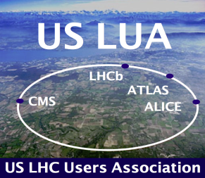

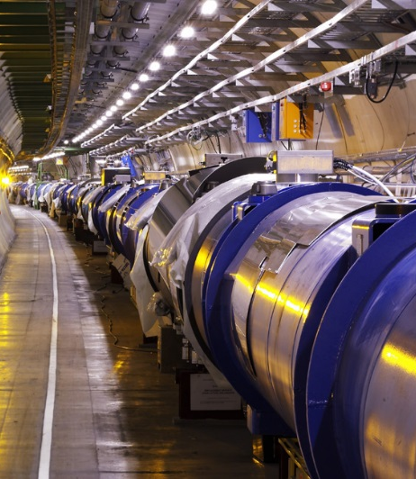
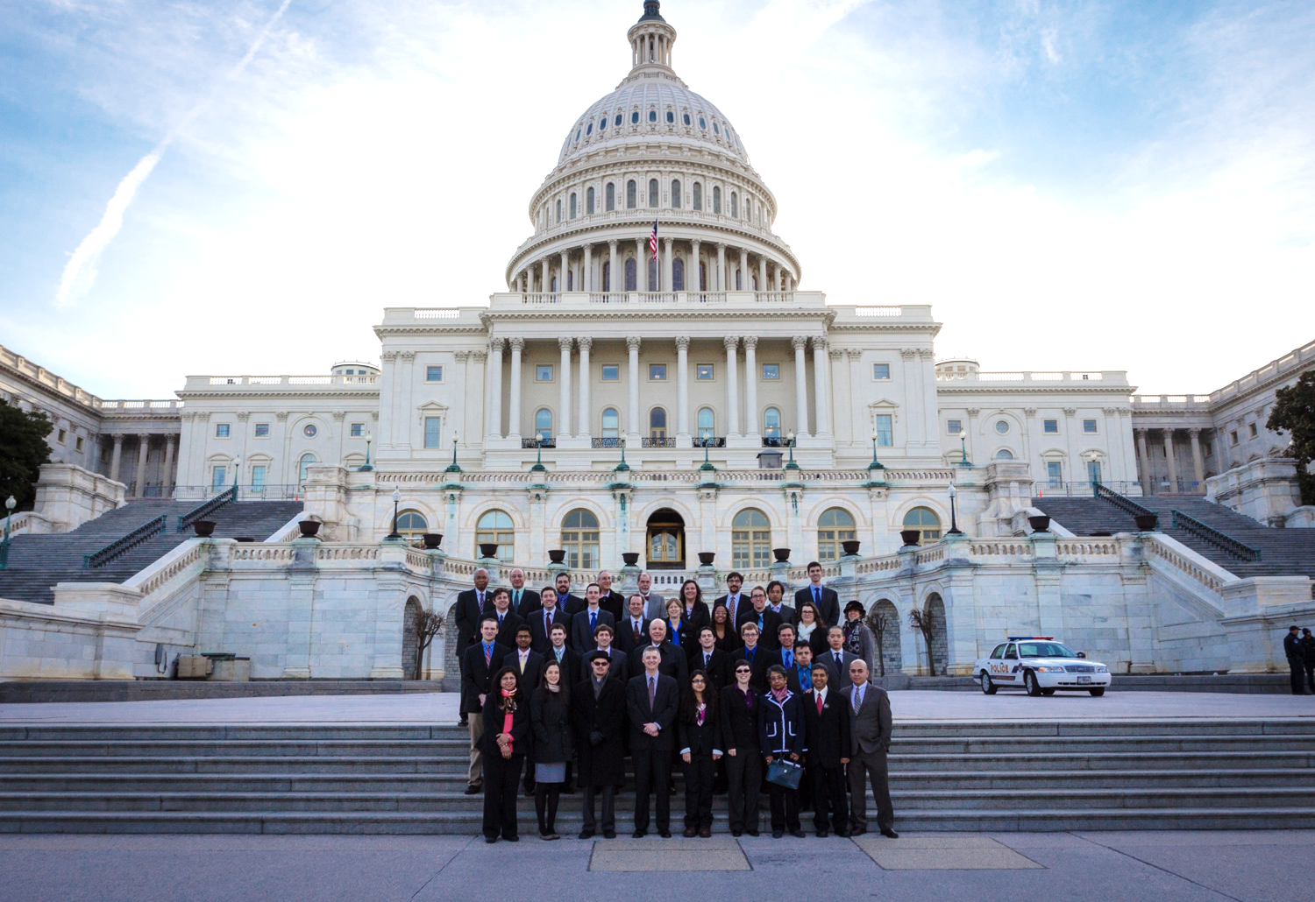
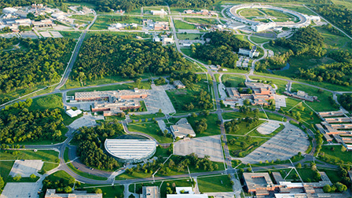
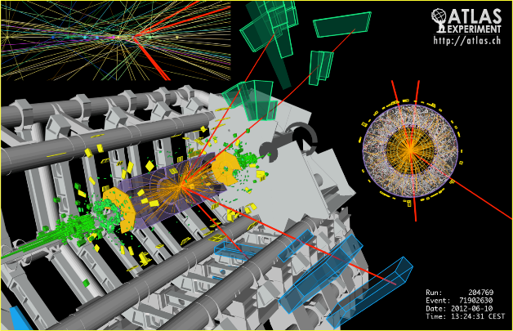
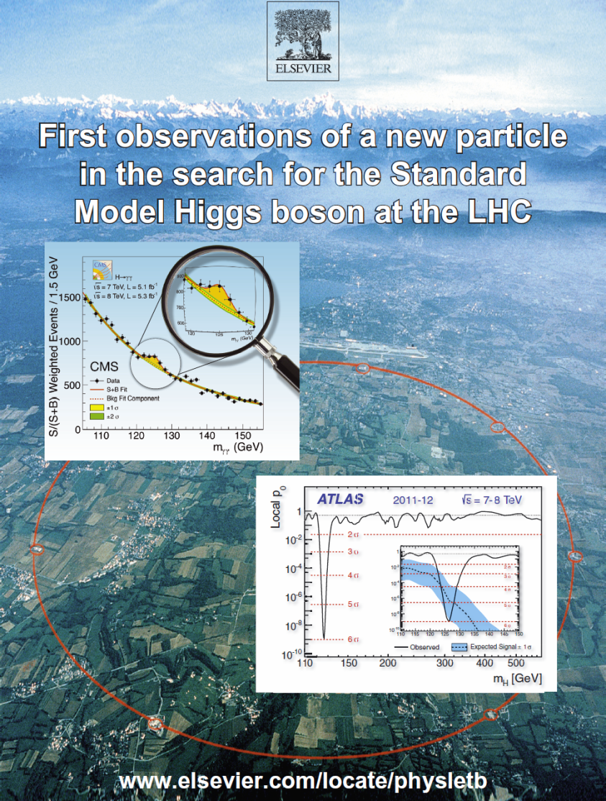
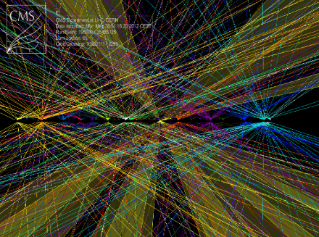

US LUA Annual Meeting
Agenda
Argonne National Lab
November 12-14, 2014
Notes:
1

Slide 2
Annual US LUA Meeting 2014 Thursday November 13 Agenda
9:00 – 9:10 Welcome to Argonne Rik Yoshida (Argonne)
9:10 – 9:40 US LUA Chair’s Report Harvey Newman (Caltech)
9:40 – 10:10 Status and Outlook of the LHC Giulia Papotti (CERN)
10:10 – 10:35 LARP Eric Prebys (Fermilab)
10:35 – 11:00 COFFEE BREAK
11:00 – 11:30 ATLAS Highlights and Outlook Chip Brock (Michigan State)
11:30 – 12:00 CMS Highlights and Outlook Tiziano Camporesi (CERN)
12:00 – 12:30 LHCb Highlights and Upgrades Mike Sokoloff (Cincinnati)
12:30 – 1:30 LUNCH
1:30 – 1:45 GROUP PHOTO
1:45 – 2:15 ALICE Highlights and Upgrades Peter Jacobs (LBNL)
2:15 – 2:40 CMS Upgrade Program Jeremy Mans (Minnesota)
2:40 – 3:05 ATLAS Upgrade Program Anadi Canepa (TRIUMF)
3:05 – 4:05 Ken Bloom (Nebraska)
4:05 – 4:25 AFTERNOON BREAK
4:25 – 4:50 Supporting Young Physicists Usha Mallik (Iowa)
4:50 – 5:15 DOE Office of HEP Report Abid Patwa (DOE/HEP)
5:15 – 5:40 NSF EPP Office Report Jim Shank (NSF)
5:40 – 6:05 DOE Office of NP Report Jim Sowinski (DOE/NP)
6:05 – 6:45 The Dark Matter and Higgs Sectors Jiji Fan (Syracuse)
7:15 – 8:30 Conference Dinner; Cocktail at 6:50
Young Physicists’ Lightning Round 1
Notes:
2
2
2

Slide 3
Annual US LUA Meeting 2014
Friday November 14 Agenda
8:30 – 8:50 Introduction; 2014 Trip to Washington Harvey Newman (Caltech)
8:50 – 9:20 US LUEC Committee Reports Committee Chairs
9:20 – 10:32
10:32 – 10:55 COFFEE BREAK
10:55 – 11:15 US – CERN Relations and the LHC Program Ruediger Voss (CERN) [**]
11:15 – 11:35 Advisory Committee of CERN Users Sridhara Dasu (Wisconsin)
11:35 – 12:35
12:35 – 1:45 LUNCH and Community Meeting on NSF and P5 Implementation
1:45 – 3:21
3:21 – 3:45 Afternoon Break
3:45 – 4:15 Outlook Following the P5 Report Andy Lankford (UC Irvine; HEPAP)
4:15 – 4:45 US HEP Program Outlook Joe Lykken (Fermilab)
4:45 – 4:55 Lightning Round Winners Announcement Ken Bloom (Nebraska)
4:55 – 5:40 Discussion; AOB
5:40 Adjourn *TBC
6:00 Dinner (self-organized) [**] by Vydio
Young Physicists’ Lightning Round Session 2
Young Physicists’ Lightning Round Session 3
Young Physicists’ Lightning Round Session 4
3
Notes:
3
3
3

Slide 4
Annual US LUO Meeting: Lightning Round 2014 Session 1 November 13
15:05 Observation and measurement of Higgs Philip Chang
boson decays to WW* with ATLAS (UIUC)
at the LHC
15:17 Physics Beyond Higgs: Searches for Sadia Khalil
Extra Vector-Like Quarks at CMS (Kansas State)
15:29 Mass measurement of the Higgs boson Laser Kaplan
in the H→ZZ*→4l channel at the ATLAS (Wisconsin)
detector
15:41 Results in B_{c} physics at LHCb Nathan Jurik (Syracuse)
15:53 A Search for Prompt Lepton-Jets in p-p Harisankar Namasivayam
at √s = 8 TeV with the ATLAS Detector (UT Dallas)
Notes:
4
4
4

Slide 5
Annual US LUO Meeting: Lightning Round 2014 Session 2 November 14 Morning
09:20 Search for resonant production of two Phillip Hebda
Higgs bosons in the two photon, two (Princeton)
b-quark final state
09:32 Evidence of Electroweak Vector Boson Jessica Metcalfe
Scattering in the same-sign WW (BNL)
channel in ATLAS
09:44 Search for Higgs production in association Daniel Knowlton
with single top quarks (Nebraska)
09:56 The UT Tracking Detector for the LHCb Matthew Kelsey
Upgrade (Syracuse)
10:08 Measurement of the differential ttbar Susan Dittmer
production cross section for high-pT (Cornell)
top quarks at 8 TeV
10:20 Search for non-pointing and delayed Andrew Hard
photons in the diphoton and missing (Wisconsin)
transverse momentum final state in
8 TeV pp collisions
Notes:
5
5
5

Slide 6
Annual US LUO Meeting: Lightning Round 2014 Session 3 November 14 Morning
11:35 Search for electroweak SUSY production Dominick Olivito
(UCSD)
11:47 Jet Reclustering in 0-lepton Direct Stop Chaowaroj Wanotayoroj
Search (Oregon)
11:59 Search for stealth supersymmetry with Marc Weinberg
photons or leptons, jets, and low MET (Florida State)
12:11 Latest Jet Results from ALICE Megan Connors (Yale)
12:23 Search for H h h  4b Souvik Das (Florida)
Notes:
6
6
6

Slide 7
Annual US LUO Meeting: Lightning Round 2013 Session 4 November 14 Afternoon
13:45 Search for W’ →tb→qqbb Decays Ho Ling Li (U. Chicago)
with the ATLAS Detector
13:57 Spin-parity measurement of H(125) Austin Belknap (Wisconsin)
using 4-lepton mode
14:09 SM Higgs searches in tau+lepton Puja Saha (NIU)
final states
14:21 UPC Physics at ALICE Barak Gruberg (Creighton)
14:33 The Global Feature Extraction (gFEX) Giordon Stark (U. Chicago)
module and its Physics Impact
14:45 The CMS L1 Track Trigger at the HL-LHC Marco Trovato (NWU)
14:57 Search for 4th generation Vector-Like Brad Schoenrock
Quarks that decay to a Z boson and a (Michigan State)
3rd generation quark in pp collisions at
√s = 8 TeV with the ATLAS detector
15:09 Search for second generation Lovedeep Saini
leptoquarks (Kansas State)
Notes:
7
7
7

Slide 8


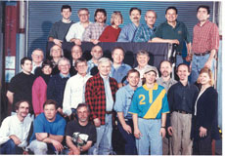

USLUA Annual Meeting 2014
Thank You Argonne HEP
for Hosting our 2014 Meeting
And Wisconsin HEP: for our 2013 Meeting
8
Notes:
8

Slide 9
US LHC Users Association (US LUA) http://www.uslua.org
Represents the entire community: Universities and Labs
  Covers the LHC experiments and LARP (Accelerator R&D)
  Forum for information and concerns; special “international” needs
Established as a non-profit tax exempt association, headquartered
in DC, collocated & hosted by URA since May 2013
In our eighth year: Successor to the US LHC Users Organization,
that was approved by the LHC experiments and LARP in April 2007
Mission Statement:
“The purpose of USLUA is to provide a forum for discussions of the US
participation in the LHC research program, with a focus on how best to enhance scientific participation in the discoveries expected from this research. In particular, USLUA aims to help the US LHC community work effectively with their colleagues at CERN while in the US, and to adapt to work at CERN and to living in the environs of the CERN laboratory. USLUA also provides communication channels between scientists working on LHC experiments, the US agencies supporting this research and the US Congress.”
Notes:
9

Slide 10
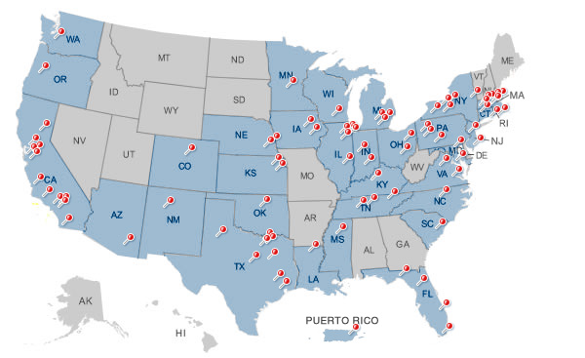
ACCU News
US LHC: 70 of 83 US Universities in URA
Alabama
Arizona
Brown
Boston Univ.
Caltech
UC Berkeley
UC Davis
UC Irvine
UCLA
UC Riverside
UCSD
UCSB
Carnegie Mellon
Case Western
Chicago
Colorado
Columbia
Cornell
Duke
Florida
Florida State
Harvard
UIC
UIUC
IIT
Indiana
Iowa
Iowa State
Johns Hopkins
Maryland
MIT
Michigan
MSU
Minnesota
Nebraska-Lincoln
New Mexico
Northeastern
NIU
Northwestern
Notre Dame
Ohio State
Oklahoma
Oregon
Pennsylvania
Pittsburgh
Princeton
Purdue (+Calumet)
Rice
Rochester
Rockefeller
Rutgers
South Carolina
Southern Methodist
Stanford
SUNY Buffalo
SUNY Stony Brook
Syracuse
Tennessee Knoxville
Texas A&M
UT Arlington
UT Austin
UT Dallas
Texas Tech
Tufts
Vanderbilt
Virginia
Washington
Wayne State
Wisconsin
Yale
US LHC
2000 Scientists, engineers, students and technicians from 96 US institutions in
33 US States and Puerto Rico

Slide 11
US LUA Executive Committee
2014 Membership (2 Year Terms)
Name Institution Collaboration Term Expires
Darin Acosta Florida CMS 2014
Ken Bloom (Elections) Nebraska CMS 2014
Tom LeCompte Argonne ATLAS 2014
Usha Mallik (Elections) Iowa ATLAS 2014
Sheldon Stone, Treasurer Syracuse LHCb 2014
Julia Thom (Secretary) Cornell CMS 2014
Kevin Black Boston ATLAS 2015
Sridhara Dasu (ACCU) Wisconsin CMS 2015
John Harris Yale ALICE 2015
Harvey Newman (Chair) Caltech CMS 2015
Michael Tuts (Vice Chair) Columbia ATLAS 2015
Gordon Watts Washington ATLAS 2015
Observers: Tulika Bose (Boston), Toyoko Orimoto (Northeastern)
Totals: CMS 5+2, ATLAS 5, LHCb 1, ALICE 1; LARP +1
Ex-Officio: US ATLAS and CMS PMs, Deputies, CB Chair, IB Chair
With Thanks to: Daniela Bortoletto, Sarah Demers, Sandor Feher (LARP)
11
Notes:
11

Slide 12
US LUEC Sub-Committees Formed
to Better Serve Our Community
Quality of Life: Usha Mallik (Chair); Darin Acosta, Sridhara Dasu
(ACCU), Ken Bloom, Julia Thom, Harvey Newman,
Sarah Demers, Sandor Feher
Gov’t Relations: Mike Tuts (Chair); Harvey Newman, Sridhara Dasu,
Kevin Black
Outreach: Julia Thom (Chair); Ken Bloom, Toyoko Orimoto,
John Harris
Web Presence: Gordon Watts, Tulika Bose (Co-Chairs); Darin
costa, Sarah Demers, Ken Bloom, Toyoko Orimoto; D. Kcira
Annual Meeting TF: H. Newman (Chair); Sridhara Dasu, Tulika Bose
Finance, Fund Raising: Sheldon Stone (Chair); Mike Tuts,
Harvey Newman, Kevin Black
Communications: Kevin Black (Chair); Ken Bloom, Gordon Watts,
Darin Acosta
Rules Taskforce: Tom Lecompte (Chair); Harvey Newman,
Mike Tuts, Sheldon Stone
12
Notes:
12

Slide 13
US LHC Users Association Status
Approved As Tax Exempt by the IRS
Formed the US LUA: An Unincorporated Nonprofit Association in DC
  Under the “Uniform Nonprofit Association Act”
  Simple to form, but needs to be operated and managed with due care
  Clear and precise Articles & Bylaws written with help of General
  Counsel of URA, and Jeff Shapiro (CFO)
Agreement for Services approved, signed by URA & USLUO 5/17/13
Applied to DC.gov to Form US LUA 6/6/13; Approved 9/17/13
a major milestone – establishing our legal existence
Selected interim officers: Vice Chair (Tuts), Treasurer (Stone),
Election Committee (Bloom, with Mallik; support by Demers)
Revisited Lab/Division Director Support at the 2014 ICFA Meeting at DESY
Applied to IRS for 501(c)(3) tax-exempt status from IRS 4/7/14;
approved Sept 8, 2014 [Quick: after 4 months; 18 was predicted]
We are about to remake our Website (to Wordpress)
We will then launch our fund raising campaign
We will need your help
Notes:
13

Slide 14
US LUO Activities (1)
US LHC Users Association (US LUA)
Activities (1)
  Formed 8 Sub-Committees:
  Quality of Life, Gov’t Relations, Outreach, Communications, Finance
  +Fund Raising, Web Presence; Rules and Annual Meeting Task Forces
  Annual Fall Meetings
    Thanks to Argonne HEP for Hosting our Meeting this Year !
    Fermilab (2012, 2010, 2008), Argonne (2011), LBNL (2009)
    We also thank Wisconsin for our 2013 Meeting [And Argonne as well]
    Review the LHC experimental & accelerator program, the view from
    Washington, and issues that affect US users at home & abroad
    Our Focus: Young Physicists’ Work ! Lightning Round
    (A tradition: thanks to Sridhara Dasu and Ken Bloom; Darin Acosta)
  Annual HEP Visits to Washington DC:
  3/2008, 4/2009, 2/2010, 4/2011, 3/2012, 3/2013, 3/2014; Planning for 3/2015
    Coordinated with FNAL UEC, SLUO, DPF, DPB
    Executive as well as Congressional and Funding Agency Visits
    Great occasions to highlight our science, the impact and need
    2014 LR Winners+ Joined Us !
    We will learn something new, given the new political landscape
Notes:
14

Slide 15
US LUA Activities (2)
  Young Physicist Quality of Life Subcomittee
  (U. Mallik, Chair)
        Get-togethers of students and young postdocs at CERN:
        the first ones were a success; we plan more – Volunteer !
    Provide Information on everyday + important issues, such as
    affordable health insurance, visa rules changes, tax laws,
    work at the CERN lab, the hostels, etc.
        Resources to help with handling of problem cases;
        working to improve the handling of such cases at CERN
        Coordinated with ACCU (through our new rep. E. Torrence (Oregon)
  Outreach about LHC
    National Events [more later]
    Work actively with existing programs:
    (QuarkNet, US LHC Program, US LHC Communications)
    Considering: Partial support for young people going to conferences;
    Outreach to other fields, when funds are available
  Media Training (Occasional): how to talk to Congress, the public, news media. Thanks to Katie Yurkewicz [Another soon]
Notes:
15

Slide 16
US LUO Activities (1)
US LUA Activities(3): Helping the US Community Adapt to Work at CERN and Life in the Region
  A number of resources linked to our website www.uslua.org:
    New Student Orientation Guide (Darren Acosta): www.dropbox.com/s/ckrjbj4ax2g9gph/NewStudentOrientationAtCERN.pdf
    required documents, registering, getting a computer account,
    getting around the sites, local transportation, etc.
    Welcome Center website for CERN newcomers supported by Volunteers: visas, housing, schools, taxes, childcare, emergency contacts, etc.
    US LUA Quality of Life Committee: posting information on how to get help for students with personal problems;
    Will add advice on careers
    Information on daily life issues: credit cards fees, taxes, health insurance, etc. Now: French insurance issue.
    We are working to redo our website (to Wordpress); refresh and
    maintain up to date information; prior to our funding campaign
Notes:
16

Slide 17
US LUO Activities (4):
National and International Events
  USA Science & Engineering Festival: April 26-27 2014
  Julia Thom working with Fermilab (Marge Bardeen)
    We Plan One Exhibit for HEP in 2016
  User Science Exhibitions on the Hill: Organized by NUFO;
  June 10 2014: Randy Ruchti and Mike Tuts
  Special Events. Two excellent examples:
    November 20, 2013 Community Visit to the House
    celebrating the Higgs discovery and recent advances
    in particle physics
    The October 20, 2014 CERN Event at UN HQ: Celebrating
    60 Years of Science for Peace and Development
Notes:
17

Slide 18

CERN UN Event: 60 Years of Science for Peace and Development
  At the UN Economic and Social Council
  Keynotes: Rolf Heuer, Ban Ki-Moon, Kofi Annan,
  Hitoshi Murayama, Carlo Rubbia
  Remarks by Fabiola Gianotti (UN Scientific Advisory Committee);
  Ambassadors of France, Switzerland and the US
  “Featuring contributions from eminent politicians and scientists, the event will:
celebrate the values promoted by science - neutrality, inclusion, and co-operation;
highlight the role of science and scientific education in sustainable development;
Promote, through an open discussion between the fields of science and politics, the idea of better integrating science into global decision-making processes.
Issue Raised: Integrating science, including fundamental science,
in the decision making process is necessary for sustainable development
Notes:
18

Slide 19
US LUA Budgets and Fund Raising
Accounts were maintained in the interim (overhead free)
at Caltech
Transitioned to URA HQ when the tax exemption last May
when our 501(c)(3) application was submitted to the IRS
A note on Fund Raising: Annual funding from the lab directors
($ 25k) forms the core, but the rest will need to come from
Institutional Donations
  Targeting $ 60k or more, per year.
  Requested donations: $ 1k/year ($ 500/year for small groups) per university (or your department or faculty discretionary fund)
    More if your group can manage
  Fund raising will start by the end of this year
URA has been very accommodating: the clock on staff time
charges has not started. It will soon; We will need your support
Notes:
19

Slide 20
US LUA Updated Budget Outline
Expenses
Annual Trip to Washington (12 young members) $ 12k
Get-togethers for young physicists at CERN $ 10k
Trips to participate in other events in Washington [e.g. APS, NUFO]: $ 6k
Funds to encourage participation by young members in the Annual US
LUA meeting, in the March APS or other science society meetings: $ 10k
Funds to allow US LUA to participate in national events, such as $ 10k
the USA Annual Science and Engineering festival
Part time URA staff person $ 31k
Webmaster part time $ 6k
Total Annual Expenses (Estimated): $ 85k
Funding
HEP Lab directors’ discretionary funds $ 30k
Fees at Annual Meeting returned to US LUA $ 10k
Requested as donations from US LUA Universities $ 45k
Total Annual Funds (Estimated): $ 85k
+ Targeted NSF travel grants will be proposed, to support more young physicists

Slide 21
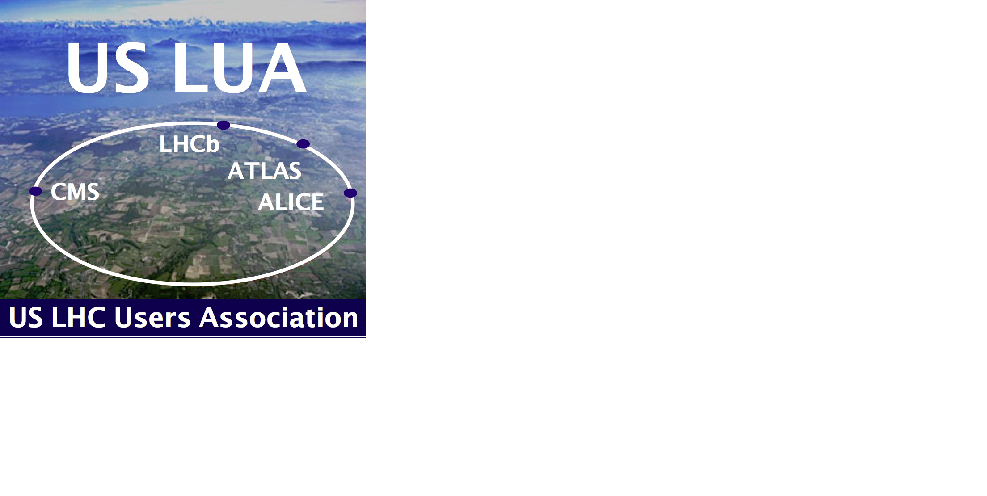

We have come a long way;
we have a long way to go.
We will need your support.
If your group members or colleagues involved in the LHC Program are not already US LUA Members, ask them to please sign up at ww.uslua.org
Notes:
21

