Slide 1

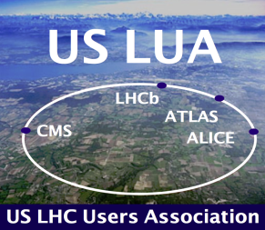

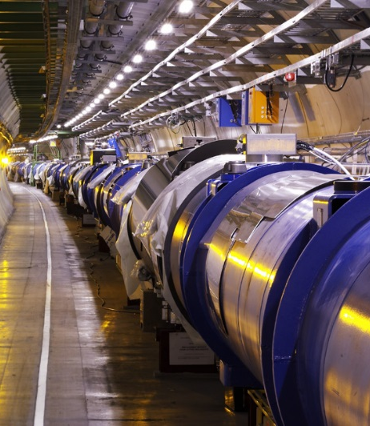
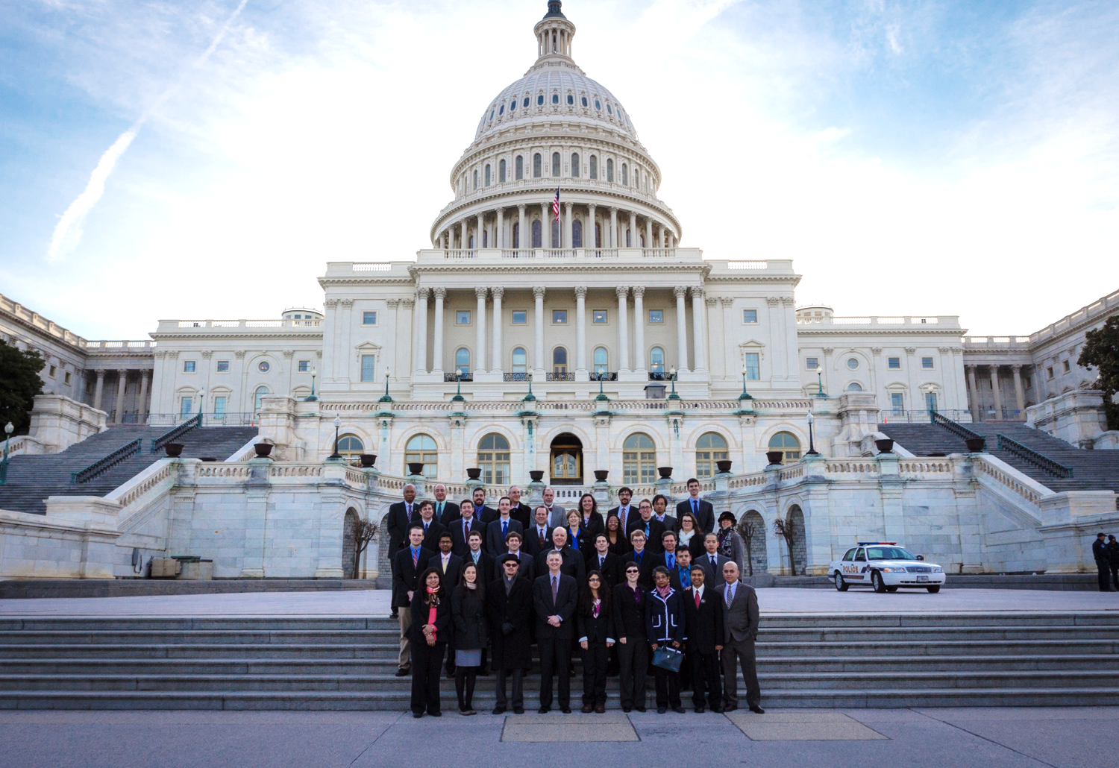
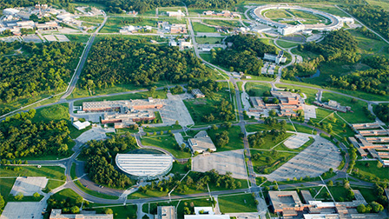
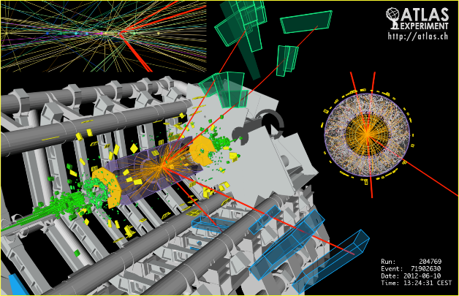
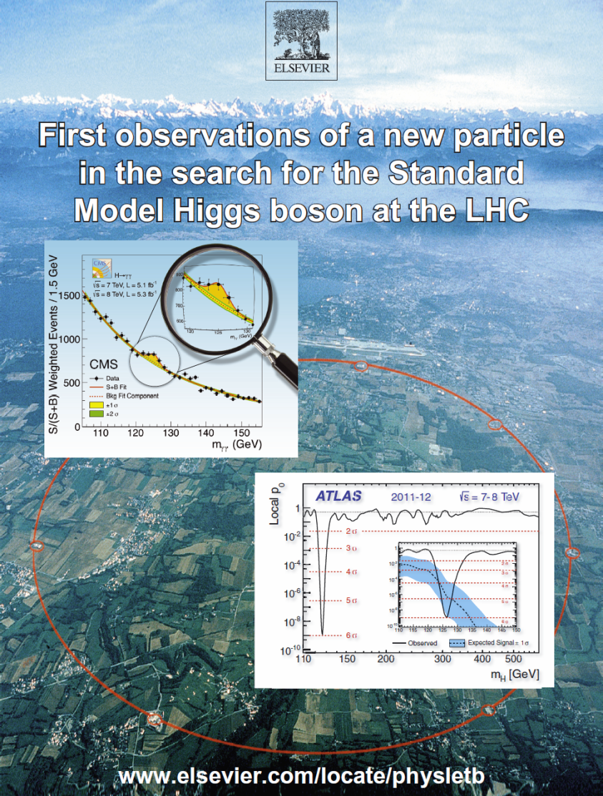
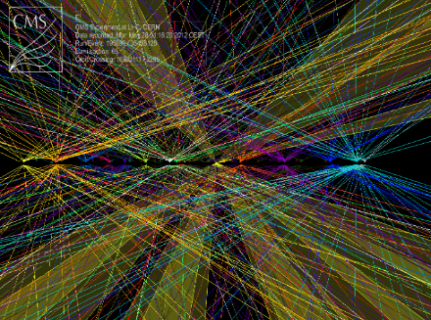

US LUA Chair Report
Harvey Newman, Caltech
US LUA Annual Meeting
Argonne National Lab
November 13, 2014
Notes:
1

Slide 2


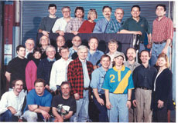

USLUA Annual Meeting 2014
Thank You Argonne HEP
for Hosting our 2014 Meeting
And Wisconsin HEP: for our 2013 Meeting
2
Notes:
2

Slide 3
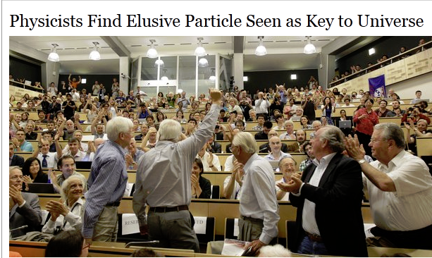
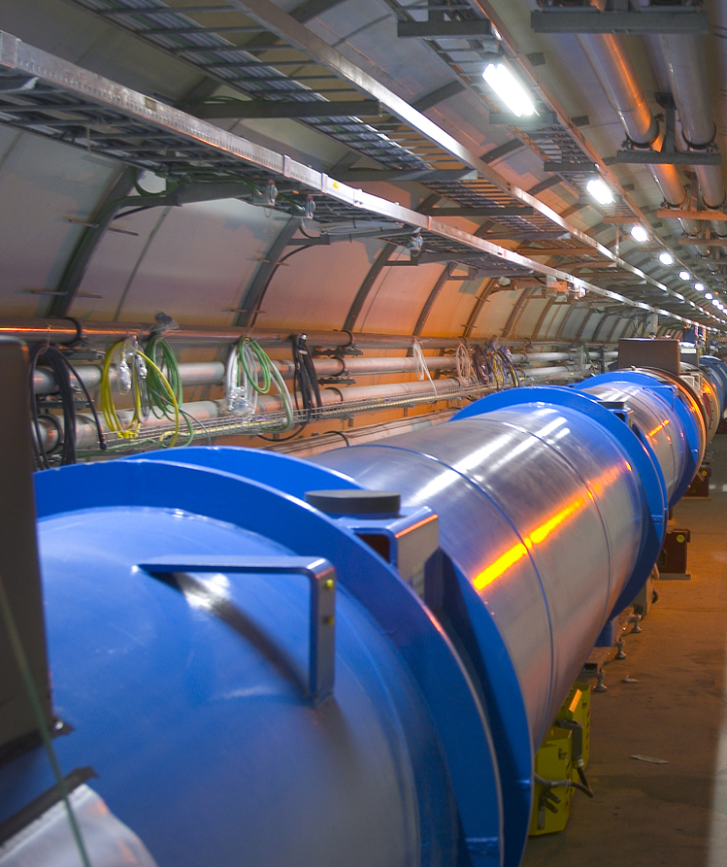
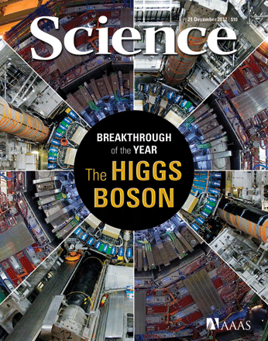

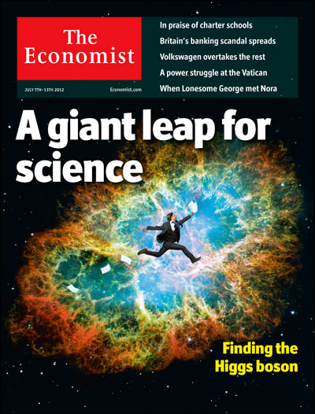
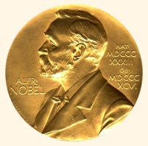
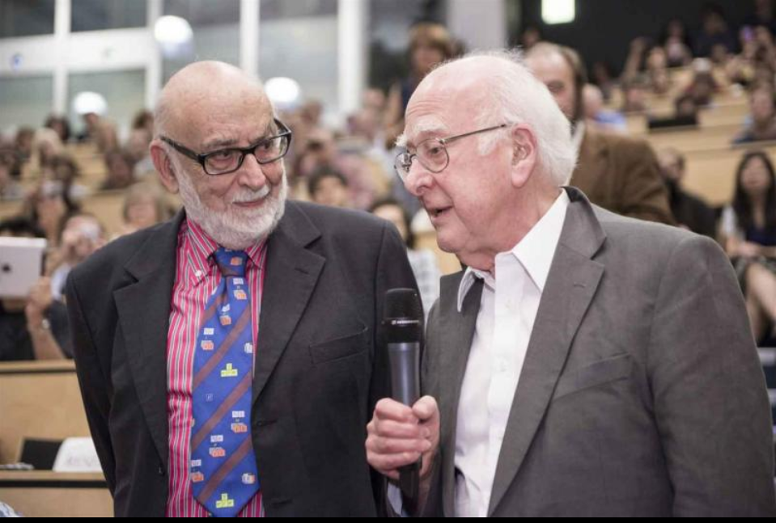
Discovery of a Higgs “Like” Boson
July 4, 2012. Confirmation by March 2013
A billion people watched
Theory : 1964
LHC + Experiments Concept: 1984
Construction: 2001
Operation + Discovery: 2009-12
Nobel Prize to Englert, Higgs: 2013
Run2: The Next Round with greater reach.
Adrift on a sea of discovery

Slide 4

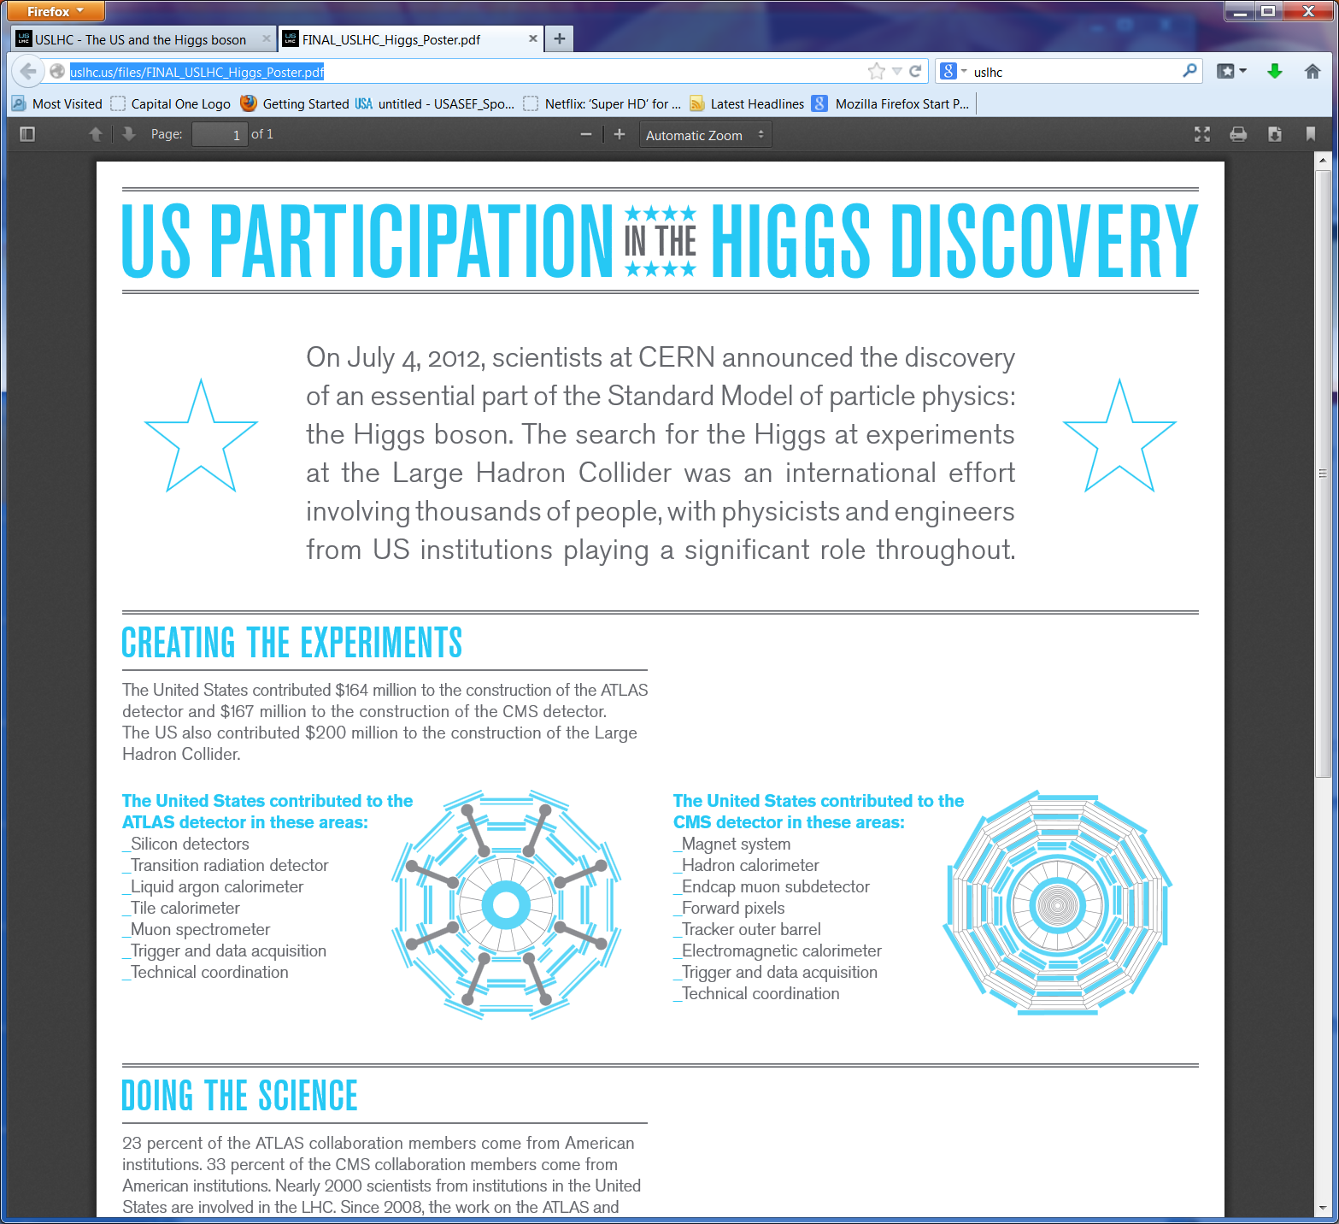
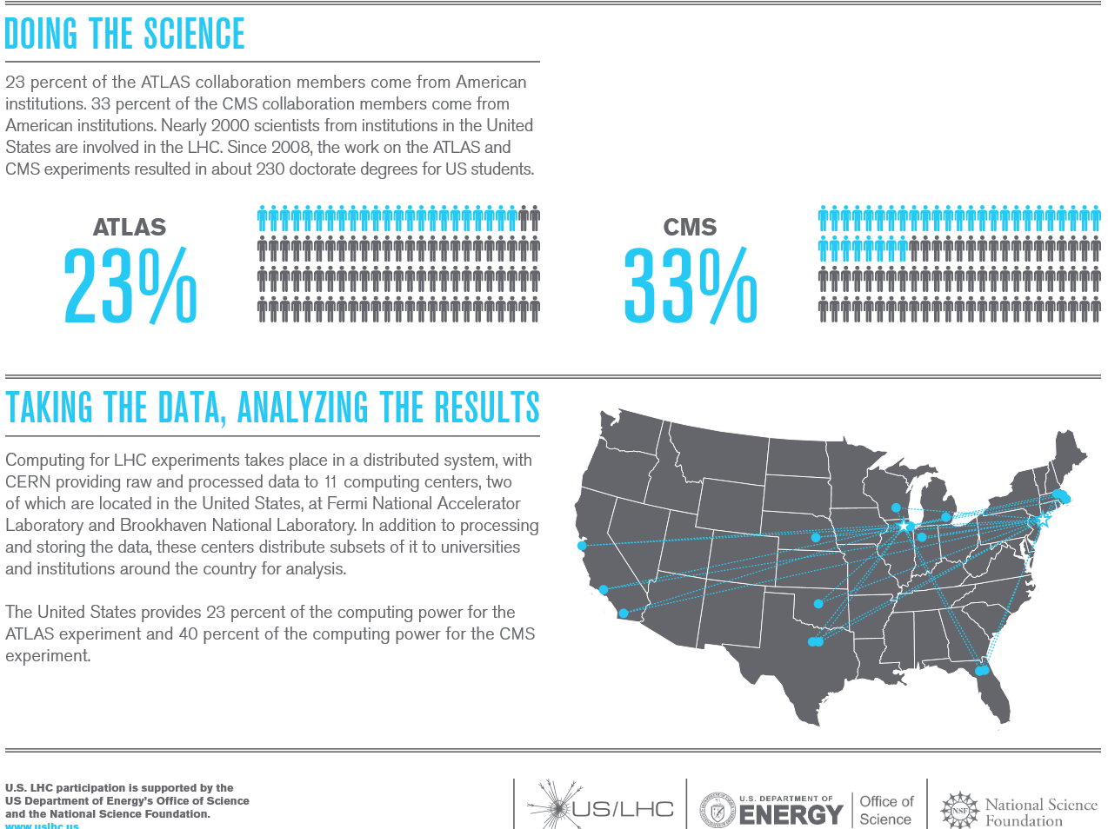
ACCU News
The US LHC Community: a Central, Essential Part of the Higgs Discovery
http://uslhc.us/The_US_and_the_LHC
US LHC
2000 Scientists, engineers, students and technicians from 96 US institutions in
33 US States and Puerto Rico
http://uslhc.us/files/FINAL_USLHC_Higgs_Poster.pdf

Slide 5
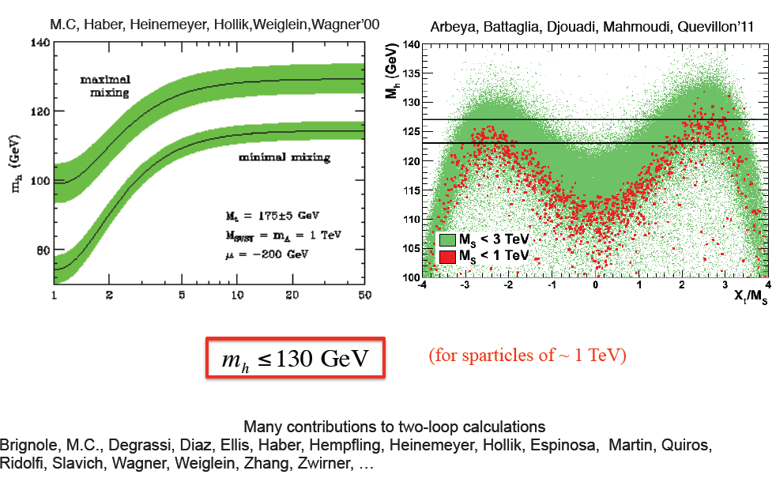
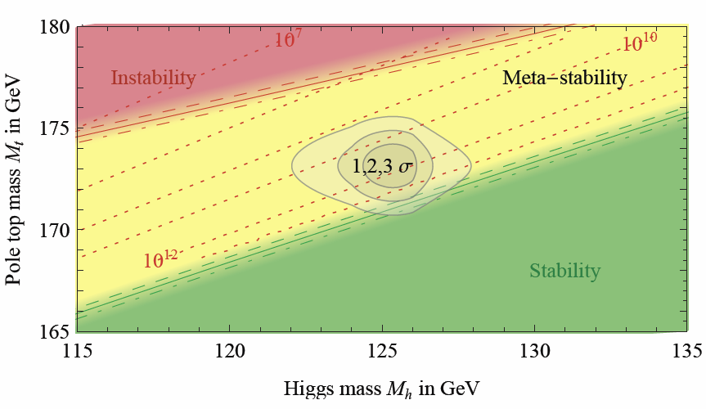
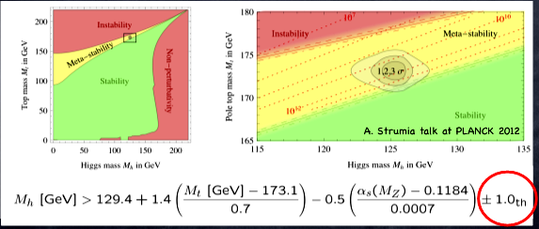
The 125 GeV Boson Discovery
A Portal that Has Expanded our Vision
SuperSymmetry and the Higgs Mass
The Higgs Mass and Vacuum Stability
Unstable
Metastable
US
Top Quark Mass in GeV
Stable
Higgs Mass in GeV
A 125 GeV Higgs is hard to fit
into the simplest forms of SUSY
  Nature may be more subtle:
  SUSY may not be so simple
2013: “industry” exploring
exotic SM and SUSY extensions
A Higgs mass of ~125 GeV
The Vacuum we are in
seems to be metastable
OR – New physics at ~10¹¹ GeV
What lies between us
and the Big Bang ?

Slide 6
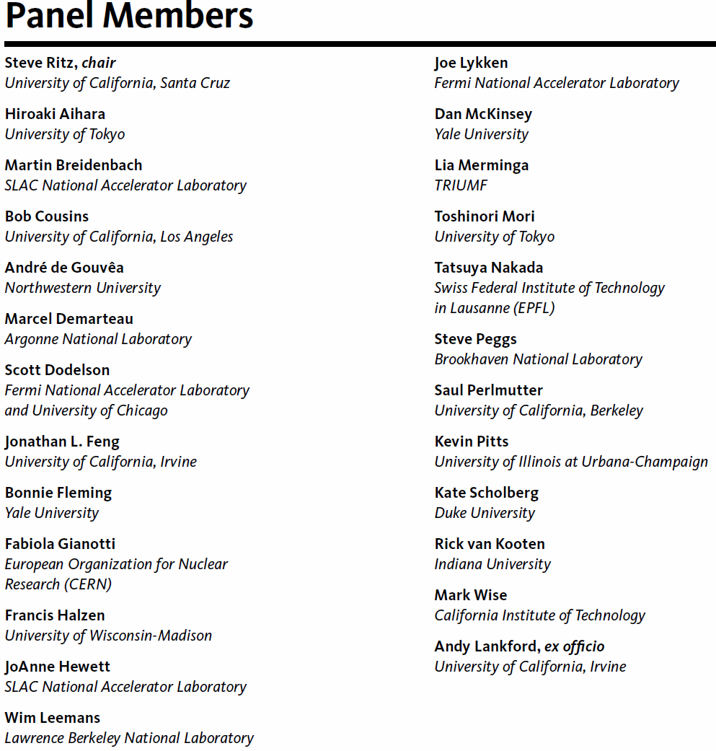
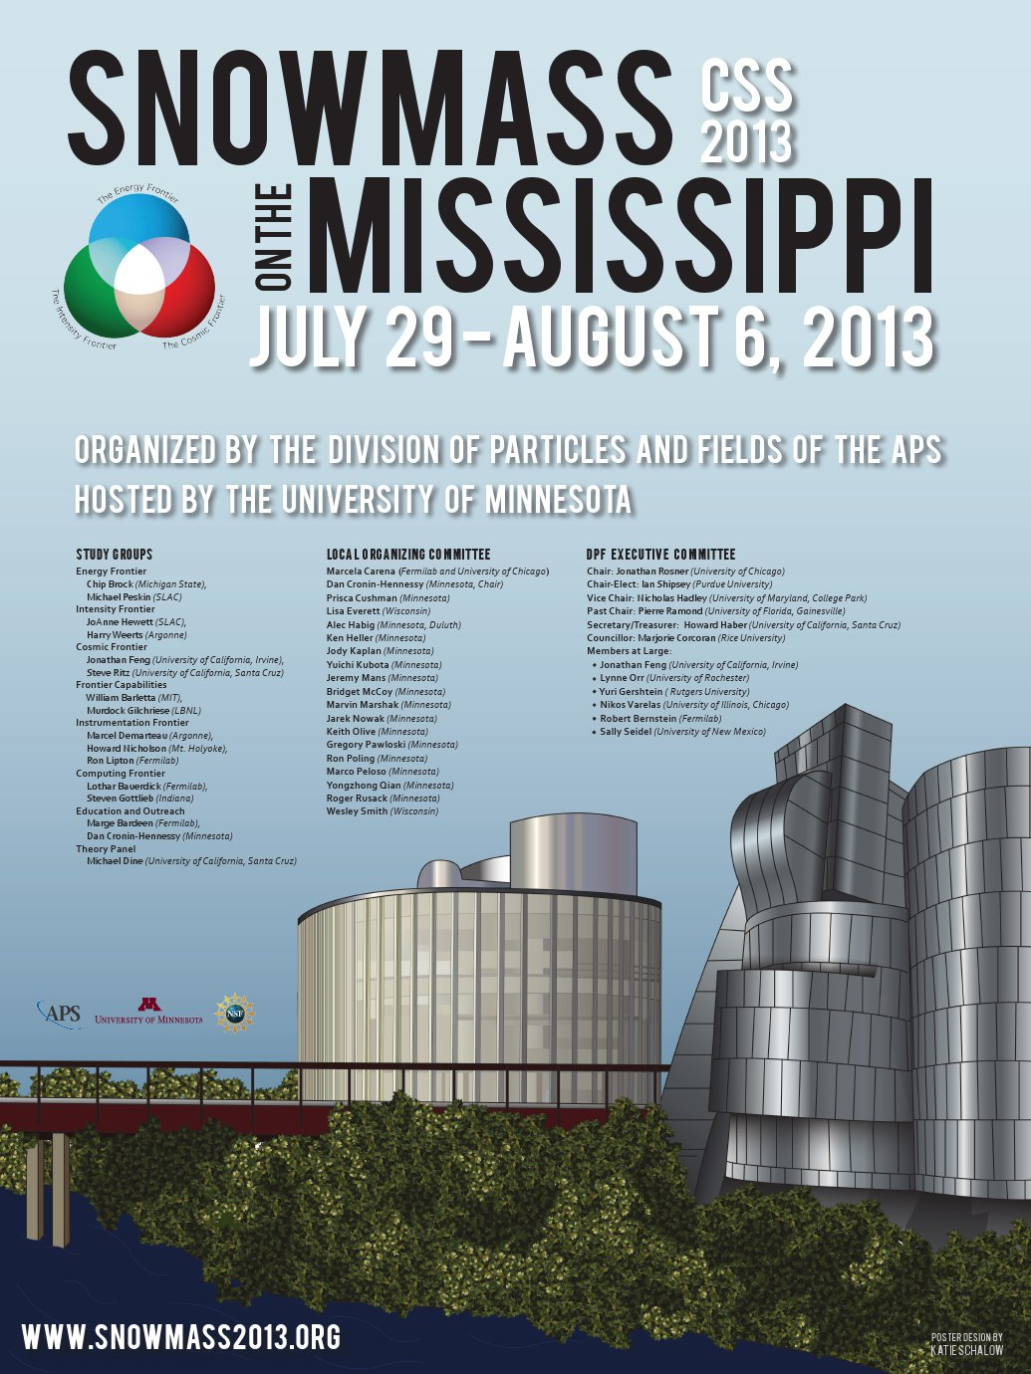

2014: Embarking on the Road to Our Future: A Two Step Process
Snowmass: Oct. 2012
to August 2013
P5 Panel and Report:
Oct. 2013 – June 2014
http://science.energy.gov/hep/hepap/reports/

Slide 7
The P5 Report: 5 Intertwined
Science Drivers. 29 Recommendations
One Major Milestone for HEP
  Use the Higgs boson as
  a new tool for discovery
  Pursue the physics associated with neutrino mass
  Identify the new physics
  of Dark Matter
  Understand cosmic acceleration: dark energy
  and inflation
  Explore the unknown:
  new particles, interactions
  and physical principles
Recommendation 10: Complete the LHC phase-1 upgrades and continue the strong collaboration in the LHC with the phase-2 (HL-LHC) upgrades of the accelerator and both general-purpose experiments (ATLAS and CMS). The LHC upgrades constitute
our highest-priority near-term large project.
“The enormous physics potential of the LHC, which will be entering a new era with its planned high-luminosity upgrades, will be fully exploited.”

Slide 8

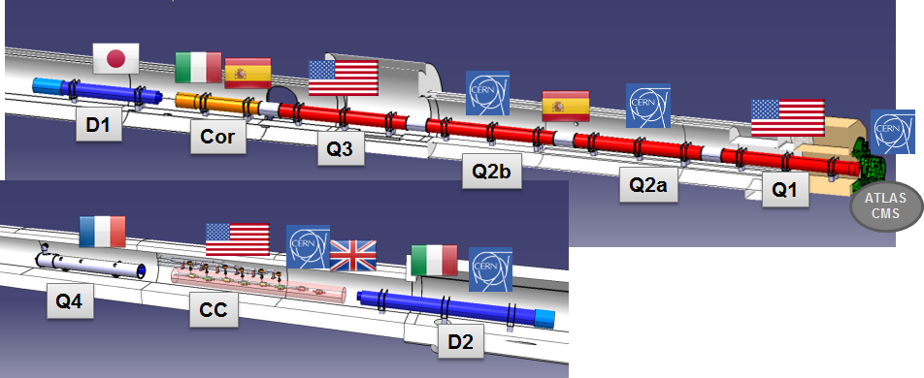
Three World Regions:
Europe, Americas & Asia
Baseline design of HL-LHC Interaction Region (Bordry)
Global design in particle physics: representation
from each region. We will have to solve problems together and be well coordinated.
ICFA has an important
role to play
A Good Example of
International Collaboration

Slide 9
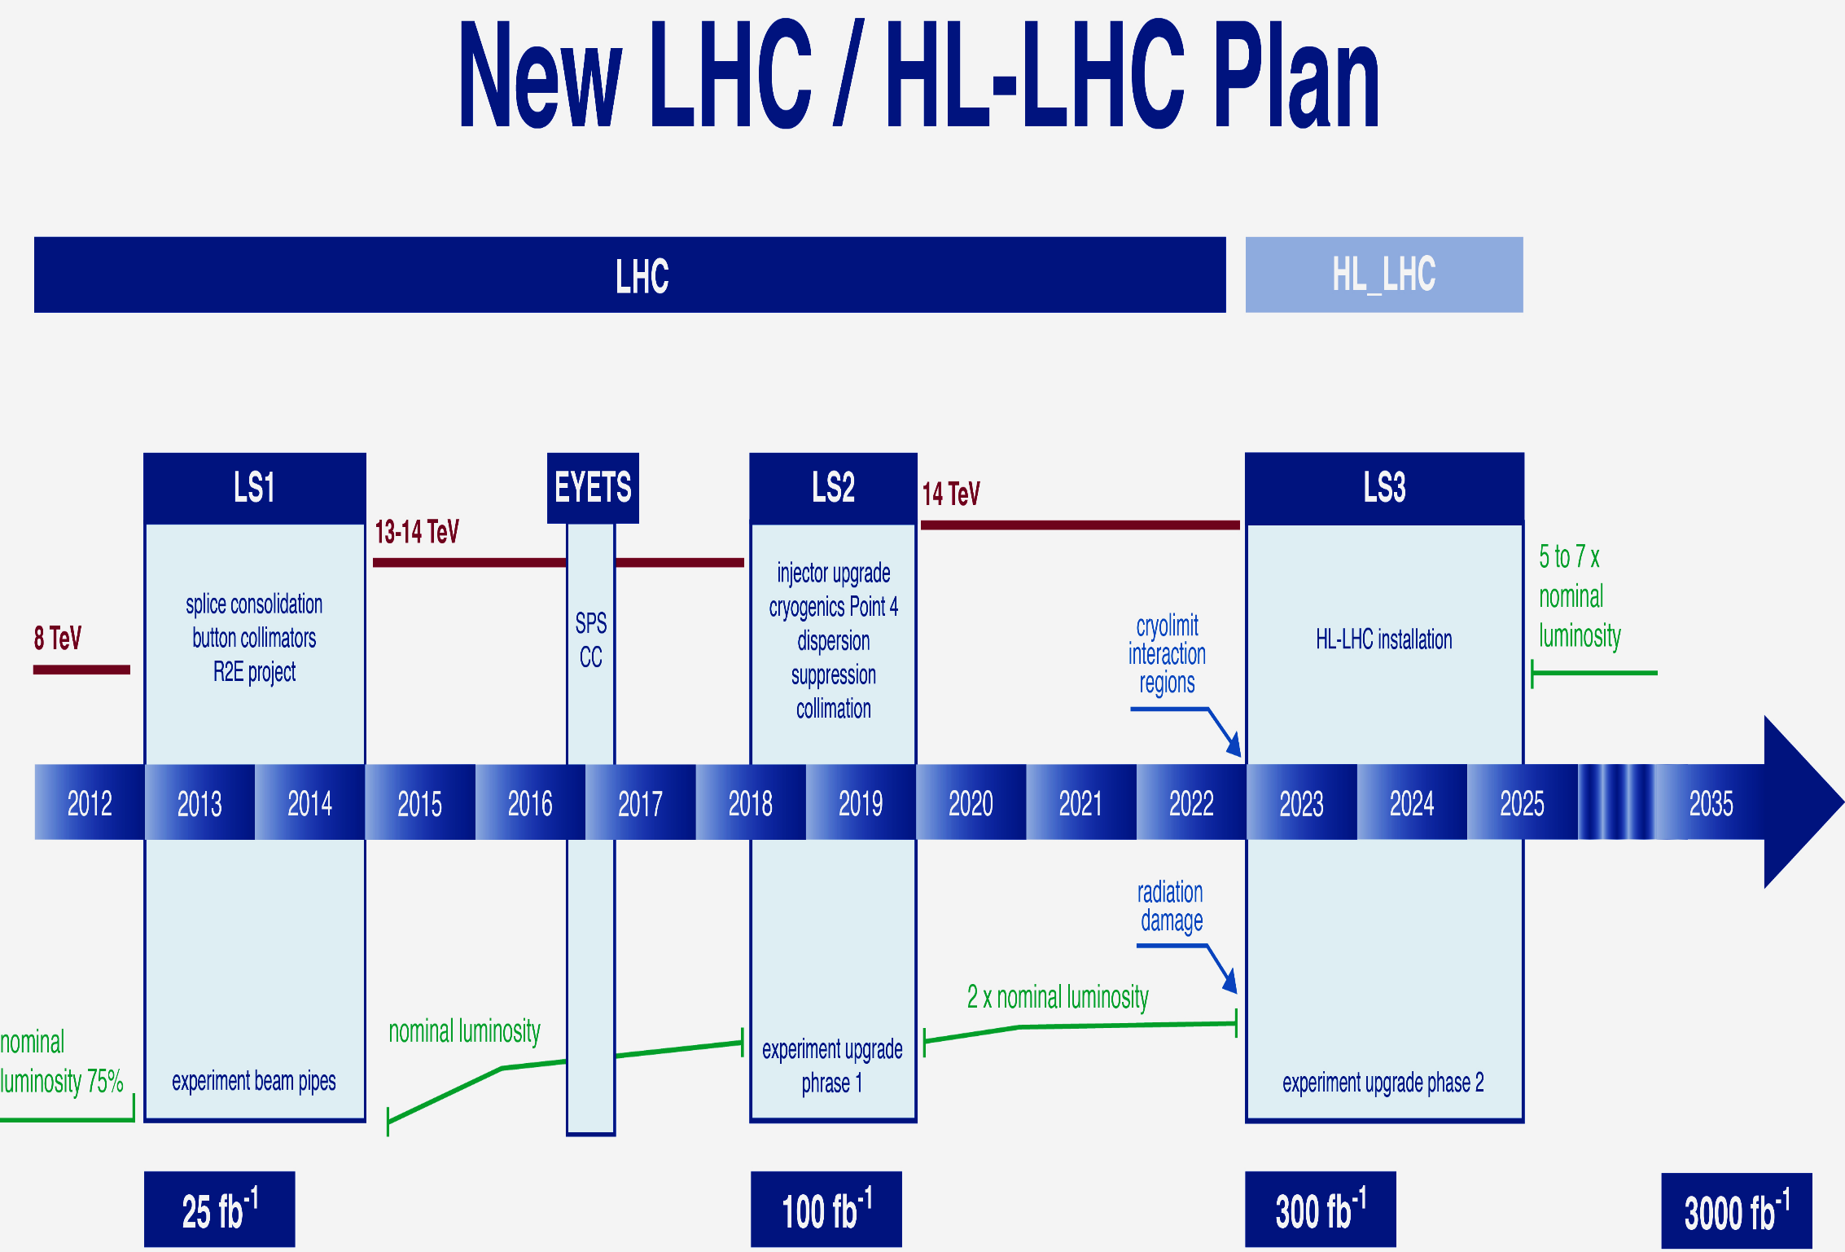
The LHC Timeline
L.Rossi
L=1.6x10³⁴
Pile-up~30-45
L=2-3x10³⁴
Pile-up~50-80
L=5x10³⁴
Pile-up~ 130-200
L~7x10³³
Pile-up~20-35
LHC Run II starts in 2015: Anticipate 13 TeV Collisions in May
  Great potential: higher energy, higher luminosity
  Perhaps a unique near term opportunity: increased reach

Slide 10
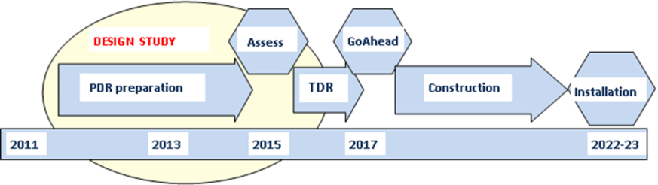
2nd ECFA HL-LHC… Accelerator and Experiments planning
Similar tight timelines for different steps for Accelerator, ATLAS &CMS
- R&D needs to be mostly completed in ≤ 3 years (TDRs)
HL-LHC planning
Example of the CMS planning for major upgrade work - it is similar for ATLAS
LHCb & ALICE TDRs approved or in process to be - construction soon starting
Didier Contardo: Concluding Talk at the ECFA HL LHC Workshop, October 2014
We need to match with US DOE and NSF processes and timelines

Slide 11
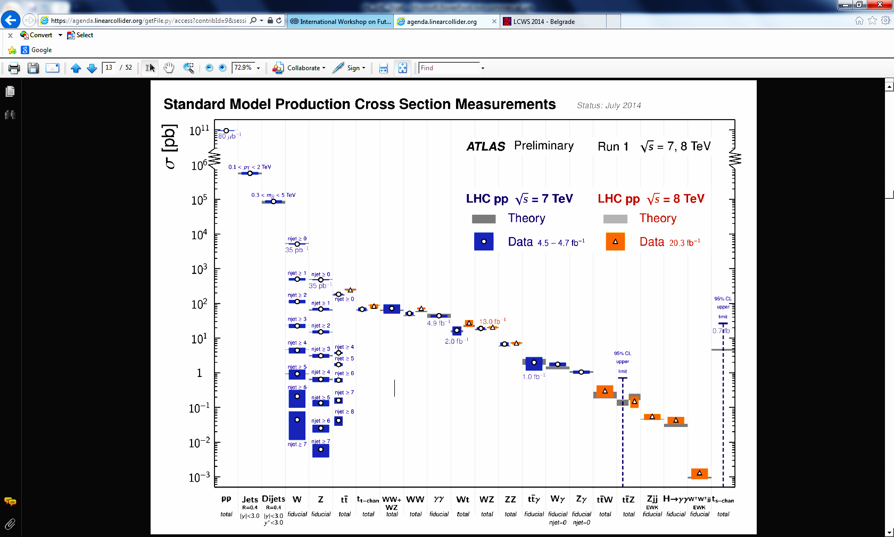
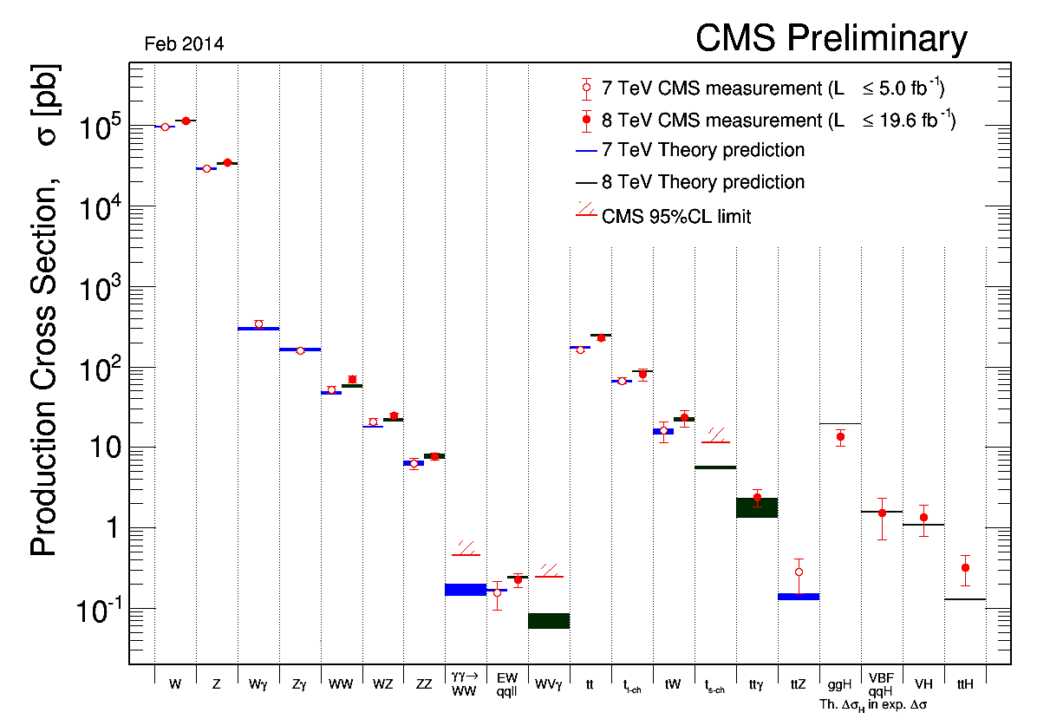


LHC: SM Cross Sections
Testing the SM Over 14 Orders of Magnitude
A tribute to experimentalists and theorists

Slide 12
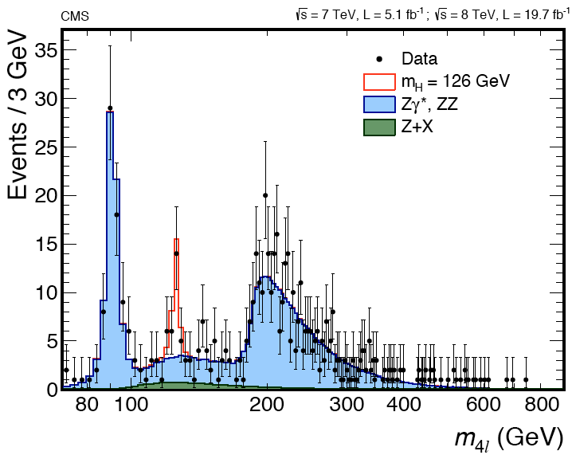
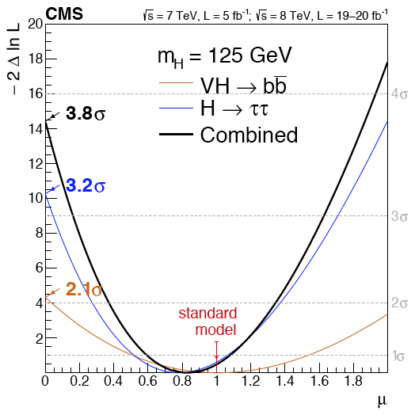
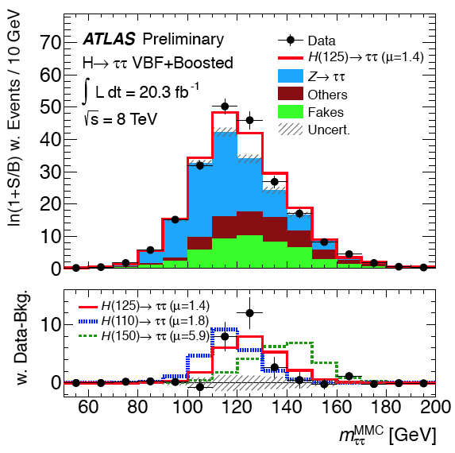
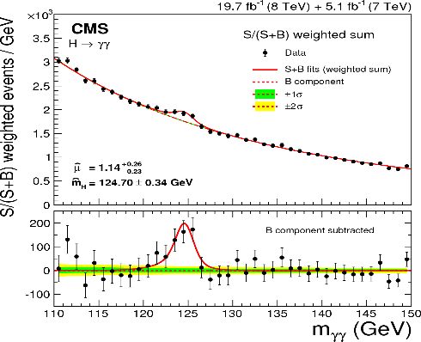
LHC: Higgs Boson Measurements
Mass: M_{H}^{CMS} = 125.03 ^{+0.26}_{-0.27} (stat) ^{+0.13}_{-0.15} (syst) GeV
M_{H}^{ATLAS} = 125.36 ± 0.37 (stat) ± 0.18 (syst) GeV
Coupling to Bosons
Coupling to Fermions
ATLAS: H→ γγ
CMS: H→ ZZ → 4l
CMS: H→ ττ, bb
ATLAS: H→ ττ
ATLAS | Exp | Obs
H → ττ | 3.2 σ | 4.1 σ
H → γγ | Exp | Obs
ATLAS | 4.1σ | 7.1σ
CMS | 4.2σ | 5.7σ
ZZ→4l | Exp | Obs
ATLAS | 4.4σ | 6.6σ
CMS | 6.7σ | 6.8σ
CMS | Exp | Obs
H → ττ | 3.4 σ | 3.2 σ
H → bb | 2.1 σ | 2.1 σ
ttH | μ | Sig.
ATLAS | 1.6±1.2 | 1.5σ
CMS | 2.8±1.0 | 2.7σ

Slide 13
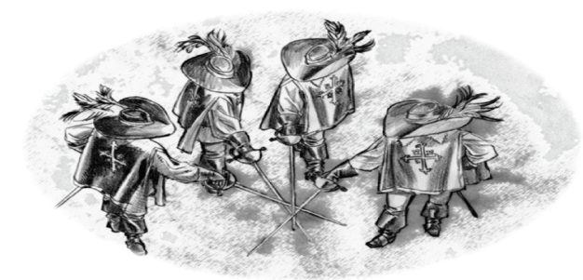
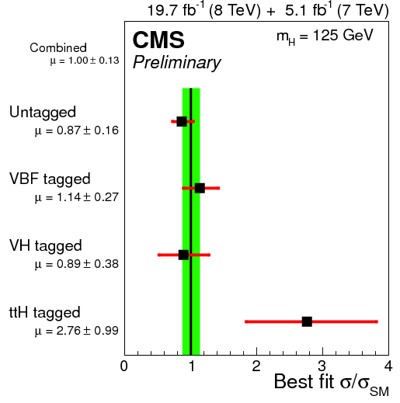
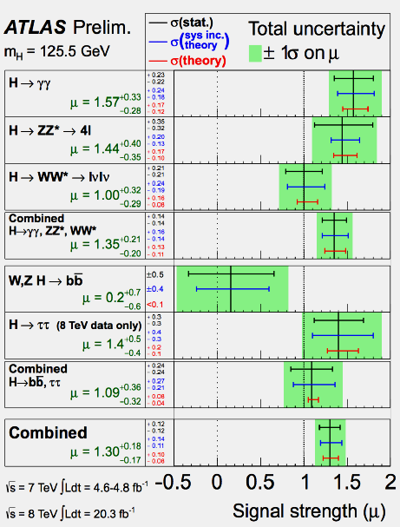
Higgs Signal Strengths
Relative to the SM
μ = 1.00 ± 0.13
μ = 1.30
+0.18
- 0.17
Coupling to Fermions, VBF, H →γγ diff. distributions, tt+H, Two HDM

Slide 14
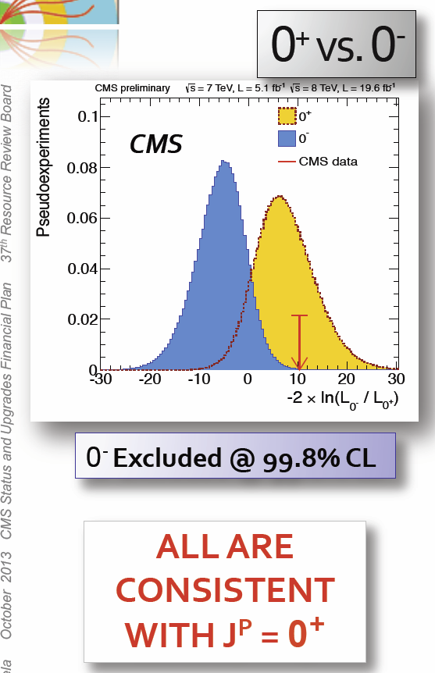
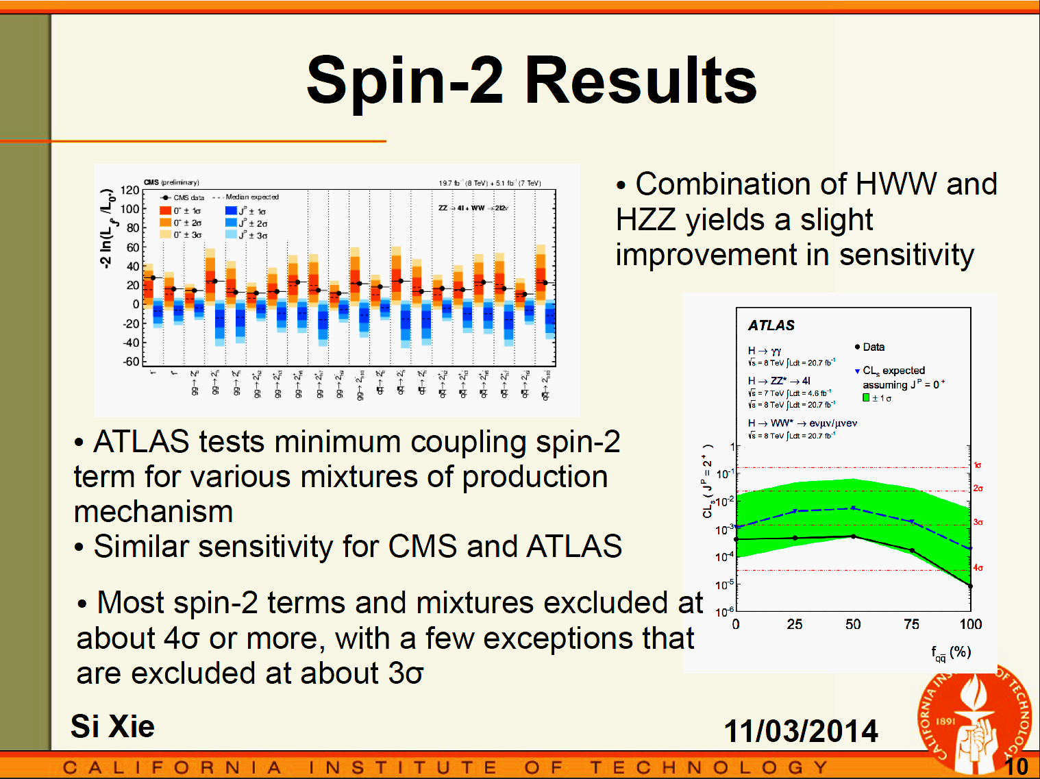
H ZZ  4 Leptons, WW, gg: Spin and Parity: J^{P}
5 angles
3 masses
Spin 2
0⁻ Excluded at 99.99% CL
Many alternative
spin-parity states
excluded at ≥ 4σ
LPC BSM Workshop

Slide 15

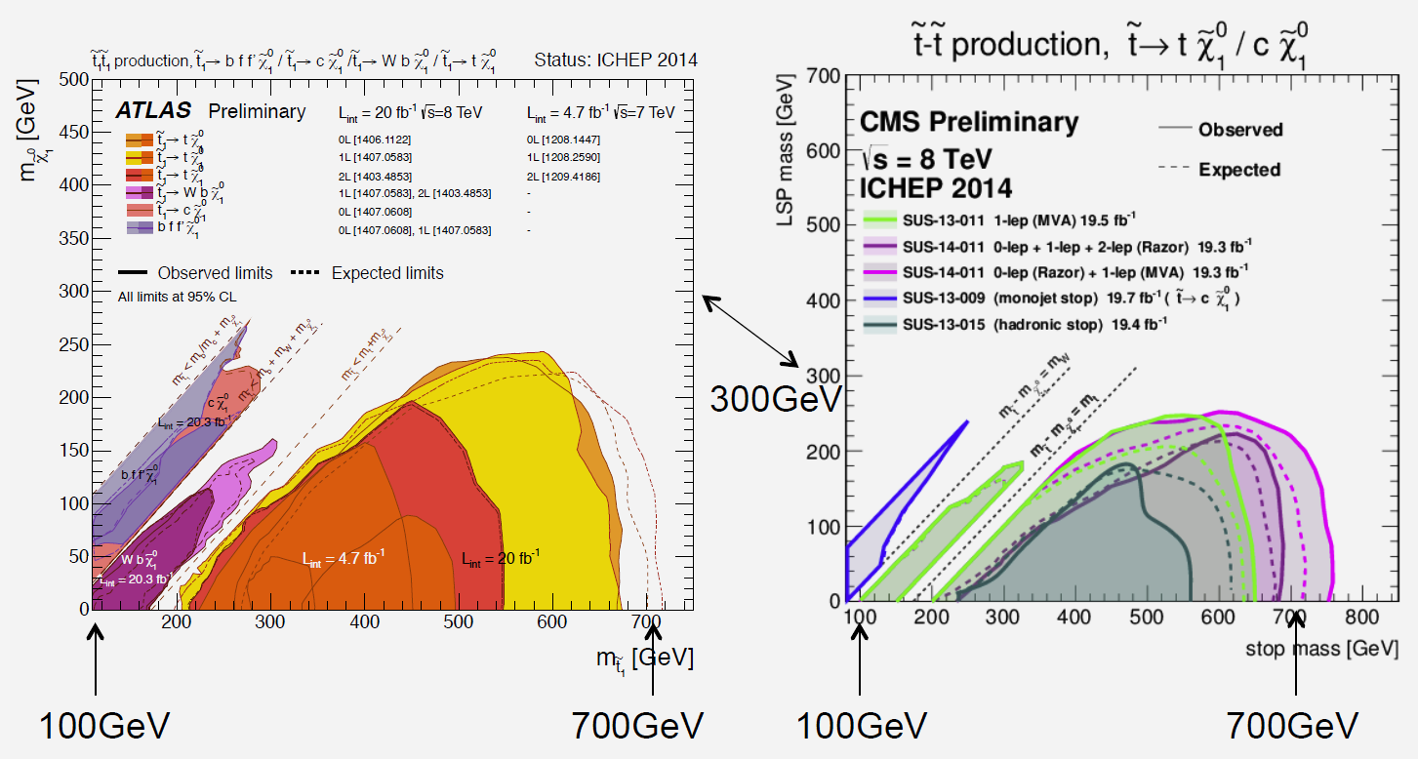
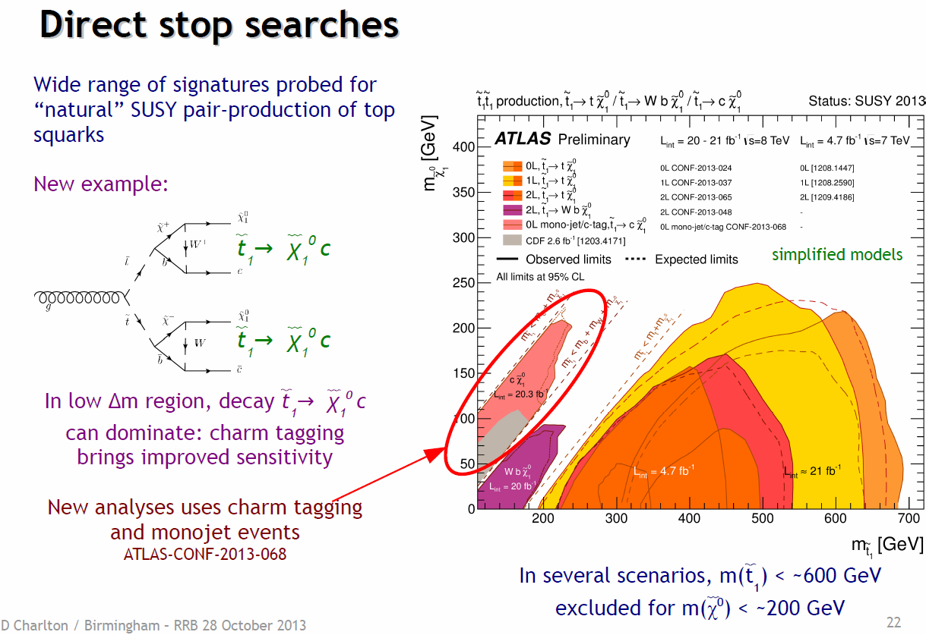

ATLAS and CMS Stop Searches: Wide range of signatures probed for “natural” SUSY
Charm Tag+Monojet
F. Wuerthwein, ICHEP

Slide 16
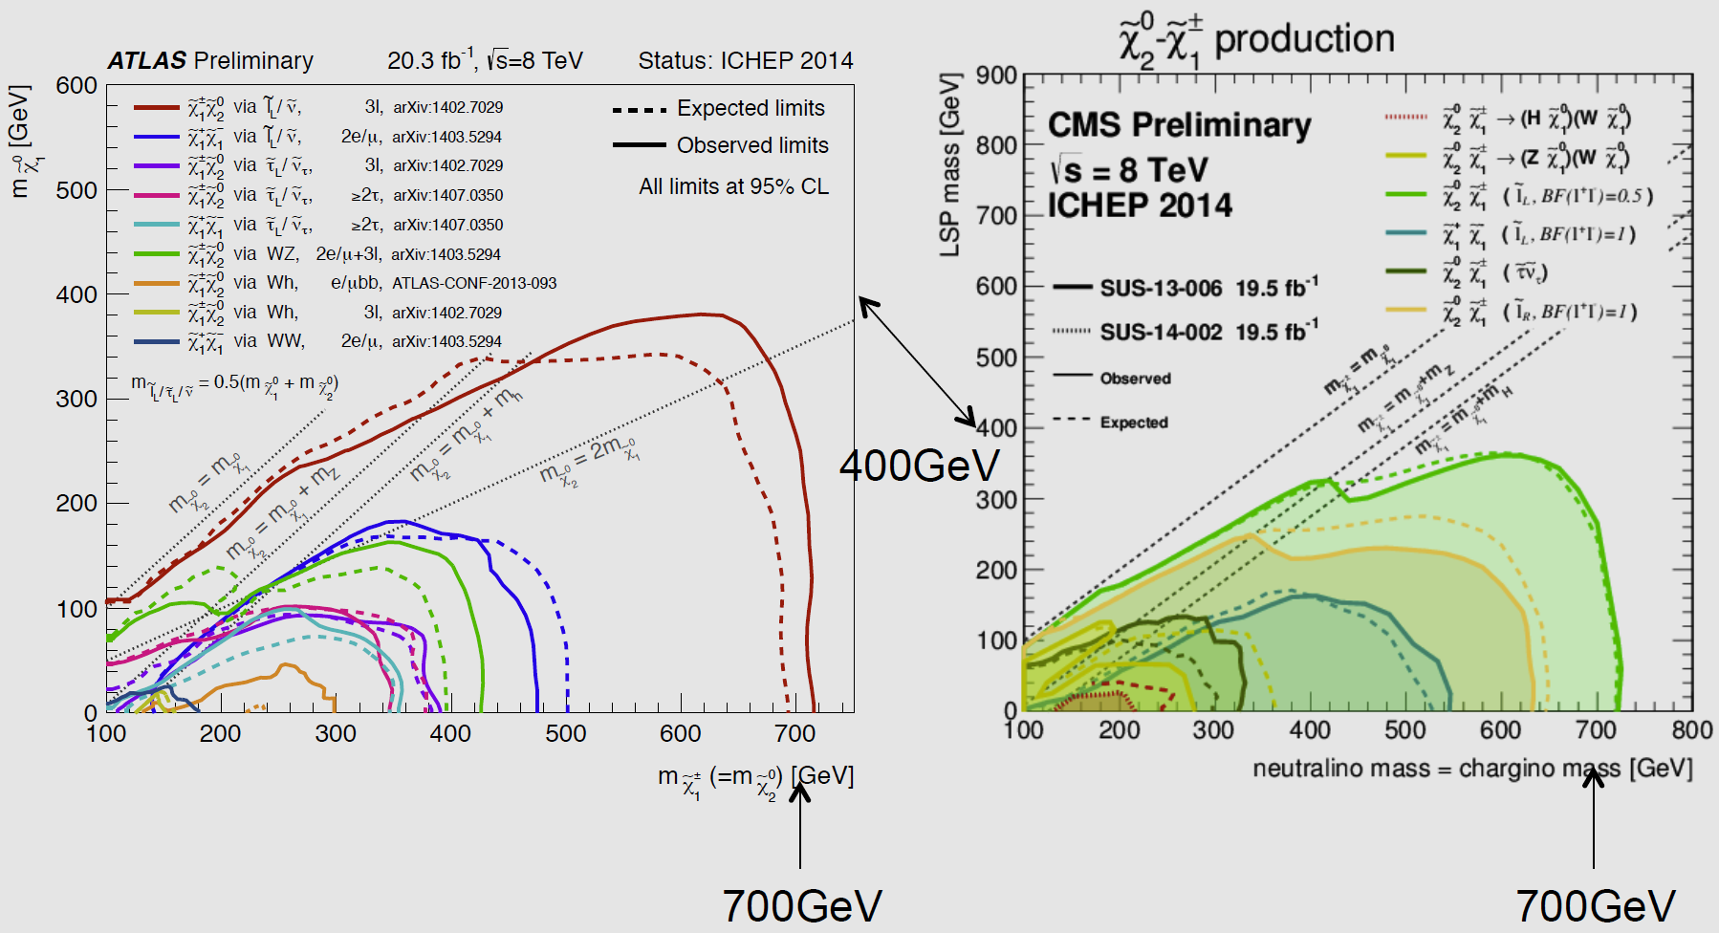
ATLAS and CMS Elwkino Searches
F. Wuerthwein, ICHEP

Slide 17

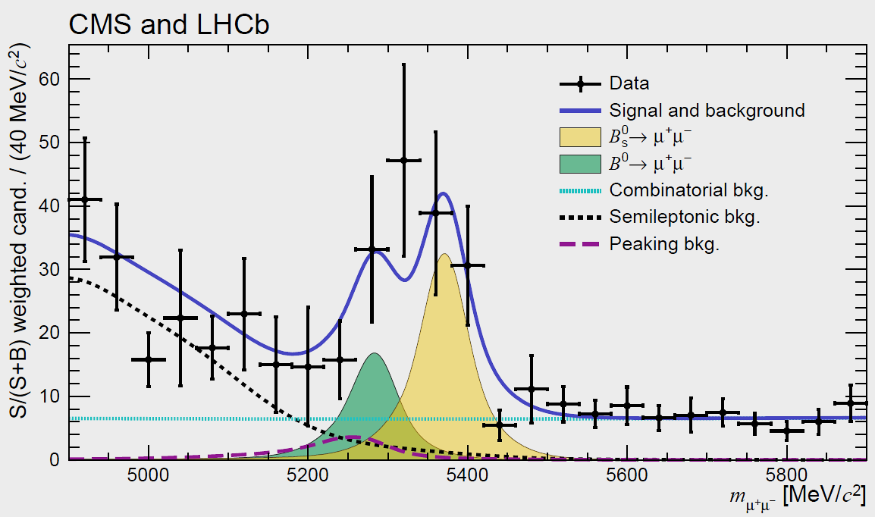
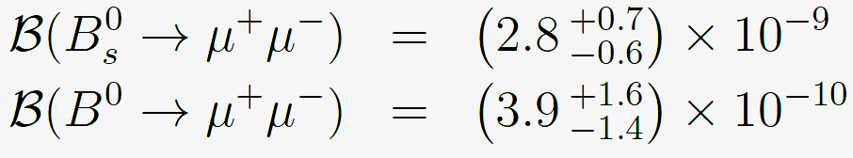


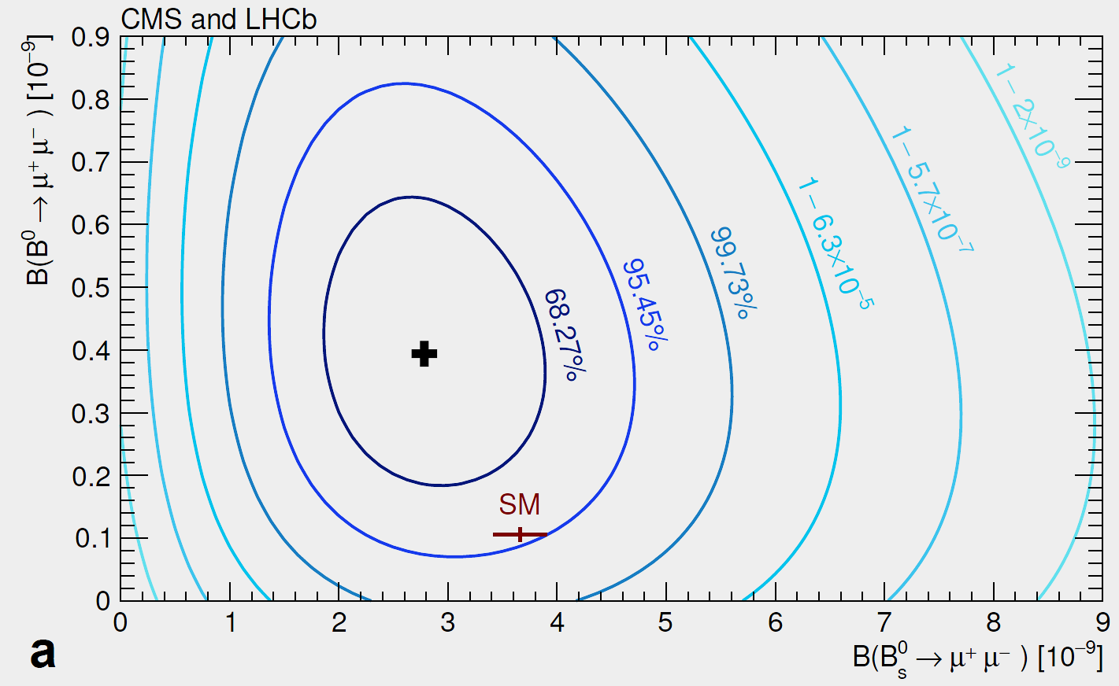
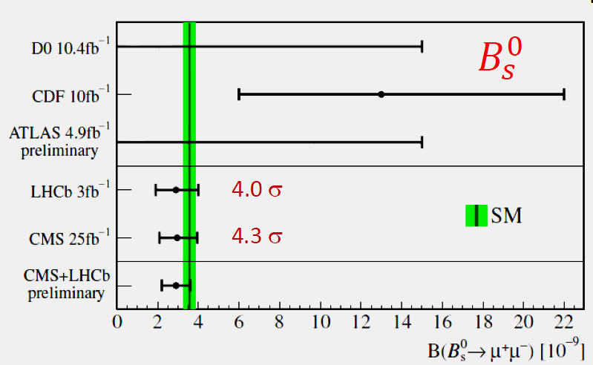
LHCb + CMS Combined B⁰_{s} and B⁰  μμ
An Observation of B⁰_{s} Compatible with the SM
B_{s}⁰ > 5σ
B⁰ Compatible with SM ?: at the 2.3σ level
CMS-BPH-13-007 LHCb-PAPER-2014-049 CERN-PH-EP-2014-220 Oct. 14, 2014

Slide 18
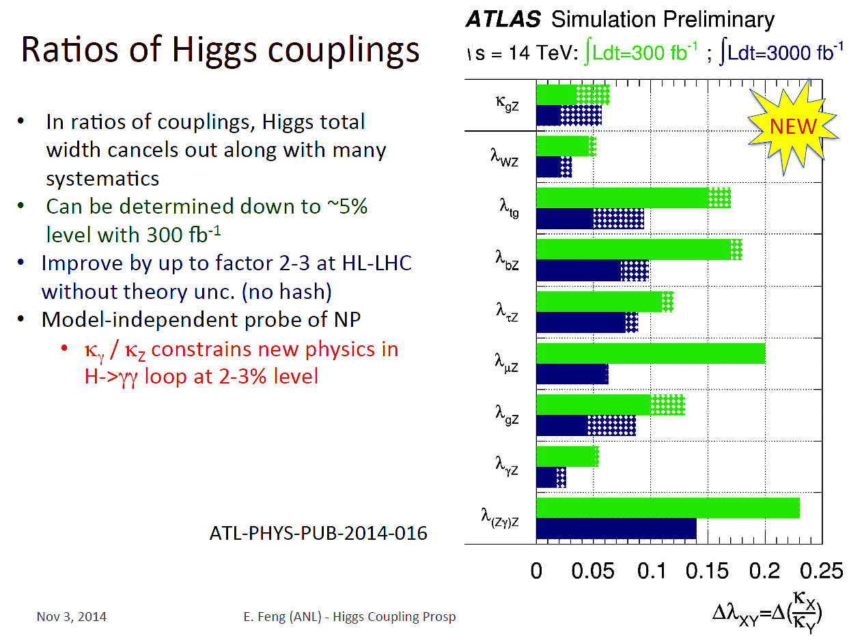
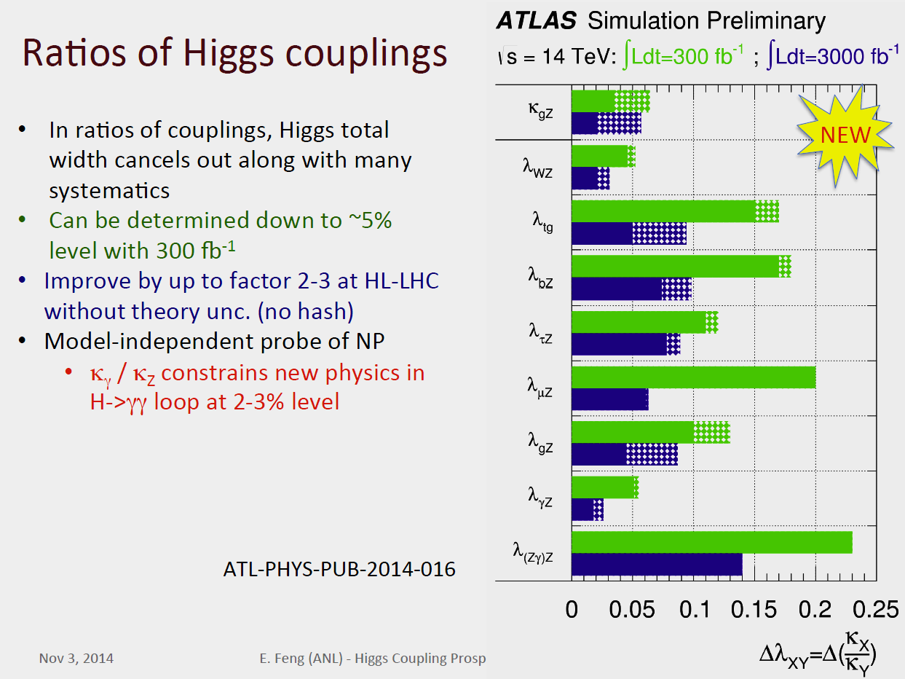

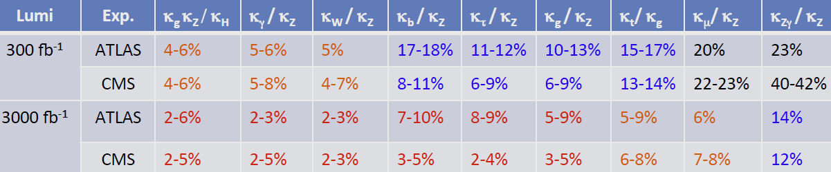
Run2 and HL LHC Outlook
Ratio of the Higgs Couplings
Eric Feng
at the BSM Workshop
at the LPC
Two Scenarios

Slide 19
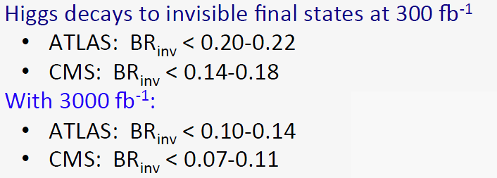
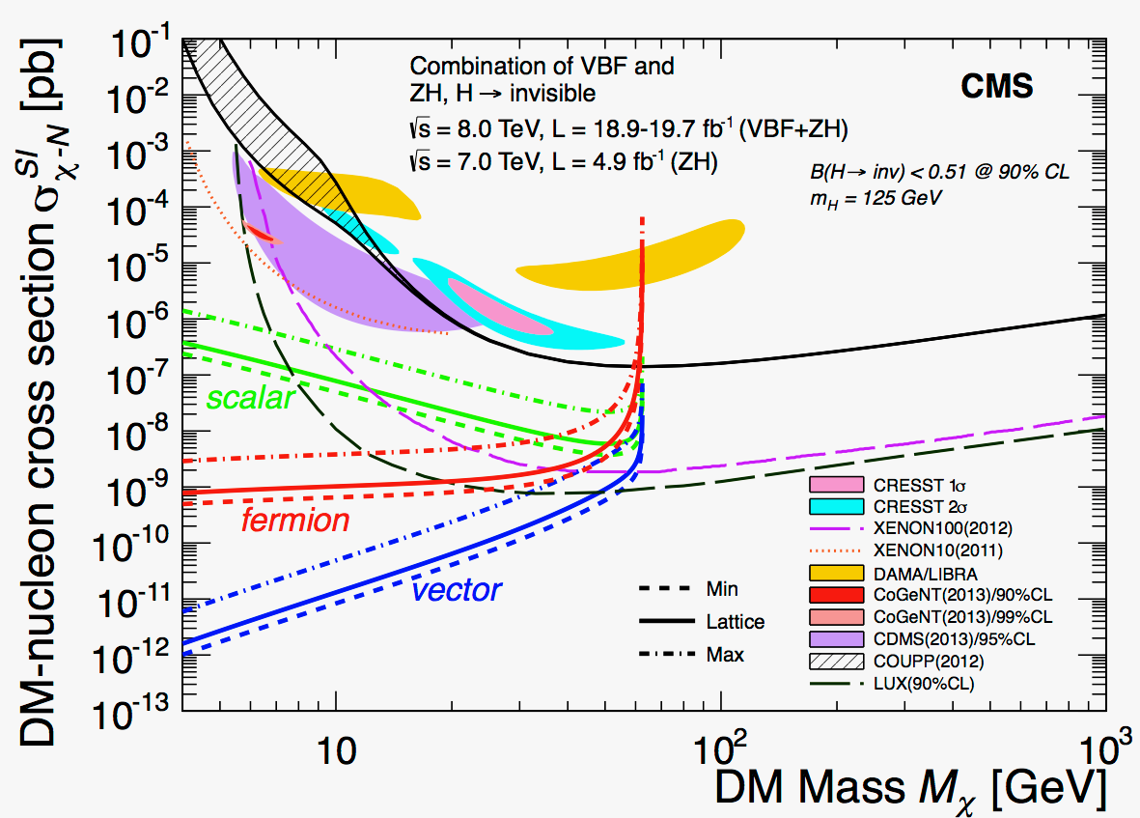
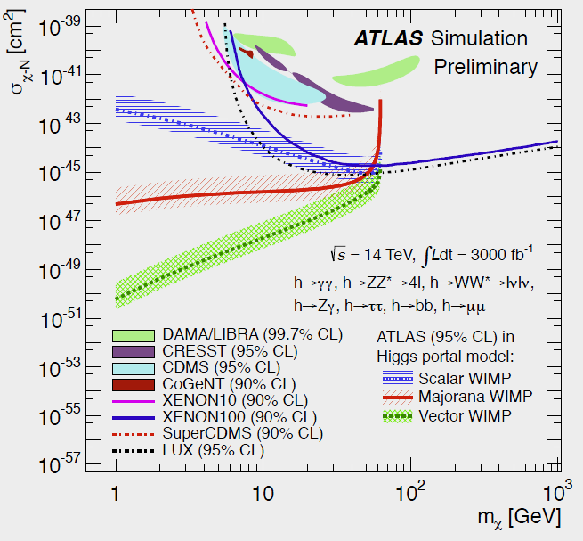
Higgs as a Tool for Discovery
H  Dark Matter Portal
Translate H  Invisible BR Limit
to Coupling of H to Wimp and
σ for wimp-nucleon scattering
HL LHC Projected
Run 1 Result
Sensitive to low mass dark matter: Complementary to direct searches

Slide 20
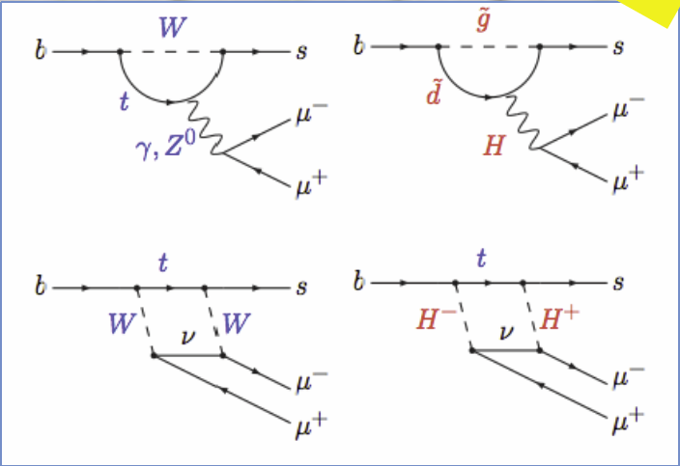
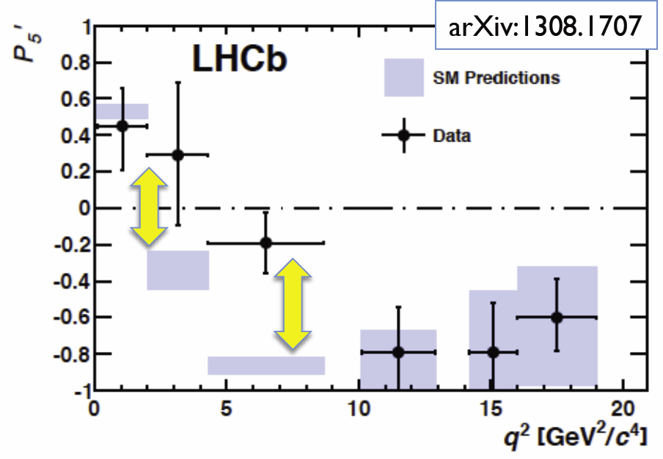
LHCb Results: Electroweak Penguins
Transitions in b sμμ arXiv 1308.1707
Penguin-dominated B⁰  K*μμ
decays. Angular Variables
Sensitive to New Physics
One of these (P₅’) shows
a local 3.7σ deviation from SM predictions
More data available still to be analyzed
NP ?: great deal of theoretical interest deeper understanding needed
NP ?: great deal of theoretical interest deeper understanding needed

Slide 21





ALICE: Identified Particle R_{AA} and R_{pA}
Exploring the nature of hot dense matter in a new regime
Pb-Pb R_{AA}: Mesons and Baryons
behave differently for P_{T} < 10 GeV
 Radial flow important in this region
While all behave similarly at high P_{T}
p-Pb R_{pA}: Species dependence, peak at intermediate P_{T} larger for heavier particles
 No peak for π,K; weak for φ
 More pronounced for p, Ξ
Central
Peripheral
Plus many other results from ALICE, CMS and ATLAS: Angular correlations, baryon/meson ratios, jet suppression, weak versus hard probes, etc.

Slide 22
US LHC Users Association (US LUA) http://www.uslua.org
Represents the entire community: Universities and Labs
  Covers the LHC experiments and LARP (Accelerator R&D)
  Forum for information and concerns; special “international” needs
Established as a non-profit tax exempt association, headquartered
in DC, collocated & hosted by URA since May 2013
In our eighth year: Successor to the US LHC Users Organization,
that was approved by the LHC experiments and LARP in April 2007
Mission Statement:
“The purpose of USLUA is to provide a forum for discussions of the US
participation in the LHC research program, with a focus on how best to enhance scientific participation in the discoveries expected from this research. In particular, USLUA aims to help the US LHC community work effectively with their colleagues at CERN while in the US, and to adapt to work at CERN and to living in the environs of the CERN laboratory. USLUA also provides communication channels between scientists working on LHC experiments, the US agencies supporting this research and the US Congress.”
Notes:
22

Slide 23

ACCU News
US LHC: 70 of 83 US Universities in URA
Alabama
Arizona
Brown
Boston Univ.
Caltech
UC Berkeley
UC Davis
UC Irvine
UCLA
UC Riverside
UCSD
UCSB
Carnegie Mellon
Case Western
Chicago
Colorado
Columbia
Cornell
Duke
Florida
Florida State
Harvard
UIC
UIUC
IIT
Indiana
Iowa
Iowa State
Johns Hopkins
Maryland
MIT
Michigan
MSU
Minnesota
Nebraska-Lincoln
New Mexico
Northeastern
NIU
Northwestern
Notre Dame
Ohio State
Oklahoma
Oregon
Pennsylvania
Pittsburgh
Princeton
Purdue (+Calumet)
Rice
Rochester
Rockefeller
Rutgers
South Carolina
Southern Methodist
Stanford
SUNY Buffalo
SUNY Stony Brook
Syracuse
Tennessee Knoxville
Texas A&M
UT Arlington
UT Austin
UT Dallas
Texas Tech
Tufts
Vanderbilt
Virginia
Washington
Wayne State
Wisconsin
Yale
US LHC
2000 Scientists, engineers, students and technicians from 96 US institutions in
33 US States and Puerto Rico

Slide 24
US LUA Executive Committee
2014 Membership (2 Year Terms)
Name Institution Collaboration Term Expires
Darin Acosta Florida CMS 2014
Ken Bloom (Elections) Nebraska CMS 2014
Tom LeCompte Argonne ATLAS 2014
Usha Mallik (Elections) Iowa ATLAS 2014
Sheldon Stone, Treasurer Syracuse LHCb 2014
Julia Thom (Secretary) Cornell CMS 2014
Kevin Black Boston ATLAS 2015
Sridhara Dasu (ACCU) Wisconsin CMS 2015
John Harris Yale ALICE 2015
Harvey Newman (Chair) Caltech CMS 2015
Michael Tuts (Vice Chair) Columbia ATLAS 2015
Gordon Watts Washington ATLAS 2015
Observers: Tulika Bose (Boston), Toyoko Orimoto (Northeastern)
Totals: CMS 5+2, ATLAS 5, LHCb 1, ALICE 1; LARP +1
Ex-Officio: US ATLAS and CMS PMs, Deputies, CB Chair, IB Chair
With Thanks to: Daniela Bortoletto, Sarah Demers, Sandor Feher (LARP)
24
Notes:
24

Slide 25
US LUEC Sub-Committees Formed
to Better Serve Our Community
Quality of Life: Usha Mallik (Chair); Darin Acosta, Sridhara Dasu
(ACCU), Ken Bloom, Julia Thom, Harvey Newman,
Sarah Demers, Sandor Feher
Gov’t Relations: Mike Tuts (Chair); Harvey Newman, Sridhara Dasu,
Kevin Black
Outreach: Julia Thom (Chair); Ken Bloom, Toyoko Orimoto,
John Harris
Web Presence: Gordon Watts, Tulika Bose (Co-Chairs); Darin
costa, Sarah Demers, Ken Bloom, Toyoko Orimoto; D. Kcira
Annual Meeting TF: H. Newman (Chair); Sridhara Dasu, Tulika Bose
Finance, Fund Raising: Sheldon Stone (Chair); Mike Tuts,
Harvey Newman, Kevin Black
Communications: Kevin Black (Chair); Ken Bloom, Gordon Watts,
Darin Acosta
Rules Taskforce: Tom Lecompte (Chair); Harvey Newman,
Mike Tuts, Sheldon Stone
25
Notes:
25

Slide 26
US LHC Users Association Status
Approved As Tax Exempt by the IRS
Formed the US LUA: An Unincorporated Nonprofit Association in DC
  Under the “Uniform Nonprofit Association Act”
  Simple to form, but needs to be operated and managed with due care
  Clear and precise Articles & Bylaws written with help of General
  Counsel of URA, and Jeff Shapiro (CFO)
Agreement for Services approved, signed by URA & USLUO 5/17/13
Applied to DC.gov to Form US LUA 6/6/13; Approved 9/17/13
a major milestone – establishing our legal existence
Selected interim officers: Vice Chair (Tuts), Treasurer (Stone),
Election Committee (Bloom, with Mallik; support by Demers)
Revisited Lab/Division Director Support at the 2014 ICFA Meeting at DESY
Applied to IRS for 501(c)(3) tax-exempt status from IRS 4/7/14;
approved Sept 8, 2014 [Quick: after 4 months; 18 was predicted]
We are about to remake our Website (to Wordpress)
We will then launch our fund raising campaign
We will need your help
Notes:
26

Slide 27
US LUO Activities (1)
US LHC Users Association (US LUA)
Activities (1)
  Formed 8 Sub-Committees:
  Quality of Life, Gov’t Relations, Outreach, Communications, Finance
  +Fund Raising, Web Presence; Rules and Annual Meeting Task Forces
  Annual Fall Meetings
    Thanks to Argonne HEP for Hosting our Meeting this Year !
    Fermilab (2012, 2010, 2008), Argonne (2011), LBNL (2009)
    We also thank Wisconsin for our 2013 Meeting [And Argonne as well]
    Review the LHC experimental & accelerator program, the view from
    Washington, and issues that affect US users at home & abroad
    Our Focus: Young Physicists’ Work ! Lightning Round
    (A tradition: thanks to Sridhara Dasu and Ken Bloom; Darin Acosta)
  Annual HEP Visits to Washington DC:
  3/2008, 4/2009, 2/2010, 4/2011, 3/2012, 3/2013, 3/2014; Planning for 3/2015
    Coordinated with FNAL UEC, SLUO, DPF, DPB
    Executive as well as Congressional and Funding Agency Visits
    Great occasions to highlight our science, the impact and need
    2014 LR Winners+ Joined Us !
    We will learn something new, given the new political landscape
Notes:
27

Slide 28
US LUA Activities (2)
  Young Physicist Quality of Life Subcomittee
  (U. Mallik, Chair)
        Get-togethers of students and young postdocs at CERN:
        the first ones were a success; we plan more – Volunteer !
    Provide Information on everyday + important issues, such as
    affordable health insurance, visa rules changes, tax laws,
    work at the CERN lab, the hostels, etc.
        Resources to help with handling of problem cases;
        working to improve the handling of such cases at CERN
        Coordinated with ACCU (through our new rep. E. Torrence (Oregon)
  Outreach about LHC
    National Events [more later]
    Work actively with existing programs:
    (QuarkNet, US LHC Program, US LHC Communications)
    Considering: Partial support for young people going to conferences;
    Outreach to other fields, when funds are available
  Media Training (Occasional): how to talk to Congress, the public, news media. Thanks to Katie Yurkewicz [Another soon]
Notes:
28

Slide 29
US LUO Activities (1)
US LUA Activities(3): Helping the US Community Adapt to Work at CERN and Life in the Region
  A number of resources linked to our website www.uslua.org:
    New Student Orientation Guide (Darren Acosta): www.dropbox.com/s/ckrjbj4ax2g9gph/NewStudentOrientationAtCERN.pdf
    required documents, registering, getting a computer account,
    getting around the sites, local transportation, etc.
    Welcome Center website for CERN newcomers supported by Volunteers: visas, housing, schools, taxes, childcare, emergency contacts, etc.
    US LUA Quality of Life Committee: posting information on how to get help for students with personal problems;
    Will add advice on careers
    Information on daily life issues: credit cards fees, taxes, health insurance, etc. Now: French insurance issue.
    We are working to redo our website (to Wordpress); refresh and
    maintain up to date information; prior to our funding campaign
Notes:
29

Slide 30
US LUO Activities (4):
National and International Events
  USA Science & Engineering Festival: April 26-27 2014
  Julia Thom working with Fermilab (Marge Bardeen)
    We Plan One Exhibit for HEP in 2016
  User Science Exhibitions on the Hill: Organized by NUFO;
  June 10 2014: Randy Ruchti and Mike Tuts
  Special Events. Two excellent examples:
    November 20, 2013 Community Visit to the House
    celebrating the Higgs discovery and recent advances
    in particle physics
    The October 20, 2014 CERN Event at UN HQ: Celebrating
    60 Years of Science for Peace and Development
Notes:
30

Slide 31

http://usasciencefestival.org
3rd USA Science & Engineering Festival in Washington DC-
the largest STEM education event in the US
Over 300 Schools, 750 STEM organizations presented
More than 350,000 visitors over 4 days
This is the ideal forum to educate & show our science!
USLUA joined forces with existing Fermilab exhibit
to show a Higgs event display, and staff the booth
with young LHC scientists.
Plan for 2016: Consolidate 3 separate LHC booths into
One US LHC exhibit: with JHU and NYU
We are looking forward to the continued involvement
of (more) US LHC scientists to represent us!
With many thanks to Julia Thom, Evan Wolfe (UVa) and Rafael de Lima (NEU)

Slide 32


Marge Bardeen (FNAL) organized the effort- young LHC scientists from NEU and UVa came to participate: Thank you!
The Higgs Postcard handed out to visitors
Rutherford Scattering Activity
Next year: Come join and help !
Excited young visitors
doing hands-on activities

Slide 33



Higgs Discovery Celebration
Nov. 20: Rayburn HOB
Sponsored by DPF & URA, Hosted by House
Science & National Lab Caucus
Dozens of Congressional visits
Reception with remarks by Reps. Hultgren, Nunnelee, Fattah, Foster, and Holt;
Speeches by Incandela, Shipsey, Bhat
– A Packed Room !
About a dozen other Congressional offices
were represented at the reception
http://physics.uoregon.edu/~jimbrau/dpf/dcevent/

Slide 34

CERN UN Event: 60 Years of Science for Peace and Development
  At the UN Economic and Social Council
  Keynotes: Rolf Heuer, Ban Ki-Moon, Kofi Annan,
  Hitoshi Murayama, Carlo Rubbia
  Remarks by Fabiola Gianotti (UN Scientific Advisory Committee);
  Ambassadors of France, Switzerland and the US
  “Featuring contributions from eminent politicians and scientists, the event will:
celebrate the values promoted by science - neutrality, inclusion, and co-operation;
highlight the role of science and scientific education in sustainable development;
Promote, through an open discussion between the fields of science and politics, the idea of better integrating science into global decision-making processes.
Issue Raised: Integrating science, including fundamental science,
in the decision making process is necessary for sustainable development
Notes:
34

Slide 35



Visit www.uslua.org
Newcomers Guide
How to Survive
and Thrive
At CERN
In Switzerland
In France
Visas
Getting a Bank Acct.
Exchange Rates
Paying Bills
Taxes
Childcare
Health (Insurance,
Emergency Contacts)
Finding Housing
Schools
Shopping
Transport, Mobility
Learning French
Culture, Dining
Whole Experience
http://newcomerwelcomecenter.weebly.com/
Other valuable resources: US CMS & US ATLAS Program Offices
    Darin Acosta’s Newcomer’s Guide: www.dropbox.com/s/ckrjbj4ax2g9gph/NewStudentOrientationAtCERN.pdf
https://twiki.cern.ch/twiki/bin/view/Main/USCMSProjectOfficeCERN
http://www.usatlas.bnl.gov/twiki/bin/view/Support/CERNVisitorInfo
Notes:
35
35

Slide 36
US LUA Budgets and Fund Raising
Accounts were maintained in the interim (overhead free)
at Caltech
Transitioned to URA HQ when the tax exemption last May
application was submitted to the IRS
A note on Fund Raising: Annual funding from the lab directors
($ 25k) forms the core, but the rest will need to come from
Institutional Donations
  Targeting $ 60k or more, per year.
  Requested donations: $ 1k/year ($ 500/year for small groups) per university (or your department or faculty discretionary fund)
    More if your group can manage
  Fund raising will start by the end of this year
URA has been very accommodating: the clock on staff time
charges has not started. It will soon; We will need your support
Notes:
36

Slide 37
US LUA Updated Budget Outline
Expenses
Annual Trip to Washington (12 young members) $ 12k
Get-togethers for young physicists at CERN $ 10k
Trips to participate in other events in Washington [e.g. APS, NUFO]: $ 6k
Funds to encourage participation by young members in the Annual US
LUA meeting, in the March APS or other science society meetings: $ 10k
Funds to allow US LUA to participate in national events, such as $ 10k
the USA Annual Science and Engineering festival
Part time URA staff person $ 31k
Webmaster part time $ 6k
Total Annual Expenses (Estimated): $ 85k
Funding
HEP Lab directors’ discretionary funds $ 30k
Fees at Annual Meeting returned to US LUA $ 10k
Requested as donations from US LUA Universities $ 45k
Total Annual Funds (Estimated): $ 85k
+ Targeted NSF travel grants will be proposed, to support more young physicists

Slide 38


We have come a long way;
we have a long way to go.
We will need your support.
If your group members or colleagues involved in the LHC Program are not already US LUA Members, ask them to please sign up at ww.uslua.org
Notes:
38

Slide 39
Extra Slides Follow
Notes:
39

Slide 40


Confirmation Day: March 14, 2013
Moriond Conference; Conclave
40
Notes:
Test
40
Around 1950, Feynman, Schwinger, Tomonaga, and Dyson developed Quantum electrodynamics, the quantum theory of electricity and magnetism. This was the first relativistic quantum field theory.

Slide 41

A Special Time in Particle Physics
The List of Outstanding Questions Grows
2012 Higgs Discovery;
2013 Nobel Prize
2011 Nobel: Accelerated Expansion of the Universe
Large neutrino mixing: θ₁₃
AND New Physics Hints
B-Modes and Inflation ?
Dark Matter in cosmic positrons and photons ?
BSM Effects in the
Flavor Sector ?
AND Mystery
Higgs and SUSY:
Nature is More Subtle
Exciting times just ahead

Slide 42

LS1: LHC Preparations for 13-14 TeV
Extending Our Reach: the Prospect of Greater Discoveries

Slide 43
2nd ECFA HL-LHC… HL-LHC Schedule
This schedule followed 1st ECFA and HL-LHC RLIUP workshops
ALICE & LHCb upgrades
Run 2
LS 2
Run 3
Longevity of IP triplets
LS 3
Run 4
LS 4
Run 5
LS 5
ATLAS & CMS Phase 2 upgrades

Slide 44

CMS has a comprehensive plan for adjusting detector, where necessary, to cope with these challenges.
New Tracker
Radiation tolerant - high granularity - less material
Tracks in hardware trigger (L1)
Coverage up to η ∼ 4
Muons
Replace DT FE electronics
Complete RPC coverage in forward region (new GEM/RPC technology)
Investigate Muon-tagging up to η ∼ 3
Barrel ECAL
Replace FE electronics
Cool detector/APDs
New Endcap Calorimeters
Radiation tolerant
High granularity
Trigger/DAQ
L1 (hardware) with tracks and
rate up ∼ 750 kHz
L1 Latency 12.5 µs
HLT output rate 7.5 kHz
Other R&D
Fast-timing for in-time pileup suppression
Pixel trigger
J. Mans ECFA 2014 Workshop

Slide 45



Top Quark Mass from Tevatron & LHC
M_{top}= 173.3 ± 0.36(stat.) ± 0.67 (syst.)= 173.3 ± 0.76 GeV
CDF, D0, ATLAS, CMS March 2014
Precision top mass → SM, new physics, cosmological implications
Degrassi et al. ArXiv:1205.6497, arXiv:1307.3536
D0, CMS New at ICHEP in July
(Tevatron uncertainty on W Mass = 16 MeV)
Notes:
The World combination includes measurements in the lepton+jets, di-leptons, all jets and EmissT +jets final states.
Mtop yields 173.34 0.27(stat) 0.71(syst) GeV, with a total uncertainty of 0.76 GeV.
6 from Tevatron, 5 from LHC
All the analyses are calibrated to the Monte Carlo (MC) top-quark mass definition. It is expected that the difference between the
MC mass definition and the formal pole mass of the top quark is up to order 1 GeV
Top CDF combined
M_{top} = 173.16 ± 0.57 (stat) ± 0.74 (syst) GeV/c²

Slide 46

No Hints of Massive Exotic New Particles

Slide 47

Searches for Supersymmetry in ATLAS: Limits of 100 GeV to 1.7 TeV
F. Wuerthwein, ICHEP

Slide 48



LHCb Results: Electroweak Penguins
Interpreting the P5′ Discrepancy

Slide 49



LHCb: Test of Lepton Universality
in
Non Standard ?

Slide 50


Slide 51

FCC: Study of 80-100 km Tunnel in Geneva area
Design driven by pp requirements
FCC-hh hadron collider with
100 TeV proton cms energy
FCC-ee a lepton collider as a potential intermediate step
FCC-eh lepton hadron option
International collaboration
CDR for EU strategy
update in 2018
16 T ⇒ 100 TeV in 100 km
20 T ⇒ 100 TeV in 80 km

Slide 52


International Linear Collider
500 GeV electron-positron
collider
Superconducting RF
Technology
TDR in 2013
Candidate site in
northern Japan
  used for site
  specific design
Notes:
Cryostats from IHEP

Slide 53


CepC/SppC study (CAS-IHEP)
e⁺e⁻ collisions; then pp collisions
Qinhuangdao (秦皇岛）
50km
CepC, SppC
J. Gao – Introduction to CEPS-SppC Design Status
50 km
Easy access
300 km from Beijing
3h by car
1h by train
70 km
“Chinese Toscana”
Yifang Wang
10

