Slide 2
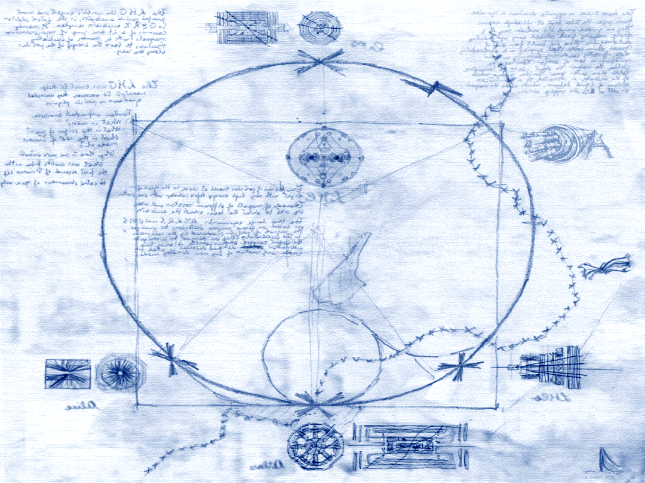
Status and Outlook of the LHC
US LHC Users Association Annual Meeting
Argonne National Laboratory, Lemont, IL
13-14 November 2014
Giulia Papotti for the LHC team
special acknowledgements to and material from:
G. Arduini, T. Baer, W. Herr, G. Iadarola, M. Lamont, E. Metral, M. Pojer, L. Rossi, G. Rumolo, G. Spiezia, L.Tavian, J. P. Tock, J. Wenninger, F. Zimmermann

Slide 3
outline
introduction
brief recap of Run 1 (2010-2012)
shutdown activities
latest news
plans for restart with beam
  parameter space
  e-cloud and scrubbing, UFOs, beam stability, R2E
longer term timeline

Slide 4

the Large Hadron Collider
Lake of Geneva
LHC ring
Control Room
SPS ring
GVA Airport
installed in the 26.7 km LEP tunnel, at a depth of 70-140 m

Slide 5


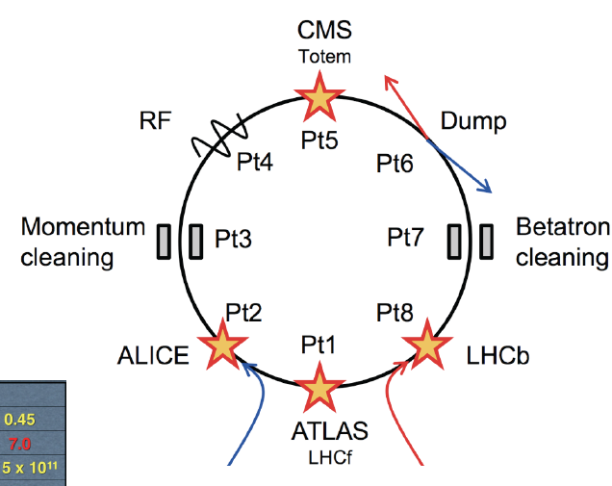




LHC layout
total length: ~26.7 km
  8 arcs (aka sectors): ~2.8 km each
  8 long straight sections: ~700 m each
2-in-1 magnet design with separate vacuum chambers
  p-p, ion/ion, or p/ion collisions
  beams cross in 4 points
    Alice, ATLAS, CMS, LHCb, LHCf, TOTEM

Slide 6
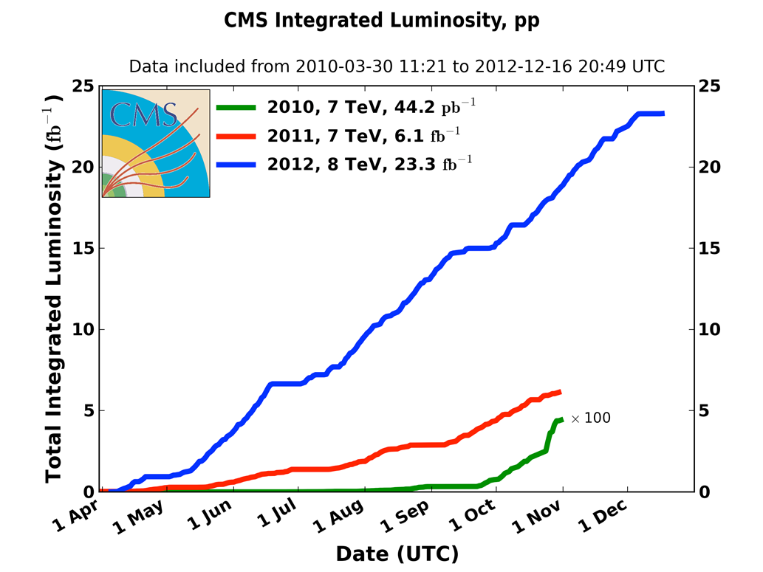
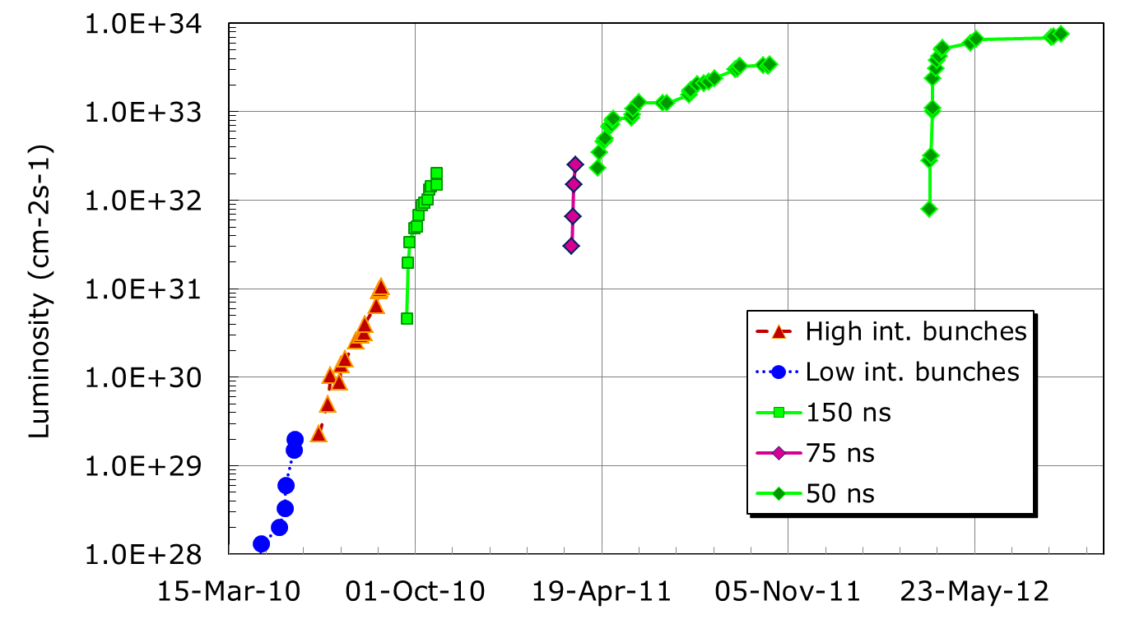
Run 1 luminosity
2010, commissioning: 0.04 fb⁻¹
2011, exploring the limits: 6.1 fb⁻¹
2012, production: 23.3 fb⁻¹
first operational experience with low bunch intensity
learn to handle intense beams (~1 MJ stored energy)
production and Higgs hunt
2011
2012
2010

Slide 7
Run 1 beam parameters
Parameter | 2010 | 2011 | 2012 | Nominal
beam energy (TeV) | 3.5 | 3.5 | 4.0 | 7.0
bunch spacing | 150 | 75 / 50 | 50 | 25
k (no. bunches) | 368 | 1380 | 1380 | 2808
N_{b} ( 10¹¹ p/bunch) | 1.2 | 1.45 | 1.6 | 1.15
ε (μm rad) | 2.4 | 2.4 | 2.5 | 3.75
β* (m) | 3.5 | 1.5 → 1 | 0.6 | 0.55
L (cm⁻²s⁻¹) | 2×10³² | 3.5×10³³ | 7.6×10³³ | 10³⁴
average pile-up @ start of fill | 8 | 17 | 38 | 26
stored energy (MJ) | 25 | 112 | 140 | 362

Slide 8
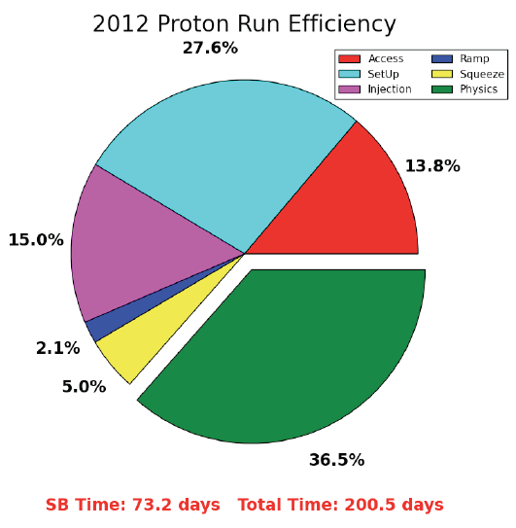
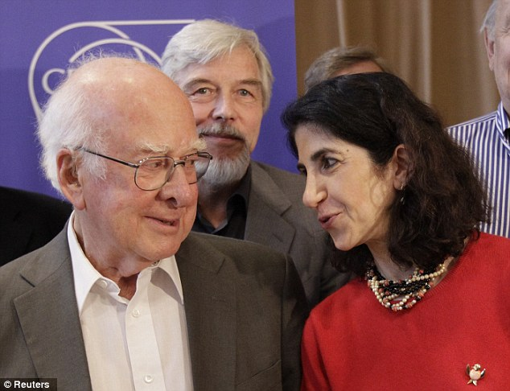
Run 1 reasons for success
77% of nominal peak luminosity
  high intensity and low emittance from injectors
  low beta*
  despite lower energy and lower number of bunches
combined with healthy availability
P. Higgs, R. Heuer, F. Gianotti

Slide 9
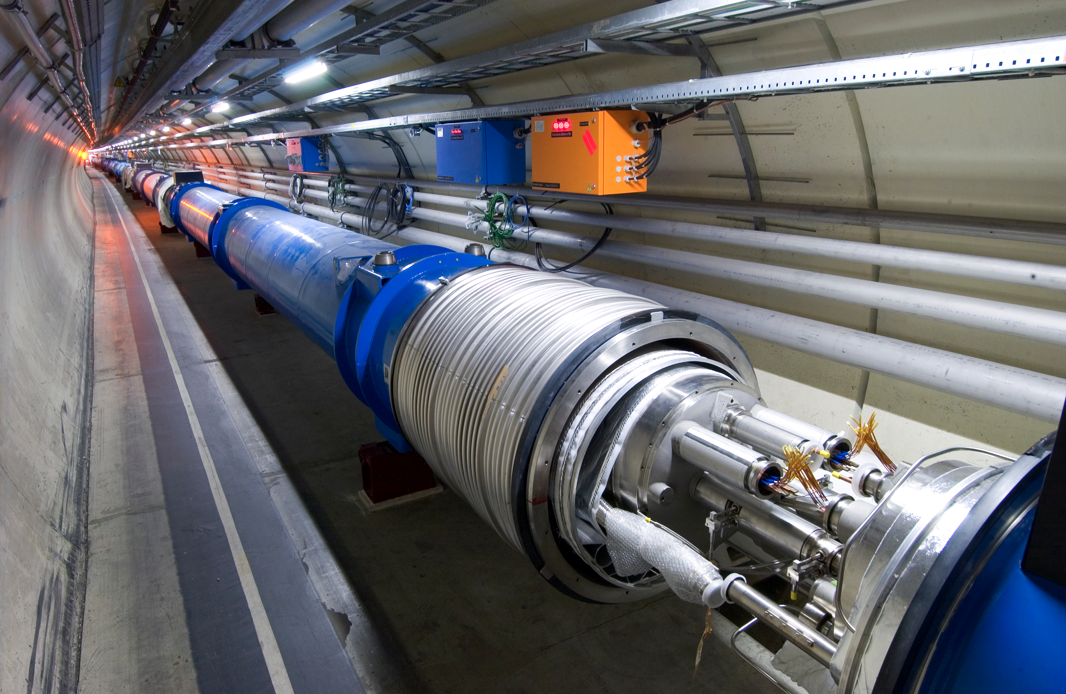
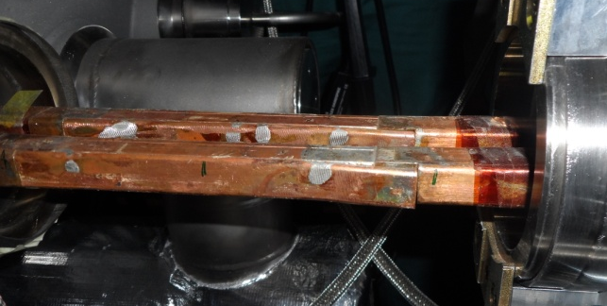
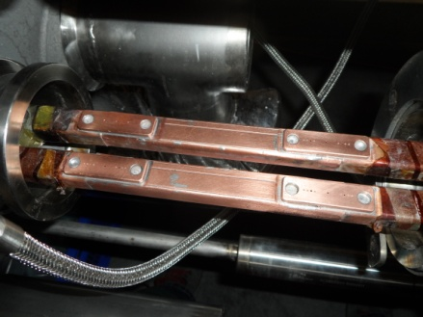
long shutdown: main activities
no beam from Feb. 2013 to early 2015
much consolidation, including:
  complete reconstruction of ~3000 splices out of 10000, installation of shunts and of electrical insulation systems
  installation of ~600 pressure relief valves
  15 dipoles and 3 quadrupoles exchanged
relocation of electronics to reduce impact of radiation
upgrades, changes and fixes in basically all systems
restart with a “new” machine
  but with experience in operating it
old splice
consolidated splice

Slide 10
present status
Magnet powering tests
CSCM
Electrical Quality
Assurance (ELQA)
sector | temp.
12 | few K
23 | ~20 K
34 | ~20 K
45 | ~20 K
56 | few K
67 | ~1.9 K
78 | few K
81 | ~1.9 K
2014
2015

Slide 11
CSCM
Copper Stabilizer Continuity Measurements
  to ensure that the current can safely bypass the magnets if case of a quench
    qualify copper stabilizer of the bus-bar, diodes, diode leads
    stabilize the sector 20 K so the magnets are not superconducting
  approved in the summer on the whole machine, added 2 weeks/sector in the schedule
  completed so far in 6 sectors
  no issues found for 7 TeV operation

Slide 12
hardware commissioning
powering tests of magnet circuits
  all magnet circuits taken to nominal current level one by one
    rigorous checks of quench protection, energy extraction, interlocks, power converters, …
  phase 1: low current levels, one sector closed
  phase 2: up to nominal 6.5 TeV currents, adjacent sectors closed also
  first sector almost finished, second sector just started
    plenty of debugging done
    schedule update in early 2015
dipole training quenches
  first training quench on dipoles in sector 67: ~5.8 TeV equivalent current
    protection systems performed as expected
  target: start no higher than 6.5 TeV/beam
    no change of beam energy in 2015
    expect ~100 quenches to reach 6.5 TeV

Slide 13
2015 priorities
establish p-p collision at 13 TeV with 25 ns and low beta*
  6.5 TeV max target energy, to be confirmed after end of powering tests
  25 ns strongly preferred by experiments, mostly due to pile-up
  start conservatively, push to low beta* in second part of the year
    beta*: ATLAS, CMS: 80-40 cm; LHCb: 3 m; ALICE: 10 m
  to prepare production run in 2016
special runs (e.g. 90m optics):
  not in the 1st part of 2015
  waiting for LHC Committee recommendations
Pb-Pb run: one month, end of 2015
integrated luminosity goal:
  2015 : 10 fb⁻¹
  Run2: ~100-120 fb⁻¹ (better estimation by end of 2015)
  300 fb⁻¹ before LS3

Slide 14
2015: draft schedule
machine checkout
  make sure everything works without beam
  overlaps with the end of the hardware commissioning
recommissioning with beam, ~2 months
  the full cycle with single bunches: from threading to circulating beam, to first ramp and squeeze, to first collisions
  many Machine Protection verifications
  add LHCf run and van der Meer scans
proceed with the “known” 50 ns beam
  system setup for trains, then scrubbing for 50 ns beam
  intensity ramp-up
  accumulate up to ~1 fb⁻¹
scrubbing for 25 ns beam, intensity ramp-up with 25 ns
then push performance (lower beta*)
emphasis on feasibility, stability and ease of commissioning
  leave more exotic options for later
machine checkout
single bunch
commissioning
50 ns
operation
25 ns
operation
push performance

Slide 15
scrubbing stages in detail
450GeV
6.5 TeV
Commissioning (low intensity)
Vacuum conditioning 50 ns
(5-7 days)
50ns
intensity ramp up + physics
Scrubbing with 25ns
(2 days)
450GeV
6.5 TeV
25 ns scrubbing
(5 days)
Scrubbing qualification
25 ns test ramps
(5 days)
Scrubbing with doublet beams
(5 days)
6.5 TeV
25 ns
intensity ramp up + physics
G. Iadarola, G. Rumolo

Slide 16
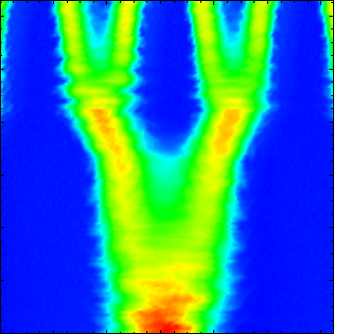
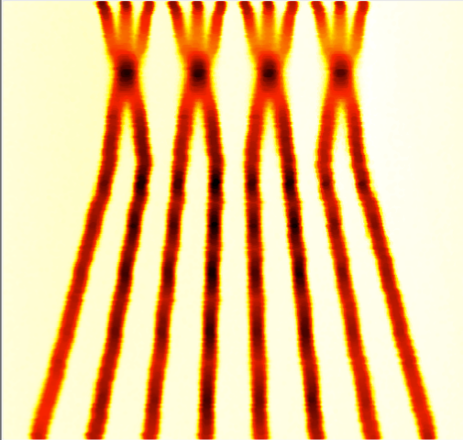
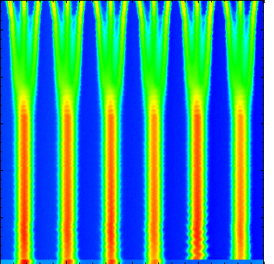
performance projection
energy [TeV] | 6.5 | 6.5
bunch spacing | 25 ns (nominal) | 25 ns (BCMS)
beta* [cm] (crossing angle [urad], b-b sep. [σ]) | 80 (290, 11) | 80 (290, 11)
ε*[μm] at start of fill | 3.1 | 1.7
max. bunch population [10¹¹ p/bunch] | 1.2 | 1.2
max. number of bunches/colliding pairs IP1/5 | 2748/2736 | 2508/2496
max. stored energy [MJ] | 342 | 313
peak luminosity [10³⁴ cm⁻²s⁻¹] in IP1/5 | 0.8 | 1.2
maximum average pile-up (σ=85 mb) | 22 | 36
after beam experience, will push beta*
  40 cm is the optimistic lower limit
BCMS = Batch Compression and Merging and Splitting

Slide 17
some of our worries
electron-cloud and scrubbing
Unidentified Falling Objects (UFOs)
beam stability
radiation to electronics (R2E)

Slide 18
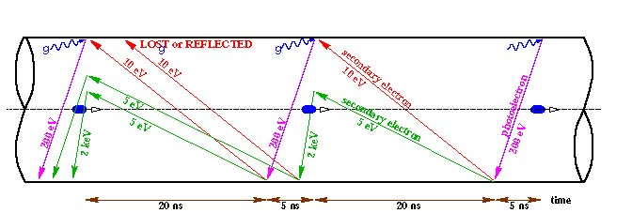
electron-cloud & scrubbing
Secondary
Emission
Yield
SEY>SEY_{th}: avalanche effect (multipacting)
  SEY_{th} depends on bunch spacing and population
e-cloud effects observed in LHC with bunch trains
  for 150, 75, 50 and 25 ns bunch spacing
  vacuum pressure rise, heat load on cryogenic systems
  beam size growth, single- and multi-bunch instabilities
e-cloud studies (Q4 2012) indicate a very slow improvement in SEY with 25 ns scrubbing
  extended scrubbing probably required in 2015
  or physics with degraded beam parameters
total intensity
[p]
improvement
saturation
heat load in arcs
[W/(hc p)]
G. Iadarola, G. Rumolo, L. Tavian
Notes:
single- and multi-bunch instabilities, beam size growth (both incoherent and due to instabilities)

Slide 19
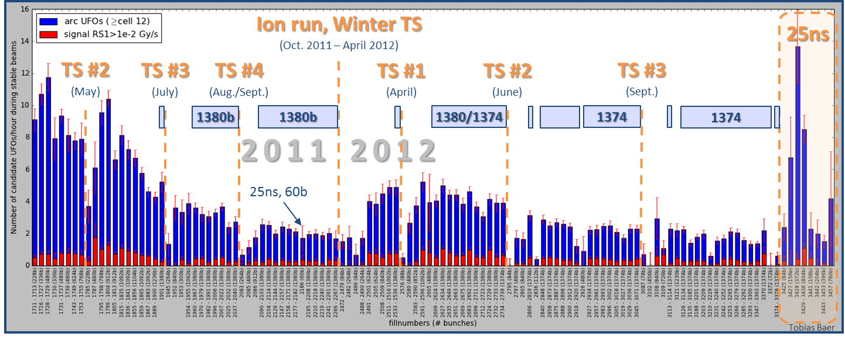
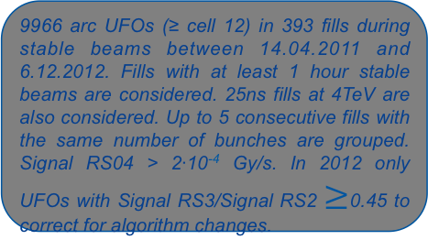
Unidentified Falling Objects
fast loss events (ms timescale) due to dust particles falling into the beam, caused ~20 dumps/year
“scrubbing” observed over the course of 2011 and 2012
  deconditioning after technical stops, thus expected after this shutdown
up to 10x increased rates for arc UFOs for 25 ns beams at 4 TeV
  at higher energy, quench margin goes down and generated losses go up: extrapolate to >100 dumps
might impose to start with 50 ns beam and/or lower energy in the very worst case
9966 arc UFOs (≥ cell 12) in 393 fills during stable beams between 14.04.2011 and 6.12.2012. Fills with at least 1 hour stable beams are considered. 25ns fills at 4TeV are also considered. Up to 5 consecutive fills with the same number of bunches are grouped. Signal RS04 > 2∙10⁻⁴ Gy/s. In 2012 only UFOs with Signal RS3/Signal RS2 $≥$0.45 to correct for algorithm changes.
T. Baer
Notes:
observed mostly in arcs and injection kickers
scrub (eg. from 10 to 2 UFO/hour in 2011)
decondition (eg. 2.5x increase in 2011-2012 winter stop)

Slide 20
beam stability
example: “snowflake” instability
many instabilities observed during run 1…
  transverse and longitudinal
  cured by high chromaticity, octupoles, transverse damper, beam-beam head-on tune spread, controlled longitudinal blow up
but not all understood
…expect instabilities also at 6.5 TeV
  octupoles will be less efficient (smaller beam size, less effective)
  profit from Landau damping by head-on beam-beam
  probably high chromaticity and high gain on transverse damper
  collimator settings as in 2012 (impedance!)

Slide 21
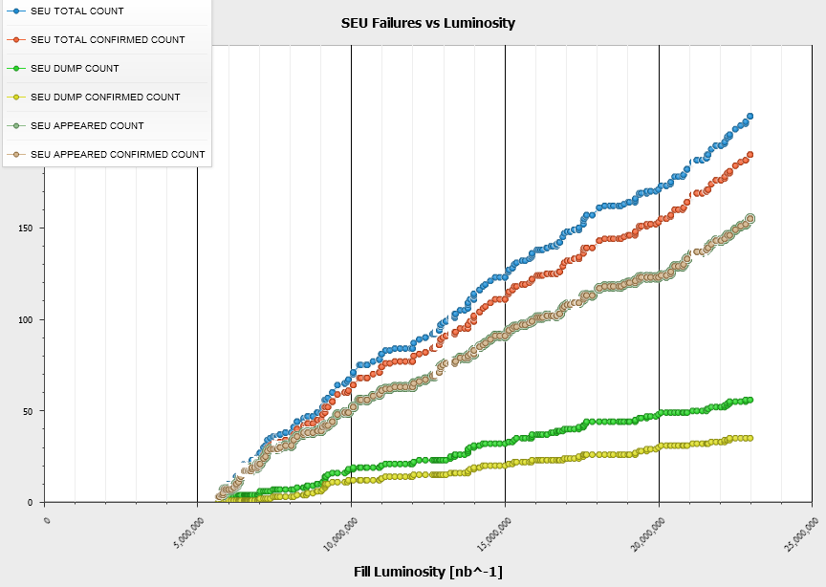
Radiation to Electronics (R2E)
SEU Failures vs luminosity (2012)
2011
150
~12 dumps per fb⁻¹
impacts availability by dumping the beam
  mostly by electronics for power converters and quench protection systems
cured by relocations, shielding, equipment upgrades
  major campaign ongoing during present shutdown
100
2012
50
~3 dumps per fb⁻¹
< 0.5 dump per fb⁻¹
>2015
G. Spiezia, M. Brugger

Slide 22
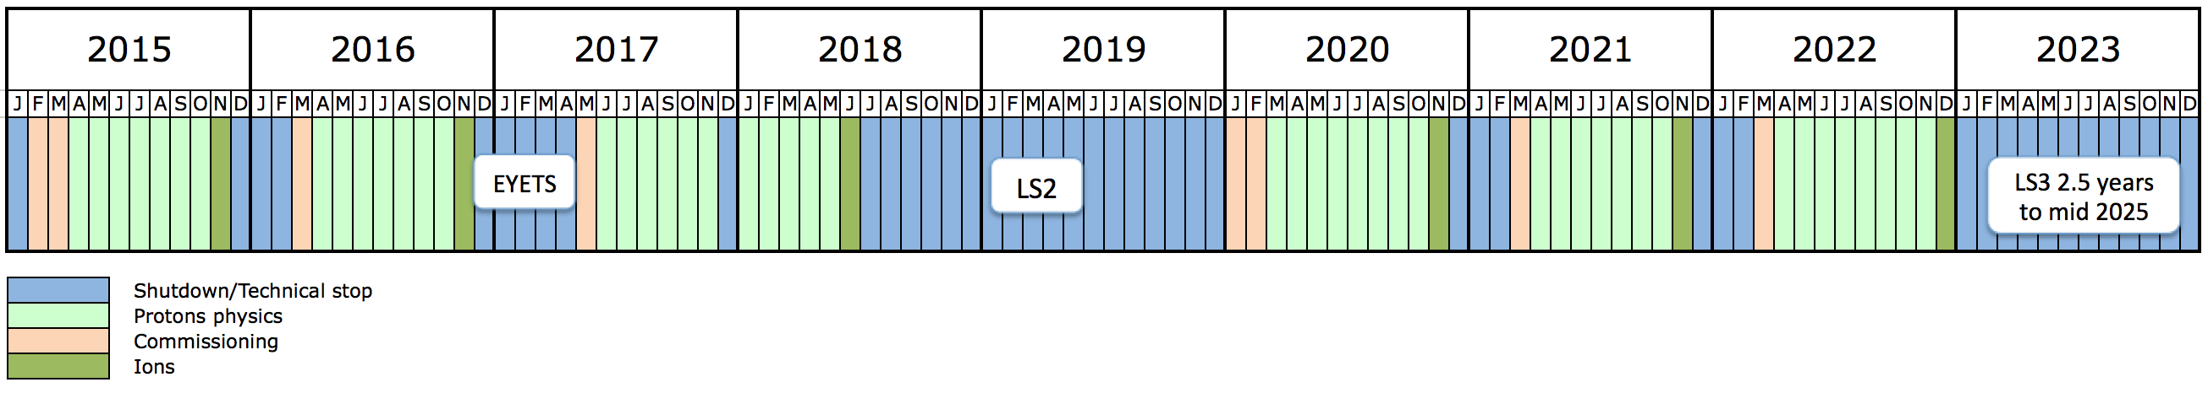

the next 10 years
run 1
run 2
run 3
Extended year end technical stop (CMS)
Connection of LINAC4
LHC Injectors Upgrade
High Luminosity LHC
present LHC will reach its limits in the early 2020s
  radiation hardness of magnets (lifetime)
    e.g. triplet and cleaning insertions to be changed in any case
  cooling and cryogenics (limit at 1.75 10³⁴ cm⁻²s⁻¹)
  radiation and R2E
    shielding and removing equipment from the tunnel (superconducting link and cold powering)
HL-LHC goal: 3000 fb⁻¹ within twelve years (run until mid 2030s)
  integrated luminosity of 250 fb⁻¹ per year, about ten times present LHC
  peak luminosity of 5 10³⁴ cm⁻²s⁻¹ with levelling (140 events per crossing!)
    need availability and reliability!

Slide 23
conclusions
run 1 performance beyond most optimistic expectations
  29 fb⁻¹ per main experiment and one new boson
shutdown consolidation finished
  some surprises solved
hardware commissioning started
  a few more months to go
  CSCM close to completion
a new machine will restart in 2015
  start cautiously, push performance after beam experience
  parameter space constrained by pile-up limit, effectiveness of electron cloud scrubbing, UFOs, beam instabilities and their cures

Slide 25
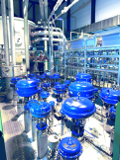
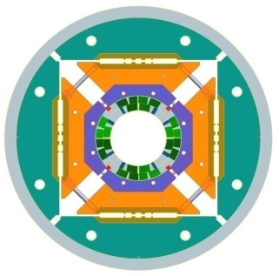
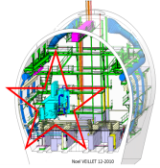
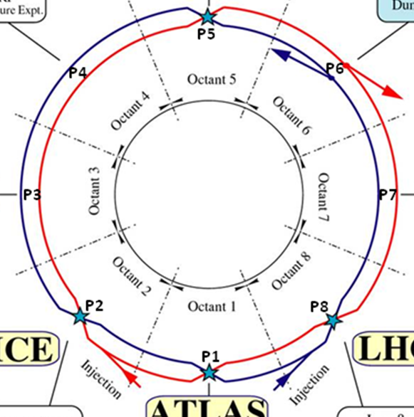
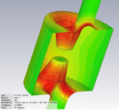

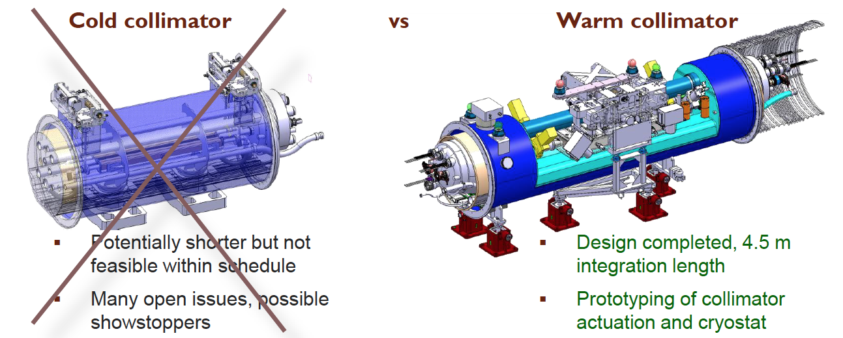
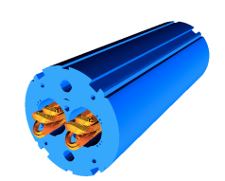
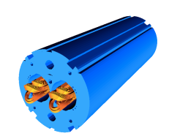
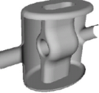
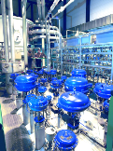
HL-LHC ongoing studies
1.2 km of new equipment:
  new magnets (Nb₃Sn, 11-13 T)
    large aperture for IP quads (beta* = 15 cm)
    high field for dispersion suppressor dipoles
  add dispersion suppressor collimators
  additional cryogenics plants for P1, P4, P5 to have the same cooling power in all arcs
  crab cavities to profit from the small beta* despite the large crossing angle (590 urad)
    test stand now, beam test in SPS in 2015-16
  300-700 m super-conducting links to allow power converters to be moved to surface
    reduce rad-risks and increase availability
upgrade of the experiments to cope with higher pile-up density
  ATLAS / CMS: pile-up of 140
upgrade in the Injector Chain (LIU)
  for brightness and reliability
  also approved project
Notes:
new collimators in DS, new materials? additional collimator… more or less impedance???
more cryo: same cooling power for all arcs (now shared between IP and arc)
cc: reached twice the field 7MV reached, 3.3MV needed for new, compact design

Slide 26
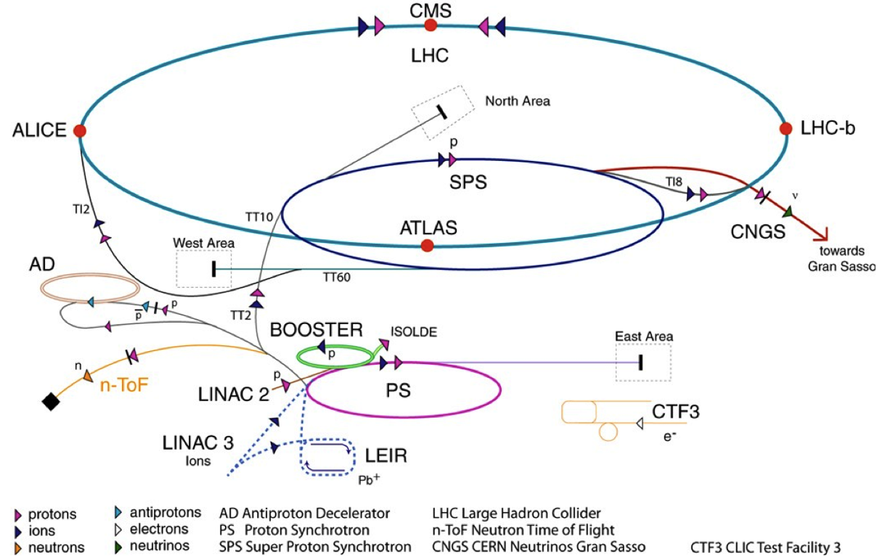
LHC accelerator complex
≥ 7 seconds from source to LHC
Beam 1
Beam 2
TI2
TI8
4 rings
 | Max. T [GeV] | Length / Circ. (m)
LINAC2 | 0.050 | 30
Booster | 1.4 | 2π×25
PS | 25 | 2π×100=4×PSB
SPS | 449 | 2π×1100=11×PS
LHC | 6999 | 26’657=27/7×SPS
LHC proton path

Slide 27
beam commissioning
a new machine to be commissioned after cold checkout
beam commissioning phases:
  first injection to circulating beam
      threading, RF capture, BPM polarity checks
  flat orbit reference with nominal bunch
      RF/instrumentation/transverse damper setup, primary collimators setup
      with pilot beam: measure aperture, magnet current decays
  first ramp and squeeze
      commission feedbacks (orbit/Q/radial), measure optics
  add crossing and separation bumps
      aperture and beta* measurements, setup tertiary collimators, tests of collimator functions
  collide 2/3 nominal bunches
      RF cogging, setup tertiary collimators
  verify protection with controlled losses
    at injection, flat top, after squeeze and in collisions
total: about 2 months in Q1 2015
pilot bunch, injection energy
nominal bunch, injection energy
acceleration, squeeze
add crossing and separation
collide

Slide 28
main 2013-2014 consolidations
splice: joint between busbars of main dipoles or quads

