Slide 1
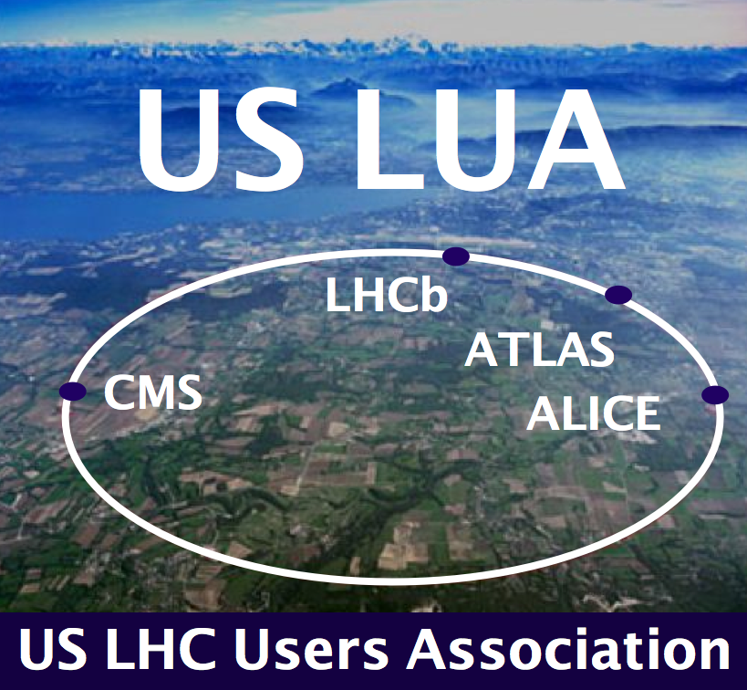
US LHC Accelerator Research Program (LARP)
Eric Prebys, Fermilab
Director, LARP

Slide 2
Disclosure
I stepped down as director of LARP about a year ago and haven’t had a lot of involvement since.
  Replaced by Giorgio Apollinari
Giorgio and most of the other LARP people are preparing for the collaboration meeting in Japan next week
I’ve come out of retirement to give this talk.

Slide 3
LARP History
The US LHC Accelerator Research Program (LARP) was formed in 2003 to coordinate US R&D related to the LHC accelerator and injector chain at Fermilab, Brookhaven, and Berkeley
  SLAC joined shortly thereafter
  Has also had some involvement with Jefferson Lab, Old Dominion University and UT Austin
LARP has contributed to the initial operation of the LHC, but much of the program is focused on future upgrades.
The budget grew, and from ~2008-2012 it was funded at
$12-13M/year, divided among.
  Accelerator research
  Magnet research (~half of program)
  Programmatic activities, including support for personnel at CERN
Starting in 2012, we have transformed LARP to a project with hard deliverables.

Slide 4
LARP Contributions to Initial LHC Operation
Schottky detector
  Used for non-perturbative tune measurements (+chromaticities, momentum spread and transverse emmitances)
Tune tracking
  Implement a PLL with pick-ups and quads to lock LHC tune
  Investigating generalization to chromaticity tracking
AC dipole
  US AC dipole to drive beam
  Measure both linear and non-linear beam optics – Primary tool for high energy optics
Luminosity monitor
  High radiation ionization detector integrated with the LHC neutral beam
  absorber (TAN) at IP 1 and 5.
Synchrotron Light Monitor
  Used to passively measure transverse beam size and monitor abort gap
  Not a LARP project, but significantly improved by LARP.
Low level RF tools
  Leverage SLAC expertise for in situ characterization of RF cavities – Fully integrated
Personnel Programs (more about these shortly)…

Slide 5
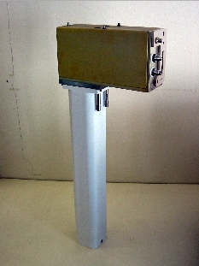
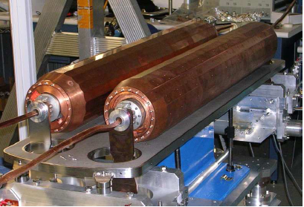
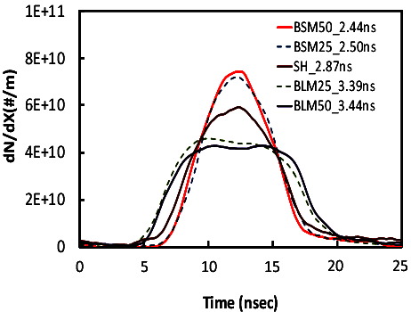
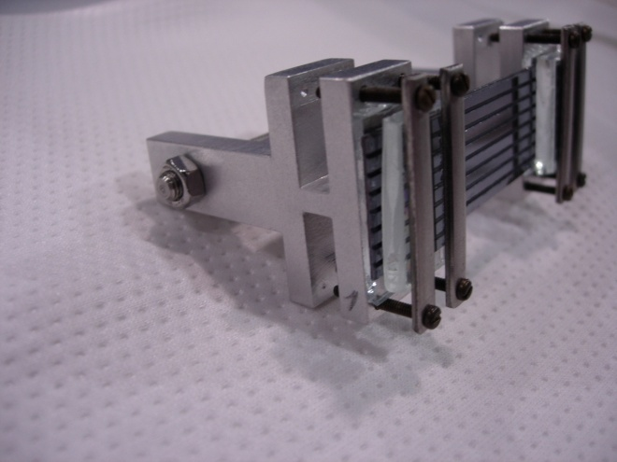
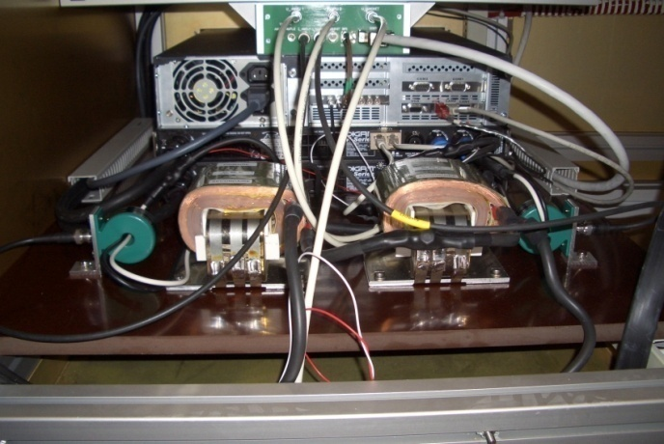
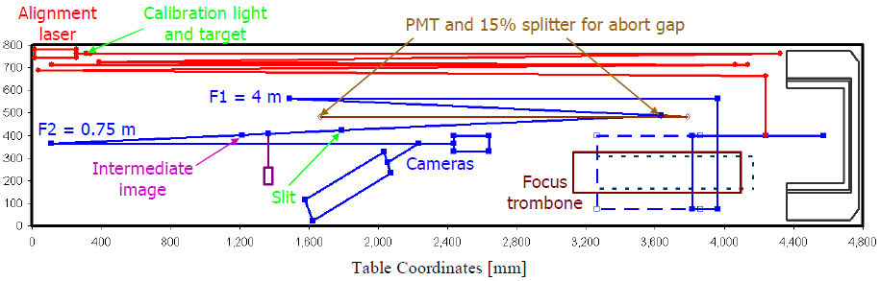
Some Random LARP Activities
Flat Bunches
Luminosity Monitor
Rotatable Collimators
AC Dipole
Crystal Channeling
Instability Modeling
Sync. Light Monitor

Slide 6
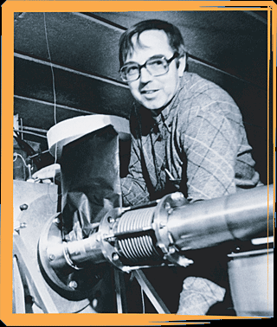
Toohig Fellowship
Named for Tim Toohig, one of the founders of Fermilab. Nursery of talent in Accelerator Technology.
Open to recent PhD’s in accelerator science or HEP to contribute to the LHC at one of the host US Labs (BNL, FNAL, LBL, SLAC).
Past
  Helene Felice, LBNL, now staff at LBL
  Rama Calaga, BNL, now CERN staff
  Ricardo de Maria, BNL, now CERN Fellow
  Themis Mastoridis, SLAC, Ass. Prof. at Cal Poly,
  SLOC
  Ryoichi Miyamoto, BNL, now ESS Staff
  Dariusz Bocian, FNAL, now Ass. Prof. at
  The Henryk Niewodniczański Institute of Nuclear
  Physics
  Valentina Previtali, now Teacher in Geneva
  Simon White, BNL Staff
  John Cesaratto, SLAC/CERN
Present
  Ian Pong, LBNL
  Silvia Verdu Andres, BNL
  Trey Holik, selected as 2014 Toohig Fellow

Slide 7
New Direction for LARP
LARP had historically been an R&D organization
  Not well structured for hard deliverables
  CERN upgrade plans in a state of flux
Watershed events
  CERN formalized the planning for the luminosity upgrade (HL-LHC/HiLumi-LHC
  In June 2012, CERN chose 150 mm as the aperture for the final focus quads
At the DOE’s request, we began the process of transforming LARP into a project to encompass all US contributions to the luminosity upgrade of the LHC.
Budget Guidance
  Flat-Flat LARP funding @ ~$12.4M/year through FY16
  A total of $200M (then year dollars) TPC, assuming CD-3 at approximately the beginning of FY17
  “Some amount” of General Accelerator Research and Development (GAR D) funds invested in support of this program.
Began the process of scope selection in Fall 2012

Slide 8
Context: Long Term LHC Plans
Leveled luminosity of: 5x10³⁴ cm⁻²s⁻¹

Slide 9
Limits to LHC Luminosity*
“Brightness”, limited by
PSB injection energy
PS
Max tune-shift (ultimate limit)
Total Beam current, limited by machine protection (!)
e-cloud and other instabilities
β*, limited by
magnet technology
chromatic effects
Geometric factor, related to crossing angle…
*see, eg, F. Zimmermann, “CERN Upgrade Plans”, EPS-HEP 09, Krakow, for a thorough discussion of luminosity factors.

Slide 10
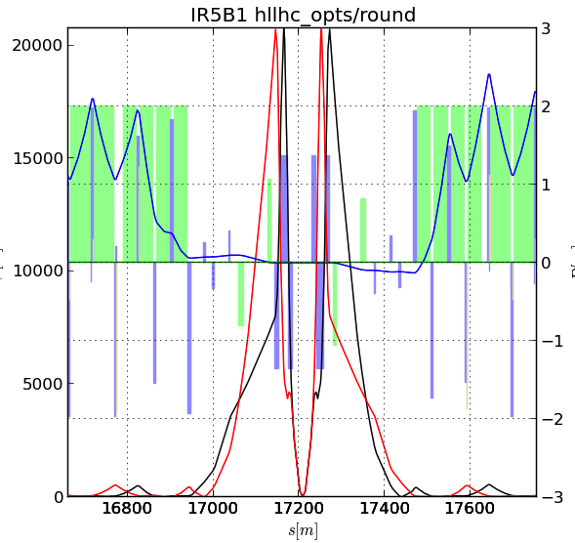
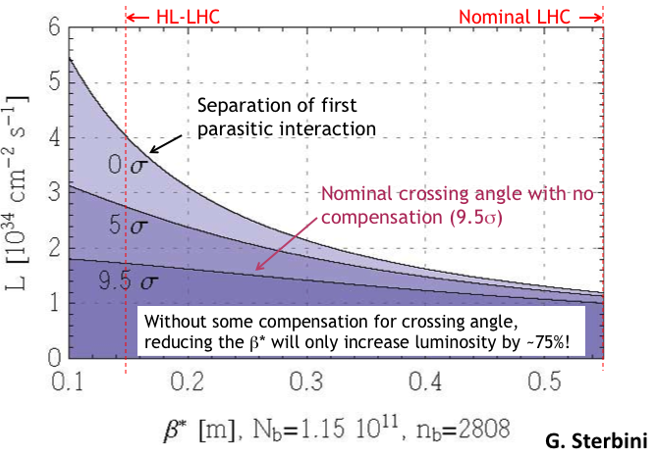
Key Components of HL-LHC
Reduce β* from 55 cm to 15 cm
  Requires large aperture final
  focus quads
  Beyond NbTi without making the quads
  unmanageably long.
  ➔Requires Nb₃Sn
    never before used in an accelerator!
    Nb3Sn R&D key component of LARP
BUT, reducing β* increases the
effect of crossing angle
“Piwinski Angle”
LARP has played a central role in both of these areas

Slide 11
High Luminosity LHC: The Big Picture
HL-LHC
LARP lives here

Slide 12
Candidate Deliverables Considered
Traditional LARP Scope
  150 mm aperture Nb₃Sn quadrupoles
    Likely just cold masses, divided between here and CERN
  Crab Cavities
    Prototypes. Production Units. Cryomodules.
  High Bandwidth Feedback System
    Pick-ups. Processing Systems. Response Kickers.
  Collimation
    Rotatable collimators.
    Hollow electron beams.
New Scope
  11 T Nb₃Sn dipoles
    Used to make room for collimation in dispersion suppression region
    Has been a bilateral CERN/FNAL effort
  Large Aperture NbTi D2 separator magnets
    First dual aperture magnets near Irs
    Has been bilateral CERN/BNL effort
Selected as primary scope
Still pursued as R&D efforts

Slide 13
Motivation for Nb₃Sn
All superconducting magnets that have ever gone into an accelerator are minor variations on the Tevatron design
  NbTi conductor
  collared pre-loading
Nb₃Sn can be used to increase aperture/gradient and/or increase heat load margin, relative to NbTi
Very attractive, but no one has ever built accelerator quality magnets out of Nb₃Sn
Whereas NbTi remains pliable in its superconducting state, Nb3Sn must be reacted at high temperature, causing it to become brittle
  Wind and react on a mandrel
Increased mechanical stresses exceed the limits of traditional collared pre-loading
  New preloading technique developed

Slide 14
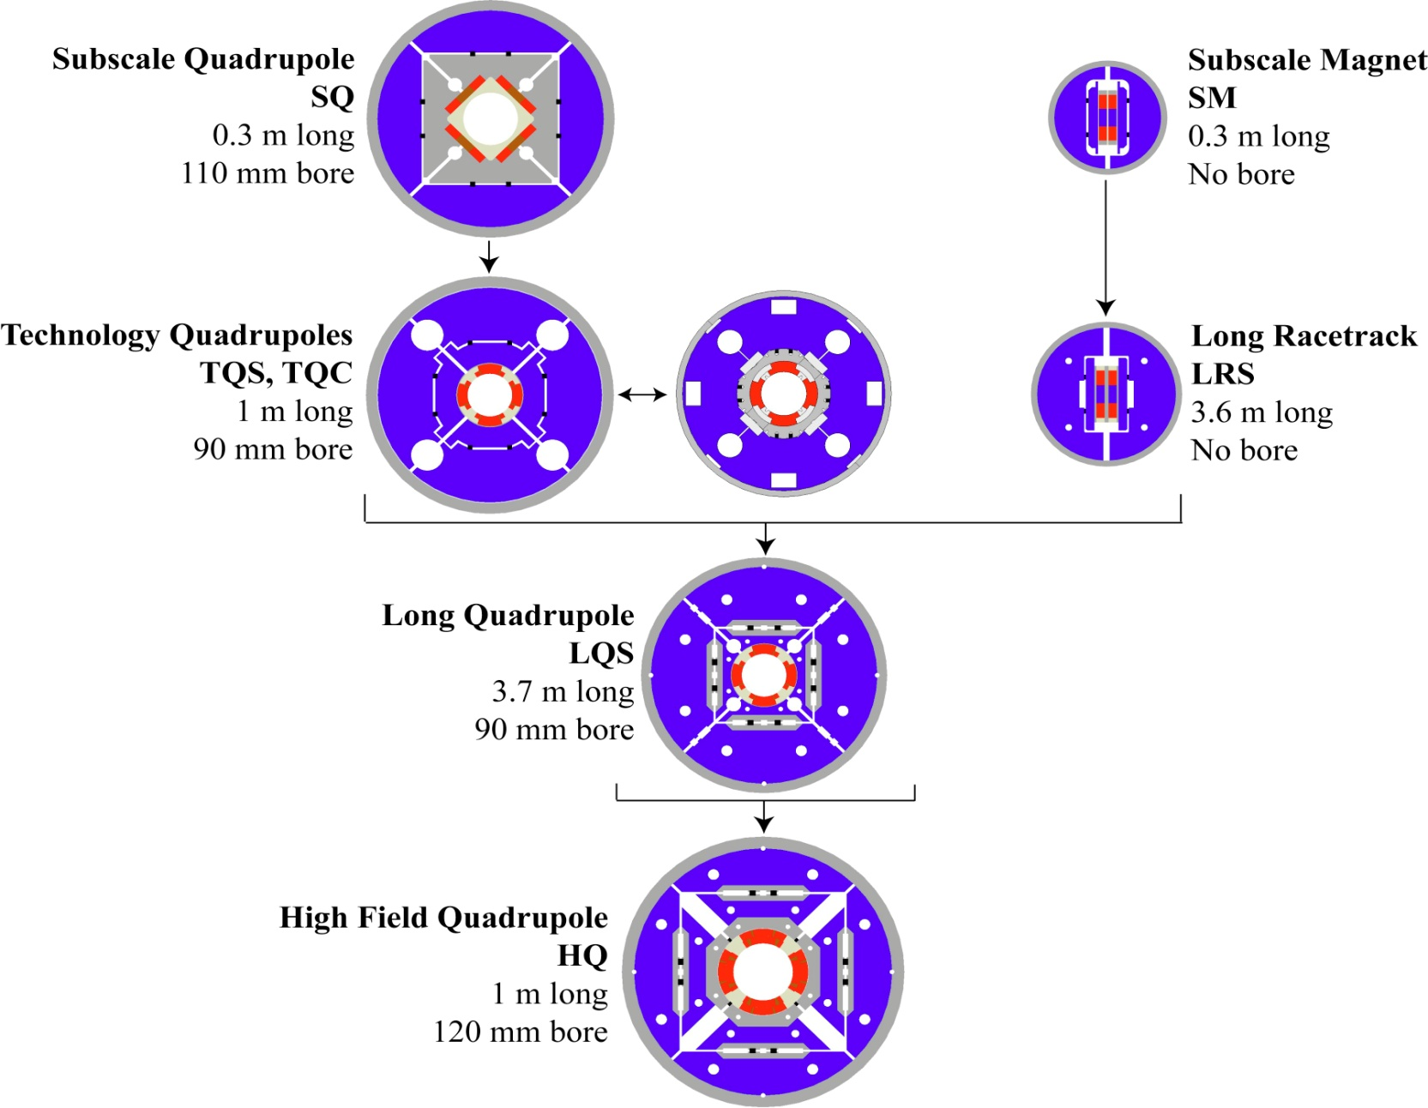
LARP Magnet Development Tree
Completed
Achieved
220 T/m
Length scale-up
High field
Accelerator features
Being
tested
Last “LARP only” magnet

Slide 15
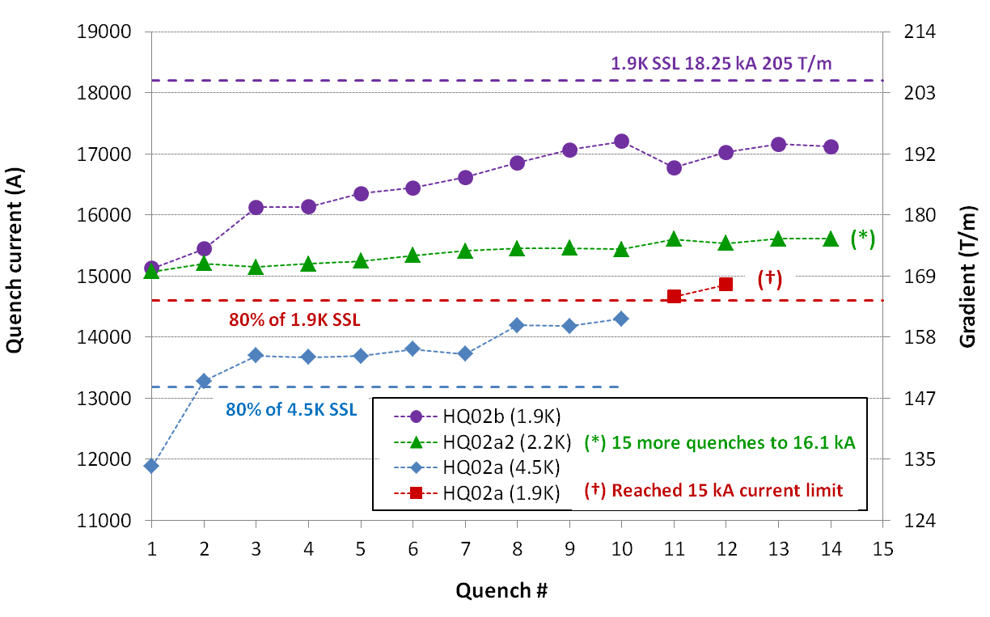
HQ (120 mm) Achievements
Goal to demonstrate all performance requirements for Nb₃Sn IR Quads in the range of interest for HL-LHC (magnetic, mechanical, quench protection etc.)
  120 mm aperture, 15 T peak field at 220 T/m (1.9K)
  First LARP design incorporating all provisions for accelerator field quality:
    Control of geometry, saturation, magnetization, eddy currents
    Alignment at all stages of coil fabrication, assembly & powering
Stainless steel core biased toward the thick edge
Dramatic reduction of ramp rate dependence
  14.6 kA (80% SSL) up to 150 A/s (1.9K)
  Safe discharge up to 300 A/s
Partial core coverage to control eddy currents while maintaining current sharing

Slide 16
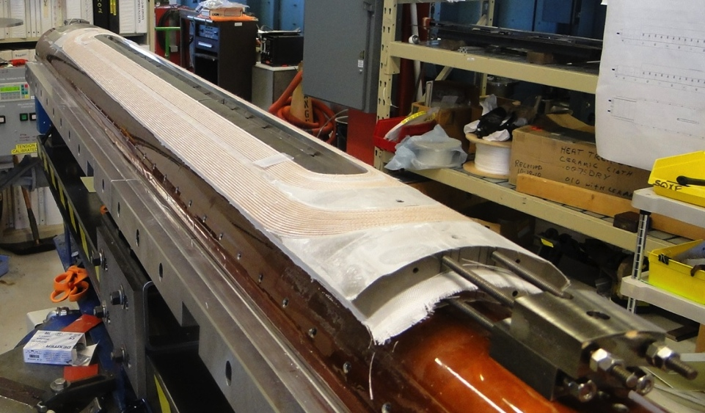
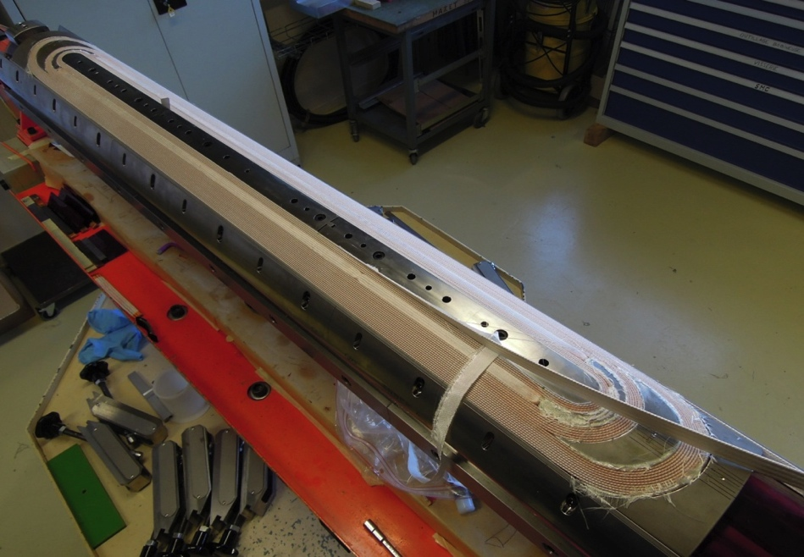
QXF (150 mm HL-LHC Quads) Plans
First genuine prototype:
  Joint project between LARP and CERN!
Short model program: 2014-2016
  First SQXF coil test (Mirror struct.) in Dec. 2014
  First magnet test (SQXF1) in May 2015
  2 (LARP) + 3 (CERN) short models + reassembly (~4)
Long model program: 2015-2018
  Coil winding starts in 2015: Jan. (LARP)
  First LQXF coil test (Mirror structure) in Dec. 2015
  First model test in Oct. 2016 (LARP) and July 2017 (CERN)
  3 (LARP) + 2 (CERN) models in total
Series production: 2018-2022
LARP
CERN

Slide 17
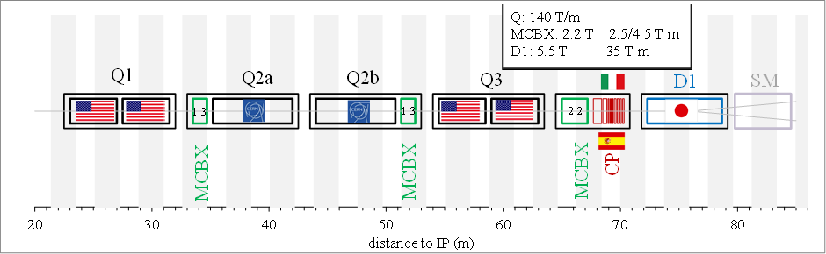
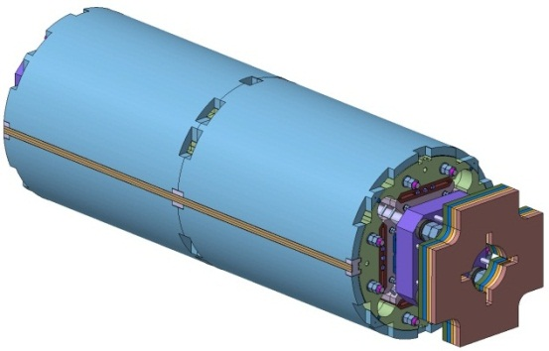
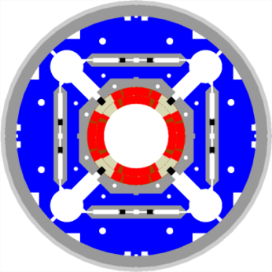
HL-LHC US Magnet Contributions
Q1 and Q3 Nb3Sn Magnets
  Preferred US Scope: Q1 and Q3 Cold Mass Assembly (x10)
    Includes two ~ 4.5m long Nb3Sn magnets installed in a SS helium vessel with end domes, ready for insertion into a cryostat
  Minimum US Scope: Component Magnets for Q1 and Q3 (x20)
    CERN responsible for assembling the Q1 and Q3 cold mass
  Decision depends on TPC and project funding level
  CERN’s Scope: Install Q1 and Q3 Cold Mass Assemblies into CERN-provided cryostats, final test, tunnel installation, commissioning, etc.
MQXF

Slide 18
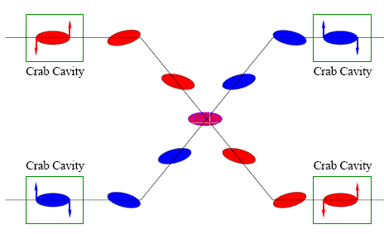
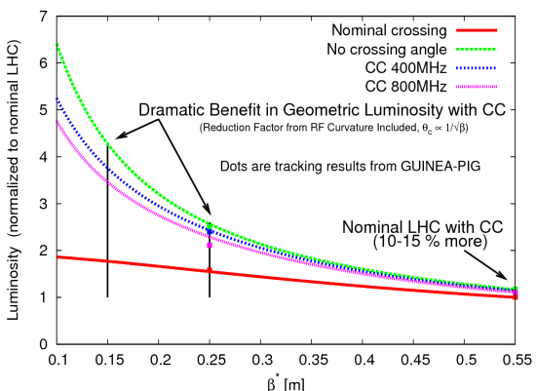
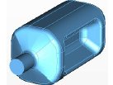
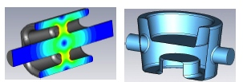
Crab Cavities
Technical Challenges
  Crab cavities have only barely been shown to work.
    Never in hadron machines
  LHC bunch length ➔ low frequency (400 MHz)
  19.4 cm beam separation ➔ “compact”
  (exotic) design
Additional benefit
  Crab cavities can aid in leveling!
Currently aiming for:
  SPS test in 2016
UK
LARP

Slide 19
Crab Kissing Scheme
Using crab cavities to level luminosity and lower peak interaction density

Slide 20
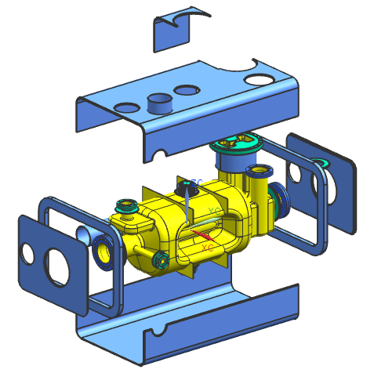
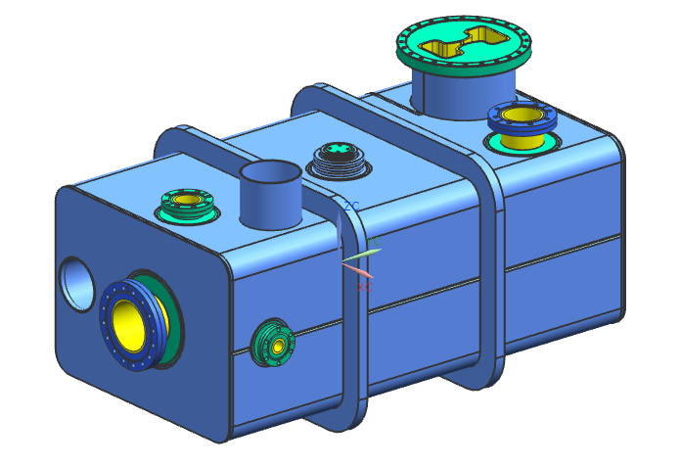
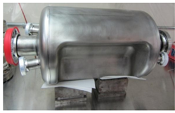
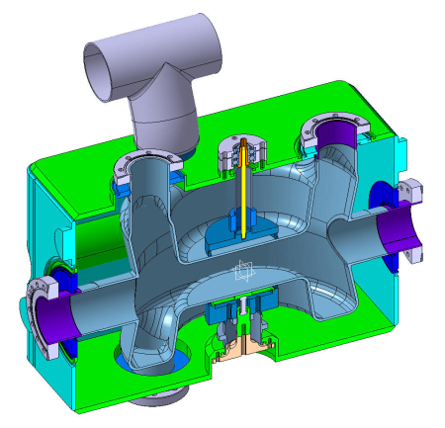
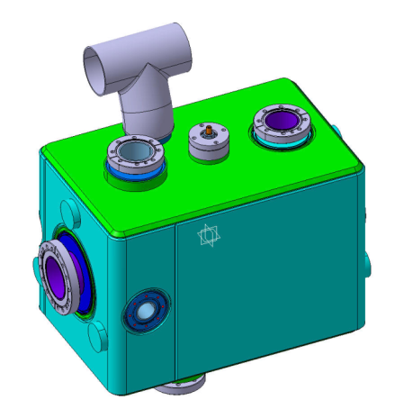
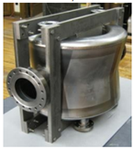
US Crab Cavity Contribution
Crab Cavities
  US Scope: 40 “dressed” crab cavities
    Components such as tuners, HOM couplers, etc. under discussion
  CERN Scope: Cryomodules
    Integrate and install dressed cavities into ten Cryomodules (four cavities each) and install in tunnel. (includes two spares)
  SPS Demonstration planned as part of LARP
    Two cryomodules, two dressed cavities each (LARP expected to deliver dressed cavities)
    Two design options under consideration (RF Dipole and Double Quarter Wave)
RFD Option
DQW Option

Slide 21
(L)ARP2
Several activities presently supported by LARP will not find space once the US-HL-LHC Project starts according to DOE order 413.3b
  Toohig Fellowship
  R&D Studies (WBFS, e-hollow lens as of today) or “soft deliverables” activities (beam-beam simulations or energy deposit calculations)
  Accelerator physicist Long Term Visitor program to LHC/HL-LHC
    Flavor change from “Transfer of experience from TeV to LHC” (~2010) to “Active Participation in World-wide Accelerator Operations Effort” (~2020)
Need for (L)ARP2 from ~2018 onward at level of few (~3-4) M$ exclusive of HFM development for HE-LHC or VLHC/FCC/SppC
  This is being negotiated.

Slide 22
High Bandwidth Feedback System
The high bandwidth feedback system is a GHz bandwidth instability control system
  Increases LHC luminosity via higher SPS currents
  Improves LHC beam quality and allows SPS operational flexibility
  Leverages US expertise from e+e- @ SLAC
LARP continues technology R&D & development of novel control methods
Test of full functionality prototype in SPS by FY15-FY16
Aiming for a deliverable (within LARP) of an SPS full-function instability control processing system hardware, firmware and diagnostic for use at SPS post LS2. Presently not planned as baseline HL-LHC or LIU
  CERN to contribute beam-line components (kickers, cable plant, etc.)
BPM
Active closed loop
Feedback
Kicker
Beam
Analog
Front
End
ADC
Signal
Processing
DAC
Analog Back
End
Power Amp
transverse
position
pre-processed
sampled
position
“slices”
calculated
correction data
correction
signal
pre-distortion
drive signal

Slide 23
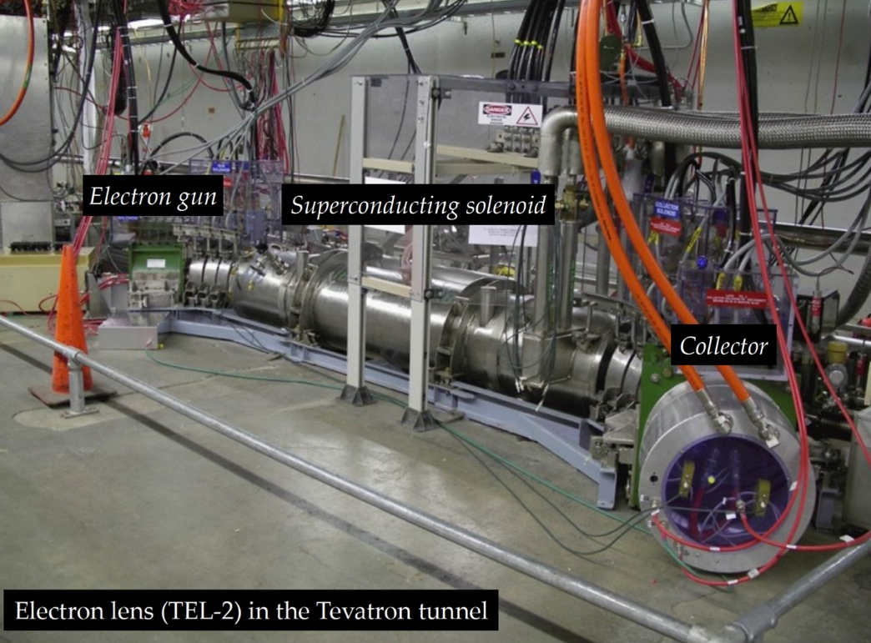
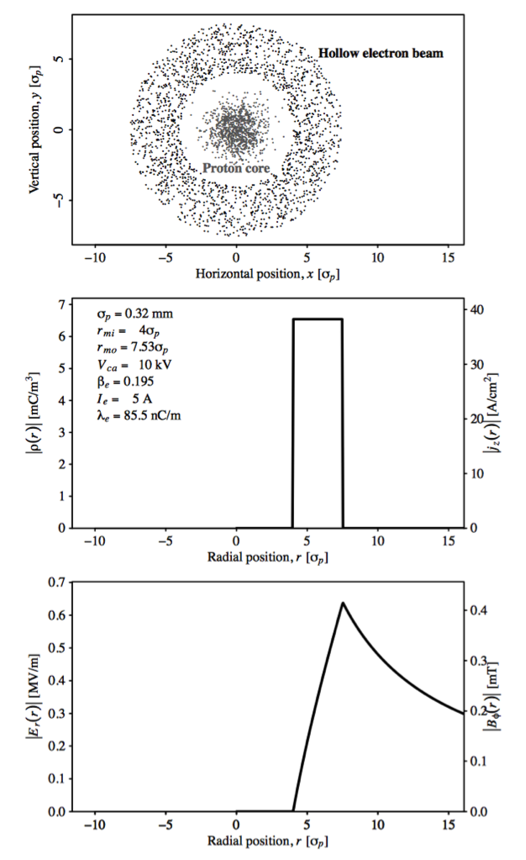
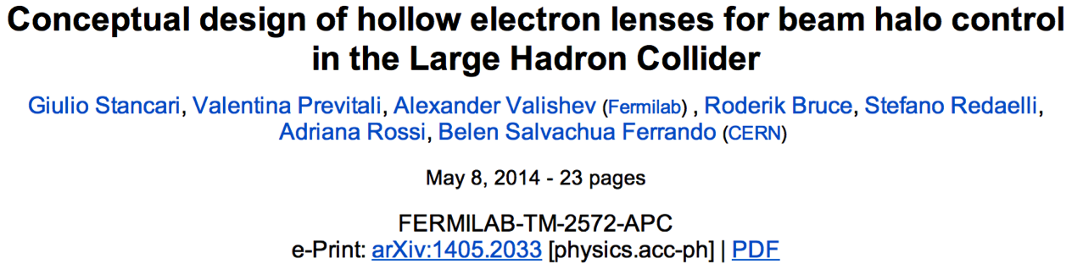
e-hollow lens & beam-beam simulation
Beam-Beam Simulation (FNAL and LBL)
  Bench-marking with US simulation/experience for beam-beam computations performed at CERN
  Assess new HL-LHC elements (large angles, CC, etc) and study all possible alternative schemes to achieve ultimate luminosity

Slide 24
Conclusions
LARP has been an effective organization for coordinating US activities on the LHC.
We have successfully transitioned into a project to produced deliverables required by the luminosity upgrade.

