Slide 1

CMS: status and outlook
Selection of recent results
Readiness for 2015
Outlook for the medium and long term future : see Jeremy Mans talk

Slide 2
CMS daily life
Winding down exploitation of Run1 data
Long Shutdown: winding down…
Preparing for 2015 run: the top priority
Upgrade phase 1
  construction: pixel, HCAL, trigger,
  In deployment: trigger, HCAL
Upgrade phase2 : focus on technical proposal

Slide 3
Legacy from LHC RUN1

Slide 4
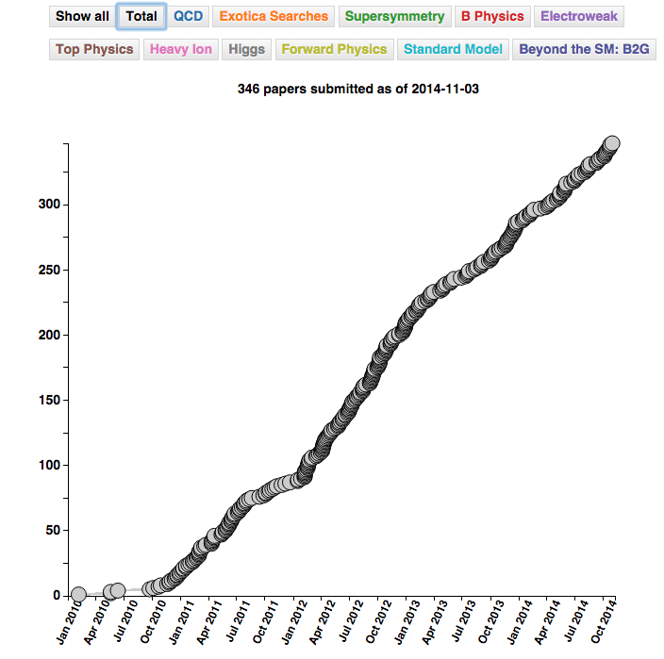
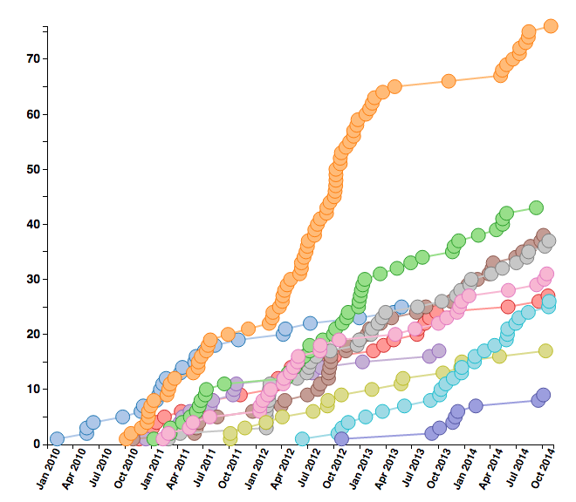
Publications
346 papers on collisions
rate = 2.3/week
Slope remains steady
+23 Cosmic Ray calibration papers (CRAFT)
+42 in Collaboration Wide review/Final Reading phase

Slide 5
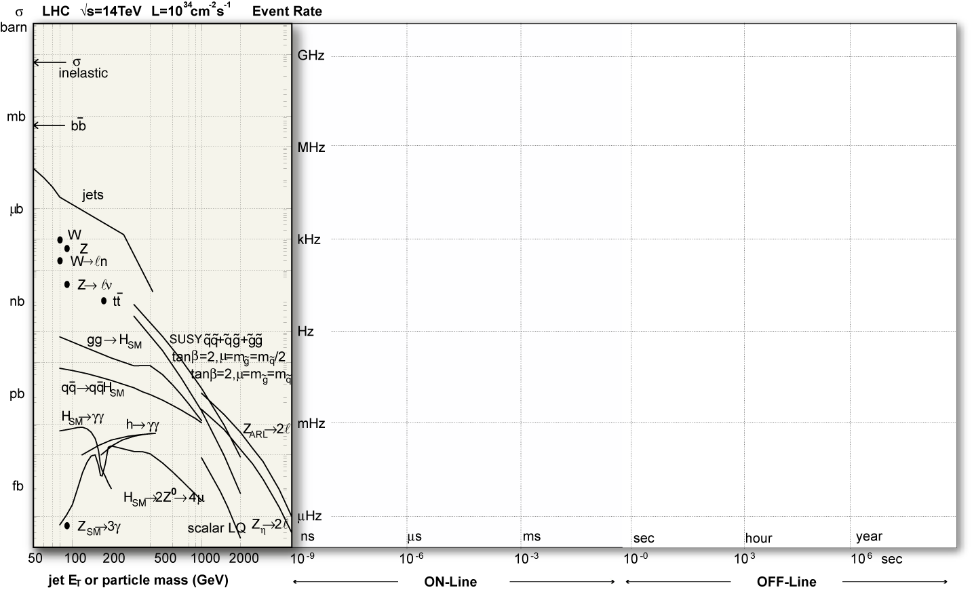
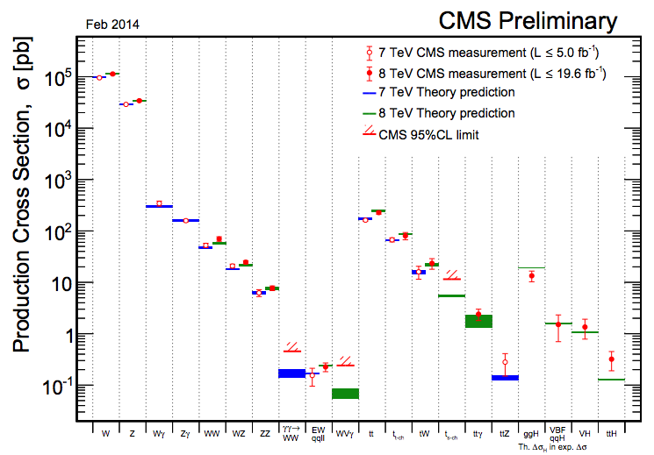
Standard model success
Shaded area: goal of measurements from the CMS proposal (20 years ago)
Single
bosons
Di
bosons
Top
quark
Multi
bosons
Higgs

Slide 6
QCD
…and it is indeed running
Precise determnations in a variety of modes

Slide 7
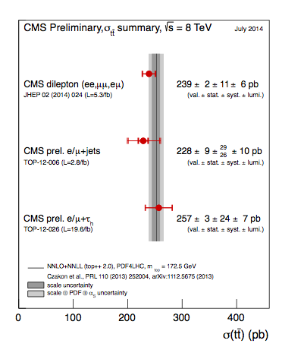
Top physics
Cross section
LHC is a top factory and CMS exploits it to its full extent
Mass

Slide 8
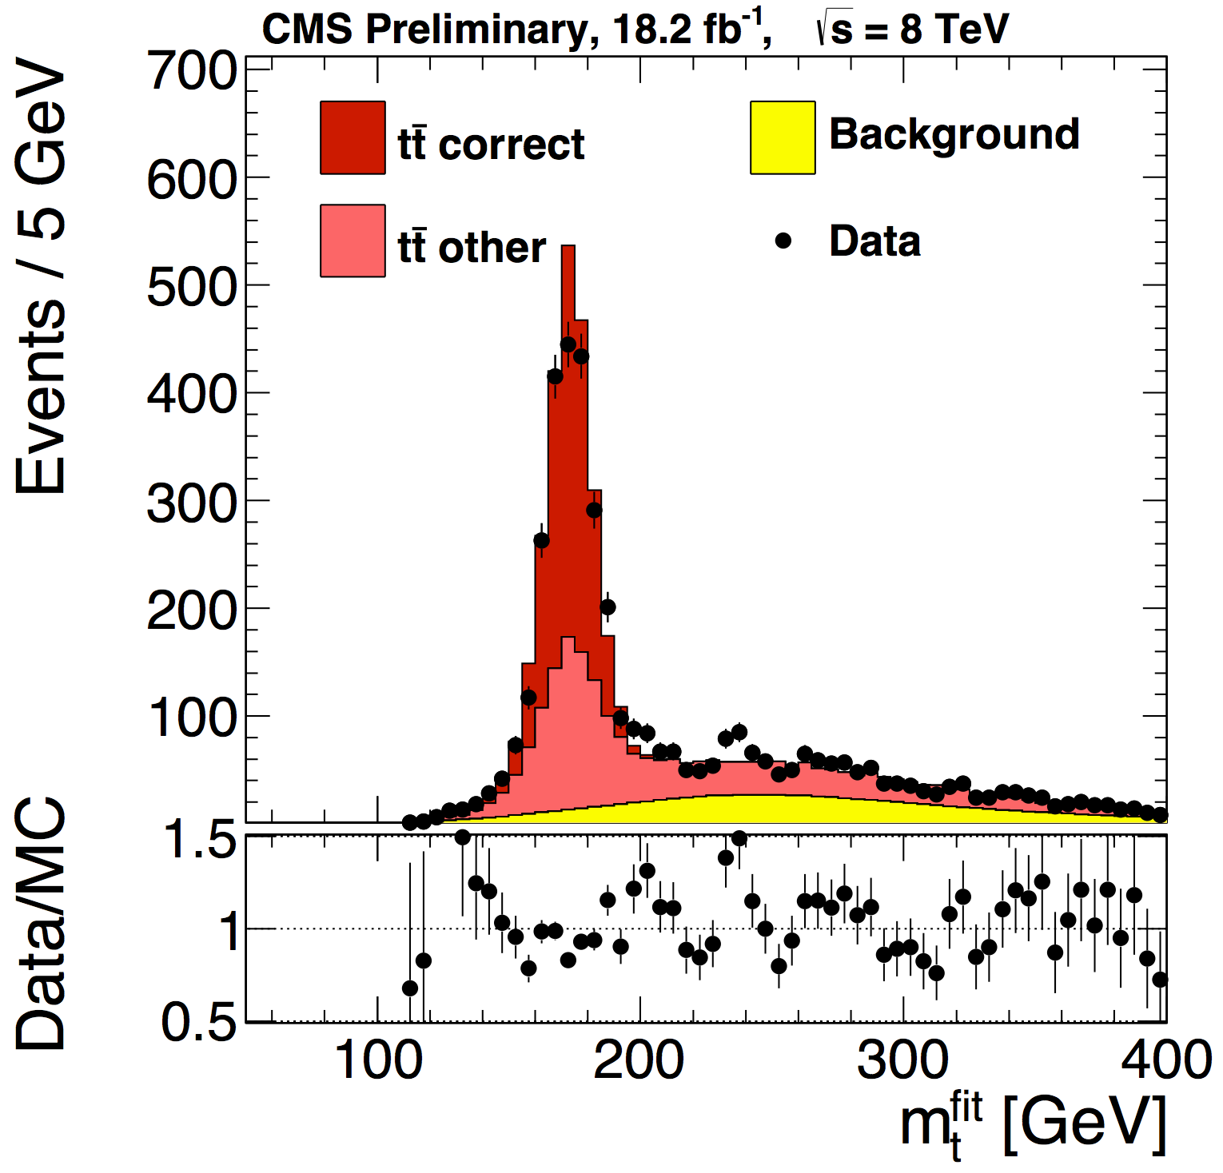
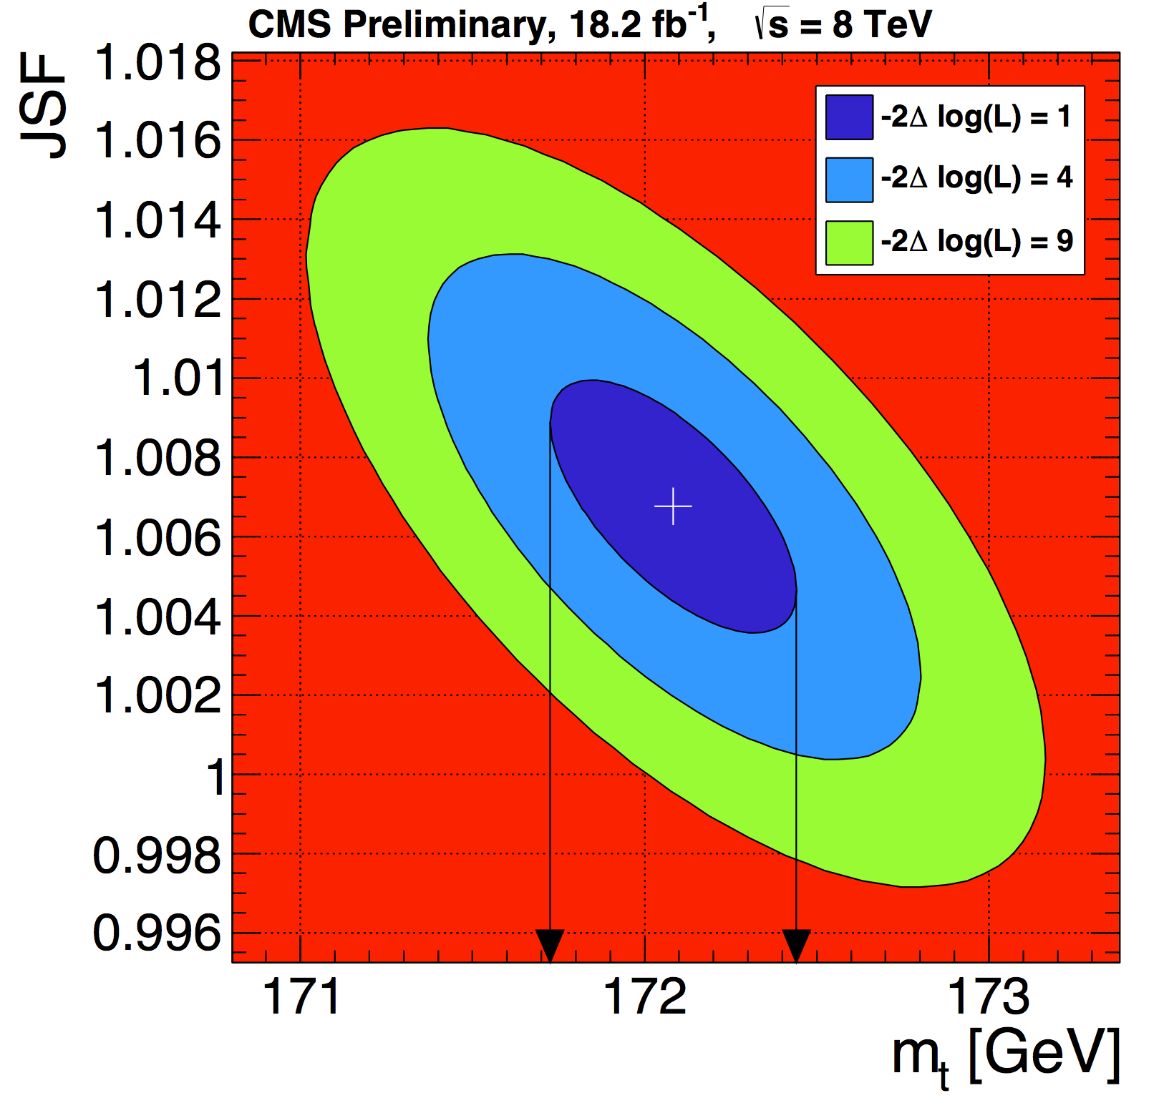
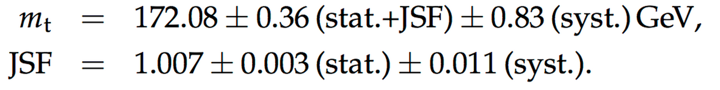
Top Mass : legacy from Run1
We have completed our top mass measurements using both the fully hadronic decays (TOP-14-002) and the fully leptonic ones (TOP-14-010).
The results will be combined with the previous lepton+jet measurement and possibly presented in the TOP2014 conference
The fully leptonic analysis is the first “blind” top mass measurement in CMS
M(had)= 172.08±0.36 (stat.+JSF) ± 0.83 (syst.) GeV
M(lep) = 172.47±0.17 (stat. ) ± 1.40 (syst.) GeV
M(l+j) = 172.04±0.19 (stat.+JSF) ± 0.75 (syst.) GeV
2 of these measurement have precision comparable or better than the recent LHC/FNAL World average

Slide 9
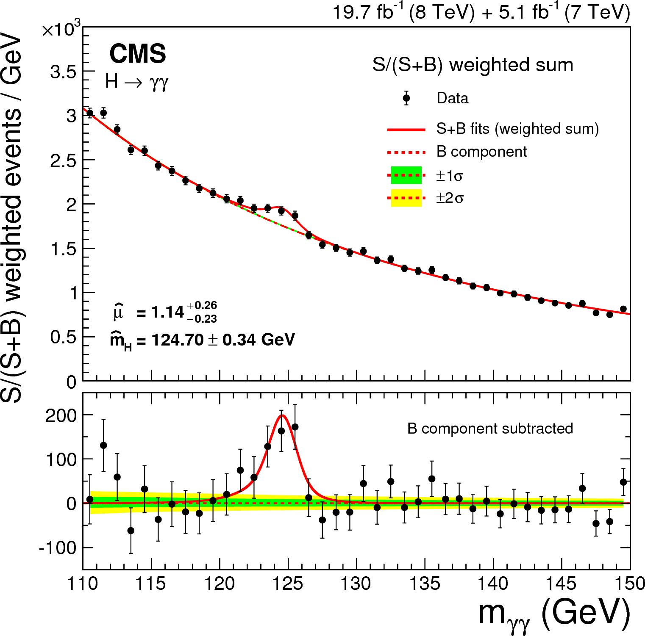
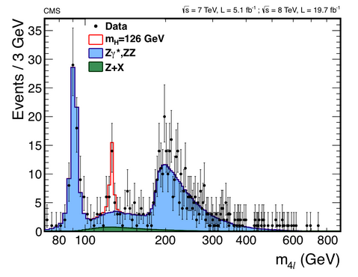
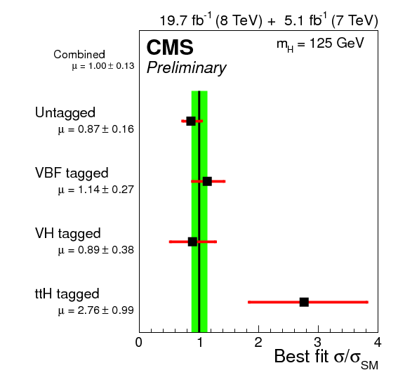

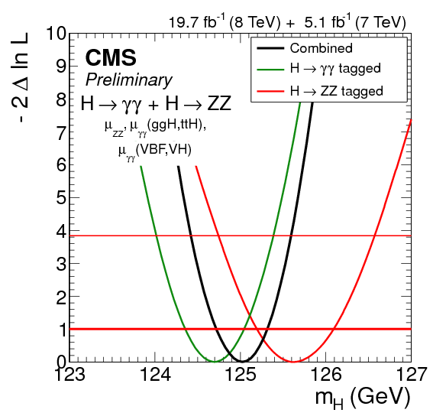
Higgs
CMS has now published the final analysis for all final states: this is our legacy for LHC RUN1
M=
μ=1.00±0.13

Slide 10
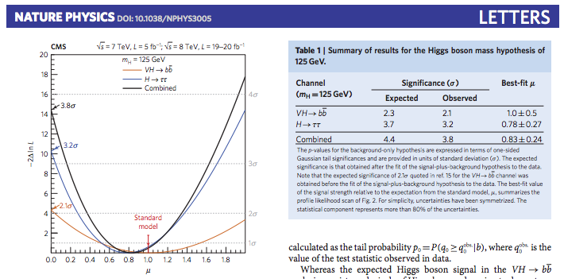
A CMS milestone
Received on June 17th from Nature editor
Dear Author,
Your paper 'Evidence for the direct decay of the 125 GeV Higgs boson to fermions' has now been scheduled for Advance Online Publication (AOP) on Nature Physics's website on 22 June 2014 at 1800 London time / 1300 US Eastern time, which is when the embargo will lift.

Slide 11
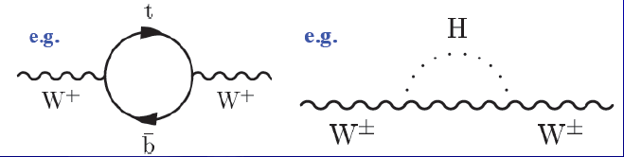
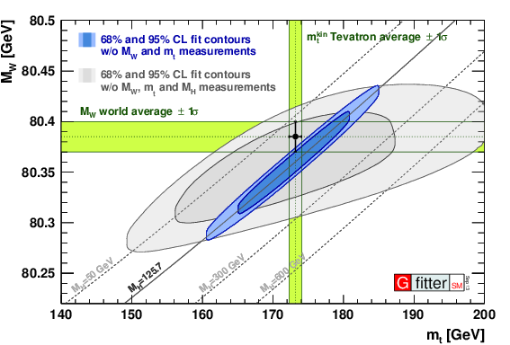
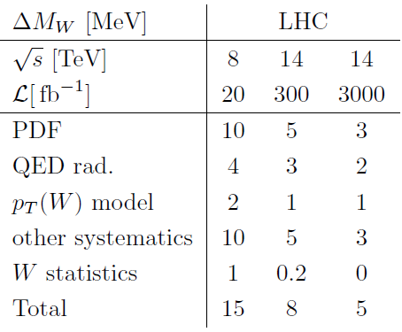
W mass: the next step
LHC can check VERY precisely the SM as it has the potential to measure the fundamental masses of the SM: Top, Higgs, W. The M_{w} is the biggest challenge
Stay posted: the goal is ambitious
Biggest three obstacles to surmount:
  PDFs: sea quarks play a much stronger role than at the Tevatron. Need at least 2X better PDFs.
  Momentum scale
  Recoil model/MET

Slide 12
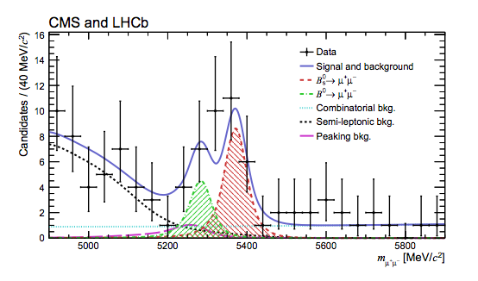



…and flavor physics:
B_{s} (combined with LHCb)
Stat significances
B_{s} 6.2 σ
B₀ 3.2 σ
Compatibility SM
B_{s} 1.2 σ
B₀ 2.2 σ
SM
SM
Being submitted to Nature

Slide 13
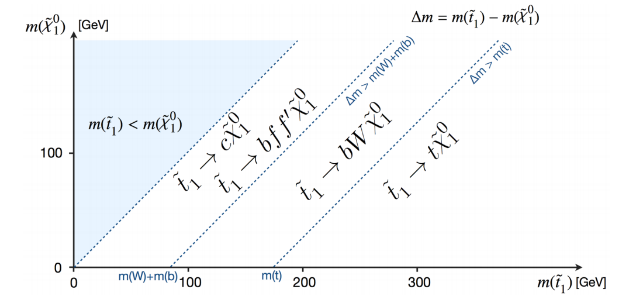
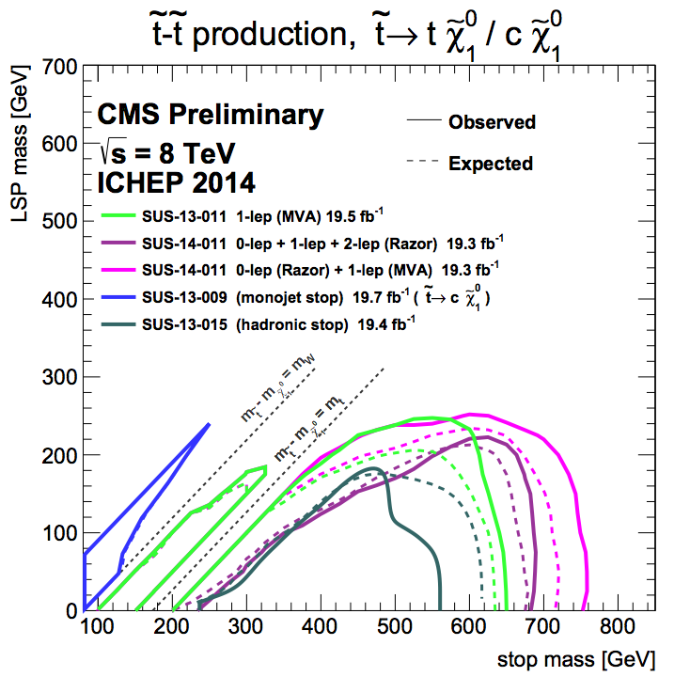
SuSy current limits : stop
M_{w}
Decay modes and hierarchy of sparticles lead to several compressed spectra regions
M_{top}

Slide 14
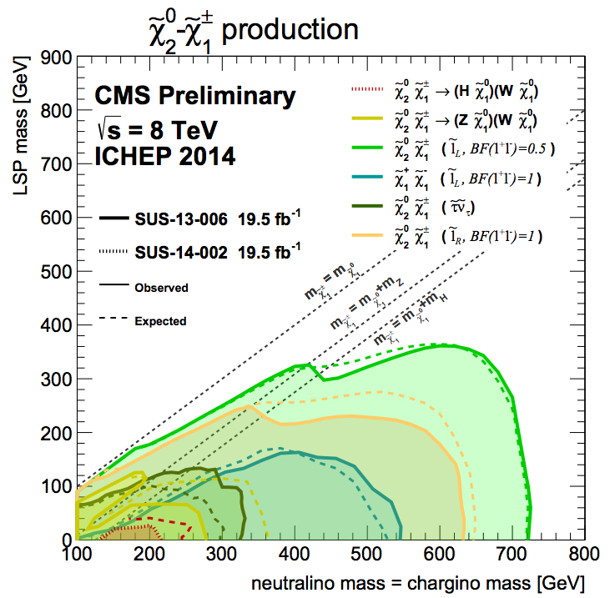
SuSy current limits : Eweakinos
Challenge: low cross-sections and irreducible diboson backgrounds: a ‘chase’ for the long run
M_{Z}
M_{Higgs}

Slide 15
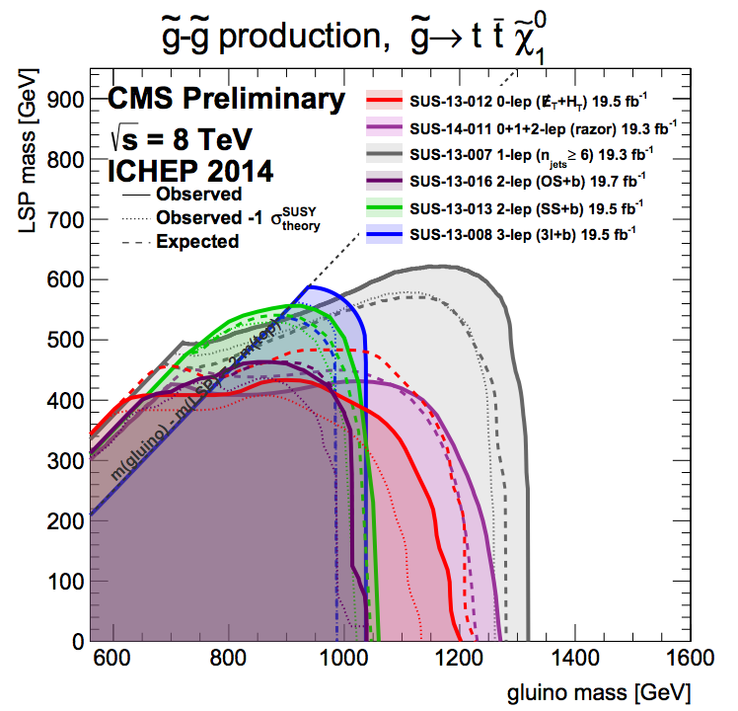
Susy current limits: Gluinos
M_{top}
A background and detector response
Challenge
A trigger
Challenge

Slide 16
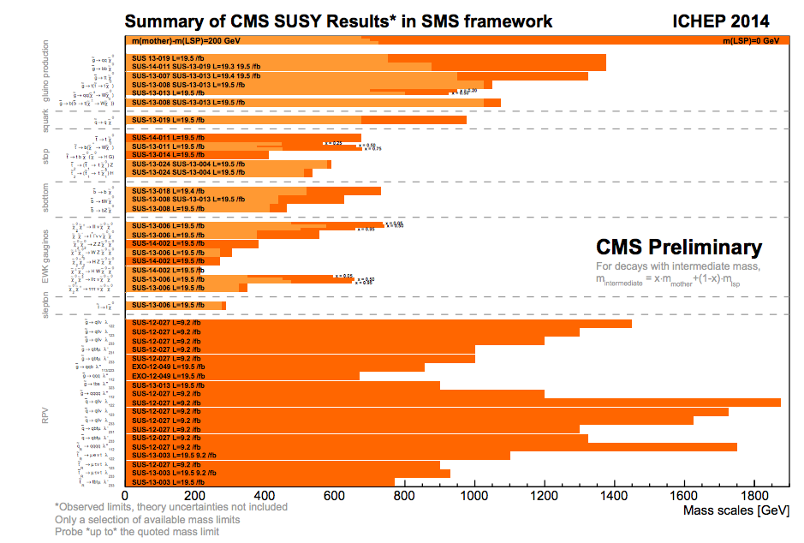
SuSy: only limits so far
Gluino
Squark
Stop
Sbot
Ewkinos
Slept
RPV
500
750
1000 GeV

Slide 17
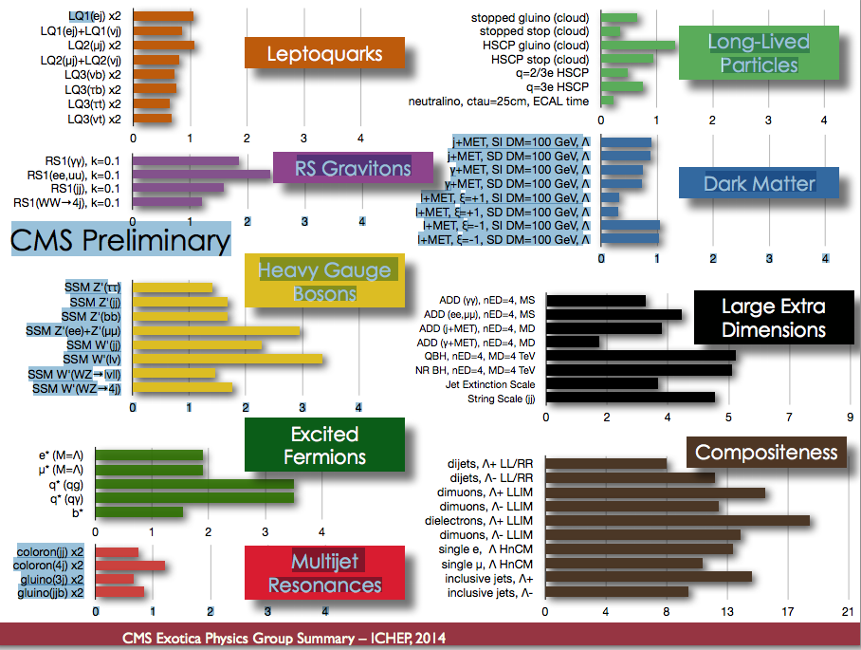
Exotica : limits

Slide 18
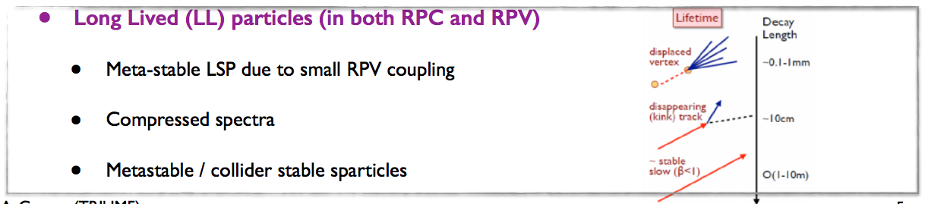
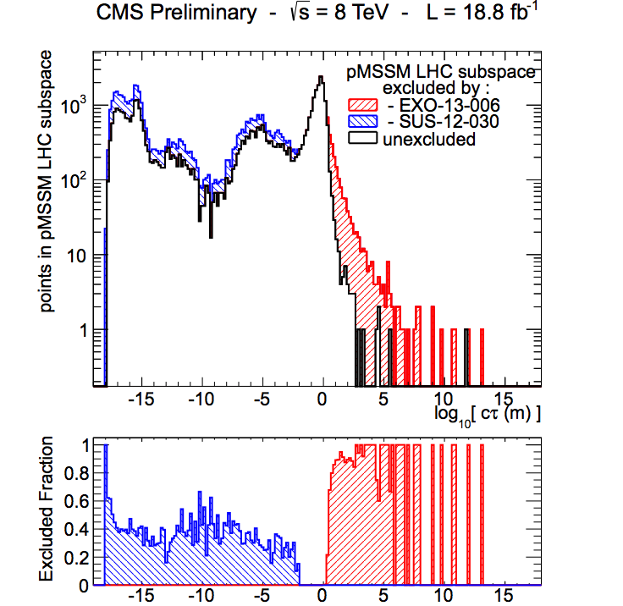
Exploring in ‘time’
pMSSM: exploration of parameter space leading to long lived sparticles (blue and red areas excluded)
Trigger, reconstruction and calibration
challenge

Slide 19
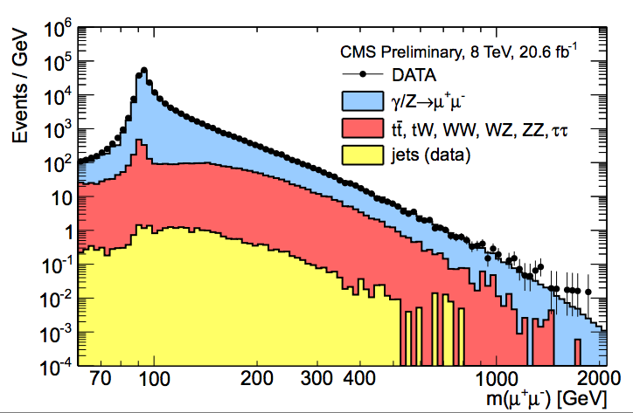
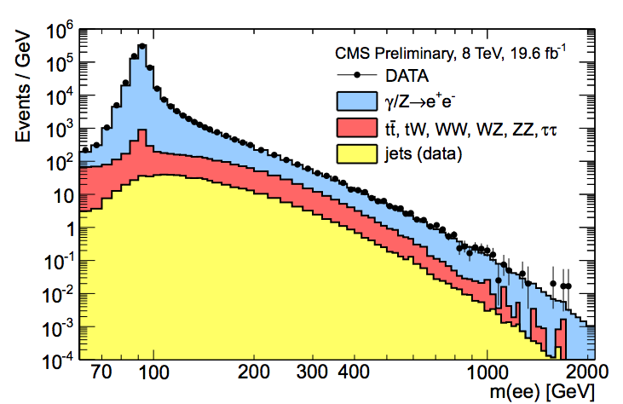
Exotic boson
Striking signature… require superb control of detector single cell response

Slide 20
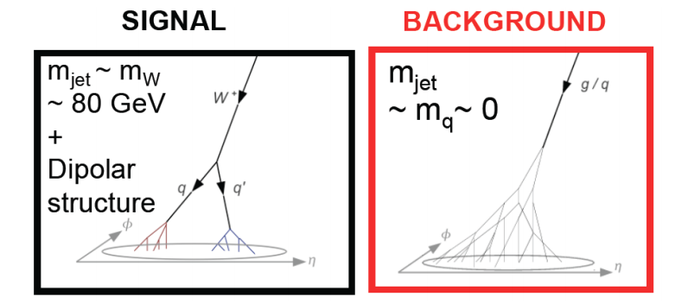
Higher energy… more challenges
Boosted topologies: traditional jet algorithm get confused

Slide 21
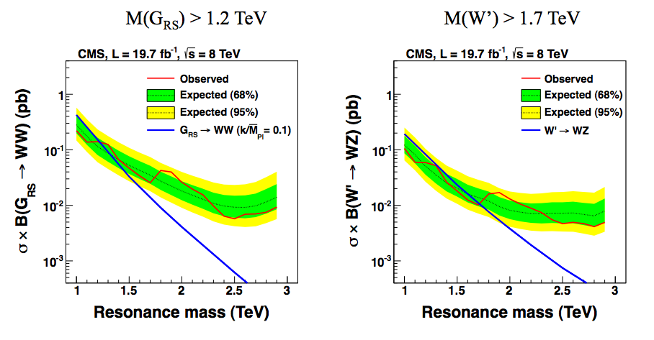
Boosted object: a booming field
New techniques and algorithm are being developed to stay competitive ( e.g. PUPPI): a challenge for reconstruction and calibration
RS Graviton
W’

Slide 22
The immediate future : readiness for
2015 and Run2

Slide 23
Potential performance
 | Nc | Beta* | ppb | EmitN | Lumi | Days (approx) | Int lumi | Pileup
50 ns | 1300 | 80 | 1.2e11 | 2.5 | 4.6e33 | 21 | ~1 fb⁻¹ | 27
2015.1 | 2496 | 80 | 1.1e11 | 2.5 | 7.4e33 | 44 | 5.1 fb⁻¹ | 22
2015.2 | 2496 | 40 | 1.1e11 | 2.5 | 1.3e34 | 51 | 10.2 fb⁻¹ | 39
Conservative beta* to start
Conservative bunch population
Reasonable emittance into collisions
Assume same machine availability as 2012
Aim to deliver > 10 fb⁻¹ in 2015

Slide 24
CMS readiness: executive summary
Detector:LS1 upgrades and repairs done
Recent ‘surprise’ : Barrel Pixel quarter with 7% modules not responding. Repair done, detector ready to be installed.
Magnet ramped to 3.8 Tesla : OK ( magnetic configuration had changed so the test was awaited with concern)
Commissioning and run: new DAQ architecture and new Timing and Control system (TCDS) deployed and being exercised in regular Mid Week Global Runs.
Software& Computing: summer challenge exercise (CSA14) successfully ended mid September. Lessons learned being integrated in our SW and computing processes
Analysis:PHYS14 exercise just started: aim to prepare high priority analysis for speedy results on first 1-5 fb⁻¹

Slide 25
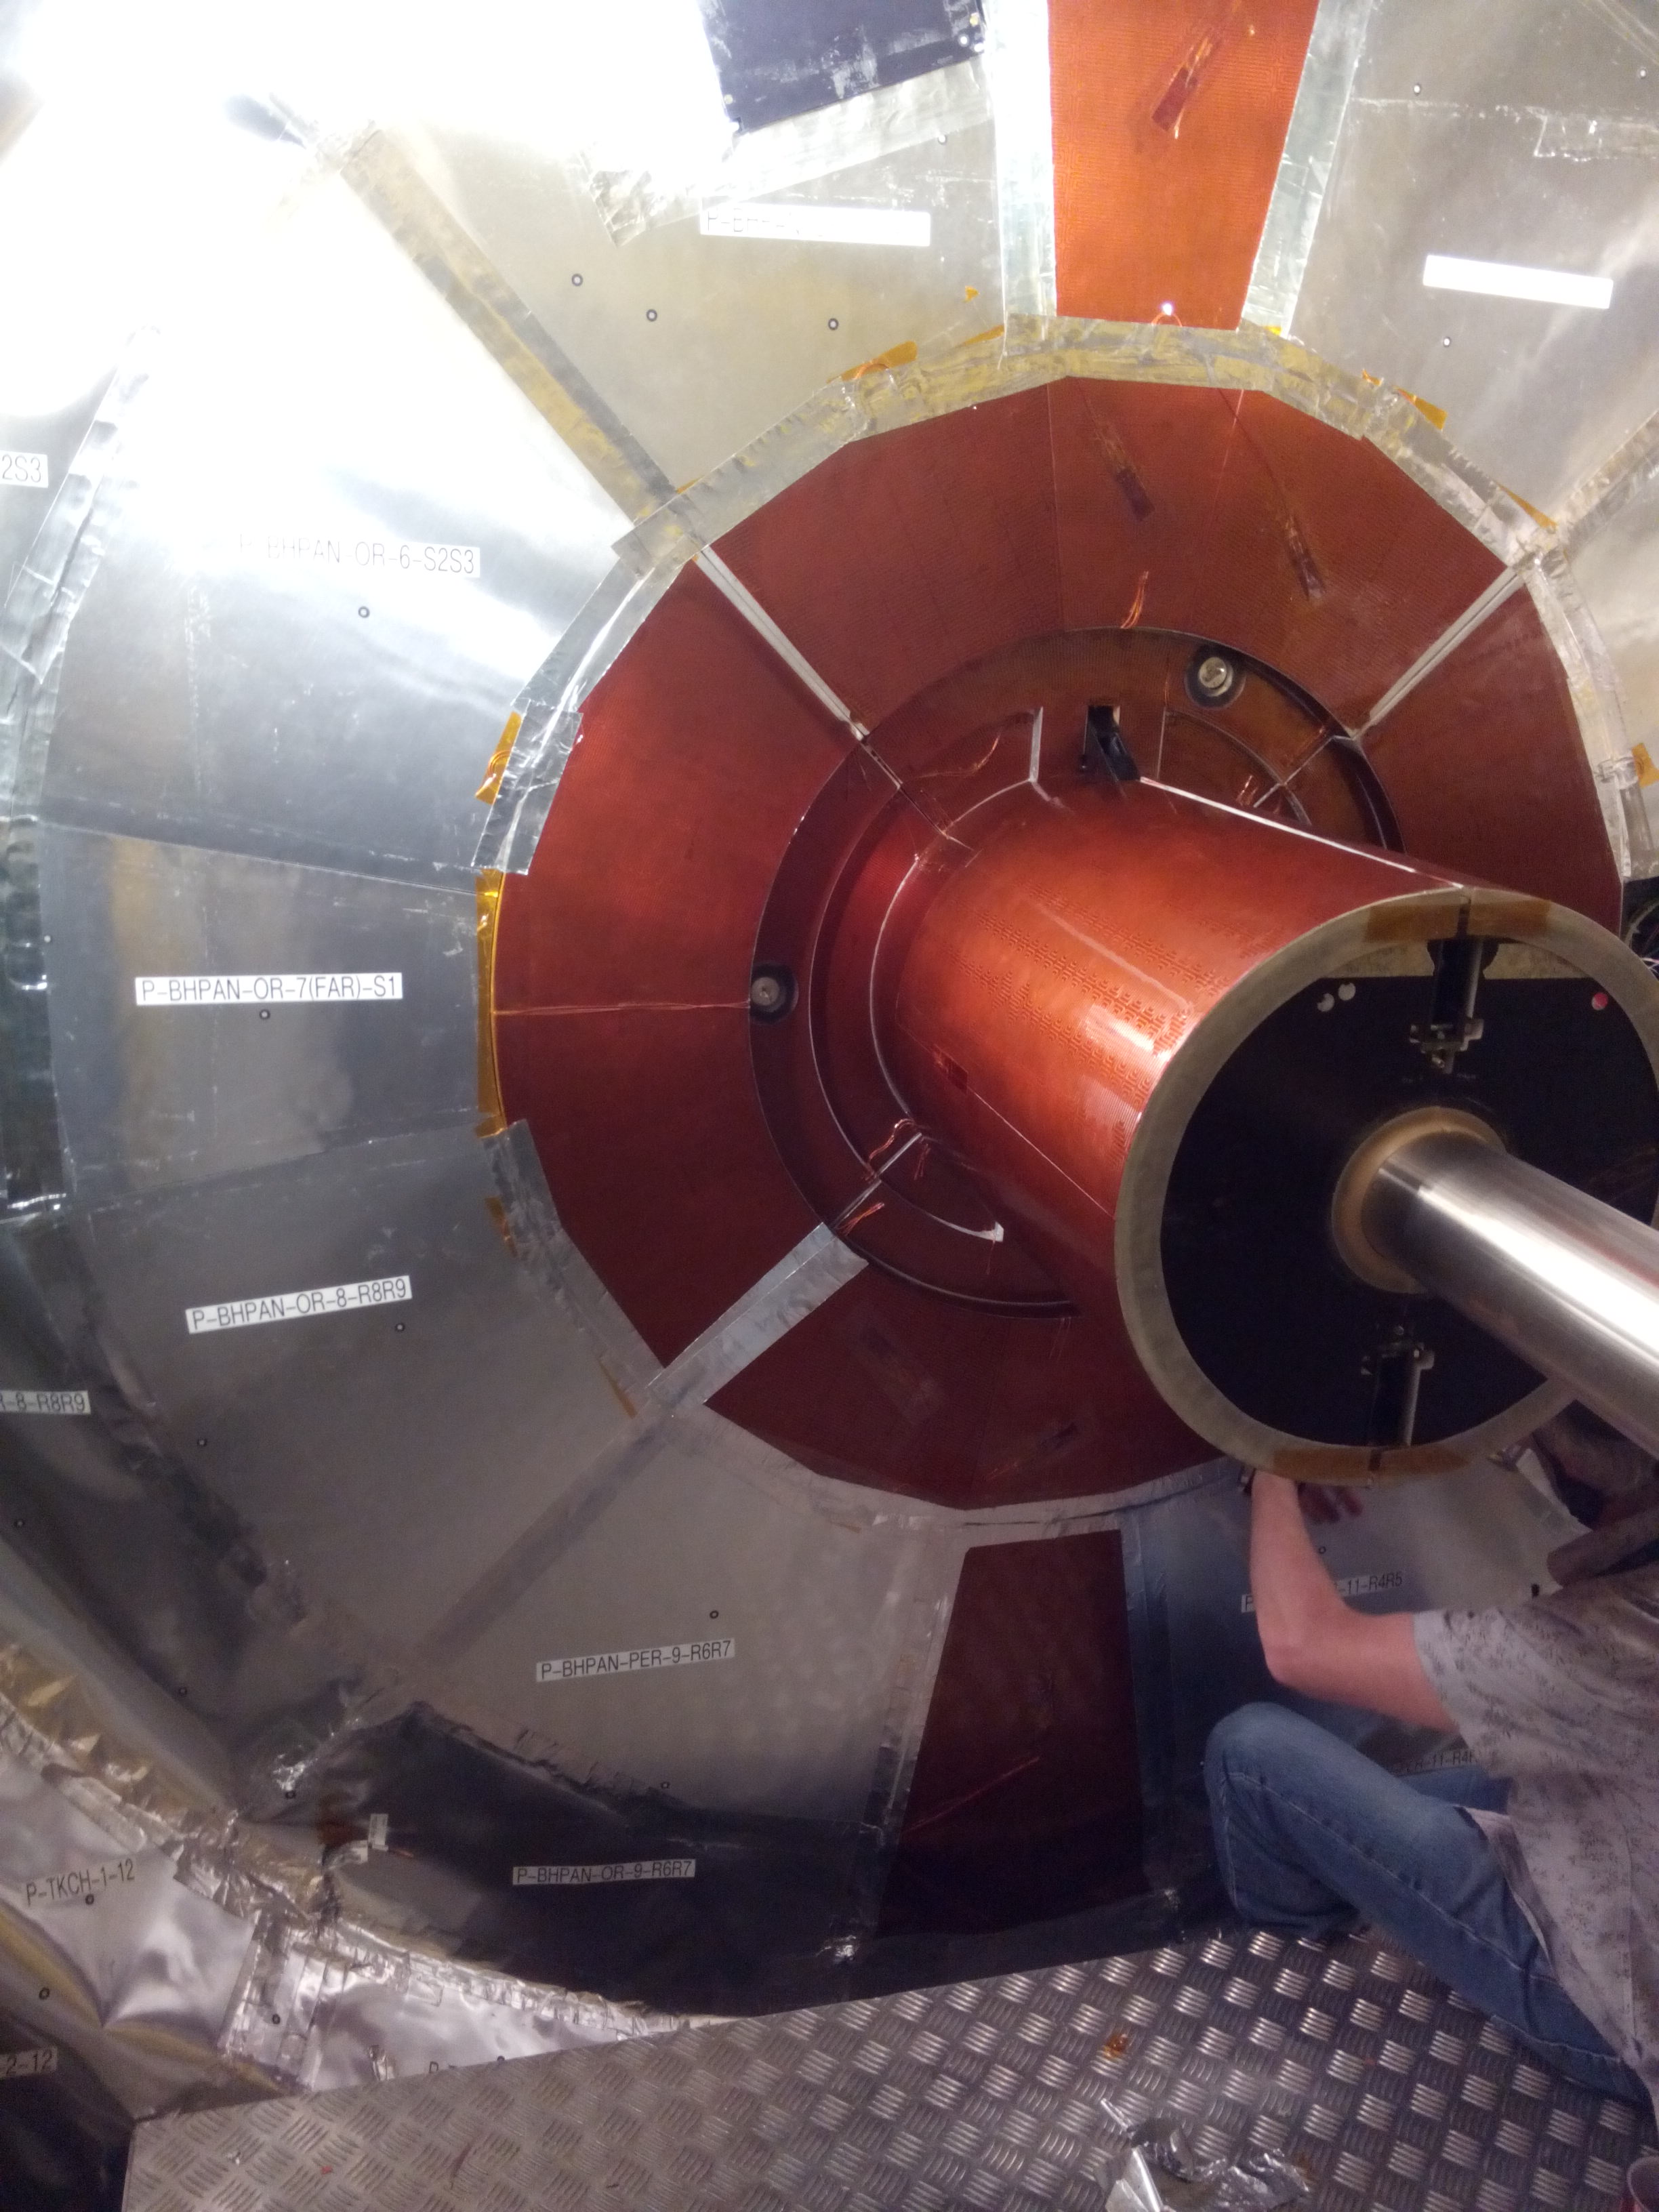
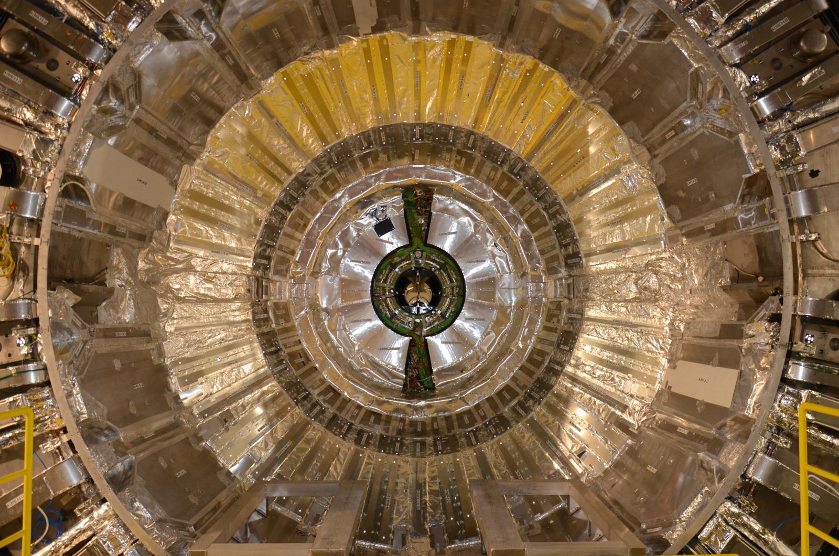
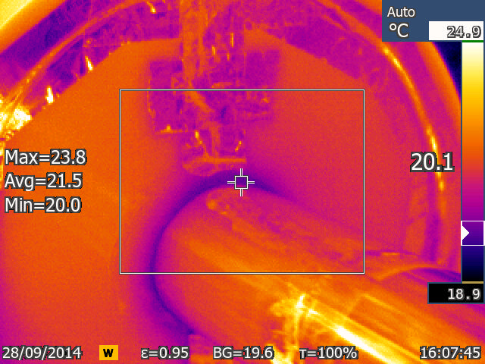
Tracker running cold (-15 degrees)
Si tracker operation at -15 C
commissioned
Final seal
Bulkhead with insulation

Slide 26
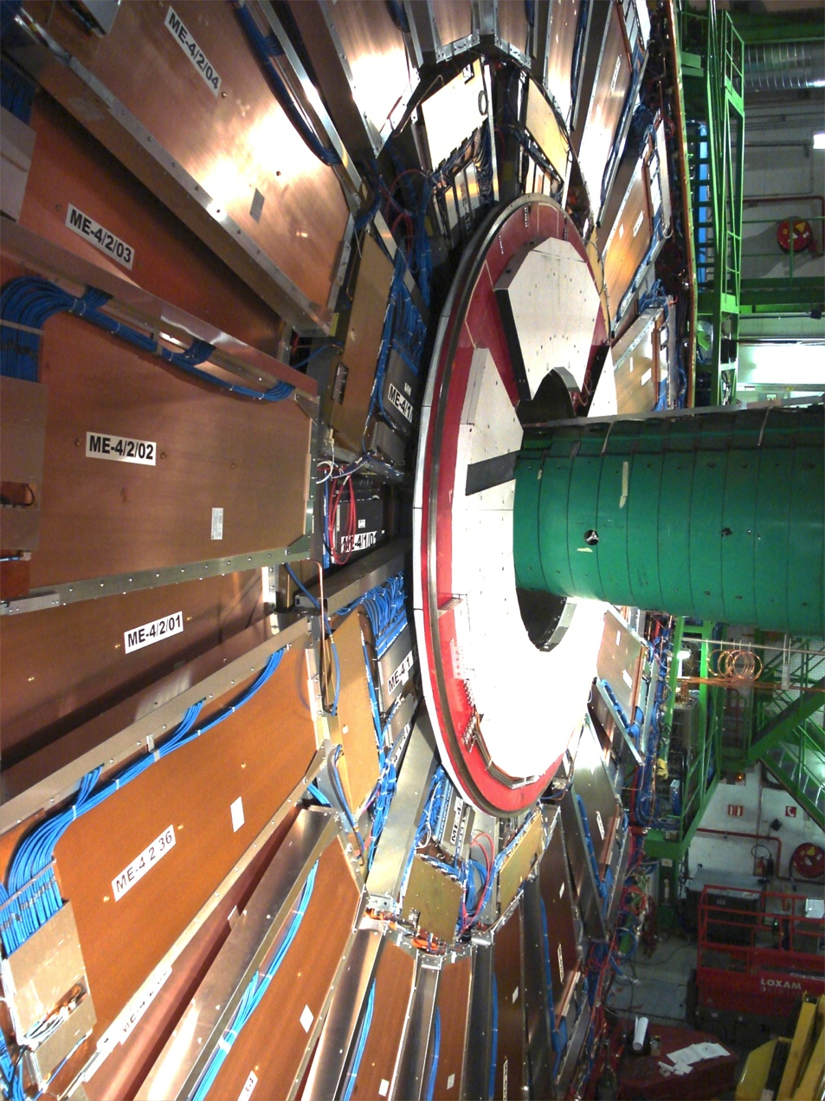
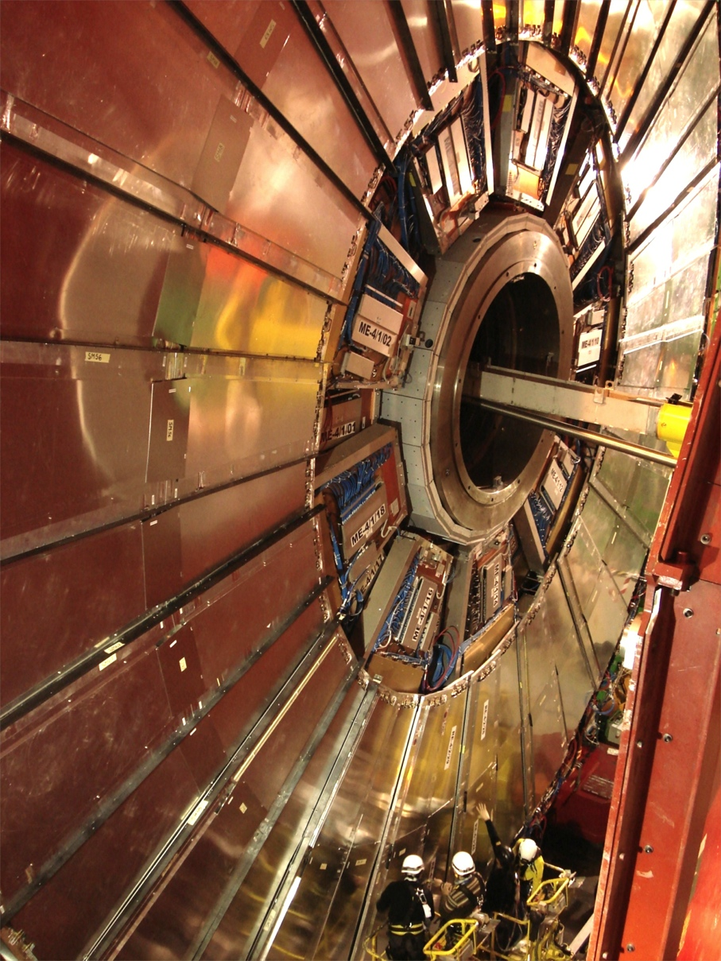
4th muon wall completed in endcaps CSC and RPC
RE4
ME4/2

Slide 27
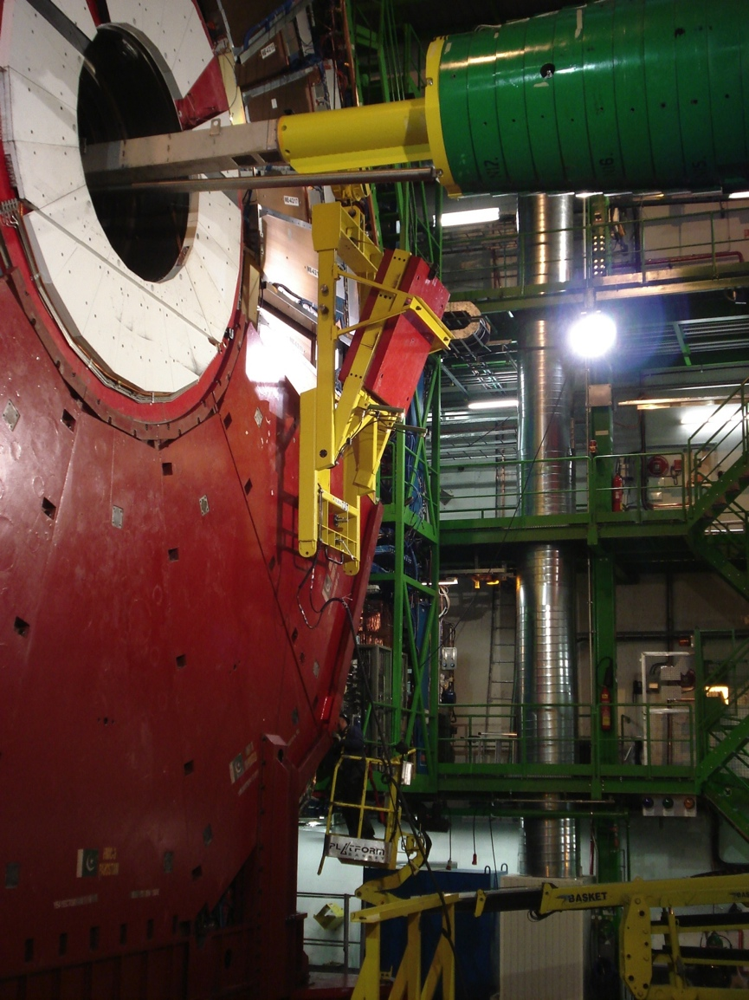
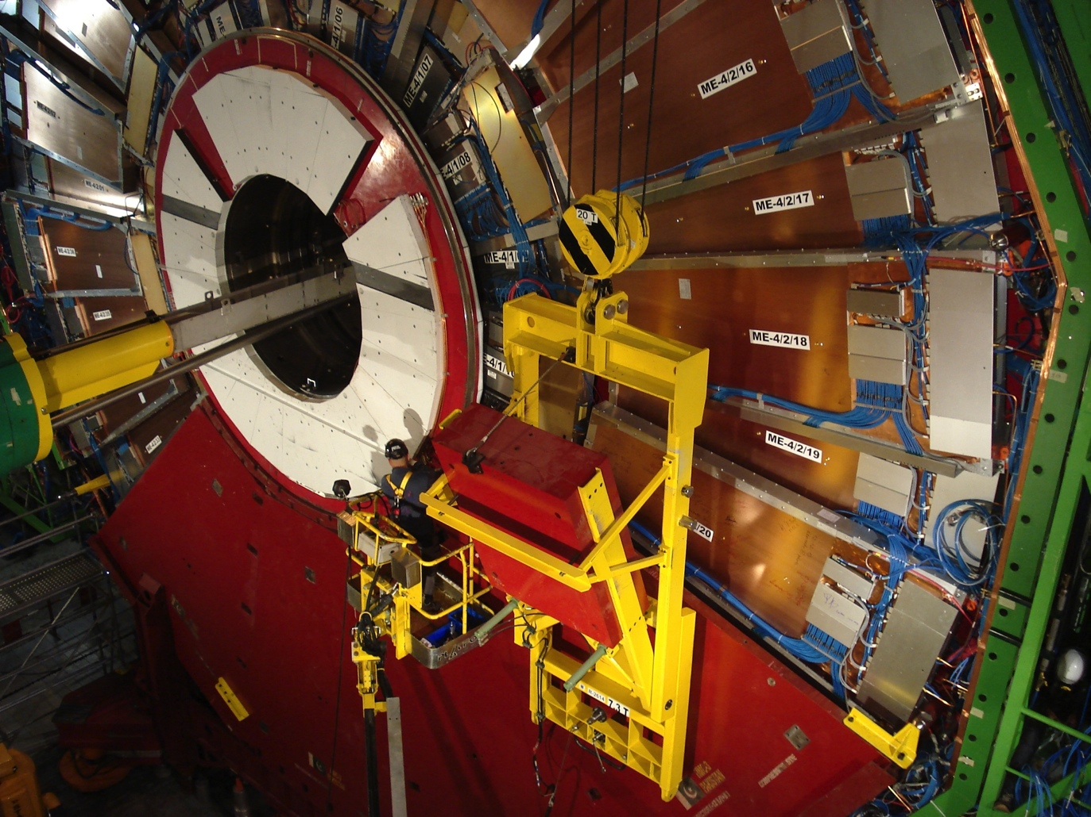
Shielding disk (Ye4) constructed in both endcaps

Slide 28
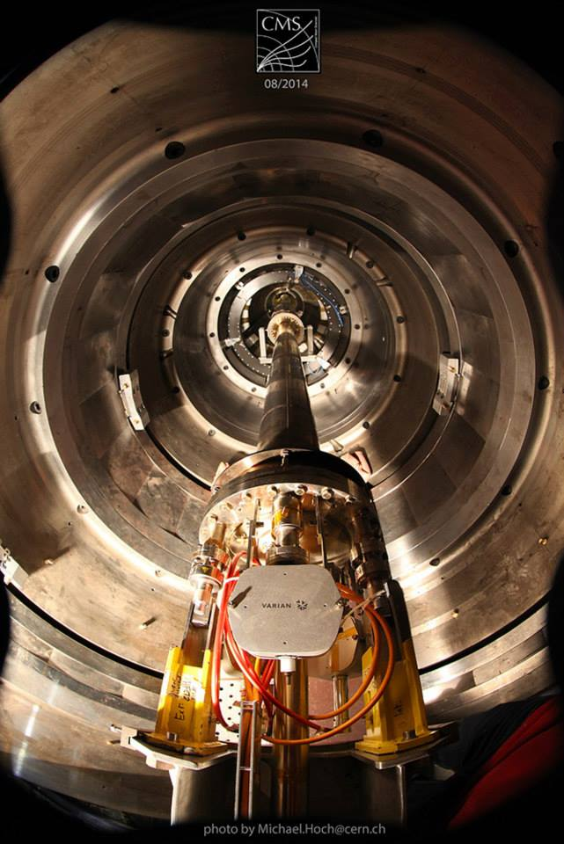
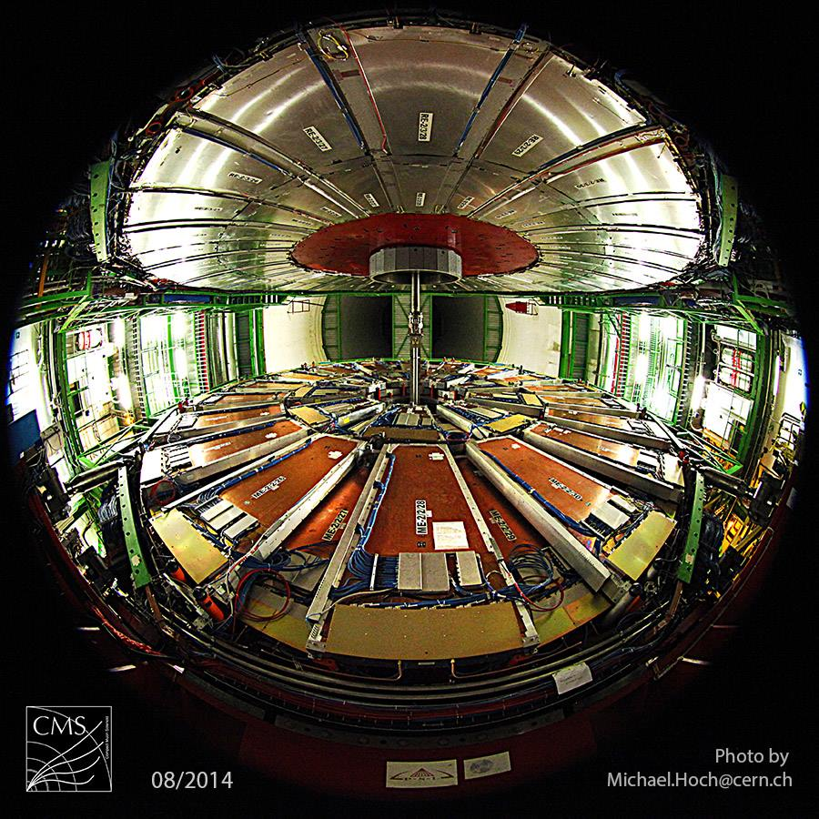
New beampipe
New reduced Diam. Pipe ready for installation of upgraded pixel in 2017

Slide 29
CSA14 & PHYS14
Summer exercise for physics users and developer community: >150 users involved, started 2nd week of July, ended mid september.
  realistic Alignment & Calibration conditions prepared for MC production
  PileUp scenario definition for 25ns and 50ns running conditions
  Validation of releases for Simulation and Reconstruction steps
  debugging of the submission infrastructure at al levels (SIM, DIGI, RECO)
  new MiniAOD (= slim analysis format for analysis) proposal/definition/deployment
followed by PHYS14 (starting now) which will exercise actual High Priority Analysis for 2015: this will prepare the analysis (code, workflow, processes) to deal with the first 1,5,10 fb^{-1.}
At software level :
  OOT PU mitigation and new tracking
  PhysObjGroups to tune new working points for physics objects
The debriefing from both exercises will lead to improvements to implement in our SW releases for 2015, both at reconstruction and analysis level

Slide 30
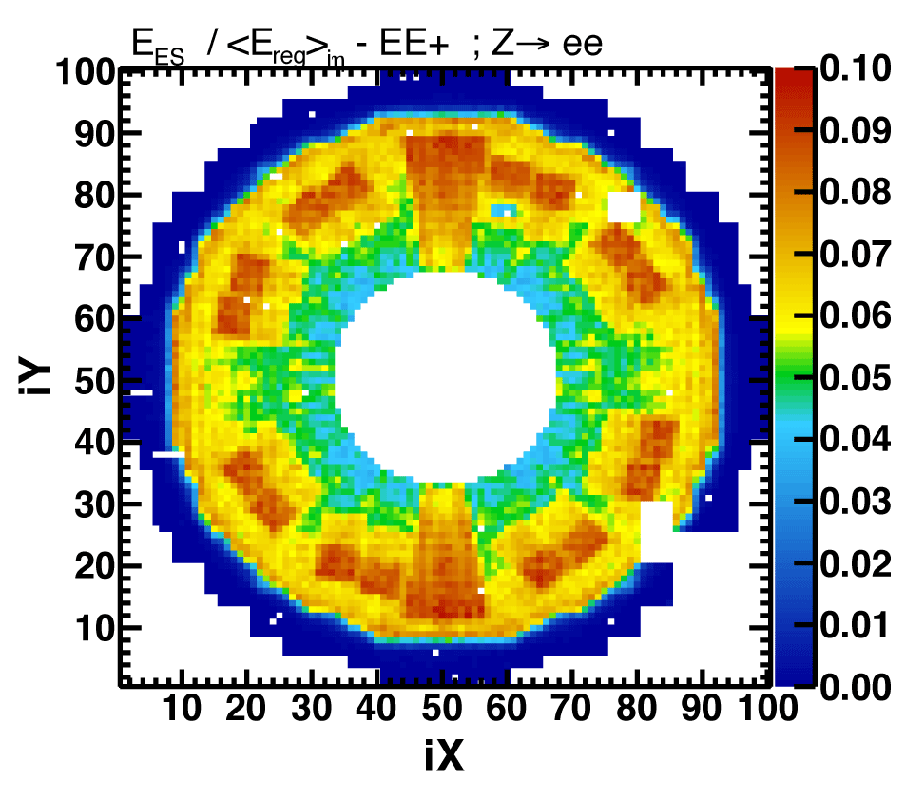
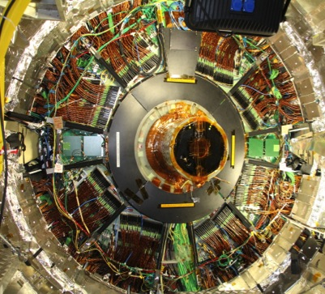
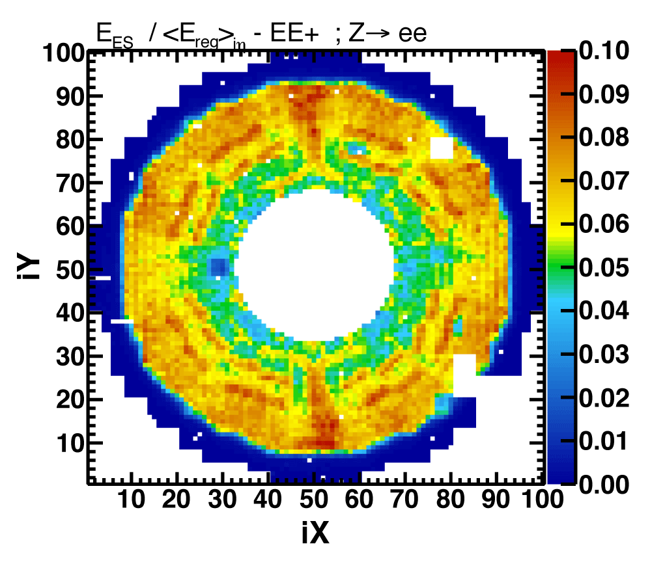
Better material simulation
Longitudinally-segmented endcap ECAL (EE+Preshower) provides information on upstream material
Simulation
Reality
Data
Structures seen in E_{ES}/E_{EE} represent the Tracker end-flange – cables and connectors. Data show the real positions – different from those modeled in the simulation ➔ data used to tune the simulation

Slide 31
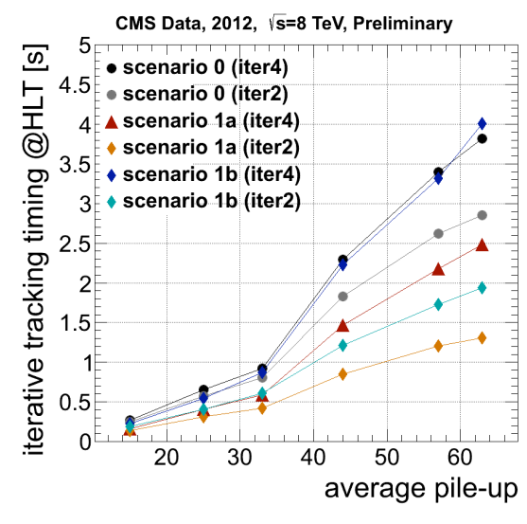
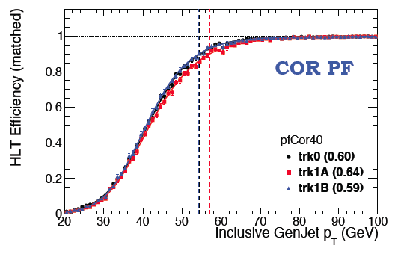
High Level Trigger: example improvements in reconstruction
Tracking
  Chosen between different improved scenarios:
    Primary vertex constrained to “selected” vertices (primary and those with Et close to primary)
    Skip last tracking iterations (3,4) when not looking for displaced tracks
  Best compromise between efficiency and CPU time gain
40GeV PFJets at HLT (25ns)
JET-MET
  Online Jet Energy correction computed for CALO and Particle Flow Jets (with the chosen tracking scenario), 25ns operations
Electrons
  Tuned working point for isolated electrons, using refined particle flow objects
    Improved S/N rejection, lower rate and higher efficiency

Slide 32
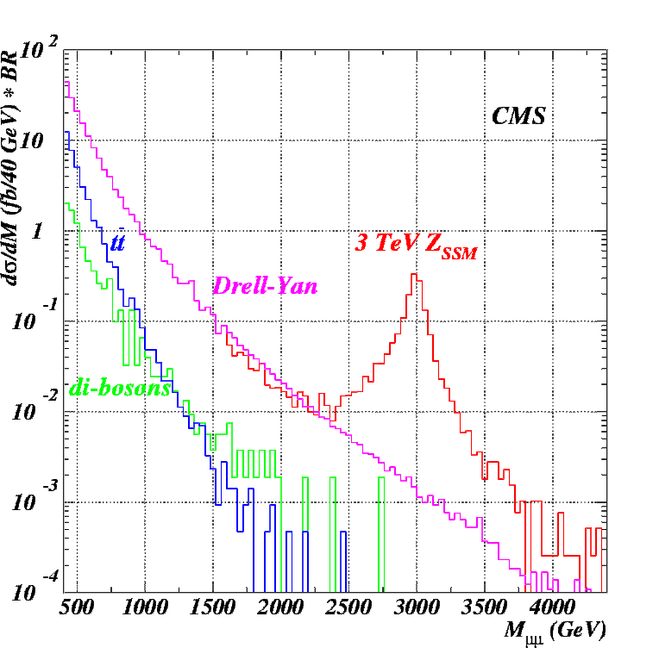
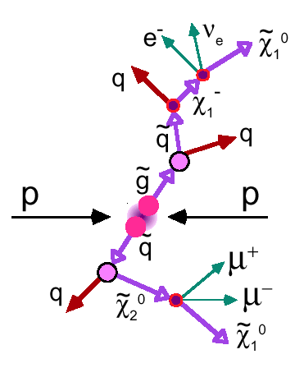
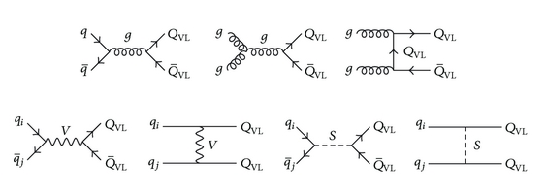
2015 and RUN2
A lot at stake: we have to be ready!
We know that there must be more than the Higgs…and that in order to make things simple the new physics should be around the corner: we have to make sure that we do not miss the corner!
Extra dims?
Susy?
Something else?

Slide 33
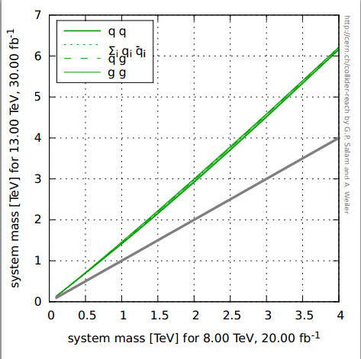
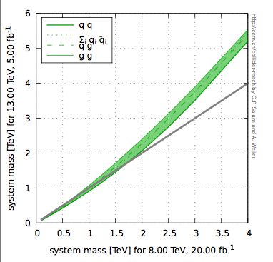
Discoveries can come early
Discovery potential comparison 20fb⁻¹ @8TeV vs X fb⁻¹ @13 TeV
30 fb⁻¹ @ 13 TeV
5 fb⁻¹ @ 13 TeV
Courtesy of Gavin Salam

Slide 34
The future is bright ( and VERY busy)!
We have exploited the run1 data : our legacy for the Higgs results is published, the majority of searches analysis are published or being published, Top physics results are beyond expectations, B rare decays an evidence of CMS global performance from trigger to reconstruction.. and more
We are now concentrating on the preparation for the 2015 run: we will again explore new frontiers
We have defined the technical proposal for our High Lumi Detector. Next step will be the choice of the forward calorimeter and the preparation of the TDRs

Slide 35
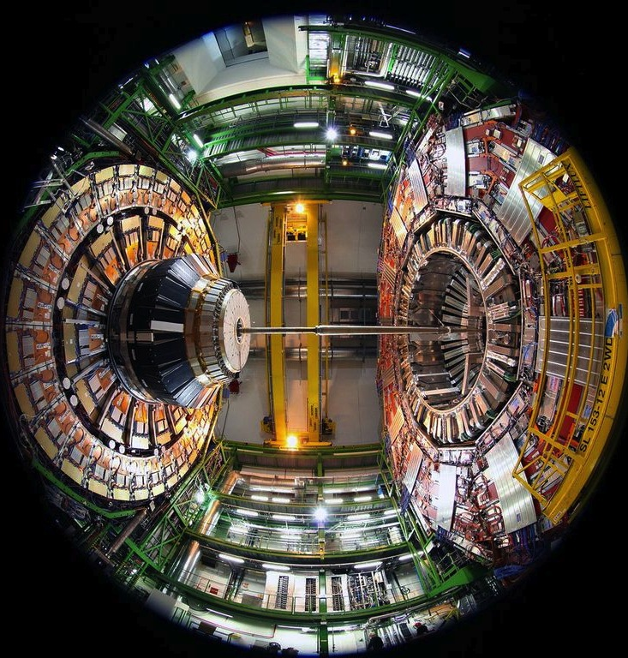
Summary
Thank you !

Slide 36
Backup

