Slide 1


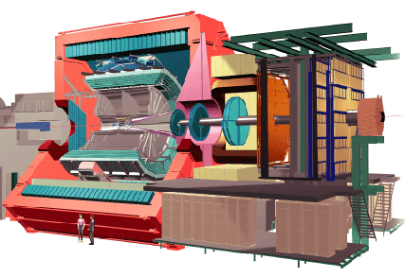
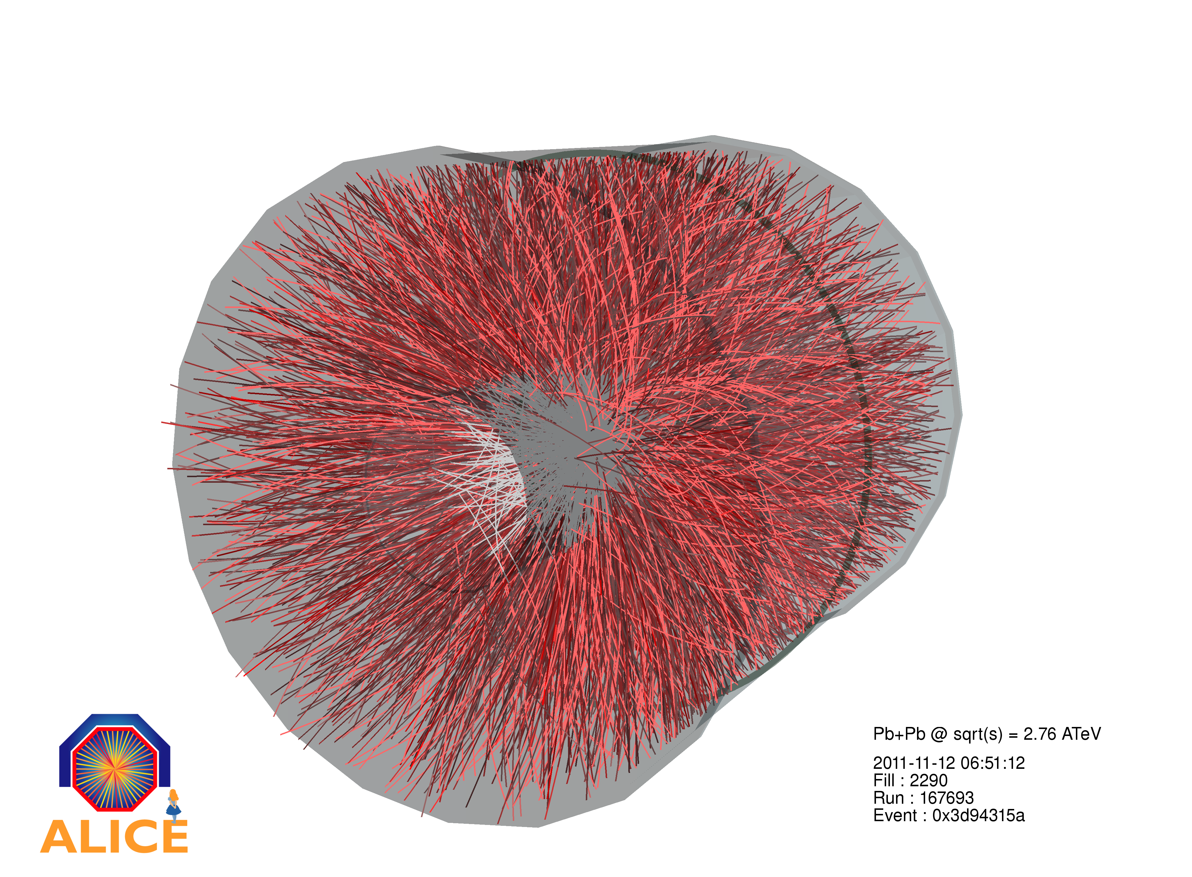
ALICE Highlights and Upgrades
Selected
^
Peter Jacobs
Lawrence Berkeley National Laboratory

Slide 2
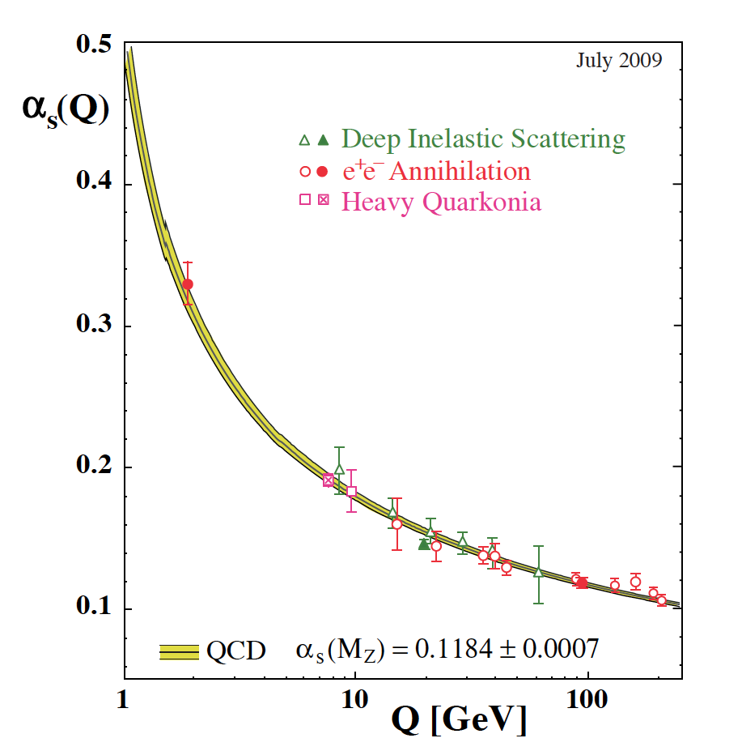
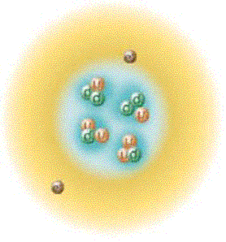
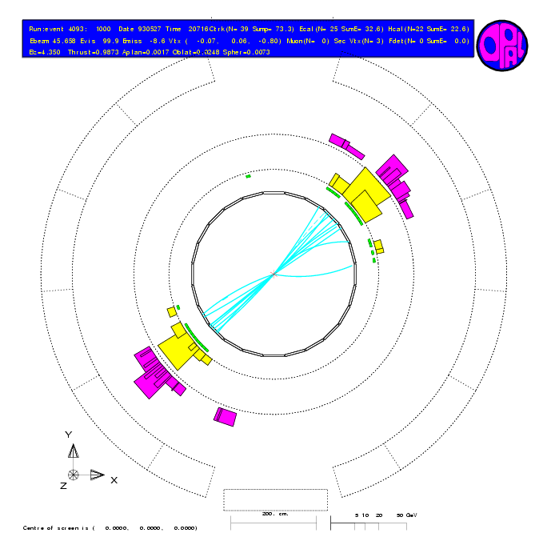
QCD: running of α_{S}
Asymptotic Freedom
Confinement
Low momentum
High momentum

Slide 3
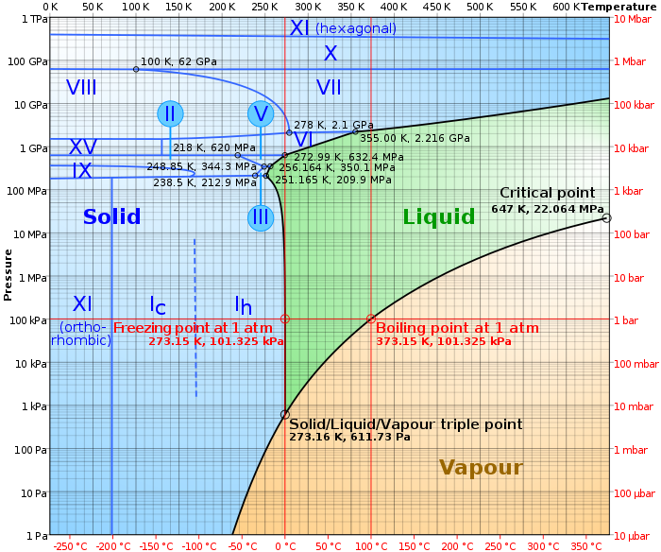
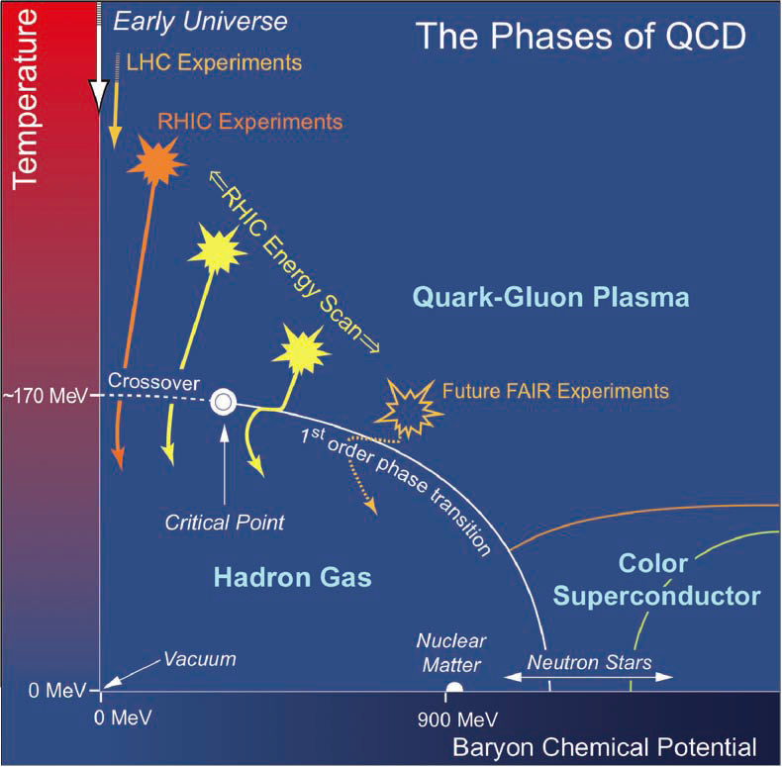
Now consider “matter”
Emergent phenomena not readily evident in the Lagrangian
Phase structure of water
Phase structure of QCD matter
heat ➔
Limited exploration to date
compress ➔
Explored in detail
heat ➔
compress ➔

Slide 4
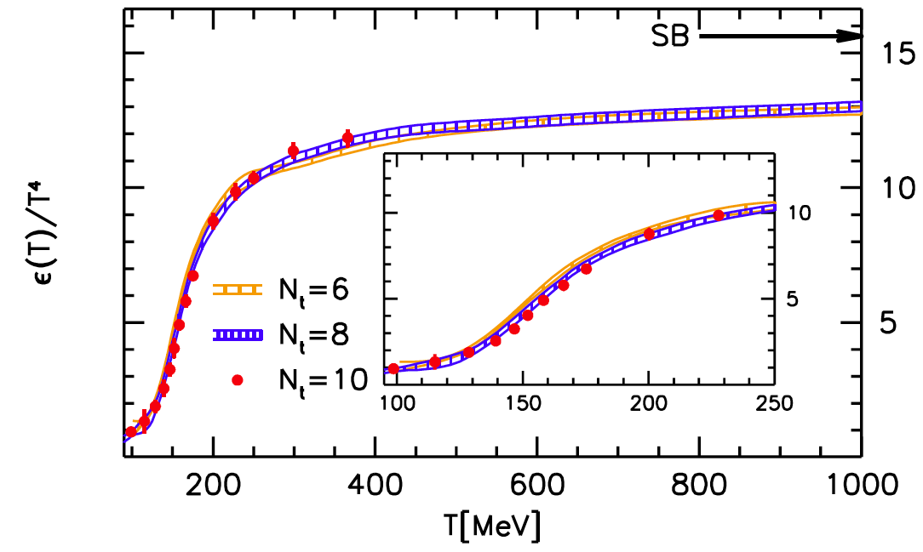
Quantitative QCD thermodynamics
Finite temperature QCD calculated numerically on the lattice (μ_{B}=0)
Slow convergence to non-interacting Steffan-Boltzmann limit
What carries energy - complex bound states of q+g? “strongly-coupled” plasma?
Energy density
S. Borsanyi et al., JHEP 1011, 077 (2010)
Temperature [MeV]
Cross-over, not sharp phase transition
(like ionization of atomic plasma)

Slide 5
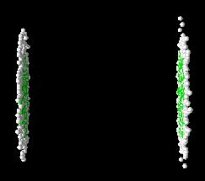
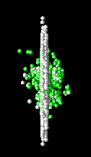
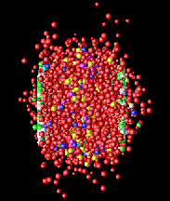

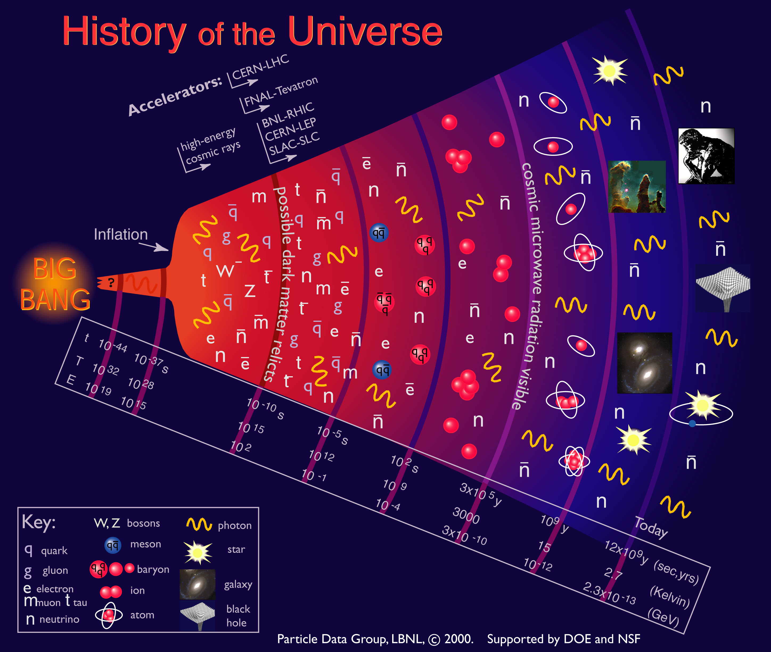
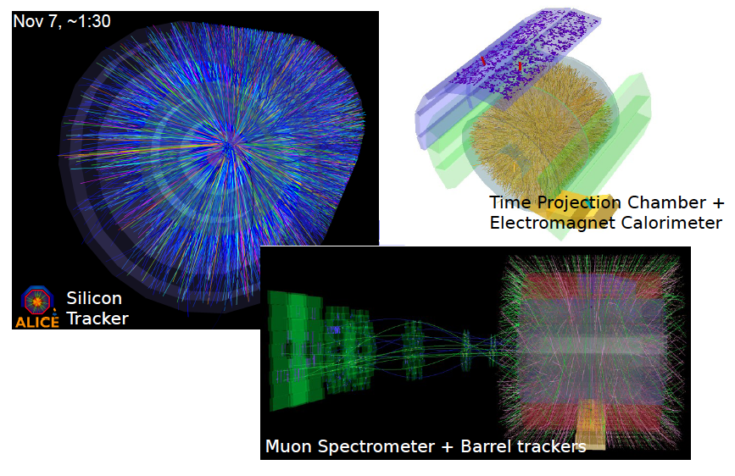
Studying hot QCD in the Laboratory: high energy collisions of heavy nuclei
Model calculation
Real LHC Pb+Pb collision
Notes:
– how to make sense out of this?

Slide 6
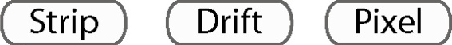



ALICE
ALICE is the comprehensive heavy ion experiment at the LHC
Design optimized for
  huge particle multiplicities of nuclear collisions
  efficient tracking over wide momentum range
  extensive particle identification
  low mass around vertex ➔ low p_{T} measurements
      QGP “temperature” ~ Λ_{QCD} ~ few hundred MeV

Slide 7
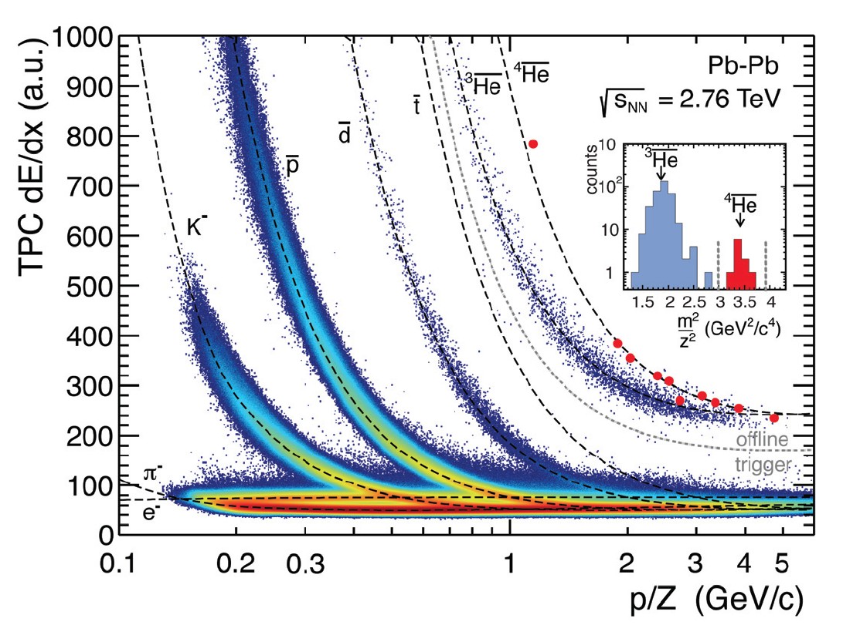
ALICE Particle ID: TPC dE/dx
Int. J. Mod. Phys. A 29 (2014) 1430044

Slide 8
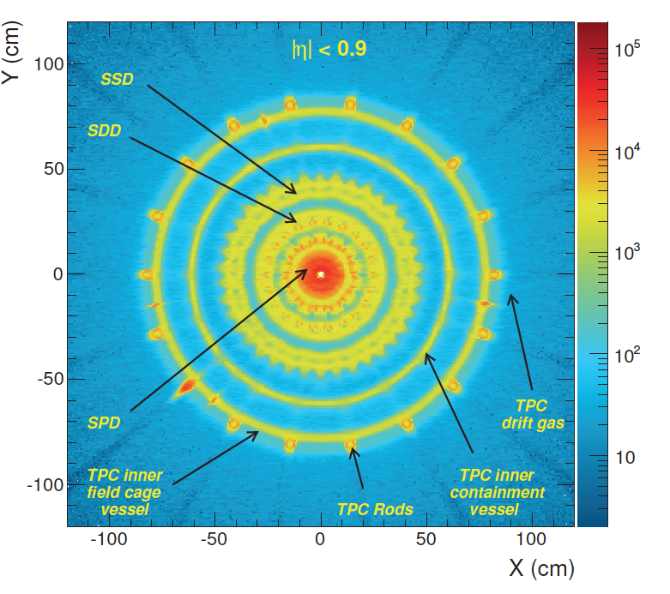
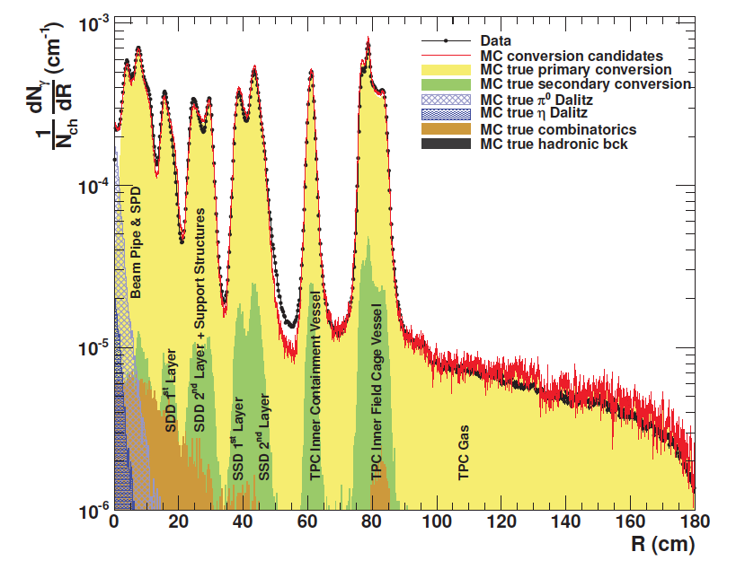
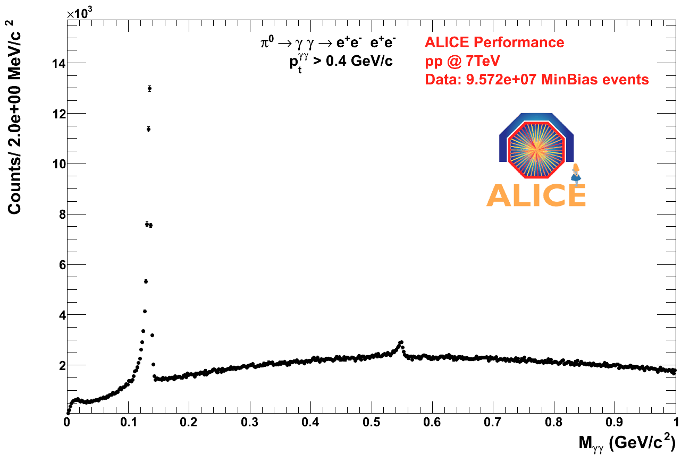
ALICE: Tomography via γ-conversions
Int. J. Mod. Phys. A 29 (2014) 1430044
M_{γγ}

Slide 9
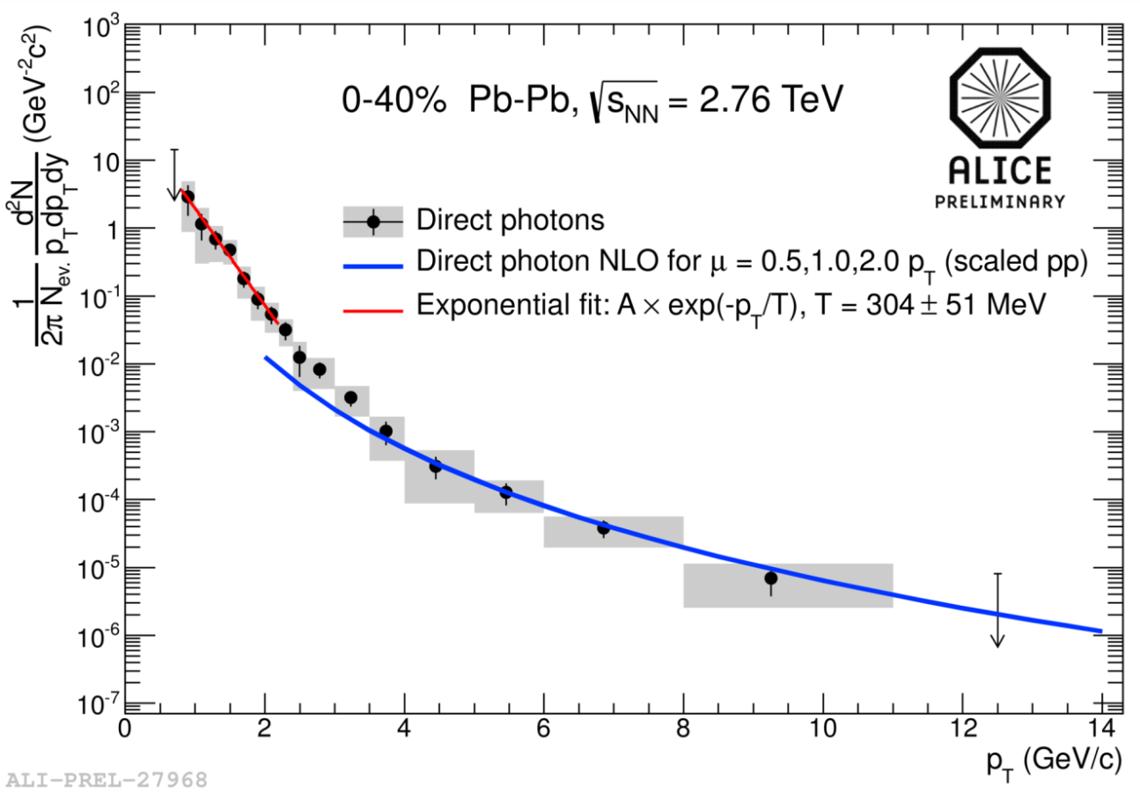
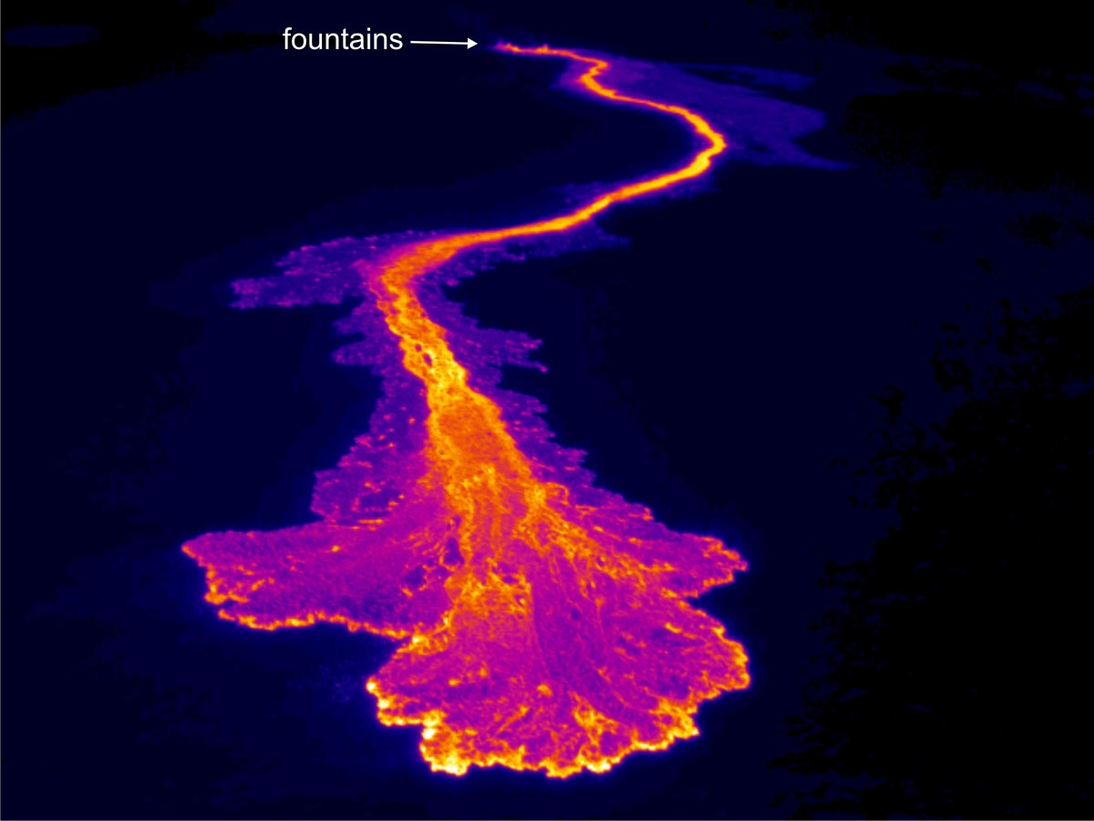
Radiation from the fireball: direct photons
Excess yield relative to perturbative expectation
Exponential fit to excess yield: T=304±51 MeV
Compare PHENIX/RHIC: T=221±19±19 MeV
Connection to temperature? Model studies ongoing…

Slide 10

Collective flow

Slide 11
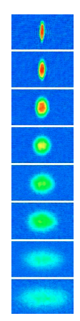
Elliptic flow of a degenerate Fermi fluid
J. Thomas et al.
time
Optically trapped ⁶Li atoms cooled to microKelvin temperature
Interactions magnetically tuned to Feshbach resonance
  ➔infinite 2-body scattering cross-section
  ➔prototypical “strongly-coupled” system
Prepare the system with spatial anisotropy and let it evolve
  ➔develops momentum anisotropy

Slide 12
Collective Flow of QCD Matter
Initial spatial anisotropy
Final momentum anisotropy
p_{y}
p_{x}
z
Interaction of constituents
y
x
Elliptic flow

Slide 13
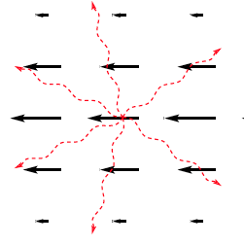
Shear viscosity in a fluid
Shear viscosity η = internal friction
  ➔energy dissipation
is driven by coupling between quasi-particles of fluid
strong interaction of constituents ➔ small η

Slide 14
Bounds on normalized shear viscosity
“Natural” units of shear viscosity: normalize by entropy density s
  ➔ η/s is universally comparable between systems
Conjectured bounds on η/s:
Kinetic theory+uncertainty principle (Danielowicz and Gyulassy)
AdS/CFT (Kovtun, Son, Starinets):
Classical hydrodynamics : Scattering of sounds waves (Kovtun, Moore, Romatschke)
Three very different physical pictures give numerically similar bounds….??

Slide 15
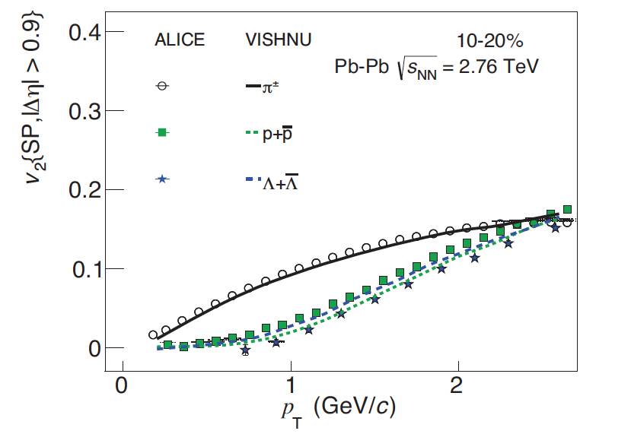
v₂: data vs. viscous hydrodynamics
arXiv:1405.4632
Precise measurements
Good agreement between ALICE data and viscous hydro
finite shear viscosity is needed
Best current value: η/s~ 0.16-0.20
systematic uncertainty under study
Close to bound ~0.1 ➔“almost-perfect liquid”

Slide 16
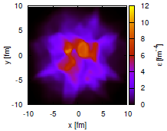
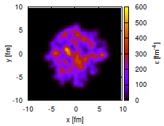
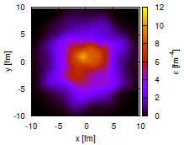
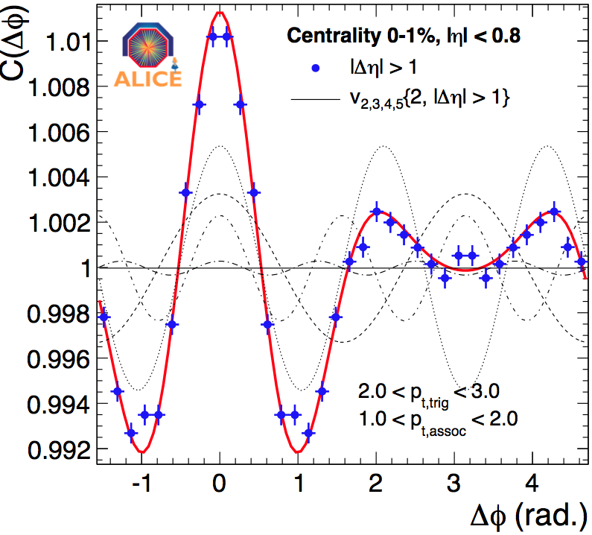
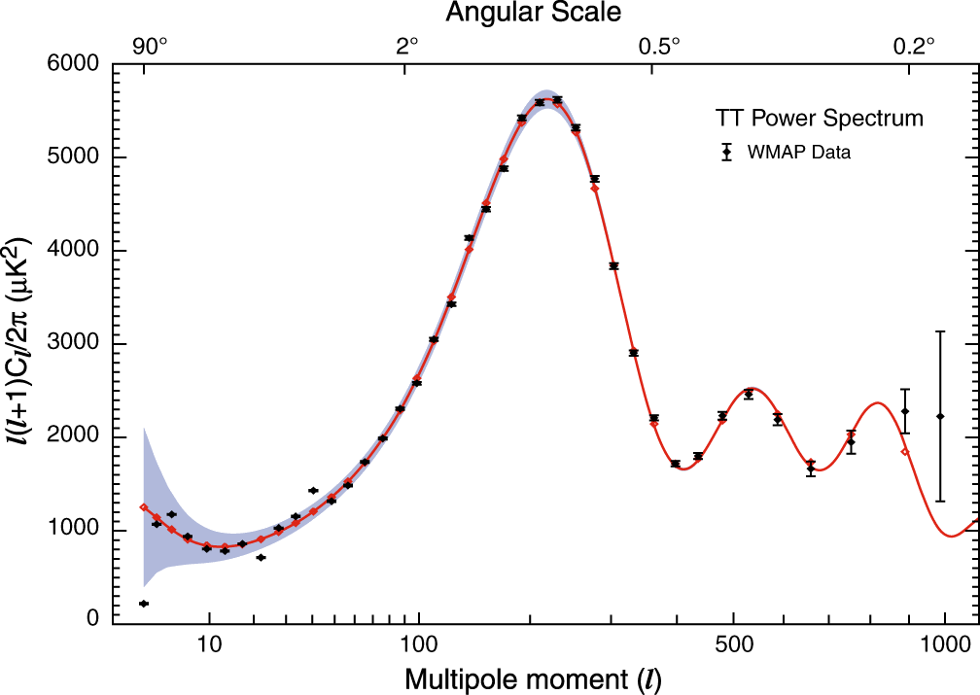
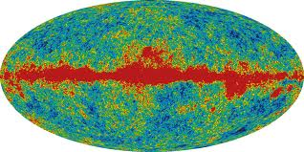
Higher order moments of flow
Initial density has large quantum fluctuations
Small shear viscosity allows detailed pattern of fluctuations to persist during expansion of fireball
  ➔observable in final state
initial
η=0
final
η=1/4π
WMAP measurement of the early universe

Slide 17
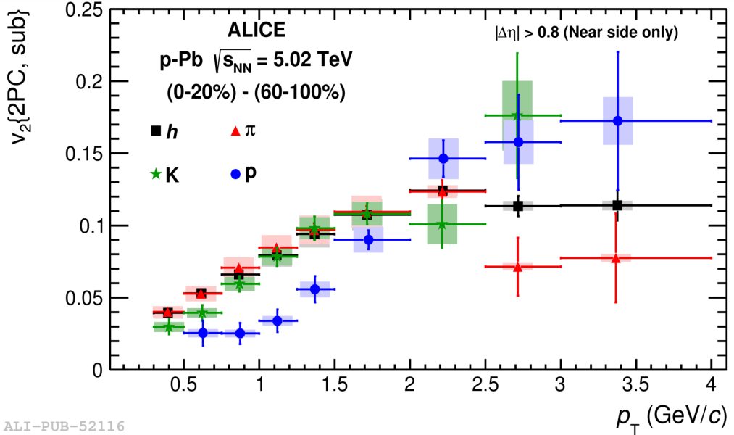
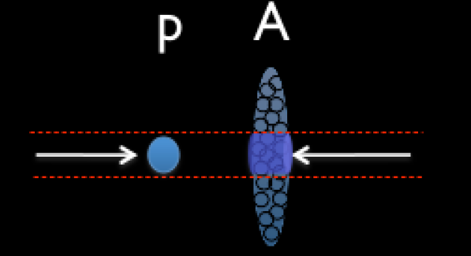
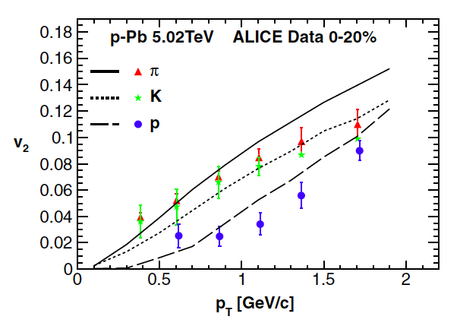
Unexpected result: flow in p+Pb collisions
ALICE, Phys.Lett. B726 (2013) 164-177
P. Bozek et al., Phys Rev Lett 111, 172303
Compare to viscous hydro calculations
How small can a system be and still achieve equilibrium?

Slide 18
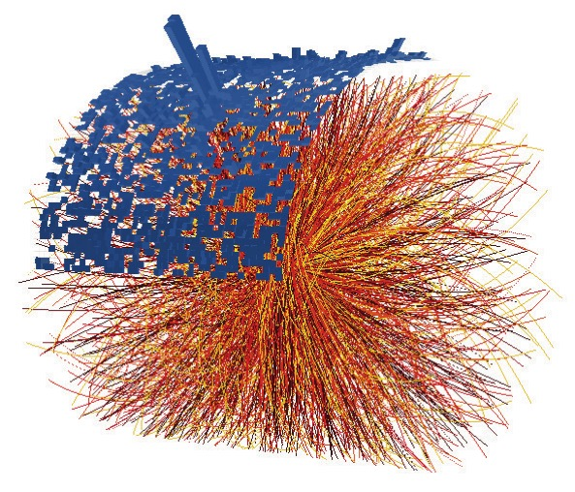
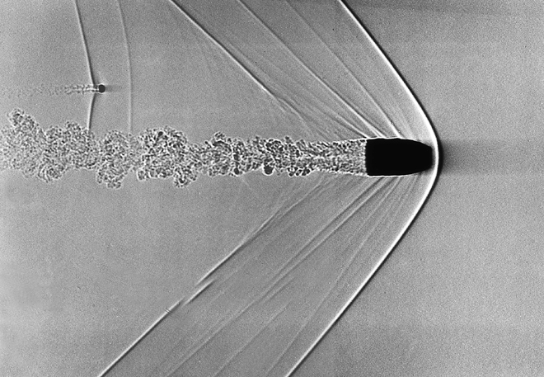
Jets in QCD matter

Slide 19
Jet quenching in QCD
collisional and radiative energy loss
L
Probability distribution of
= expectation value of Wilson loop of spatial extent L (incorporates effects of the medium)
Second moment:
Total medium-induced jet energy loss (multiple soft scattering):

Slide 20
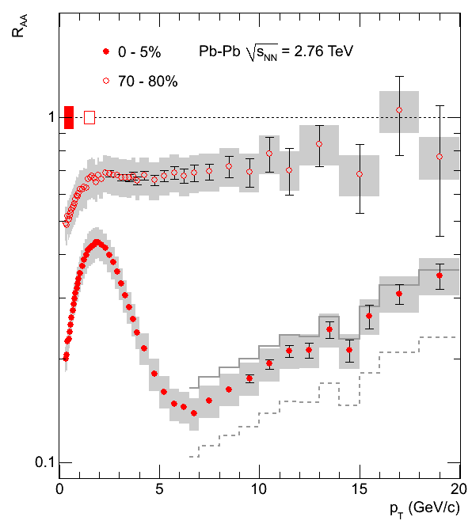
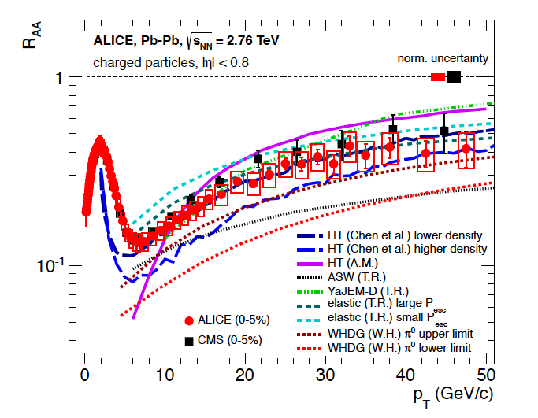
Jet quenching via high p_{T} hadron suppression
PLB 696 (2011) 30-39
PLB 720 (2013) 52-62
R_{AA}
R_{AA}
p_{T} (GeV/c)
p_{T} (GeV/c)

Slide 21
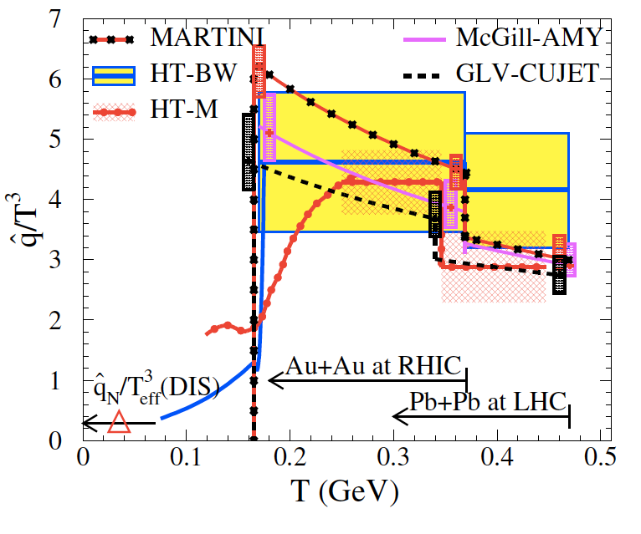
Measurement of : data + modeling
JET Collaboration, arXiv:1312.5003
Fit pQCD-based models to single-hadron suppression data at RHIC and LHC
For a 10 GeV light quark at time 0.6 fm/c:
Compared to 5 years ago: significant improvement in precision due to LHC data

Slide 22
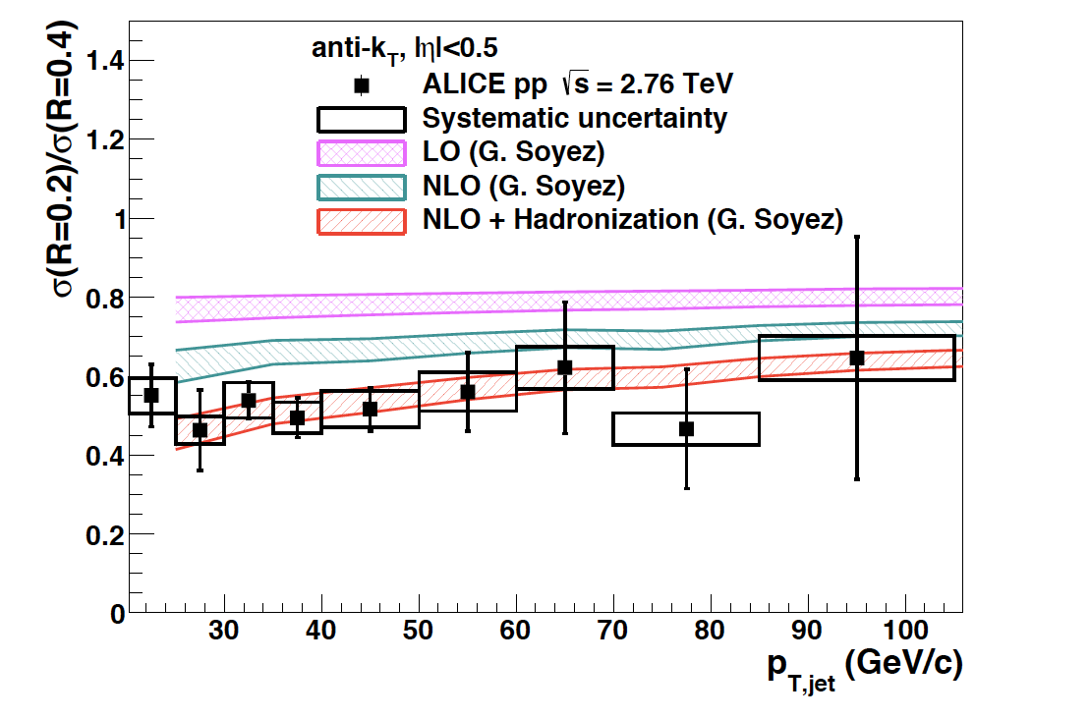
First inclusive jet cross section for p+p @ 2.76 TeV
Phys Lett B722 (2013)262
p+p @ 2.76 TeV : brief 3-day run in March 2011 ➔ key reference data for PbPb
ALICE jets measurements: tracking + EMCal
  optimal approach for heavy ion jets up to ~150 GeV
Anti-k_{T}, R=0.4:
JER ~ 18%
JES uncert < 3.6%

Slide 23
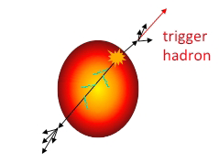
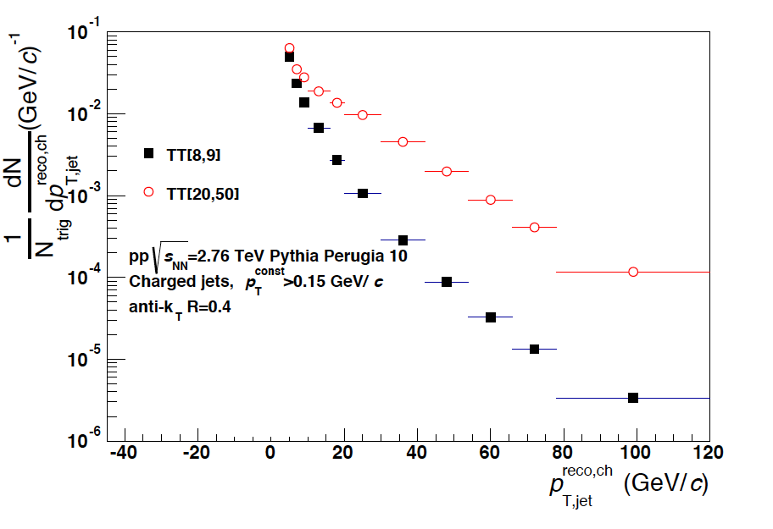
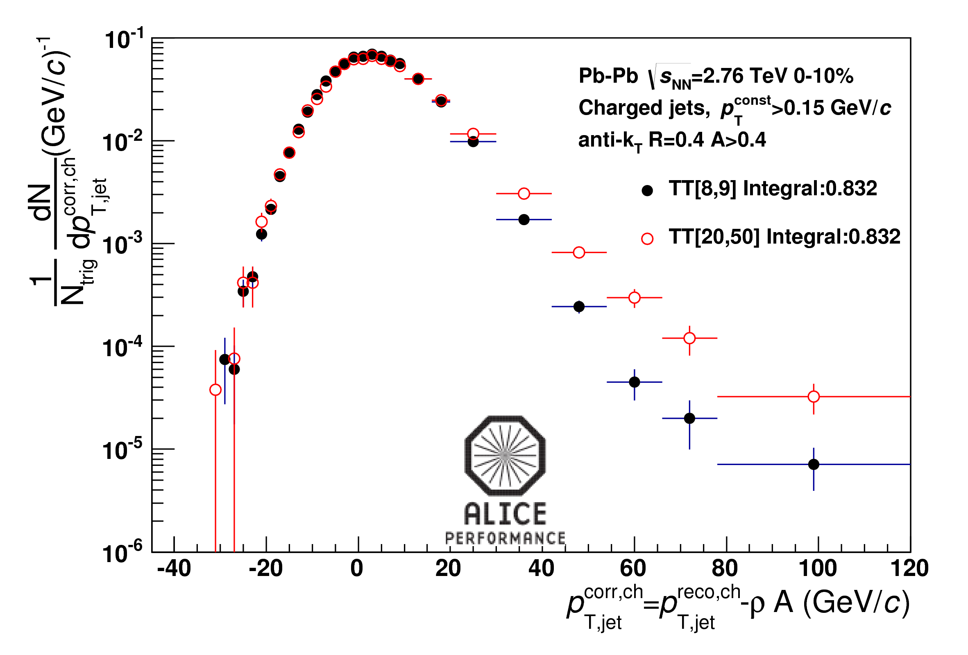
IRC-safe jets in heavy ion collisions: hadron+jet correlations
Semi-inclusive yield of jets recoiling from a high p_{T} hadron trigger
Recoil jet
Measure recoil jet spectrum for two exclusive hadron trigger p_{T} intervals
➔Separate correlated from uncorrelated yield using ensemble-averaged distributions
ALICE simulation
8<p_{T}^{trig}<9 GeV/c
8<p_{T}^{trig}<9 GeV/c
20<p_{T}^{trig}<50 GeV/c
20<p_{T}^{trig}<50 GeV/c
Central Pb+Pb
p+p
pedestal-corrected

Slide 24
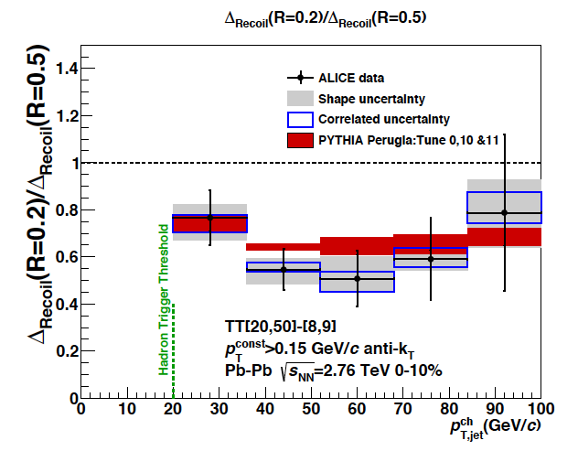
IRC-safe jets: intra-jet broadening due to quenching?
Nucl.Phys. A904-905 (2013) 728c
Ratio of differential recoil yields
  R=0.2/R=0.5
Compare ratios for central
Pb+Pb and p+p
No evidence of intra-jet broadening due to quenching
within jet radius R~0.5

Slide 25
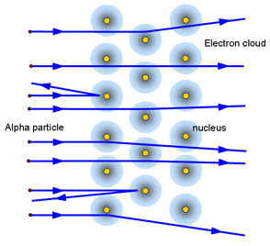
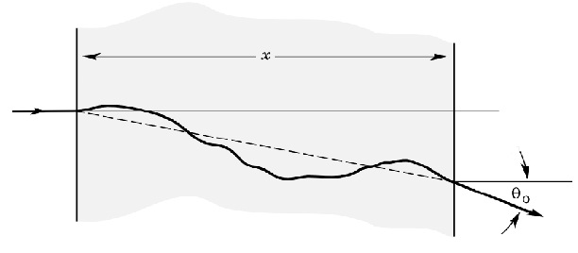
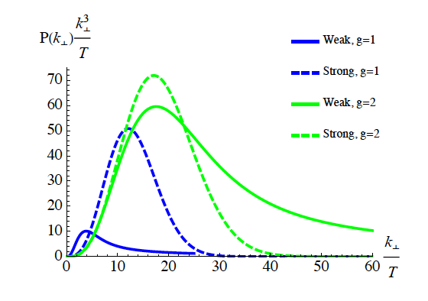
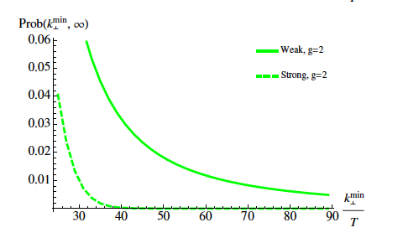
Large-angle scattering off the QGP
d’Eramo et al, arXiv:1211.1922
Discrete scattering centers or effectively continuous medium?
Look at the rate of large-angle deflections
(DIS-like scattering off the QGP)
what are the quasi-particles at scale Q²?
Weak coupling: pQCD calculation
Strong coupling: AdS/CFT calculation
Strong coupling:
Gaussian distribution
Weak coupling:
  hard tail

Slide 26
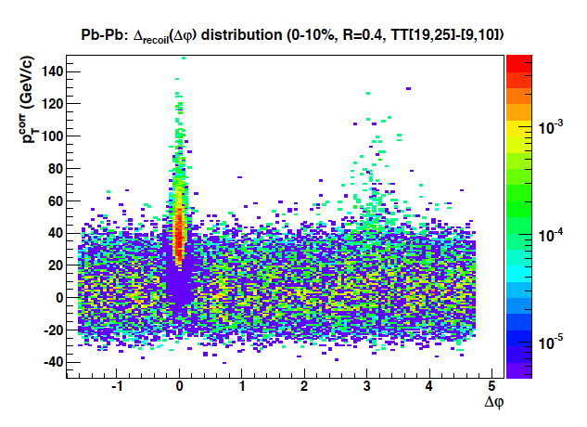
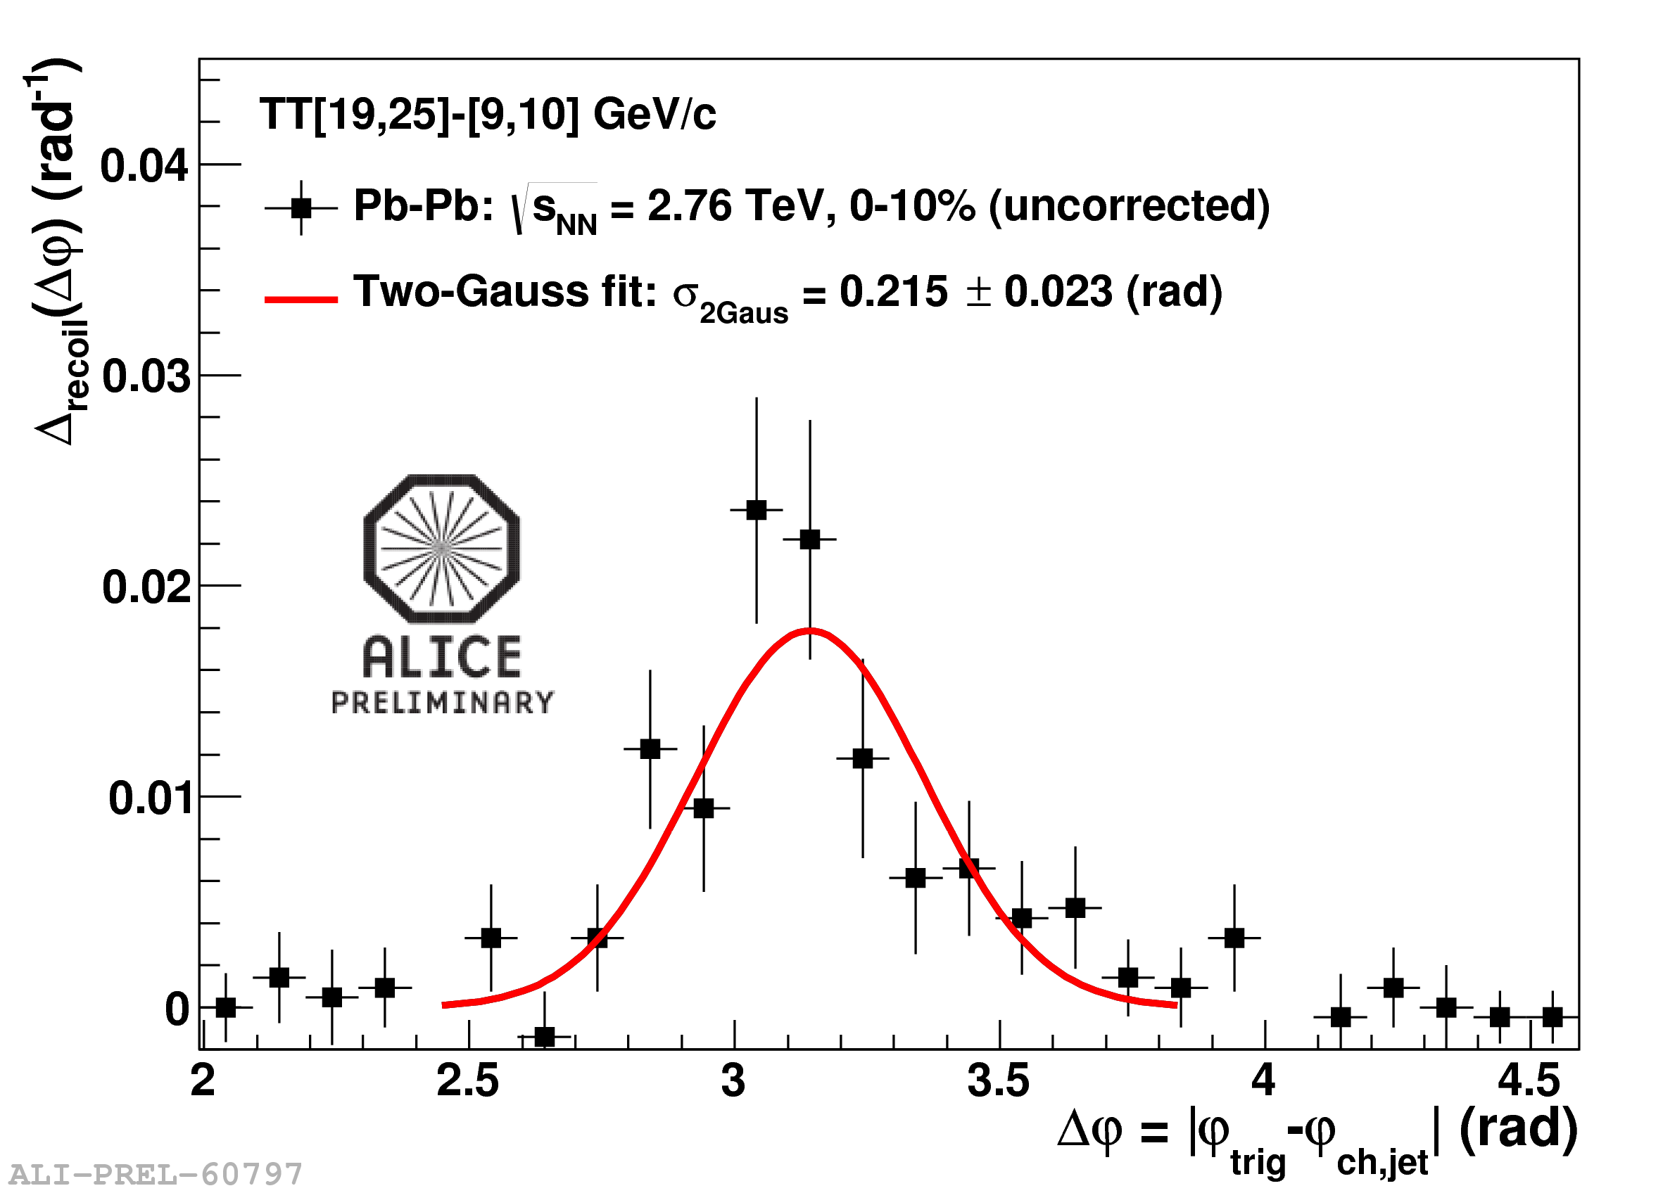
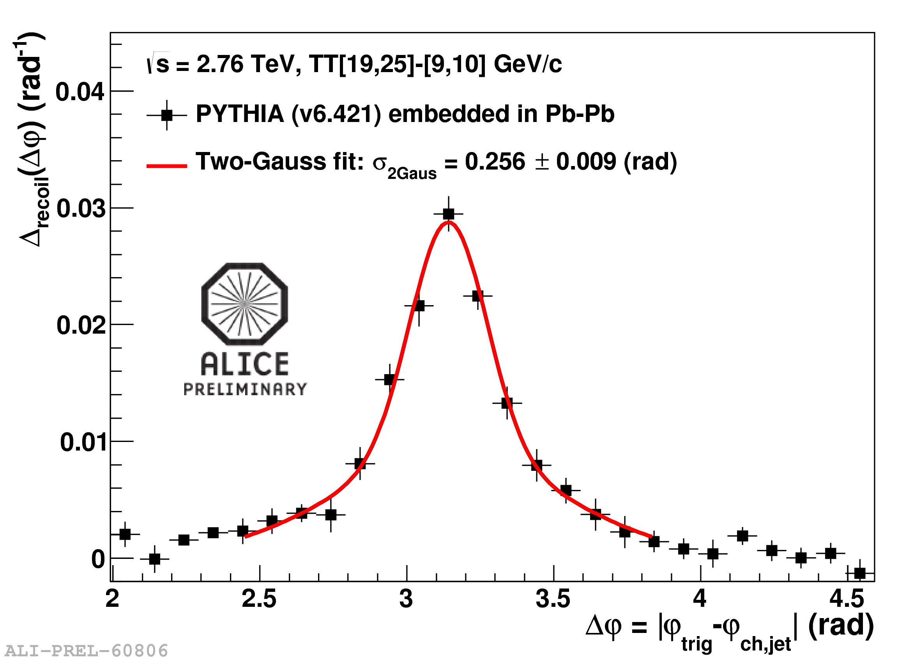
h+jet @ LHC: medium-induced acoplanarity?
Nucl.Phys. A904-905 (2013) 728c
Δφ
Δφ
“DIS off the QGP”: look at rate of large-angle scattering…? ➔Run 2
Compare to p+p
Limited precision to search for medium-induced acoplanarity ➔Run 2
d’Eramo et al, arXiv:1211.1922

Slide 27
ALICE Run Plan: past, present and future
 | Year | System | √s_{NN} [TeV] | Int Lumi/events
Run 1 | 2010 | Pb+Pb | 2.76 | 10 μb⁻¹
 | 2011 | Pb+Pb | 2.76 | 100 μb⁻¹
 | 2012 | p+Pb | 5.02 | 30 nb⁻¹
LS1
Run 2 | 2015-17 | Pb+Pb | 5.5 | 1 nb⁻¹ triggered 10⁹ events MB
 |  | p+Pb MB | ~5.5 | 10⁹ events
 |  | p+p triggered | 13 (5.5?) | 60 pb⁻¹ (48 weeks)
 |  | p+p MB | 13 | 10⁹ events (24 wks)
LS2
Run 3 | 2019-22 | Pb+Pb | 5.5 | 10 nb⁻¹ triggered 10¹¹ events MB
Pb+Pb running:
Triggerable observables: int lumi factor 10 increase Run 1➔Run 2➔Run 3
Untriggerable (soft) observables: factor 100 increase in events Run 2➔Run 3

Slide 28

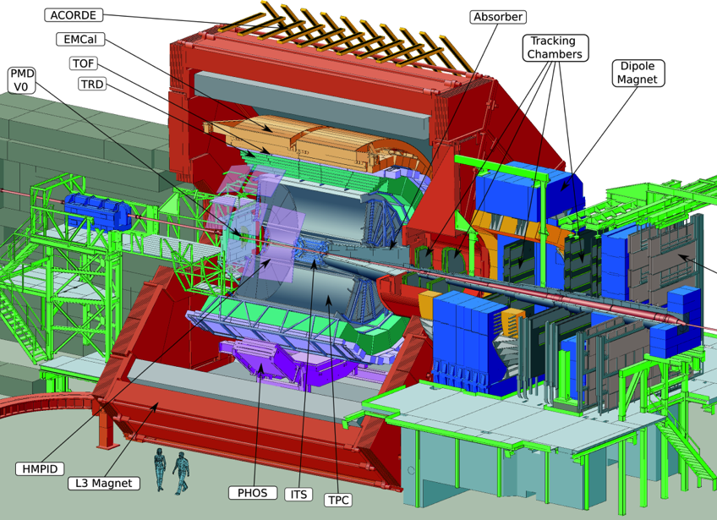
The Current ALICE Detector
The ALICE Detector
LHC Run 3: Current readout of ALICE is too slow by factor ~100. Both TPC and ITS limit rate

Slide 29

ALICE LS2 Upgrades
New Inner Tracking System (ITS)
improved pointing precision
less material -> thinnest tracker at the LHC
Muon Forward Tracker (MFT)
new Si tracker
Improved MUON pointing precision
MUON ARM
continuous readout electronics
Time Projection Chamber (TPC)
new GEM technology for readout chambers
continuous readout
faster readout electronics
New Central Trigger Processor
Data Acquisition (DAQ)/ High Level Trigger (HLT)
new architecture
on line tracking & data compression
50kHz Pbb event rate
TOF, TRD
Faster readout
New Trigger
Detectors (FIT)

Slide 30



ALICE LS2 Upgrade status
TDRs
P
TDR approved by LHCC, UCG and RB
Approved by LHCC, UCG, RB
Approved by LHCC, UCG
Submitted to LHCC
P
TDR approved by LHCC and UCG
TDR submitted to LHCC, discussion in progress
ALICE-USA Barrel Tracking Upgrade Proposal:
  major contributions to both TPC and ITS upgrades
  Total cost: ~$10M
  Under discussion with DOE; CD1 reviews in spring 2015

Slide 31


New ITS Layout
η coverage: |η| ≤1.5
Pointing Resolution
r coverage:
22 – 400 mm
x 3
X 7
7 layers of MAPS
12.5 G-pixel camera
(~10 m²)
Tracking efficiency
Mean X/X0 = 0.282%
Total weight
1.4 grams
Total weight
1.4 grams

Slide 32




TPC Upgrade with GEMs
World Largest TPC
ALICE key tracking and PID instrument
500 million pixels
Replacement of wire-chambers with GEM-chambers
100 m² single-mask foils
Limit Ion-Back-Flow into drift volume
Maintain excellent dE/dx resolution
New readout electronics
Keep all other subsystems
Replace wire chambers with quadruple-GEM or 2 GEMs + Micro Megas (full scale prototypes for both in beam in late 2014)

Slide 33



TPC prototypes and test beams
Test beam campaign in Nov/Dec 2014 at PS and SPS
Two full-size IROC prototypes being prepared:
4 single-mask GEMs: S-LP-LP-S
MM-S-S: MicroMegas (400 LPI) + two standard GEMs

Slide 34
Outlook
I did not touch on many important ALICE measurements
Heavy flavor: collective flow, HF jet quenching
Quarkonium as a probe of deconfinement
Results from p+Pb collisions: separating initial and final state effects
UPCs: LHC as a γ-hadron collider
Chiral symmetry restoration
The paradigm of the Quark-Gluon Plasma as a strongly-coupled liquid continues to stand up to scrutiny
Progress in quantitative measurement of transport properties: qhat, η/s; more to come
Run 2: factor 10 increase in precision
Definitive measurements of jet quenching (ALICE has unique approaches)
Run 3: major upgrade, qualitatively new physics:
Probes of chiral symmetry
Heavy flavor in jets and in bulk
….

