Slide 1

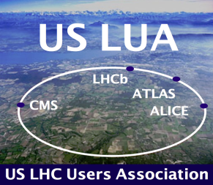

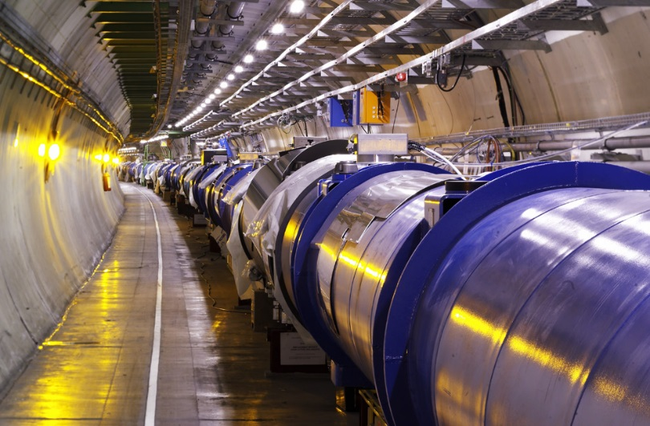
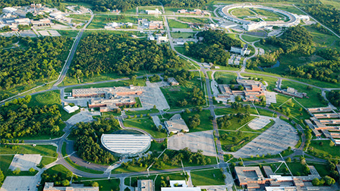
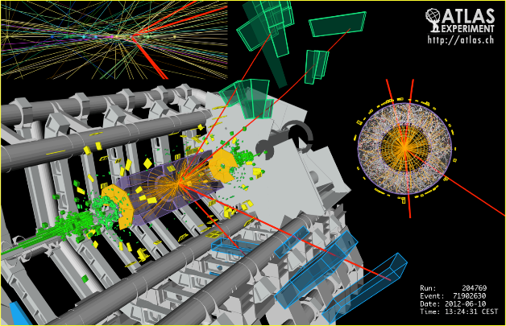
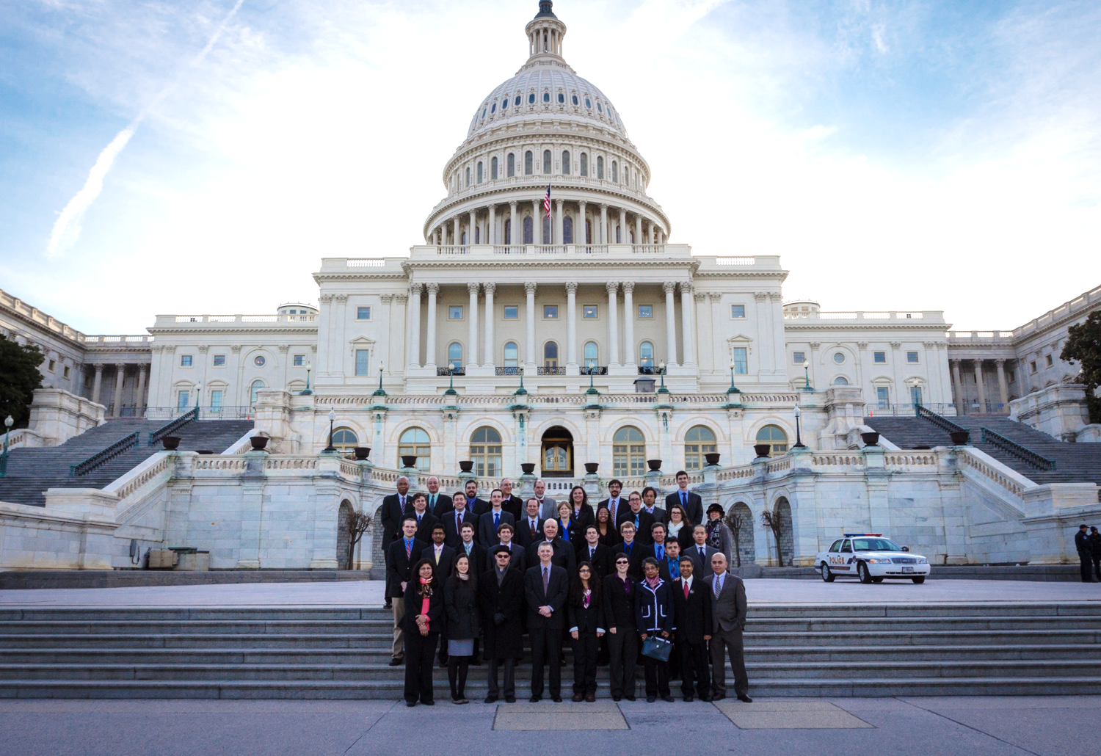
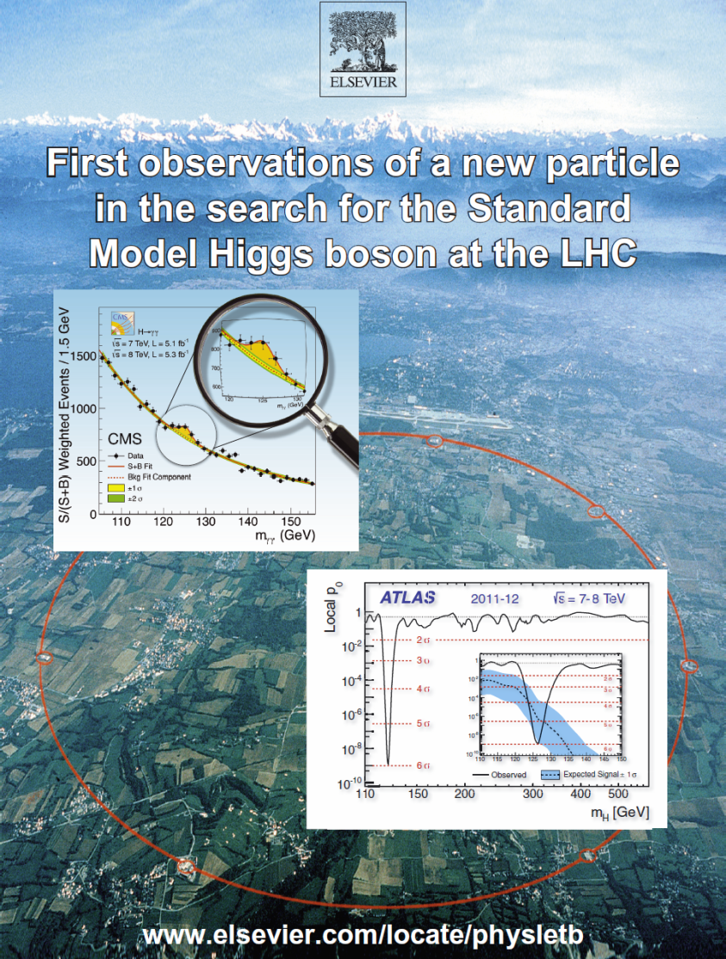

US LUA DC Trip Report
Harvey Newman, Caltech
US LUEC Chair
Argonne National Lab
November 13, 2014
Notes:
1

Slide 2
Annual US LUA Meeting 2014
Friday November 14 Agenda
8:30 – 8:50 Introduction; 2014 Trip to Washington Harvey Newman (Caltech)
8:50 – 9:20 US LUEC Committee Reports Committee Chairs
9:20 – 10:32
10:32 – 10:55 COFFEE BREAK
10:55 – 11:15 US – CERN Relations and the LHC Program Ruediger Voss (CERN) [**]
11:15 – 11:35 Advisory Committee of CERN Users Sridhara Dasu (Wisconsin)
11:35 – 12:35
12:35 – 1:45 LUNCH and Community Meeting on NSF and P5 Implementation
1:45 – 3:21
3:21 – 3:45 Afternoon Break
3:45 – 4:15 Outlook Following the P5 Report Andy Lankford (UC Irvine; HEPAP)
4:15 – 4:45 US HEP Program Outlook Joe Lykken (Fermilab)
4:45 – 4:55 Lightning Round Winners Announcement Ken Bloom (Nebraska)
4:55 – 5:40 Discussion; AOB
5:40 Adjourn *TBC
6:00 Dinner (self-organized) [**] by Vydio
Young Physicists’ Lightning Round Session 2
Young Physicists’ Lightning Round Session 3
Young Physicists’ Lightning Round Session 4
2
Notes:
2
2
2

Slide 3
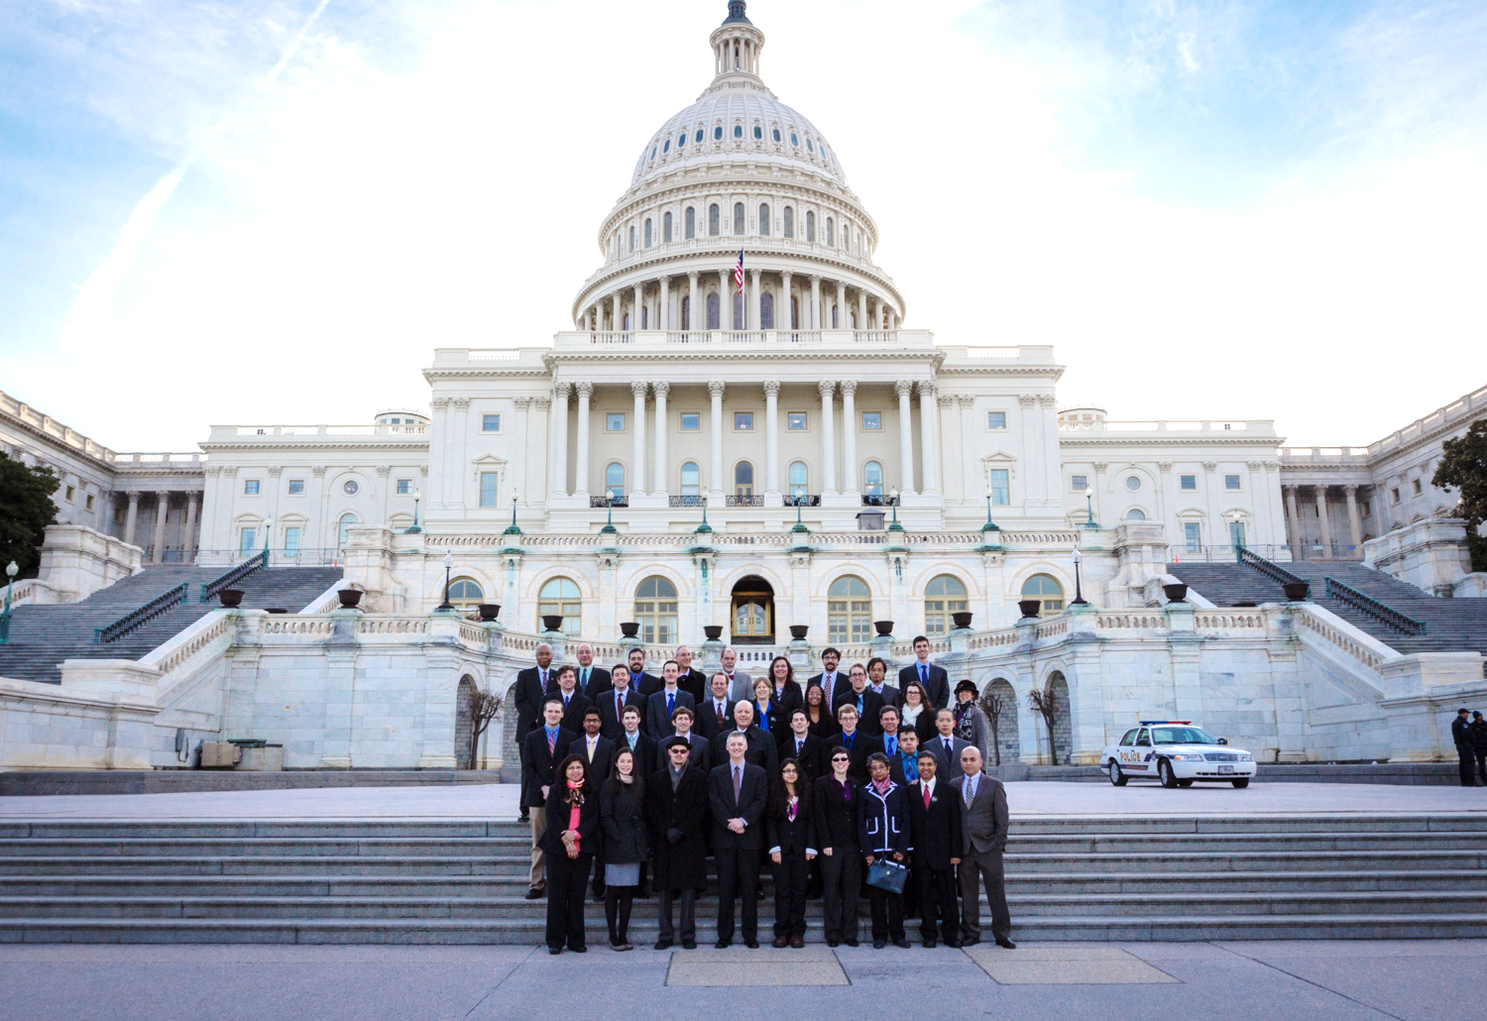
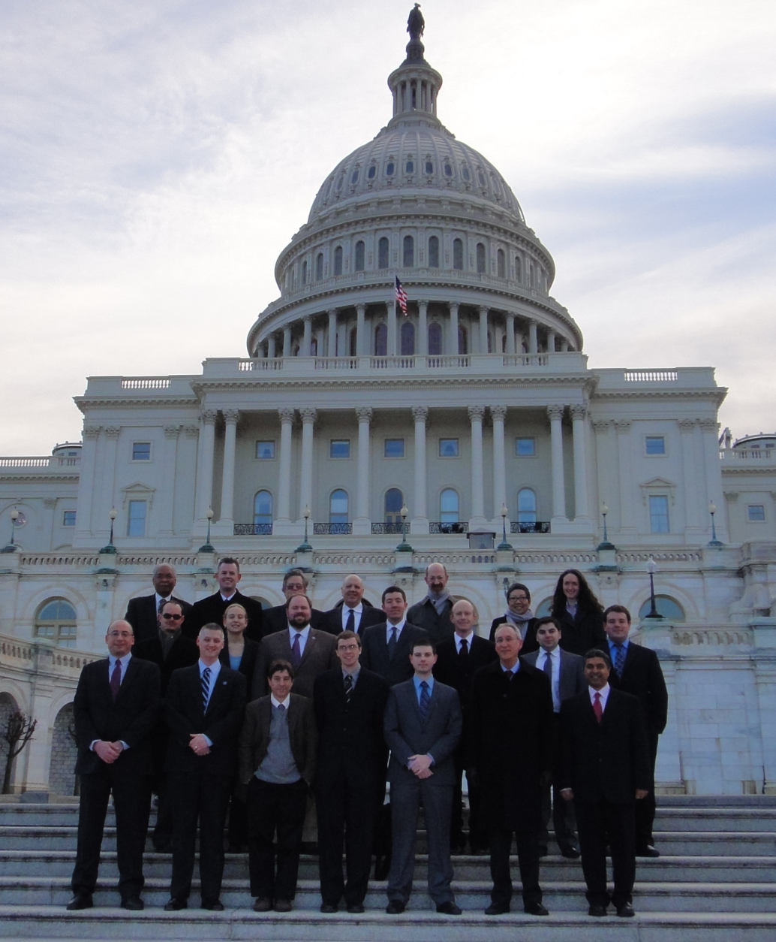
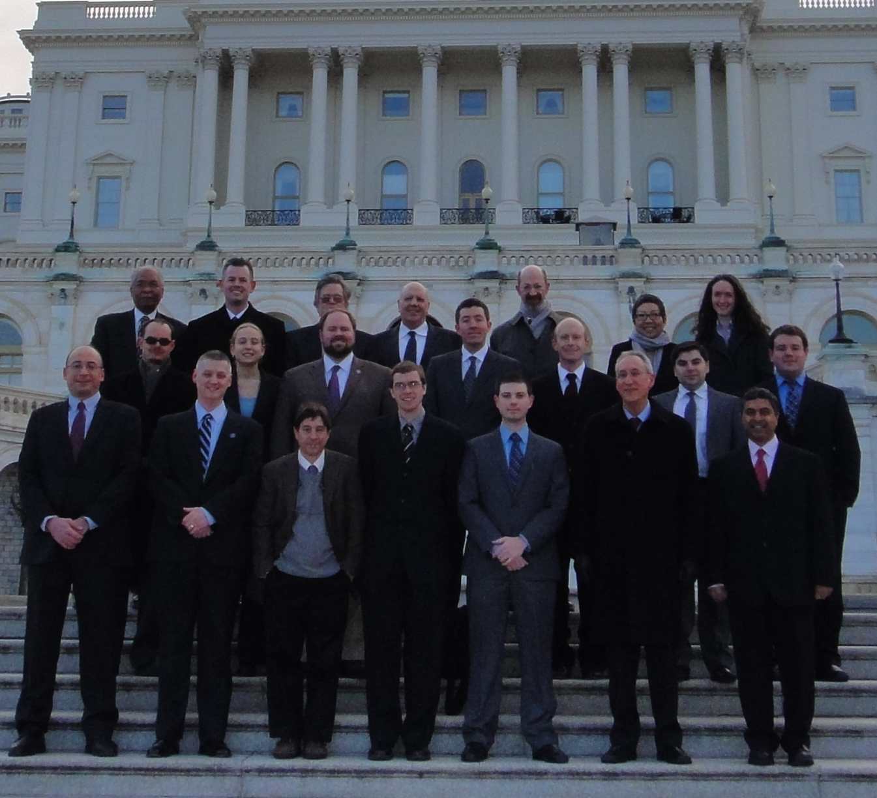
HEP DC Trip 2014: 50 People, 20 from USLUA
Visited >350[*] Offices in Congress + Executive Branch
USLUA
Darin Acosta (Florida)
Sapta. Bhattacharya (Brown)
Kevin Black (Boston)
Yi Chen (Caltech)
Sridhara Dasu (Wisconsin)
Adam Davis (Cincinnati)
Sarah Demers (Yale)
Andrew Hard (Wisconsin)
Andrew Leister (Yale)
Chris Lester (Penn)
Dan Marlow (Princeton)
Samuel Meehan (Chicago)
Hari Namasivayam (UT Dallas)
Harvey Newman (Caltech)
Danny Noonan (Kansas)
Saehanseul Oh (Yale)
Isobel Ojalvo (Wisconsin)
Neeti Parashar (Purdue Calumet)
Jacob Searcy (Michigan)
Mike Tuts (Columbia)
*
*
*
*
*
*
*
*
Special thanks to Breese Quinn
*
[*]A record; we ran out of folders for Congress
http://www.fermilab-uec.org/mediaWiki/index.php?title=DC2014 [login]
Notes:
3

Slide 4
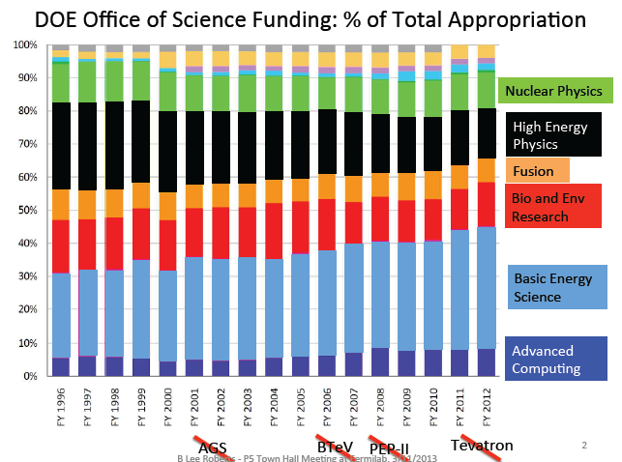
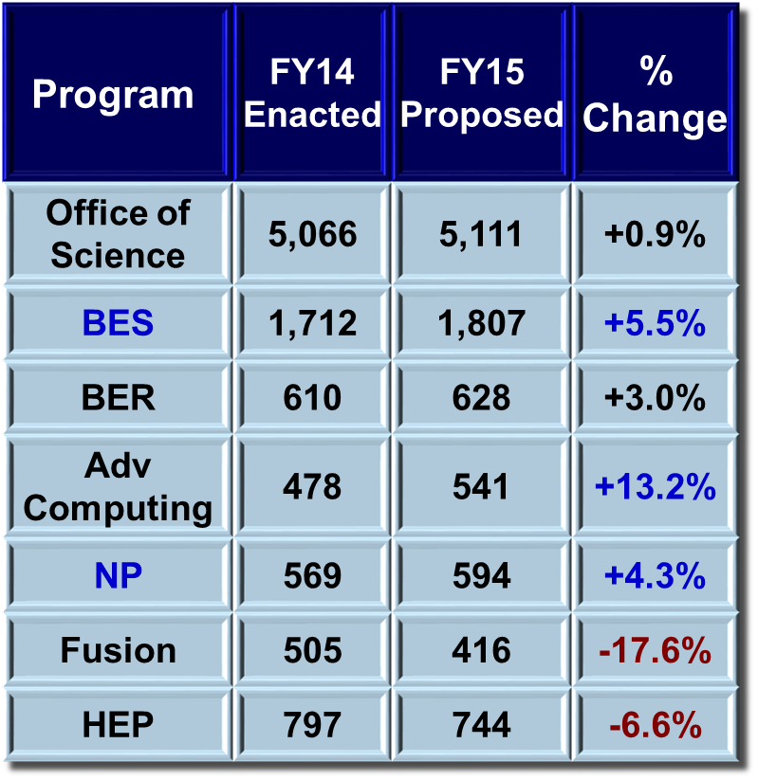
Background to the DC Trip: HEP funding vs other fields in the Office of Science
$$\text{Program}$$ | FY14 Enacted | FY15 Proposed | % Change
Office of Science | 5,066 | 5,111 | +0.9%
BES | 1,712 | 1,807 | +5.5%
BER | 610 | 628 | +3.0%
Adv Computing | 478 | 541 | +13.2%
NP | 569 | 594 | +4.3%
Fusion | 505 | 416 | -17.6%
HEP | 797 | 744 | -6.6%
30% Reduction in Real Terms
Courtesy
Lee Roberts
The Basic Science fields that have prospered
have unified behind a clear strategic plan. P5 was our response.

Slide 5
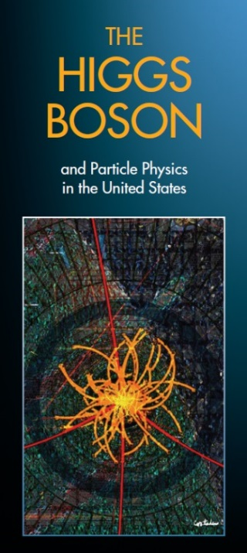
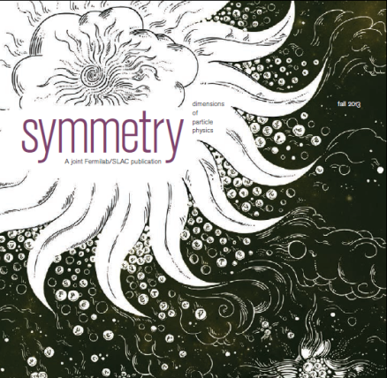

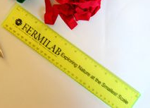
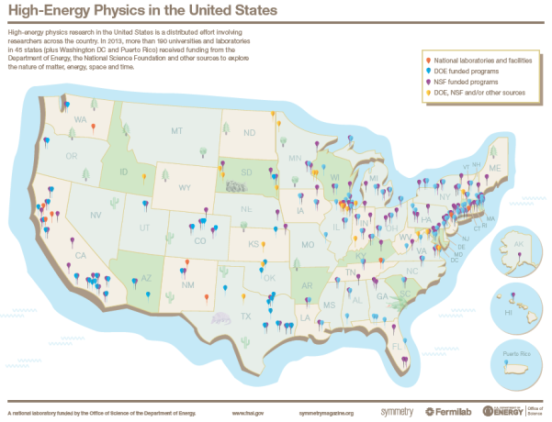
DC Trip: Packet Materials
Great help from Femilab and DPF, DPB
Produce & collect packet materials
  Message brochure, science information, accelerator tech.
  & benefits to society literature, maps, “souvenirs”, etc.
  MASSIVE help from
    Fermilab Communications – Katie Yurkewicz
    Fermilab Users Office – Barb Book
    Symmetry – Kelen Tuttle
    DPF, DPB
350 Sets and We Ran Out

Slide 6
HEP Messages on the Hill
  OUR ASK: Please provide sustained funding for HEP as part of
  the science portfolio of the DOE Office of Science and the NSF
    “Sustained” means: At the Level of the Enacted FY14 Budget; $ 795M
    Slightly Above P5 Scenario B: $ 775M
  Dear Colleague Letters released just as we began our visits to Congress
  provided a focus: Support for NSF and the DOE Office of Science
  Thank you ! For our funding in a difficult budget climate
Communicated the excitement of our field: especially the young physicists
    Higgs Discovery, prospects of new discoveries at Run2;
    Neutrinos, DM, Dark Energy, Inflation
  Education and outreach
    We first attract the very young to science; train the problem solvers,
    the innovators, the discoverers; and the teachers
    Essential to the progress and leadership of our nation
  We are the stewards of particle accelerators
    Medical research, diagnosis & treatment, industrial processes, security
  Innovation: Electronics, imaging, grids, networks & the world wide web
Notes:
6

Slide 7
DC Trip and P5
The 2014 Messages We Delivered
We are in the midst of an incredibly exciting and productive period of discovery in HEP
  Highlighting, e.g. Higgs, Muon g-2, neutrinos, dark matter,
  dark energy
  Wealth of great ideas for future projects, but we understand
  we can’t pursue them all
All particle physics is global
  Emphasize scientific and funding partnerships in projects abroad (LHC) and at home (neutrinos)
  Maximize global resources, minimize unnecessary duplication
  Maintain US leadership at home and abroad through partnership
The whole field is eagerly anticipating the P5 report
  Community is fully behind the thorough, and fully inclusive process
  It has prepared us to accept the hard choices that will be made
  We will come back to Congress the report
  [Rapidly, and we did]

Slide 8
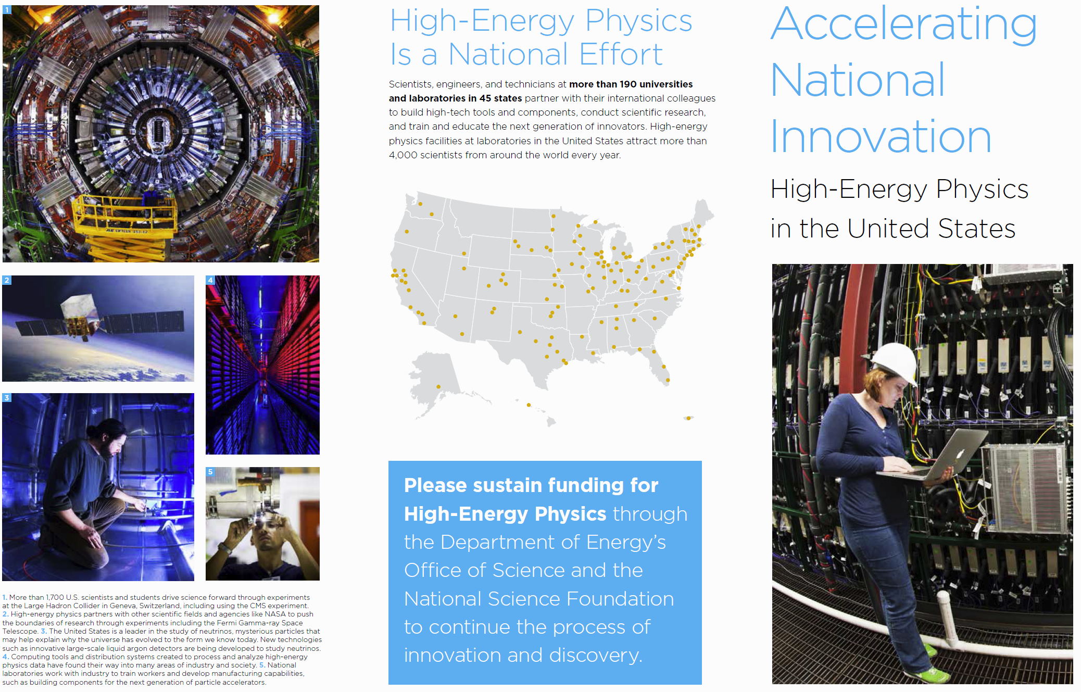
2014 HEP Brochure Page 1
Notes:
8

Slide 9

2014 HEP Brochure Page 2
Notes:
9

Slide 10
DC Trip & P5
Key points from Steve Ritz’ (P5 chair) March 13 Preliminary Comments to HEPAP
5 Scientific Drivers for HEP
  Use the Higgs as a new tool for discovery.
  Explore the physics associated with neutrino mass.
  Identify the new physics of Dark Matter.
  Test the nature of Dark Energy in detail, and probe the physics of the highest energy scales that governed the very early Universe.
  Search for new particles and interactions; new physical principles.
These are intertwined, requiring a selected set of different, reinforcing experimental approaches

Slide 11
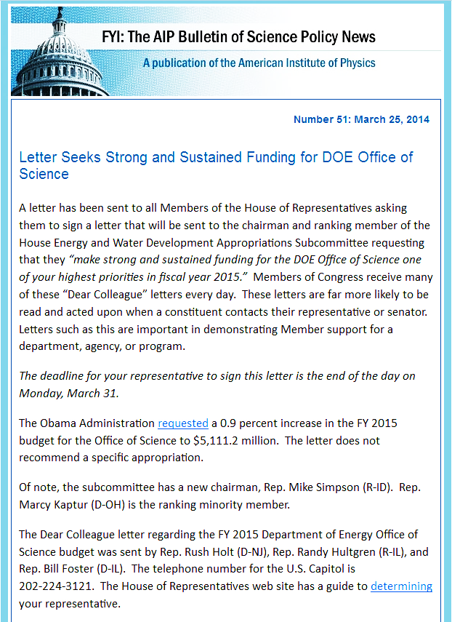
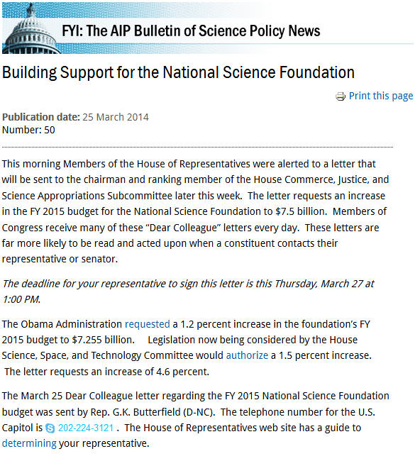
Dear Colleague Letters in the House
Strong Sustained Support for DOE/SC; NSF at $ 7.5B
March 25, due March 31
March 25, due March 27

Slide 12
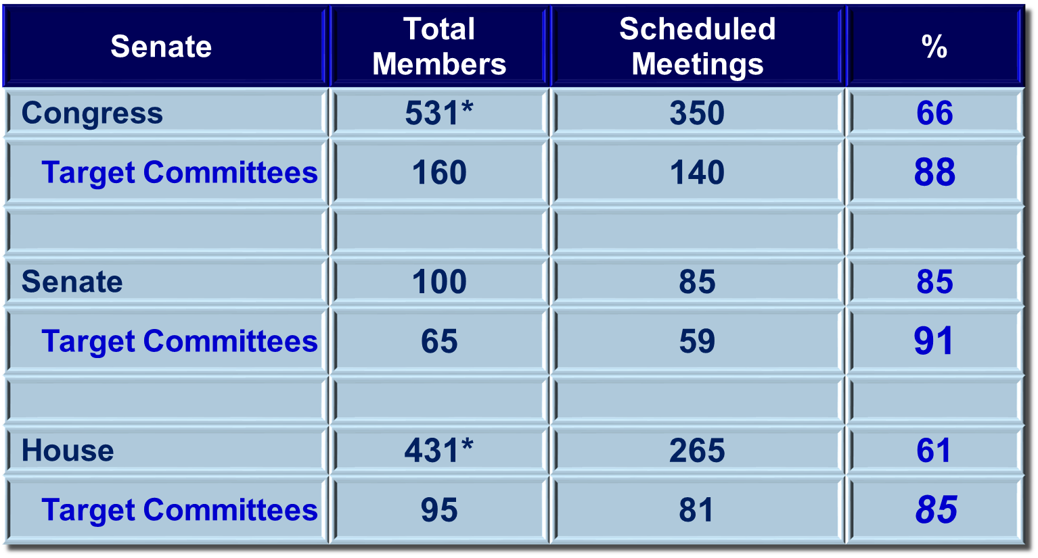
2014 DC Trip: Congressional
Meetings Coverage
Excellent Committee coverage
*4 House seats vacant at time of trip
$$\text{Senate}$$ | Total Members | Scheduled Meetings | %
Congress | 531* | 350 | 66
Target Committees | 160 | 140 | 88
Senate | 100 | 85 | 85
Target Committees | 65 | 59 | 91
House | 431* | 265 | 61
Target Committees | 95 | 81 | 85
Courtesy
Breese Quinn

Slide 13
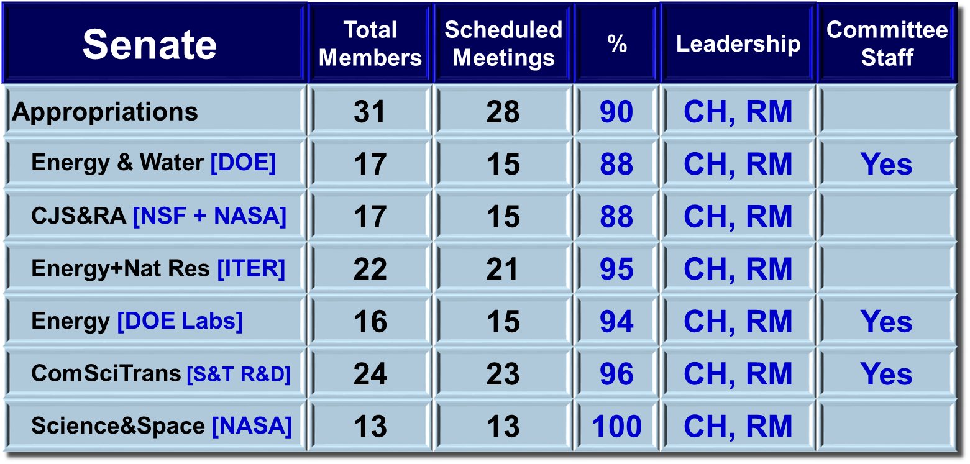
Senate Appropriations Offices: Statistics
$$\text{Senate}$$ | Total Members | Scheduled Meetings | % | Leadership | Committee Staff
Appropriations | 31 | 28 | 90 | CH, RM
Energy & Water [DOE] | 17 | 15 | 88 | CH, RM | Yes
CJS&RA [NSF + NASA] | 17 | 15 | 88 | CH, RM
Energy+Nat Res [ITER] | 22 | 21 | 95 | CH, RM
Energy [DOE Labs] | 16 | 15 | 94 | CH, RM | Yes
ComSciTrans [S&T R&D] | 24 | 23 | 96 | CH, RM | Yes
Science&Space [NASA] | 13 | 13 | 100 | CH, RM
Just a Few Notable misses (fewer than last year):
  Appropriations: McConnell (EW, CJS), Tester (EW), Leahy (CJS)
  Energy & Nat Res: Wyden (Energy)
Courtesy
Breese Quinn

Slide 14
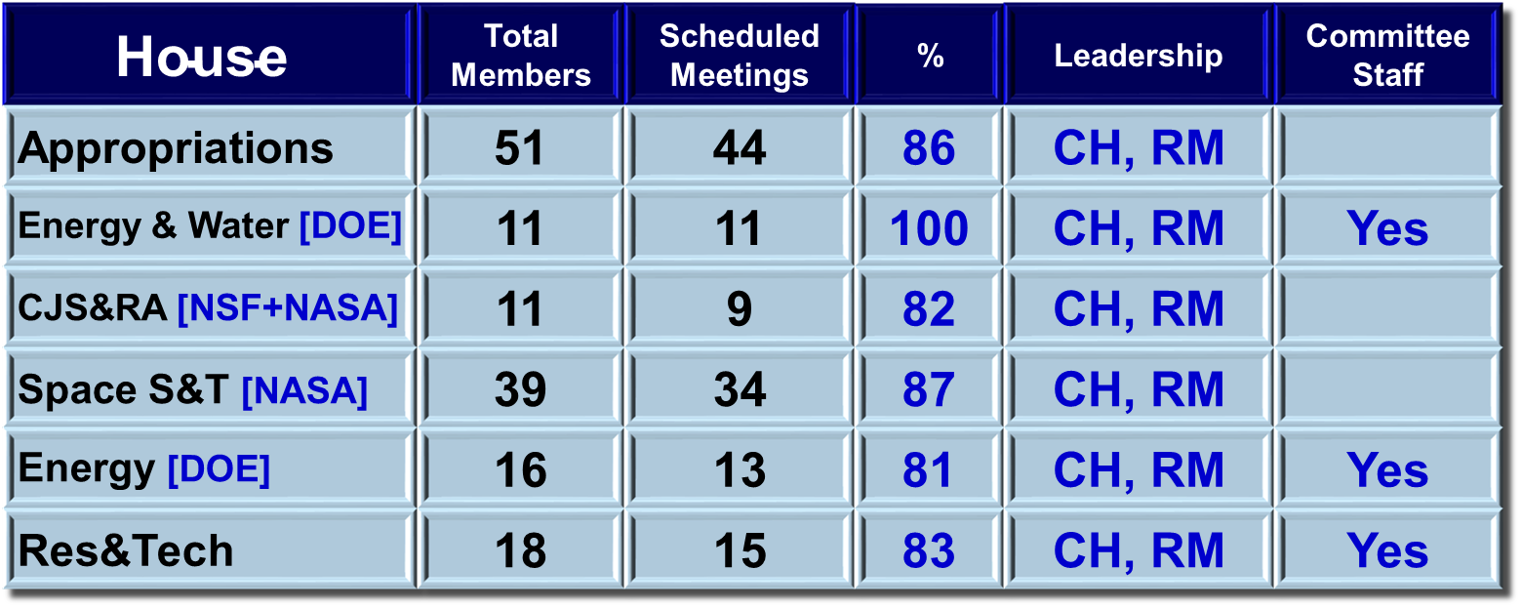
House Appropriations Offices: Statistics
$$\text{House}$$ | Total Members | Scheduled Meetings | % | Leadership | Committee Staff
Appropriations | 51 | 44 | 86 | CH, RM
Energy & Water [DOE] | 11 | 11 | 100 | CH, RM | Yes
CJS&RA [NSF+NASA] | 11 | 9 | 82 | CH, RM
Space S&T [NASA] | 39 | 34 | 87 | CH, RM
Energy [DOE] | 16 | 13 | 81 | CH, RM | Yes
Res&Tech | 18 | 15 | 83 | CH, RM | Yes
Notable misses:
  Appropriations: Harris (CJS), Diaz-Balart (CJS), Farr, Valadao, Wasserman-Schultz, Price, Ryan
  SciSpaceTech: Massie (E,RT), Takano (E), McCaul (E), Peters (RT), Bridenstine (RT)
Courtesy
Breese Quinn

Slide 15
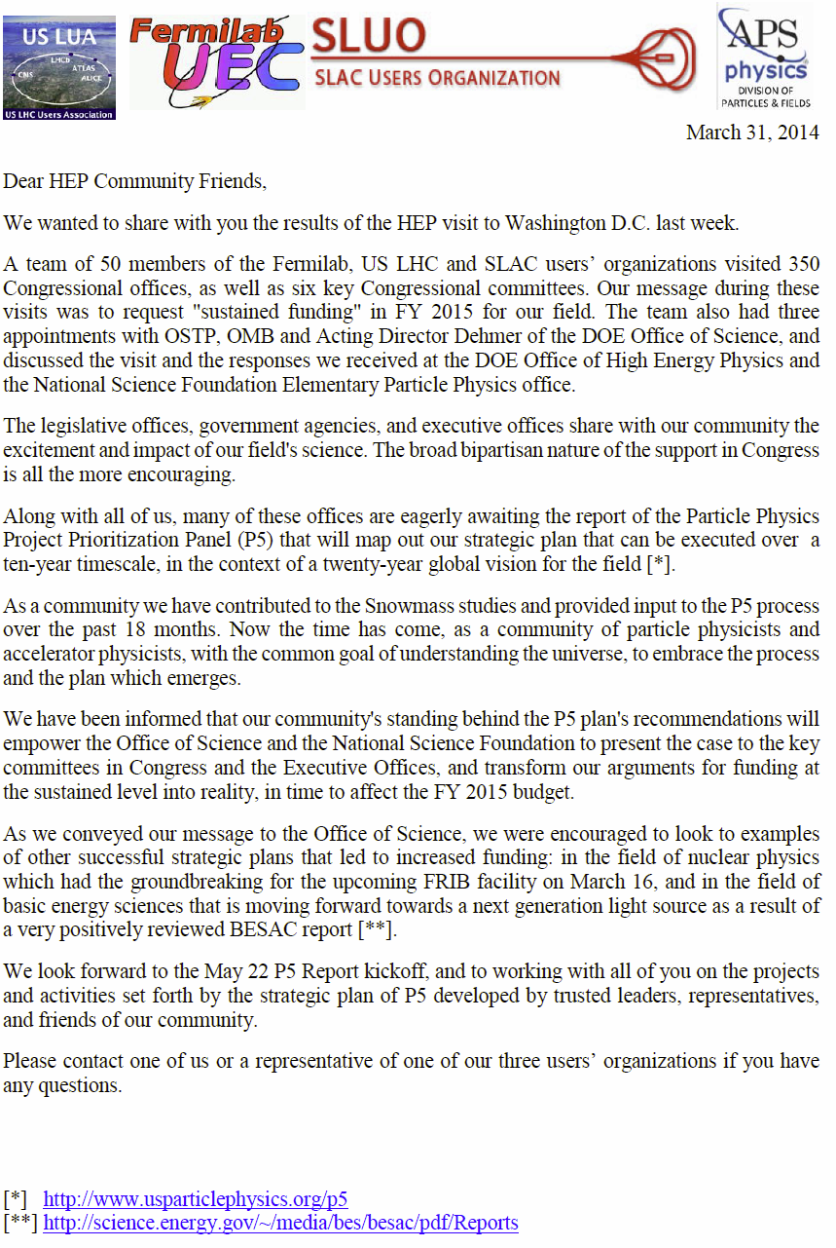
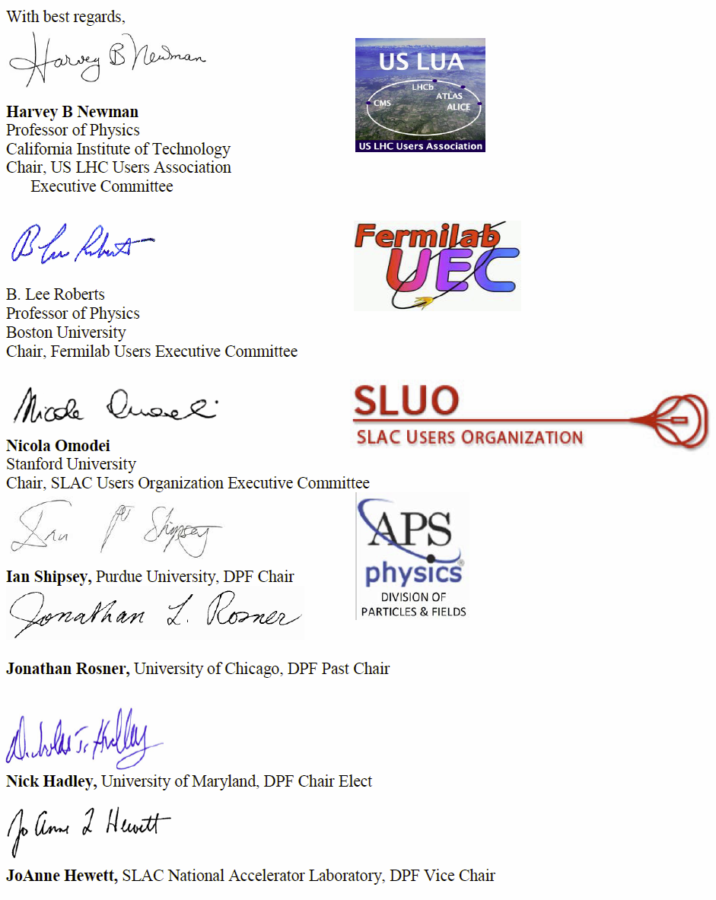
March 31: Letter to the HEP Community on P5 and the DC Trip

Slide 16
Feedback from Visits: Senate Energy
& Water Appropriations Subcommittee Briefing
  Concerned about FY15 budget proposal
    Were waiting on the P5 Report; not committing funds to projects
    not yet endorsed by P5
    Thought cuts may be too deep for current program
  Looking for clear direction [priorities] in each frontier
  (Energy, Intensity, Cosmic)
  P5 has to coalesce, bring field together around great opportunities
    Don’t fall into Fusion/ITER trap
    – i.e. avoid a report that makes no hard choices
  NP and FRIB: good communication strategy example to follow
  We struggle with members of Committee who say “I know I should care about this, but I just don’t.” We need to figure out how to reach out and convince them. [A Republican Congress brings new challenge]
  Key points about our field to communicate:
    Benefit to other fields (LCLS II, medicine, etc.)
    First attractor of students
  Pat Dehmer is our biggest cheerleader. The country owes her a lot. Give her something good, and she will push it. [We did; she did]

Slide 17
Feedback from Visits: House Science Space and Technology Energy Subcommittee, and Research & Technology Subcommittee
House Committee on Timing of P5 didn’t affect their committee too much
  Wanted to know direct connection between specific experiments/projects and specific technology applications
    Accelerators & Beams booklet fit the bill fairly well
  Do want to get particle physics language of specific facilities (e.g. fully vetted LBNE) into their bill.
    Could do it through amendments after P5 release
  Would like special event to pitch HEP, e.g. a hearing like Pier Oddone and Lisa Randall did. Maybe a joint Energy and Research & Technology hearing.

Slide 18
Feedback from Visits: Senate Commerce, Science & Transportation Committee
Very much want to see funding increases, but…
Very worried about FY16 and beyond (sequestration may be back). Trend of shrinking fraction for HEP is likely to continue absent some unforeseen change.
We need to do more outreach, particularly to Appropriations. Definitely more than 1 visit/year. Other larger groups come often. Heard this message from DOE Germantown as well.
  Focus on need for fundamental research, as distinct from applications like connections to medicine
  Were not aware of Higgs celebration event (shame on us!),
  but that’s just what they’re talking about.
Liked the inclusive nature of P5 process.

Slide 19
Feedback from Visits:
OMB: Claire Cramer
OMB’s Role: Ensure agency proposals reflect President’s policy priorities; These are climate change and renewable energy
Provide economic scenario guidance to agencies, receive budget plans from agencies, and program value assignment from OSTP, evaluate whether programs “fit”: the mission goals; funding profiles, and planning metrics (e.g. facilities versus research percentage)
Generally provide top line numbers, but will drill down several levels to individual grants where needed, to ensure consistency with President’s priorities, and with the program goals and metrics
A key criterion for them is science/$ [Or rather scientists/$]
  Challenge for HEP – e.g. our facility users/$ is half that of light sources. We must focus on science quality instead of quantity.
Another problem for HEP has been ‘bickering scientists’
– we have not shown a clear, unified, consistent set of priorities
P5 is pivotal, and it must have broad support for its priorities,
so OSTP can provide OMB with clear guidance

Slide 20
Feedback from Visits:
OSTP: Phil Rubin, Jo Handelsman
OSTP Mission: set funding at high level, while ensuring the President’s priorities are respected
  A more upbeat meeting than last couple of years
  Will not be getting explicit language supporting ‘basic science’ in Holdren’s memo to agencies anytime soon
    “Science and technology” references as close as we’ll get, but basic science is included in that
  They asked if accelerators are accessible to all who need them (versus say synchrotron radiation facilities in BES)
    This echoes the science/$ concerns of OMB

Slide 21
Feedback from Visits
DOE Office of Science: Pat Dehmer
Strong focus on the P5 report and how critical it is for future of HEP
Impressed by Steve Ritz’ preliminary comments to HEPAP; concerned with HEPAP’s ensuing discussion: “unity begins with HEPAP itself”
FY15 6.6% cut was "the best I could do, and it was crappy’’
  Partly due to HEP not being a priority, partly due to not having
  a long term plan and demonstrated unity yet
With an inspiring, excellent P5 report approved by HEPAP, and full community buy-in, she said she could take it to Congress and OMB
in time for conferencing and final markup of FY15 appropriations
May 22 P5 rollout will be a big media event – we better be prepared,
and better prepare reporters, in order to avoid negative headlines
Learn from the BES and NP recent successful strategic plans
  Made real sacrifices to make highest the priority science possible
  within the constrained budgets
  Don’t be the kid whining for a pony for Christmas, when Mom and Dad have already said NO
If we fail with this P5, she said: “we are toast”

Slide 22
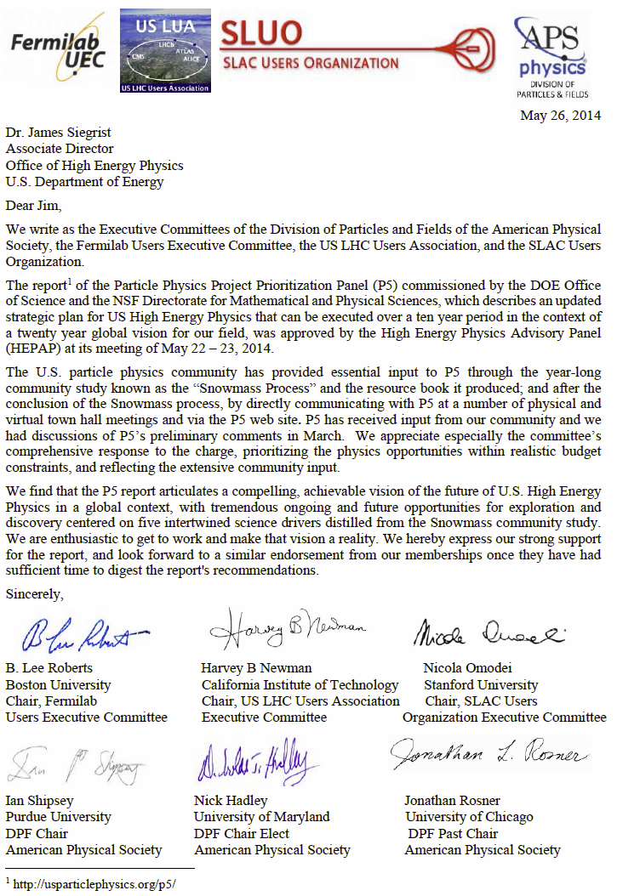
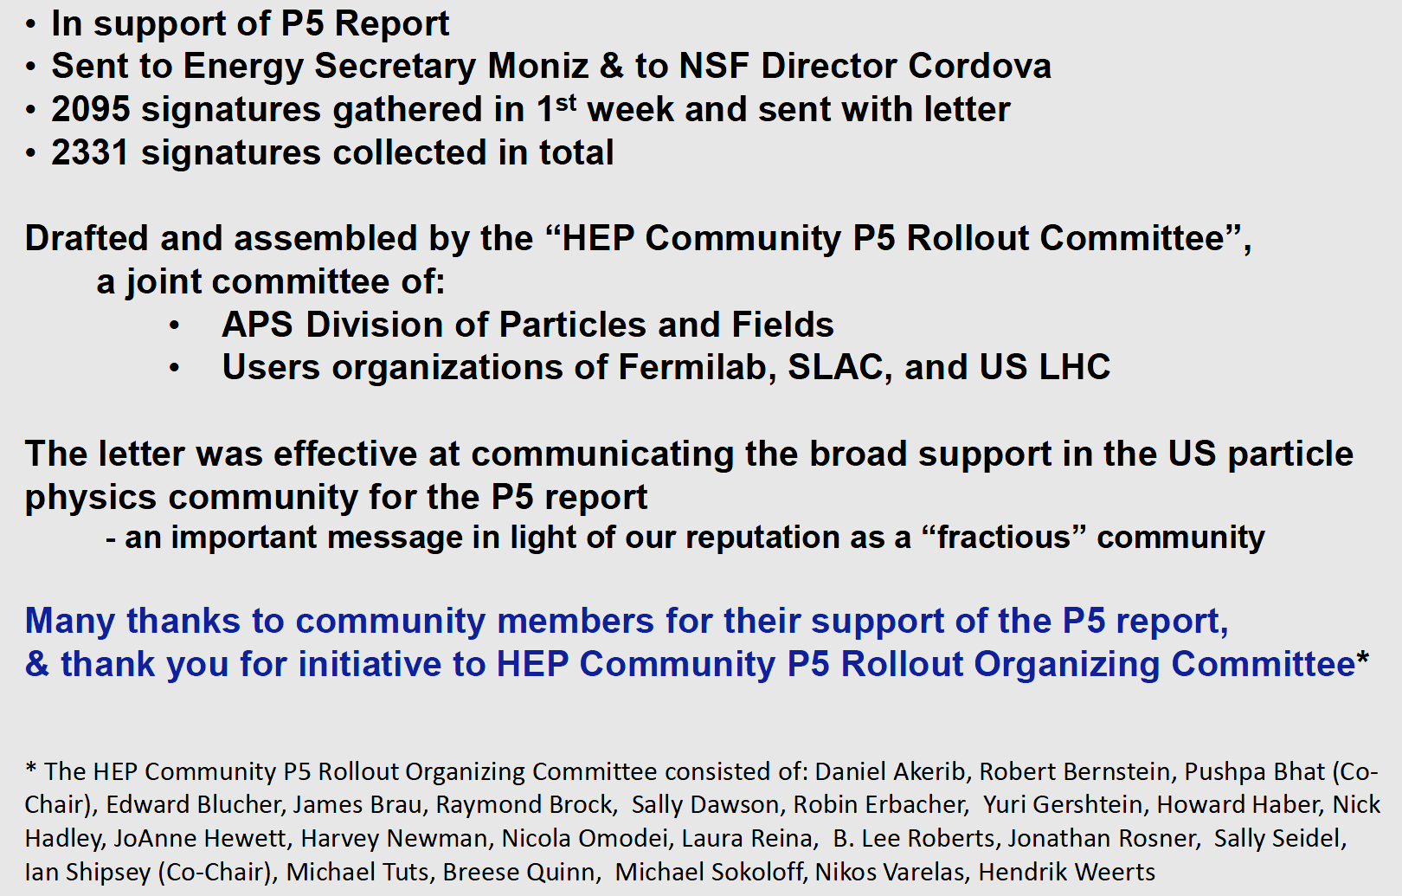
After the DC Trip: Community Support for the P5 Report: P5 Rollout Organizing Committee
May 26 Letter from US LUEC, UEC, SLUO and DPF to OHEP,NSF/MPS
June 23 Community Letter Sent to Energy Secretary Moniz and NSF Director Cordova
Reported by Andy Lankford
at Sept. 29-30 HEPAP Meeting
Community Letters to DOE and NSF and final signatory list at http://dpfnewsletter.org/?p=1065

Slide 23

http://usasciencefestival.org
3rd USA Science & Engineering Festival in Washington DC-
the largest STEM education event in the US
Over 300 Schools, 750 STEM organizations presented
More than 350,000 visitors over 4 days
This is the ideal forum to educate & show our science!
USLUA joined forces with existing Fermilab exhibit
to show a Higgs event display, and staff the booth
with young LHC scientists.
Plan for 2016: Consider consolidating 3 separate LHC booths into One US LHC exhibit: with Fermilab, JHU and NYU
We are looking forward to the continued involvement
of (more) US LHC scientists to represent us!
With many thanks to Julia Thom, Evan Wolfe (UVa) and Rafael de Lima (NEU)

Slide 24
What Can You Do?
Be responsive
  Periodically we will call on the HEP user community to send letters to Congress. Spend the 5-10 minutes to help when called on.
Stay unified; be ready
  P5 has delivered an outstanding report and the responses
  at every level in government are positive.
  We will need everyone to pitch in and maintain a unified message.
  Working towards increased funding is a marathon; not a sprint.
Be available
  We will be asking you to make local visits to your Congressmen in 2015.
How can you contribute ?
  Join our activities: helping young people, outreach, fund raising
Want to do more ?
  Run for the US LUEC in the next election, coming up !

Slide 25
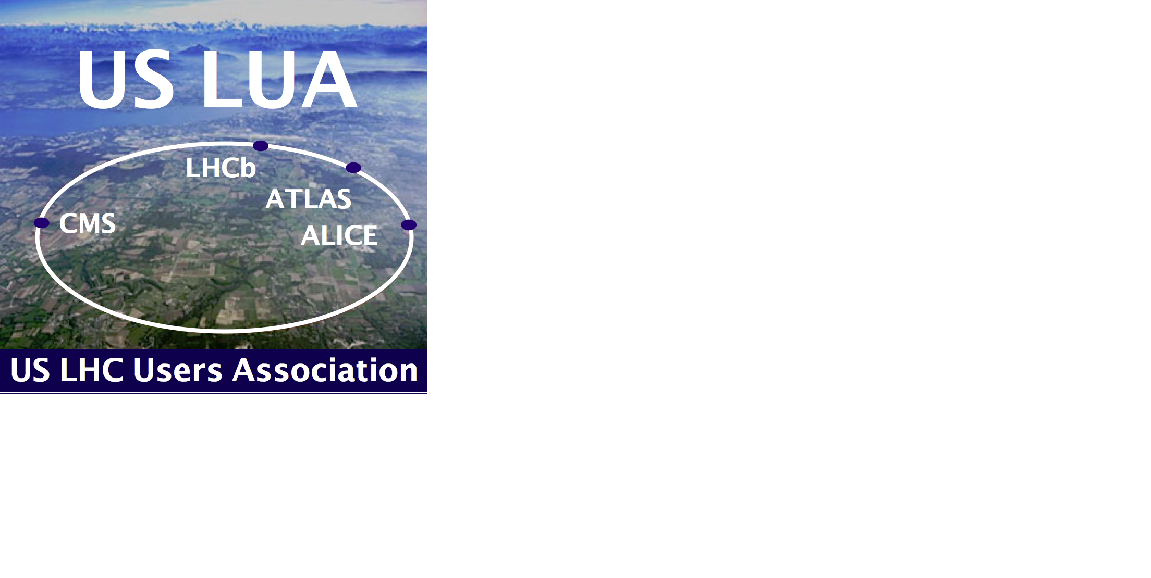
We have come a long way;
We have a long way to go. Please help.
Run2 will be different.
So will be the next Congress.
If your group members or colleagues involved in the LHC Program are not already US LUA Members, ask them to sign up at ww.uslua.org
Notes:
25

Slide 26

Extra Slides on P5
the DC trip
the Rollout Campaign
Notes:
26

Slide 27

US HEP Community
Visit to Congress
Notes:
27

Slide 28





The Federal Budget Players
Executive Branch
President: the White House
  Deputy Chief of Staff (Science)
Office of Science & Technology Policy (OSTP)
Office of Management & Budget (OMB)
Department of Energy (DOE)
  Office of Science (OSc)
    Office of High Energy Physics (OHEP)
National Science Foundation (NSF)
  Math and Physical Sciences (MPS)
    Office of High Energy Physics (OHEP)

Slide 29
DC Trip and P5: Context in DC
HEP has acquired a “less than stellar reputation” in DC
in some respects
  Impression: We can’t make choices; there is discord rather than unity in our community [OMB, OSTP, Office of Science]
Non-optimal timing of final report (May 22)
  Report public 3 months after President’s budget request (OMB), 2 months after DC Trip and Appropriations markups (Congress)
Big challenge to our message during our trip:
  Major players in DC (OMB, Appropriations) knew P5 was coming, but took a “wait & see” approach to FY15 funding
  We couldn’t give them any specifics, but gave a consistent message consistent with P5 report (based preliminary information from the March HEPAP meeting)
Approach: compelling and consistent on the science;
necessarily vague on the P5 Report

Slide 30
Feedback from Visits: House Energy
& Water Appropriations Subcommittee
Wanted to know impacts of the $50M cut in FY15 budget proposal (what stops or gets delayed)
Hoped to get some of that money back during conferencing (P5 too late for initial markup)
[Note Added: but in time for the final markup]
They wanted to get P5 report significantly sooner
than May 22
Very focused on LBNE, seems like they expected it to be top priority

Slide 31
DC Trip and P5 Followup
With UEC, SLUO, DPF, DFB
Working with P5, DOE, DPF, House S&NL Caucus, House Space S&T Committee on summer rollout events
    House S&NL hosted event similar
    to the Higgs Celebration
    Committee Hearings
    Targeted office visits by smaller groups
We will mount a large local office visit efforts to support
previous two points
  Aiming to reach all the key committee members
  in their home districts; through their constituents

Slide 32
DC Trip and the P5 Rollout/Followup
With UEC, SLUO, DPF, DFB
Follow up communications with Congress
  Thank you notes, Dear Colleague Letters, Appropriations requests, provide requested info; Alerts on the P5 Report
  UEC/USLUA/SLUO Submitted joint written testimony
  to the E&W Appropriations subcommittee
P5 Rollout: Letters, Visits and Events
  Letters to alert and prepare the community in March - April
  Letter of support of P5 Plan to Siegrist; signed by the Executive Committees May 26, to support 1st briefings to decision makers
  Community notes/visits/calls to key Appropriators on the E&W Subcommittees in home offices, to affect FY15 HEP funding
  Testimony to key committees June 5 and 10, organized by DPF
  Community Support Letter to Moniz (DOE) and Cordova (NSF) being finalized now, with an online signing mechanism:
    A major signup campaign: 2331 signatures
    This strong community support, with the report itself,
    left its mark

