Slide 1
DOE ONP Perspective
2014 US LHC Annual Users' Meeting
Dr. James Sowinski
Acting Program Manager for Heavy Ion Physics
Office of Nuclear Physics
DOE Office of Science

Slide 2

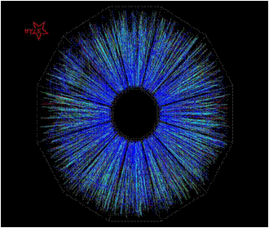
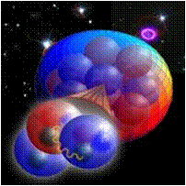
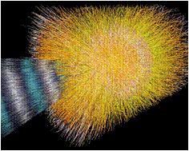
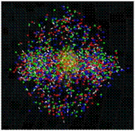
Nuclear Physics’ Mission
Discovering, exploring, and understanding all forms of nuclear matter
The Scientific Challenges
  The existence and properties of nuclear matter under extreme conditions, including that which existed at the beginning of the universe
  The exotic and excited bound states of quarks and gluons, including new tests of the Standard Model
  The ultimate limits of existence of bound systems of protons and neutrons
  Nuclear processes that power stars and supernovae, and synthesize the elements
  The nature and fundamental properties of neutrons and the neutrino and their role in the evolution of the early universe

Slide 3
NP has Five/Six Subprograms
Medium Energy (TJNAF 12 GeV Energy Upgrade, RHIC spin)
  Studies the force which binds quarks and gluons in protons and neutrons
  Searches for Parity violating processes relevant to the New Standard Model
  Studies the origin of the spin structure of the proton
Low Energy/Fundamental Interactions (ATLAS and FRIB)
  Studies nuclear structure and nuclear astrophysics
  Investigates the properties of neutrinos, and uses cold neutrons and nuclei to test the Standard Model
Isotope Production and Applications
  Produces, prepares, and distributes isotopes for commercial applications and research
  Research and development relevant to isotope production
Heavy Ion (RHIC and Heavy Ion Research at the LHC)
  Investigates the properties of new states of matter with ∼100 higher energy density than “normal’
  nuclear matter
Theory
  Explores all three frontiers of nuclear physics
  Encompasses the Nuclear Data Program

Slide 4
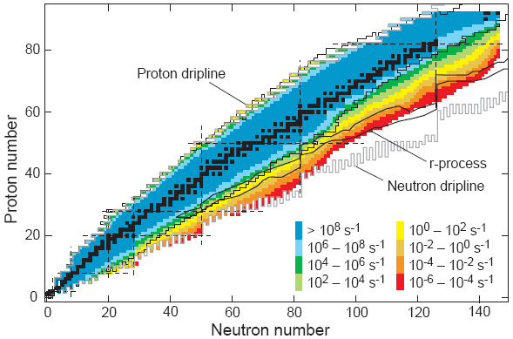
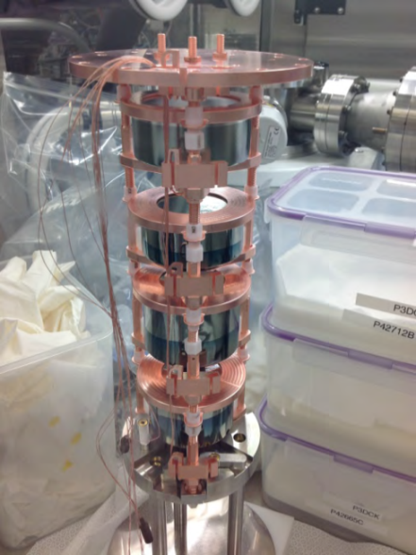
Low Energy Nuclear Physics
Nuclear Structure
  Explore the limits of existence and study new phenomena
  Possibility of a broadly applicable model of nuclei and how they interact
  Probing neutron skins
  Synthesis of superheavy elements
Nuclear Astrophysics
  The origin of the heavy elements
  Explosive nucleosynthesis
  Composition of neutron star crusts
Fundamental Symmetries
  Tests of fundamental symmetries, Atomic EDMs, Weak Charge, Neutrino-less Double Beta Decay
Majorana Demonstrator – 0ν2β decay
First string of Ge detectors. One of many demonstration projects in NP and HEP.

Slide 5
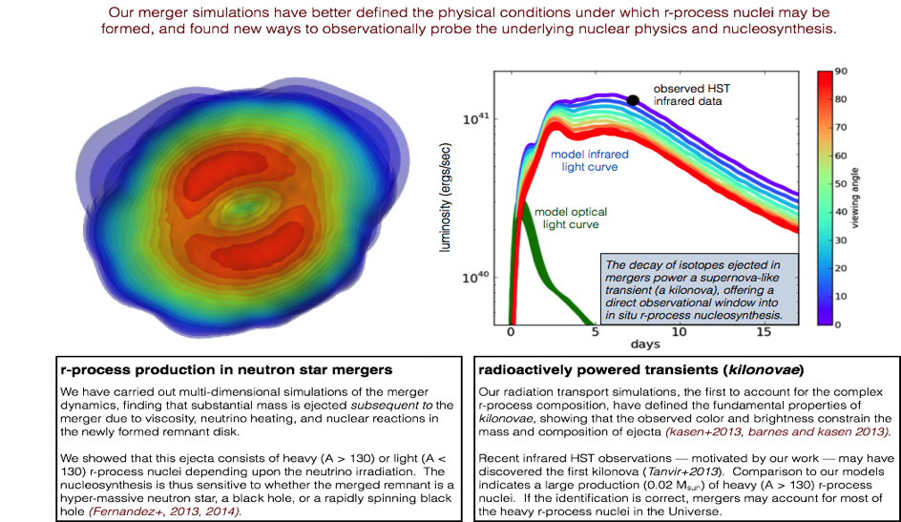
Nuclear Theory – Spans the entire NP program
Example from Astrophysics – Neutron STAR Mergers –
Universe’s largest Nucleus-Nucleus Collision
Substantial mass ejection
Mass distribution of r-process nuclei depends on neutrino irradiation
Sensitivity to resulting remnant, massive neutron star or black hole
LBNL, Fernandez 2013, 2014
Decay of ejected isotopes produces a super-nova like transient
Brightness and color constrain the mass and composition of ejected isotopes
Hubble observation may indicate large amount of A>130 r-process nuclei
LBNL, Kasen; Kasen and Barnes 2013

Slide 6
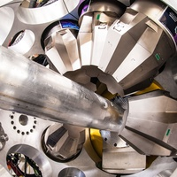
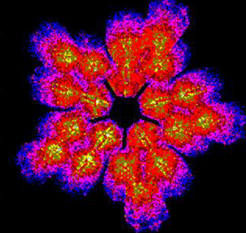
New Equipment and techniques provide critical input
GRETINA Gamma-Ray Energy Tracking Array
In its first science campaign at NSCL, GRETINA’s high peak efficiency and excellent position and energy resolution has proven a powerful combination for a broad range of measurements to study the forces that control nuclear properties and the synthesis of elements in the universe.
GRETINA “fixes” a key astrophysical reaction.
⁵⁶Ni is an important waiting point in the rp process, influencing the energy production and hence the observed light curves during an x-ray burst. The delay imposed by ⁵⁶Ni on the rp process is determined by its effective lifetime against proton capture, which depends and the ⁵⁷Cu(p,γ)⁵⁸Zn reaction rate. GRETINA was used to precisely determine the energies of critical excited states in ⁵⁸Zn. This result reduced the uncertainty in the ⁵⁷Cu(p,γ)⁵⁸Zn reaction rate by several order of magnitude and essentially eliminates this uncertainty from x-ray burst models.
(C. Langer et al. Phys. Rev. Lett. 113, 032502 (2014)).
GRETINA detector modules surrounding the beam pipe at the National Superconducting Cyclotron Laboratory, Michigan State University

Slide 7
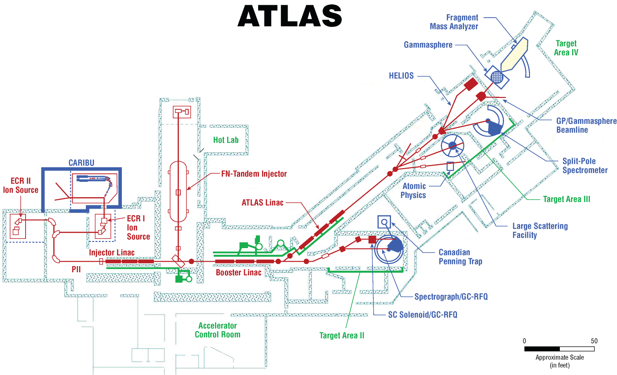
Argonne Tandem Linac Accelerator System Layout
A Unique Premier Stable Beam Facility
For research on Nuclear Structure &
Nuclear Astrophysics
First SRF ion beams in 1978

Slide 8
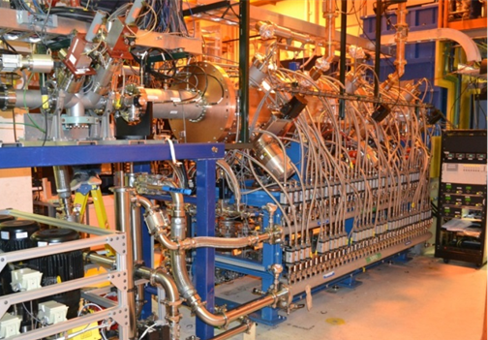
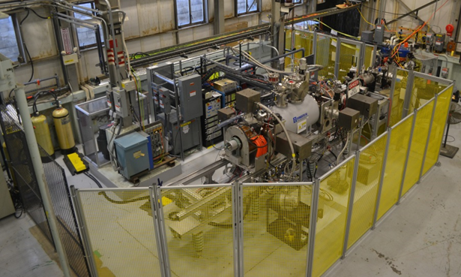
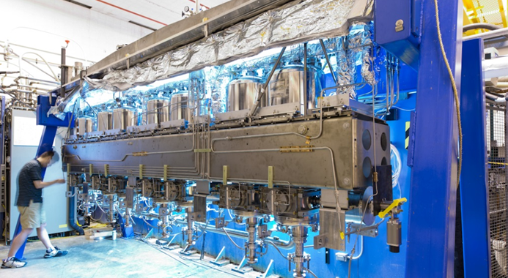
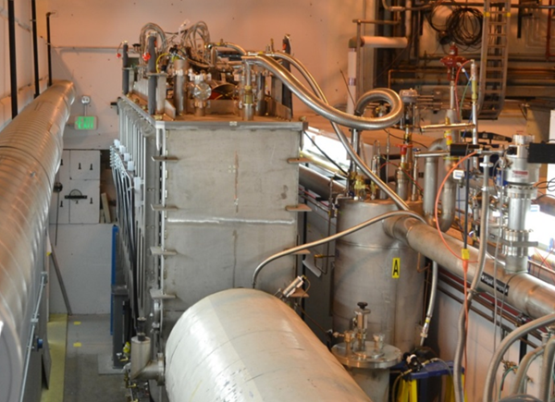
Recent ATLAS Upgrade Projects
New RFQ Accelerator Section for PII Linac (ARRA-funded), Replacement of First Booster Cryostat Module & Liquid Helium Upgrade (ARRA-funded), and Electron Beam Ion Source (EBIS)
60 MHz RFQ
EBIS: will be installed on-line in 2015
Fruitful collaboration on SRF with HEP here at ANL and FNAL
2013
Assembly stand for the 72 MHz Cryomodule
First Beam delivered with the 72 MHz Intensity Upgrade Cryomodule (enclosed in the tunnel).
Record setting gradient for ion beams – 40-60 MV/m
June 2013
Feb 2014
Notes:
Edited text box (spelled out EBIS/dropped statement on completion – EBIS not yet complete (caption is correct)

Slide 9
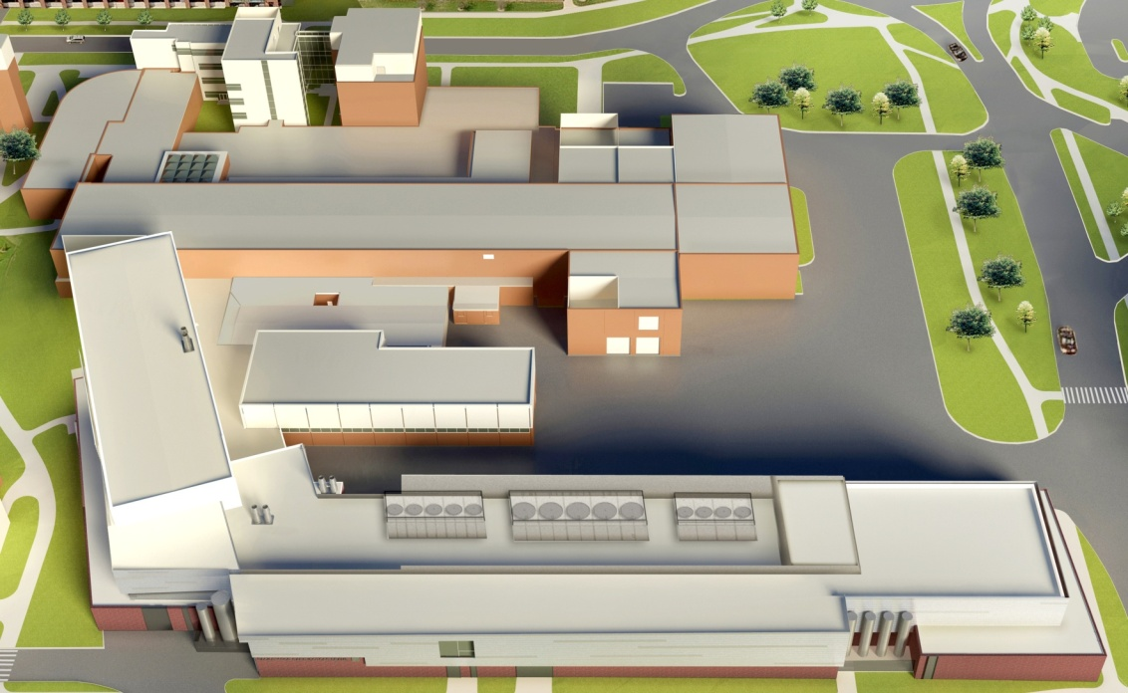
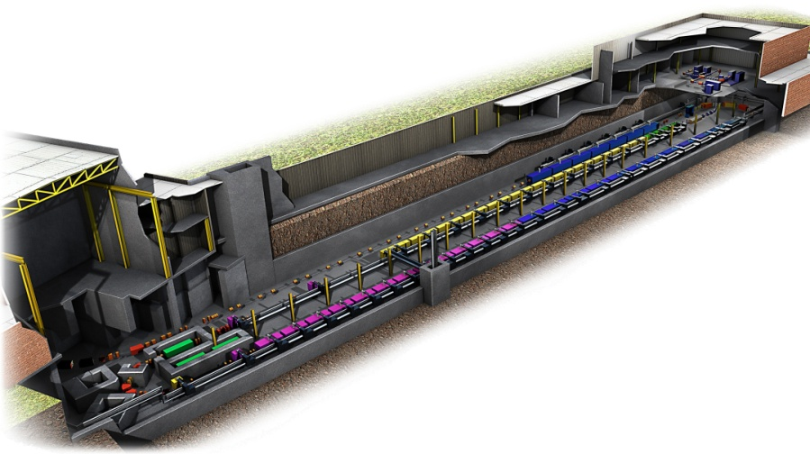
Research Focus of the Facility for Rare Isotope Beams
Existing National Superconducting Cyclotron Laboratory
FRIB will increase the number of isotopes with known properties from ~2,000 observed over the last century to ~5,000 and will provide world-leading capabilities for research on:
Nuclear Structure
  The ultimate limits of existence for nuclei
  Nuclei which have neutron skins
  The synthesis of super heavy elements
Nuclear Astrophysics
  The origin of the heavy elements and explosive nucleo-synthesis
  Composition of neutron star crusts
Fundamental Symmetries
  Tests of fundamental symmetries, Atomic EDMs, Weak Charge
  This research will provide the basis for a model of nuclei and how they interact.
NSCL
New FRIB Linear Accelerator
Front End
Tunnel is
  550 ft long
  70 ft wide
  25 ft underground
Beam Delivery
System

Slide 10
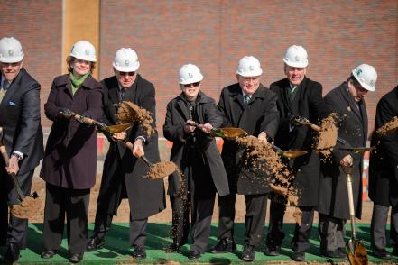
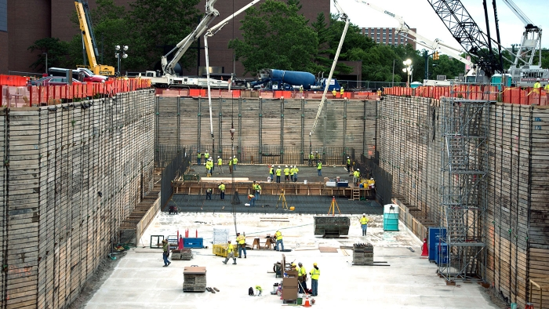
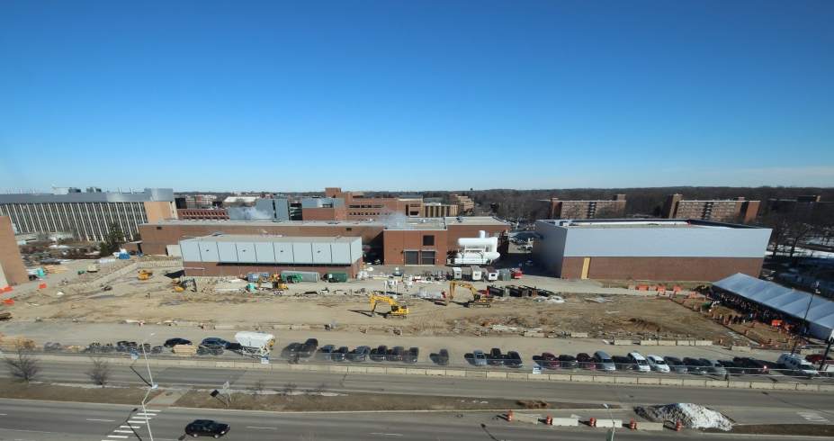
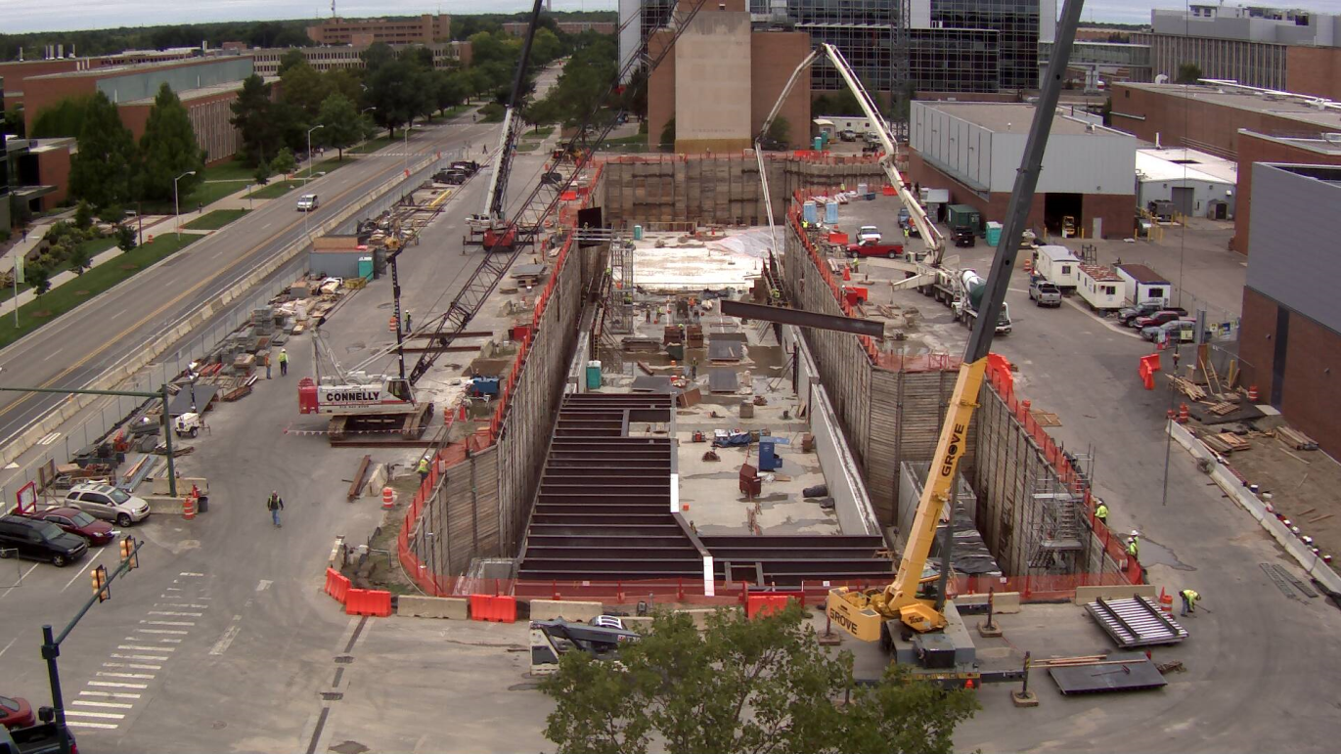
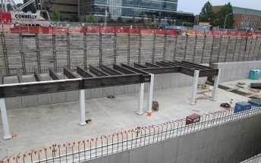
Progress of the Facility for Rare Isotope Beams at MSU
Ground breaking ceremony on March 17, 2014.
In July 2014, 140 truckloads of concrete arrived at MSU.
Aug. 1, 2013 CD-2 and CD-3a TPC $730M with $93.5M provided by MSU, completion by 2022
Project received CD-3B, Approval to Start Construction, on August 26, 2014.
FRIB Site Sept 11, 2014

Slide 11
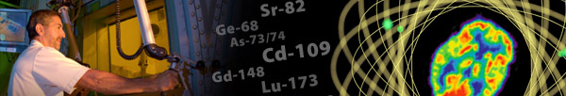
Isotope Program Mission
The mission of the DOE Isotope Program is threefold
Produce and/or distribute radioactive and stable isotopes that are in short supply, associated byproducts, surplus materials and related isotope services.
Maintain the infrastructure required to produce and supply isotope products and related services.
Conduct R&D on new and improved isotope production and processing techniques which can make available new isotopes for research and applications.
Produce isotopes that are in short supply only –
The Isotope Program does not compete with industry
1,010 customer quotes in FY2014
More than 450 shipments in FY2014

Slide 12

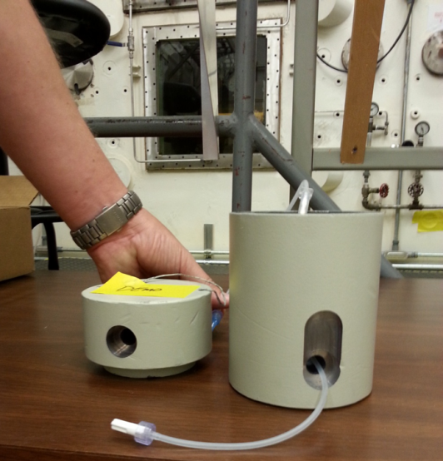
Alpha-Emitter Production for Targeted Radiotherapy NSAC High Priority
Actinium-225
  Continue to process Th-229 for Ac-225; up to about 360 mCi per year.
  R&D has been supported to demonstrate the viability of production of Ac-225 via high energy proton-induced spallation of Th-232 targets.
  Developing production scale targets and processing techniques in order to implement regular, full-scale production of Ac-225.
Actinium-227
  Separated and purified Ac-227 from surplus actinium-beryllium neutron sources at ORNL and from legacy Ac-227 at PNNL.
  Ac-227 used as a source (cow) for the decay production of Th-227 and Ra-223, important alpha-emitting isotopes for medicine.
  Conducting R&D on reactor-based production of Ac-227.
Astatine-211
  Developing nationwide production network at four institutions.
  Lead-212/Bismuth-212
  Separated Th-228 from U-233 at ORNL
  Th-228 used as a cow for the decay production of Ra-224, the parent of Pb-212 and Bi-212, important alpha-emitting isotopes for medicine.
Notes:
Actinium 225 bind to organic molecule that seeks out cancer cell. 4 alphas released in vicinity of that cell. Also source of Bi213 which can be used in same way but produces only one alpha
Actinium 227 source of Ra 223 FDA approved for treating cancers in bone
Astatine 211 acts as a halogen and presents additional means of labeling an organic molecule

Slide 13
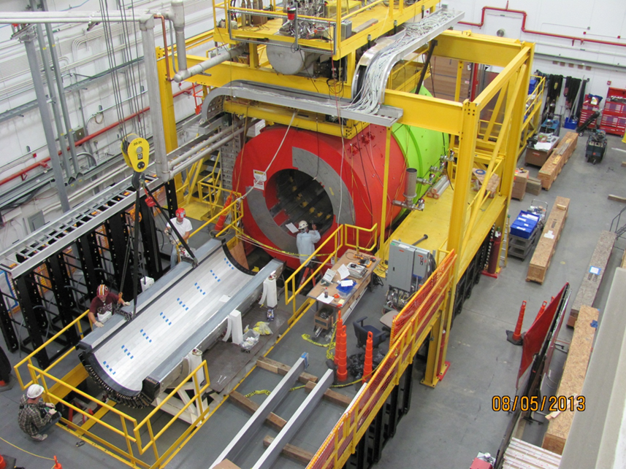
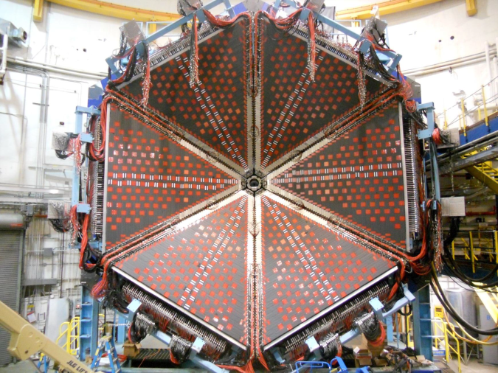
The 12 GeV CEBAF Upgrade at TJNAF is 90% Complete
With the completion of the 12 GeV CEBAF Upgrade, researchers will address:
The search for exotic new quark anti-quark particles to advance our understanding of the strong force
Evidence of new physics from sensitive searches for violations of nature’s fundamental symmetries
A detailed microscopic understanding of the internal structure of the proton, including the origin of its spin, and how this structure is modified when the proton is inside a nucleus
August 2013
Hall D GlueX
Hall B: Completed Forward Time-of-Flight detector arrays on the forward carriage
Project was re-baselined in September 2013 with a Total Project Cost of $338M and completion in September 2017
April 2014

Slide 14
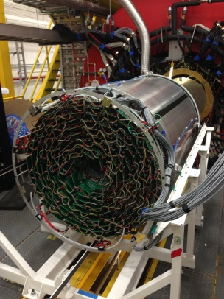
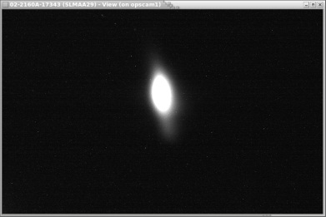
The 12 GeV CEBAF Upgrade at TJNAF is 90% Complete
With the completion of the 12 GeV CEBAF Upgrade, researchers will address:
The search for exotic new quark anti-quark particles to advance our understanding of the strong force
Evidence of new physics from sensitive searches for violations of nature’s fundamental symmetries
A detailed microscopic understanding of the internal structure of the proton, including the origin of its spin, and how this structure is modified when the proton is inside a nucleus
May 2014
First gammas 10/28/14
Overview of Hall D. Insert: Hall D Central Drift Chamber on installation rails prior to insertion in magnet bore.
Hall B: Completed Forward Time-of-Flight detector arrays on the forward carriage
April 2014
Project received CD-4A, Approve Accelerator Project Completion, on July 30, 2014.
A synchrotron light image from a 9.55 GeV electron beam in the Continuous Electron Beam Accelerator Facility accelerator's Arc 10 (Arc A). This image was taken on May 7.
April 2014

Slide 15
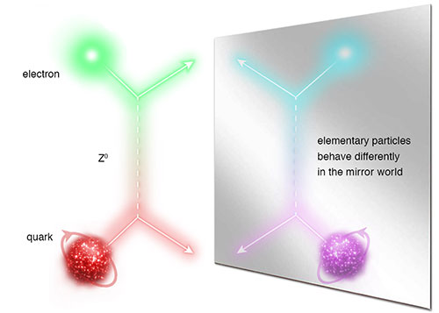
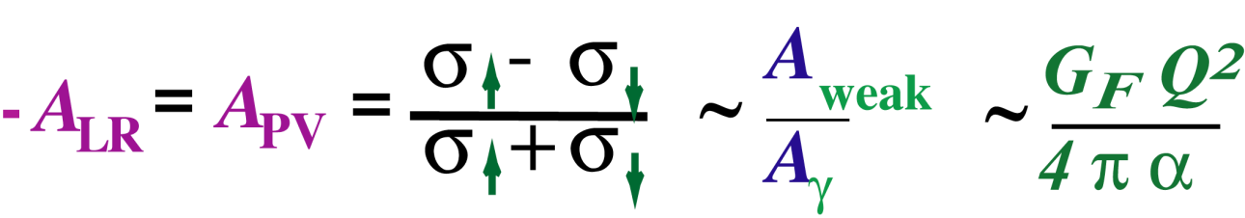
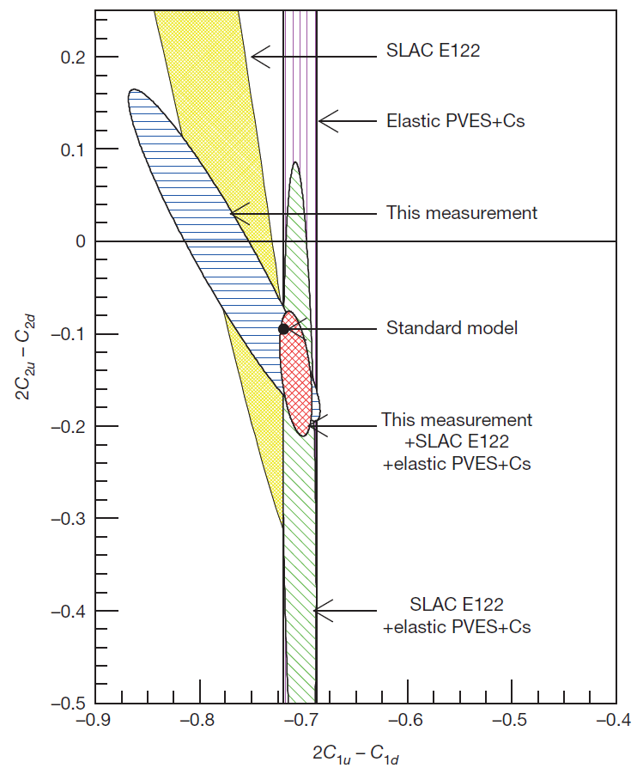
Measurement of the Parity-Violating Asymmetry in
eD Deep Inelastic Scattering
Nature 506, 67–70 (06 February 2014)
The Jefferson Lab PVDIS Collaboration
See also News & Views, Nature 506, 43–44 (06 February 2014)
Longitudinally Polarized Electron Scattering from Unpolarized Deuterium
(α [2C_{1u} – C_{1d}] + β [2C_{2u} – C_{2d}])
The present result leads to a determination of the effective electron-quark weak coupling combination 2C_{2u} – C_{2d} that is five times more precise than previously determined.
It is the first experiment to isolate, when combined with previous experiments like Qweak, a non-zero C_{2q} (at 95% confidence level).
This coupling describes how much of the mirror-symmetry breaking in the electron-quark interaction originates from the quarks' spin preference in the weak interaction. The result provides a mass exclusion limit on the electron and quark compositeness and contact interactions of ~5 TeV.
Quark
chirality
Electron chirality

Slide 16
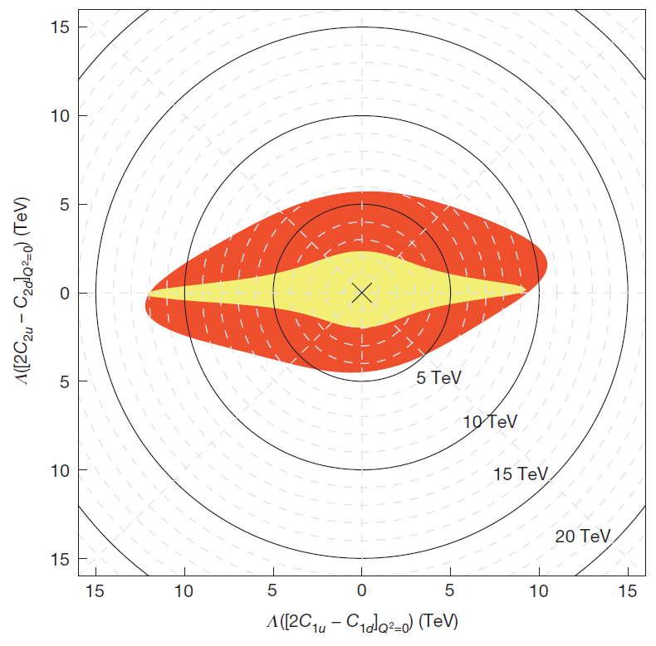
Measurement of the Parity-Violating Asymmetry in
eD Deep Inelastic Scattering
Nature 506, 67–70 (06 February 2014)
The Jefferson Lab PVDIS Collaboration
See also News & Views, Nature 506, 43–44 (06 February 2014)
Longitudinally Polarized Electron Scattering from Unpolarized Deuterium
(α [2C_{1u} – C_{1d}] + β [2C_{2u} – C_{2d}])
The present result leads to a determination of the effective electron-quark weak coupling combination 2C_{2u} – C_{2d} that is five times more precise than previously determined.
It is the first experiment to isolate, when combined with previous experiments like Qweak, a non-zero C_{2q} (at 95% confidence level).
This coupling describes how much of the mirror-symmetry breaking in the electron-quark interaction originates from the quarks' spin preference in the weak interaction. The result provides a mass exclusion limit on the electron and quark compositeness and contact interactions of ~5 TeV.

Slide 17
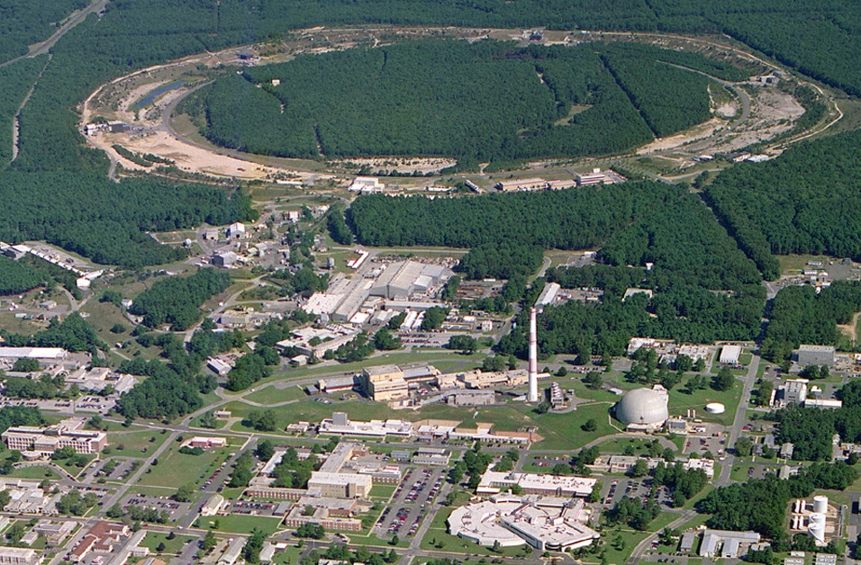
Complimentary Results from RHIC and LHC
Polarized Jet Target
12:00 o’clock
RHIC
PHENIX
8:00 o’clock
RF
4:00 o’clock
STAR
6:00 o’clock
LINAC
NSRL
EBIS
Booster
BLIP
AGS
Tandems

Slide 18
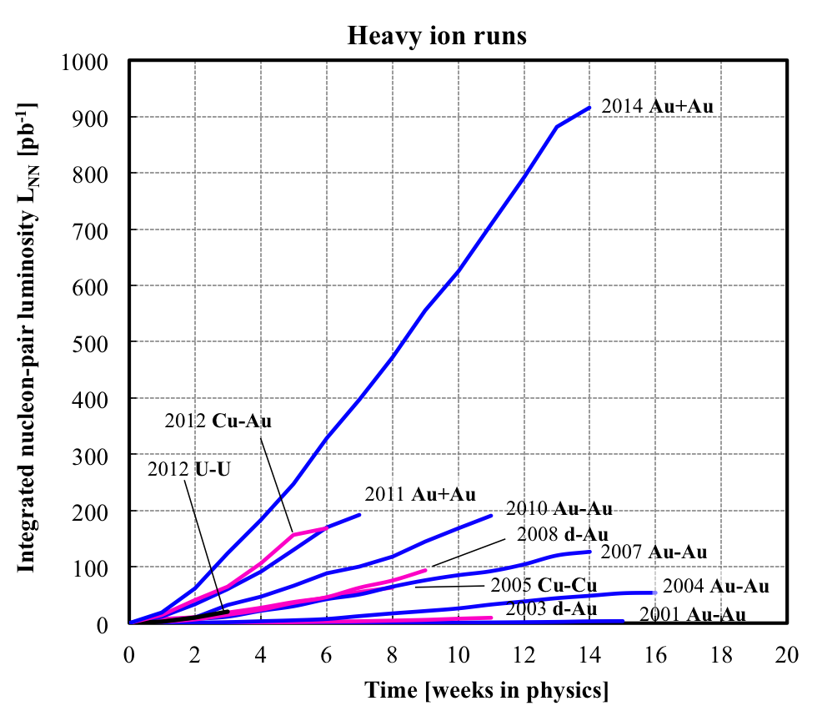
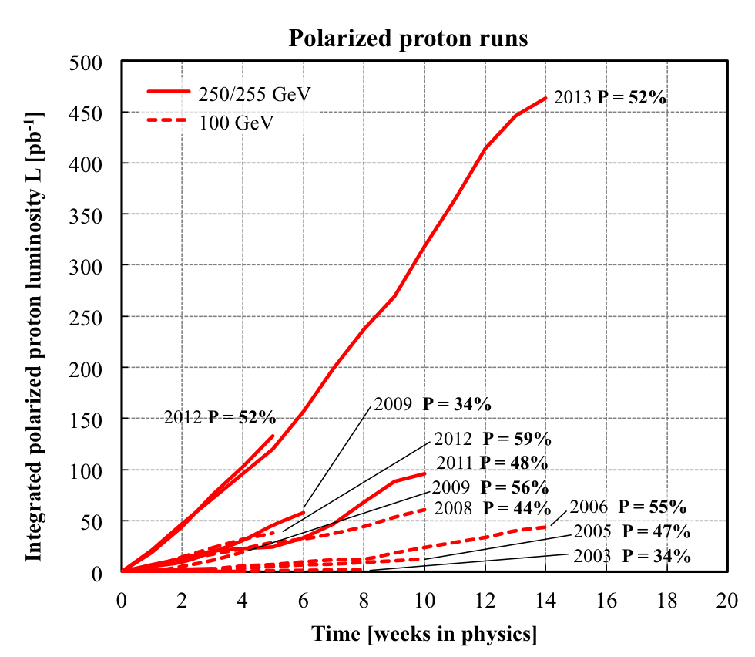
RHIC: Record Integrated Luminosity and Polarization
Au+Au luminosity from Run-14 exceeds
all previous Au+Au runs combined
p+p luminosity from Run-13 exceeds
all previous p+p runs combined

Slide 19
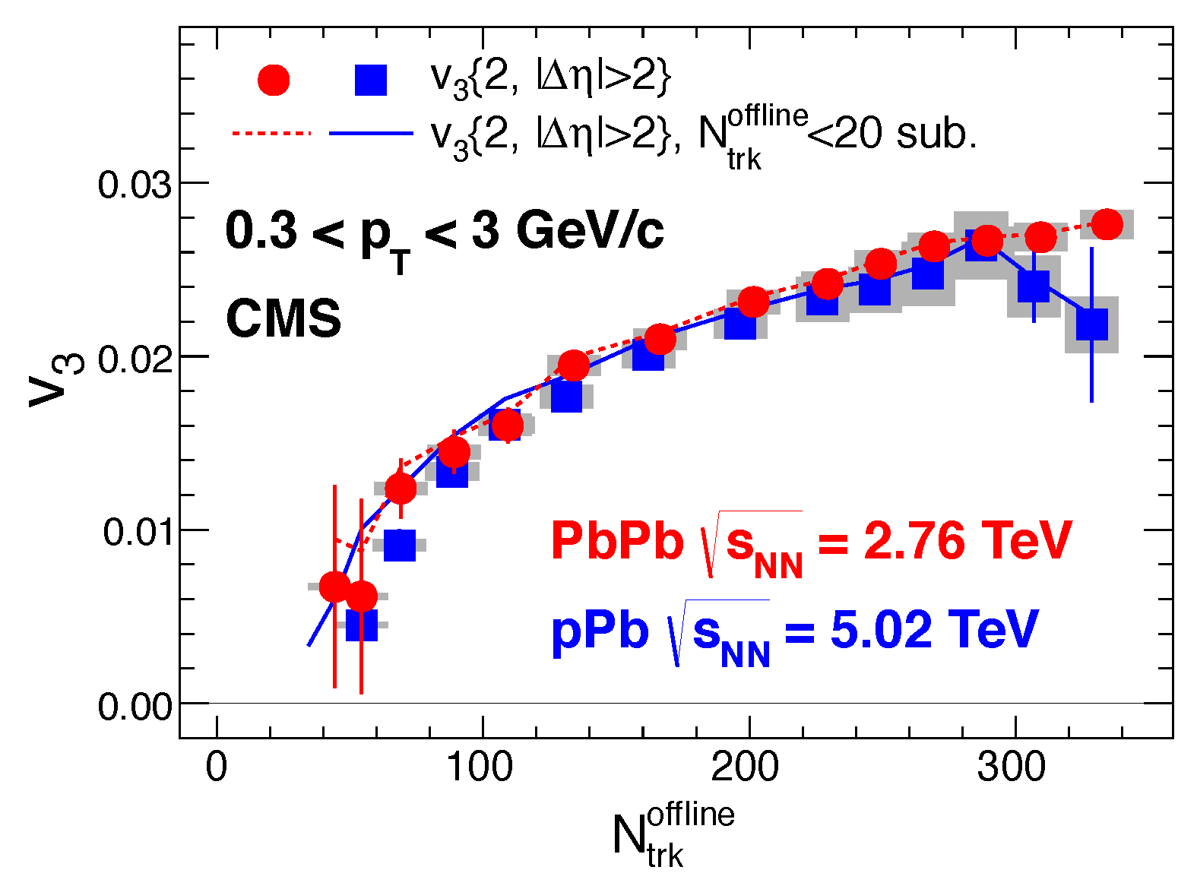
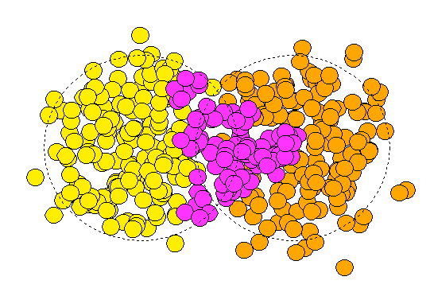
Triangular flow
Remarkable similarity in the v₃ signal as a function of multiplicity in pPb and PbPb
  PLB724 (2013) 213
ψ₃
(event multiplicity)

Slide 20
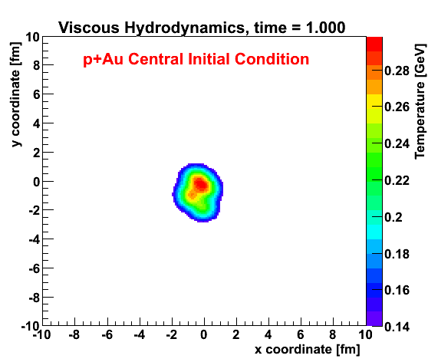
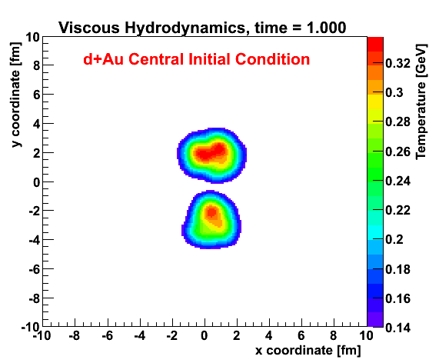
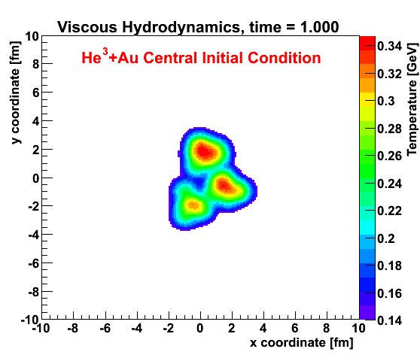
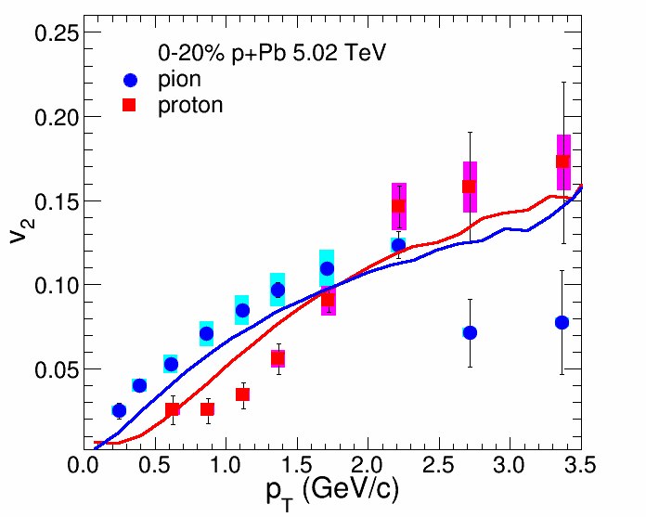
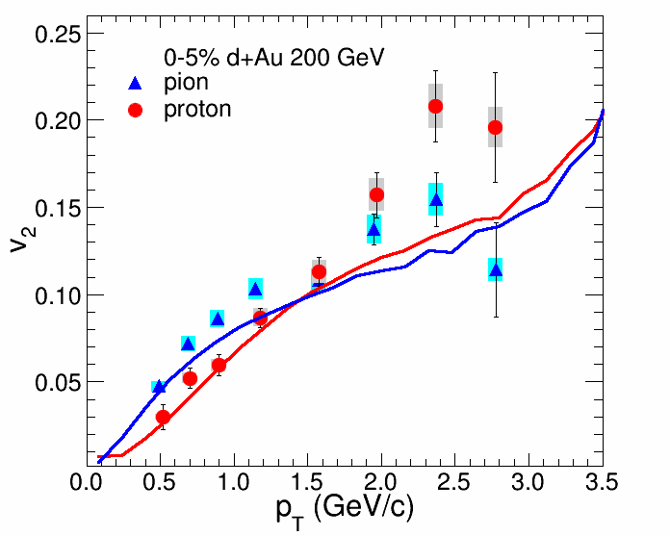

Creating Quark-Gluon Plasma Droplets (Easy as 1,2,3)
Collision geometry engineering allows RHIC to answer questions about how small QGP droplets can be.
RHIC just completed a very successful 3He + Au in the 2014 run. Investigate enhanced V₃.
ALICE Experiment
p+Pb @ LHC
PHENIX
d+Au @ RHIC
PHENIX just completed
very successful
³He + Au
Data taking
arXiv:1404.7461

Slide 21
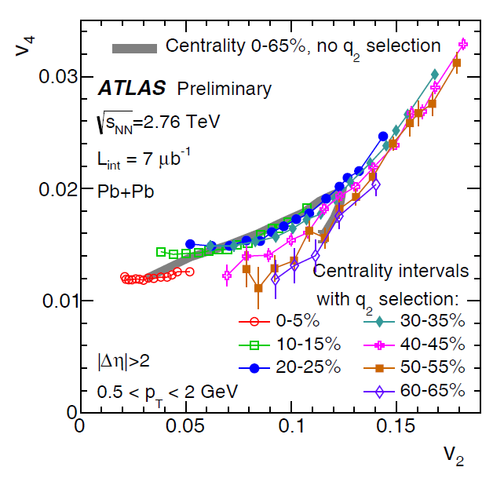
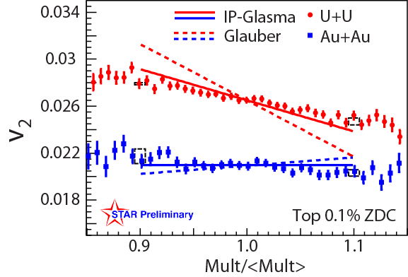



Further investigations of flow
Deformed geometry of U+U allows discrimination between models of initial state fluctuations.
Investigations of nonlinear feeding of higher moments of flow from lower.

Slide 22
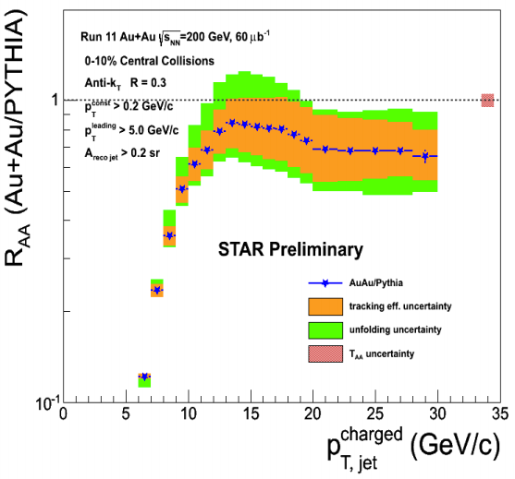
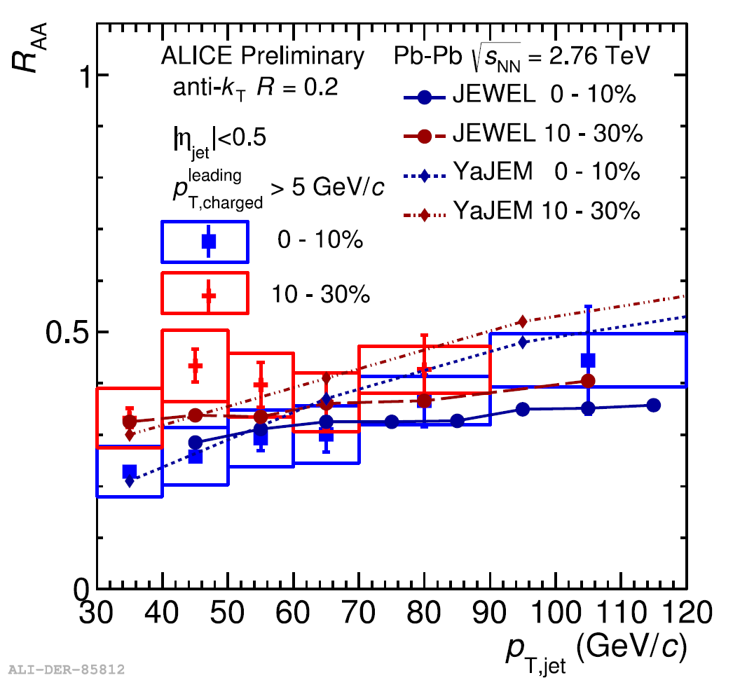
Jets at LHC and RHIC
Reconstructed jets with STAR at RHIC allow for comparison with ALICE jet data which has been pushed to lower jet p_{T}.

Slide 23
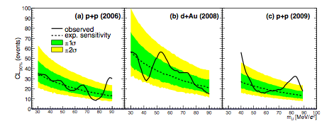
Dark photon limit (PHENIX)
http://arxiv.org/abs/1409.0851
Several existing experimental anomalies (muon g-2, lamb shift in muonic hydrogen, positron excess in cosmic rays) all can be potentially explained by a “dark photon” weakly mixing with real photons
Search performed in Dalitz decays of neutral mesons in p+p and d+Au.
The observed yield is consistent with background fluctuations at 2σ level, and can be translated into upper limit on the coupling strength ϵ²
The PHENIX data rule out the dark photon explanation of the muon g-2 discrepancy over almost the entire relevant mass range.

Slide 24
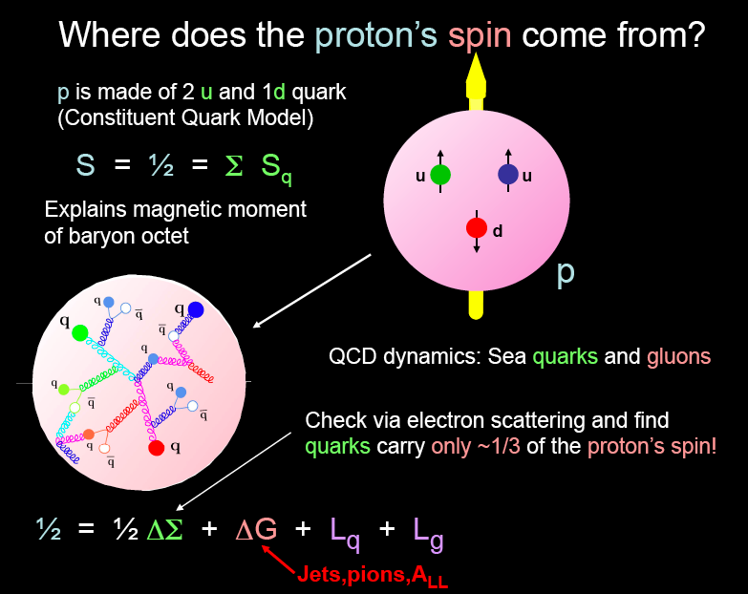
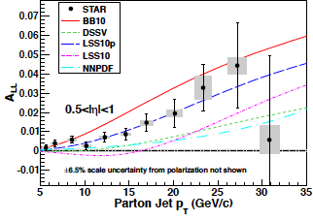
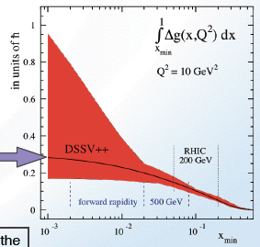
RHIC the only collider with polarized beams
A worldwide scientific quest:
A_{LL} ∼ Δq ΔG
q G
First significant non-zero Δg(x) measured with jets at RHIC Work continues to extend to lower x at RHIC and motivates EIC

Slide 25
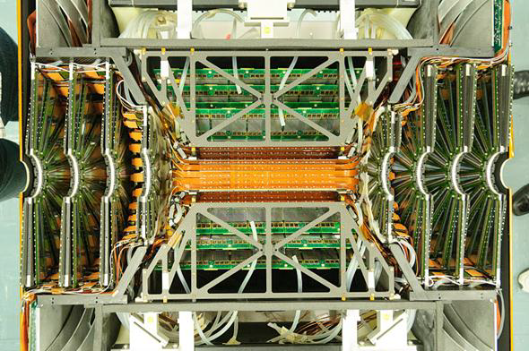




Some Recent and Ongoing Investments in Heavy Ions
ALICE Dcal installation recently complete
PHENIX VTX &FVTX
Upgrade CMS ZDC
Current R&D on ALICE TPC upgrade.
STAR HFT Inner Pixel shown

Slide 26





NSAC Long Range Plan Process Underway
1979
NP accomplishments and successes largely a result of:
Responsible/visionary strategic planning provided by the Long Range Plans.
Federal government’s decision to utilize the guidance and provide the needed resources
1983
1989
1996
2002
2007
Charge issued April 2014
58 member working group
Town meetings have been held
Resolution meeting in the spring
Long Range Plan due October 2015

Slide 27


EIC science: Understanding the glue that binds us all
Proton (and nuclei) and black holes are the only fully relativistic (high enough energy density to excite the vacuum) stable bound systems in the universe. Protons can be studied in the laboratory.
Protons are fundamental to the visible universe (including us) and their properties are dominated by emergent phenomena of the self-coupling strong force that generates high density gluon fields:
  The mass of the proton (and the visible universe)
  The spin of the proton
  The dynamics of quarks and gluons in nucleons and nuclei
  The formation of hadrons from quarks and gluons
The study of the high density gluon field that is at
the center of it all requires a high energy, high
luminosity, polarized Electron Ion Collider
The 2013 NSAC Subcommittee on Future Facilities identified the physics program for an Electron-Ion Collider as absolutely central to the nuclear science program of the next decade.

Slide 28
Nuclear Physics
FY 2015 Budget Status
We are currently operating at FY 14 levels under a continuing resolution
NP bottom line increase in FY15 is dominated by the construction profile of FRIB

Slide 29
DOE Office of Nuclear Physics
Office of Nuclear Physics
Director’s Office Staff
Joanne Wolfe, Financial Advisor
Cathy Hanlin, Program Analyst
Brenda May, Program Analyst
Kyungseon Joo, IPA
Gulshan Rai (A), Technical Advisor
Timothy J. Hallman, Associate Director
Sonya Carter, Administrative Specialist
Physics Research Division
Timothy J. Hallman (A)
Christine Izzo, Program Support Specialist
Facilities & Project Management Division
Jehanne Gillo, Director
Cassie Dukes, Program Support Specialist
Luisa Romero, Isotope Program Analyst
Medium Energy Nuclear Physics
Gulshan Rai
Heavy Ion Nuclear Physics
James Sowinski (A)
Nuclear Physics Facilities
Jehanne Gillo (A)
Michelle Shinn (Detailee)
James Sowinski
Isotope Facilities
Marc Garland
Low Energy Nuclear Physics
Cyrus Baktash
Isotope R&D
Dennis Phillips
Nuclear Physics Instrumentation
Elizabeth Bartosz
Nuclear Theory
George Fai
Advanced Technology R & D
Manouchehr Farkhondeh
Stable Isotopes and Accountable Material
Joel Grimm
Nuclear Data and Nuclear Theory Computing
Ted Barnes
Nuclear Physics Major Initiatives
James Hawkins
Fundamental Symmetries
Cyrus Baktash (A)

Slide 30
DOE Office of Nuclear Physics
Office of Nuclear Physics
Director’s Office Staff
Joanne Wolfe, Financial Advisor
Cathy Hanlin, Program Analyst
Brenda May, Program Analyst
Kyungseon Joo, IPA
Gulshan Rai (A), Technical Advisor
Timothy J. Hallman, Associate Director
Sonya Carter, Administrative Specialist
Physics Research Division
Timothy J. Hallman (A)
Christine Izzo, Program Support Specialist
Facilities & Project Management Division
Jehanne Gillo, Director
Cassie Dukes, Program Support Specialist
Luisa Romero, Isotope Program Analyst
Medium Energy Nuclear Physics
Gulshan Rai
Heavy Ion Nuclear Physics
James Sowinski (A)
Nuclear Physics Facilities
Jehanne Gillo (A)
Michelle Shinn (Detailee)
James Sowinski
Isotope Facilities
Marc Garland
Low Energy Nuclear Physics
Cyrus Baktash
Isotope R&D
Dennis Phillips
Current open searches for Heavy Ion and new Fundamental Symmetries PM positions. Research Division Director Search to open soon.
Opportunities exist to work in our office as a detailee or IPA for a year or longer.
Nuclear Physics Instrumentation
Elizabeth Bartosz
Nuclear Theory
George Fai
Advanced Technology R & D
Manouchehr Farkhondeh
Stable Isotopes and Accountable Material
Joel Grimm
Nuclear Data and Nuclear Theory Computing
Ted Barnes
Nuclear Physics Major Initiatives
James Hawkins
Fundamental Symmetries
Cyrus Baktash (A)

Slide 31
Concluding Perspective
Nuclear Science continues to produce exciting physics
The US HI program benefits strongly from participation in physics at the LHC.
  RHIC and the LHC provide complementary tools to explore the Quark Gluon Plasma and partonic structure of the nucleus
  New results from RHIC and the LHC continue to be surprising and exciting
  We look forward to the upcoming RHIC runs and return of the LHC to operation at higher energy.
We are continuing to invest in the future of Nuclear Science
The future of nuclear science in the United States continues to be rich with science opportunities and we look forward to the guidance to be provided in the next Long Range Plan.

