Slide 1


CERN-US Relations
and the LHC Program
Rüdiger Voss
Head of International Relations, CERN
USLUA Annual Meeting, Argonne| November 12-14, 2014

Slide 2

From the P5 report
Recommendation 10: Complete the LHC phase-1 upgrades and
continue the strong collaboration in the LHC with the phase-2
(HL-LHC) upgrades of the accelerator and both general-purpose
experiments (ATLAS and CMS). The LHC upgrades constitute
our highest-priority near-term large project.

Slide 3
European Strategy for Particle Physics
The LHC
After careful analysis of many possible large-scale scientific activities requiring significant resources, sizeable collaborations and sustained commitment, the following four activities have been identified as carrying the highest priority.
c) The discovery of the Higgs boson is the start of a major programme of work to measure this particle’s properties with the highest possible precision for testing the validity of the Standard Model and to search for further new physics at the energy frontier. The LHC is in a unique position to pursue this programme.
Europe’s top priority should be the exploitation of the full potential of the LHC, including the high-luminosity upgrade of the machine and detectors with a view to collecting ten times more data than in the initial design, by around 2030. This upgrade programme will also provide further exciting opportunities for the study of flavour physics and the quark-gluon plasma.

Slide 4
LHC schedule beyond LS1
LS2 starting in 2018 (July) => 18 months + 3 months BC
LS3 LHC: starting in 2023 => 30 months + 3 months BC
Injectors: in 2024 => 13 months + 3 months BC
Physics
Shutdown
Beam commissioning
Technical stop
30 fb⁻¹
YETS
EYETS
YETS
LS 2
YETS
Run 2
Run 3
Run 2
LS 2
Run 3
YETS
LS 3
Run 4
YETS
LS 3
Run 4
300 fb⁻¹
LS 4
Run 5
LS 5
LS 4
Run 5
LS 5
(Extended) Year End Technical Stop: (E)YETS
3’000 fb⁻¹

Slide 5
European Strategy for Particle Physics
The energy frontier
After careful analysis of many possible large-scale scientific activities requiring significant resources, sizeable collaborations and sustained commitment, the following four activities have been identified as carrying the highest priority.
d) To stay at the forefront of particle physics, Europe needs to be in a position to propose an ambitious post-LHC accelerator project at CERN by the time of the next Strategy update, when physics results from the LHC running at 14 TeV will be available. CERN should undertake design studies for accelerator projects in a global context, with emphasis on proton-proton and electron-positron high energy frontier machines. These design studies should be coupled to a vigorous accelerator R&D programme, including high-field magnets and high-gradient accelerating structures, in collaboration with national institutes, laboratories and universities worldwide.

Slide 6
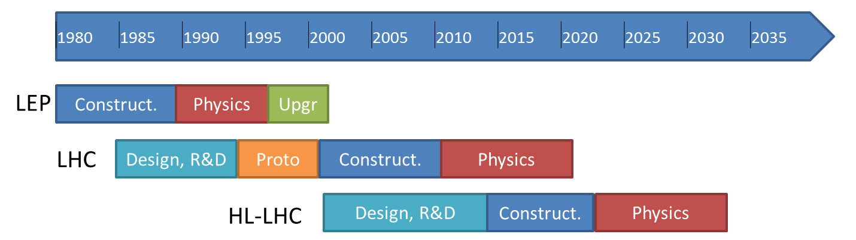

European Strategy: “CERN should undertake design studies for accelerator projects in a global context, with emphasis on proton-proton and electron- positron high-energy frontier machines.”
today
Project
FCC Study : p-p towards 100 TeV
Kick-off meeting: February 2014 (Univ. Geneva)
FCC: Future Circular Colliders

Slide 7
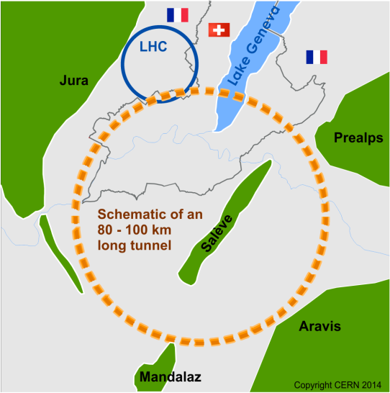
Future Circular Collider Study - SCOPE
CDR and cost review for the next ESU (2018)
Forming an international collaboration to study:
pp-collider (FCC-hh) → defining infrastructure requirements
e⁺e⁻ collider (FCC-ee) as potential intermediate step
p-e (FCC-he) option
80-100 km infrastructure in Geneva area
~16 T ⇒ 100 TeV pp in 100 km
~20 T ⇒ 100 TeV pp in 80 km

Slide 8
European Strategy for Particle Physics
The ILC
After careful analysis of many possible large-scale scientific activities requiring significant resources, sizeable collaborations and sustained commitment, the following four activities have been identified as carrying the highest priority.
e) There is a strong scientific case for an electron-positron collider, complementary to the LHC, that can study the properties of the Higgs boson and other particles with unprecedented precision and whose energy can be upgraded. The Technical Design Report of the International Linear Collider (ILC) has been completed, with large European participation. The initiative from the Japanese particle physics community to host the ILC in Japan is most welcome, and European groups are eager to participate. Europe looks forward to a proposal from Japan to discuss a possible participation.
At CERN ILC efforts continue
in the framework of the LC efforts.
Hosting LCC Director(ate) at CERN

Slide 9
P5 on Linear Collider(s)
Continue working on the technical design report for CLIC and common research on ILC (machine and detectors)
P5 Recommendation 11: Motivated by the strong scientific importance of the ILC and the recent initiative in Japan to host it, the U.S. should engage in modest and appropriate levels of ILC accelerator and detector design in areas where the U.S. can contribute critical expertise. Consider higher levels of collaboration if ILC proceeds.
This parallel research (CLIC and ILC) aims to be ready to decide on the way forward at the time of the next European Strategy update (around 2018)

Slide 10
European Strategy for Particle Physics
The intensity frontier
After careful analysis of many possible large-scale scientific activities requiring significant resources, sizeable collaborations and sustained commitment, the following four activities have been identified as carrying the highest priority.
f) Rapid progress in neutrino oscillation physics, with significant European involvement, has established a strong scientific case for a long-baseline neutrino programme exploring CP violation and the mass hierarchy in the neutrino sector.
CERN should develop a neutrino programme to pave the way for a substantial European role in future long-baseline experiments. Europe should explore the possibility of major participation in leading long-baseline neutrino projects in the US and Japan.

Slide 11
Neutrino Platform
Create a platform to pave the way for a European contribution in a neutrino facility in the US or Asia
Financial scenario with an allocation to allow for
  Extension of the experimental area of the SPS complex (North Area)
  (liquid argon) detector R&D for neutrino experiments
  Preparing detectors at CERN for transport to US
P 5 Recommendation 13: Form a new international collaboration to design and execute a highly capable Long-Baseline Neutrino Facility (LBNF) hosted by the U.S. To proceed, a project plan and identified resources must exist to meet the minimum requirements in the text. LBNF is the highest-priority large project in its timeframe.

Slide 12
Summary:
With
  the European Strategy Update, approved by the CERN Council May in 2013,
  the P5 recommendations, approved by HEPAP in the US,
  the Japanese roadmap
we have developed for the first time a cross-region vision for our field
CERN and US will play a major role in this global endeavour

Slide 13
The near future: LHC upgrades
HL-LHC now formal part of European Strategy and approved MTP 2014-2018
Significant US contributions to accelerator upgrades, presently at R&D stage:
  USLARP (BNL, Fermilab, LBNL, SLAC): post-NbTi technologies, accelerator physics and commissioning
  Participation in FP7 EuCARD high luminosity project
CERN welcomes a participation in detector and Grid computing upgrades commensurate with the size of the US community

Slide 14
Today’s formal framework
US have Observer status at CERN
  Granted in recognition of significant in-kind contributions to LHC
  Status quo – to be phased out under new membership policy
CERN-DOE-NSF Co-operation agreement on LHC activities (ICA-US-0058)
  Signed December 8, 1997 for 20 years duration
  Protocol on accelerator co-operation (expired) and on co-operation on ATLAS and CMS detectors (P026/LHC, concluded December 19, 1997 for 20 y)

Slide 15
Accelerator Protocol II
‘Stop-gap’ protocol to present ICA for continued collaboration on LHC accelerator science, including injector complex
  In particular, formal framework for CERN-USLARP collaboration
Signed by CERN and DOE in July 2014
Paves the way for Accelerator Protocol III

Slide 16
New CERN-US Co-operation Agreement
CERN, DOE and NSF agreed to work on a new Co-operation Agreement, to replace present ICA expiring in 2017
All parties agree on principle of an open-ended “umbrella” agreement
Intense work in 2014, language nearly agreed upon
  Sign early 2015?
“Old” (1997) will continue in parallel until 2017
  Required to maintain present Experiment Protocol

Slide 17
New CERN-US Co-operation Agreement
Under the umbrella, collaborative projects and actions are implemented through Protocols
  Enhanced flexibility
  Focus on scientific and technical aspects
Planned:
  Accelerator Protocol III on US in-kind contributions to HL-LHC
  Neutrino Protocol: European gateway into LBNF
  Experiments Protocol II (from end-2017)

Slide 18
The US, an Associate Member of CERN?
Beyond new ICA, Associate Membership of the US remains a strategic objective of CERN Council & Management
Seeking opportunities for high-level discussions
  Invited Secretary of Energy to CERN
  Still waiting for new Director of DOE Office of Science to be confirmed…
Support from the community will be essential
  See opinion articles in “Physics Today” by Burton Richter and Chris Quigg
  We sense that the idea is gaining widespread support in the US community

Slide 19
Conclusions
The US-CERN partnership in building and operating the LHC has become a solid backbone of a successful scientific and technological collaboration of unprecedented, global dimension
  Now underpinned by coherent cross-continent roadmaps
CERN wants this partnership to continue and to expand, while strengthening at the same time the institutional links with the US

