Slide 1
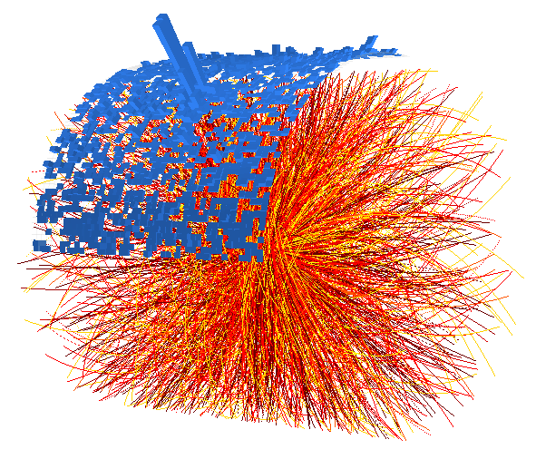



Jet Results from ALICE
Megan Connors (Yale University)
US LHC Users Meeting
November 14, 2014

Slide 2
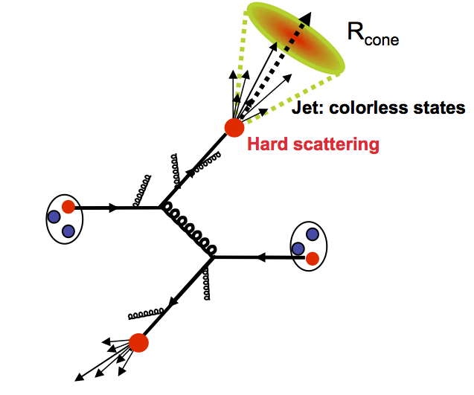
Defining a Jet
Collimated spray of particles
  Originating from a hard scattering
  Radiation of soft gluons and quarks
  Hadronization
Defined by the jet finder
  Anti-k_{T}
Useful probe to study QGP
  Experimentally and theoretically
  Reflects hard scattered parton kinematics
  Scattering occurs prior to QGP formation
  Partons traverse the QGP and lose energy
Hard Scattering
Notes:
----- Meeting Notes (10/22/13 15:16) -----
high pt hadron label
move hard scattering
question mark in title
subscripts

Slide 3
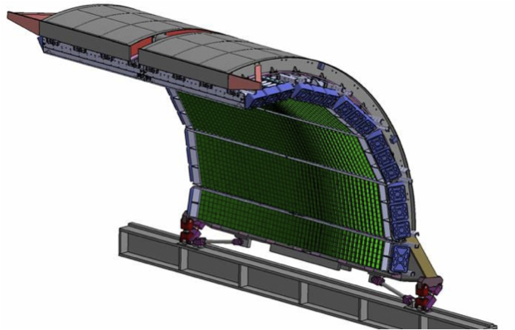
Jets at ALICE
EMCal is a Pb-scintillator sampling calorimeter which covers:
  |η| < 0.7,
  1.4 < ϕ < π
Tracking:
|η|< 0.9, 0<ϕ<2π
TPC: gas drift detector
ITS: silicon detector
Charged
particles
Neutral
particles
JET
Notes:
----- Meeting Notes (6/24/13 14:33) -----
fix to match 3
hadronic correction -> show in more detail

Slide 4
Jets in Pb-Pb
Is AA simply a superposition of pp collisions?
Energy density subtracted event-by-event
Unfold for detector effects and background fluctuations
Energy shift?
p+p
1
Absorption?
A+A
R_{AA}=1 implies yes!
R_{AA} < 1 implies energy loss
Notes:
----- Meeting Notes (10/22/13 15:16) -----
diagrams
switch diagram order
pT on x axis
energy loss --> energy deposition

Slide 5
Jets in Pb-Pb
Central Pb-Pb collisions
Jet Quenching!
Suppression observed relative to N_{coll} scaled pp
Good agreement with energy loss models

Slide 6
Motivation for Jets in p-Pb
Could some of the suppression observed in Pb-Pb result from Cold Nuclear Matter (CNM) effects?
Is multiplicity dependence of particle ratios observed in p-Pb present in the jet fragmentation?
Is the fragmentation behavior of jets different in p-Pb?

Slide 7
Jets in p-Pb
Motivation: Quantify CNM effects in Pb-Pb jet quenching observation
Spread of results from MC references shows uncertainty on pp reference
Consistent with no CNM effects
  Suppression in Pb-Pb not a CNM effect
  Need to reduce uncertainties with pp data
  Baseline for Run II Pb-Pb
No pp data at 5 TeV
Compare to MC

Slide 8
Fragmentation Properties in p-Pb
p-Pb ratio consistent with pp collisions at 2.76 TeV
R=0.2
R=0.4
PLB 722 (2013) 262-272
No modification of the jet sub-structure observed
charged hadrons
j_{T}
jet axis
Data is best described by PYTHIA with angular ordering
Notes:
----- Meeting Notes (5/29/14 15:02) -----
define jT
remove circle from picture

Slide 9
Λ/K⁰_{s} Multiplicity Dependence in p-Pb
Multiplicity dependence observed for inclusive Λ/K⁰_{s}
No multiplicity dependence for Λ/K⁰_{s} ratio in jets
Ratio within the jet lower than inclusive ratio
High Multiplicity
Low Multiplicity
Charged Jets

Slide 10
Λ/K⁰_{s} Ratio Compared to PYTHIA
Ratio within the jet consistent with PYTHIA
Increased inclusive Λ/K⁰_{s} ratio due to UE
Charged Jets
Notes:
----- Meeting Notes (5/29/14 15:02) -----
check wording of agreement
what is the red curve?
pythia is black curve and above

Slide 11
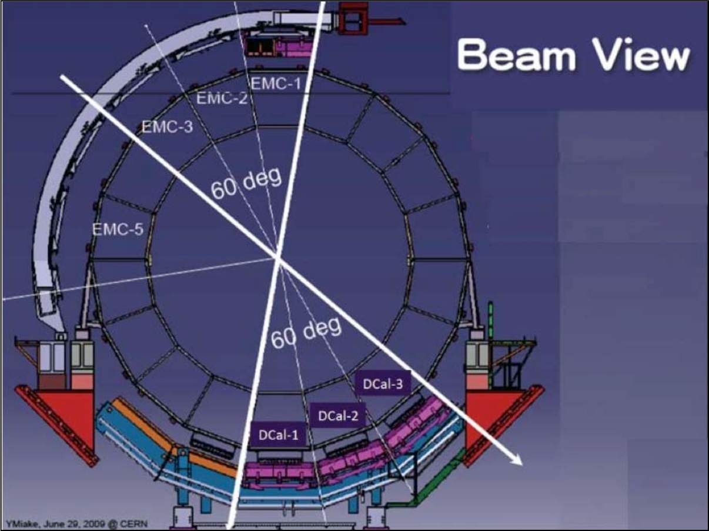
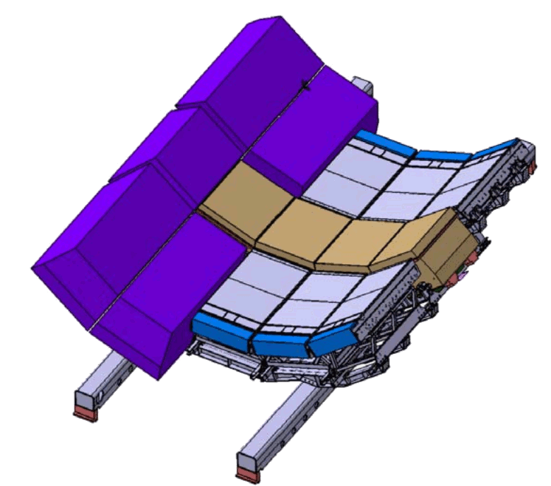
New ALICE Capabilities in Run II
New DCal calorimeter
  Increased acceptance for jets
  Allows for di-jet observables
EMCal
DCal
Δη=1.4,Δφ=60º
Ready for Run II

Slide 12
Summary
Jet quenching observed in central Pb-Pb collisions
p-Pb consistent with model calculations for 5.02 TeV pp
  Need 5.02 TeV pp data to reduce uncertainties
  CNM effects cannot account for strong suppression of Pb-Pb
Jet substructure or particle ratios in p-Pb collisions consistent with pp expectations
Energy loss models reproduce Pb-Pb suppression
  Additional observables will provide more constraints to energy loss models
Looking forward to measuring jets in Run II
  Increased energy and statistics
  New (di-)jet capabilities with the DCal

Slide 14
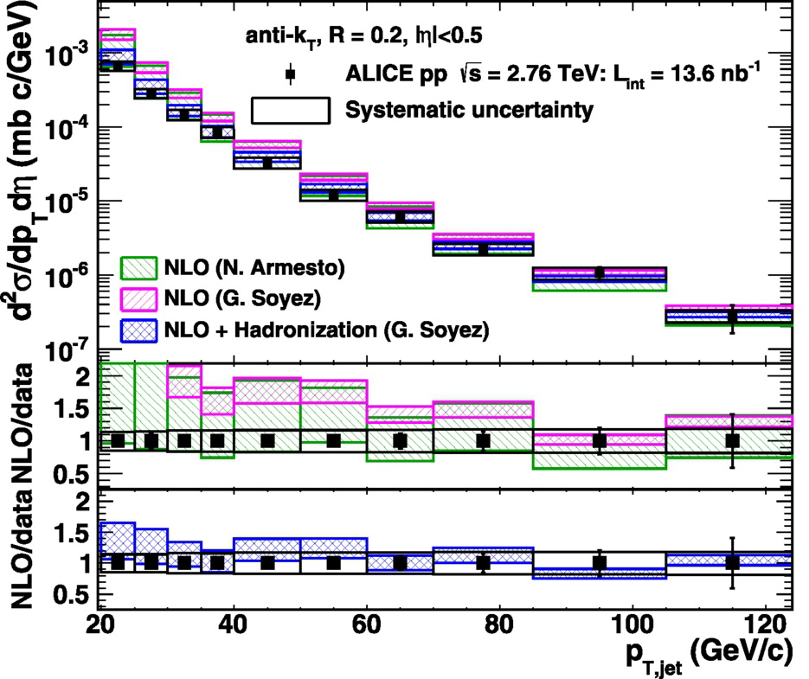
Jet Cross-Section (pp)
√s = 2.76 TeV, R = 0.2
arXiv:1301.3475
PLB: 10.1016/j.physletb.2013.04.026
Important reference for Pb-Pb collisions
Good agreement between data and
NLO calculations
  Many orders of magnitude
  Jets are a well calibrated probe for the QGP
Hadronization needed for theory-data agreement!
Notes:
----- Meeting Notes (6/24/13 16:47) -----
PRB -> PLB
mention ratio

Slide 15
Agreement with Models
Good agreement with energy loss models

