Slide 1



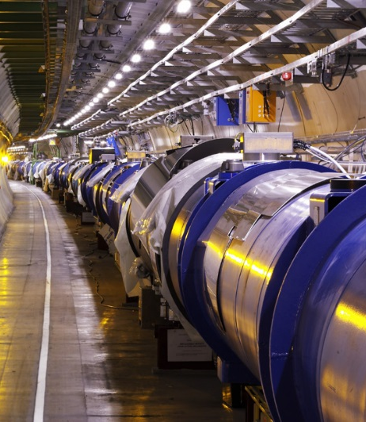
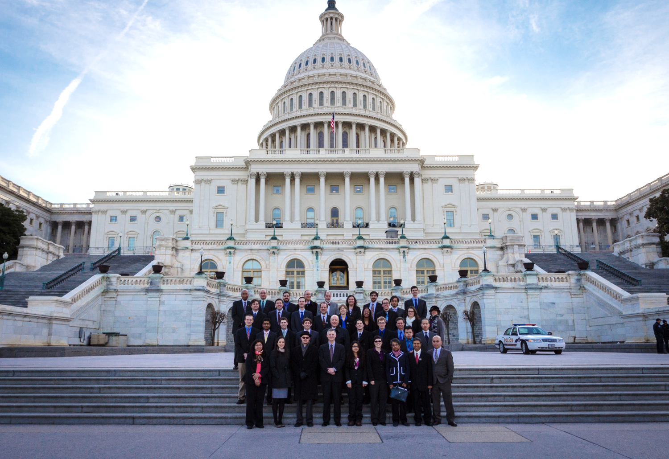
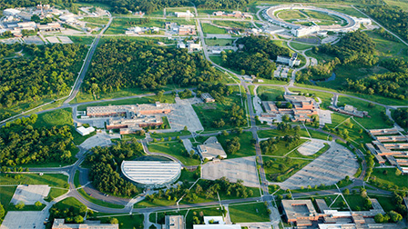
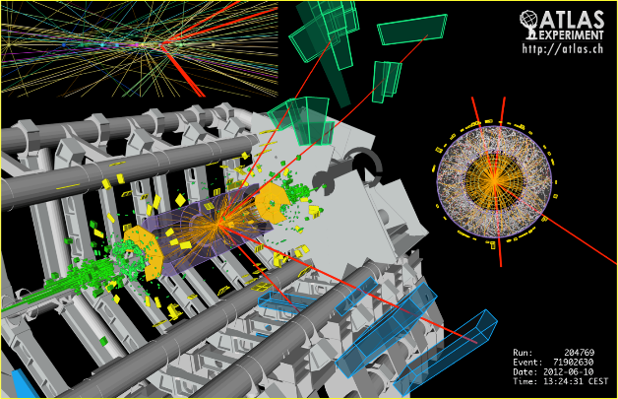
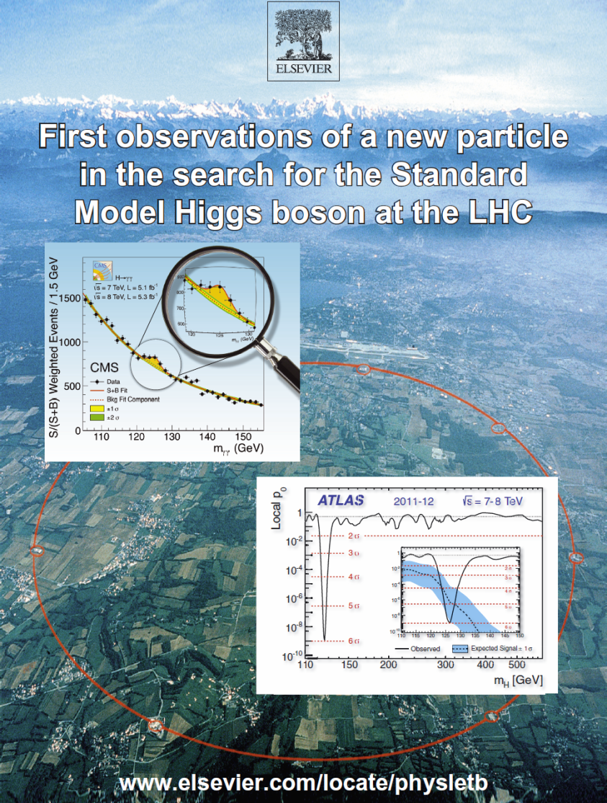
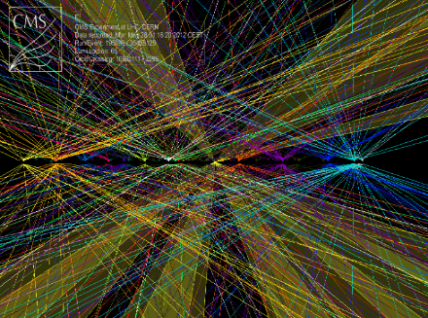

US LUA Annual Meeting
Agenda
Argonne National Lab
November 12-14, 2014
Notes:
1

Slide 2
Annual US LUA Meeting 2014 Thursday November 13 Agenda
9:00 – 9:10 Welcome to Argonne Rik Yoshida (Argonne)
9:10 – 9:40 US LUA Chair’s Report Harvey Newman (Caltech)
9:40 – 10:10 Status and Outlook of the LHC Giulia Papotti (CERN)
10:10 – 10:35 LARP Eric Prebys (Fermilab)
10:35 – 11:00 COFFEE BREAK
11:00 – 11:30 ATLAS Highlights and Outlook Chip Brock (Michigan State)
11:30 – 12:00 CMS Highlights and Outlook Tiziano Camporesi (CERN)
12:00 – 12:30 LHCb Highlights and Upgrades Mike Sokoloff (Cincinnati)
12:30 – 1:30 LUNCH
1:30 – 1:45 GROUP PHOTO
1:45 – 2:15 ALICE Highlights and Upgrades Peter Jacobs (LBNL)
2:15 – 2:40 CMS Upgrade Program Jeremy Mans (Minnesota)
2:40 – 3:05 ATLAS Upgrade Program Anadi Canepa (TRIUMF)
3:05 – 4:05 Ken Bloom (Nebraska)
4:05 – 4:25 AFTERNOON BREAK
4:25 – 4:50 Supporting Young Physicists Usha Mallik (Iowa)
4:50 – 5:15 DOE Office of HEP Report Abid Patwa (DOE/HEP)
5:15 – 5:40 NSF EPP Office Report Jim Shank (NSF)
5:40 – 6:05 DOE Office of NP Report Jim Sowinski (DOE/NP)
6:05 – 6:45 The Dark Matter and Higgs Sectors Jiji Fan (Syracuse)
7:15 – 8:30 Conference Dinner; Cocktail at 6:50
Young Physicists’ Lightning Round 1
Notes:
2
2
2

Slide 3
Annual US LUA Meeting 2014
Friday November 14 Agenda
8:30 – 8:50 Introduction; 2014 Trip to Washington Harvey Newman (Caltech)
8:50 – 9:20 US LUEC Committee Reports Committee Chairs
9:20 – 10:32
10:32 – 10:55 COFFEE BREAK
10:55 – 11:15 US – CERN Relations and the LHC Program Ruediger Voss (CERN) [**]
11:15 – 11:35 Advisory Committee of CERN Users Sridhara Dasu (Wisconsin)
11:35 – 12:35
12:35 – 1:45 LUNCH and Community Meeting on NSF and P5 Implementation
1:45 – 3:21
3:21 – 3:45 Afternoon Break
3:45 – 4:15 Outlook Following the P5 Report Andy Lankford (UC Irvine; HEPAP)
4:15 – 4:45 US HEP Program Outlook Joe Lykken (Fermilab)
4:45 – 4:55 Lightning Round Winners Announcement Ken Bloom (Nebraska)
4:55 – 5:40 Discussion; AOB
5:40 Adjourn *TBC
6:00 Dinner (self-organized) [**] by Vydio
Young Physicists’ Lightning Round Session 2
Young Physicists’ Lightning Round Session 3
Young Physicists’ Lightning Round Session 4
3
Notes:
3
3
3

Slide 4
Annual US LUO Meeting: Lightning Round 2014 Session 1 November 13
15:05 Observation and measurement of Higgs Philip Chang
boson decays to WW* with ATLAS (UIUC)
at the LHC
15:17 Physics Beyond Higgs: Searches for Sadia Khalil
Extra Vector-Like Quarks at CMS (Kansas State)
15:29 Mass measurement of the Higgs boson Laser Kaplan
in the H→ZZ*→4l channel at the ATLAS (Wisconsin)
detector
15:41 Results in B_{c} physics at LHCb Nathan Jurik (Syracuse)
15:53 A Search for Prompt Lepton-Jets in p-p Harisankar Namasivayam
at √s = 8 TeV with the ATLAS Detector (UT Dallas)
Notes:
4
4
4

Slide 5
Annual US LUO Meeting: Lightning Round 2014 Session 2 November 14 Morning
09:20 Search for resonant production of two Phillip Hebda
Higgs bosons in the two photon, two (Princeton)
b-quark final state
09:32 Evidence of Electroweak Vector Boson Jessica Metcalfe
Scattering in the same-sign WW (BNL)
channel in ATLAS
09:44 Search for Higgs production in association Daniel Knowlton
with single top quarks (Nebraska)
09:56 The UT Tracking Detector for the LHCb Matthew Kelsey
Upgrade (Syracuse)
10:08 Measurement of the differential ttbar Susan Dittmer
production cross section for high-pT (Cornell)
top quarks at 8 TeV
10:20 Search for non-pointing and delayed Andrew Hard
photons in the diphoton and missing (Wisconsin)
transverse momentum final state in
8 TeV pp collisions
Notes:
5
5
5

Slide 6
Annual US LUO Meeting: Lightning Round 2014 Session 3 November 14 Morning
11:35 Search for electroweak SUSY production Dominick Olivito
(UCSD)
11:47 Jet Reclustering in 0-lepton Direct Stop Chaowaroj Wanotayoroj
Search (Oregon)
11:59 Search for stealth supersymmetry with Marc Weinberg
photons or leptons, jets, and low MET (Florida State)
12:11 Latest Jet Results from ALICE Megan Connors (Yale)
12:23 Search for H h h  4b Souvik Das (Florida)
Notes:
6
6
6

Slide 7
Annual US LUO Meeting: Lightning Round 2013 Session 4 November 14 Afternoon
13:45 Search for W’ →tb→qqbb Decays Ho Ling Li (U. Chicago)
with the ATLAS Detector
13:57 Spin-parity measurement of H(125) Austin Belknap (Wisconsin)
using 4-lepton mode
14:09 SM Higgs searches in tau+lepton Puja Saha (NIU)
final states
14:21 UPC Physics at ALICE Barak Gruberg (Creighton)
14:33 The Global Feature Extraction (gFEX) Giordon Stark (U. Chicago)
module and its Physics Impact
14:45 The CMS L1 Track Trigger at the HL-LHC Marco Trovato (NWU)
14:57 Search for 4th generation Vector-Like Brad Schoenrock
Quarks that decay to a Z boson and a (Michigan State)
3rd generation quark in pp collisions at
√s = 8 TeV with the ATLAS detector
15:09 Search for second generation Lovedeep Saini
leptoquarks (Kansas State)
Notes:
7
7
7

