Slide 1
Alternatives to MCPs
The Tipsy single soft photon detector:
A pixelized detector for single free electrons in vacuum
with ps time resolution
Hassan Akhtar, Yevgen Bilevych, Hong Wah Chan, Edoardo Charbon,
Harry van der Graaf, Kees Hagen, Gert Nützel,
Serge D. Pinto, Violeta Prodanović, Daan Rotman, Lina Sarro,
Dennis R. Schaart, Emile Schyns, John Smedley, Shuxia Tao, Annemarie Theulings
MCP Conference
Argonne National Lab
Argonne, Ill, USA
Dec 4, 2014

Slide 2









Slide 3
Tipsy principle use pixel chip as 2D sensitive anode
dynode stack above individual pixel
set of closely spaced transmission dynodes

Slide 4
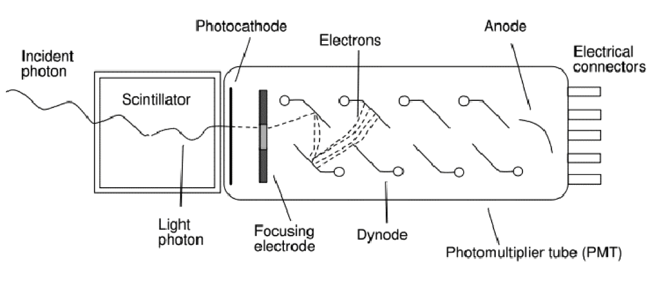
A very successful photon detector: the Photomultiplier (1934 -1936)
‘good’ quantum efficiency
rather fast
low noise @ high gain: very sensitive
little dark current, no bias current
radiation hard
quite linear
voluminous, bulky & heavy
no spatial resolution, not even 1D
expensive
quite radioactive
can’t stand B fields
Amplification by multiplication: low noise!

Slide 5
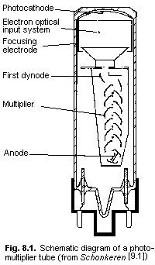

Reduce size of dynodes (volume downscaling),
and place set of dynodes on top of pixels of
CMOS chip
keep potentials as they were (V_{step} ~ 200 V)
(non relativistic) electron trajectories same
form, but smaller (volume)
multiplication yield: assume SEY ~ 4, typical for PMs
pixel input source capacity: only ~ 10 fF
required gain ~1000 = 2.5⁴ ⁼ : 5 dynodes sufficient
Apply MEMS Technology:
glass window
photo cathode
1st dynode
2nd – 5th dynode
input pads
pixel chip
1 mm
VACUUM!
No ‘gas amplification’

Slide 6
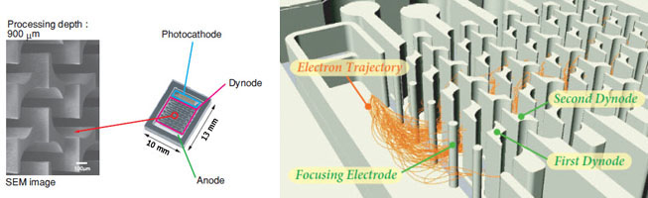
Hamamatsu: the first MEMS made μPMT
Small dynode geometry as in Tipsy

Slide 7
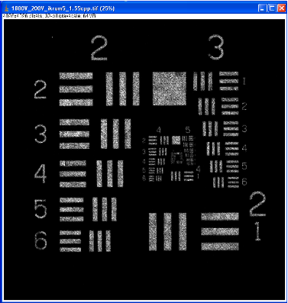
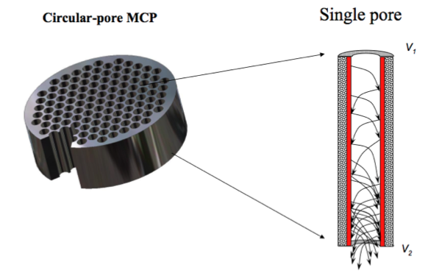
Use a MicroChannelPlate MCP?
MCP (in
vacuum)
John Vallerga: TimePix + MCPs
We do not know how to make MEMS made MCP.
Problem: aspect ratio of holes
But recently Nicolas Wyrsch (Univ of Neuchatel, Swiss) has success (NDIP 2014, Tours, France)
Quantum Limited Imaging Detectors, RIT 2009, John Vallerga, jvv@ssl.berkeley.edu

Slide 8
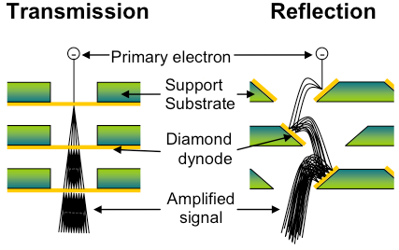
New: the Transmission Dynode:
faster
more compact
B compliant
rad hard

Slide 9
window + photo cathode
Ultra thin planar dynode membranes
vacuum
CMOS pixel chip
Thin (~10 nm), planar dynodes, spaced ~ 30 μm
CMOS pixel chip, square pitch ~ 55 μm
Electron crossing time ~ 5 ps: straight short path due to homogeneous E-field
With gain of ~ 30 k: digital (1 V) signal on pixel input pad (small source cap)
Very strong electric field between dynodes, but far away from Fowler-Nordheim limit
B-field has little influence since Lorentz force is small wrt. electrostatic force
Signal development on pixel chip defined by crossing of the last gap (~ 2 ps)
No ion feedback (not even a little bit)
Noise-free electron multiplier
No bias current: no bias current noise or bias current dissipation
radiation hard
“the best electron is a free electron”

Slide 10
Competitor:
Si-Photomultipliers (APDs, SPADs, D-APDs)

Slide 11
Competition: Silicon Photomultipliers Photo Diodes
Avalanche Photo Diodes APD
Single Photon APD SPAD
Digital SPAD
Very popular:
Planar, thin
Cheap
Operate in B-field
Potentially QE = 1
faster than PMTs
But they are:
noisy
have bias current
suffer afterpulsing
hard to pixelize
limited to ~ 40 ps
not so radhard

Slide 12
Essential difference between SiPMs and Tipsy
noisy <==> free-of noise
E_{e} = ~ 250 eV
E_{e} = 1.2 + Δ eV
4 - 40 V
1200 V
SiPM
Tipsy/MEMBrane

Slide 13
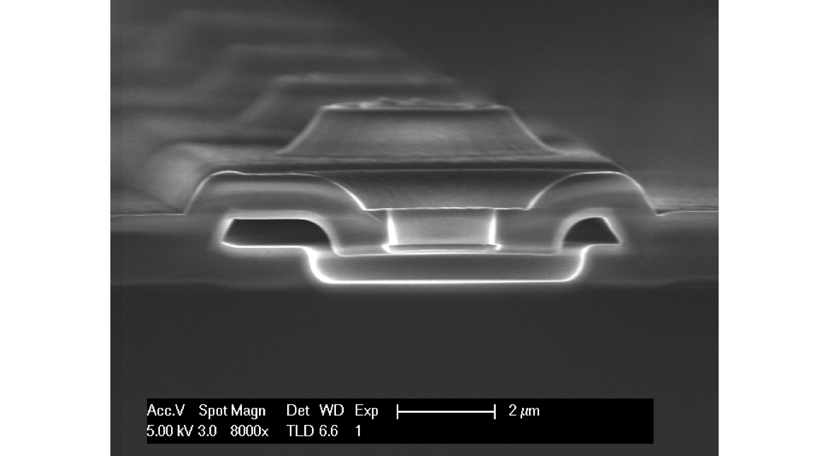
Thickness 15 nm!
SiliconNitride
Ultra thin membranes
Delft University of Technology: DIMES

Slide 14
window + photo cathode
Ultra thin planar dynode membranes
vacuum
CMOS pixel chip
First (2D) simulations: influence magnetic field
0 Tesla 1 Tesla

Slide 15
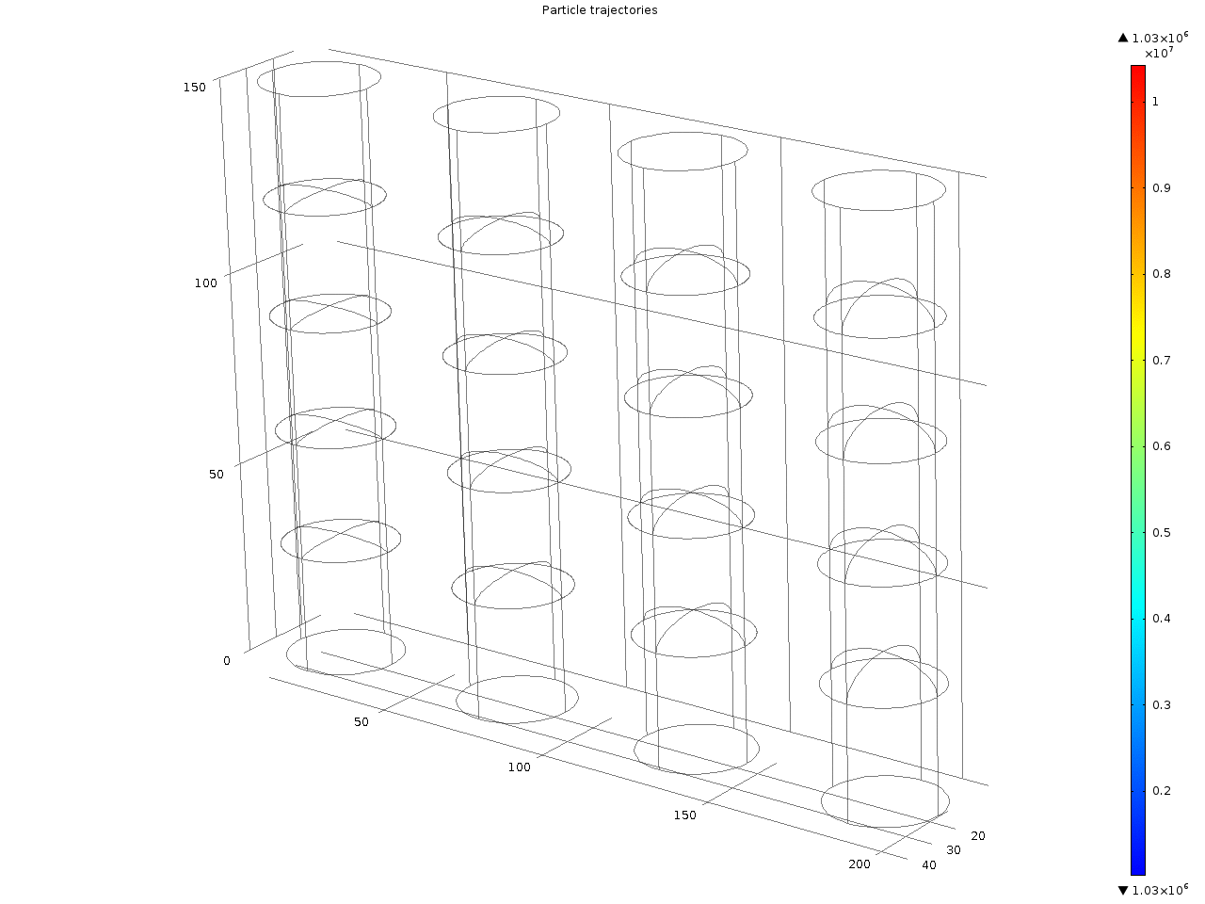

Slide 16
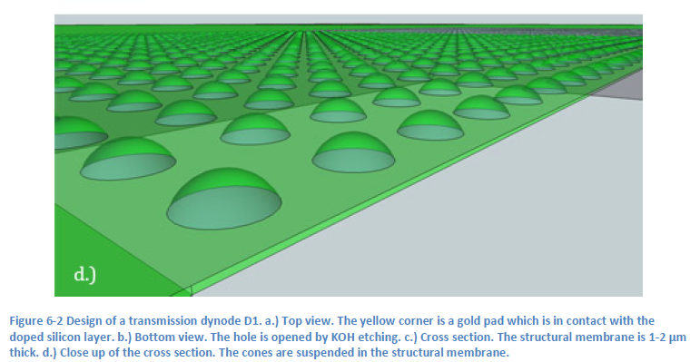
Array of ultra thin domes

Slide 17
A new single, free electron detector in vacuum
transmission dynodes
+
pixel chip
MicroElectronicMechanicalSystems ‘MEMS’ Technology
- ultra thin membranes
Cone shape dynode section:
  focusing electron from above
  focusing emitted electrons
  mechanically robust: larger diameter cones feasible

Slide 18
Timed Photon Counter
TiPC, Tipsy
Fast: electron mobility is highest
for free electrons in vacuum
Low noise: no bias current
Thin, planar, light single soft photon detector
Electron crossing time t_{c} = D √ (2 m/qV) = 5 ps for V = 150 V, D = 20 μm
Electron path: quite straight line towards next dynode
30 k e- enough for digital signal on pixel input pads: 7 dynodes adequate
Signal response after 7 x 5 ps = 35 ps
Time resolution determined by last electron crossing time: ~ 2 ps
Spatial resolution determined by pixel granularity (55 μm x 55 μm)
No noise from electron multiplier, no bias current from electron multiplier
Radiation hard
Operates in magnetic field
But:
Secondary electron emission yield not known
Very strong electric field between dynodes: Fowler-Nordheim limit (10⁹ V/m)
QE limited by QE of classical photo cathode (20 – 40 %)!

Slide 19
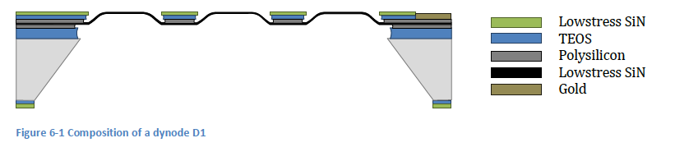
Transmission Dynode construction

Slide 20
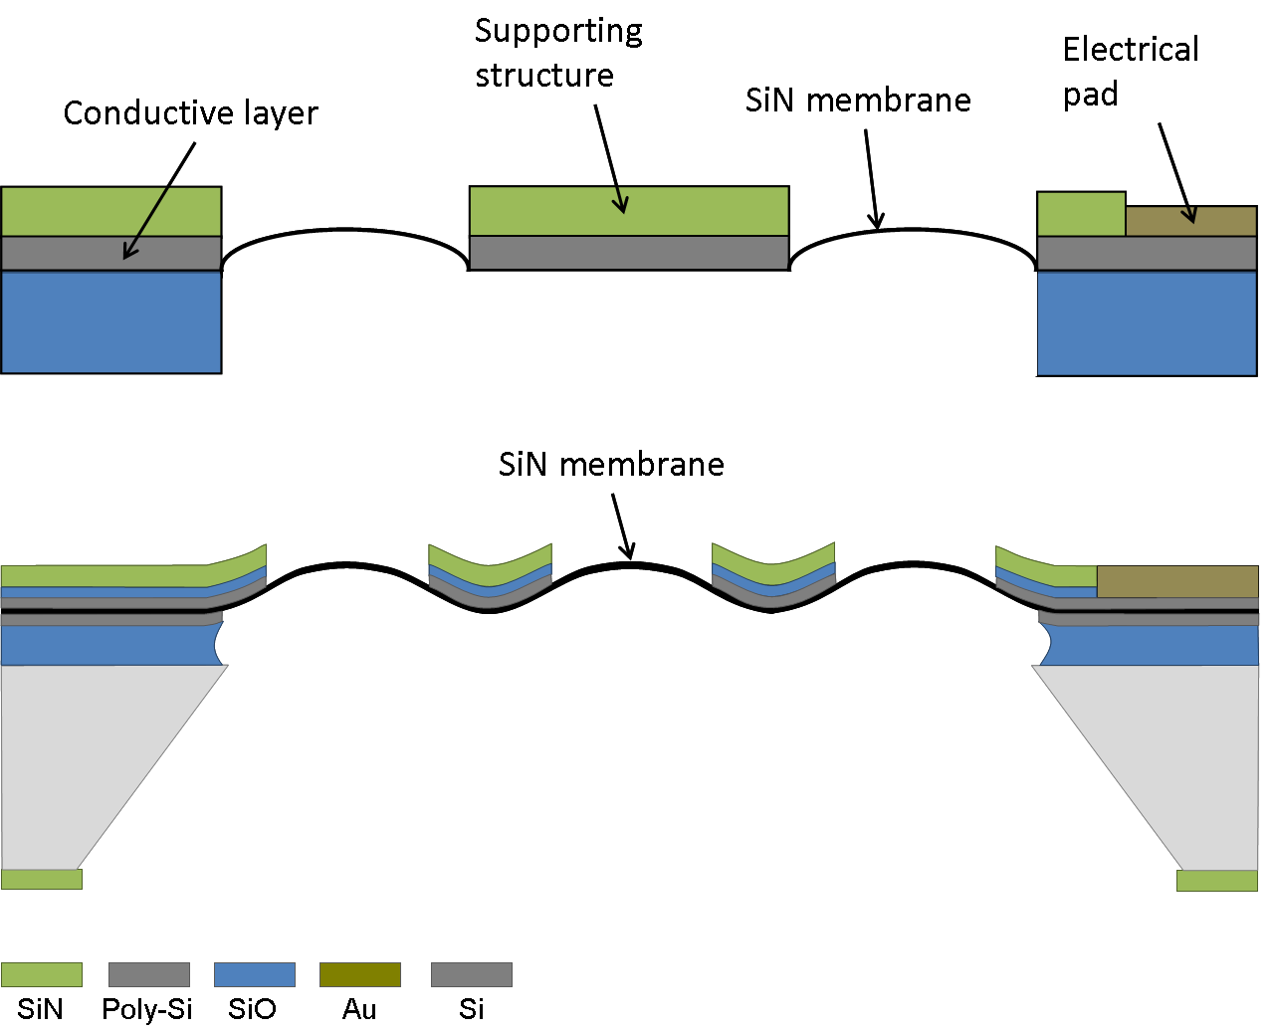
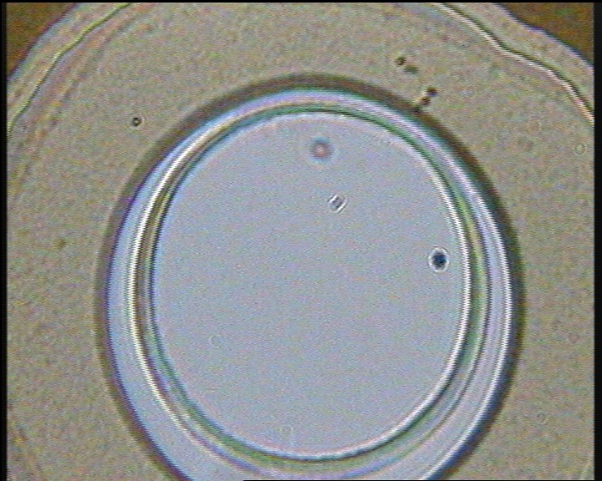
Fabio Santagata
Lina Sarro
Hong Wah Chan
Violeta Prodanović
DIMES, TU-Delft
dia 25 μm
15 nm thin dynode material
Si Rich SiNitride (SRN)
First realistation of transmission dynode @ DIMES, Delft University of Technology

Slide 21
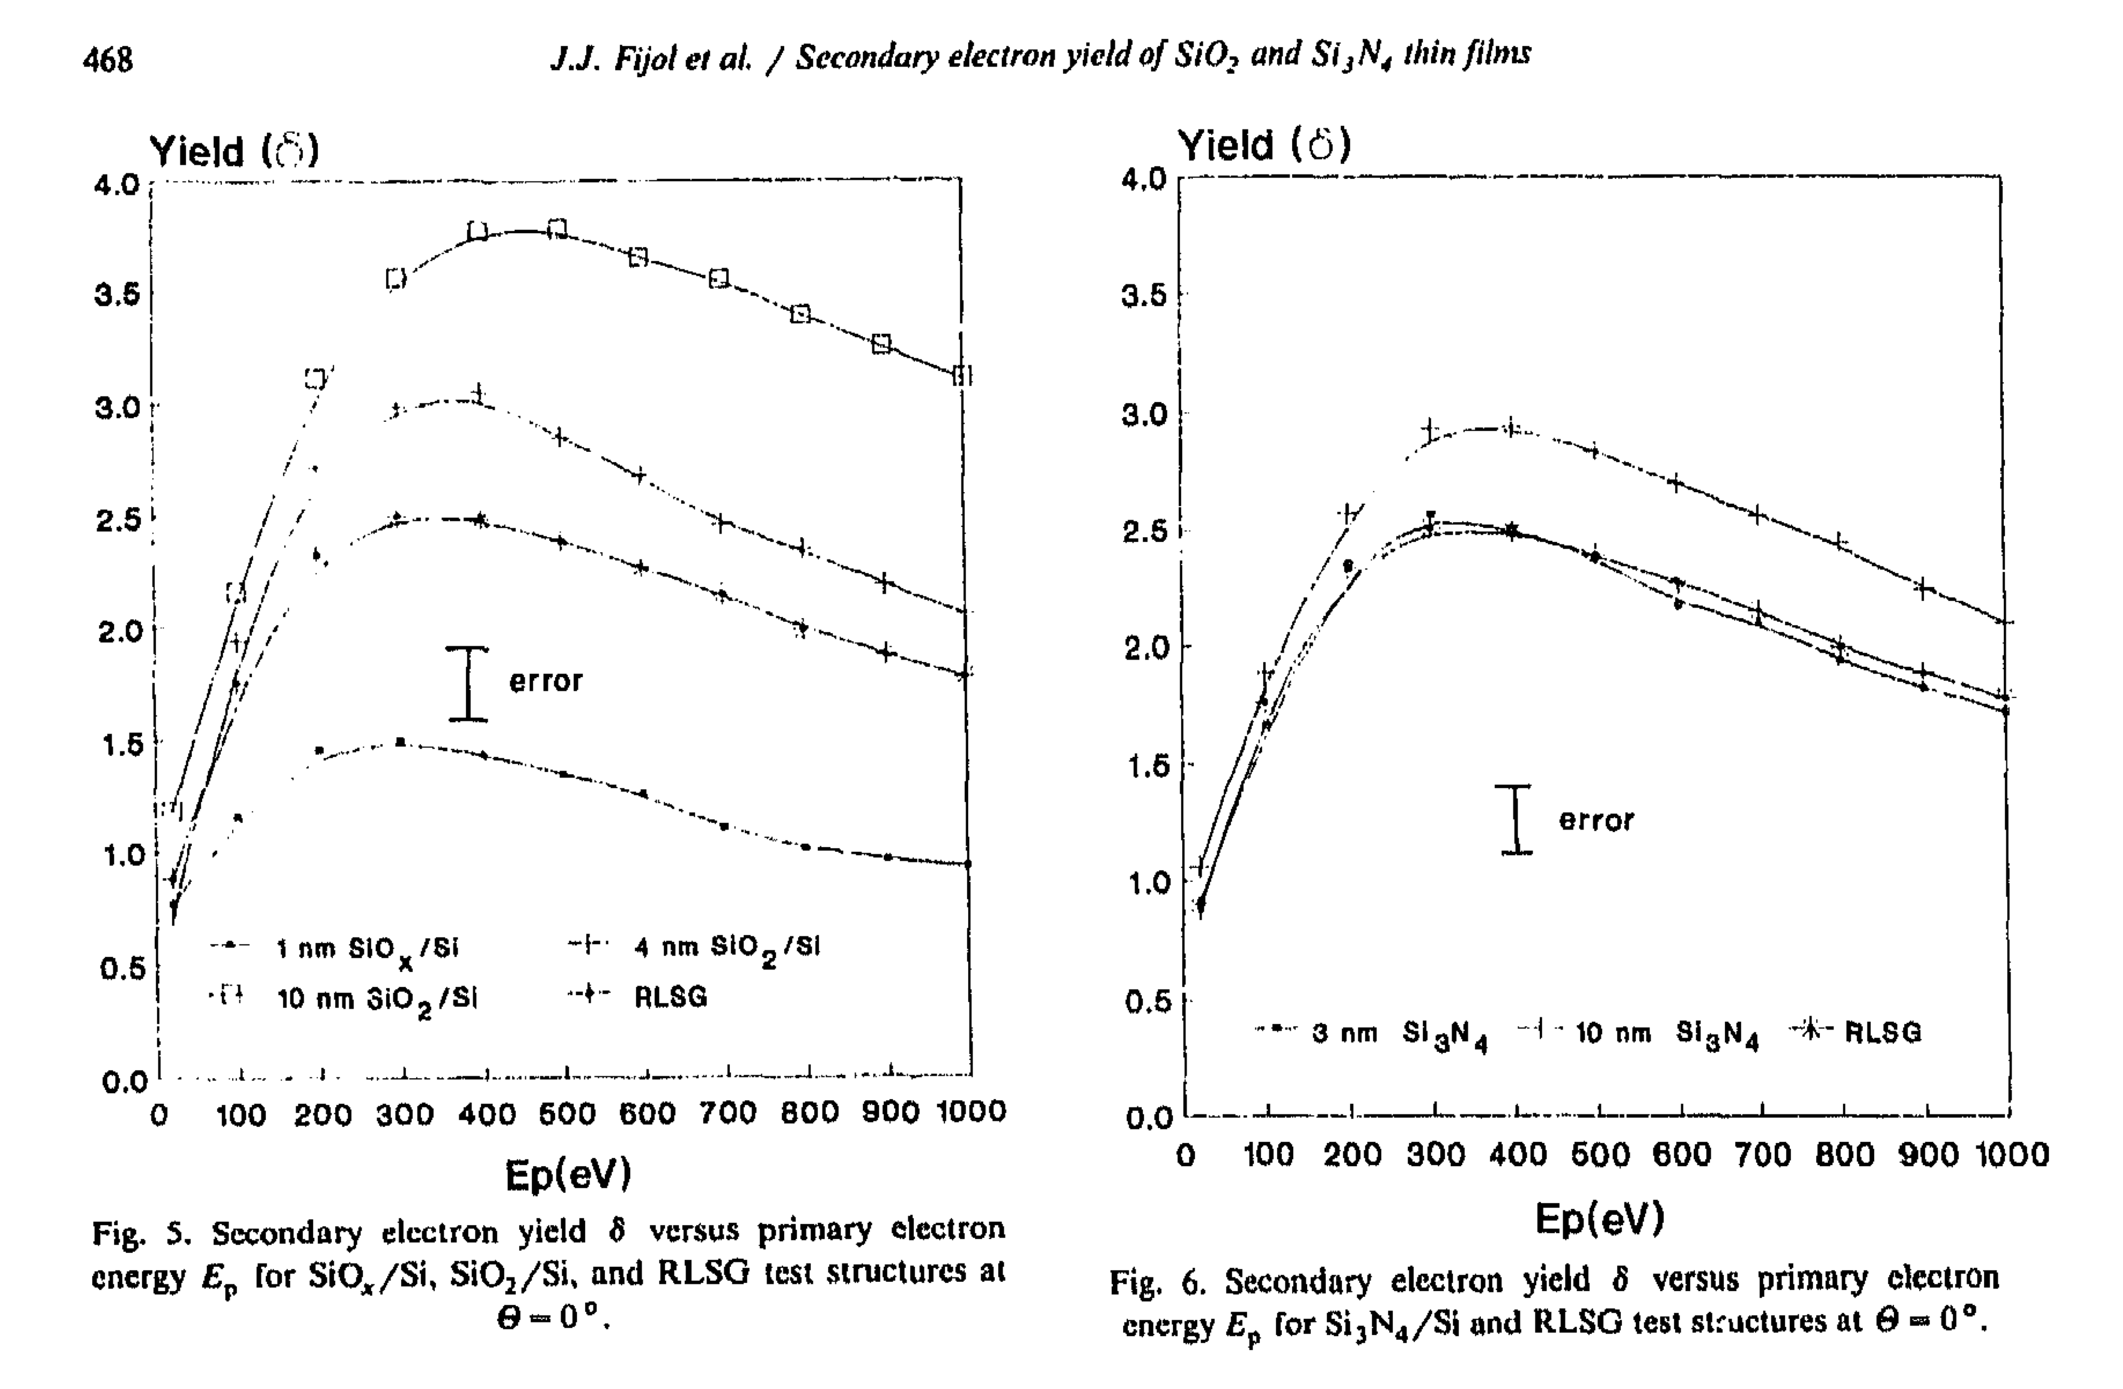
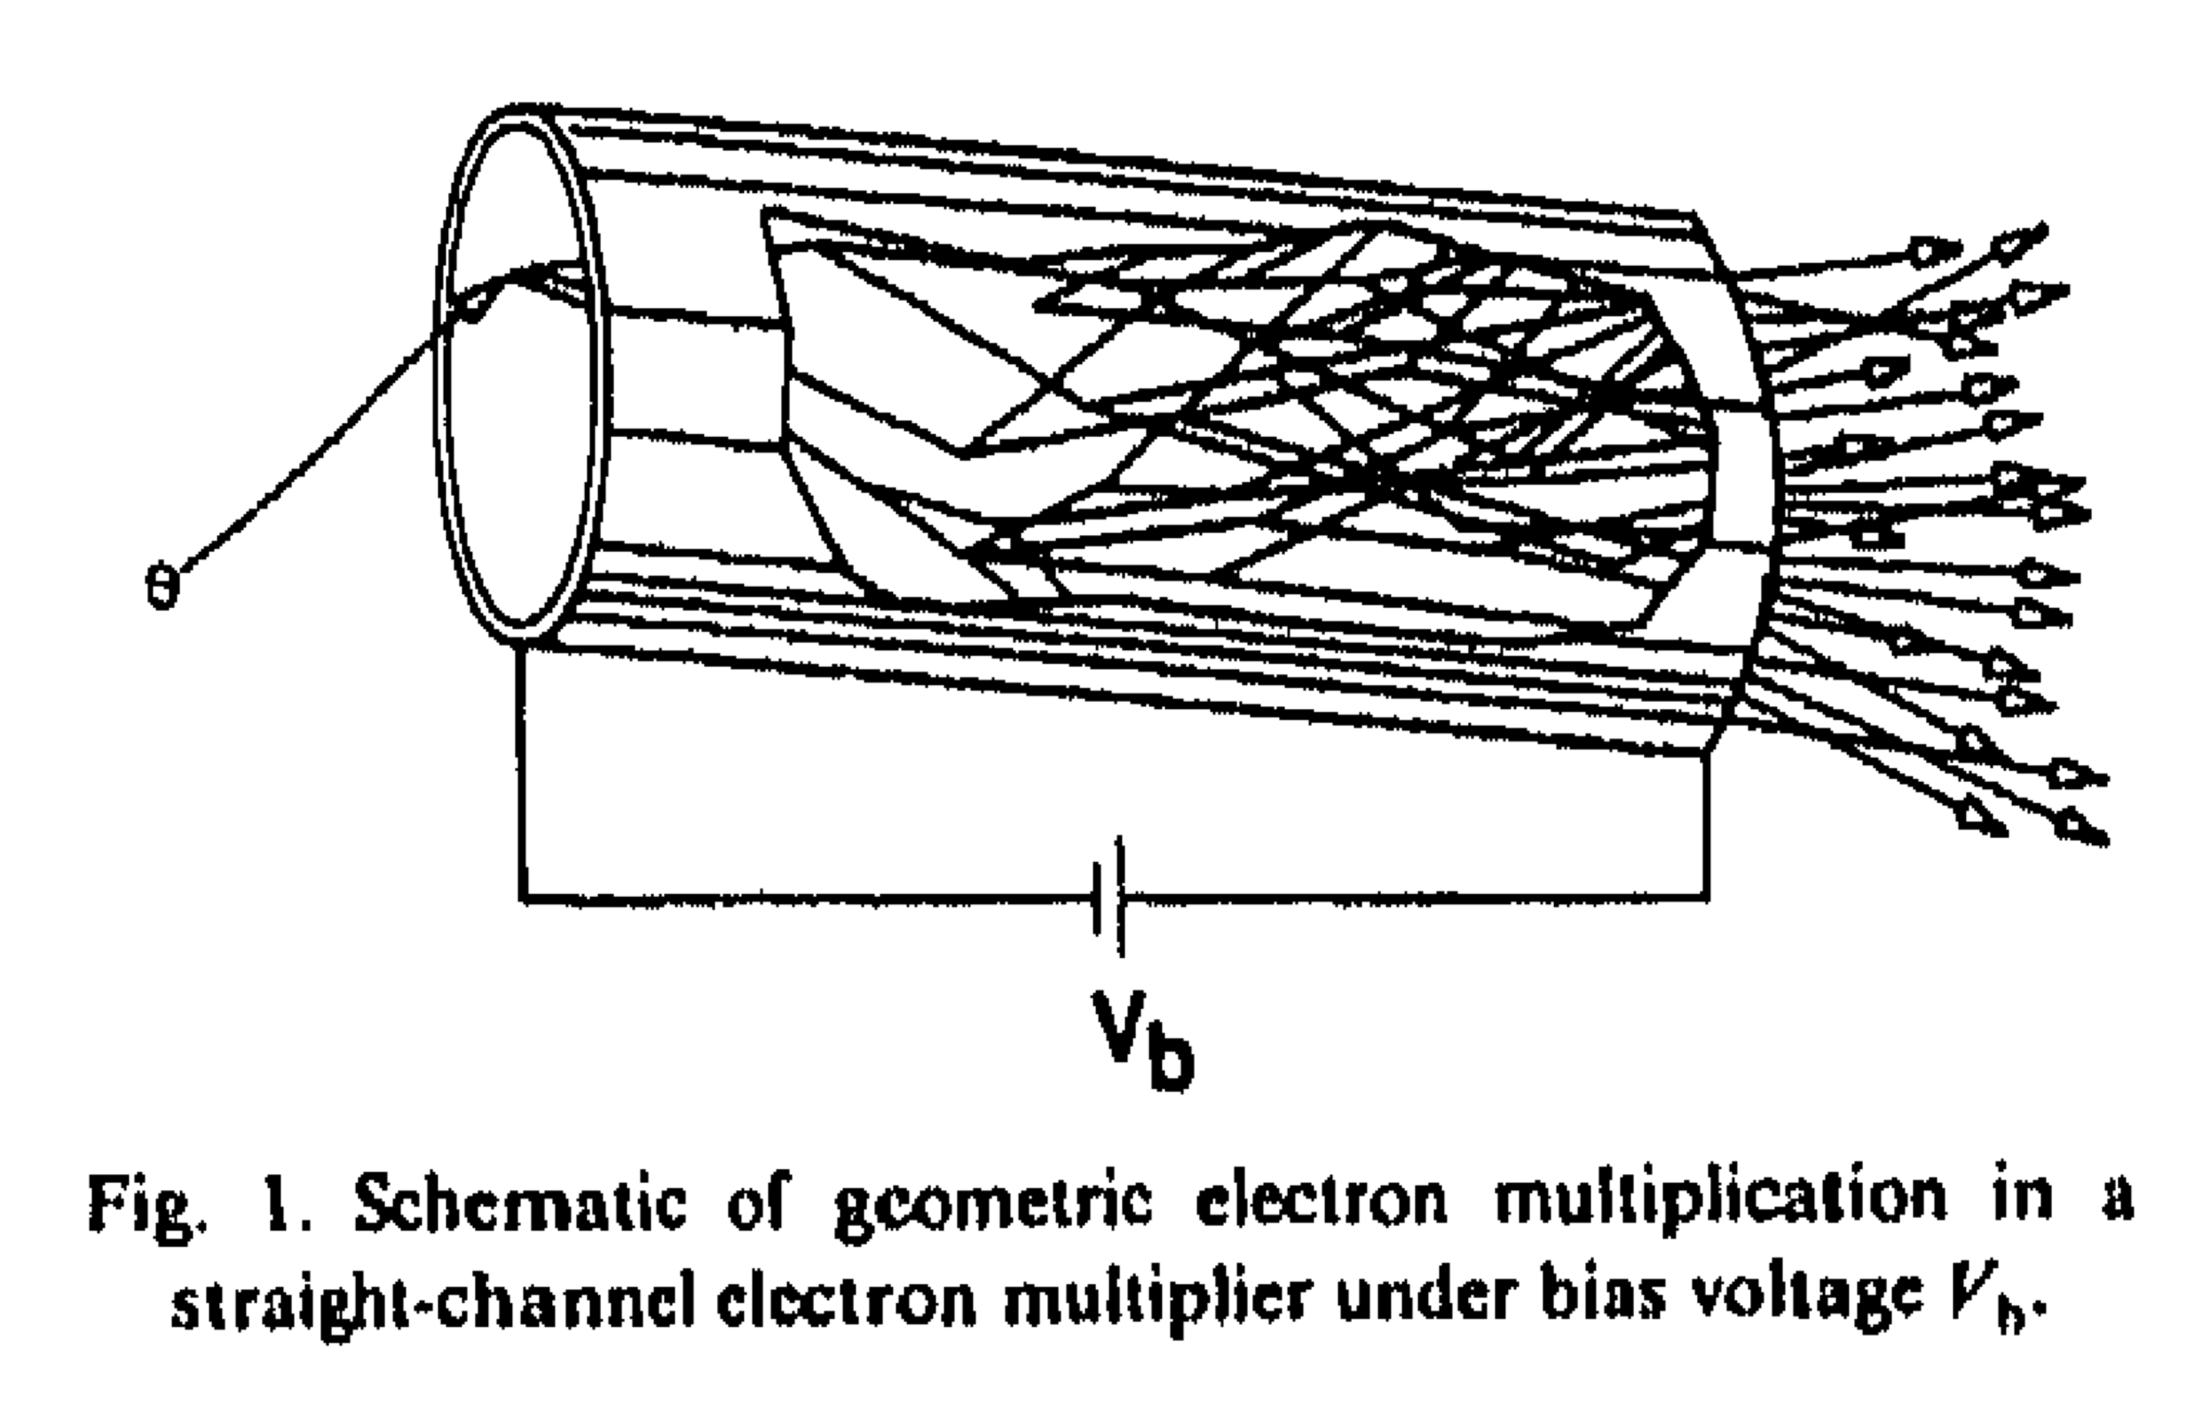
Secondary electron emission yields of SiNitride: Fijol et al.

Slide 22
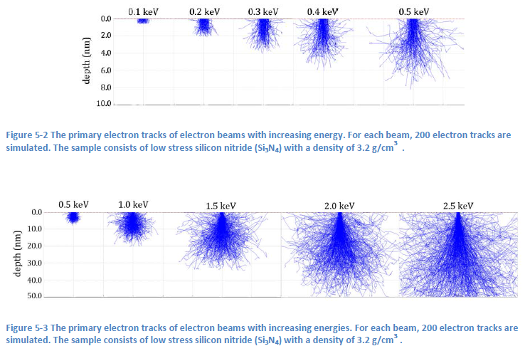
Depth-of-penetration of 300 eV electron
in dynode material: ~ 5 nm
from simulations
from SEY of reflective dynodes with different active layer thickness
Expected for
transmission dynodes:
SEY same order as for reflective dynodes
SEY above about equal to SEY below

Slide 23
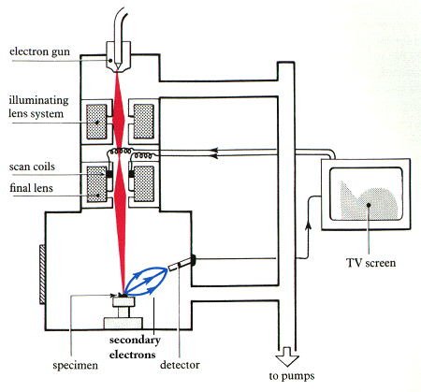
Secondary Electron Yield
SEY Measurement 1 in SEM
Dual Faraday Cup in SEM
made at Nikhef
SEM/TEM to measure reflection/transmission SEY@
Particle Optics Group TU Delft

Slide 24
Dual Faraday Cup
i_{top}
i_{tmesh}
i_{sample}
i_{bmesh}
i_{bot}
incoming primary beam
secondary electrons (reflective and tranmission)
backscatter & punch through electrons

Slide 25
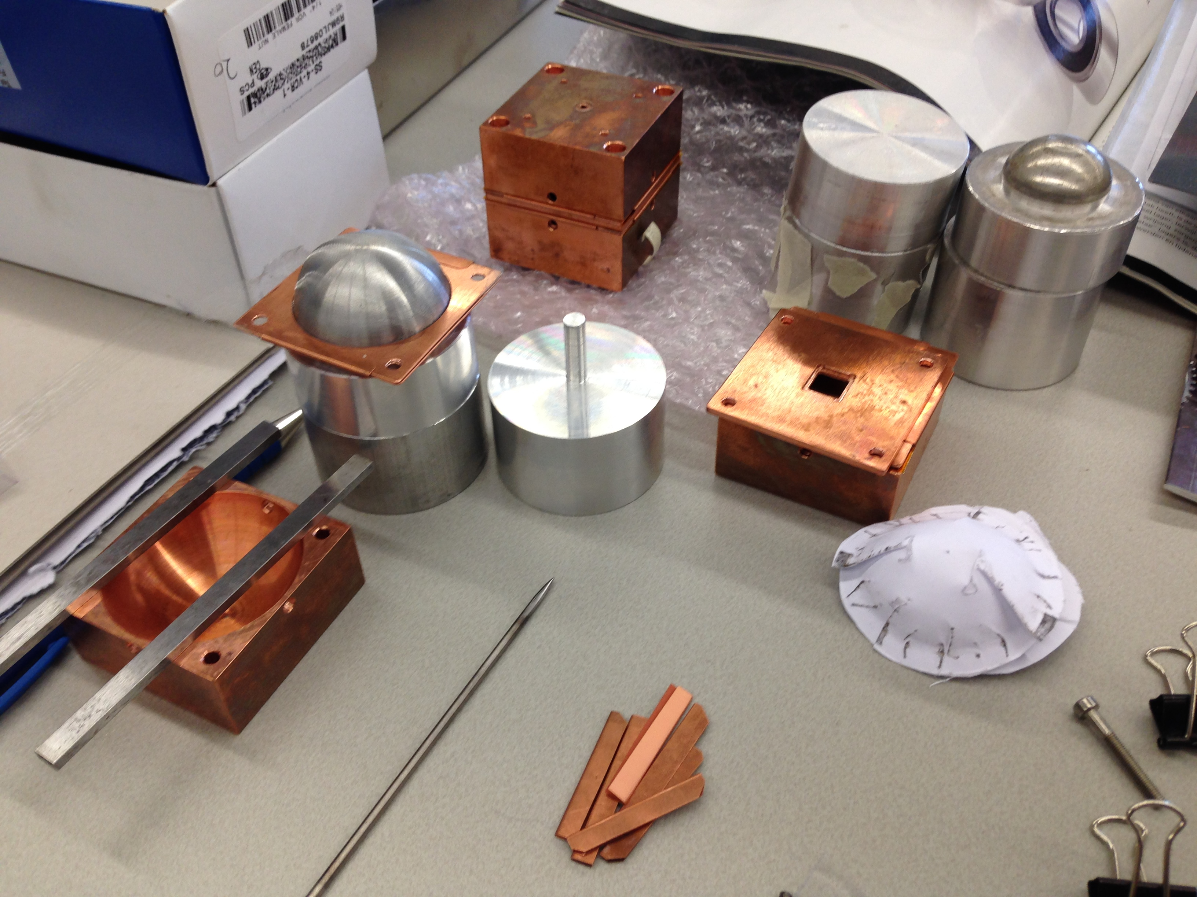
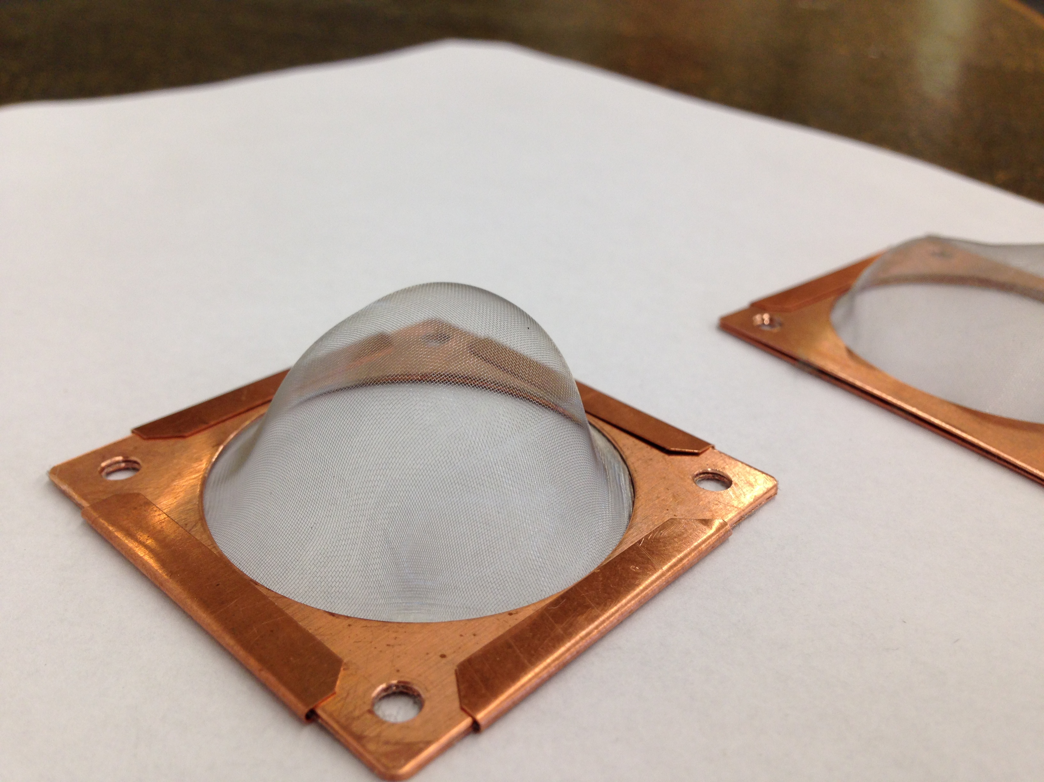
Dual Faraday Cup
First preliminary result: SEY (transmission) = 1.3
suffer charge up effects

Slide 26
SEY measurement 2
Set-up at Nikhef
electron gun
(Kimball Physics)
dynode under test
TimePix

Slide 27
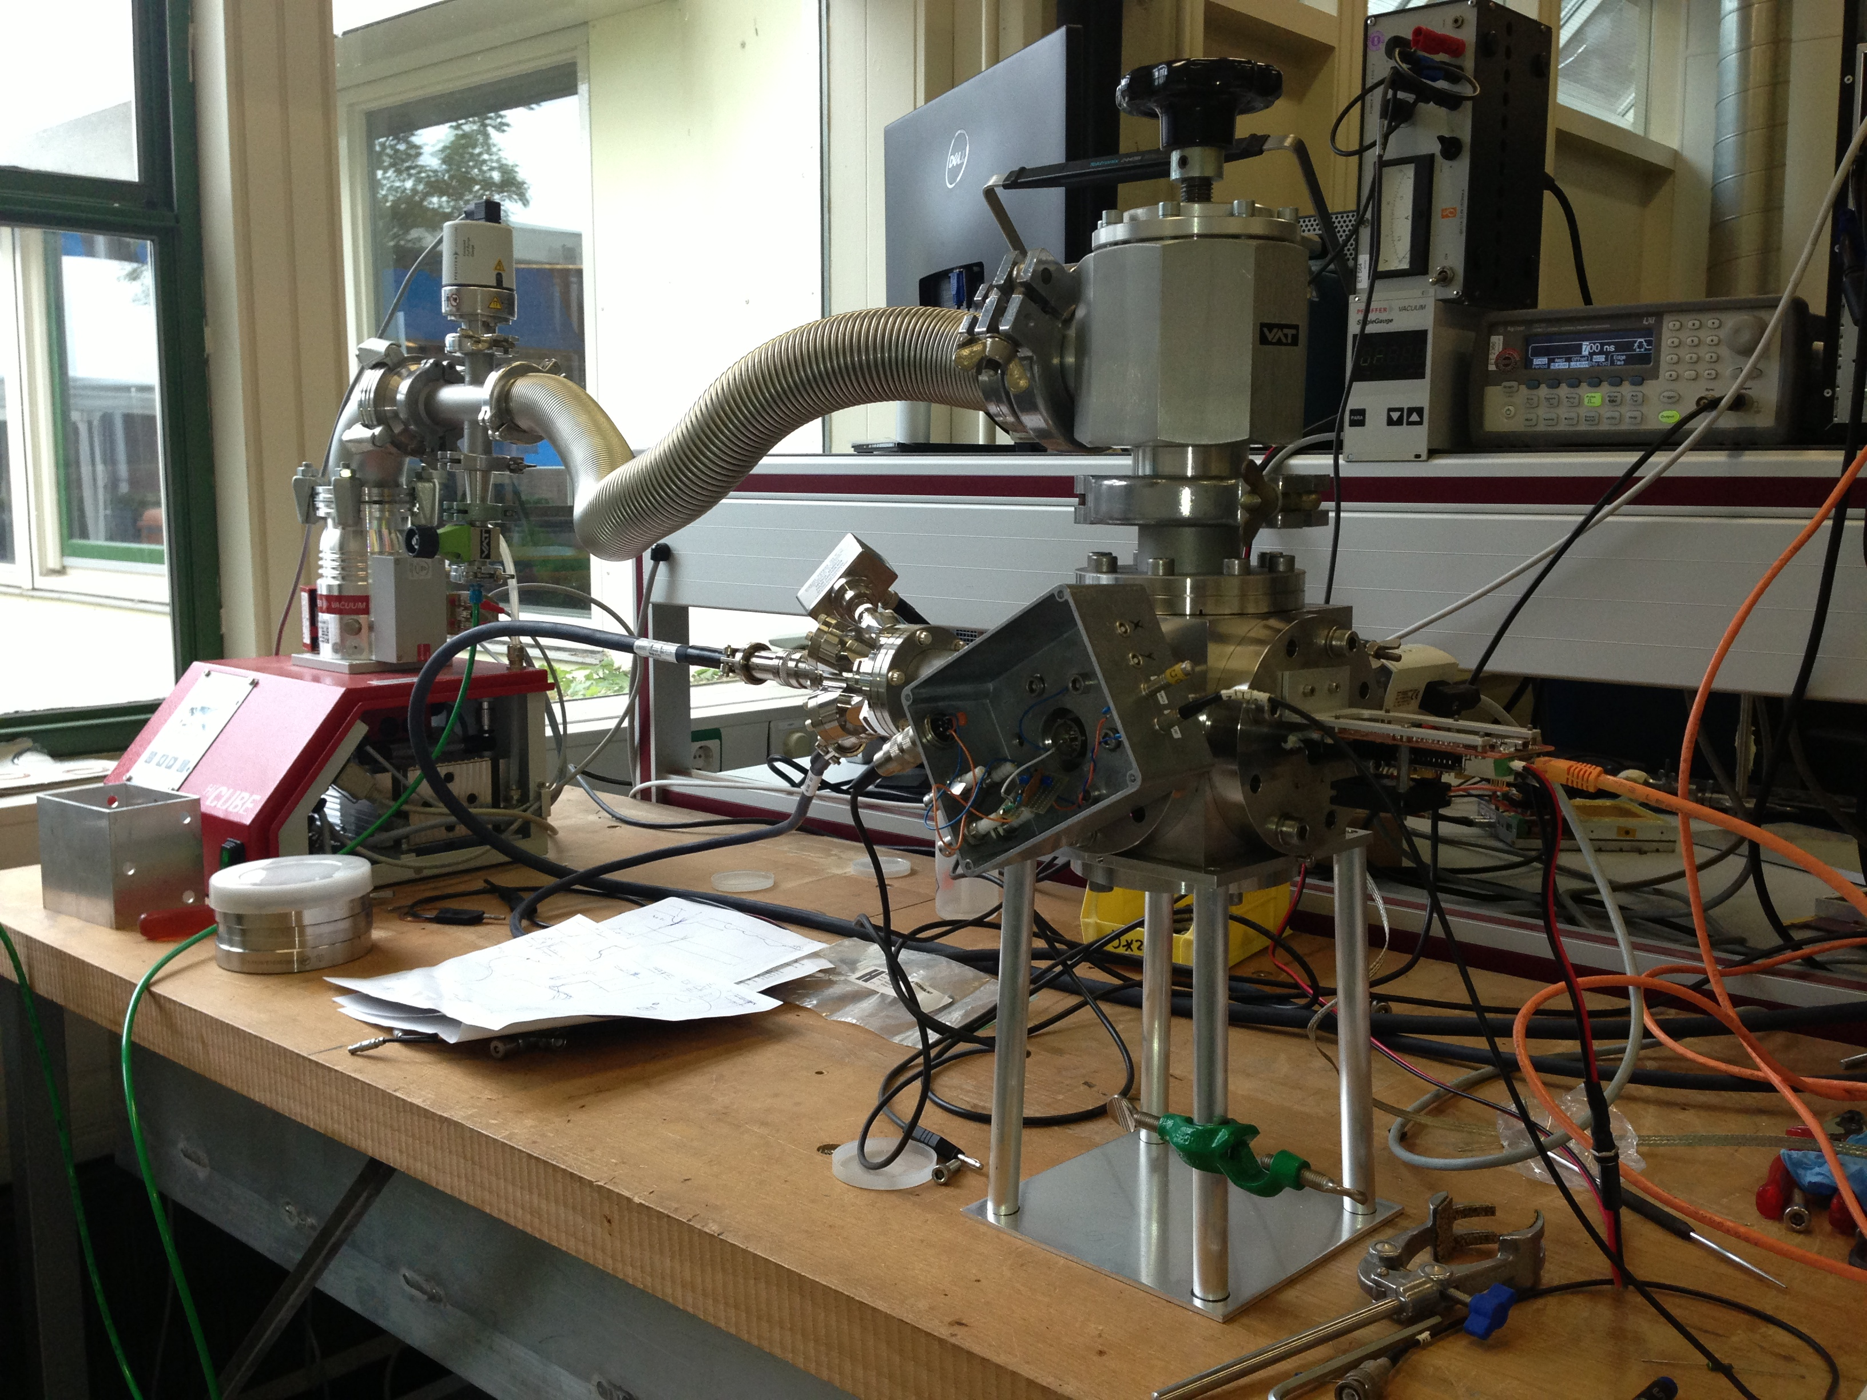

Slide 28
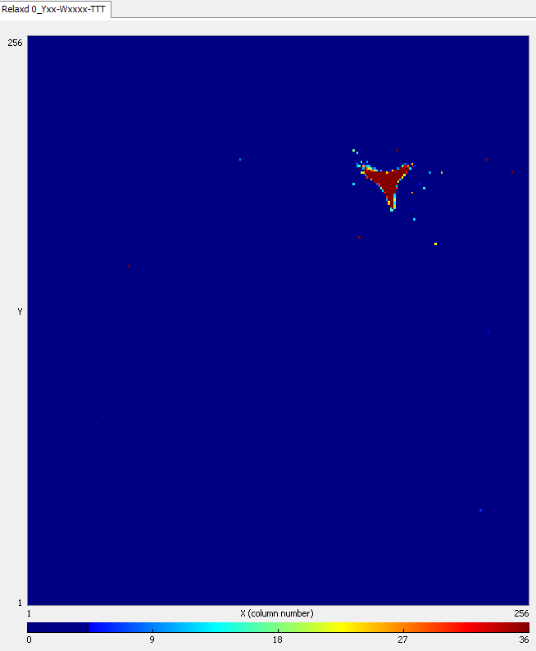
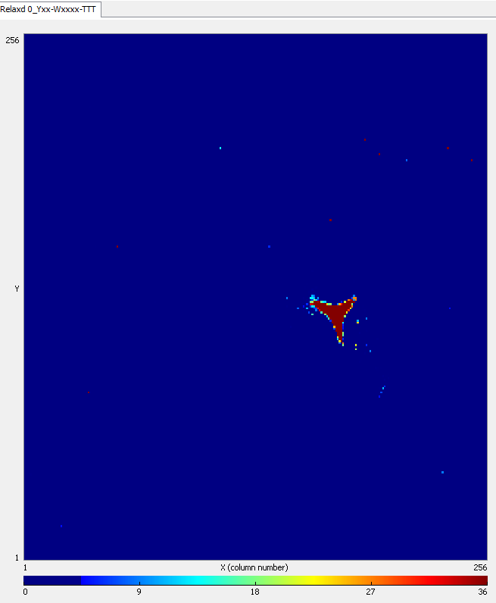
60 eV electrons on TimePix (without dynode)
….with a permanent magnet placed 1 m away…..

Slide 29
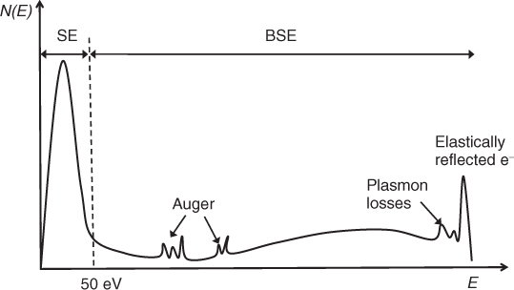

SEY Measurement 3
Photo emission spectrum (PES) - a new way of measuring SEY in Si₃N₄ proposed by John Smedley
Photon( about 400eV) ➔ Auger electron( 400 eV) ➔Secondary electron
obtain energy distribution
by varying inverse bias voltage
First round measurements April 2014
@synchrotron rad. beam line NSLS Brookhaven National Laboratory;
Second round proposals @BESSY Berlin & ALS LBNL

Slide 30
Theoretical support
Solid State Physics (no high energy physics!)
Inpact of ~500 eV e⁻ in matter:
  energy transfer to electrons
  scattering, phonon production
result: distribution of energetic electrons in volume dV
Propagation (diffusion) of energetic electrons to surface
(cross sections, phonon losses)
Electron emission in vacuum: electron affinity (Work Function, Escape Potential

Slide 31
Low-energy GEANT extensions
Fig. 1. Schematics of a transmission dynode. Primary electrons (PE) hit the dynode from the top, secondary electrons (SE) and back scattered electrons (BSE) leave the dynode from the top and forward scattered electrons (FSE) and transmission secondary electrons (TSE) leave the dynode from the bottom.
transmission and forward scattered
electron yield as a function of the
energy of the incoming electron.
Layer thickness 20 nm. An electron
affinity of 1,5 eV was assumed

Slide 32
Data from NSLS-Brookhaven
Fig. 4. Measured SE counts for a SRN sample irradiated with 420 eV photons. The sample is biased by -15V.
Fig. 5. Simulated spectrum of the energy distribution of SE’s where the photons create 'primary electrons' of 300 eV in the sample. The electron affinity is taken to be 1.5 eV. The simulated sample is not biased.

Slide 33
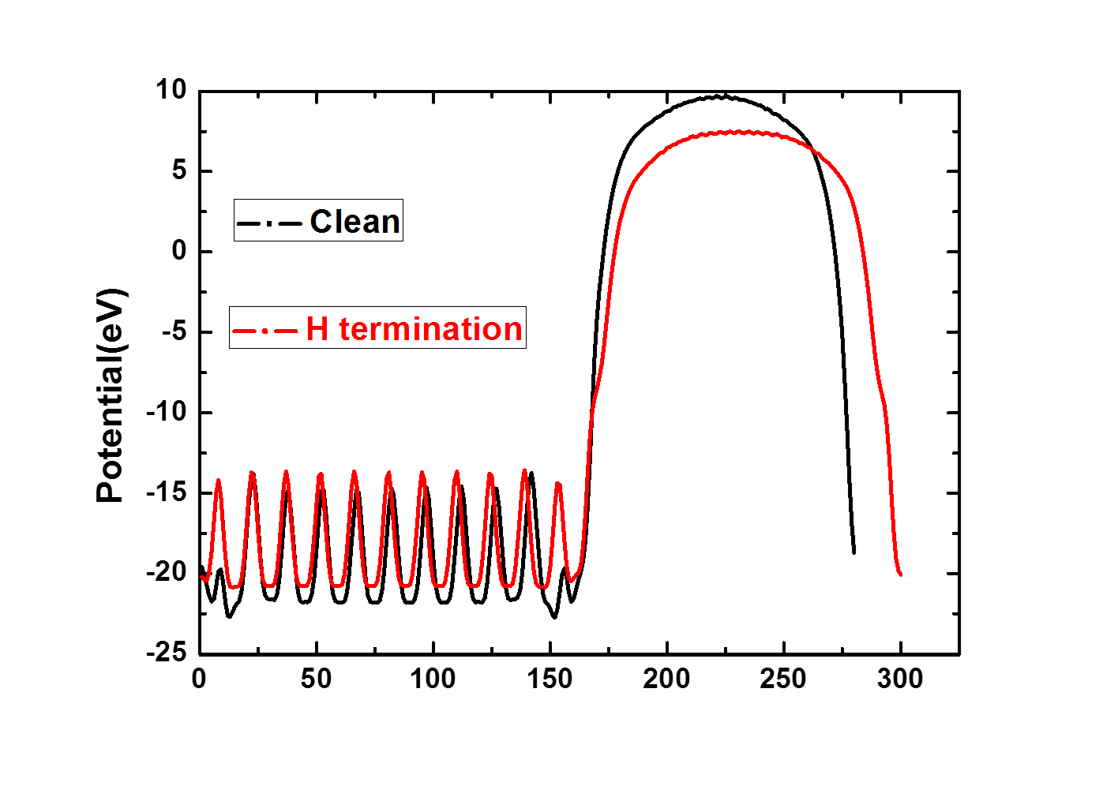
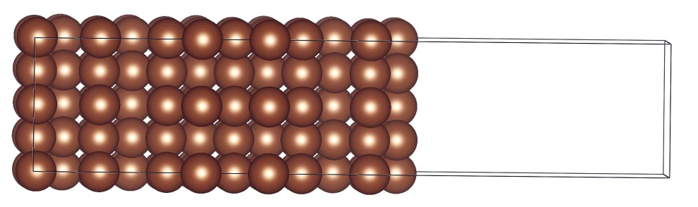
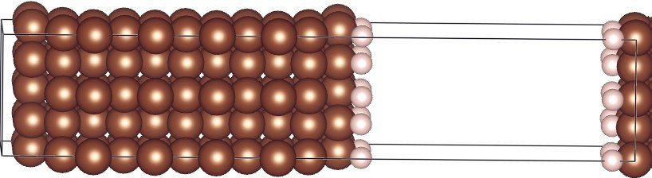
Electron Affinity:
Density Functional Theory DFT Simulations
Vienna Ab-Initio Simulation Program
VASP
Important results on H termination and alkli
metal and metal oxide
H termination on diamond
- Negative Electron Affinity
- Enhanced SEY

Slide 34
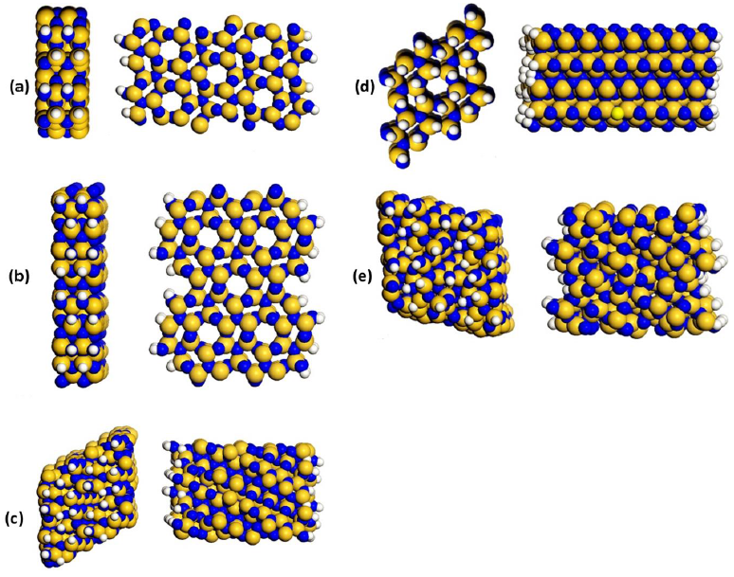

Slide 35
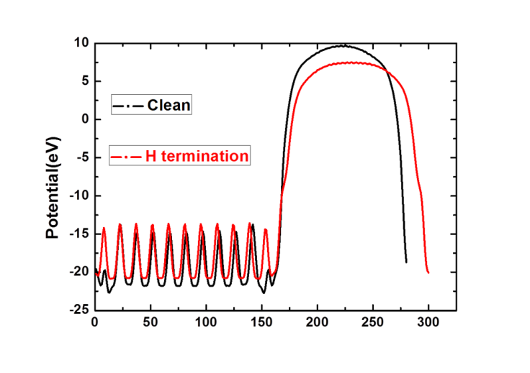
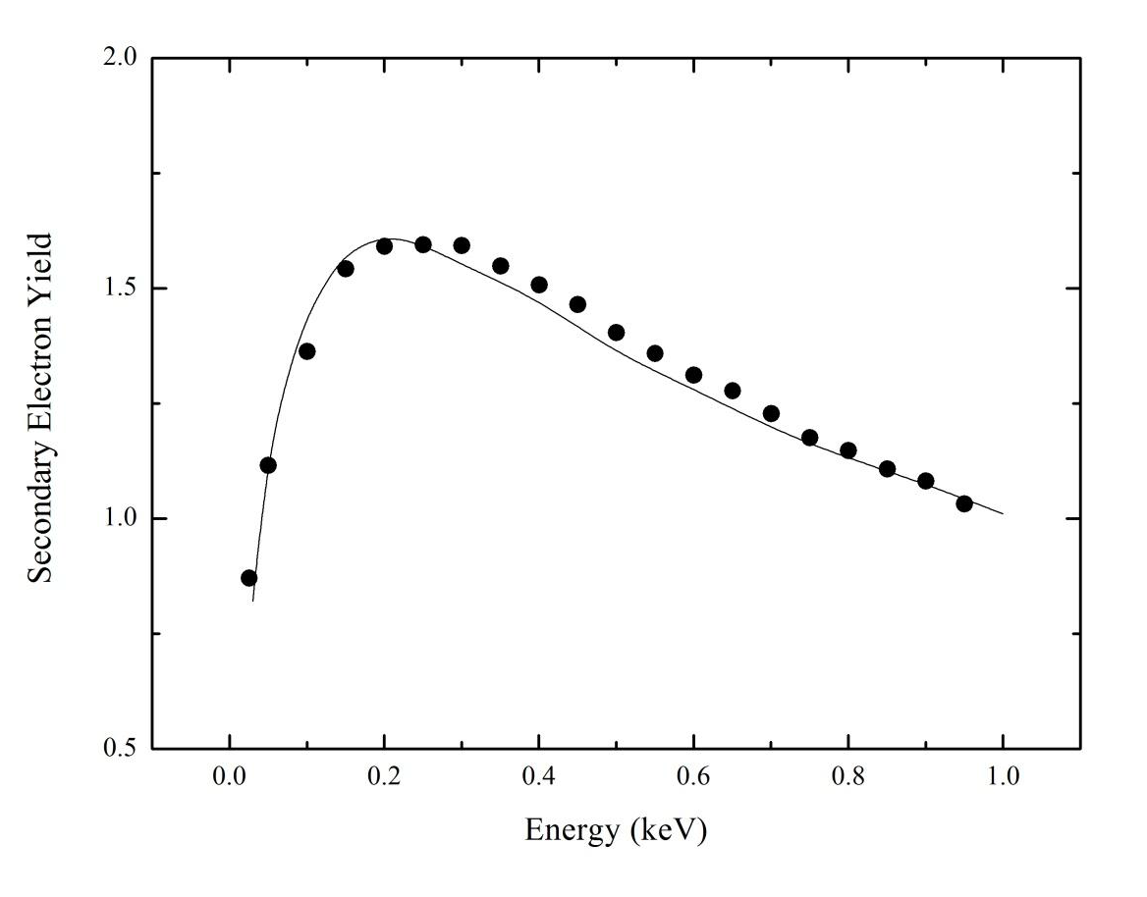
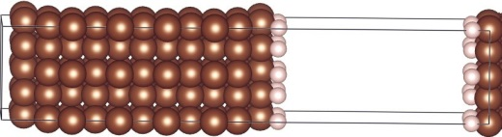
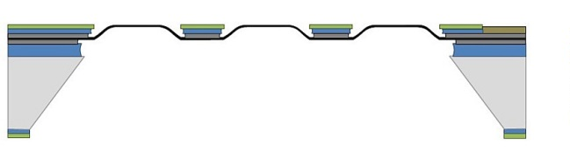
Density Functional Theory simulations
Monte Carlo simulation
Electronic
structure,
work function,
optical data
Model
validation
SEY
Energy spectrum
Select doping/
coating candidates
Fabrication
Material
Property
Dynode fabrication
SEY measurements

Slide 36
The low-energy simulations seems to agree with the photon test beam data
A clear difference in SE emission was observed from SiNitride samples
unprocessed and H- terminated
Electron affinity can be well calculated using ab-initio simulations.
It has been predicted that H-termination works for SiNitride as well as
diamond (which is known). Li-termination may even be better

Slide 37
For tracking of fast charged particles (MIPS):
Replace photocathode (depleted Si or gas) by:
electron emission membrane e-brane
Emits (at least one) electron at the
crossing point of membrane surface
and MIP, with a high probability, in vacuum
e-brane
aluminium foil:
- at least 1 electron is emitted in 2 - 4 % of the cases
energy of electron: 0 – 5 eV
probability depends on surface condition
increase to 6 % if layer of AlOxide is present

Slide 38

electron emission membrane ‘e-brane’
Issue: to reach a high yield (prob. to emit at least one electron) > 50 – 95 %
low work function material (low exit potential)
Plain aluminium foil: 2 – 4 % yield
2. Surface enlargement
Skin effect: only ~ 50 nm
surface layer participates to yield
3. Field assistance
(depletion layer)
4. Strong extracting E-field
Fractal
nano grass
…..needs solid state (theoretical) physicists…..

Slide 39
Electron Affinity
Interesting: - photo cathodes of PMs (bi-alkali etc)
- coating of dynodes of PMs
What is the yield of a photocathode?
120 GeV pion+
100 % yield, due to Cerenkov photons created in entrance window
With pions+ from opposite direction?

Slide 40
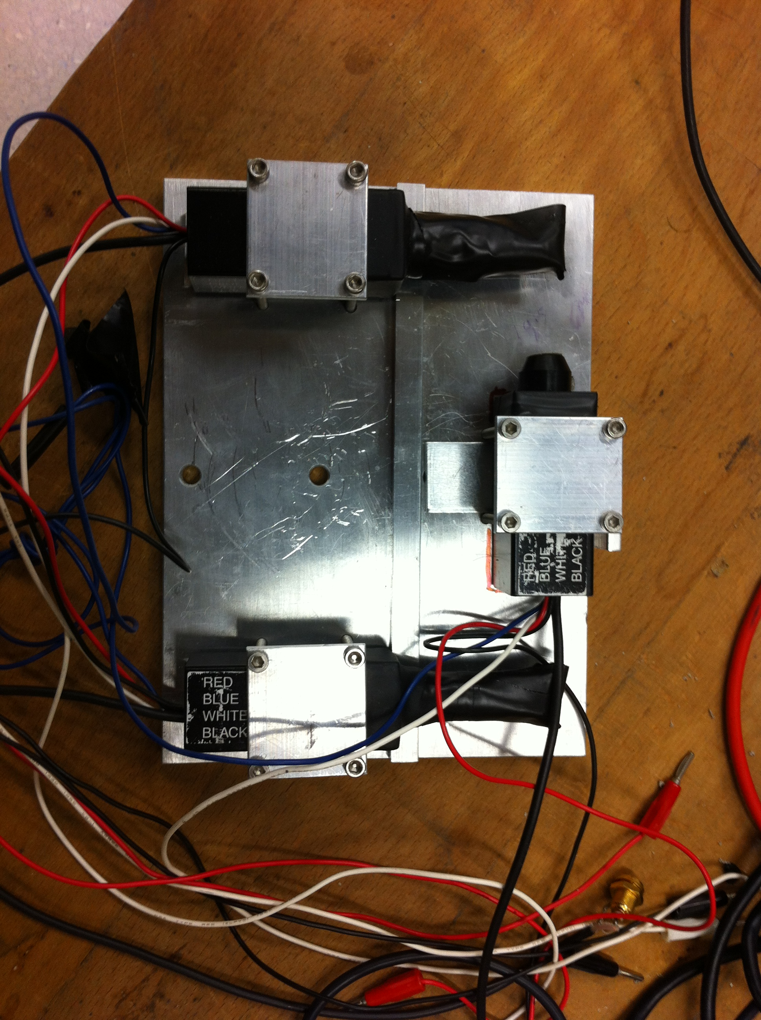
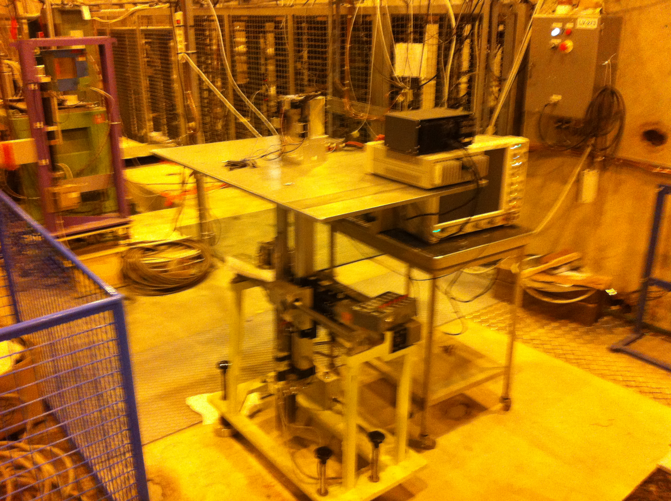
First test in 120 GeV pion beam (H6B ATLAS/MAMMA), Sept 21 2012.
Second test with photon absorber on window at RD51 testbeam on Nov 12, 2012.
~ 51 Ch photons expected
in 2 mm crown glass window

Slide 41
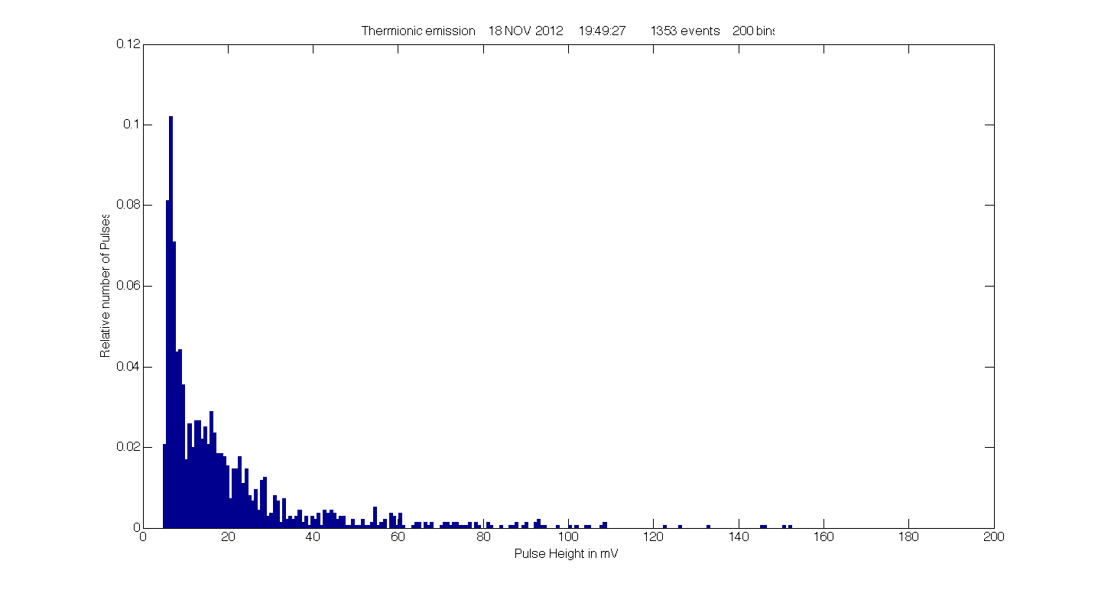
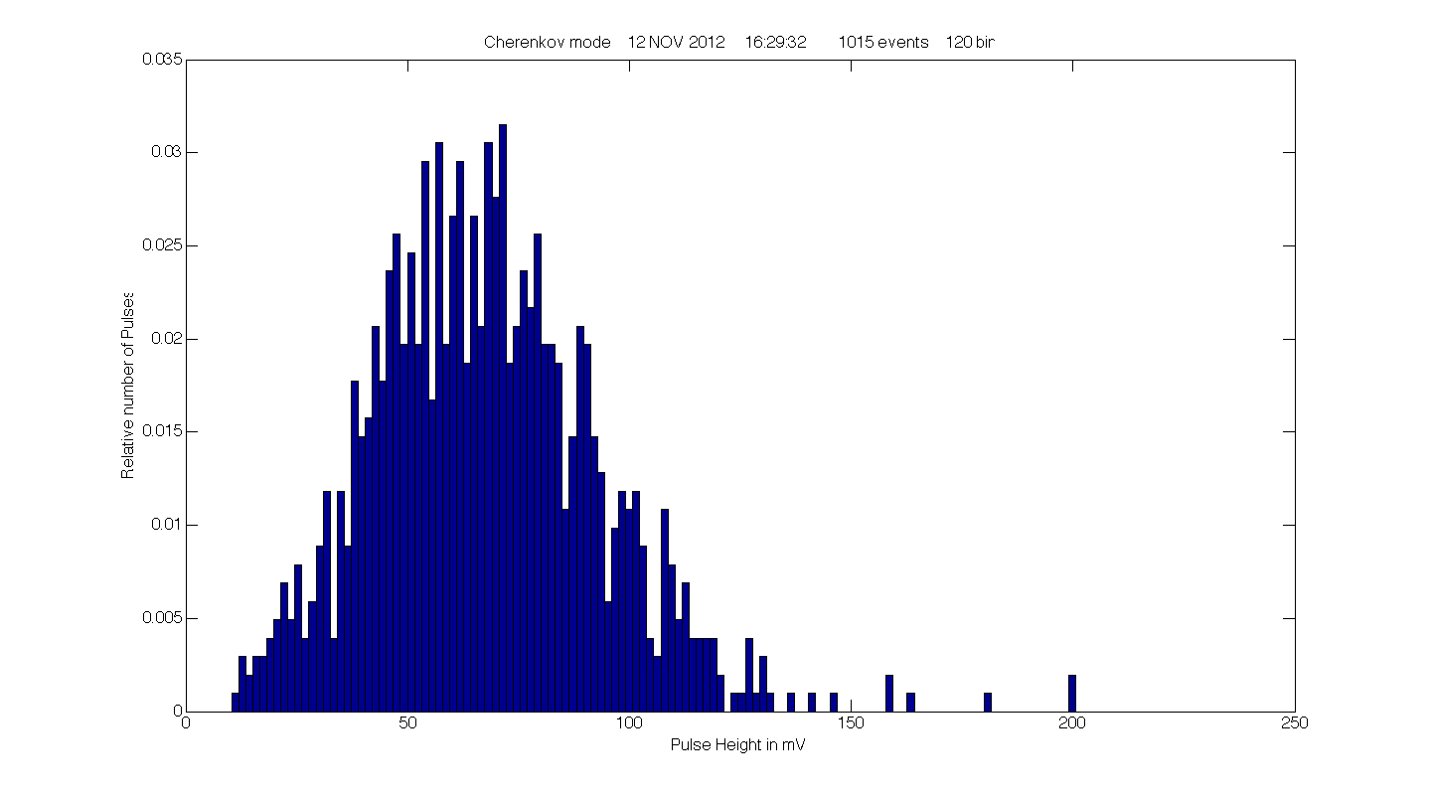
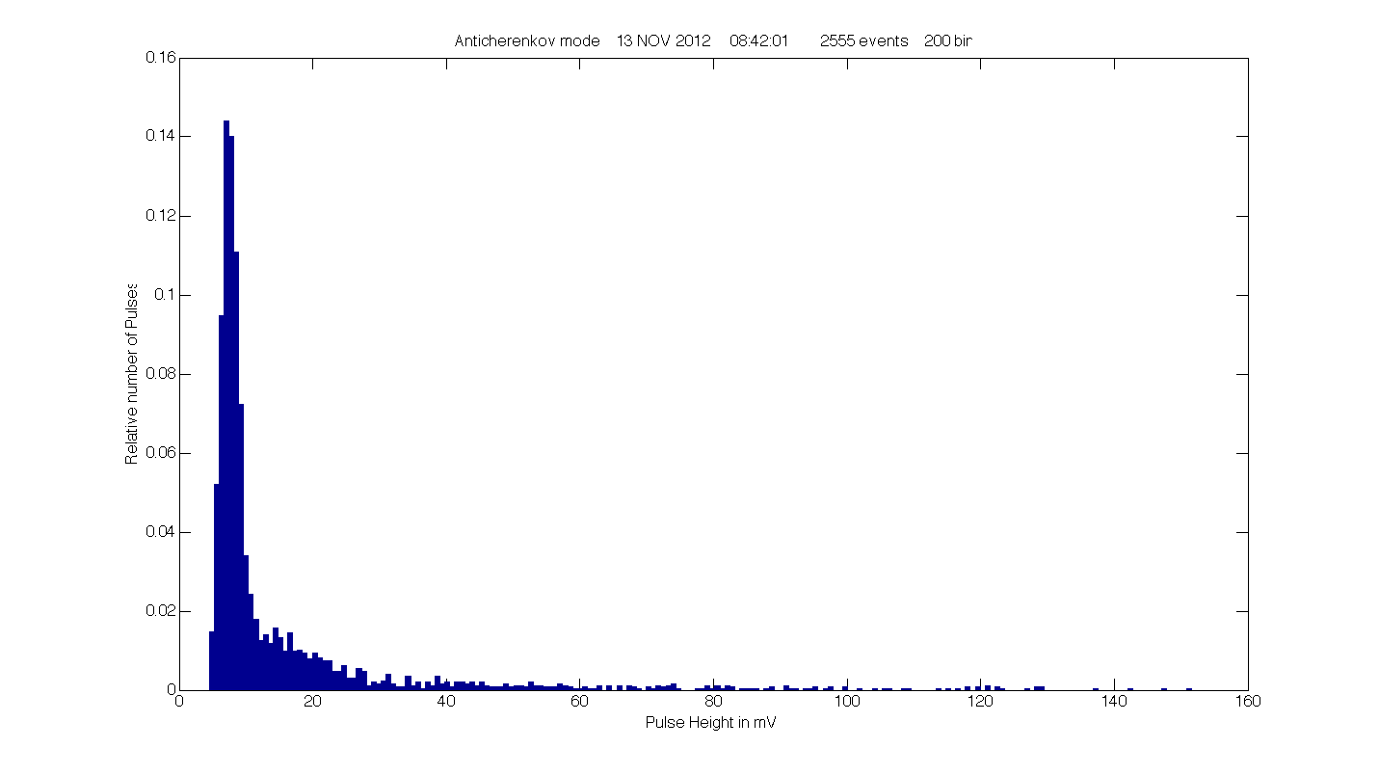
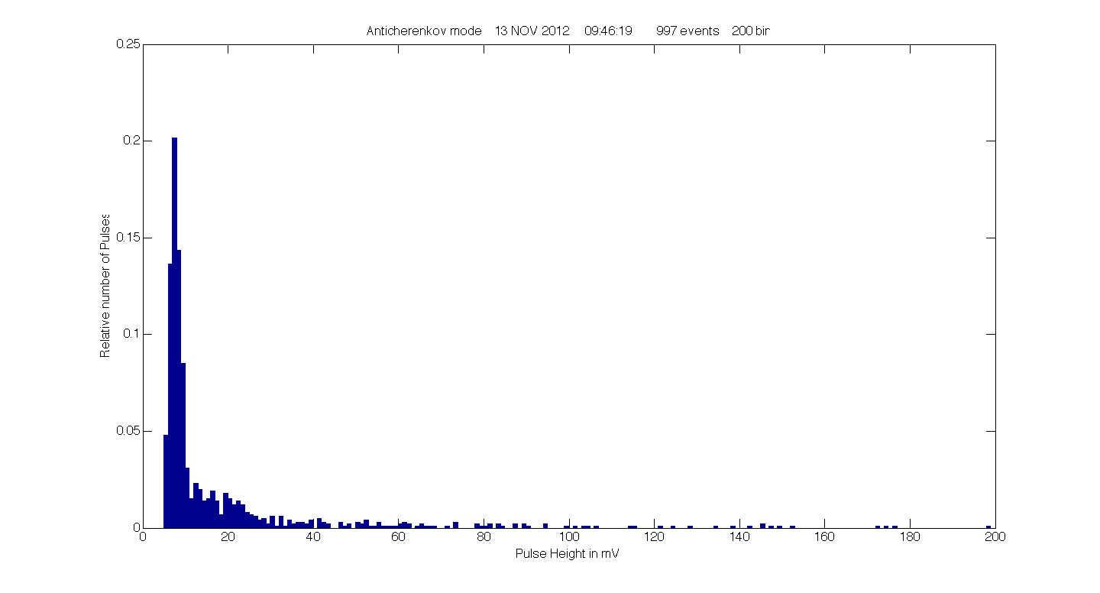
Thermal noise: single electrons from photocathode
(naked) PM in Cherenkov mode
Yield: 100 %
(naked) PM in non Cherenkov
mode. Yield: 100 %
(naked) PM in non Cherenkov
mode, with exiting Ch photon
absorber. Yield: 29 %

Slide 43
Surface enlargement
Skin effect: only ~ 50 nm
surface layer participates to yield
Fractal
Use surface enlargement for high QE photocathodes?
The QE of Tipsy of ~0.3 is its only disadvantage wrt. Si-PMs
Surface roughening: papers + Hamamatsu

Slide 44
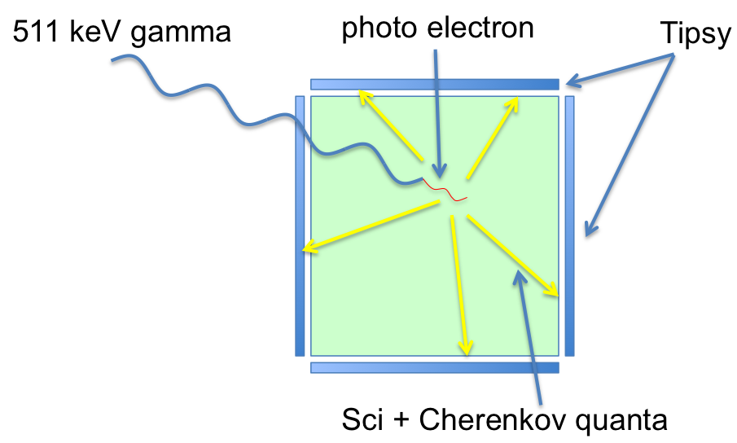
Applications of new generic soft photon detector
PET scanner
Cherenkov radiation becomes more relevant
PET
0.511 MeV gamma
with Pb glass:
only prompt Ch soft photons
With NaI: Ch + Sci soft photons
use Ch photons for timing
use all photons for energy
granularity: multi single soft photon
detection within event
low noise

Slide 45
Future HEP collider experiment: inner (central) tracker
very low detector mass
Tipsy layer at safe distance from IP
spatial resolution: no extrapolation
Tipsy
Cylindrical layer
thin transparent foils
generating Cherenkov photons
The Vacuum Cherenkov Tracker

Slide 46
Only one crucial milestone/deliverable:
a MEMS made transmission dynode with a
secondary electron yield (SEY) > 3
for an incoming e- with energy lower than 500 eV

Slide 47
Hassan Akhtar, Yevgen Bilevych, Hong Wah Chan, Edoardo Charbon,
Harry van der Graaf, Kees Hagen, Gert Nützel,
Serge D. Pinto, Violeta Prodanović, Daan Rotman, Lina Sarro,
Dennis R. Schaart, Emile Schyns, John Smedley, Shuxia Tao, Annemarie Theulings
Thanks to Arjen van Rijn, Michiel Jaspers, Oscar van Petten, Gerrit Brouwer,
Wim Gotink, Joop Rövekamp, Bas van der Heijden, Berend Munneke, Henk Peek

