Slide 1
MCP-based Detectors for
Nuclear Non-proliferation
Erik Brubaker
Sandia National Laboratories, Livermore, CA
December 2, 2014
Sandia National Laboratories is a multi-program laboratory managed and operated by Sandia Corporation, a wholly owned subsidiary of Lockheed Martin Corporation, for the U.S. Department of Energy’s National Nuclear Security Administration under contract DE-AC04-94AL85000. SAND2014-20194 C.

Slide 2
Outline
Nuclear non-proliferation applications
  Detection principles & physics
    How MCP-based detectors fit in
      Specific example: Single-Volume Neutron Scatter Camera
      Other ideas for MCP-based detectors
NB: Acknowledged bias toward
  Neutrons
  Imaging
  Arms control

Slide 3
Nuclear non-proliferation application space

Slide 4
Nuclear security Venn diagram
Nuclear
security
Proliferation detection
Safeguards
Emergency
response
Arms control
treaty verification
Horizontal proliferation: new actors acquiring nuclear capabilities
Vertical proliferation: existing NWS increasing nuclear capabilities
Special nuclear material (SNM) is the common element.
  Detect
  Locate
  Characterize
Radiation detection can help!

Slide 5
Special Nuclear Material
What is it?
  Plutonium, or
  Uranium enriched in U-233 or U-235.
  Sine qua non of a nuclear explosive.
What does it look like?
  Many different forms & colors.
Special nuclear material emits ionizing radiation.
  Sensitive and specific signature
  Only neutral particles (n,γ) useful in most cases
WGPu
HEU

Slide 6
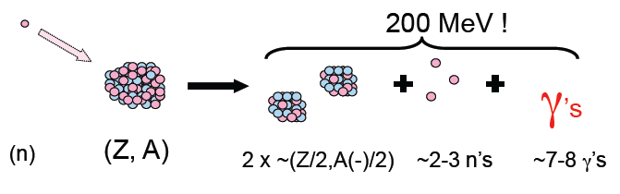
SNM radiation signatures
These physical processes…
Spontaneous fission
Induced fission
  Self-interrogation
  External interrogation
Other radioactive decays
  Gamma
  (α,n)
… produce these signatures
Gamma spectrum reflects isotopics
Neutron fission spectrum
Time correlations (multiplicity analysis)

Slide 7
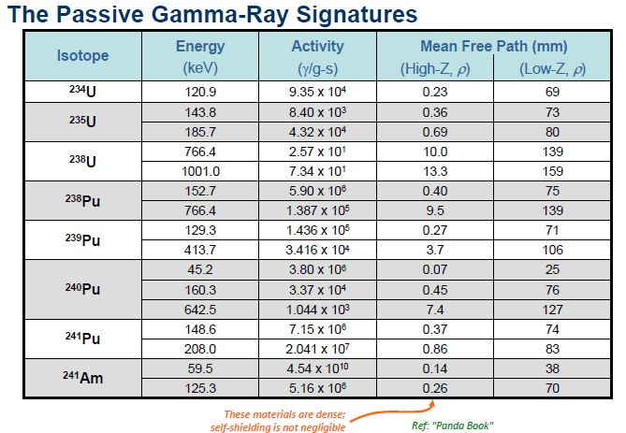
Gamma signatures
Slide courtesy of David Chichester, INL

Slide 8
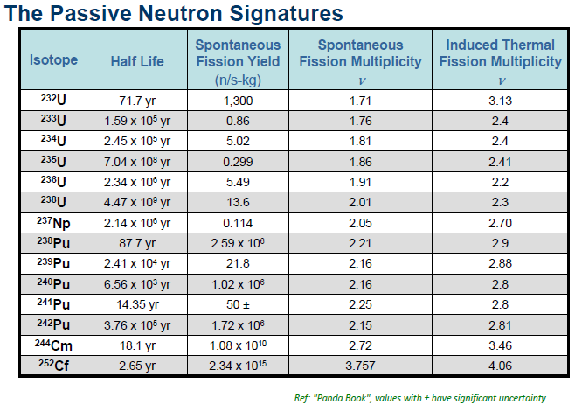
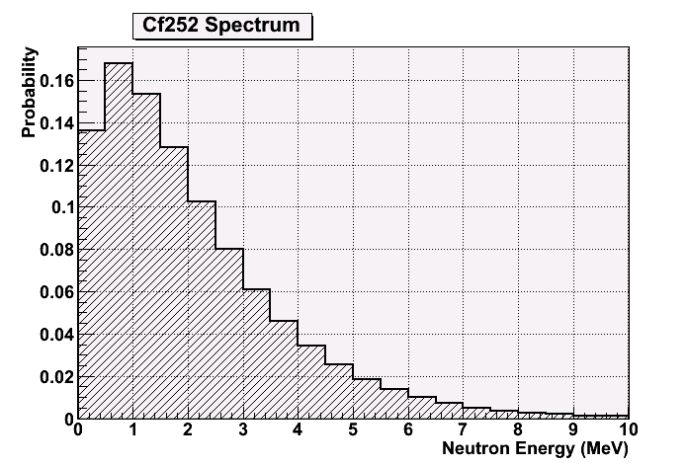
Neutron signatures
Table courtesy of David Chichester, INL

Slide 9
Rad detection for detecting SNM
Notional scenarios:
Sources indicate that a significant quantity of nuclear material is present in X neighborhood. Find it or provide all clear.
Radiographic/active interrogation of rail cargo: scan rates of 8 to 24 km/h, scan lengths over one kilometer, and a penetration depth of 90 cm of steel
By definition, interesting/difficult cases have low S:B.
Active interrogation can increase signal at cost of more/different background
Radiation detection needs:
  High efficiency
  Scalability
  S:B discrimination

Slide 10
Rad detection for locating SNM
Notional scenarios:
Nuclear material is present in building X. Determine which floor/apartment.
Count number of nuclear warheads on an ICBM without visual access.
Radiation detection needs:
  Directional information
  Field of view depends on specific application

Slide 11
Rad detection for characterizing SNM
Signatures (physics)
SNM emits γ, n radiation
  {Spectrum, rate, vector field, correlations} determined by {SNM mass, isotopics, configuration}
Surrounding material attenuates, scatters, modifies signature
Interactions between SNM, surroundings
Detectors (technology)
Typically optimized for measuring one aspect of the radiation signature, e.g.
  Gamma spectrum → good energy resolution
  Neutron timing correlations → Large effective area for n detection
  SNM configuration → position, direction resolution
  Low-rate processes → active stimulation
SNM
Materials
Detectors

Slide 12
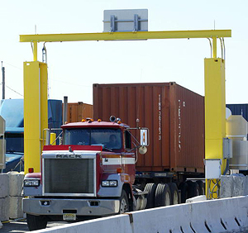
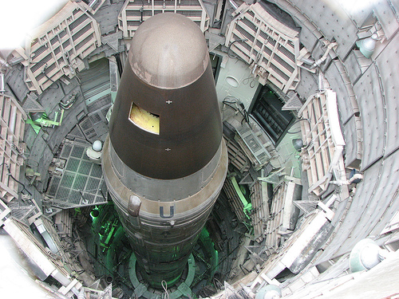
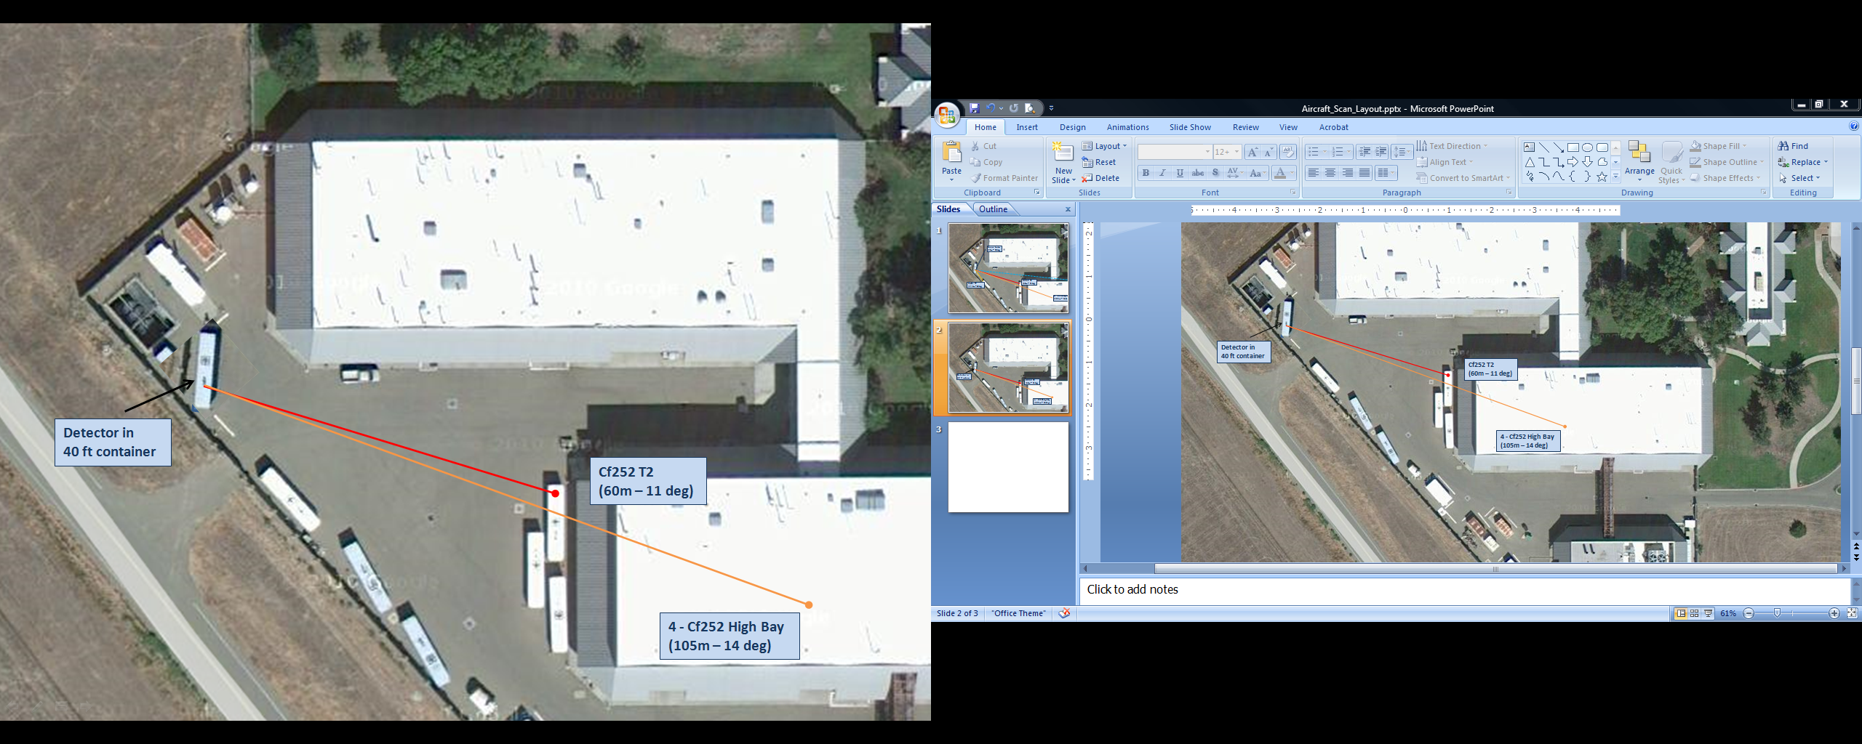

SNM detection/imaging
We develop systems for eventual application in a range of scenarios:
Emergency
response
Standoff detection
Arms control treaty verification
Cargo screening
SNM detection applications
Low signal rate
  Need large area detectors!
Low signal to background
  Need background discrimination!
SNM imaging applications
High resolution required
  Fine detector segmentation
Multiple or extended sources

Slide 13
Standoff detection
~5.5e4 n/s/kg
IAEA sig = 8 kg
WGPu
Example: Large stand-off application (100 meters)
  8 kg WGPu = ~4.4e5 n/s →
  4.4e5 *exp(-R/100)/4πR² ≈1.3 n/s/m²
  Background = ~50 n/s/m² (at sea level)
  100% efficient, 1 m² detector →
  5σ detection in ~13 minutes
  10% efficient, 1 m² detector →
  5σ detection in ~2 hours
  10% efficient, 1 m² detector, 3% bg rate systematic → 5σ detection in never
Background
~5e-3 n/s/cm²

Slide 14
Cargo screening
Extremely challenging problem!
  Needle in a haystack
  Flow of commerce
  Potential for heavy shielding
  Background variations
Primary screening, secondary, etc.

Slide 15
Emergency response
Learn as much as possible, as quickly as possible, about a package containing SNM.
All information is potentially useful.

Slide 16
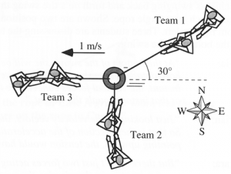
Arms control treaty verification
Treaty needs:
Warhead counting
  Verify declarations
Warhead confirmation
  Verify it is a warhead
  Verify warhead type
Chain of custody
  Monitored storage
  Spot check status
Dismantlement/disposition
  Maintain perimeter
  Track item through process
Desired result
Sensitive
information
Detector
capability
Three-way tug of war!

Slide 17
Signatures/detectors
0.1 MeV – 10 MeV gammas
  High natural backgrounds, many NORM sources
  Shielded by high-Z materials
  Energy resolution key to determine isotopics
0.1 MeV – 10 MeV neutrons
  Low natural backgrounds, few benign sources
  Shielded by low-Z materials
  Weak spectral information
  Direct access to fission process: time correlations
Directional information improves S:B, locates sources, measures spatial configuration of material
Active interrogation, radiography are wild cards

Slide 18
Signatures/technologies
0.1 MeV – 10 MeV gammas High natural backgrounds, many NORM sources Shielded by high-Z materials Energy resolution key to determine isotopics | Plastic scintillator/PMT Inorganic scintillators/PMT (NaI, CsI) Semiconductors (HPGe, CZT) Shaping/MCA electronics
0.1 MeV – 10 MeV neutrons Low natural backgrounds, few benign sources Shielded by low-Z materials Weak spectral information Direct access to fission process: time correlations | Thermal neutron detectors (He-3 tubes) Organic scintillators/PMT (plastic, liquid, crystalline) Pulse height/shape discrimination Multiplicity analysis
Directional information improves S:B, locates sources, measures spatial configuration of material | More complex systems—high channel counts, calibrations, data processing, analysis, image reconstruction
Active interrogation, radiography are wild cards | Gamma sources Neutron sources

Slide 19
Where does MCP fit in?
MCPs can detect/amplify
  Charged particles directly
  With PC, optical photons (e.g. from scintillator)
MCP-based detectors have intrinsically
  Good spatial resolution (10s of um)
  Good time resolution (10s of ps)
  Decent scalability
Not trivial to take advantage of those qualities!
  Cost/capability tradeoff
Where in the nuclear security application space is the tradeoff worth it?

Slide 20
Single-Volume Neutron Scatter Camera
Jim Brennan, Erik Brubaker, Aaron Nowack, John Steele, Melinda Sweany, Eli Woods
Sandia National Laboratories, Livermore, CA
John Mattingly, Kyle Weinfurther
North Carolina State University
Cf. mTC…

Slide 21
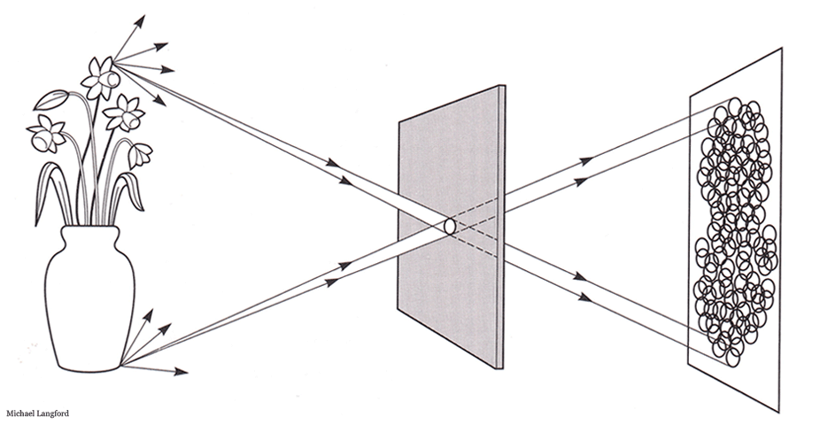
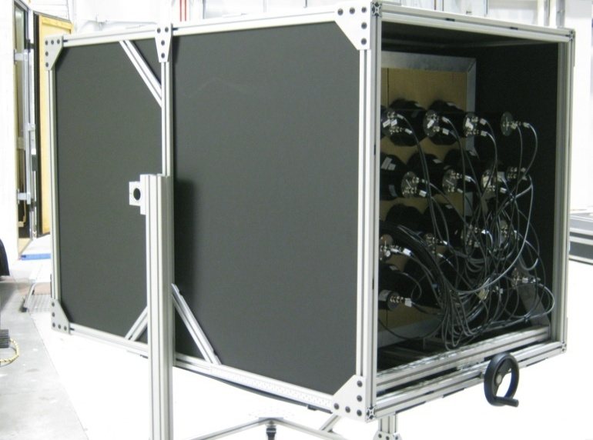
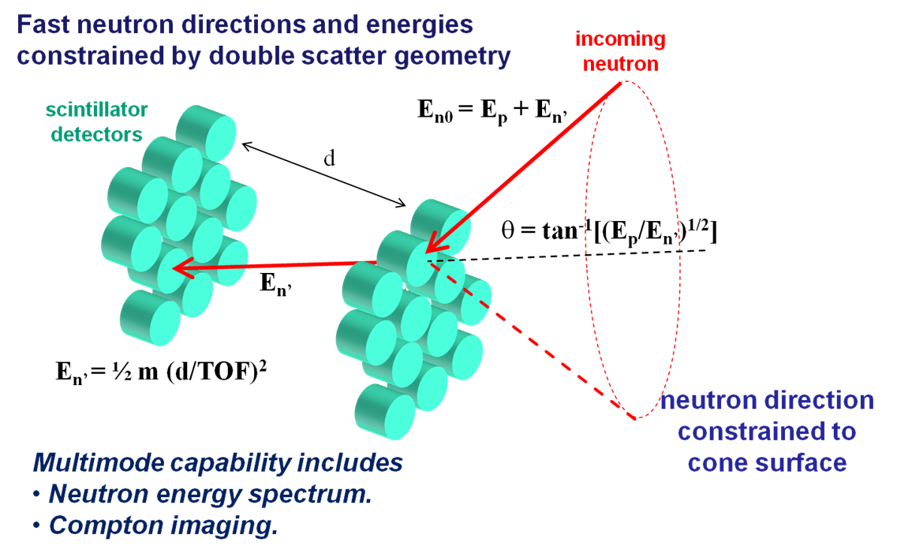
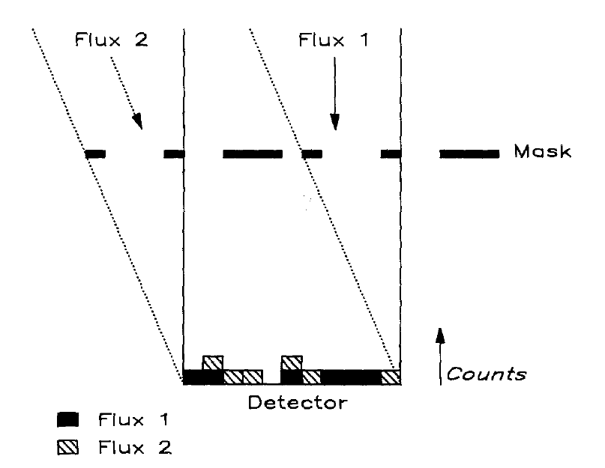
Neutron camera approaches
Pinhole: High Resolution,
Low Throughput
Coded aperture: High Resolution, High Throughput

Slide 22
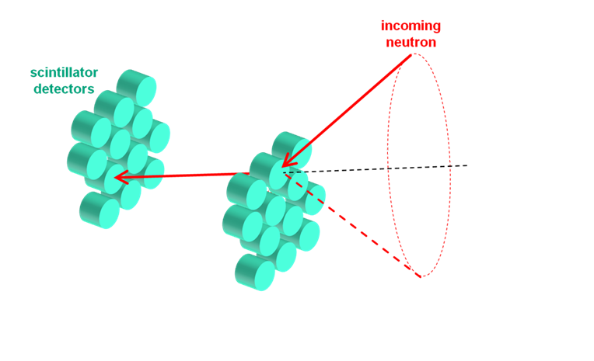
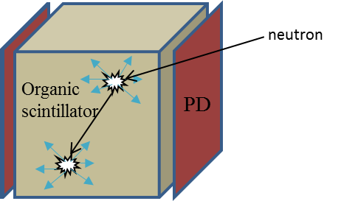
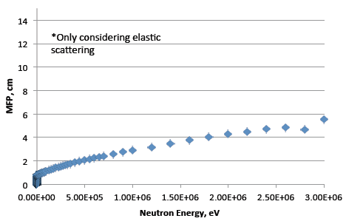
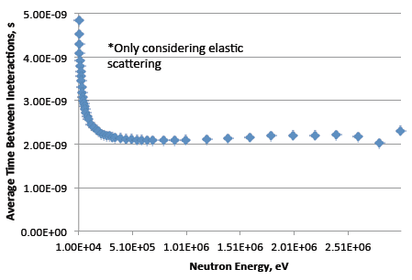
Single-Volume Neutron Scatter Camera
Mean free path:
~3 cm @ 1 MeV
Avg intrascatter time:
~2 ns @ 1 MeV

Slide 23
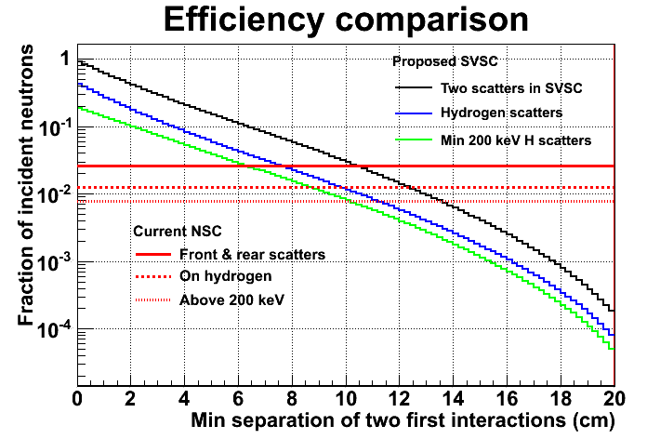
Single-Volume Neutron Scatter Camera
A scatter camera built from a highly voxelated volume can recover more than an order of magnitude of efficiency if nearby interactions can be resolved.
Additional advantages of compact form factor.
Resolving multiple interactions of a neutron separated by O(cm) and O(ns) in a bulk scintillator is difficult!
Excellent spatial and temporal resolution of photodetectors based on microchannel plates is the key enabling technology.
Voxelated scatter camera
neutron
Organic
scintillator
PD

Slide 24
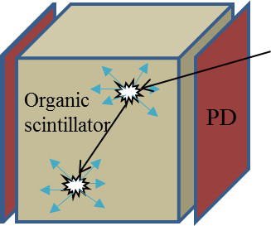
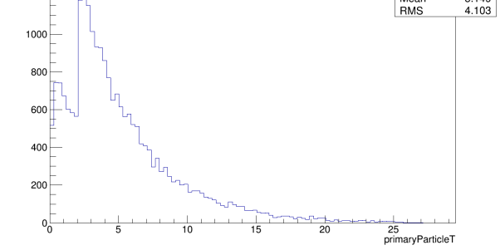
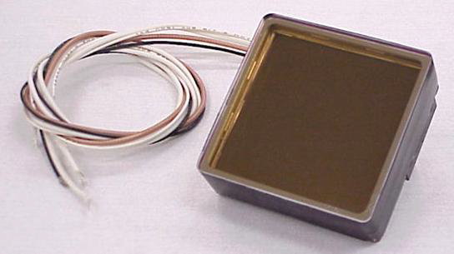
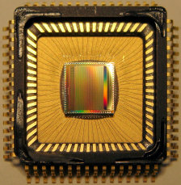
System Components
Active material
  Fast organic scintillator
  Plastic vs crystalline
Photodetector
  MCP-PMT, e.g. Planacon
  Position resolution depends on
  anode structure
  35 ps transit time spread
    Equals 8 mm photon travel
Electronic readout
  Switched capacitor array
    e.g. DRS4 (5 GS/s, 950 MHz, 11.5 enob)
  Need careful board design—bandwidth, noise
  Long reset time
Photonis
+ Simulation
+ Event reconstruction algorithm
+ Image reconstruction algorithm
PSI

Slide 25
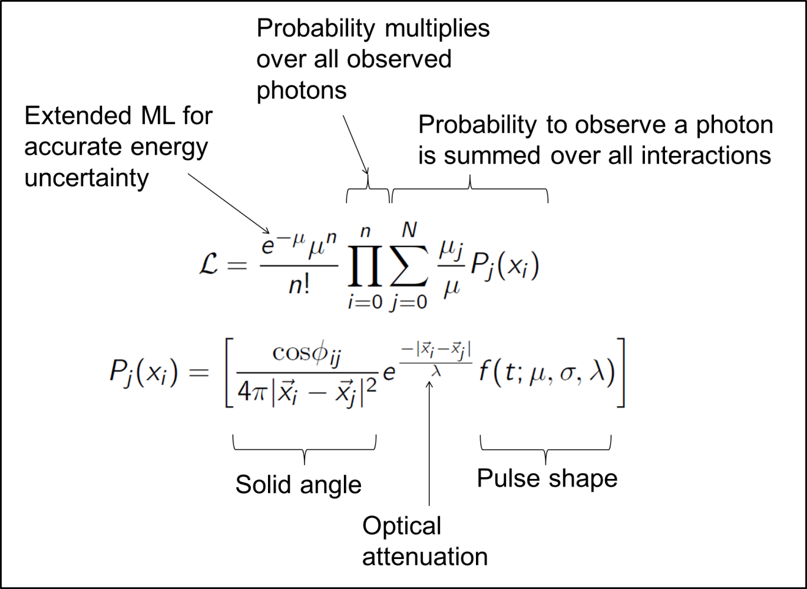
Simulation/Reconstruction
Event reconstruction via likelihood maximization.
Input is a list of photon arrival positions and times.

Slide 26
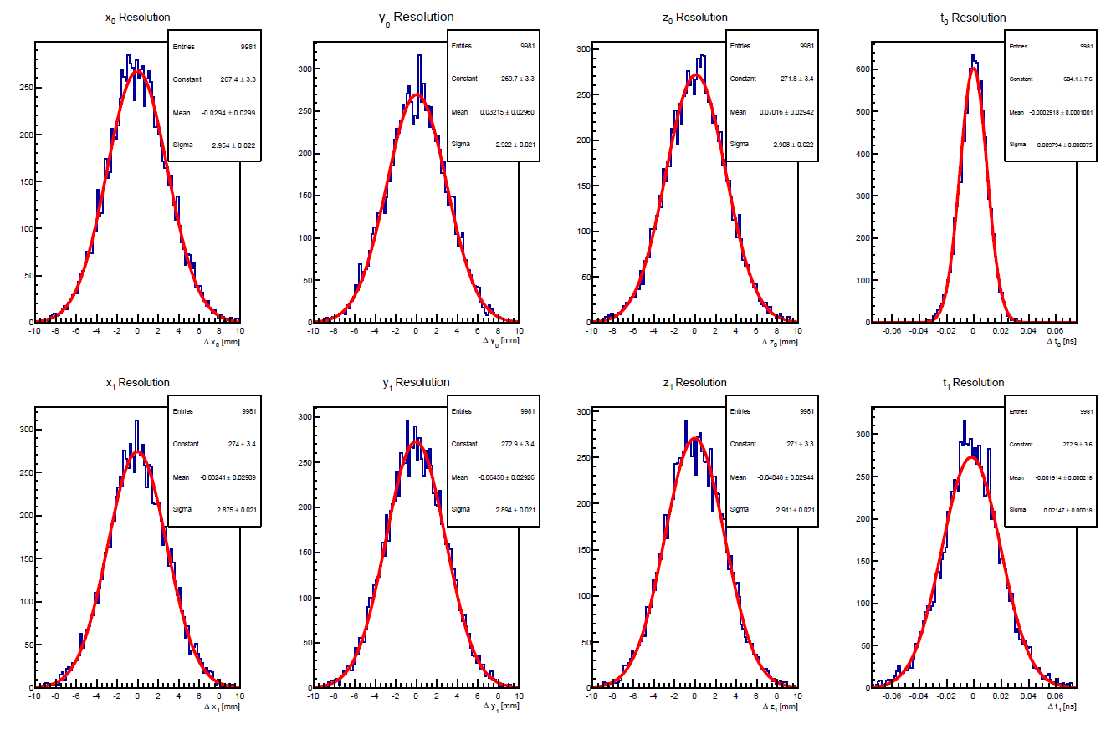
Simulation/Reconstruction
First Interaction x, y, z, t
GEANT4 simulation incl optical photons
(10 cm)³ detector, PD on all six sides
Fixed event: 3 cm/2 ns separation, ~1 MeVee each recoil
Stilbene pulse shape (0.1 ns rise, 4.5 ns decay)
Idealized PD response/resolution
σ ≈ 3 mm
σ ≈ 10 ps
σ ≈ 20 ps
Second Interaction x, y, z, t
Ideal case, NOT predictions of experimental resolutions!

Slide 27
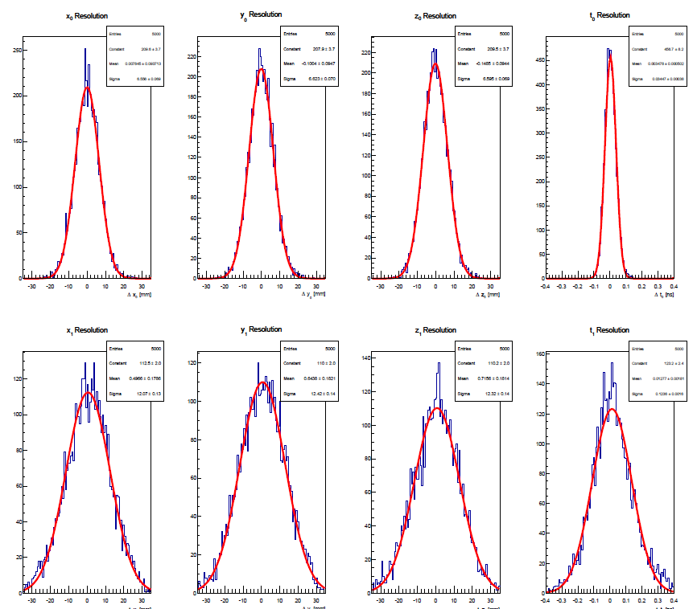
More realistic
First Interaction x, y, z, t
GEANT4 simulation incl optical photons
(10 cm)³ detector, PD on all six sides
Fixed event: 3 cm/2 ns separation, 1.5 MeV, 0.75 MeV proton recoils
BC-422 pulse shape (fast plastic)
Idealized PD response/resolution
σ ≈ 6.5 mm
σ ≈ 35 ps
σ ≈ 12 mm
σ ≈ 125 ps
Second Interaction x, y, z, t
Ideal case, NOT predictions of experimental resolutions!

Slide 28
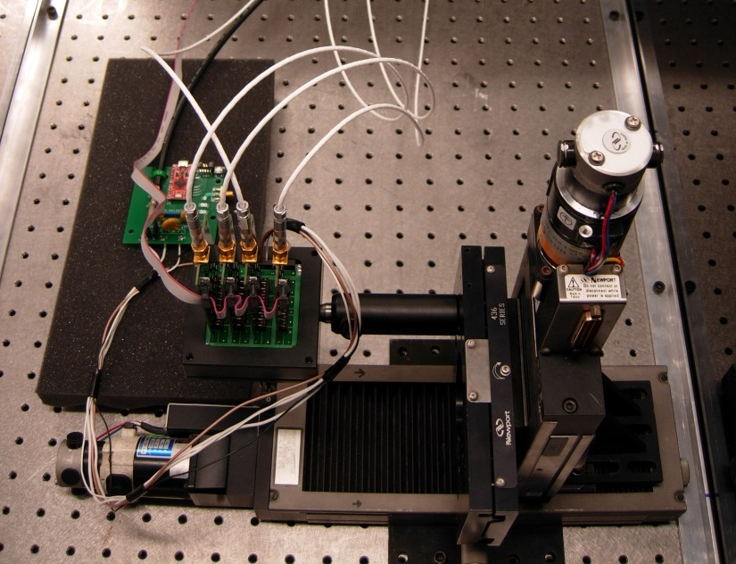
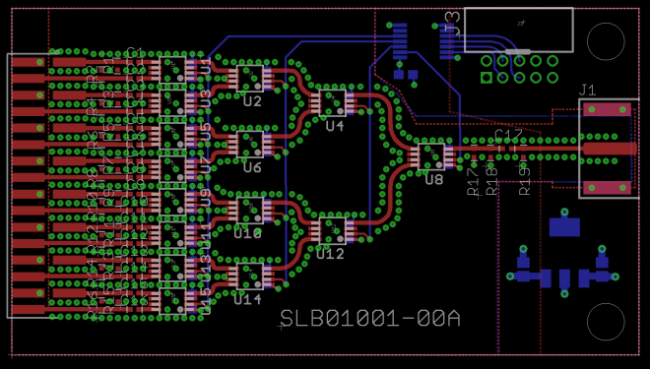
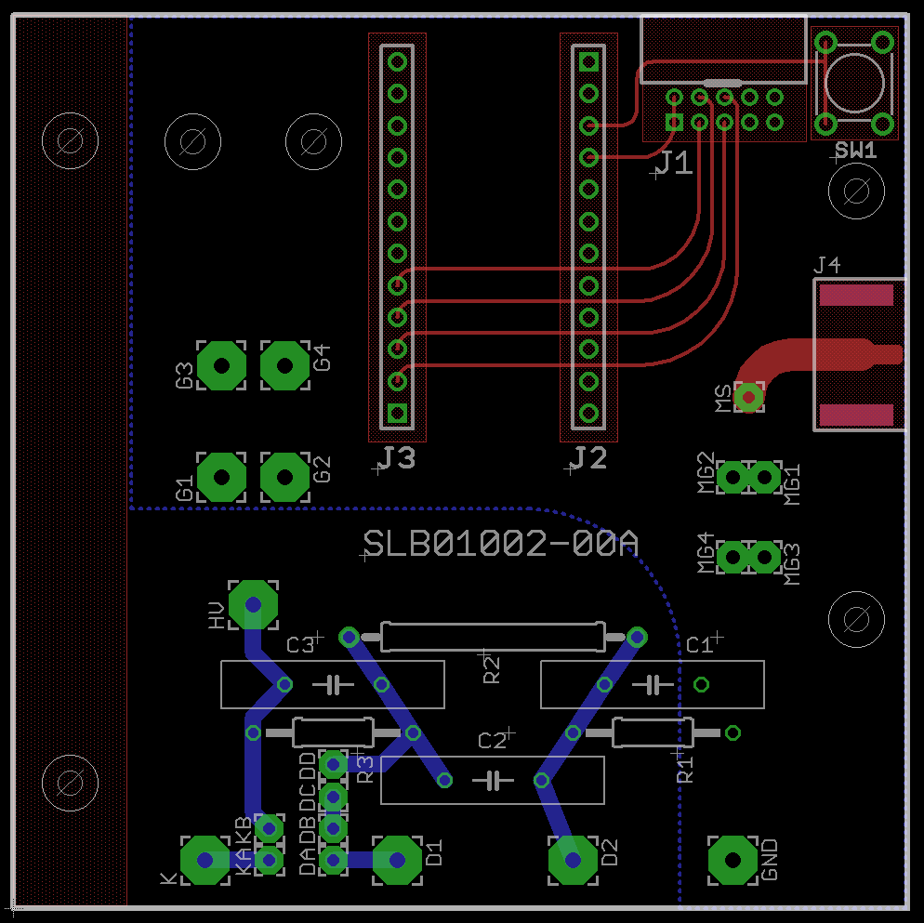
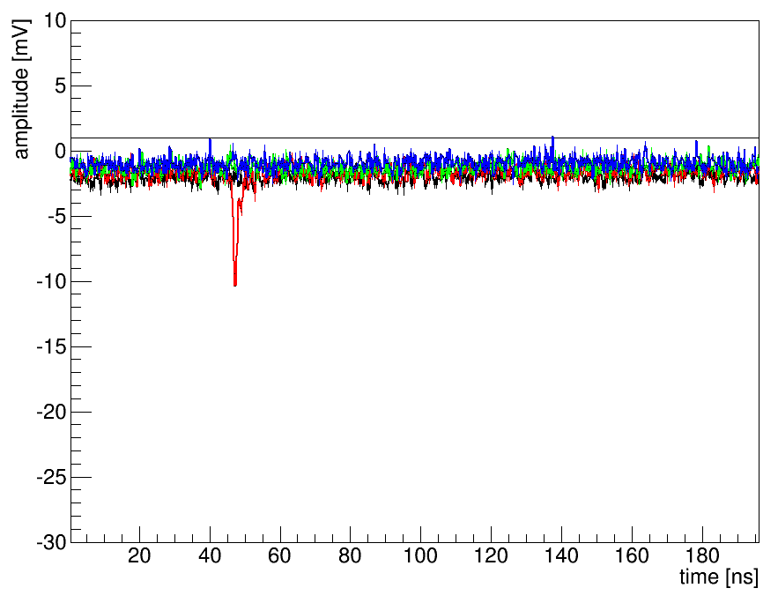
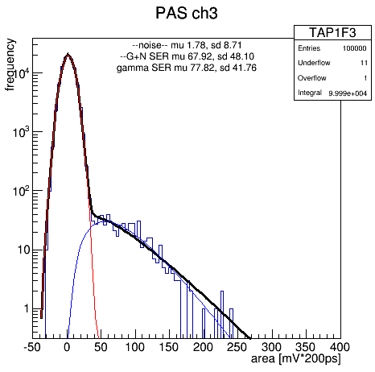
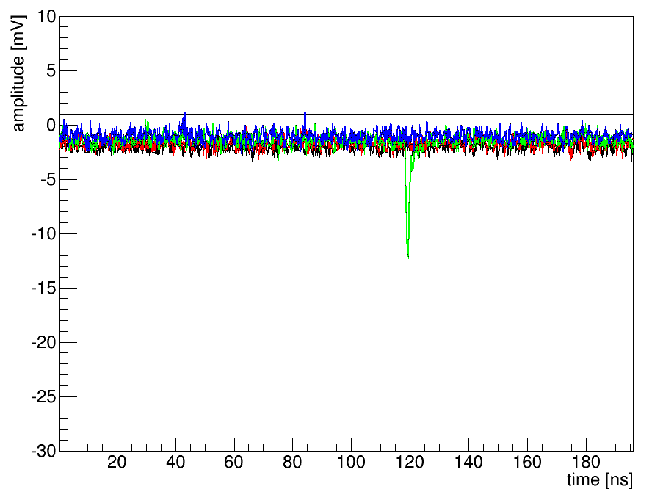
Experimental Status
Pulsed LED
Planacon XP85012
Multiplexer
DRS4 eval board (4 ch)
C++ DAQ
Single
electron
response

Slide 29
Photodetector characterization
Complex PD/electronics requires significant effort to characterize and calibrate.
Use LED with 1 mm pinhole aperture; scan Planacon in x,y
Determine position response of Planacon
  N_{pe} ∝ QE
  Pulse height ∝ gain
  Also see anode response, charge sharing
Ultimately feed back to simulation for increased realism & systematic studies.

Slide 30
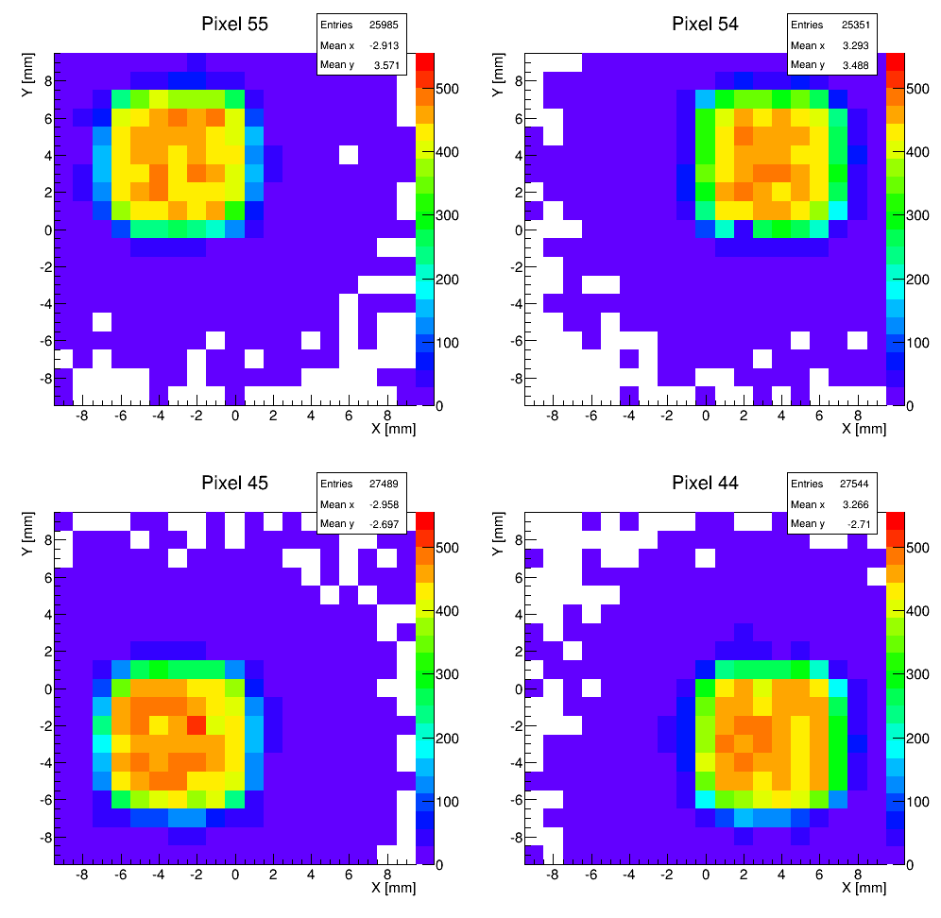
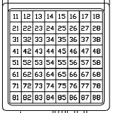
Collimated LED scan
QE quite flat (over small region)
Sharp anode pixel boundaries
  1 mm collimation
Some PE scatter

Slide 31
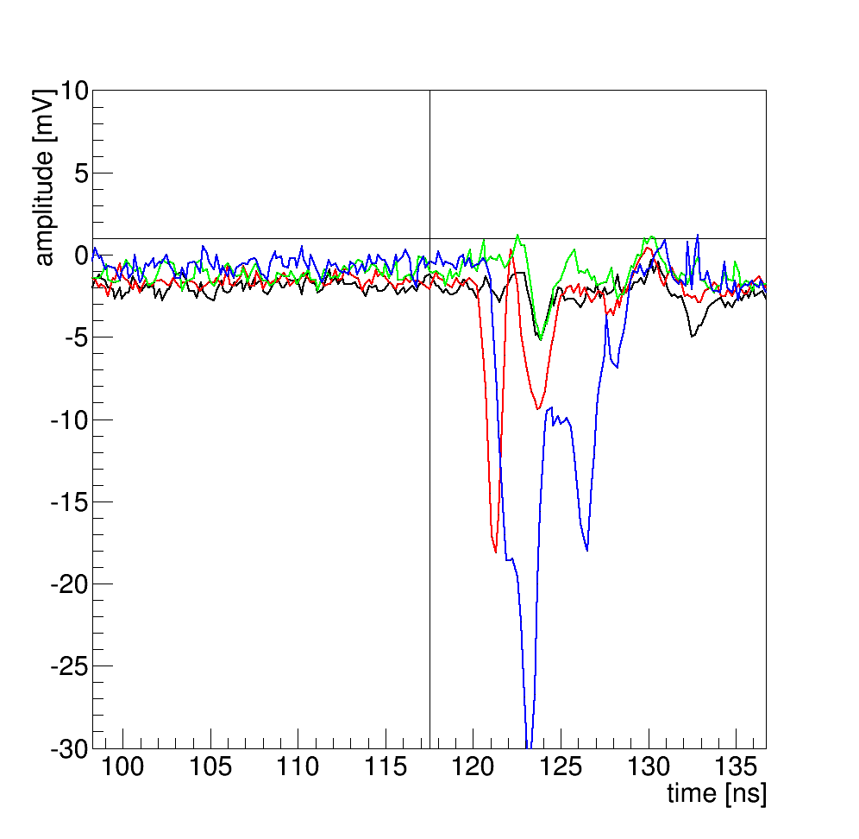
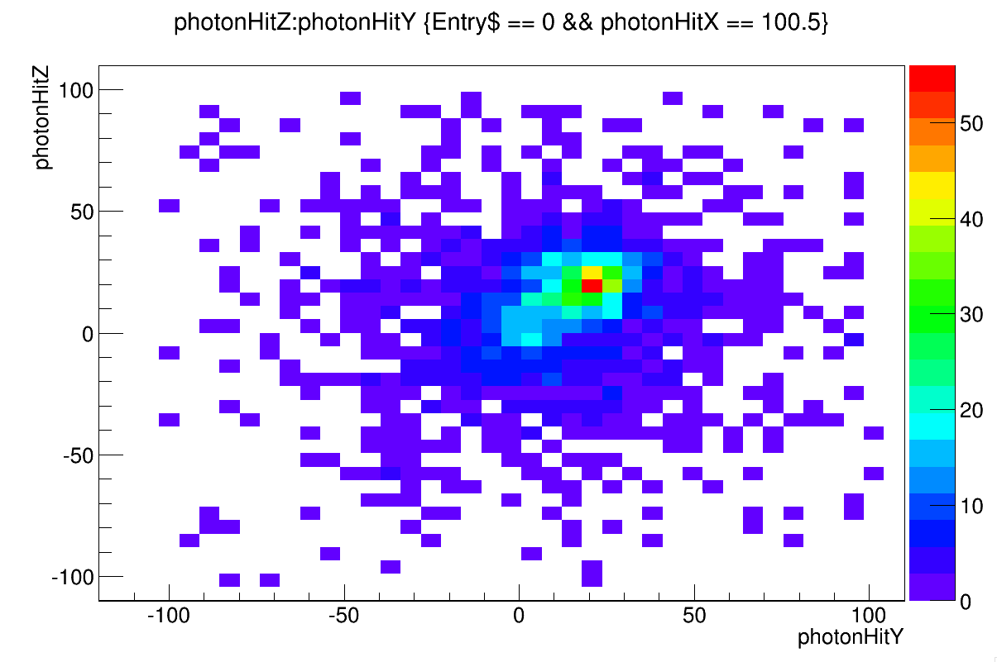
Signal readout/processing
Not all pixels see well separated single photons.
Reconstruction algorithm assumes it is handed a list of photon arrival positions & times.
How to analyze signal trace?

Slide 32
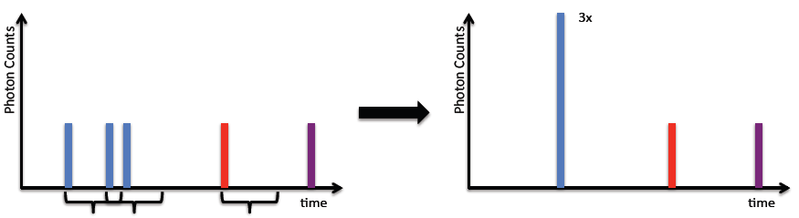
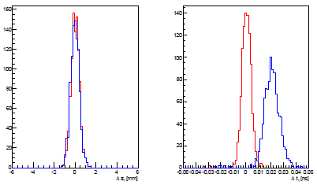
Signal readout/processing
What if the best we can do for overlapping photons is count them?
Check in simulation study.
For t_{window} = 300 ps, time is shifted but reconstruction still reasonable.
Original
Rebinned
z₂ – z₂^{true}
t₂ – t₂^{true}

Slide 33
SVSC MCP/readout concerns
MCP-PMT lifetime
  Limited by back-propagating ion bombardment of photocathode, \propto integrated charge through MCP.
  We want single-photon sensitivity → run at high gain → reduce lifetime.
  Need to use ALD MCPs.
Tradeoff between anode segmentation, system cost/complexity.
  Segmentation driven by occupancy, not resolution!
  Strip readout saves channels, but disambiguation problem may be intractable.
Inherent dead time of SCA readout.
  Need separate trigger pathway, possibly complex trigger analysis.
Even a (5 cm)³ prototype w/ pixelated anodes has 128–384 channels.
  Need significant effort to build full readout system.
Bright scintillators, high rates

Slide 34
Other non-proliferation applications

Slide 35
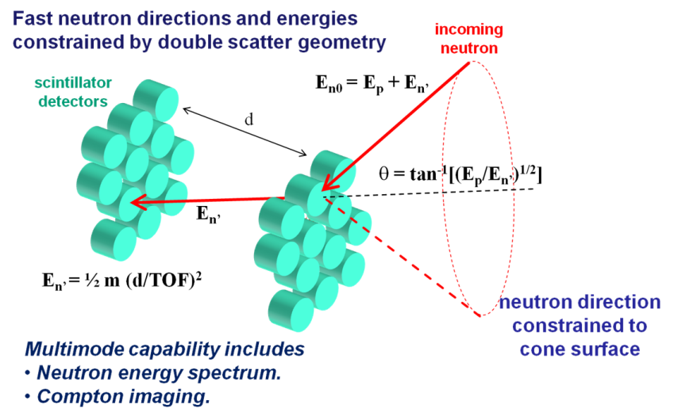
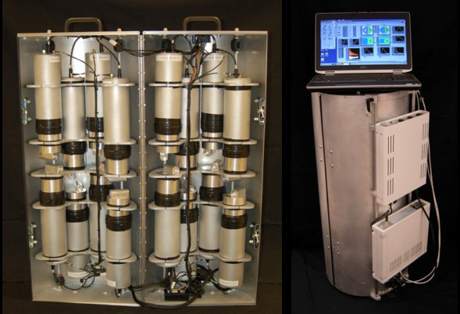
Traditional neutron scatter camera
MINER system: Mobile Imager of Neutrons for Emergency Responders
(a compact, portable, low-power neutron scatter camera)
Shorter distance between cells means TOF resolution is more of a limiting factor on spectral & angular resolution.
Interested in 3” single-anode MCP-based photodetectors for improved hit timing resolution.
Detect, Locate, Characterize

Slide 36
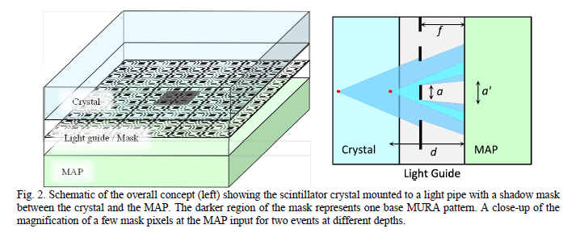
Crystal Compton Imager
K.-P. Ziock, J. Braverman, ORNL
Use coded aperture technique on optical photons to reconstruct interaction positions.
Time resolution not important for gamma imaging, but need good spatial resolution, large area.
Proc. SPIE 8542, 854210 (November 19, 2012); doi:10.1117/12.979787
Locate
Characterize

Slide 37
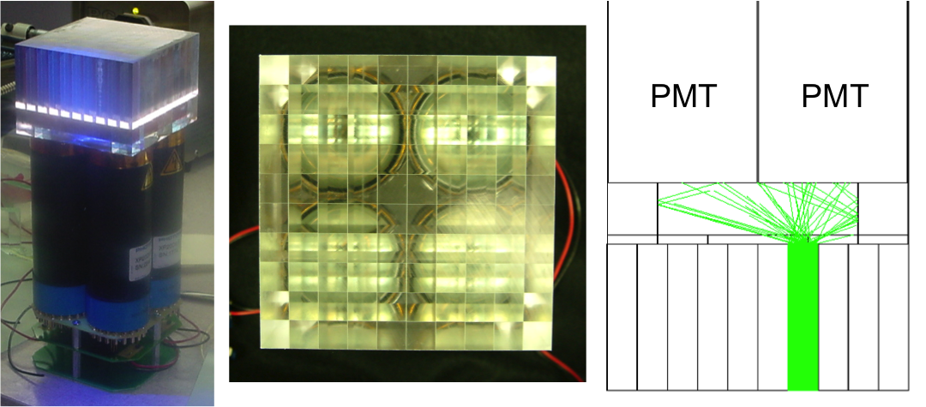
PSD scintillator block detector
Anger logic allows 4 PMTs to locate an interaction in 100 optically isolated pixels.
  No sub-pixel resolution.
  Confused by multiple interactions.
Used in
multiple
neutron
imaging
systems.
P. Hausladen et al., ORNL
Locate, Characterize

Slide 38
Next-gen scintillator block detector
With MCP-based photodetector, determine interaction location in continuous scintillator.
  Like SVSC, but lower coverage; goal is to locate 1st interaction.
  Resolution not limited by scintillator pixelation.
  Timing can determine/resolve first interaction.
Building block for position-sensitive detector plane for energetic neutrons, gammas.
  Pinhole imager
  Coded aperture imager
  Double-scatter imager
MCP-PMT
Light guide
Scintillator
Significant overlap with medical imaging.
  E.g. Hunter et al., "Multiple-Hit Parameter Estimation in Monolithic Detectors," Medical Imaging, IEEE Transactions on , vol.32, no.2, pp.329,337, Feb. 2013
Locate, Characterize

Slide 39
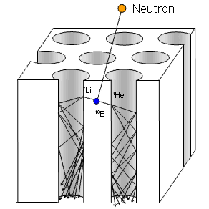
Direct position sensing for thermal n
Instead of photocathode, add thermal neutron capture agent to MCP itself.
Makes high efficiency, high resolution position-sensitive thermal neutron detector.
Use with coded aperture for thermal neutron imaging, or with thermalized neutron source for radiography.
Nova Scientific
http://www.novascientific.com/neutron.html
Characterize

Slide 40
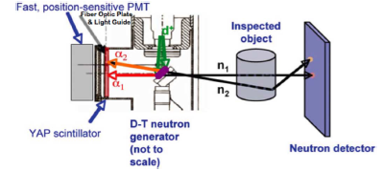
API alpha detector
Associated particle imaging technique for 14 MeV neutron transmission imaging.
  D + T → α + n
  Detect α to determine neutron direction, t₀.
P. Hausladen et al., ORNL
Cates, J.W., et al., "Timing Resolution Study of an Associated Particle Detector for Fast Neutron Imaging," Nuclear Science, IEEE Transactions on , vol.59, no.4, pp.1750,1756, Aug. 2012
“… a significant improvement in reconstructed image quality is achievable if the system timing resolution can be reduced below 500 ps, while ideal imaging reconstruction is possible with a timing resolution of 200 ps.”
Characterize

Slide 41
Neutrinos
Non-proliferation application of neutrino detection is to monitor or discover nuclear reactors.
  Neutrino presence determines reactor on/off status
  Neutrino spectrum sensitive to diversion (Pu/U ratio)
  Neutrino direction improves detectability of weak sources relative to background
Detection concepts not different from reactor neutrino physics experiments.
  For ease of deployment, high desire for above-ground detection system → need exquisite background rejection.
Detect, Characterize

Slide 42
MCPs for non-proliferation
Everything (except neutrinos) in this survey of MCPs for non-proliferation applications relates to γ or n imaging.
  Takes advantage of good intrinsic spatial resolution.
  Timing resolution used to extract information from detected particles; not from source itself.
Primarily interested in detection of optical photons from scintillator.
Advantages of MCP-based detectors include improved efficiency, resolution, and form factor.

Slide 43
Conclusions
Overview of non-proliferation application space
  Detect, locate, characterize SNM
Single-Volume Neutron Scatter Camera
  Motivation, goals, progress, issues
Other non-proliferation MCP-based detection concepts
  Spatial/temporal resolution of MCP valuable for imaging applications.
  Increased adoption will depend on price, scalability, ease of use.

Slide 44
Additional Slides

Slide 45
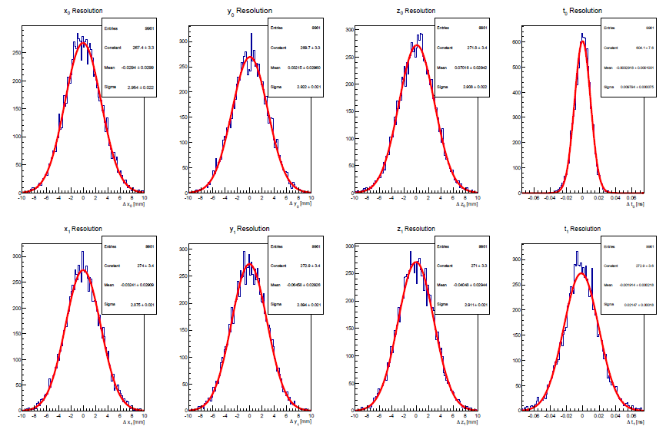
Central event
(10,0,0,0) [mm,ns]
(20,20,20,2) [mm,ns]

Slide 46
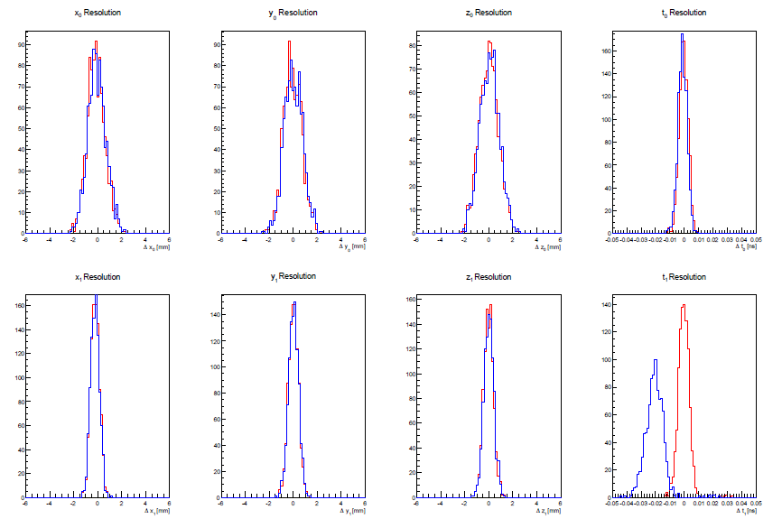
Shifted event
(80,0,0,0) [mm,ns]
(90,20,20,2) [mm,ns]

Slide 47
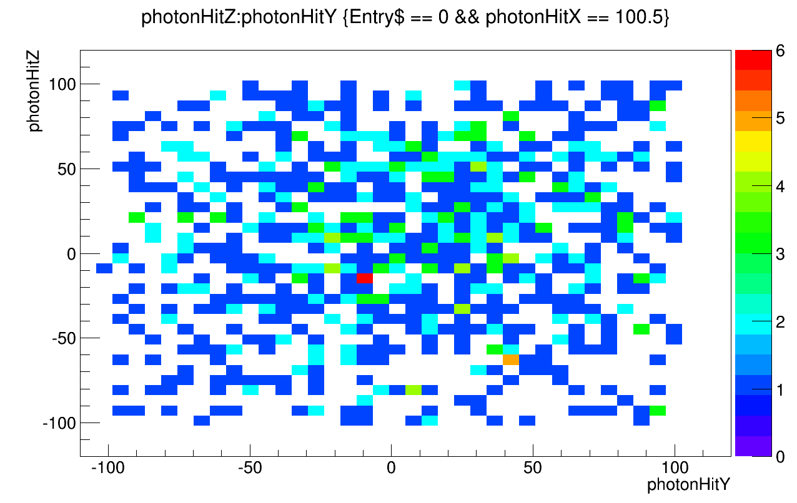
Pixel populations

Slide 48
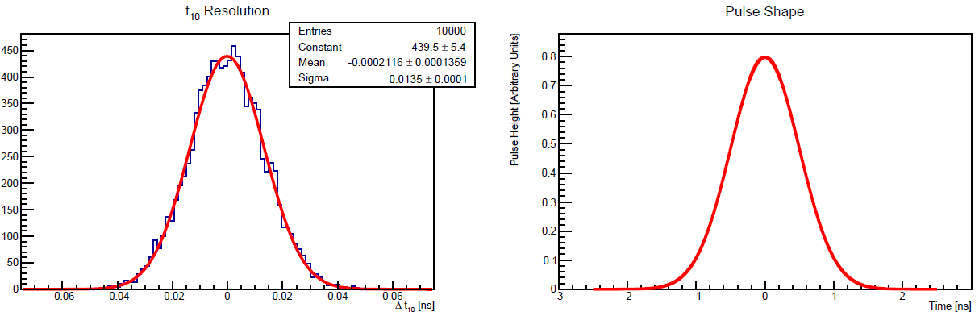
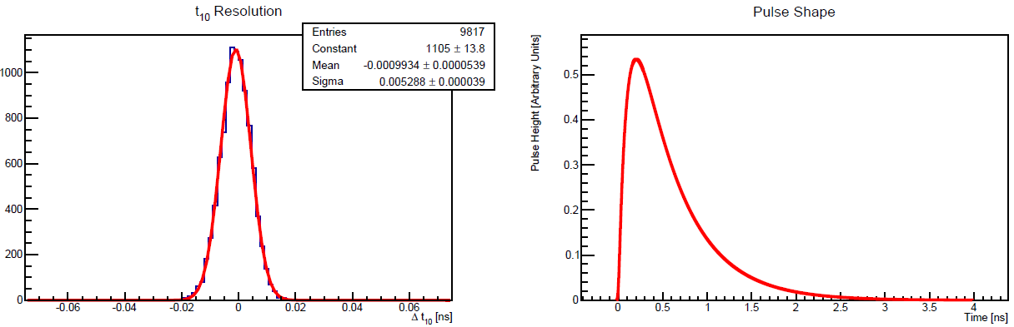
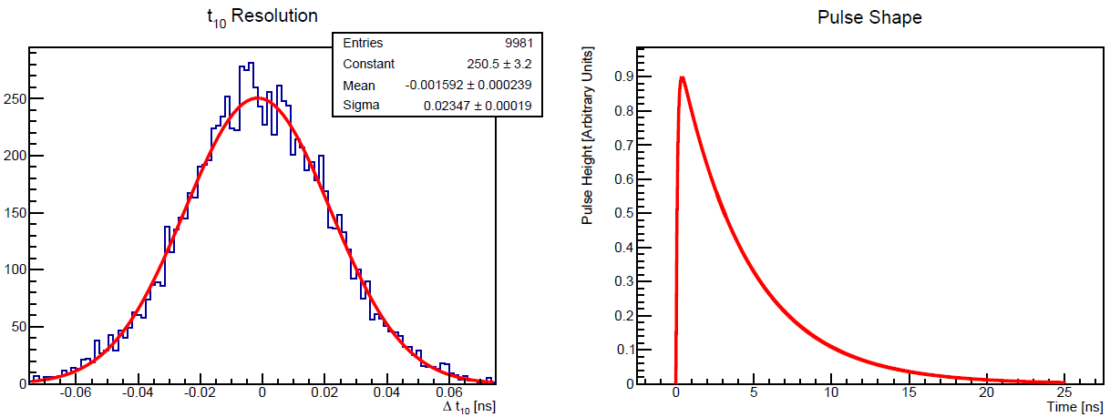
Active material studies
Δt - Δt_{true}
Study effect of pulse shape on Δt resolution
Same default event as earlier slide
Pulse width important, especially rise time
Quenched plastics?
  Short decay
  But slower rise
  Low light output
Gaus,
0.5 ns
width
σ ≈ 14 ps
“Stilbene”,
0.5 ns decay
σ ≈ 5 ps
Stilbene,
4.5 ns decay
σ ≈ 23 ps

Slide 49
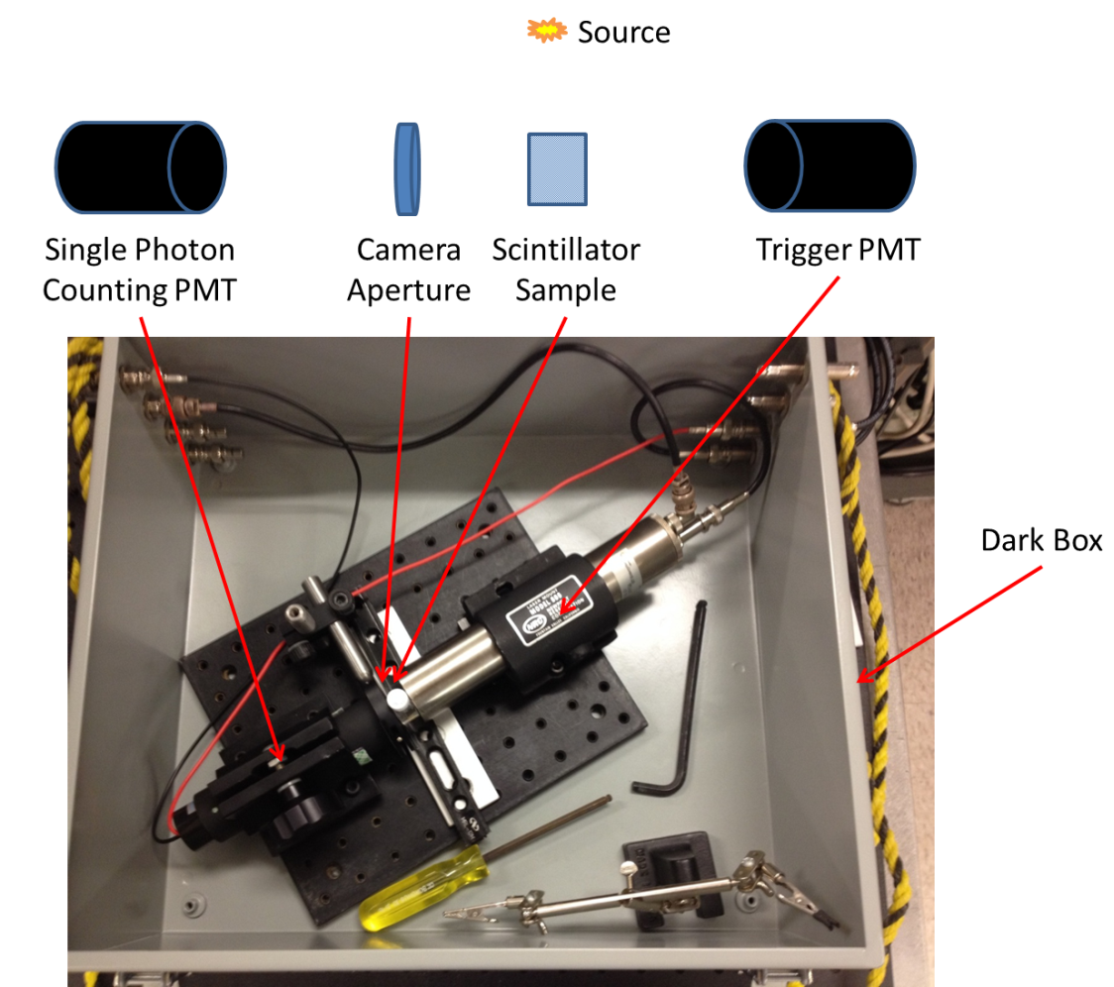
Active material studies
Use single-photon time-delay method to measure pulse shape of
  3 quenched plastics
  Stilbene single crystal
  EJ-309 (reference)
System time resolution is comparable to pulse width!
Use Planacon/DRS4 in place of PMTs?

Slide 50
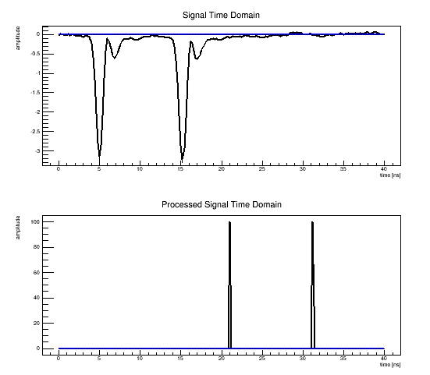
Signal readout/processing
Not all pixels see well separated single photons.
Reconstruction algorithm assumes it is handed a list of photon arrival positions & times.
How to analyze signal trace?
Use deconvolution with average pulse shape?
Works great with no noise!
Two “average”
SER pulses
Deconvolved
times (with shift)

Slide 51

Signal readout/processing
Not all pixels see well separated single photons.
Reconstruction algorithm assumes it is handed a list of photon arrival positions & times.
How to analyze signal trace?
Use deconvolution with average pulse shape?
Broken with noise!
Two “average”
SER pulses
+ noise
Deconvolved
times (with shift)

Slide 52

Signal readout/processing
Not all pixels see well separated single photons.
Reconstruction algorithm assumes it is handed a list of photon arrival positions & times.
How to analyze signal trace?
Use Wiener deconvolution with average pulse shape?
Better, but not great…
Two “average”
SER pulses
Deconvolved
times (with shift)

Slide 53


MINER: Building to Building Imaging
Left: source location (red star) in adjacent high-rise (28 m distance).
Right: neutron image overlaid on photograph

Slide 54


MINER: Neutron Spectroscopy
Left – peak-normalized spectra as measured using MINER. Right – insensitivity of Cf spectrum to intervening material as measured by MINER.

Slide 55

MINER: Gamma Insensitivity for Neutron Imaging
The images above were recorded using a ²⁵²Cf source 2 m from MINER at a relative angle of 135°, a strong ¹⁵²Eu source 1 m from MINER at a relative angle of 0°, and both sources together. This demonstrates the robustness of the neutron image reconstruction process in the presence of gamma fields. (Background neutron rate: ~1.5 pairs/minute.)

Slide 56



Fast neutron imagers @ SNL/CA
Cast:
P. Marleau
S. Kiff
N. Mascarenhas
J. Brennan
M. Gerling
A. Nowack
J. Steele
S. Mrowka
P. Schuster
K. McMillan
J. Lund
J. Goldsmith
C. Tewell

Slide 57

Fast neutron directional detectors
Common features
N-P elastic scattering
Sensitivity to direction
  Event by event (kinematics)
  Statistical (many events form a pattern)
Liquid scintillator based.
  Gamma discrimination
Shielding is hydrogenous material.
System attributes
A_{phys}
= π r²
System angular resolution: resolution of the reconstructed image in the far field.
Event angular resolution: resolution on the direction of a single event.
r
WGPu
Effective area: area over which the detector would be 100% efficient.
  Physical cross-sectional area times the detection efficiency.
A_{eff} = A_{phys} * ε

