Slide 1

Studies at JLAB of Photodetectors for EIC Experiments
Carl Zorn*
Jefferson Laboratory
Newport News, VA
*on behalf of EIC/DIRC and EIC/RICH collaborations

Slide 2
Radiation Detector & Imaging Group
Support design and construction of new detector systems
Technical consultants for the lab scientists and users
Development and use of imaging and non-imaging detector systems
Expertise in nuclear particle detection
Dr. Drew Weisenberger- Group Leader/detector scientist
Brian Kross- mechanical engineer
Jack McKisson- electrical engineer
John McKisson- software engineer
Dr. Seung Joon Lee- detector scientist
Dr. Wenze Xi- detector scientist
Dr. Carl Zorn- detector scientist
The Group makes use of expertise in the JLab
  Fast Electronics Group
  Data Acquisition Group

Slide 3

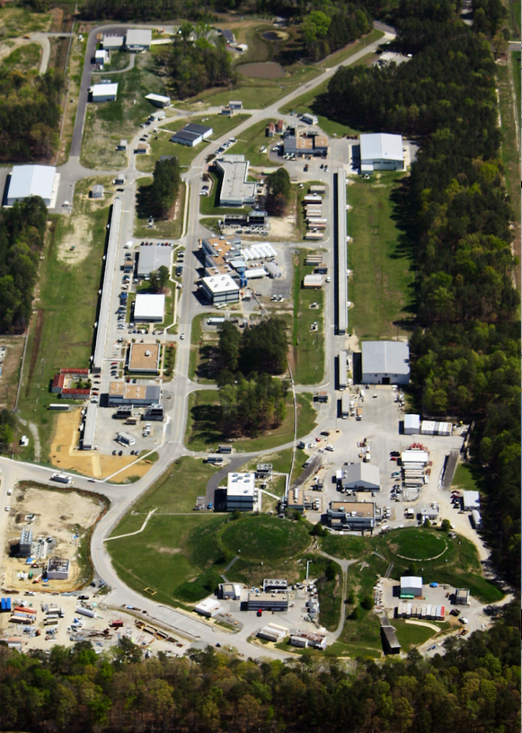
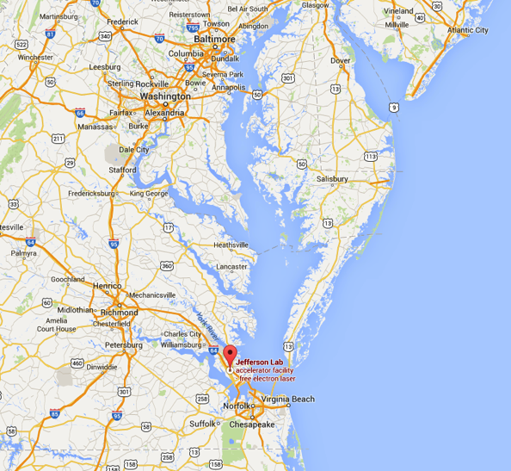
Jefferson Lab – QCD Physics
Built originally as 4 GeV high intensity electron accelerator in early 90’s. Eventually reached 6 GeV.
Now beginning new 12 GeV physics program to continue QCD studies.
Hall D
Baltimore
D.C.
Richmond
JLAB
A B C
Halls

Slide 4
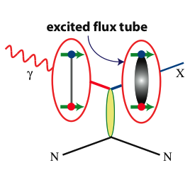
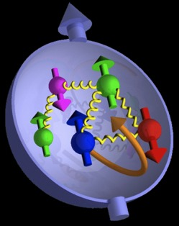
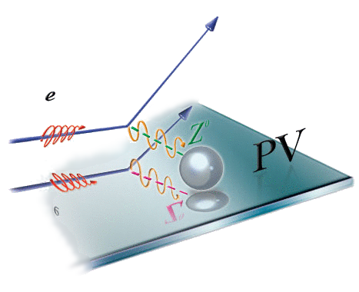
21st Century Science Questions
What is the role of gluonic excitations in the spectroscopy of light mesons?
Where is the missing spin in the nucleon?
What is the role of orbital angular momentum?
Can we reveal a novel landscape of nucleon substructure through measurements of new multidimensional distribution functions?
What is the relation of short-range nuclear structure and parton dynamics?
Can we discover evidence for physics
beyond the standard model
of particle physics?
Excited Glue

Slide 5

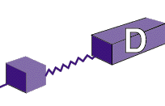
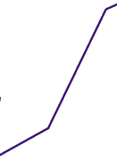
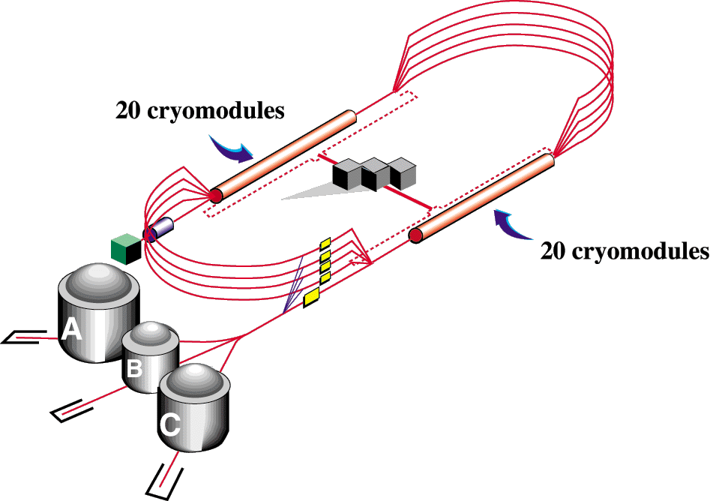


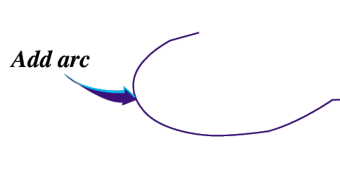


Jefferson Lab 12 GeV Upgrade
JLab’s 12 GeV Upgrade was ranked the highest priority in the 2007 Nuclear Science Advisory Committee (NSAC) Long Range Plan
New Hall-D
Max energy: 12 GeV
CHL-2
  Enhanced capabilities in existing Halls A/B/C
  Max energy: 11 GeV
Two 1.1 GeV LINACs, maintain capability to deliver lower pass beam energies: 2.2 – 8.8 GeV

Slide 6

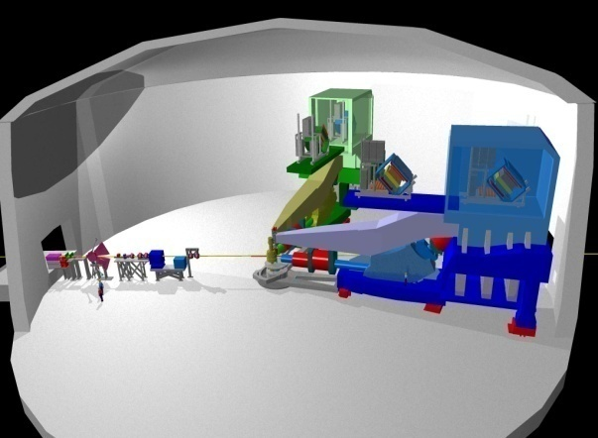
Hall A
Hall A
nucleon form factors,
& future new experiments like Moller & SOLID

Slide 7
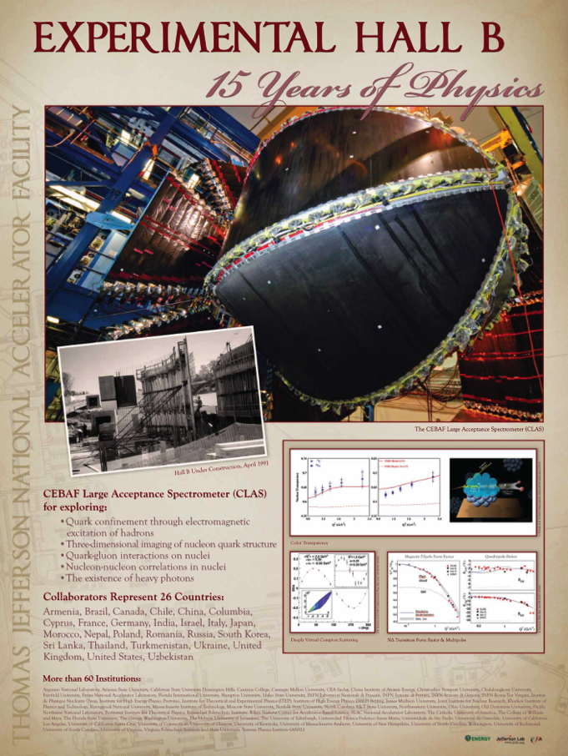
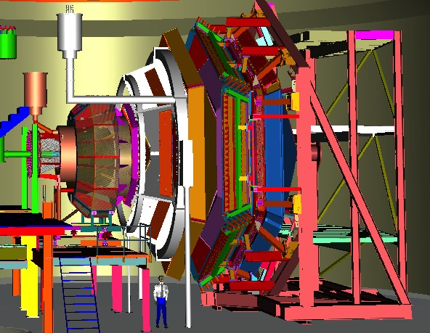
Hall B (CLAS12)
CLAS12 (Hall B)
understanding nucleon structure via generalized parton distributions

Slide 8

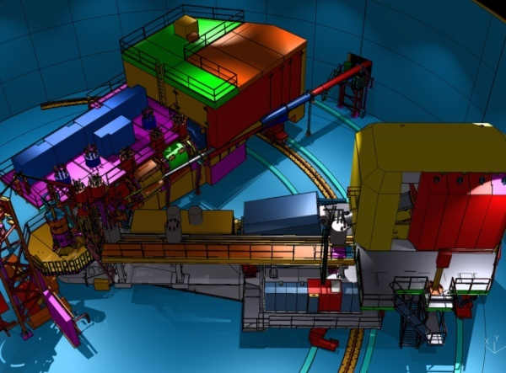
Hall C
SHMS (Hall C)
precision determination of
valence quark properties in nucleons and nuclei

Slide 9
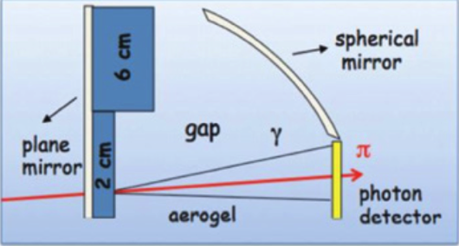
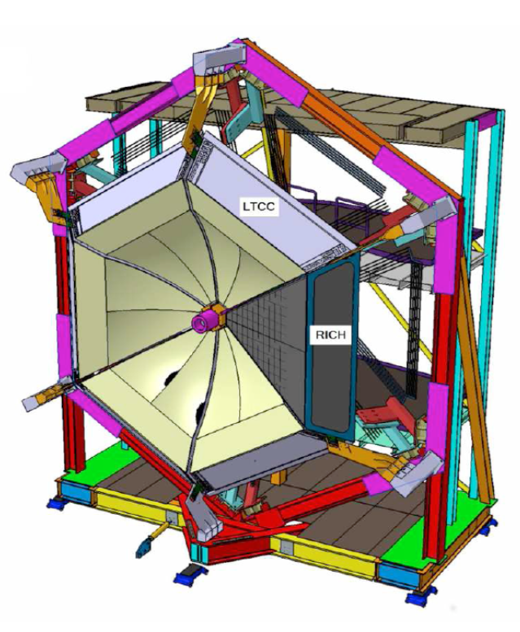
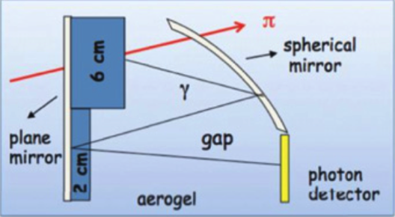
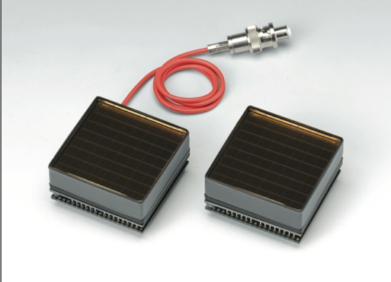
CLAS12 RICH
need400
H12700
better single pe resolution
H8500 series

Slide 10
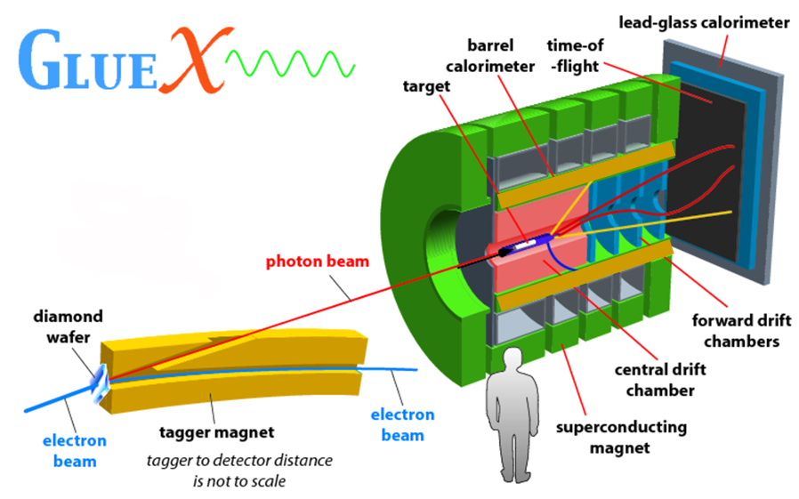
New Hall D – Photon Beam
FCAL
TOF
Excited Glue
BCAL
start counter
FDC
CDC
BCAL

Slide 11
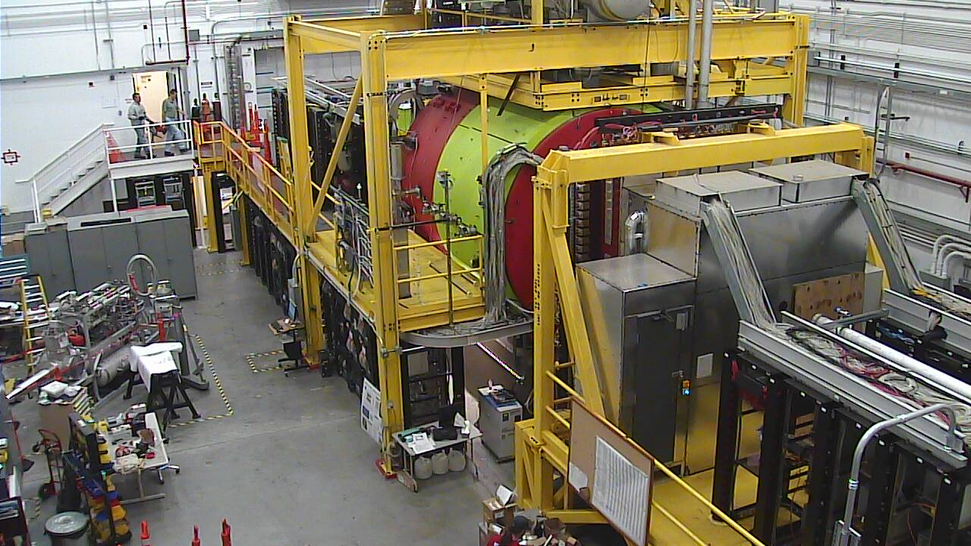
Hall D – Oct,2014 – now taking beam
GLUEX (Hall D)
exploring origin of confinement by studying hybrid mesons

Slide 12
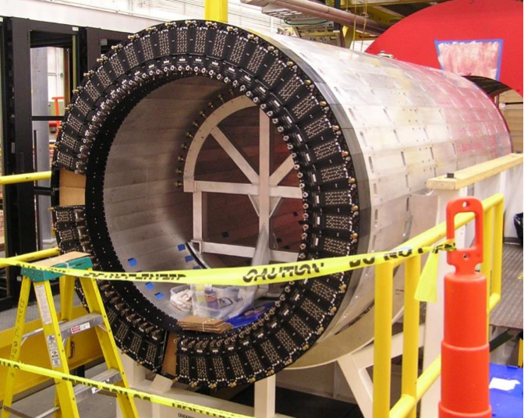
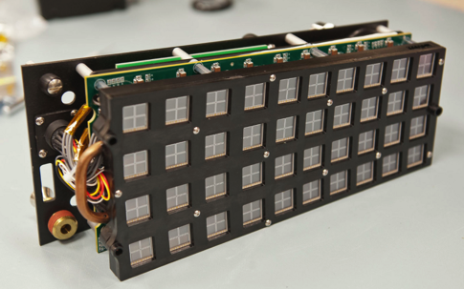
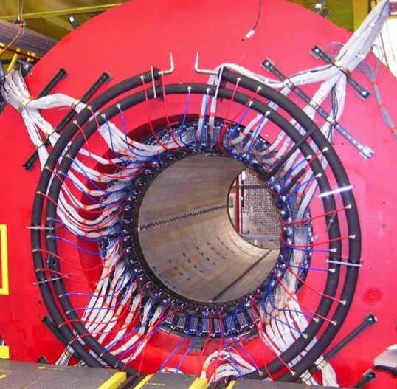
Hall D – First Use of SiPMs
Barrel Calorimeter
3840 SiPM arrays
4x4 array of 3x3 mm² 50 µm microcell (Hamamatsu)

Slide 13
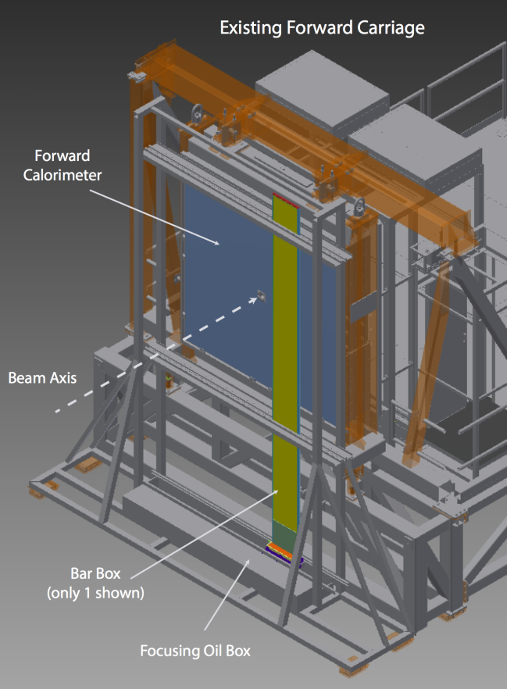
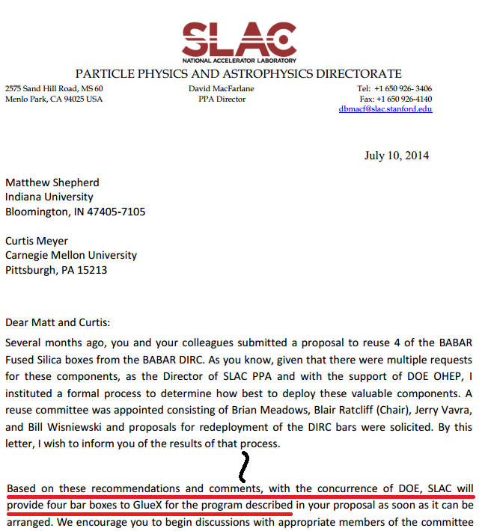
FDIRC PID Add-on to GlueX
4 of the orginal bars
given to GlueX

Slide 14
The prototype READOUT BOX

Slide 15
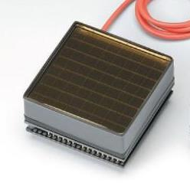
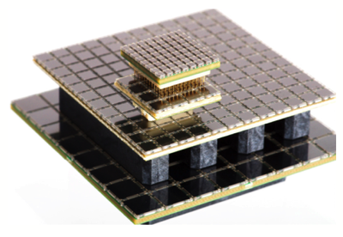
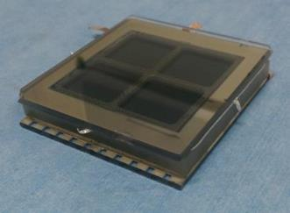
Options for Readout
 | MaPMT | SiPM | MCP-PMT
Cost | ~ $1M/m² | ~ $1M/m² | Low
Position resolution | ~ mm | ~ mm | ~ mm
Time resolution | fair | good | very good
Dark rate | low | high | low ?
Single photon detection | fair | good | fair ?
Rate capability | good | good | fair ?
Radiation hardness | good | poor | good ?
Field sensitivity | poor | very good | fair ?

Slide 16
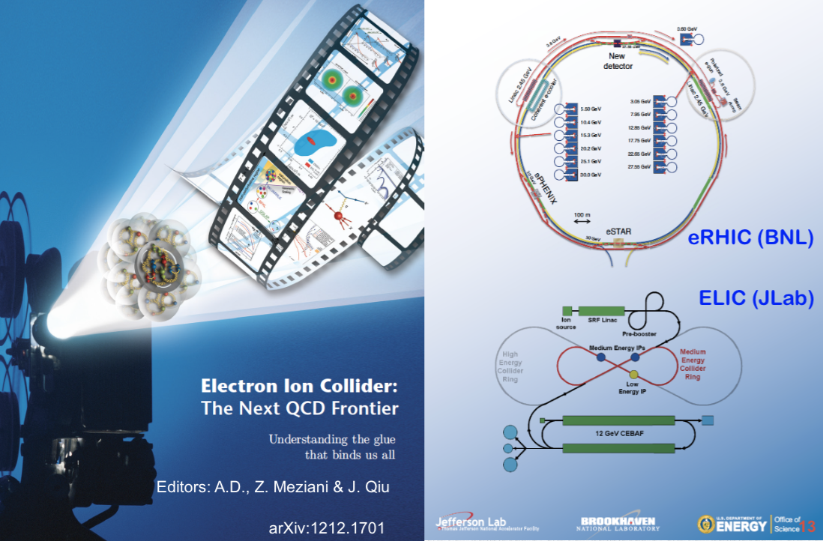
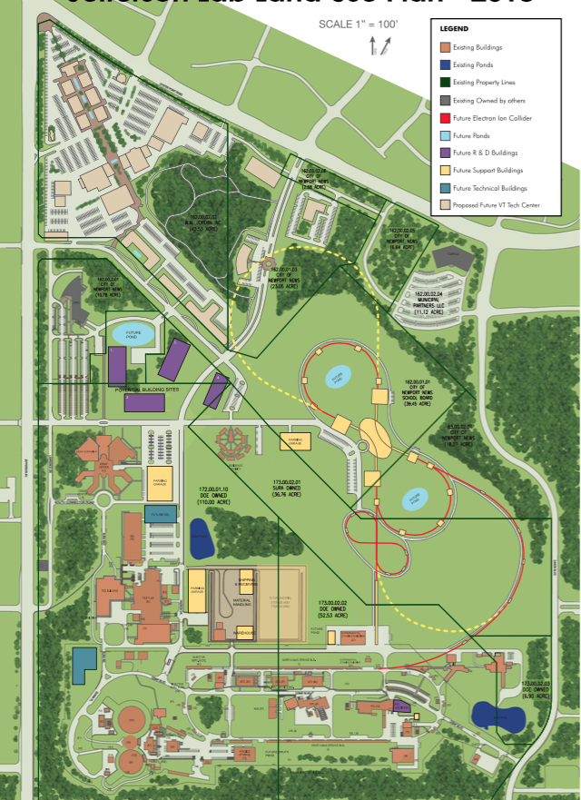
The Future for QCD Studies - EIC

Slide 17
RICH Detector for the EIC’s Forward Region Particle Identification (RD2013-4)
an EIC R&D Proposal – July 21, 2014
F. Barbosa, W. Brooks, M. Contalbrigo, A. Datta, M. Demarteau,
J.M. Durham, D. Fields, X. He, H.van Hecke(co-PI), J. Huang,
M. Liu, J. McKisson, Y. Qiang(co-PI), P. Rossi, M. Sarsour,
R. Wagner, W. Xi, L. Xue, Z. Zhao, C. Zorn

Slide 18
EIC PID Requirements
Very rich physics program:
  Nucleon tomography and spin structure
  Quark hadronization
  Spectroscopy
  Many more …
Dedicated EIC machine and spectrometer
  Hermetic detector system
  Large momentum range
  Multi-particle detection in final states
EM Calorimeter
EM Calorimeter
Barrel EM Calorimeter
RICH Detector
Ion
beam
Cherenkov Counter
Tracking
electron
beam
TOF/DIRC
Magnet
9 m
Notes:
We all know that EIC is a very promising project which covers a lot of important physics topics.
Therefore, dedicated …
Forward region with respect to the ion beam

Slide 19
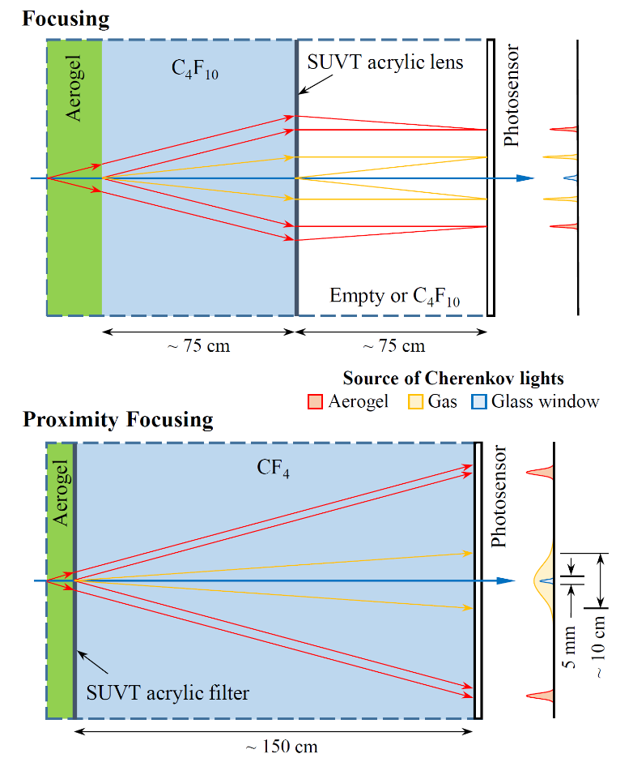
Dual Radiator Concepts
MEIC design geometry constraint: ~150 cm length
Focusing RICH
  Aerogel RICH: 3 – 10 GeV
  C₄F₁₀: 10 – 20 GeV
  Focused by a Fresnel lens
    absorbs scattered UV lights
  Readout resolution: < 2 mm
Proximity Focusing
  Aerogel RICH: 3 – 10 GeV
  CF₄ threshold counter: 8 – 17 GeV
    signals from readout window mixed with photons from CF₄
  Readout resolution: < 4 mm
Notes:
SUVT acrylic, > 280 nm
Two concentric rings will be formed on the readout plane

Slide 20

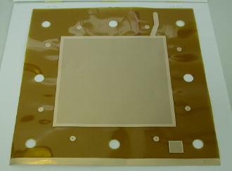
Options for Readout
 | MaPMT | SiPM | MCP-PMT | GEM
Cost | ~ $1M/m² | ~ $1M/m² | Low | Low
Position resolution | ~ mm | ~ mm | ~ mm | ~100 µm
Time resolution | fair | good | very good | poor
Dark rate | low | high | low ? | fair
Single photon detection | fair | good | fair ? | poor
Rate capability | good | good | fair ? | good
Radiation hardness | good | poor | good ? | good
Field sensitivity | poor | very good | fair ? | good

Slide 21
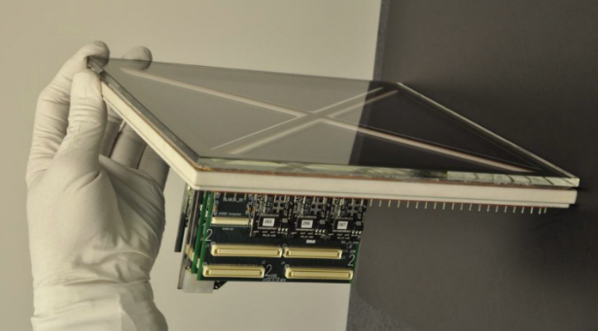
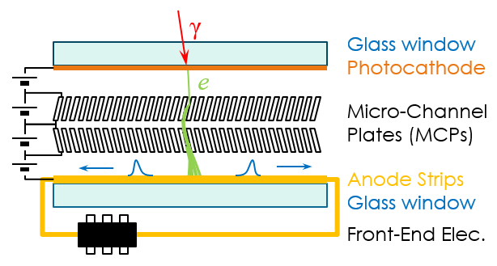
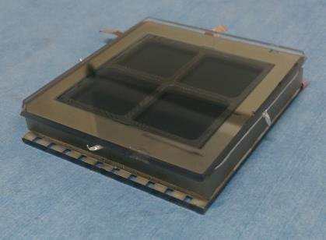
MCP-based LAPPD
large area photocathode
ALD MCP
1.2 mm
20 μm pore
vacuum transfer system
6×6 cm²
20×20 cm²
15 GS/s waveform
sampling DAQ
transmission line readout

Slide 22
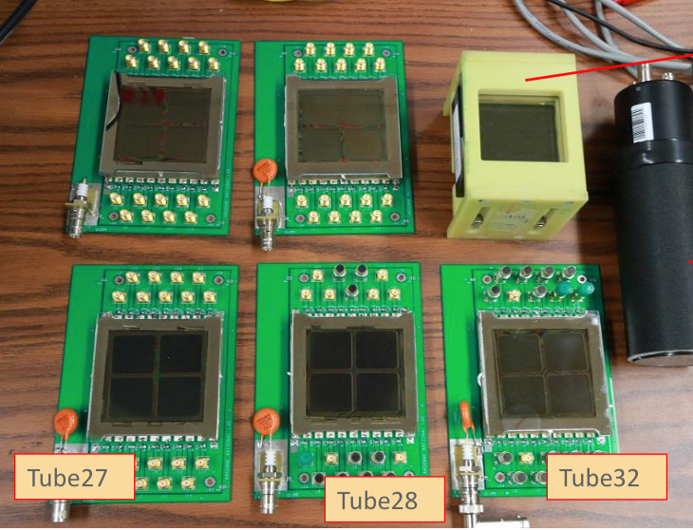
First 6x6 cm² samples

Slide 23
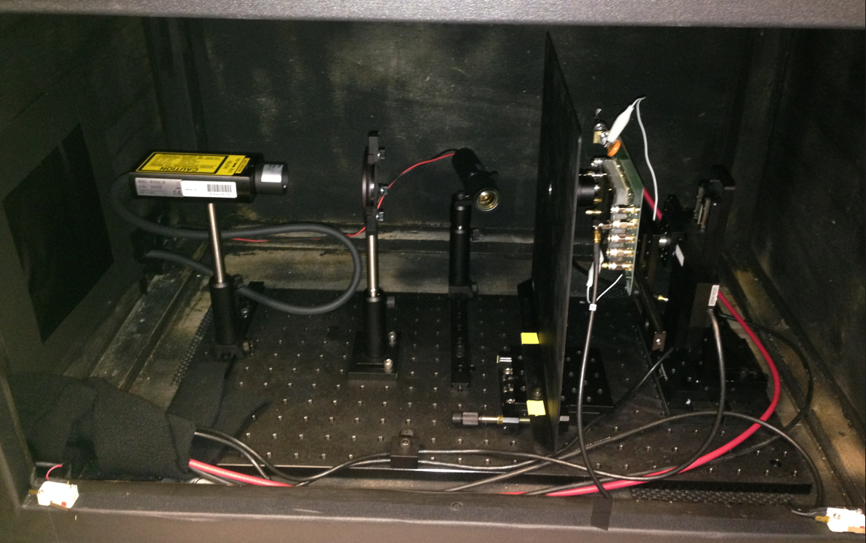
Test Set for mini-LAPPD sample 28
Hamamatsu picosecond laser
405 nm
60 ps pulse width
Collimator
2.5 mm ø
diffuser
Trigger PMT R4998
X/Y stage

Slide 24
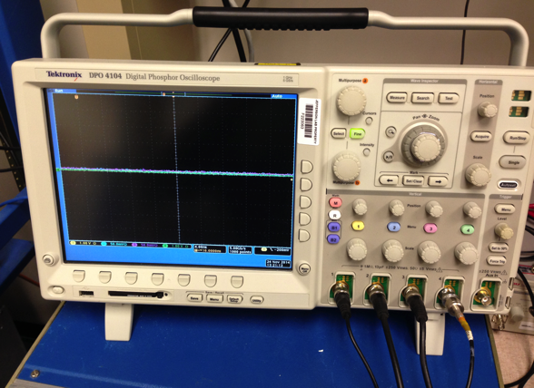
Initial DAQ – 1 GHz BW, 5 Gs/s scope
A few quick results
Readout strip width
4.7 mm physical
Scan FWHM = 4.5 mm
Strip Signal transmission speed
178 µm/ps (ANL)
180 µm/ps (JLAB)
Also plan to implement full standard ADC/TDC DAQ
Some Key Investigations to Come
Irradiation – Neutrons and Gammas
High B-field test
Ponder a pixel-based readout

Slide 25
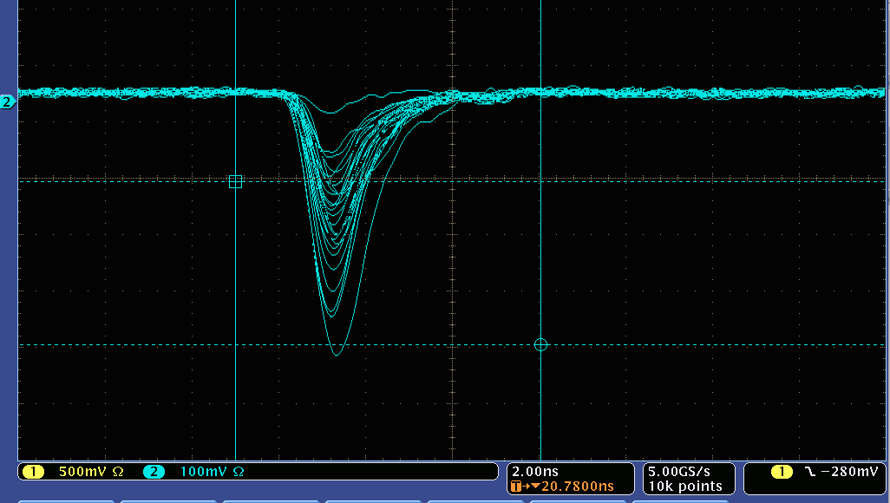
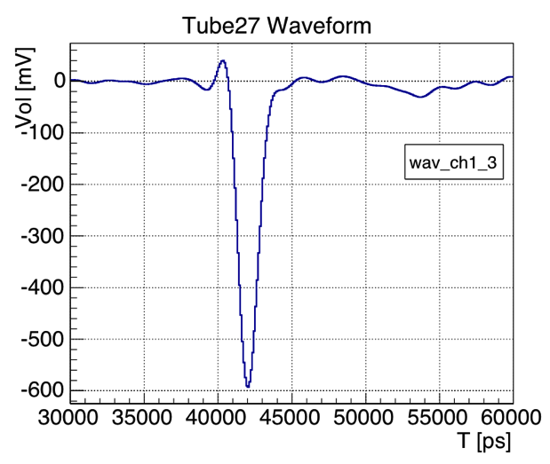
Pulse comparison
5 ns
JLAB sample
1 GHz BW
5 Gs/s scope
ANL sample
3.5GHz BW 40 Gs/s scope
Rise time 0.75 ns
5 ns
Scope limit 0.35 ns

Slide 26
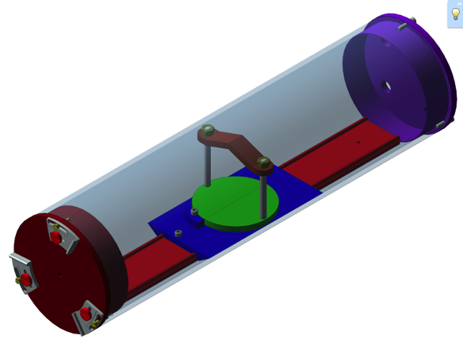
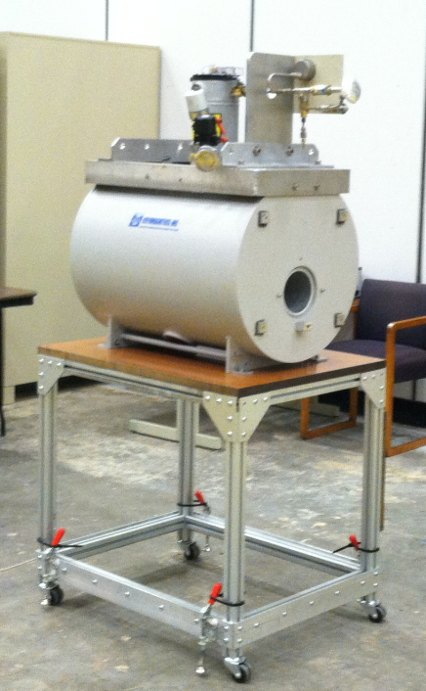
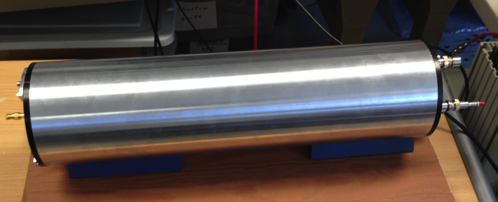
High B field Test Setup
Sample Tube – fits bore
18 inch length
PMT can moved axially
or rotated in a plane
Light source is blue LED (470 nm) fed through quartz fiber optic
All components non-magnetic
Up to 5 Tesla
5 inch diameter bore
30 inch length

Slide 27
High B field Test Setup
Sample Tube – fits bore
18 inch length
PMT can moved axially
or rotated in a plane
Light source is blue LED (470 nm) fed through quartz fiber optic
All components non-magnetic
Up to 5 Tesla
5 inch diameter bore
30 inch length

Slide 28
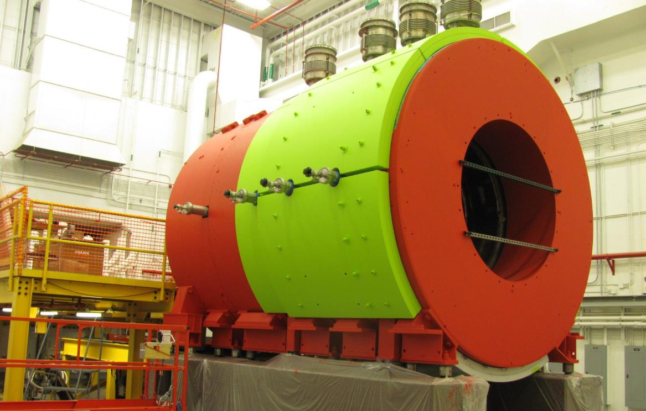
Use the GlueX magnet
Used for LASS at SLAC, for MEGA at Los Alamos, refurbished for Hall-D
Bore inner diameter 1.85 m, length 4 m, B_{MAX} 2.2 T @ 1500 A

Slide 29
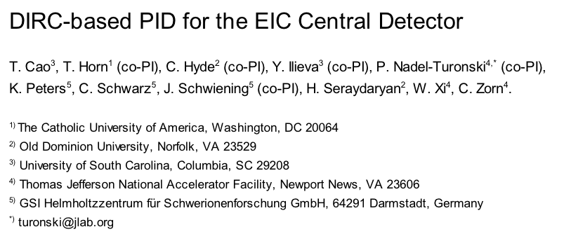
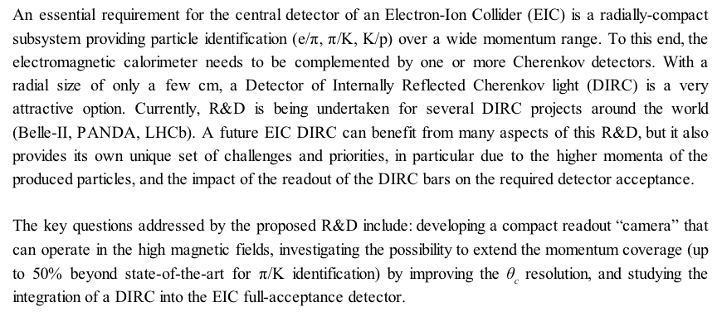
Add Title

Slide 30




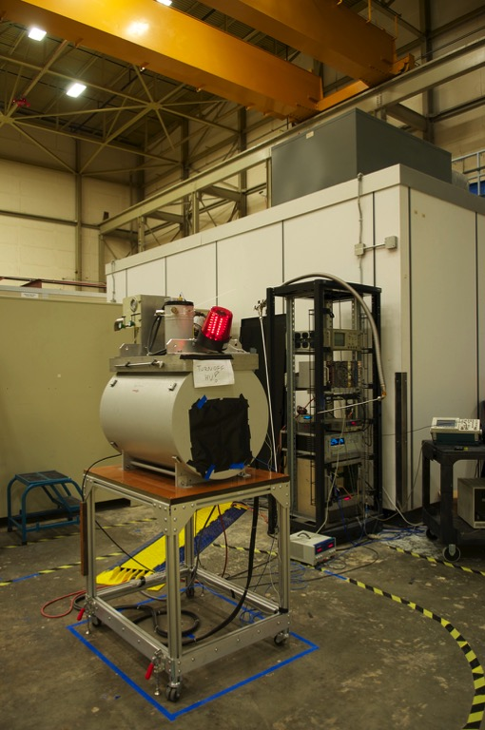
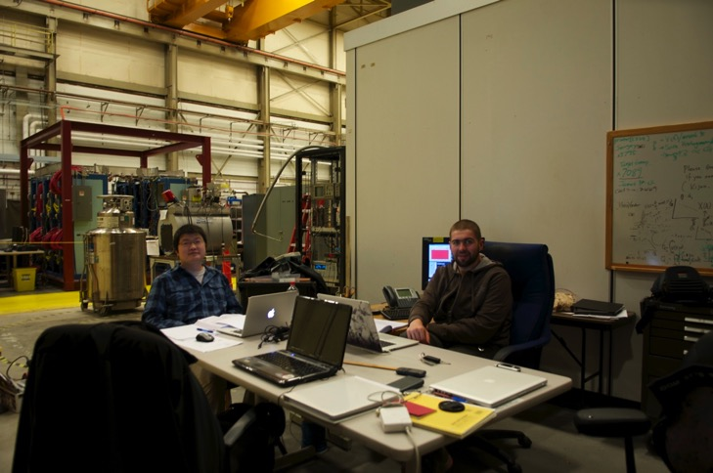



Purpose: Evaluation of PMT gain in B fields
Commissioning: July/August 2014
Data taking: November 2014
People: JLab: P. Nadel-Turonski, C. Zorn; USC: Y. Ilieva, T. Cao, E. Bringley; ODU: K. Park, G. Kalicy, L. Allison
Notes:
Purpose: to evaluate the gain of small photon sensors in magnetic fields
The underlined names are of Tongtong and Greg who are featured working this November taking data in the facility.

Slide 31
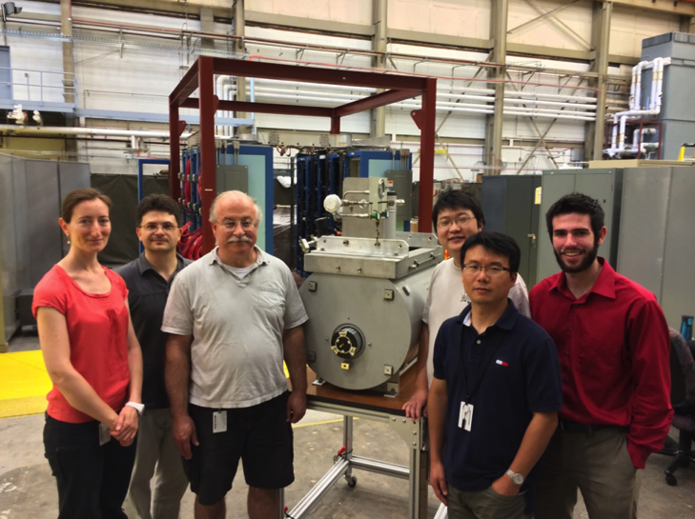
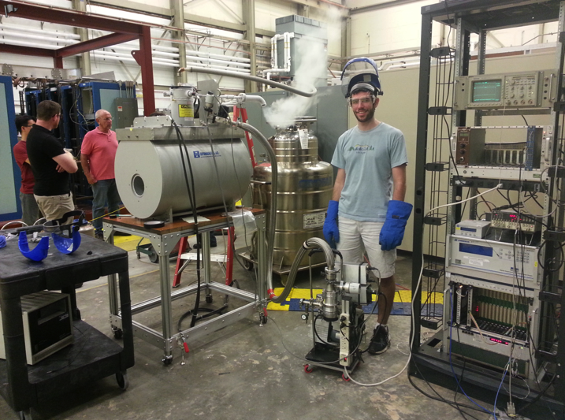
Some More Snaps
The limiting factor – cooling down the magnet
L->R: Yordanka Ilieva (USC)
Pawel Nadel-Turonski (JLAB)
some guy, Tongtong Cao (ODU)
Kijun Park (ODU), Eric Bringley (USC)

Slide 32
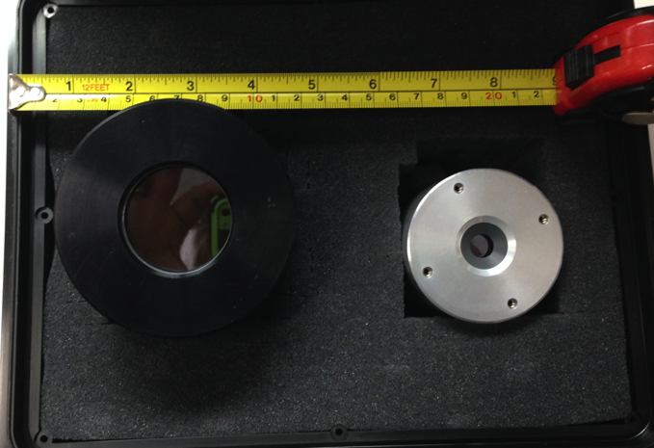

Initial Samples Tested
Photonis PP0365G
6 µm pore
18 mm window
Double MCP
Photek 240 & 210
10 & 40 mm windows
double MCP
S20 photocathode

Slide 33




Major Components

Slide 34




Sensor Orientation Capabilities
φ: rotation about Z’
θ: rotation about Y(Y’)
Y (Y’)
φ
X’
Z’ (along sensor’s axis)
θ
X
Z (along B-field)
Notes:
The range and step-size of phi rotation depends on the sensor’s shape.
The step-size of the theta rotation is 5deg and the range depends on the sensor’s size.
Theta is the angle between Z and Z’.
The way we collected data was: Fix theta, fix phi, then change the field from 0 T until signal disappears.
We also inserted the dark box from the other side of the magnet to simulate rotation of B field to 180 deg.

Slide 35

Welcome to 3D printing
We use this regulaly now to make custom plastic parts “on the fly”
Several pieces were made to improve the performance of the “Dark Tube”

Slide 36

Trigger
Pulser
Fan In/Fan Out
Dark Tube
LED
470 nm
Diffuser
Discriminator
MCP-PMT
NIM to ECL
PreAmp
MVME
fADC250
Sync
Trigger Board
Notes:
I think the most notable feature here is the sampling flash ADC. The Quantum efficiency of the sensors we tested is about 10 - 15% for this wavelength.

Slide 37



Charge Generator PS7120
Q(t)
fADC250
ADCch
Q (pC)
ADCch
Notes:
In case there is time for details. But we do not make use of the calibration anywhere later in the talk, so just to demonstrate that we did it.
The fADC calibration is a two-step process: first we calibrate the negative DC output, Vm, of the charge generator: Q vs Vm. Then we take fADC calibration data for various Vm and calibrate the fADC response, ADCch: Q vs ADCch.
Currently, the uncertainties of the points are smaller than the symbol size and only account for the uncertainty of the total Q due to the choice of range of integration of the V(t) pulse. Statistical and pedestal subtraction uncertainties are not taken into account yet.
ADCch is the average sum of all background-subtracted pulse heights: ADCch=[sum(ADcch_i-ADCch_pedestal)]/N, where i is a counter over all the samples for each pulse, ADCch_pedestal is the pedestal peak position in ADCch, and N is the number of events.

Slide 38


θ=0°
Photek PMT210
signal height is averaged over all events in the run
average pedestal is subtracted from pulse height at each time
increasing the field from 0. to 0.5 T leads to an increased gain
above 0.5 T the signal amplitude continuosly deacreses
B = 0.5 T
B = 0.0 T
B = 2.5 T
B = 3.5 T
B = 4.0 T
Average-Pulse Height (ADC ch)
time (a.u.)
Notes:
Profile of the average signal (average over all events and all amplitudes in one run). The X axis shows time in units of ADC samples. The fADC digitizes the pulse height each 2 ns (our signals are very fast, however the ADC stretches the signal without, hopefully, changing its total area).
The figures are showing raw data taken in November 2014 with Photek PMT210 and just demonstrate the effect of the field and sensor rotation on the PMT output.
The pedestal is determined for each B (data run) separately and then subtracted.
The signals shown contain single- and multi-photoelectron hits.

Slide 39

θ=0°
Photek PMT210
max. high voltage: -4.8 kV
very preliminary 10% uncertainty shown
operating the sensor at nearly maximum high voltage extends the range of applied field to 5 T
HV=-4.76 kV
Average-Pulse Area (a.u.)
HV=-4.44 kV
B (T)
Notes:
This figure shows the area under the average pulse as a function of B-field for standard orientation of the sensor (Photek PMT210). Data were taken at an operating value of the high voltage and at nearly maximum high voltage. The latter allows to extend the range of applied field while still obtaining a relevant signal from the PMT.
To obtain the area reported above, only the positive pulse heights (in ADC ch) of the average signal (shown in the previous slide) are summed up. The time interval covering the positive part of the signal is the same for all B but I have not scaled down the points, thus, the units on the Y axis are arbitrary.
It is interesting to note that applying a nearly-maximum HV increases the + area of the average pulse almost 4 times, but this factor actually depends on the field: it is 3.6 times at 2 T and about 5 times at 4 T.

Slide 40

events
θ=0°
Photek PMT210
high voltage: -4.4 kV
pedestal peak at about 1530 ch
gain can be extracted from fits to spectra to identify position of single-photoelectron peak
analysis of spectra is ongoing
B = 0.5 T
B = 0.0 T
B = 2.5 T
B = 3.5 T
B = 4.0 T
ADCch
Notes:
Event distribution of pulse area in units of ADC ch. The spectra exhibit the same features as the average-pulse spectra on slide 5: 0.5 T seems to be the best field for largest output signal. From 0.5 T up, the signal amplitude decreases. These spectra are to be fit to extract the absolute gain of the sensor (that may turn out to not be feasible given that it is hard to “see” where the single phe peak is at higher fields, still we can report relative gain change with field and angles). The figure is shown to demonstrate how the increasing field changes the ADC spectra. The number of events in each spectrum is not necessarily the same and no quantitative conclusions are to be drawn.

Slide 41
Summary
The facility is established and fully operational
Data collected
  Photek PMT210: B = (0, 5) T; θ = (0∘, 30∘, 180∘); φ=0∘, 90∘, 135∘
  Photek PMT240: B = (0, 5) T; θ = 0∘; φ=0∘
  Photonis PP0365G: B = (0, 3) T; θ = (0∘, 30∘, 180∘); φ=0∘, 90∘, 135∘
Gain analysis is ongoing
Future runs: Summer 2015

Slide 42

Future Developments
Installation of a 4.7-T superconducting solenoid with 25-cm bore
Time resolution evaluation in B-field up to 5 T

Slide 43



More MCP-PMTs to Test
XP85012 (25 µm)
XP85112 (10 µm)
Katod UFK-1 (5 µm)
Hamamatsu R10754-07-M16M

Slide 44
In Summary
Continue high B-field tests of MCP-based photomultipliers
Test new mini-LAPPD (“LAP-P-Dino”?) in high B field
Also test its radiation tolerance
LAPPD are of interest because of several possibilities that are addressed:
[1] compact in format and adaptable to different sizes
[2] can have excellent time and position resolution
[3] should be operable in high magnetic fields
[4] should be reasonably radiation tolerant
[5] may be affordable as large area photodetectors
However, will keep an eye on other technologies – e.g. SiPMs
*in quantities of 500-1000, full 5x5 cm² array can be had for $1.5K per unit

