Slide 1
Weak Interaction Studies with
Laser Trapped ⁶He
… and what MCPs have to do with it
Peter Müller
Physics Division, Argonne National Laboratory
P. Mueller, A. Leredde, T.P. O’Connor, K. Bailey
Physics Division, Argonne National Laboratory
A. Garcia, M. Sternberg, D. Zumwalt, R. Hong, Y. Bagdasarova,
H.E. Svanson, Z. Alexander, T. Cope, Y. Kim, G. Harper, F. Wauters
CENPA, University of Washington
X. Flechard, E. Liennard
LPC Caen
O. Naviliat-Cuncic
NSCL, Michigan State University
$ PM DOE Early Career Research Grant, DOE CENPA, LPC $

Slide 2
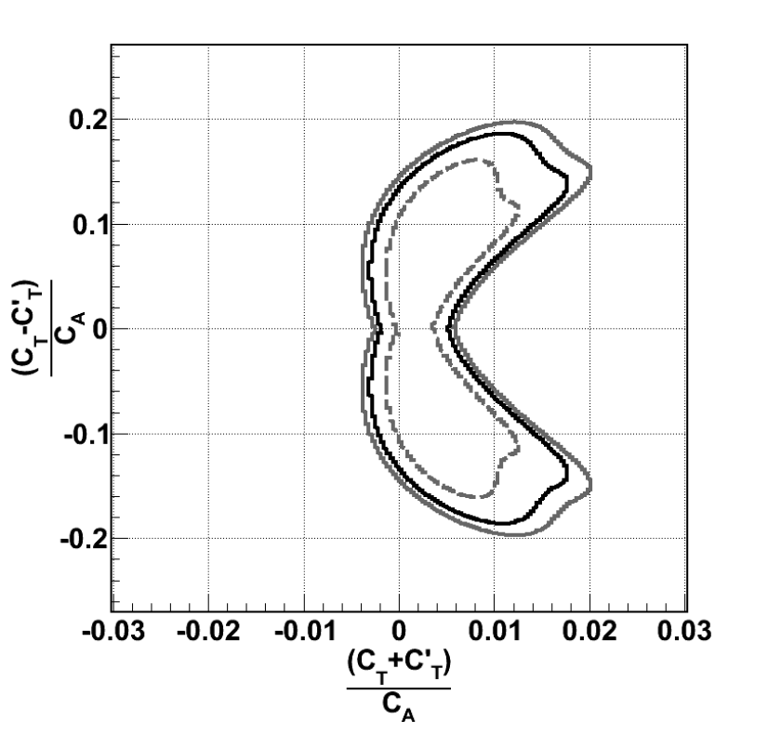
Weak Interaction Studies
ß-Decay Rate
J.D. Jackson, S.B. Treiman, H.W. Wyld, Nucl. Phys. 4 (1957) 206
Standard Model
Only V-A terms
a_{SM} = -1/3 for GT
a_{SM} = +1 for Fermi
Beyond Standard Model
Exotic couplings have not been
excluded beyond the 5-10% level
a = +1/3 for pure tensor GT
GT transition sensitive to C_{T} & C_{T}’
δa/a = 1%
from ⁶He decay
Johnson, Pleasonton,
Carlson, PhysRev 1963
Right-handed
δa/a = 0.1%
Left-handed
F. Wauters et al., arXiv:1306.2608

Slide 3
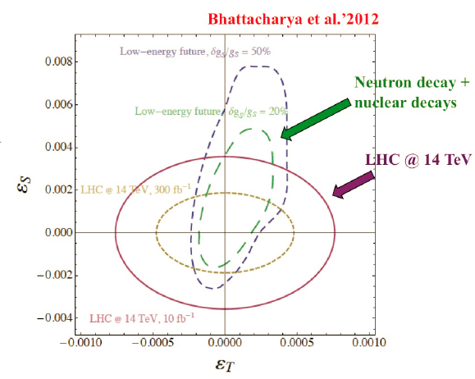
Beta Decay and LHC
Bhattacharya et al. PRD 85, 054512 (2012)
Effective field theory approach
effective nucleon couplings C_{X}
vs. effective quark couplings ε _{X}
correlate via lattice calculations
Future experiments
need to aim for 10⁻³ for b
and 10⁻⁴ for a
Future Projections
Beta-Decay Weak Interaction Studies in the Era of the LHC,
Solvay Institutes Workshop, Brussels, Sept. 3-5 2014

Slide 4
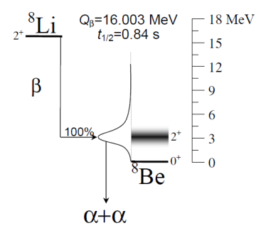
Weak Interaction Studies: β−ν Angular Correlations
Atom Trap
Ion Trap
⁶He
0⁺
Q_{β}=3.510 MeV
²¹Na
t_{1/2}=0.808 sec
β
100%
1⁺
⁶Li

Slide 5
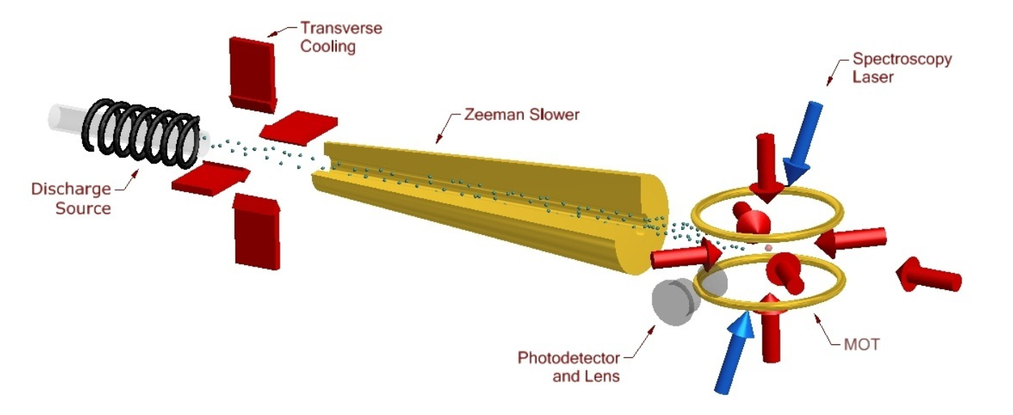
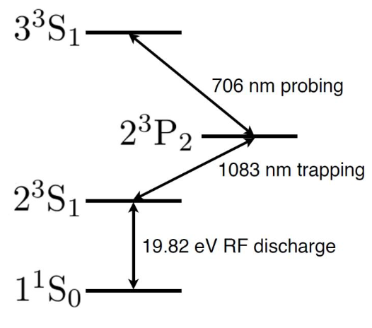
Experimental setup
²H(⁷Li, ³He) ⁶He
15 μA
2.10¹⁰ pps
18 MeV
10⁻⁵
x 80-100
Capture efficiency
1.10⁻⁷
+LN₂ cooling
Capture velocity:
900 m/s → 70%

Slide 6
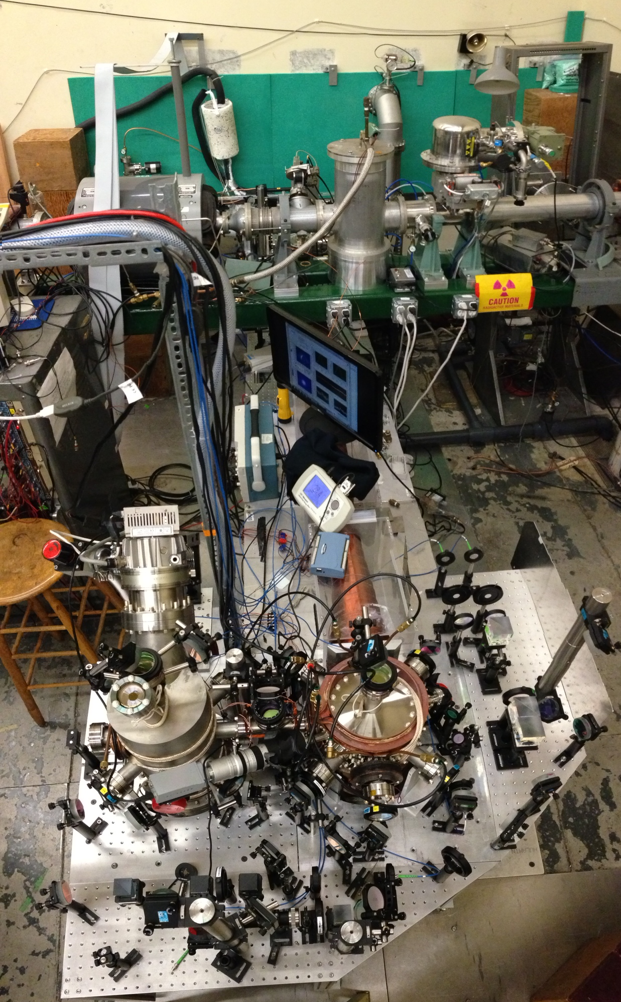
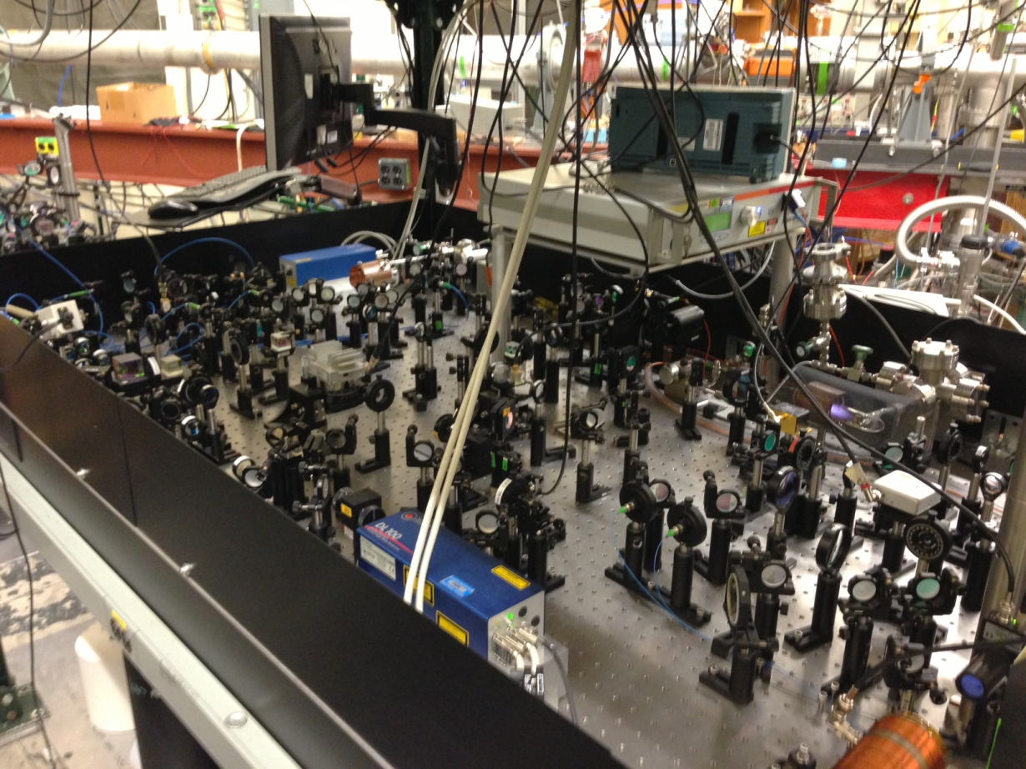
Helium MOT
Setup @ CENPA

Slide 7
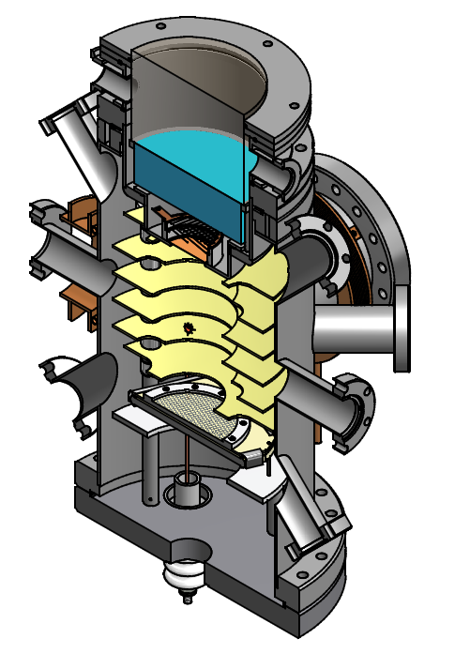
Beta-Decay Study with Laser Trapped ⁶He
Recoil time-of-flight spectrum
(MC simulation)
β-Detector
a
= +1/3
Trapped ⁶He
a
Counts
= -1/3
⁶Li recoil ion
detector
250
300
350
400
450
Time of Flight, ns
Atom trap properties
Highly selective capture
No RF fields or space charge
Low temperature sample (<mK)
Tight spatial confinement (< 100μm)
~5x10⁹ ⁶He/s production yield
trapping rate ~1x10³ ⁶He/s
~0.1% statistics in ~8 weeks beam time

Slide 8
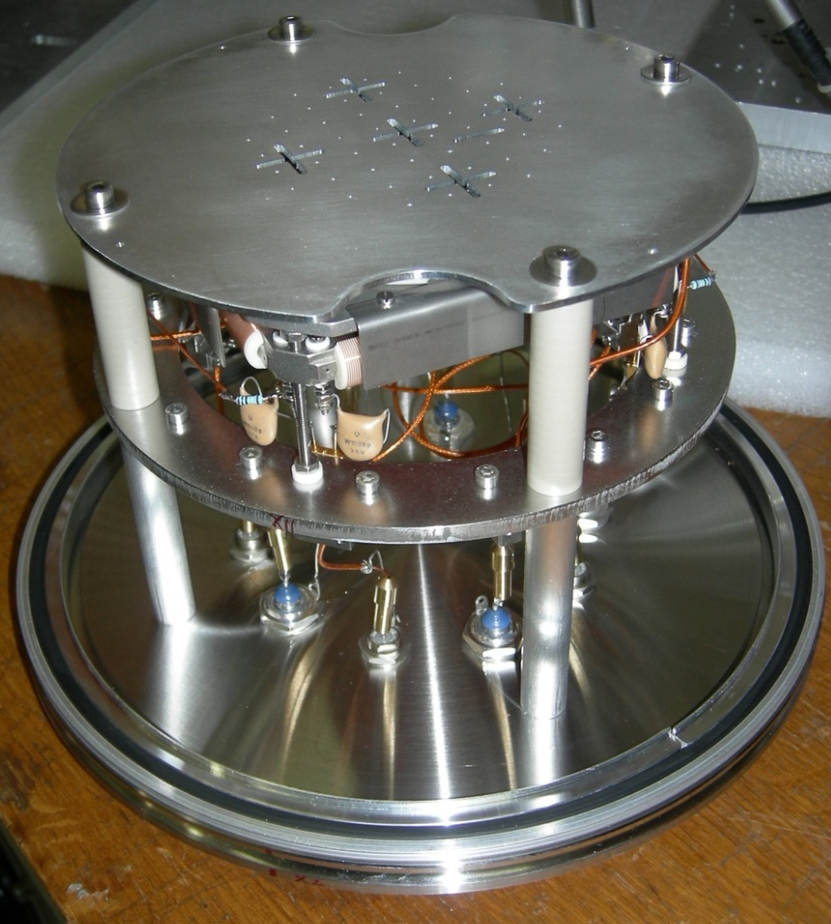
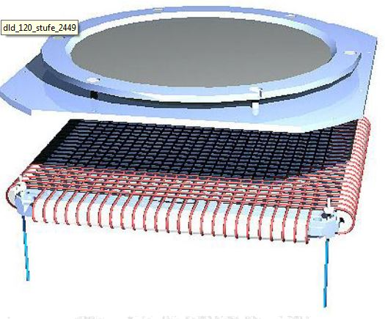
MCP - Recoil Ion Detector
Xavier Flechard, Etienne Liennard
MCPs (micro channel plates)
Delay line anodes
RoentDek DLD80 with custom
digital readout, FPGA processing
(LPC FASTER DAQ system)
On test flange with calibration mask

Slide 9
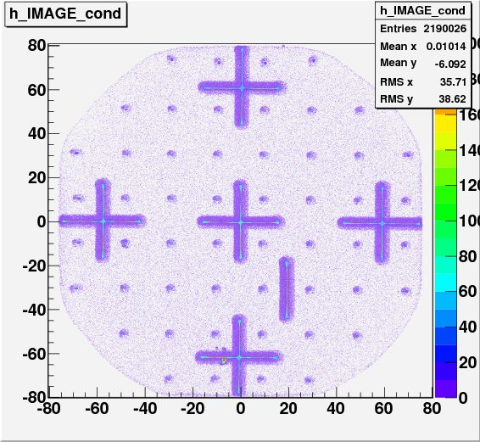
Recoil Ion Detector
Position calibration
with mask, Na⁺ beam
DAQ system for beta and recoil
detectors works
MCP efficiency 52 % (70%)
MCP uniformity 95.5 – 99.8%
Timing resolution ~100 ps
Position resolution ~100 μm
Position reconstruction ~ 1 mm
Need to do
In situ calibration with ⁶He BG
Timing calibration with ⁴He
Photo-ions (337 nm pulsed N₂ laser)

Slide 10
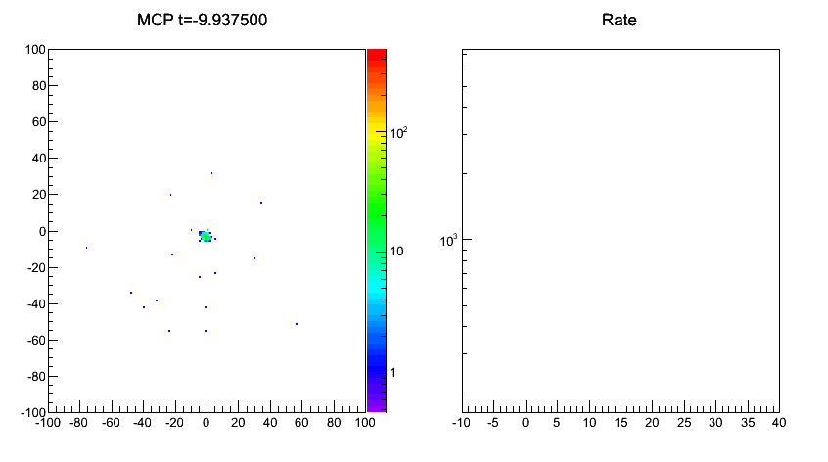
⁴He trap diagnostics with MCP
ms
dt_{y} (ns)
dt_{x} (ns)
t (ms)
He* + X -> He + X⁺ + e⁻
He* + He* -> He + He⁺ + e⁻

Slide 11
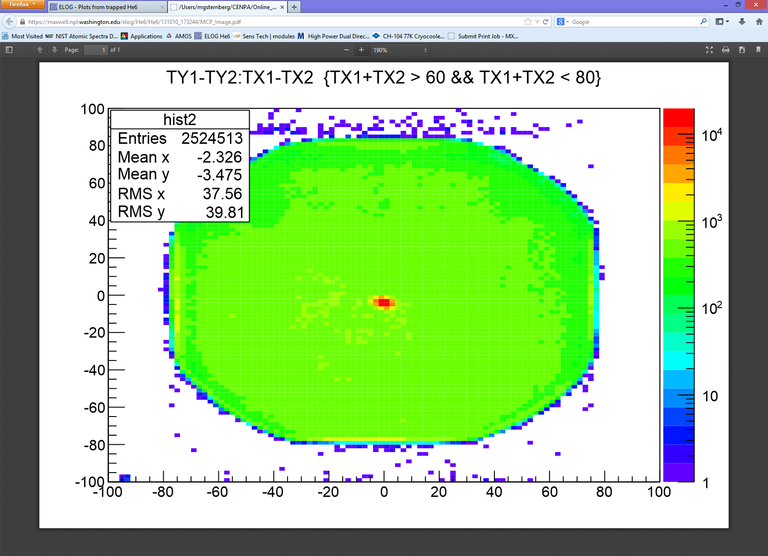
MCP Image of Trapped ⁶He
dt_{y} (ns)
dt_{x} (ns)
8 cm MCP diameter

Slide 12
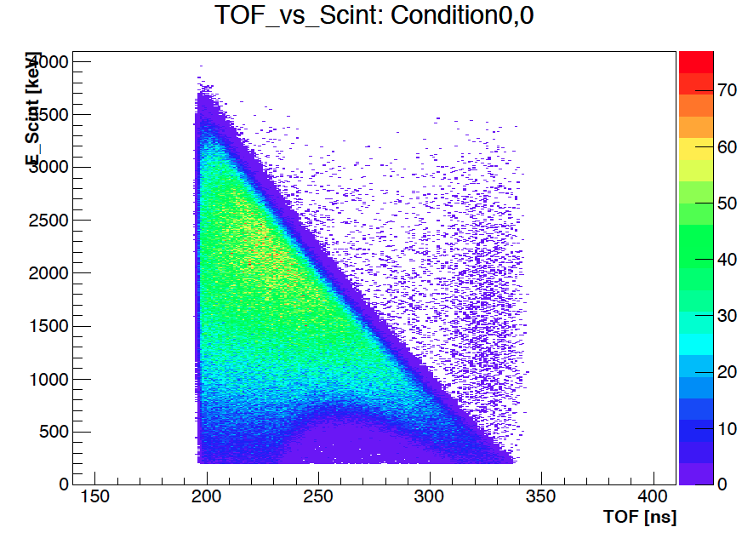
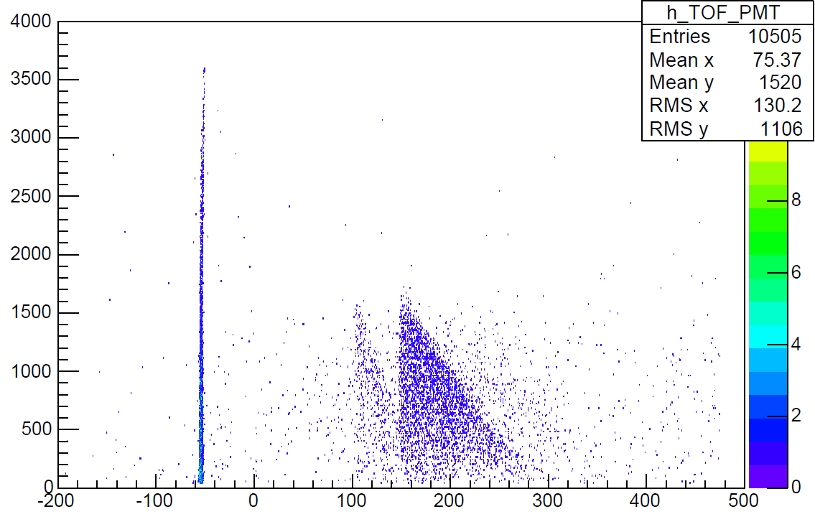
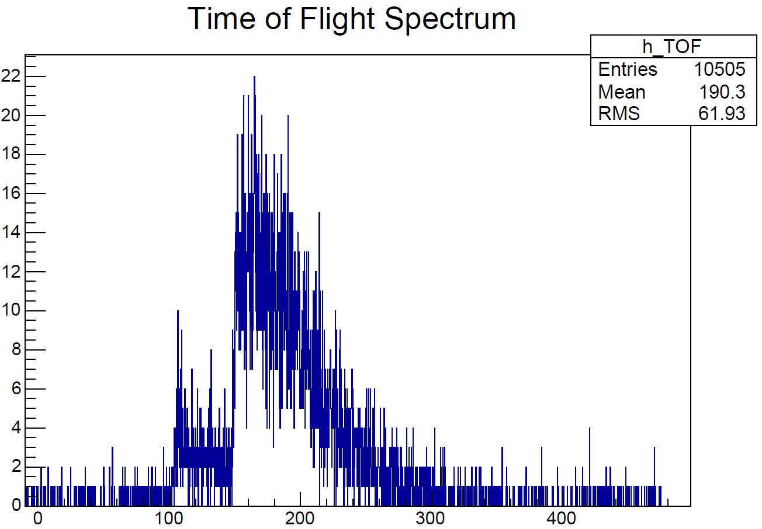
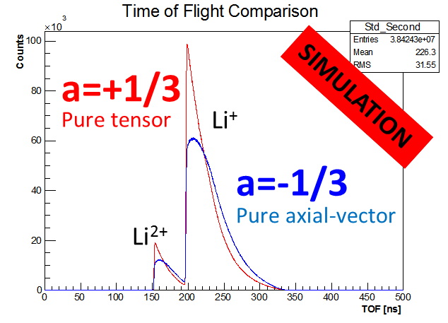
Results: First coincidences
  150 ⁶He/s in 2nd MOT
  Up to 0.5 coincidences/s (trapped ⁶He)
  ~ 0.15 coincidences/s background (untrapped ⁶He)

Slide 13
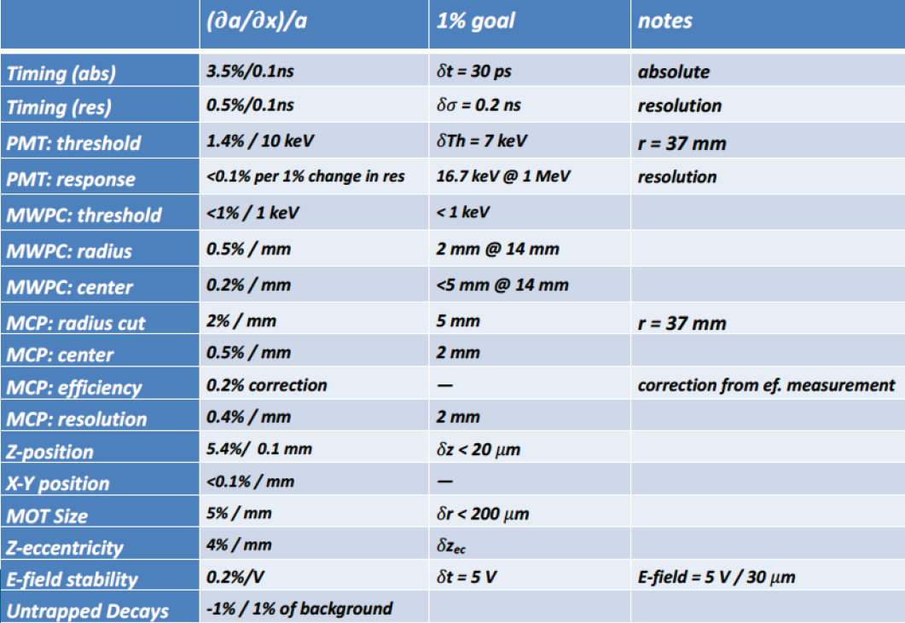
Systematic effect budget

Slide 14
What we could do with a larger MCP
Need to improve systematics toward a 0.1 % (or below) measurement
Recoil ion detection with 15 - 20 cm diameter MCP
Collect 100 % solid angle, even at lower electric field
-> eliminate acceptance uncertainties
-> reduce electric field systematics
Shake-off electron detection with ~ 6 cm diameter MCP
Coincidence with low-energy shake-off electrons instead of beta
  -> reduce systematic effects from tracking beta scattering
  -> increase coincidence detection efficiency
Questions:
Combine large area MCP with delay line readout
Gain uniformity, timing and position resolution for recoil ions and electrons
Energy and impact angle dependence
In-situ position calibration
…

Slide 15

Thank you!
P. Mueller, A. Leredde, T.P. O’Connor, K. Bailey
Physics Division, Argonne National Laboratory
A. Garcia, M. Sternberg, D. Zumwalt, R. Hong, Y. Bagdasarova,
H.E. Svanson, Z. Alexander, T. Cope, Y. Kim, G. Harper, F. Wauters
CENPA, University of Washington
X. Flechard, E. Liennard
LPC Caen
O. Naviliat-Cuncic
NSCL, Michigan State University
$ PM DOE Early Career Research Grant, DOE CENPA, LPC $

Slide 16
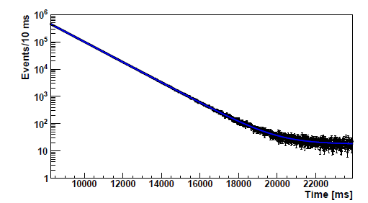
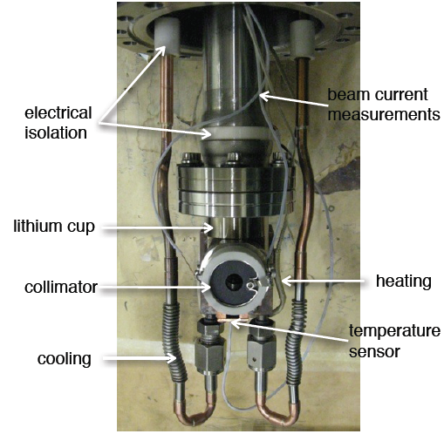
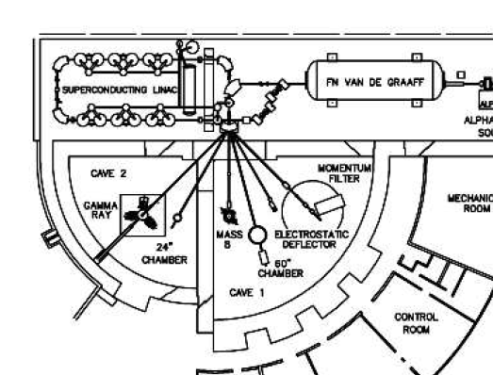


⁶He Production @ CENPA, U Washington
Li target
⁶He decay curve
~1×10¹⁰ atoms of ⁶He/s
via ⁷Li(d,³He)⁶He
15 μA d beam
18 MeV
⁶He half-life
ft-value
Compare with ab-initio calculations of |M_{GT}|
to obtain g_{A} in nuclear medium
-> less than 2% quenching
A. Knecht et al., PRL 108, 122502 (2012)
A. Knecht et al., PRC 86, 035506 (2012)
A. Knecht et al., NIM A 660, 43 (2011)

Slide 17
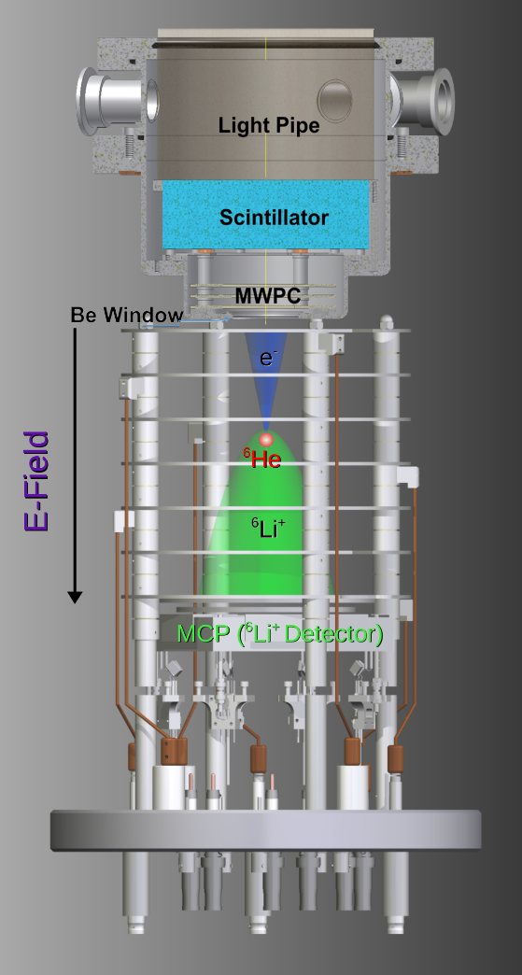
Experimental setup: Transfer/Detection
Slowing beam
Transverse cooling
MOT 1
MOT 2
Push beam
Zeeman Slower
  Push beam MOT 1 → MOT 2 : 30%
  2nd MOT : Science chamber
      Beta-ion coincidence
      Penning ions
      Photo-ions

Slide 18
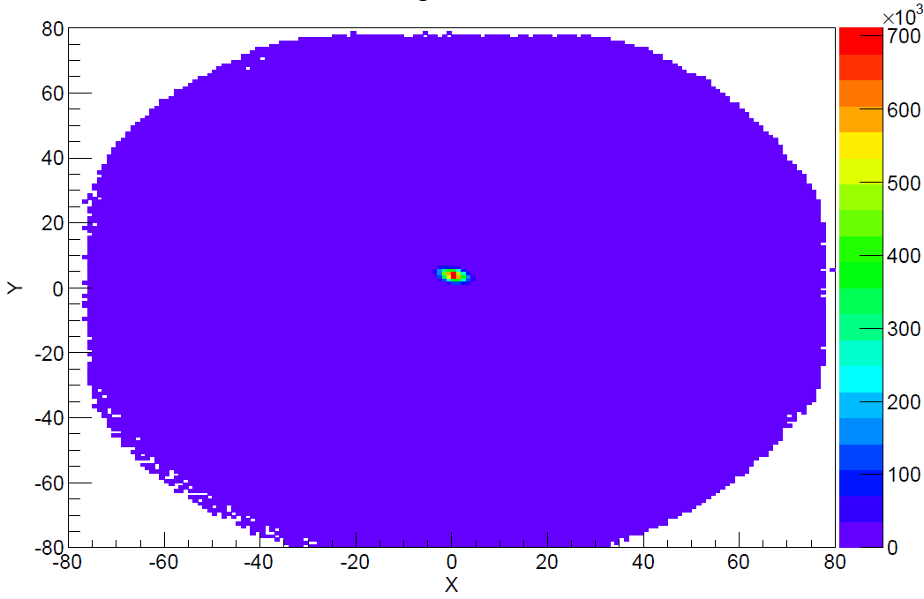
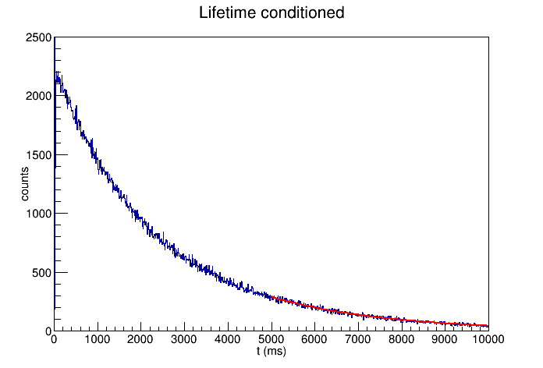
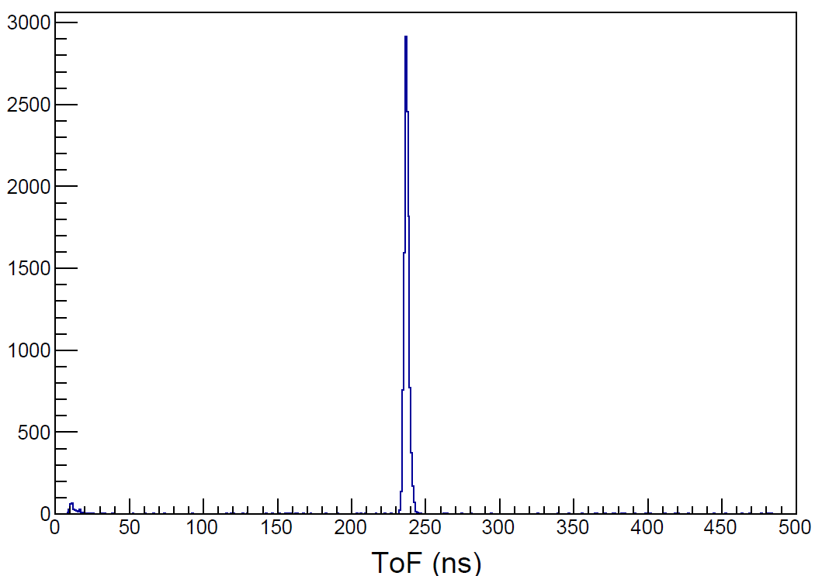

Example of systematic studies
$$\frac{dN(t)}{dt}=−αN−βN^{2}$$
80 mm
⁴He
  Ion detection
    X/Y position stability
    Width
  Trap lifetime > 2s (T_{1/2}(⁶He)=807 ms)
  With pusled Nitrogen laser
    Z position stability or
    Electric field
UV photons

Slide 19
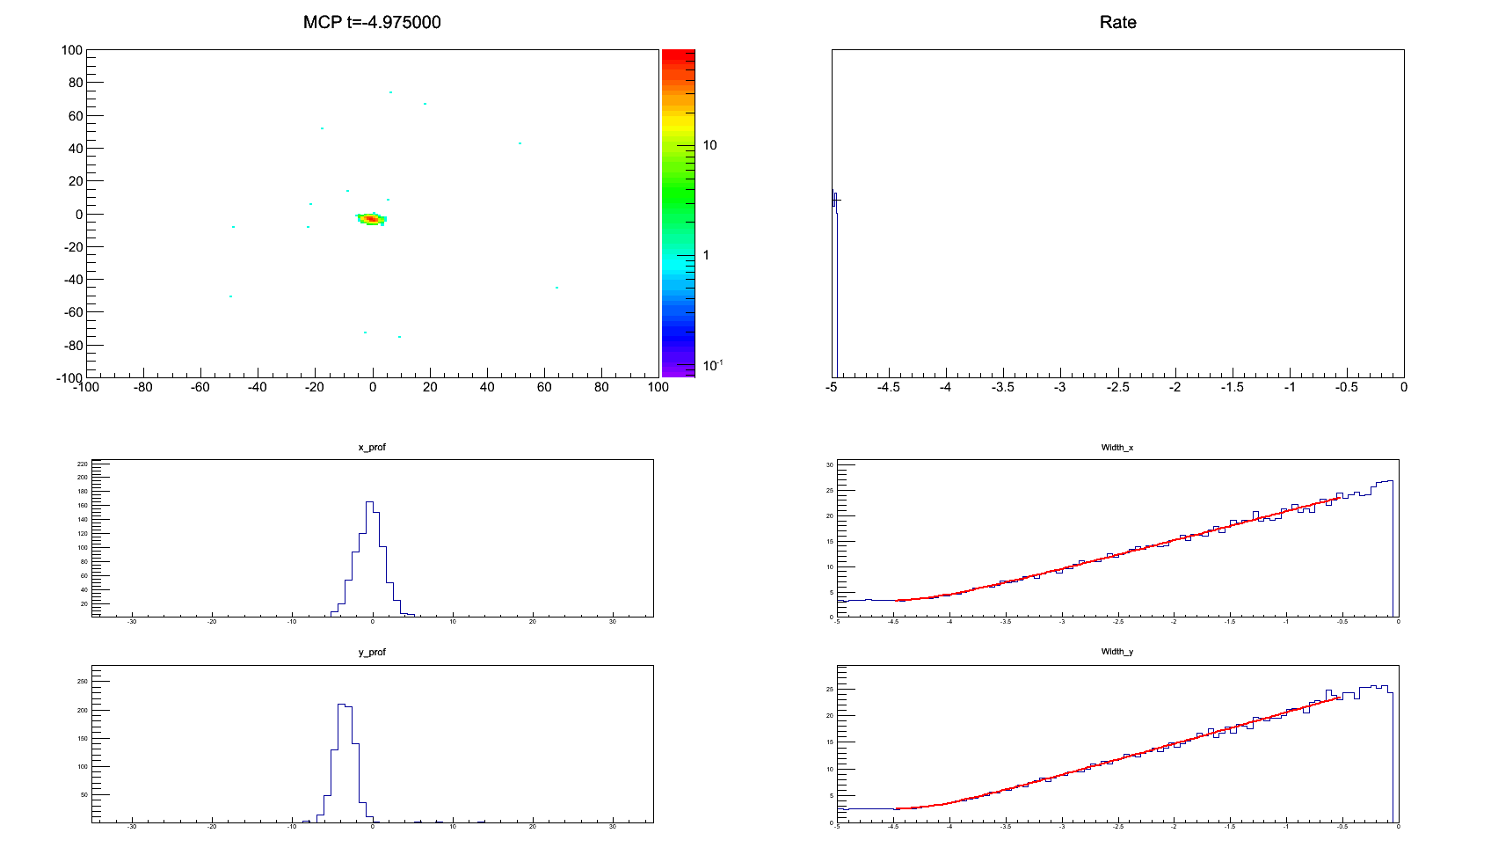
Expanding Cloud of ~1 mK ⁴He Atoms

