Slide 1
Fast Timing Detector R&D
Andrew Brandt, University of Texas at Arlington
+Jim Pinfold (Alberta),M Rijssenbeek
(Stony Brook)+FP420 +Giessen+others
Purpose: Pileup background rejection/signal confirmation
Use time difference between protons in pp->pXp events to measure z-vertex compared with primary tracking vertex
Ex: Two protons from one interaction and two jets from another
Intro to fast timing
The key issues for detector design
The key issues for MCP-PMT (newish lifetime results)
Switching from Hamburg Pipe to Roman pot
Upgrading from low lum to high lum running

Slide 2
Timing System Design Goals
Requirement | Low Lum | High Lum
High efficiency (≥90%) | X | X
Large Acceptance (~1) | X | X
Robust operation in radiation environment | X | X
L1 Trigger | Essential | Useful
Resolution | 30 ps or better | 10 ps or better
Reconfigurable/ Upgradeable | X | X
High rate capability | N/A | ~5 MHZ/pixel
Detector lifetime | N/A | > 100 fb⁻¹
2

Slide 3
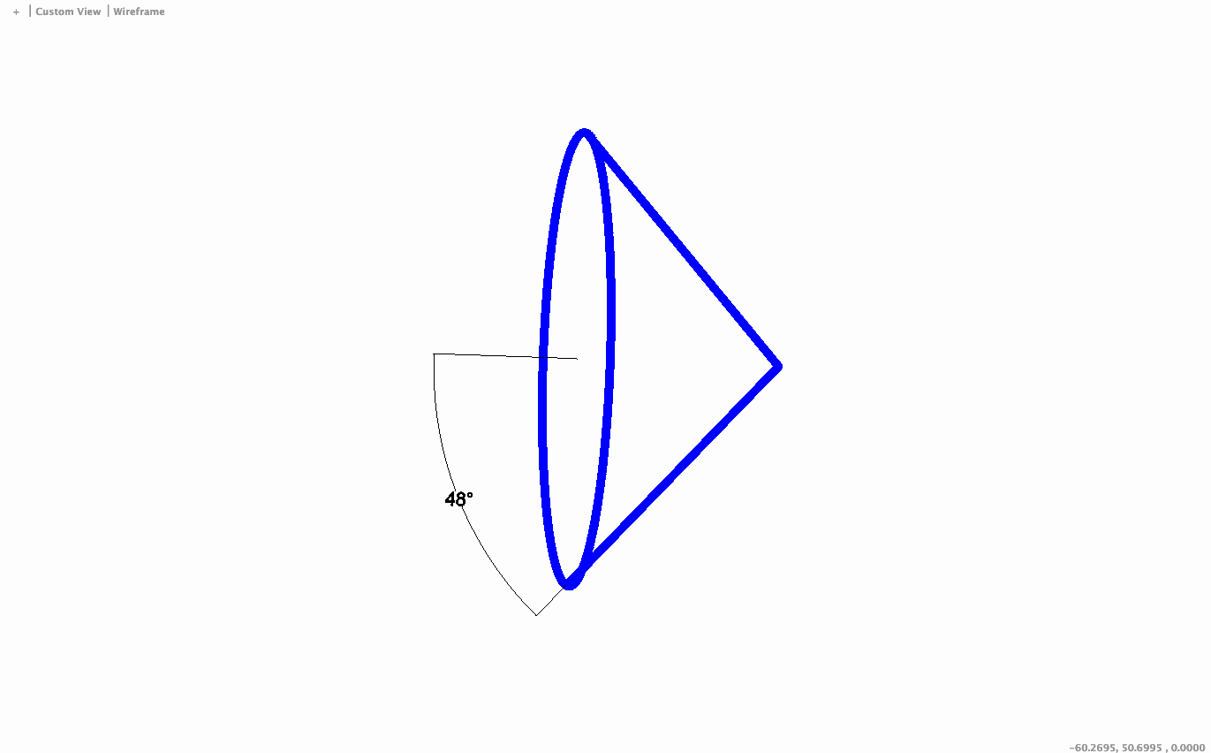
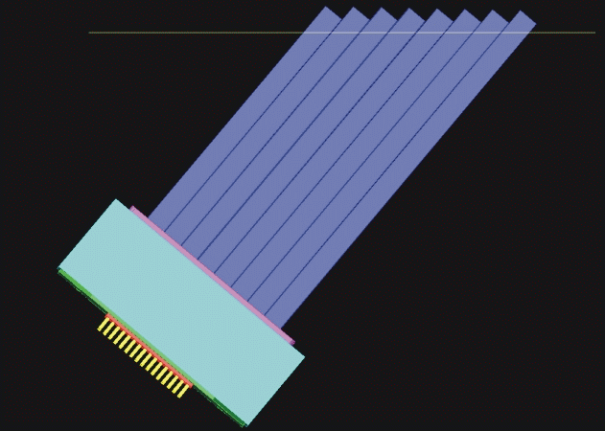
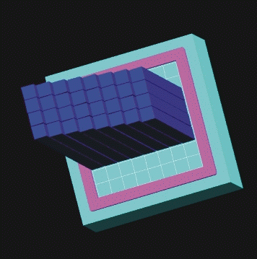
QUARTIC Concept (an oldie but a goodie)
Quartz bars at Cherenkov angle read out by MCP-PMT
Idea of Mike Albrow for FP420 (joint ATLAS/ CMS effort) 2005 based on “Nagoya detector “
Initial design: 4x8 array of 6x6 mm² ~10 cm long quartz (fused silica) bars, not coincidentally well-matched to 2-inch micro-channel plate photmultipler (Photonis Planacon)
proton
Isochronous—by mounting detector at Cherenkov angle, light emitted at different z reaches the PMT in coincidence
1.4.1.1
photons
Proton is deflected into one of the rows and measured by up to eight consecutive bars with a MCP-PMT
More rows limit rate/pixel
and multi-proton effects
1 2 3 4
MCP-PMT
If δt= 40 ps/bar need 16 measurements/row for 10 ps
If δt= 28 ps/bar need 8 measurements/row for 10 ps

Slide 4
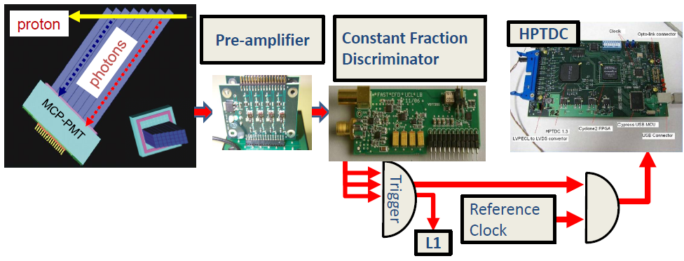
Components of an LHC Fast Timing System
We have developed all the necessary components of the readout electronics chain to preserve the detector/PMT resolution and validated them in pulser, laser, and beam tests
4

Slide 5
Detector R&D : UTA, Alberta, Giessen
Detector composed of radiator (default: fused silica bars) and
photosensor (default: MCP-PMT). Optimization of radiator/sensor
is strongly coupled and depends on running conditions and physics
goals .
Detector optimization issues:
Layout of quartz bars; this should
provide as much light as possible in a short a time window
maximize acceptance (avoid cracks)
have pixelation for multi-proton timing
MCP-PMT issues:
a) timing
b) rate
c) lifetime
d) cross talk
Optimization done through
simulation, laser tests, and
test beam.
5

Slide 6
An R&D Success Story
Led by UTA/Brandt raised ~400k$ in Generic R&D funds from Texas ARP (2006) , DOE ADR (2007 w/ Burle/Photonis), NSF SBIR (2011 w/ Arradiance Inc.) , DOE ADR (2011 w/Stony Brook), and in-kind from Universities, +~100k$ from U.S. ATLAS
From 2006 to 2012 averaged nearly one TB/year. Improved the resolution: - by a factor 5 from 100 ps/bar to 19 ps/bar (for DET/AMP/MCP-PMT/CFD) or by a factor 4 (24 ps/bar) if you include the HPTDC
The improvement was due to a combination of many factors:
- starting with a lack of knowledge of the subject
- improved amplifier and CFD (based on Louvain design refined by
Alberta + Stony Brook) . Note: a low noise, well-shielded amplifier is
a crucial, rarely discussed aspect of fast timing
- interface of quartz bars to PMT, improvements in MCP-PMT: pore size
25 µm to 10 µm, optimized gain/HV
6

Slide 7
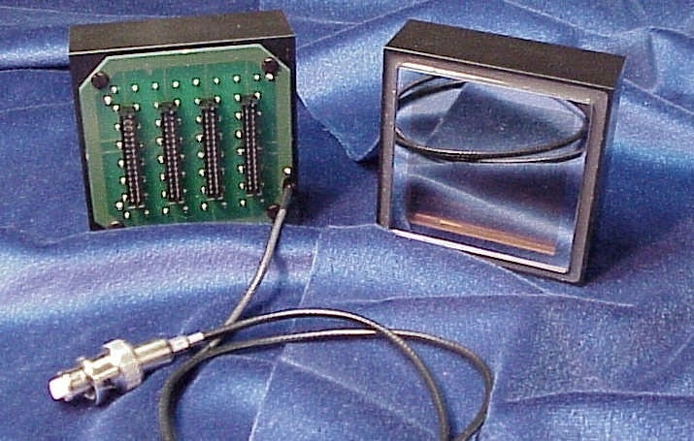
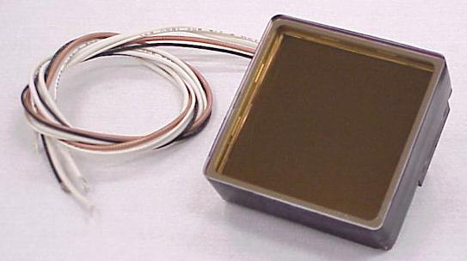
MCP-PMT is Heart of Timing System
Only one multi-anode reasonably-sized tube when we started: Burle/Photonis Planacon (now also Hamamatsu SL10≅1/4 Planacon)
Time resolution aka TTS=transit time spread
(single pe response) ~35ps [~20 ps for 10 pe’s]
Multi anode: 8x8 has pixel size of ~6.5 mm x 6.5 mm
(defined initial detector concept), or 32x32 (1/4 pixels)
Pore Size: 10 μm or 25 μm
Tube Size: 2 inch square (53 mm active area)
Independent control of Cathode, MCP, and anode voltages
(32x32)
(8x8)
In addition to timing performance, need to have capability of simultaneous measurements of multiple pixels, and be ready for next event, which could be 25 ns later, and also sufficient rate capability and lifetime, acceptable cross talk

Slide 8
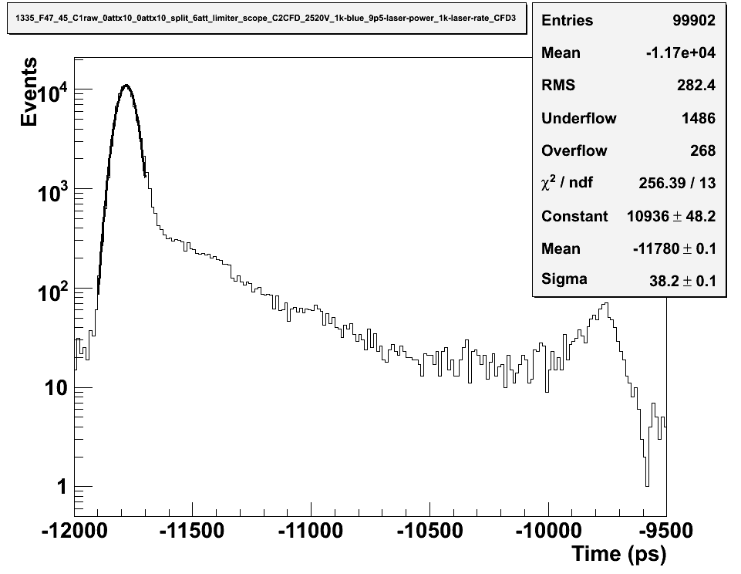
MCP-PMT: TTS and Cross Talk
TTS=transit time spread
Photons
δt=38 ps
(σ of main peak)
Optical Crosstalk
Photoelectron Recoil
Rebound
Pe Rebound
Recoil
Electrical
Crosstalk
(charge
sharing)
Cross talk could correlate adjacent channels within a row and reduce expected √N improvement
Cross talk can give a false signal in channel in adjacent row which distorts/biases time measurement if there is a second proton in that row
Anode 1
Anode 2
Will get back to these points anon

Slide 9
Rate Lifetime Issues
Historically MCP-PMT’s have not been extremely robust, and were typically capable of operating only for a few hundred mC/cm² before their performance (QE) degrades, presumably due to positive ions damaging the photocathode.
If operated at high gain without sensible pixelation, the current demands would be too large for normal operations and the accumulated charge would render the tubes inoperable in a few weeks (rule of thumb at LHC for every 10 fb⁻¹ or so 1 C/cm² is accumulated). Considered by some as “an unsolvable problem”
We said “Challenge accepted!”
Helped form a collaboration between UTA, Arradiance Inc. , and Photonis in 2009 to address PMT lifetime (2011 SBIR funds important for Arradiance/Photonis ALD development including refining process leading to Lehman Super tube)

Slide 10
Brandt’s Ideal MCP-PMT
e⁻
Improved lifetime (3 main options)
1) Suppressed positive ion creation (Arradiance)
+
2) Ion Barrier keeps positive ions from reaching photocathode
(Nagoya/Hamamatsu) also NEW! Photonis active ion supressor
10 μm pore EDR MCP for max rate
ALD by Arradiance
+
+
+
3) Use more robust “Solar Blind” photocathode
4) Also considered 3rd MCP (Zstack) and improved vacuum
photon
Increase cathode voltage to improve collection efficiency (UTA)
Photocathode
Photoelectron
Dual MCP
ΔV ~ 400V
ΔV <2500V
Run at low gain to reduce integrated charge (UTA)
Gain <10⁵
MCP-PMT
Increase anode voltage to reduce crosstalk (UTA)
Reduce anode gap to reduce cross talk
Anode
ΔV ~ 400V

Slide 11

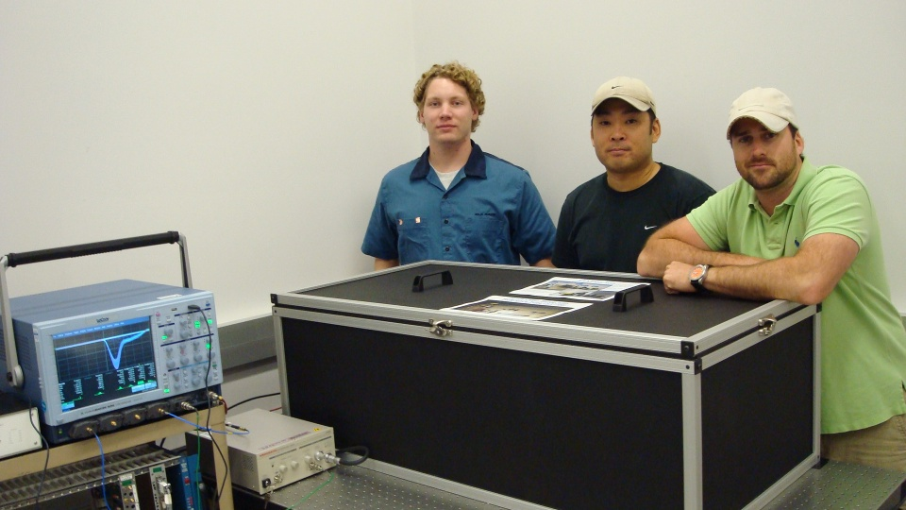
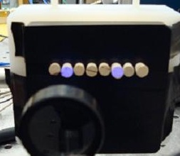

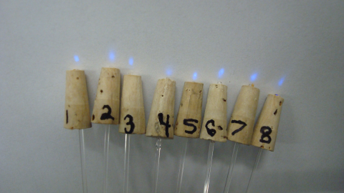
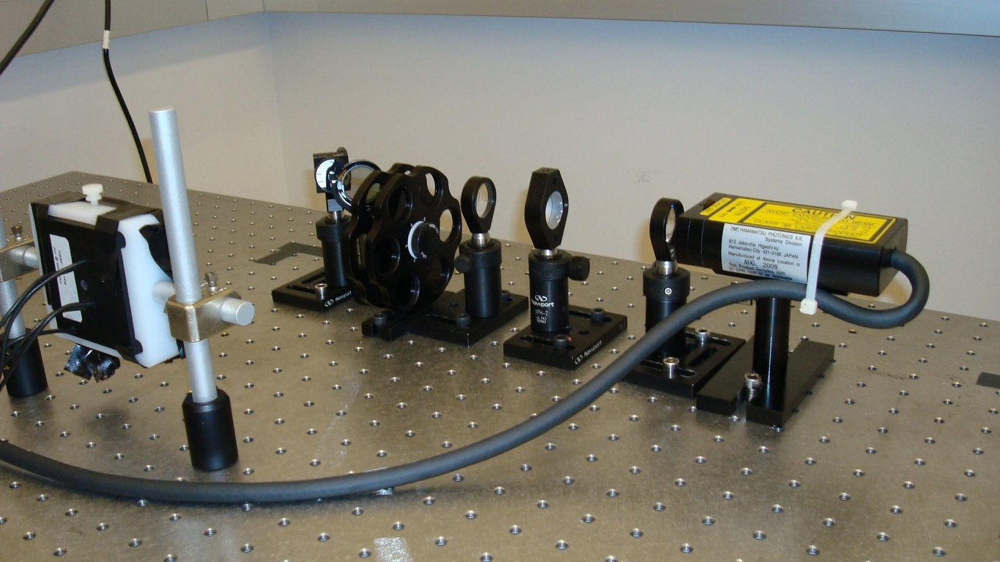
LeCroy Wavemaster
6 GHz Oscilloscope
Established in 2009 at UTA with DOE Advanced Detector Research,+Texas ARP funds, primarily to evaluate MCP-PMT’s for use in fast timing.
Relies heavily on undergraduate manpower
The PTL serves as a permanent configurable test bed to study a myriad of subtle effects associated with picosecond timing
Hamamatsu
PLP-10 Laser Power Supply
Laser Box
beam mode
beam splitter
mirror
filter
fiber mode
MCP-PMT
lenses
laser
1)Evaluate MCP-PMT and electronics with laser tests 2) Evaluate detector/full chain with test beam
Early setup

Slide 12
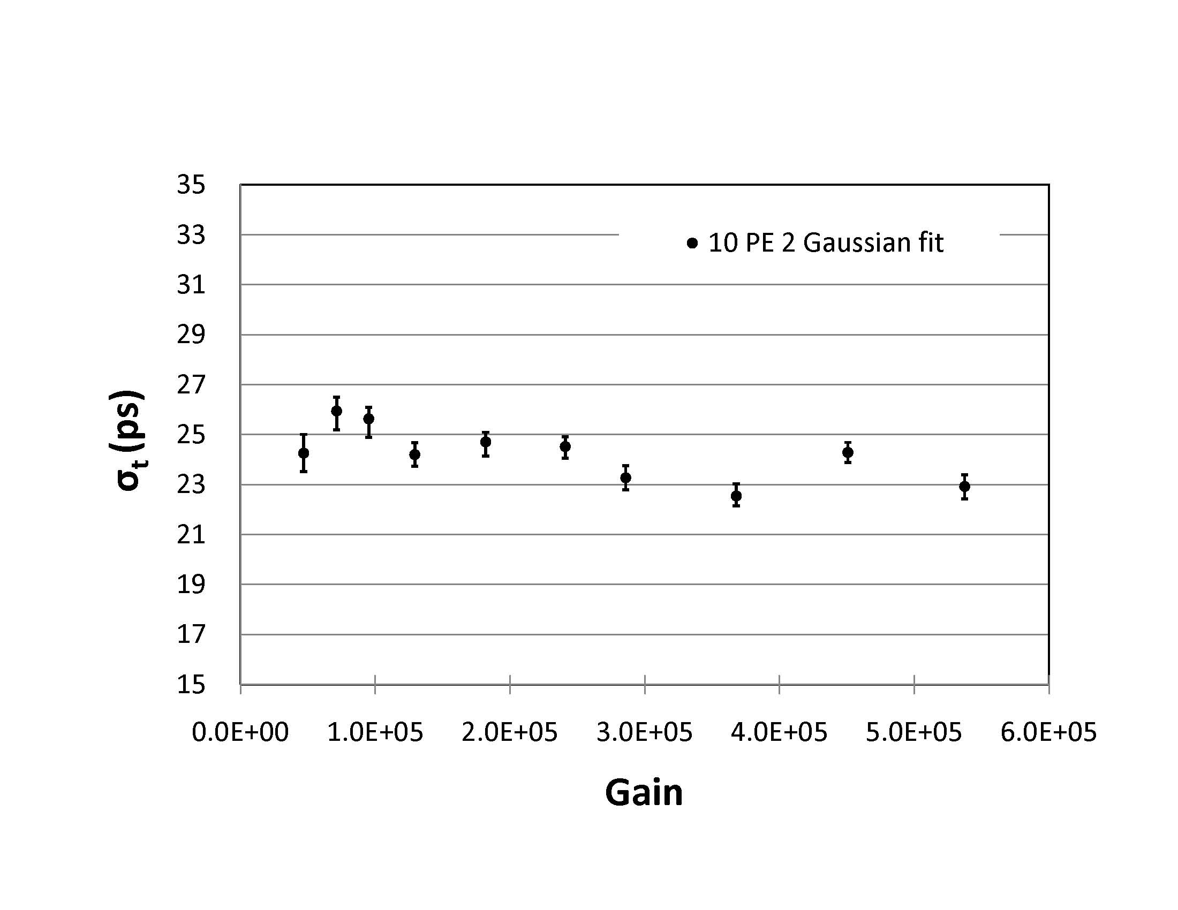
MCP-PMT Rate and Current
Anode Current = proton Rate × Number of photo-electrons generated by each proton × Gain × charge
4 MHz proton rate with 10 pe’s at 10⁶ gain gives 6.4 µA in a 0.4 cm² pixel or about 16 µA/ cm², several times what is possible!
Conventional wisdom: need high gain for fast timing
(but it was based on single pe experience). From UTA
laser tests timing is ~ independent of gain as long as
For 10 pe’s reduces current requirement by x10 to 20

Slide 13
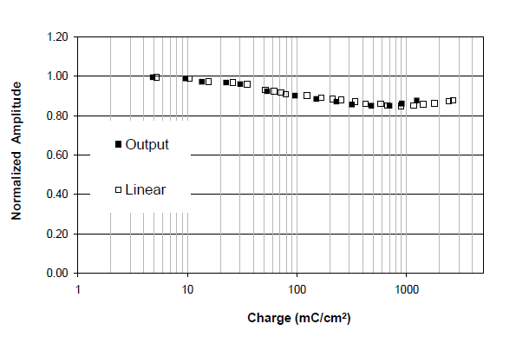
Extended MCP-PMT Lifetime!
UTA accelerated tests of 1st Generation 25 uArradiance ALD modified tube shows initial 15% gain loss but no QE loss over 2-3 C/cm²
In house Photonis tests showed same beaviour
(Needed laser for other tests at this point).
No QE loss
at 3 C/cm²
Note Nagoya/Hamamatsu
have achieved 2 C/cm² lifetime with orthogonal ion barrier approach
Linear corrects for saturation (gain reduction due to
pores not fully recharged before next event).
Saturation would be reduced/eliminated by using a
10 μm pore tube (smaller pore size, means more pores)
and/or EDR (extended dynamic range), a special low
resistance MCP glass that allows higher current
Notes:
lehman

Slide 14
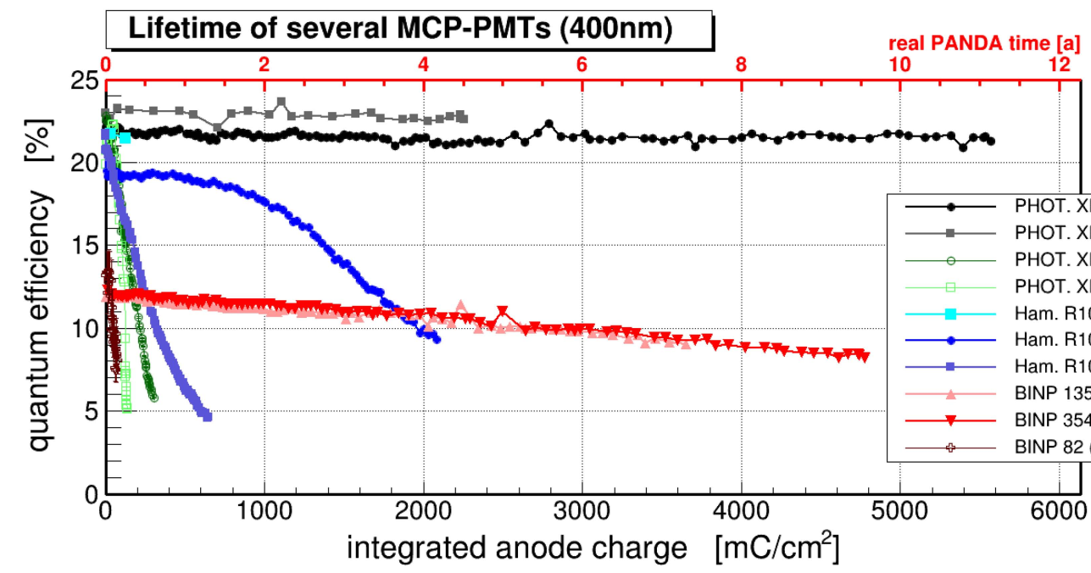
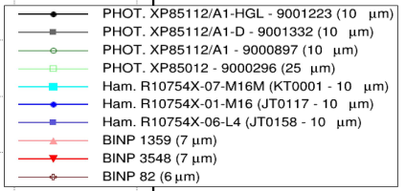
Improved Lifetime with ALD
Photonis Planacon with Arradiance (Gen 1) ALD-coated 10 μm pores
Hamamatsu ion barrier SL10
Lehman et al. (Panda conditions) No loss in QE with ∫Q>6 C/cm² >10x improvement over non-ALD tube For LHC 1C~10 fb⁻¹

Slide 15
Timing vs. Rate
Arradiance Gen 2, 25 µm pore Planacon with EDR MCP (high current capability).
Expected to have 2-3 times longer life than Gen 1, would in principal be > 100 fb⁻¹ tube, but needed for rate tests + test beam, so not life tested yet (no funding for dedicated lifetime setup
Timing resolution (δt) measured using CFD as read out by scope and fitting distributions
12 pe’s @ low gain: 5x10⁴ and 1x10⁵
5MHz
(~2 µA/cm²)
Time resolution ~constant 17 to 18 ps out to about 1 MHz, where saturation starts and timing begins to degrade; 10% to 20% worse at 5 MHz
a 10 µm pore (EDR) tube would have 3 to 5 times the current capability and should maintain timing beyond 5 MHz

Slide 16
Timing vs. Rate for mini-planacon

Slide 17
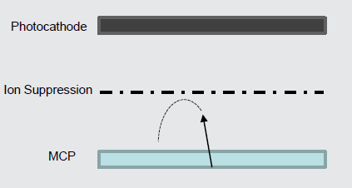
Lifetime Solutions (NEW!)
Photonis Parallel Development Effort (patent pending)
Could be used instead of, or as a complement to, ALD coating of MCP’s
-Features an electrostatic ion suppression
grid (basically an energized ion barrier)
Grid between MCP and photocathode
to reduce/prevent + ions from reaching
and damaging photocathode.
Complete suppression requires grid bias
to be energetically higher than the highest bias source of + ions (MCP-out)
Time delay (ion TOF aka afterpulsing) increases as the ions are decelerated
and eventually suppressed from reaching the photocathode
NOTE 1) Could still get some level of afterpulsing from ions on surface of MCP or from energetic neutrals 2) barrier reduces collection efficiency (effective QE) by about 40%

Slide 18
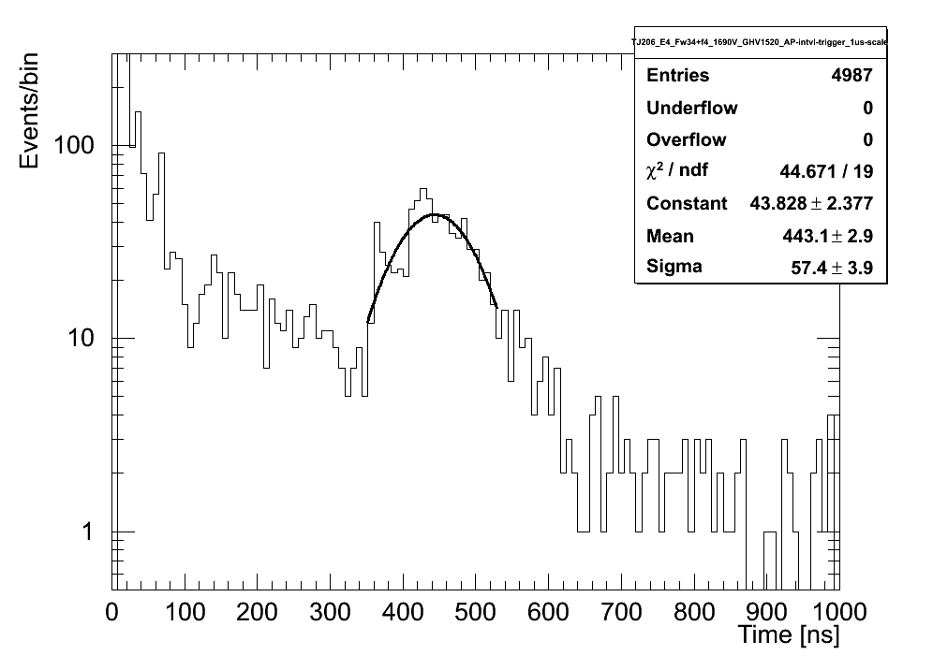
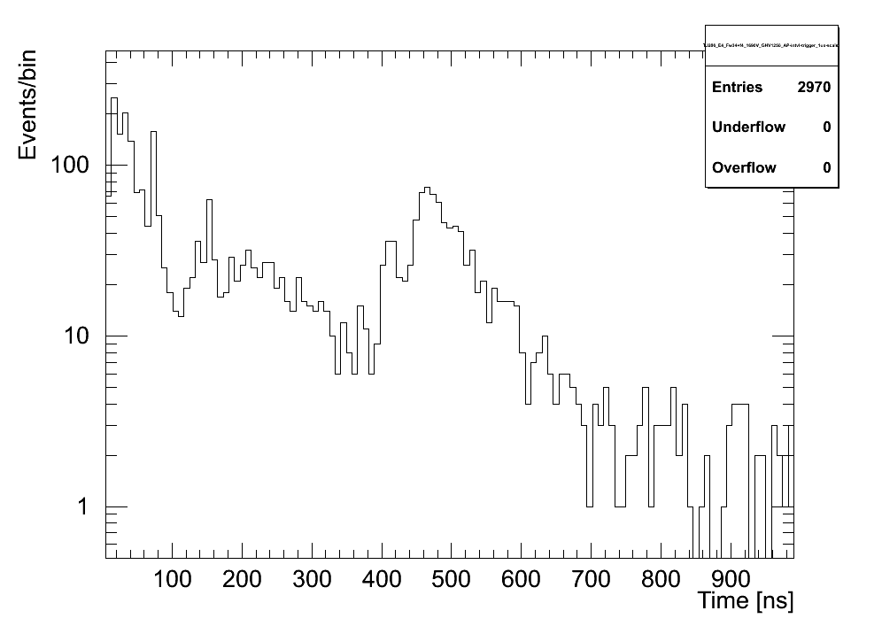

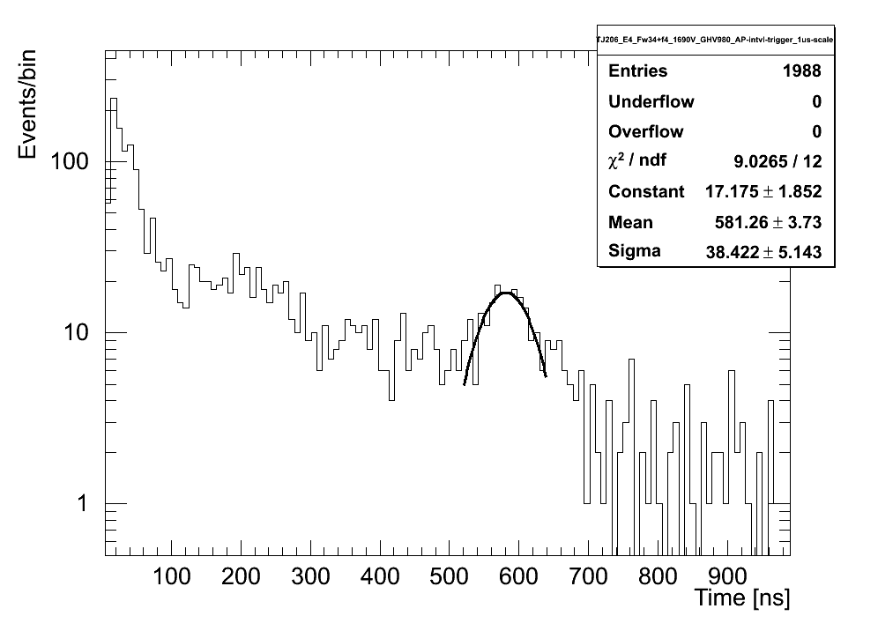
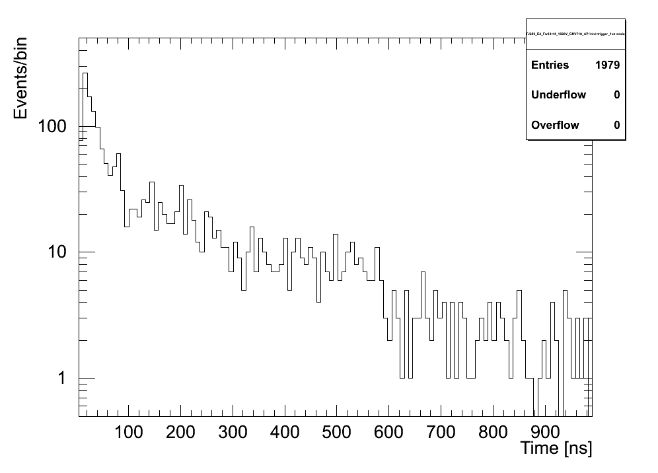
Afterpulsing as a f(GridVoltage)
Grid off
Grid 20%
Tests
Done
In
Secret
At
UTA
PTF
Preliminary
Grid 40%
Grid 60%
Large suppression ~x20 in “heavy metals” as grid is activated;
generic positive ion suppression factor (#AP grid on/grid off) is about 4x

Slide 19
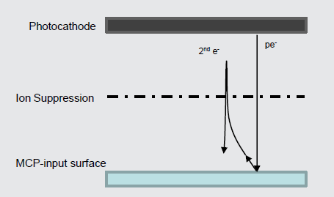
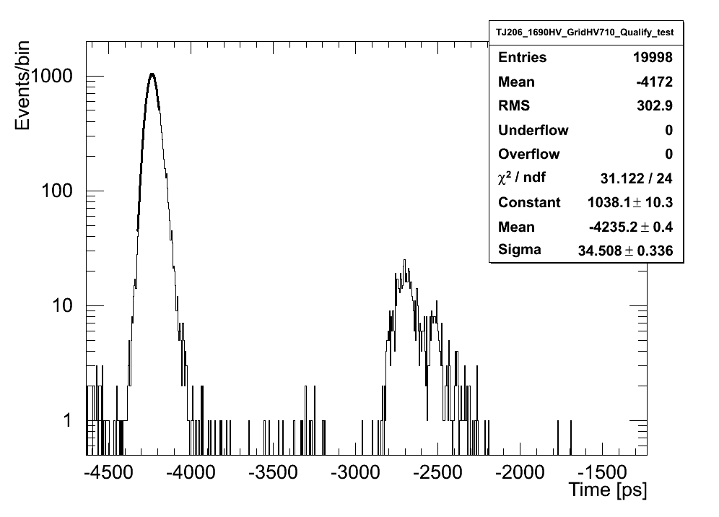
Active Ion Barrier Improves TTS
Secondary electron peak is focused a couple ns later, results in improved TTS by 10-20% (we obtained 34 ps for 25 um tube)
Scattered electrons are organized and delayed (separated from main peak)
Tail of TTS distribution is suppressed

Slide 20
MCP-PMT Lifetime Summary
Over past several years the difficult problem of PMT lifetime has been attacked on several fronts leading to significant improvements in the prospects of using MCP-PMTs in a high rate environment
Operational
a) Reduce pixel size near beam (x3)
b) Operate tube at lower gain x10-20
2) Technological
a) ALD suppresses creation of +ions x10-100
b) Electrostatic x4- x20
3) Further suppression possible with more ALD tuning O(2-3)
*The net effect of these gains is O(1000) improvement over initial calculations
that led some to abandon the technology.
HOWEVER, too early to declare victory! Development effort is
not complete! More R&D funds required to finish optimization
and make “long-life” a standard product option

Slide 21
Cross Talk and other MCP-Issues
Pedro Duarte, Masters Thesis on early test beam studies 2007
Ryan Hall UTA, Honors Thesis on cross talk 2010
Paul Pryor UG Thesis on Lifetime 2011
James Bourbeau, Honors Thesis on Phase 0 2013
-Currently have team of 5 undergraduates (10/hr/week/person)
Have studied many features of MCP’s @PTF
(in close contact with Jeff Defazio, primary Photonis MCP-PMT engineer )
Cross talk: Using a series of fibers with different path lengths to simulate proton arrival time, found that ~10% of pulse is collected in adjacent pixel due to charge sharing
-improves resolution for pixels in same row and correlates pixels since light is in time
-degrades resolution and biases time for pixels in adjacent row (on either side) for later arriving proton
Two protons in same pixel mixes time in complicated manner
After pulsing and correlation to lifetime
Forming a data-based simulation of MCP response to augment GEANT capabilities
Raising cathode voltage to increase collection efficiency and sharpens timing
(up to 20% resolution improvement)

Slide 22
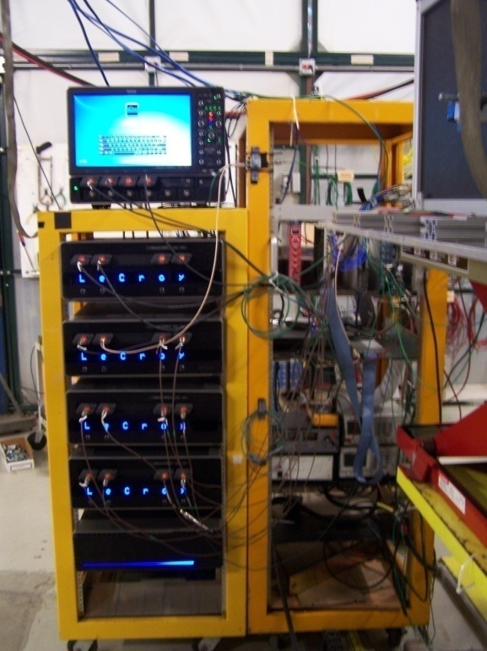
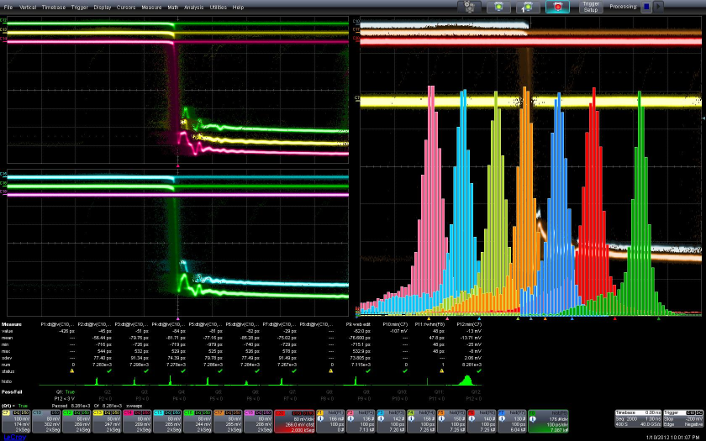
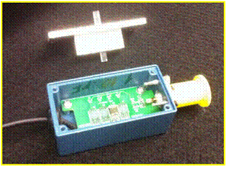
T958 DAQ (FNAL 1/2012)
Time difference between 10-12 ps reference detector (FNAL SiPM in Nagoya mode courtesy of Albrow +Ronzhin) and 6 –bar Quartic average gives online FWHM=47 ps (σ=20 ps), removing SiPM resolution gives δQavg=14-15 ps
2 3 4 5 6 7 Avg
“mini-Nagoya” SiPM
Just your garden variety 20 channel, 20 GHz/ch, 40 Gs/s/ch (point every 25ps) 500k$ LeCroy 9Zi scope! Thanks for the loaner LeCroy

Slide 23
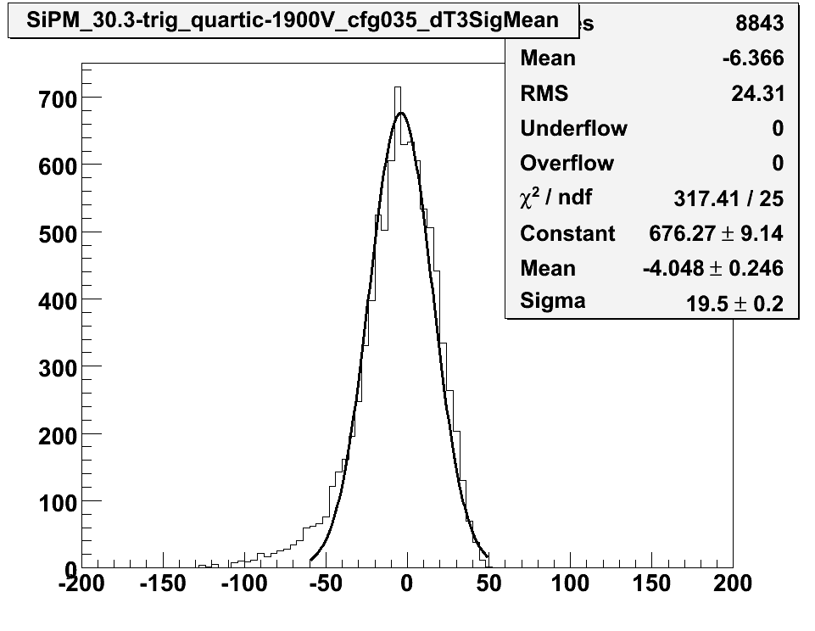
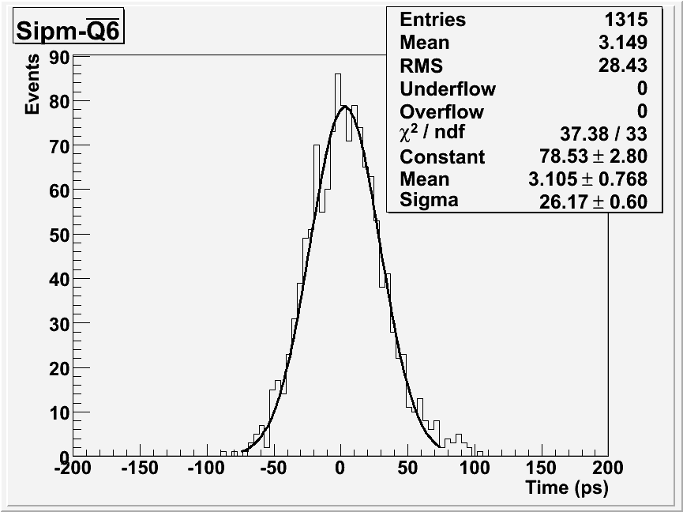
SiPM- Quartic 6-Bar Average
CFD read out by SCOPE
CFD read out by HPTDC
δt =19.5 ps
δt 26.2 ps
26.2 ps
QUARTIC and SiPM signals amplified, sent to CFD, then to scope, calculate
Δt(SiPM-Qi) and average over 6 bars. Repeat for HPTDC readout. Difference between the measurements is dominated by 16 to 18 ps resolution of SiPM HPTDC
Extract QUARTIC resolution (6 bar) 14 to 15 ps including Q-HPTDC
(Note: edge channels had different gain, not useful for this run)

Slide 24
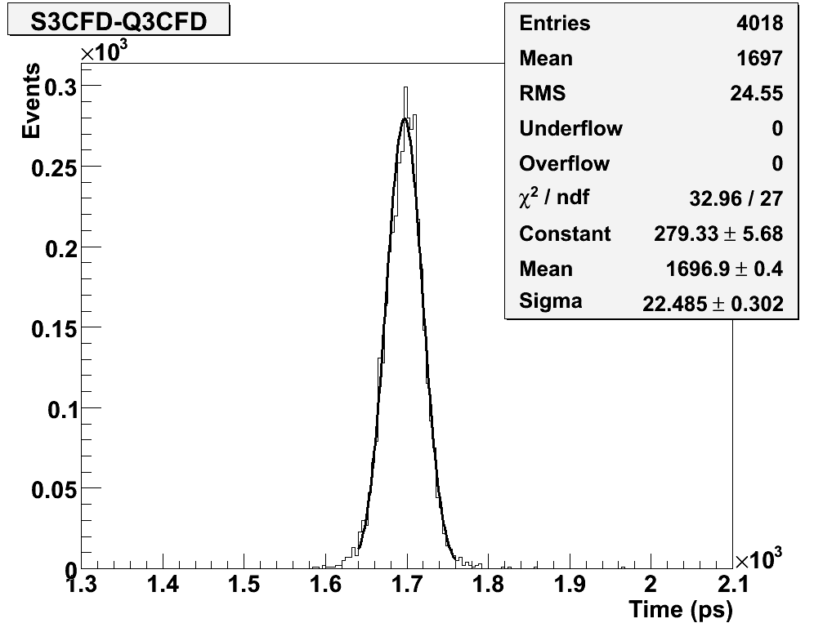
Validate Thin Bar
With 10 um tube and 2x6x140mm quartz bar we get same results as 5x6x140 mm bar, and both are improved from 1/2012 single bar timing. Resolution: Bar+PMT+CFD=22ps - SiPM = 19 ps +HPTDC~24 ps/bar!
We have some 1x6 bars, but
they look very fragile

Slide 25
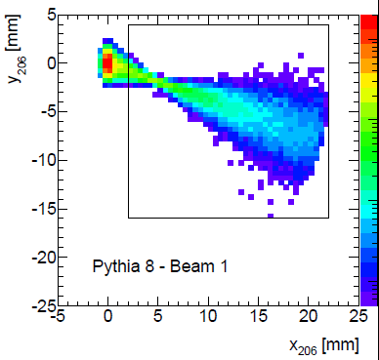
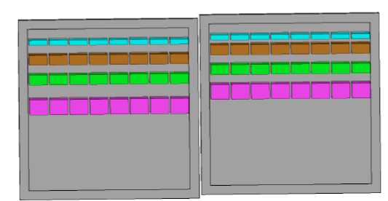
We Developed a 10 ps TOF System for use with a Hamburg Pipe
2 cm x2 cm
beam
Large x proton
Deflection from beam)
Validated the components of this design in test beam and at UTA Picosecond Test Facility with laser and “undergrad army”
Design considerations:
1) full acceptance, excellent timing expected <10 ps
8 rows with Δx =1.5 to 3 mm (x=distance of proton from beam) to
minimize multi-proton effects (>90% efficient ) and keep rate/pixel
under 5 MHz to help control current/lifetime issues
gaps between rows to reduce cross talk
capable of operating beyond 50 interactions/crossing (where <N>=1/det/BC)

Slide 26
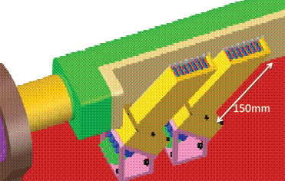
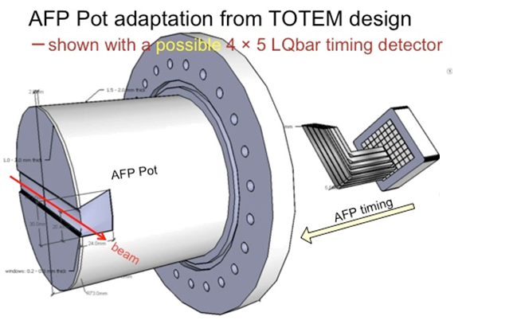
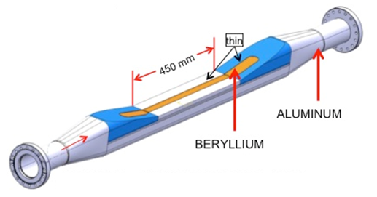
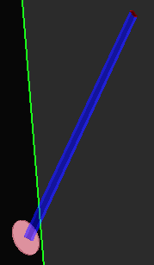
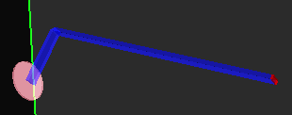
New Challenge: Adapt Timing Detector to be compatible with Roman Pot instead of HBP…
1) Arggh! 2) Challenge Accepted!
Q-Bar straight bar at Cherenkov angle
LQBar still at Cherenkov angle but take light out at 90 degrees
(Albrow Lbar parallel to beam takes light out at 90)
Notes:
LHC logistics required us to move away from our original Hamburg Pipe design to a Roman pot design
Need to conserve detector performance
Simulation of single elements, now require a 90 degree bend

Slide 27
New GEANT4 Simulation Effort
Led by Tom Sykora’s group at Palacký University, Olomouc Czech Republic (Libor Nozka, Leszek Adamczyk et al with with input from moi and help from UTA UG Tim Hoffman)
Start with straight Qbar (θ_{c} ~48°) (2mm x 6mm x 150 mm), since we have test beam data for this we can normalize simulation of LQbars and other geometries to Qbar
We also are undergoing detailed studies of how MCP-PMT treats different photon arrival time distributions , as correlations between photon arrival times exist are a f(TTS, gain, rise time, etc.) and are generally not well modeled.

Slide 28
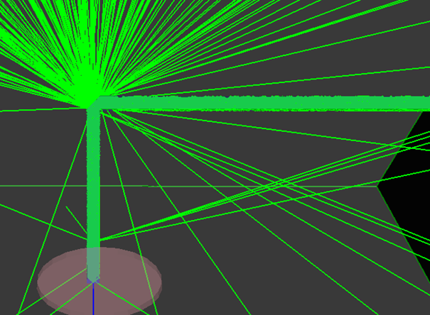
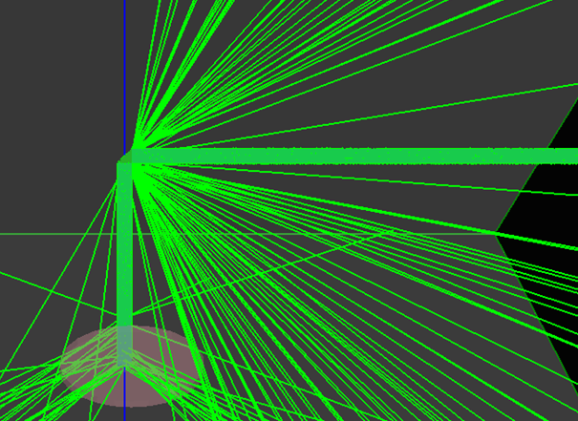
LQbar* (radiator bar at θ_{c} +light guide bar)
2x6x(30+120)mm
Without Mirror
With Mirror
*Not to be confused with Albrow’s Lbar
which is oriented parallel to beam and has no elbow
45 degree bend to route light from radiator to perpendicular light guide bar, lose some light at elbow
Aluminizing helps but light ~⊥ to mirror lost opposite to elbow.still lost at elbow
Notes:
Talk about bouncing up and down vs. side to side (mapping a cone onto a rectangle)

Slide 29
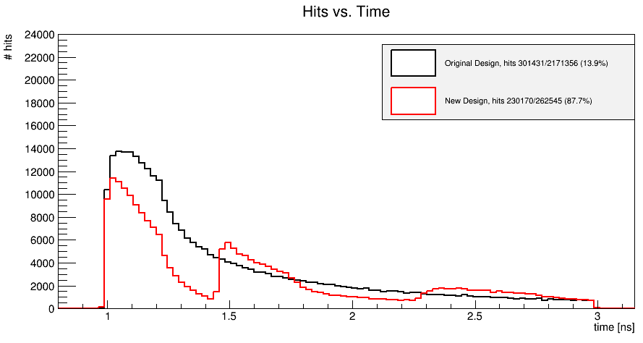
LQbar vs. Qbar Initial Performance
QBAR (15 cm)
LQBAR (3+12 cm)
As expected LQbar is worse: significantly less early light
What can we do to improve the amount of light ?
Notes:
long tail out to large times due to light reflecting mutliple times
Our studies show it is the light within the first 100-200 ps that is the most important, after 400 ps
Very little impact

Slide 30
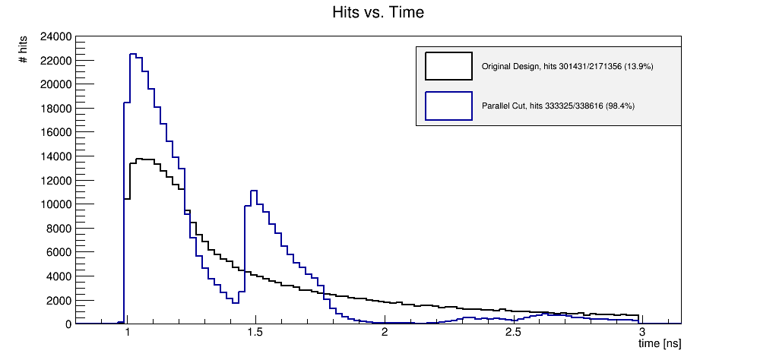
LQbar Modification: Parallel Cut
Square cut
Qbar
LQbar y=0.1 mm
Parallel cut
What about this
2nd peak?
The parallel cut captures the lower hemisphere of the Cherenkov
cone for small (x,y), however benefits only extend to about y=5 mm
Notes:
Show height of proton on plot
Perhaps draw one photon on parallel cut

Slide 31
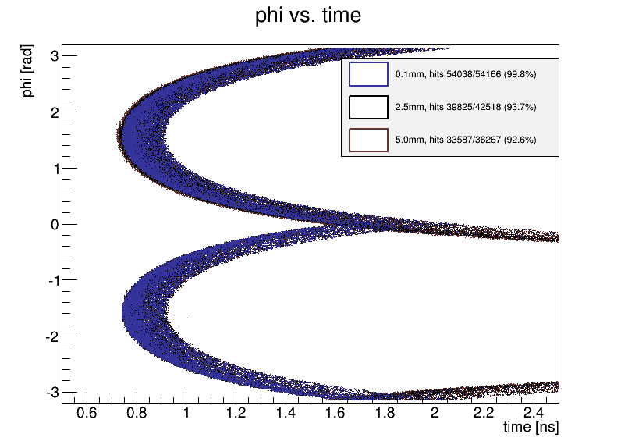
Phi vs Time for Parallel Cut on Qbar
φ = π/2 straight down bar φ ≠ π/2 ⇒longer path
length ⇒ longer time
Color dispersion
Much of bottom hemisphere of the Cherenkov cone (negative phi) is reflected up the bar as shown earlier (depending on proton height with respect to parallel cut)

Slide 32
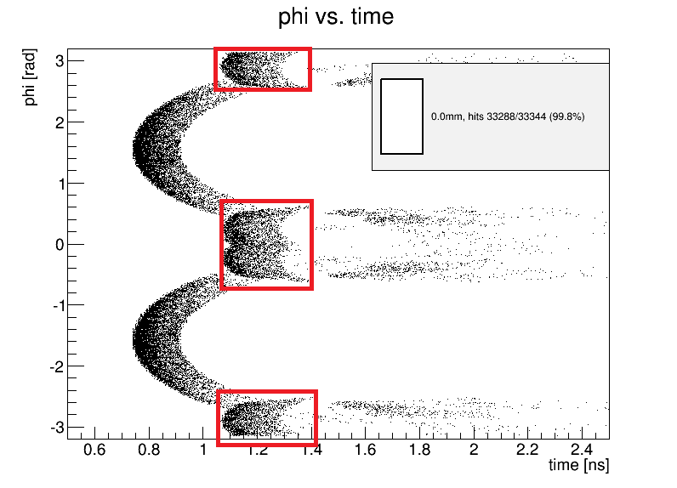
The 2nd Peak aka“Wings”
Taking the Cherenkov cone around the 90° degree bend leads to “wings” that are relatively faster (shorter path length) compared to the prompt light then for the straight bar case.

Slide 33
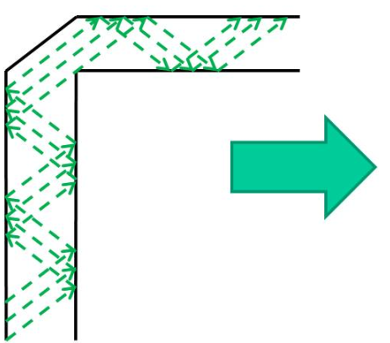
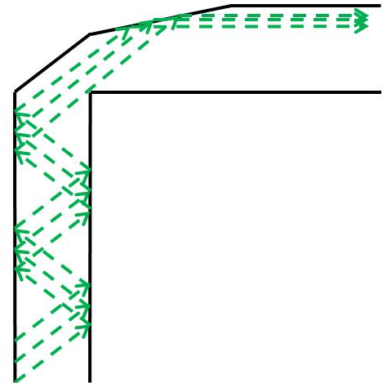
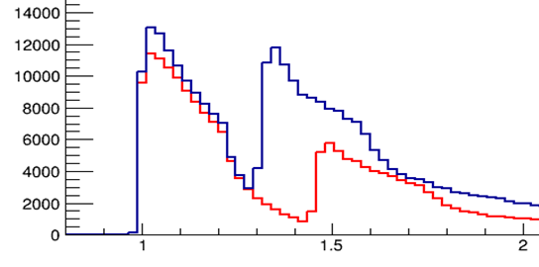
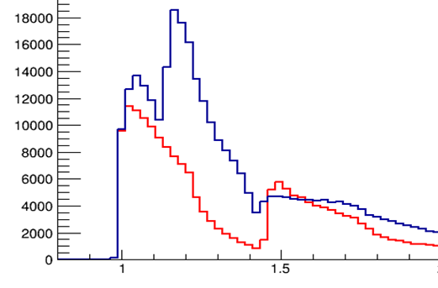
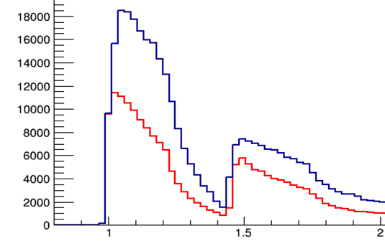
Speed up the “Wings”
Add a “taper”
and optimize angle
to “straighten” wings speeding up 2nd peak
5º
15º
30º
As taper angle increases,
bulk of 2nd peak
merges with first peak
33

Slide 34
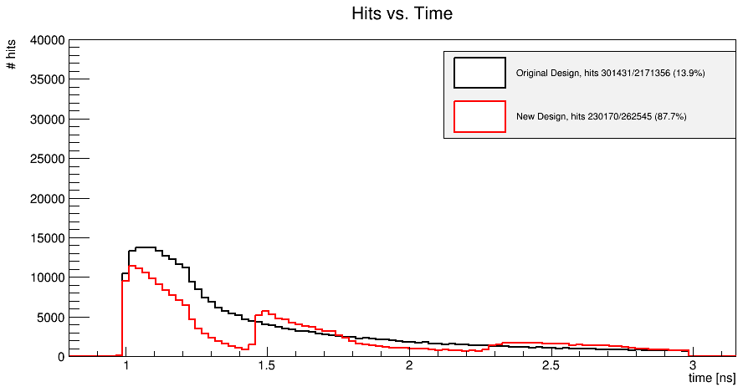
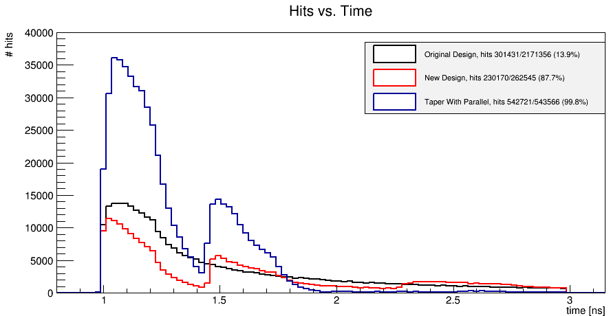
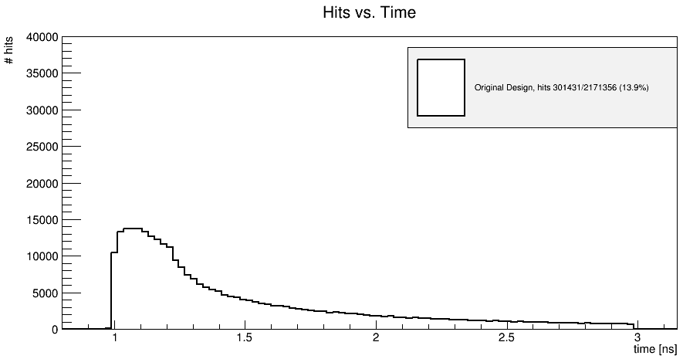
All Together Now!
QBAR (15 cm)
LQBAR (3+12 cm)
LQBAR with parallel cut y=0.1
and 30° taper
Simulation says this is a superior detector with up to 2x more light in the same time window as the Qbar case! TB says (Censored)
Notes:
After optimizing we can incorpoarte these bars in a detector

Slide 35
New Nuclear Interaction Study
At 14 TeV find about 2% chance per bar (8 mm of quartz) of an interaction
These interactions have a high multiplicity
O(tens) particles, which would typically saturate amps and cause that bar timing to be mismeasured (but the event could be salvaged with somewhat degraded resolution almost all of the time).
Significant Implications on timing detector optimization: Ex. Filling a pot or pipe w/quartz is a good fixed target experiment, may not be so great as timing detector

Slide 36
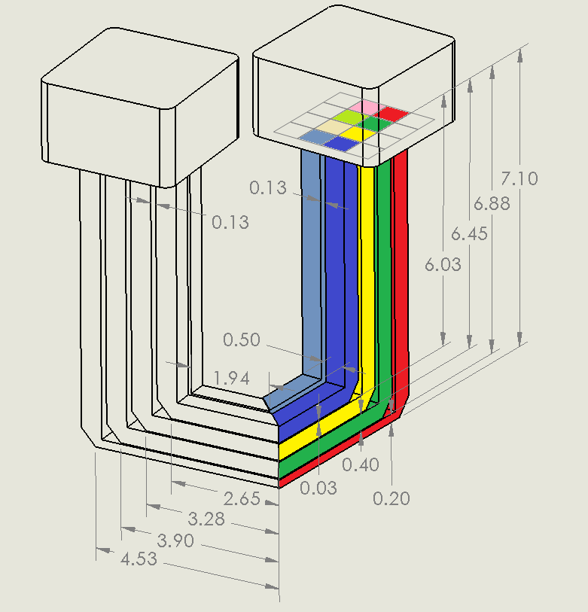
Two Arm UPTOP Detector
Ultra Precise Timing of Protons
16 ch/side, 4 layers (depths in x)
2 rows (depths in z)
2 y measures (+/-) [the 2arms]
Main features:
Takes advantage of
parallel cut (lots of light)
Very compact 5x9 cm
Segmentation of 8, so this detector can not only serve as lowlum detector but also could be used for highlum tests
Only two very accurate
measurements per proton
Easily upgradeable to 32 channels (see next slide)
Could have 6mm x4 mm light guide bars
New ¼ planacon
makes this design
viable

Slide 37


6.5 cm allows for all 16 pixels/tube to be instrumented (adds in yellow and pink bars)
Two Arm UPTOP Detector
Silicon lives
here (don’t cross the
red line!)

Slide 38
Timing System Resolution
Component | δt(ps) Current (HBP) | δt(ps) Projected (RP 1arm 16 ch) | δt(ps) Projected (RP 2arm 16 ch) | δt(ps) Projected (RP 2arm 32 ch) | δt(ps) Ultimate (RP 2arm 64 ch)
Radiator/MCP-PMT/CFD | 19 | 19* | 14* | 14** | 12***
HPTDC | 15 | 15 | 15 | 15 | 5
Total/bar | 24 | 24 | 21 | 21 | 13
Total (ideal) | 11 | 14 | 14 | 10 | <5
Ideal=Assume clock, cables, unknown unknowns don’t contribute
*1 arm with 4 channels has ~½ the light of two arms 2 channels,
So should be comparable resolution; **2x32 adds 2nd detector or
uses 4 rows/side;*** 2x64 adds both also 6 µm pores +new HPTDC

Slide 39
Highlights of Timing R&D
At CERN test beam (10/2012) a single quartz bar/PMT/CFD resolution of 19 ps was obtained, independent of bar cross section (2x6 mm vs 5x6 mm).
This corresponds to a 6 bar resolution of 11 ps including prototype readout electronics for a Hamburg-pipe-based QUARTIC detector
Developed with background group new simulation and visualization techniques
Used these to demonstrate that multiple interactions in quartz, while measurable, result in a modest efficiency loss or resolution degradation; after a design optimization only a few % of events are affected
Using new simulation, a modified design suitable for installation in a Roman pot has been obtained. Compared to design used in test beam, the new design gives more accepted light in the same time window, implying that we can achieve <10 ps in a dedicated Roman pot, and <20 ps in a shared Roman pot
Arradiance+Photonis with assist from UTA/Erlangen have developed a special phototube capable of sustained proton rates in the 5-10 MHz /pixel range. It has been demonstrated to have lifetime >50 fb⁻¹, with an additional factor of 2 -3 expected from new processing techniques, this implies one tube could be expected to be operable for >200 fb⁻¹
We have also tested for Photonis a new orthogonal life time approach, involving an active ion barrier, which shows 4-20x reduction in after-pulsing, believed to be the cause of PMT lifetime
Have successfully modified low-jitter SLAC Phased Lock Loop Clock circuit for AFP’s circumstances and obtained <5ps jitter
Developed a 20 ps detector suitable for sharing a Roman pot in 2015
no known technical obstacles to a 10 ps high lum ToF system in 2016

Slide 40
Proton Distribution and Rates
To design detector need to take account of rates and their distribution
PYTHIA: about 2% of all interactions have a proton in AFP acceptance
For µ=25 (50) the integrated detector rate @25 ns
is thus 0.02*25*(40MHz*0.8) = 16 (32) MHz
Distribution is peaked at low x (displacement from
the beam), such that the closest 2 mm receives
20 to 25% of the rate and the closest 6mm receives
50 to 60% of the rate. So to equalize the rate
per bin, it is necessary to have smaller bins clsoe to
the beam: four bins in x as shown (bars integrate
over y), each would have a rate near 4 (8) MHz
Can an MCP-PMT deal with these rates? What about multi-proton effects?
2 4 6 8 mm
Num of int. | n=0 | n=1 | n=2 | n=3 | n=4 | n>1
µ=25 | 61% | 30% | 8% | 1% | 0% | 9%
µ=50 | 37% | 37% | 18% | 6% | 2% | 26%
40

Slide 41

Is 50 Interactions a Problem for QUARTIC?
As the number of interactions increase, the rate/pixel increases (rate and lifetime concerns for MCP-PMT), combinatorics reduce your rejection, multi-proton events ( 2 protons in a bar) reduce efficiency, cross talk between rows becomes an issue
1 proton/detector/event average background (big, but not so bad) 32 MHz so 8-10 bins okay for rate and average multiplicity/bar only 0.1 to 0.2 so efficiency okay
Increasing the number of pixels helps with rate and efficiency, but the only way to keep the rejection from degrading with increased µ, would be to improve the timing resolution, or raise the mass threshold
*START THE HIGH LUM
PROGRAM AS EARLY AS POSSIBLE OR EARLIER*

Slide 42

Pixelation and Efficiency for Different Scenarios
Scenario 1:
7 rows
2, 6x3.25 mm
Scenario 2:
10 rows @ 2 mm
Scenario 3:
10 rows @ 1 mm
Royon and Sampert study confirms pixellation of 8-10 is adequate

