Slide 1
The Argonne Small Tile Photodetector Facility and Device Processing
Lei Xia

Slide 2
What is the small tile facility? (or, the 6cm system)
It is an R&D system
  After successes of LAPPD R&D on all individual components and techniques, the 6cm system combines all steps into the fabrication of the first functional devices
  The 6cm system deals with some of the challenges for larger tile at a reduced scale
  The system is designed to have independent subsystems and be able to transfer parts between subsystems
  The system is very flexible to change of procedure and sequence, and is capable of studying any isolate steps
It is also a test production system
  The goal is to produce the first batch of fully functional small form factor devices, and make them available to the user community for evaluation
  The expected production rate is ~ 1 tile/week

Slide 3
6cm system design
The whole system consists of four major parts
The four parts are connected with gate valves
Three transfer arms can move components between different part of the system
Scrubbing
Chamber
Deposition
Chamber
Control
Arm #1
Load
Lock
Gate
valve 1
Gate
valve 2
Gate
valve 3
Sealing
Chamber
Control
Arm #2
Control
Arm #3

Slide 4
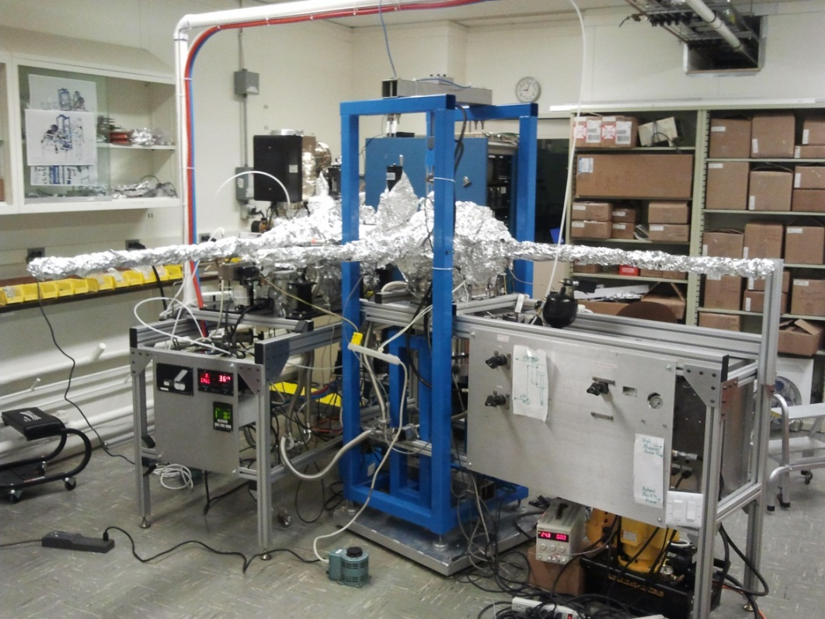
6cm tile system status
Overall system
  System was largely finished around mid-May, and we did a few weeks test run
    Demonstrated 1st seal with system, observed hint of signal from UV light source
  System went into continuous running from July to end of October
    Processed 17 tiles, system availability > 90%
    System maintained a vacuum level at low 10⁻⁹ to mid 10⁻¹⁰ torr
  We just finished a month long maintenance on the system, currently in bake-out
  Expect to be back on-line next week

Slide 5
Tiles processed so far
Serial # | 17 | 18 | 19 | 20 | 21 | 22 | 23 | 24 | 25
Seal | Good | Good/ Cracked | Good | Good | Good | Good/ Cracked | Cracked | Good | Good
MCP | --- | --- | --- | Gen I | Gen I | (none) | --- | Gen I (bad) | Gen I (bad)
Getter | --- | --- | --- | Bad | Bad | Better | --- | Good | Good
lifetime | --- | --- | --- | 1-2 days | 1-2 days | 4 days (cracked) | --- | Since 9/1/14 | Since 9/8/14
Serial # | 26 | 27 | 28 | 29 | 30 | 31 | 32 | 33
Seal | Cracked | Good | Good | Bad | Good | Good | Good | Bad
MCP | (none) | Gen I | Gen II | (none) | Gen I Gen II | Gen I Gen II | Gen II | Gen I Gen II
Getter | --- | Good | Good | --- | Bad | Bad | Good | Bad
lifetime | --- | Since 9/17/14 | Since 9/24/14 | --- | 1 day | 2 days | Since 10/15/14 | ---
Notes:
#17, #18, #19 are sealing tests with dummy component
#22, #26, #29 are special tiles for QE measurements, with no MCPs in them
#24 and #25 didn’t produce signal at reasonable HV, due to MCP resistance drop

Slide 6
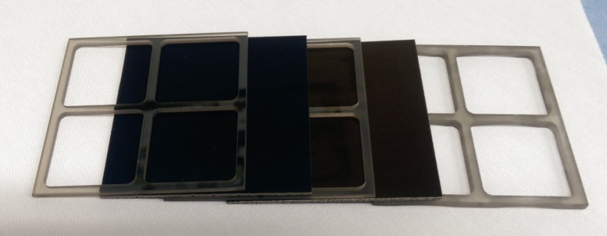
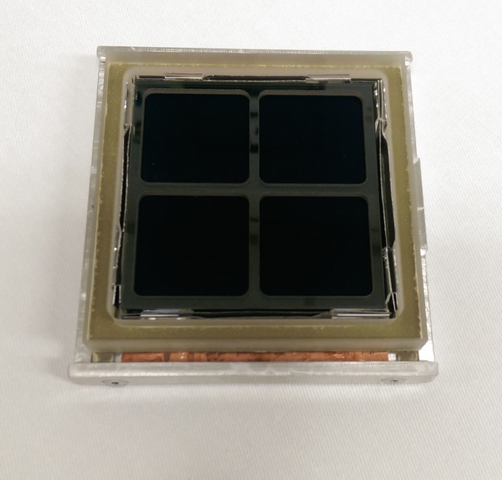
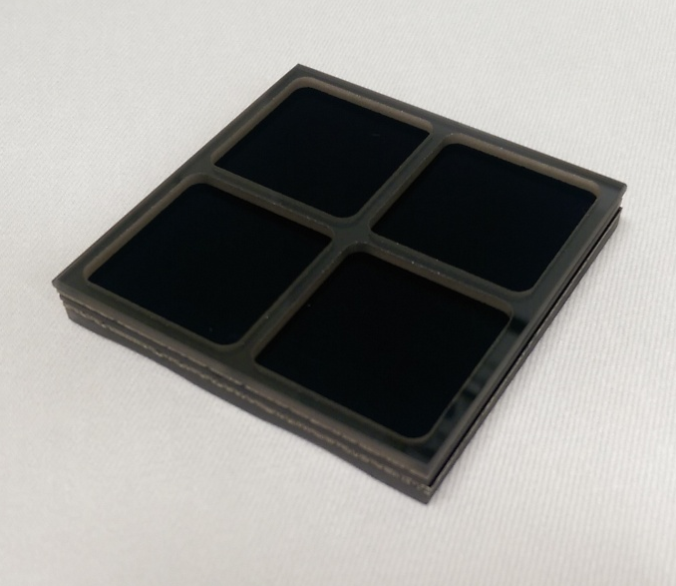
LTA stack up: based on glass envelope
Getter strips
Tile base
Tile fixture

Slide 7
6cm LAPPD tile processing procedure
Lower Tile Assembly (LTA: tile base + MCPs + spacers + getter strips) scrubbing
  Bombard LTA with electrons (1kV/0.1-0.2mA) for ~24hrs
  End pressure ~ 1 – 2 x 10⁻⁸ torr, dominated by electron gun
LTA baking and getter activation
  Several baking/activation scheme tried
  Latest procedure involves a low temperature back and a high temperature activation
  Low temperature bake lasts for 2-3 days, with end pressure ~ 1 x 10⁻⁹ torr
  High temperature bake/activation is short
Bi-alkali photocathode deposition (see last talk today)
Tile sealing
  Heated press seal with Indium gasket
  Pressing/heating/cooling cycle run for ~24hrs

Slide 8
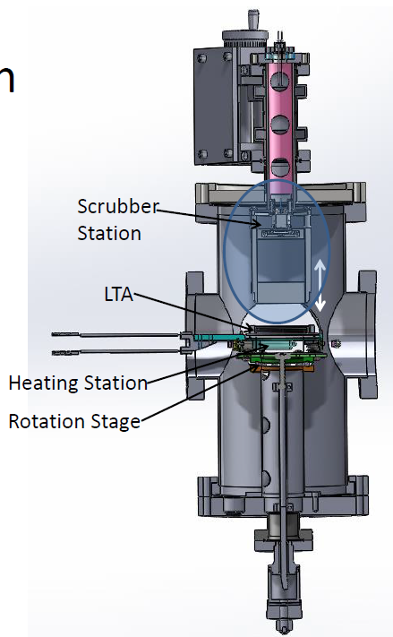
MCP scrubbing
This process is still somewhat a mystery
  Known fact: scrubbing is important to stabilize gain, and help
  with MCP out-gassing process
  Supposed to apply modest HV across MCP/spacer stack and
  monitor the gain as we scrub with electrons
Past setup
  We were not able to make electrical contact to the top of the
  stack (originally designed contact will crush the stack), so the
  HV was applied between electron gun and anode readout strips
  (not explicitly on stack), and we couldn’t monitor the MCP gain.
procedure
  Run at 1kV/0.1 – 0.2 mA, until pressure drops back down
Issues:
  Need to have contact with MCP/spacer stack, to create steady electrical field across stack
  Need to monitor MCP gain change
  Need to study electron gun coverage and uniformity
  Issues has been addressed in the maintenance period last month

Slide 9
Baking and getter activation (I)
The process was designed to be done in the bake/scrub chamber, but has been carried out in the deposition chamber
  The heater in the bake/scrub chamber has been installed during the maintenance period
Boundary condition of baking/activation
  Main constraint: the temperature of the frit on the tile base can not exceed ~ 350 C
  Getter gets activated when reaching high enough temperature for long enough time
  MCPs release enormous amount of gas at elevated temperature
  One of the two heater lamp has a bad contact that disconnect at high temperature
  Getter temperature carefully mapped out with two lamps, as a function of time and heating power
Several baking/activation scheme tried
  Scheme 1: heating LTA at ~ 350C for 20 – 40 hrs
    #20 - #23 was produced in this way
    Tiles with MCPs only lived for 1 – 2 days: not successful
    System pressure reached low 10⁻⁶ during activation
    Looks like the getter was saturated by the end of the activation

Slide 10
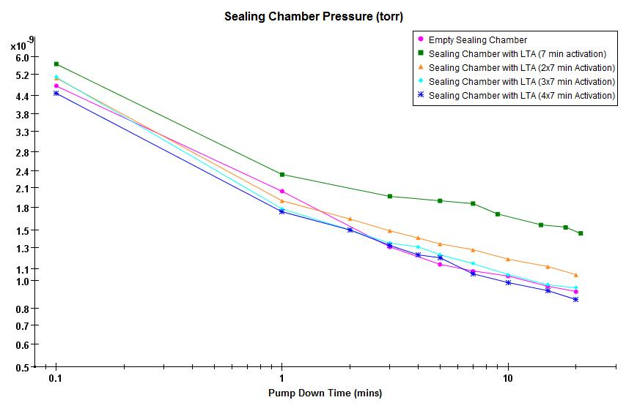
Baking and getter activation (II)
Several baking/activation scheme tried (continue…)
  Scheme 2: low – high bake
    Suggested by an old SEAS paper, to deal with ‘dirty’ environment
    Low temperature bake at < 200C to avoid getter activation, till 1 x 10⁻⁹ torr or lower (> 2days)
    High temperature bake with only 1 lamp for 2.5 – 4 hrs
    Getter strips close to lamp reaches 350 - 400C, but far end getter is probably not hot enough
    #25 - #31 were produced in this way
    2 long lived, 2 short lived, 1 non-conclusive: mixed results
  Scheme 3: low – higher bake
    Same low temperature bake
    Higher temperature bake with two lamps for short exposure(s)
    All getter strips reaches > 400C for short time
    Tile base heats up slower and won’t exceed 350C
    Getter pumping speed evaluated during/after activation
    #24, #32, #33 were produced in this way
    1 long lived, 2 non-conclusive: mixed results
Many of the system issues has been addressed
  (wait for maintenance period discussion)
Getter test during #32 processing

Slide 11
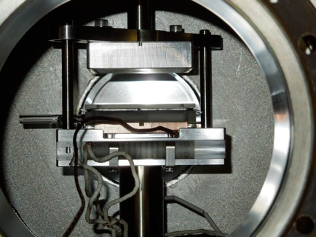
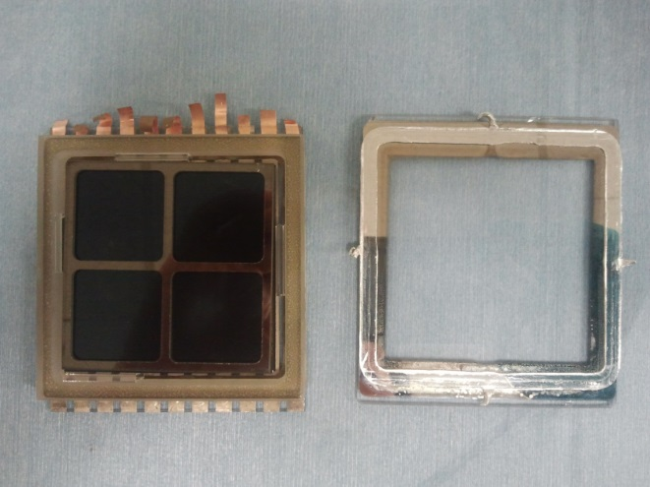
Tile sealing process (I)
The sealing method was systematically developed by Dean Walters and Marc Kupfer several years ago, with hundreds of samples
  Heated press seal, without melting Indium gasket
  Proved to be viable for both 6cm and 8in devices
  High yield with lab test samples
Sealing process with 6cm system
  Implementation on the 6cm system
    Developed a series of fixtures to handle parts in vacuum
    Designed alignment methods to precisely locate parts
    Ceramic heater(s) for heating, hydraulic system for pressing
  Had some trouble at the beginning: low yield and cracking
  Dealing with low yield
    Adjusted procedure to follow exactly the lab sealing process
  Dealing with cracking problem
    Carefully measured the flatness of several critical pressing fixtures
    Modified a few fixtures to deal with after sealing cracking
    Adjusted sealing procedure to avoid hard impact on LTA
    QA on tile base to avoid bad parts

Slide 12
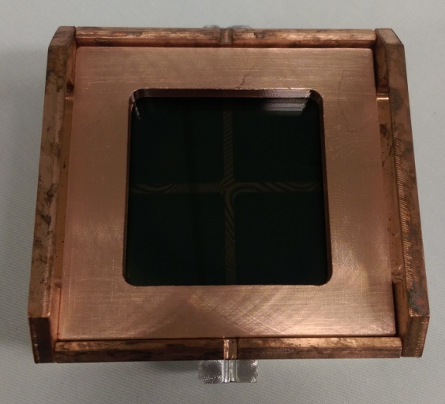
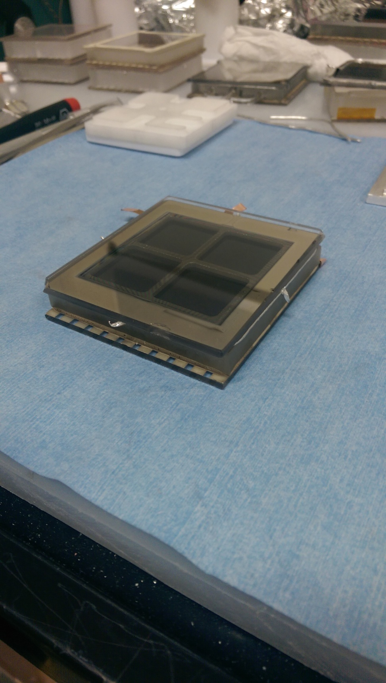
Tile sealing process (II)
Recent tiles processed: #17 -- #33
  11 tiles (out of 17) have good seals
  4 tiles had cracking problem
    2 cracked after good seals were initially formed
    2 cracked during sealing process: one tile base problem, one operation issue
    Cracking after seal issue has been eliminated after fixture change
  Only 2 tile (#29,#33) had leak on the indium seal
Sealing is a pretty mature process on the 6cm system
  High yield
  Issues are well understood
  No further development planned
  Have changed sealing heater (ceramic heater → halogen lamp heaters) during maintenance period

Slide 13
6cm system maintenance period
After processing tile #33, the system entered a month long maintenance period
  Address existing issues with the system
    Bake/scrub chamber: add new heater, add electrical contact for scrubbing
    Deposition chamber: replace bad heater contact, replace light bulbs, recharge effusion cells
    Deposition chamber: replace ceramic heaters, replace leaky gate valve
  Measurements and studies
    Map out temperature profile for all heaters
    Study baking conditions
    Study getter activation conditions
All maintenance tasks has been successfully finished over the Thanksgiving weekend
  System currently under baking
  Expect to start processing tiles next week

Slide 14
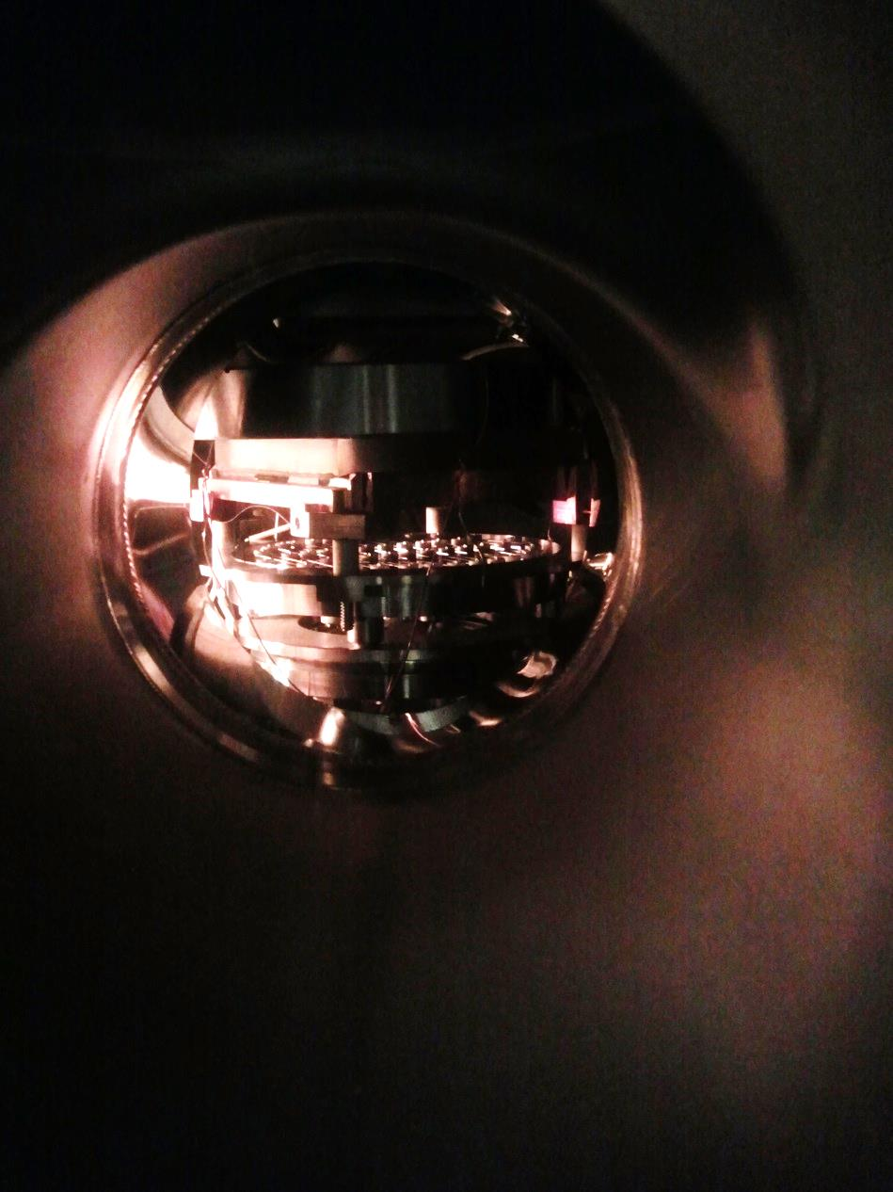
Bake and scrub chamber status
Tile for heating test
New Tungsten filament heater installed
The new heater require a compressing mechanism to help the heat conduction
  Modified the existing scrubbing electron gun frame to compress stack
  Also provide scrubbing ground contact to the top of stack at the same time
Heating test done
Scrubbing test will follow
New Tungsten filament heater
Bake & scrub chamber illuminated by
deposition heater (not in picture)

Slide 15
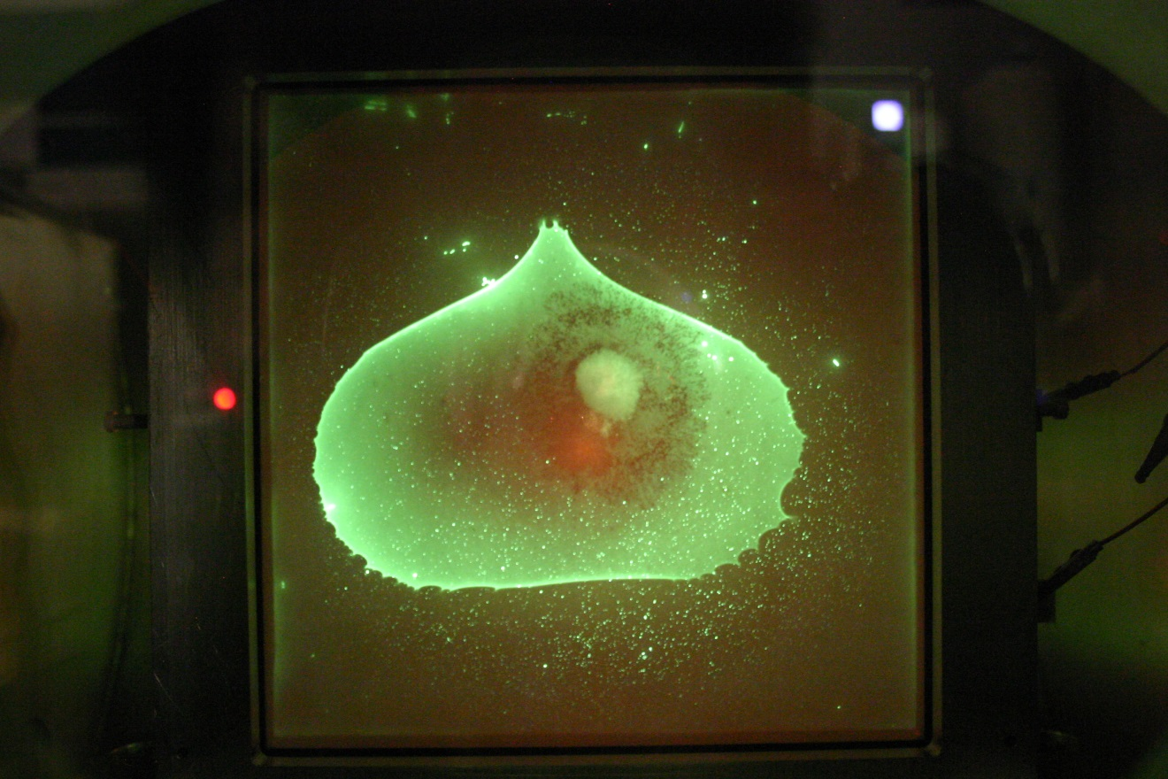
Electron gun test in phosphor chamber
Accelerating voltage: 600V
Current focusing seem to be optimal setting (vendor recommended value)
Electron beam can cover entire stack with reasonable uniformity

Slide 16
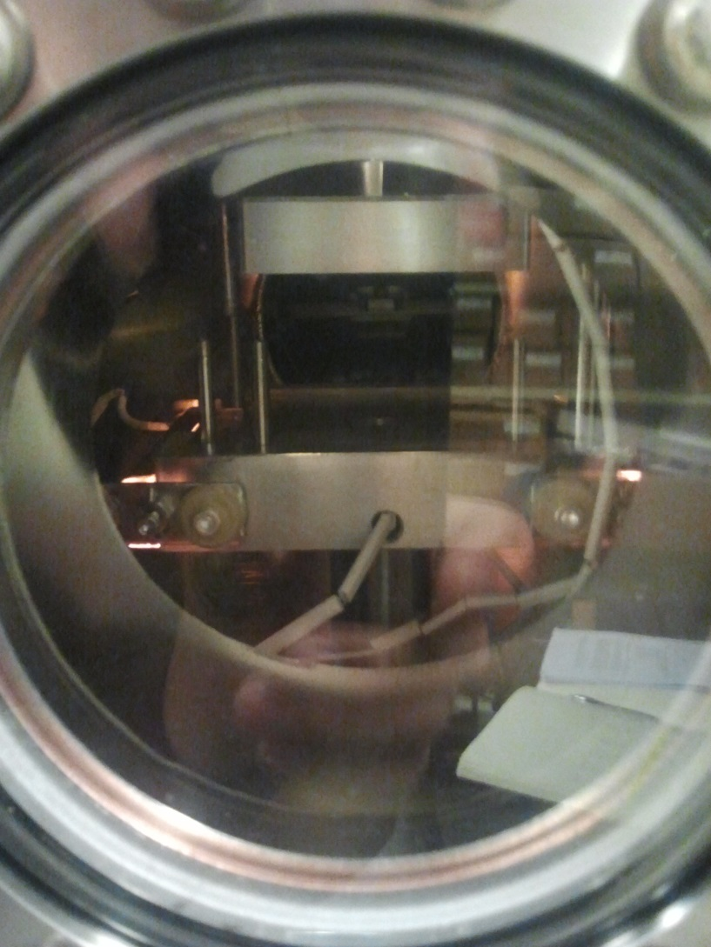
Sealing chamber status
New sealing heaters
Took out ceramic heater
Installed two halogen lamp heaters
Replaced a leaky gate valve
Measured sealing temperature as a function of heater power
Tested chamber baking with sealing heater (>200ºC)
Sealing chamber under baking test

Slide 17
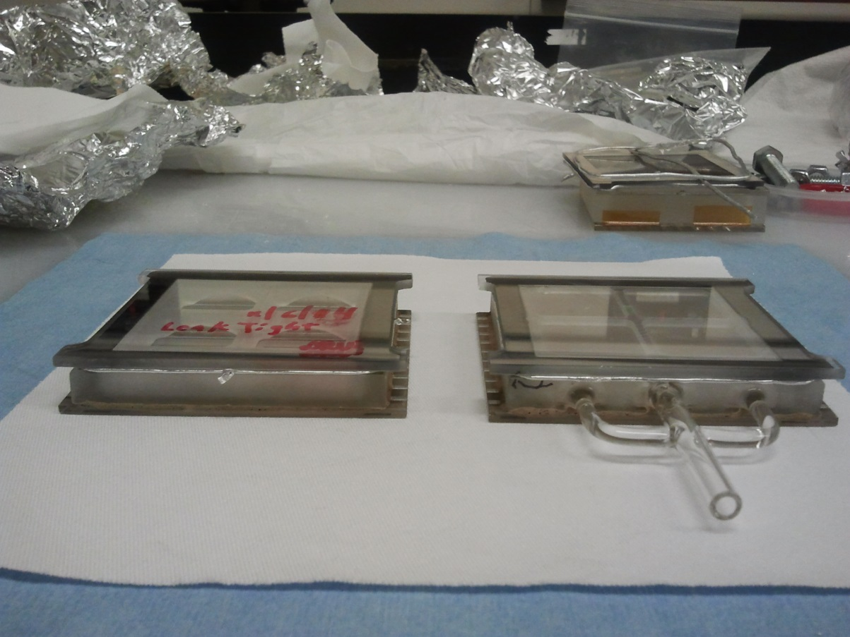
Sealing tests
Leak spot
Performed 2 sealing tests with the new heaters
Verified part manipulation and alignment
#1 (left): regular tile base with pumping hole on anode plane, successfully sealed
#2 (right): tile base with pump-out port (not often used for sealing tests these days), has a tiny (10⁻⁹torr*l/s) leak on one ‘corner’
Conclusion: new sealing heater works

Slide 18
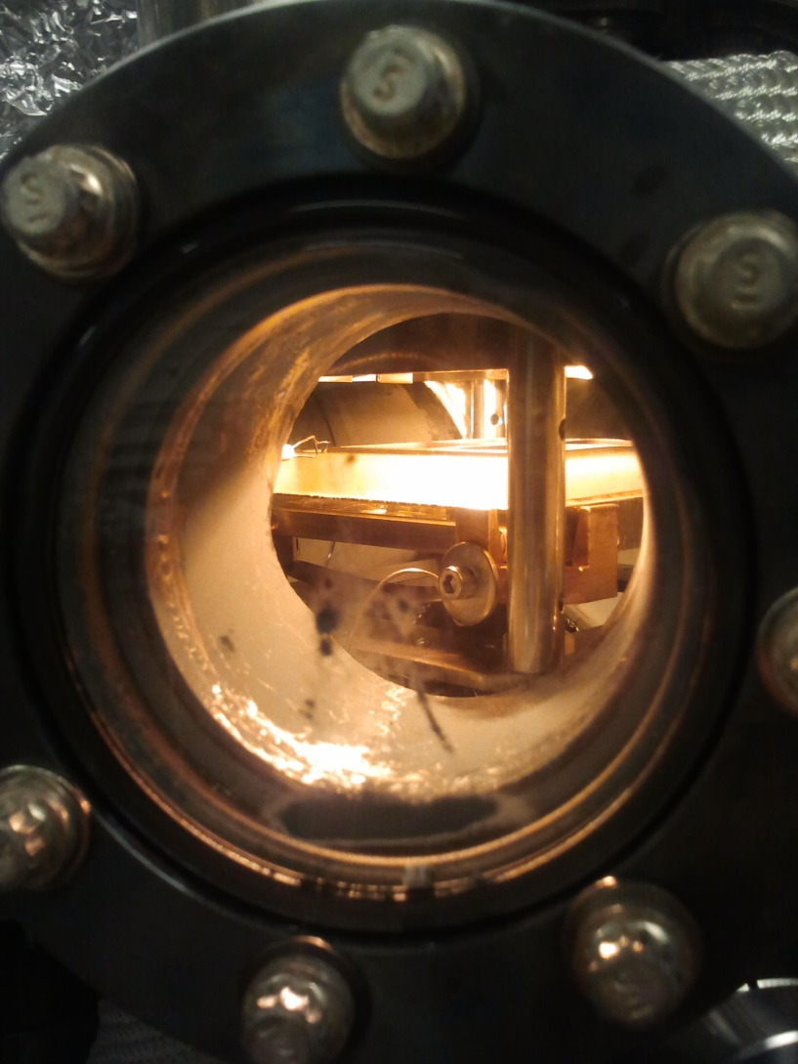
Deposition chamber status
Replaced heater contacts
Cleaned deposition chamber
Recharge effusion cells
A series of tests are done:
  High power overnight tests confirmed the contact issue was fixed
  Top window temperature measured as a function of heating power
  Top window temperature uniformity measured
  Getter temperature measured as a function of heating power
  Tested getter activation conditions
  Tested MCP and tile base baking

Slide 19
Future plan
System will finish bake-out this week, and tile processing will resume
With the improved system and recent tests/studies, we expect to improve device yield and characteristics
QE optimization is one of the next tasks
New device designs are also being considered

